Slide 1
This material is a work of the U.S. Government and is not subject to copyright protection in the United States
Improved Techniques for Measuring Static Ground Wind Loads on the NASA Space Launch System
Mobile Launcher 2
Jesse G. Collins,
Lee J. Mears, Patrick R. Shea, Sarah L. Langston, Morgan A. Walker, Jeremy T. Pinier
NASA Langley, Configuration Aerodynamics Branch
jesse.g.collins@nasa.gov
2023 AIAA SciTech Forum
January 23, 2023
SLS Special Session

Slide 2
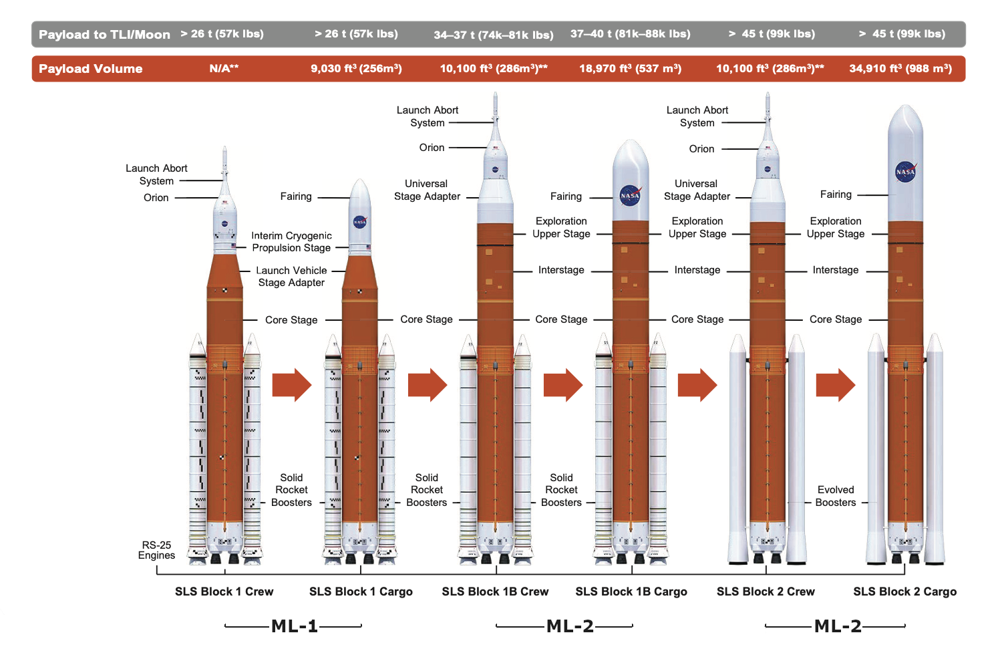
Introduction
The NASA Space Launch System is:
  A modular, multipurpose family of rockets
  For a wide array of mission profiles to enable deep-space crewed exploration
Supporting the SLS vehicles are the NASA Mobile Launchers (ML)
  Designations:
    ML-1 : SLS Block 1 Rockets (missions Artemis I-III)
    ML-2 : SLS Block 1B and 2 Rockets (missions Artemis IV+)
  Supports vehicle throughout:
    Assembly
    Transport to/from Launch Complex
    Liftoff
Block 1 Vehicles
Block 1B Vehicles
Block 2 Vehicles

Slide 3
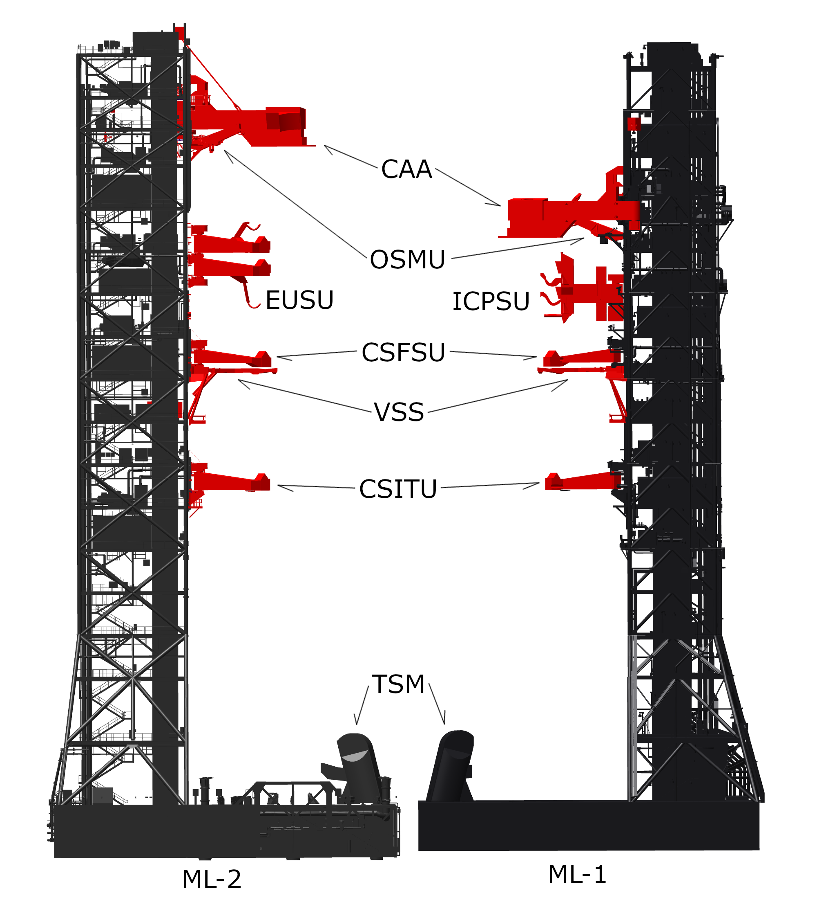
Introduction
NASA Mobile Launchers:
  Are the base upon which the Vehicles are stacked (assembled)
  Transport vehicles to/from launch complex via the Crawler Transporter (CT)
  Vehicles are launched from the ML
ML-1 is currently existing hardware
  Was used to Launch Artemis I on 2022-11-16 @ 0147 EST
  Will be used for missions Artemis II-III
ML-2 is in design phase
  Will be used for missions Artemis IV+
Have the following support systems:
Label | Full Name | Present On:
CAA | Crew Access Arm | Both
OSMU | Orion Service Module Umbilical | Both
EUSU | Exploration Upper Stage Umbilical | ML-2
ICPSU | Interim Cryogenic Propulsion Stage Umbilical | ML-1
CSFSU | Core Stage Forward Skirt Umbilical | Both
VSS | Vehicle Stabilizer System | Both
CSITU | Core Stage Inter-Tank Umbilical | Both
TSM | Tail Service Masts | Both

Slide 4
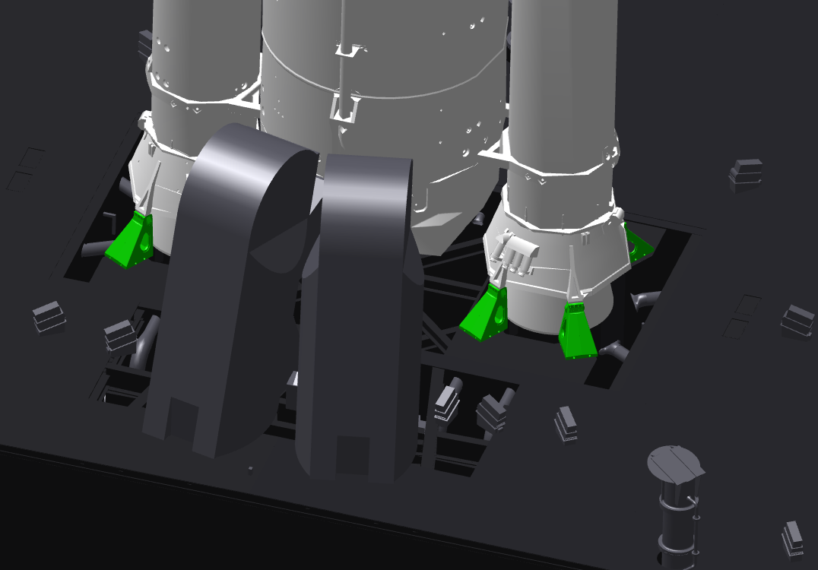
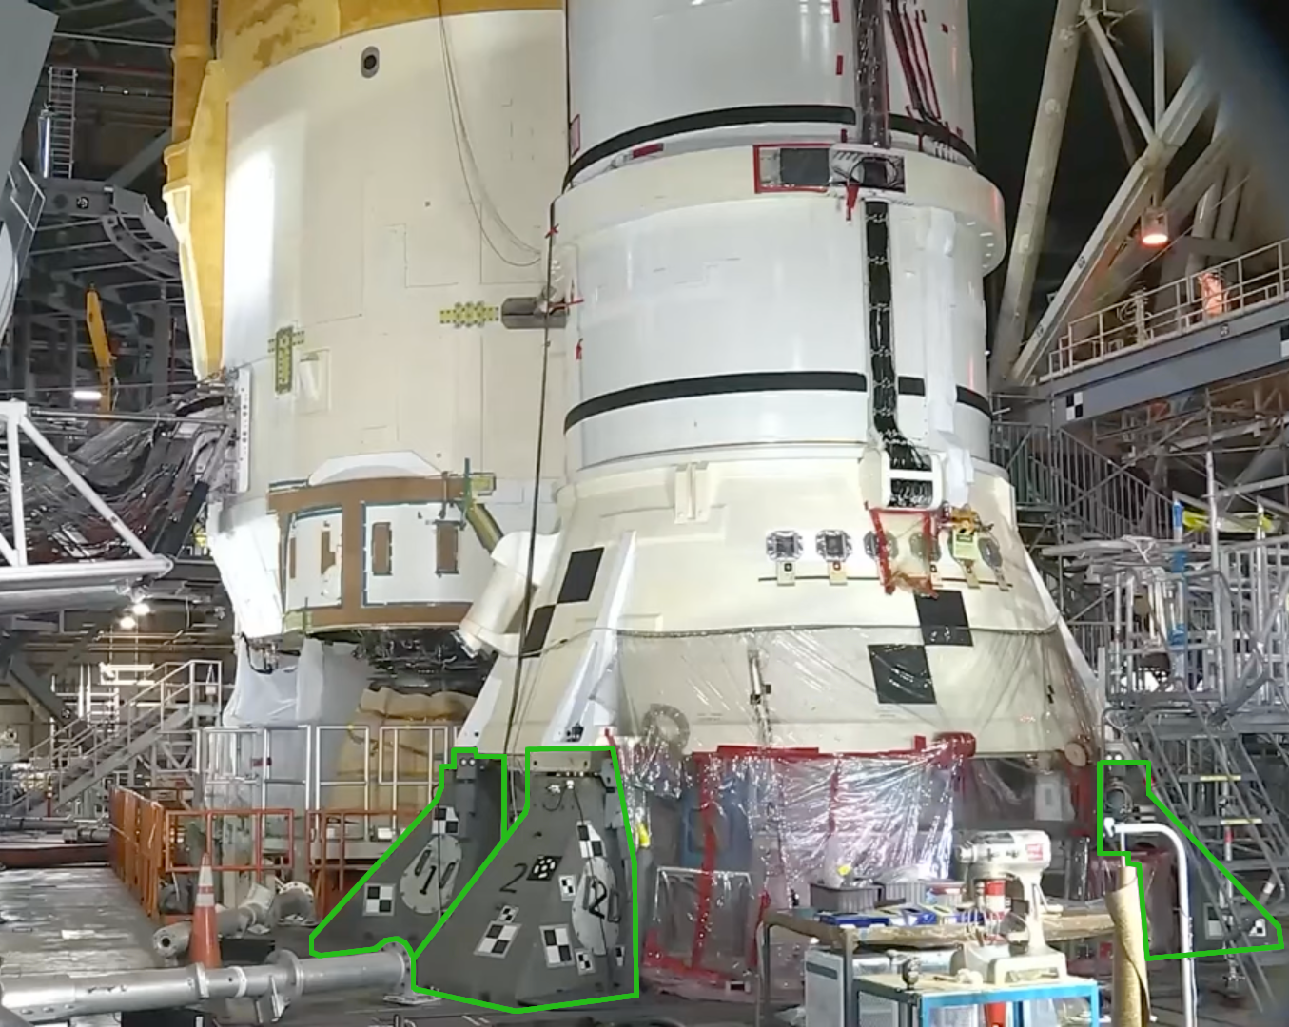
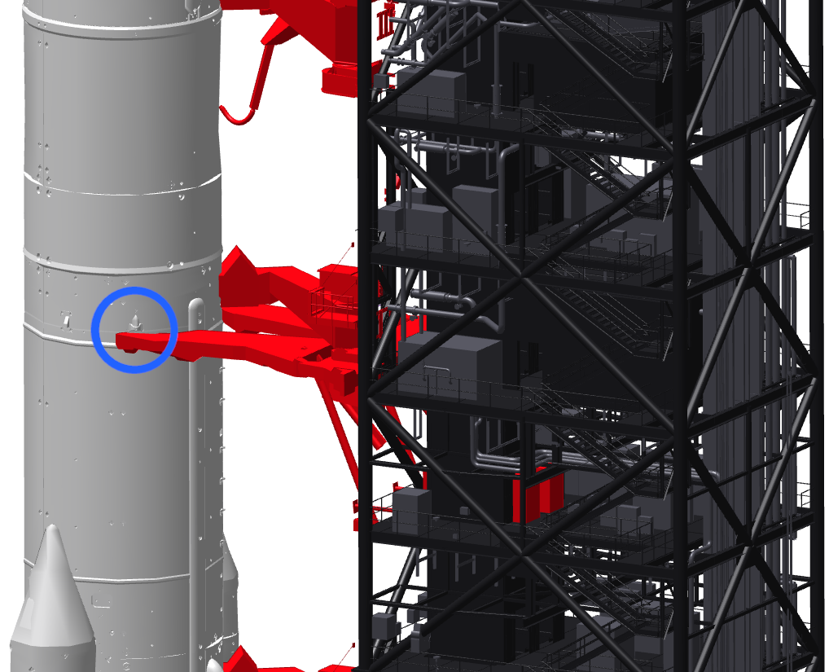
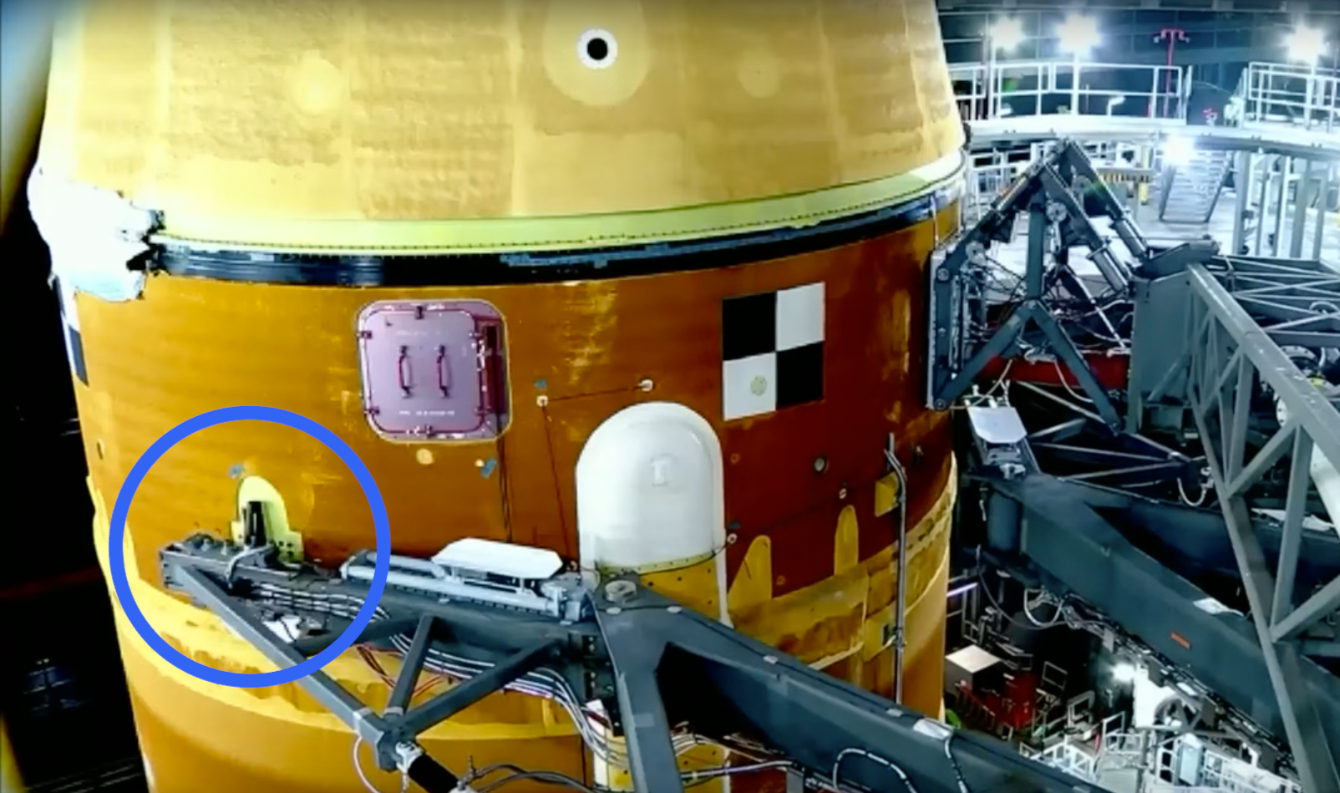
Introduction
The vehicle is restrained and supported at two interfaces:
  SRB support posts
  Vehicle Stabilizer System
  (Red support systems are “space claim” geometric representations)
Photo Credit: NASA, https://www.youtube.com/watch?v=oeuU_ffBlGI
Photo Credit: NASA, https://www.youtube.com/watch?v=oeuU_ffBlGI

Slide 5
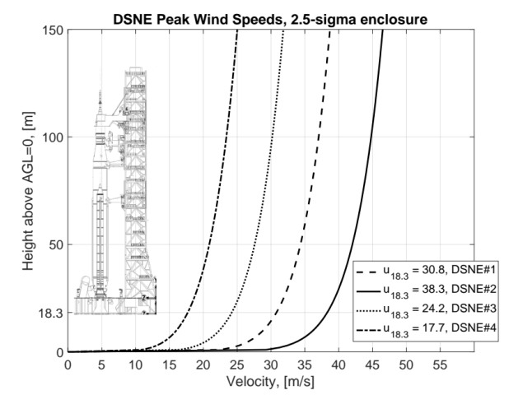

Introduction
Wind Loads
  During transport and on-pad stay ML+Vehicle are subject to ground winds prevalent in the central Florida eastern coast
  It is critical to understand the magnitude and direction of the loads on the ML, Vehicle, and the interfaces between them
  This information guides structural design and operational wind placard development
ML utilized in four phases in support of vehicle, each with associated peak wind velocities:
  Peak Velocity vs. height:
Height |  | Scenario 1 Transport To/From pad | Scenario 2 On-pad (Unfueled) | Scenario 3 On-pad (Fueled) | Scenario 4 Vehicle Launch
m | ft | m/s | m/s | m/s | m/s
18.3 | 60 | 30.8 | 38.3 | 24.2 | 17.7
4
3
1
2

Slide 6
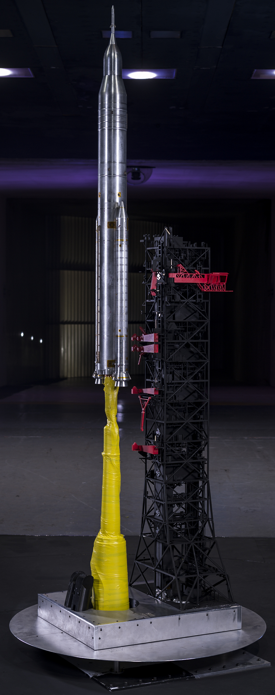
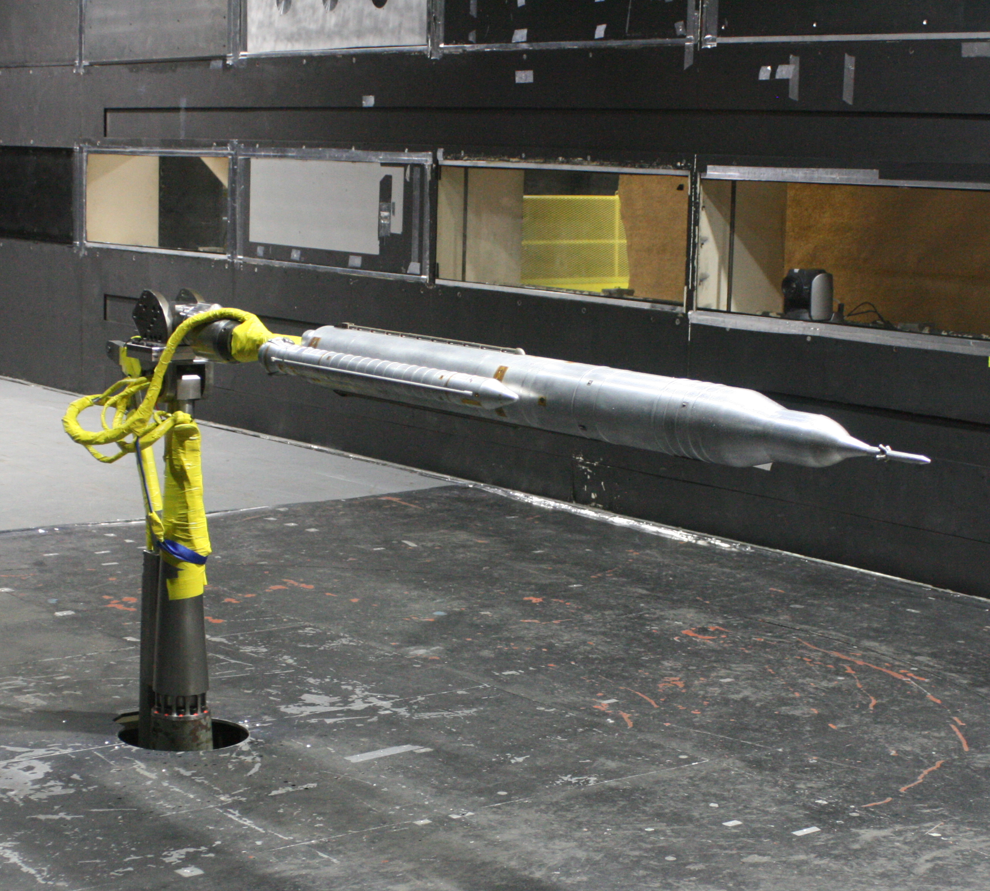
ML-2 Test Article for Wind Tunnel Test
Photo Credit: NASA/LaRC Photo Lab
Test articles utilized for wind tunnel testing
  Constructed at 1.75% scale for use in Liftoff and Transition testing
  This work will focus on Liftoff testing phase results
  Test conducted at the NASA LaRC 14-by 22-foot Subsonic Tunnel
    26 April 2021 → 30 June 2021
  For Liftoff testing entire ML is modeled, including base portion (Mobile Launch Platform, MLP)
Photo Credit: NASA/Patrick Shea
For more info see: Mears et al, “Experimental Characterization of the Space Launch System Block 1B Liftoff and Transition Environment”
Transition Phase Testing
Liftoff Phase Testing

Slide 7
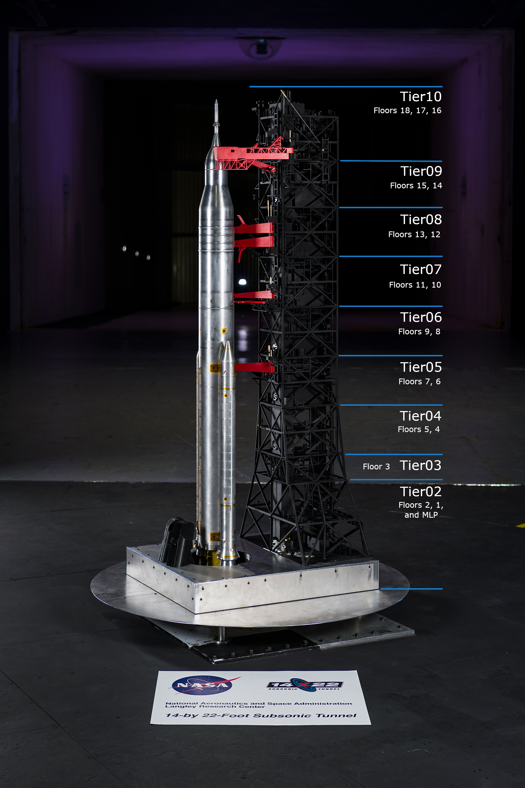
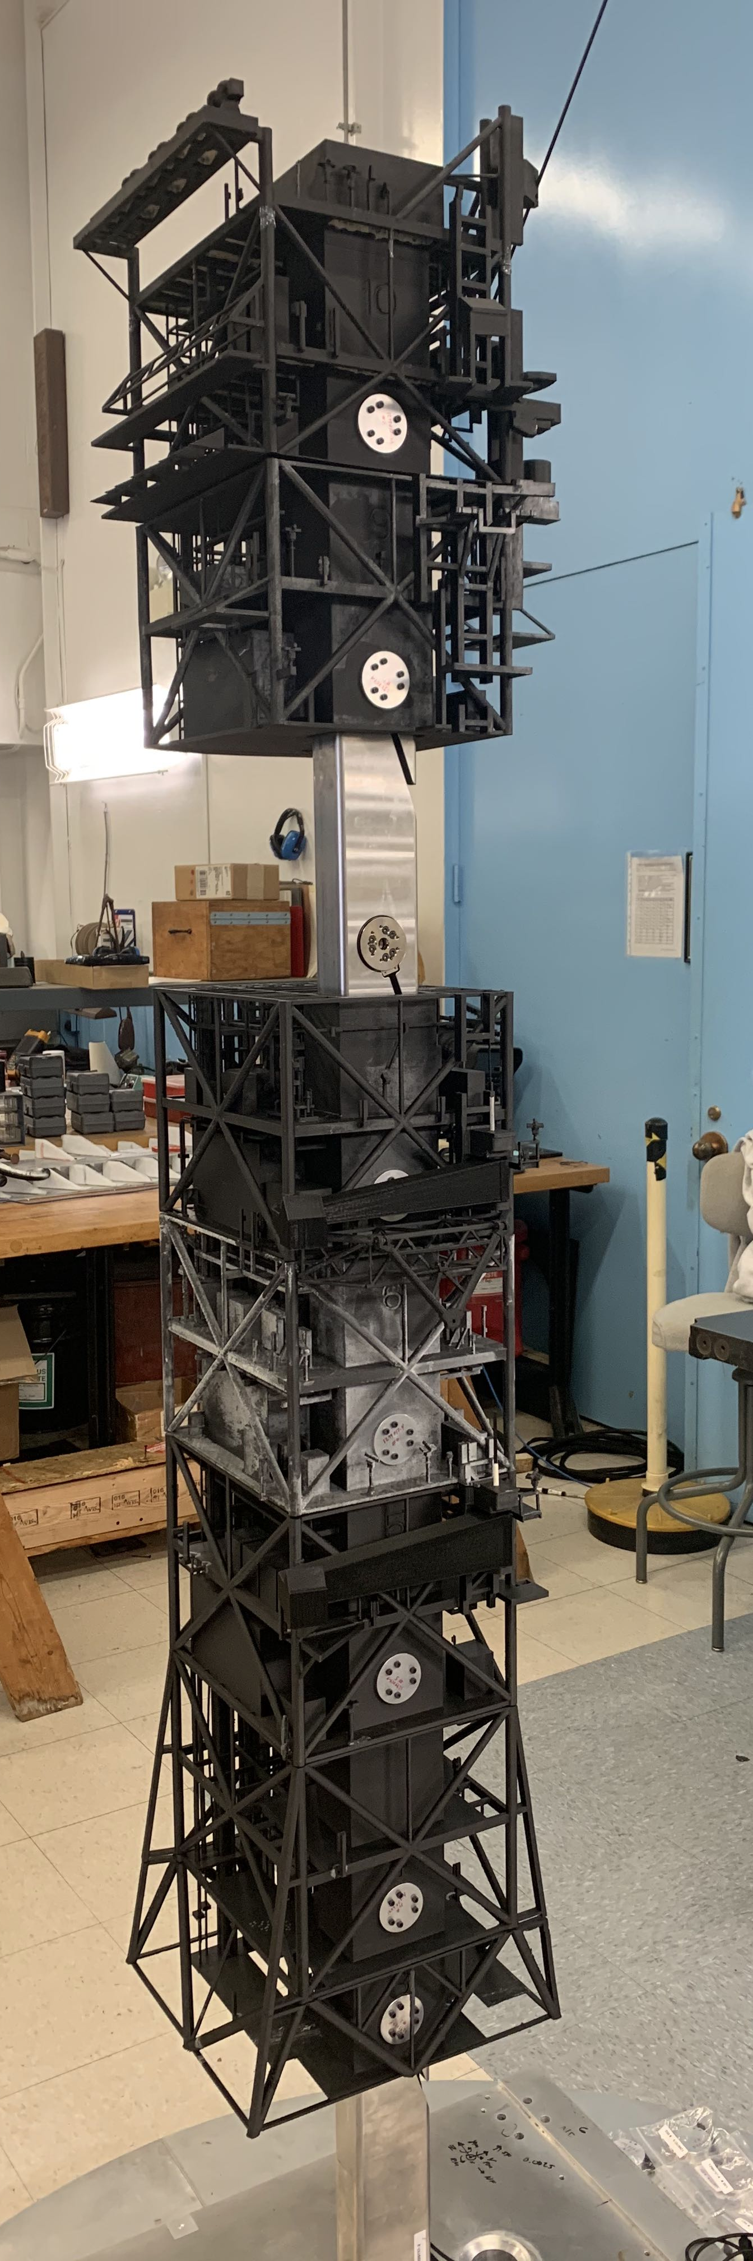
ML-2 Test Article for Wind Tunnel Test
ML-2 construction
  Machined aluminum (Al) and stainless steel (SS), Carbon Fiber (CF) infused Nylon, and 12x six-component Force and Moment (F/M) transducers
Main features
  Al construction of MLP with a set of 4x F/M transducers
    4x transducers measure global loads on entire ML
  SS vertical bar cantilevered to top surface of MLP
    Acts as inner support structure for tower
  8x F/M transducers mounted to the SS bar, distributed along its length
  9x 3D-printed sections (“Tiers”) of the tower; 8x mount to the metric end of transducers along the bar
    8x individually metric Tiers directly measure load distribution along tower
  Representative, manually deployable umbilical systems
Global balance
Photo Credit: NASA/LaRC Photo Lab
Photo Credit: NASA/Jesse Collins

Slide 8
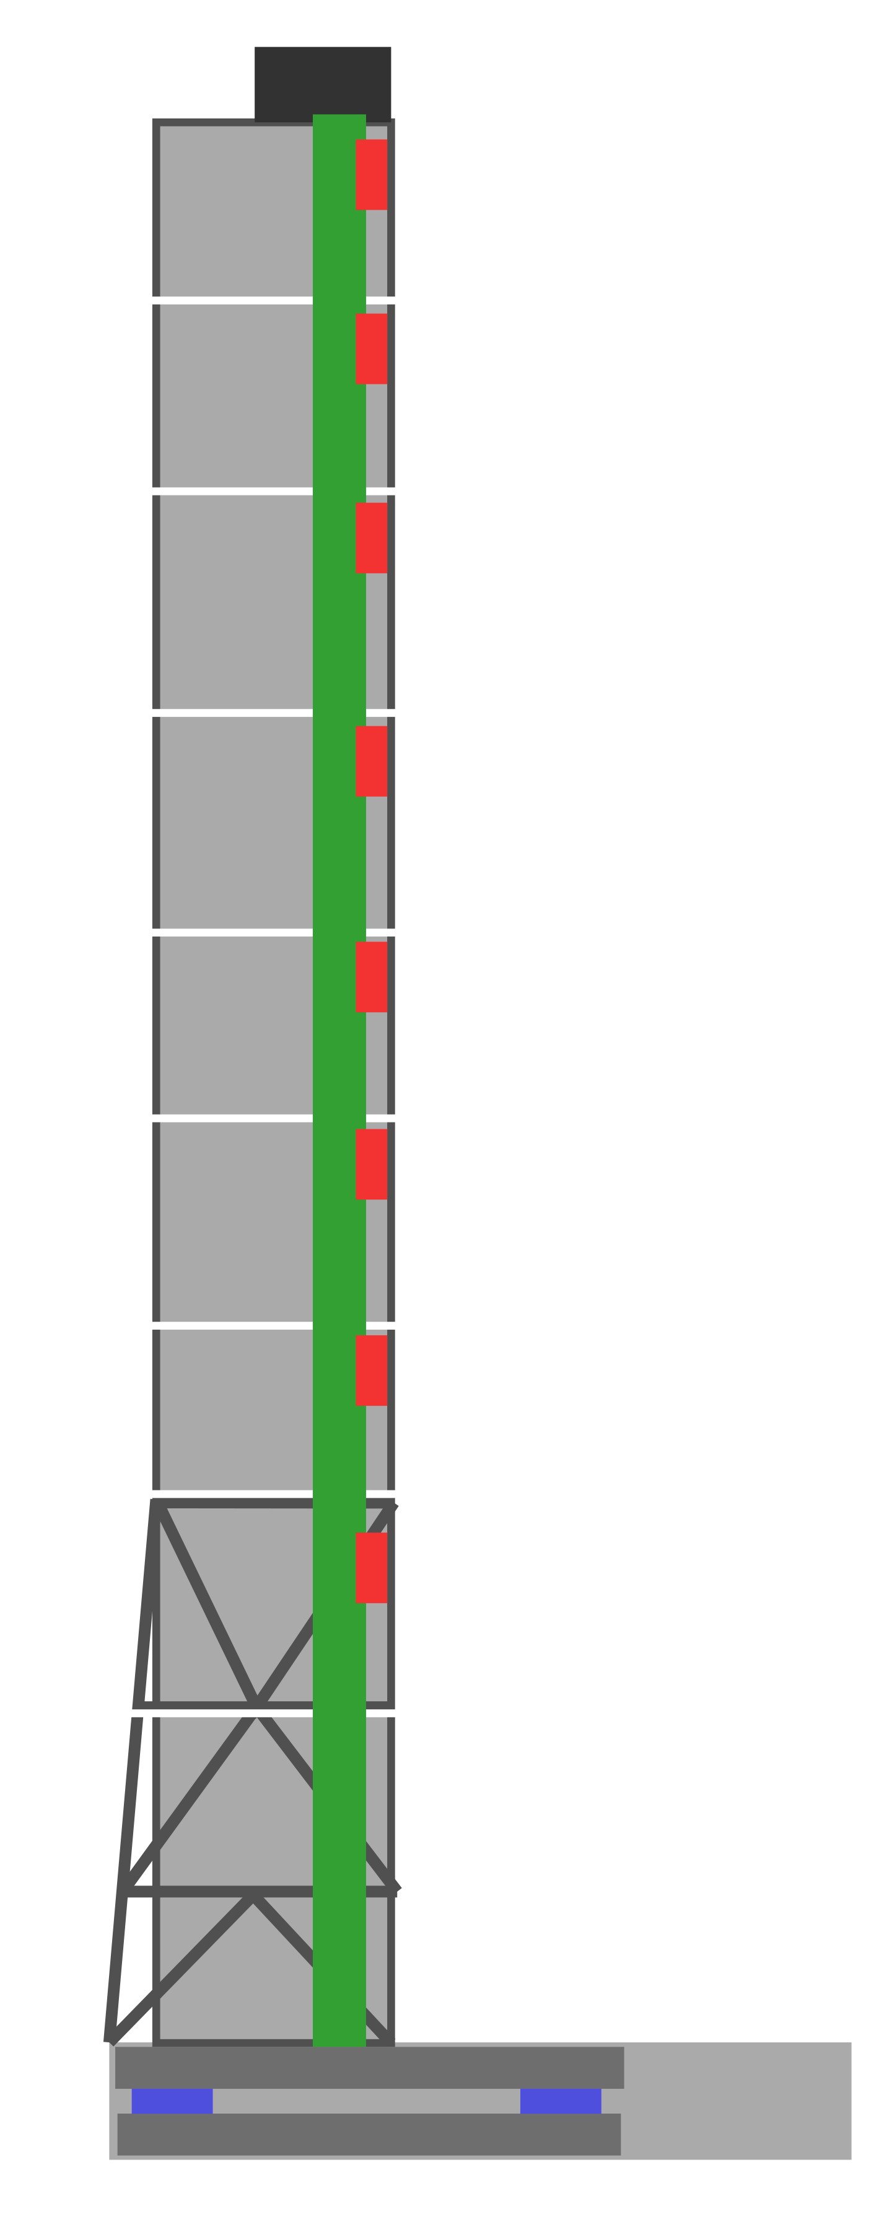
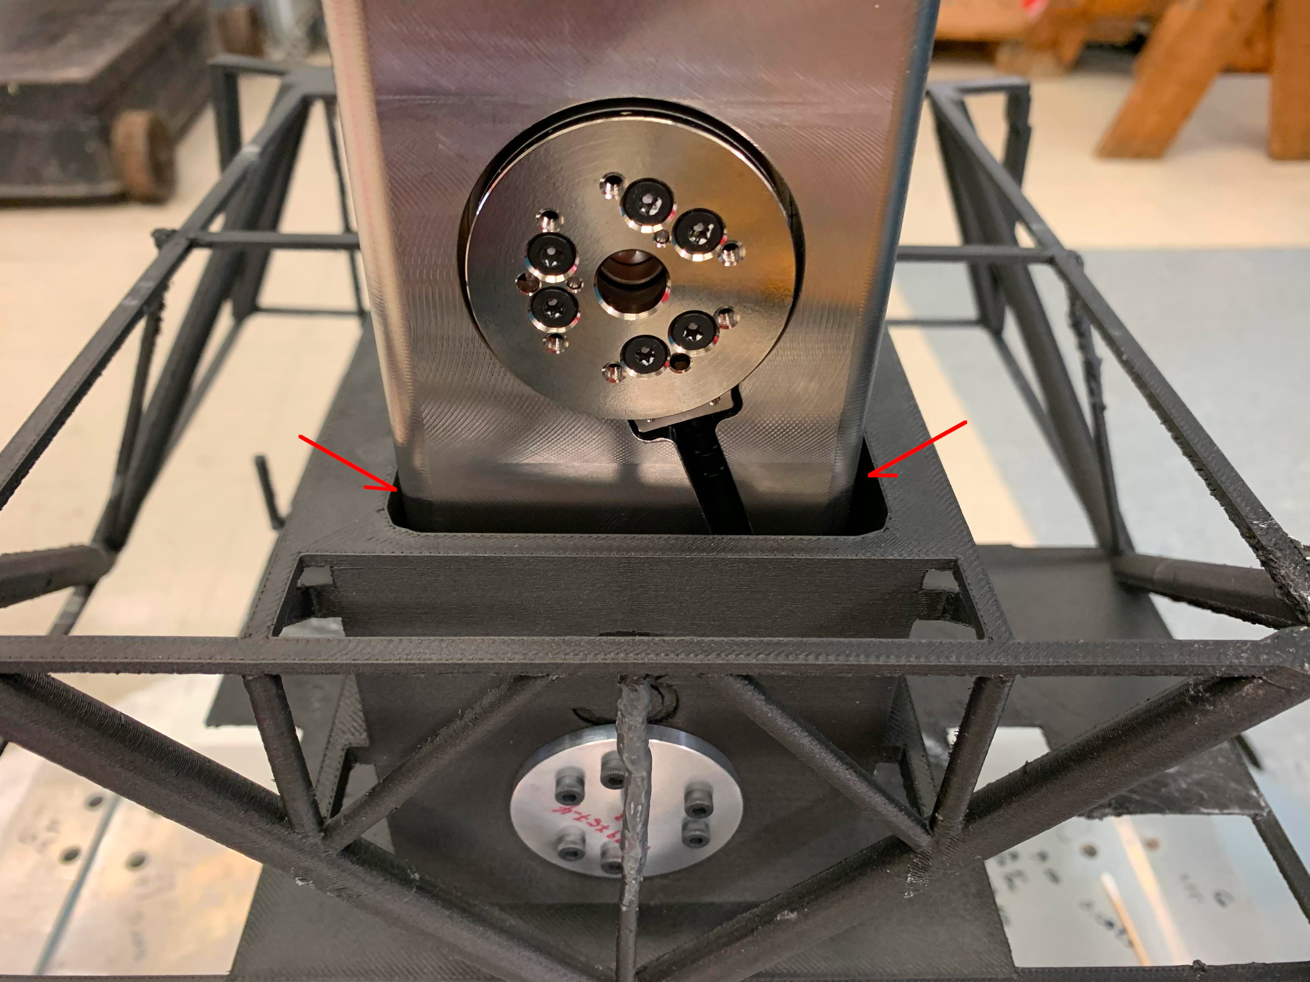
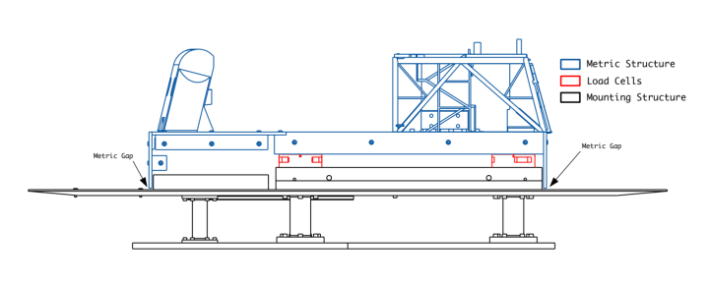
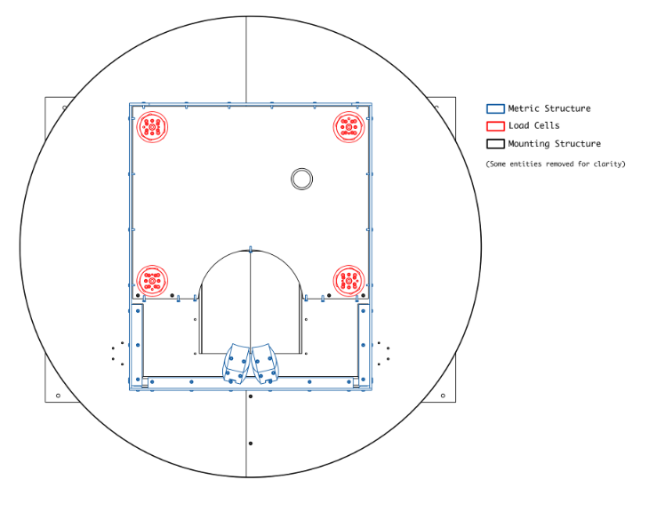
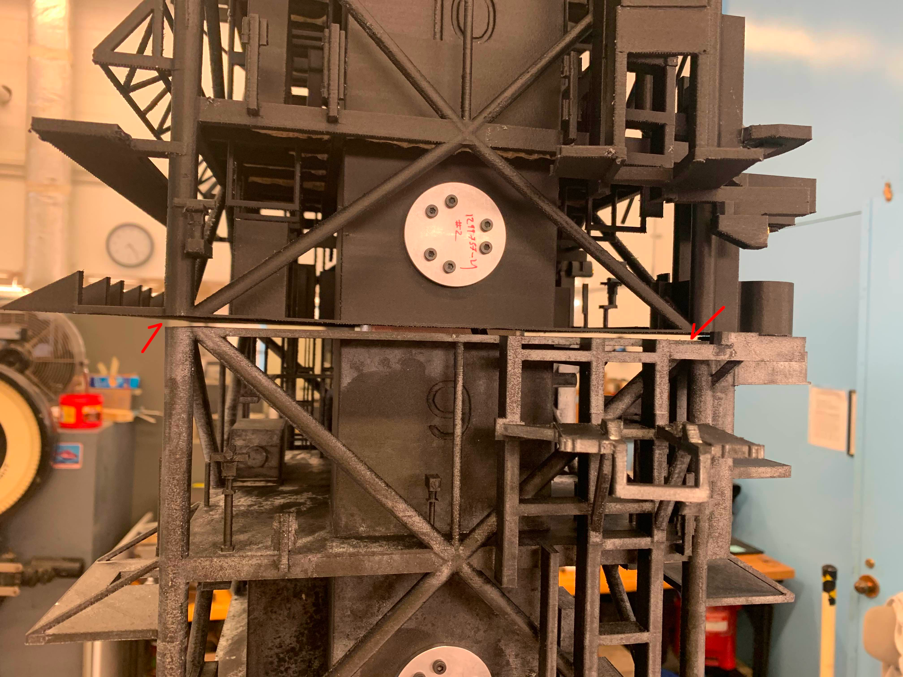
ML-2 Test Article (Metric Gaps)
Photo Credit: NASA/Jesse Collins
Photo Credit: NASA/Jesse Collins

Slide 9




ML-2 Test Article for Wind Tunnel Test
First 2x floors above ML Deck 0 are not individually metric
Because of this, Tier02 loads are calculated with:
Tier10
Tier09
Tier08
Tier07
Where:
NF = Body-axis Normal Force
SF = Body-axis Side Force
PM = Body-axis Pitching Moment
YM = Body-axis Yawing Moment
X₂ = Calculated Force or Moment component of Tier02
X_{gb} = Measured Force or Moment component of the global balance
X_{n} = Measured Force or Moment component of individually metric Tier n
Tier06
Tier05
Tier04
Tier03
ML Deck 0
Tier02

Slide 10
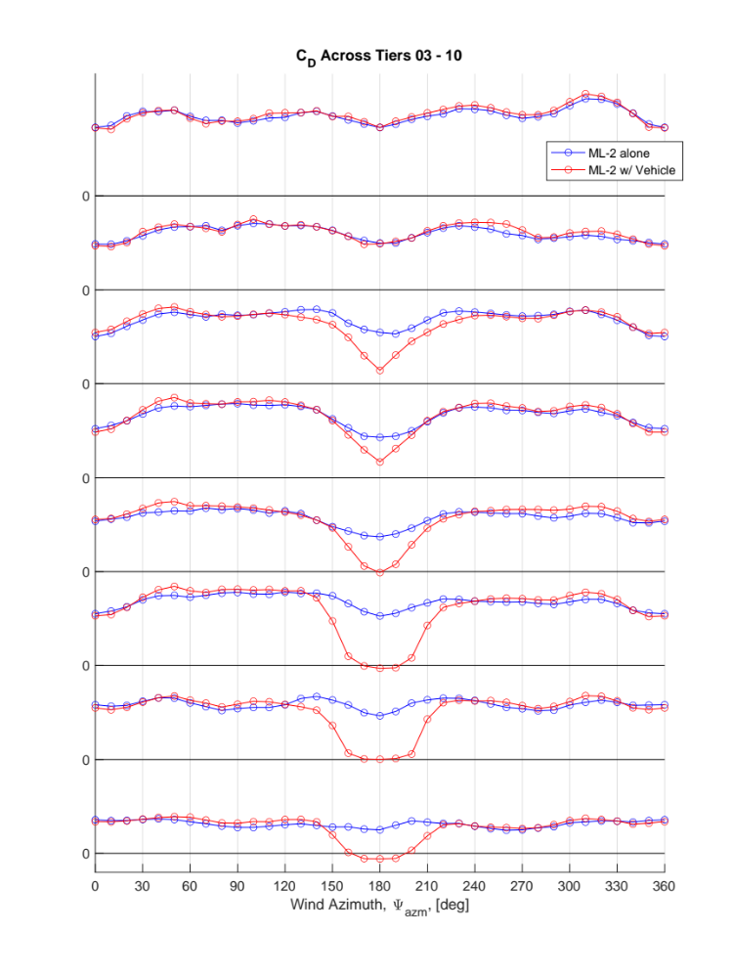
Results / Discussion
Observation:
  Several tiers show Negative Drag coefficient readings
  Correlates to the wider regions of the vehicle (when SRBs present)
    Larger wake region
    Recirculating flow region causing flow to impinge on leeward side of ML
  Important improvement on previous model:
    Where load distribution was inferred by an area analysis
    Global balance measurements were the only source of ML loads information
    Would never predict negative drag for any Tier
T10
T09
T08
T07
T06
T05
T04
Photo Credit: NASA/LaRC Photo Lab
T03

Slide 11
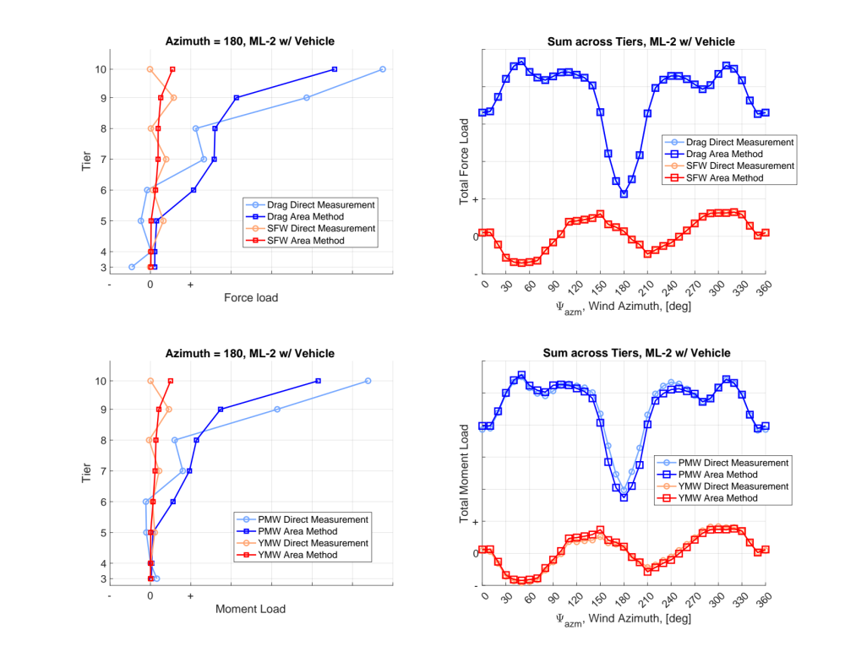
Results / Discussion
Comparison of load estimation methods
  For the sum of forces, it is by definition that the methods match
  Distribution of forces is very different however
    Negative Drag is observed as before
  The sum of the moments won’t necessarily be the same (as shown)
    The former method results in reduced estimates of total moment load in the region of most vehicle-to-tower blockage
  Distribution of moments is also very different

Slide 12
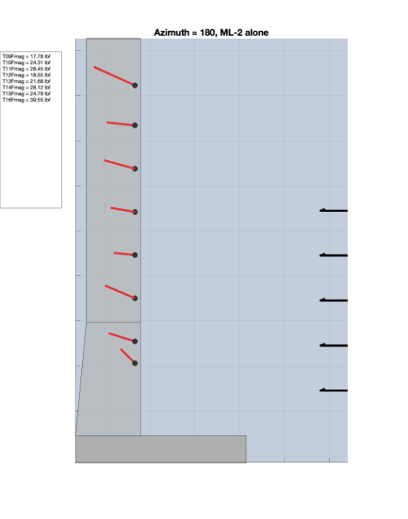
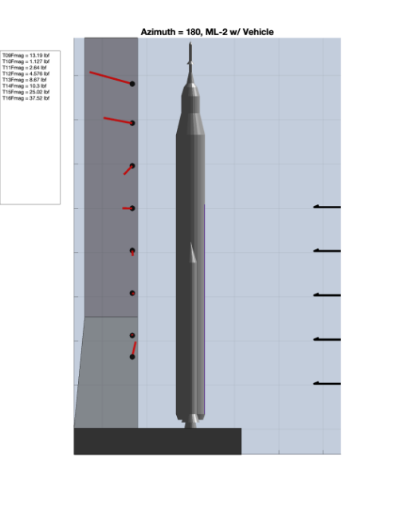
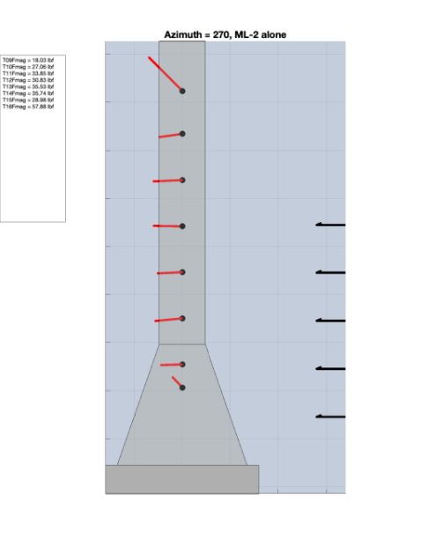
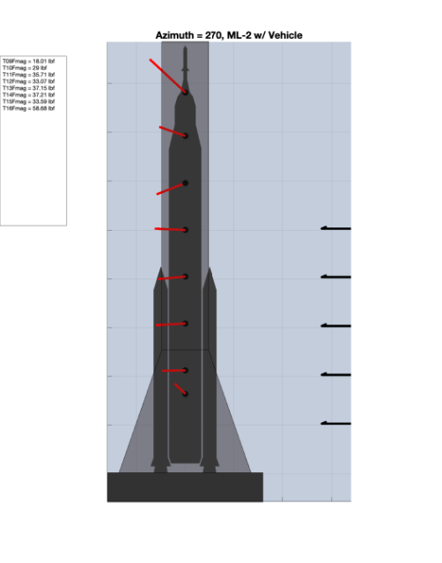
Results / Discussion
-AF
Observation:
  Axial loads observed on several Tiers
    Usually the higher tiers: flow curvature over top of ML
    Less expected: Tier03 AF
    Could be explained by the cross-sectional area change vs. elevation
+AF
Photo Credit: NASA/LaRC Photo Lab

Slide 13
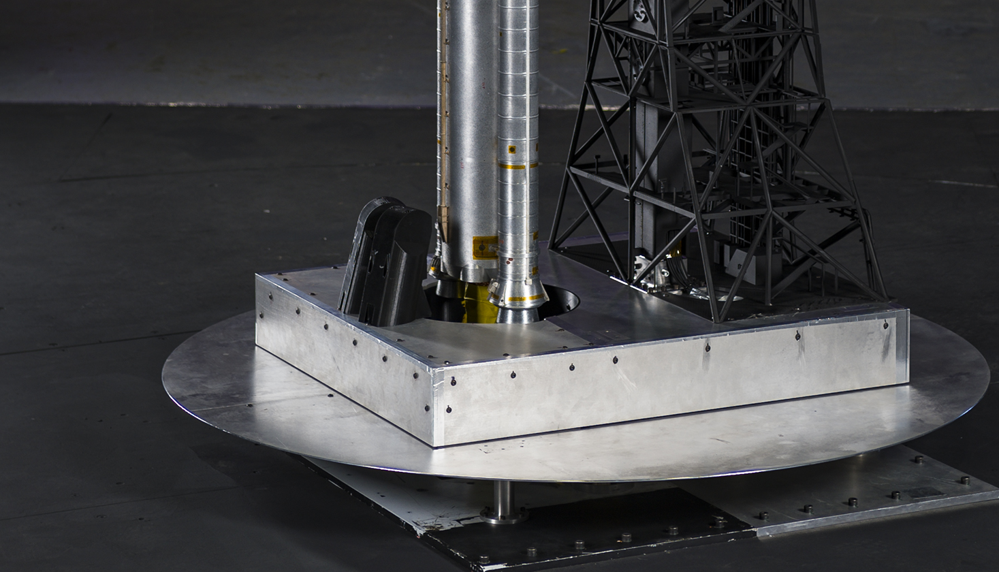
Results / Discussion
Previous test ignored ML global balance measure of Axial loads
  Base environment is known to be different
  During testing not-insignificant flow was observed through vehicle sting pass-through hole
    Brush-seal bristles were seen to deflect upwards through the pass-through hole
As a result:
  Full-scale ML loads estimates don’t consider the axial direction
  There is no technical concern with any of the distributed axial loads; these loads are dwarfed by the entire structure’s dead weight, blast and other plume effects
Photo Credit: NASA/LaRC Photo Lab

Slide 14
Concluding Remarks
Static ground wind loads were measured and presented from a recent wind tunnel test at the NASA LaRC 14-by 22-foot subsonic tunnel.
New measurement technique discovered:
  Some regions of the ML experience negative drag when the vehicle is present
  Some regions of the ML experience observable axial load
Vertical distribution of loads was able to be measured directly via a novel arrangement of sensors
  Using these sensors to measure the distribution yields a higher quality estimate of loads over the previously utilized method
  Area-based distribution of loads method was less accurate in calculating
    Force and Moment load distribution
    Total sum of Moment loads across ML tiers
  These are important for estimating vehicle-to-ML interface loads as well as wind operational placards
  Higher fidelity information can avoid costly redesigns of critical structural systems while still ensuring safety margins are met
This new measurement technique will continue to be a unique and valuable tool for the SLS Program ground wind loads measurement and database construction for future vehicle and ML configurations

Slide 15
Questions?

