Slide 1

Langley Research Center
A Preliminary Development of the Intelligent Change Detection System (ICDS):
Using Machine Learning to Combat Change Blindness in Remote Operation Environments
Vincent E. Houston¹, Eric T. Chancey²
Michael S. Politowicz³, Noah E. Jennings⁴
NASA Langley Research Center^{1,2,3}
Old Dominion University⁴
This material is a work of the U.S. Government and is not subject to copyright protection in the United States.

Slide 2
Langley Research Center
Presentation Outline:
The Technical Challenge
Ground Station Operators & Change Blindness
Intelligent Change Detection System (ICDS) Architecture
  ICDS Autonomous Trigger (AT)
  Real-Time Streaming Data Architecture (RTDA)
  ICDS Intelligent Machine Agent (IMA)
ICDS Component Integration and Evaluation

Slide 3
Langley Research Center
The Technical Challenge:
The Next-Gen National Airspace System (NAS) will need to facilitate the emergence of Advanced Air Mobility (AAM) as the NAS continues to experience a dramatic up shift in the types and number of aerial vehicles.
The amount of actionable data (information) will increase exponentially, in all modalities, i.e., visually, textually, auditorily.
Human-Agents performing direct-action aviation (DAA) tasking, to ensure the safe entry, operation, and egress of unmanned aerial vehicles within the NAS, will require a “collaborator.”
NASA’s Autonomous Systems, a sub-project of the Transformational Tools and Technologies – Revolutionary Aviation Mobility (T³-RAM) project identified a technical challenge focused on the design of visual interfaces for complex monitoring and control system within a ground control station operator’s (GCSO) environment, thus equipping the GCSO with the necessary tool(s) to reduce or eliminate their vulnerability to “change blindness” (CB).
The Intelligent Change Detection System (ICDS) is one such tool that is going through prototype development to demonstrate the capacity Intelligent Machine Agents (IMAs) or autonomous systems have at preventing the occurrence of CB, in GCSOs.

Slide 4
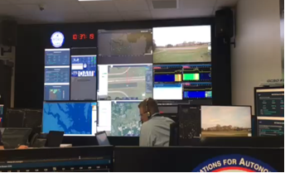
Langley Research Center
GCSO & Change Blindness:
Volume
(Petabyte, Zettabytes)
Variety
(Social Network, Blogs, Logs, Sensors etc.)
Velocity
(Real-time, Near Real-time)
Ground Control Station Environment:
  Complex Visual Displays
  Large Volumes of Data
  Various Types of Data
  Increased Speed of Data Ingestion
Visual Transients:
  Eye Blinks
  Screen Flicker
  Scene Relocation
  Panning Motion of Head
Notes:
The major implication of a Ground Control Station environment is that it makes CB inherent to the human-agent. Therefore, the environment should provide the users with intelligent change-detection systems dedicated to eliminating change blindness, instead of leaving its prevention to the human-agent’s memory and attention processing, which will be overwhelmed by the Three-Vs of Big Data.

Slide 5
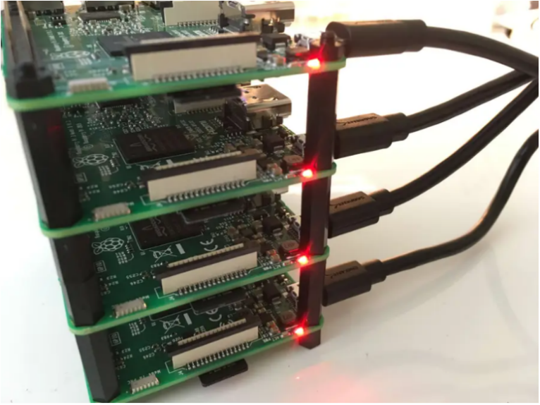


Langley Research Center
ICDS Architecture Overview:
Tobii Pro Nano Eye Tracker
MPATH
MAVProxy
Intelligent Change Detection System (ICDS)
Cleanse
Enrich
Normalize
Real-Time
Analytics
©
©
Streaming Data Pipeline
Data Warehouse

Slide 6
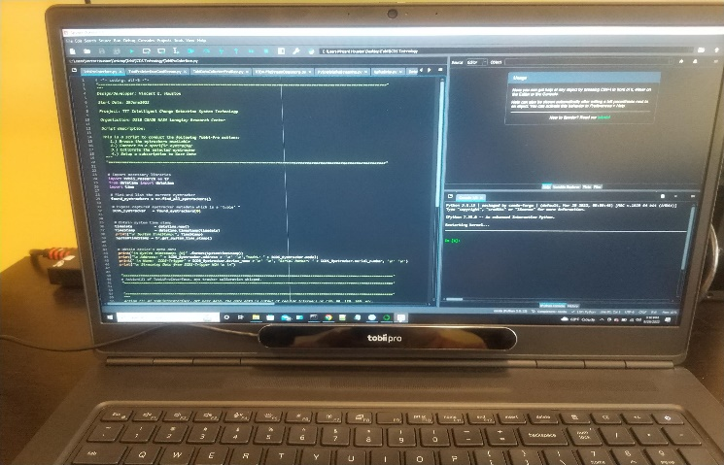
Langley Research Center
ICDS Architecture (AT):
Time synchronized with MPATH data stream
Autonomously identifies loss of GCSO eye focus
Triggers the ingestion of all UAV MPATH state data
Triggers the implementation of the ICDS relevant data determination
Notes:
Data is continuously streamed from the source. However, it is only when the GCSO has lost visual focus, and the AT is pulled, does the ICDS use the ingested data to make determinations as to whether relevant data has been missed or not.
This triggering is provided via the eye tracker’s or AT’s parameter output. When the AT is no longer output gaze coordinates it becomes engaged and the ICDS IMA begins relevant data assessment.
Only when the ICDS is triggered by the AT does data get stored in the warehouse for future use, such as training.

Slide 7

Langley Research Center
ICDS Architecture (RTDA):
Lambda Data Architecture:
  Service Layer
    Apache Kafka
  Speed Layer
    Apache Spark
  Batch Layer
    Apache Spark
Cleanse
Enrich
Normalize
Real-Time
Analytics
©
©
Streaming Data Pipeline
Notes:
The Lambda architecture produces a merger of both the batch and real-time views, which allows for both immediate and future use of ingested data continued training and testing of the ICDS IMA.
Error occurrences are identified and resolved on the three layers of the RTDA’s Lambda architecture.
RTDA- (Data wrangling and storage) utilizes a Lambda architecture which is a streaming-first architecture deployment pattern where data is processed in real-time. The hardware is implemented with one server computer and one or more Raspberry PIs in order to implement a “Overseer” “Worker” structure. However, this hardware structure could be implemented with only Raspberry PIs.
In a nutshell, this entire architecture stream process data from the messaging system, transforms it, and publishes the enriched data to the messaging system, making it available for real-time analytics, alerts, machine learning (ML), reporting, dashboarding, predictive and preventive maintenance.
The main reason that the RTDA has been developed as an element of the ICDS is that, in addition to the previously stated capabilities, adds an intelligent and autonomous element to data ingestion and dissemination through the data pipeline.

Slide 8
Langley Research Center
ICDS Architecture (RTDA): Service Layers
Tobii Pro Nano Eye Tracker
MPATH
MAVProxy
Sourced Data Ingestion
Low-Latency Querying
Autonomous Data Dissemination
©
Intelligent Change Detection System (ICDS)
Data Warehouse
Notes:
Kafka is (open sourced) and combines three key capabilities so that our use cases can be implemented for event streaming end-to-end with a single battle-tested solution or batch processing:
By publishing (writing) and subscribing to (reading) streams of events, which includes continuous import/export of data from the Tobii eye tracker and MPATH.
By storing those event data streams durably and reliably for as long as desired.
By processing those event data streams as they occur or retrospectively.
This functionality is provided in on a distributed, highly scalable, elastic, fault-tolerant, and secure platform.
A key benefit to Kafka is that it can be deployed on bare-minimal hardware, virtual machines, and containers, and on-premises as well as in the cloud, which made it ideal for use in the ROAM lab. I choose to self-manage
The created Kafka environment for customization purposes.
Low-Latency Querying is due to a NoSQL Database being used as the servicing layer. With this layer, allows indexing of Batch views which in-turn lowers the latency.
Through data topics and Kafka ML directing data to the IMA or to a warehouse is autonomous.

Slide 9
Langley Research Center
ICDS Architecture (RTDA): Speed & Batch Layer
Apache Spark
Normalize
Real-Time
Analytics
Cleanse
Enrich
Master Dataset Management
Computation of Batch Views
Management of high latency updates
Generates real-time querying to the
servicing layer
Notes:
Apache Spark is an open-source unified analytics multi-language engine that significantly supports executing data engineering, data science, and machine learning on single-node
machines or clusters engine for large-scale data processing. Spark provides an interface for programming clusters with implicit data parallelism and fault tolerance.
2) A Batch Feature View defines transformations against one or more Batch Sources, which are data sources

Slide 10
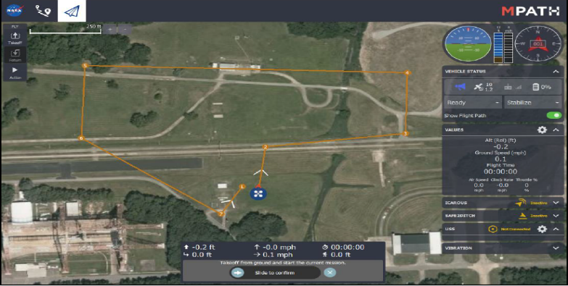
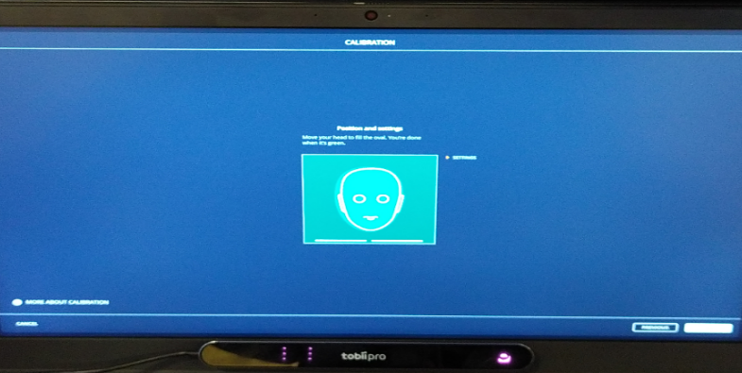


Langley Research Center
ICDS Architecture (IMA):
MPATH Full Parameter List & Synchronized Timestamp
Intelligent Change Detection System (ICDS)
Left & Right Eye Gaze Data + Device Timestamp
Notes:
Start with a Naïve Bayes eventually then perform a comparison between it and the Multi-View Ensemble Learning Method which used four classifiers (Naïve Bayes, K-NN, Tree-Bagger, and Support Vector Machines) to determine ensemble learning improves accuracy and latency in the design. There is a possibility of enlisting SSL or Self Supervised Learning.
The methodologies put forth in the development of ICDS IMA was that of implementing and integrating both the Multinomial and Bernoulli Naïve Bayes algorithms
Multinomial Naïve Bayes uses feature vectors to represent the frequent occurrence of certain data and Bernoulli uses the features as independent Booleans (binary parameters) that describe the inputs to ICDS IMA determining if a data has occurred or not.
Utilizing both Multinomial and Bernoulli, in a lattice structure of algorithms, provides strength and flexibility to the ICDS IMA predictive capabilities.
The simplified Naïve Bayes Classifiers work well in real-world situations without needing large amounts of data, even if available.

Slide 11
Langley Research Center
ICDS Component Integration:
Integration:
  Thus far, both the hardware and software of Tobii Eye Tracker Sensor, RTDA, and ICDS IMA has taken place.
  The system’s autonomous trigger streams data to the RTDA for real-time dissemination to the ICDS for real-time prediction of relevant data, while also directing that same data to warehouses for future use.

Slide 12
Langley Research Center
ICDS Component Future development:
Future Development and Use:
  Three of the four components that comprise the ICDS (Tobii Eye Tracker, MAVProxy, RTDA) have gone through preliminary development and testing.
  The fourth component (ICDS IMA) has yet to be tested due in part to incomplete system integration.
  Therefore, in addition to training and testing the ICDS IMA with data from the system’s data sources (Tobii Eye Tracker, MAVProxy), there is a need to integrate the ICDS IMA with the other system components and retrain and retest.

Slide 13
Langley Research Center
Questions or Comments:

Slide 14

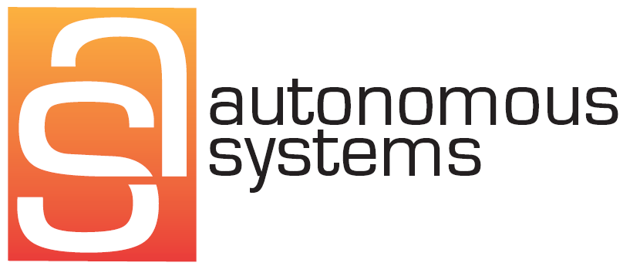
Langley Research Center
Thank you for your time and interest

