Slide 1
Technology for the UVOIR Telescope
Lee Feinberg, NASA Goddard Space Flight Center
AAS Splinter

Slide 2
Topics
Decadal Recommendation Regarding UVOIR Relating to Technology
JWST Performance as State of the Art
LUVOIR and Habex Technology Roadmaps from the 2019 Reports
The NASA Infrastructure Landscape And How it Can Impact Architecture and Technologies
Next Steps

Slide 3
From the Astro 2020 Decadal:
Section 7.5.2: “The mission the survey puts forward will combine a large, stable telescope with an advanced coronagraph intended to block the light of bright stars. It will be capable of surveying a hundred or more nearby Sun-like stars to discover their planetary systems and determine their orbits and basic properties. Then for the most exciting ~25 planets, astronomers will use spectroscopy at ultraviolet, visible, and near infrared wavelengths to identify multiple atmospheric components that could serve as biomarkers (see Figure 7.5). It will also have high-resolution imaging and multi-object spectroscopic capability (particularly at ultraviolet wavelengths) to address a broad range of astrophysical science selected through guest investigator programs.

Slide 4

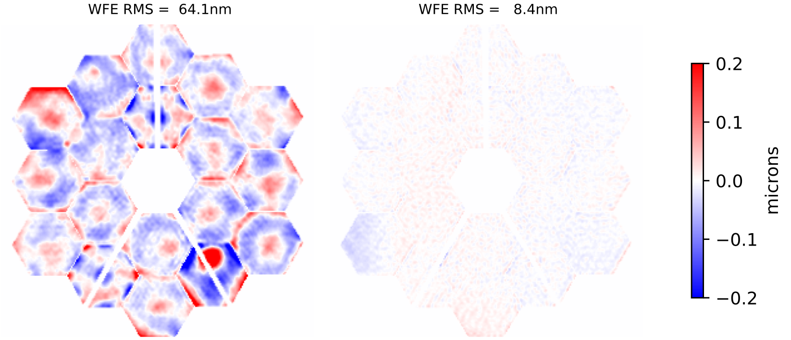
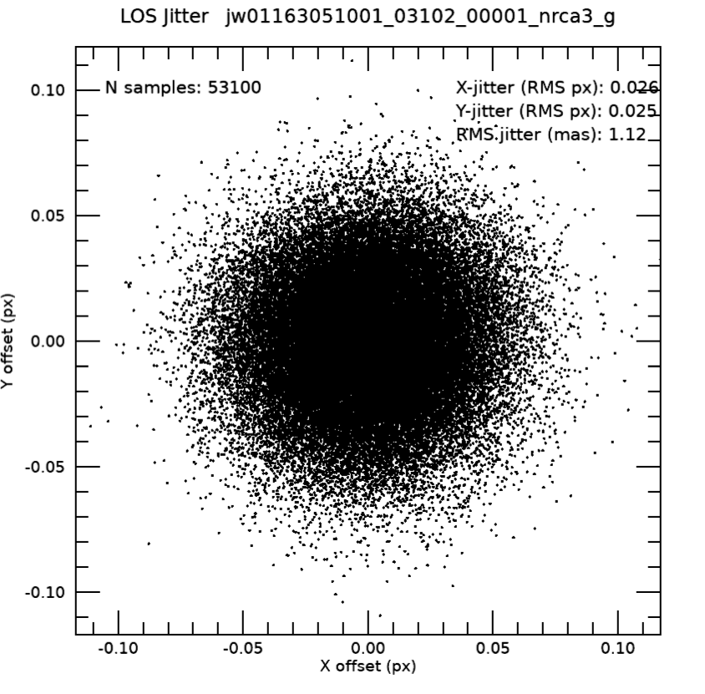
JWST Performance nearly 2x spec Gives High Confidence a .5um diffraction limited telescope is feasible
Telescope performance is dominated by the primary mirror
  WFE improvements .5um RMS WFE well within the state of the art
  Need to define key high contrast specs like edges, PSD
HWO is expected to be diffraction limited at .5um or about 37.5nm RMS WFE
JWST’s 1 mas stability with simple isolation and 1hz fine steering loop
Occasional tilt events first few months after cooldown have diminished, can be removed with an active loop or calibration
Micrometeoroids can be reduced 100x with a baffle
Telescope ~ 65 nm rms
Telescope + SIs ~ 70-130 nm
Absolute pointing < 0.2”
Line of sight jitter ~ 1 mas
Dither precision ~2-4 mas
As of July 12th
λ/14 at 1.1 µm
λ/25 at 2.0 µm
λ/100 at 10 µm…
No measurable vibration from
cryocooler or reaction wheels

Slide 5
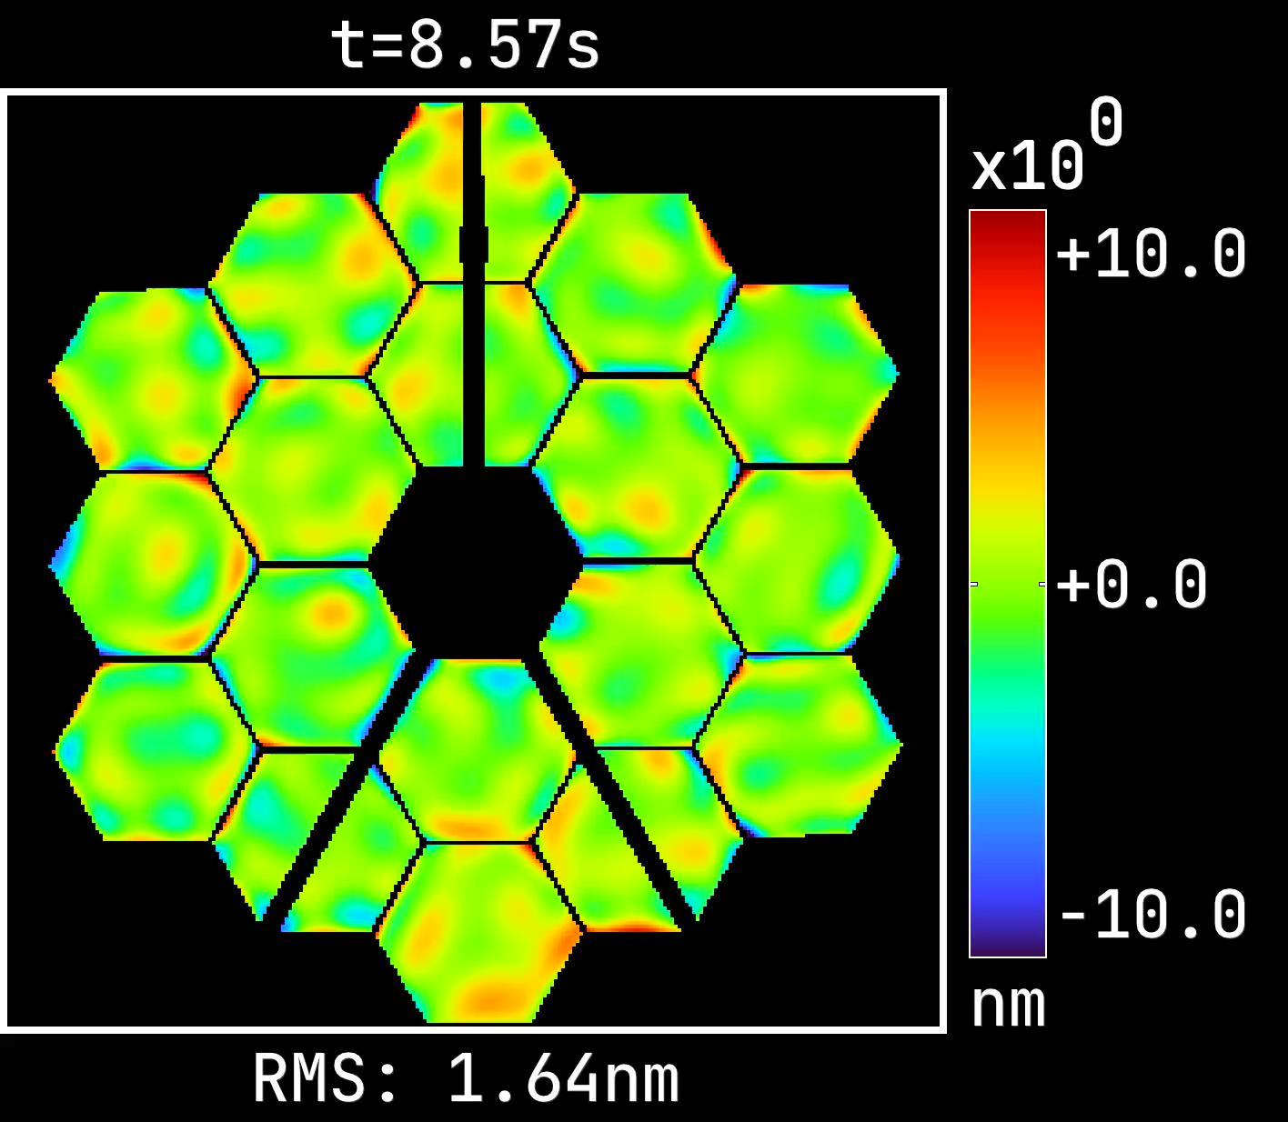
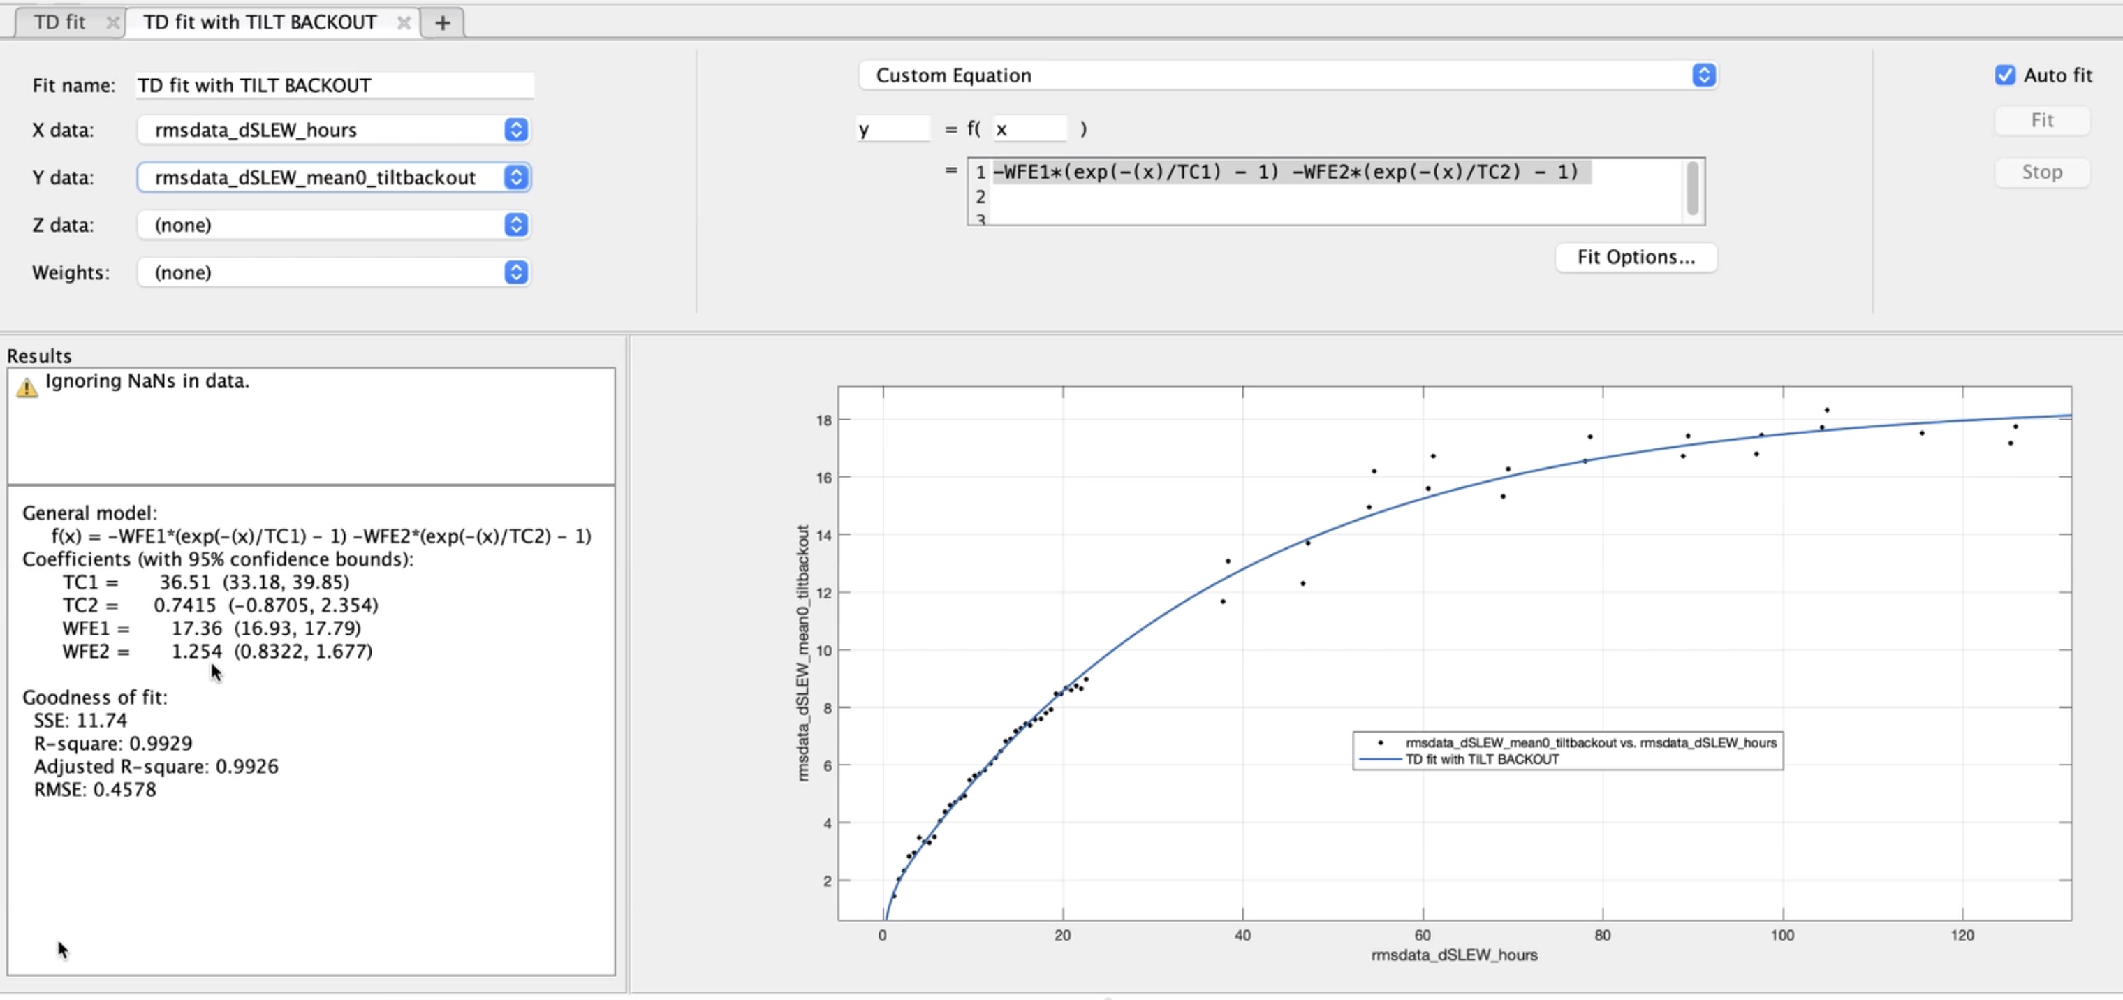
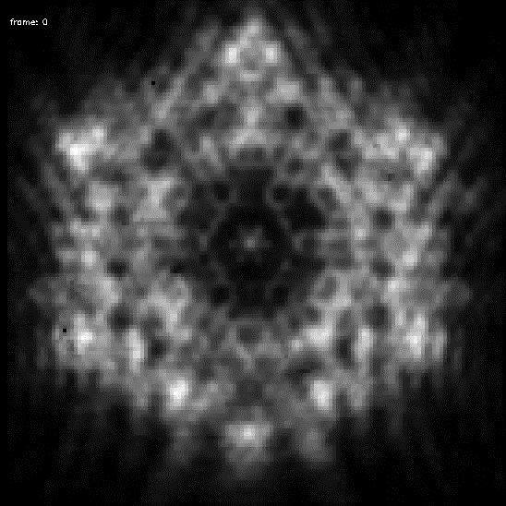
JWST passive thermal stability defines upper bounds for active controls
Alden Jurling, Joe Howard (NASA GSFC)
18 nm RMS WFE
over 8 days after nearly
worst case slew
37 hours
Short Term Oscillations result from heaters used on instrument electronics panels connected to PM with .5K deadband
RST predicts 1mK class control on PM

Slide 6
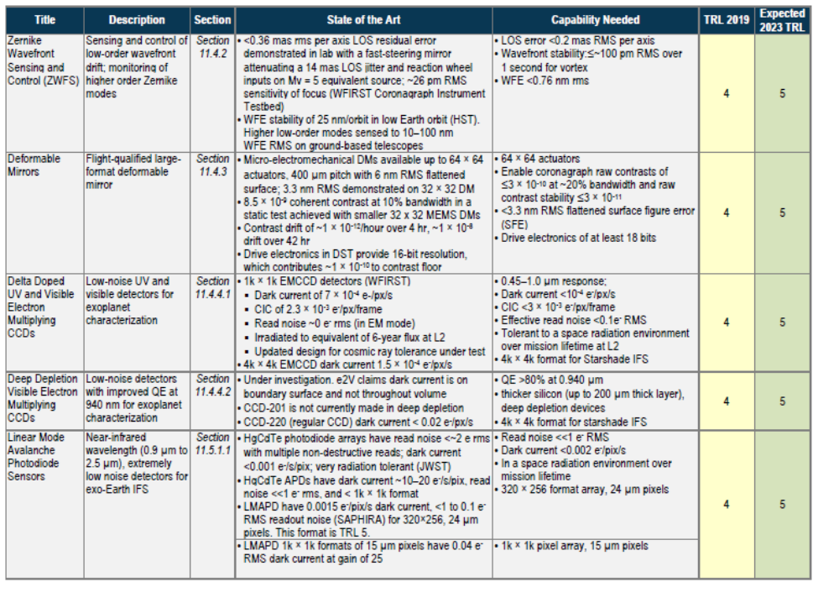
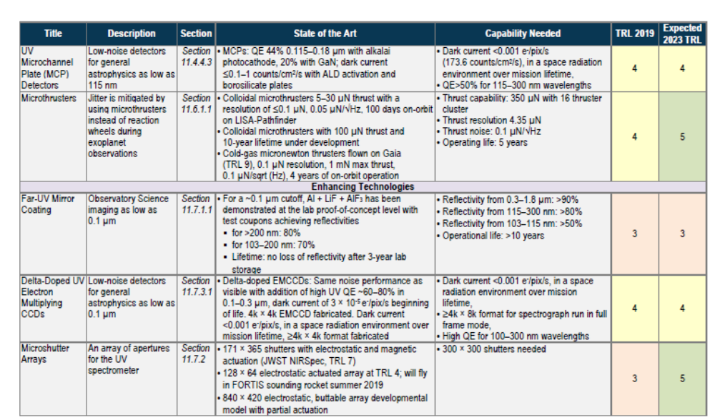
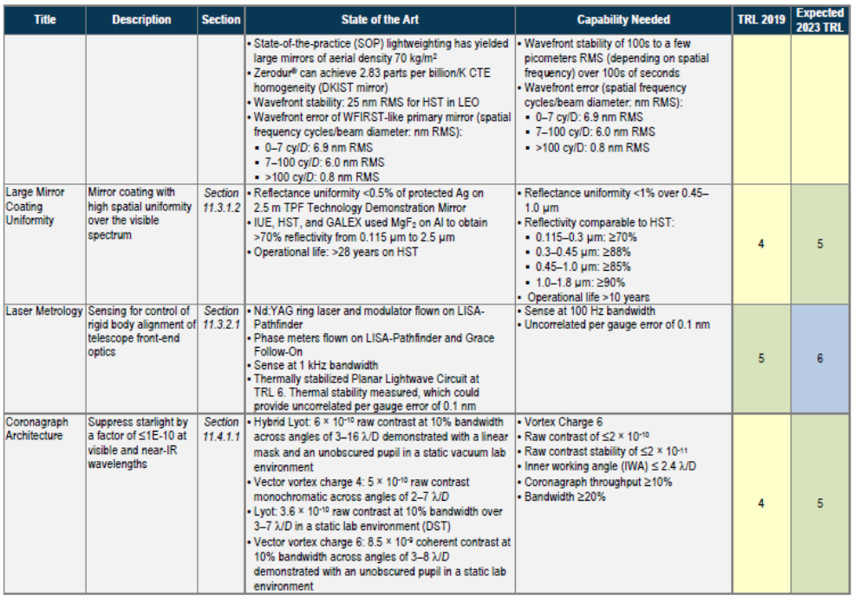
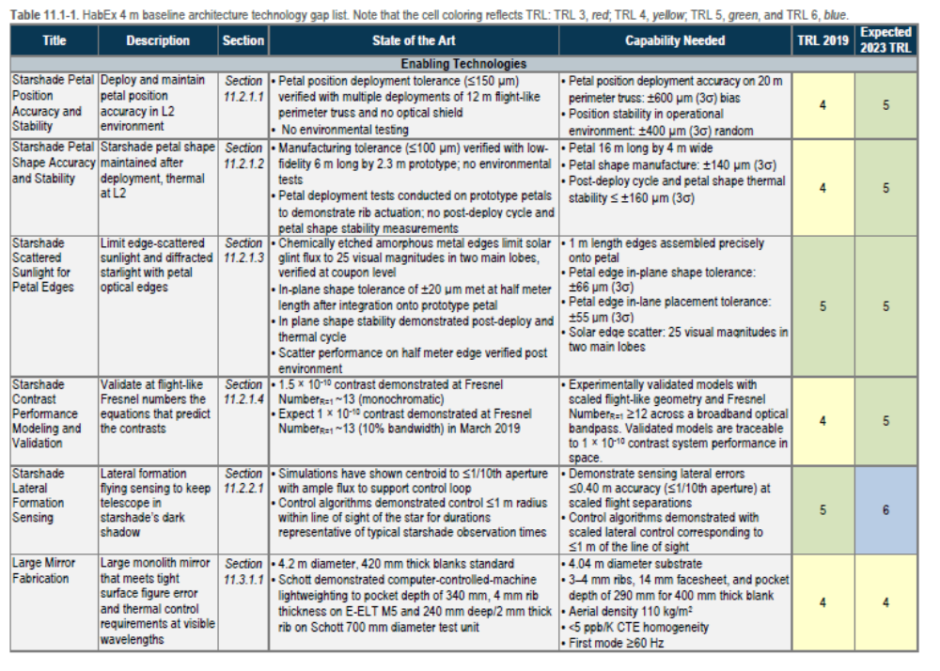
Habex Technology Captures Coronagraph and Starshade with a 4 meter UV-Optical Telescope (2019 assessment)

Slide 7
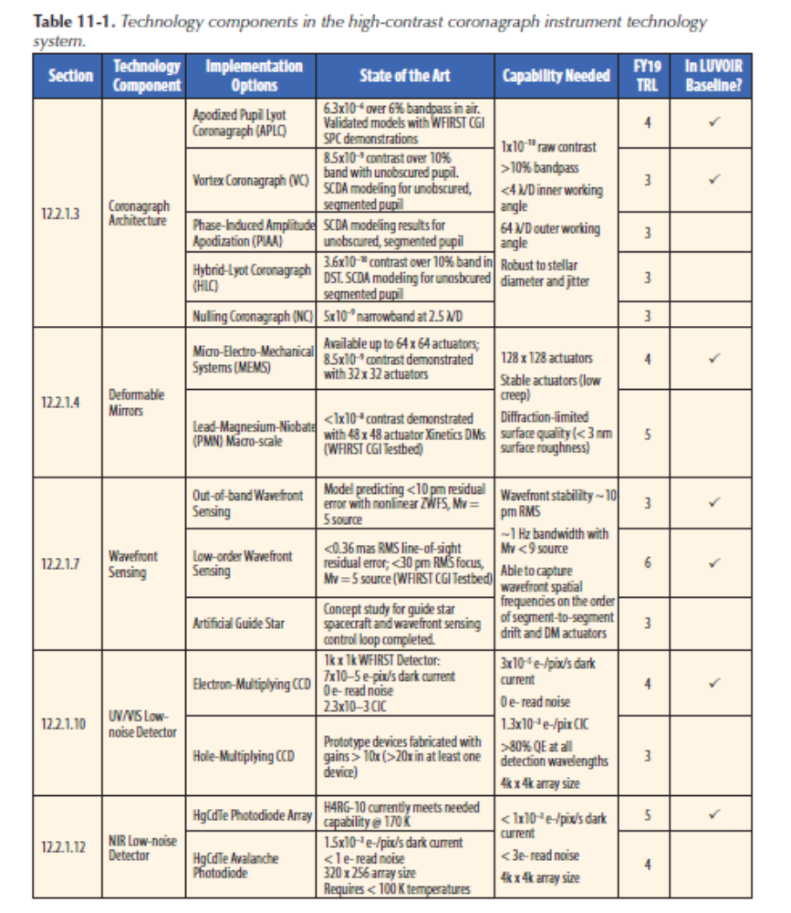
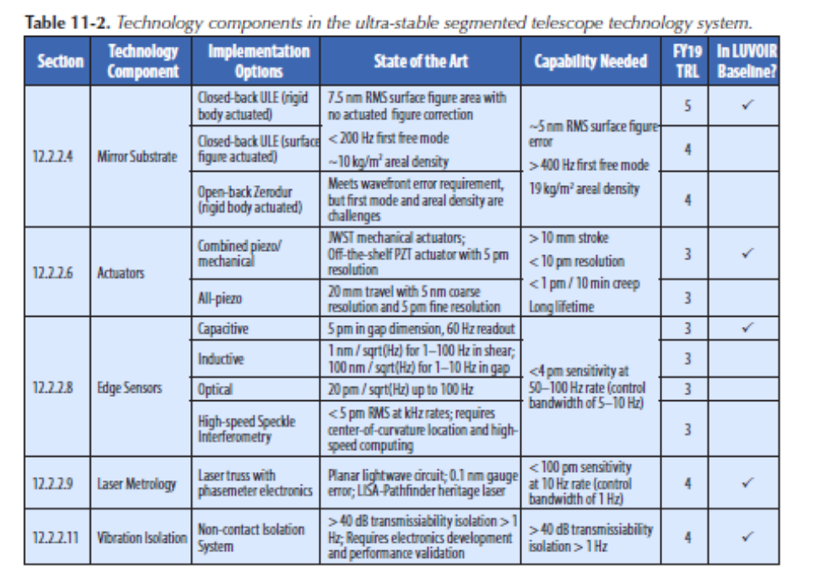
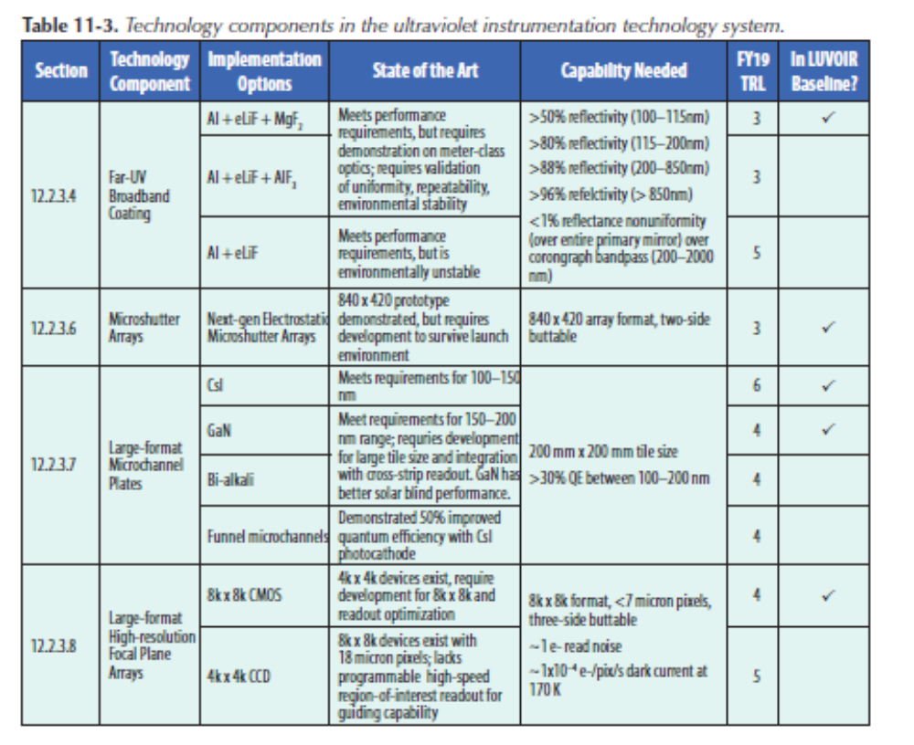
LUVOIR Technology Captures Coronagraph and Starshade with a 8 or 15 meter UV-Optical Telescope (2019 assessment)

Slide 8
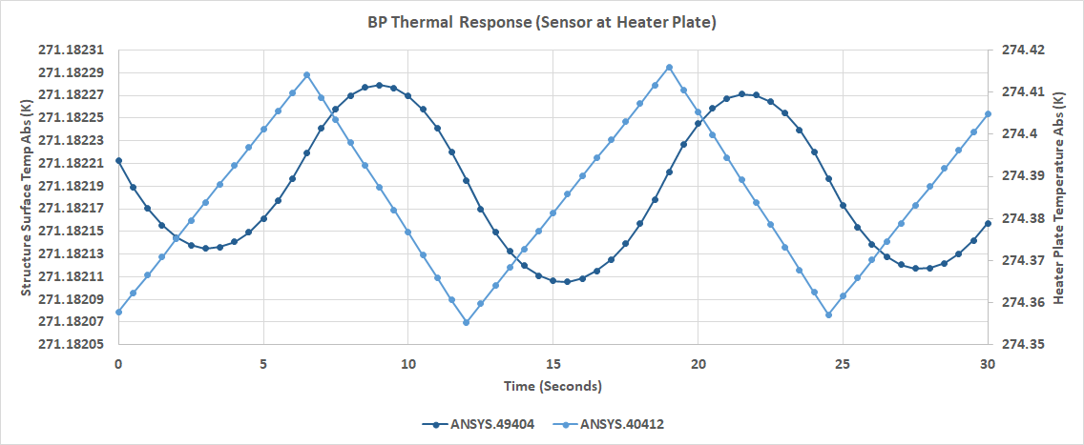
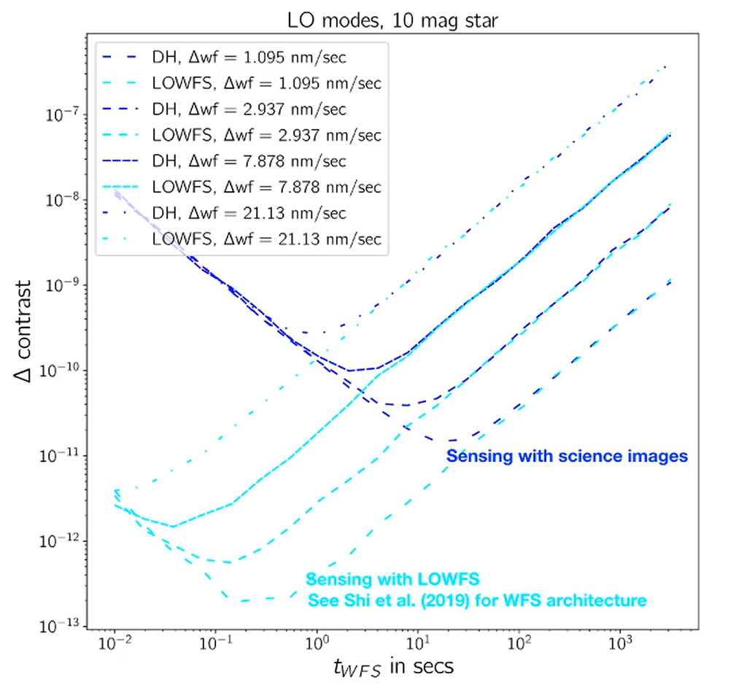
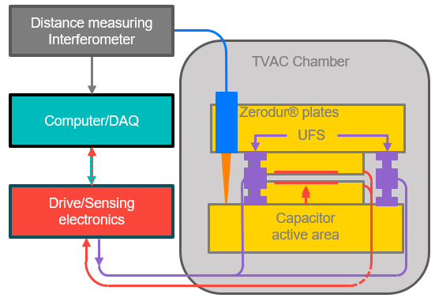
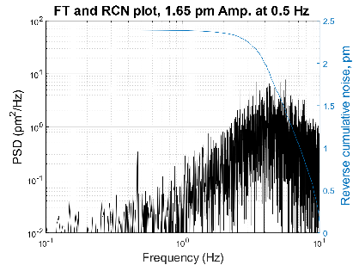
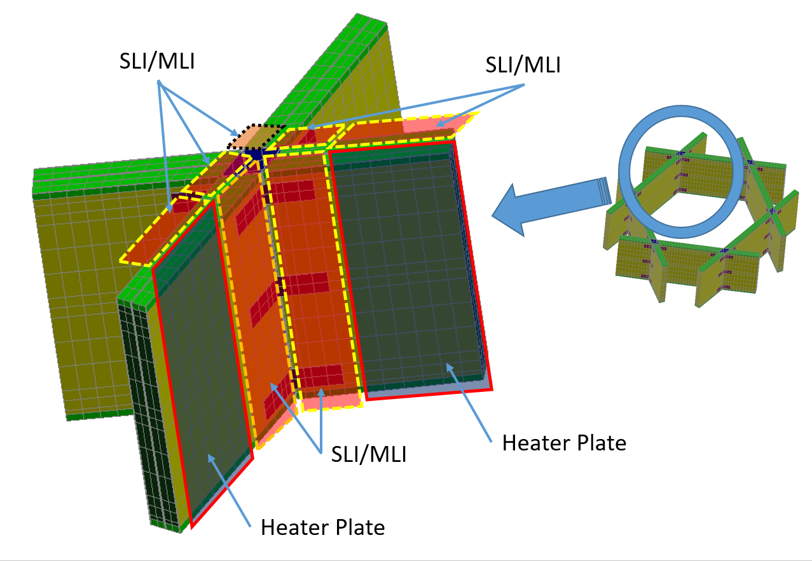
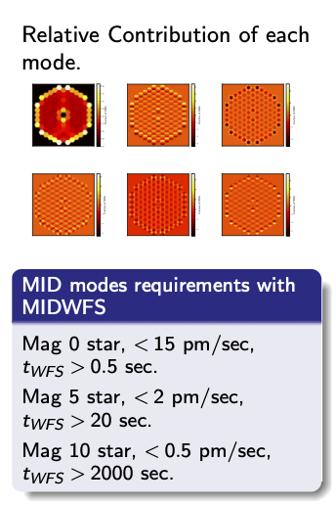
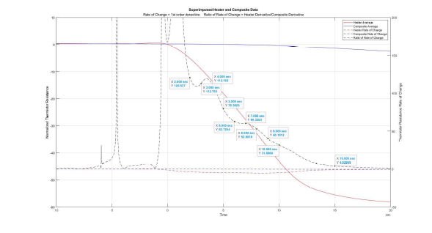
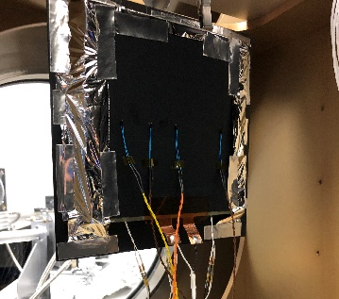
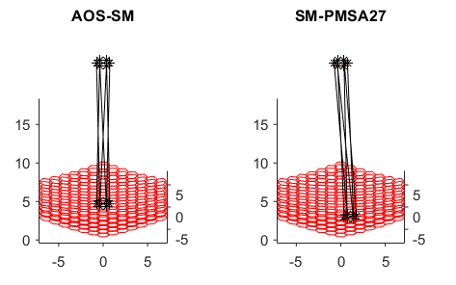
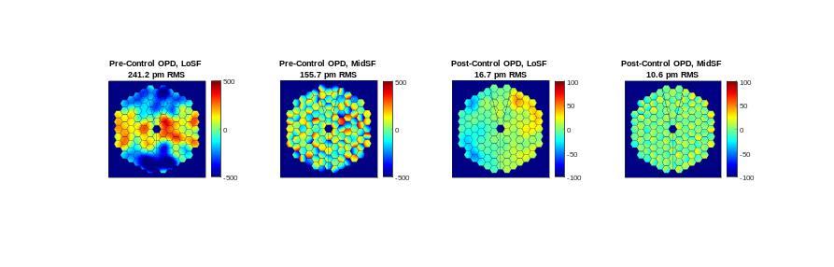
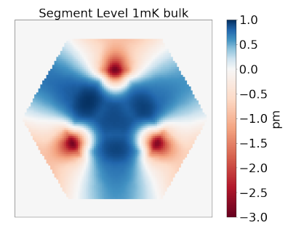
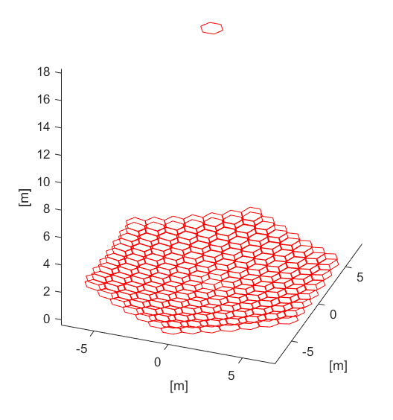
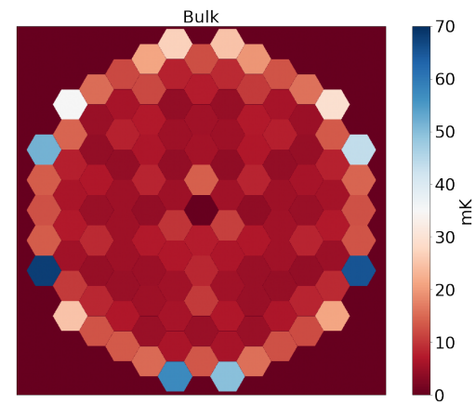
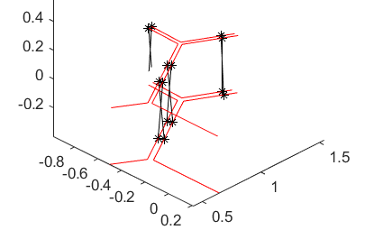
ULTRA-TM (Ball/NG/L3 Harris) Recent Progress
CORONAGRAPH SENSITIVITES
Calculate contrast stability vs. spatial-temporal domain, active WFSC in coronagraph, noise
SEGMENT SENSING AND CONTROL
Demonstrate picometer-level edge sensor and actuator components with flight-traceable designs. Model network performance.
THERMAL SENSING AND CONTROL
Develop a radiative heating approach with stability in the mK regime
Key Result: Derived allocations for system stability budget, set necessary performance for systems/ subsystems/components, used to evaluate technology gaps
Key Result: Achieved 2.5 pm RMS closed loop sense/actuate residual from 0.01-10 Hz.
Developed flexible time domain simulation for architecture trades and component evaluation
Key Result: Modeling and hardware demo of sub-mK thermal stability from rigid heater-integral-to-composite heater panel on structure element. Identified novel temp sensors.

Slide 9
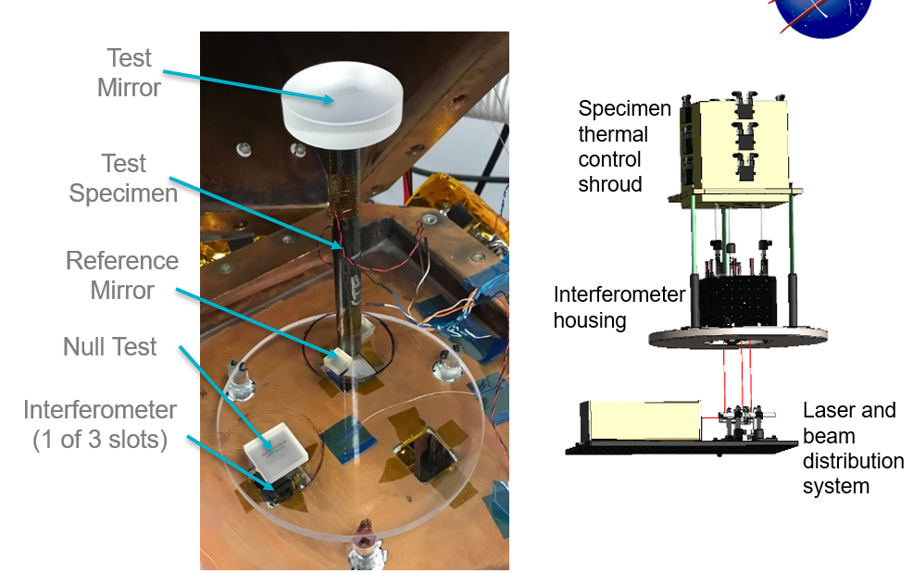
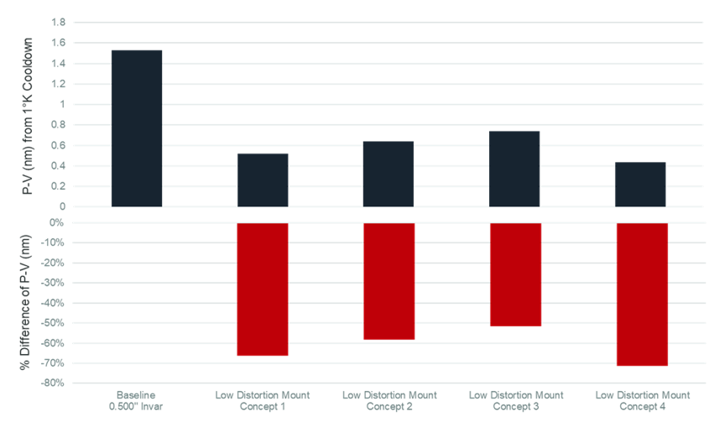
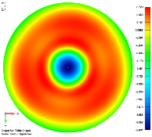
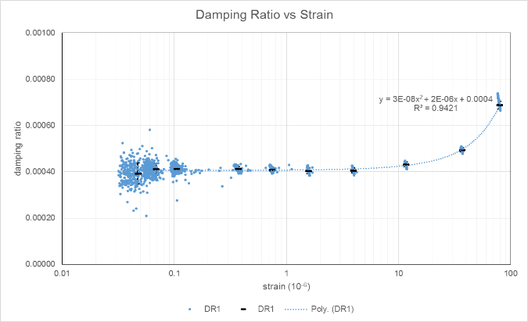
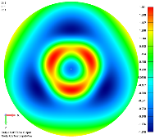
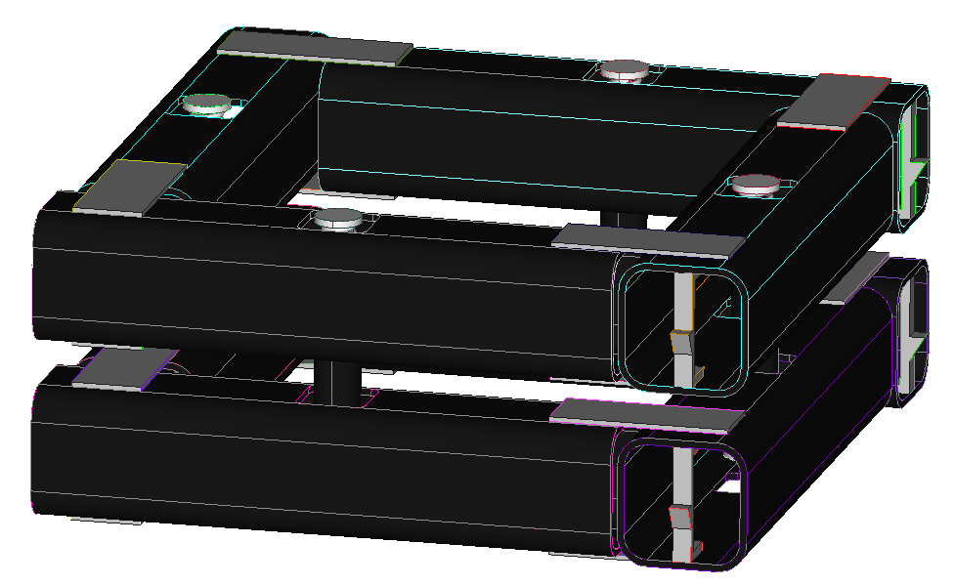
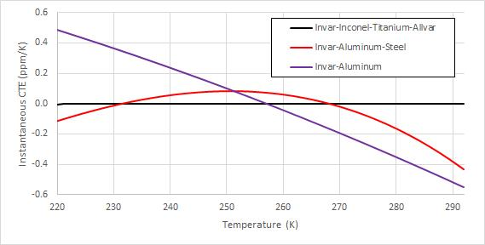
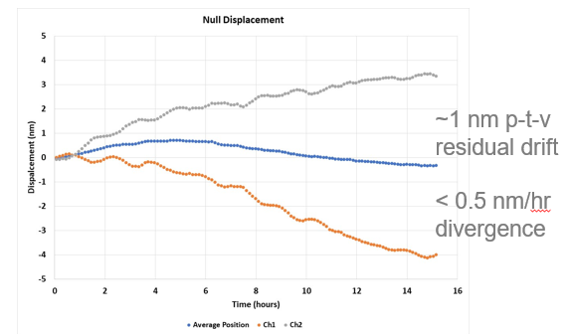
ULTRA-TM Progress (Continued)
STABLE MIRROR MOUNTING
Design of novel mount pads, struts with improved passive stability to reduce mirror distortion
STABLE STRUTURES – LATCHING AND DAMPING
Increase damping in large structures with foil treatment. Re-design latches to improve passive thermal & dynamic stability.
MATERIAL PROPERTY METROLOGY
Reduce uncertainty in measured CTE/CME of composites by 100X
10 K
Key Result: Design and hardware demo of novel pad geometry with predicted 15-20X reduction in SFE distortion over solid pad.
Developed strut design with metal alloys that has comparable CTE to ULE/Zerodur.
Key Result: Hardware demo showed foil appreciably increased damping ratio in composite coupons. Hardware demo of latchplane test article showed new design reduces deformation by several orders of magnitude.
Key Result: 10X improvement in displacement measurement. Improved isolation from lab environment. Completed analysis of alignment stability on displacement.

Slide 10
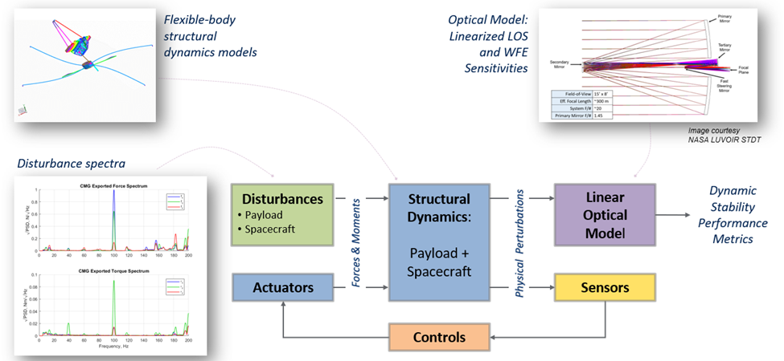
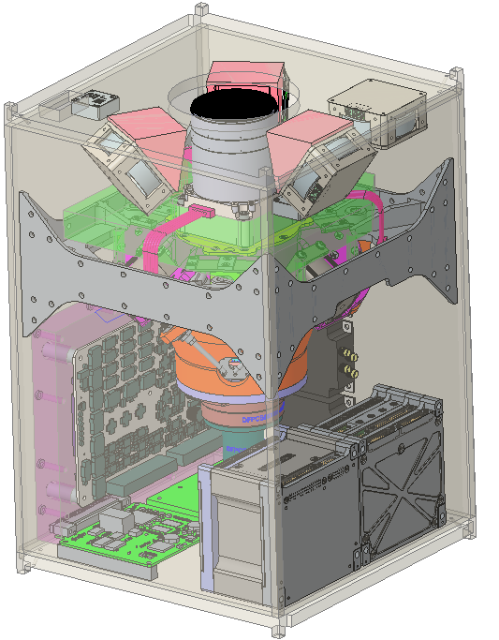
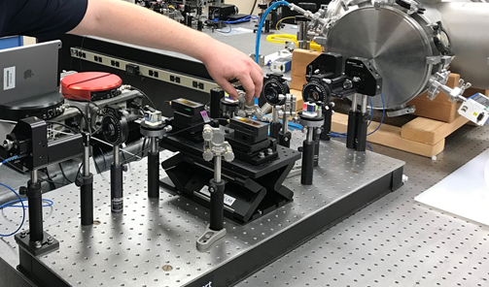
TechMAST Areas of Active Work (Lockheed)
Program goal is to mature the TRL of key technologies that enable large ultra-stable space telescopes
Next-generation astrophysics missions will require:
  Extreme pointing stability
  Picometer-level wavefront error control
  Large structures with low frequency modes
TechMAST seeks to mature technologies directly relevant to achieving requirements for next-generation astrophysics missions
  Disturbance-Free Payload addresses vibration isolation for wavefront error stability and precision pointing stability
  Integrated Modeling develops predictions for telescope performance
  Picometer Metrology develops techniques measure dimensional stability of optics
Integrated Modeling Process
DFP CubeSat
Picometer Metrology Testbed

Slide 11
Habex Assesment of Technology Progress (from Rhonda Morgan/JPL)
Starshade edges anti-reflection coating (McKeithen Jan 2021)
Starshade Petal Shape Accuracy and Stability: Starshade Milestone 6 reached. Medium-fidelity test article demonstrated on-orbit thermal stability of shape critical features.
Starshade Contrast Model Validation, Milestone 2 delayed by COVID. Two masks completed testing and results under analysis. Report and EXOTAC review in the fall.
Large Mirror Fabrication (Stahl, in preparation)
  Predicted thermal control has completed testing of the AMTD 1.5-meter ULE mirror
    Active control compensated for external thermal gradient to accuracy of 2-K and stability of 2-mK (meets HabEx need)
Coronagraph Architecture
  SATs slowed down by COVID
  Vector vortex 5x10⁻⁹ contrast at 10% bandwidth, 3.1x10⁻¹⁰ at monochromatic
Zernike WFS (Ruane Nov 2020)
  https://arxiv.org/abs/2010.10541
  Closed loop stability of 34 pm RMS over 1000 seconds (required ~100 pm over 1 second)
  WFE sensitivity <0.3 nm RMS (<0.76 nm RMS required)
  Not test simultaneously with coronagraph (no plan to do so)
Deformable Mirrors (Eduardo and Garreth Tech Talk https://exoplanets.nasa.gov/exep/technology/tech_colloquium/
  BMC DMs achieved a few 1E-9 contrast, limited by print through
  BMC SBIR to improve print through, status unknown
  BMC 48x48 survived random vibe with flight-like connectorization
Deep Depleted EMCCDS (Nathan Bush, proposal)
  Proposal to test 40 um thick, CCD97 EMCCD devices at JPL, QE=0.7 at 900 nm. (HabEx needs 200 um thick)
Notes:
https://www.spiedigitallibrary.org/journals/Journal-of-Astronomical-Telescopes-Instruments-and-Systems/volume-7/issue-02/021208/Antireflection-coatings-on-starshade-optical-edges-for-solar-glint-suppression/10.1117/1.JATIS.7.2.021208.full?SSO=1

Slide 12
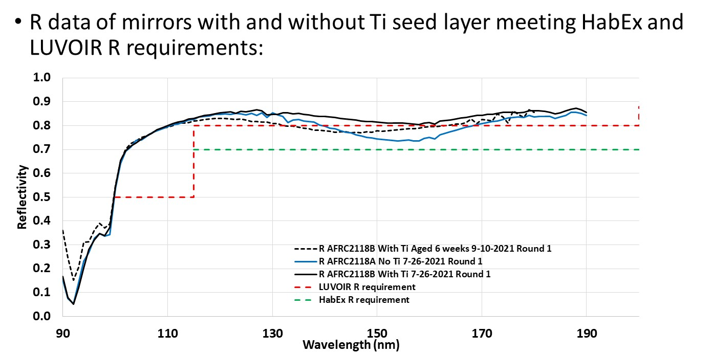
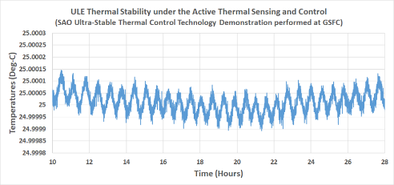
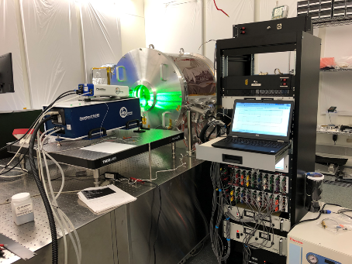
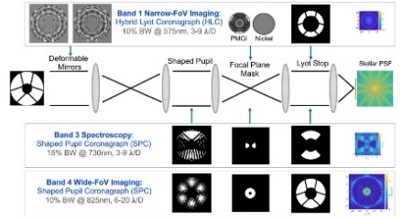
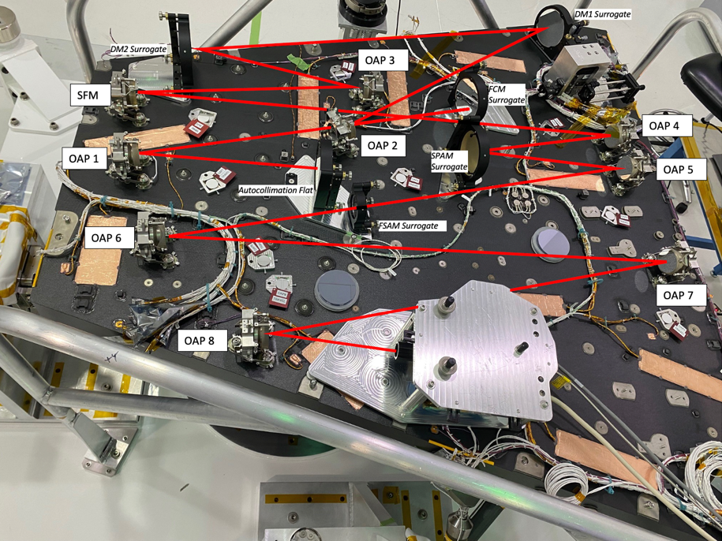
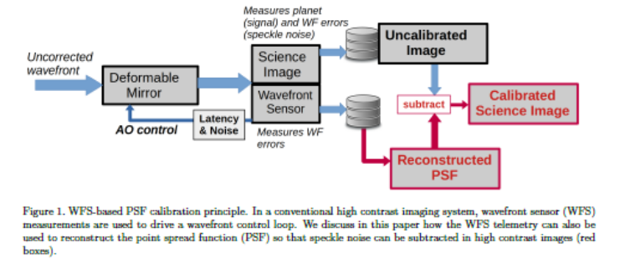
Other Examples of Technology Progress….
Ultrastable Telescopes
Manuel Quijada/GSFC
+-75uK thermal control, pm/s drift measurements
Coatings
ULE thermal stability was demonstrated at +25 °C to 0.25mK Peak-to-Valley (P-V) over 18 hours. At a short time span, the thermal stability was demonstrated to less than 0.15mK P-V (150uK or +/- 75 µK) over an hour.
First Continuous PSF calibration Demonstrated
GSFC Ultrastable testbed/Picometer High Speed Interferometry
Roman Space Telescope Coronagraph/JPL
High Contrast Imaging with Photon Noise Limit Calibration, O. Guyon/SPIE/2022

Slide 13
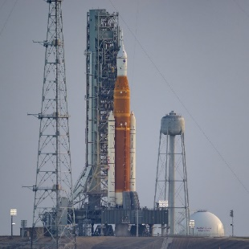
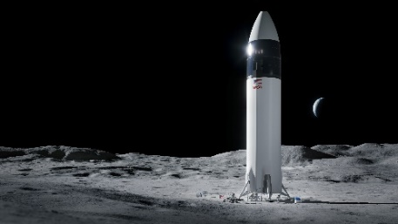
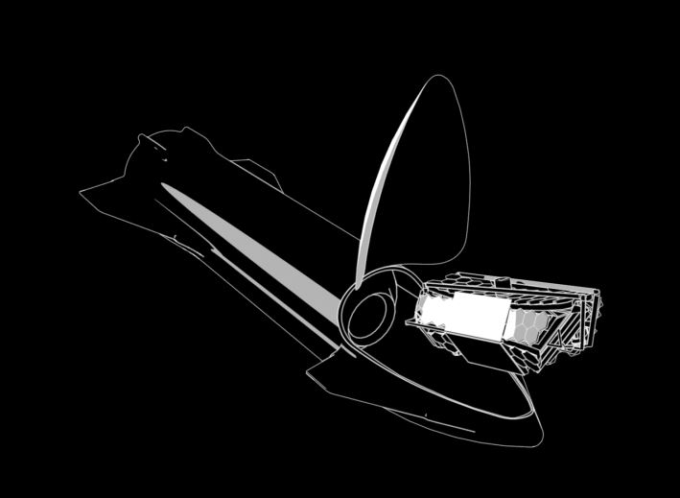
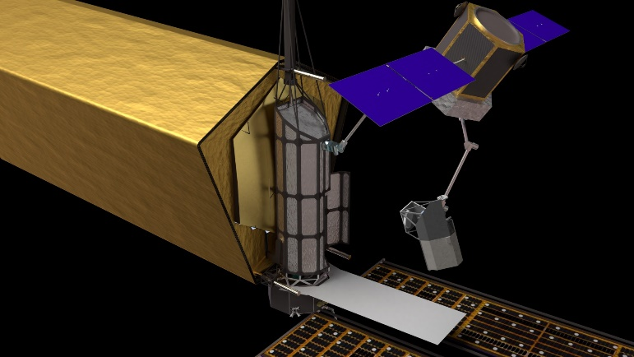
NASA Infrastructure Landscape Will Impact Technology Roadamps
The era of big rockets that can carry big telescopes has begun with the launch of the first Artemis mission. Big rocket Mass and Volume are significant:
  Mass:
    JWST was 6,100Kg
    Starship capable of 100,000Kg to L2 injection trajectory with refueling
    SLS capable of >40,000Kg to L2
  Volume:
    JWST fit in a 5m standard fairing diameter
    Starship 9m, SLS 8.4m
Servicing and deployment checkout can be enabled both by advances in robotic servicing capabilities and in the abilities to refuel and return
Servicing of instruments using a Hubble like model could change how we think about technology
  Allows first generation instruments to be less ambitious in terms of wavelength coverage, bandpass, etc

Slide 14
Next Steps
Update Roadmaps Consistent both With Progress and The Decadal Recommendation and Develop Initial Investment Strategy
  Need updated investment strategy for next fiscal year
    Prioritize enabling technologies, tall polls, largely derived from LUVOIR and Habex Roadmaps
Science/Architecture/Technology Studies:
  Focus first on key driving architectural decisions:
    Example: Basic assumptions about servicing could significantly impact investment approach
  Error budgets/sensitivities/calibration developed to flow requirements
  Science Prioritization for tall poll parameters like bandpass, wavelength range
Critical that science, technology development and system/architecture studies happen in parallel and iterate

