Slide 1


Should We Build Foundation Models for Earth Science?
AGU, 2022
Dr. Rahul Ramachandran*, NASA/MSFC IMPACT
Dr. Tsengdar Lee, NASA/HQ
Dr. Raghu Ganti, IBM Research
Contact:
rahul.ramachandran@nasa.gov

Slide 2
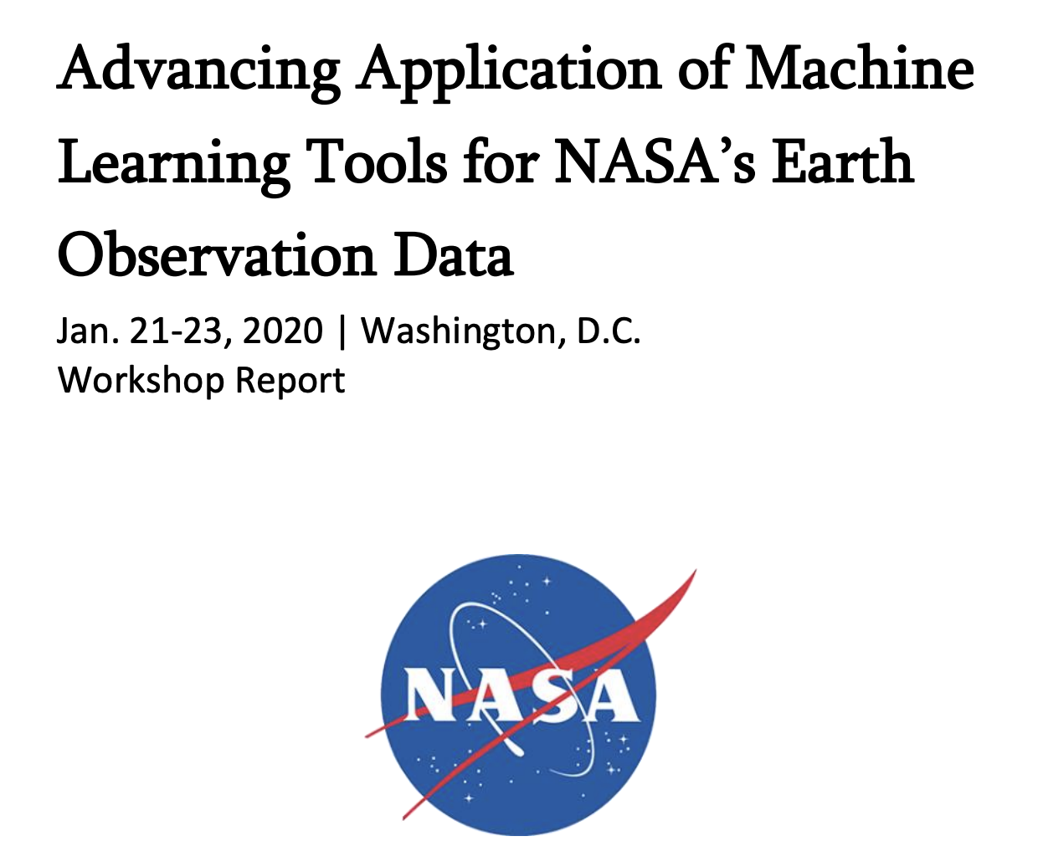
AI Challenges in Earth Science
Training data is the main component of supervised machine learning techniques and is increasingly becoming the main bottleneck to advance applications of machine learning techniques in Earth science.
Geoscience models must generalize across space and time; however, for supervised learning one needs large training datasets to build generalizable models.
Potential innovative solutions in which to invest include techniques that require less data, such as transfer learning, representation learning, semi-supervised learning, and unsupervised learning.
Advancing Machine Learning Tools for Earth Science: Workshop Report Earthdata (nasa.gov)

Slide 3
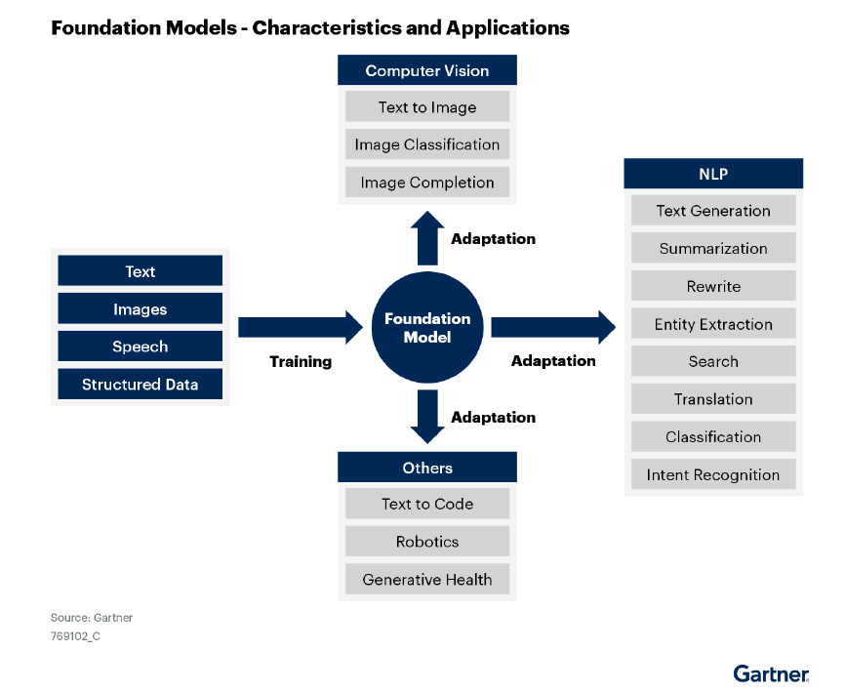
What Are Foundation Models?
Foundation models (FM) are AI models that are designed to replace task-specific models and be applied to many different downstream applications.
FM are trained using self-supervised techniques and can be built on any type of sequence data.
  Self supervised learning removes the existing roadblock for developing a large annotated dataset for training.
FM models have the following characteristics:
  Mostly utilize transformer architectures that utilize the notion of attention or self-attention Allows the network to model the influence of distant data elements on each other both in time and space
  Exhibit emergent properties that are induced from the data, rather than explicitly constructed
  Can be applied to downstream tasks by using few shot learning and fine tuning
  Have to be trained at scales that limits the ability to a handful organizations
Image source: Gartner Report - Innovation Insight for Artificial Intelligence Foundation Models, Published 27 Oct 2022

Slide 4
Why Are FMs Important for Science?
Scale of these models results in better performance for downstream tasks.
Specialized language models can be used augment and automate processes within the data lifecycle.
FM-based applications show better accuracy over models built from scratch.
Drastically reduce the cost of entry to build downstream applications
Time/effort required to build and run an application is low compared to building from scratch.
FM models for select datasets can accelerate downstream applications → Data quality monitoring, feature detection, monitoring, anomaly detection, prediction.
FM have shown the ability to adapt to specific domain.
Make it easier to infuse AI into scientific research and analysis
Remove the training data bottleneck
Increase the use of NASA data
Natural language FM → Text generation, summarization, rewrite, entity extraction, search, translation, classification, intent, recognition
Computer vision → Language to images, image completion, classification

Slide 5
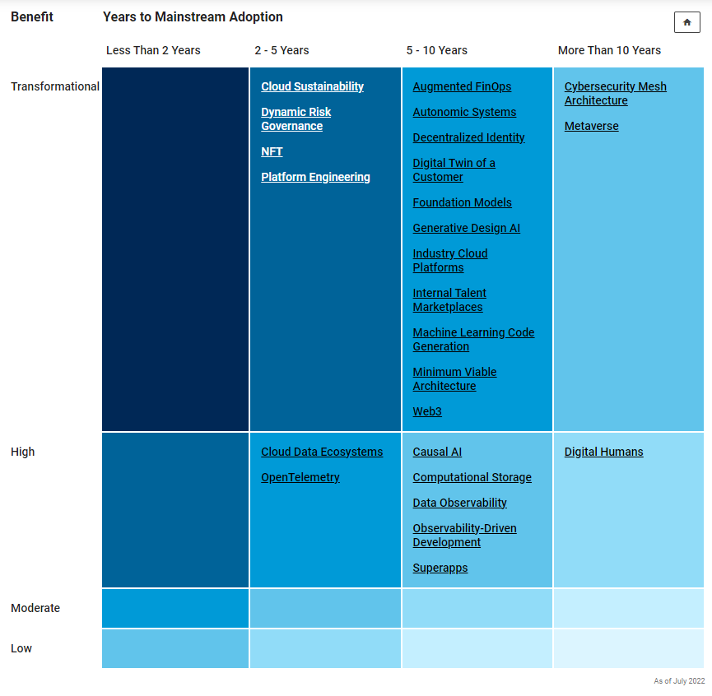
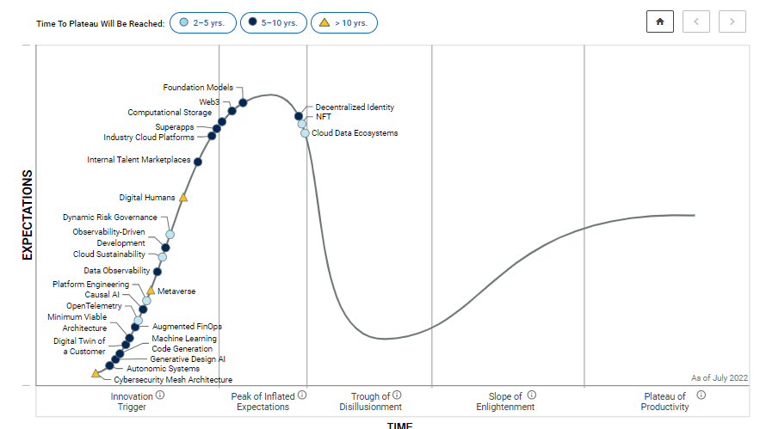
The Time Is Now
Opportunity to Drive the Change
“Change before you have to.”
– Jack Welch
“If you always do what you’ve always done, you’ll always get what you’ve always gotten.”
– Anonymous
Image sources: Gartner Report - Hype Cycle for Emerging Technologies, 2022

Slide 6

Foundation AI Models for Earth Science
Application 1
Can we build foundation AI models for domains or representative types of data?
  Optical remote sensing data, SAR, climate simulations
Can these models capture underlying physical processes?
Foundation Model
Application 2
⋮
Application n
ML Model 1
Application 1
ML Model 2
Application 2
⋮
⋮
ML Model n
Application n

Slide 7

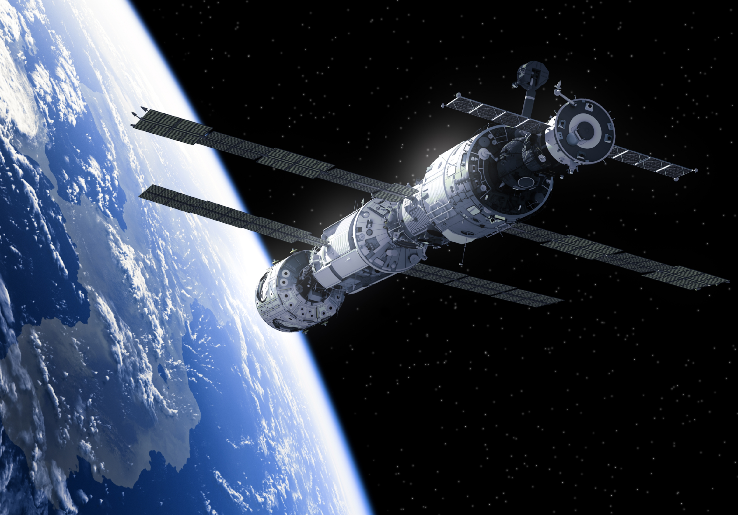
Language Model for Earth Science
  Train a new domain specific foundation model on Earth science literature that improves downstream tasks and enables information retrieval
NASA RoBERTa model
Standard English RoBERTa
CAPE increase due to [anthropogenic greenhouse warming].
The second most abundant element in the atmosphere is [oxygen].
[Oxygen] atoms combine to form dioxygen.
An igneous rock is a rock that crystallizes from [magma].
An igneous rock is a rock that crystallizes from [igneous melt].
CAPE increase due to [weather].
The second most abundant element in the atmosphere is [water].
[The hydrogen] atoms combine to form dioxygen.
An igneous rock is a rock that crystallizes
from [ashes].
An igneous rock is a rock that crystallizes
from [the ground].
Models built using FM stack
Standard RoBERTa base architecture (125M)
120k papers (after data preprocessing and duplicate removals, reduced from 275k papers)
64 NVIDIA A100 GPUs
10 hrs of training
67k words/GPU/sec throughput
Slide source: Raghu Ganti/IBM Research

Slide 8
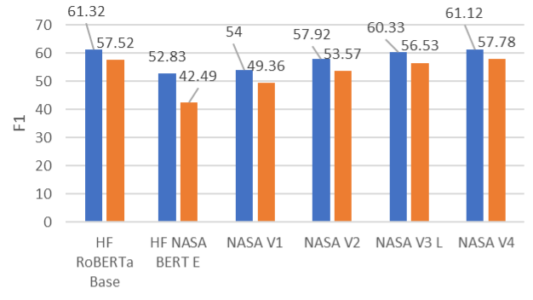
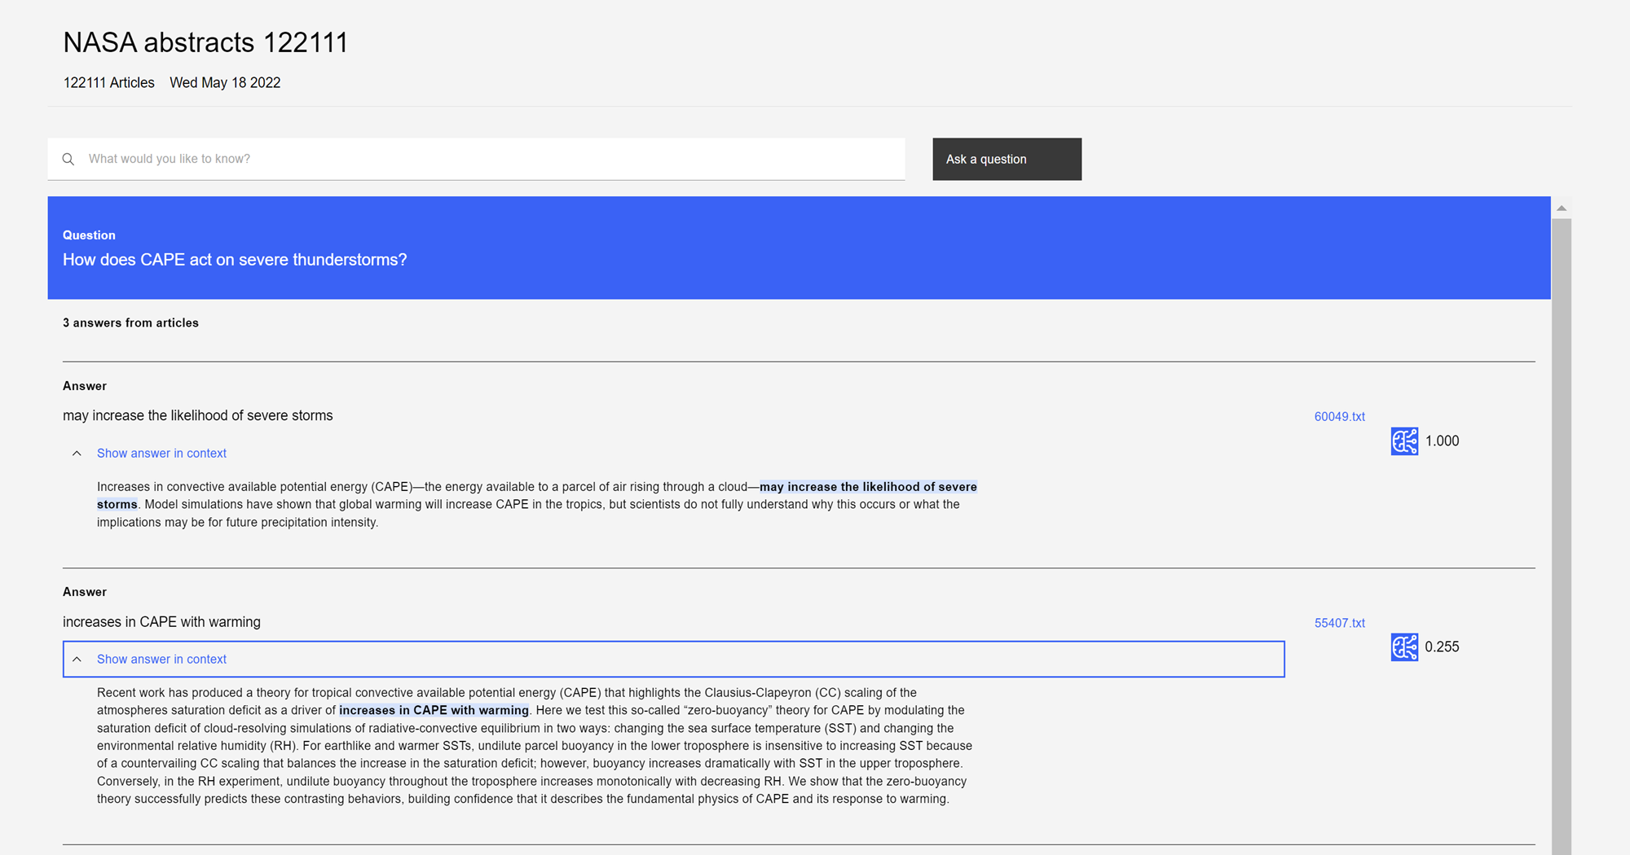
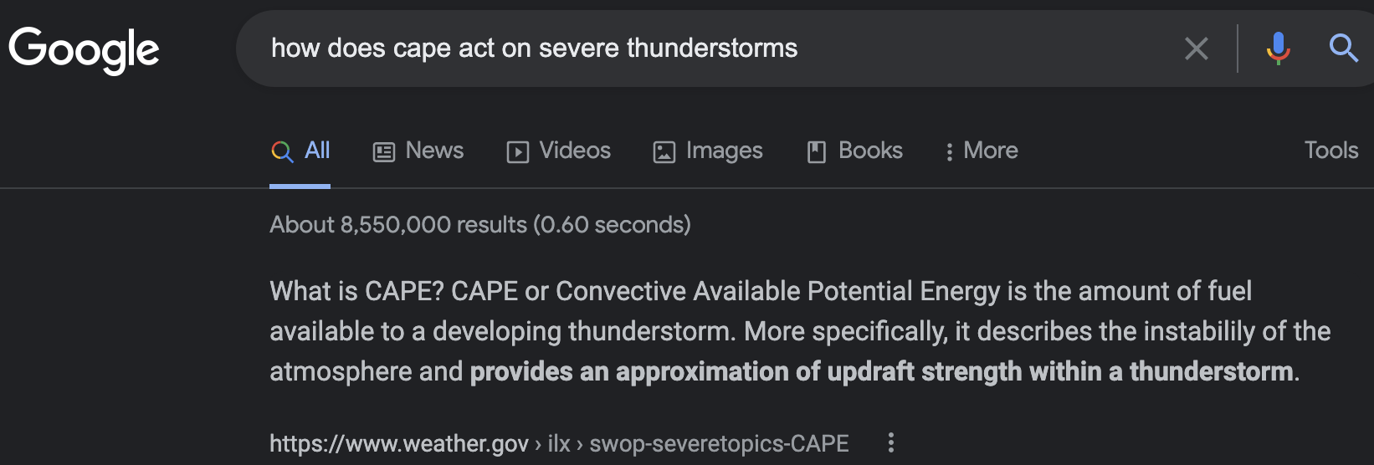
Language Model for Earth Science: Q&A
  Integrate trained model with IBM’s PrimeQA technology for natural language Q&A with provenance
Next steps
Improve model by adding relevant data
Validation of Q&A responses underway by NASA
Open-source model with Q&A service
Major contribution to Transform to Open Science (TOPS) effort
Slide source: Raghu Ganti/IBM Research
Better domain specific search

Slide 9
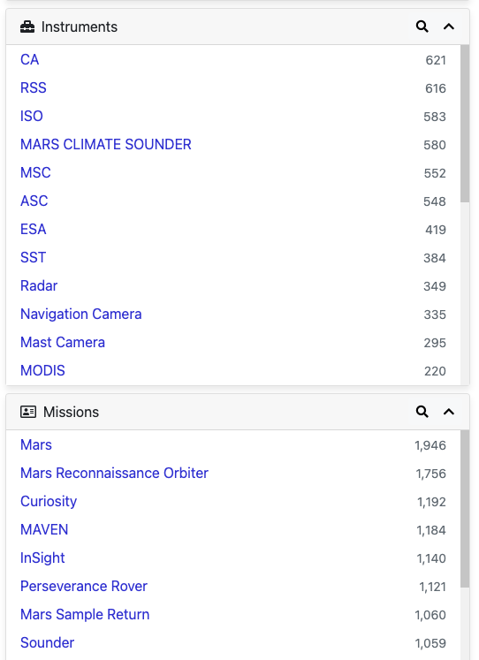
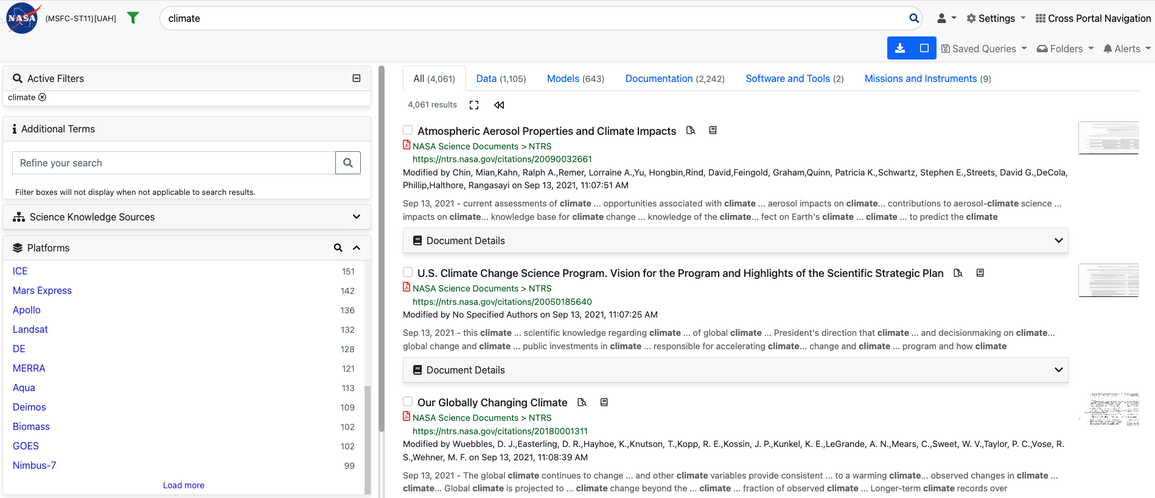
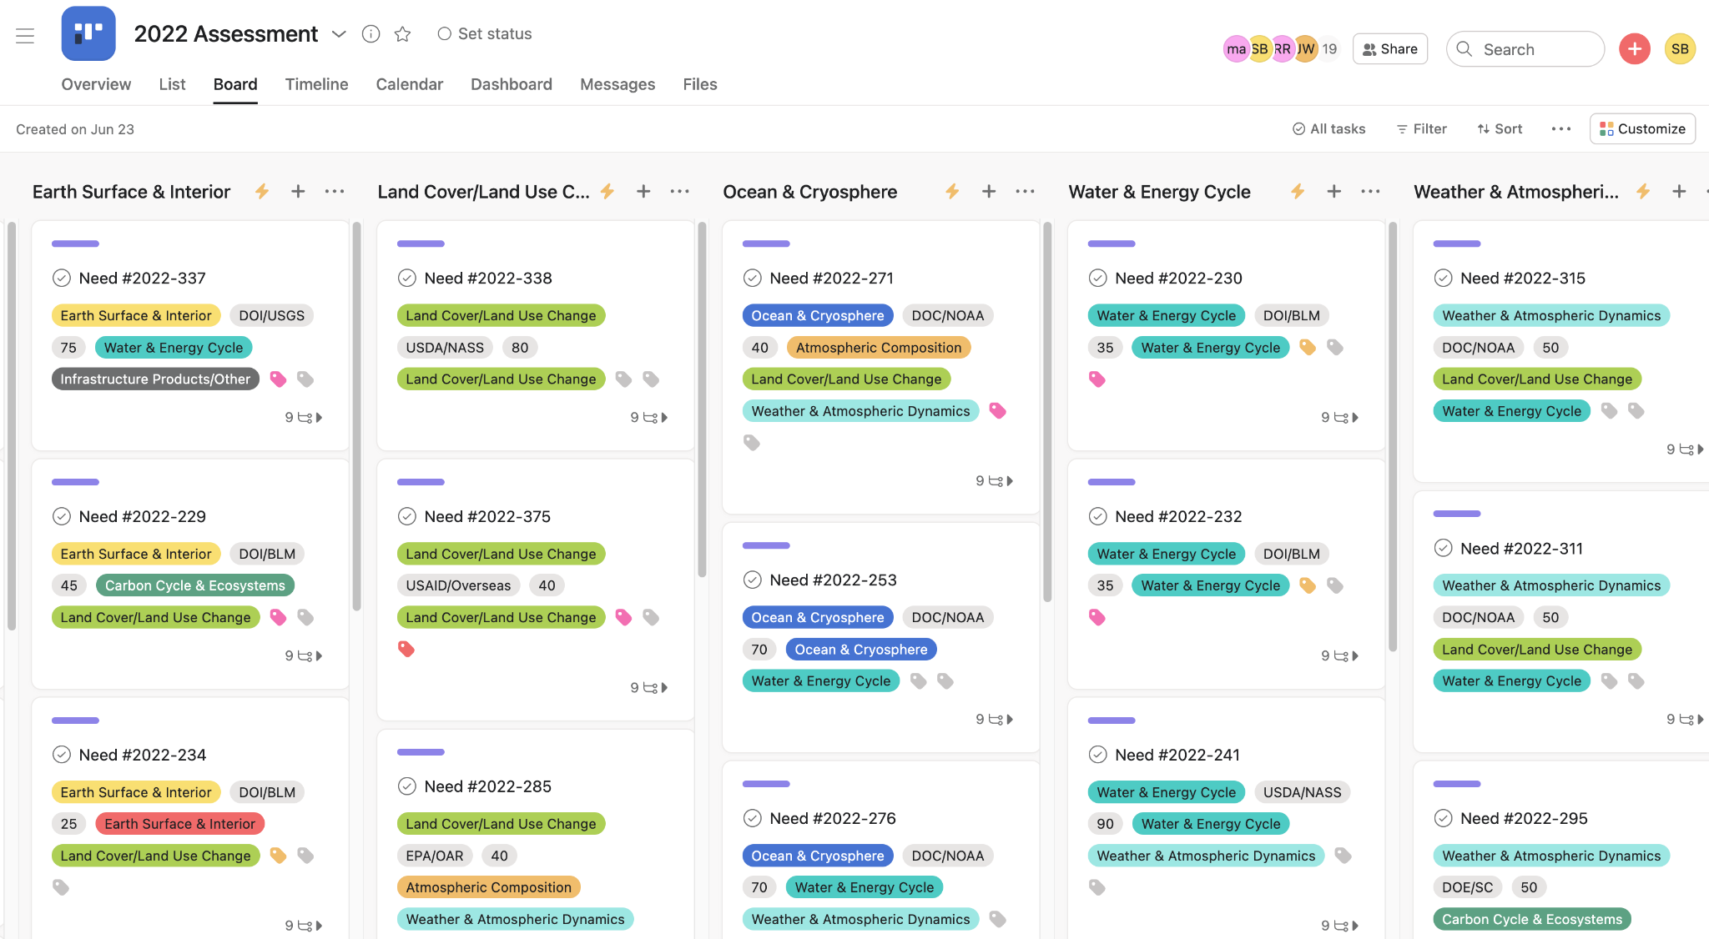
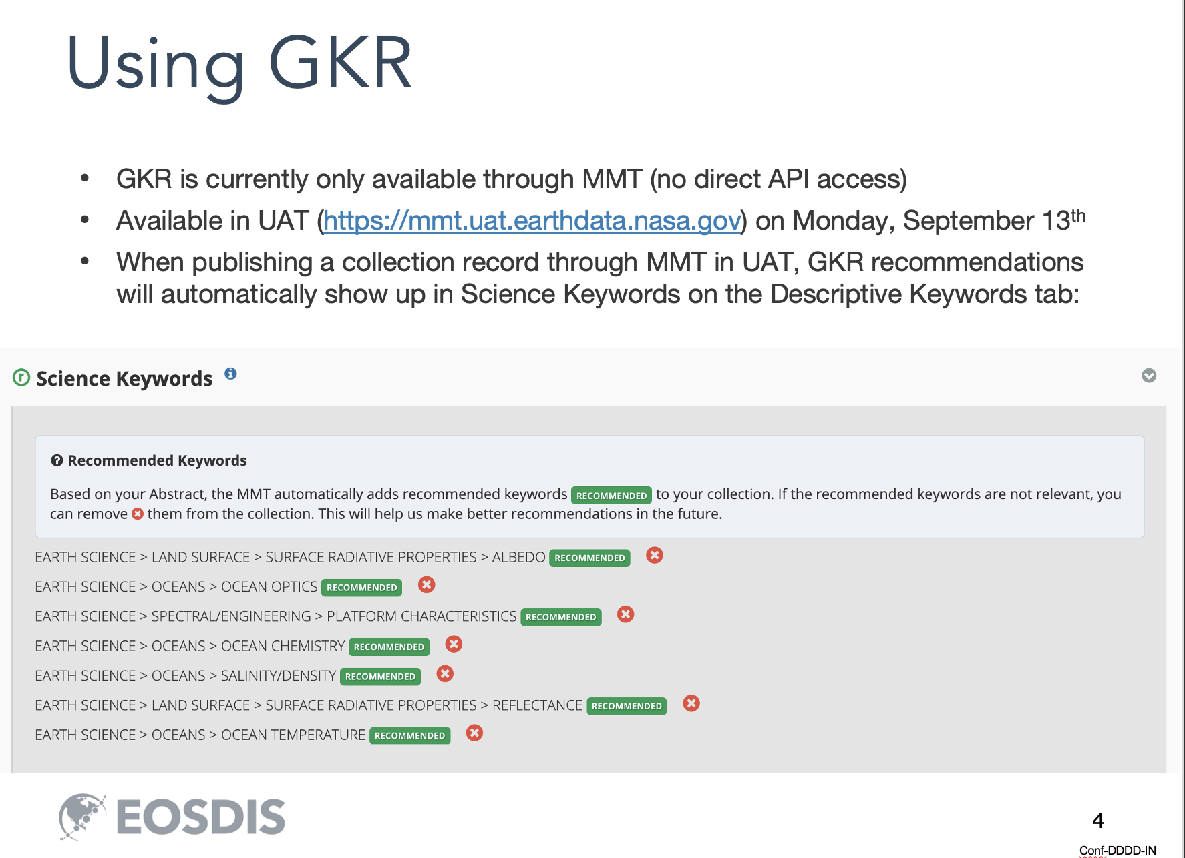
AI Language Model to Improve Operational Processes
Augmenting facet design to improve search and discovery
AI Language Model
Automated binning of SNWG surveys into NASA ES focus areas
Improving data stewardship by automating keyword
Notes:
We currently have 1.5 million documents in the SDE and that number will most likely grow (in other words, its not just raw data that needs to be analyzed, sometimes you need help to just get to the data)

Slide 10
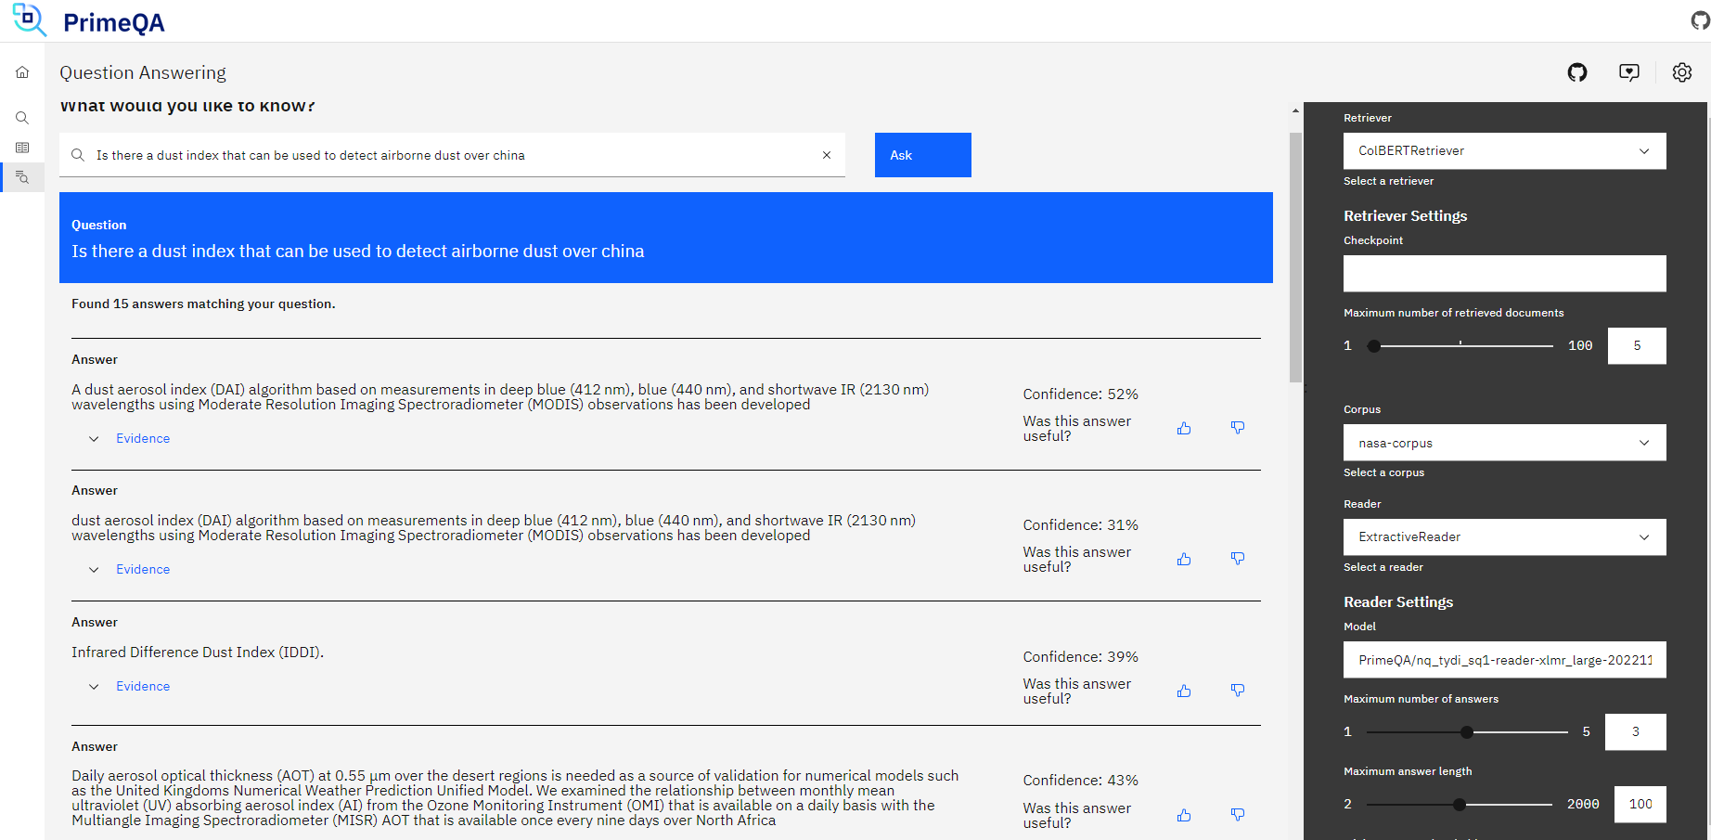
Using the Language Model for Question Answering
Proof of concept demo (IBM Research collaboration)
Notes:
We currently have 1.5 million documents in the SDE and that number will most likely grow (in other words, its not just raw data that needs to be analyzed, sometimes you need help to just get to the data)

Slide 11
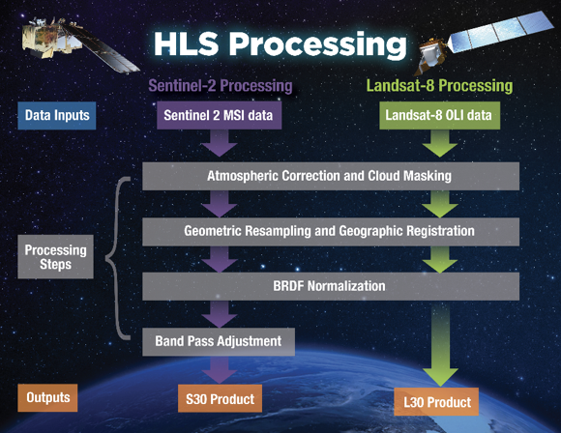
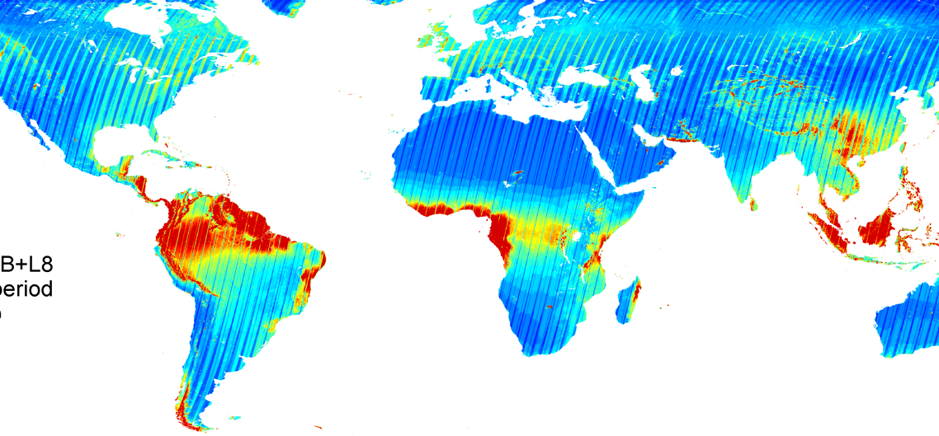
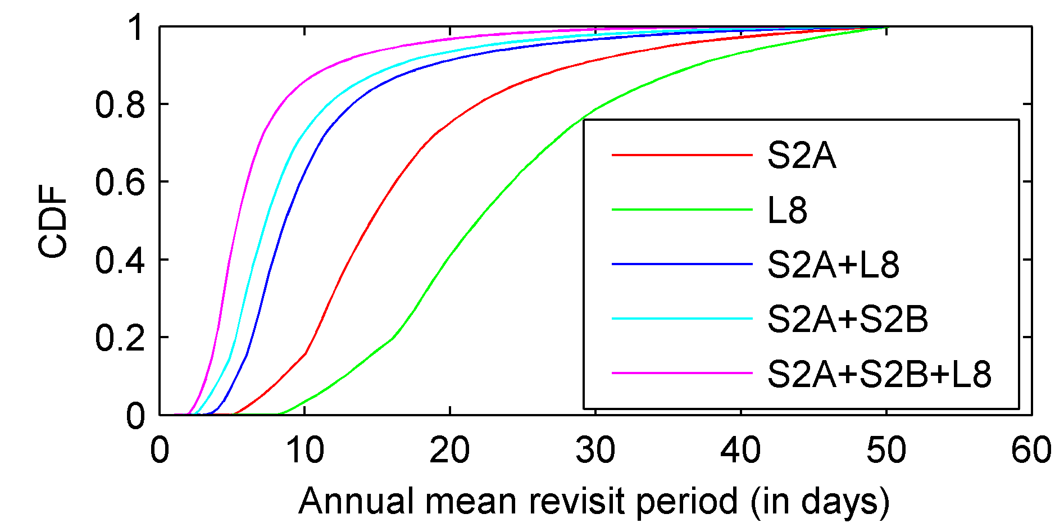
Foundation AI Model for Optical Remote Sensing Data
Harmonized Landsat Sentinel (HLS)
“Seamless” near-daily 30m surface reflectance record including atmospheric corrections, spectral and BRDF adjustments, regridding
Merges Sentinel-2 and Landsat data streams and can provide 2-4 day global coverage
Potential Revisit using
different Virtual Constellations

Slide 12
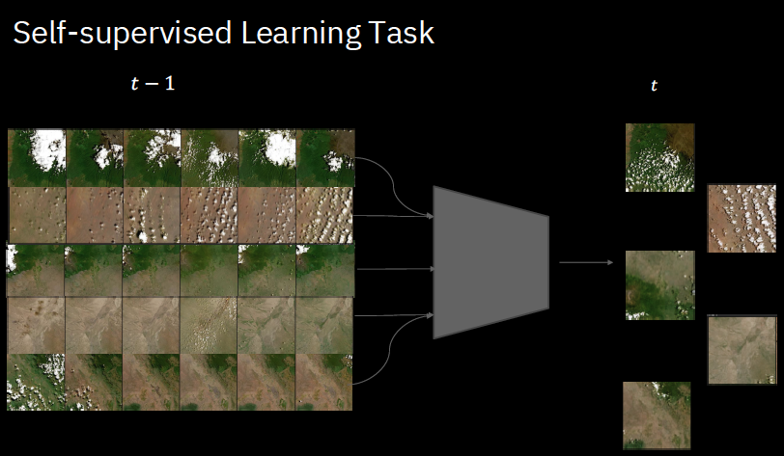
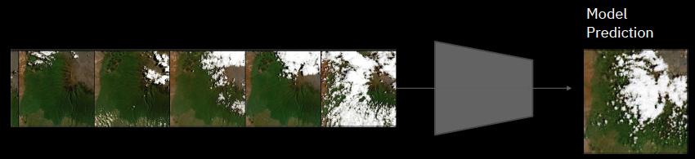
Foundation Model for Harmonized Landsat Sentinel (HLS) Data
(IBM Research: Dr. Raghu Ganti)
Key innovation: Spatiotemporal attention mechanism
Divide an image 224x224 pixel into 14x14 patches
Time as 7 sequences for the image
Spatial attention across multiple patches
Temporal attention for each patch
Methodology and initial results
Trained on 50k images
Model is capable of “in-painting”, 85% of images had some missing portion
Initial model predictions look “promising”
Notes:
If successful we can expand to other major data sets - MERRA
HLS

Slide 13
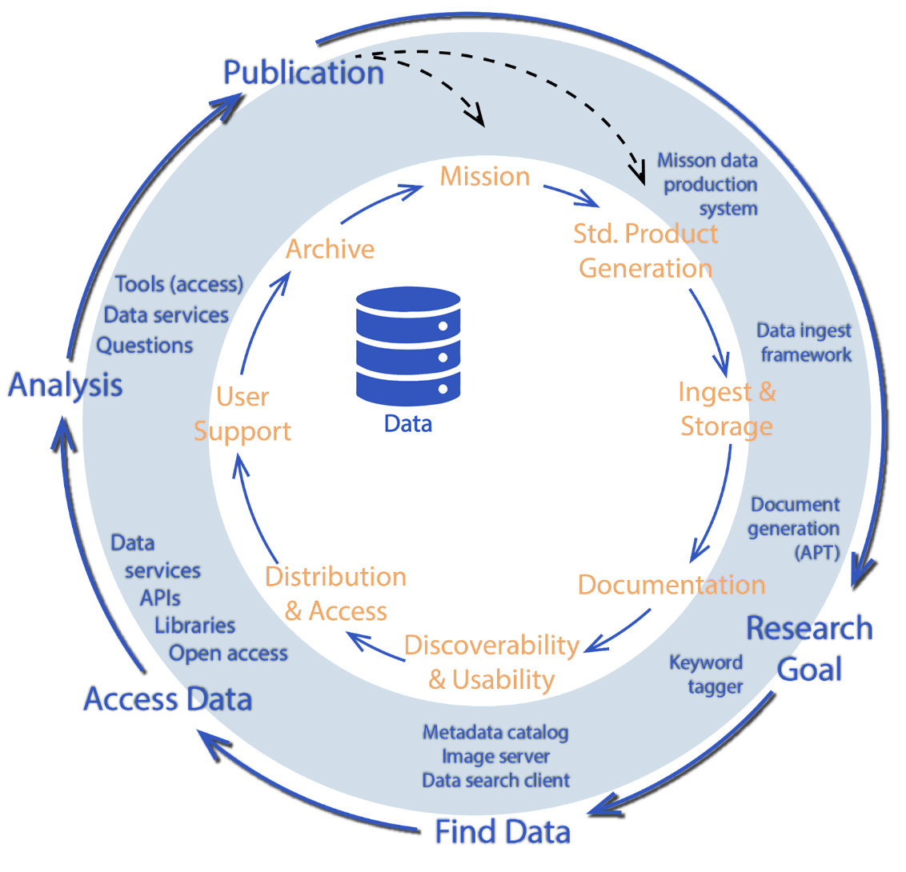
Building Blocks: Future State
“most significant innovations end up generating second- or third-order effects that are difficult to predict in advance...”
– Steven Johnson
Foundation Models
Data + Tools/Infrastructure + AI Foundational Models -> Accelerate Research and Applications

Slide 14
Challenges
Need the right mix of specialized skills: AI/ML, domain as well data expertise
Cost to build the models can be high
Need to systematically evaluate the foundation models for broad downstream applicability

Slide 15
Open Discussion Questions
How should we systematically develop and select foundation models (FM) that can have many downstream applications?
How do we foster the use of these FMs into applications?
How do we integrate these FMs as “science tools”?
How should we develop the capacity of the science community to effectively utilize these FMs?

