Slide 1
This material is a work of the U.S. Government and is not subject to copyright protection in the United States
Ground Wind Loads on the Space Launch System’s Mobile Launcher Crew Access Arm
T.J. Wignall,
Jesse G. Collins, Brent W. Pomeroy, and Jeremy T. Pinier
NASA Langley, Configuration Aerodynamics Branch
thomas.j.wignall@nasa.gov
2023 AIAA SciTech Forum
January 23, 2023

Slide 2
Outline
Crew Access Arm and SLS
Data Sources
  Wind Tunnel
  Computational Data
Results
Conclusions

Slide 3
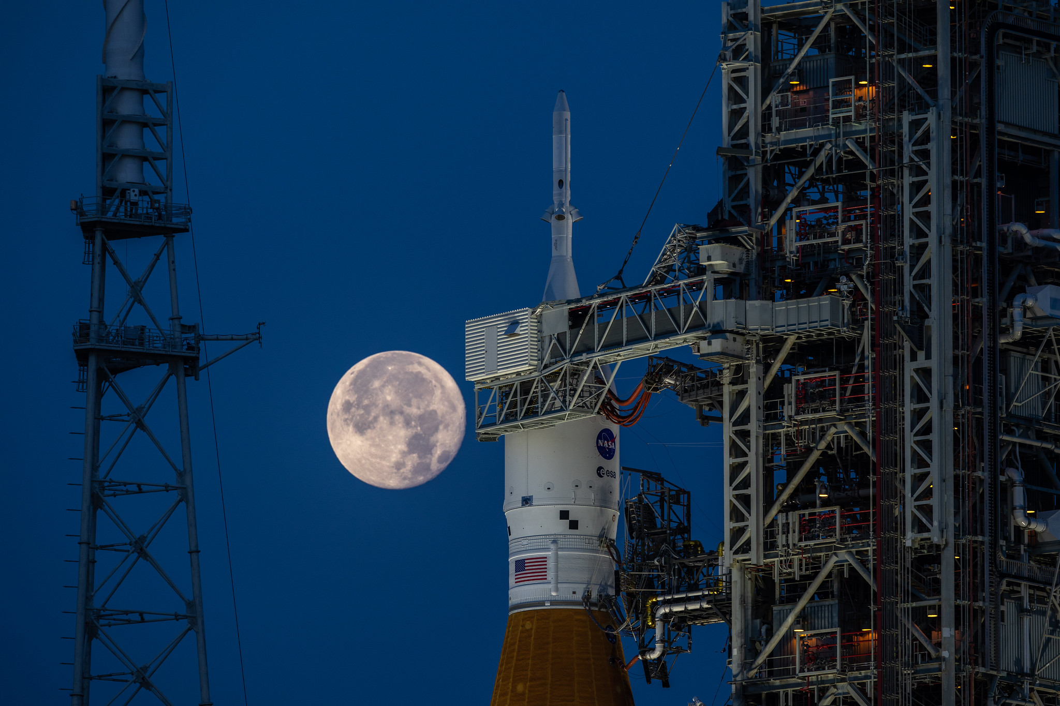
Crew Access Arm and SLS
The Crew Access Arm (CAA) spans the distance from the Mobile Launcher (ML) to the Space Launch System (SLS)
The CAA allows loading of astronauts into the Orion spacecraft
Prelaunch it is retracted to be adjacent to the ML
In an emergency, the CAA must move into position within 45 seconds
Need to characterize aerodynamic forces to help confirm operational capabilities
Photo Credit: NASA/Ben Smegelsky

Slide 4
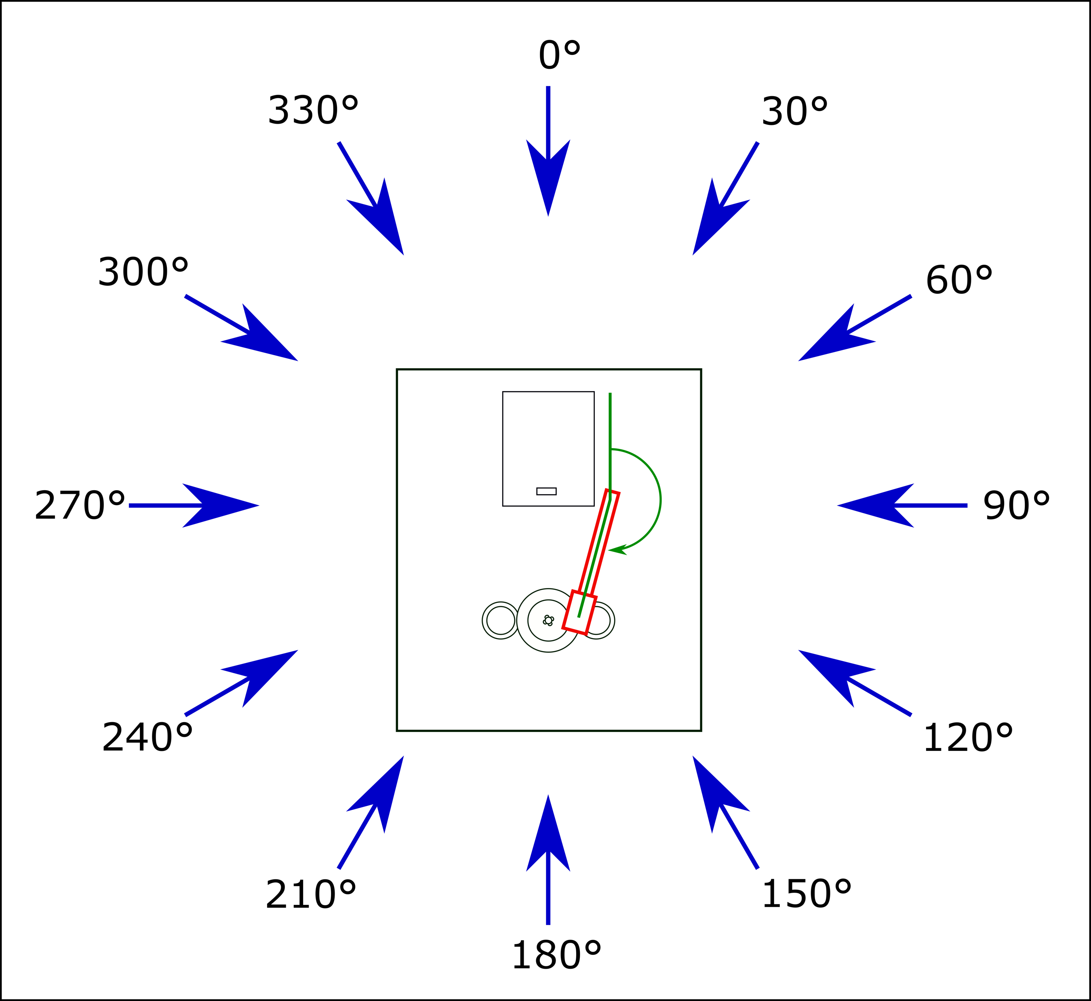
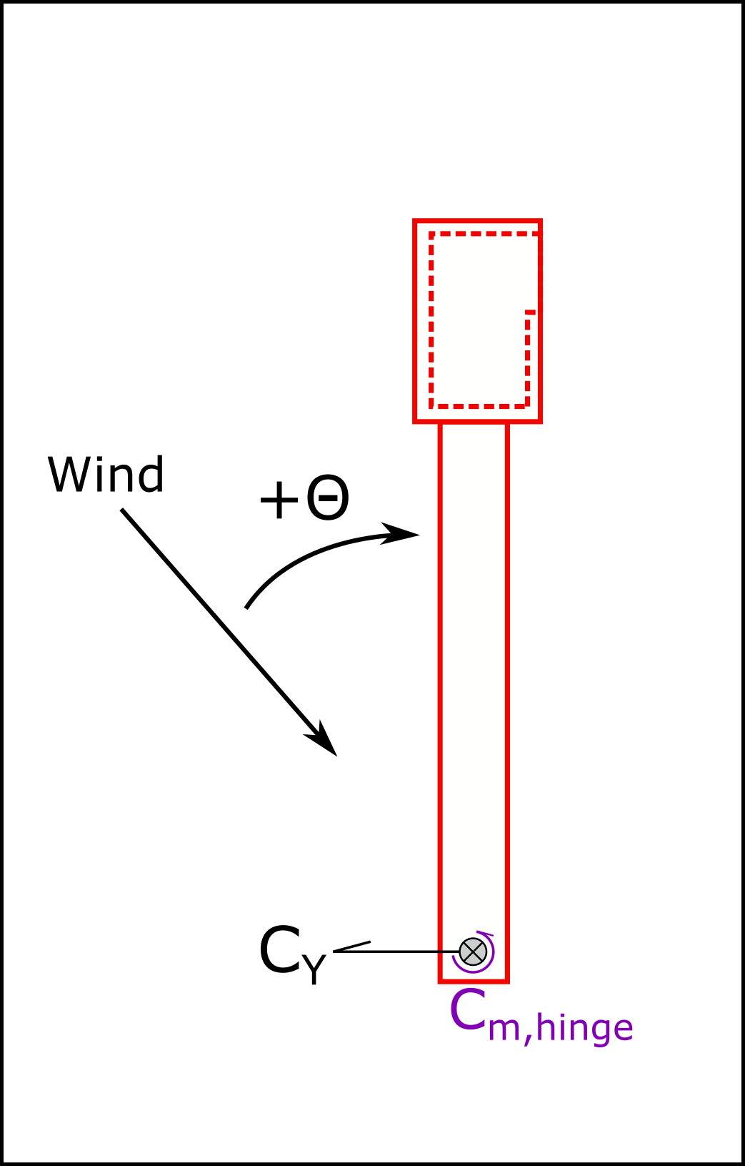
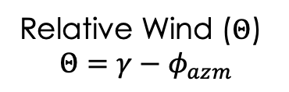


CAA and SLS Wind Directions
ML
CAA
SLS
Relative Wind ($Θ$)
$$Θ=γ−φ_{azm}$$
Wind Direction ($φ_{azm}$)
Side Force (C_{Y})
Hinge Moment (C_{m,hinge})
CAA Deployment Angle ($γ)$

Slide 5
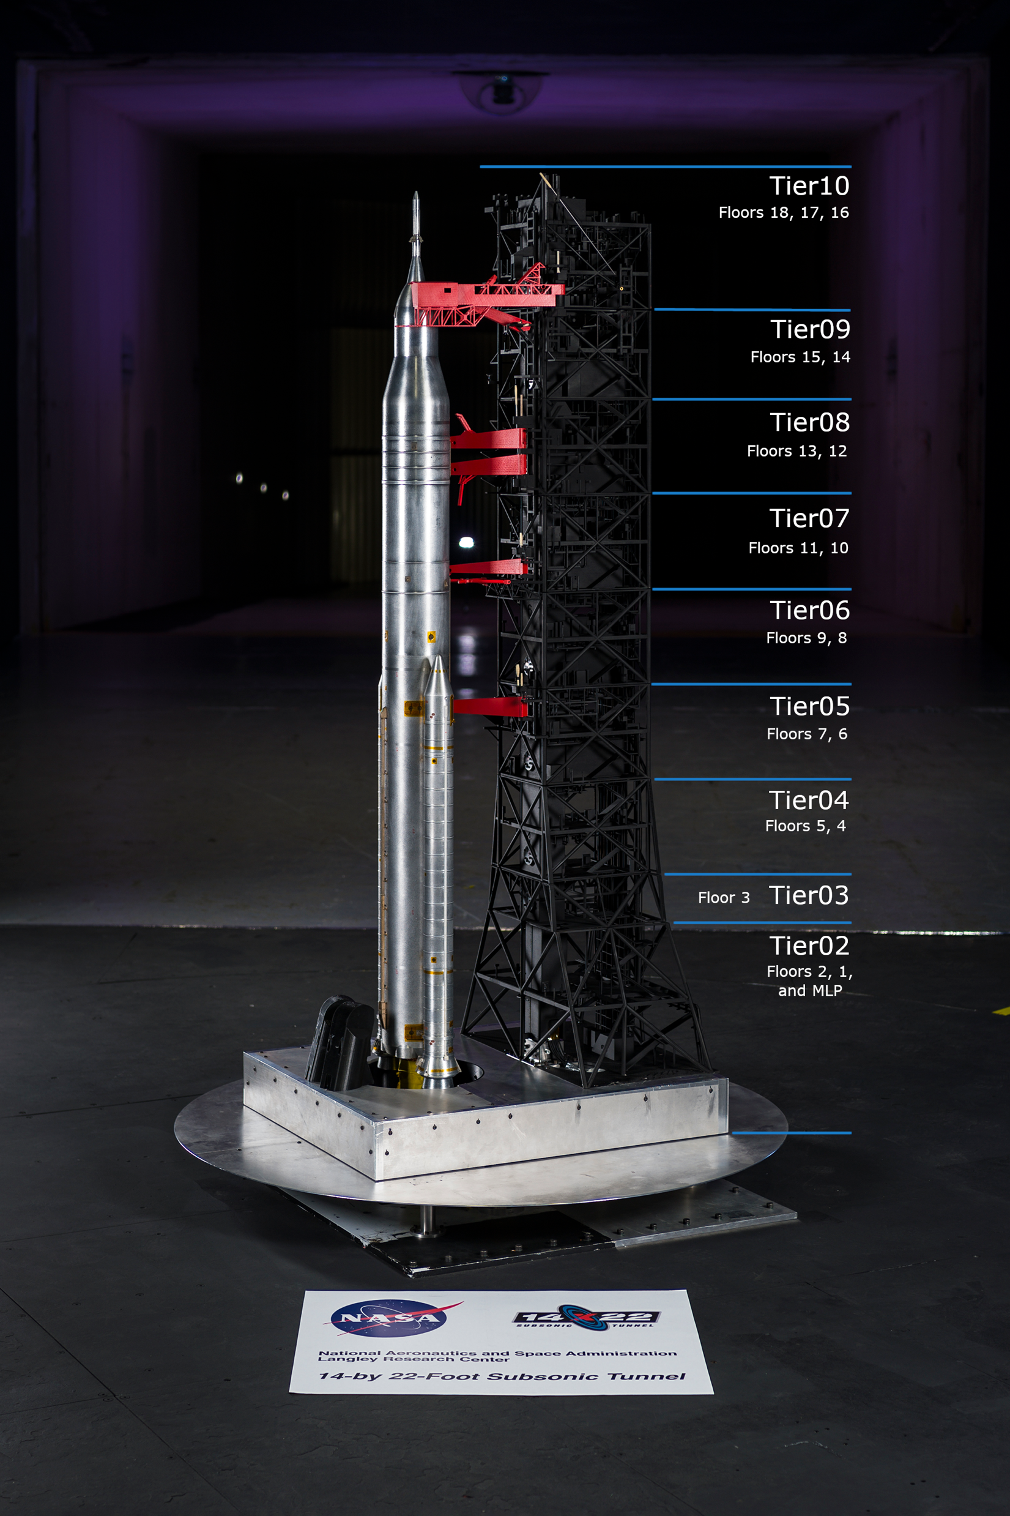
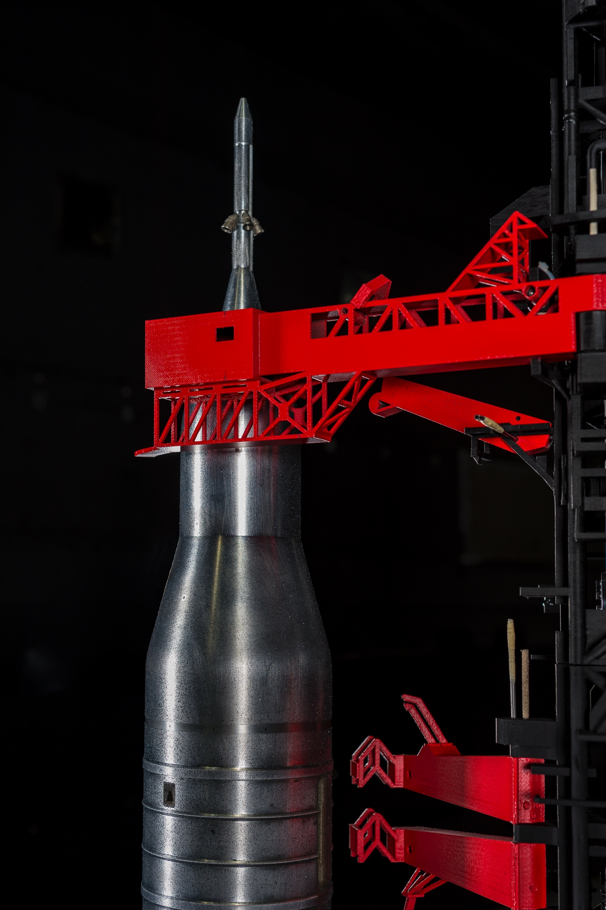
Wind Tunnel Data
Recently completed test in the NASA Langley 14- by 22-Foot Subsonic Tunnel
3D printed ML and CAA
Load cells distributed along ML
  Allow individual loading on each “Tier”
  CAA attached to Tier 10
Three states for CAA
  Fully deployed
  Fully retracted
  Removed
For more info see: Collins et al. “Improved Techniques for Measuring Static Ground Wind Loads on the NASA Space Launch System Mobile Launcher 2”

Slide 6
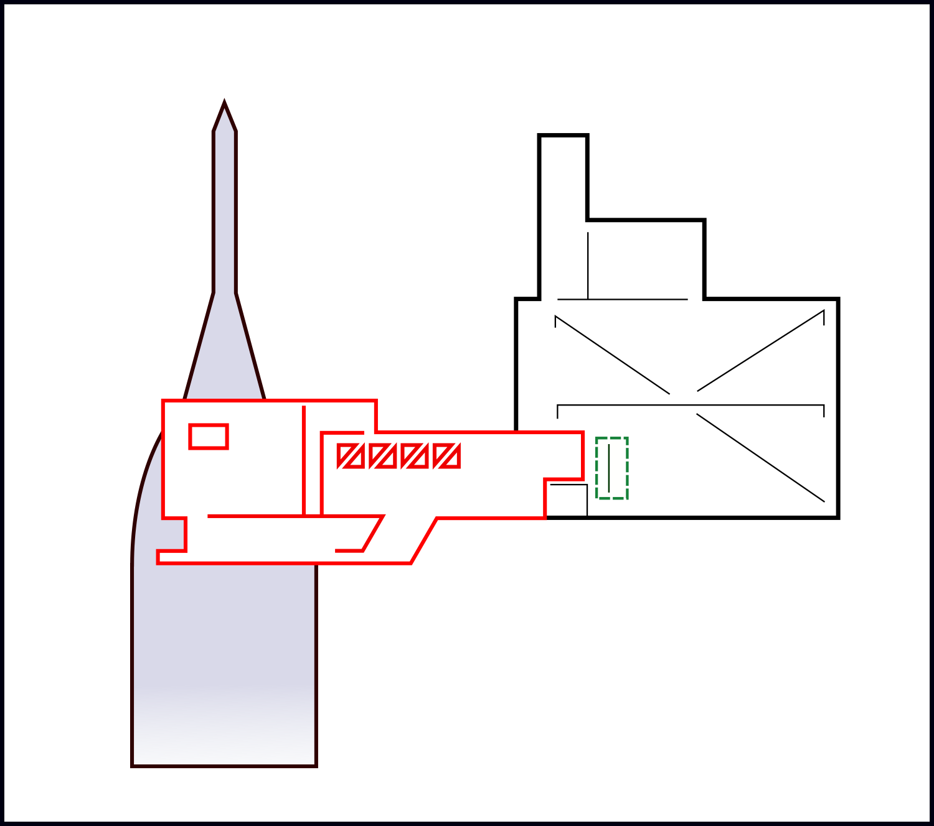
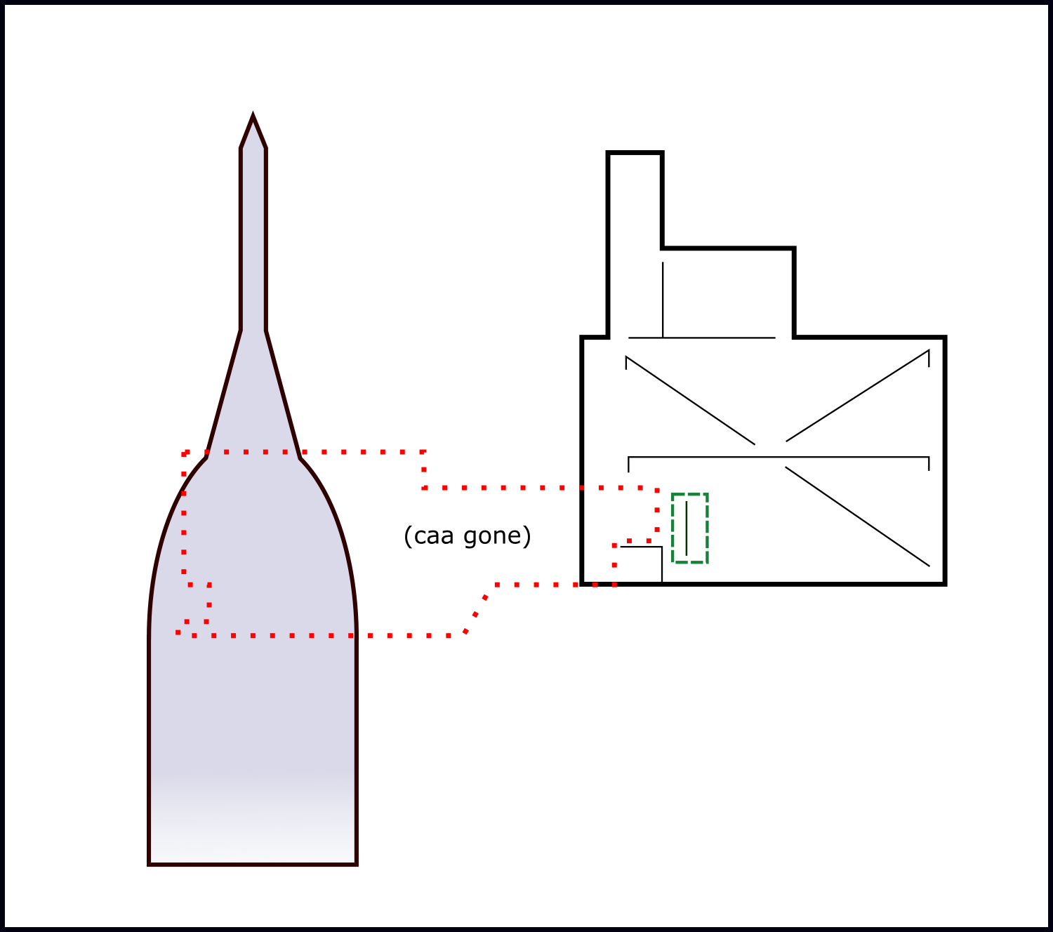
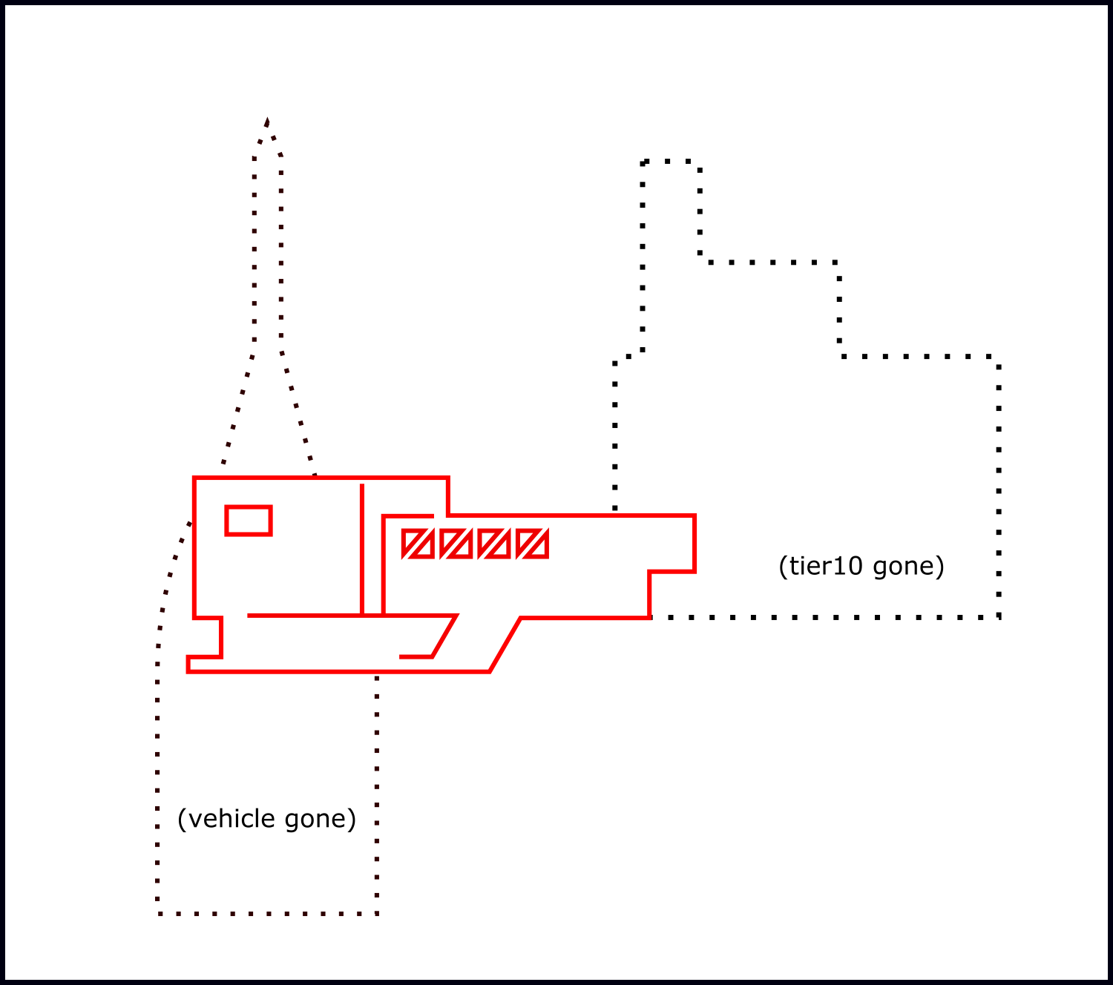
Wind Tunnel Data
minus
yields
Loading on the CAA acquired through superposition assumptions

Slide 7
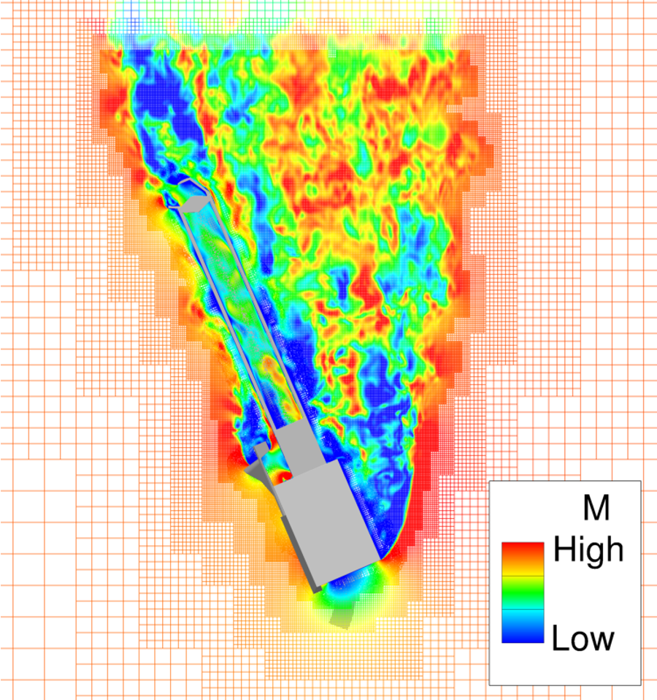
Computational Data
The CREATE-AV Kestrel CFD solver
  Finite Volume, Cell centered, unstructured
Coupled with SAMAIR to solve an offbody cartesian grid
  Grid refinement based on vorticity every 250 time steps
Turbulence Model: SA IDDES
Time averaged solutions

Slide 8
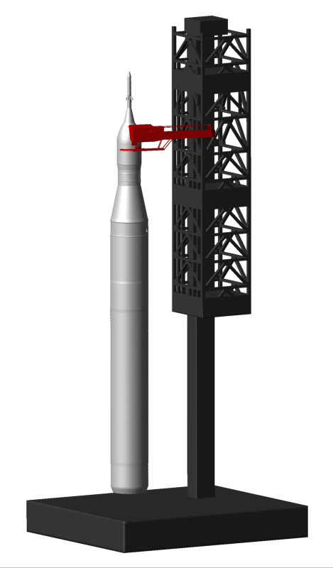
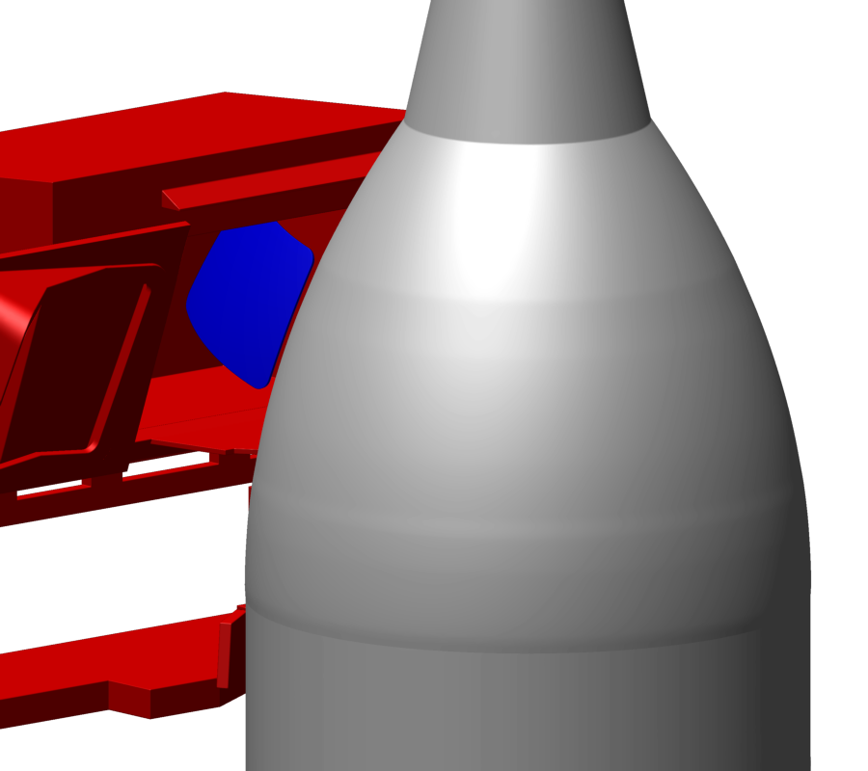
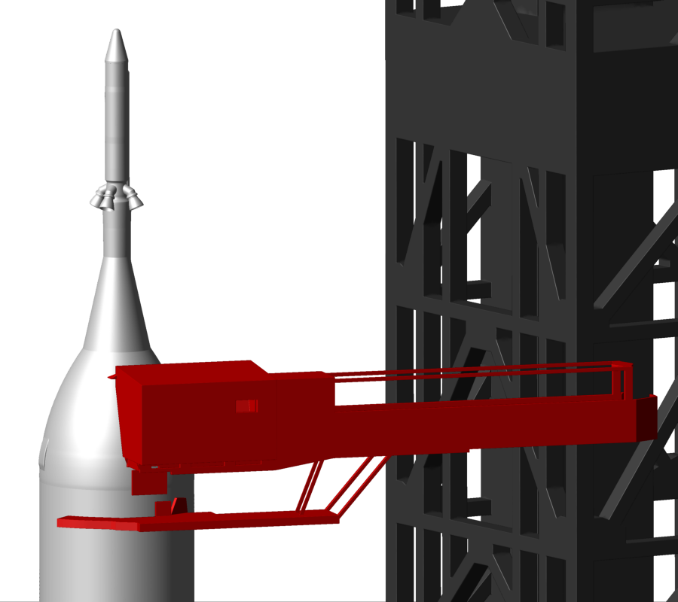
Computational Data
CAA, ML, and vehicle
  Simplified to focus results on CAA
  Removed SRBs
  Further simplified ML
  Can vary both wind and deployment angle
  100,000 processor hours per case
Isolated CAA
  Can vary relative wind angle
  12,000 process hours per case
Dynamic Isolated CAA
  Test quasisteady state assumptions
  Can vary relative wind as a function of time
  55,000 process hours per case

Slide 9
CFD Run Matrix
Wind Angle [Deg]
CAA Deployment Angle [Deg]

Slide 10




Wind Tunnel To CFD: Fully Deployed
Confirm similarity of CFD and wind tunnel predictions
Plateau at 270 deg. to 300 deg. caused by ML between freestream and CAA
Plateau at 180 deg. caused by vehicle between freestream and CAA
$${\hat{C}}_{Y}$$
$${\hat{C}}_{m,hinge}$$
$Θ$, Relative Wind Angle, [deg]
$Θ$, Relative Wind Angle, [deg]

Slide 11
Effect of Deployment Angle
CFD used to explore sensitivity of deployment angle
Confirmed use of relative wind as single characterizing variable
$${\hat{C}}_{Y}$$
$${\hat{C}}_{m,hinge}$$
$Θ$, Relative Wind Angle, [deg]
$Θ$, Relative Wind Angle, [deg]

Slide 12
Isolated CAA
Computational cost of ML and vehicle were significant
Isolated CAA cases predict similar if not higher loading
  Especially on the moment
$${\hat{C}}_{Y}$$
$${\hat{C}}_{m,hinge}$$
$Θ$, Relative Wind Angle, [deg]
$Θ$, Relative Wind Angle, [deg]

Slide 13
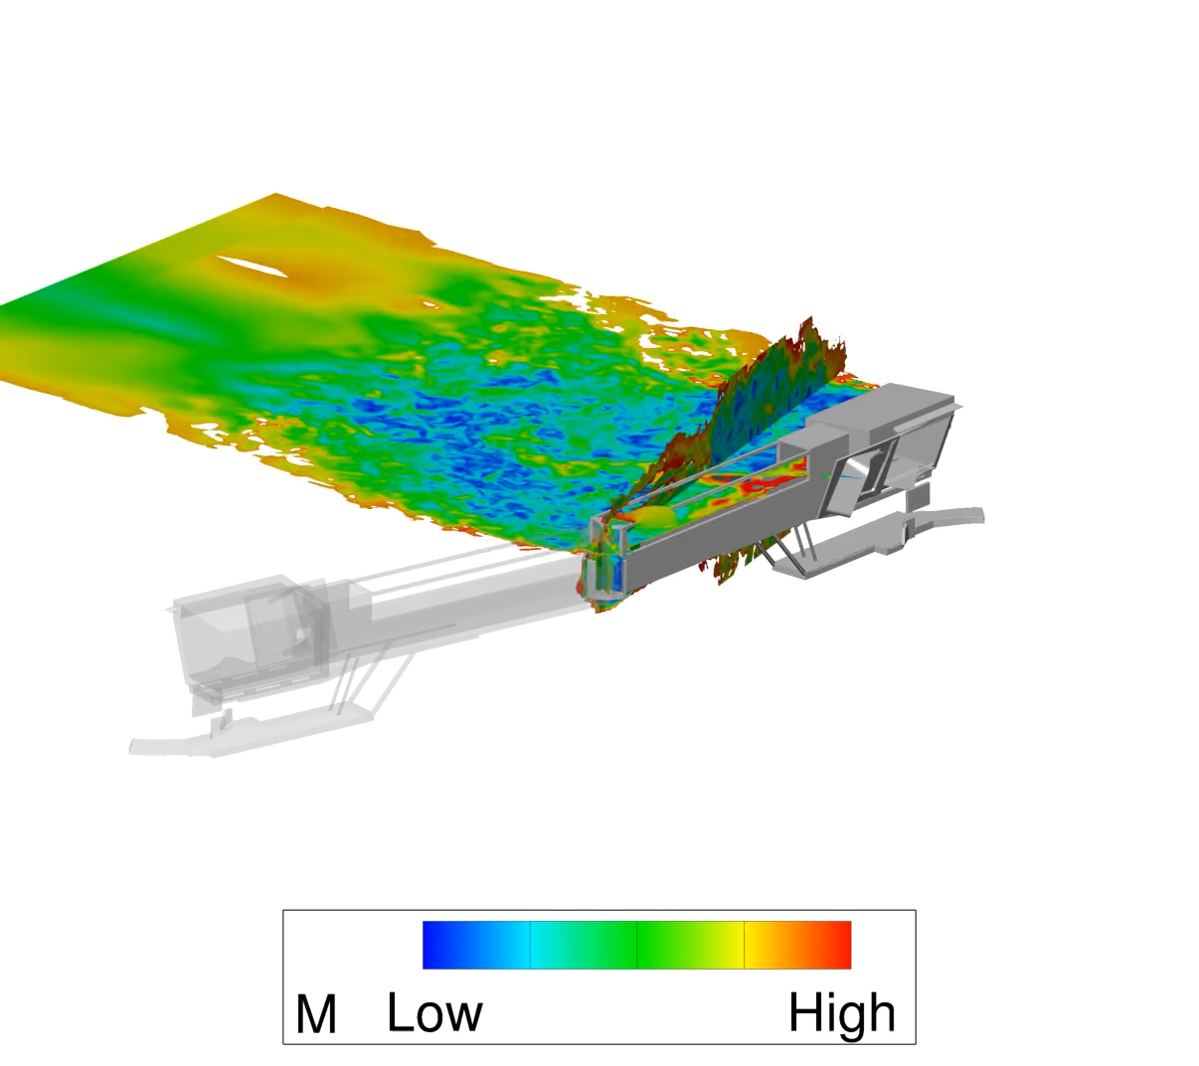
Dynamic CAA

Slide 14
Dynamic CAA
Database built with quasi-steady state assumptions
Single dynamic case of isolated CAA ran to evaluate the assumption
15% higher moment but within acceptable bounds
$${\hat{C}}_{Y}$$
$${\hat{C}}_{m,hinge}$$
$Θ$, Relative Wind Angle, [deg]
$Θ$, Relative Wind Angle, [deg]

Slide 15
Conclusions
Good agreement between experimental and computational methods
Relative wind angle is sufficient to characterize the force and moment of interest
Minimal vehicle and ML proximity effects on the CAA
Quasisteady state assumptions cause underprediction but within acceptable bounds

Slide 16
Questions?

