Slide 1
VNIR Reflectance Spectroscopy
Justin Filiberto
Thanks to
Piero D’Incecco, Gabe Eggers, David Trang, and Allan Treiman

Slide 2
Emissivity is the gold standard but much more difficult to measure in the laboratory
Can we use VNIR reflectance?
Can room temperature VNIR Reflectance be applied at temperature?

Slide 3
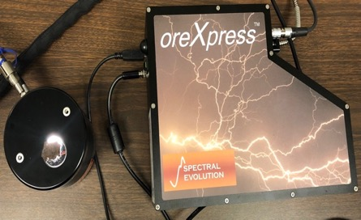
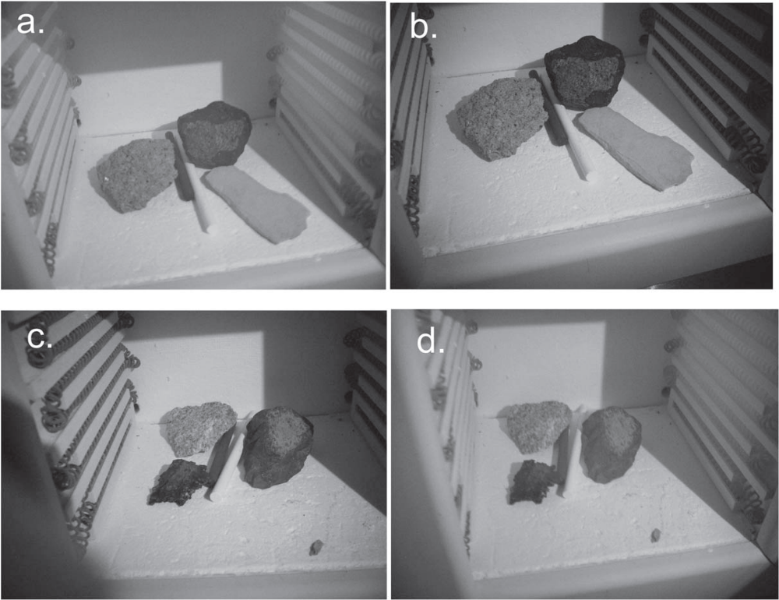
Methods
Room temperature measurements
  oreXpress
  Contact probe
  350 – 2500 nm
  Before and after
High temperature
  400-500C in a box furnace in air
  Open the door of the furnace
  LED Camera w
    850 and 940 nm bandpass filter
  Graphite and MgO standards
|VNIR spectroscopy|
Treiman et al. (2021 PSJ)

Slide 4
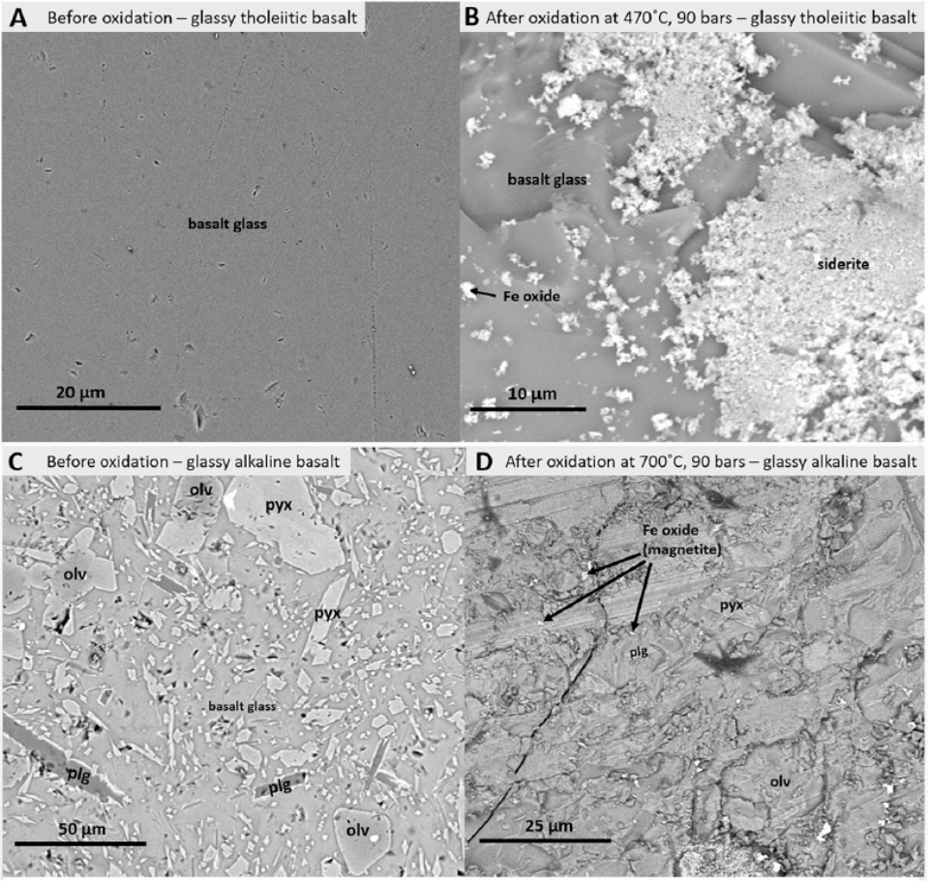
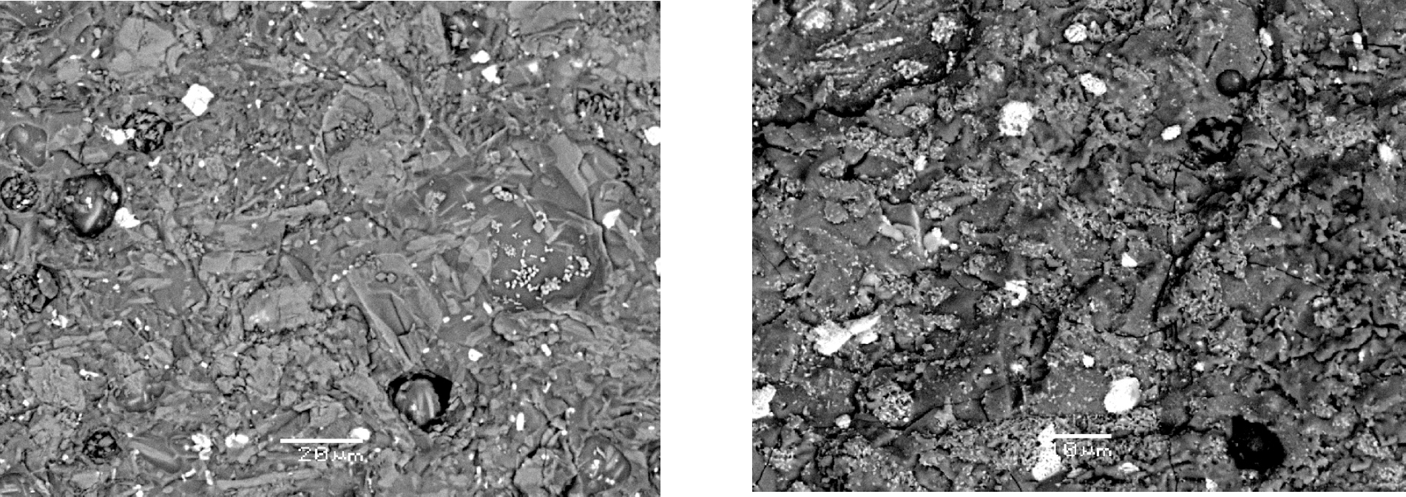
Worry about oxidation during experimentation
Teffeteller et al. (2022)
Cutler et al. (2020)

Slide 5
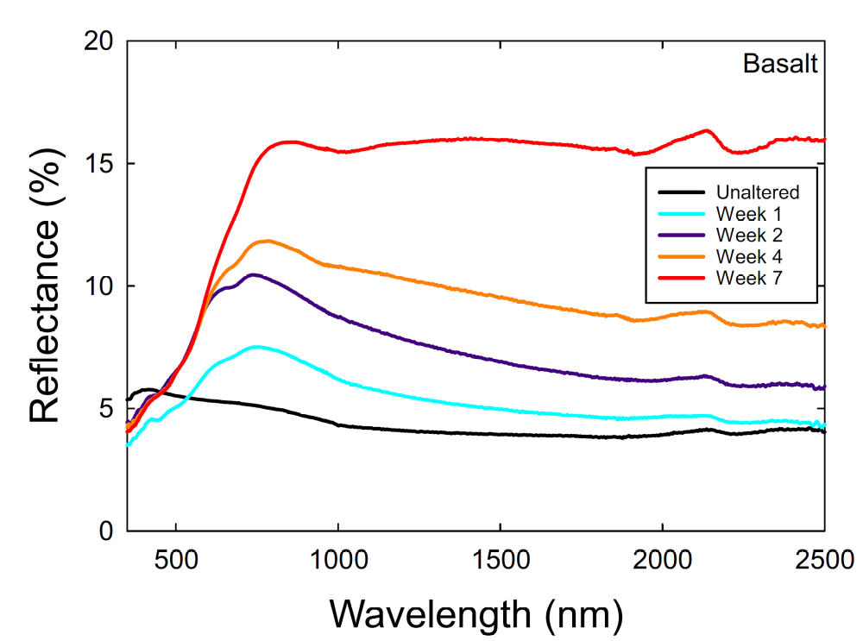
Effect of Oxidation on Spectra
Increasing time
  Increases reflectance
  Features shift towards higher wavelength
  Features of olivine/pyroxene disappear
  Form features of hematite
Cutler et al. (2020)

Slide 6
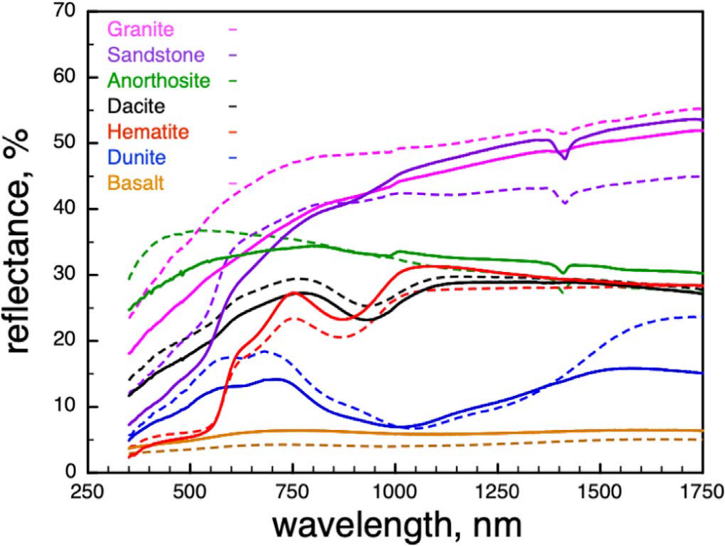
VNIR Reflectance Spectroscopy
Before and After
Treiman et al. (2021 PSJ)

Slide 7
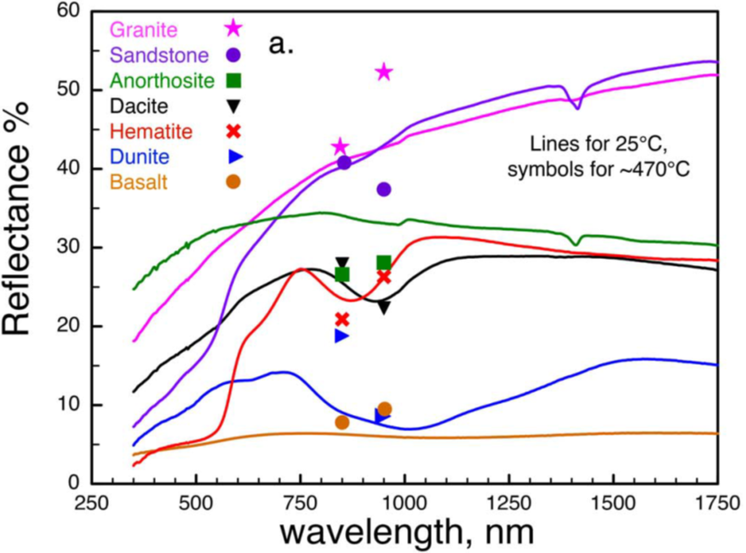
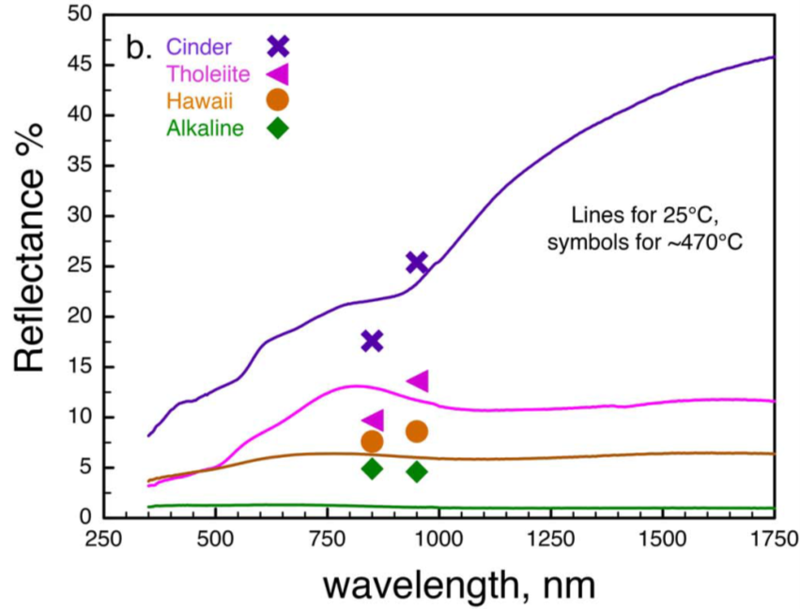
Can room temperature spectra be applied at temperature?
Treiman et al. (2021 PSJ)

Slide 8
Can room temperature spectra be applied at temperature?
First order – yes!
There are changes
  Are these due to temperature?
  Mineralogical changes?
    Oxidation
  Hematite specifically
Treiman et al. (2021 PSJ)

Slide 9
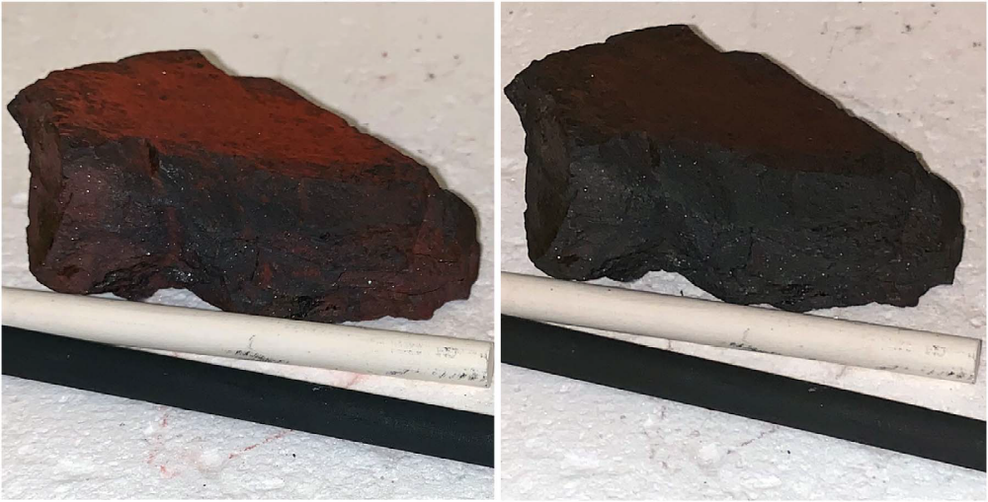
Hematite is weird!
Visible images
Room Temperature
~400 C
Treiman et al. (2021 PSJ)

Slide 10
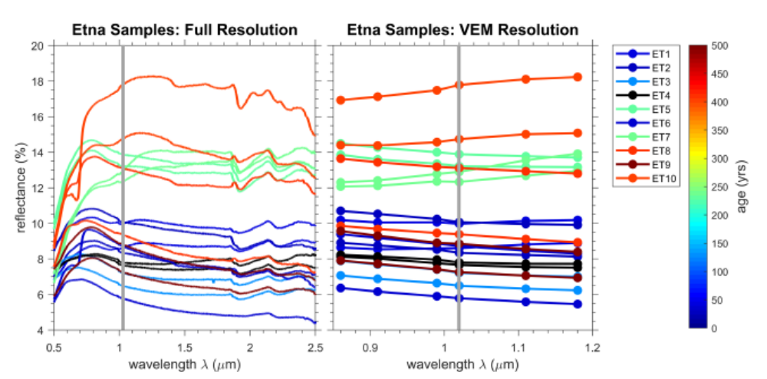
Terrestrial analogs!
Eggers et al (2022) LPSC

Slide 11
What do we need?
High Temperature Reflectance measurements of a wide range of materials
  Igneous samples with known mineralogy/chemistry
  Alteration coated samples
More quantitative comparisons
  This was a very simplistic study as proof of concept
  Control the atmosphere
Hemispherical measurements using the same approach

