Slide 1
Structured Covariance Gaussian Networks for Orion Crew Module Aerodynamic Uncertainty Quantification
Tenavi Nakamura-Zimmerer, Mary T. Stringer
Brendon K. Colbert, James B. Scoggins
NASA Langley Research Center
AIAA SciTech Forum
25th January, 2023

Slide 2
Outline
Aerodynamic modeling and uncertainty quantification
Structured Covariance Gaussian Networks (SCGNs)
Sampling functions from SCGNs
Comparison with Gaussian process regression (GPR)

Slide 3
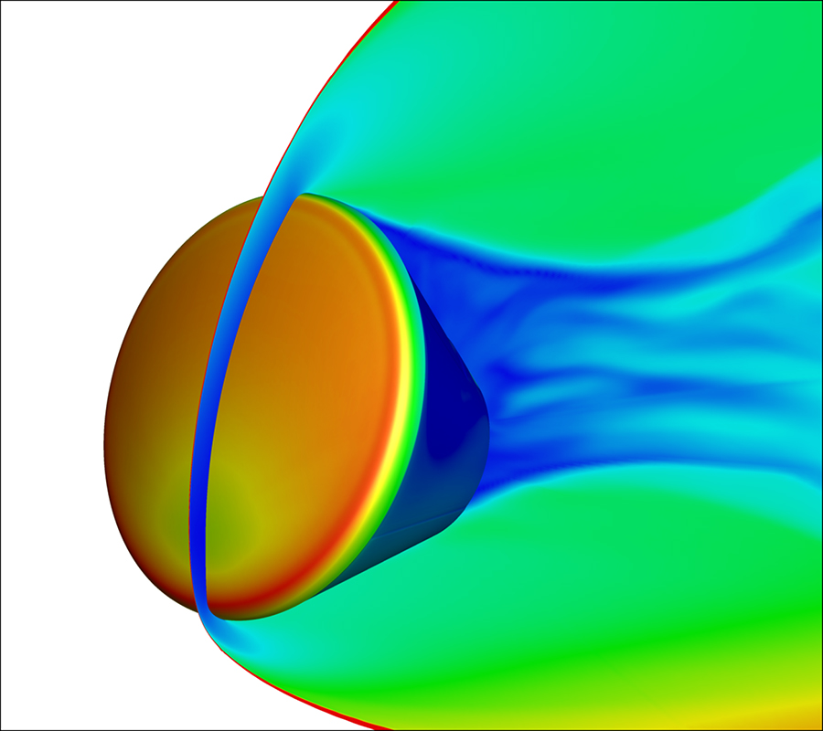
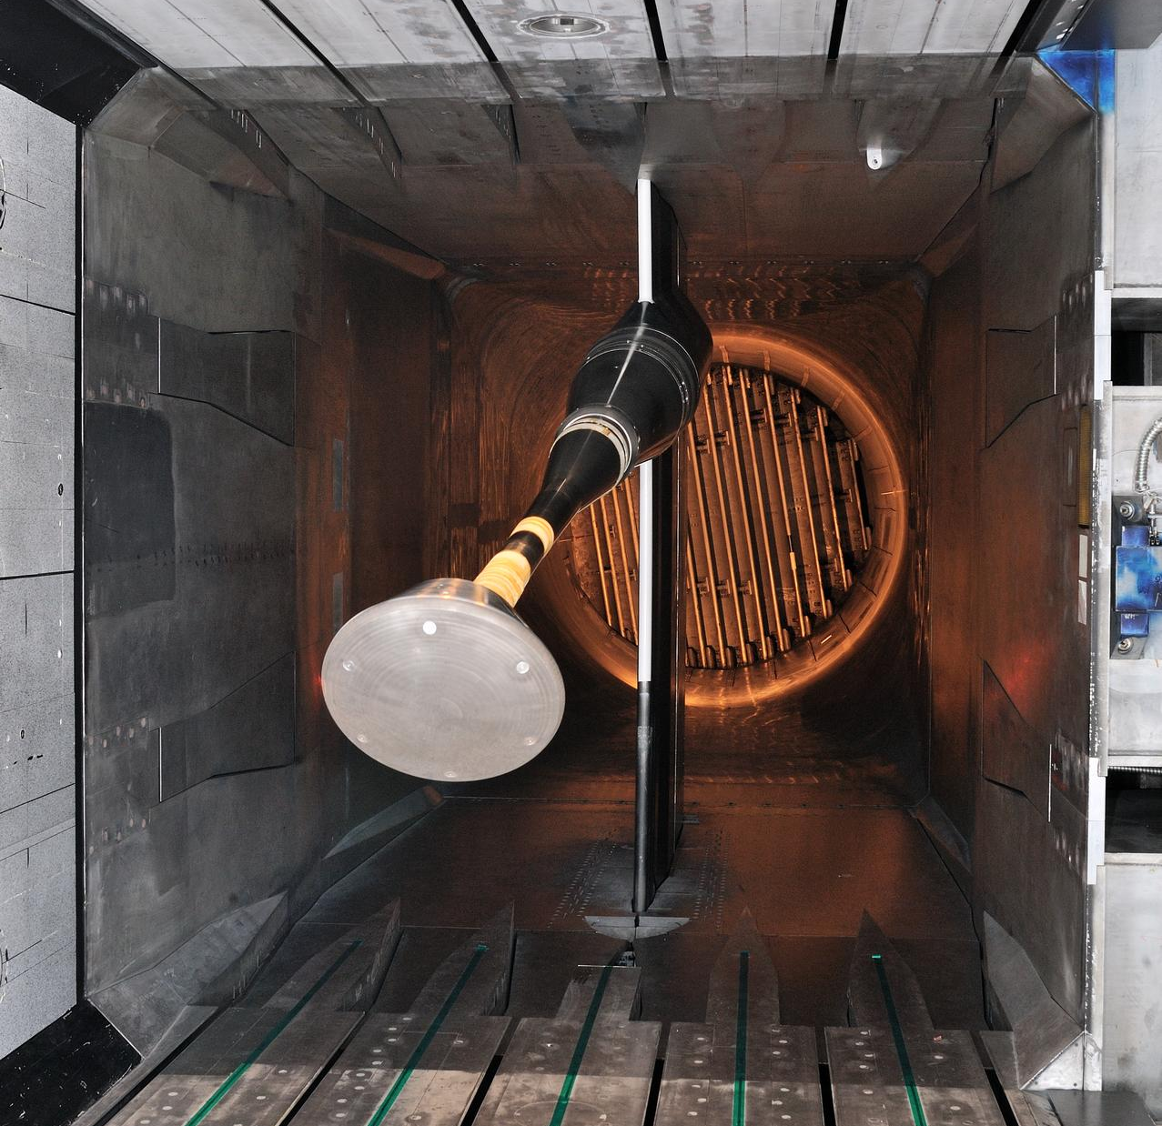
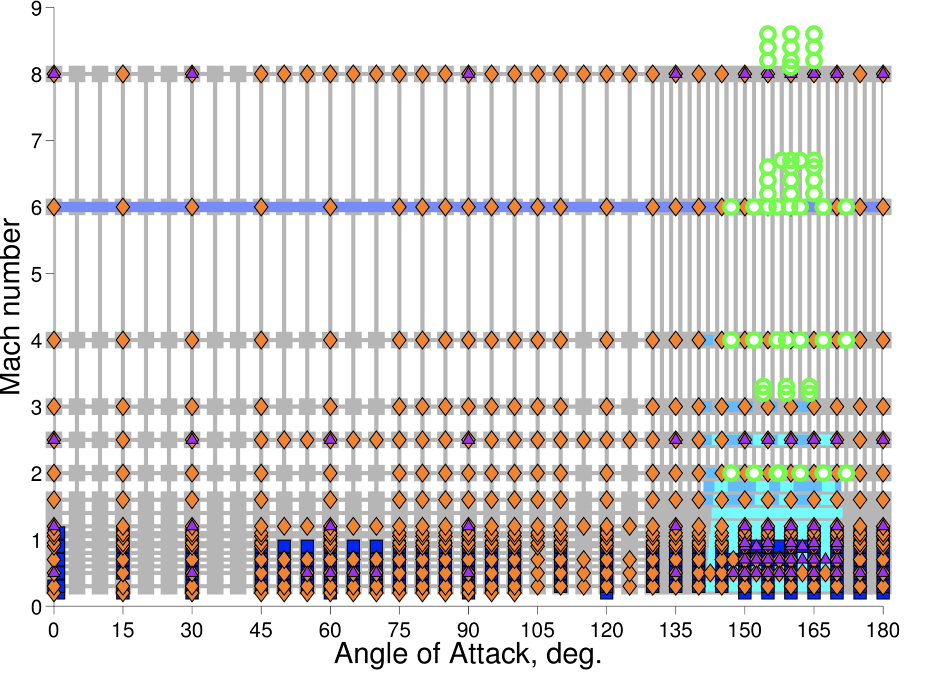
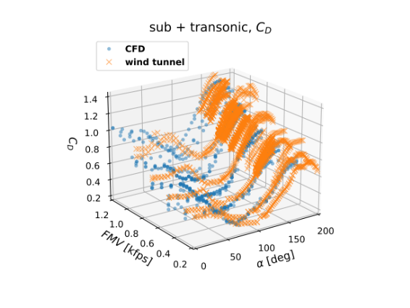
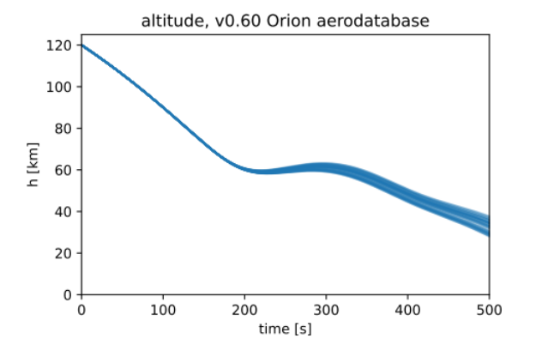
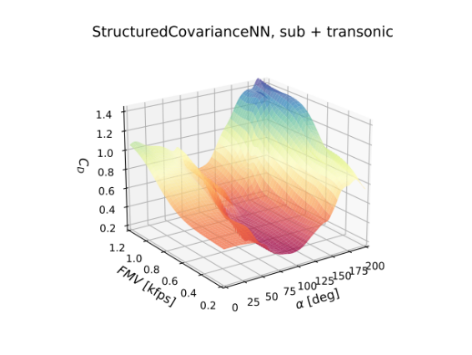
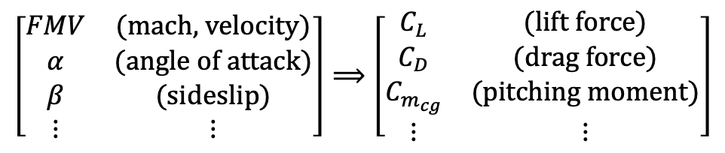
Aerodynamic modeling
DATA
ENGINEERING & MISSION DESIGN
GNC algorithm development
1
2
3
AERO-DATABASE
$$\left[\begin{matrix}FMV & \text{(}\text{mach}\text{, }\text{velocity}\text{)} \\ α & \text{(}\text{angle} \text{of} \text{attack}\text{)} \\ β & \text{(}\text{sideslip}\text{)} \\ ⋮ & ⋮\end{matrix}\right]⟹\left[\begin{matrix}C_{L} & \text{(}\text{lift} \text{force}\text{)} \\ C_{D} & \text{(}\text{drag} \text{force}\text{)} \\ C_{m_{cg}} & \text{(}\text{pitching} \text{moment}\text{)} \\ ⋮ & ⋮\end{matrix}\right]$$
Trajectory simulations
Image credits. 1: Chun Tang, NASA. 2: Sandra Gibbs, NASA. 3: Karen Bibb, NASA.

Slide 4
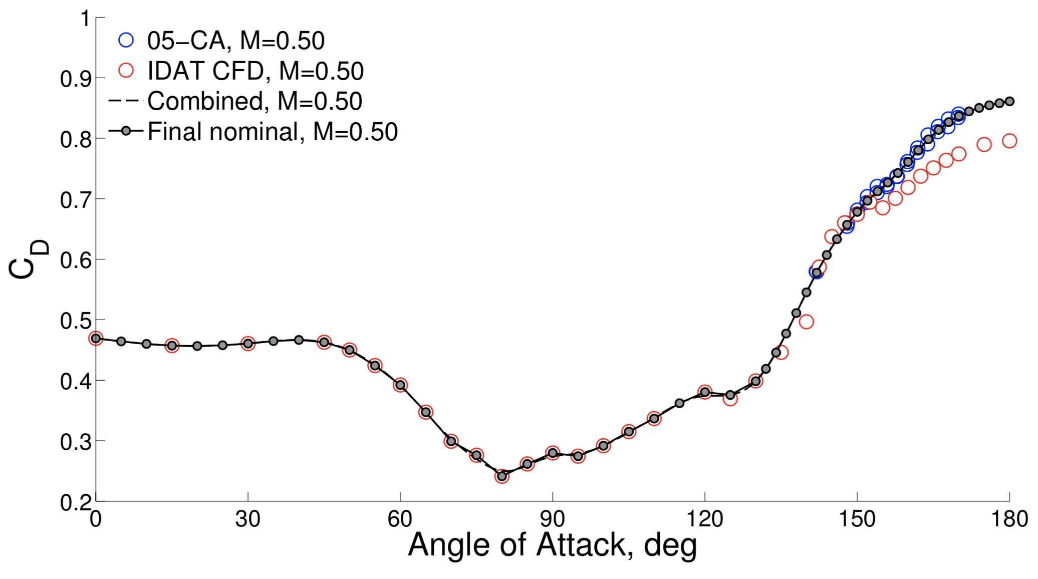
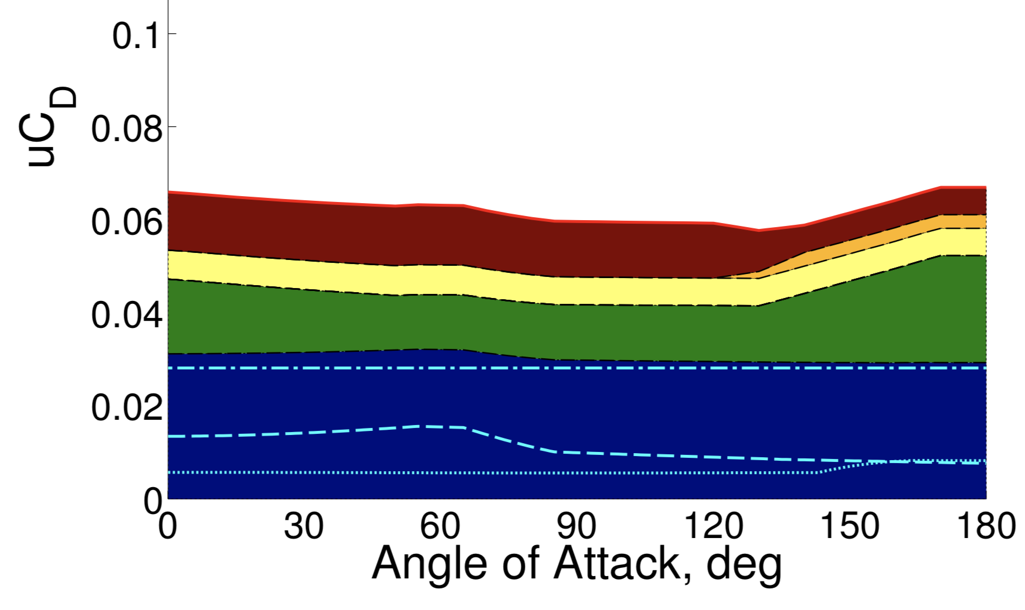
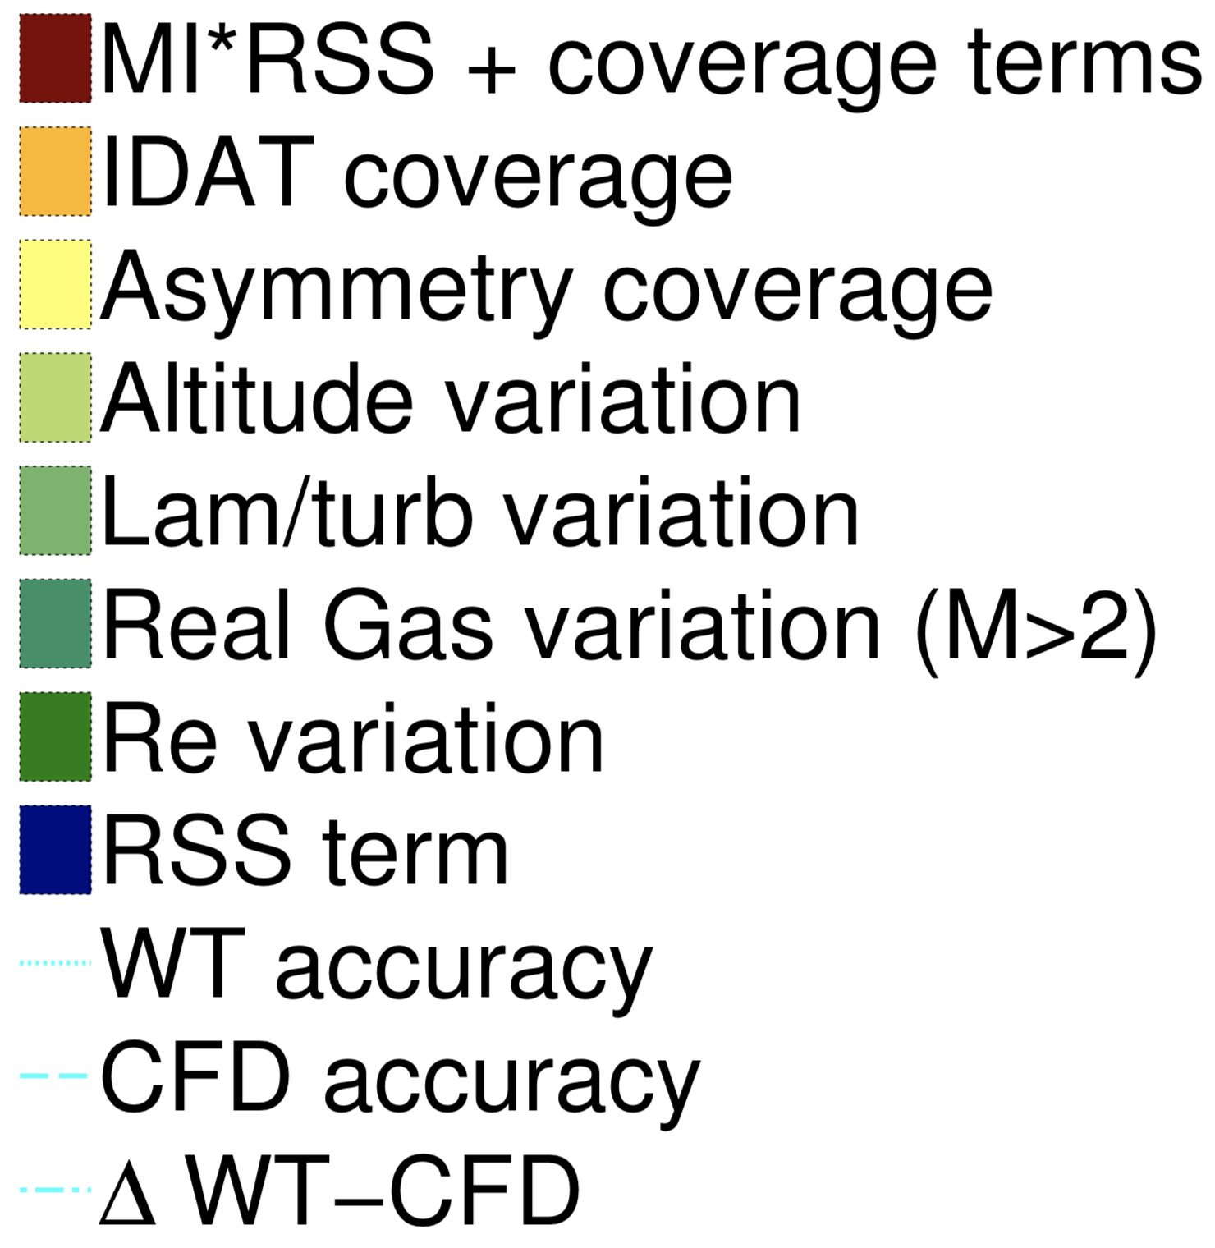
Aerodynamic uncertainty quantification (UQ)
Data isn’t perfect: contains noise, does not perfectly capture full physics, can reflect different stages of vehicle design process – need UQ!
State of the practice: “UQ by inspection”
Development of the Orion crew module static aerodynamic database, part I: Hypersonic & part II: Subsonic/supersonic (Bibb et al., AIAA SciTech Forum, 2011a,b)
1. Nominal aero
2. Uncertainty buildup
$${uC}_{D}=δ_{Re}+{MI}_{hs}{MI}_{idat}MI∙k\sqrt{{\left(σ_{wt2cfd}\right)}^{2}+{\left(\max\left\{σ_{wt},σ_{cfd}\right\}\right)}^{2}}$$

Slide 5
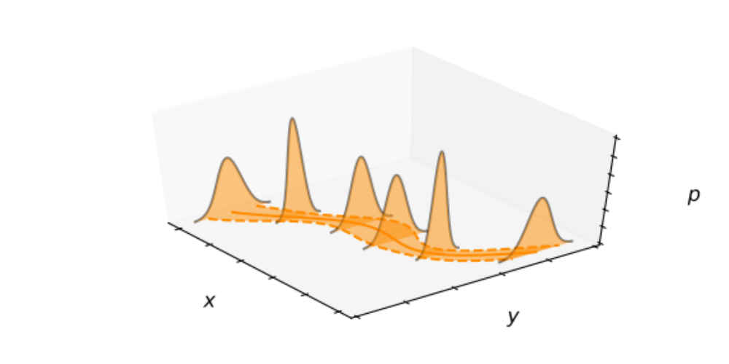

Machine learning for aerodynamic UQ
AeroFusion Early Career Initiative:
Tailor and apply modern ML for streamlined & repeatable aerodynamic UQ
From data, learn a surrogate conditional probability distribution
Many possible methods…
Gaussian process regression
Polynomial regression
Generalized polynomial chaos
Bayesian NNs
Dropout NNs
Conditional generative NNs
Structured covariance Gaussian NNs
$$y\sim p\left(y | x\right)$$

Slide 6
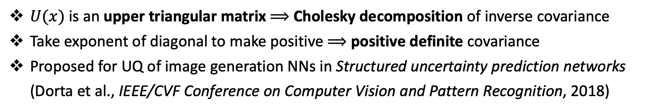
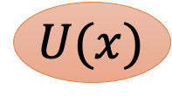
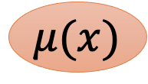
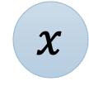
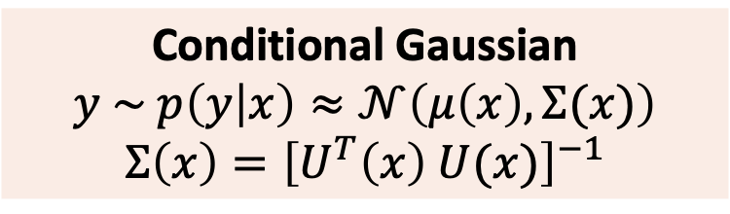
Structured Covariance Gaussian Networks (SCGNs)
Mean network
Conditional Gaussian
$$y \sim p\left(y | x\right)≈𝒩\left(μ\left(x\right),Σ(x)\right)$$
$$Σ\left(x\right)={\left[U^{T}\left(x\right) U(x)\right]}^{−1}$$
$$μ(x)$$
$$x$$
Covariance network
$$U(x)$$
$U(x)$is an upper triangular matrix $⟹$ Cholesky decomposition of inverse covariance
Take exponent of diagonal to make positive $⟹$ positive definite covariance
Proposed for UQ of image generation NNs in Structured uncertainty prediction networks (Dorta et al., IEEE/CVF Conference on Computer Vision and Pattern Recognition, 2018)

Slide 7
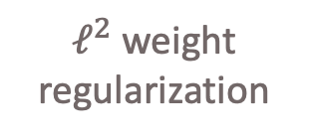
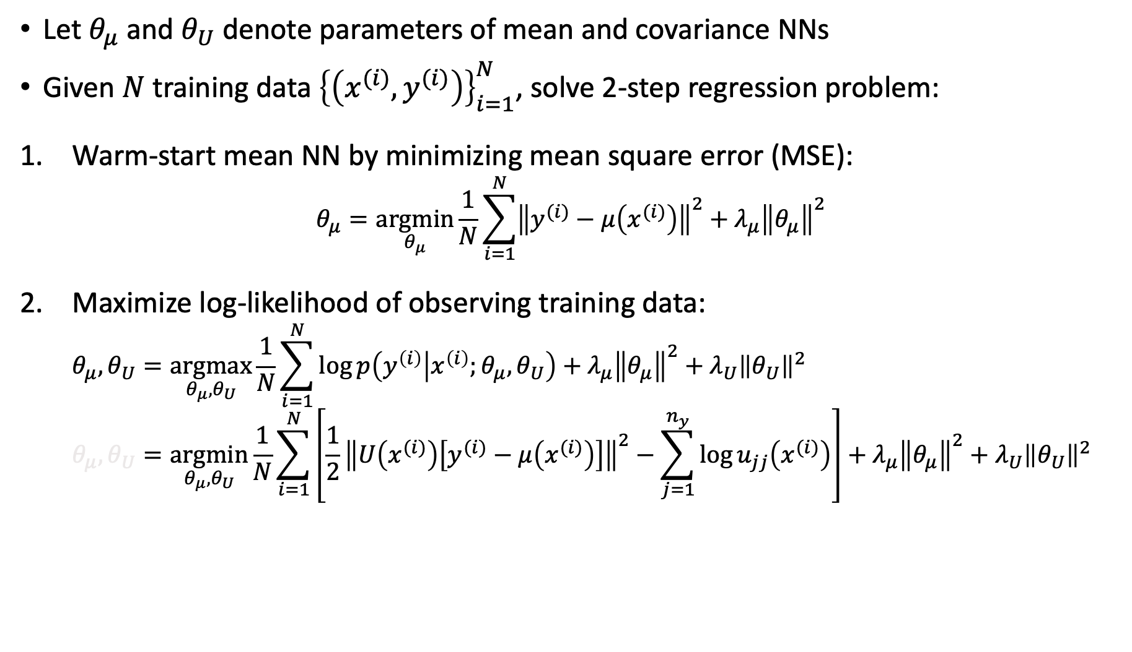
Training SCGNs
Let $θ_{μ}$ and $θ_{U}$ denote parameters of mean and covariance NNs
Given $N$ training data ${\left\{\left(x^{(i)},y^{(i)}\right)\right\}}_{i=1}^{N}$, solve 2-step regression problem:
Warm-start mean NN by minimizing mean square error (MSE):
$$θ_{μ}=\underset{θ_{μ}}{argmin}{\frac{1}{N}\sum_{i=1}^{N}{{\left\|y^{(i)}−μ\left(x^{(i)}\right)\right\|}^{2}}+λ_{μ}{\left\|θ_{μ}\right\|}^{2}}$$
Maximize log-likelihood of observing training data:
$$\begin{matrix}θ_{μ},θ_{U}=\underset{θ_{μ},θ_{U}}{argmax}{\frac{1}{N}\sum_{i=1}^{N}{\log{p\left(y^{\left(i\right)} | x^{\left(i\right)};θ_{μ},θ_{U}\right)}}+λ_{μ}{\left\|θ_{μ}\right\|}^{2}+λ_{U}{\left\|θ_{U}\right\|}^{2}} \end{matrix}$$
$$θ_{μ},θ_{U}=\underset{θ_{μ},θ_{U}}{argmin}{\frac{1}{N}\sum_{i=1}^{N}{\left[\frac{1}{2}{\left\|U\left(x^{(i)}\right)\left[y^{(i)}−μ\left(x^{(i)}\right)\right]\right\|}^{2}−\sum_{j=1}^{n_{y}}{\log{u_{jj}\left(x^{(i)}\right)}}\right]}+λ_{μ}{\left\|θ_{μ}\right\|}^{2}+λ_{U}{\left\|θ_{U}\right\|}^{2}}$$
fit data
decrease variance
$ℓ^{2}$ weight regularization

Slide 8
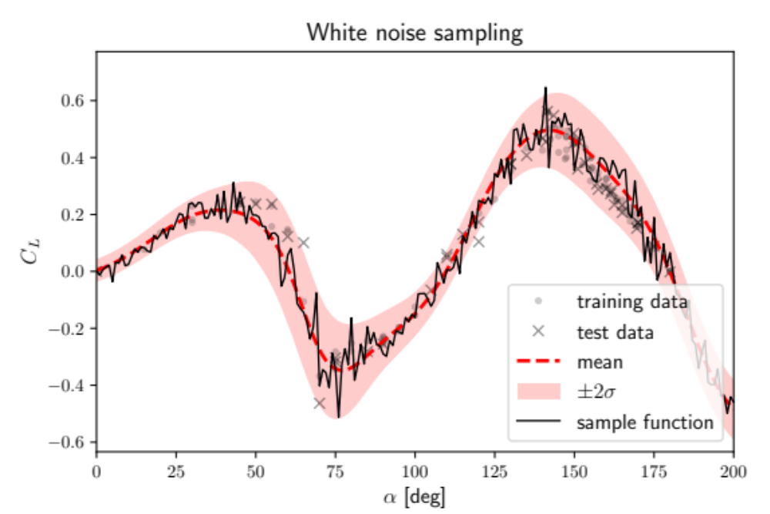
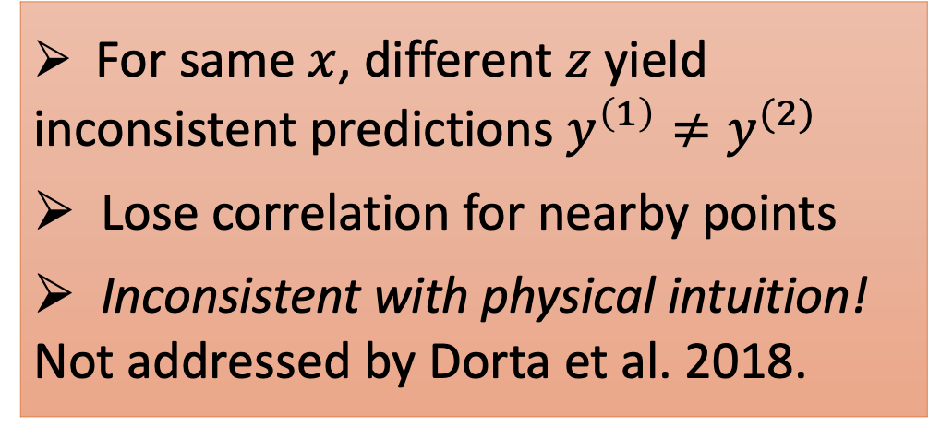
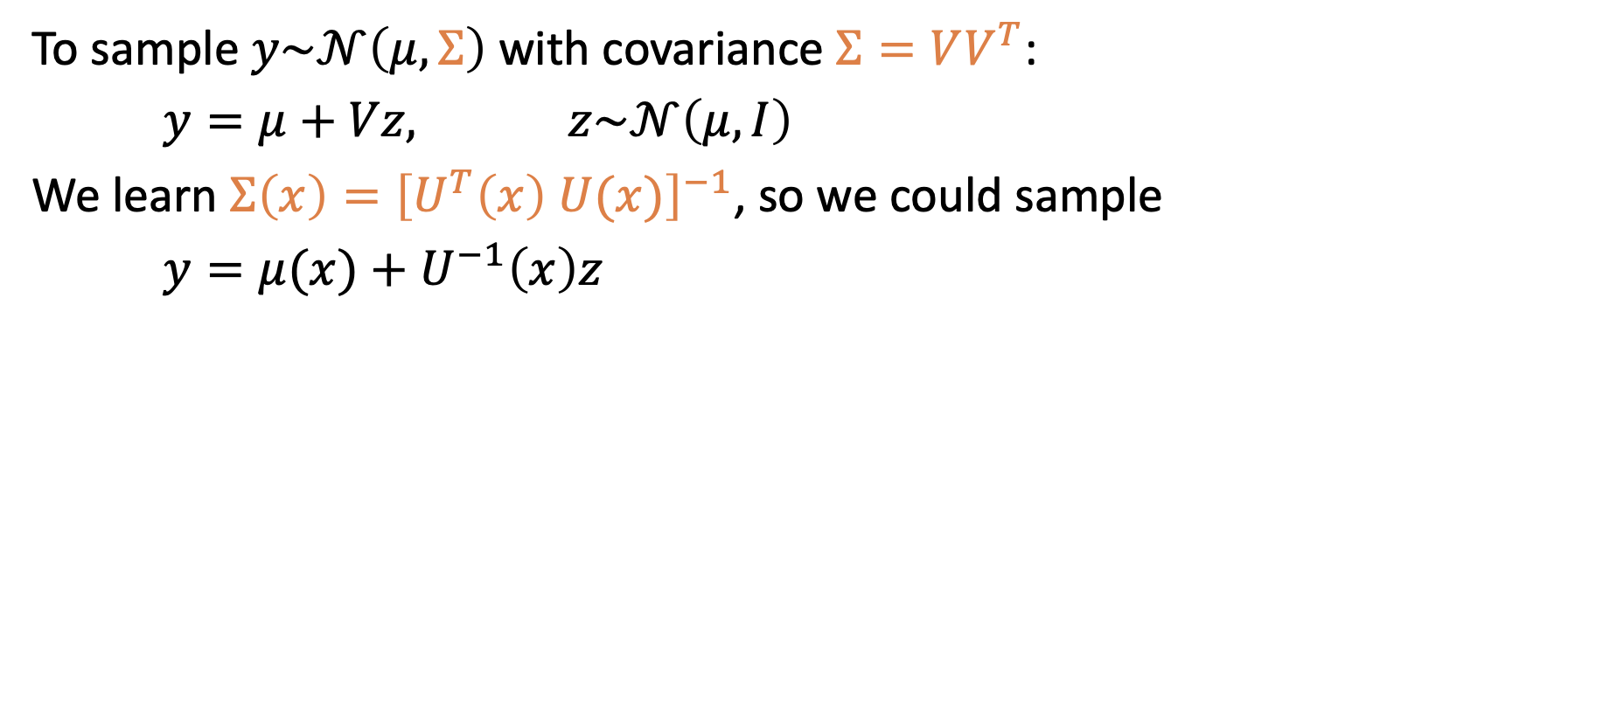
Sampling the conditional distribution
To sample $y\sim 𝒩\left(μ,Σ\right)$ with covariance $Σ=VV^{T}$:
$\begin{matrix}y=μ+Vz, & z\sim 𝒩\left(μ,I\right)\end{matrix}$
We learn $Σ\left(x\right)={\left[U^{T}\left(x\right) U(x)\right]}^{−1}$, so we could sample
$y=μ(x)+U^{−1}\left(x\right)z$
For same $x$, different $z$ yield inconsistent predictions $y^{\left(1\right)}≠y^{(2)}$
Lose correlation for nearby points
Inconsistent with physical intuition! Not addressed by Dorta et al. 2018.

Slide 9
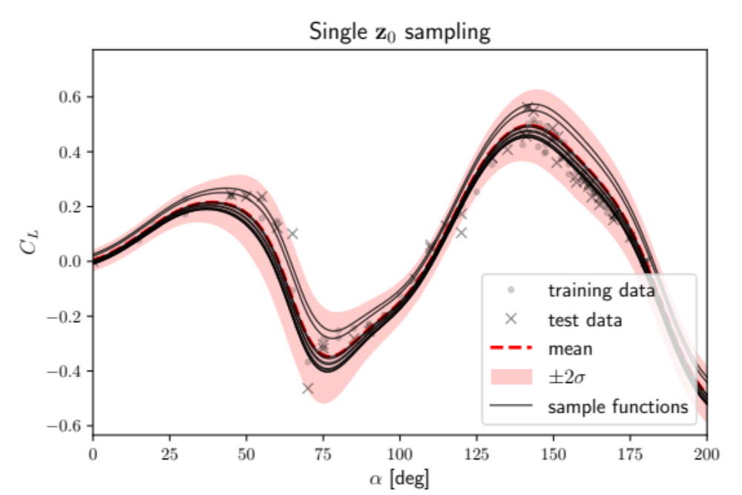
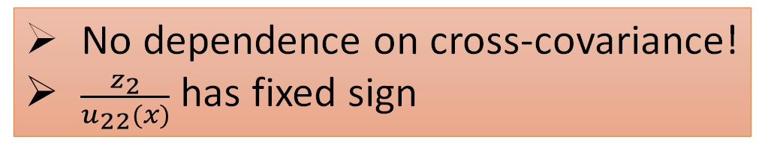
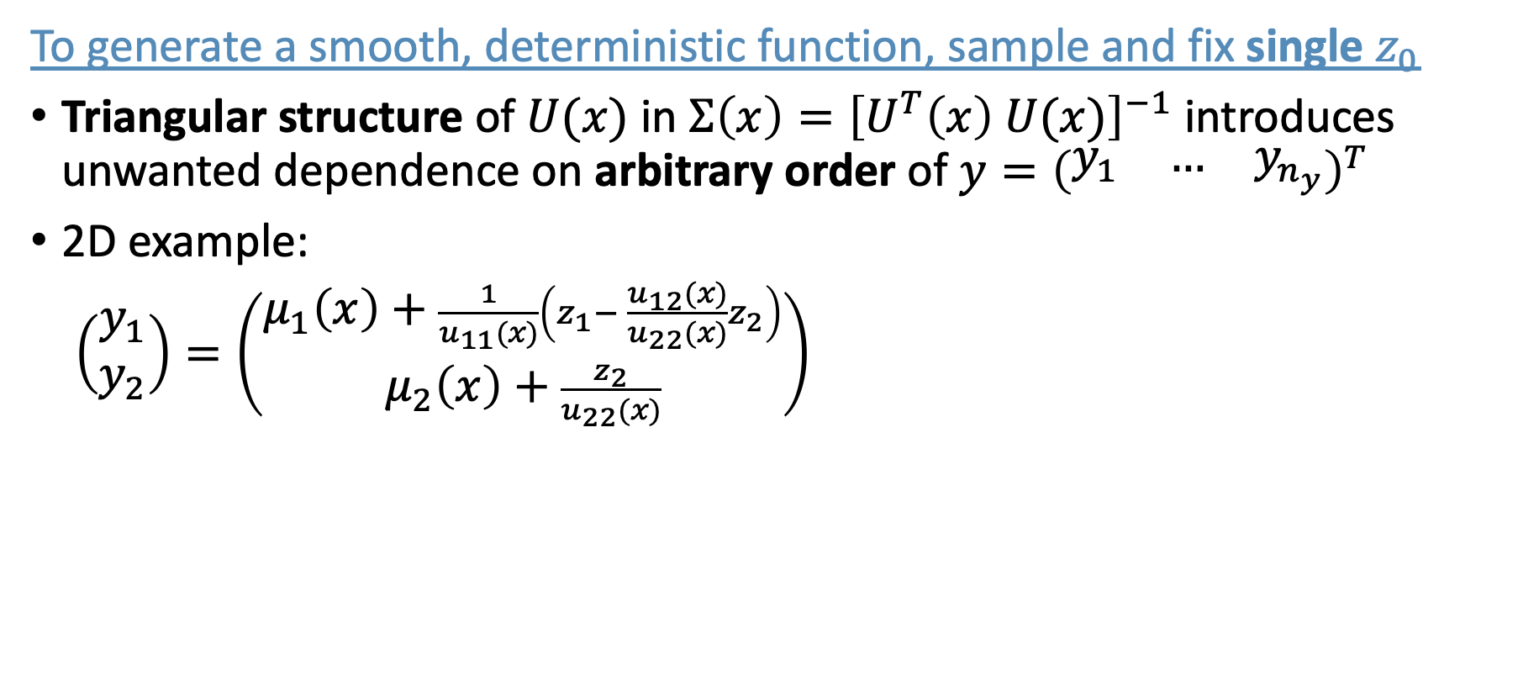
Towards smooth function samples
To generate a smooth, deterministic function, sample and fix single $z_{0}$
Triangular structure of $U(x)$ in $Σ\left(x\right)={\left[U^{T}\left(x\right) U(x)\right]}^{−1}$ introduces unwanted dependence on arbitrary order of $y={\left(\begin{matrix}y_{1} & … & y_{n_{y}}\end{matrix}\right)}^{T}$
2D example:
$\left(\begin{matrix}y_{1} \\ y_{2}\end{matrix}\right)=\left(\begin{matrix}μ_{1}\left(x\right)+\frac{1}{u_{11}(x)}\left(z_{1}− \frac{u_{12}(x)}{u_{22}(x)}z_{2}\right) \\ μ_{2}\left(x\right)+\frac{z_{2}}{u_{22}(x)}\end{matrix}\right)$
No dependence on cross-covariance!
$\frac{z_{2}}{u_{22}(x)}$ has fixed sign

Slide 10
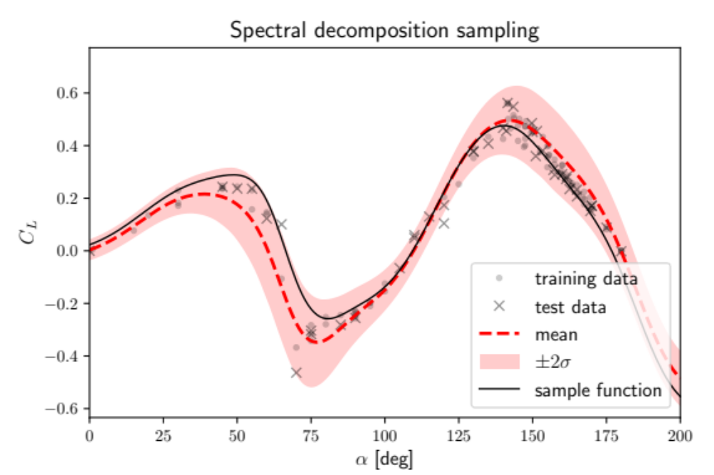
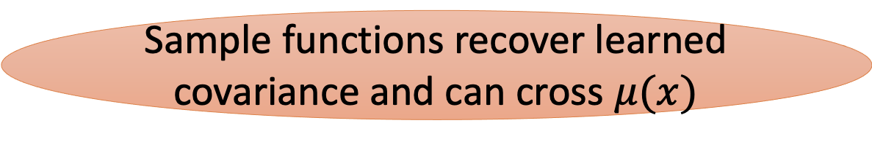
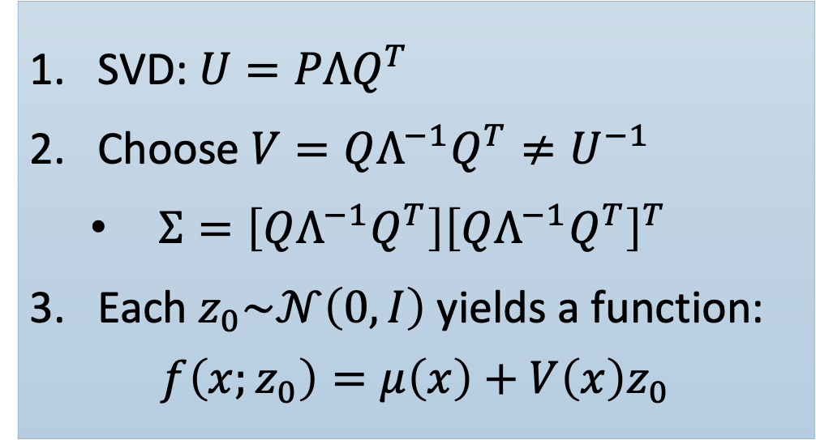
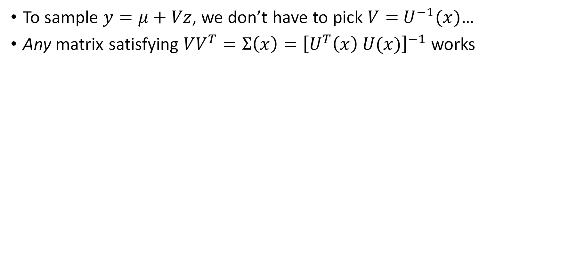
Spectral decomposition sampling
To sample $y=μ+Vz$, we don’t have to pick $V=$ $U^{−1}(x)$…
Any matrix satisfying $VV^{T}=Σ\left(x\right)={\left[U^{T}\left(x\right) U(x)\right]}^{−1}$ works
Sample functions recover learned covariance and can cross $μ(x)$
SVD: $U=PΛQ^{T}$
Choose $V=QΛ^{−1}Q^{T}≠U^{−1}$
  $Σ=\left[QΛ^{−1}Q^{T}\right]{\left[QΛ^{−1}Q^{T}\right]}^{T}$
Each $z_{0}\sim 𝒩\left(0,I\right)$ yields a function:
$$f\left(x;z_{0}\right)=μ\left(x\right)+V\left(x\right)z_{0}$$

Slide 11
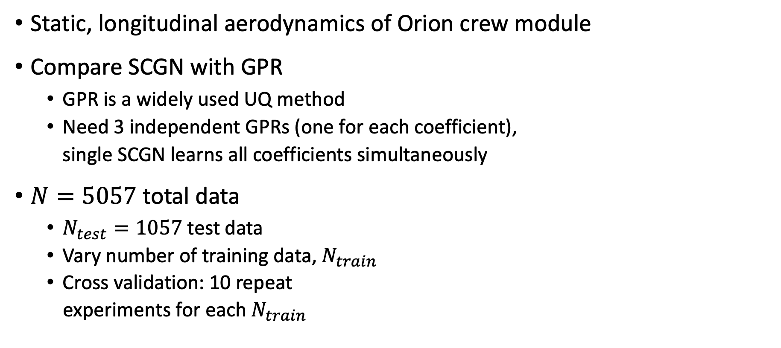



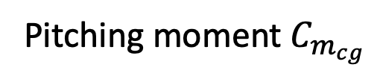

Numerical experiments
Static, longitudinal aerodynamics of Orion crew module
Compare SCGN with GPR
  GPR is a widely used UQ method
  Need 3 independent GPRs (one for each coefficient),
  single SCGN learns all coefficients simultaneously
$N=5057$ total data
  $N_{test}=1057$ test data
  Vary number of training data, $N_{train}$
  Cross validation: 10 repeat
  experiments for each $N_{train}$
Drag $C_{D}$
Lift $C_{L}$
Velocity $FMV$
$$α$$
Airflow
Angle of attack
Center
of mass
Pitching moment $C_{m_{cg}}$

Slide 12
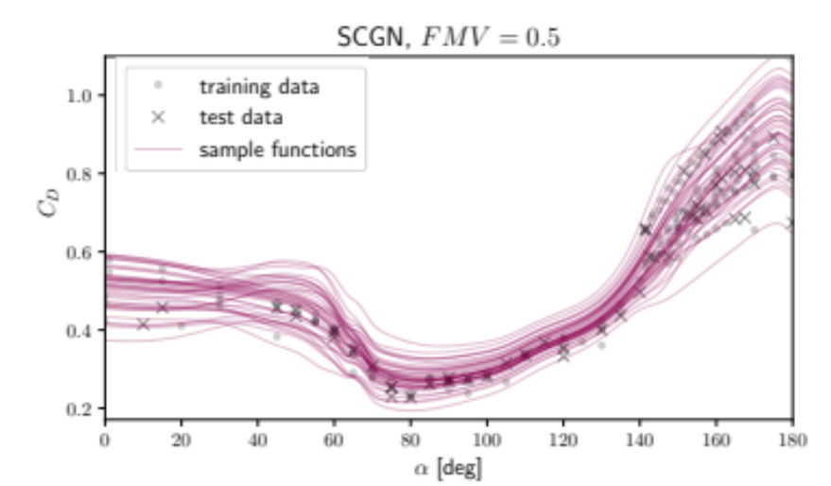
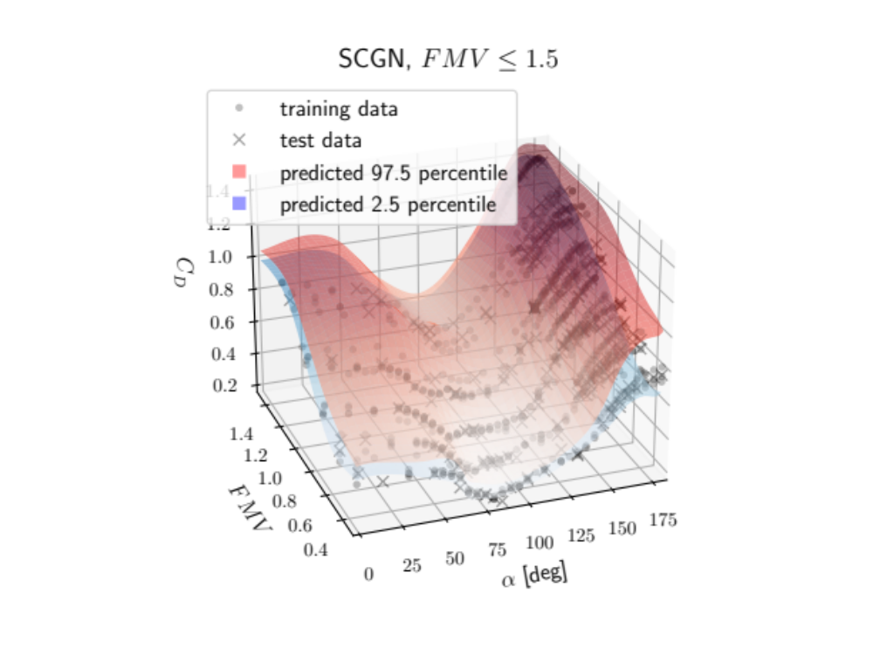
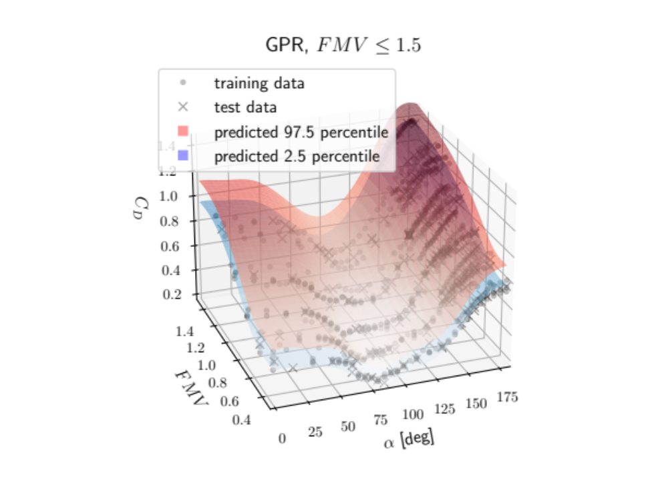
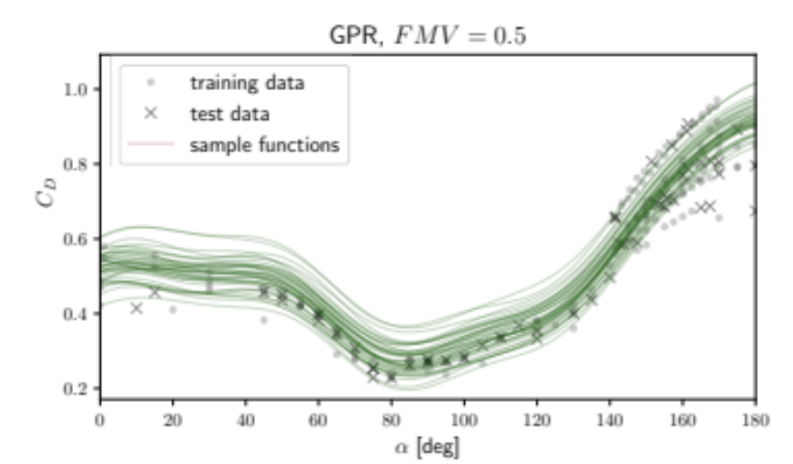

SCGN and GPR predictions
See paper for $C_{L}$ and $C_{m_{cg}}$

Slide 13
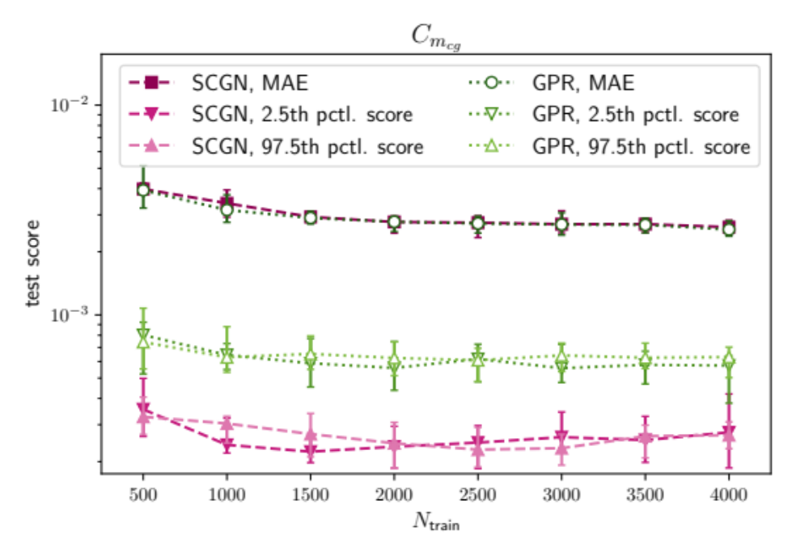
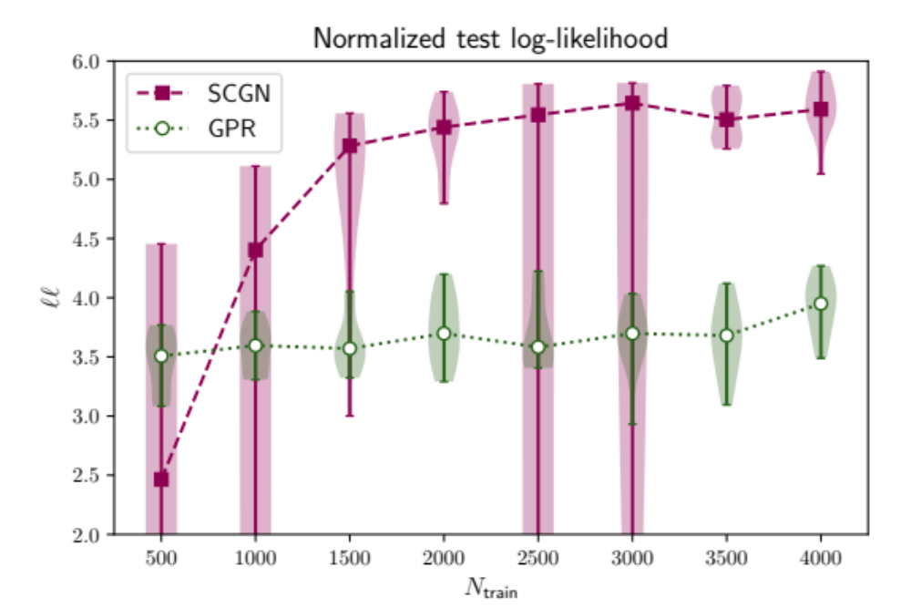
Prediction accuracy

Slide 14
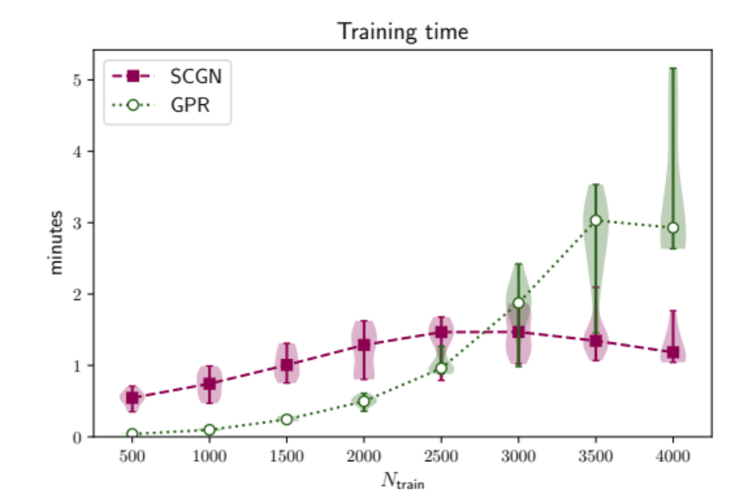
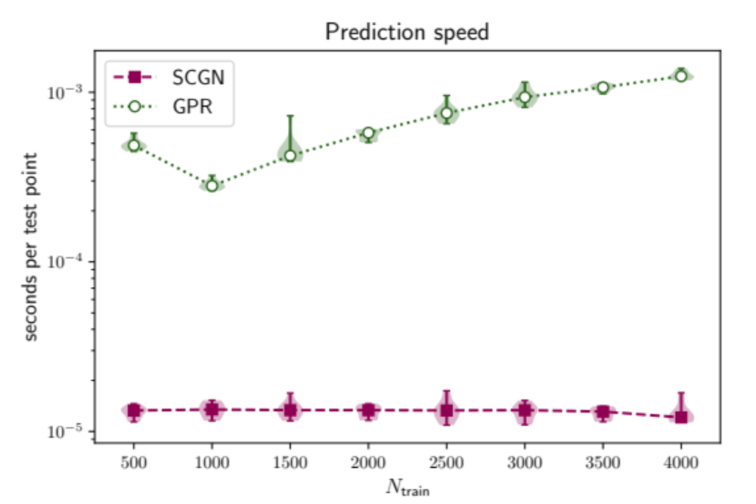
Training and prediction

Slide 15
Concluding remarks
Adapted and applied SCGN method for nonlinear regression and UQ
Introduced spectral decomposition sampling
  Generate smooth function realizations without changing NN architecture
  Preserve learned covariance at each point
  Results independent of arbitrary variable order
Compared empirically with GPR
  Learn cross-covariance between aero coefficients
  Competitive nominal accuracy and uncertainty descriptions
  Significantly improve computational efficiency and scaling with dataset size

Slide 16
Backup slides

Slide 17
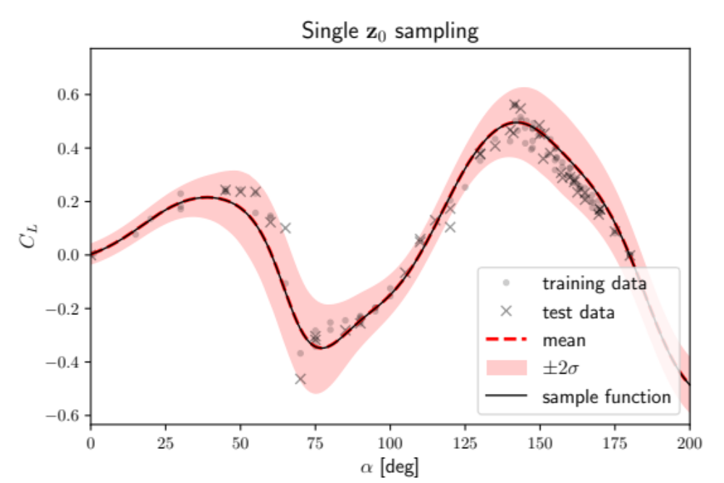
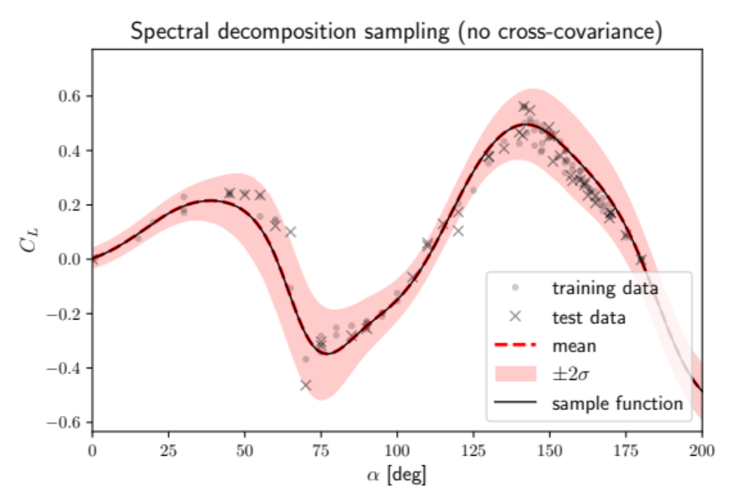
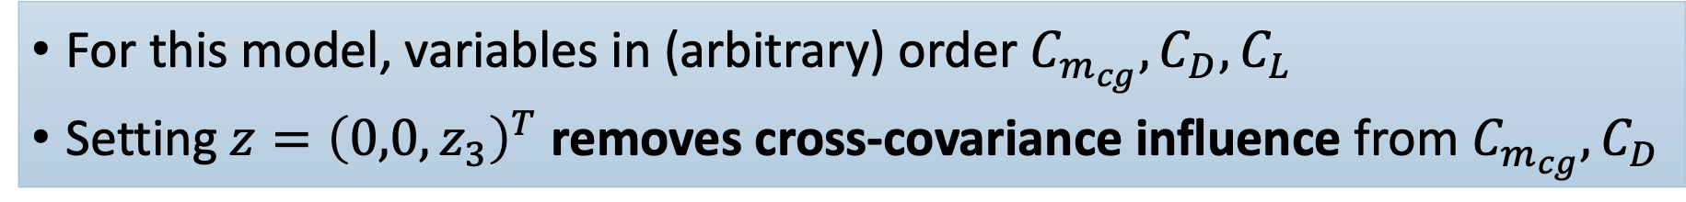
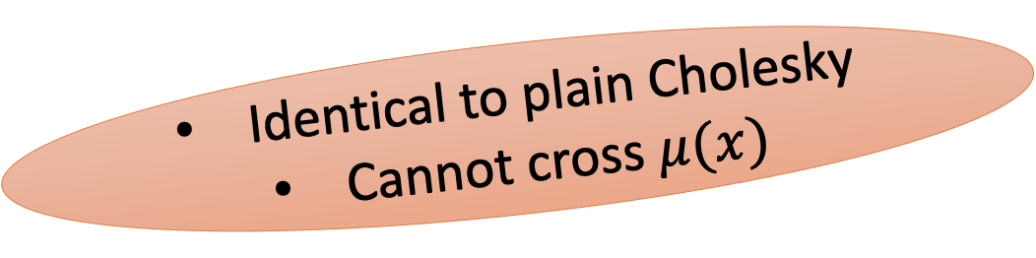
Why spectral decomposition?
For this model, variables in (arbitrary) order $C_{m_{cg}},C_{D},C_{L}$
Setting $z={\left(0,0,z_{3}\right)}^{T}$ removes cross-covariance influence from $C_{m_{cg}},C_{D}$
Identical to plain Cholesky
Cannot cross $μ(x)$

Slide 18
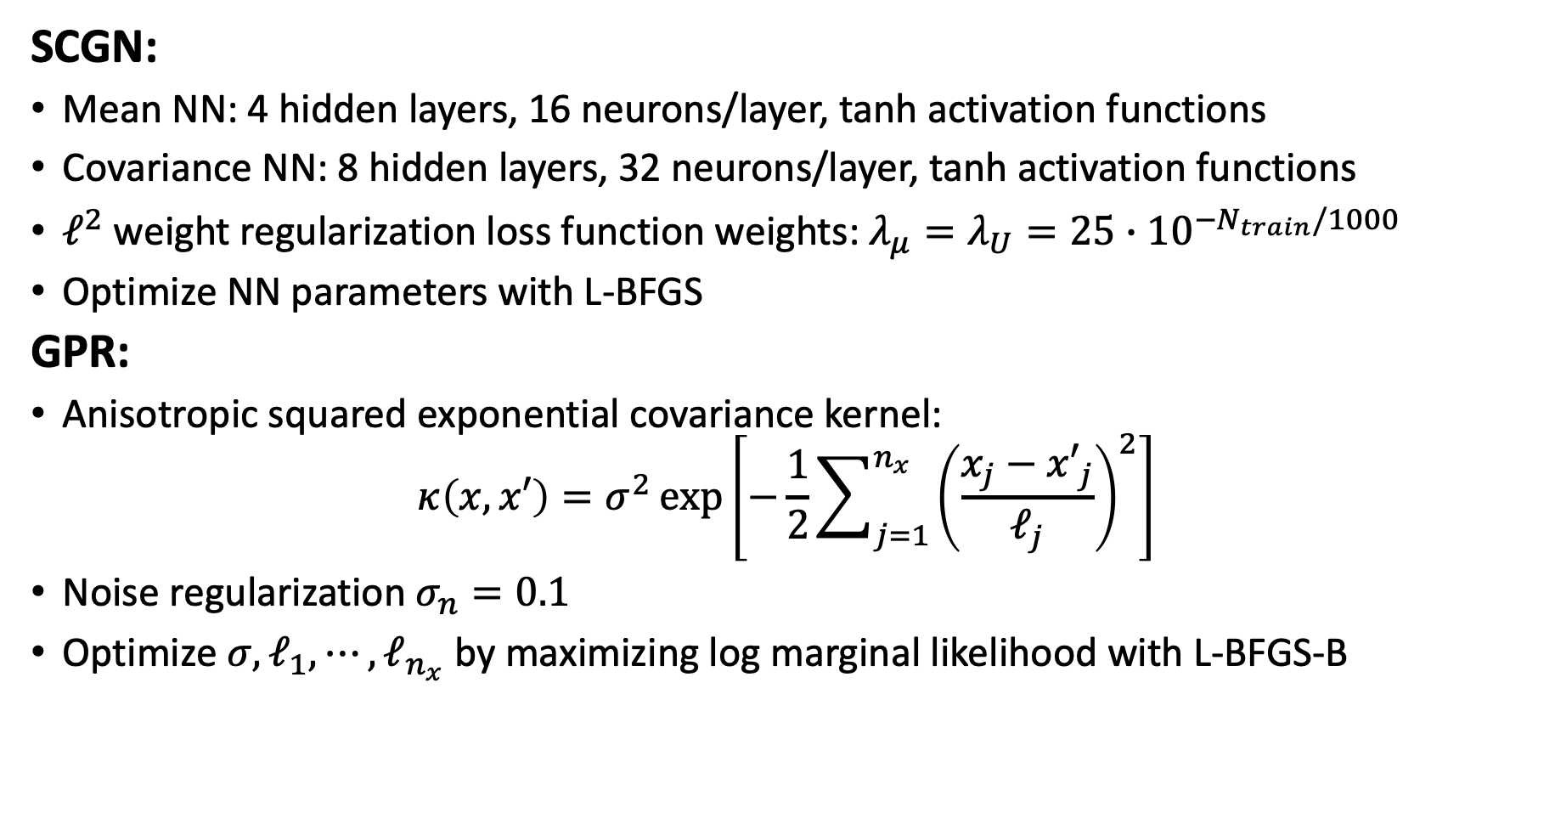
Model hyperparameters
SCGN:
Mean NN: 4 hidden layers, 16 neurons/layer, tanh activation functions
Covariance NN: 8 hidden layers, 32 neurons/layer, tanh activation functions
$ℓ^{2}$ weight regularization loss function weights: $λ_{μ}=λ_{U}=25∙{10}^{−N_{train}/1000}$
Optimize NN parameters with L-BFGS
GPR:
Anisotropic squared exponential covariance kernel:
$$κ\left(x,x′\right)=σ^{2}\exp\left[−\frac{1}{2}\sum_{j=1}^{n_{x}}{{\left(\frac{x_{j}−{x′}_{j}}{ℓ_{j}}\right)}^{2}}\right]$$
Noise regularization $σ_{n}=0.1$
Optimize $σ,ℓ_{1},⋯,ℓ_{n_{x}}$ by maximizing log marginal likelihood with L-BFGS-B

