Slide 1


Preparations for Quesst Acoustic Validation
Larry J. Cliatt, II
Technical Lead for Quesst Acoustic Validation
National Aeronautics and Space Administration (NASA)
2023 AIAA SciTech Forum
This material is a work of the U.S. Government and is not subject to copyright protection in the United States.

Slide 2
Topics of Discussion
Acoustic Validation Goals & Objectives
Overview and Concept of Operations
New Ground Systems Development
  State-of-the sonic boom ground recording system
  Unattended recording system trigger
  X-59 sonic boom flight path planning tool
  Real-time sonic boom prediction display
New Airborne Systems Development
  Airborne near field probing system
  In-flight, full-scale shockwave imagery systems
  Real-time relative position pilot display
Acoustic Validation Test Approach

Slide 3
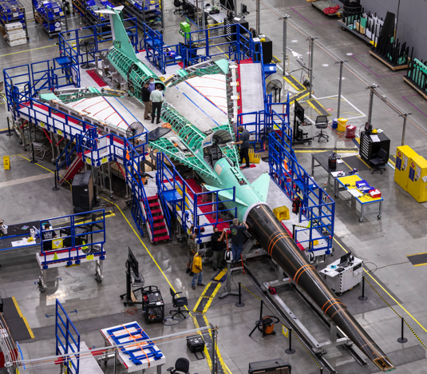
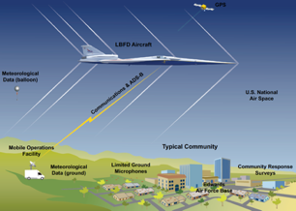
Quiet Supersonic Mission Overview
Phase 1 – Aircraft Development – In progress
  Detailed design
  Fabrication, integration, ground test
  Checkout flights
  Subsonic envelope expansion
  Supersonic envelope expansion
Phase 2 – Acoustic Validation – Preparation in progress
  Aircraft operations & support, range Ops, support aircraft
  In-flight measurement capabilities
  Ground measurement capabilities
  Validation of X-59 boom signature and prediction tools
  Development of acoustic prediction tools for Phase 3
Phase 3 – Community Response Testing Preparation in progress
Aircraft operations & support, deployment logistics
Ground measurement capabilities
Ground crew operations
Noise exposure design
Community response surveys
Data analysis and database delivery
Notes:
NASA STRIVES Document ID: 20205010936

Slide 4
Quesst Mission Acoustic Validation Goal & Objectives
The Acoustic Validation Test Preparation & Execution activity consists of the test planning and measurements required to support Quesst acoustic validation flights – Phase 2 of the NASA Quesst Mission
Goal: Validate that the ground acoustic signature loudness of the X-59 aircraft is acceptable for community response testing
Objectives:
Gather X-59 airborne (near-, mid- and far-field) & ground data that will be used to anchor sonic boom propagation and acoustics models in a real atmosphere
Characterize the shock signature and sonic boom envelope of the X-59 aircraft
Coordinate multiple ground and flight assets to efficiently gather multiple sonic boom flight research data types
Project Approach:
Ground equipment development
Test planning
Test execution & validation

Slide 5
Acoustic Validation
Overview &
Concept of Operations

Slide 6
Phase 2A – Probing
Phase 2C – Imagery
Phase 2B – Ground
Quesst Phase 2 Combined Concept of Operations
Notes:
NASA STRIVES Document ID: 20205010936

Slide 7
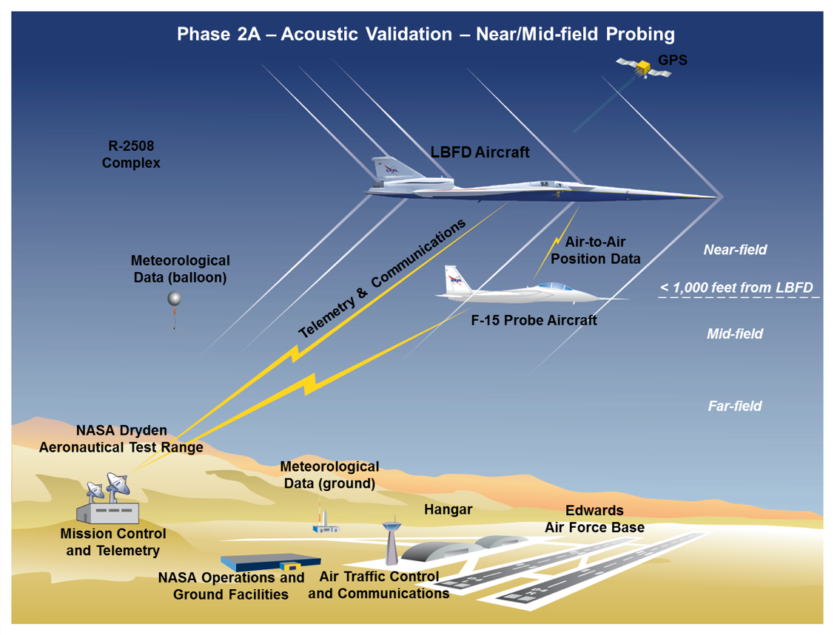
Near/Mid-Field Probing Flights
Notes:
NASA STRIVES Document ID: 20205010936

Slide 8


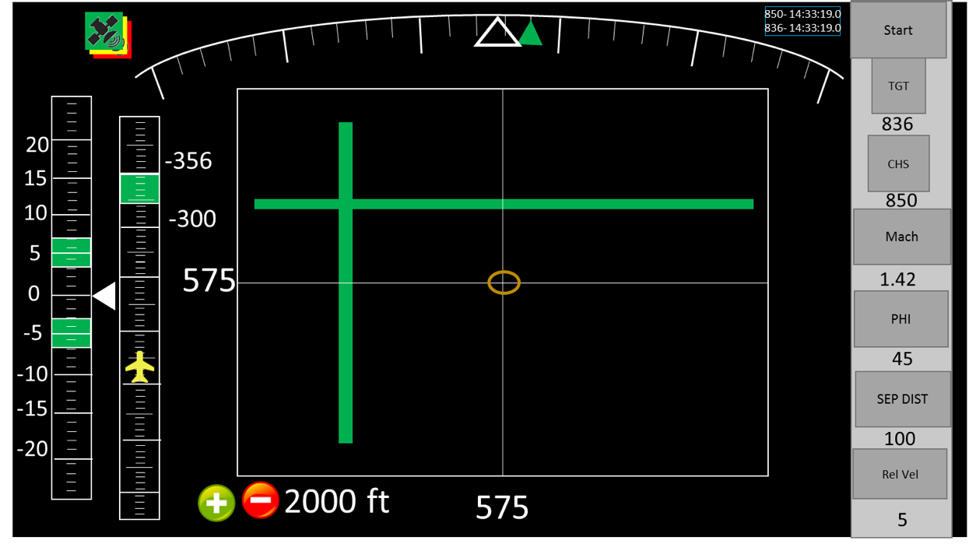


Probing & Flight Positioning
X-59 flies at low-boom design cruise conditions
F-15 flies relative to X-59 – forward and aft for multiple passes
    25 test points 300-500 feet below X-59 (±50º lateral offset below)
    Six test points 300-1,000 feet above X-59
    Six test points 20,000 feet below X-59 (±20º mid-field)
Research Support Aircraft (F-15)
  Shockwave Sensing Probe and Modified Life Support System
20 Flights | 2 / day
300-1000 ft
300-500 ft
±50º
F-15 Probing Positioning Display
X-59 and F-15 Relative Positions
Notes:
NASA STRIVES Document ID: 20205010936

Slide 9
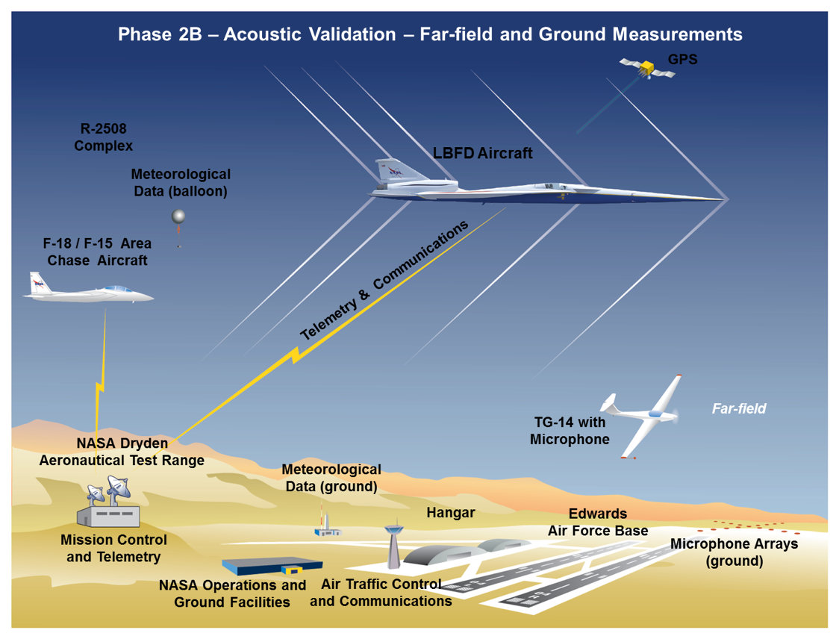
Far-Field and Ground Measurement Flights
Notes:
NASA STRIVES Document ID: 20205010936

Slide 10
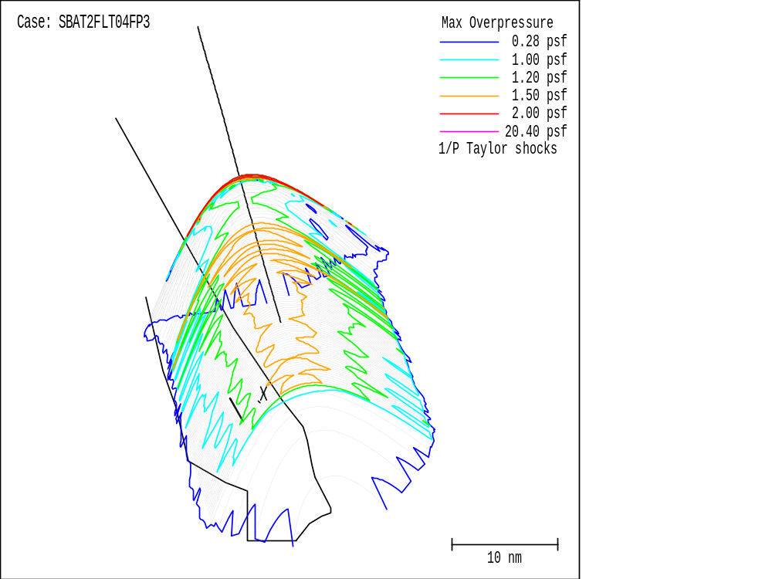
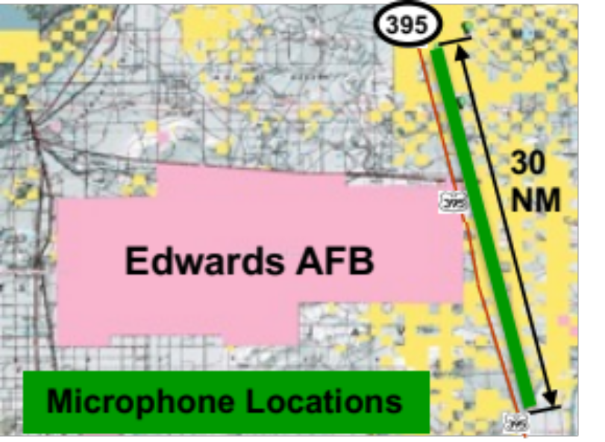
Far-Field and Ground Measurement Flights
30 Flights | 2-3 / day
X-59 flies at low-boom design conditions
  Flies a precise position based on weather data for the boom carpet to hit the microphone array
  TG-14 above the turbulent layer in-line with microphones
Large microphone array required
Area Chase Aircraft (F-15 or F-18)
  Used for departure, recovery and emergency support
  Positioned away from X-59 during boom recording
Flight Path
On Condition
Footprint
15-50 nm
Sonic Boom Carpet
Notes:
NASA STRIVES Document ID: 20205010936

Slide 11
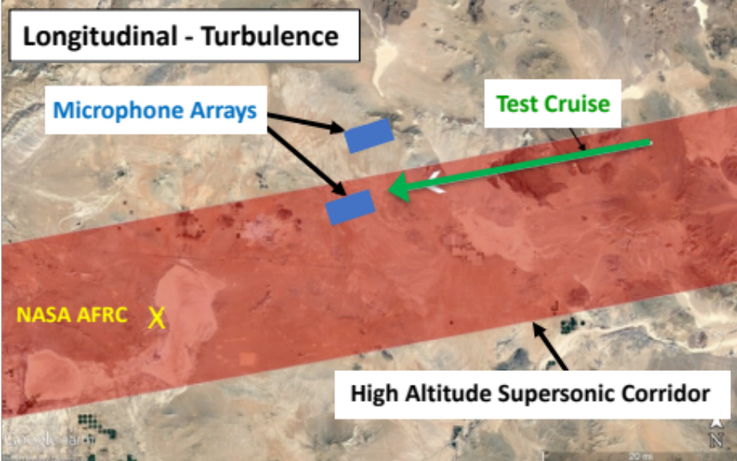
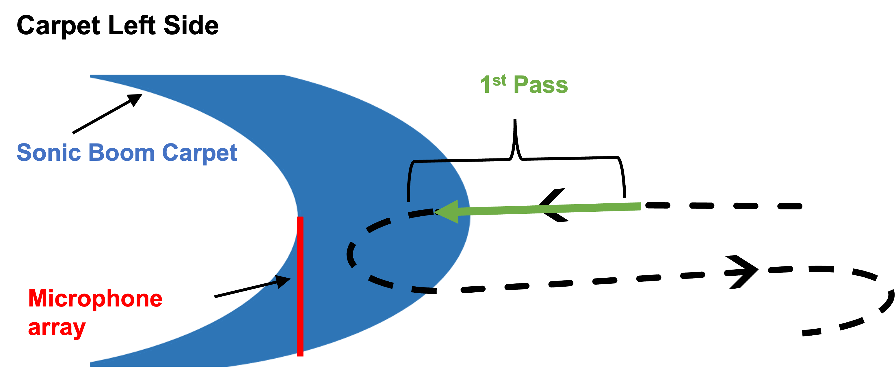
Far-Field: Flight Profile and Airspace
Lateral Measurements (carpet width)
  Expected boom carpet width of < 50 nmi, 90% of the time
  30 nmi microphone array with microphones spaced 0.5 nmi apart
  Requires two passes to capture full carpet for one heading angle
  Will fly both eastward and westward headings
  Approximately four passes at each flight condition
Longitudinal Measurements
  Two subarrays parallel to the flight path
  (one undertrack and one offtrack)
  Each subarray will have 16 microphones spaced 150 ft. apart
  Primarily used to assess effects of turbulence
Notes:
NASA STRIVES Document ID: 20205010936

Slide 12
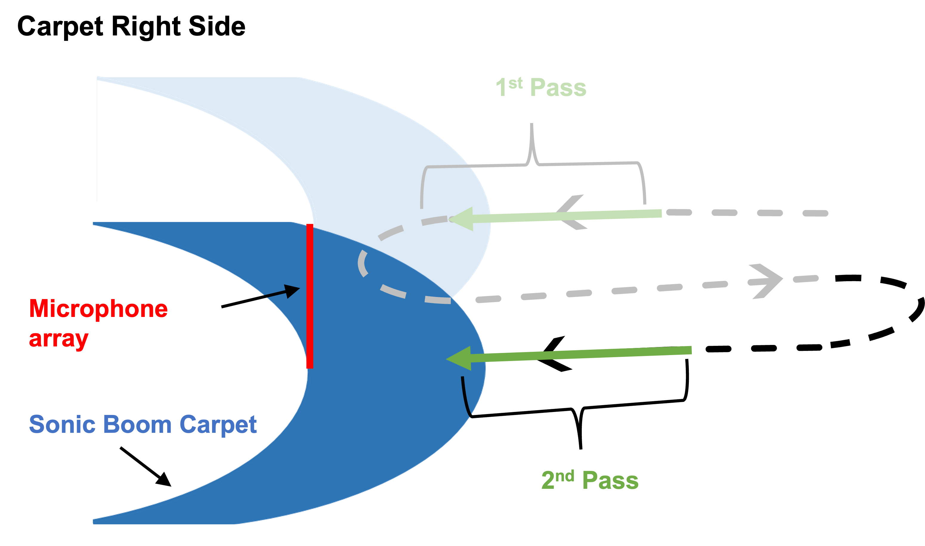
Far-Field: Flight Profile and Airspace
Lateral Measurements (carpet width)
  Expected boom carpet width of < 50 nmi, 90% of the time
  30 nmi microphone array with microphones spaced 0.5 nmi apart
  Requires two passes to capture full carpet for one heading angle
  Will fly both eastward and westward headings
  Approximately four passes at each flight condition
Longitudinal Measurements
  Two subarrays parallel to the flight path
  (one undertrack and one offtrack)
  Each subarray will have 16 microphones spaced 150 ft. apart
  Primarily used to assess effects of turbulence
Notes:
NASA STRIVES Document ID: 20205010936

Slide 13
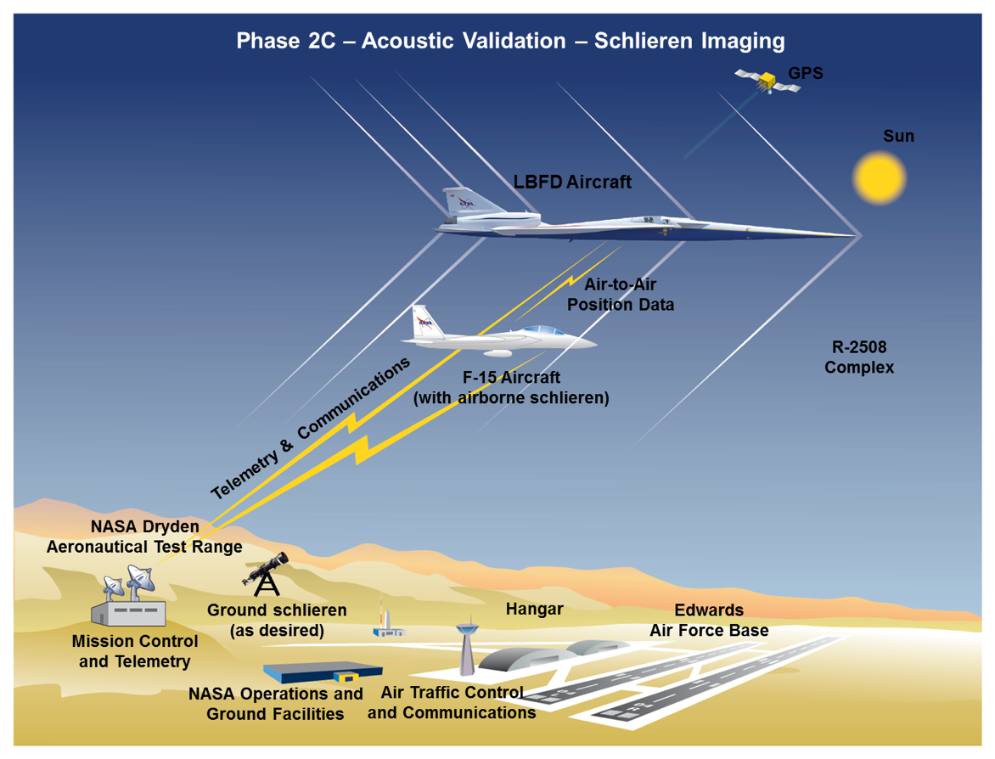
Shockwave Imaging Flights

Slide 14
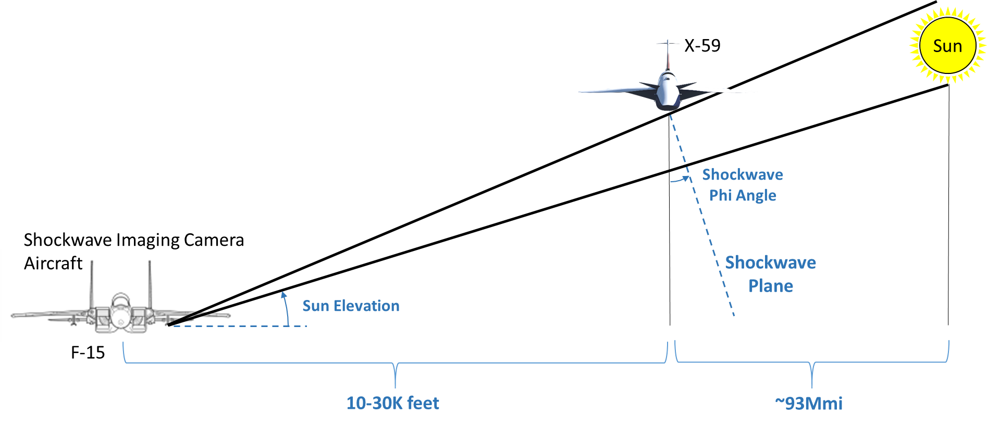
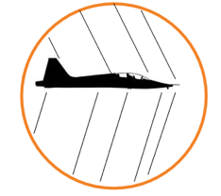
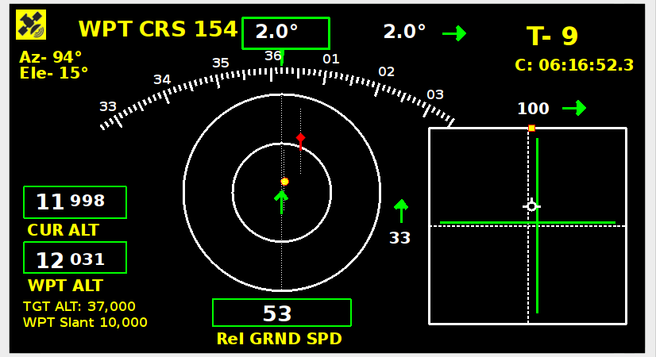
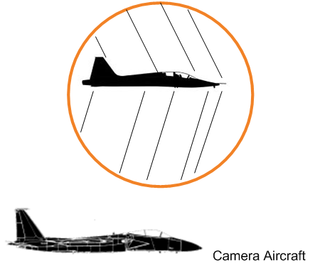
Shockwave Imaging for X-59
Research Support Aircraft (F-15)
  Shockwave imaging pod with Modified Life Support System
  Requires X-59 GPS position data via air-to-air modem
  F-15 positioning display and shockwave imaging pod in development
X-59 flies at low-boom design conditions
  Imaging of shocks beneath X-59 aircraft at normal cruise altitude will require very low Sun elevation angle.
  Low elevation angles
  will require small
  differential altitude,
  So future imaging
  system will be airborne.
F-15 Positioning Display
10 Flights | 1 / day
Camera Aircraft
Notes:
NASA STRIVES Document ID: 20205010936

Slide 15
Ground Systems
Development

Slide 16
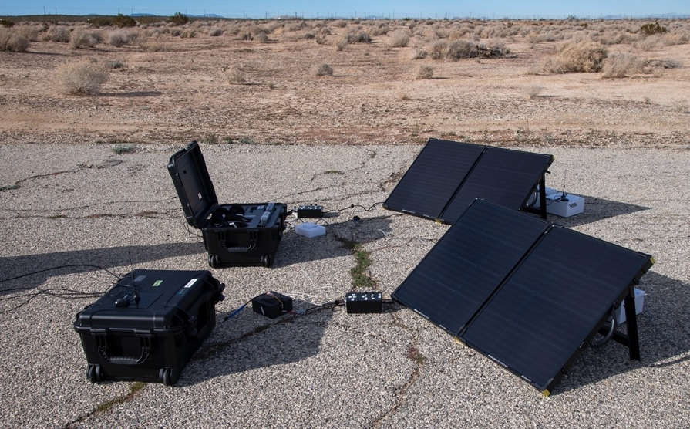
Sonic Boom Field Measurement Challenges
(175+ System Requirements)
Size/count of measurement field (≅ 37 Requirements)
  Requires remote operations:
    Triggering, two-way communications, functional checks, etc.
Remote data analysis and transmission (≅ 19 Requirements)
  Analysis should be done at the recorder to limit bandwidth and increase
  turn-around speed
  Runs specialized software:
  sonic boom finder, metric calculations, triggering algorithms, functional checks
Remote health and functional checks (≅ 14 Requirements)
Single-person deployment (≅ 9 Requirements)
  Small, compact, light, portable
Long deployment and operational time (≅ 22 Requirements)
  Full day operations over weeks/months
  Needs to withstand harsh environmental elements
  Security (vandals, animals, etc.)
NASA Sonic Boom Field Testing
Ground Recording Systems
Research quality measurements (≅ 35 Requirements)
  Major components are established components that can be readily calibrated
  Capable of computing human-response metrics
  Data quality, High sample rate, Time-tagging/accuracy, Frequency range, etc.

Slide 17
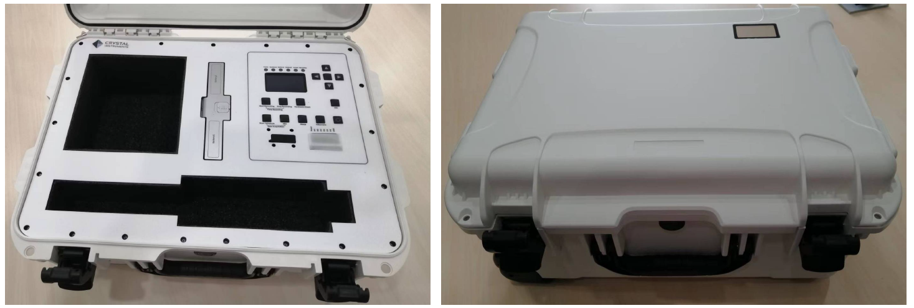
NASA Sonic Boom Ground Recording System (GRS)
Additional Storage
Batteries
LEDs
LCD Display
See-through Display
SD Card
Digital I/Os
Inputs:
Data
GPS
Cellular
ADS-B
Ethernet
Microphone Storage
GRS Prototypes

Slide 18
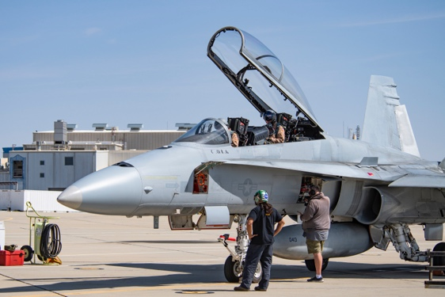
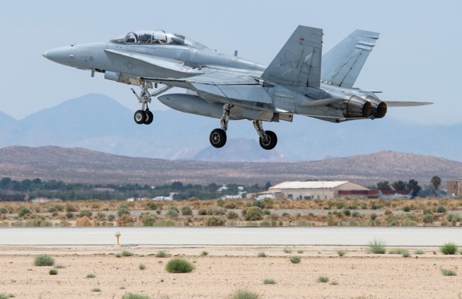
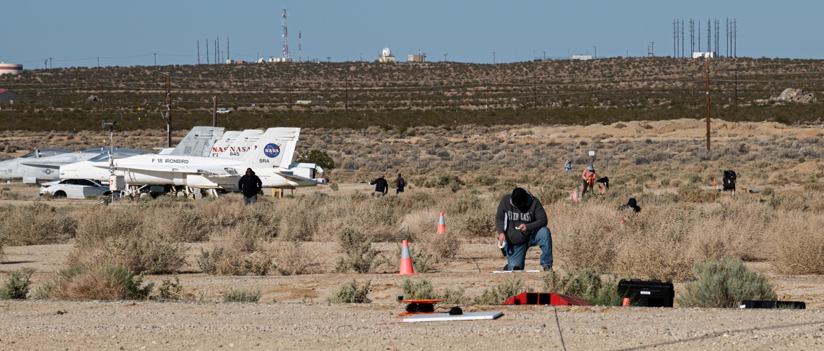
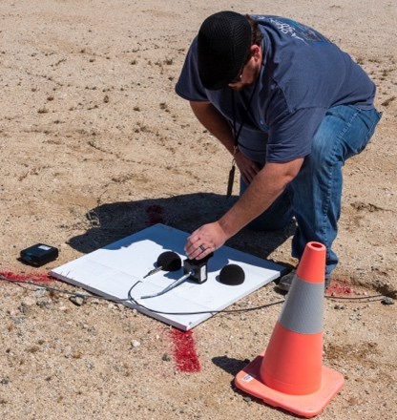
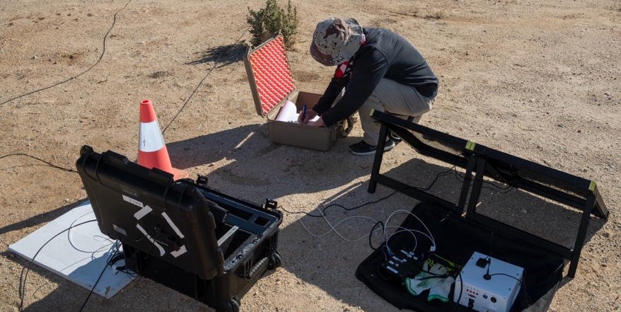
Ground Recording System (GRS) Field Testing, 2022
Four flights, 13-26 April 2022
  21 Passes, 545 booms recorded
  Centerline and offset for evanescent waves
  Headwind and tailwind with N-waves
  Headwind for evanescent waves
GRS data and operations were compared to NASA legacy systems with promising results
Tested two unattended trigger concepts:
  Automated trigger using Automatic Dependent Surveillance-Broadcast (ADS-B)
  Satellite communications trigger
Notes:
GRS field testing

Slide 19
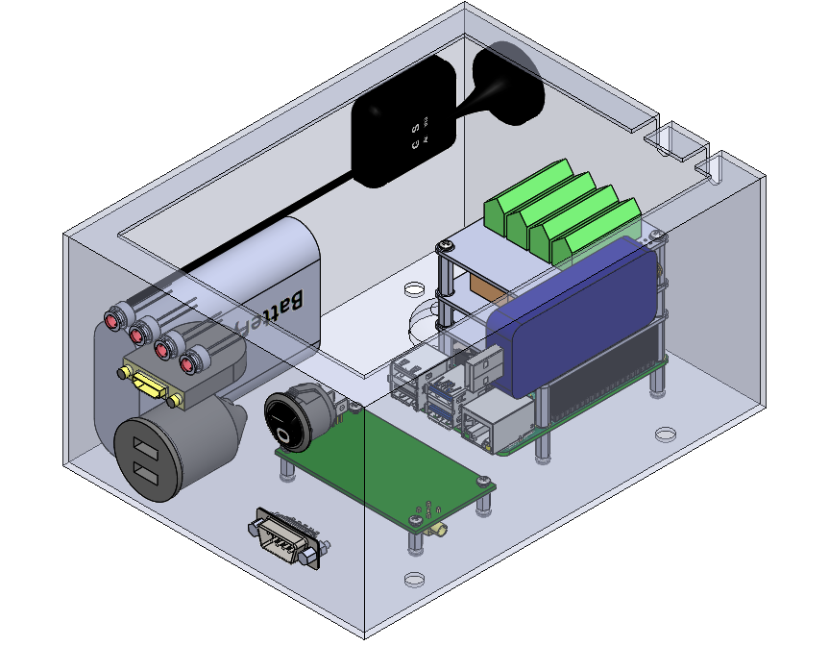
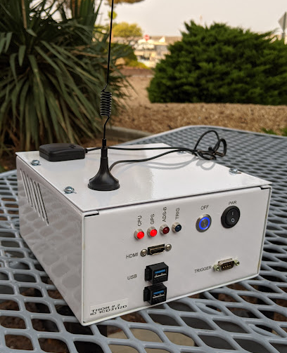
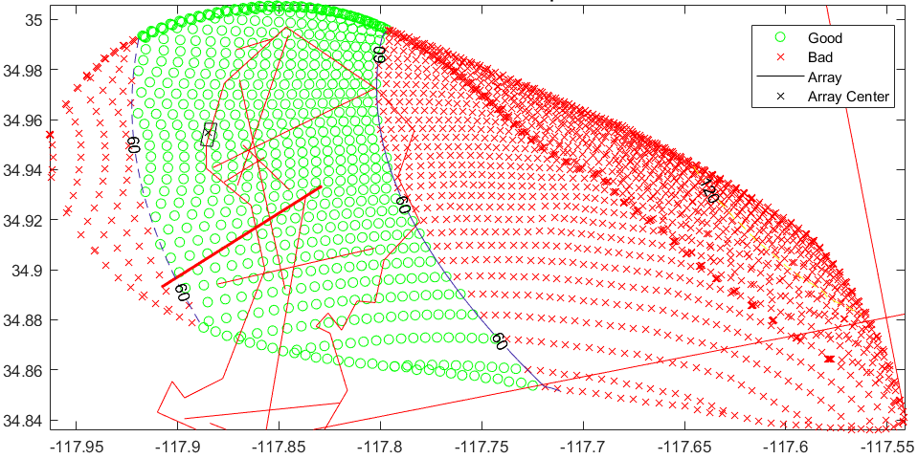
Unattended Trigger System
Nickname: Triggering Hardware and Observation Recorder (THOR)
ADS-B trigger was chosen due to reliability, speed, and operator-out-of-the-loop
The unattended trigger uses passive Automatic Dependent Surveillance-Broadcast (ADS-B)
from aircraft
THOR uses rudimentary, light-weight sonic boom propagation arrival time estimations
Feb. 2021: First live demonstration of THOR triggering with supersonic aircraft
O Standby
X Record
🟦 Recorder location
Flight Direction
Latitude, deg
Longitude, deg
Sonic Boom Carpet – THOR Triggering Timing
THOR Units
Notes:
Four Passes at 33,000 ft,
Mach 1.35
HAMRTime correctly
predicted boom arrival time
with both headwind and
tailwind
Image shows portion of
sonic boom carpet when
THOR issues “record”
command (approx. ± 60s)

Slide 20
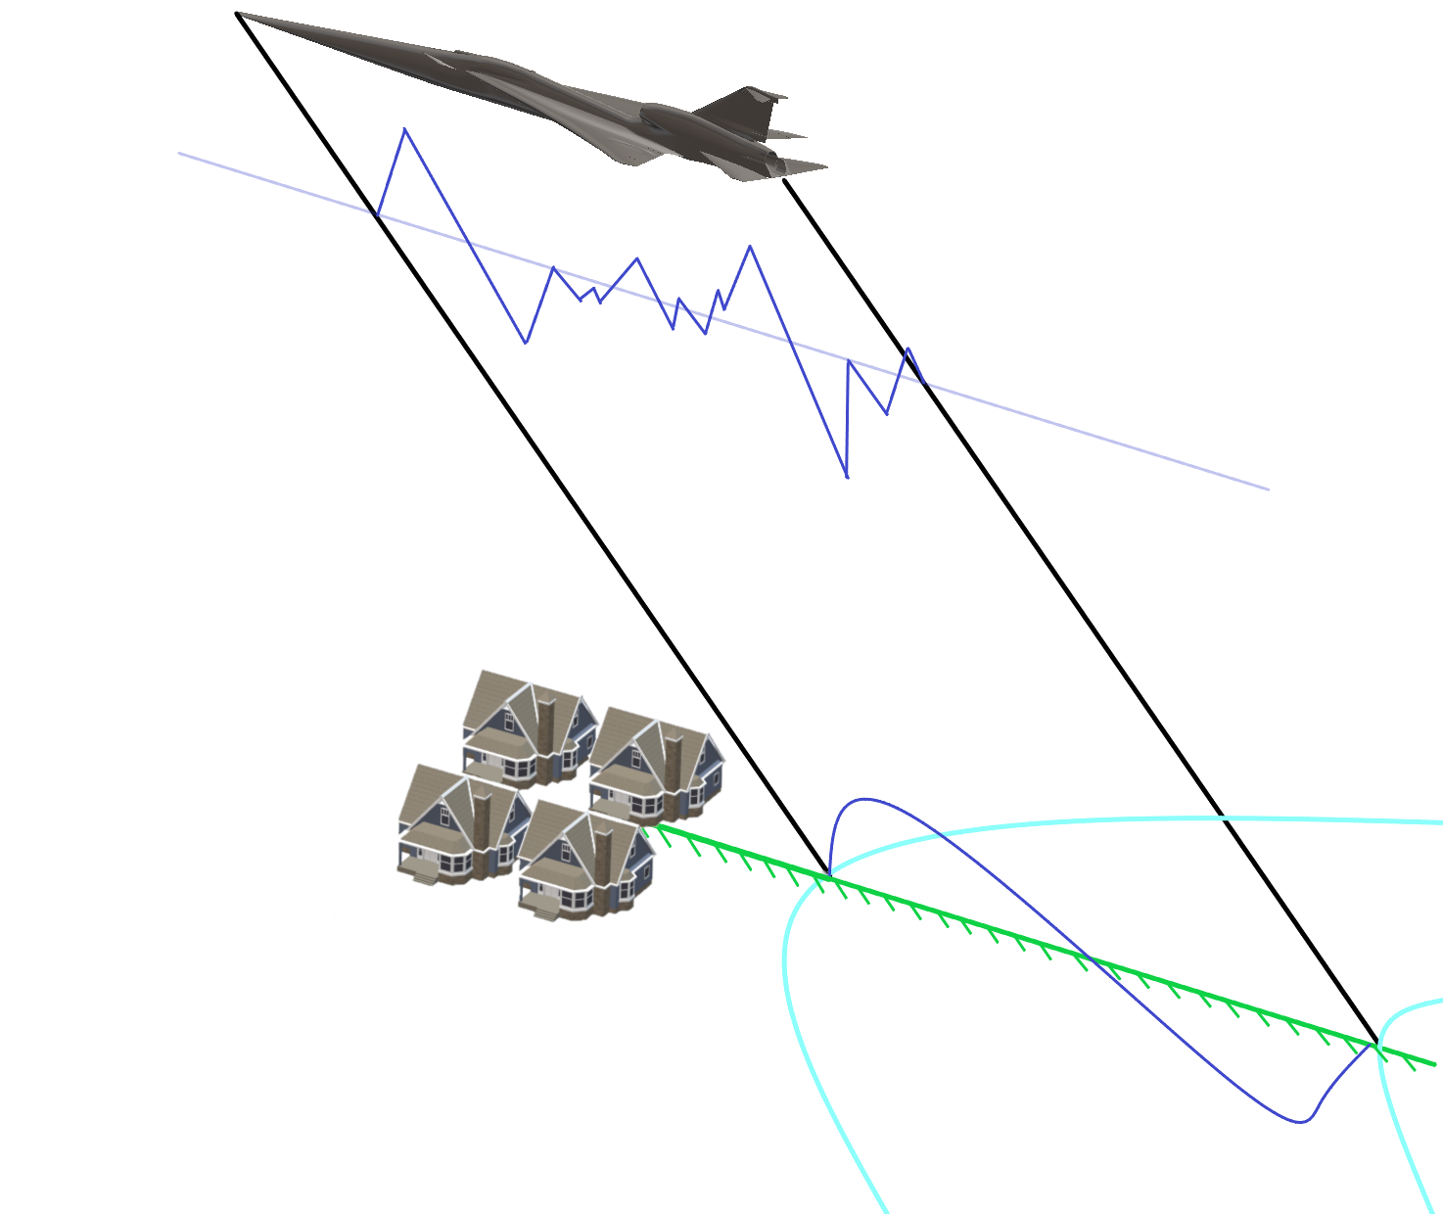
X-59 Sonic Boom Flight Path Planning Tool
Nickname: Community Low-boom Exposure, Operations, Piloting, And Trimming Analyzer (CLEOPATRA)
CLEOPATRA is a flight path planning tool developed for planning Quesst Phase 3 community overflights
  Optimizes flight conditions and aircraft trajectory to meet a desired sonic boom loudness over the test community
Will also be used for acoustic validation flight path planning to guide the pilot where to fly
Uses Gaussian process surrogate model, trained with X-59 CFD data, queried during optimization to provide appropriate nearfield pressure field for sonic boom propagation
CLEOPATRA is also capable of:
  Training the nearfield surrogate model using CFD data
  Determining “trimmed” values of angle-of-attack, engine throttle setting, and control surface positions needed as input to surrogate model
  Applying empirical turbulence corrections to the desired PLdB
  Performing post-flight analysis of as-flown trajectories
Flight Path Design
Trimmed Control Surface Determination
Surrogate Model
Domain
Integrated PCBoom Propagation
Atmospheric Turbulence
Community Response
Prediction
CLEOPATRA
Notes:
Surrogate model input are flight conditions (e.g., Mach, angle-of-attack, etc.) and trimmed control surface positions

Slide 21
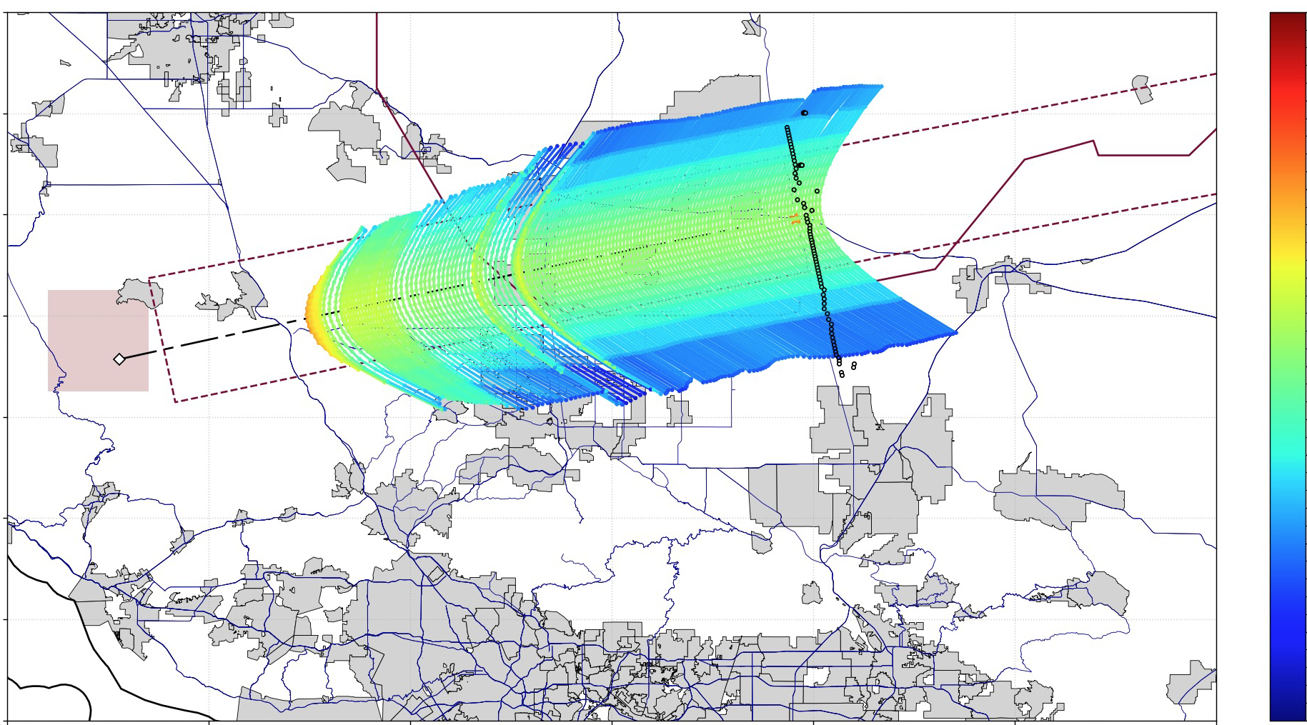
CLEOPTRA Test Point Planning – Acoustic Validation Example
X-59 Flight Path
Microphone Array
Sonic Boom Loudness
Simulation
Input Region

Slide 22
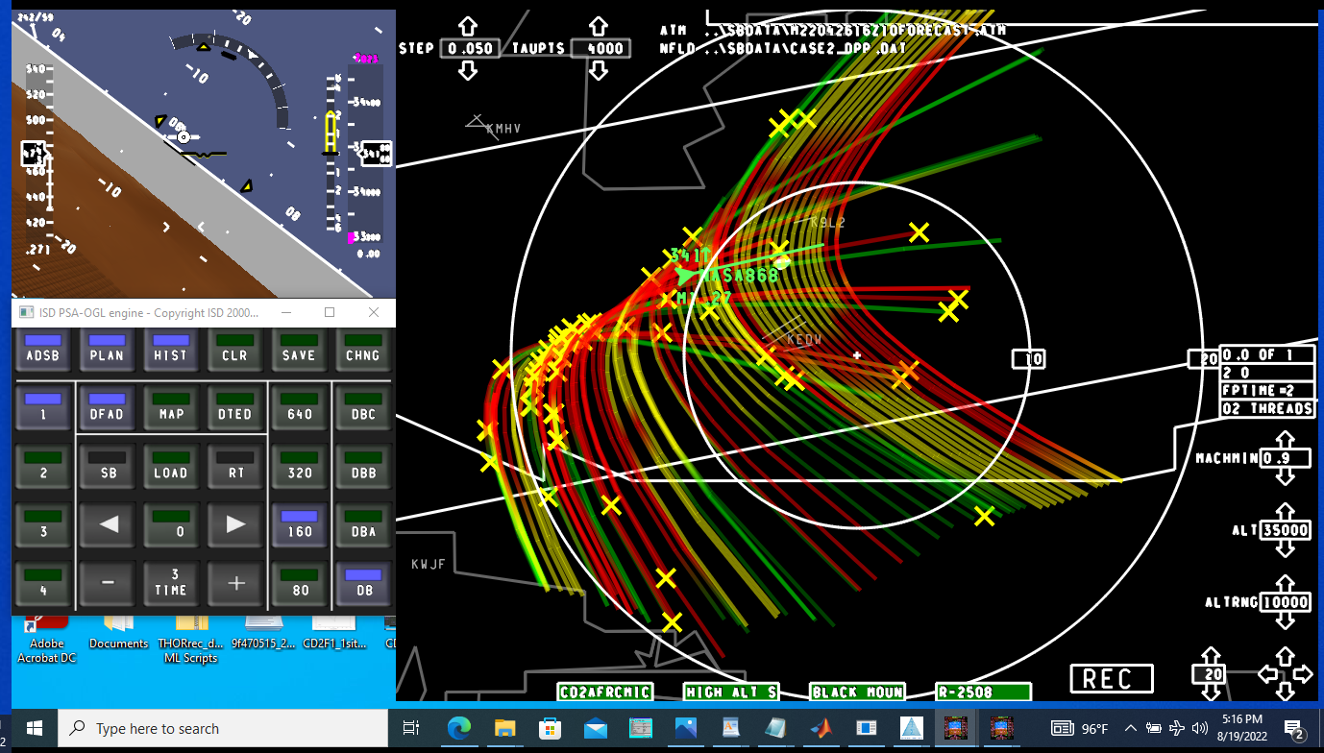
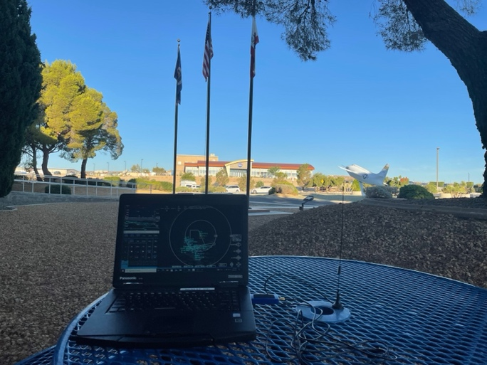
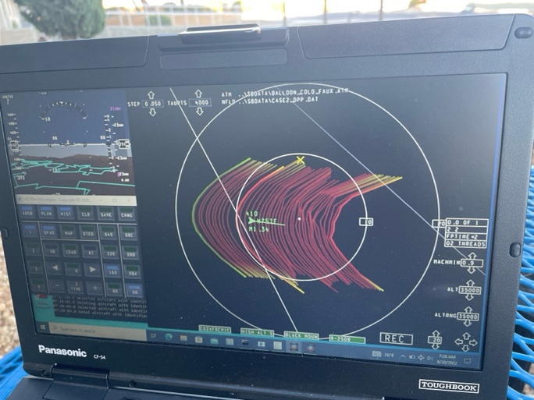
Real-time Sonic Boom Planning
Nickname: Cockpit Interactive Sonic Boom Display Avionics (CISBoomDA)
Provides a real-time sonic boom graphical user interface (GUI) that can be used by pilots and/or control rooms for situational awareness and flight path planning
Computes in real-time sonic boom:
  Location
  Pressure
  Focus
  Metrics
  Arrival times
Various input options: X-59 telemetry, simulator, or ADS-B
Lightweight set-up: PC, ADS-B receiver, antenna, & GPS time
Can track single ship or multiple aircraft
Tested and compared with microphone data with pleasing results

Slide 23
Airborne Systems
Development

Slide 24
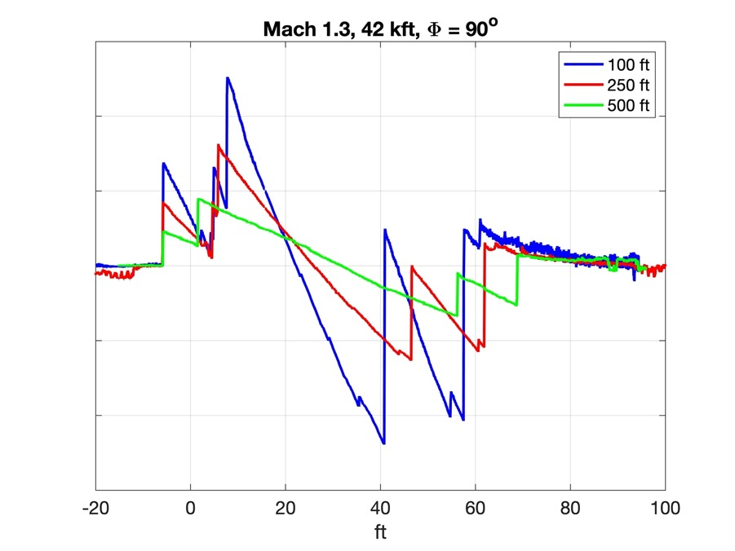
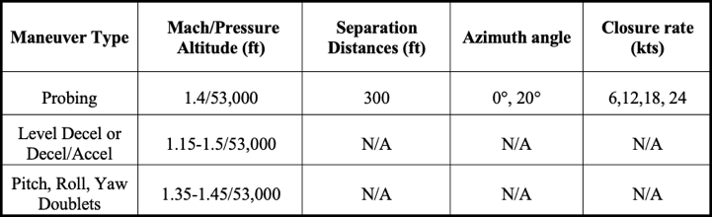
Airborne Near-Field Probing System
Nickname: Shock Sensing Probe (SSP)
Improvement over legacy system. New capabilities include:
  Resolving the very small shock features of the X-59
  Measuring shocks at high altitudes (low static pressure)
  Reduced lag (i.e. faster response rates) to allow more measurements per flight
Pressure transducers are built into the probe, removing the need for long tubing, and related issues
Bow Shock
Exhaust Plume
Upcoming Test Points
SSP Near-field Measurements of an F-18

Slide 25
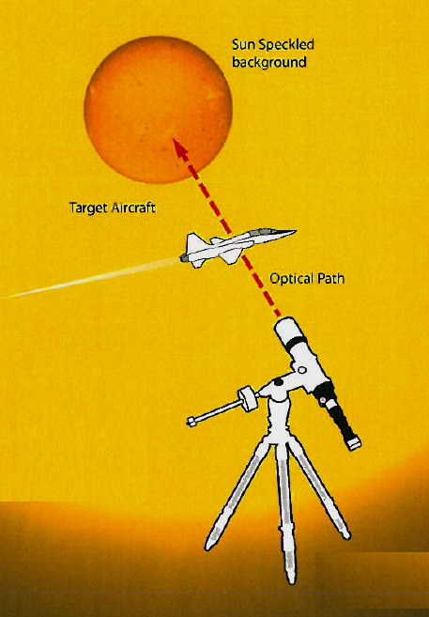
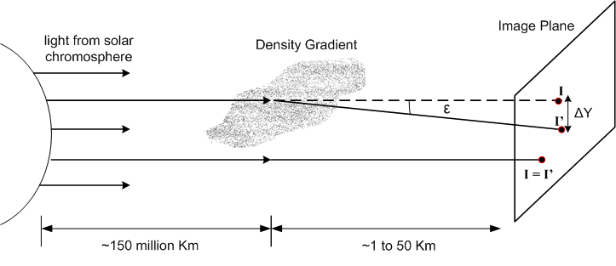
In-flight Shockwave Imagery Systems
All of NASA concepts are based on background oriented schlieren (BOS)
Nickname: Background Oriented Schlieren using Celestial Objects (BOSCO)
Uses narrow band optical filters to give the sun a textured appearance.
The texture allows for the Background Oriented Schlieren method
Ability to image from below and to the side of the target aircraft
Sun speckled
background
Target aircraft
Optical plane
Notes:
NASA STI DAA: 70053

Slide 26
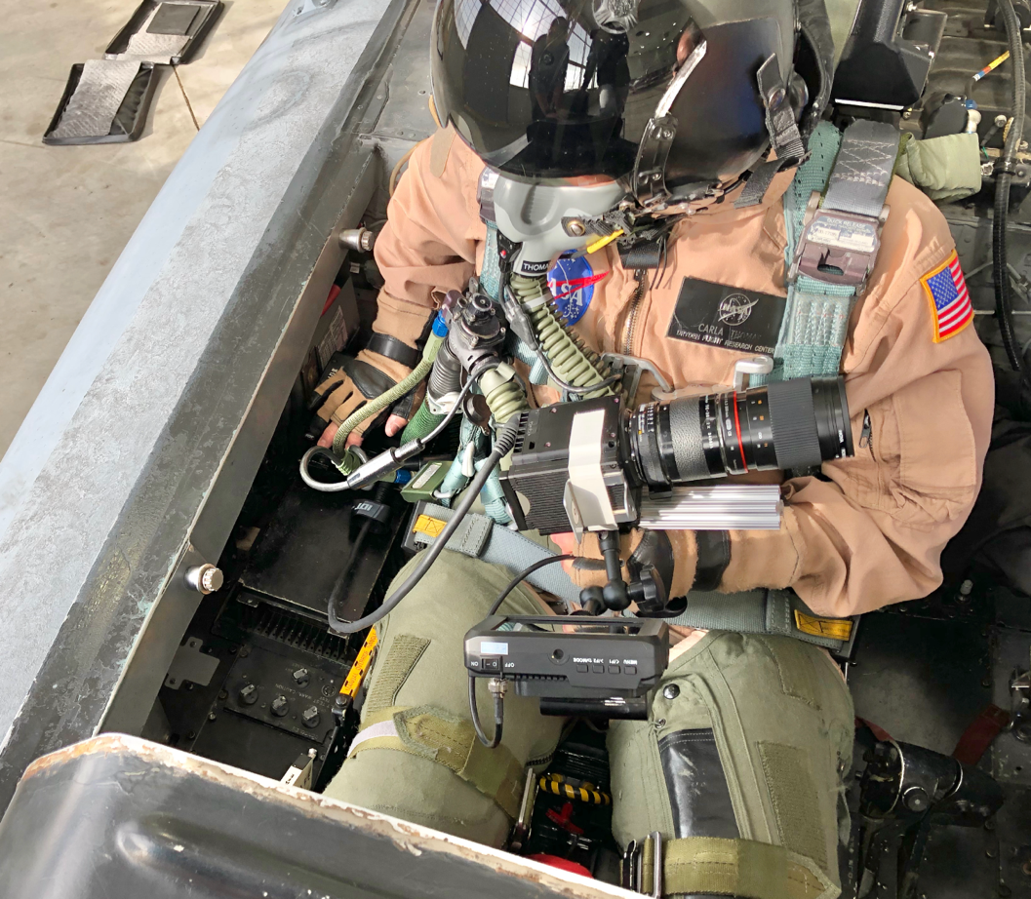
In-flight Shockwave Imagery Systems Concepts
Airborne Schlieren Photography System (ASPS)
  BOSCO technique with a backseat user holding a specialized solar-filtered camera
Limb Background Oriented Schlieren (LimBO)
  Uses a motorized high-speed camera mounted on an aircraft wing, with the edge of the sun providing as distortions
Airborne Background Oriented Schlieren (AirBOS)
  Uses a high-speed camera mounted beneath an aircraft, with distinct geographical features providing distortions (e.g., tumbleweeds in the desert)
T-38 BOS Images
AirBOS Horizon
  AirBOS technique, with the Earth’s horizon providing distortions
AirBOSCO
  BOSCO technique with a motorized, solar-filtered camera mounted on an aircraft wing
ASPS Cockpit Set-up

Slide 27
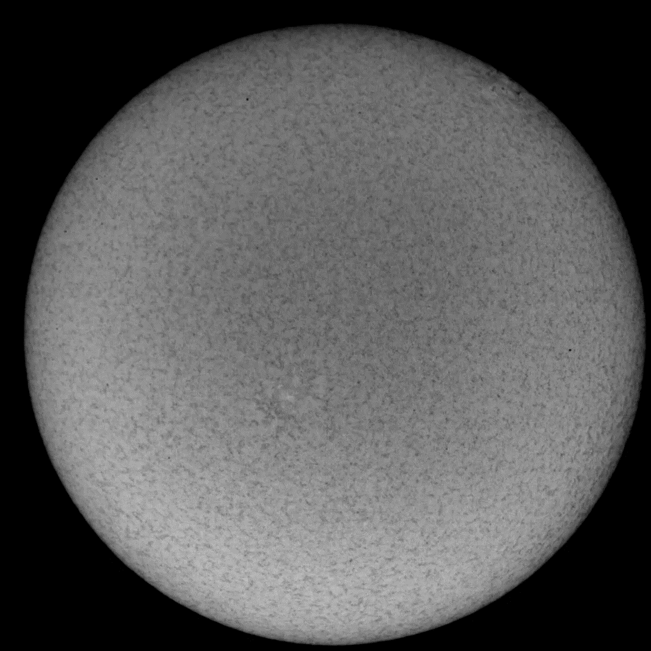
BOS using Celestial Objects – Raw Data
Notes:
NASA STI DAA: 27657

Slide 28
BOS using Celestial Objects – Processed Image

Slide 29
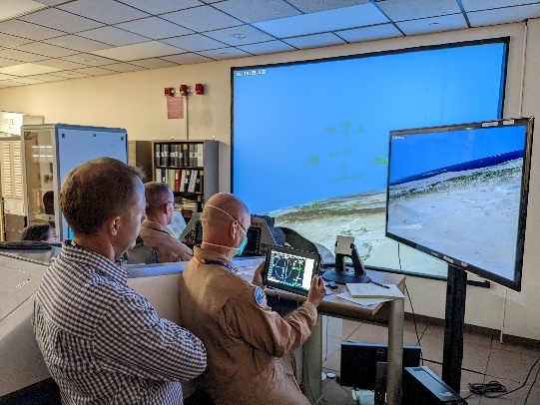
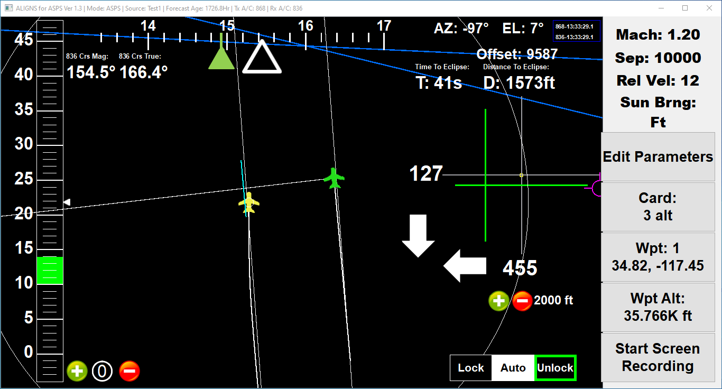
Real-time, Relative Position Pilot Display
Nickname: Airborne Location Integrating Geospatial Navigation Systems (ALIGNS)
Used during dual-aircraft measurements to direct pilot into position:
  Near-field probing – Directs the probing aircraft into appropriate, targeting shock structure of the X-59 aircraft
  Shockwave imagery – Directs the photographing aircraft into location to position X-59 aircraft into field of view in front of background distortion (e.g., Sunspots or Earth’s horizon)
Pilots testing ALIGNS software in F-15 simulator
Upcoming Flights:
  Next ASPS Phase 2 flight using ALIGNS – December 2022
  Next SSP flight using ALIGNS – March 2023
  Next Schlieren flight using ALIGNS – June 2023
ALIGNS v1.2 with moving Map

Slide 30
Acoustic Validation
Test Approach

Slide 31
Acoustic Validation Test Approach Overview
Planned for 2024
X-59 aircraft to be flown at low-boom design conditions and additional flight conditions
  Fly a precise trajectory based on weather data for the boom carpet to hit the microphone array
  TG-14 glider to fly above the atmospheric boundary layer in-line with the X-59 flight path and microphones for turbulence characterization
  F-15 flying in formation to measure and photograph near-field shock structure
Approximately 60 flights
  With two microphone passes per flight or
  One long supersonic pass with several probing measurements or schlieren images
Meteorological measurements at array sites
  Weather balloons launched at takeoff time for post-flight analysis
  Ground weather stations and atmospheric turbulence measurement systems

Slide 32
Acoustic Validation Test Approach (1)
Near-Field shock measurements
  ≈ 65 Total test points (two measurements each)
  ≈ 12 measurements per flight
  Conditions:
    Design cruise
    Control surface/CG/trim optimization
    Off-condition, varying Mach
    New optimal boom condition (if found)
  Primary points are 3 BL separation, 0- and 20-deg phi
  One flight over the microphone array, per flight
Sonic boom carpet characterization
  ≈ 24 measurements, 2 measurements per flight
  Mostly design cruise
  High PLdB points (Mach 1.3, 43 kft & Mach 1.4, 46 kft.)
Acoustic Validation 2A Near/Mid-Field Probing 2B Far-Field & Ground Measurements 2C Schlieren Shockwave Imaging Total: | 20 30 10 60
Planned Mission Flights

Slide 33
Acoustic Validation Test Approach (2)
Mid-field shock measurements
  ≈ 8 measurements, 2 measurements per flight
  (could improve with updated ALIGNS)
  Design cruise
  20 kft separation, 0- and 25-deg phi
Focus measurements
  ≈ 12 measurements, 2 measurements per flight
  Repeatable transition focus
  (could include push-over focus)
Turbulence measurements
  ≈ 12 measurements, 2 measurements per flight
  Design cruise, varying turbulence levels
Shockwave imaging (schlieren)
  ≈ 8 measurements, 2 measurements per flight
  Design cruise
Acoustic Validation 2A Near/Mid-Field Probing 2B Far-Field & Ground Measurements 2C Schlieren Shockwave Imaging Total: | 20 30 10 60
Planned Mission Flights

Slide 34


Any Questions?
34

Slide 35
Backups

Slide 36
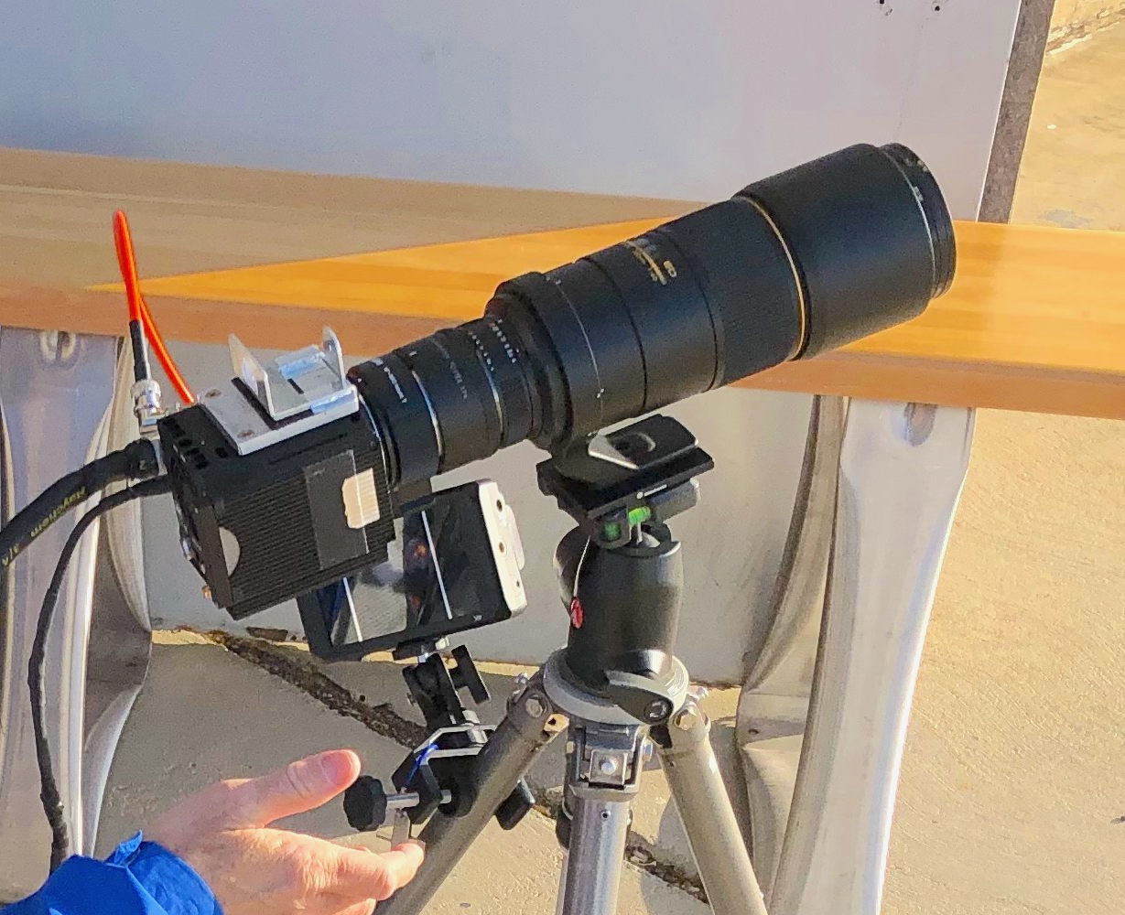
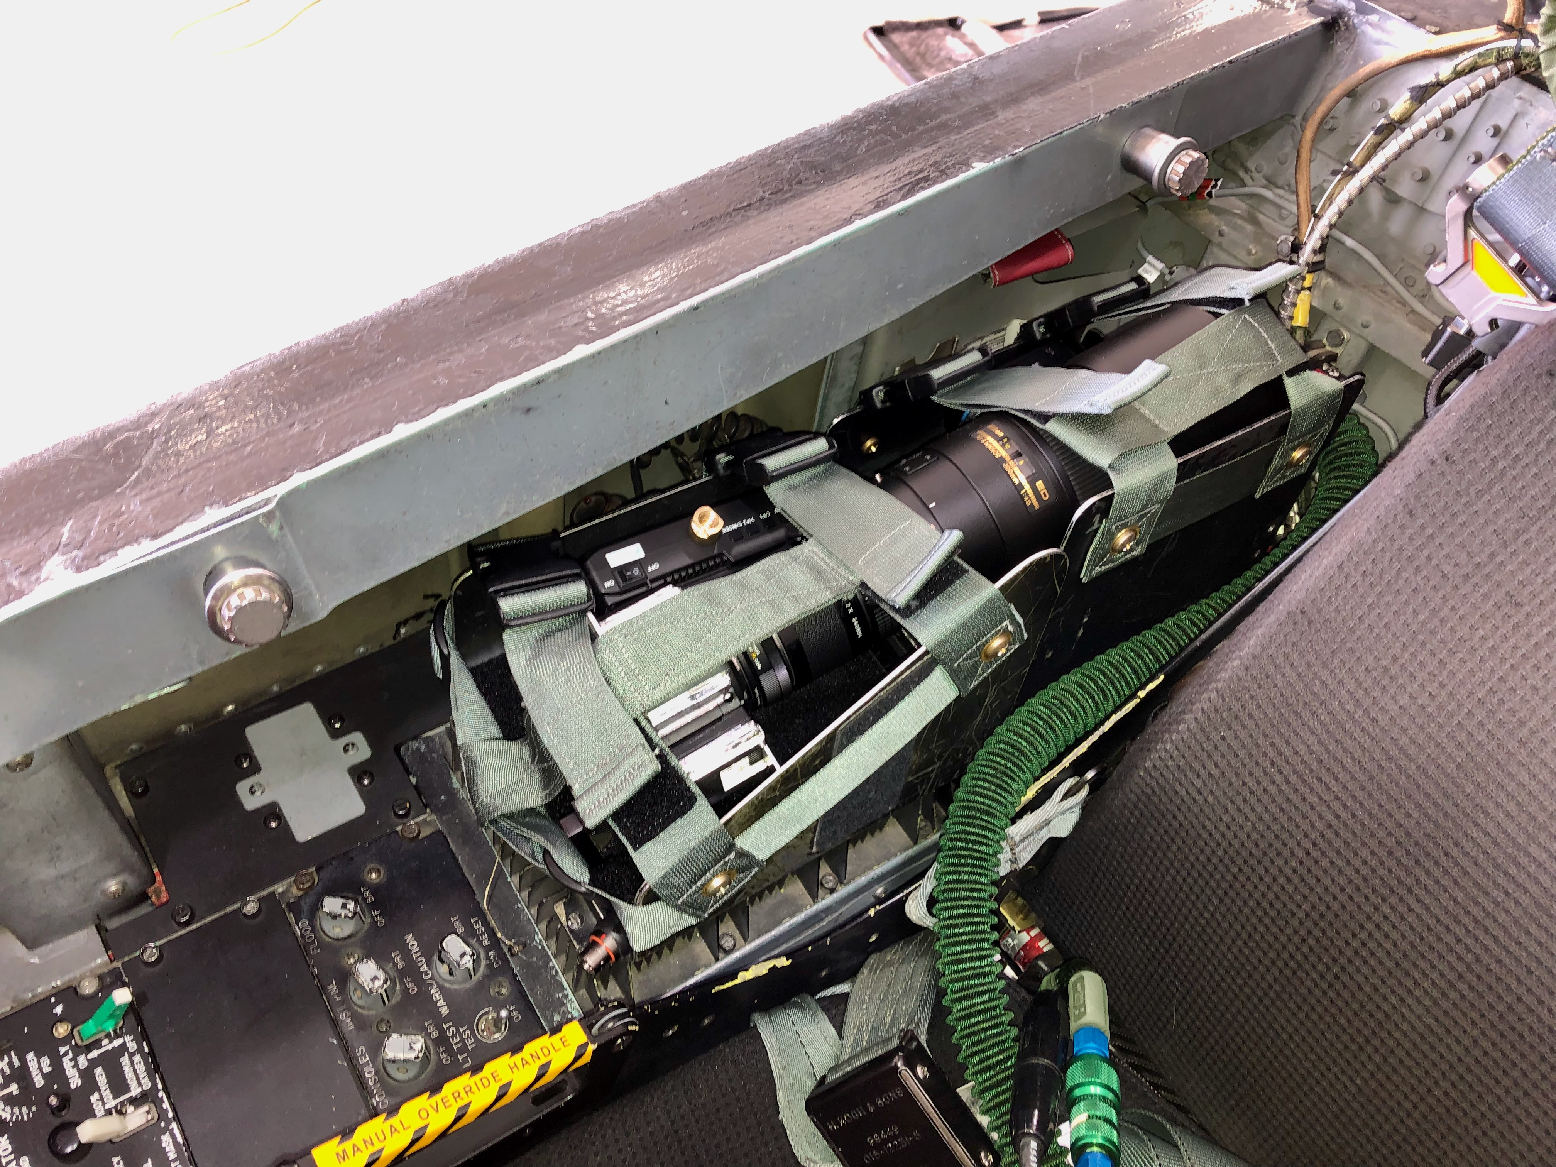
ASPS Set-up
IDT O10 camera (same as for ATIMS-V pod)
  Monochrome
  9 pixels for every 1 TS3 pixel
300mm Nikkor lens
Nikon C-M43 III 1.4X teleconverter
Solar filters (ND 1.8 + 1.8)
IR/UV cut filter
Separate articulating monitor and battery
Trigger grip
Gunsight alignment fixture
Support bar
Power/data hub
Camera battery
Current Lens
Gear Stowed
One trigger press
  Takes 20-second burst of 125 fps images
  Downloads data to SSD, 22 seconds
  Recycles for a new burst, 31 bursts total

Slide 37
CLEOPATRA Software Architecture
Software split into four operating modes: Train, Lite, Prime, and Post-flight:
“Train” Mode
Construct surrogate model from provided CFD database
Feeds into
Feeds into
Feeds into
“Lite” Mode
Used for pre-flight planning
  Quesst Phase II specific (and beyond)
Determines “optimal” trajectory placement needed to meet mission objective
  Example objective: place undertrack boom at (x, y)
  Only modifies a trajectory’s initial point and heading angle
Can be used without CFD surrogate model
“Prime” Mode
Used for pre-flight planning
  Quesst Phase III specific
Determines “optimal” cruise conditions (Mach, altitude, heading) to achieve desired loudness objective
  Surrogate modeling used to approximate CFD solution of trimmed aircraft nearfield cylinder for boom propagation
  Atmospheric turbulence can be accounted for
“Post-flight” Mode
Used for post-flight analyses
Utilizes measured data (e.g., trajectory, control surface positions, weather) to provide best prediction of conditions experienced
  CFD Surrogate model employed in a point-wise manner along trajectory to approximate “as-flown” nearfield conditions
“Where to fly”
“Where and how to fly”
“How loud do we think we were?”

