Slide 1
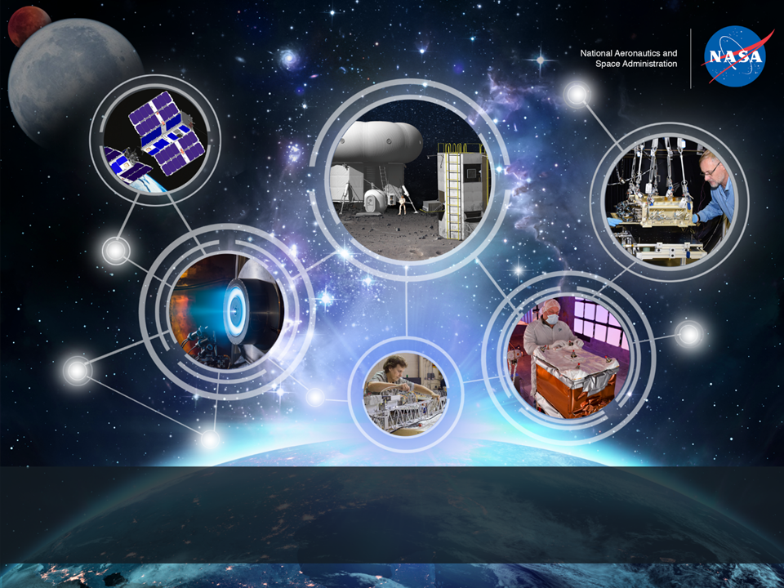
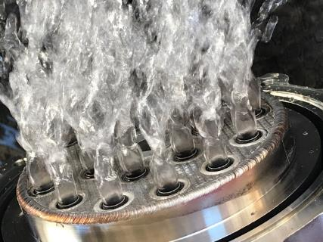

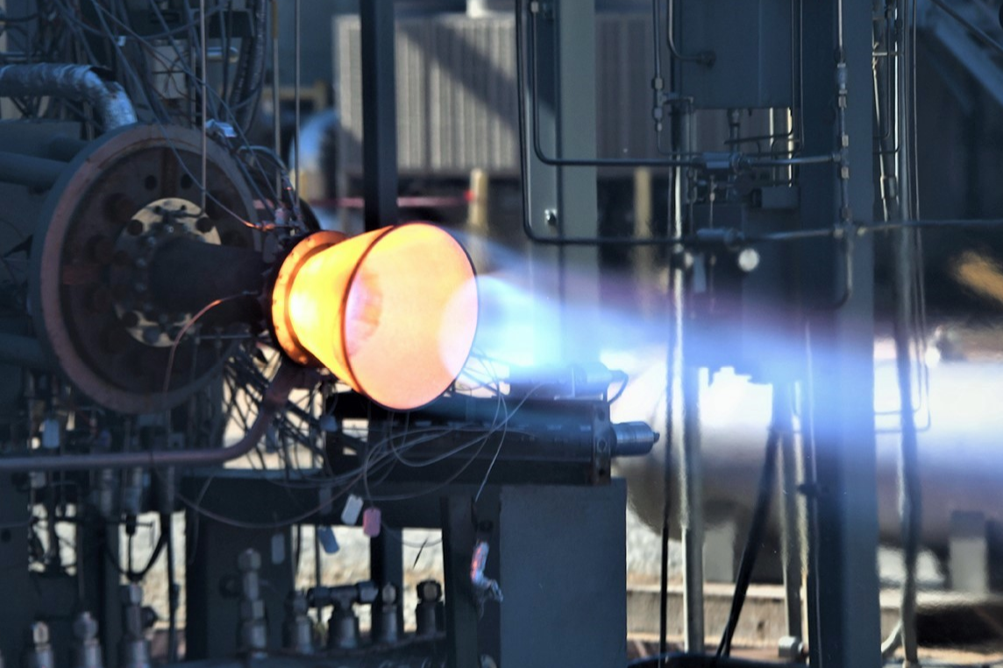
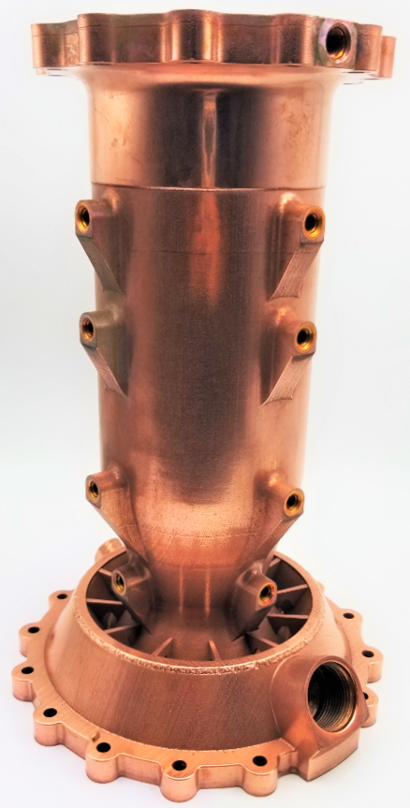
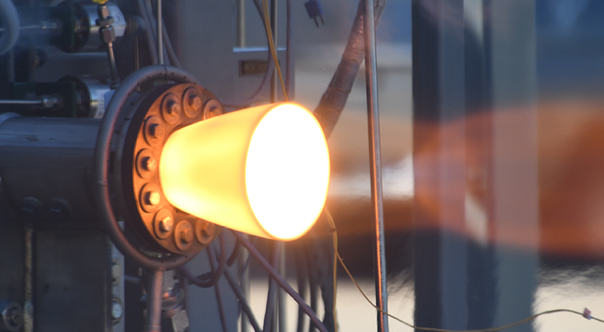
Current State of NASA Continuously Rotating Detonation Cycle Engine Development
2023 AIAA Propulsion and Energy Forum, January 23-27, 2023
Thomas Teasley*, Tessa Fedotowsky*, Paul Gradl*,
Dr. Benjamin Austin^, and Dr. Stephen Heister^.
*ER13 Combustion Devices | Marshall Space Flight Center | 1/26/2023
^IN Space, LLC and Purdue University
This material is a work of the U.S. Government and is not subject to copyright protection in the United States.

Slide 2

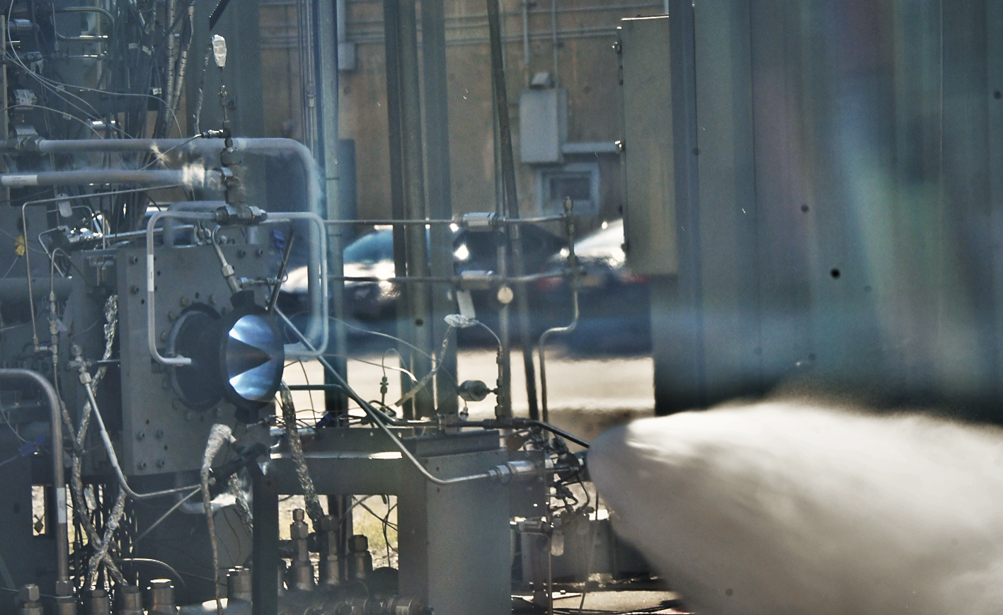
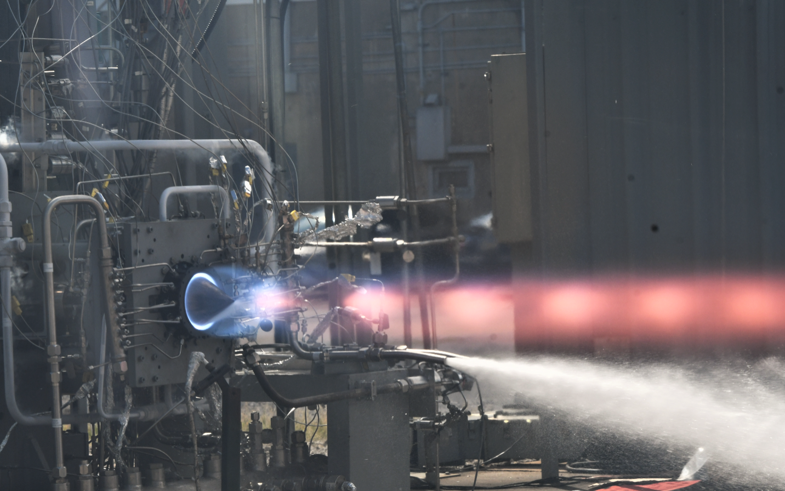
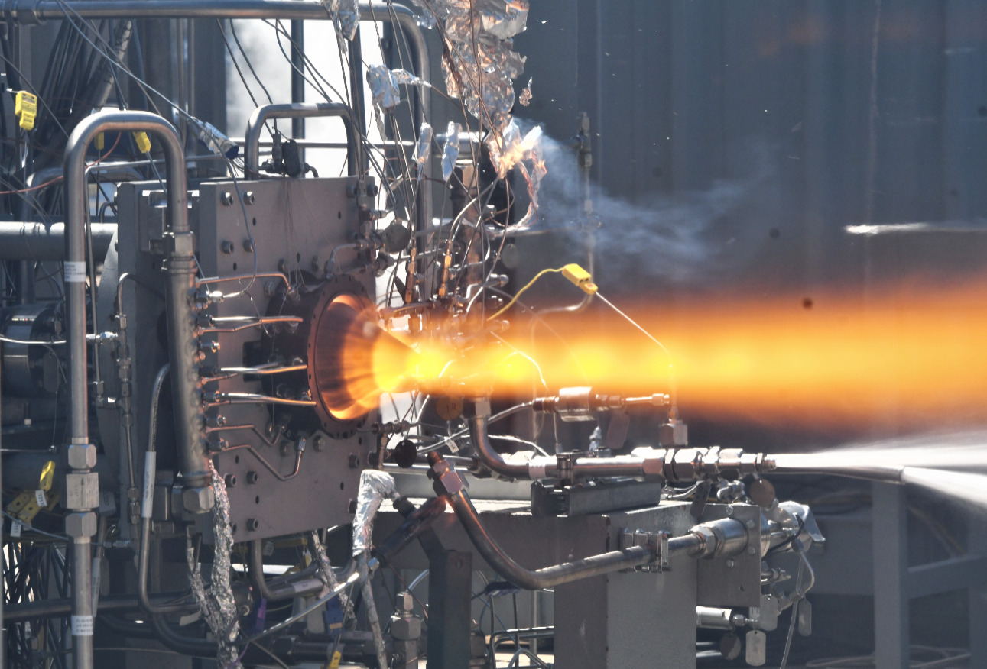
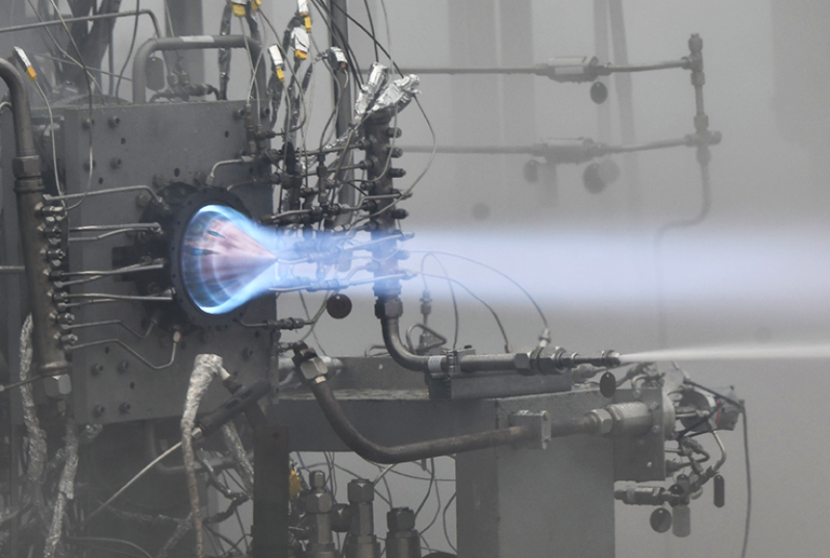
Introduction
Original Project Goal: Demo AM GRCop-alloys RDRE with wave modes >100s.
Top Left: High pressure test at 622 psia, MR 3.74, 4180 lbf, 4-5 co rotating detonation modes.
Top Right: Direct Injection Liquid Oxygen/ Liquid Methane 2-3 co rotating detonation modes.
Bottom Left: First ignition using additive calorimeter chamber.
Bottom Right: First successful throttled test with detonation modes.

Slide 3
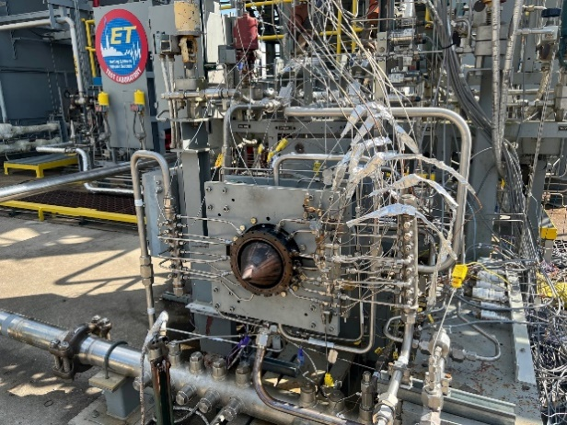
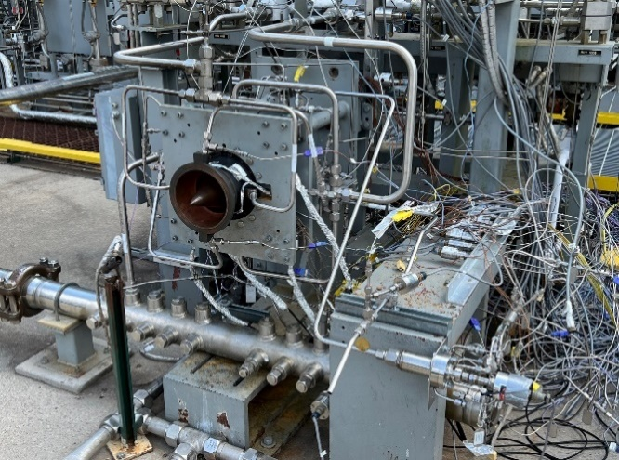
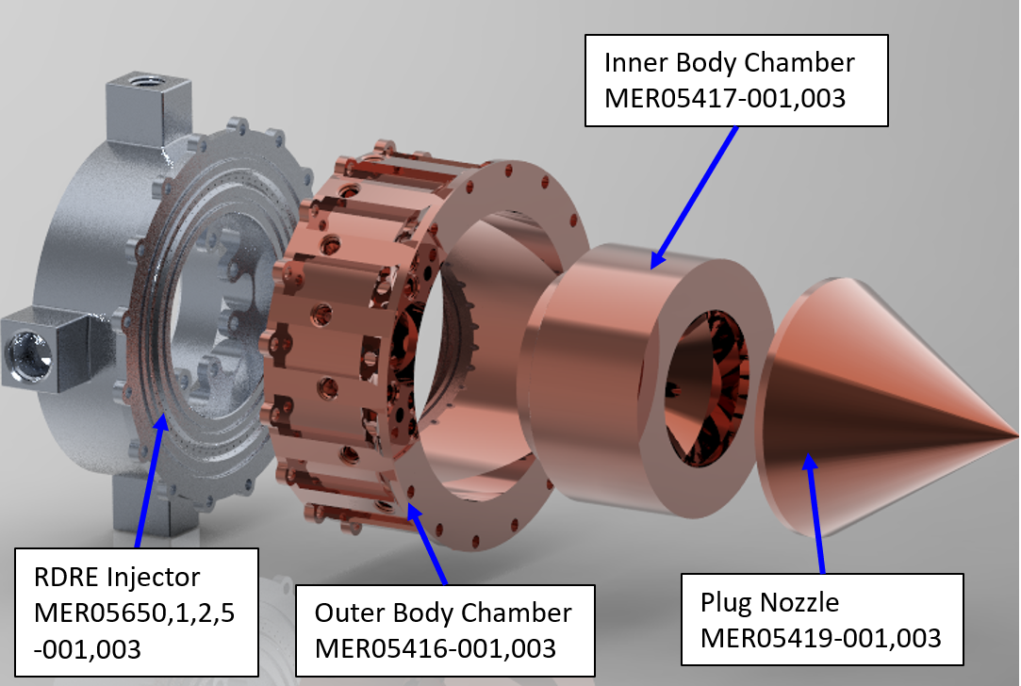
Chamber Geometry
2 Chamber variations: V1 calorimeter with radial cooling channels, V2 traditional axial running coolant channels.
Gap width of 0.33”, length of 2.75, OB diameter of 6.25”.
Universal injection design.
2 ignition configurations: internal and external.

Slide 4
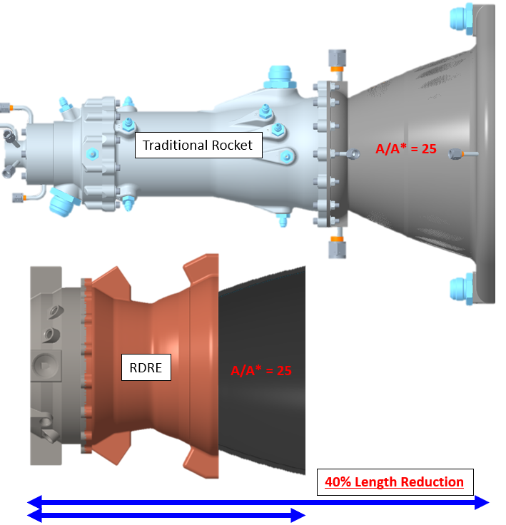
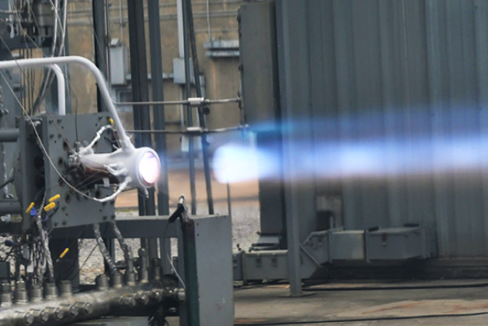
Chamber Geometry - Scale
WHALE CP Lander
RDRE V2

Slide 5
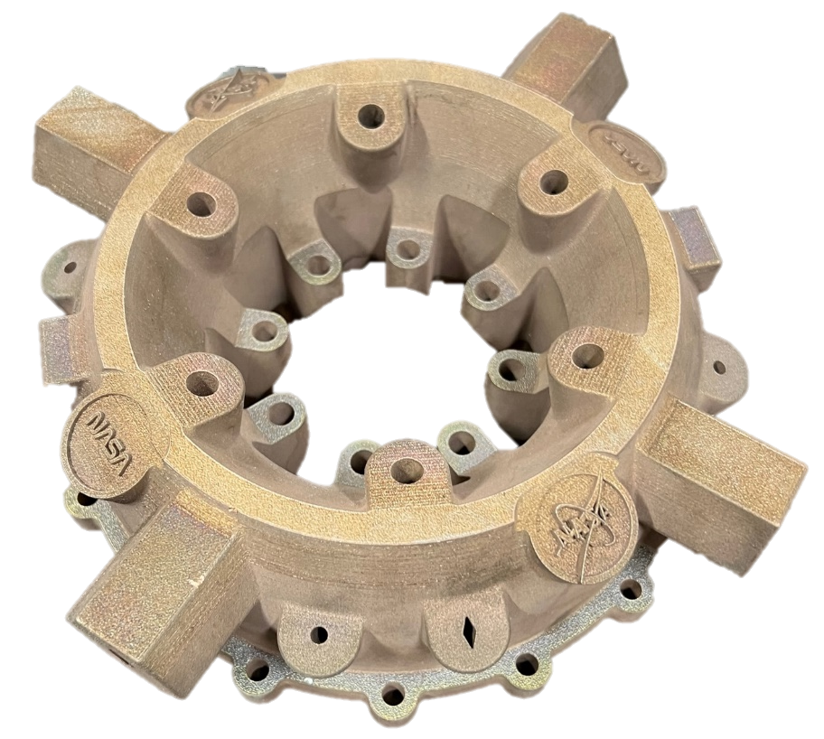
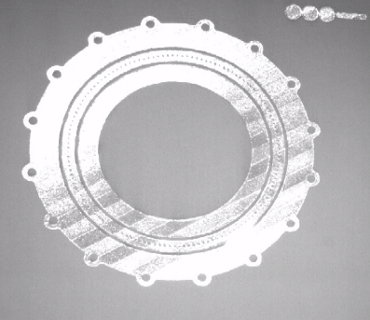
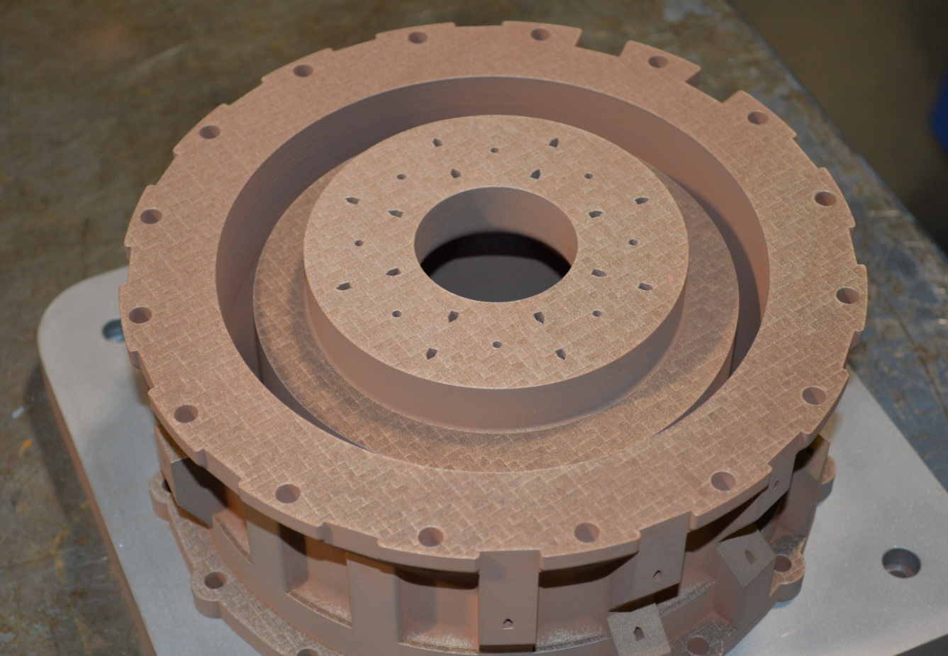
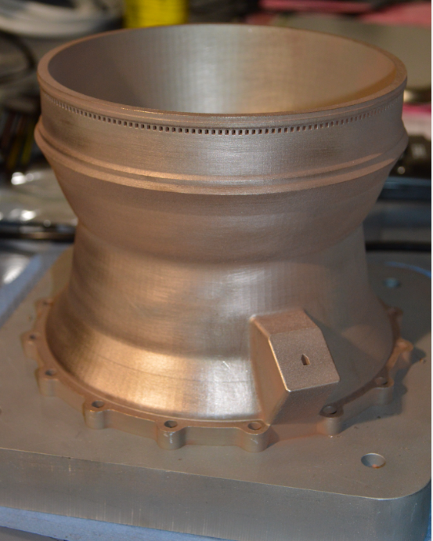
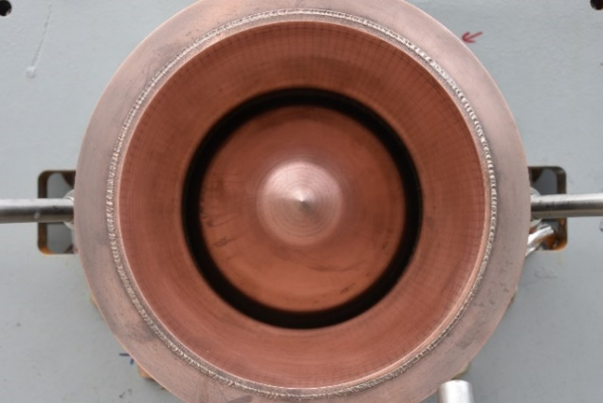
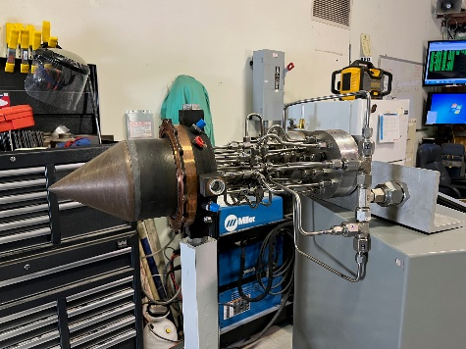
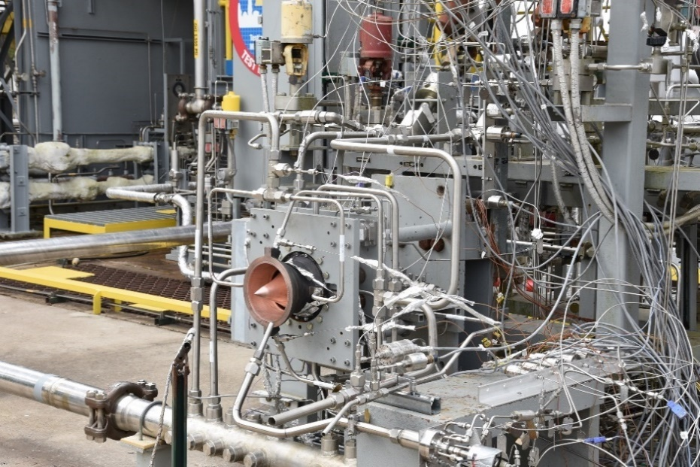
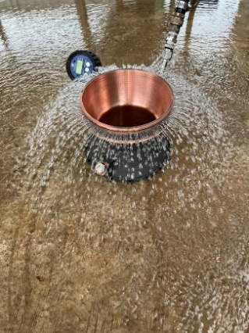
Print and Post Processing of Hardware
Produced using AM L-PBF process.
Powder removal, EDM, Heat treatments, machining, welding, proof testing, flow testing, polishing, and assembly.

Slide 6
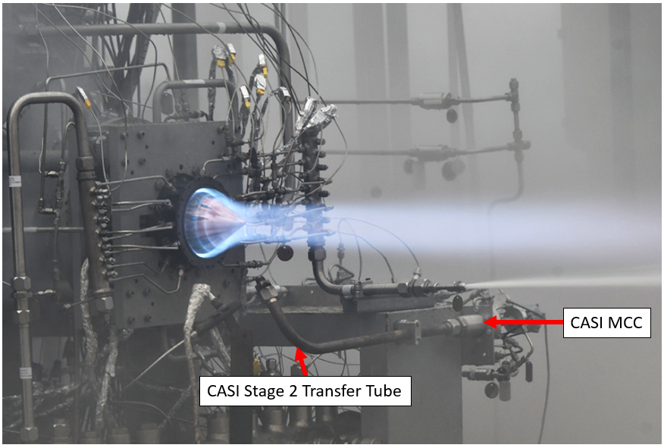
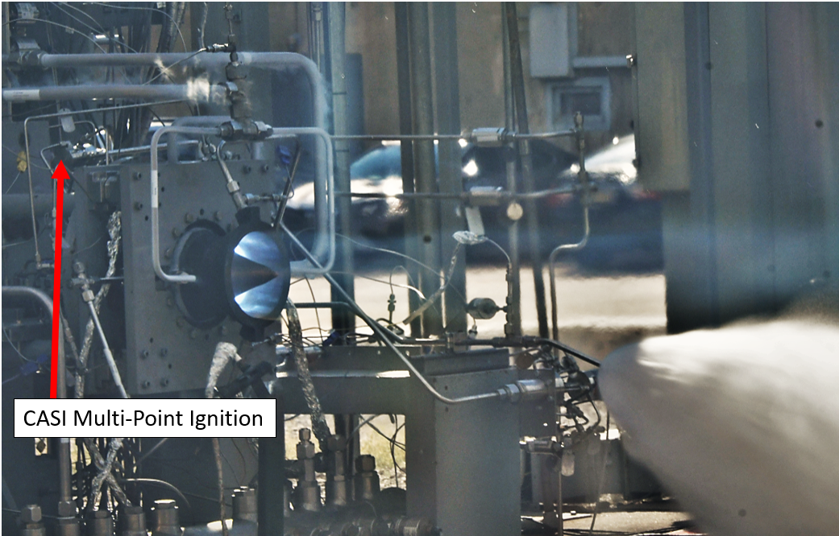
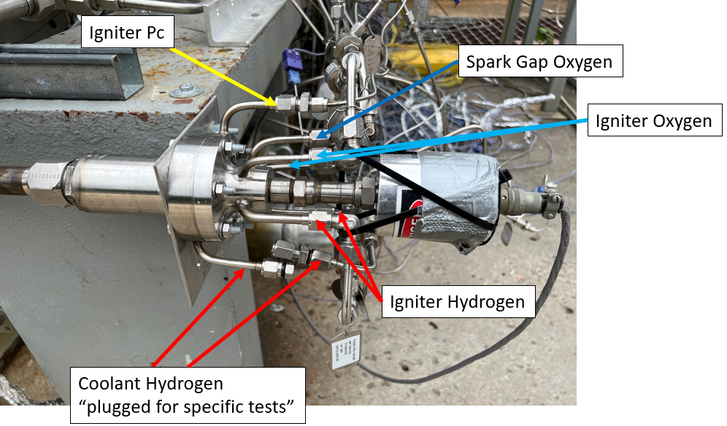
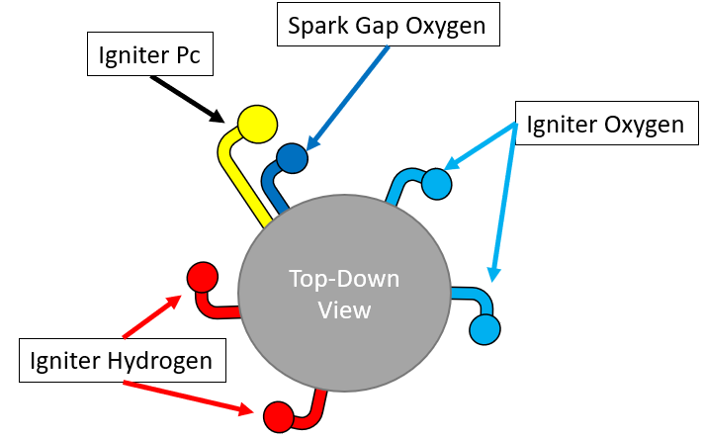
Ignition Methodology
NASA compact augmented spark igniter: external and internal ignition.

Slide 7
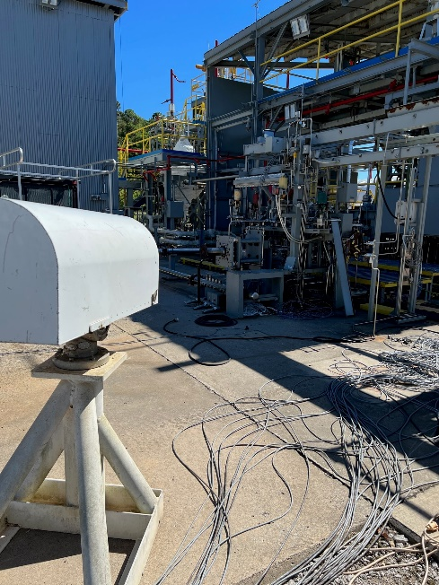
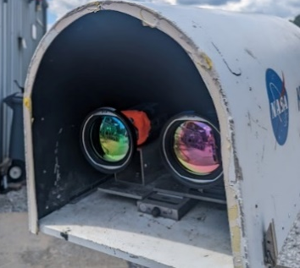
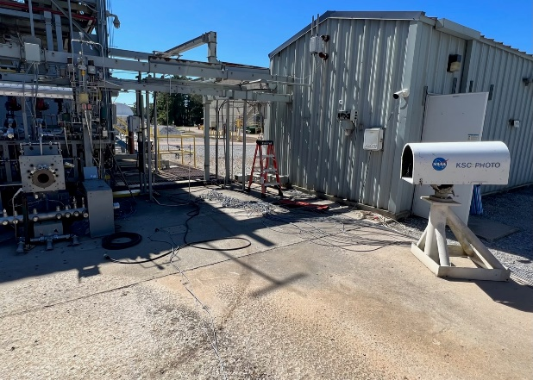

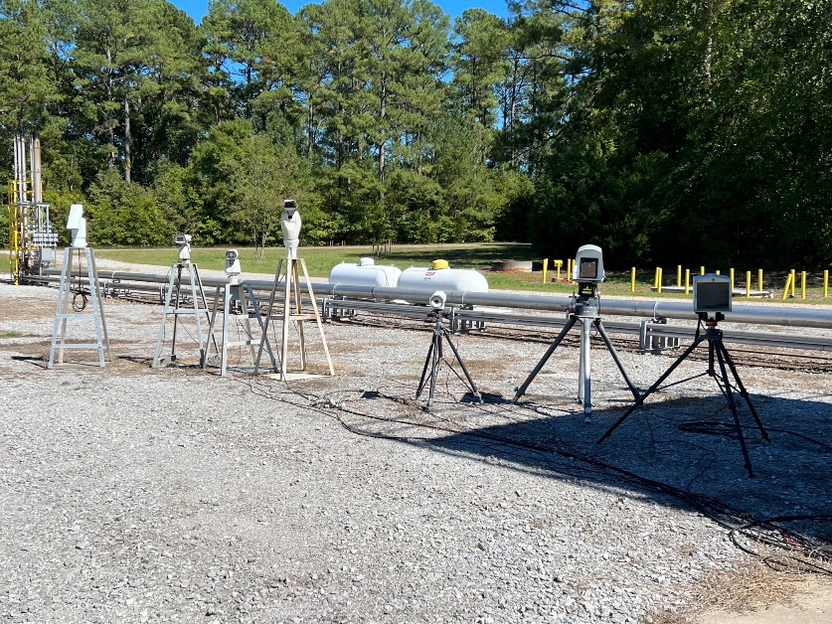
Instrumentation and Diagnostics
FLIR
3X High Speed Phantoms.
1X FLIR imager: high and low temp regimes.
High-definition video.
GoPro and DSLR stills.
Pressure and temperature measurements throughout the test article.
4X CTAP ports evenly spaced on the injector face.

Slide 8

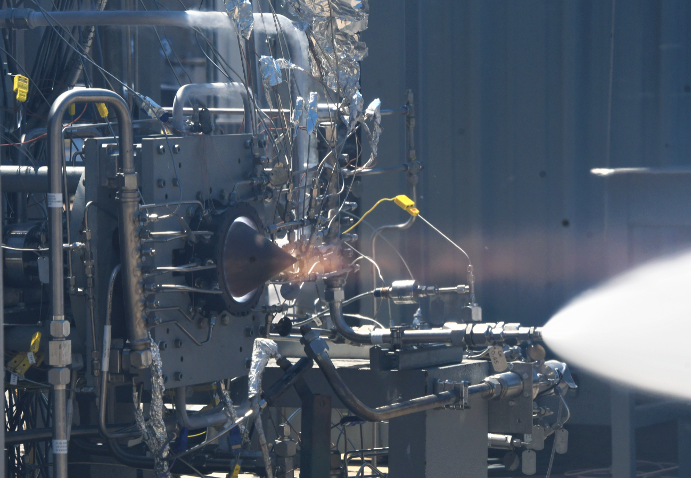
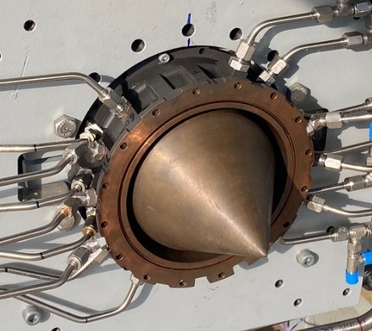
Phase 1: Hydrogen Tests
Overcooling with DI water better for unknown heat fluxes.
Direct injection of gaseous H2/liquid Ox.
Likelihood of deflagration dominated environment based on previously reported experimental results would give constant pressure cases for direct comparison.
Only tested with V1.
Ignition
Mainstage

Slide 9
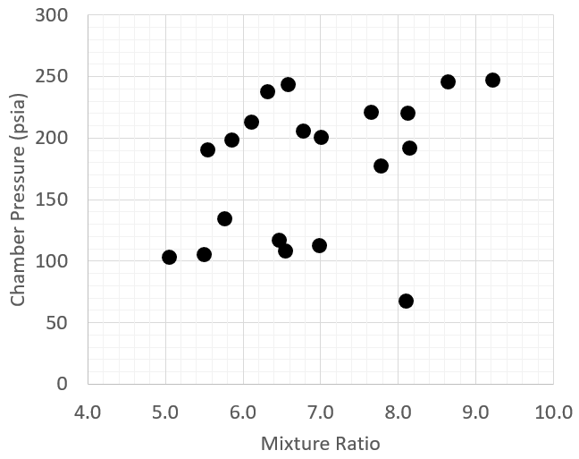
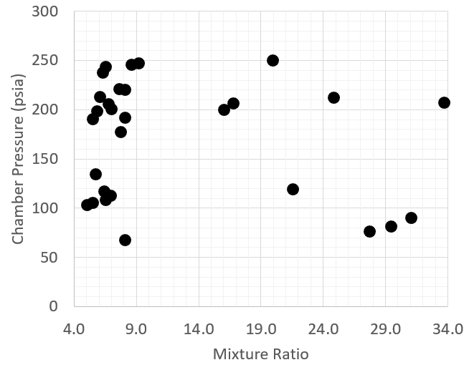
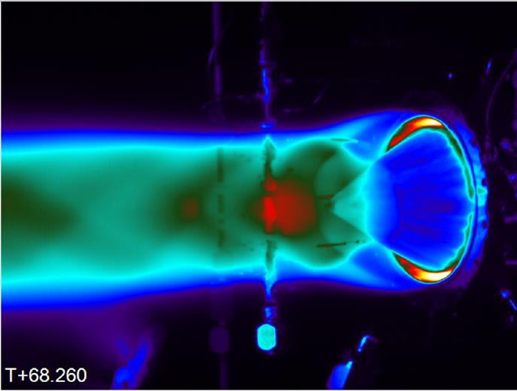
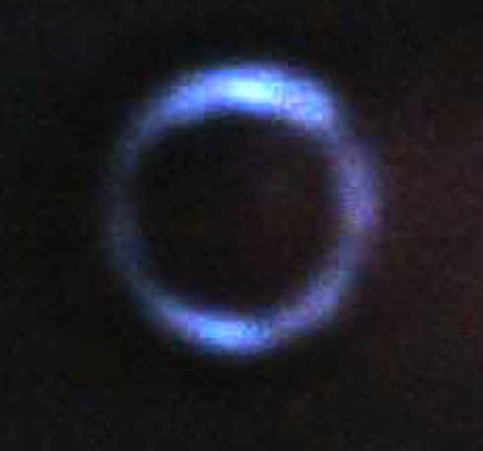
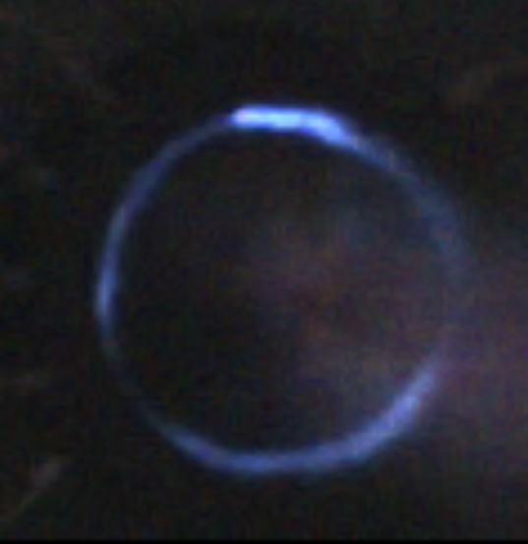
Hydrogen Heat Flux
Low MR Range
Full MR Range
Hydrogen Test Map
No visual evidence of wave activity confirmed under phase 1.
High speed manifold pressures uncertain. Limited to 100K sps.
Completion of combustion, C*, was extremely high relative to the L* and L’.
Lead-in hydrogen/LOX using V2 chamber did show wave activity at ignition prior to CH4 injection.
Flame Holding
V1
V2
Test 006 – GH2
Test 016 – Pre-CH4

Slide 10
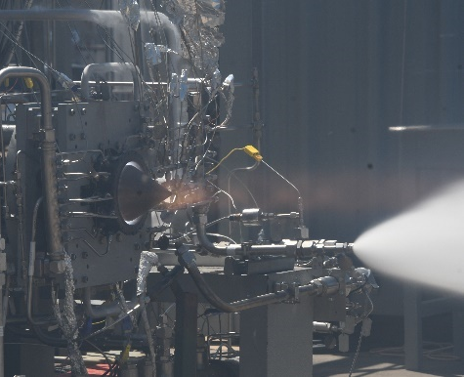
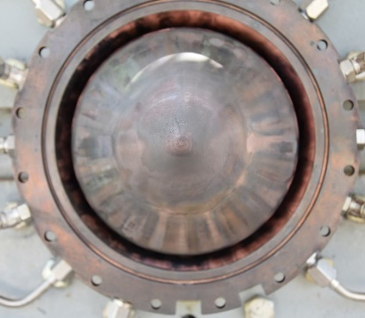
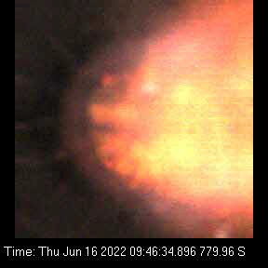
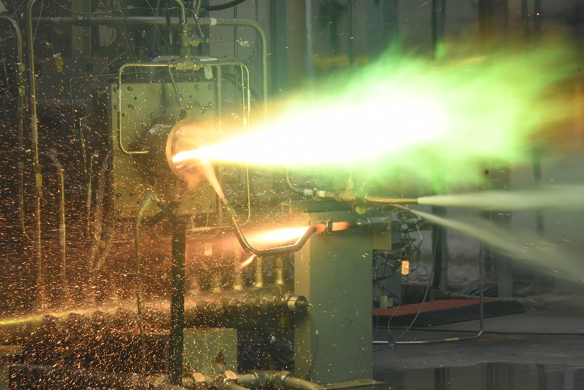
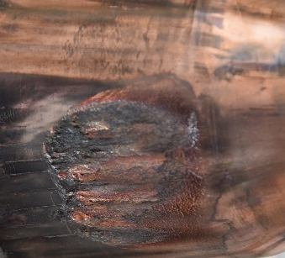
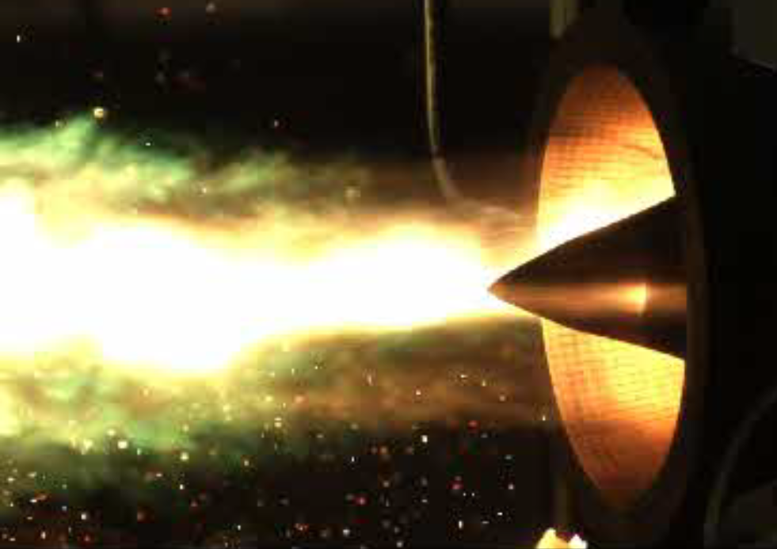
Phase 1: Hydrogen
Gaseous hydrogen and liquid oxygen direct injection.
Advantage: independent of heat load, overcooling of hardware with DI-water.
No wave activity confirmed in the high speed.

Slide 11
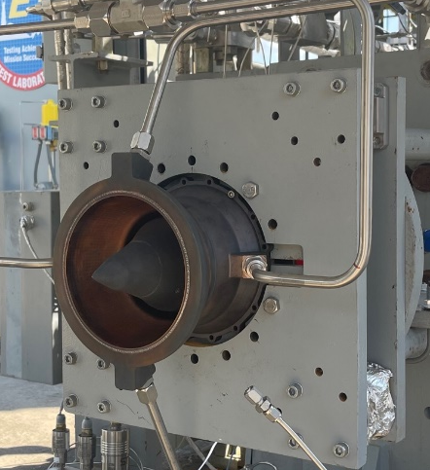
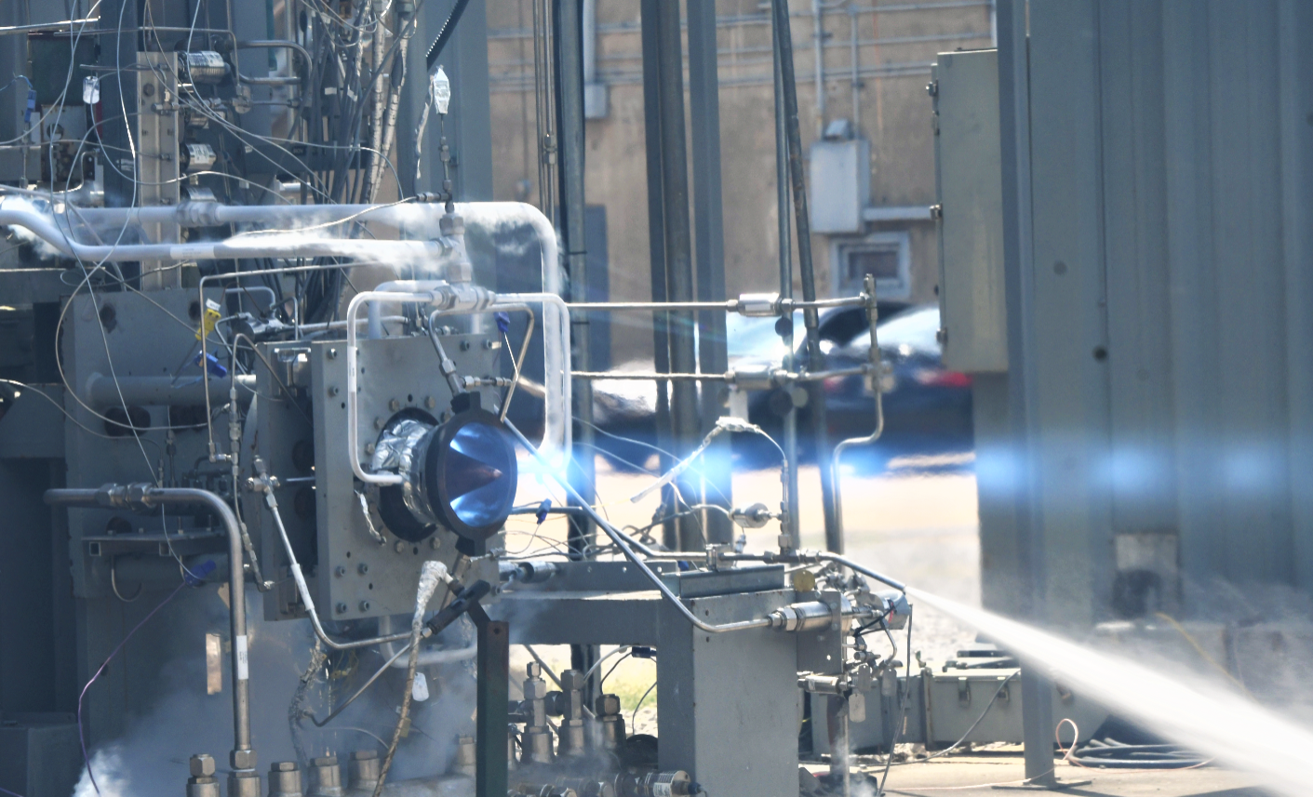
Phase 2: Methane Tests
V2
Tested both V1 and V2.
V1

Slide 12
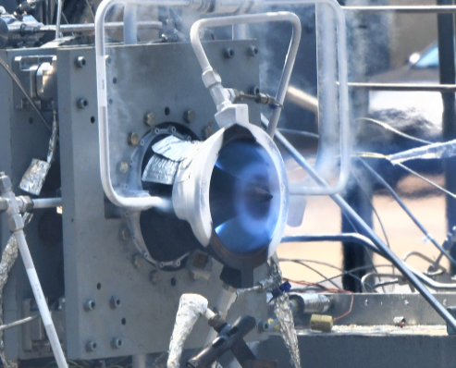
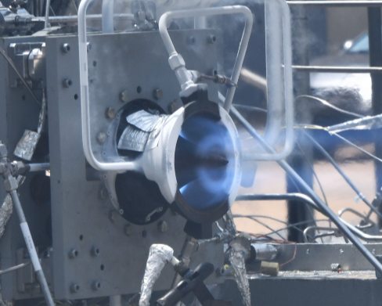
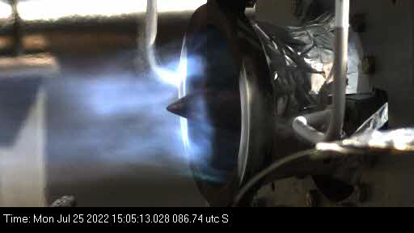
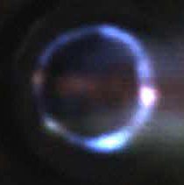
Phase 2: Methane
Hydrogen lead in ignition did show detonation activity before methane injection, 2-3 co/counter modes.
The transpiration injector yielded 4-5 co-rotating waves and blew out permeable structure near fuel inlet ports 30 seconds into the test. Still showed wave activity even after this event.

Slide 13
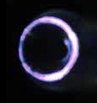

Phase 2: Methane - High Pressure Test Case
A single high-pressure test was conducted up to 622 psia at MR 3.74 with subsequent throttle points.
4-5 co rotating waves observed regardless of MR or throttle point.
Significant deflagration between wave nodes.
High force on inner body ruptured head end seal groove thus leaking water into the annulus.

Slide 14




Phase 2: Methane - Liquid/Liquid Direct Injection
Direct Injection liquid methane/liquid oxygen successfully conducted for 3 tests with throttle points.
Cryogenic fluids froze over pressure ports and thus no mean pressure obtained.
Consistently 2-3 co rotating waves observed with wave undertones.
Strong wave heads with minimal deflagration

Slide 15
Summary
All major objectives and milestones were achieved.
ARDVARC test program achieved 802 seconds of total duration and 18 total starts.
1. Several long duration firings were also achieved up to 133 seconds for a single burn, both with and without detonation modes present. Demonstrating the resilience of additive GRCop-alloys to the most extreme combustion environments.
2. Successful internal ignition was achieved for a more flight like configuration.
3. Direct measurement of heat flux via calorimetry was achieved.
4. Direct injection LOX/LCH4 with detonation modes was achieved.
5. Active throttling.
6. Mean chamber pressure with detonation modes of 622 psia at 4171 lbf.

Slide 16
Future Work
New work awarded through NASA STMD will push the technology toward a more flight like configuration with mean pressures up to 1000 psia at 10,000 lbf class.
Self sustained cooling.
Reliable internal ignition.
Hardware lifecycle.
Reduced injector pressure drop.
Design parameterization toward higher performance.
Targeting the needs of lander and interplanetary propulsion.

Slide 17

Contact:
Thomas Teasley
NASA MSFC
thomas.w.teasley@nasa.gov

Slide 18
Backup

Slide 19




Methane Test Map and Wave Activity
Substantial wave activity at varying conditions.
No apparent difference in wave parameters with changing Pc or MR.
Higher Pc yields more deflagration between wave heads.
Completion of combustion high for all cases even with deflagration dominant.
Methane Test Map

