Slide 1

Using Coordinated, Multi-Agent Platforms for Dynamic Ocean Worlds Science
Dr. Bethany Theiling
DSM Team:
Matthew Brandt, Lily Clough, Gary Crum, Evana Gizzi, Cheryl Gramling, Michael Johnson, Asmita Korde-Patel, James MacKinnon, Robert Morgenstern, Lynnae Quick, Conrad Schiff, Elaine Stewart, Mahmooda Sultana, Sabrina Thompson, Orenthal Tucker, Wayne Yu

Slide 2
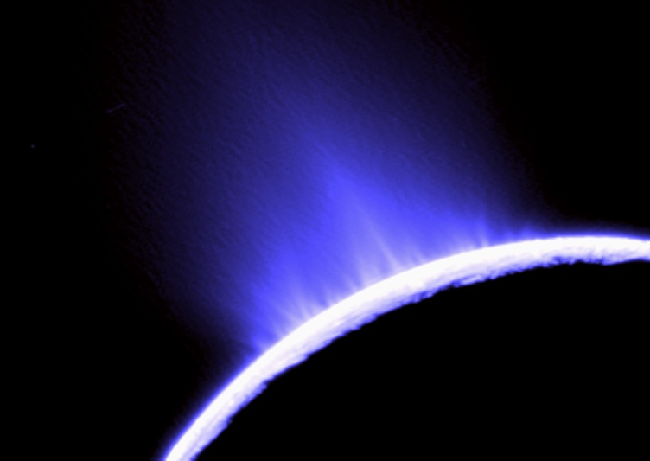
Our vision: spacecraft or systems acting collaboratively, adapts to new information
Reduce need for ground-based analyses and decision-making for instrument operations
Enhance science return
Enable science ‘on-the-fly’
Enable science in environments with poor/no communication
Create ‘agile’ architecture that could be used for any mission

Slide 3
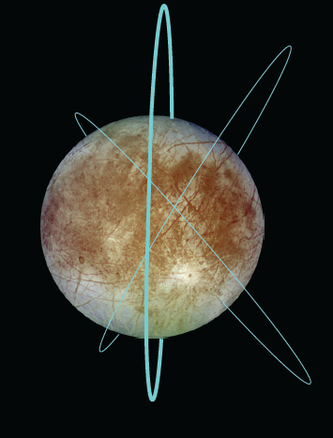
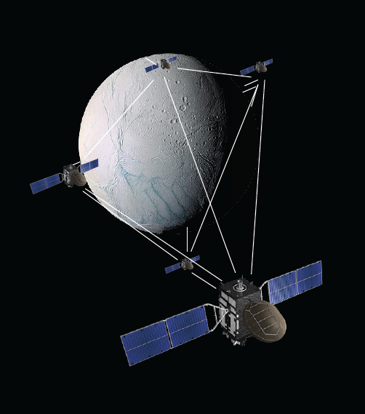
Start with the impossible
Icy Moon SmallSat constellation
3 orbits
8 spacecraft in each orbit

Slide 4
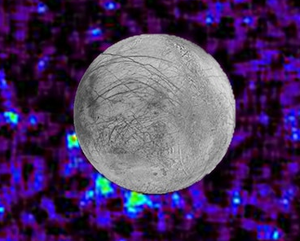
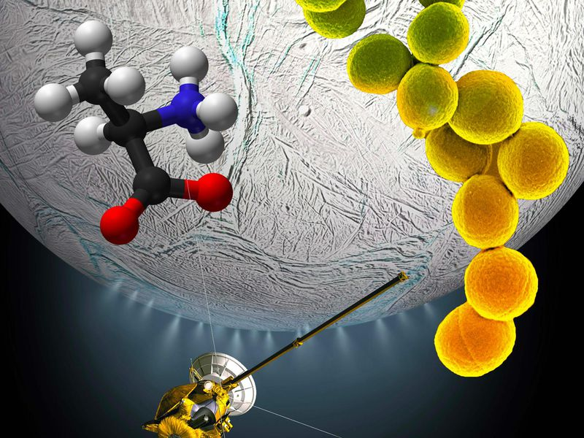
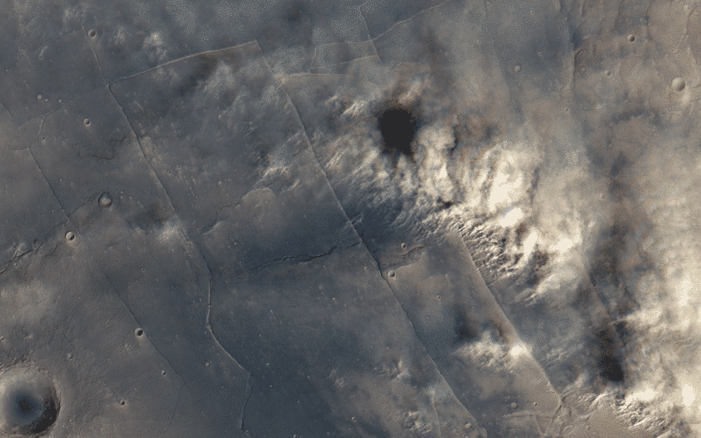
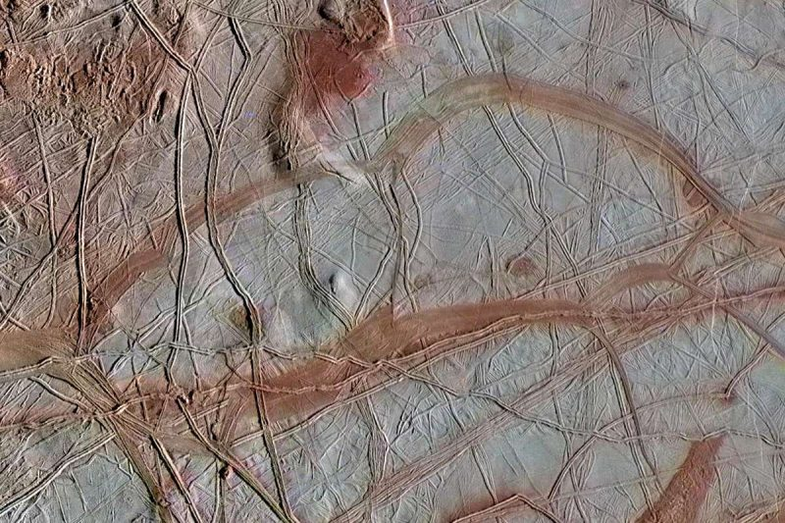
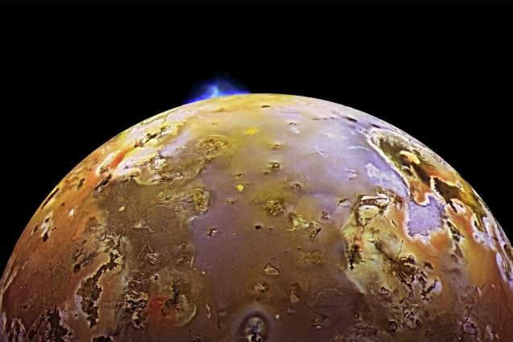
Planetary DSM enables:
Global Coverage, High Cadence, and Opportunistic Science
Identify novel events
More detailed measurements
Real-time response
Plume detection
Habitability and Biosignature Detection
Planetary and Space Weather
Volcanic eruptions
Active Tectonism
Opportunistic Science

Slide 5
Pathway to Development
SYSTEM
ENABLING CAPABILITY
4. “Whole Mission” Digital Transformation Environment
Extensible, Evolvable, Interoperable “Plug and Play” Framework
Interoperable Modules
3. Open Architecture Mission (System of Systems)
Open Architecture Framework (Network-centric mission approach)
Planning/Scheduling
Science LOBs collaboration. Continue & increase science representation in DSM team.
COMPLEXITY
Data Analytics, Fusion, and Resampling
2. Event/Data Assimilation Based Collaboration
Ubiquitous Communication Standards [C/N LOB]
Autonomous Navigation, Guidance, and Control [C/N LOB]
Mission Resilience
Onboard Processing
1. Event/Data Assimilation Based
(Intelligent Instrument)
Downlink Data Prioritization
Intelligent Decision Engine
Science Measurement [Science LOBs]

Slide 6
Science Agent Example
DRM: Ocean World parent-childcraft
Goal: Characterize plume
Observations: visual ejection of plume material, increases in particles, gases, and water, occultation, changes in surface brightness
‘first contact’
instrument
Instrument
Instrument Analysis
Onboard Analysis / ML
UV / IR / Vis Spectrometer 1
Data: Column abundance of photons (albedo)
Threshold detection of features / novelties
UV / IR / Vis Spectrometer 2
Data: Column abundance of photons over specific wavelength (λ) range
Threshold detection of features / novelties
Detection > set threshold,
or Δx intensity
Magnetometer
LIDAR
Data: Δ surface topography
Find predictive topographic change/surface features assoc. w/plumes
Thermal IR Imager
Data: spectral abundance over specific λ
Thermal IR Imager
Create thermal map to predict plume occurrence
Camera
Data: Images
A priori + onboard learning of plume ID
Plasma Spectrometer
Threshold detection of a priori features / novelties
Onboard learning – determine ‘normal’ plume conditions + novelties in plume
Mass Spectrometer
Data: intensity of ions over range of mass/charge
Send signal to instruments on separate smallsats
Switch to analysis mode
Example relevant for investigations of plumes, volcanic eruptions, planetary weather, surface fires and dust storms

Slide 7
Using Science Autonomy: Threshold Detections
Novelty: Something unexpected
or anomalous
Intensity
Threshold
Feature: What do you expect?
A priori, onboard learing, both
Limit of detection (LOD)
mass/charge (m/z)

Slide 8
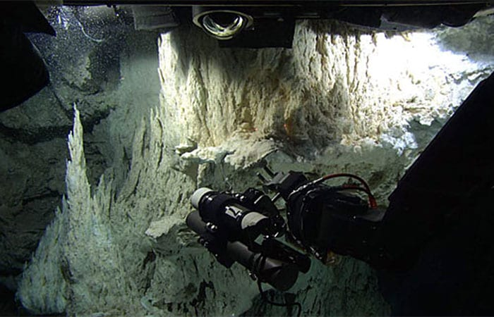
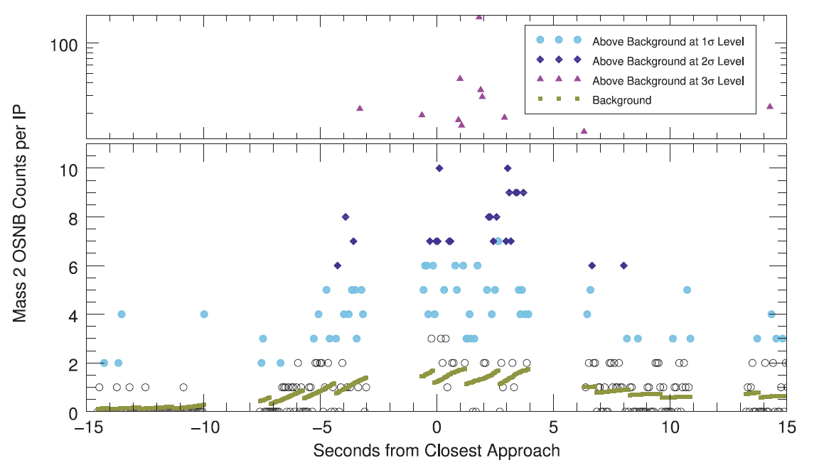
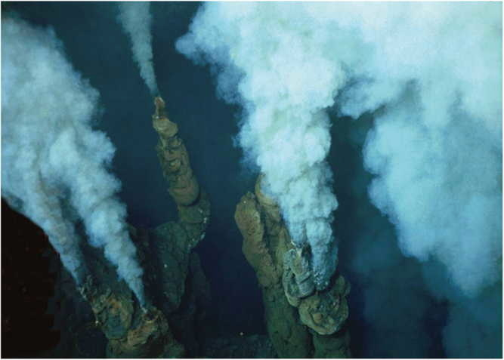
Prioritize Data Over an Established Threshold
Waite et al. (2017): Science
©HERMINE 2017, Ifremer

Slide 9
Using Science Autonomy: Algorithm Detections
Are there unique characteristics of these spectra that could be used to extract additional information?
Chemical composition
Biotic vs abiotic
Evolution of sample (e.g., during freezing)
Intensity
mass/charge (m/z)

Slide 10
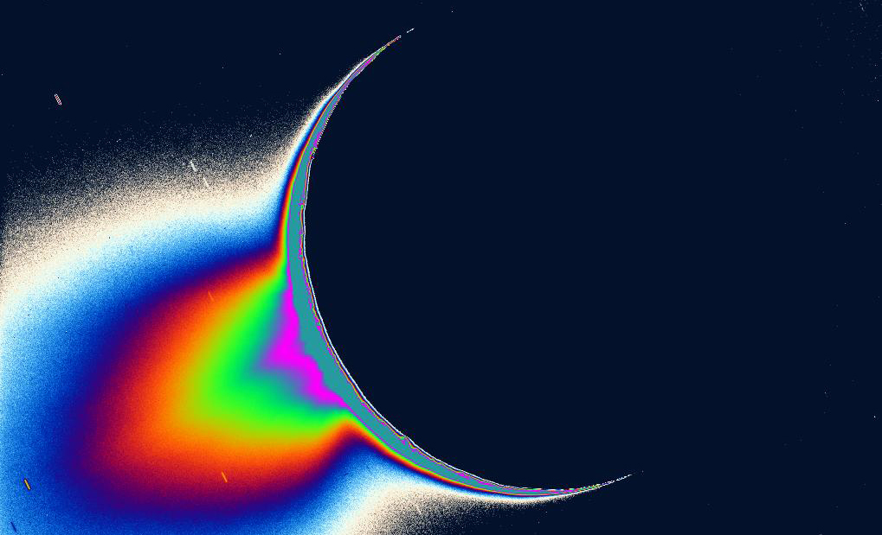
Developing ‘Science Agent’ Framework for integrated DSM decision-making
Integrates
Science observations
Established priorities
Analytical requirements
Onboard data processing
Autonomous scheduling
Autonomous prioritization ‘tough choices’
Tied into engineering ‘agents’
Notes:
Guaranteed observation: characterize sources and losses of the global volatile environment, monitor response of the electromagnetic environment due to Europan sources and forcing from the Jovian magnetosphere.

