Slide 1


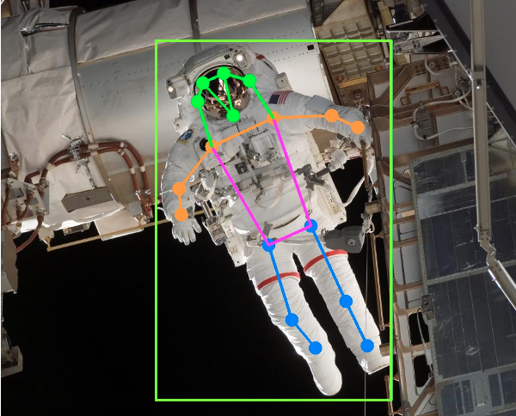
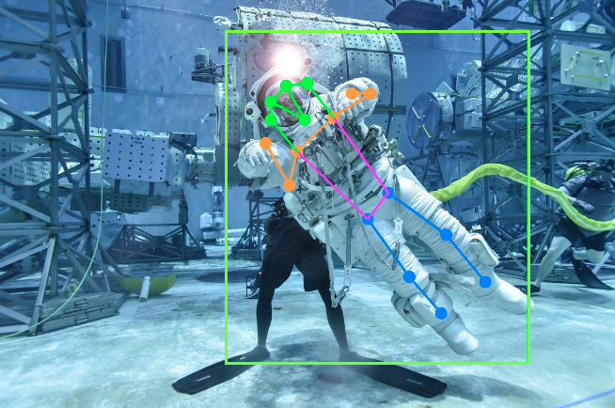
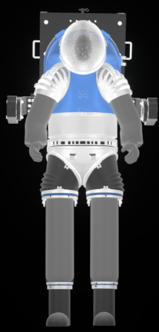
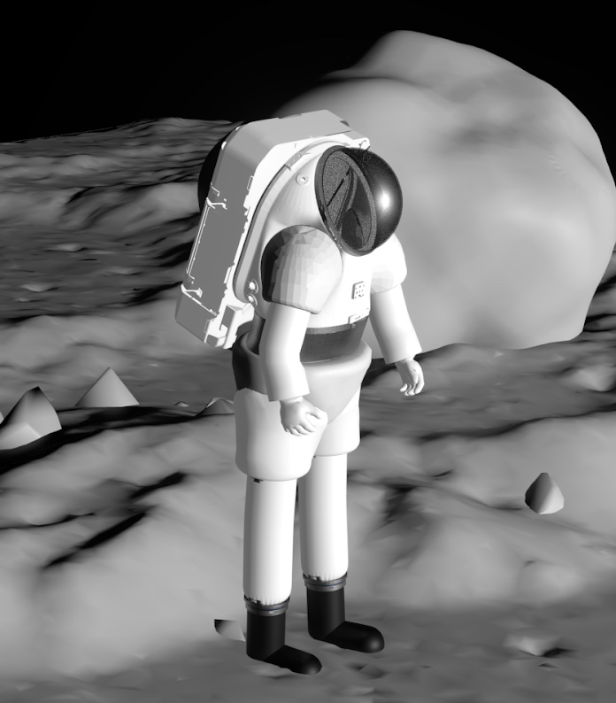
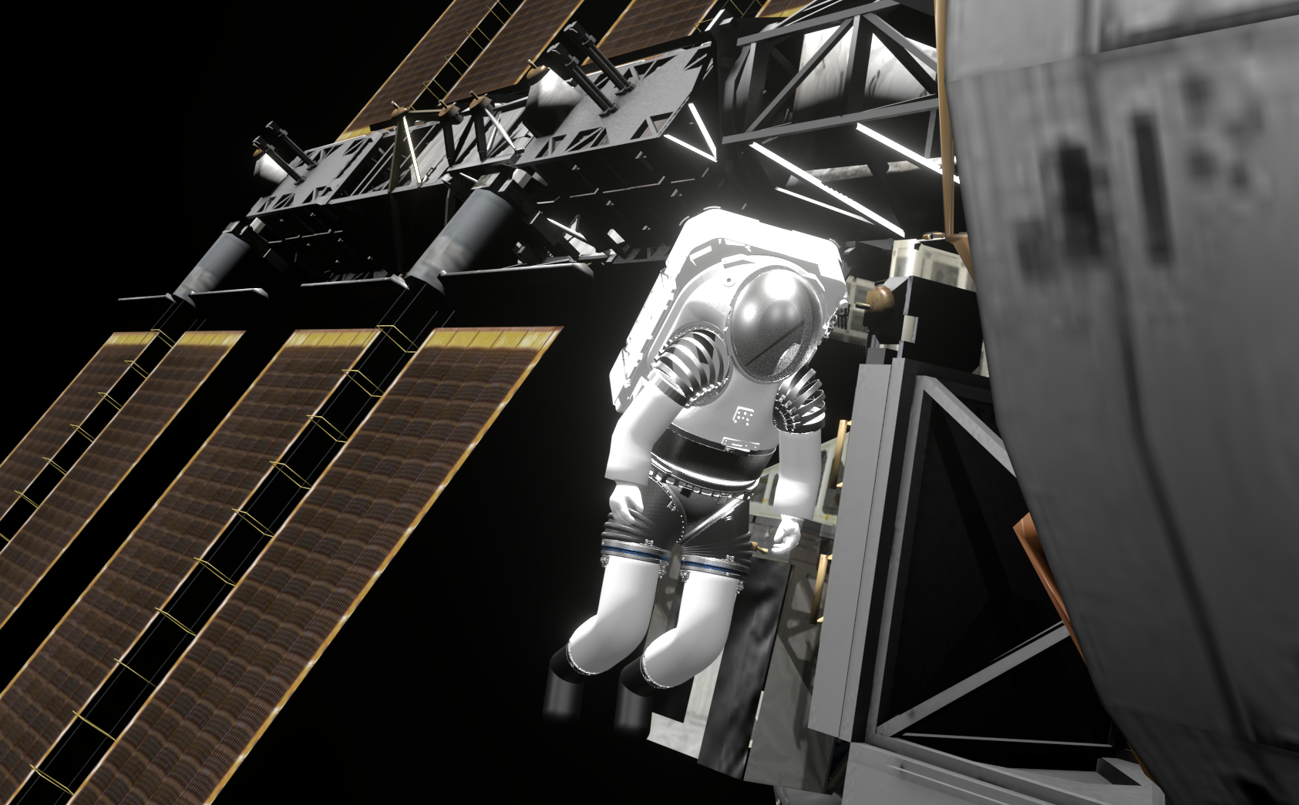
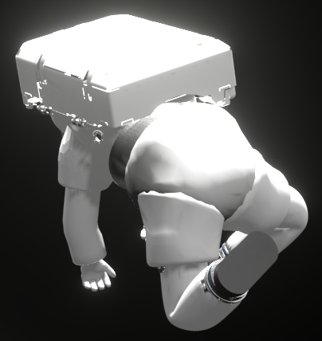
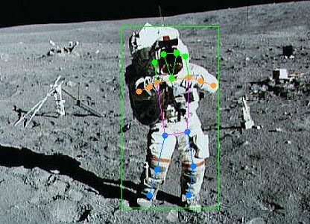
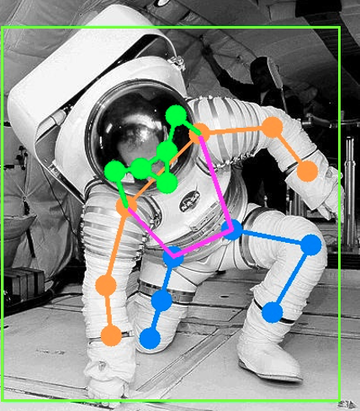
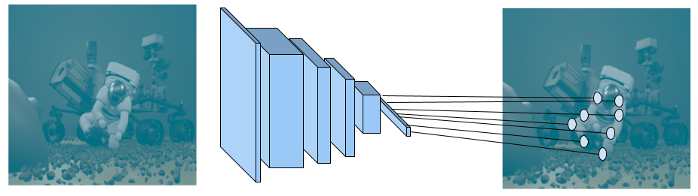
EVA Task and 3D Pose Recognition from Video
FY22 CIF IRAD # ___
National Aeronautics and Space Administration
Johnson Space Center (JSC) / White Sands Test Facility (WSTF) 2022 JSC Technology Showcase: FY22 CIF IRAD & JSC/WSTF ICA
Investigator(s): Sudhakar Rajulu, Han Kim, Kenton Fisher, Linh Vu, Alex Stoken, Mark Lambert, Joseph Yao
Technology Taxonomy Area (TX): TX 06: Human Health, Life Support, and Habitation Systems
6.2: Extravehicular Activity Systems, 6.6: Human Systems Integration
TRL: Start 4 / Current 5
Outcome
Rendering tool built for synthetic EVA image generation. The tool incorporates various suit poses, camera angles and backgrounds.
Implemented, trained and tested an AI/ML system in the Microsoft Azure cloud computing environment. Assessed accuracy and reliability.
Infusion Space / Earth
In FY22, our system was tested with video feeds from the xEMU Design Verification Test (DVT) series. Conversations were held regarding setup of a dedicated camera system in the NBL for future suited test series. A project was proposed to integrate inertial measurement units (IMU) to enhance accuracy.
A peer-reviewed paper was published and presented:
Vu, et al., Machine-learning Solution for Automatic Spacesuit Motion Recognition and Measurement from Conventional Video. ICES-2022-111
Future Work
A proposal was made for integration with ongoing suited injury mitigation efforts for ergonomics assessments, including the following improvements:
Multi-camera optical triangulation techniques
Spacesuit environmental protection garment updates for optimal detection
Integration with a kinematic toolbox of real time assessment capabilities
Suit agnostic model for future expansion and xEVAS readiness
FY22 IRAD PROJECT Overview
Extravehicular Activity (EVA) task and suit design create a need for measuring spacesuit motion patterns, but existing techniques are cost-prohibitive and infeasible for retrospective analysis. In this work, an artificial intelligence and machine learning (AI/ML) tool was developed to recognize spacesuit postures from photographs or videos, without the use of special sensors or equipment. The tool allows for the quantification of injury risk and task performance characterization for both current and past missions and training, which can help to improve EVA task and suit design.
INNOVATION
AI/ML-based human pose recognition works by learning representations of human poses from training data and applying those representations, stored in the weights of a neural network, in new situations. Our model, a Convolutional Neural Network (CNN), is based on general-purpose human pose estimation techniques, then refined to specifically estimate the pose of spacesuits, including the suit’s unique geometry and mechanical characteristics. We constructed a new dataset of 3D suit models using modeling software. The suit postures were parametrically adjusted and permuted based on past suit test data. The rendered images and ground truth 3D joint coordinates were used for the AI/ML system training and testing. By using this NASA-specific dataset, our deep learning model is capable of estimating EVA-specific poses. We can apply this model on new imagery and video to extract estimated joint positions and suit outlines. The joint positions can then be further processed to capture activity (“digging”), pose labels (“bending”), and other useful downstream information.
Training and Test Set Data Generation
1
2
Fig 1: Simulated poses for training, created from suit CAD. Poses were constructed and permuted based on past suit test data.
AI/ML Model Training
3
4
Fig 3: Trained pose model results on actual EVA images from ISS (1), NBL training (2), Apollo Mission (3), Parabolic Flight Testing (4)
Object Keypoint Similarity (OKS) | Average Precision (AP) [%] | Average Recall (AR) [%]
0.50:0.95 | 59.9 | 64.6
0.50 | 92.7 | 93.9
0.75 | 72.9 | 77.0
Fig 2: Network trained on simulated images and poses. The same network can be deployed on real world images.
Table 1: Model performance. OKS is a measure of how close predicted points are to true points, ranging from 0-1. Lower OKS is a looser threshold of correctness. For AP and AR, higher numbers are better.
MSC-27475-1
DAA# ______________________

