Slide 1
ACTIVATE cloud data from in-situ instruments - Overview and first results
Simon Kirschler, Christiane Voigt, DLR
Rich Moore, Luke Ziemba, Ewan Crosbie, Claire Robinson, Bruce Anderson and LARGE team
Armin Sorooshian and ACTIVATE team

Slide 2
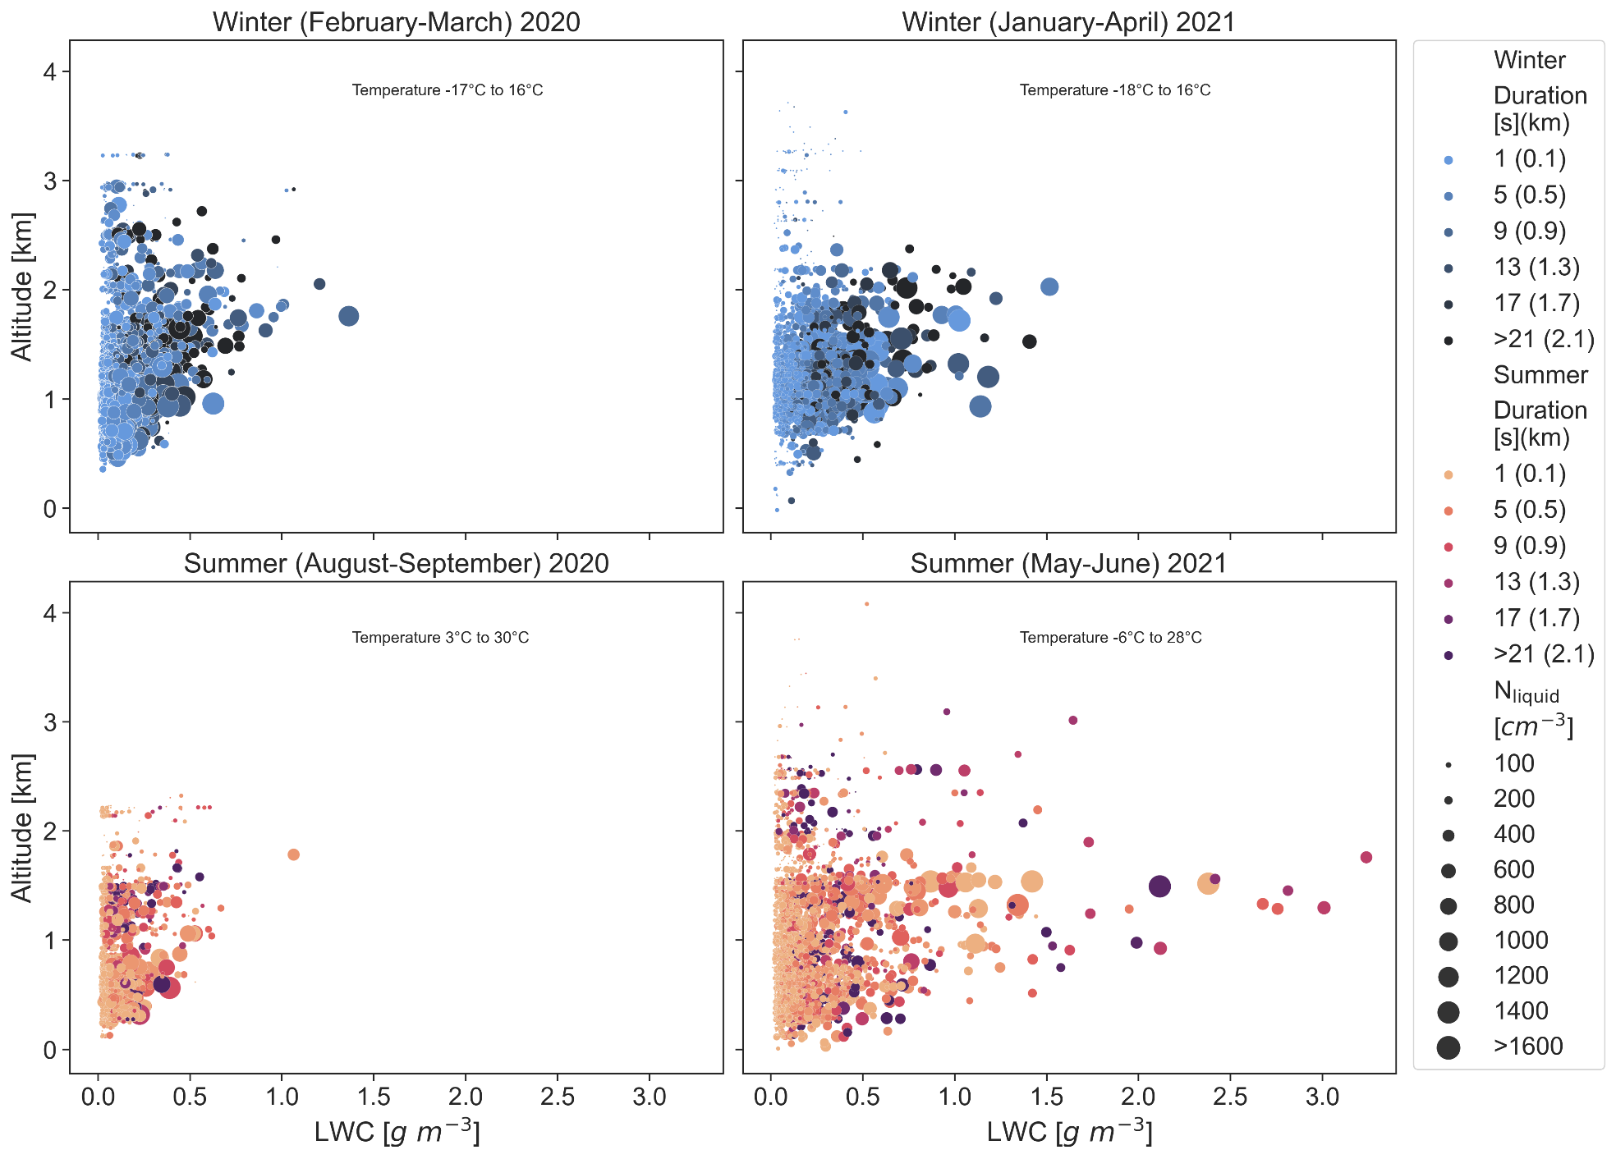
Overview of cloud properties
Kirschler et al., in prep, 2022

Slide 3
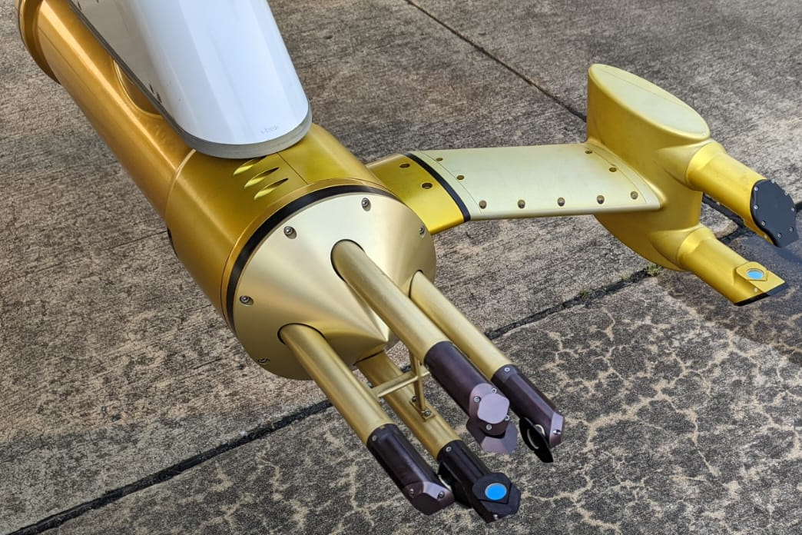
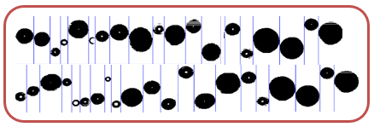
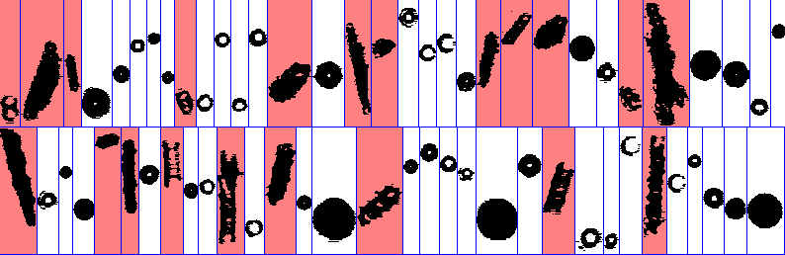
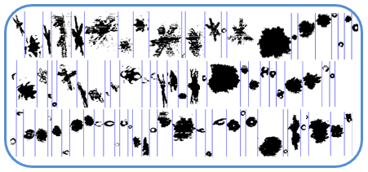
Two Dimensional Stereo (2D-S)
Manufacturer: SPEC Inc.
Type: Optical Array Imager
Size Range: 28.5-1464.9 µm diameter
Resolution: 11.4 µm
Fast Cloud Droplet Probe (FCDP)
Manufacturer: SPEC Inc.
Type: Forward Light Scattering Probe
Size Range: 3-50 µm diameter
Liquid
Phase distinction by
2D-S Images
Ice

Slide 4
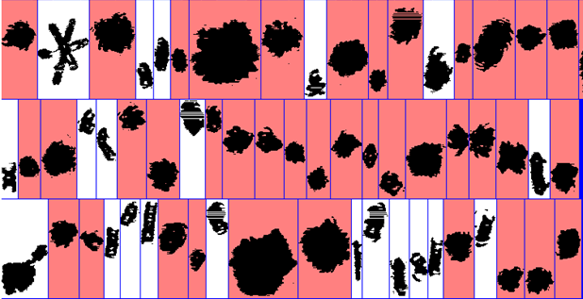
Archived Geophysical Variables
On Request:
2D-S:
Cloud Number Size Distribution for Liquid, Ice and Total, m⁻³
Integrated Cloud Number for Liquid, Ice and Total, m⁻³
Liquid Water Content, kg m⁻³
Ice Water Content, kg m⁻³
Ice Flag, [1,0]
Effective Diameter for Liquid, Ice and Total, m
Median Volume Diameter for Liquid and Total, m
FCDP:
Aerosol and Cloud Droplet Number Size Distribution, m⁻³
Integrated Aerosol and Cloud Droplet Number, m⁻³
Liquid Water Content, kg m⁻³
Effective Diameter, m
Median Volume Diameter, m
FCDP-2D-S Combination (3-1464.9 µm) :
Cloud Number Size Distribution for Liquid, m⁻³
Integrated Cloud Number for Liquid, m⁻³
Liquid Water Content, kg m⁻³
Effective Diameter for Liquid, m
Median Volume Diameter for Liquid, m
2D-S:
Images
Graupel Identifier, [1,0]
Integrated Graupel Number, m⁻³
Effective Diameter for Graupel, m
Graupel to Ice Ratio
Graupel Identifier

Slide 5
Data Use: Best Practices
*** Please read the ICARTT file headers ***
All Data Products are given at ambient Temperature, Pressure and Relative Humidity.
2D-S:
Stuck Bit Correction, Pixel Noise Filtering, Shattering Correction and True Air Speed Correction are applied.
Binned Size concentrations are normalized by the log of the bin width (dN/dlogDp).
Liquid ➔ Depth of Field corrected Diameter
Ice ➔ Maximum Diameter and Area-Mass Relation
FCDP:
The FCDP sample volume is computed using a constant sample area of 0.248 mm² and the particle air speed measured by the LARGE-CAPS flow tube.
The FCDP is equipped with a pinhole for coincidence reduction.
Symmetry Filter, Shattering Correction and Transit Time Correction are applied.
Binned Size concentrations are normalized by the log of the bin width (dN/dlogDp).
Sizing is calibrated according to Mie-theory assuming the refractive index of water.
Please contact us for any questions/comments/concerns (Christiane.Voigt@dlr.de, Simon.Kirschler@dlr.de)

Slide 6
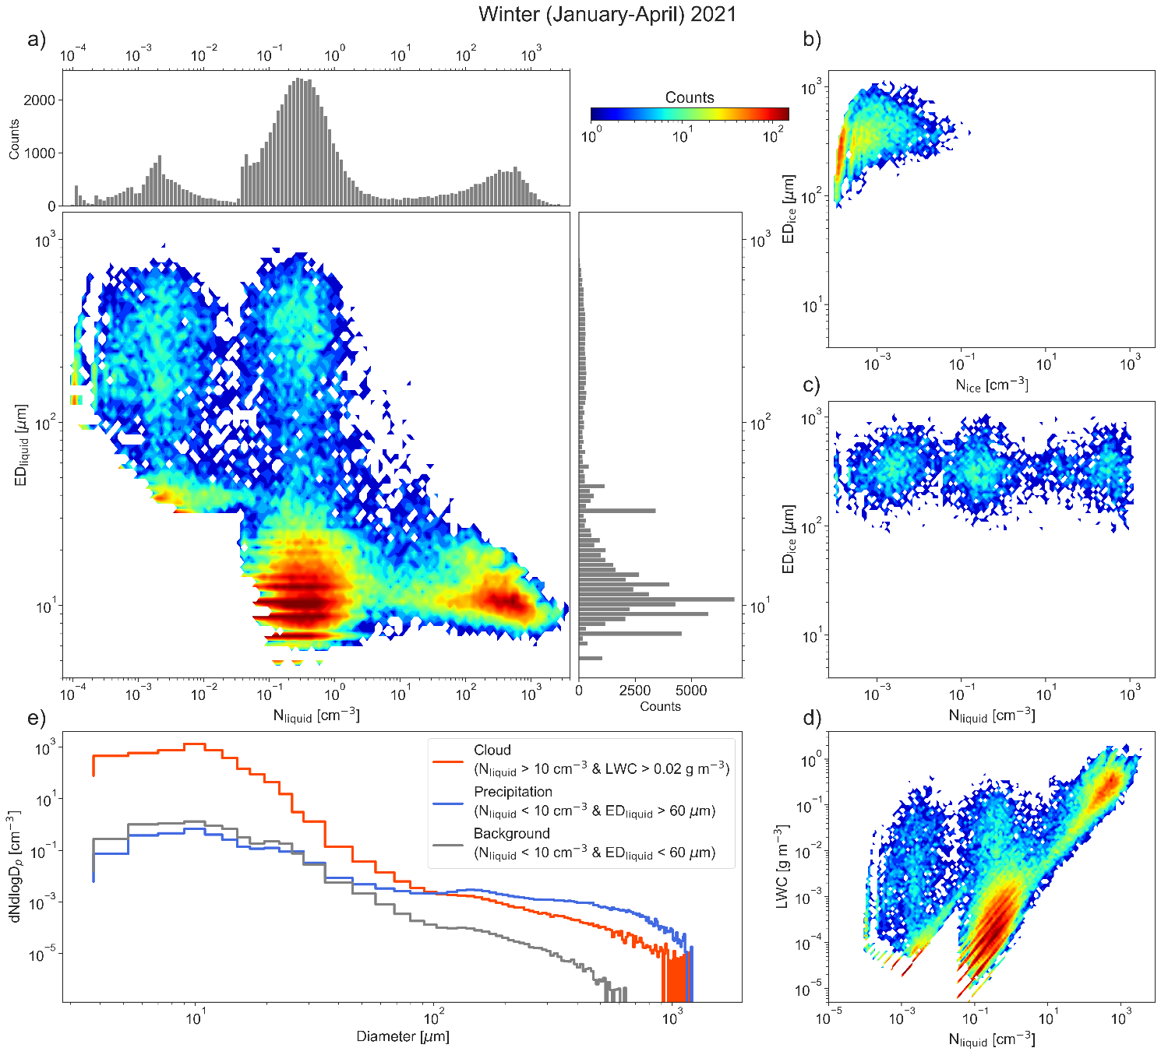
Cloud Overview and phase space
Kirschler et al., in prep, 2022

Slide 7
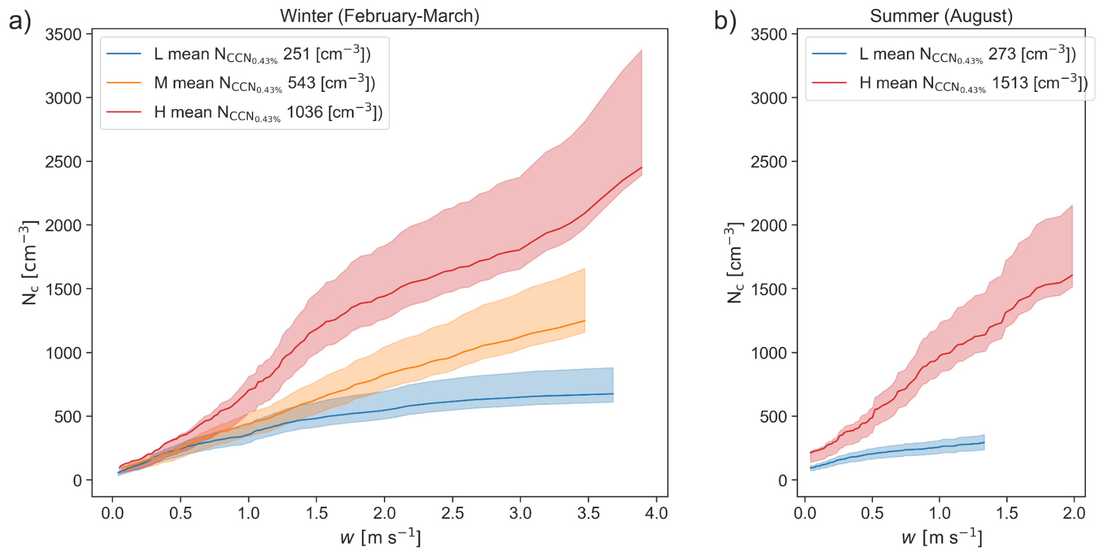
Impact of updraft on cloud droplet number concentration
Kirschler, S., Voigt, C., Anderson, B., Campos Braga, R., Chen, G., Corral, A. F., Crosbie, E., Dadashazar, H., Ferrare, R. A., Hahn, V., Hendricks, J., Kaufmann, S., Moore, R., Pöhlker, M. L., Robinson, C., Scarino, A. J., Schollmayer, D., Shook, M. A., Thornhill, K. L., Winstead, E., Ziemba, L. D., and Sorooshian, A.: Seasonal updraft speeds change cloud droplet number concentrations in low-level clouds over the western North Atlantic, Atmos. Chem. Phys., 22, 8299–8319, https://doi.org/10.5194/acp-22-8299-2022, 2022.

