Slide 1
AIAA SciTech 2023
Navigation Doppler Lidar Signal Processing Architecture and Algorithms
Dr. Glenn Hines
NASA Langley Research Center
January 23, 2023

Slide 2
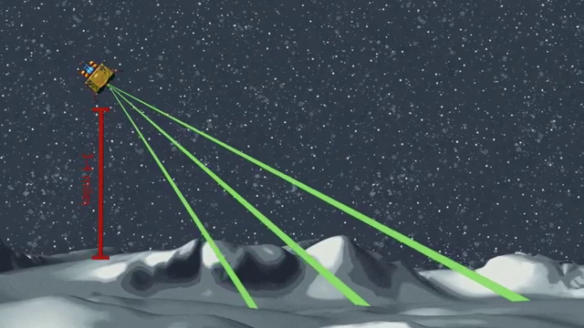
Introduction
NDL is a laser-based sensor capable of providing precision ground-relative velocity and altitude
Measures velocity and range along three laser beams
  Utilizes Doppler frequency shift to determine line-of-sight (LOS) velocity
  Utilizes time of flight to determine LOS range
Simultaneous LOS measurements are used to estimate:
  Velocity Vector (V)
  Altitude relative to local ground

Slide 3
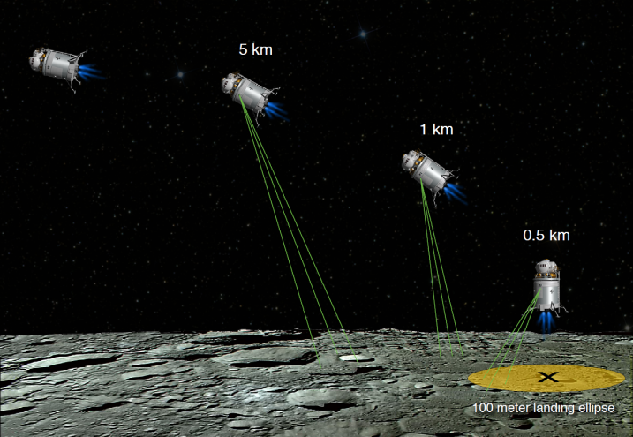
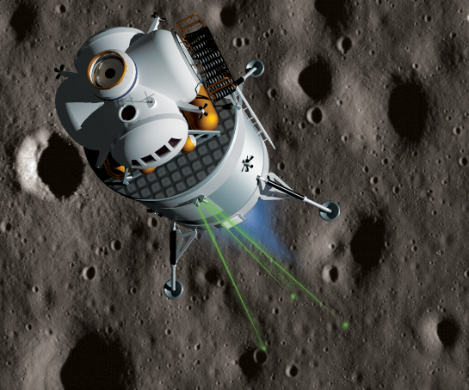
NDL Enables New Landing Capabilities
  Viable replacement for radars with an order of magnitude higher precision and much better data quality
  NDL enables “precision navigation” to the designated landing location
  NDL enables “well-controlled” descent, landing, and ascent maneuvers to within a few cm/sec
NDL is expected to be a standard sensor on landing vehicles

Slide 4
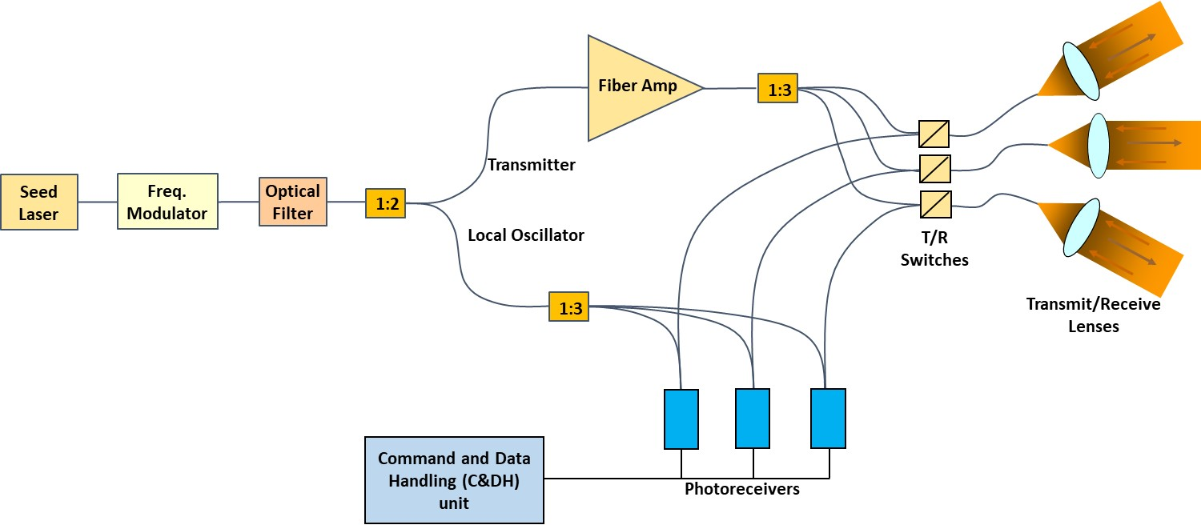
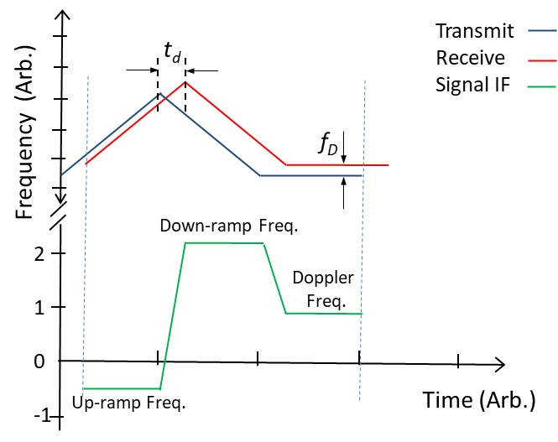
NDL System Functional Architecture
Frequency Modulated, Continuous Wave (FMCW) Technique

Slide 5
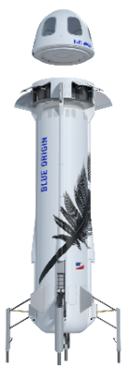
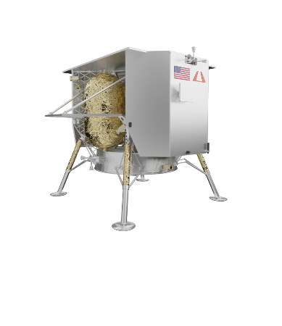
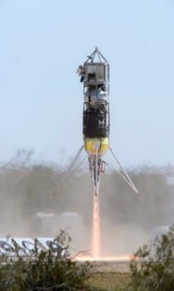
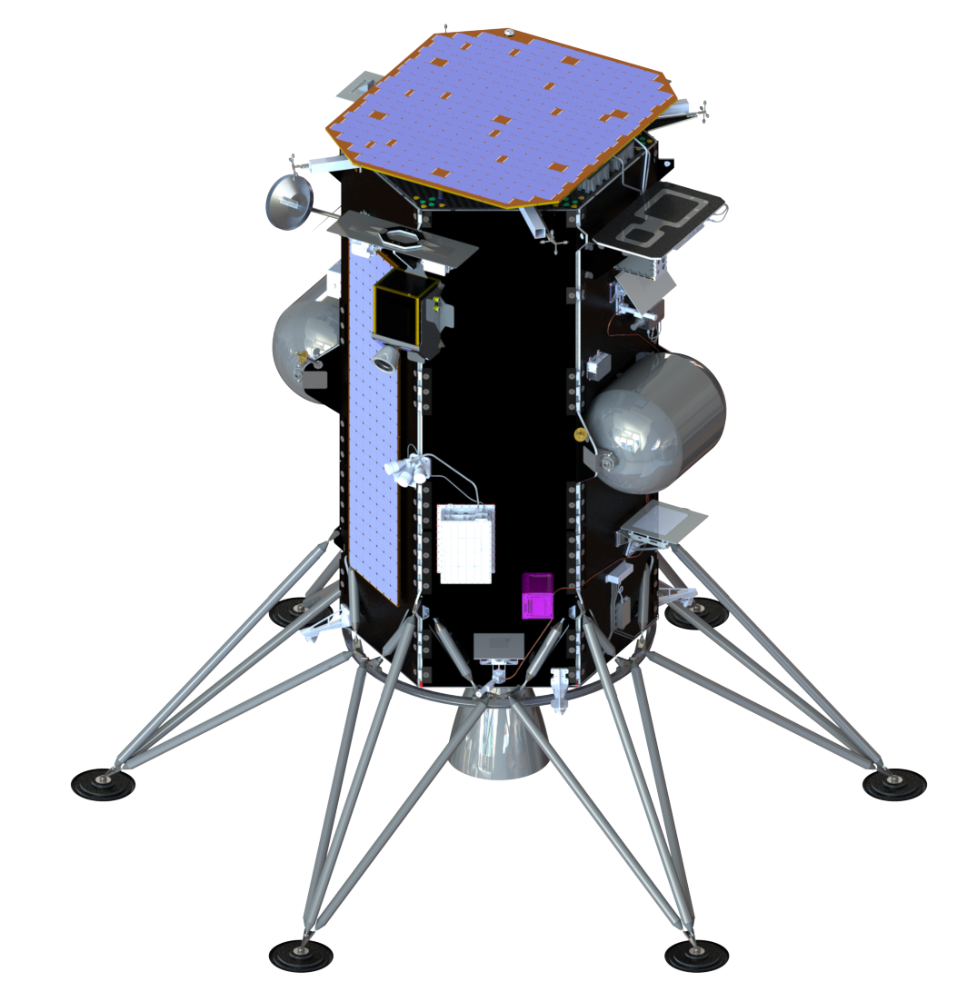
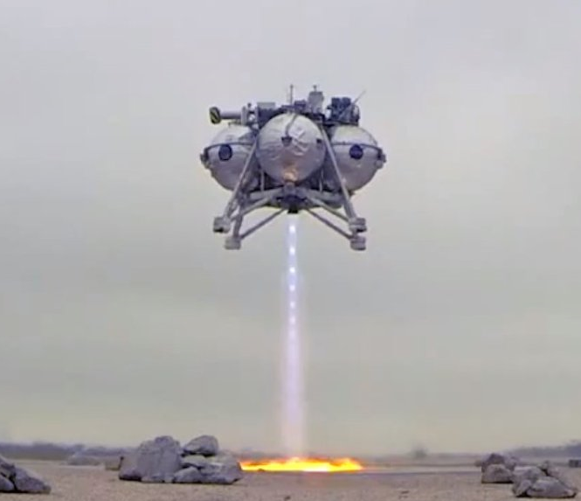
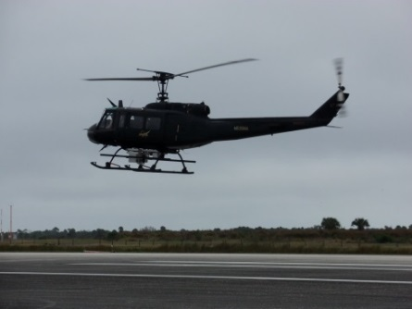
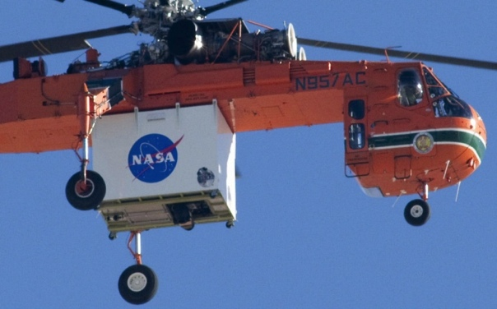
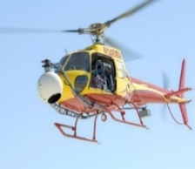
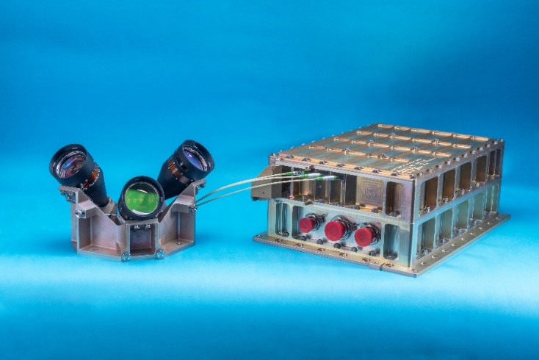
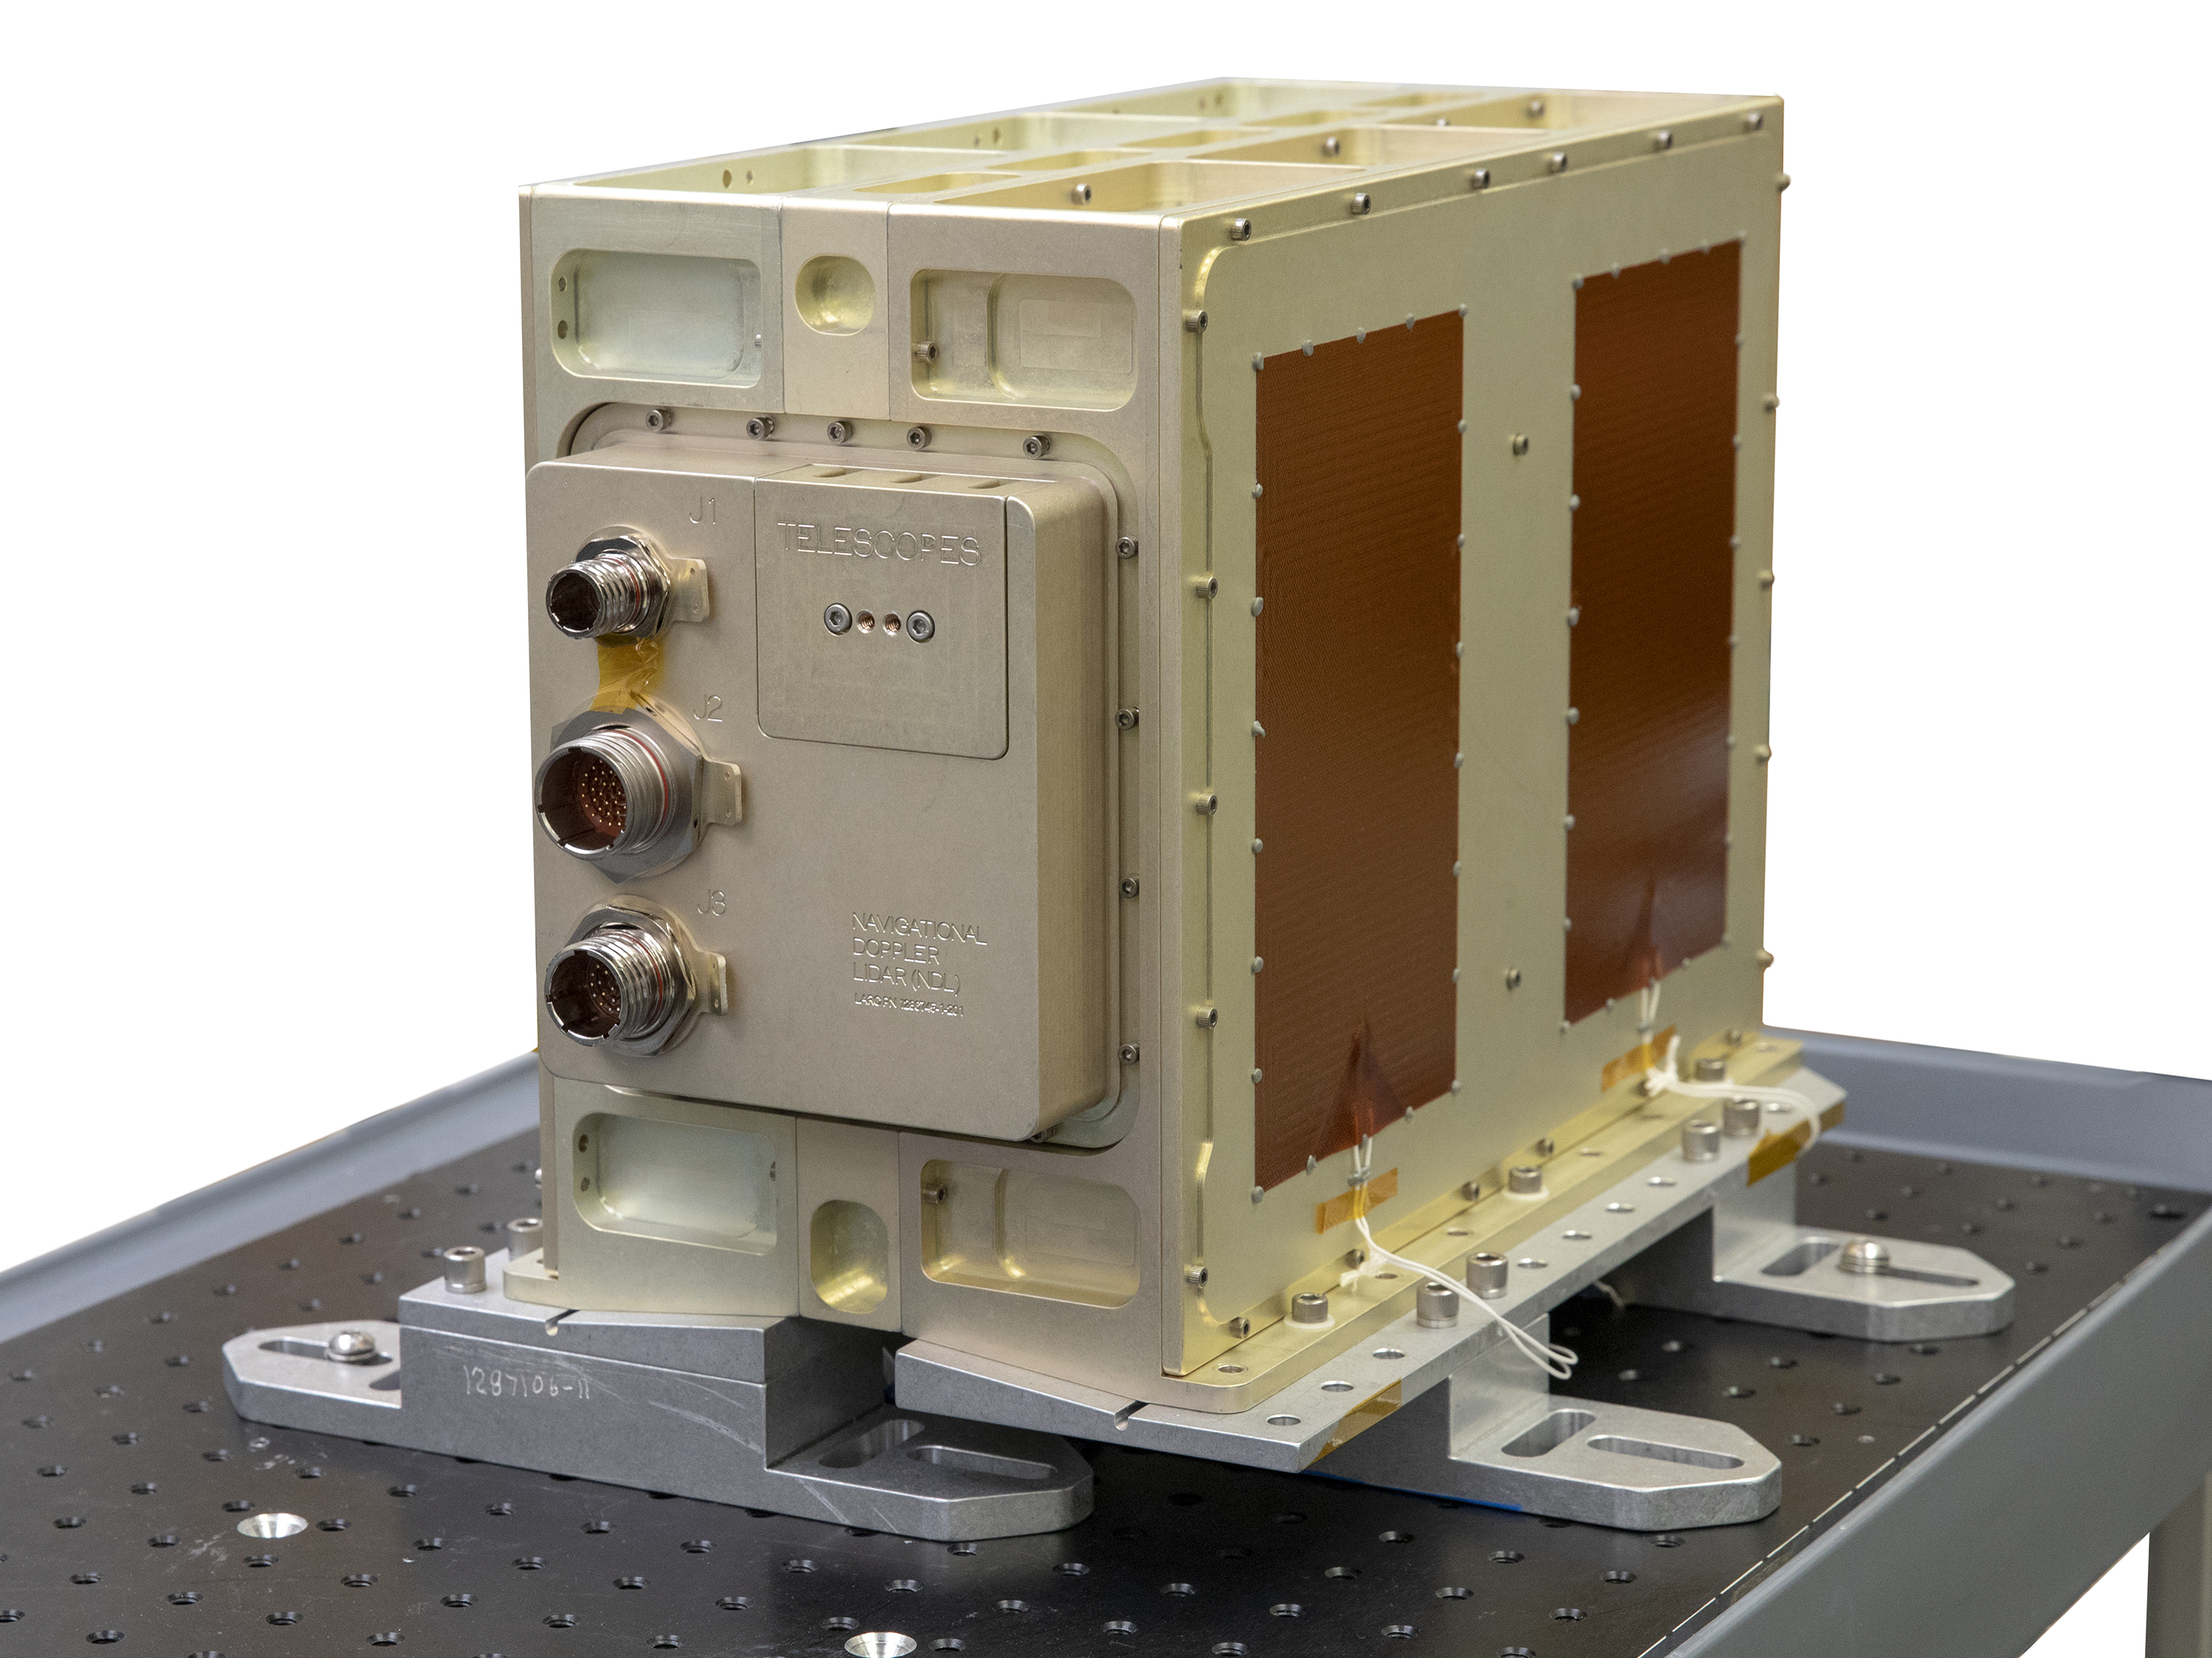
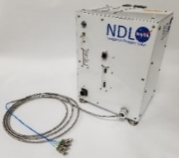
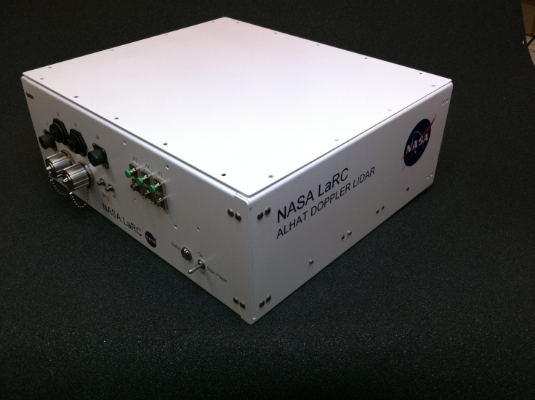
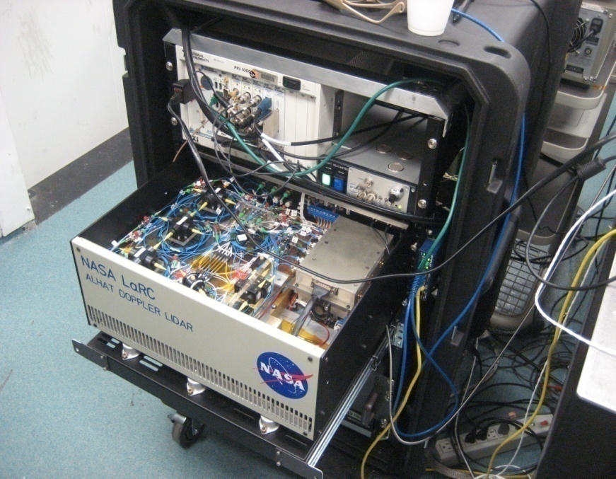
NDL from Concept to Lunar Landing Demonstration
Intuitive Machines
Nova-C Vehicle
Astrobotic
Peregrine Vehicle
Masten
New Shepard
Morpheus
2017
2020/2021
2023
2014
Spaceflight ETU
2012
2010
Fully-Autonomous Prototype
2008
Breadboard without real-time processing
ETU 1, 2
ETU 3, 4
GEN 3
GEN 2
Spaceflight
Engineering Test Unit (ETU)
Proof-of-Concept
GEN 1

Slide 6
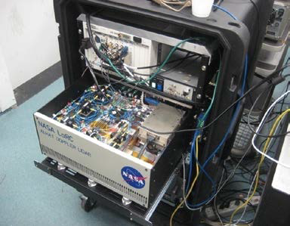
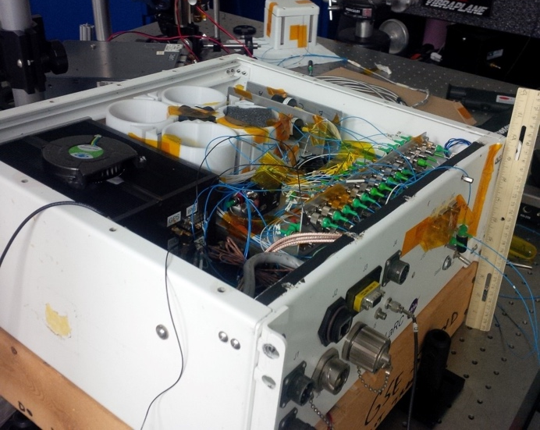
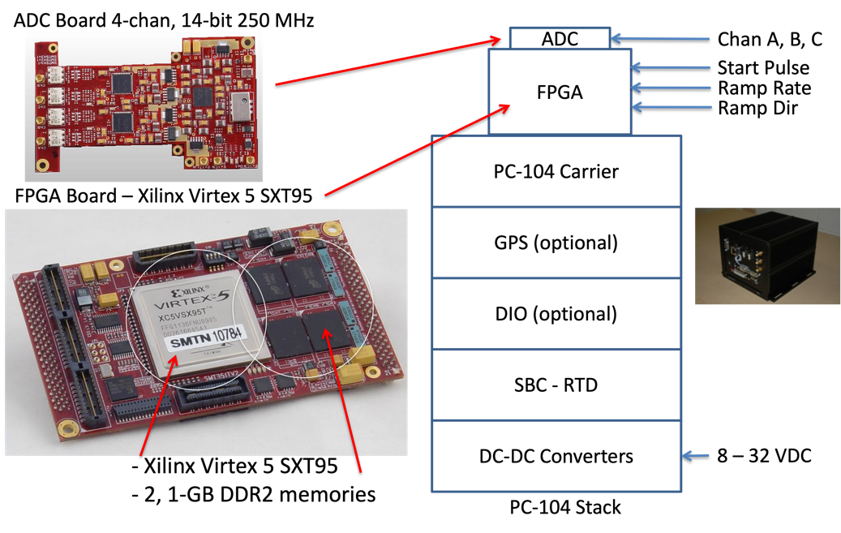
Signal Processing Background
Gen 1 recorded data but did not perform real-time signal processing
Gen 2 performed real-time signal processing and command and control
  Command & Data Handling (C&DH) was implemented in a PC-104 stack
  Still large, relatively high power, and no path to space for some components
GEN 1
GEN 2

Slide 7
Signal Processing Trades/Optimizations
Consolidation of functionality – embed functions inside the FPGA
Minimize volume and mass – move from PC104 stack to single board
Change thermal management –convective to conduction cooling
Wise parts selection – move to space-grade parts when and where possible
Based on these potential improvements a new, LaRC designed and developed, custom C&DH board was created

Slide 8
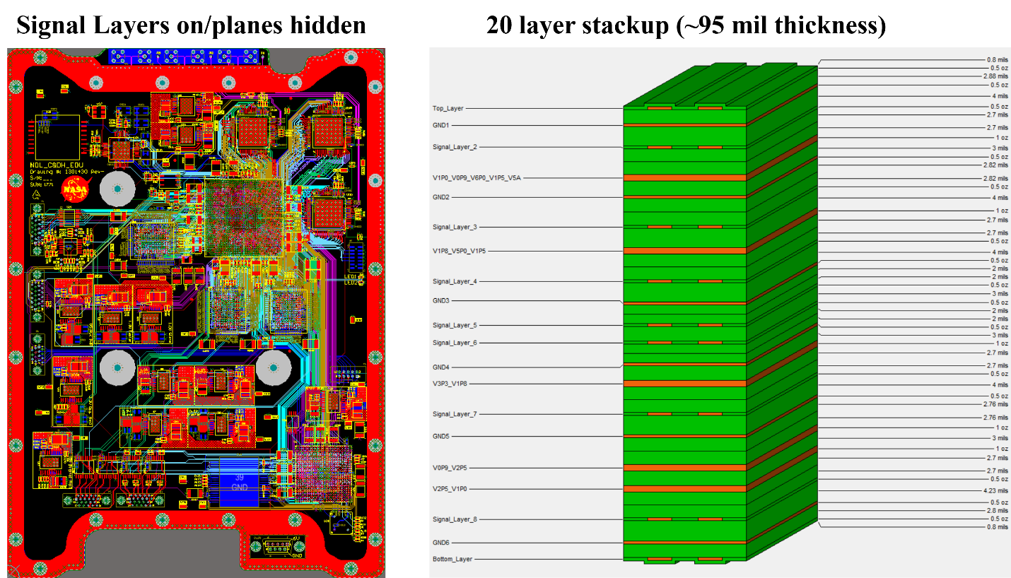
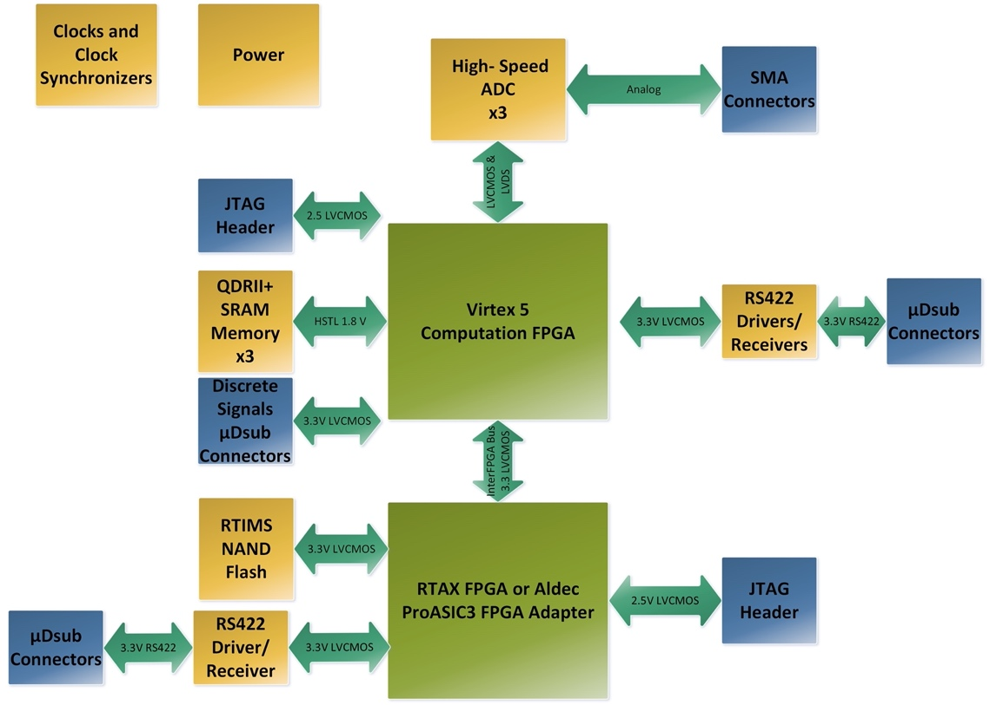
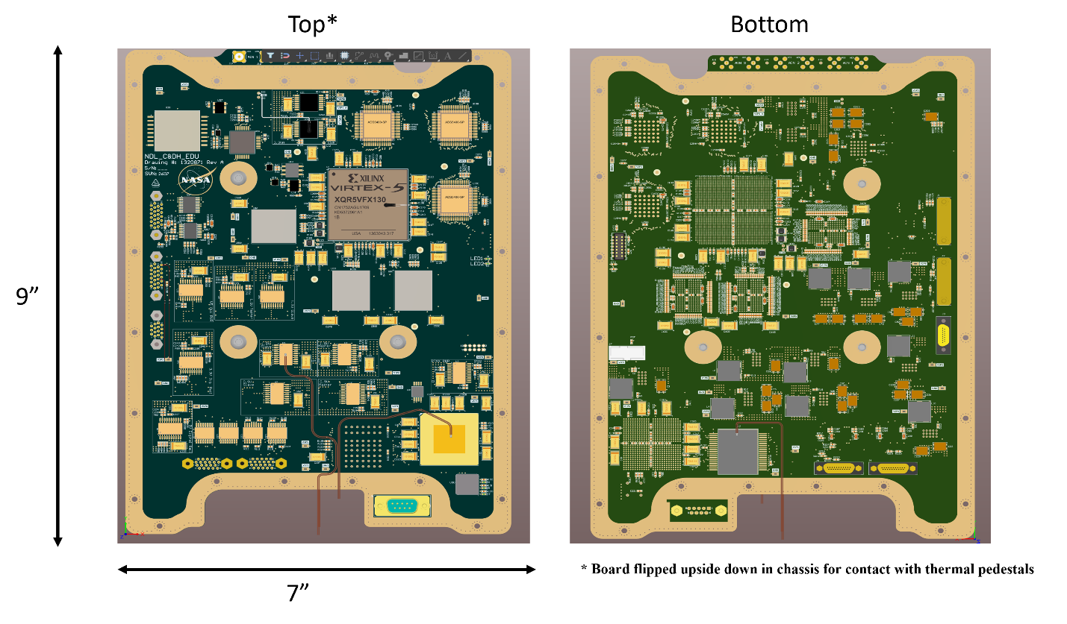
C&DH Block Diagram
Primary components of the custom C&DH

Slide 9
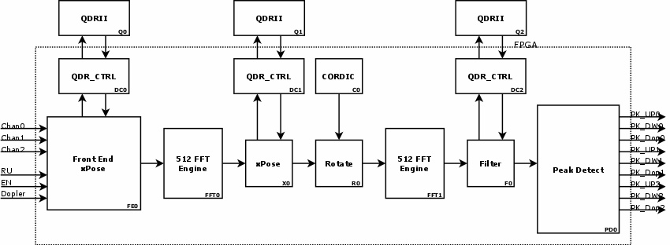
C&DH Signal Processing Firmware
Core processing engine within the C&DH
9 256 K point FFTs performed in ~23.8 ms

Slide 10
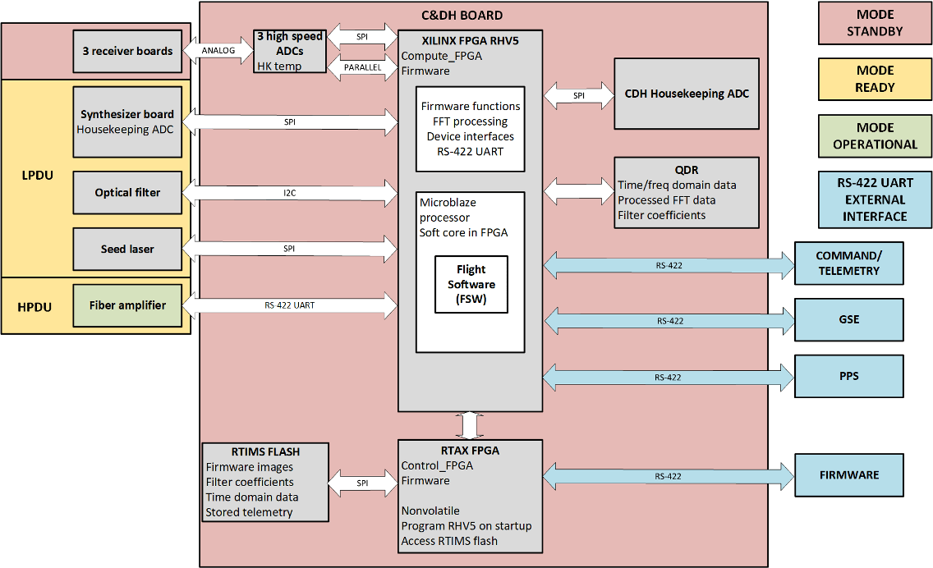
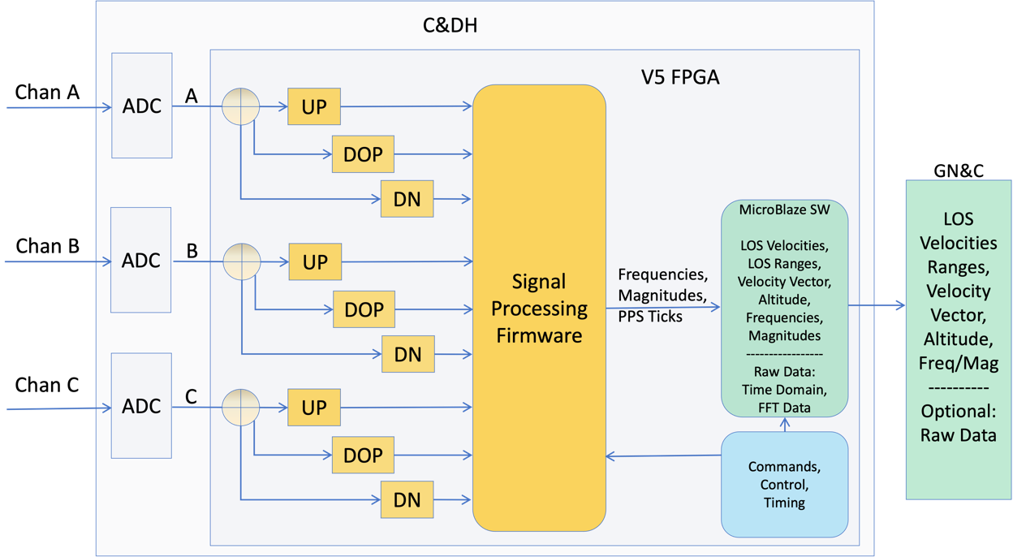
C&DH Software
Calculates the output velocity and range measurements

Slide 11
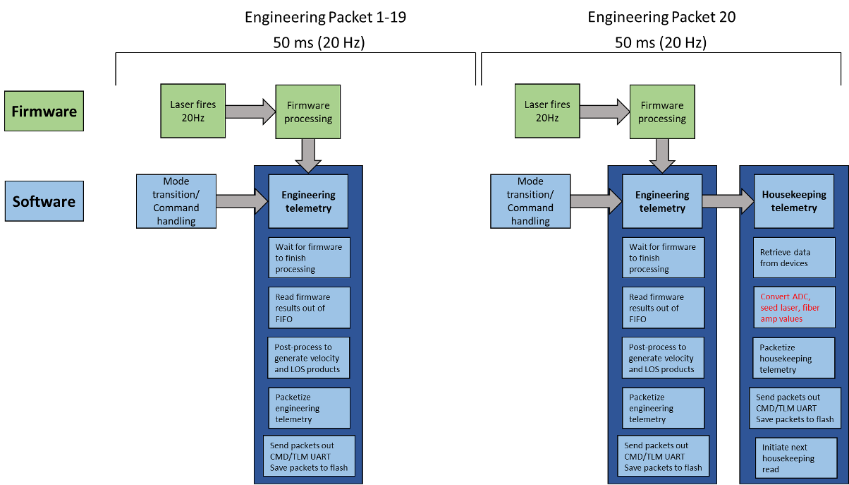
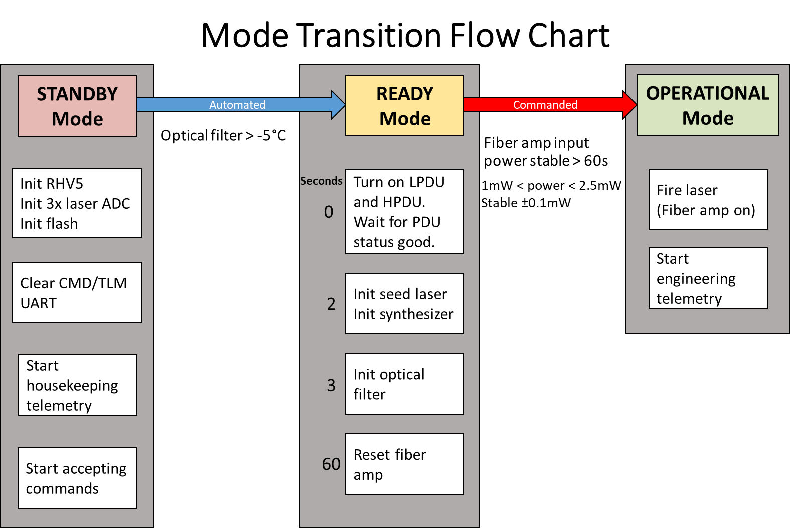
C&DH Software
Processes commands, sends telemetry and controls internal components
Instrument modes (standby, ready, operational) enable power saving and warm-up flexibility

Slide 12
Signal Processing Fault-Tolerance
Protection from radiation is ensured via parts selection and implementation of fault-tolerance methods
Virtex 5 is protected against single event upsets and transients using triple mode redundancy in the device fabric
NAND flash is also protected by triple mode redundancy
Redundant boot configuration files are used – RTAX FPGA will automatically move to the backup if there is a failure
EDAC is used on the QDR SRAM modules
RTAX FPGA is an anti-fuse device so it is rad hard by design
All other IC’s have demonstrated performance in a radiation environment

Slide 13
Future Work
Using beam steering instead of telescopes would reduce size, mass and power by eliminating two processing channels
Appropriate ADC with serial output could shrink board layout requirement resulting in a smaller footprint
Direct power on configuration of the Virtex 5 could remove need for RTAX
Alternative processors such as the Xilinx Kintex could improve performance

Slide 14
Conclusion
NDL provides a viable alternative to radars and delivers very precise velocity and range measurements in a small, low power package
Has evolved from a concept to spaceflight instrument
Flying on two lunar missions in 2023 – Intuitive Machines and Astrobotic
A core enabling technology is its LaRC developed custom Command and Data Handling board
Fault tolerance is embedded in the design
Architecture can be improved with reduced channels and new processors

