Slide 1



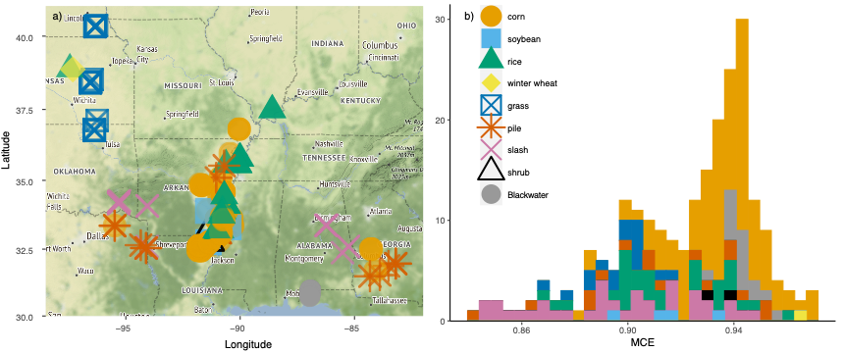


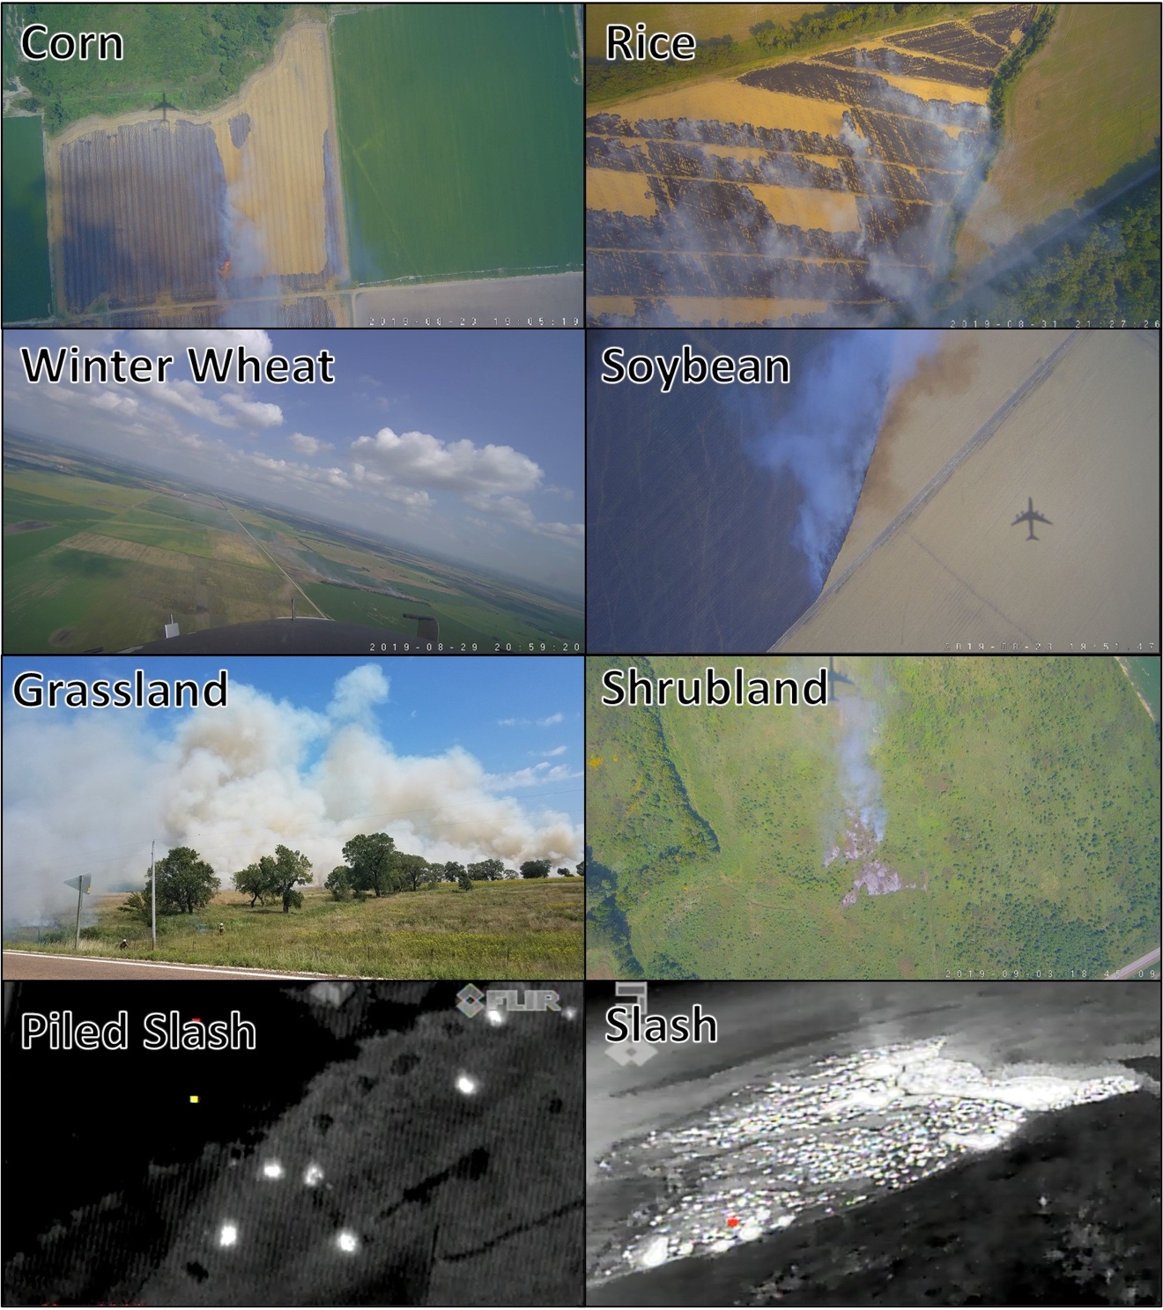
GH35A-0659: Cropland and Land-clearing Emission Factors from FIREX-AQ
Katherine R. Travis, NASA LaRC (katherine.travis@nasa.gov)
J. H. Crawford, R. Moore, A. J. Soja, E. B. Wiggins, E. Gargulinski, A. Fried, J. E. Dibb, C. Warneke, J. P. DiGangi, J. B. Nowak, D. R. Blake, G. M. Wolfe, A. W. Rollins, J. A. Neuman, G. S. Diskin, A. Wisthaler, P. Campuzano Jost, D. Pagonis, H. Guo, A. E. Perring, J. M. Katich, P. R. Veres, J. L McCarty, C. Womack
Introduction
Land-clearing and agricultural fuels have distinct MCE
Evidence of significant positive relationships with MCE
Prescribed fires are a frequent tool for land management, used for both land-clearing and agricultural activities. Determining emissions and subsequent air quality impacts from these fires requires emission factors appropriate for the type of biomass being burned. The NOAA/NASA Fire Influence on Regional to Global Environments and Air Quality (FIREX-AQ) campaign that took place from July to September 2019 provided comprehensive sampling of prescribed fires in the Eastern United States. We calculate emission factors for agricultural and land-clearing activities from FIREX-AQ and the dependence of these emission factors on fuel type/burning characteristics (i.e., modified combustion efficiency).
Identified 4 agricultural fuels (corn, rice, soybean, winter wheat) and 5 types of land-clearing (slash, piled slash, grassland, shrubland, Blackwater forest (understory) across 76 fires.
Half of all sampled fires (38 vs. 76) were burning corn agricultural residue.
Corn residue burned at a higher MCE (0.94) than rice or soybean residue (0.91), or prescribed fuels (0.90-0.91) likely due to drying of the fuel.
Liu et al. (2016) found insignificant positive correlations for NO, NO₂, and SO₂ for 15 agricultural fires in the Southeast U.S..
We obtain positive significant correlations for NO, NO₂, SO₂, ammonium and chloride.
Agricultural/prescribed fire plumes sampled during FIREX-AQ, colored by fuel type. a) Map of plume locations. b) Histogram of modified combustion efficiency (MCE) for sampled plumes.
Corn methane EF is 2.7 g kg⁻¹
Only 30% of Andreae (2019) or Akagi et al., 2011 EF (~6 g kg⁻¹)
Akagi et al., 2011
Andreae et al., 2011
VOC emission factors show possible evidence of different combustion processes
Determine 97 VOC emission factors, some never/rarely reported before for agricultural/land-clearing fires
Example photographs for fuel types sampled during the Eastern U.S. component of FIREX-AQ, from the DC-8 visible camera (corn, rice, soybean, winter wheat, shrubland), DC-8 infrared camera (piled slash, slash), and a ground-based camera (grass).
Largest are formaldehyde (14%), acetaldehyde (11%), methylglyoxal, 2,3-butanedione (diacetyl), 5-methylfurfural, and acrolein (~6% each).
2,3-butanedione: only VOC with shorter lifetime against photolysis (~1 hour) than OH oxidation (~3 days).
Impact of this species is missed when viewing biomass burning emissions in terms of OH reactivity.
Land-clearing and agricultural fuels have distinct emissions
After correcting for any significant dependence on MCE, the following species have significant differences (>50%) between agricultural and land-clearing fuels.
Long-lived species are ~30% of total measured VOCs
Approximately 30% of measured VOCs are long-lived (lifetime > 12 h) and may have larger impacts on air quality downwind of agricultural and prescribed fires.
Conclusions: Variability in emission factors may be a strong function of MCE and/or fuel type. FIREX-AQ reveals new significant relationships with MCE/fuel due to the large increase in sample size over previous compilations.

