Slide 1
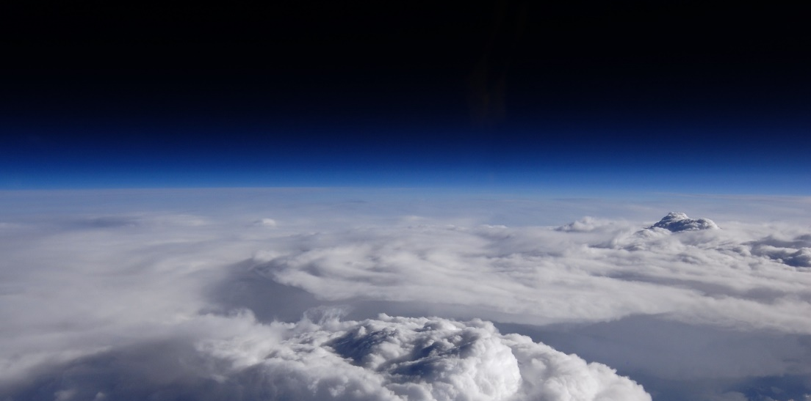
Daniel Watters¹, Patrick Gatlin², Pierre Kirstetter^{3,4,5,6}, George Huffman⁷, Jackson Tan^{7,8}, Dave Bolvin^{7,9},
Eric Nelkin^{7,9}, Dave Wolff¹⁰, Jianxin Wang^{7,9}, Bob Joyce^{7,9}, Sarah Ringerud^{7,11}
1 - NASA Postdoctoral Program, NASA Marshall Space Flight Center, Huntsville, Alabama
2 – NASA Marshall Space Flight Center, Huntsville, Alabama
3 – Advanced Radar Research Center, University of Oklahoma, Norman, Oklahoma
4 – School of Civil Engineering and Environmental Sciences, University of Oklahoma, Norman, Oklahoma
5 – School of Meteorology, University of Oklahoma, Norman, Oklahoma
6 – NOAA/National Severe Storms Laboratory, Norman, Oklahoma
7 – NASA Goddard Space Flight Center, Greenbelt, Maryland
8 – University of Maryland, Baltimore County, Baltimore, Maryland
9 – Science Systems and Applications, Inc., Lanham, Maryland
10 – NASA Wallops Flight Facility, Wallops Island, Virginia
11 – Earth Systems Science Interdisciplinary Center, University of Maryland, College Park, Maryland
The GPM Validation Network: Oceanic Validation of IMERG and GPROF with Ground-Based Radars

Slide 2
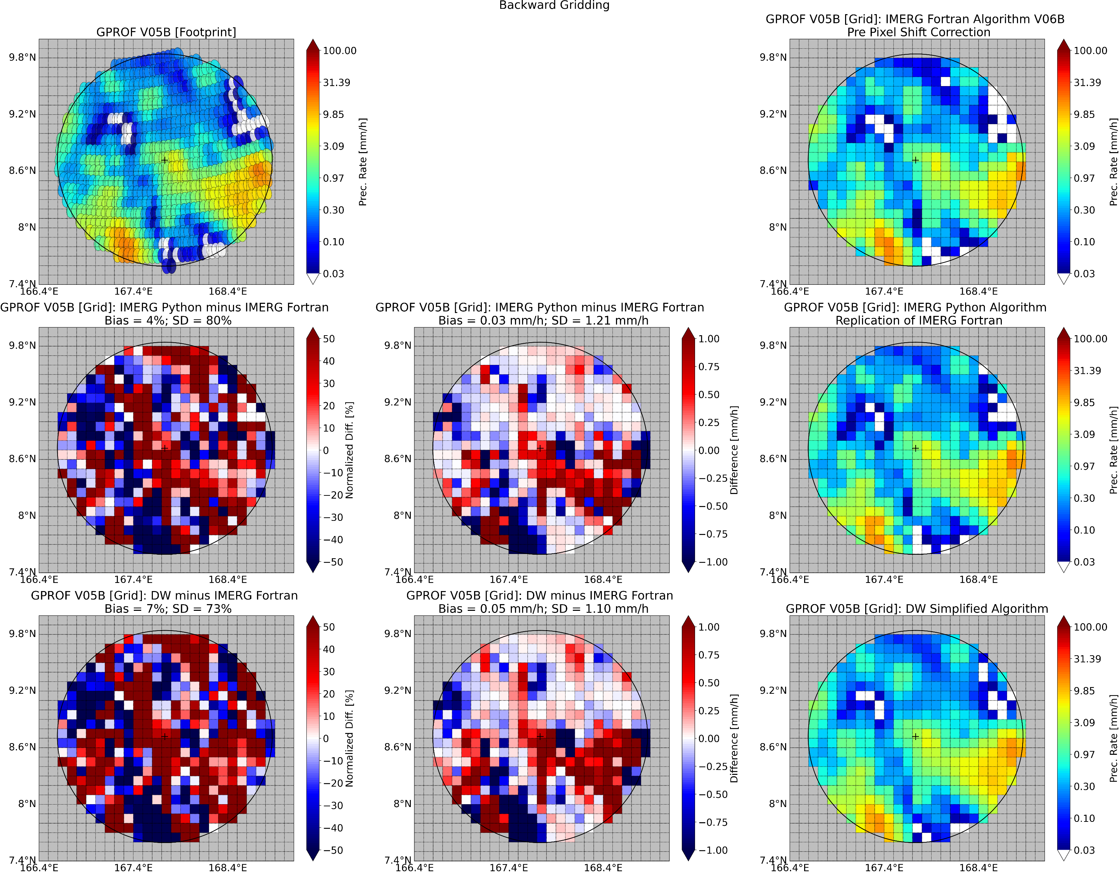
Novel Validation of IMERG Precipitation
Novelties
Oceanic validation of IMERG and GPROF across multiple sites
Tracing errors in IMERG back through the algorithm to the GPM Core GMI (GPROF-GMI) estimates
Why?
IMERG is NASA’s most popular precipitation product
Where?
Performance assessment over ocean is very limited
How?
By comparing to ground-based radar estimates
GPROF-GMI
Level 2 – Satellite Footprint
IMERG
Level 3 – Gridded Footprint

Slide 3
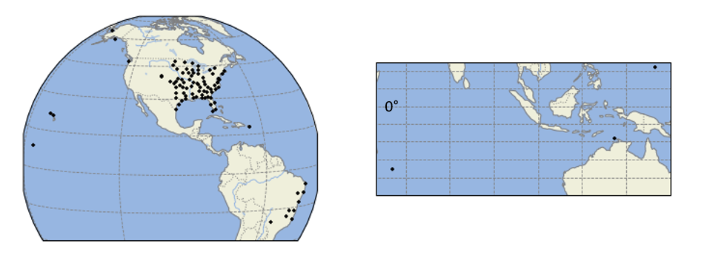
The GPM Validation Network
Validation Network Ground Radar (GR) Sites
Alaska
Washington
Eastern CONUS
Guam
Hawaii
Puerto Rico
Kwajalein
Darwin
La Reunion
Island-based radars with GPROF-GMI 3D matchups
Eastern Brazil
Adapted from Gatlin et al. (2020)
A NASA software system run at Marshall Space Flight Center that geometrically matches 3D precipitation retrievals from GPM Core sensors to ground-based radars.
Purpose of the GPM VN: To serve as a long-term evaluation of GPM satellite retrievals.

Slide 4
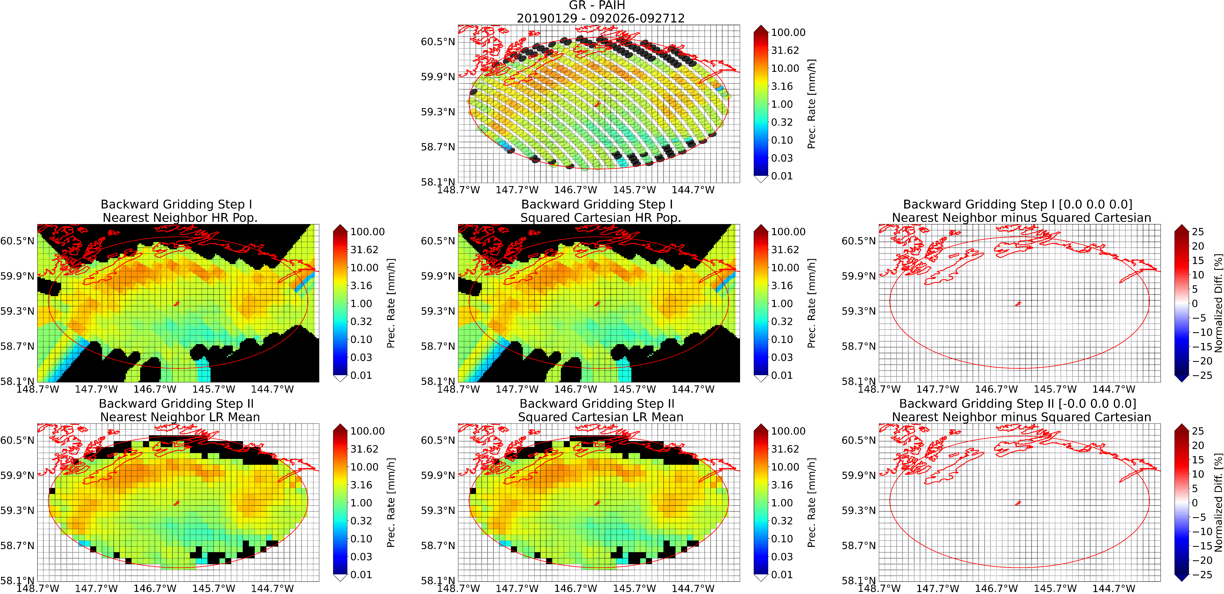
The GPM Validation Network
Ground Radar to GMI to IMERG Matchup
Ground Radar [GPROF-GMI Footprints]
Ground Radar [0.1º IMERG Grid]
Key: Black = Missing
The VN is currently set up to evaluate Level-2 GPM products (satellite footprint – e.g. GPROF-GMI), though adding the Level-3 GPM IMERG product will be a novelty.
Public matchup files (GRtoGPROFtoIMERG) to be added to the Validation Network in 2023/2024.
Notes:
Why gridding is worthwhile – precipitation is a statistical mess, discontinuous, and highly skewed. Therefore, bilinear interpolation does not work.

Slide 5
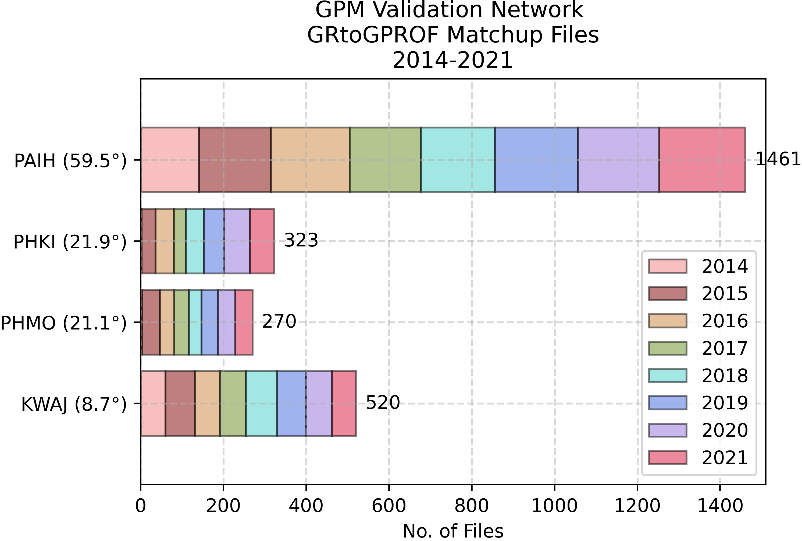
The GPM Validation Network
Oceanic Validation using Island Sites
Validate IMERG V06B and GPROF V05 over:
  Alaska’s Middleton Island [PAIH]
  Hawaii [PHKI; PHMO]
  Kwajalein Atoll [KWAJ]

Slide 6
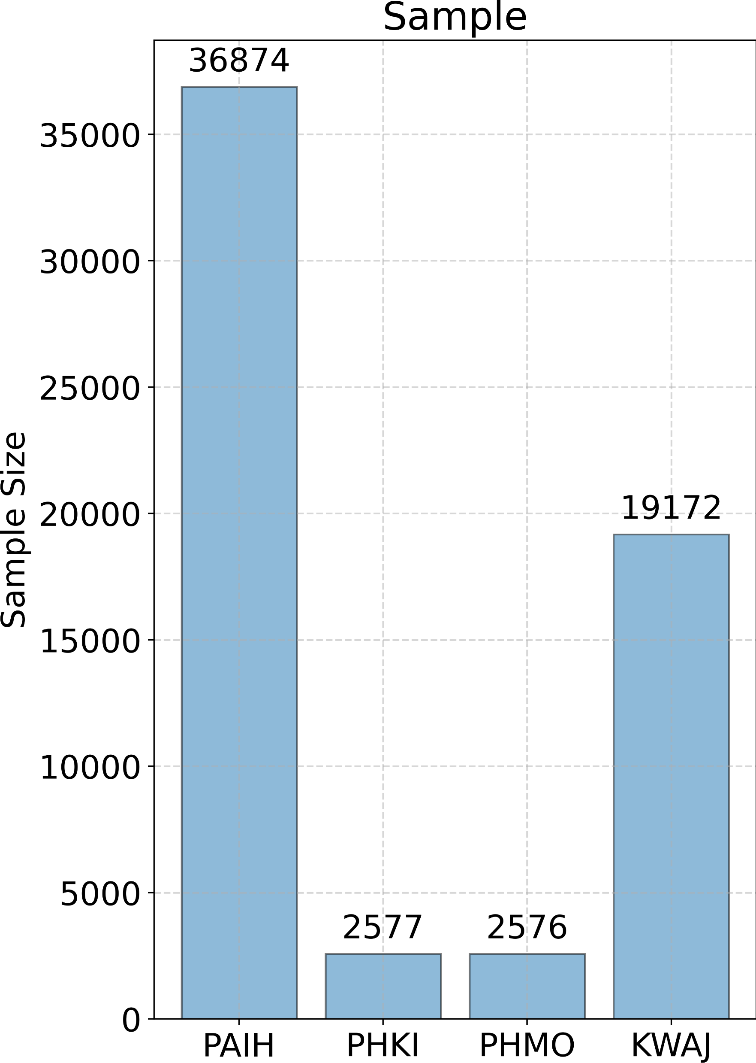
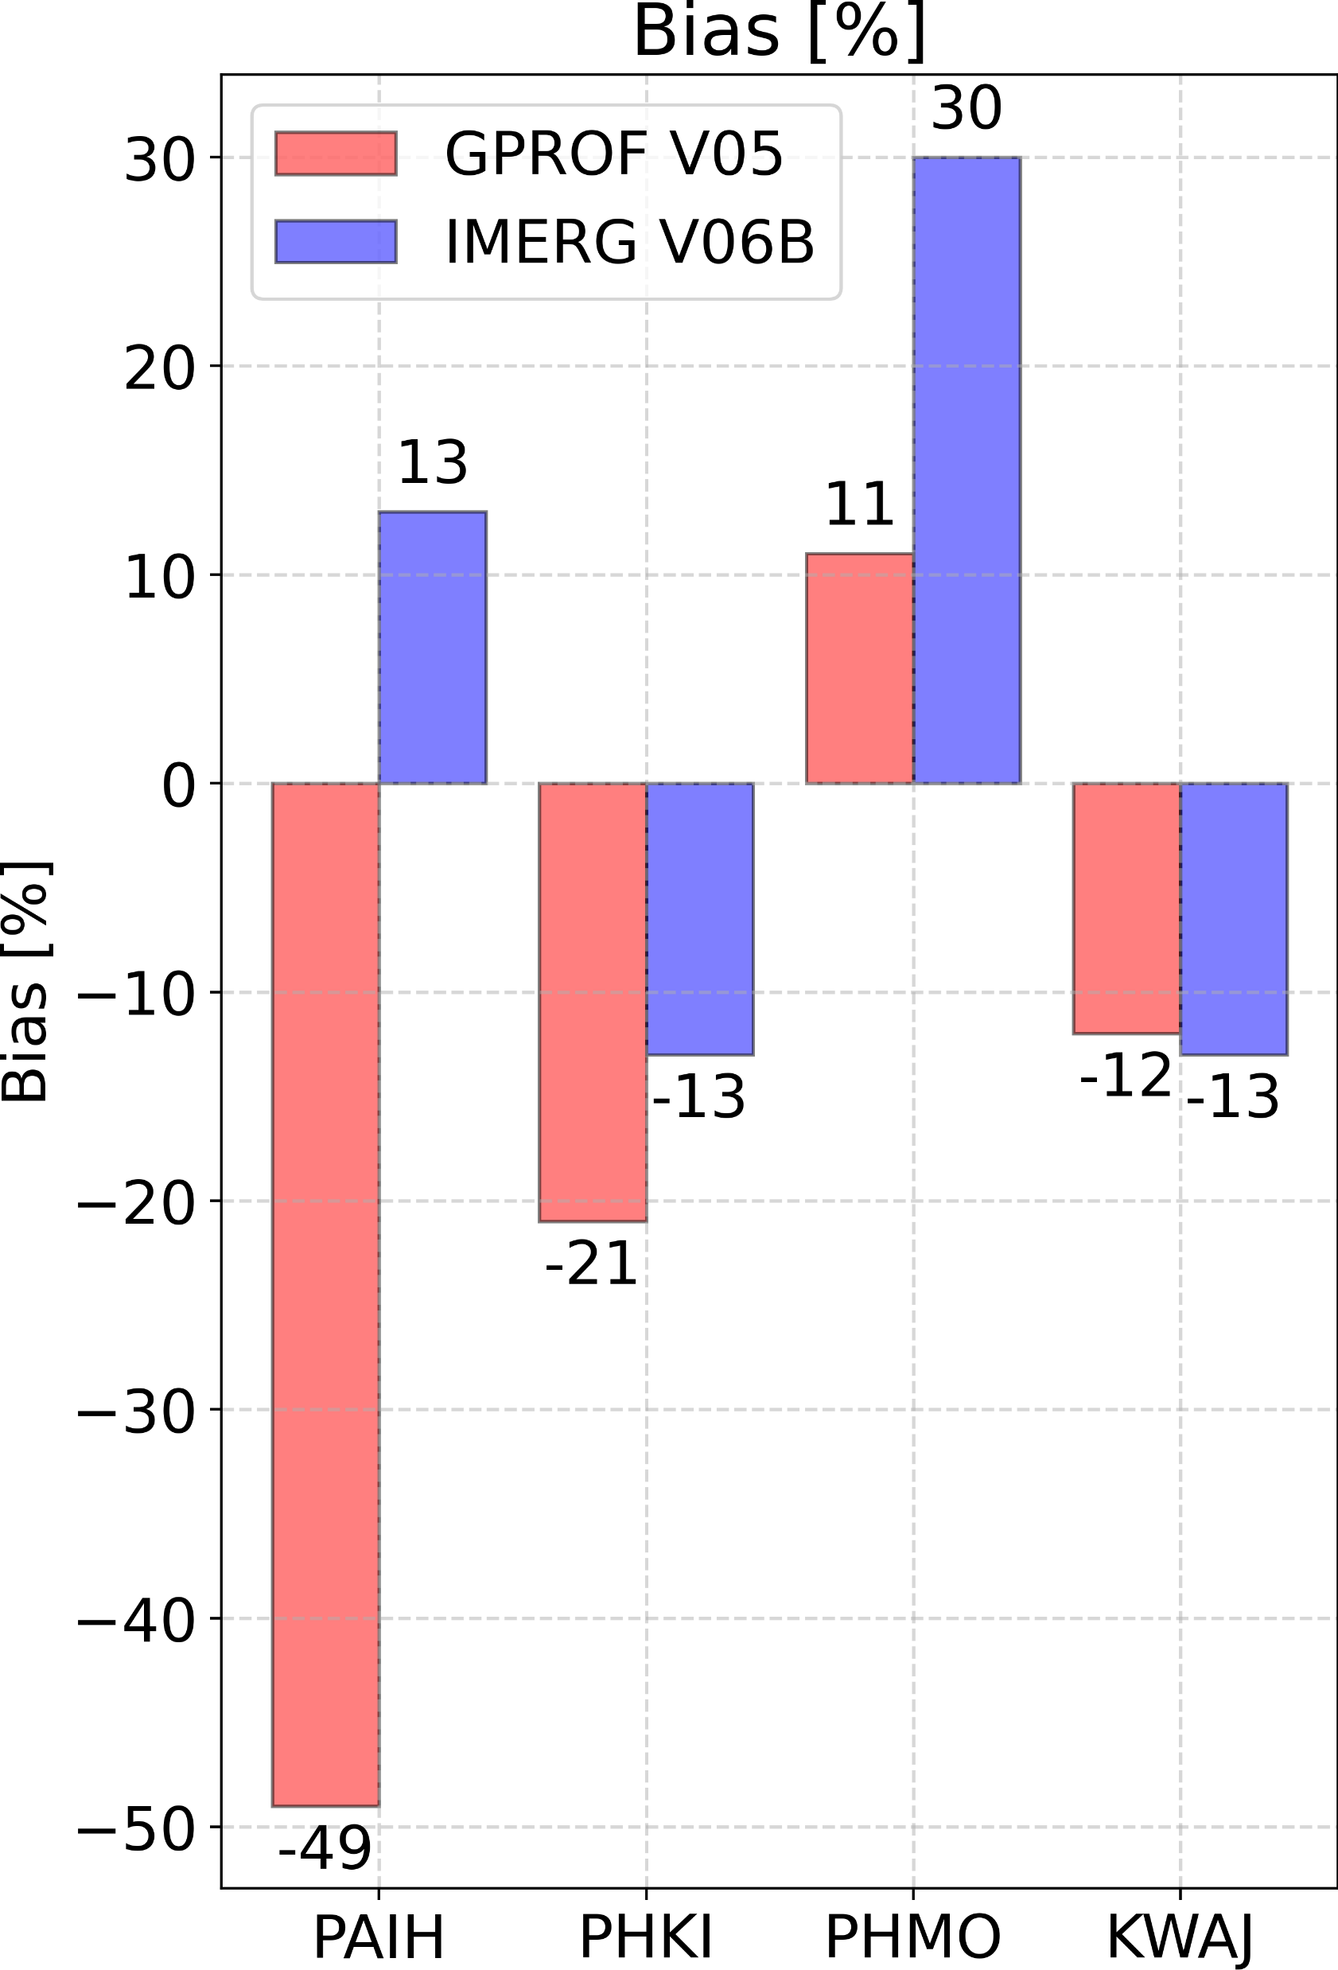
Oceanic Validation with the Validation Network
IMERG oceanic biases vary by location
IMERG error tracing back to GPROF varies by location
Lat.
59.5º
21.9º
21.1º
8.7º
Lat.
59.5º
21.9º
21.1º
8.7º
Lat.
Ground-Based Radar Site
Ground-Based Radar Site
Ground-Based Radar Site
Ground-Based Radar Site

Slide 7
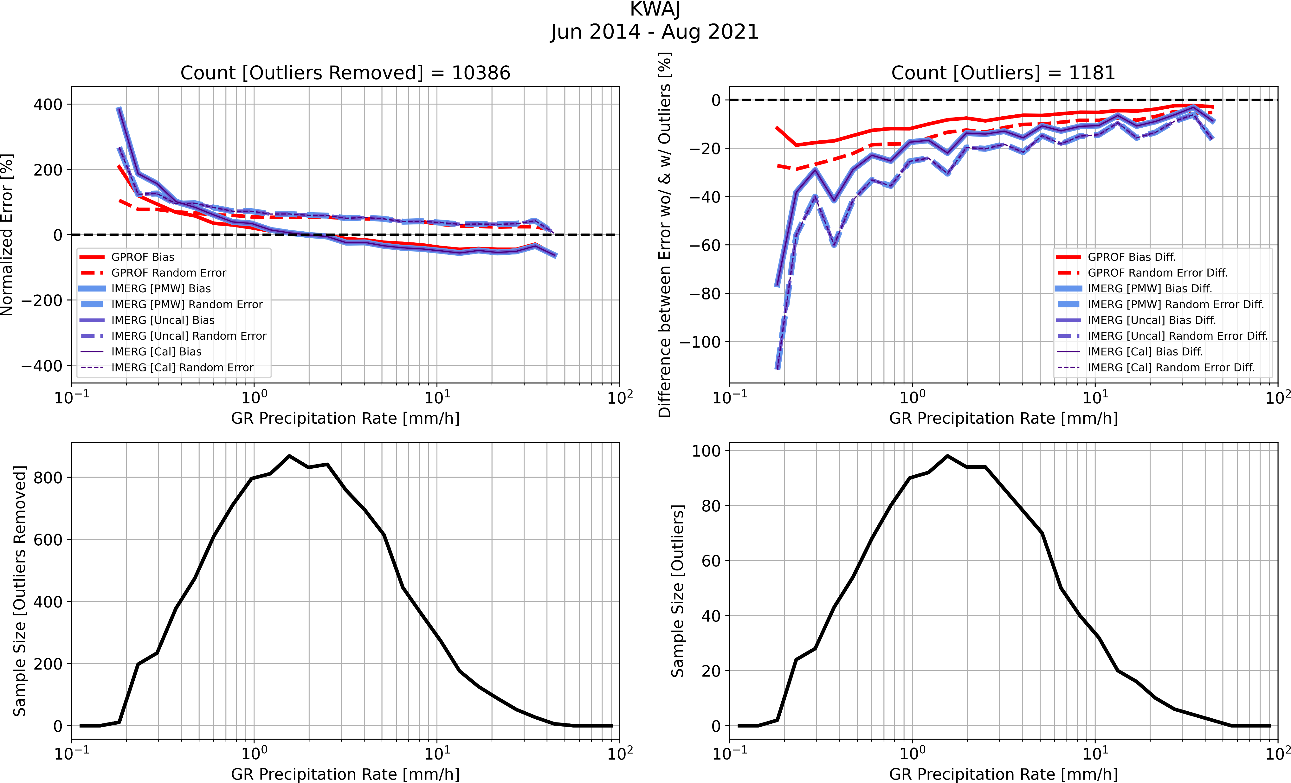
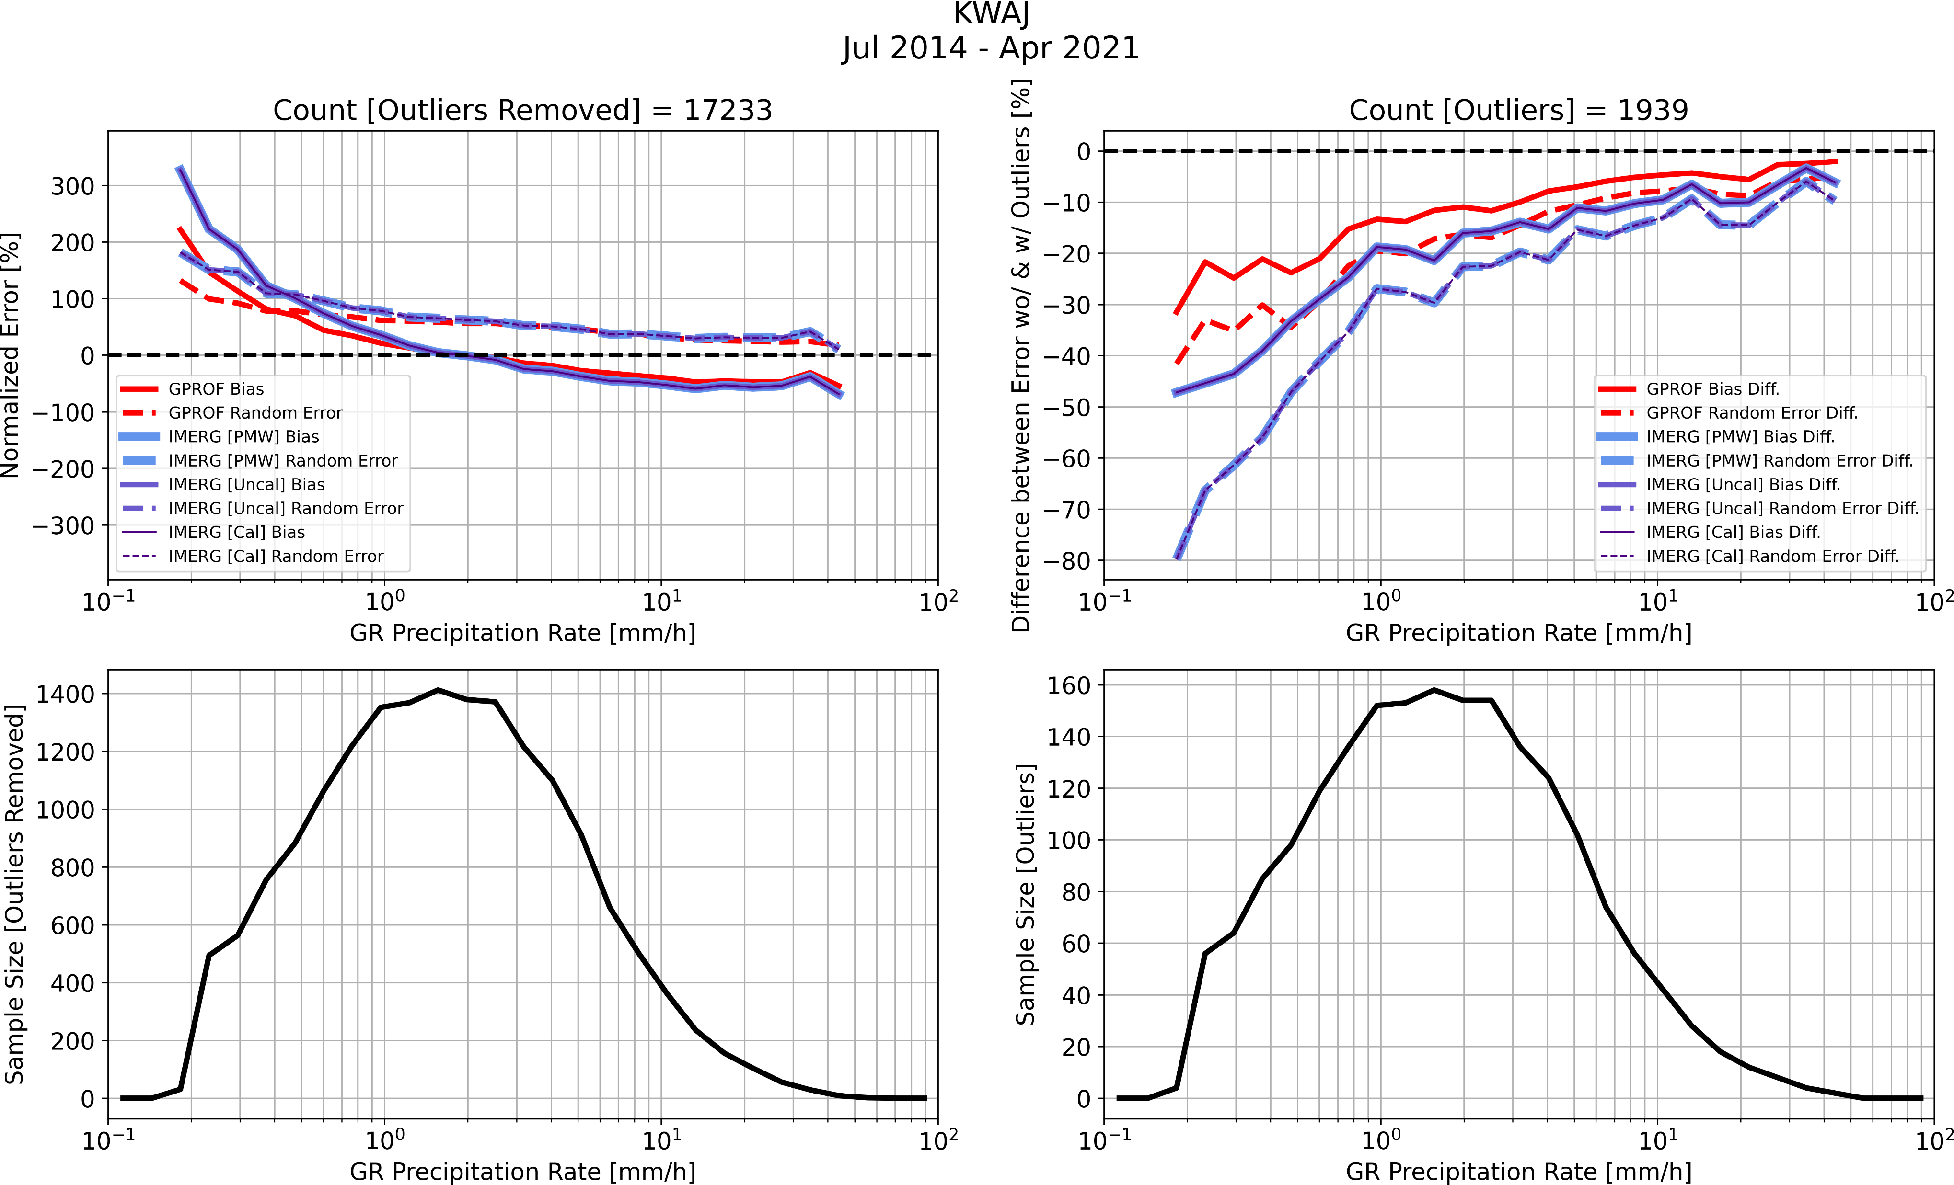
Oceanic Validation with the Validation Network
IMERG appears to increase overestimating bias from GPROF for light precipitation rates across all sites.
GPM products overestimate light rain and underestimate heavy rain across all sites (except PHMO where heavy rain estimates are in close agreement with GR). V07 should address these biases across the rainfall spectrum.

Slide 8
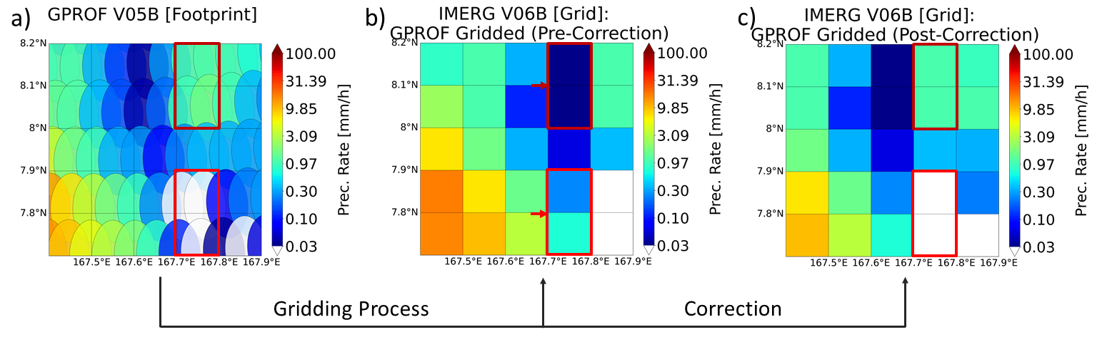
IMERG Assessments with the Validation Network
IMERG Gridding Error Found: IMERG’s PMW estimates were incorrectly geolocated by 0.1º eastward globally between 75ºN-S in V06 and all preceding versions.

Slide 9
Conclusions and Future Work
IMERG and GPROF exhibit varying performance for GMI measurements over different oceanic regions – highlights requirement for more oceanic evaluation of spaceborne precipitation products.
GRtoGPROFtoIMERG matchup files to be produced and available publicly in 2023/2024.
Next steps:
  Assess the impact of the IMERG gridder offset, which has incorrectly geolocated GPROF footprints by 0.1º eastward globally between 75ºN-S in V06 and preceding versions.
  Include Validation Network’s 3D reflectivity, water content and hydrometeor identification profiles in analysis.

Slide 10
References
Gatlin, P.N., Petersen, W.A., Pippitt, J.L., Berendes, T.A., Wolff, D.B. and Tokay, A. (2020). The GPM Validation Network and Evaluation of Satellite-Based Retrievals of the Rain Drop Size Distribution. Atmosphere, 11(9), p.1010. https://doi.org/10.3390/atmos11091010
NASA (2021). Global Precipitation Measurement (GPM) Mission Ground Validation System – Validation Network Data Product User’s Guide – Volume 2 – GPM Data Products. Accessed May 5, 2022, https://gpm.nasa.gov/sites/default/files/document_files/Val_Network_Users_Guide_Vol_2_Nov2015.pdf.
Rajagopal, M., Zipser, E., Huffman, G., Russell, J. and Tan, J., 2021. Comparisons of IMERG version 06 precipitation at and between passive microwave overpasses in the tropics. Journal of Hydrometeorology, 22(8), pp.2117-2130. https://doi.org/10.1175/JHM-D-20-0226.1

Slide 11
Supplementary Material

Slide 12
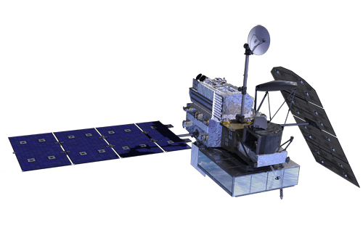
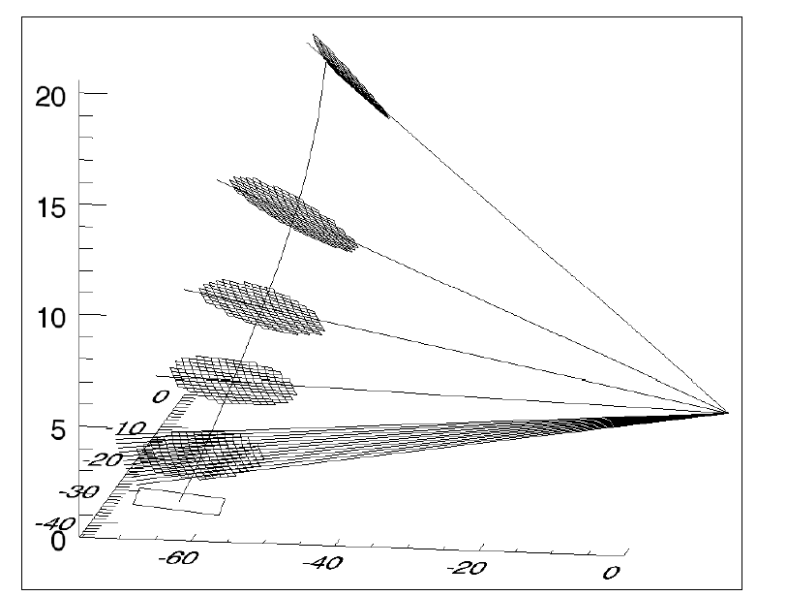
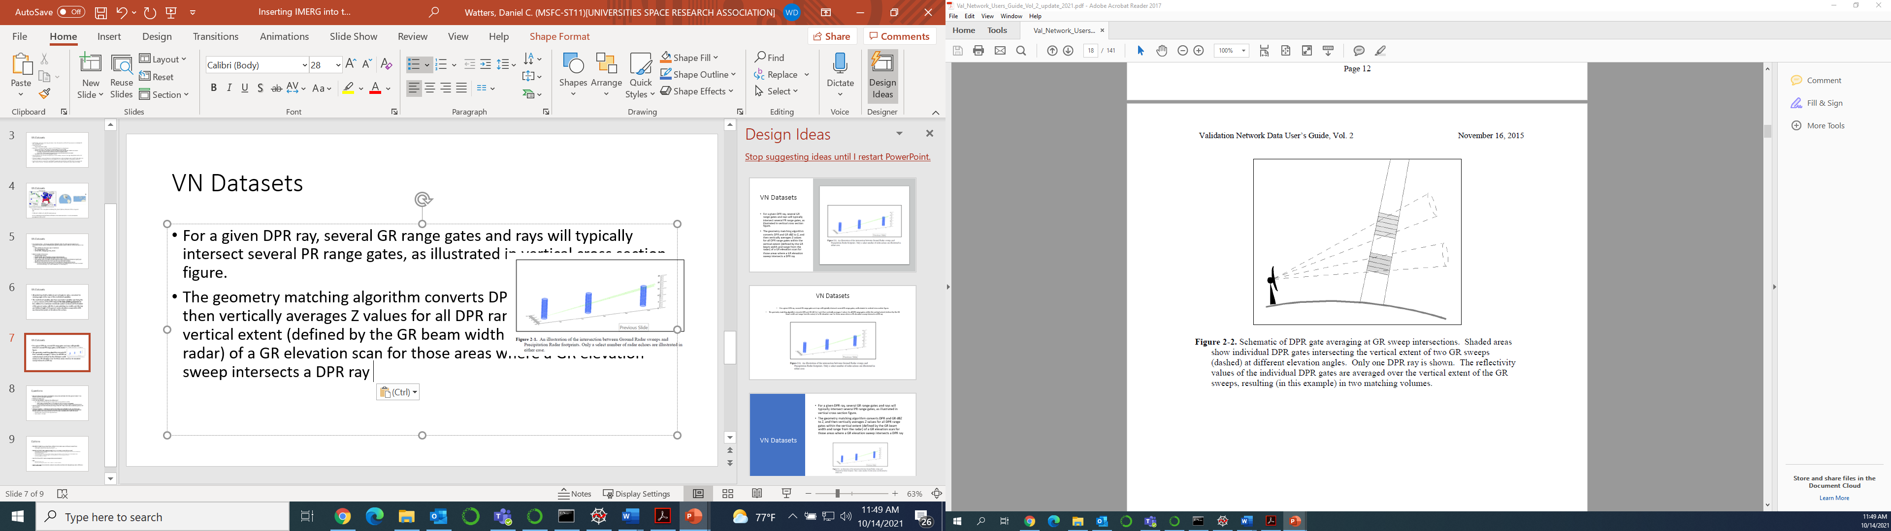
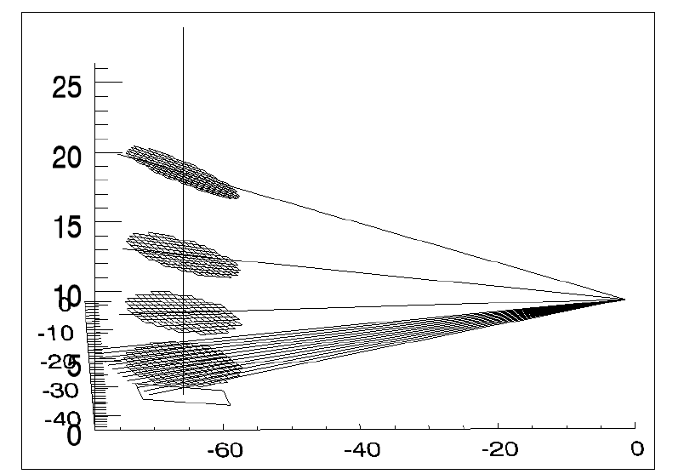
The GPM Validation Network
Line of Sight
GPM Core
Ground Radar (GR) to GPROF-GMI Matchup
Matchup event criterion: GPM Core 2AKu product identifies certain rain for >100 grid pixels (4 km x 4 km) within 100 km of GR
3D spatial matchups: GPROF near-surface precipitation field is matched to GR reflectivity and dual-polarization fields along:
  Line of sight
  Vertical profile
Temporal matchups: GR scan set with first sweep closest in time to GPM Core overpass time is selected.
GR
Vertical Profile
GPM Core
GR

Slide 13
The GPM Validation Network
GR to GPROF-GMI to IMERG Matchup
Currently uses an approximation of the IMERG backward gridding technique for gridding precipitation at the GPROF-footprint scale.
Assign footprint precipitation rates to a 0.025-degree grid using a nearest neighbor population technique;
Coarsen the 0.025-degree precipitation grid to the IMERG 0.1-degree resolution.
GR [GPROF Footprints]
GR [0.025-Deg. Grid]
GR [0.1-Deg. Grid]
Soon to be updated to use the IMERG backward gridding technique, which populates GPROF footprints to a 0.1-degree grid using a minimum squared elliptical distance technique and accounts for the elliptical footprint dimensions.
Public matchup files (GRtoGPROFtoIMERG) to be added to the Validation Network in 2023/2024.

Slide 14
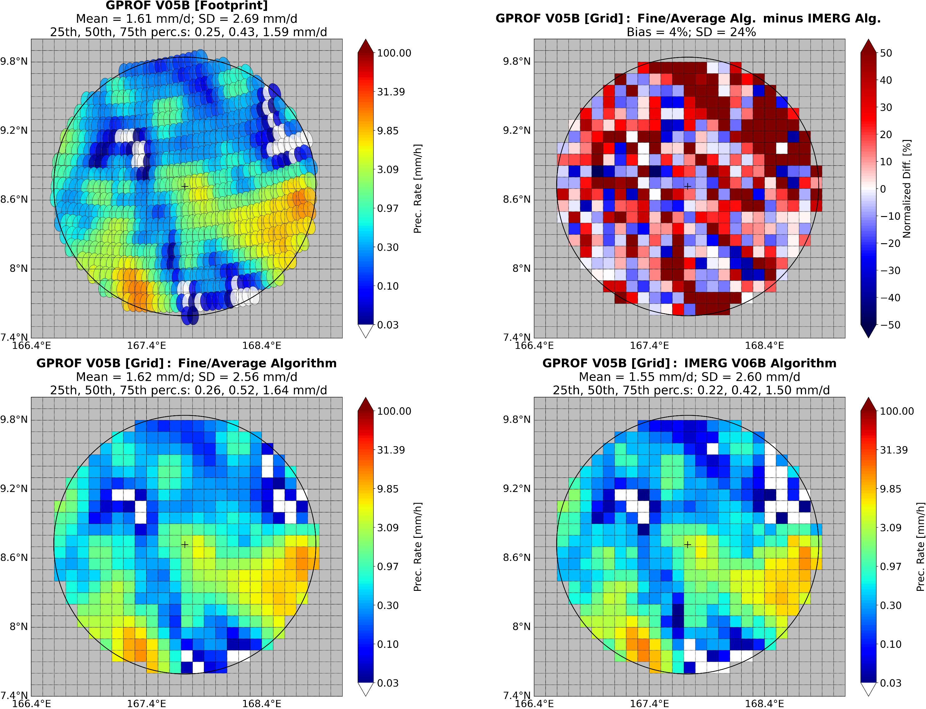
IMERG Gridding Assessment with the Validation Network
A Superior Gridding Process?
Previous NASA alg.
Gridding
Current NASA alg.
IMERG V06B Gridding Algorithm
Populates 0.1º grid
Accounts for the footprint dimensions
Fine/Average Gridding Algorithm
Populates a 0.025º (fine) grid then averages to a 0.1º grid
Abandoned by IMERG to speed up computation
GPROF V05B [Footprint]
Case Study: 20190712, Granule 030509
Mean = 1.61 mm/d
First Quartile = 0.25 mm/d
Median = 0.43 mm/d
Third Quartile = 1.59 mm/d
Mean = 1.55 mm/d
First Quartile = 0.22 mm/d
Median = 0.42 mm/d
Third Quartile = 1.50 mm/d
Mean = 1.62 mm/d
First Quartile = 0.26 mm/d
Median = 0.52 mm/d
Third Quartile = 1.64 mm/d
The Fine/Average algorithm could better grid the GPROF-GMI precipitation field according to case studies, but further analysis is required.

Slide 15
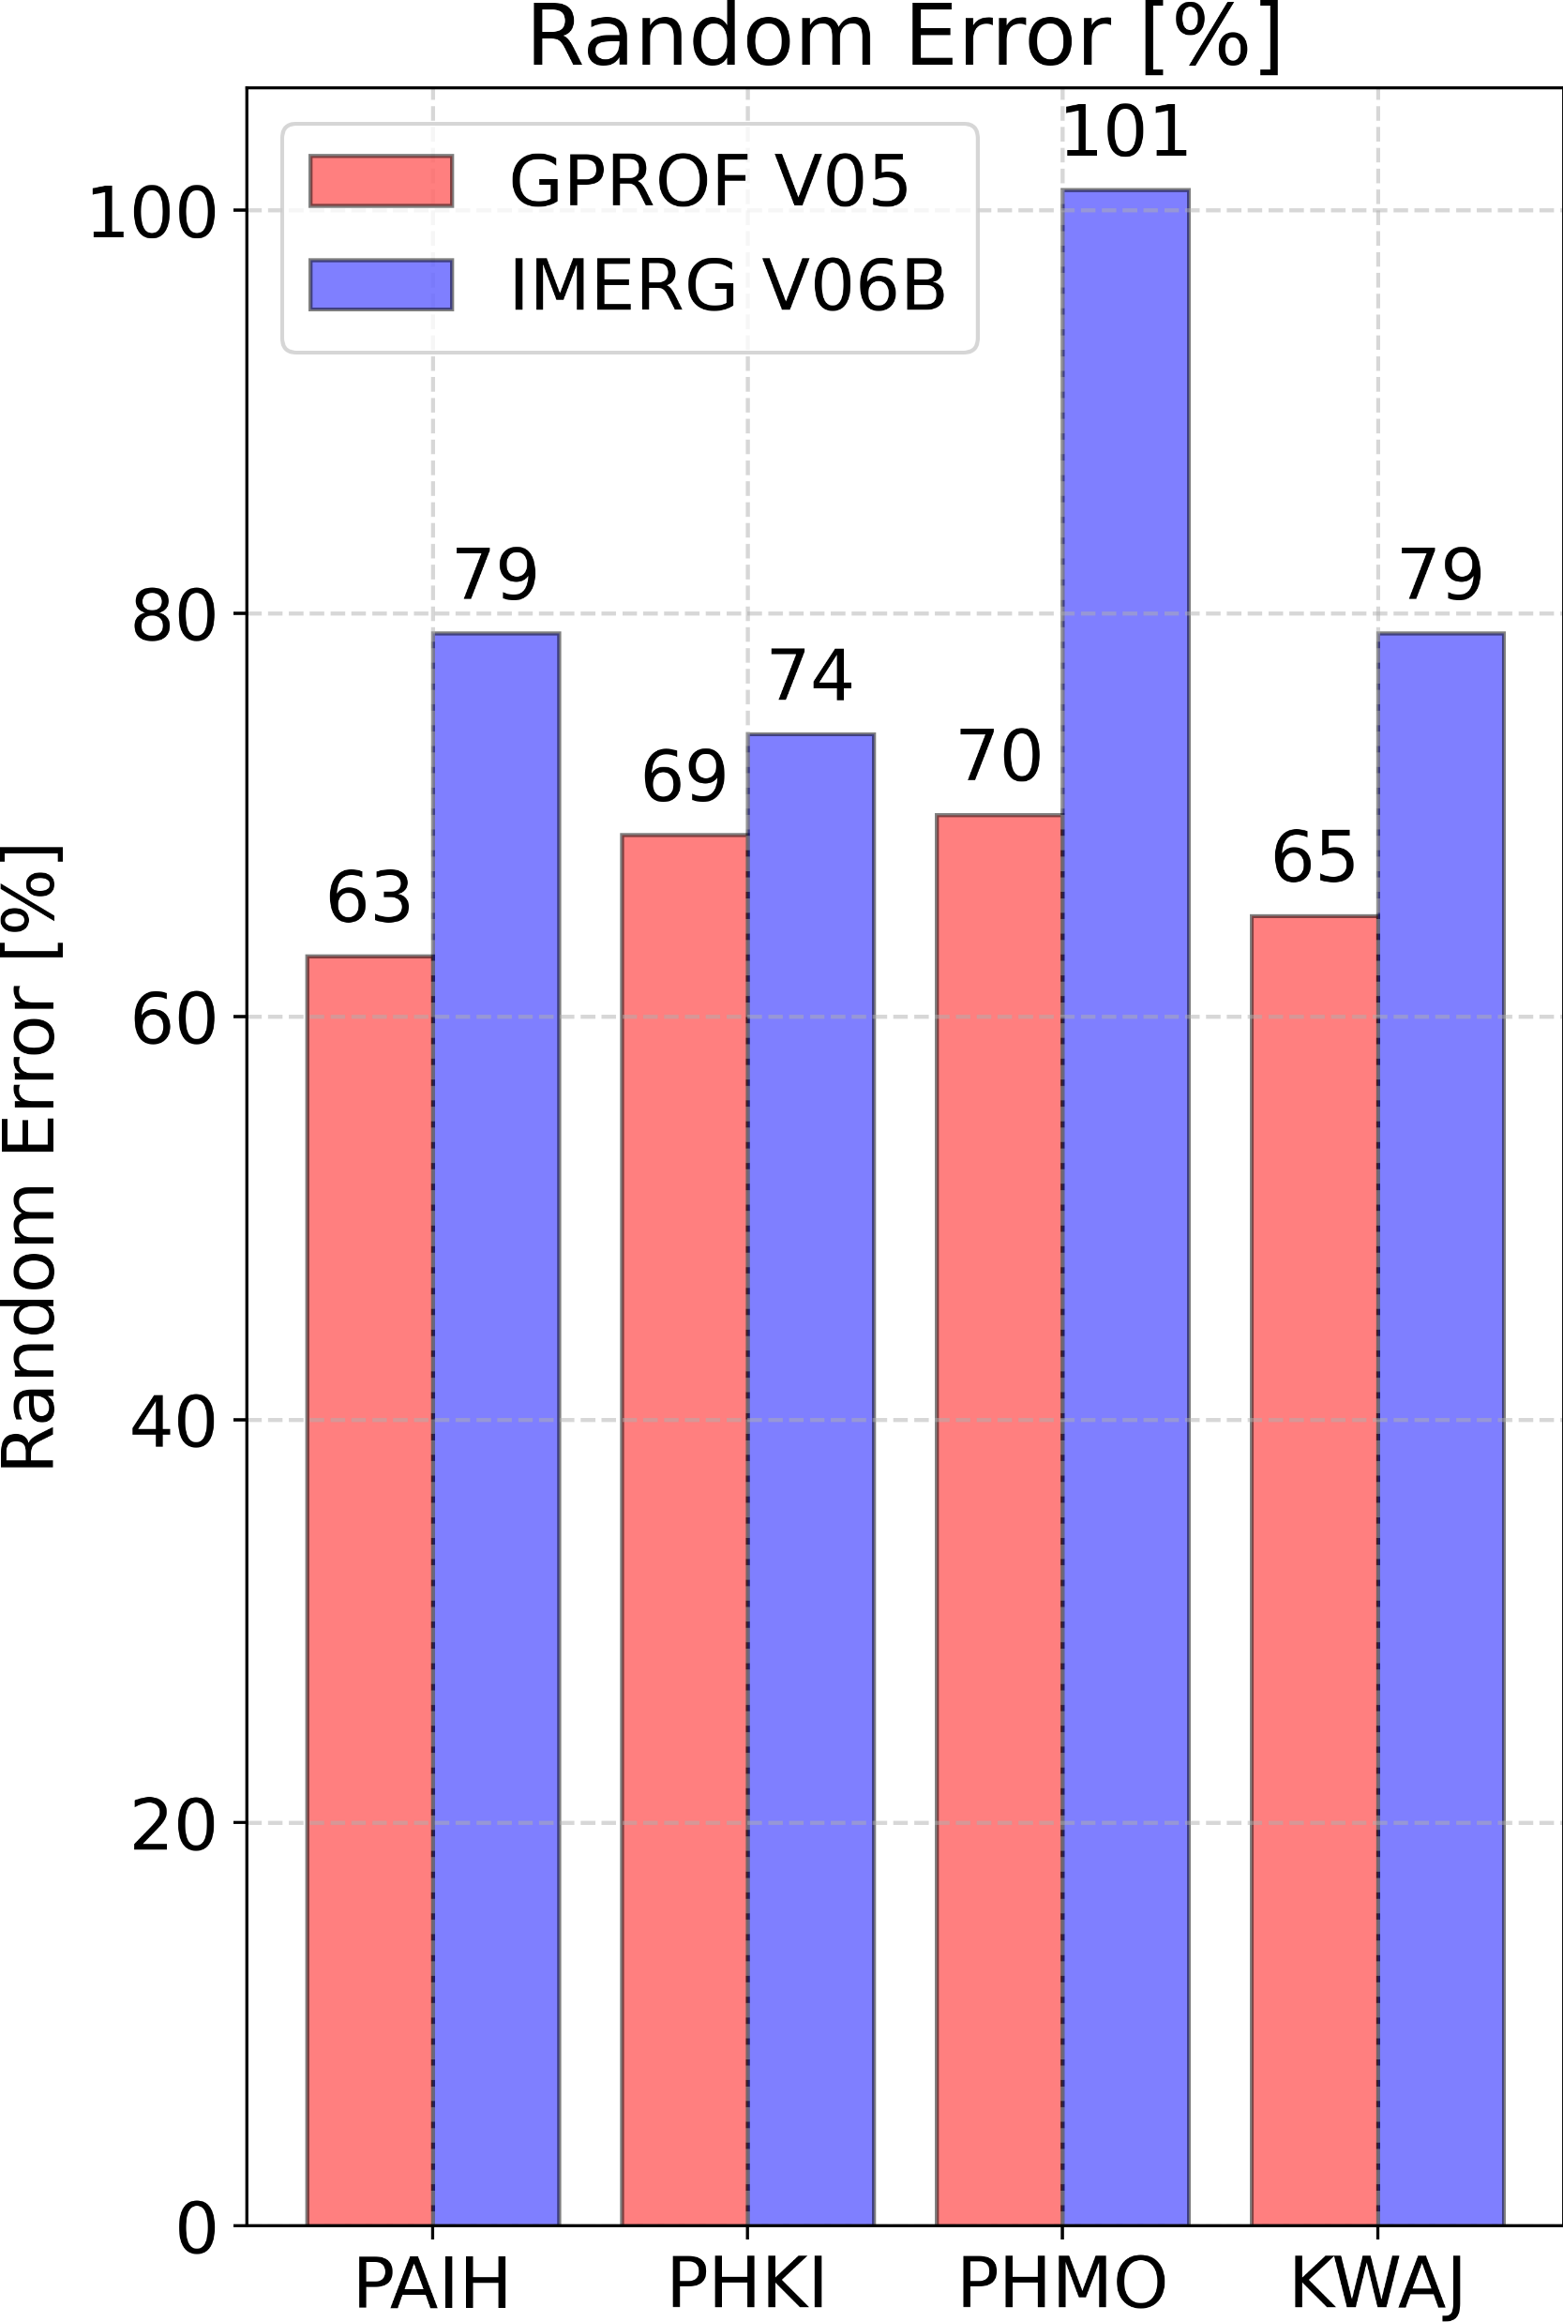
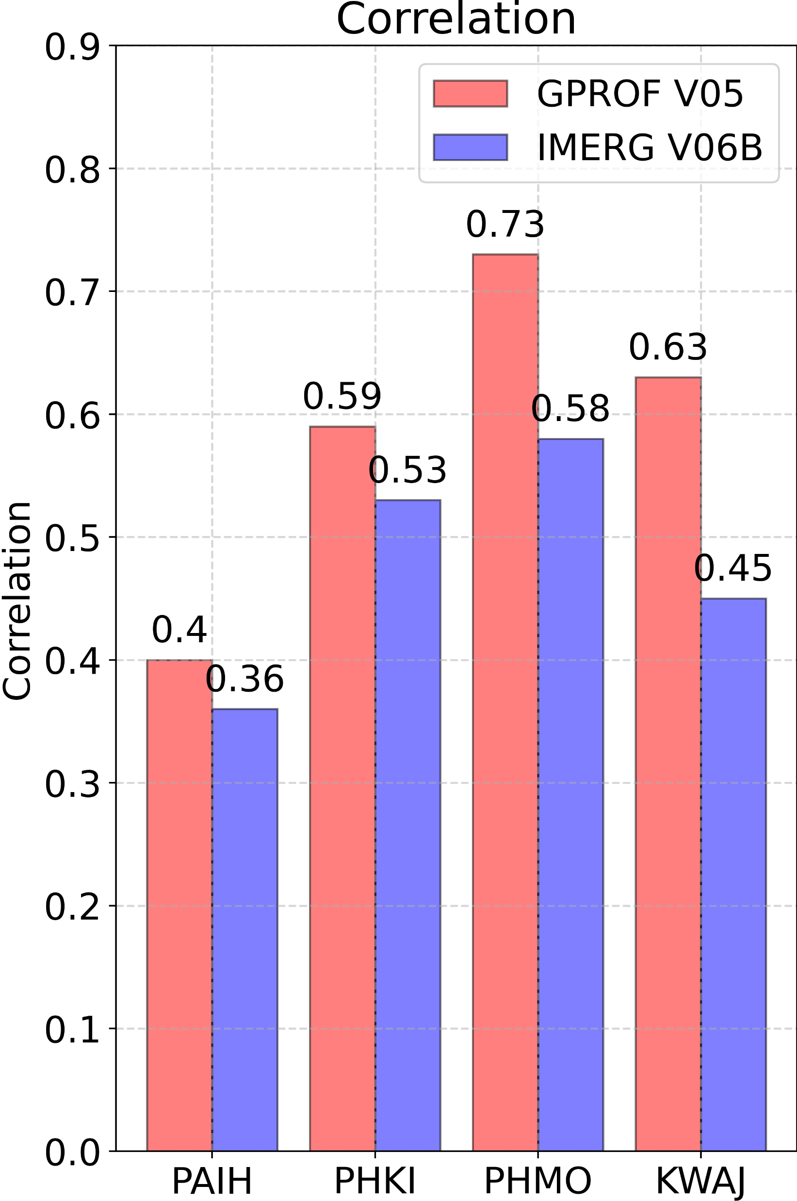
Oceanic Validation with the Validation Network
IMERG has more variable oceanic biases and weaker correlation with GRs than GPROF.
Lat.
59.5º
21.9º
21.1º
8.7º
Lat.
59.5º
21.9º
21.1º
8.7º
Ground-Based Radar Site
Ground-Based Radar Site

