Slide 1
Construction of a Fluid Flow Field from Discrete Point Data using Machine Learning
Yury Lebedev¹, Michael W. Lee², Alina Zare¹
¹University of Florida, ²NASA Langley Research Center
AIAA SciTech Forum
01/25/2023

Slide 2
Background
Data incompatibility exists
Most physical experiments lack continuous surface or volume data
Continuous surface or volume data makes comparison to simulations more informative
Our research
Pattern recognition with physics-constrained shallow encoder neural network
Can approximate surface and volume data from sparse point measurements

Slide 3
Methodology
Sparse, discrete measurements → continuous field
$$s∈ℝ^{p} ⟼ f∈ℝ^{m} ; p≪m$$
Seek to estimate inverse model
$$f=G(s)$$
Fully connected neural network trained on ${\left\{f_{i},s_{i}\right\}}_{i=1}^{n}$
$k$ layers, nonlinear activation $R,$weights $W$
$$G\left(s\right)≈ℱ\left(s,W\right)=R\left(W^{k}R\left(W^{k−1}⋯R\left(W^{1}s\right)\right)\right)$$

Slide 4
Shallow Encoder Structure
hidden layer
Given sensor measurements, which learned features are dominant?
feature identification
$$Φ\left(s\right)=R\left(W^{ϕ}s+b^{ϕ}\right)$$
hidden layer
Given dominant features, how are they scaled to match sensors and integrated values?
matching measured values
$$V\left(Φ\right)=R\left(W^{v}Φ+b^{v}\right)$$
linear output layer
Define output at linear combination of weighted dominant features
continuous field output
$$f=ΦV+b^{Φ}$$

Slide 5
Network Training and Physics-based Constraints
Enforce incompressible mass conservation if modeling a low-Mach flowfield
introduce a discrete divergence operator${ L}_{div}$ associated with a finite difference scheme
${\left(L_{div}f\right)}_{k}≈\left(∇⋅\vec{u}\right)\left(p_{k}\right)=0$ at all grid points $\{p_{1},⋯,p_{N}\}$
Added as a regularizer: $λ|L_{div}|_{2}^{2}$ to mean-squared error (MSE) in Euclidean flow space
Minimize error in Euclidean flow space over all sensor measurements
$ℱ_{s}=\text{argmin} \sum_{i=1}^{k}{|f_{i}}−G\left(s_{i}\right)|_{2}^{2}$ + $λ|L_{div}|_{2}^{2}$
Enforce agreement of measured integrated values $N$ and
computed integrated values $ℒ$
$$ℱ_{r}=\text{argmin} \sum_{i=1}^{p}{{\left|N\left(f_{i}\right)−ℒ\left(s_{i}\right)\right|}_{2}^{2}}$$
Modified loss: $ℱ$= $ℱ_{s}$ + $ℱ_{r}$

Slide 6
Regularization
overfitting
test error
error
train error
iterations
Batch Normalization (BN) stabilizes outputs during training
Dropout Layers (DL) ensure that single neurons do not dominate convergence
Shallow Encoder structure:
$$s↦Φ\left(s\right)↦BN↦DL↦V↦BN↦f$$

Slide 7
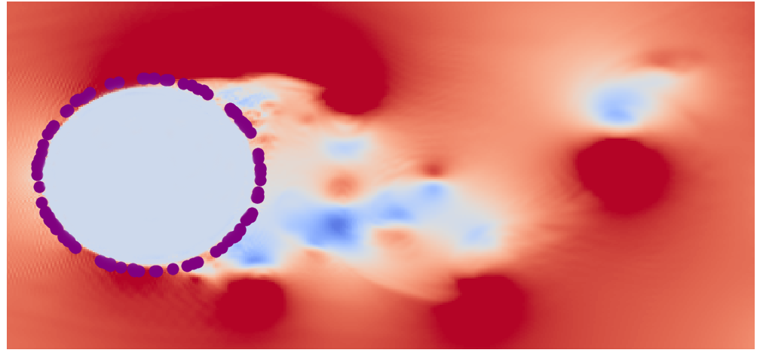
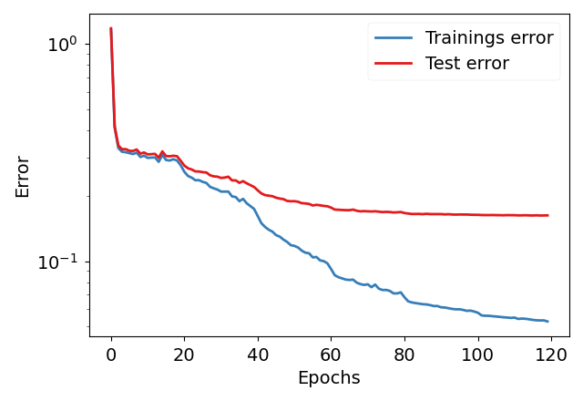
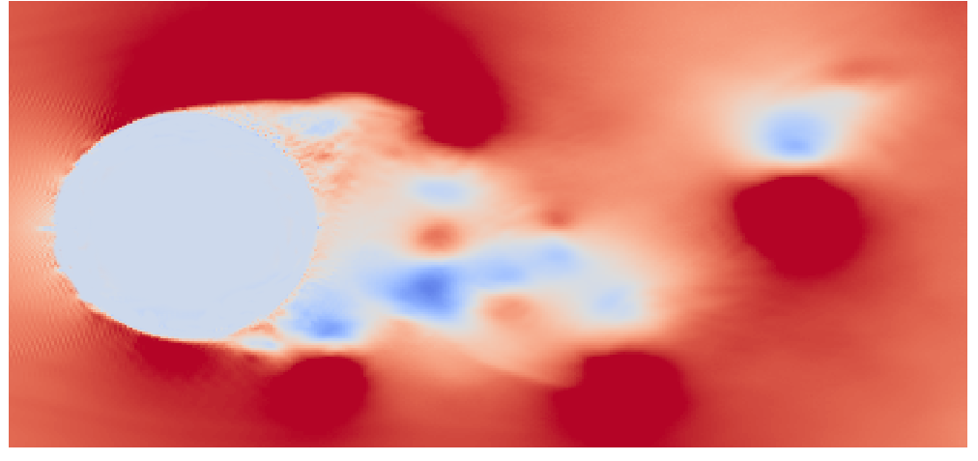
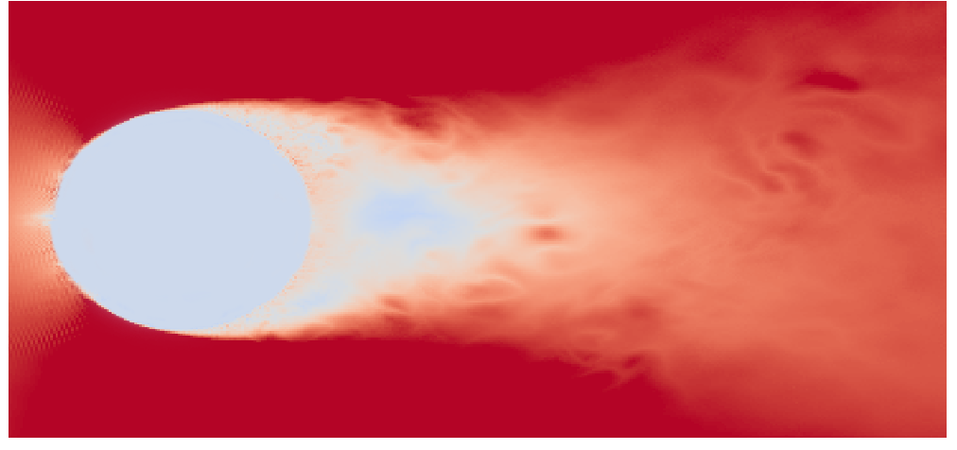
Flow Over a Circular Cylinder: Re = 20k
sensors
700 training snapshots
300 test snapshots
true snapshot
reconstructed snapshot
16.2%
5.28%
pointwise difference

Slide 8
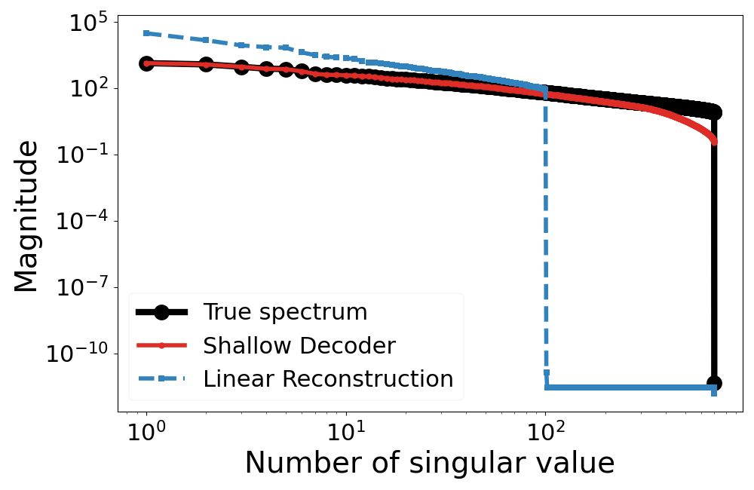
Flow Over a Circular Cylinder: Re = 20k
Modal spectra are another way to quantify reconstruction accuracy
Singular-value decomposition (SVD) is a common way to identify snapshot eigenspectrum
Plot square-root of singular values

Slide 9
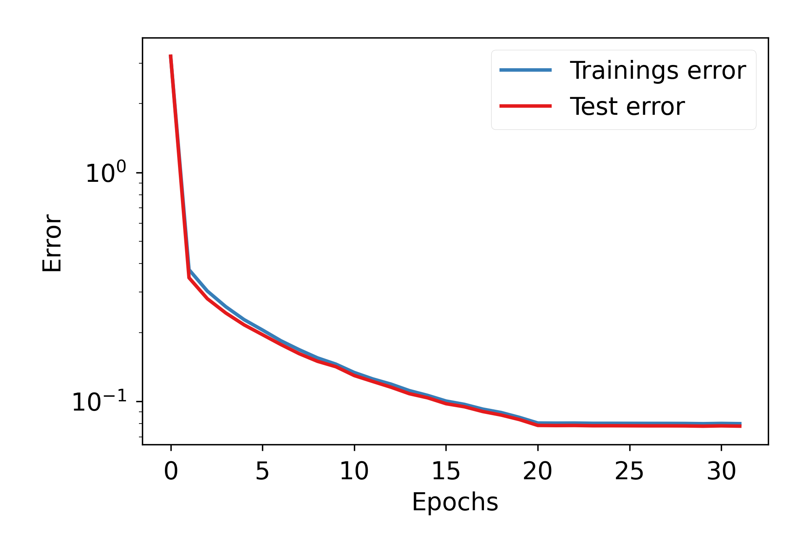
Regularized Lid-Driven Cavity Flow: Re = 30k
100 sensors randomly placed in 2D volume
true snapshot
reconstructed snapshot
4200 training snapshots
1800 test snapshots
7.8%
8.0%
sensors

Slide 10
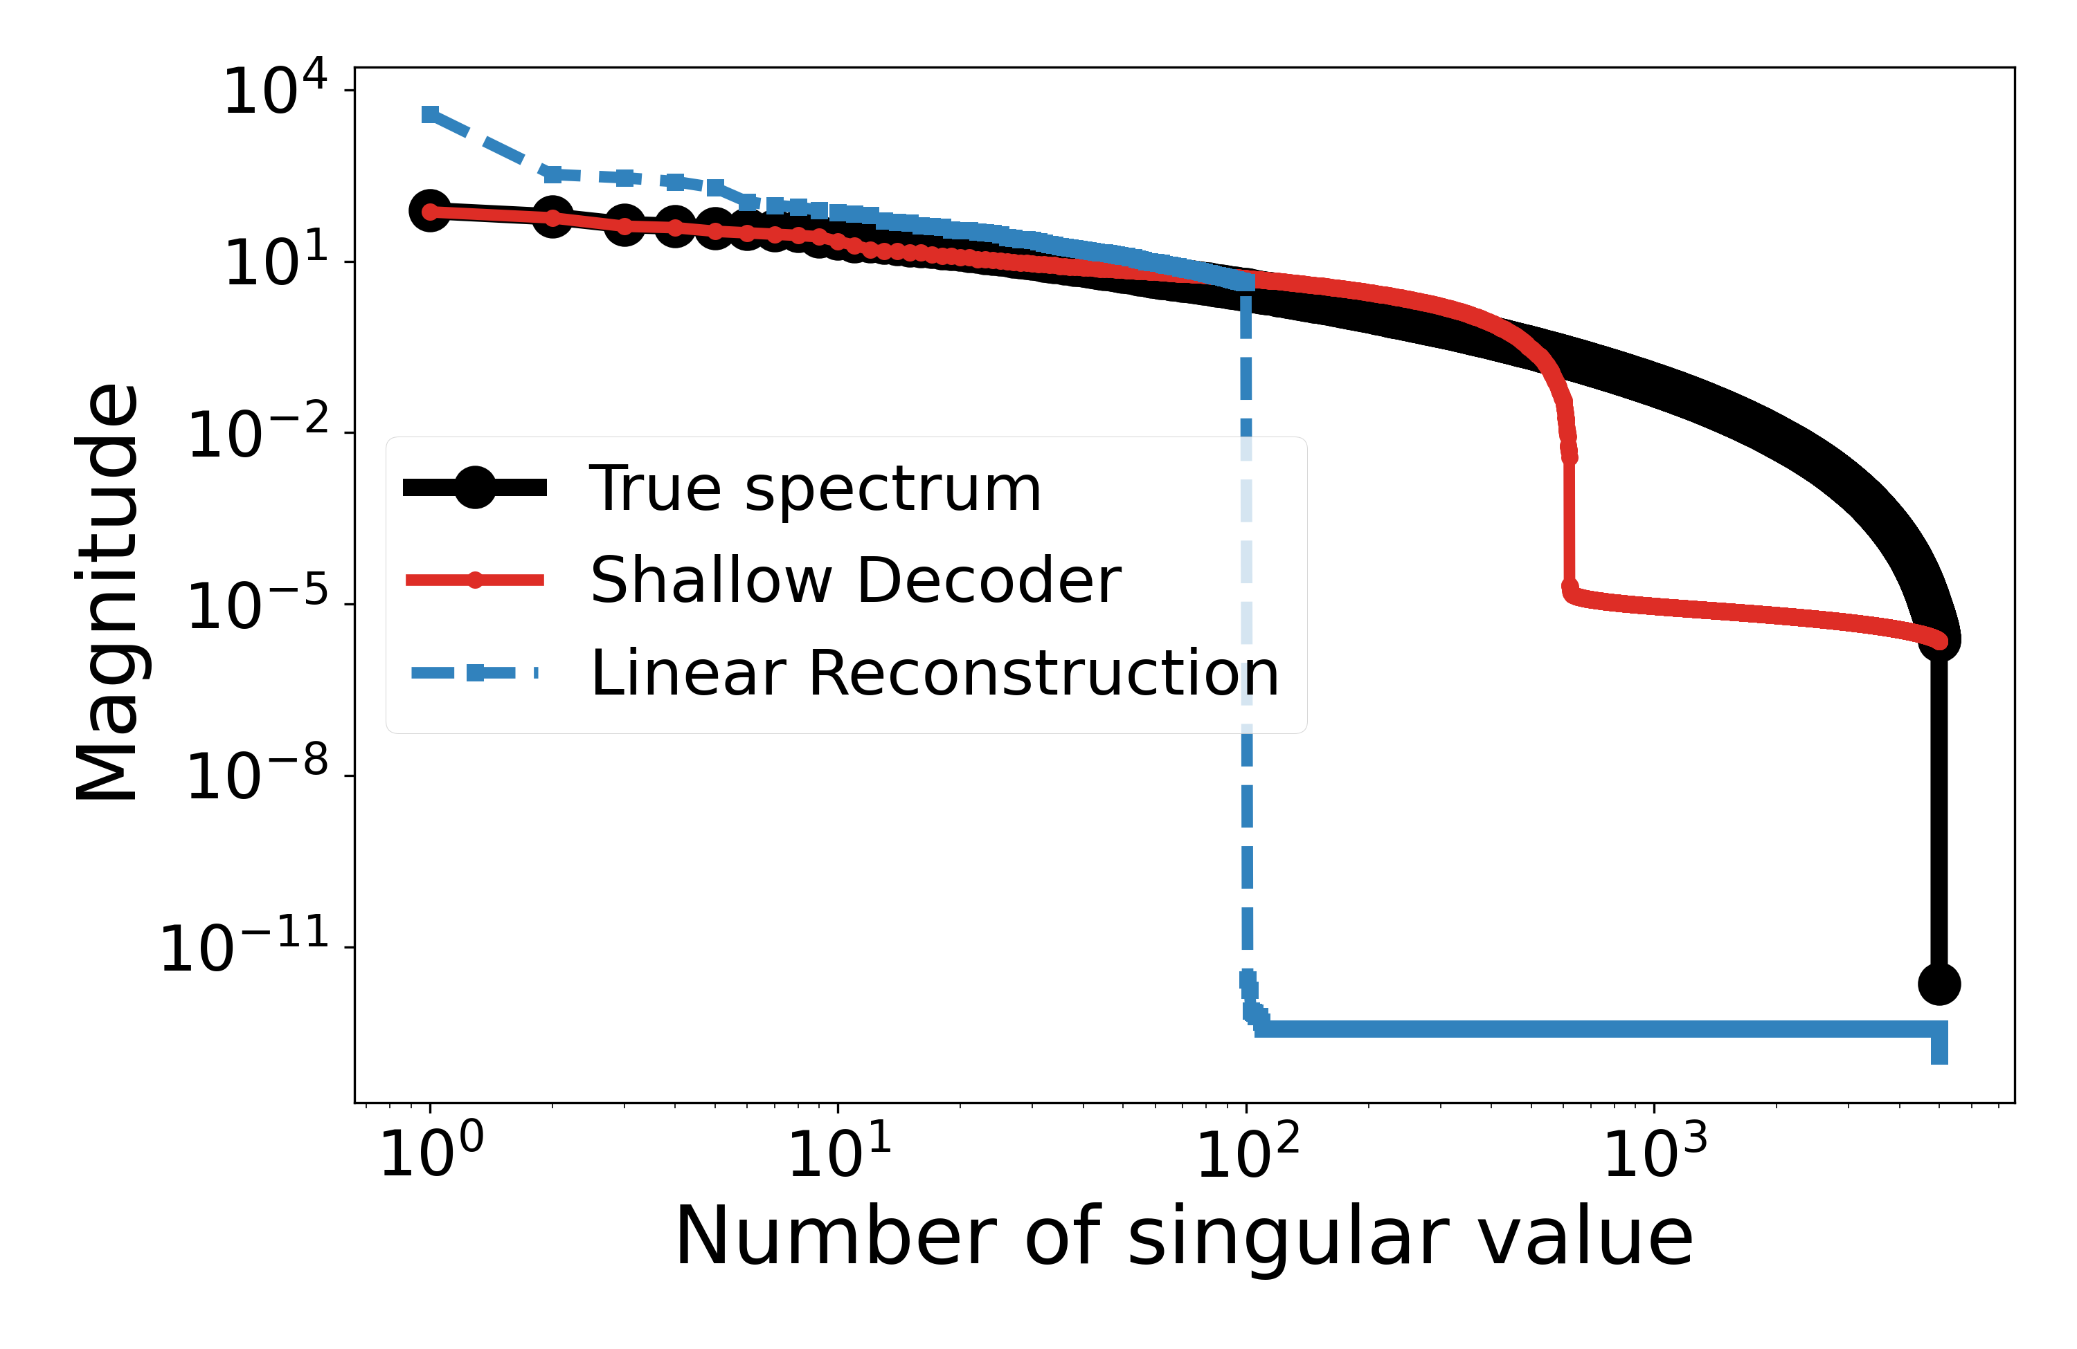
Regularized Lid-Driven Cavity Flow: Re = 30k
Eigenspectrum reconstruction again shows improved agreement

Slide 11
Conclusion
Fully connected, physics-constrained neural network developed which can construct flowfield approximations from sparse, discrete samples
Reconstructions yield integrated measurements equal to those collected experimentally and, where applicable, satisfy mass conservation
Network can be applied real-time to visualize flowfield during wind tunnel tests

Slide 12
Integrated forces computation
With parametric surface defined by
$\left(λ,ξ\right)∈{\left[0,1\right]}^{2}→\left(x_{∂},y_{∂},z_{∂}\right)∈R^{𝟛}$
With Pytorch Autograd (with respect to $λ$ ) compute normal vector to the boundary
$\vec{n}(λ) = (n_{x}(λ),n_{y}(λ)) = (−\frac{∂y_{∂}}{∂λ}(λ),\frac{∂x_{∂}}{∂λ}(λ))$
Total integrated force by averaging the Monte Carlo simulations to integrate local forces $\vec{df}\left(x,y\right)$
$\vec{F}=\int_{∂Ω_{f}}{\vec{df}}dl$

Slide 13
Integrated forces computation
For incompressible flow, local forces
$df_{x} = −pn_{x} + \frac{2}{Re}\frac{∂u}{∂x}n_{x} +\frac{1}{Re}(\frac{∂u}{∂y} + \frac{∂v}{∂x})n_{y}$
$df_{y} = −pn_{y} + \frac{2}{Re}\frac{∂v}{∂y}n_{y} +\frac{1}{Re}(\frac{∂u}{∂y} + \frac{∂v}{∂x})n_{x}$
Integrated force is approximated via Monte-Carlo
$\vec{F}(t) = ∫_{∂Ω_{f}}\vec{d}f(x,y,t)dl = ∫_{[0,1]}\vec{d}f(x_{∂}(λ),y_{∂}(λ),t) \left|\frac{dl(λ)}{dλ}\right| dλ≈\frac{1}{\left|V_{λ}\right|}\sum_{λ∈V_{λ}}{\vec{d}f(x_{∂}(λ),y_{∂}(λ),t) \left|\frac{dl(λ)}{dλ}\right|}$ where $V_{λ}$ is sampling of $\left[0,1\right]$ after which is mapped to the airfoil boundary by $λ→x_{∂}\left(λ\right),y_{∂}\left(λ\right)$
Now use adaptive sampling with Monte-Carlo to compute $\left|\frac{dl(λ)}{dλ}\right|$ using the probability distribution of random variable $λ$

Slide 14
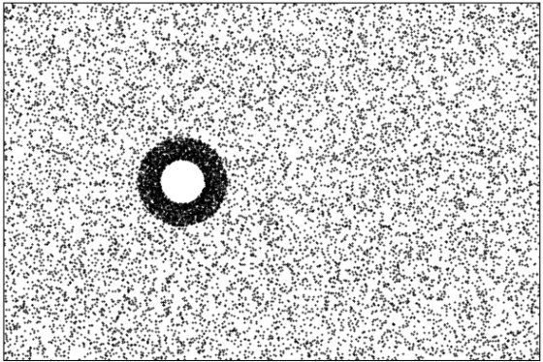
Integrated forces computation
Now we compute residual term $ℱ_{r}$ by randomly sampling points $V_{in}$ by evenly spreading $80\%$ of the points and focusing the remaining $20\%$ within a predetermined radius around the 2D cylinder
This increases the relative weight of the residuals in the cylinder's boundary layer relative to those in the remaining fluid domain.

