Slide 1

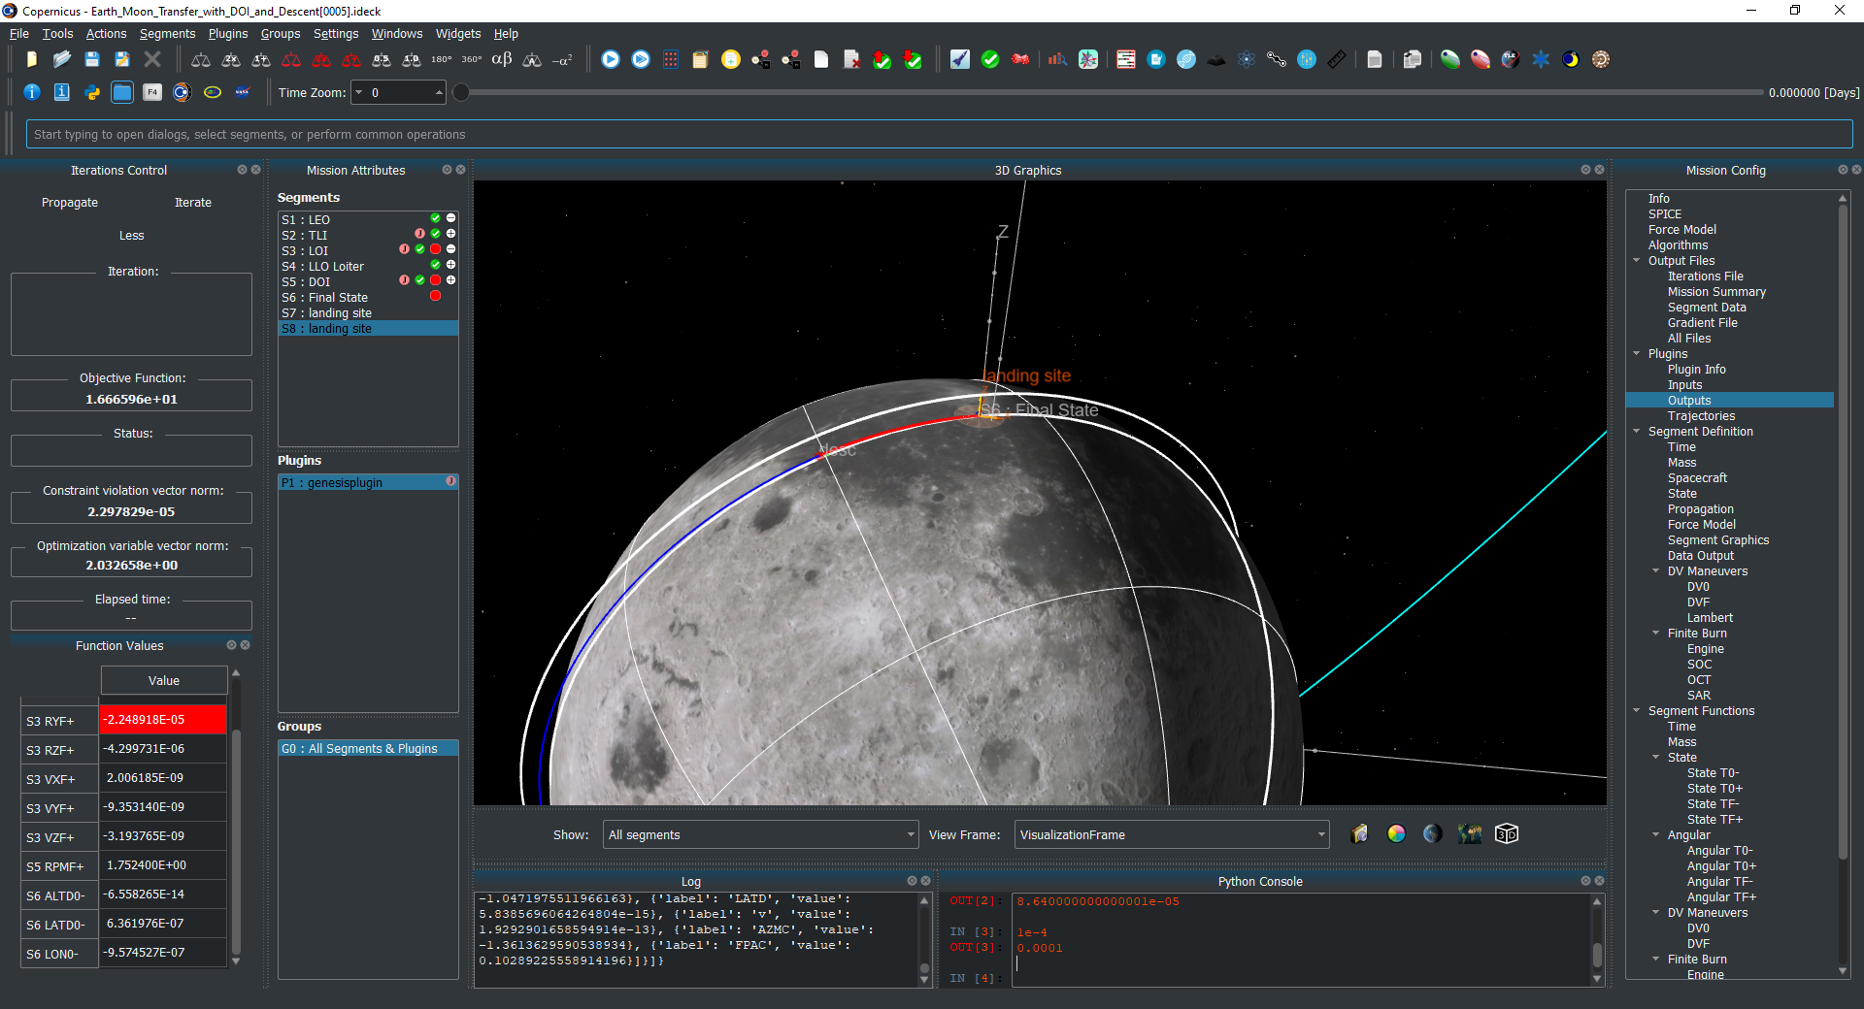



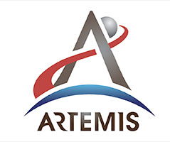
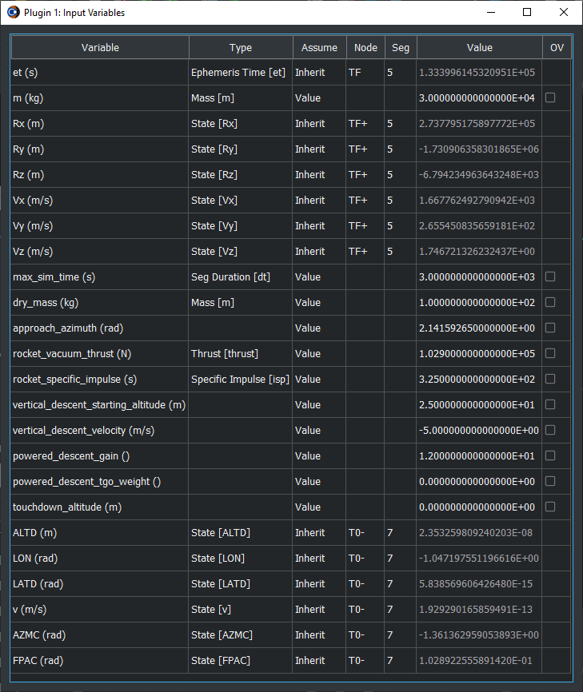
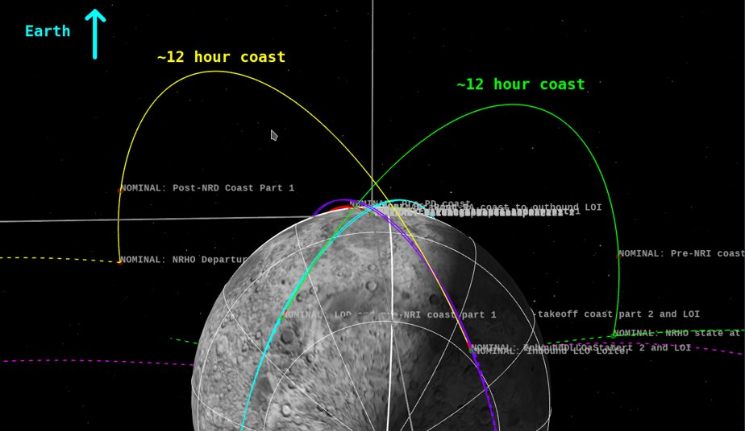
End-to-End Mission Design & Trajectory Optimization
CIF-5
Principal Investigator(s): Jacob Williams, Daniel Matz
Technology Taxonomy Area (TX): 15.2.1 Trajectory Design and Analysis, 13.4.1: Mission Planning, 09.4.5: Modeling and Simulation for EDL
TRL: Start 5 / Current 7
FY21 IRAD PROJECT Overview
The ability to compute end-to-end mission optimized trajectories is a critical component needed for the next generation of complex human spaceflight design and operations (Orion, HLS, Gateway, Mars). This project created a new interface for two of NASA’s trajectory tools: Copernicus and Genesis, enabling them to be used together for end-to-end mission design and optimization of all flight phases, including Earth ascent, lunar ascent, rendezvous, and lunar descent. This capability can also serve as a pathfinder for developing a future autonomous, onboard trajectory optimizer.
INNOVATION
This project is innovative because it combines two of NASA’s trajectory tools (Copernicus and Genesis), allowing them to interact in order to optimization end-to-end missions. Historically, this has been difficult, with different tools optimizing different mission phases (e.g., on-orbit vs. ascent/descent) with hand-off points from one tool to the other. This workflow is suboptimal and time consuming, since it may involve different groups, different file formats, and a person-in-the-loop. Creating a seamless integration of an on-orbit and powered ascent/descent tool has great potential to reduce cost, produce more optimization missions (e.g., most cargo to the lunar surface), and is also a critical component for potential autonomous trajectory operations for future missions.
Outcome
In Year 1 (FY22) on the project, the project successfully completed upgrades to Copernicus and Genesis, and created a new plugin to allow Genesis to be used in Copernicus. Specifics include:
Released a new version of Copernicus (5.2). This update included many new features including an improved Python API, improved Conda environment installation, as well as improvements to the plugin architecture to enable the Genesis integration.
Released a new version of Genesis (0.2). More powered flight guidance algorithms were implemented, as well as a new algorithm that automatically detects when to initiate powered descent.
The Copernicus/Genesis plugin was developed, which allows a Genesis trajectory (e.g., ascent or descent) to be incorporated into a Copernicus mission, enabling an end-to-end optimization. Inputs from Copernicus are sent to Genesis, which runs and produces output sent back to Copernicus. Thus, the full power of the Genesis tool is available in Copernicus and can be used for a wide variety of applications.
PARTNERSHIPS / collaborations
This project was supported by various organizations at NASA/JSC including the Engineering Directorate (Aeroscience and Flight Mechanics Division and the Project Management and Systems Engineering Division) as well as the Flight Operations Directorate (Flight Dynamics Division).
Parking Low-Lunar Orbit
Genesis descent trajectory
From Earth
Copernicus screenshot showing an integrated end-to-end case of an Earth transfer with lunar descent
Infusion Space / Earth
A wide range of use cases exist for the end-to-end optimization capability, and there are many potential users and infusion paths:
The technology was presented to the NASA Engineering and Safety Center (NESC) in August 2022.
Artemis & HLS: It can be used for the design of complex trajectories involving SLS, Orion, Gateway, and commercial landers, for example, optimization of entire trajectories between the Gateway Near Rectilinear Halo Orbit (NRHO) and the lunar surface.
Industry partners have also endorsed and expressed interest in the technology; recognizing the critical need for an end-to-end capability for future lunar landing missions (both crew and cargo).
Future work
FY23 (Year 2 IRAD): This project will continue in a year 2 IRAD activation to further refine this technology. An initial guess generation capability will be incorporated in order to demonstrate robust end-to-end optimization with little or no user input. This system can be used for analysis as well as for prototyping on-board operations and crew interactions.
HLS Mission Design Case
Copernicus/Genesis plugin GUI inputs
2022 JSC Technology Showcase MSC# _TBD_______
DAA# _TBD________

