Slide 1
GAME BASED LEARNING FOR EARTH SCIENCE APPLICATIONS TRAINING
Trista Brophy, NASA HQ Intern
AGU SY56A
Notes:
ANIMATED-option 1

Slide 2

NASA EARTH FLEET
SENTINEL-6 Michael Freilich (ESA, EUMETSAT, NOAA)
CURRENT OPERATING MISSIONS
LANDSAT 9 (USGS)
GRACE-FO (2) (GFZ)
ICESAT-2
INVEST/CUBESATS
CIRIS
NACHOS
CTM
NACHOS-2
CYGNSS (8)
SMAP
NISTAR, EPIC (DSCOVR/NOAA)
GPM (JAXA)
OCO-2
LANDSAT 8 (USGS)
ISS INSTRUMENTS
EMIT
SAGE III
TSIS-1
LIS
GEDI
ECOSTRESS
OCO-3
SUOMI NPP (NOAA)
CLOUDSAT (CSA)
CALIPSO (CNES)
AURA (NSO, FMI, UKSA)
AQUA (JAXA, AEB)
LANDSAT 7 (USGS)
TERRA (METI, CSA)
11.03.22
Notes:
International and US agency collaborations noted

Slide 3



TEAM
Trista Brophy
Intern with NASA Earth Science Applied Sciences Program; Doctoral Student in Interdisciplinary Ecology at University of Florida
Margaux Reynolds
Design Strategist and Industrial Designer with NASA Jet Propulsion Laboratory
Shobhana Gupta
Open Innovation and Community Applications Manager with NASA Earth Science Applied Sciences Program

Slide 4
Project Goals
Understand user needs & priorities for Earth Observation training
Explore games & interactive activities as possible training tool
Notes:
The Earth Observation (EO) community needs to focus on advancing individual and institutional capacity to apply EO information. In order to do that, we need to first understand what the needs and priorities are for those individuals and institutions. This includes what their current knowledge and technical capacity is as well as what limitations and barriers they may face when trying to incorporate Earth Observation data into their decision-making.

Slide 5
Goal # 1: Explore User Needs
Notes:
We are going to start with our first goal of exploring user needs.

Slide 6
Why is understanding user needs important?
Buy-In
Adoption of Solutions
Notes:
This is important because regardless of what innovative solutions the Earth observation community comes up with, users must be involved and have buy-in before and during development of the solutions. Innovative approaches to training solutions could be interesting, engaging, easy to use, etc, but the user buy-in influences the use and adoption of those solutions.
So how do we get that buy-in?

Slide 7
Human-Centered Design Approach
DESIGN THE RIGHT THING
DESIGN THE THING RIGHT
DEFINE
FOCUSED
PROBLEM
TRANSITION,
SHARE
SOLUTION
IDENTIFY
PROBLEM
RESEARCH
CREATE
DISCOVER
DEFINE
PROTOTYPE
TEST
REFINE
Notes:
Start with a human-centered design approach (what is human centered design?... CX, UX, etc)
This approach starts with the people you're designing for and ends with new solutions that are purpose-built to suit their needs.
This ensures that we design the right thing, and that we design it right, increasing the likelihood of adoption and use.

Slide 8
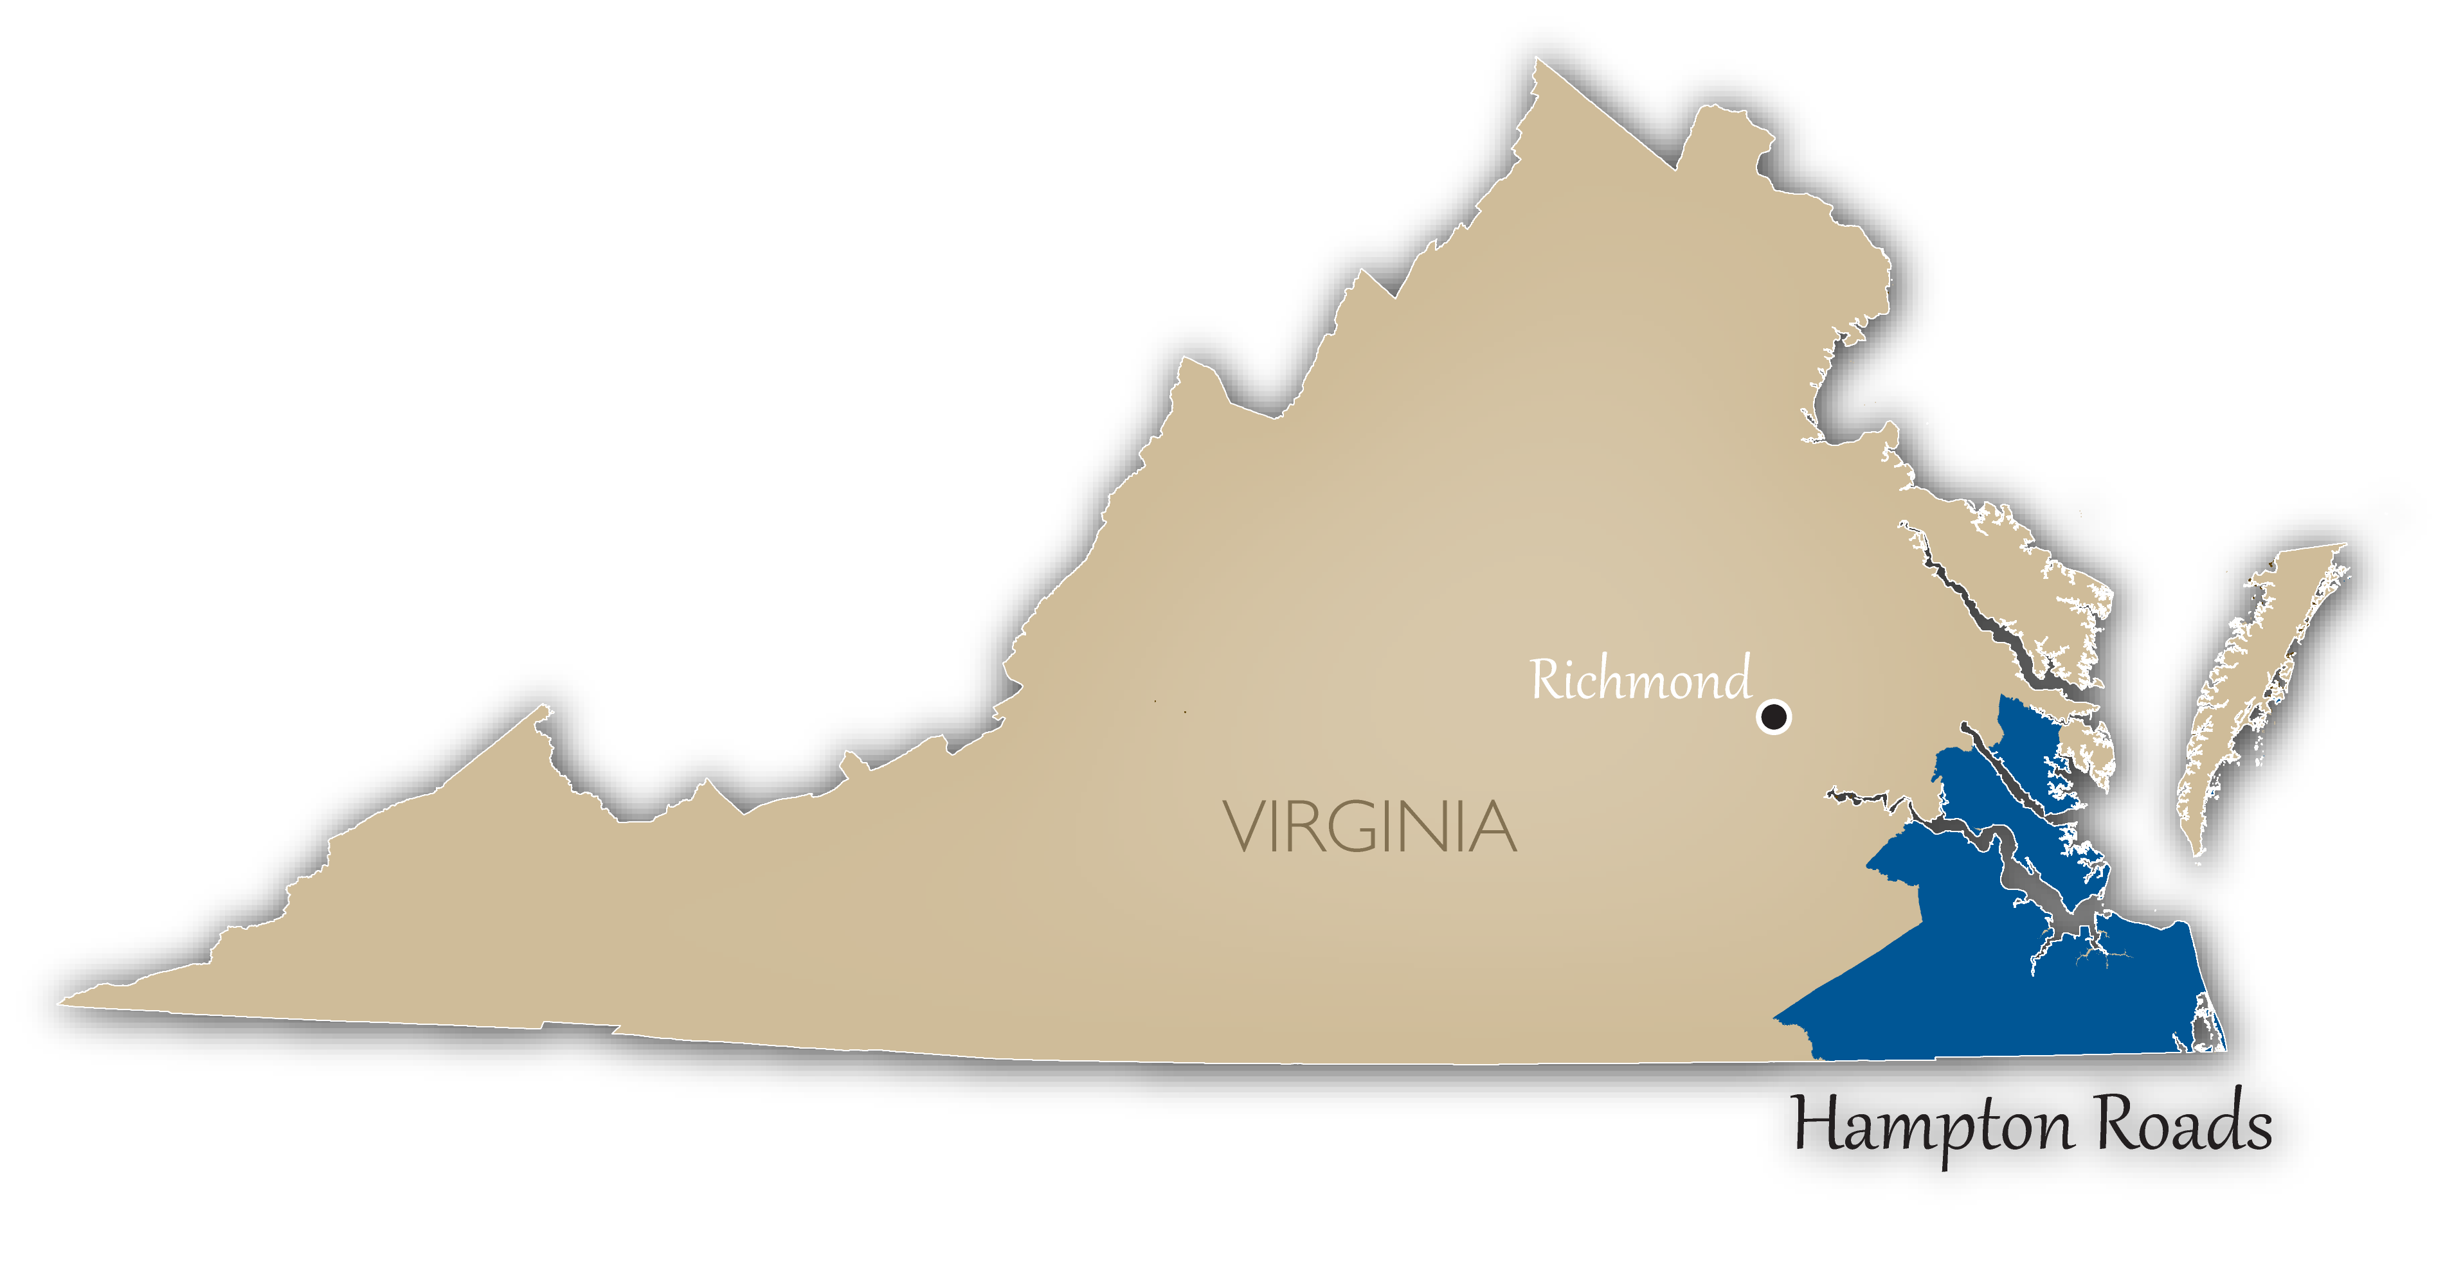
Case Study: Hampton Roads, Virginia
City of Hampton
City of Poquoson
City of Virginia Beach
Hampton Roads Planning District Commission
Hampton Roads Chamber of Commerce
Notes:
We worked with potential end users in the Hampton Roads region of Virginia who were engaged with climate resilience, climate services, climate adaptation, and climate mitigation efforts.

Slide 9
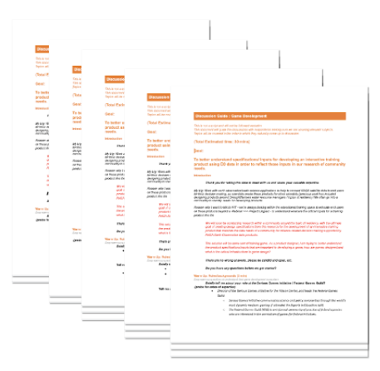
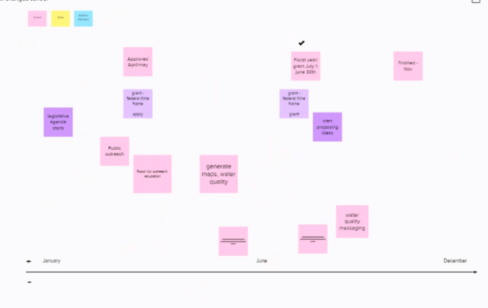
Explore User Needs
Explore User Needs With Design Thinking
Discussion Guides
Timeline Activity
Notes:
We explored user needs and priorities through semi-structured interviews that incorporated discussion guides and interactive timeline activities.
Semi-structured interviews, facilitated with discussion guides, work particularly well when evaluating the needs of program recipients, administrative or managerial staff, and other interested stakeholders who may be affected (Adam, 2010). We conducted interactive timeline activities using Muralboard to better understand how individuals and organizations move through their decision-making process when budgeting, collecting and analyzing data, and using that data to inform decisions and activities that impact their communities.

Slide 10
User Insights
Focus
Findings
Key risk, disaster, & resilience issues
Data & decisions
Resource availability
Coastal & inland flooding impacts are priority
Users need high spatial & temporal resolution
EO data needs to integrate with local GIS & non-environmental data
Federal data are difficult to find & confusing to use
Notes:
Time, resources, team structure that tie into why a game based learning method would work.

Slide 11
Goal # 2: Explore Games as a Training Tool
Notes:
Our second project goal was to explore games as a potential Earth observation training tool.

Slide 12
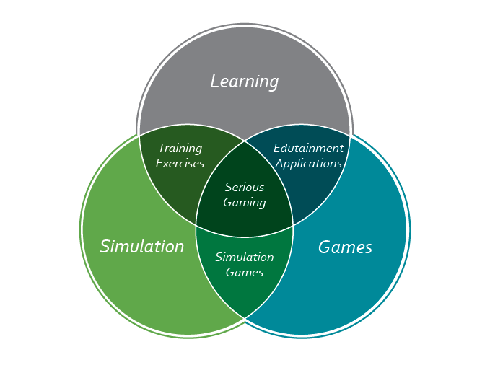

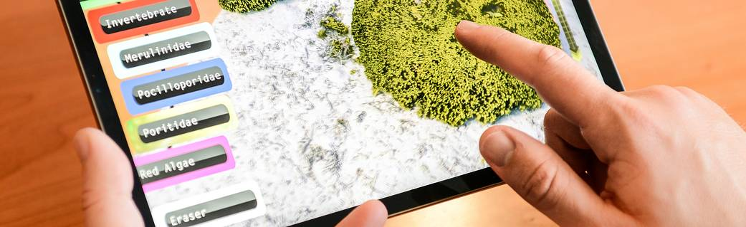
Serious Games for Serious Problems
Photo Credit: NASA NeMO-Net | NASA
Notes:
Through this project we want to explore the benefits of game based-learning, which offers rich, interactive experiences that mimic real world situations and can be a tool for building capacity to use Earth observation data in climate and resiliency decision-making
Games and similar immersive activities offer interactive learning experiences, incentivize learning and practice to improve performance, can mimic real-world scenarios, and can allow for multidisciplinary collaboration for problem solving.

Slide 13
Other Stakeholders
Will users want to train using this product?
Will the users be able to maintain and update the product?
Data and Service Providers:
NASA ARSET Program
NASA Laboratory of Advanced Sensing
NASA Nemo-Net Project
Game Developers:
Wilson Center Serious Games Initiative
American University Playful City Lab
School of Interactive Games,
Rochester Institute of Technology
Virtual Reality and Technology Lab,
University of Texas Center for GIS and Technology,
Rochester Institute of Technology
NASA JPL Protospace
Will users have the necessary resources to use this product?
Useful and Usable Training Game
Will users have time to use this training product?
Will all users be able to afford the product?
Is the
game
easy to
use?
Notes:
In addition to interviewing potential end users of Earth observation data, we invited stakeholders to provide perspectives on game development. Using a human centered design approach, we worked with NASA data and service providers to better understand the types of Earth observation data and training methods and worked with game developers to learn about the game development process, what their information and data needs would be, as well as opportunities and limitations to creating games.
Specifically, we wanted to understand if and how a game could be designed that facilitates user training going from data collection to decision-making.
We were not just looking at what data products may be useful for resiliency-related decision-making, but were also asking training specific questions for our users.

Slide 14




Data & Service Provider and
Game Developer Insights
Simple is best
Customize for multiple tracks or applications
Games can help users understand, identify, download, visualize, & integrate data
Can track user participation, learning, & satisfaction metrics
Notes:
Keep the training product simple
Product that can be customized multiple “tracks” or applications
Each track allows user to:
Understand environmental phenomena and impacts for decision-making
Identify NASA data relevant to their application
Download and visualize NASA data from local – global scales
Integrate with non-NASA data
Product owners have guidance for:
Adding new NASA data to existing tracks
Creating new tracks for new applications *should be straightforward
Tracking user participation and satisfaction metrics

Slide 15
Final Insights & Recommendations
Human Centered Design Advances Institutional Knowledge About User Needs
Games & Interactive Activities Present An Opportunity to Build End User Capacity
End users in our case study need a better way to access Earth observation data
Notes:
End users in our case study reported difficulty with knowing which Earth observation data to use, how to find it, and how to incorporate it into their workflows. They all reported a willingness and desire to build their capacity in this area but time and financial constraints were major considerations for learning new material.
There is potential and opportunity to apply the power of game-based learning to Advance User and Institutional Skills to Use Earth Observations in Climate Services, Adaptation, and Mitigation efforts.
Human-centered design improves user needs assessments through dynamic, personalized conversation that focuses on what end users need and without applying assumptions about how NASA data would be useful to them.
Furthermore, the semi-structured interviews leverage a tool common in social sciences as an efficient and effective qualitative data collection methodology in the earth sciences,

Slide 16

Thank you!
For further questions, please contact
Shobhana.Gupta@nasa.gov
Trista.Brophy@nasa.gov

