Slide 1
A data driven approach to study Water-Energy-Food Nexus
Binita KC, Xiaohua Pan, Jennifer Wei
NASA Goddard Earth Sciences Data and Information Services Center (GES DISC)
December 13, 2022
Notes:
Abstract ID: 1149125
Abstract Title: A data driven approach to study Water-Energy-Food Nexus
Final Paper Number: GC25C-08
Presentation Type: Oral
Session Number and Title: GC25C: Earth Science for Advancing National Implementation of the Sustainable Development Goals III Oral
Session Date and Time: Tuesday, 13 December 2022; 14:45 - 16:15 CST
Presentation Length: 15:55 - 16:05 CST
Location: McCormick Place, S406b and online

Slide 2
Motivation
Water, Energy and Food (W-E-F) are interconnected and are at the heart of United Nation’s Sustainable Development Goals (SDGs)
  Climate change impact on Water-Food-Energy system
Increasing demand in Nepal for Water, Food and Energy
  Due to urbanization, rising population (207.6 km² in 2022), economic growth
  Agricultural country - primarily rainfed agriculture
    Lack of irrigation infrastructure
  96.2% Energy from hydropower
  Nepal’s water security is among the weakest in Asia and the Pacific (ADB, 2016)
  Adverse impacts of climate change
Notes:
Goal 2- Zero Hunger, Goal 6: Clean Water and Sanitation , Goal 7: Affordable and Clean Energy
Asian Development Bank. (2016). Asian water development outlook 2016. Manila: Author.
[Google Scholar]

Slide 3
Challenges on W-E-F Nexus Study
Sparse data
Limited long-term observations to study impact of climate change
Data available at different geographic units
Lack of Reproducible science

Slide 4
Variables of Interest
Variables | Time | Geographic Unit | Source
precipitation (kgm-2s-1) [Precip] | 2000-2022 | gridded (Global) | GLDAS NASA GES DISC
air temperature (K) [Temp] | 2000-2022 | gridded (Global) | GLDAS NASA GES DISC
soil moisture (kgm-2) [SoilM] | 2000-2022 | gridded (Global) | GLDAS NASA GES DISC
evapotranspiration (kgm-2s-1) [Et] | 2000-2022 | gridded (Global) | GLDAS NASA GES DISC
water supply % [WaterSupp] | 2011 | District | SACOSAN-IV Country Paper-Nepal
area equipped for irrigation (ha) [TotIrr] | 2001/2002 | District | AQUASTAT - FAO
water body coverage (ha)[WArea] | 2001 | District | Department of Forest
actual generation (mwh) | 2020/2021 | Hydropower Station | Nepal Electricity Authority
import to powerstation bus bar (mwh) | 2020/2021 | Hydropower Station | Nepal Electricity Authority
power station available energy (mwh) [AvEnergy] | 2020/2021 | Hydropower Station | Nepal Electricity Authority
food production (metric ton) [FoodProd] | 2017 | District | Ministry of Agriculture (2000-2017
food required (metric ton) [FoodReq] | 2017 | District | Ministry of Agriculture (2000-2018
total family number | 2021 | District | Census Nepal 2021 (cbs.gov.np)
total household number | 2021 | District | Census Nepal 2021 (cbs.gov.np)
total population [TotPop] | 2021 | District | Census Nepal 2021 (cbs.gov.np)
total male | 2021 | District | Census Nepal 2021 (cbs.gov.np)
total female | 2021 | District | Census Nepal 2021 (cbs.gov.np)
Water
Energy
Food
Demography

Slide 5
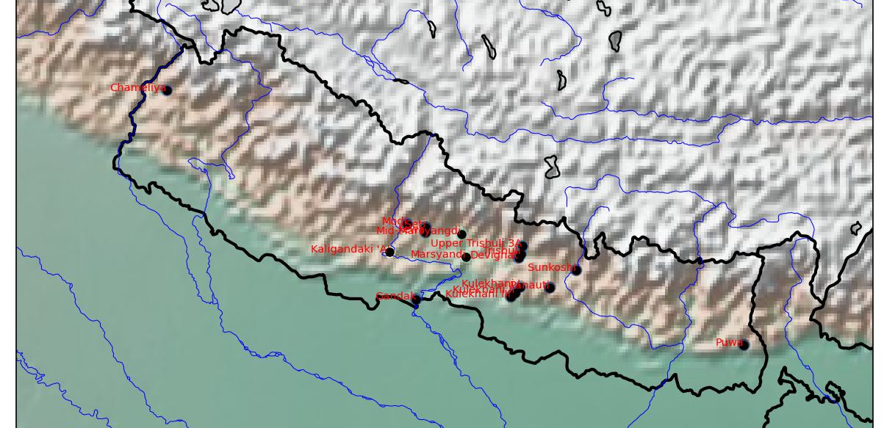
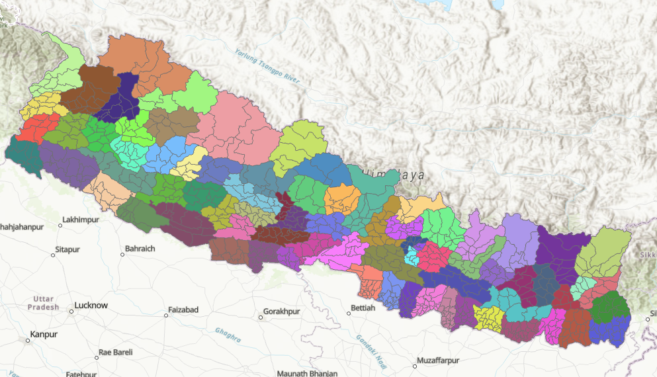
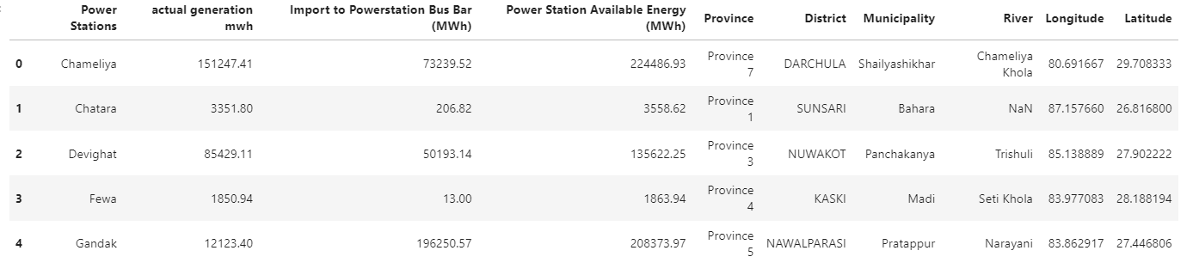
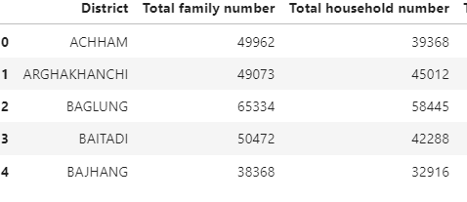
Geographic Units

Slide 6
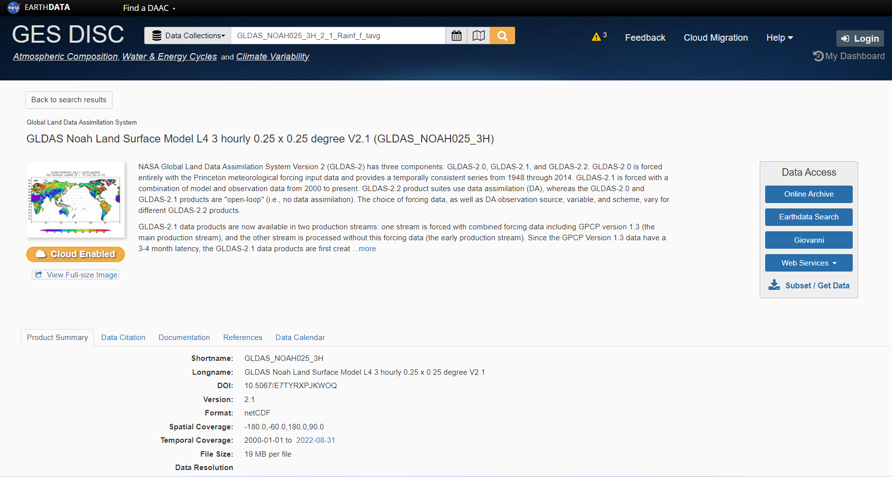
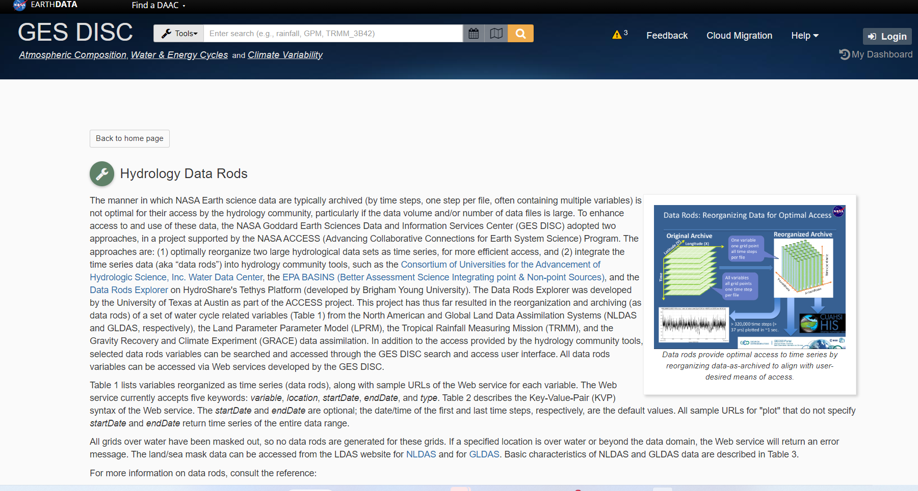
Available Earth Science Data and Tools
Hydropower Locations (csv)
Jupyter Notebook
API (specify time, location, variables)
Extract time series
Open Access to Earth Science Data
Single point time series extraction
Data Analysis

Slide 7
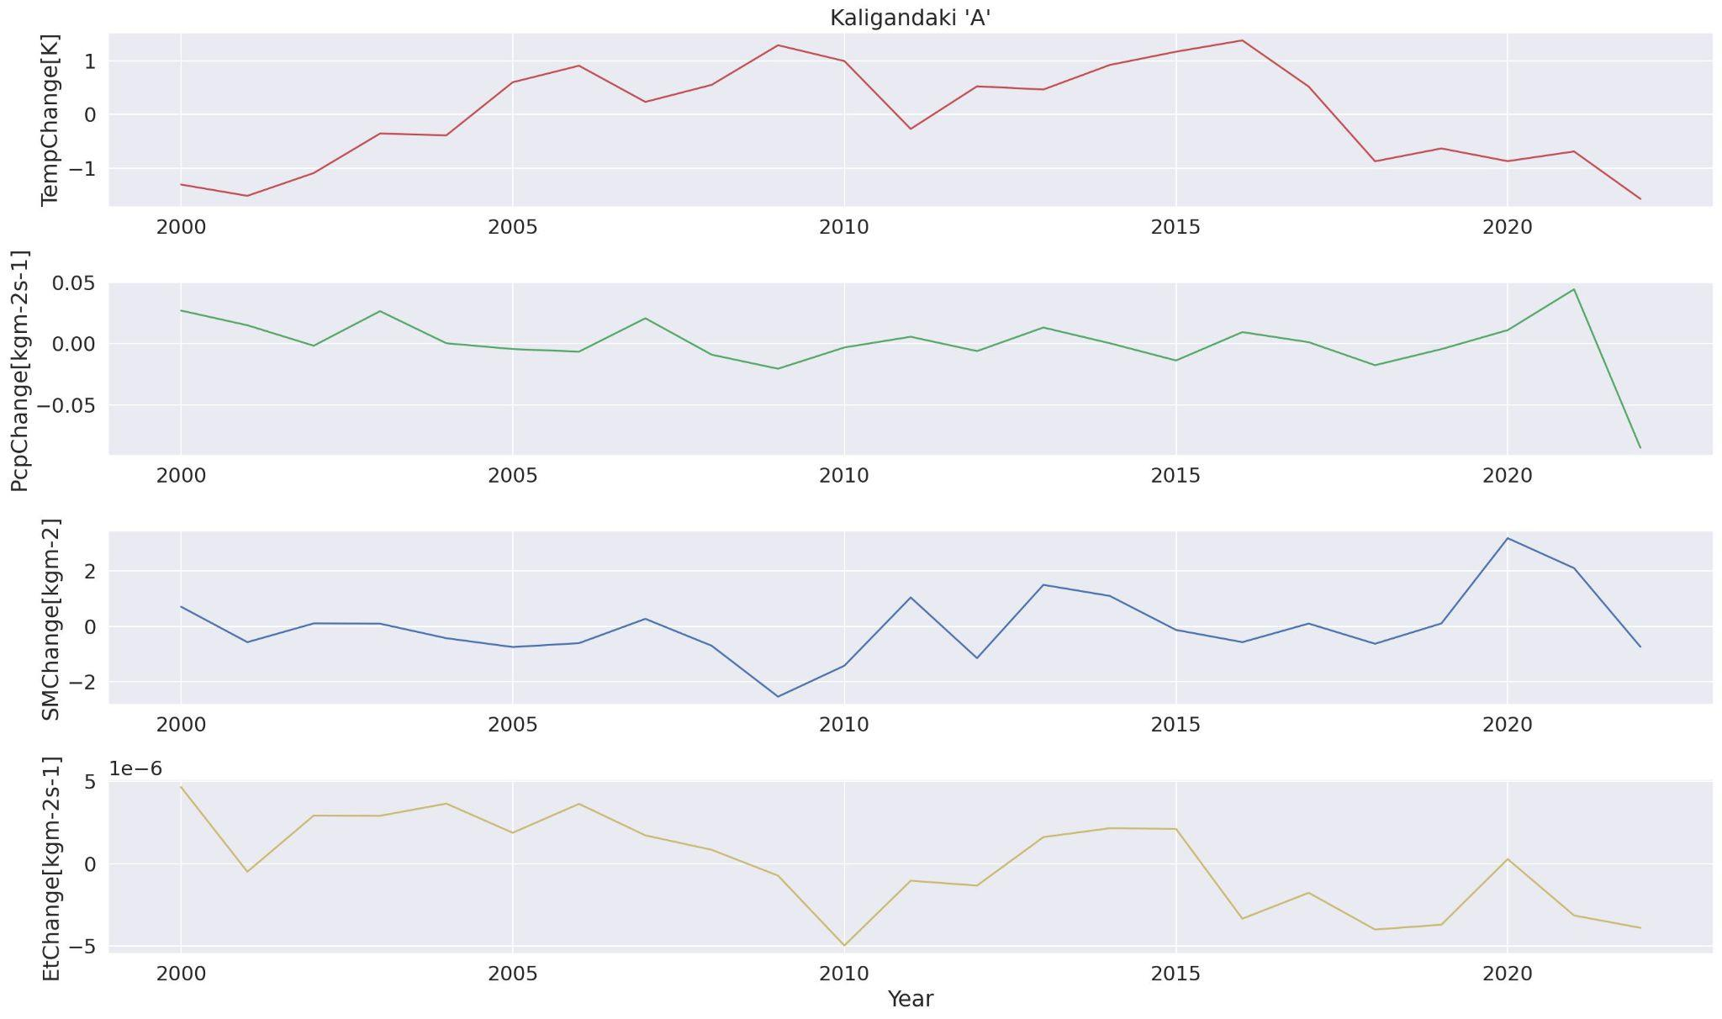
Monitor Changes at Hydropower Station Level
Temperature
Change
Study change in the hydro- meteorological parameters at a station level
Precipitation Change
Soil Moisture Change
Evapotranspiration
Change

Slide 8
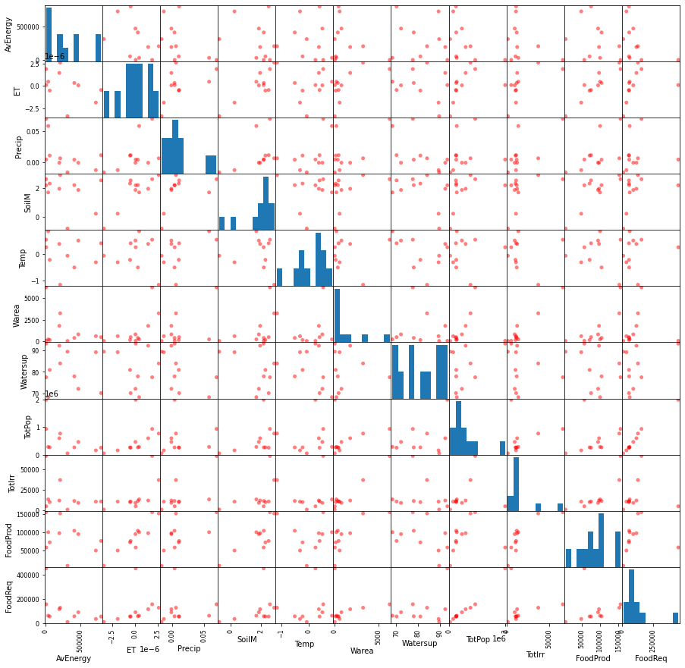
Scatterplot of the Variables
Variables
precipitation (kgm-2s-1) [Precip]
air temperature (K) [Temp]
soil moisture (kgm-2) [SoilM]
evapotranspiration (kgm-2s-1) [Et]
water supply % [WaterSupp]
area equipped for irrigation (ha) [TotIrr]

Slide 9
Correlation Heatmap
 | AvEnergy | ET | Precip | SoilM | Temp | WArea | WaterSup | TotPop | TotIrr | FoodProd | FoodReq
AvEnergy | 1.00 | -0.42 | -0.51 | -0.27 | -0.15 | -0.31 | -0.17 | -0.51 | -0.34 | -0.31 | -0.47
ET | -0.42 | 1.00 | 0.52 | 0.86 | -0.05 | 0.65 | -0.19 | 0.43 | 0.66 | 0.94 | 0.33
Precip | -0.51 | 0.52 | 1.00 | 0.46 | 0.49 | 0.57 | -0.55 | 0.17 | 0.69 | 0.62 | 0.09
SoilM | -0.27 | 0.86 | 0.46 | 1.00 | -0.01 | 0.41 | -0.37 | 0.43 | 0.47 | 0.79 | 0.36
Temp | -0.15 | -0.05 | 0.49 | -0.01 | 1.00 | -0.02 | -0.38 | 0.10 | -0.04 | -0.08 | 0.13
Warea | -0.31 | 0.65 | 0.57 | 0.41 | -0.02 | 1.00 | -0.04 | 0.25 | 0.97 | 0.76 | 0.10
Watersup | -0.17 | -0.19 | -0.55 | -0.37 | -0.38 | -0.04 | 1.00 | 0.37 | -0.18 | -0.37 | 0.39
TotPop | -0.51 | 0.43 | 0.17 | 0.43 | 0.10 | 0.25 | 0.37 | 1.00 | 0.23 | 0.22 | 0.99
TotIrr | -0.34 | 0.66 | 0.69 | 0.47 | -0.04 | 0.97 | -0.18 | 0.23 | 1.00 | 0.80 | 0.08
FoodProd | -0.31 | 0.94 | 0.62 | 0.79 | -0.08 | 0.76 | -0.37 | 0.22 | 0.80 | 1.00 | 0.09
FoodReq | -0.47 | 0.33 | 0.09 | 0.36 | 0.13 | 0.10 | 0.39 | 0.99 | 0.08 | 0.09 | 1.00
Variables
precipitation (kgm-2s-1) [Precip] | water body coverage (ha)[WArea]
air temperature (K) [Temp] | power station available energy (mwh) [AvEnergy]
soil moisture (kgm-2) [SoilM] | food production (metric ton) [FoodProd]
evapotranspiration (kgm-2s-1) [Et] | food required (metric ton) [FoodReq]
water supply % [WaterSupp] | total population [TotPop]
area equipped for irrigation (ha) [TotIrr]

Slide 10
Summary
Open Science -Reproducible
  Code sharing GitHub- coming soon
Include long-term observations to study impact of climate change
  Including more Earth Science Data
Quality of data- Reliable data source
NASA GES DISC
binita.kc@nasa.gov
Notes:
Data_Process… (auto-e) - JupyterLab (2i2c.cloud)

