Slide 1
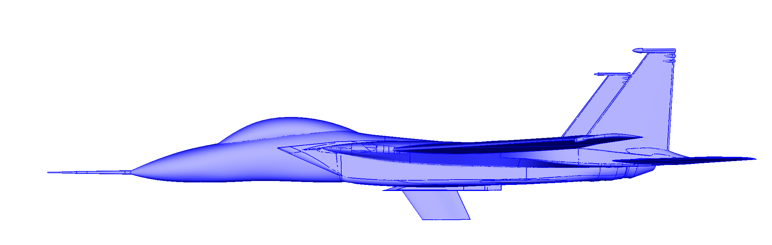
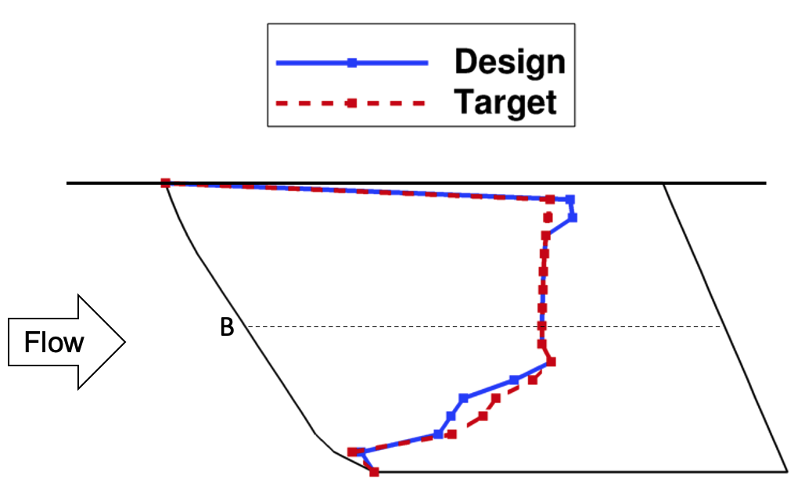
Crossflow Attenuated Natural Laminar Flow (CATNLF) Technology Development: From Concept to Flight
Michelle Banchy (Lynde), Richard Campbell, and Brett Hiller
AIAA HRS Young Professionals Technical Excellence Lecture
December 12, 2022

Slide 2
Outline
Background and Motivation
CATNLF Concept Development
Computational Study
Wind Tunnel Test
Flight Test
Current and Future Work
Summary
AIAA HRS YP Technical Excellence Lecture

Slide 3
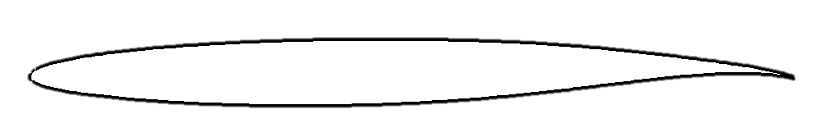
Why Laminar Flow?
Transition from laminar to turbulent
Less skin friction
Smaller wake
Fully-Turbulent Airfoil
Airfoil with Laminar Flow
“Laminar” and “turbulent” describes the state of the boundary layer (fluid very near the surface)
Laminar flow significantly improves vehicle performance by reducing skin friction and profile drag
For 777-class aircraft with laminar flow on 60% of the wings upper surface, the potential fuel burn savings per aircraft per year is 5-10%
390,000 gallons of fuel savings
$1.8 million in fuel cost savings
8.2 million pounds of CO₂ emissions reduced
AIAA HRS YP Technical Excellence Lecture

Slide 4
Potential for Laminar Flow on Commercial Transports
Wings
(Upper Surface)
Fuselage
Nacelles
Vertical/Horizontal Tails
AIAA HRS YP Technical Excellence Lecture

Slide 5
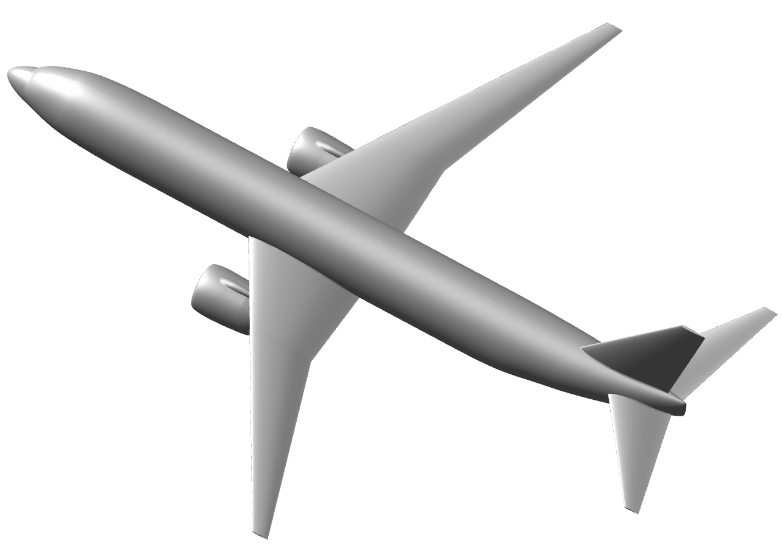
Challenge with Laminar Flow on Transport Wings
Transport aircraft require swept wings to reach desired cruise speeds, which leads to 4 primary mechanisms of transition
AIAA HRS YP Technical Excellence Lecture

Slide 6
Challenge with Laminar Flow on Transport Wings
Transport aircraft require swept wings to reach desired cruise speeds, which leads to 4 primary mechanisms of transition
Attachment Line Transition
Cause: Turbulent fuselage boundary layer
Effect: Total loss of laminar flow
AIAA HRS YP Technical Excellence Lecture

Slide 7
Challenge with Laminar Flow on Transport Wings
Transport aircraft require swept wings to reach desired cruise speeds, which leads to 4 primary mechanisms of transition
Crossflow Transition
Cause: Increasing sweep and Reynolds number
Effect: Leading edge transition
Attachment Line Transition
Cause: Turbulent fuselage boundary layer
Effect: Total loss of laminar flow
AIAA HRS YP Technical Excellence Lecture

Slide 8
Challenge with Laminar Flow on Transport Wings
Transport aircraft require swept wings to reach desired cruise speeds, which leads to 4 primary mechanisms of transition
Crossflow Transition
Cause: Increasing sweep and Reynolds number
Effect: Leading edge transition
Tollmien-Schlichting Transition
Cause: Adverse pressure gradients
Effect: Midchord transition
Attachment Line Transition
Cause: Turbulent fuselage boundary layer
Effect: Total loss of laminar flow
AIAA HRS YP Technical Excellence Lecture

Slide 9
Challenge with Laminar Flow on Transport Wings
Transport aircraft require swept wings to reach desired cruise speeds, which leads to 4 primary mechanisms of transition
Crossflow Transition
Cause: Increasing sweep and Reynolds number
Effect: Leading edge transition
Tollmien-Schlichting Transition
Cause: Adverse pressure gradients
Effect: Midchord transition
Attachment Line Transition
Cause: Turbulent fuselage boundary layer
Effect: Total loss of laminar flow
Bypass Transition
Cause: Surface imperfections
Effect: Turbulent wedges
AIAA HRS YP Technical Excellence Lecture

Slide 10
Historic NLF Boundary
x10⁶
Laminar Flow Extent, Re_{T}
Historic NLF experiments
AIAA HRS YP Technical Excellence Lecture
Wing Sweep, deg.

Slide 11
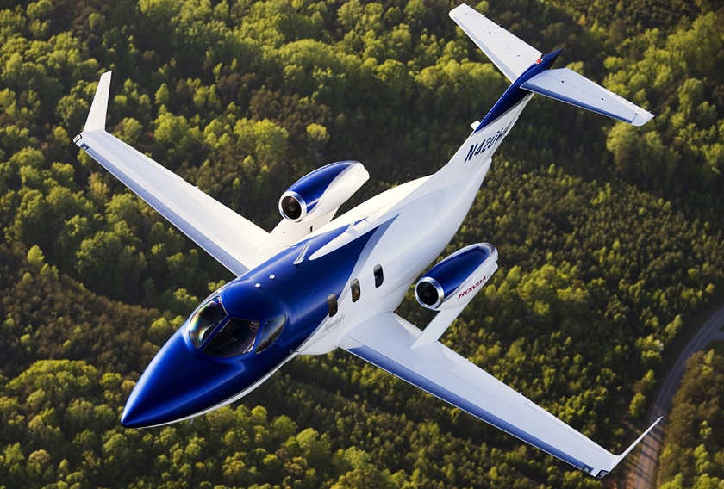
Historic NLF Boundary
x10⁶
Laminar Flow Extent, Re_{T}
Typical 777-Class Aircraft
Speed ≈ Mach 0.85
Wing Sweep ≈ 34 – 38 deg.
Historic NLF experiments
NLF Wing on Honda Jet
Speed = Mach 0.72
Wing Sweep = 10 deg.
AIAA HRS YP Technical Excellence Lecture
Wing Sweep, deg.

Slide 12
Historic NLF Boundary
x10⁶
Estimated historic boundary for NLF
Additional flow control needed (i.e., suction)
Laminar Flow Extent, Re_{T}
Historic NLF experiments
AIAA HRS YP Technical Excellence Lecture
Wing Sweep, deg.

Slide 13
Crossflow Transition on Transport Wings
Historic options to address crossflow transition on wings:
Reduce wing sweep
Penalty: Requires aircraft to fly slower
Introduce a flow control system, such as suction
Penalty: Increases weight, complexity, and cost
Neither option has “bought its way onto” commercial transports
Research Goal
Obtain significant extents of laminar flow on typical transport wings without historic crossflow penalties
AIAA HRS YP Technical Excellence Lecture

Slide 14
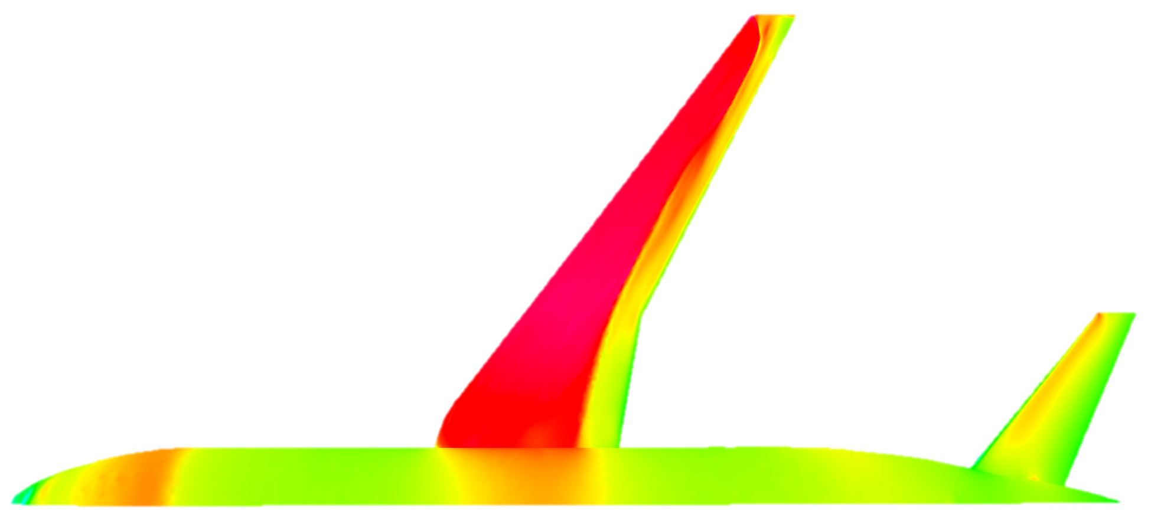
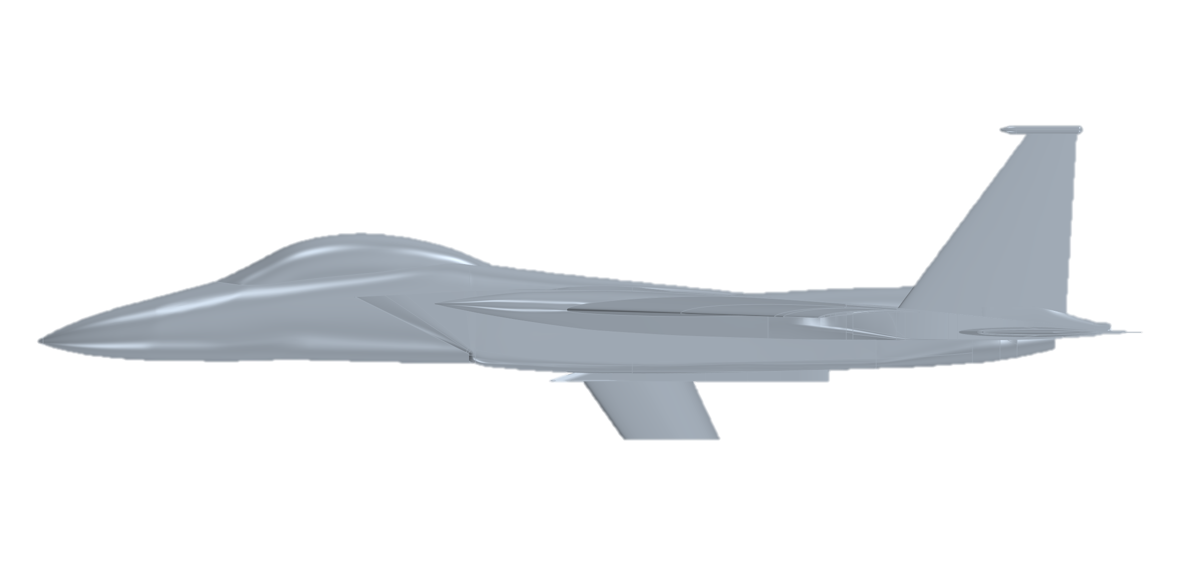
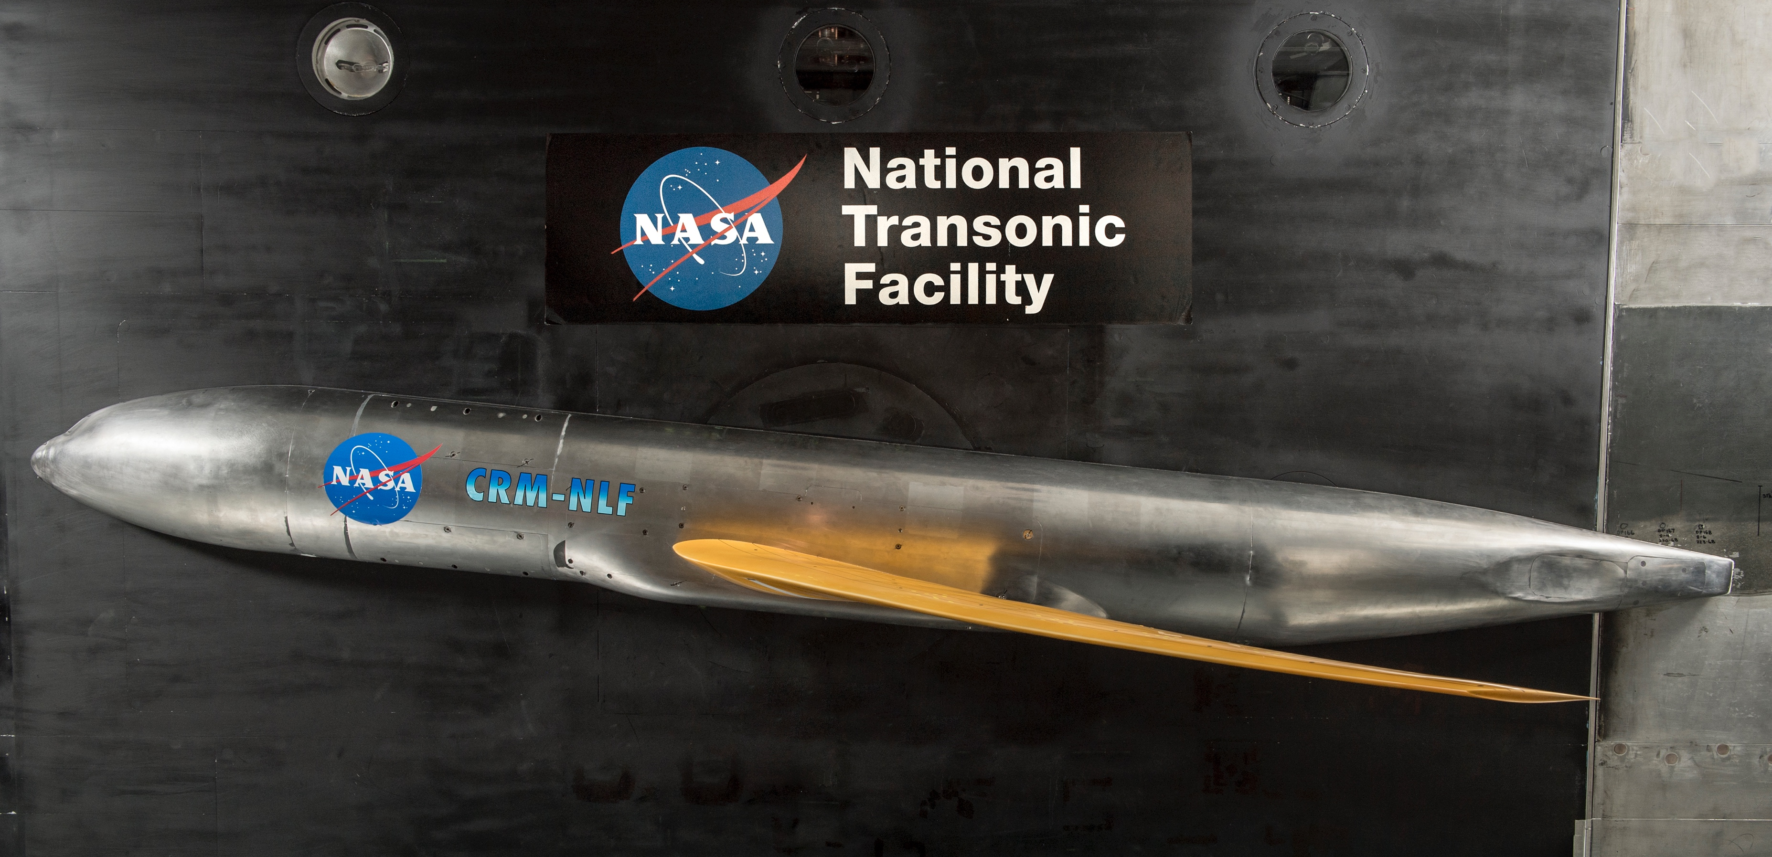
CATNLF Concept Development
NASA Laminar Flow Design Method
Crossflow Attenuated NLF (CATNLF) design method changes the shape of the wing airfoils to obtain pressure distributions that delay transition by damping crossflow instabilities
Computational Study
Wind Tunnel Test
Flight Test
2014 – 2017
2017– 2019
2019 – Present
Test article
Goal: To develop technology
Reference: AIAA 2016-4326
Goal: To confirm computations
References: AIAA 2017-3058, AIAA 2019-3292
Goal: To advance technology
Reference: AIAA 2021-0173
AIAA HRS YP Technical Excellence Lecture

Slide 15
CATNLF Concept Development
Computational Study
Wind Tunnel Test
Flight Test
2014 – 2017
2017– 2019
2019 – Present
Test article
Goal: To develop technology
Reference: AIAA 2016-4326
Goal: To confirm computations
References: AIAA 2017-3058, AIAA 2019-3292
Goal: To advance technology
Reference: AIAA 2021-0173
AIAA HRS YP Technical Excellence Lecture

Slide 16
Computational Tools
Design Module: CDISC
Applies knowledge-based design rules to change geometry to match target pressure distributions
Flow Solver: USM3D
Solves Navier-Stokes equations on unstructured tetrahedral grid
Boundary Layer Profile Solver: BLSTA3D
Calculates boundary layer velocity and temperature profiles based on chordwise pressure distribution assuming conical flow
Boundary Layer Stability Analysis: LASTRAC
Stability analysis and transition prediction using e^{N} Linear Stability Theory method with compressibility effects
AIAA HRS YP Technical Excellence Lecture

Slide 17
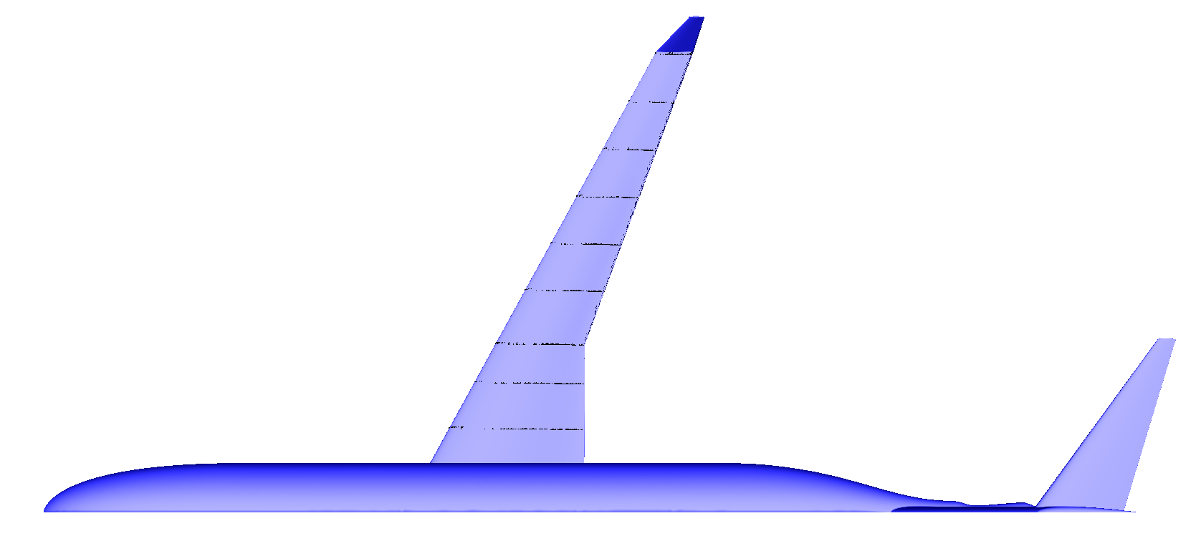
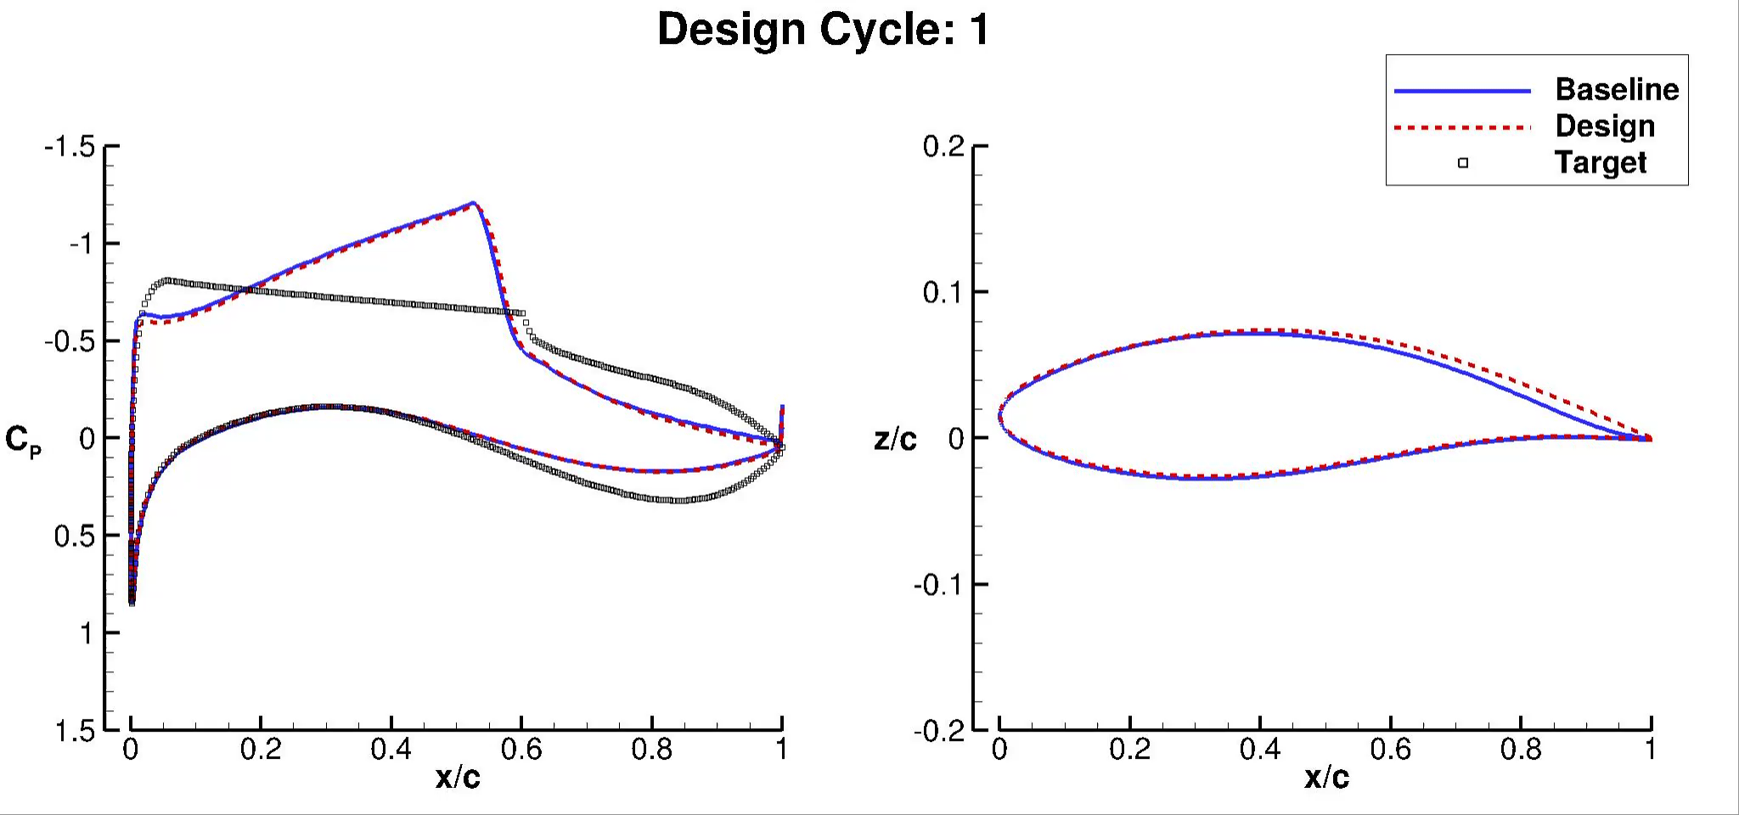
Example Turbulent Airfoil Design
Wing Station
NASA STARC-ABL Configuration
AIAA HRS YP Technical Excellence Lecture
17

Slide 18
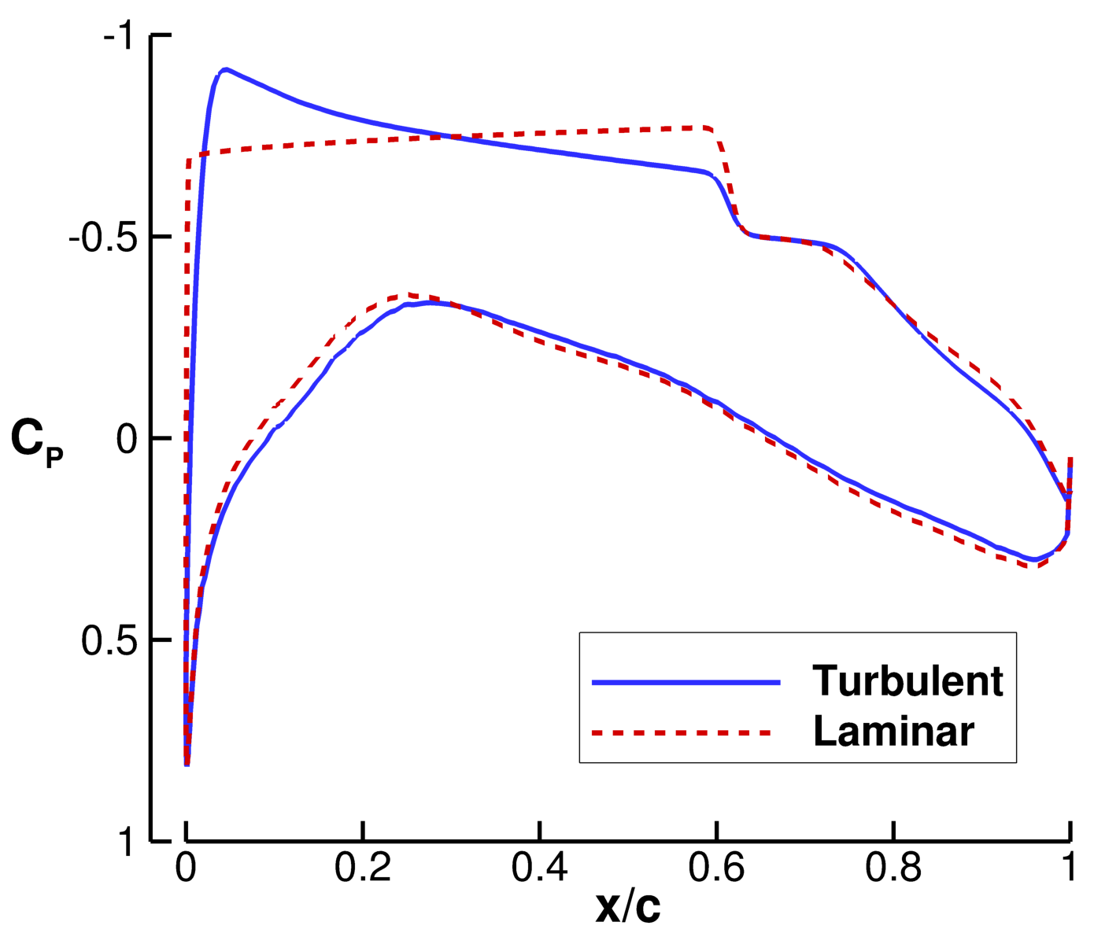
Example CATNLF Pressures
Acceleration
C_{P} gradient
Notable differences:
Leading-edge acceleration
Laminar uses rapid acceleration for crossflow (CF) control
Rooftop pressure gradient
Laminar uses mild favorable gradient for Tollmien-Schlichting (TS) control
Turbulent uses mild adverse gradient for shock strength reduction
Shock strength
Turbulent has weaker shock
Shock strength
AIAA HRS YP Technical Excellence Lecture

Slide 19

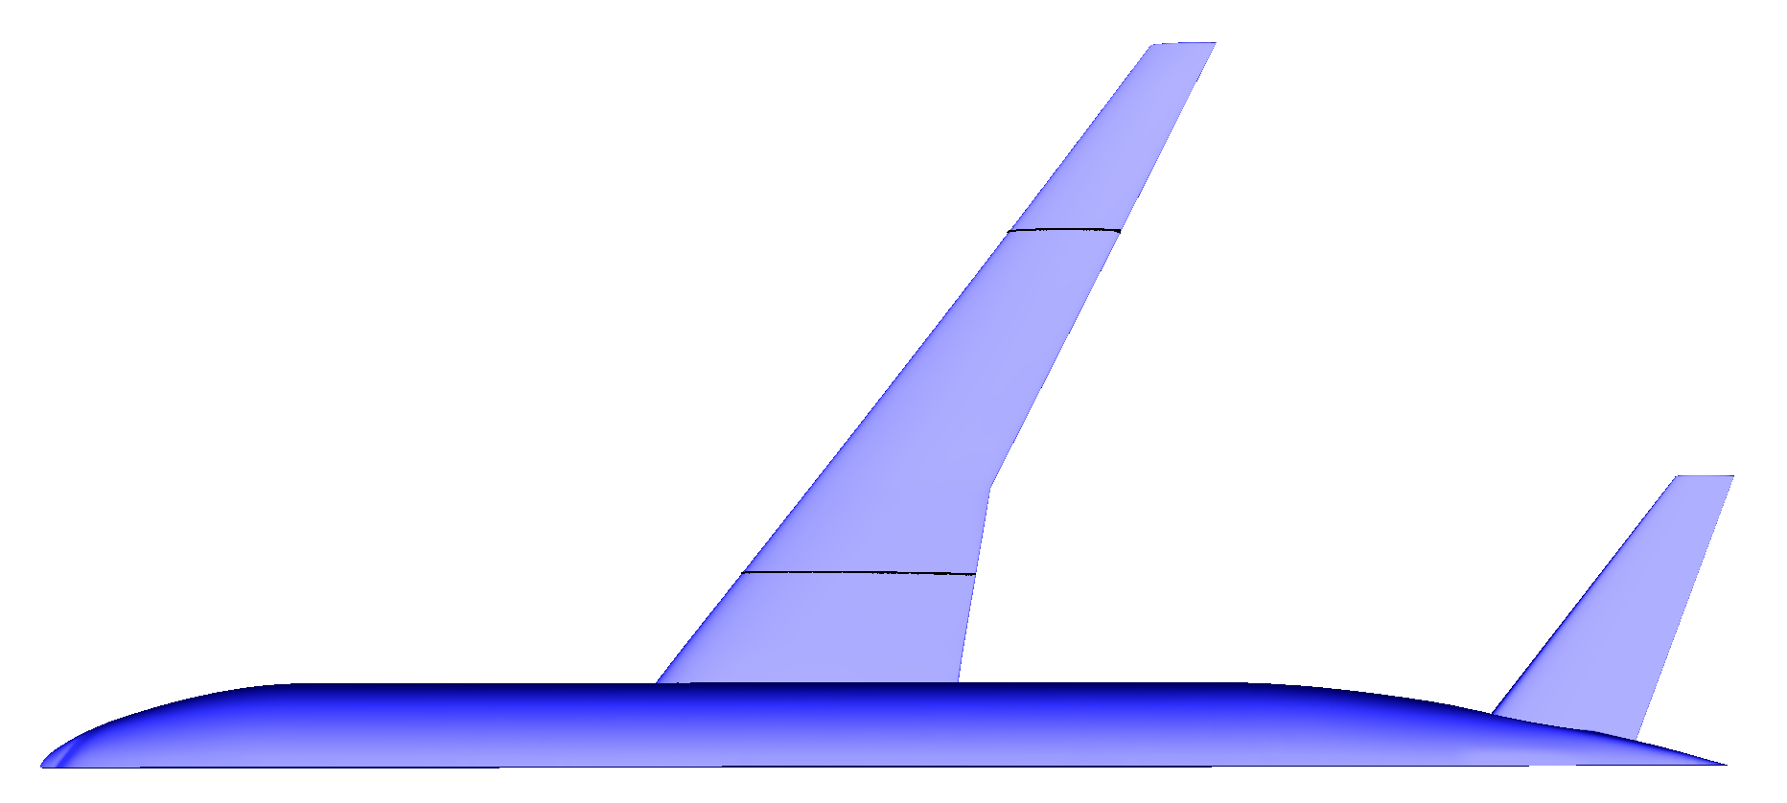
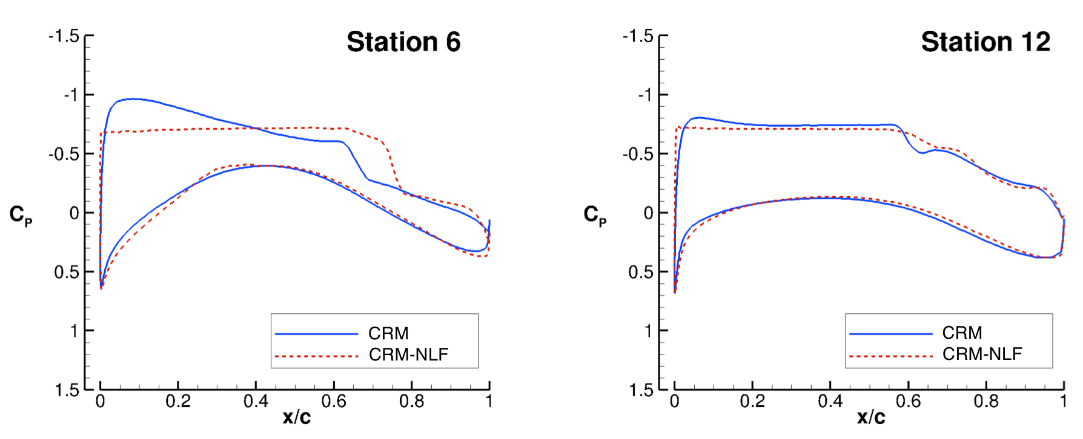
Pressure Changes Needed for CATNLF Concept
Design Conditions: Mach = 0.85, C_{L} = 0.50, Re_{MAC} = 30 x10⁶, Λ_{LE} = 35 deg.
Turbulent Wing
CATNLF Wing
Inboard
Outboard
Outboard
Inboard
AIAA HRS YP Technical Excellence Lecture

Slide 20
Crossflow Growth Resulting from CATNLF Concept
Design Conditions: Mach = 0.85, C_{L} = 0.50, Re_{MAC} = 30 x10⁶, Λ_{LE} = 35 deg.
Turbulent Wing
CATNLF Wing
Inboard
Outboard
Outboard
Inboard
CF N-factor Growth
Critical N-factor
CF N-factor Growth
AIAA HRS YP Technical Excellence Lecture

Slide 21
Tollmien-Schlichting Growth Resulting from CATNLF Concept
Design Conditions: Mach = 0.85, C_{L} = 0.50, Re_{MAC} = 30 x10⁶, Λ_{LE} = 35 deg.
Turbulent Wing
CATNLF Wing
Inboard
Outboard
Outboard
Inboard
TS N-factor Growth
TS N-factor Growth
Critical N-factor
AIAA HRS YP Technical Excellence Lecture

Slide 22
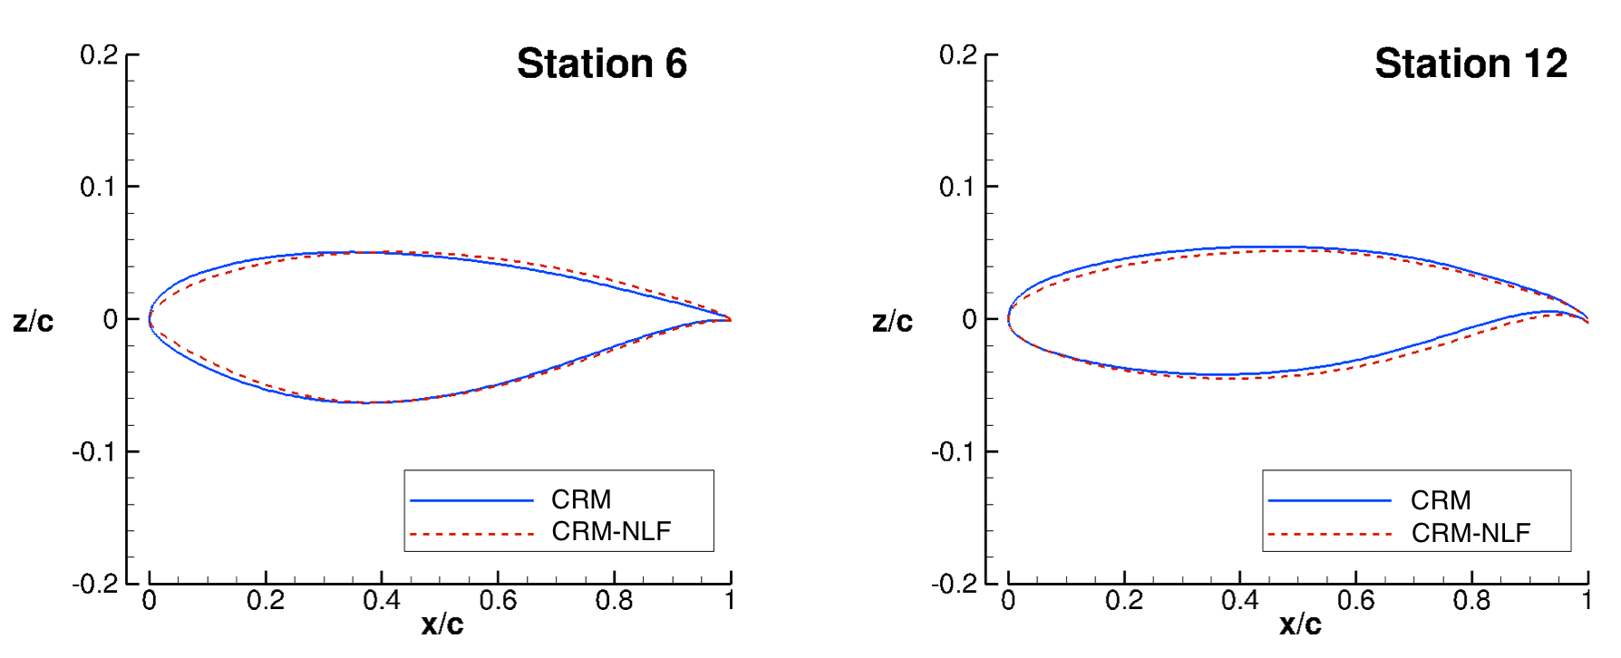
Airfoil Changes Needed for CATNLF Concept
Design Conditions: Mach = 0.85, C_{L} = 0.50, Re_{MAC} = 30 x10⁶, Λ_{LE} = 35 deg.
Turbulent Wing
CATNLF Wing
Inboard
Outboard
Outboard
Inboard
AIAA HRS YP Technical Excellence Lecture

Slide 23
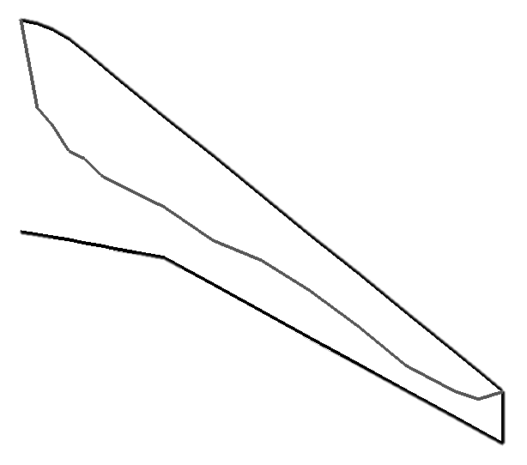

Laminar Flow Extent for CATNLF Wing
Design Conditions: Mach = 0.85, C_{L} = 0.50, Re_{MAC} = 30 x10⁶, Λ_{LE} = 35 deg.
CATNLF method enables laminar flow on 56% of the wing upper surface at the design condition, which provides a 7% drag reduction compared to a turbulent wing
Flow
Configuration | C_{L} | C_{D} | ΔC_{D} (from Baseline)
Turbulent Baseline | 0.500 | 0.0236
NLF Design | 0.500 | 0.0220 | -16 counts (7% savings)
NLF Design (Fully Turbulent) | 0.500 | 0.0246 | +10 counts (4% penalty)
Laminar
Turbulent
AIAA HRS YP Technical Excellence Lecture

Slide 24
Computational Results Relative to Past NLF Experiments
Computational predictions of a wing designed with CATNLF method significantly expand the historic boundary for NLF technology
x10⁶
Estimated historic boundary for NLF
Computational results of CATNLF wing in flight environment
Laminar Flow Extent, Re_{T}
Historic NLF experiments
AIAA HRS YP Technical Excellence Lecture
Wing Sweep, deg.

Slide 25
CATNLF Concept Development
Computational Study
Wind Tunnel Test
Flight Test
2014 – 2017
2017– 2019
2019 – Present
Test article
Goal: To develop technology
Reference: AIAA 2016-4326
Goal: To confirm computations
References: AIAA 2017-3058, AIAA 2019-3292
Goal: To advance technology
Reference: AIAA 2021-0173
AIAA HRS YP Technical Excellence Lecture

Slide 26
Facility Description
Aerial view of the NTF complex
Test completed in October 2018 in the National Transonic Facility (NTF)
NTF is a pressurized cryogenic closed-circuit, continuous-flow, fan-driven wind tunnel
Motivation for testing in the NTF:
Flight Reynolds numbers for relevant laminar flow data
Semispan testing capability for reducing unit Reynolds numbers
Acceptably low turbulence levels for laminar flow testing
AIAA HRS YP Technical Excellence Lecture

Slide 27
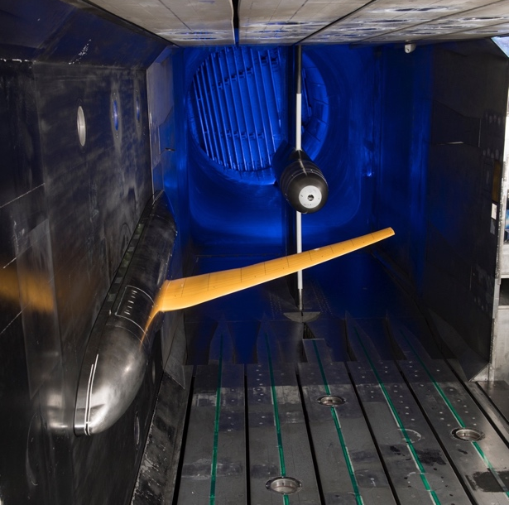
Instrumentation and Measurements
Model designed using CATNLF method called Common Research Model with Natural Laminar Flow (CRM-NLF)
5.2% scale semispan model
Semispan length = 60.2 inches
Reference chord = 14.3 inches
Data acquired:
Surface pressure
Transition visualization
Force and moment
Model deformation
Primary Test Conditions
Mach | α (deg.) | T_{T} (°F) | Re_{MAC} (million)
0.86 | 1.5 to 3.0 | +40 | 10.0 to 15.0
 |  | -50 | 12.5 to 20.0
 |  | -150 | 20.0 to 30.0
CRM-NLF semispan model installed in the NTF
AIAA HRS YP Technical Excellence Lecture

Slide 28

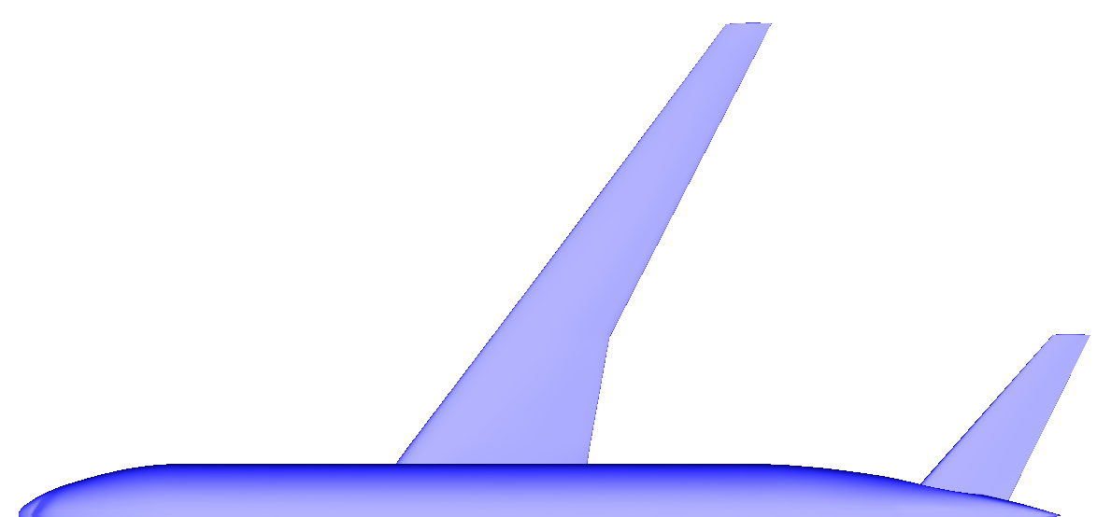
Wind Tunnel Pressure Measurements
Pressure measurements from the wind tunnel test showed CATNLF pressure distributions are obtained on the model
Computations
Wind Tunnel
Inboard
Outboard
Outboard
Inboard
AIAA HRS YP Technical Excellence Lecture

Slide 29
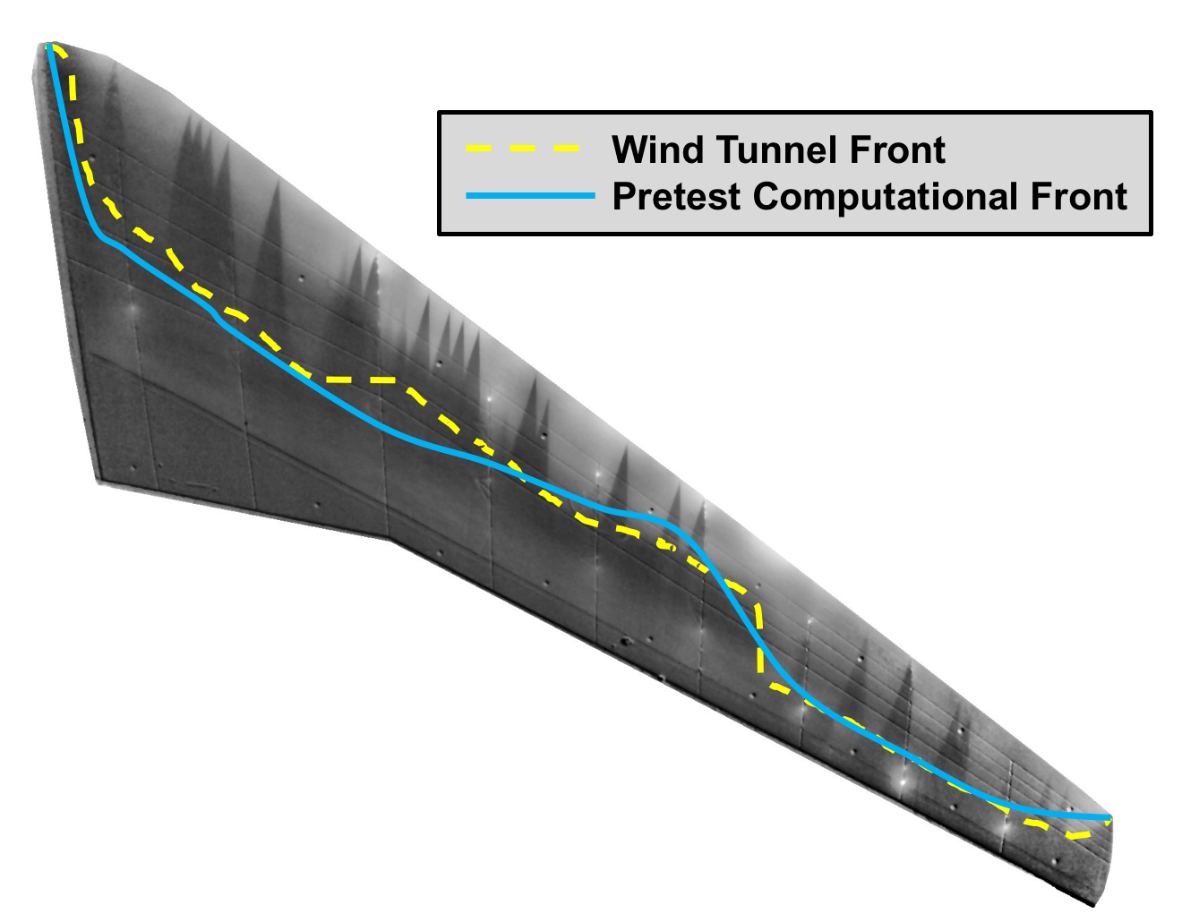
Wind Tunnel Results Relative to Computational Predictions
Good agreement between pretest predictions and experimental extents of laminar flow suggest CATNLF assumptions, tools, and design method are valid
AIAA HRS YP Technical Excellence Lecture

Slide 30
Wind Tunnel Results Relative to Past NLF Experiments
CRM-NLF in the NTF showed extents of laminar flow that nearly double the historic maximum seen at comparable wing sweep
x10⁶
Estimated historic boundary for NLF
Laminar Flow Extent, Re_{T}
CRM-NLF in the NTF
Historic NLF experiments
AIAA HRS YP Technical Excellence Lecture
Wing Sweep, deg.

Slide 31
Wind Tunnel Results Relative to Past NLF Experiments
Difficulties acquiring high Reynolds number laminar flow data in a wind tunnel environment motivate flight test to expand historic NLF boundary further
x10⁶
Estimated historic boundary for NLF
Computational results of CRM-NLF in flight
Smaller extents of laminar flow in tunnel due to different environment and limited model size
Laminar Flow Extent, Re_{T}
CRM-NLF in the NTF
Historic NLF experiments
AIAA HRS YP Technical Excellence Lecture
Wing Sweep, deg.

Slide 32
CATNLF Concept Development
Computational Study
Wind Tunnel Test
Flight Test
2014 – 2017
2017– 2019
2019 – Present
Test article
Goal: To develop technology
Reference: AIAA 2016-4326
Goal: To confirm computations
References: AIAA 2017-3058, AIAA 2019-3292
Goal: To advance technology
Reference: AIAA 2021-0173
AIAA HRS YP Technical Excellence Lecture

Slide 33
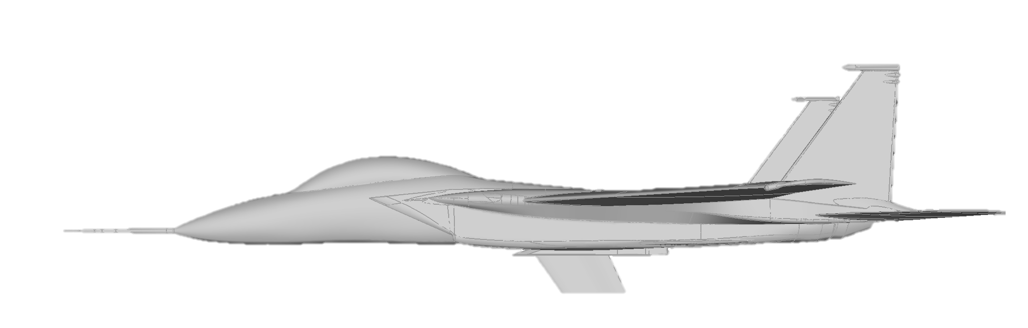
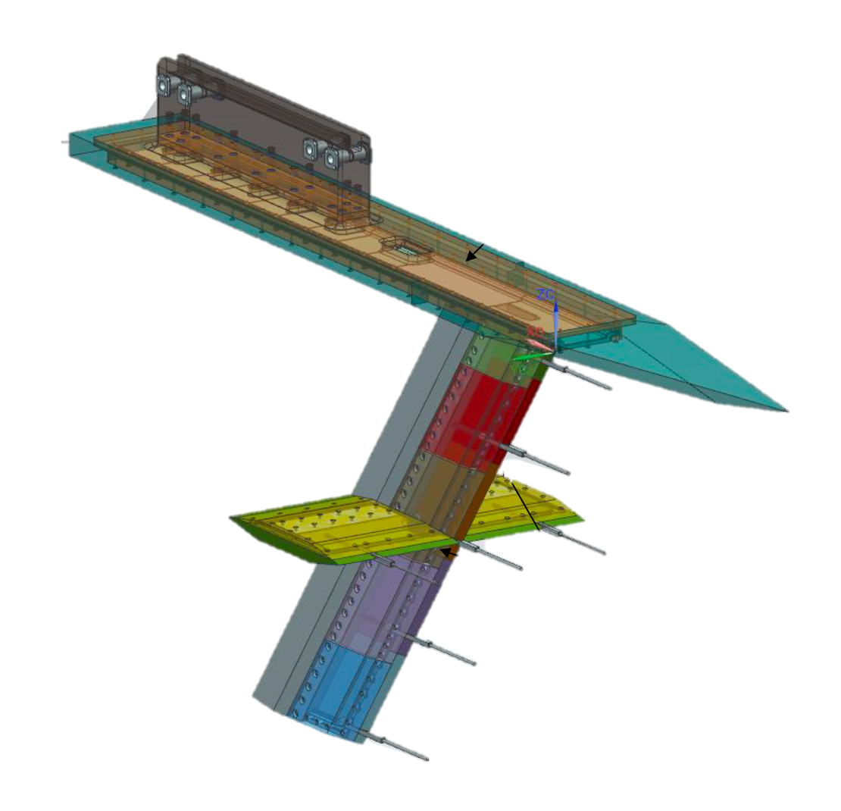
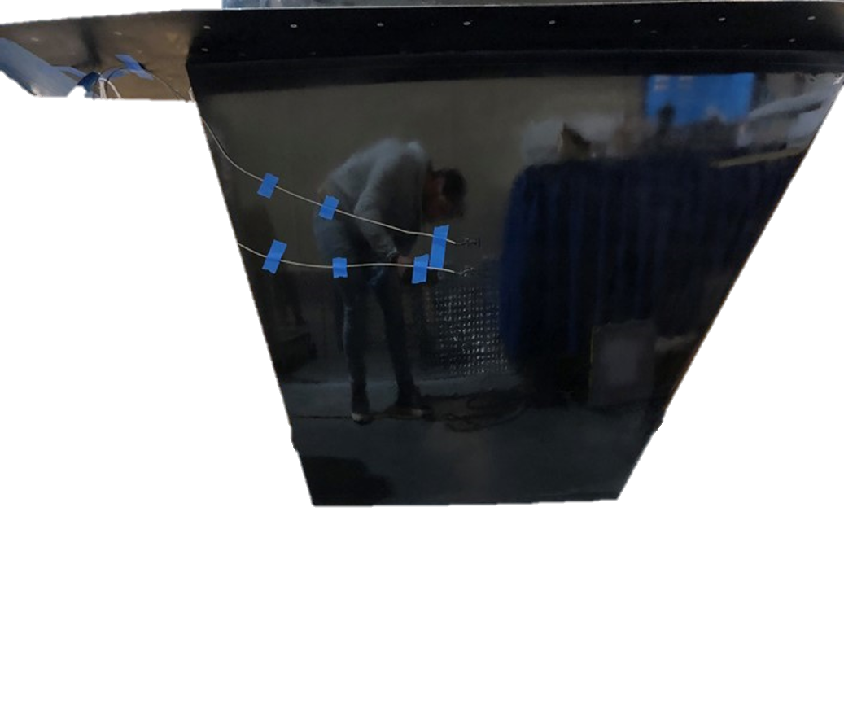
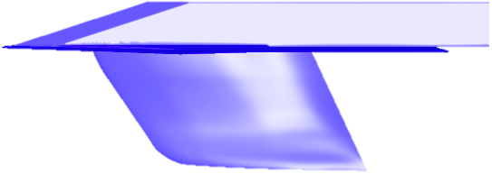
CATNLF Flight Test Series
Changeable test article
AFRC F-15 CLIP Flight Test Bed
ReHEAT Experiment
Flow Rake Experiment
CATNLF Experiment
Series of 3 flight tests underneath the F-15 in collaboration with Armstrong Flight Research Center
Resistive heating (ReHEAT) experiment to improve laminar flow detection (2019)
Flow rake experiment to quantify the flow environment under the F-15 (2023)
CATNLF “stub wing” test article to advance technology (2023)
AIAA HRS YP Technical Excellence Lecture

Slide 34
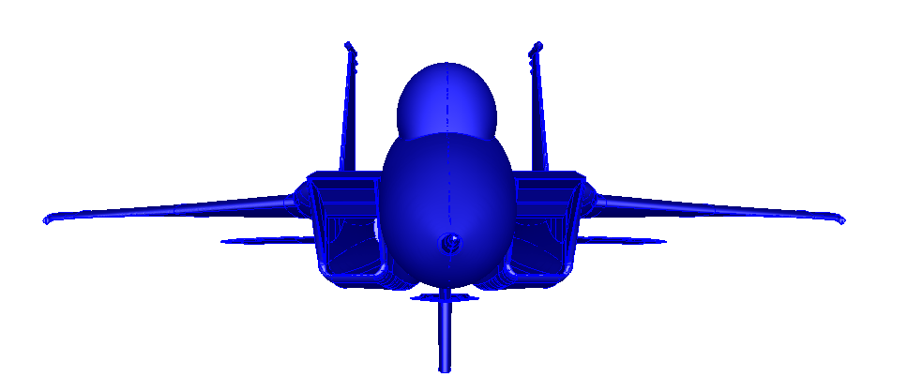
Test Article Dimensions and Design Conditions
Geometry Parameters
Mean Aerodynamic Chord (MAC) | 5.9 ft
Span | 3.3 ft
Reference Area | 19.7 ft²
Leading-Edge Sweep | 35 deg
Max Thickness | 10% chord
Test Article
CLIP
Side View
Design Conditions
Mach | 0.85
Altitude | 5,000 ft
Re_{MAC} | 31 million
Sectional Lift Coefficient | 0.50
Critical N-Factor | 10
Laminar Flow Target | Suction side only
Test Article
CLIP
Front View
AIAA HRS YP Technical Excellence Lecture

Slide 35
Test Article Design
Designed test article is predicted to support laminar flow on approximately 53% of the suction side surface area in a flight environment
Design was conducted to enable flight test goals
Primary Goal: To confirm the effectiveness of the CATNLF method in attenuating crossflow growth at conditions representative of a modern transonic transport wing
Secondary Goal: To investigate the surface requirements for laminar flow applications on transonic transport wings
Laminar
Turbulent
AIAA HRS YP Technical Excellence Lecture

Slide 36
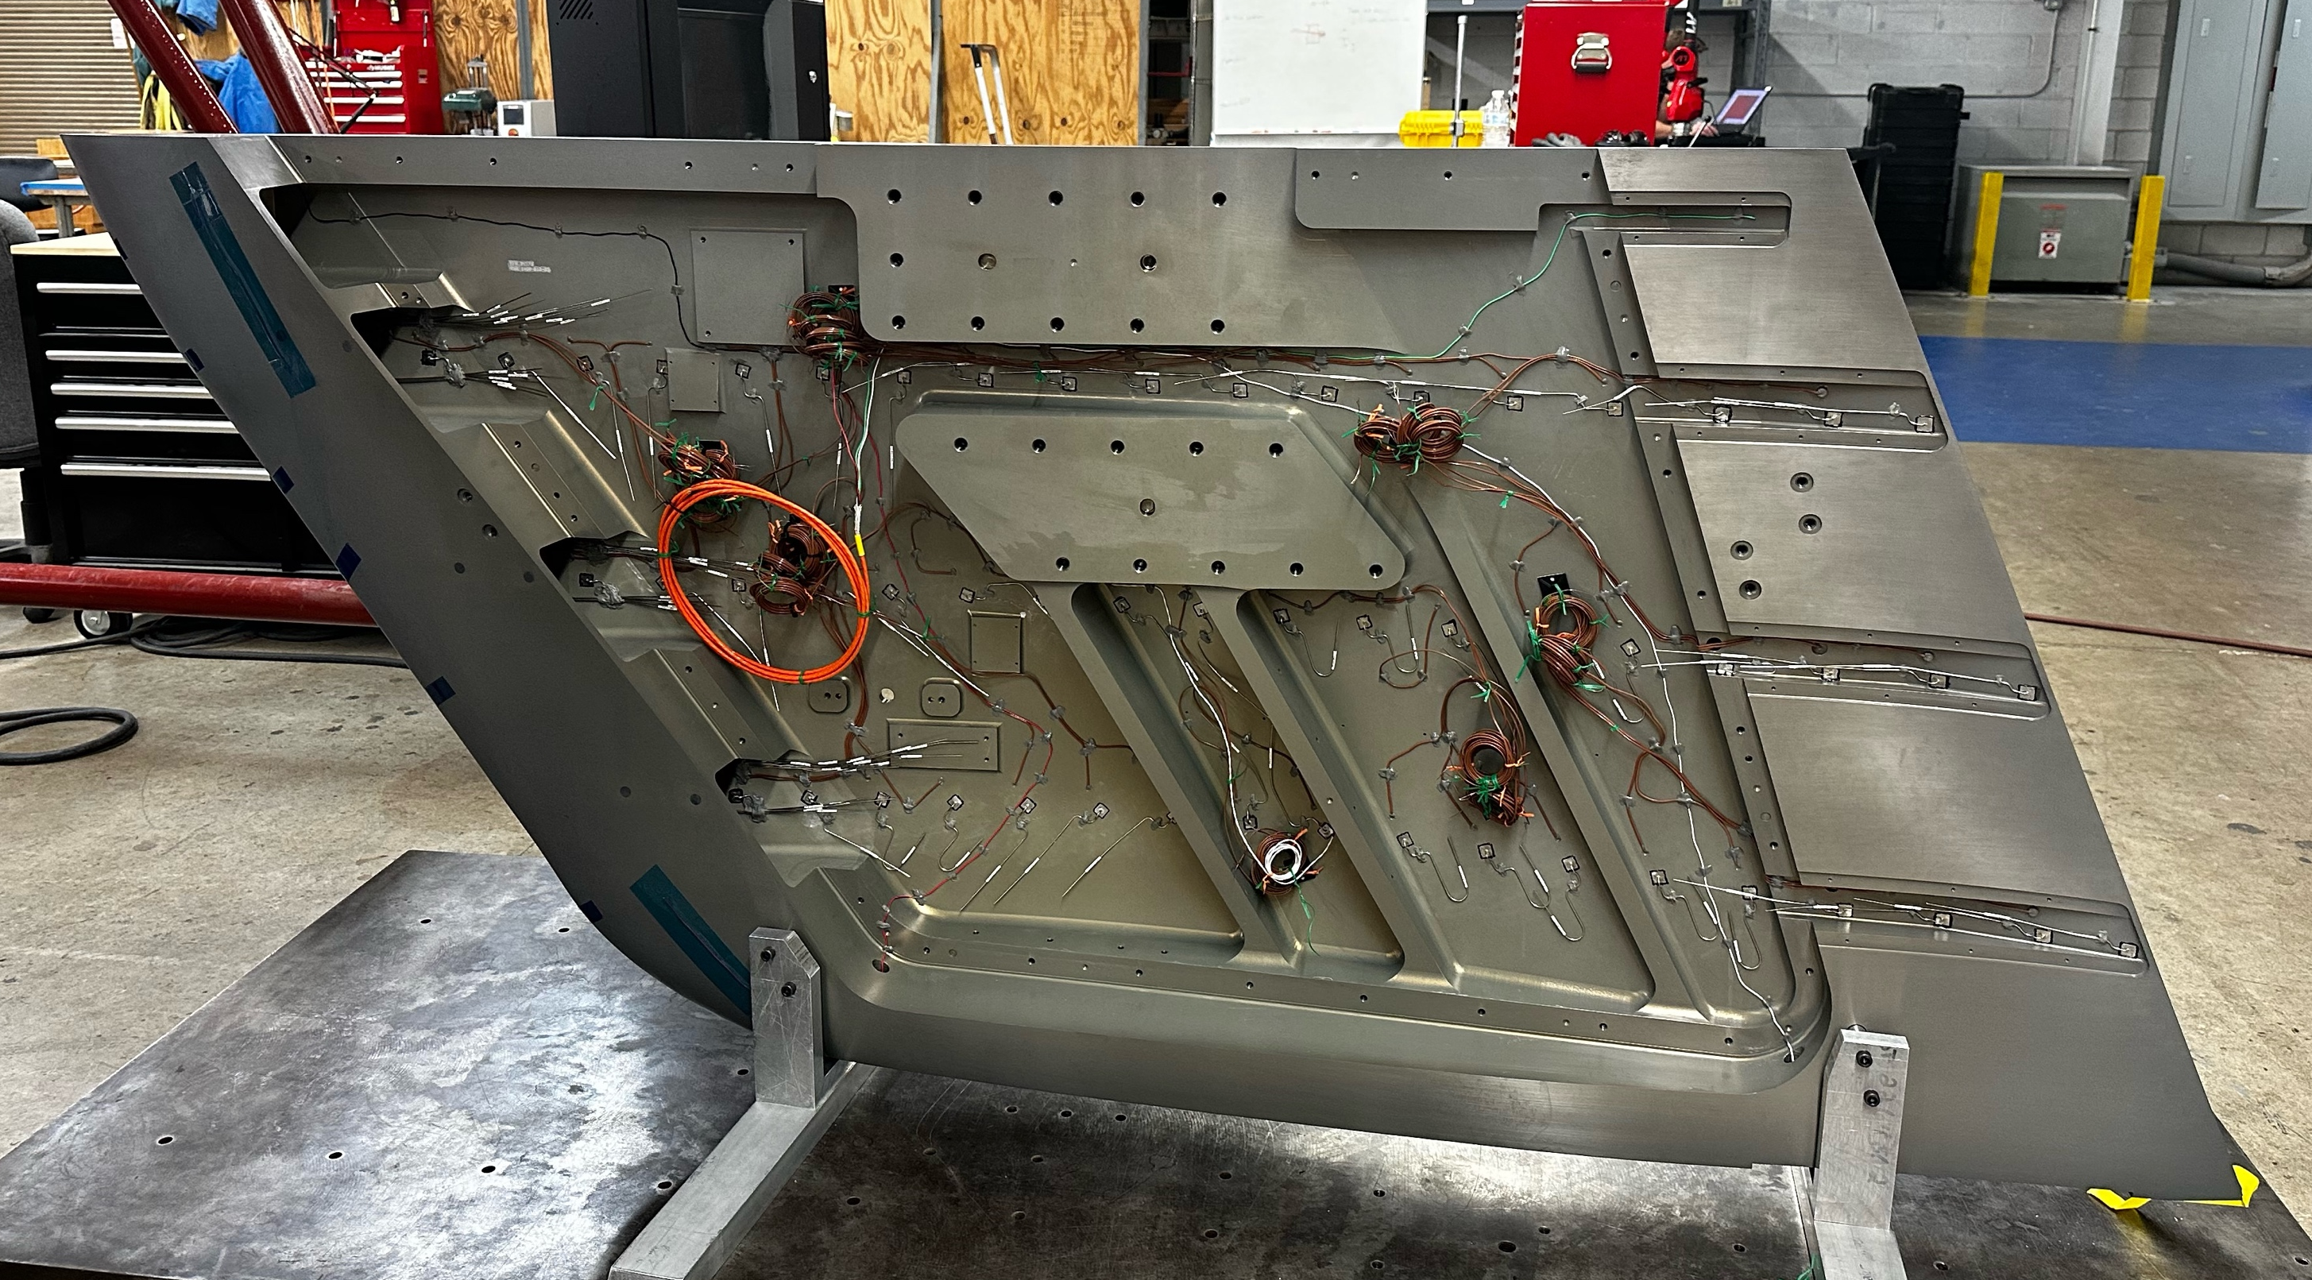
Flight Test Strategy
Flight conditions are selected to acquire data for flight test goals
Mach = 0.85
Altitude = 5,000 – 49,500 ft
Re_{MAC} = 6 – 31 million
Unit Re = 1.0 – 5.3 million/ft
Data and instrumentation:
Transition images using IR with heating layer
123 static pressure sensors
12 dynamic pressure sensors
54 subsurface thermocouples
4 accelerometers
F-15 conditions and nose boom probe
Pressure side of test article showing instrumentation cavity
AIAA HRS YP Technical Excellence Lecture

Slide 37
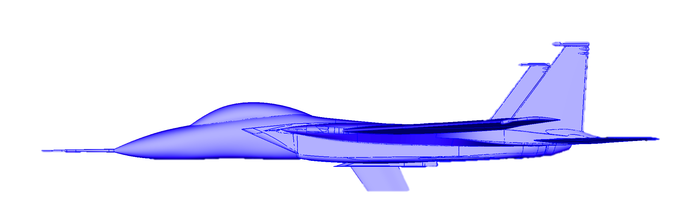
CATNLF Compared to Historic NLF Boundary
Computational predictions of the CATNLF test article
significantly expand the historic boundary for NLF technology
x10⁶
Estimated historic boundary for NLF
CATNLF in flight* *Computational predictions
Larger extents of laminar flow due to flight environment
Laminar Flow Extent, Re_{T}
CRM-NLF in the NTF
Historic NLF experiments
AIAA HRS YP Technical Excellence Lecture
Wing Sweep, deg.

Slide 38
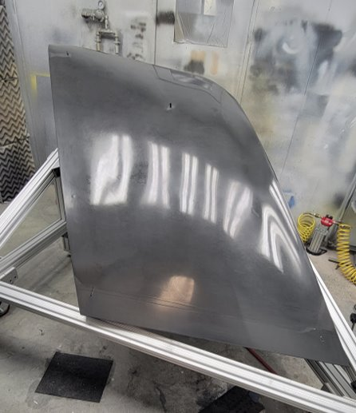
Current and Future Work
Current status of CATNLF flight test:
Test article manufactured and delivered to Langley September 2022
Pre-flight instrumentation and safety analysis work underway
First flight scheduled for June 2023
Future work for CATNLF:
Plans to release flight test data to community to advance computational tools
Potential follow-on wind tunnel test of flight test article to compare laminar flow in two environments
Painted test article at Langley
AIAA HRS YP Technical Excellence Lecture

Slide 39
Summary
Laminar flow on transport wings has the potential to reduce fuel burn by 5-10%, but has been limited in practical application due to the challenge of crossflow growth on swept wings
A new NASA laminar flow design method, CATNLF, has been developed to provide the known NLF performance benefit without historic penalties
CATNLF design method has been developed in three phases:
Computational study to develop technology
Wind tunnel test to confirm computations
Flight test to advance technology
CATNLF flight test effort is underway with first flight scheduled June 2023
Plans to release the flight test data to community and potential wind tunnel test of flight test article
AIAA HRS YP Technical Excellence Lecture

Slide 40
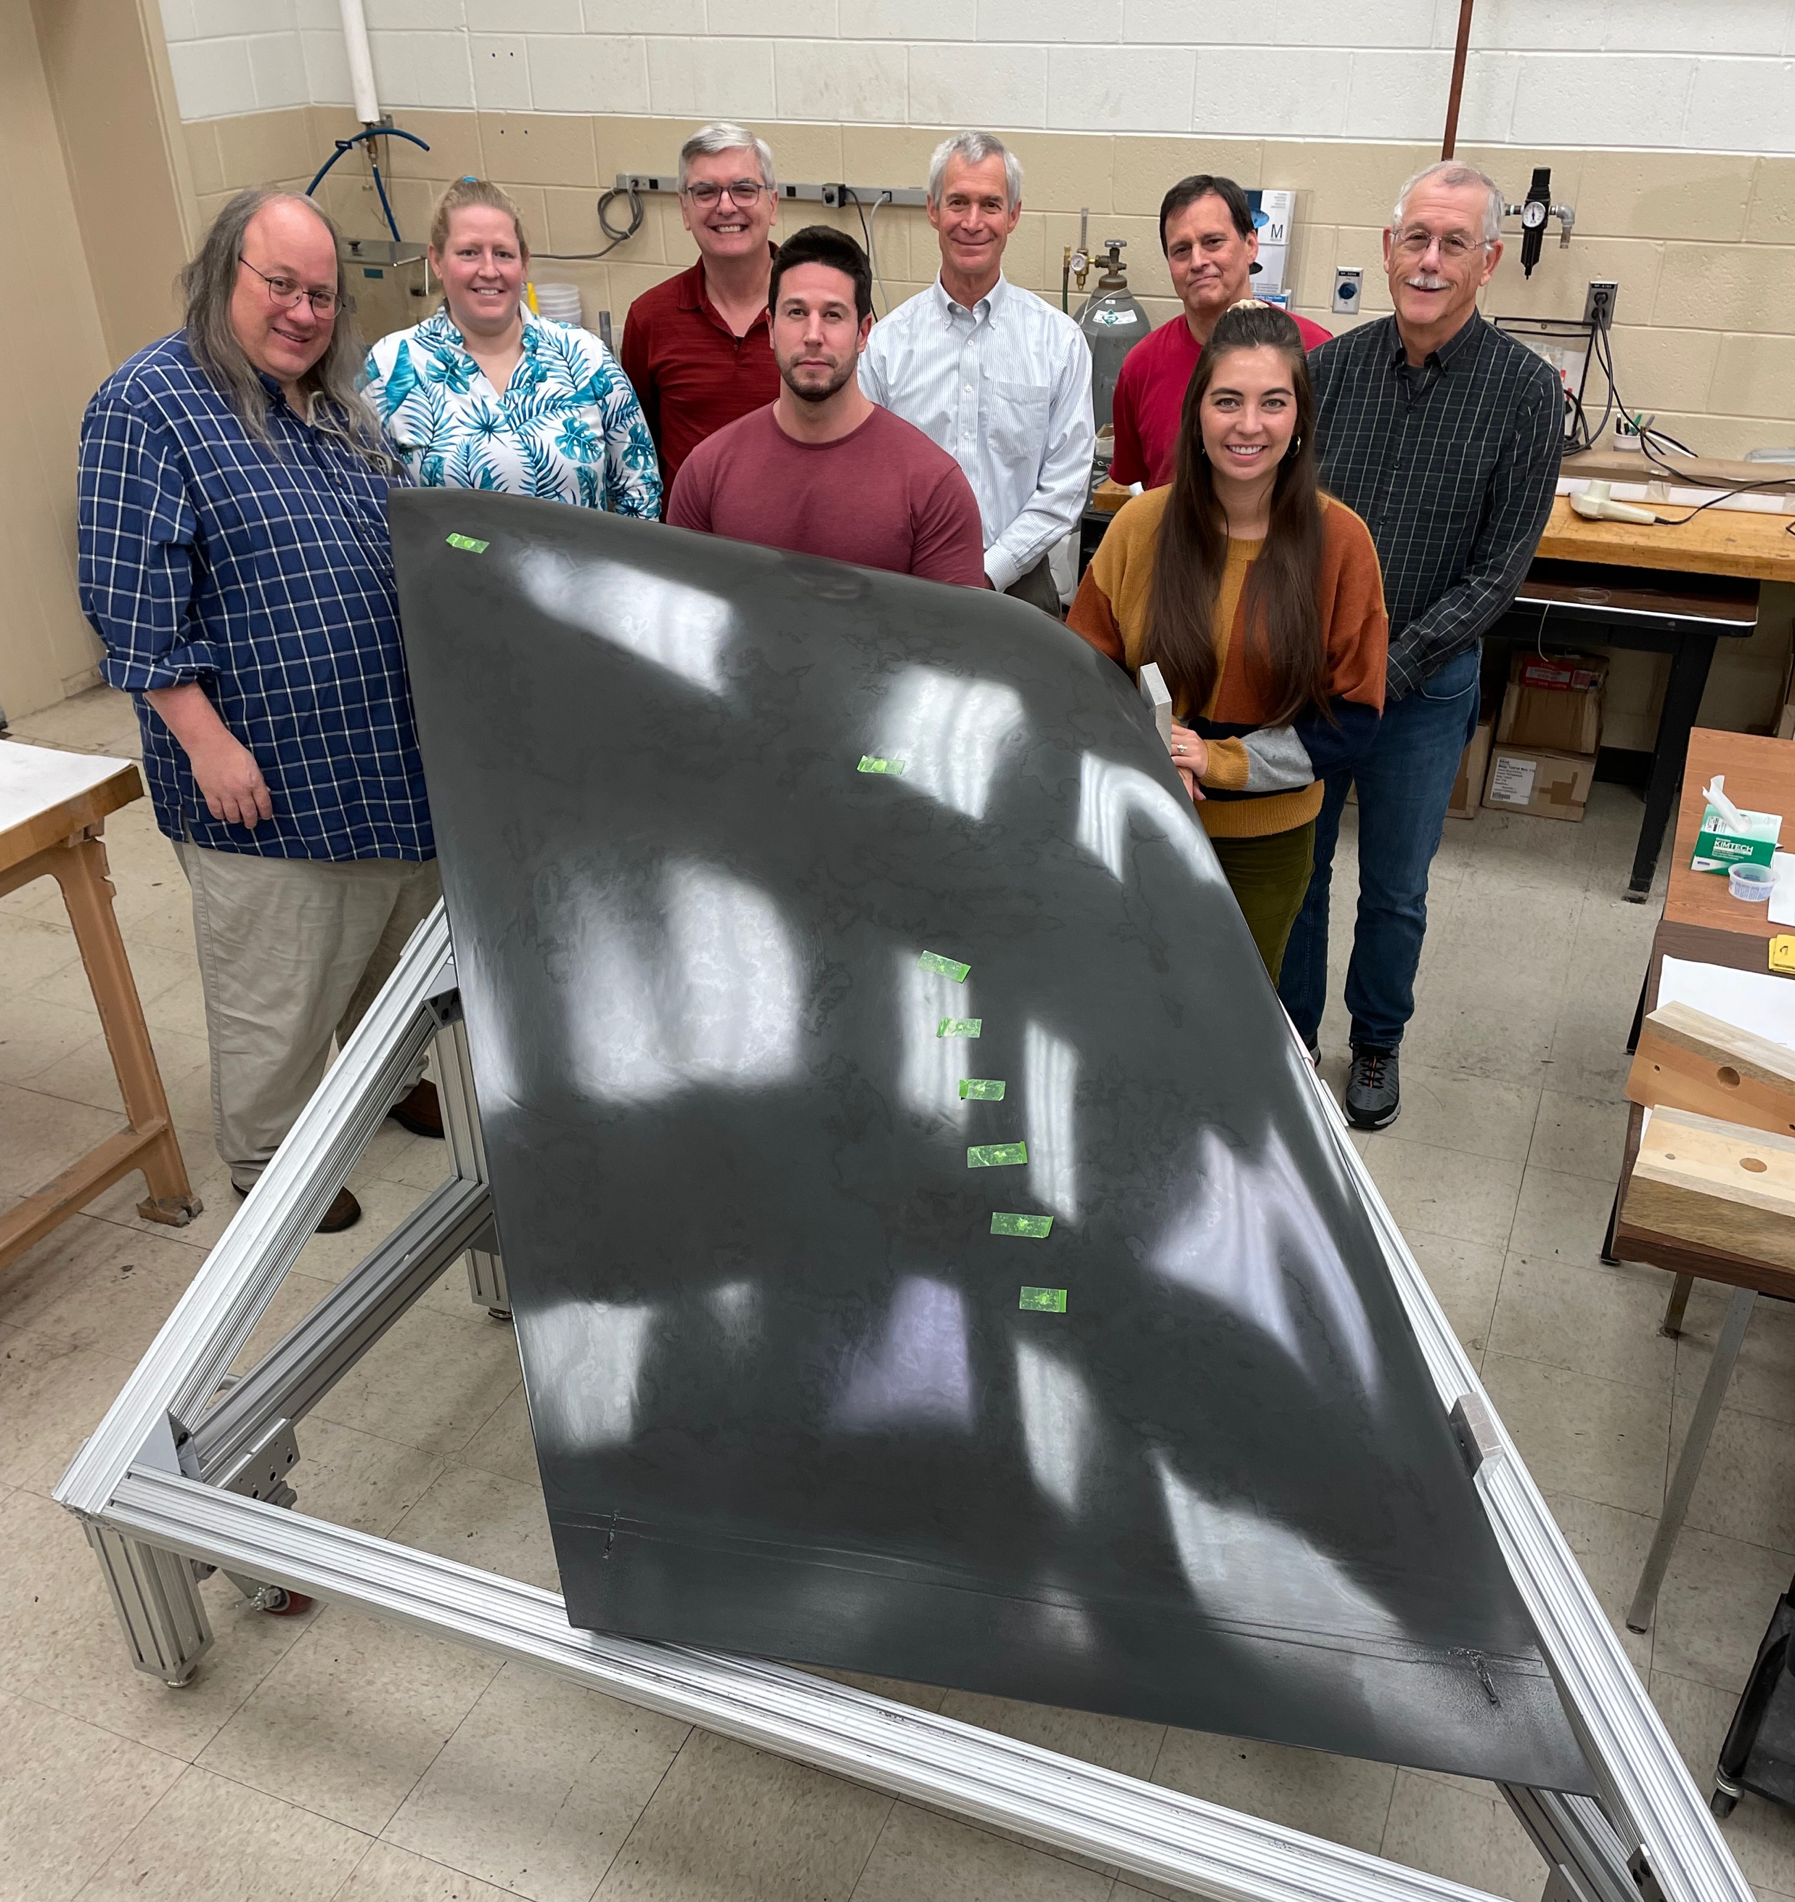
Contact: Michelle Banchy (Lynde) <michelle.n.lynde@nasa.gov>

