Slide 1
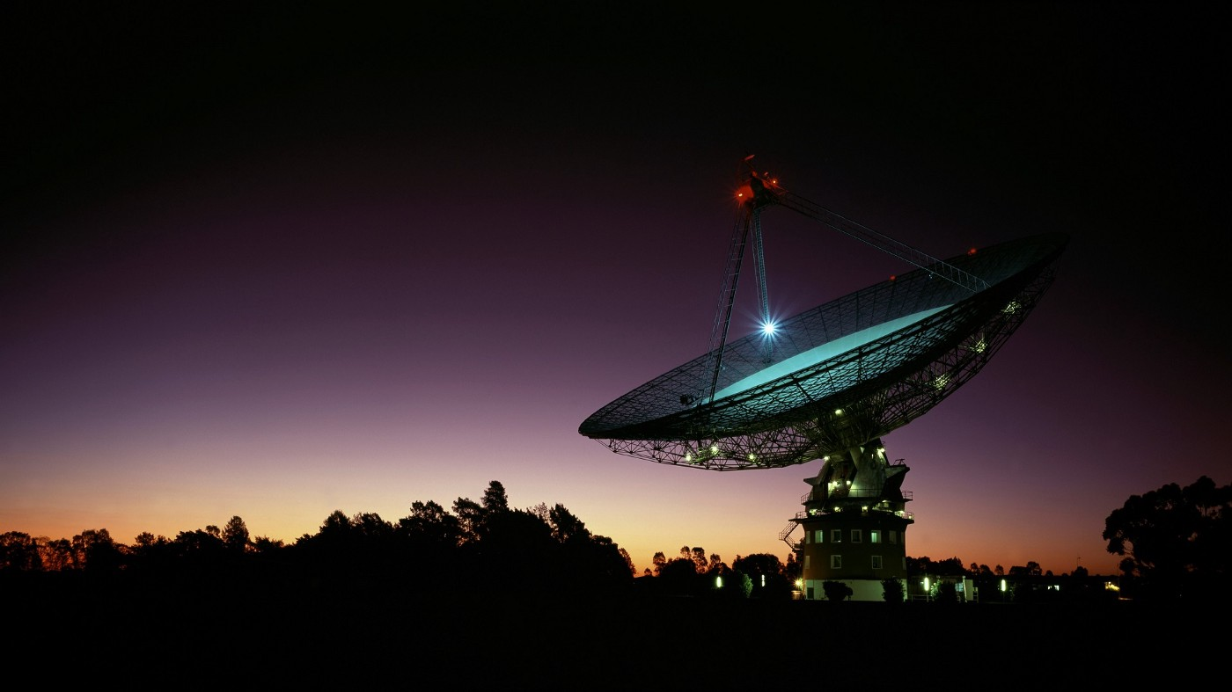
Squeezing Every Last ‘bit’ of Information from Enceladus Mass Spectrometry
Bethany P. Theiling, Lily Clough, Victoria Da Poian, Jonathan D. Major, Brett McKinney, Jingyi Chen, Lauren Seyler

Slide 2
Specific needs for mass spectrometry (MS) data analysis
Process data quickly for rapid ground-based analyses
Understand if compositional and biosignature information could be extracted from MS data
Evaluate whether onboard ML techniques could improve sample analysis, cadence, and transmission prioritization.

Slide 3
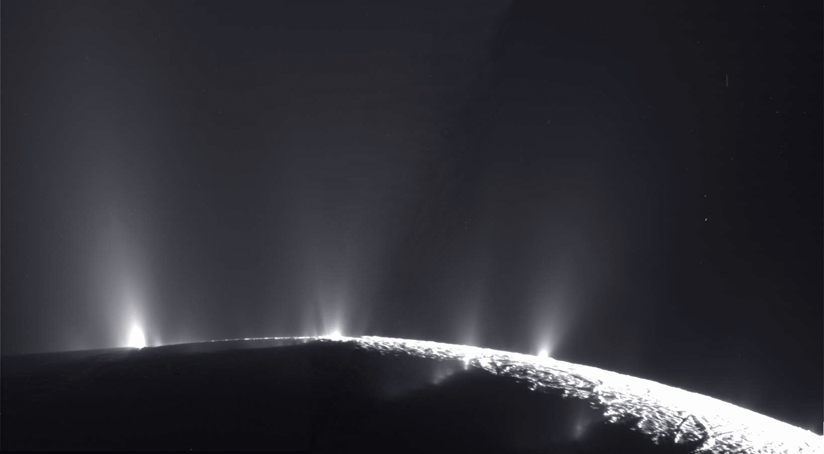
Simulating Enceladus’s seawater and plume chemistry
abiotic
biotic
Observed composition:
H₂O, CO₂, NaCl & NaHCO₃ salts, CH₄, H_{2,} organics, silica particles
CO₂
CO₂
HCO₃⁻
HCO₃⁻
CO₂
CO₂
organics
Cl⁻
Cl⁻
Na⁺
Na⁺
Mg²⁺
Mg²⁺

Slide 4
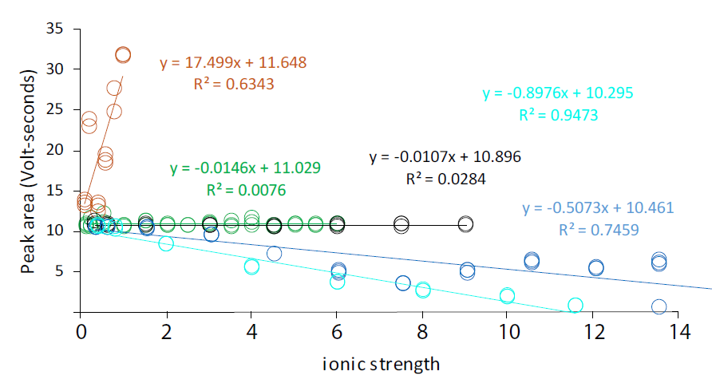
CO₂ from Europa and Enceladus analog seawaters demonstrates compositional fractionation
NaHCO₃
NaCl
Na₂SO₄
MgCl₂
MgSO₄
Limit of quantification
Theiling et al., in prep

Slide 5
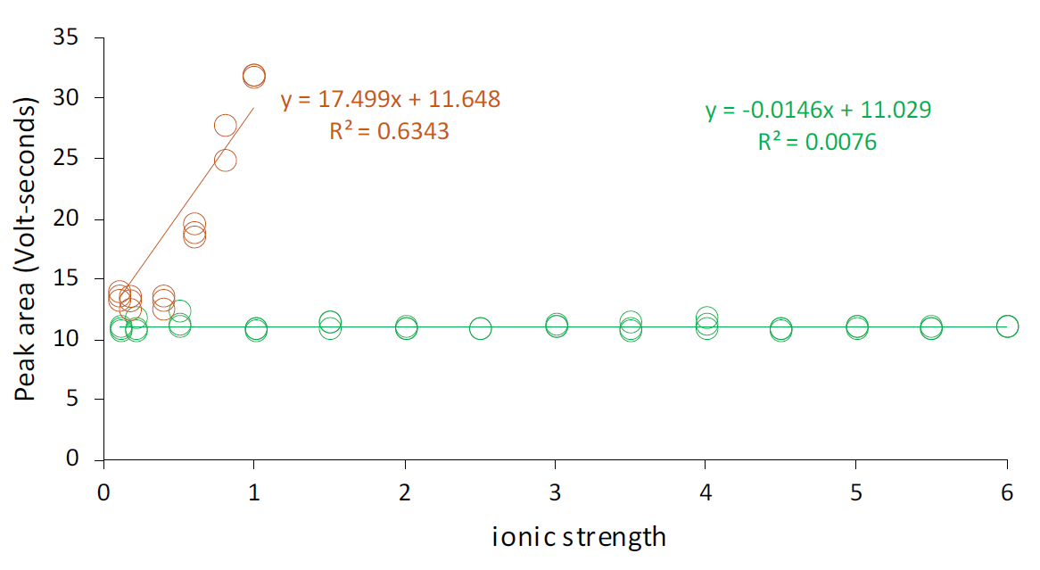
pH dramatically changes the expression of CO₂ measured by mass spectrometry
NaHCO₃
NaCl
Limit of quantification
Theiling et al., in prep

Slide 6
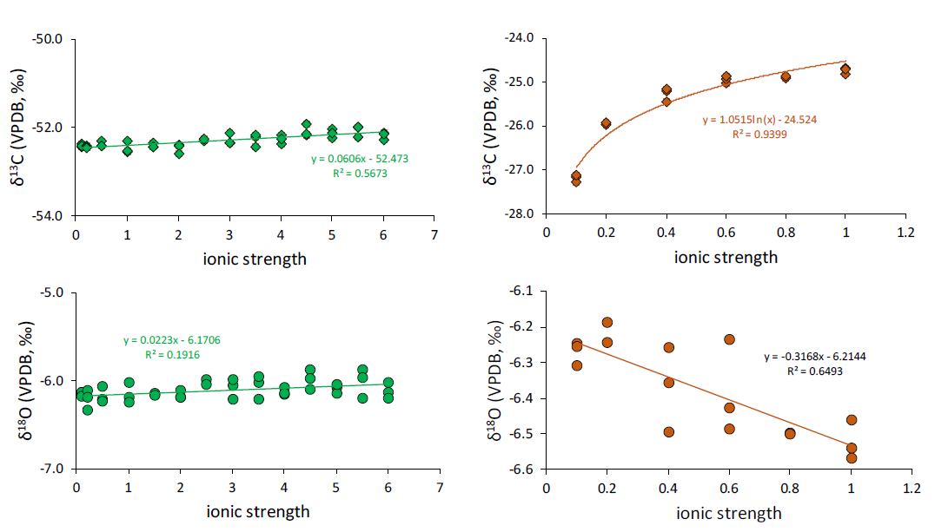
NaHCO₃ concentration affects both δ¹³C and δ¹⁸O
NaCl
NaHCO₃
Theiling et al., in prep

Slide 7
MS Threshold, Feature, Novelty Detections
Novelty: Something unexpected
or anomalous (detection or even isotope ratios)
Intensity
Threshold
Feature: What do you expect?
A priori, onboard learing, both
Limit of detection (LOD) / Limit of Quantification (LOQ)
mass/charge (m/z)

Slide 8
MS Threshold, Feature, Novelty Detections
Are there unique characteristics of these spectra that could be used to extract additional information?
Chemical composition
Biotic vs abiotic
Evolution of sample (e.g., during freezing)
Intensity
mass/charge (m/z)

Slide 9
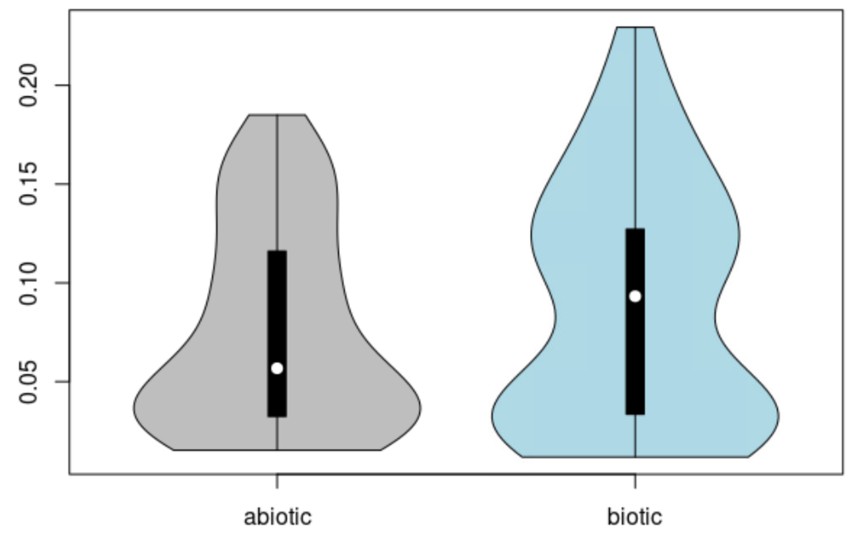
Isotopic variance for biotic vs abiotic experiments are overall too similar to be a useful feature
δ¹³C variance
(Isotopic) biosignatures are likely complex: involve statistical interactions
Clough et al., in prep

Slide 10
Supervised Machine Learning (ML) demonstrates high accuracy for
Confusion Matrices for varying methods
RF NPDR-URFP features (12)
RF LASSO-NPDR-URFP features (9)
actual
actual
Test accuracy = 87.9% | Abiotic | Biotic
Abiotic | 20 | 3
Biotic | 1 | 9
Test accuracy = 87.9% | Abiotic | Biotic
Abiotic | 20 | 3
Biotic | 1 | 9
predicted
predicted
Random Forest Nearest-Neighbor Projected Distance Regression (RF NPDR) with Unsupervised Random Forest Proximity (URFP)
Clough et al., in prep

Slide 11
Preliminary Conclusions
Compositional and isotopic fractionation of volatiles due to variations in Enceladus seawater salinity may confuse interpretations
Understanding the plume / seawater salt composition will allow us to better constrain fractionation models to interpret data
Models can be deployed as onboard threshold, feature, or novelty detection algorithms
Combined supervised and unsupervised ML classification so far has high accuracy in differentiating between biotic and abiotic spectra
Caveat: More biotic experiments needed to increase variable space
Check out Lily Clough’s Poster for more on biosignature detection ML: P25A-68

Slide 12
Acknowledgements
Data collection funded through a NASA Oklahoma EPSCoR Space Grant and the Fundamental Laboratory Research (FLaRe) program at NASA GSFC
Machine Learning funded through the Internal Research and Development (IRAD) and FLaRe program at NASA GSFC

Slide 13
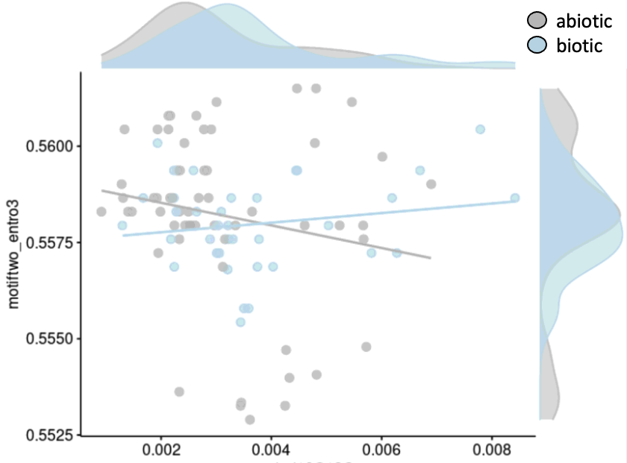
Regression on nearest neighbors efficiently
detects interactions
Regular methods = values of individual samples
Interactions detected over all variable space
NPDR = Nearest-neighbors projected distance regression
→ Takes advantage of higher dimensions
Statistical interaction
𝛿¹⁸O/𝛿¹³C variance
Notes:
Projected differences used to determine importance; distance metrics are important for neighborhood construction

Slide 14
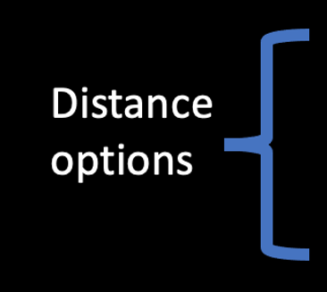
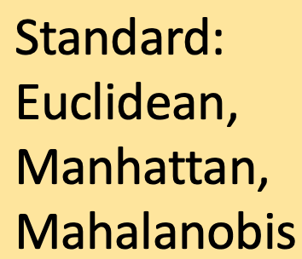
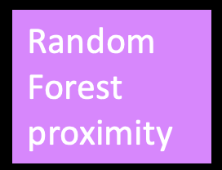
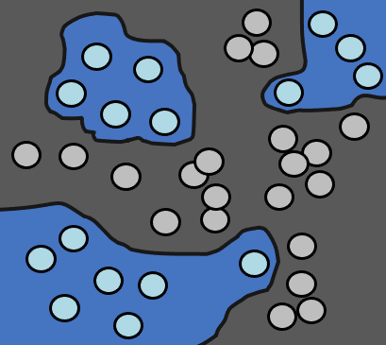
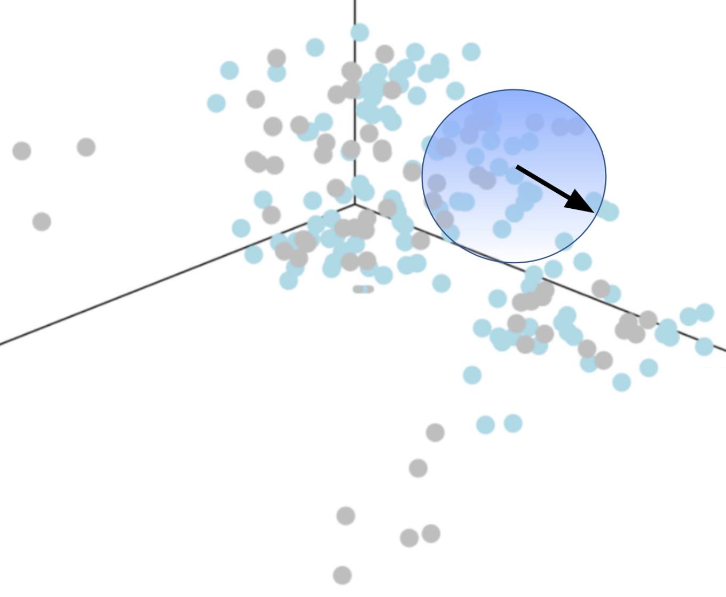
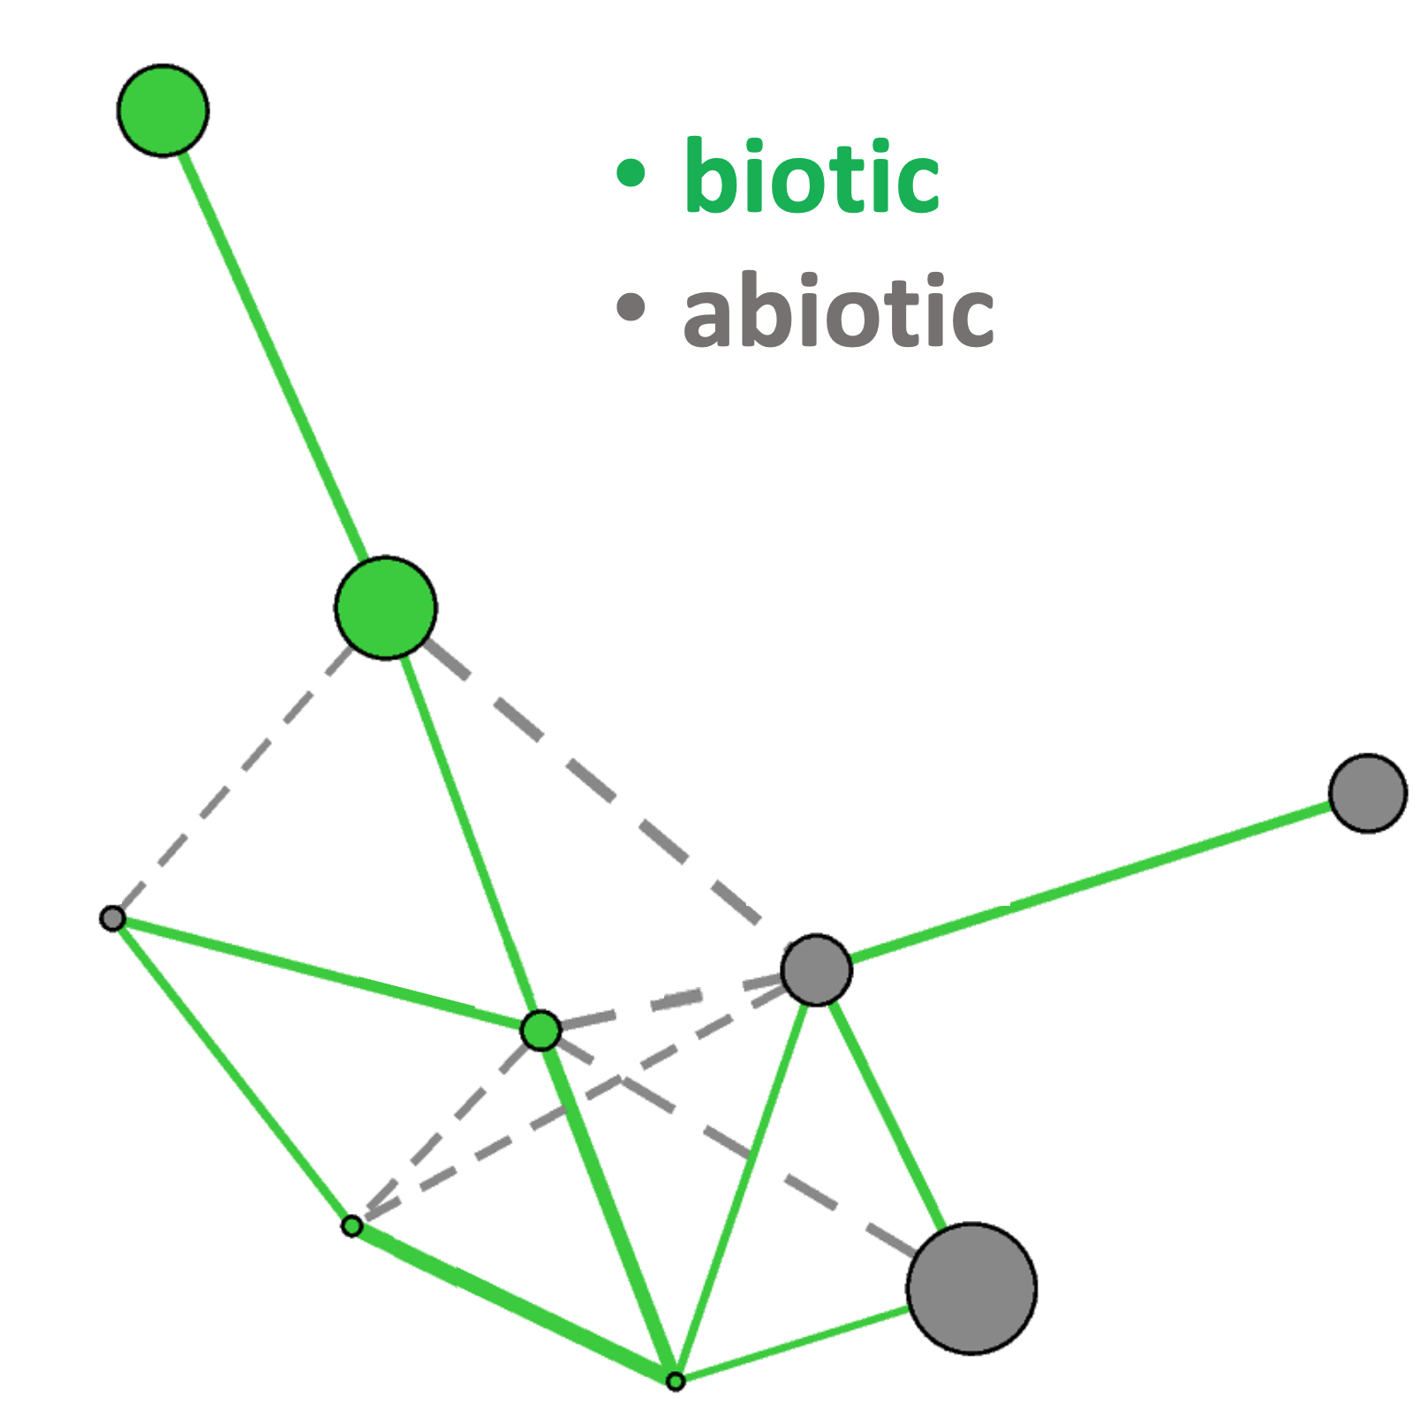
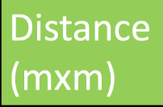
NPDR improved to accept novel distance metrics
Neighborhood → classification
Biotic
Biotic
Other user-specified distances
TS + MS
Biotic
- NPDR
- Variable scores
- Interpretation
Dawkins, Le, McKinney, “Theoretical properties of distance distributions and novel metrics for nearest-neighbor feature selection,” PLoS ONE (2021)
Notes:
NPDR focused on interpretation of models

