Slide 1
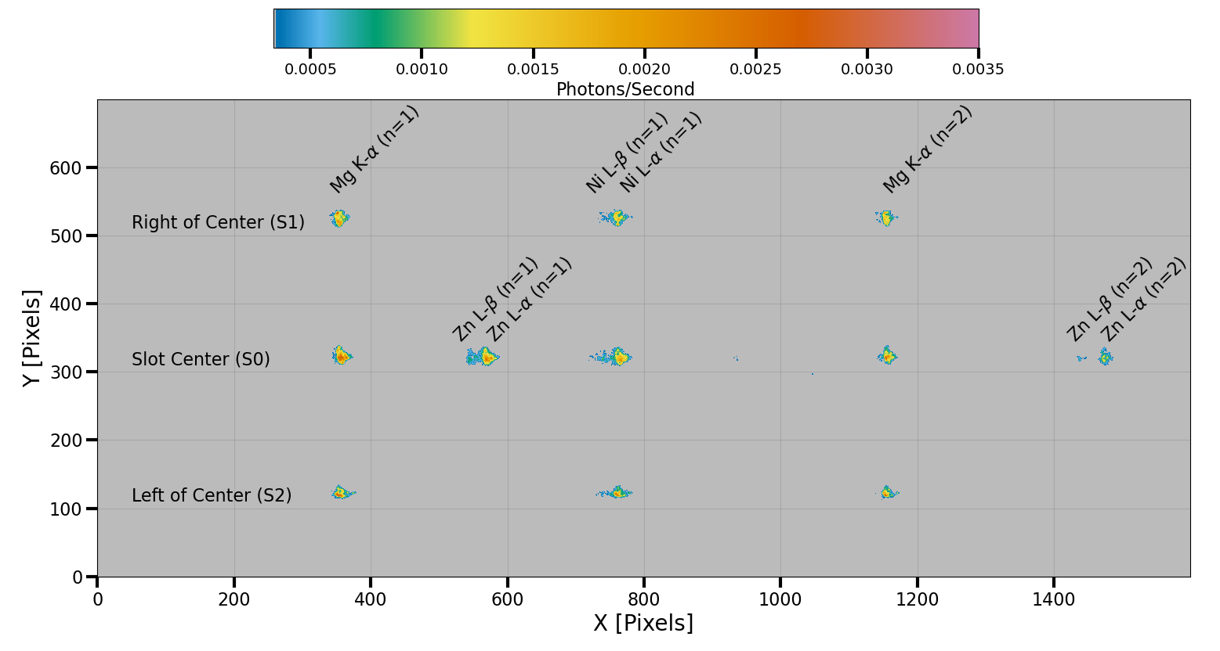
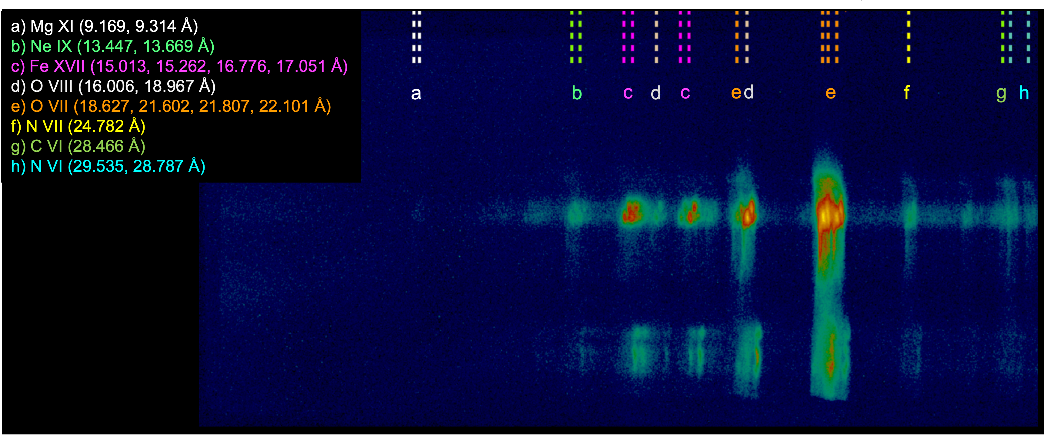
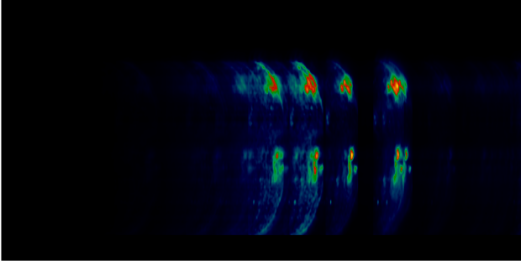
MaGIXS 2: Preparations for the Second Flight of the Marshall Grazing Incidence X-ray Spectrometer
Patrick Champey¹, P.S. Athiray², Amy Winebarger¹, Ken Kobayashi¹, Sabrina Savage¹, Adam Kobelski¹, Genevieve Vigil¹, Brent Beabout¹, Dyana Beabout¹, Peter Cheimets³, Leon Golub³, Anthony Guillory¹, Harlan Haight¹, Edward Hertz³, William Hogue¹, Jagan Ranganathan¹, Robert Walsh⁴ and the Science Team
¹NASA Marshall Space Flight Center, ²The University of Alabama in Huntsville, ³The Smithsonian Astrophysical Observatory, ⁴The University of Central Lancashire
MaGIXS is a slitless soft X-ray (SXR) imaging spectrometer designed to observe solar active regions.
The instrument produces spatially resolved SXR spectra, known as “overlappograms.” (Athiray et al. 2019 & Champey et al., 2022)
The first sounding rocket flight of the Marshall Grazing Incidence X-ray Spectrometer occurred on July 30, 2021 from the White Sands Missile Range, New Mexico.
Spectrally pure images of X-ray bright points were obtained through the inversion of overlappograms, e.g. Fig. 3 (Savage et al., 2022).
MaGIXS 2 is a simplified version of the original design, less the spectrometer mirror pair.
Eliminating the spectrometer mirror pair improves spatial resolution, increases effective area and the field of view (Table 1).
No field stop in this design, data will be an overlappogram with the same spatial and spectral plate scale.
Table 1: Performance
Fig. 1: Optical Layout
Parameter | MaGIXS 1 | MaGIXS 2
Spatial Resolution [arcseconds] | 23 | 17
Resolving Power [λ/Δλ] | 70-100 | TBD
Effective Area [cm²] (@ 12.25 Å, 1.02 keV ) | 0.005 | 0.021
FOV (disp. X cross-disp.) [arcmin] | 9.2 X 25 | 16 X 33
MaGIXS 1
OVERVIEW
Wolter-I
Telescope
Focal Plane
The spec. mirror pair was eliminated, and the grating was placed behind the telescope. The MaGIXS 1 grating will be reused.
MaGIXS 2
Grating
741.1 mm
1208.4 mm
467.3 mm
Fig. 3: MaGIXS FOV
Level 1.5 processed image summed over the duration of the flight (296 seconds).
The overlapped SXR spectral lines emitted from different solar coronal structures as identified in the FOV shown in Fig. 2.
The inversion technique, a variant of Cheung et al. (2015, 2019) and Winebarger et al. (2019), is applied to unfold the overlappogram resulting in an emission measure distribution over the FOV.
Fig. 2: MaGIXS 1 Point- and Line-Spread Functions
N
Cross-Dispersion (spatial)
33’
Fig. 4: MaGIXS 1 Flight Observations
25’
Dispersion (increasing λ)
SOLAR OBSERVATIONS
9.2’
Cross-Dispersion (spatial)
MaGIXS 1 calibration was completed in the 500m beamline at the XRCF, Fig. 2 shows the calibration image (Athiray et al., 2019, 2021 and Champey et al., 2022).
The instrument point- and line-spread functions were sparsely mapped, largely due to low count rates and long integration times.
MaGIXS 2 will be calibrated in the 100m beamline at the Stray Light Test Facility
Expected to have ~28X greater X-ray flux.
Better efficiency enables great sampling of the PSF over the full FOV.
MaGIXS 1
MaGIXS 2
16’
A full sun, summed DEM determined using SDO/AIA.
The solar disk at the time of the MaGIXS 1 observations.
The pink box is the size of the slot field stop (located at the telescope focal plane) and the orange-white contour is the vignetting function.
The teal rectangle is the MaGIXS 2 FOV, vignetting is no longer a limiting factor.
Dispersion (increasing λ)
CALIBRATION
Fig. 5: MaGIXS 2 Forward model
Table 2: Off-Axis PSF Mapping
References:
Athiray, P. S., Winebarger, A. R., Barnes, W. T. et al. 2019, ApJ 884, 24.
Athiray, P. S., Winebarger, A. R., Champey, P. et al. 2020, ApJ 905, 66.
Athiray, P. S., Winebarger, A. R., Champey, P. et al. 2021, ApJ 922, 65.
Champey, P. R., Winebarger, A. R., Kobayashi, K. et al. [2022], JAI 11, 2250010
Cheung, M. C. M., Boerner, P., Schrijver, C. J., et al. 2015, ApJ, 807, 143.
Cheung, M. C. M., De Pontieu, B., Martinez-Sykora, J., et al. 2019, ApJ, 882, 13.
Savage, S. L., Winebarger, A. R., Kobayashi, K. et al., ApJ (submitted)
Winebarger, A. R., Weber, M., Bethge, C., et al. 2019, ApJ, 882, 12.
FA | -6 | -4 | -2 | -1 | -0.5 | -0.25 | 0 | 0.25 | 0.5 | 1 | 2 | 4 | 6
-16
-8
-4
-2
0 |  |  |  |  |  |  | *OA
2
4
8
16
MaGIXS 2 forward model using the image in Fig. 3.
The model considers the MaGIXS 2 response function (key parameters in Table 1).
Smaller PSF reduces spatial spectral overlap.
Greater effective area over a larger FOV.
Enables MaGIXS 2 to observe and better resolve coronal features with improved dynamic range.
Acknowledgments:
We acknowledge the Marshall Grazing Incidence X-ray Spectrometer (MaGIXS) instrument team for making the data available through the 2021 NASA Heliophysics Low Cost Access to Space (HLCAS) program, funded via grant ###. MSFC/NASA led the mission with partners including the University of Alabama in Huntsville, the Smithsonian Astrophysical Observatory, the University of Central Lancashire, and the Massachusetts Institute of Technology.
*OA: On-axis

