Slide 1
Solving Forward and Inverse Problems for Hyperspectral Satellite Remote Sensors using Principal Component Analysis
Xu Liu
NASA Langley Research Center, Hampton, VA, USA
Wan Wu¹, Qiguang Yang², Xiaozhen Xiong¹, Ming Zhao², Daniel K Zhou¹, Allen M Larar¹, Robert J D Spurr³, Ping Yang⁴, Liqiao Lei², Hyun-Sung Jang⁵, Yolanda Shea¹, Snorre Stamnes¹, David R. Thompson⁶, Xiong Liu⁷, Lihang Zhou⁸, Qing Yue⁶, Feng Xu⁹, and Larrabee Strow¹⁰
(1) NASA Langley Research Center, Hampton, VA, (2) SSAI Inc, Hampton, VA, (3) Rt Solutions Inc., Cambridge, MA, (4)Texas A&M Univ, College Station, TX, (5) NIA, Hampton, VA, (6) JPL/CalTech, Pasadena, CA, (7) Center for Astrophysics | Harvard & Smithsonian, Cambridge, MA, (8) NOAA, (9) University of Oklahoma, Norman, OK, (10) UMBC, College Park, MD
Acknowledgement
NASA Sounder SIPS, NOAA NUCAPS Team, NASA NAS and NCCS, NASA DACC, NASA Science of Terra, Aqua, and Suomi NPP, NAST-I, CPF, TEMPO, and SBG programs

Slide 2
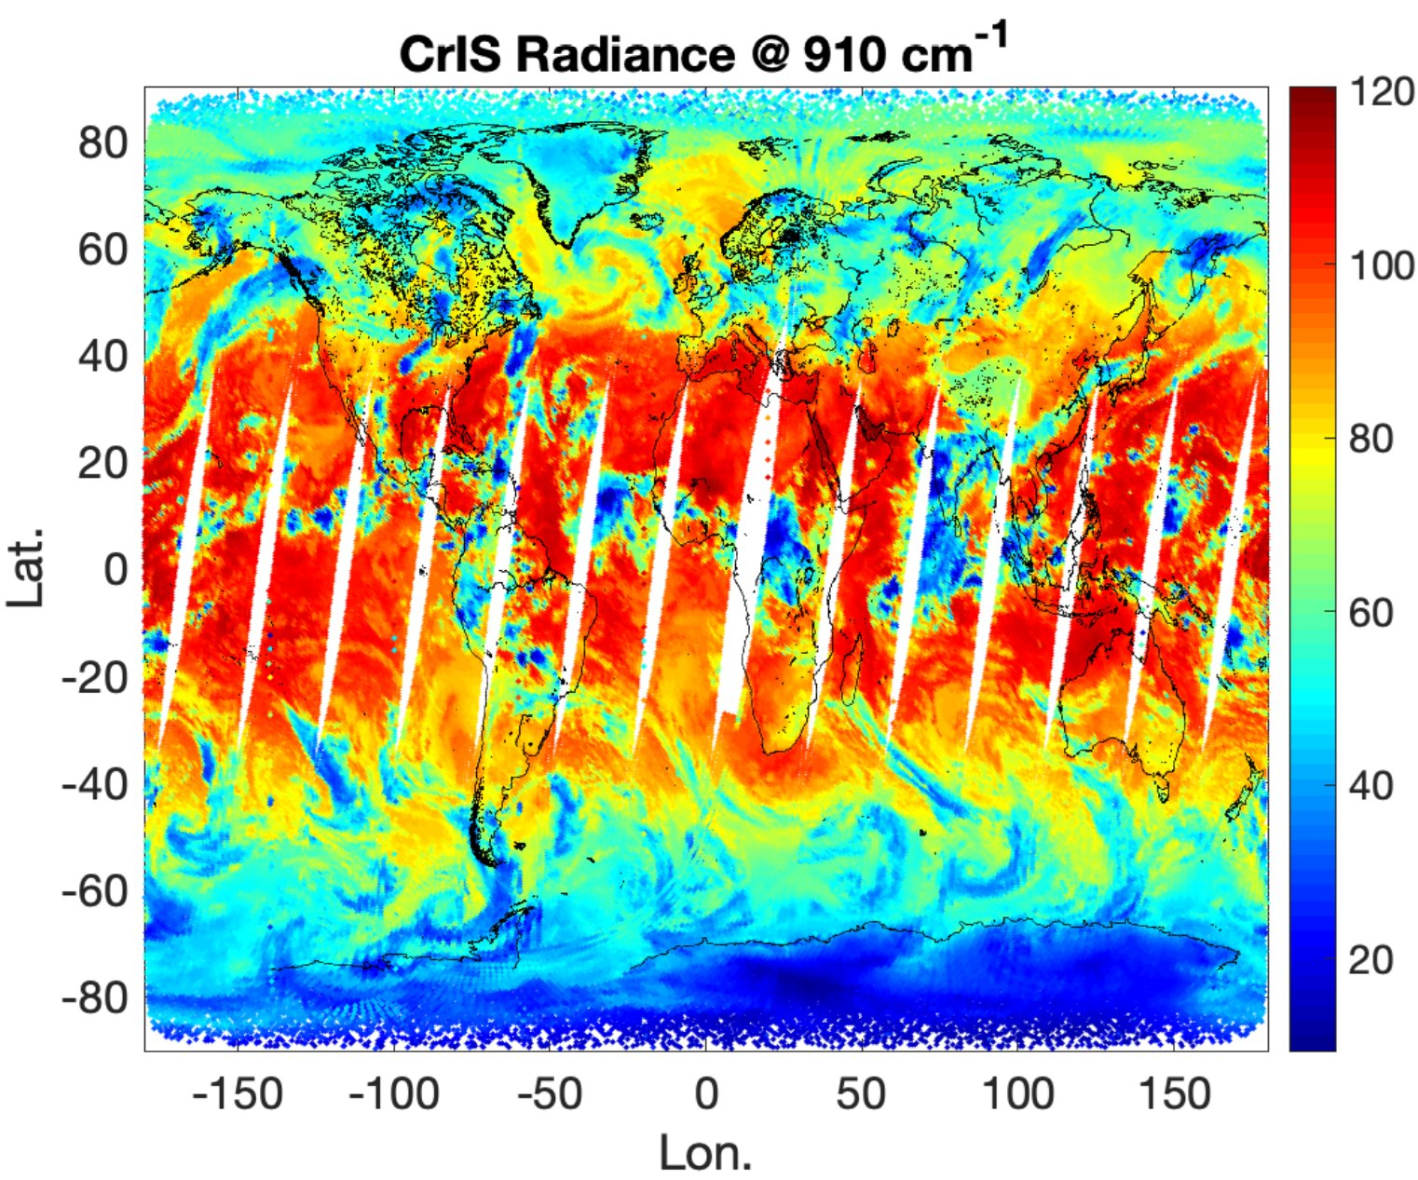
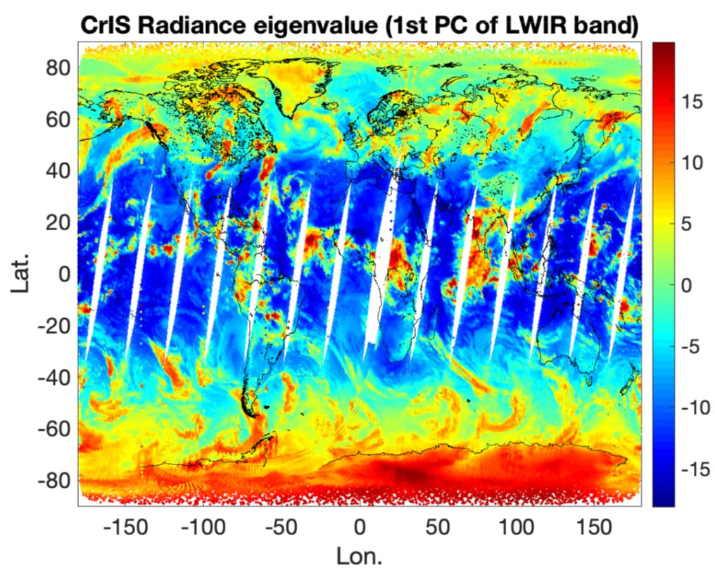
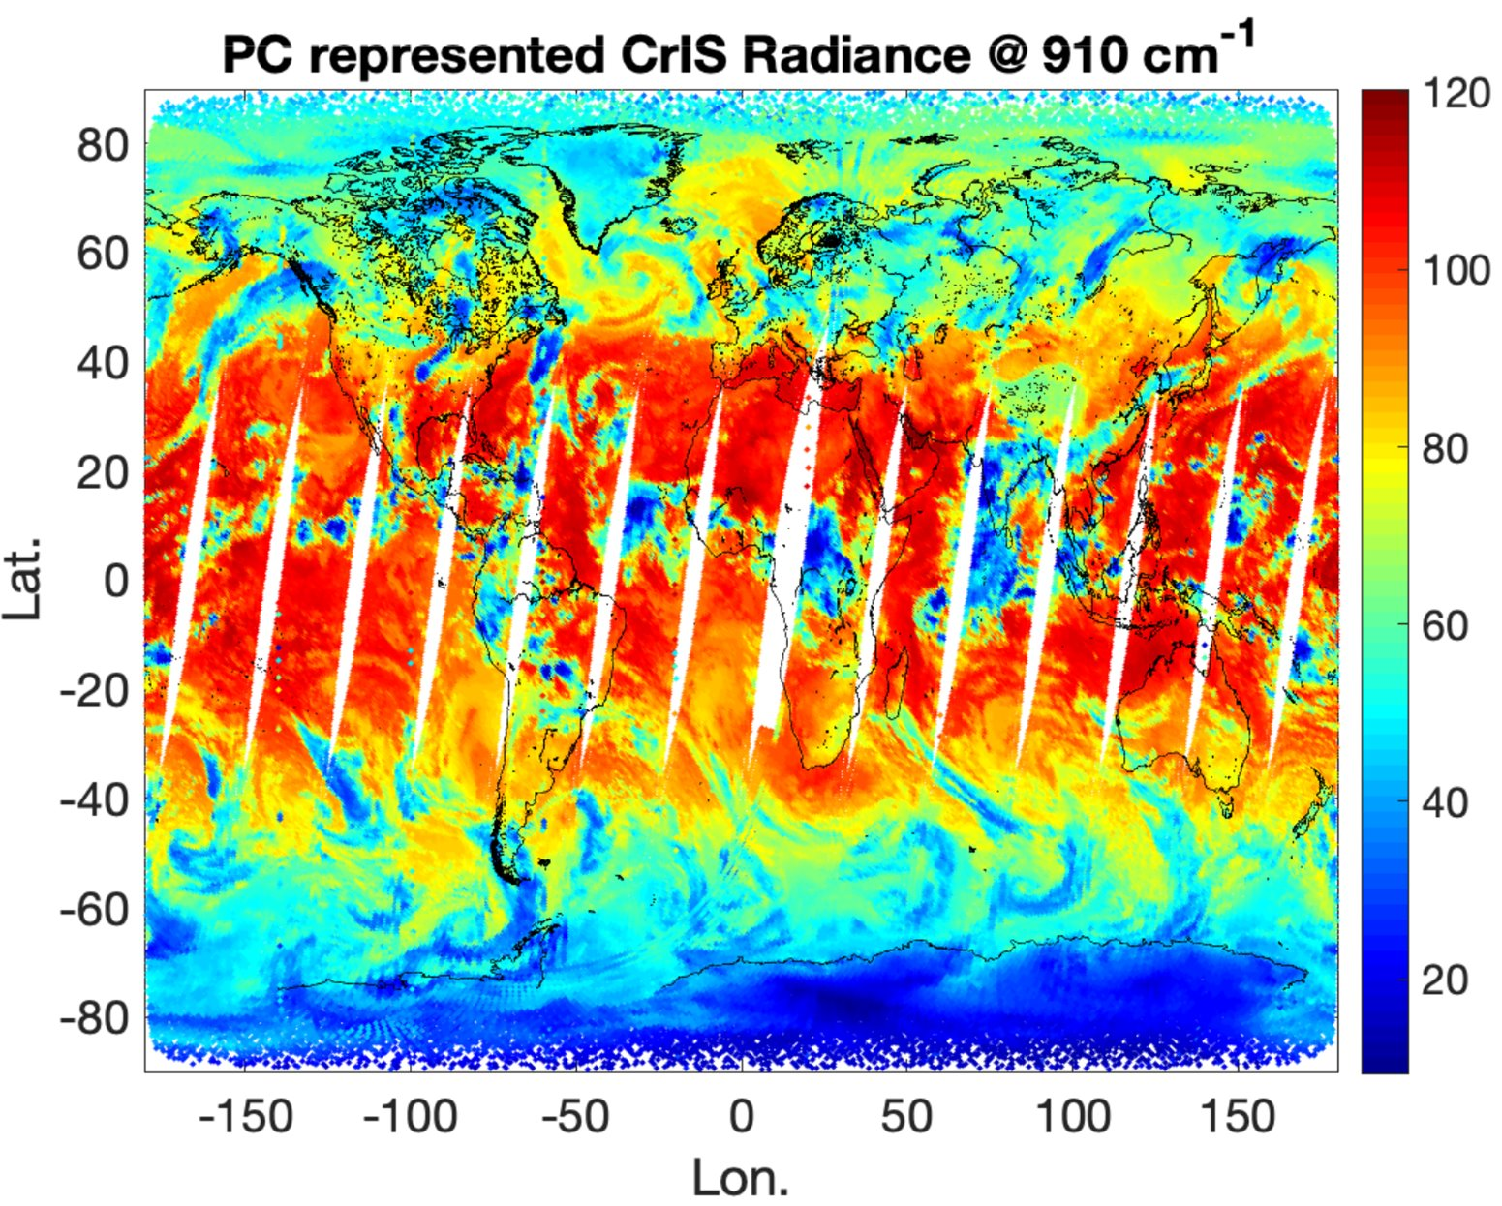
Introduction
Modern hyperspectral satellite remote sensors provide wealth of information on
Atmospheric properties such as temperature, water vapor and trace gas vertical profiles
Cloud and aerosol properties
Surface properties (temperature, emissivity, reflectivity …)
Fast and accurate forward models are needed to invert hyperspectral data
Hundreds to thousands of spectral channels with millions of observations each day
Line-by-line (LBL) radiative transfer model (RTM) is too slow (needs millions of LBL RT calculations to account for atmospheric gas spectral contributions)
Traditional channel-based forward models are also too slow (at least one RT calculations needed for each channel
Principal Component Analysis (PCA) converts hyperspectral data into super-channels
Principal Components (PCs) capture the spectral correlations (remove redundant info)
Super channels capture the information content of the original channel spectrum
Super-channel number << than the original channel numbers

Slide 3
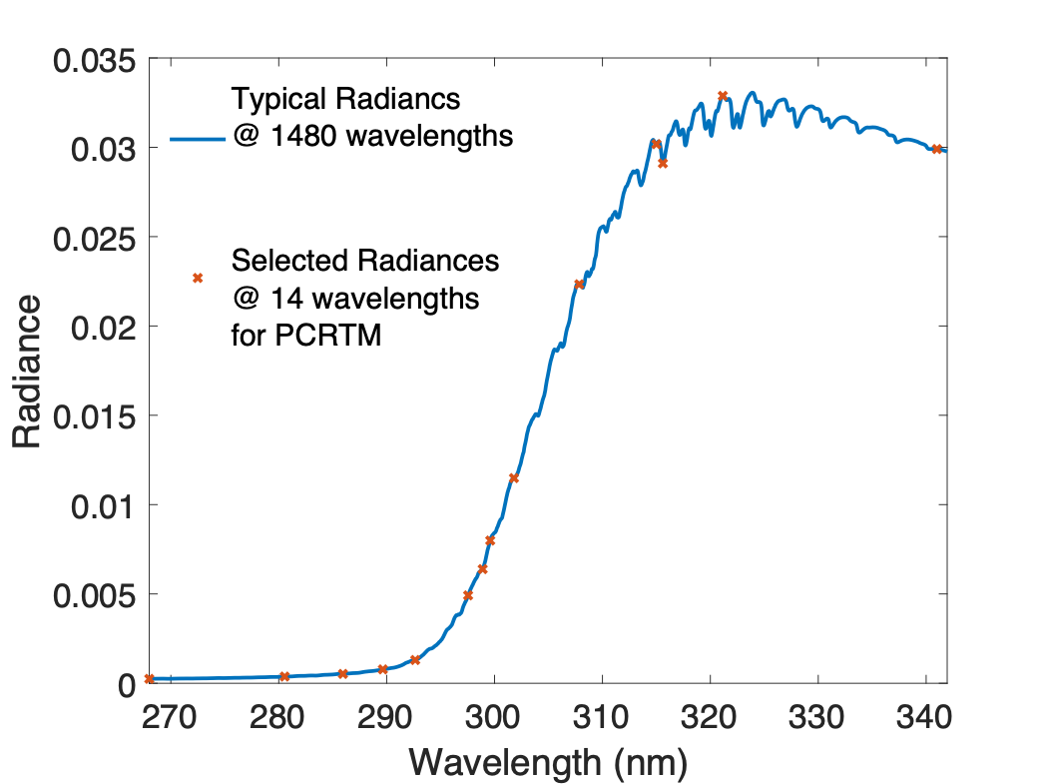
Principal Component Based Radiative Transfer Model (PCRTM)
PCRTM was first developed in 2004 specifically for hyperspectral remote sensors
Number of RT calculations are << number of spectral channels
Orders of magnitude faster than LBL RTMs
RT calculations done monochromatically
Physical-based RTM and accurate relative to LBL RTMs
Provides analytical Jacobian needed for satellite data inversions
PCRTM is different from other PCA-based RTMs
PC scores (super-channels) which contain all spectral information
Reduced inversion dimension for satellite data analysis
Instrument Line Shape (ILS) functions included in the PCs (eigenvectors)
No need to calculate high resolution spectra and then convolve with ILS
Multiple scattering clouds and aerosols included
Wide range of spectral coverage
Thermal: 50-3000 cm⁻¹
Solar: 200 nm – 2500 nm
Suitable for AIRS, CrIS, IASI, PREFIRE, IRS, IASI-NG, NAST-I, S-HIS, CLARREO, CPF, SBG, TEMPO, OMI, SCIAMACHY …
Fast:
Milliseconds to fraction of seconds in IR
3-4 orders of magnitude faster than LBL in solar
Accurate relative to LBL:
Thermal: Bias error < 0.002 K RMS error < 0.03 K
Solar: bias error < 0.001%, RMS error ~0.05%

Slide 4
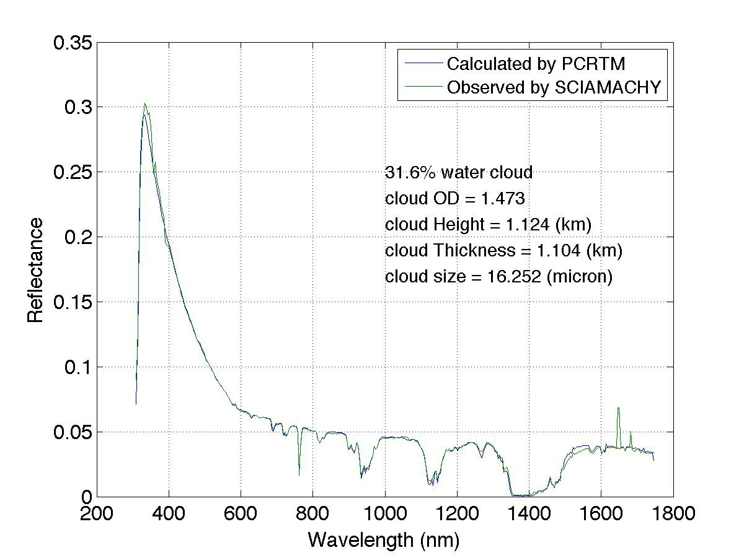
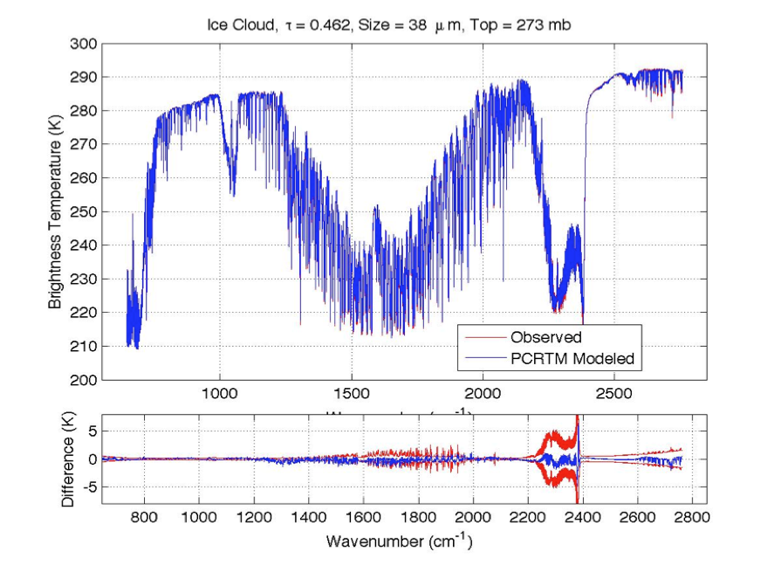
PCRTM Calculated Radiance Spectra Agree Well With Satellite Observations
PCRTM Simulated Reflectance @646 nm using MODIS L2 data
MODIS L1 Observed
Reflectance @646 nm
SCIAMACHY
IASI
CrIS
AIRS
MODIS L2 + CPF simulator @646nm

Slide 5
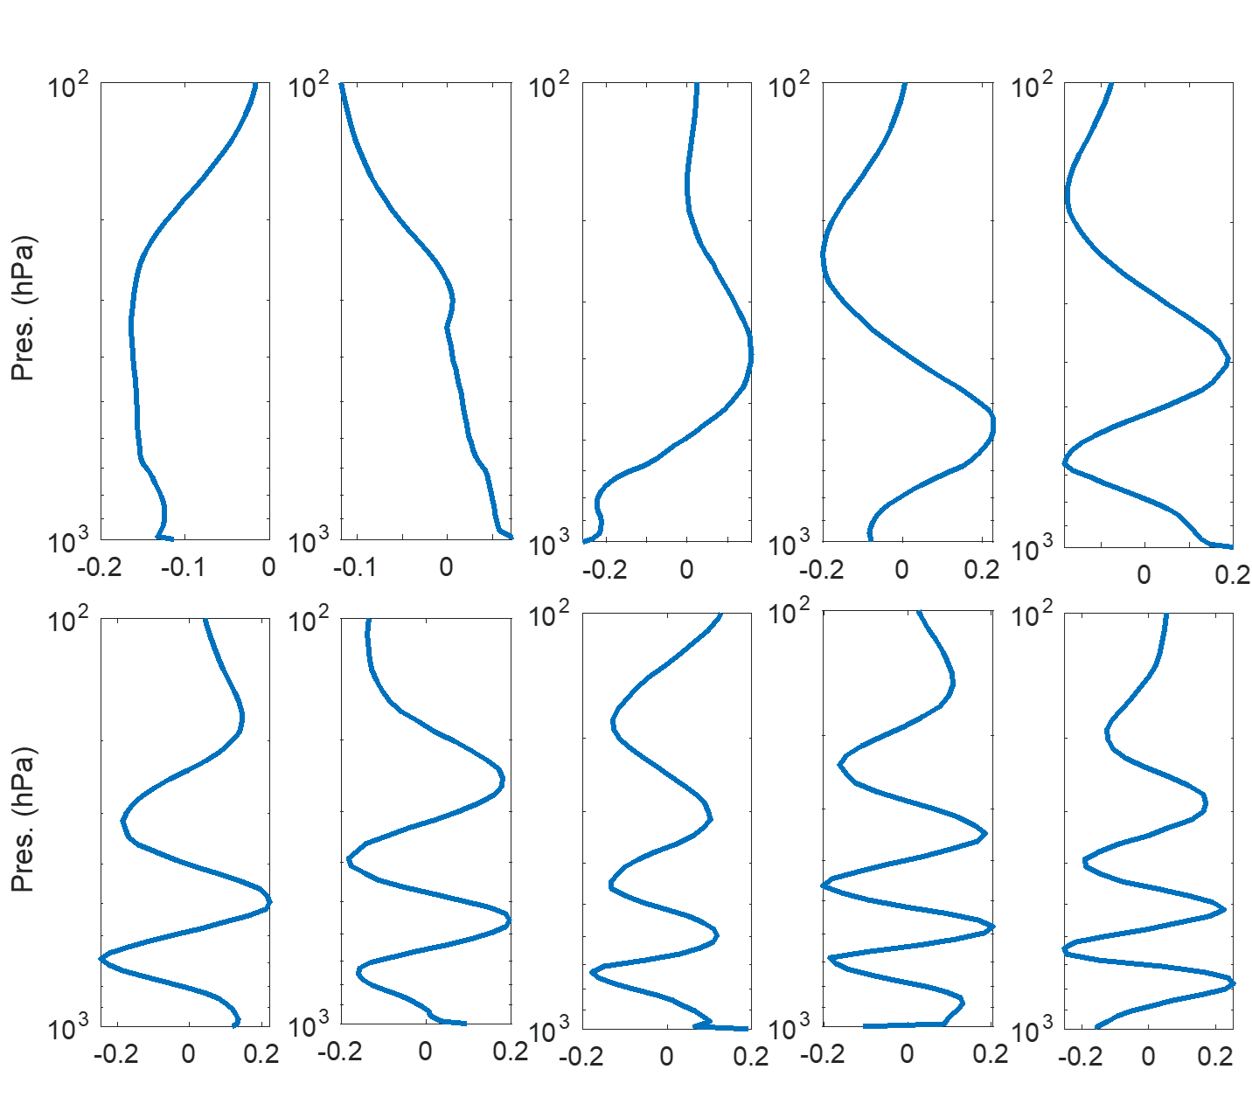
PCA-based Inversion Algorithms
Iterative Optimal Estimation Inversion:
PCRTM compresses R, Se, and K into smaller dimensions
Applying PCA to X will further reduce the dimension of X, K and Sa
Advantages of using PCA
reduces the ill-condition of the inversion process
Speed up the inversion
Easy to store the retrieved parameters with associated error covariance matrix
$$X_{n+1}−X_{n}={\left(K^{T}S_{ε}^{−1}K+S_{a}^{−1}\right)}^{−1}\left(K^{T}S_{ε}^{−1}\left(R−R_{n}\right)−S_{a}^{−1}\left(X−X_{a}\right)\right)$$
Example of PCs representing H2O vertical profiles
Satellite Sensors | Original Dim | PC-compressed Dim
CrIS | 2211 | 124
AIRS | 2378 | 120
IASI | 8461 | 190
Geophysical Parameters | Original Dimension | PC-compressed Dimension
Temperature | 101 | 20
H2O | 101 | 15
CO2 | 101 | 1
O3 | 101 | 10
CO | 101 | 4
CH4 | 101 | 2
N2O | 101 | 2
IR Surface Emissivity | Hundreds -thousands | 8
MW Surface Emissivity | 15-22 | 5
Notes:
Flow diagram shown as applied to NAST-I, but has analogous applicability to all sensors.
Bottom QC is for spot checking in spectral domain, if desired; entire loop stays in PC domain (fast).
Super channels = PCs

Slide 6
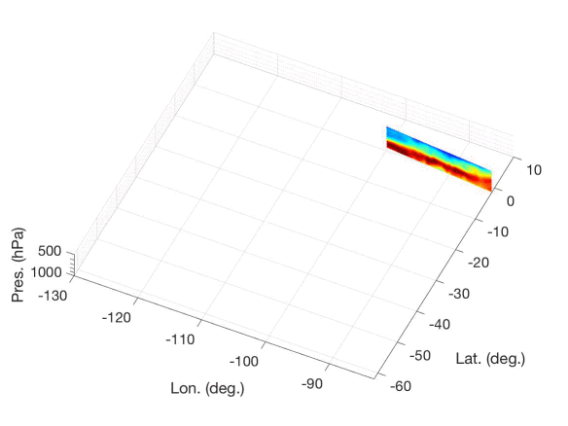
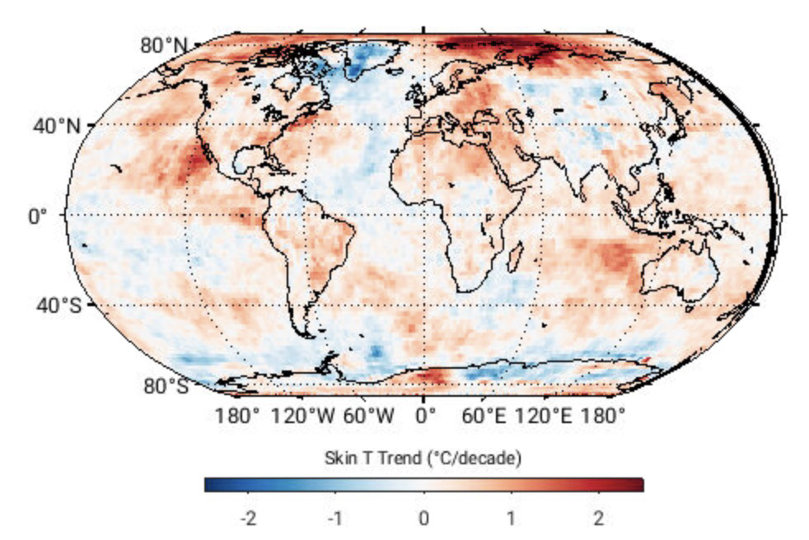
Two PCRTM-based Inversion Algorithms
L2 products: Single Field-of-view Sounder Atmospheric Product (SiFSAP)
3-times higher spatial resolution
Uses all spectral channel
All sky algorithm-retrieves cloud explicitly
Retrieve temperature, clouds, trace gases, and surface properties simultaneously
L3 Products: Climate Fingerprinting Sounder Products (ClimFiSP)
Works on spatiotemporally averaged radiance spectra
High quality climate product from multiple satellite data fusion
Use consistent radiative kernels
Ensure radiometric closures
Both products will be available at NASA GES DISC for public access
The PCRTM based algorithm can be easily extended to solar spectral region
Example of SiFSAP H₂O product
Example of ClimFiSP derived global surface temperature trend

Slide 7
Summary and Conclusions
PCA can be used to compress both the satellite observed data and the state vector in an inversion process
Stabilize inversion solution by reduce random noise
Speed up inversion process by reducing the matrix and vector dimensions
PCRTM is a fast and accurate forward model for analyzing satellite data
Enable all sky retrievals due to accurate cloud calculations
Uses all spectral channels instead limited selected channels
Can be used for pre-launch sensor design and post-launch data analysis
PCRTM-based inversion algorithms provide radiometrically consistent products
High-spatial resolution L2 products for weather, air quality, and atmospheric dynamic studies
Consistent long-term climate data records (T, Q, cloud …) from multiple satellite IR hyperspectral sounders

