Slide 1
Big-data Efficient Automated Science Transfer (BEAST):
an open-source software architecture for arc jet data management, modeling, and automation
Dr. Magnus A. Haw
Dr. Megan E. MacDonald
Sebastian V. Colom

Slide 2


BEAST: Efficient Arc Jet Data Storage/Analysis
More data → better models →
better mission planning and risk management
Mission
Uncertainty
Arc Jet testing
material response
model development
First step in getting to lower uncertainty:
Efficiently acquire, organize, and analyze more data
Notes:
CIF = Center Innovation Fund

Slide 3
Goals of BEAST
Centralized digital data storage/retrieval architecture
Automated data processing for faster turnaround
Integrated machine learning – automatically updated models can estimate results for conditions that have never been run
Implement first at the miniature Arc jet Research Chamber (mARC II) facility
Extend to large arcjet facilities

Slide 4
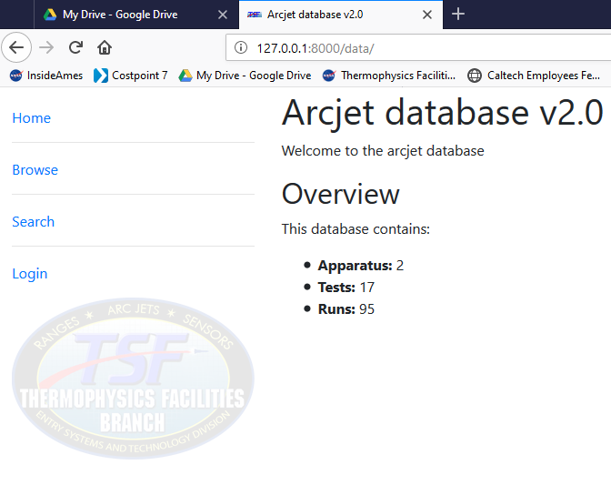

Why is better data infrastructure needed?
Problems
Existing data systems limit the resolution of diagnostics
Long data delivery times (weeks)
No integration with modeling efforts
No statistical metrics for facility uncertainty
Simple system modeling
Flow Characterization
Model Verification
database
+
data pipeline
As we add diagnostics with higher spatial and temporal resolution, a new paradigm is needed to process and store data.
Notes:
We need to improve flow and material characterization, as well, but without these data pipelines in place, additional flow or material data would get lost.

Slide 5


How to address these issues?
Problems
Existing data systems limit the spatial and temporal resolution of diagnostics
Long data delivery times
No integration with modeling efforts
No statistical metrics
Simple system models
Integrate Data Technologies
Enterprise databases
Automation
Machine learning
Benefits
Remove constraints on diagnostics
Immediate data delivery
Integration with modeling efforts
Statistical characterization
Machine learning for more accurate system models

Slide 6



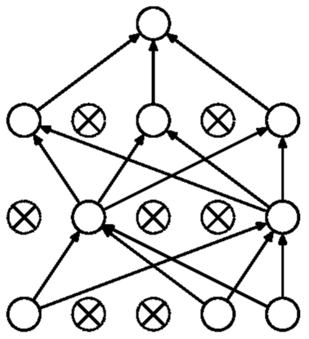




Tapping into Technology Tidal Waves
Automation
Machine
Learning
wireless
sensor
networks
computer
vision
algorithms
Multi-axis
sting arms
non-linear
statistical models
laser absorption
spectra
high speed
imaging
high-cadence
emission
spectra
mARC
enterprise database
Big Data
Notes:
Maybe make the argument here of why big data and automation are good. More efficient, faster,

Slide 7
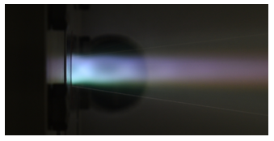
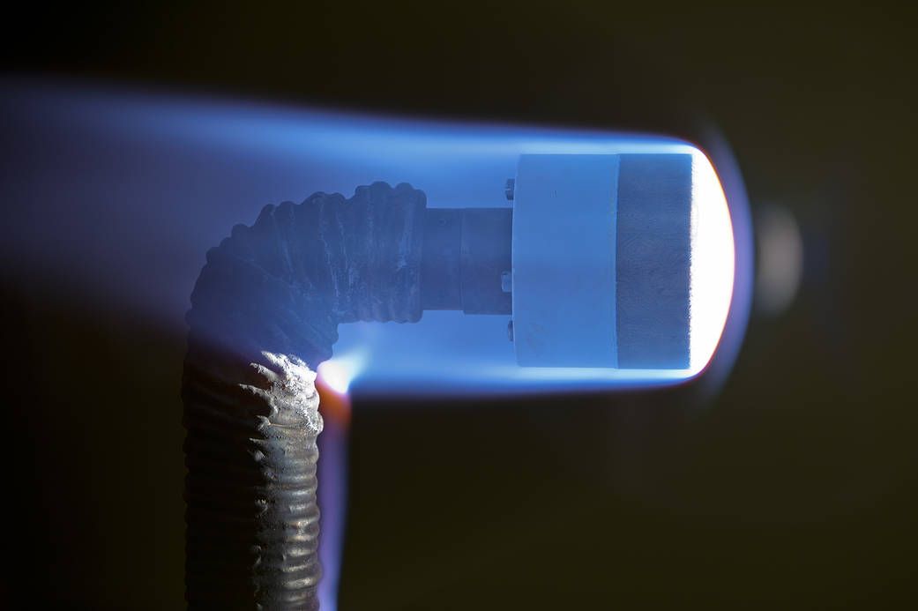
Leverage the mARC II arc jet
Implement BEAST at a laboratory-scale arc jet
  Small, cheap, low power
  Suitable for rapid R&D
  Flexible operation
  Success is not mandatory
After establishing verification pipelines, this technology can be applied to the larger facilities

Slide 8

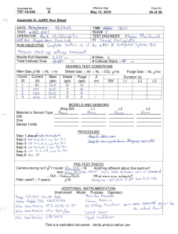



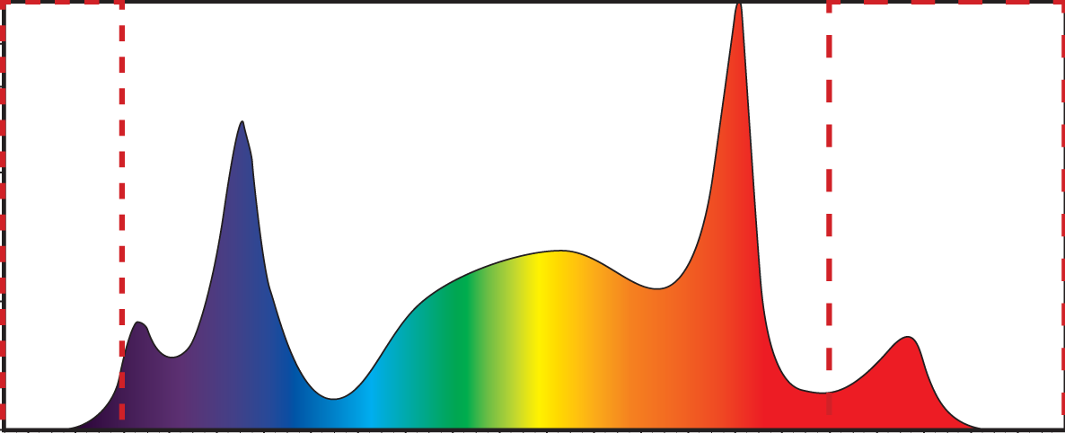








mARC II Arc Jet before BEAST
Post-run
Run Sheet
During run
Pre-run
Summary
8

Slide 9





BEAST Updates
During run
Post-run
Pre-Run
Automatic Time
Logging
More Efficient
Automatic Summary
Database
Added Data Accessibility
Automated/searchable facility statistics
Machine learning

Slide 10
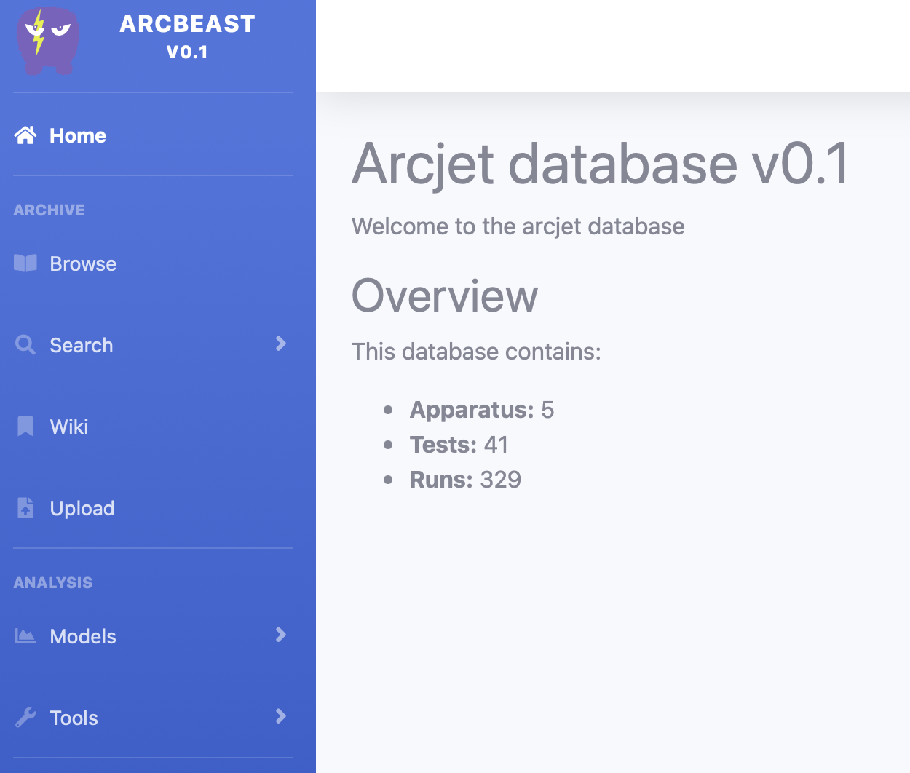
Database Interface Demo

Slide 11
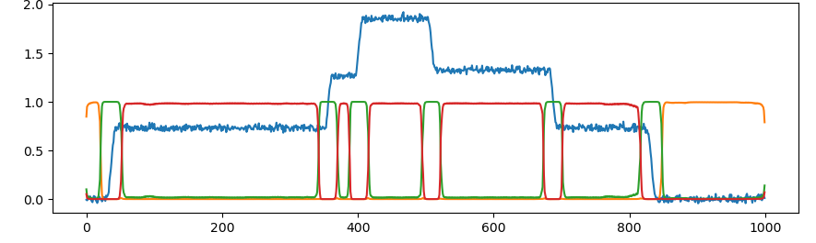
1D convolutional neural net: time segmentation
3 class semantic segmentation
on
transition
off
robust to noise
automates cropping and measurement windowing
fast subsecond performance
runs on arbitrary length sequences
time segmentation is critical for larger data sets

Slide 12
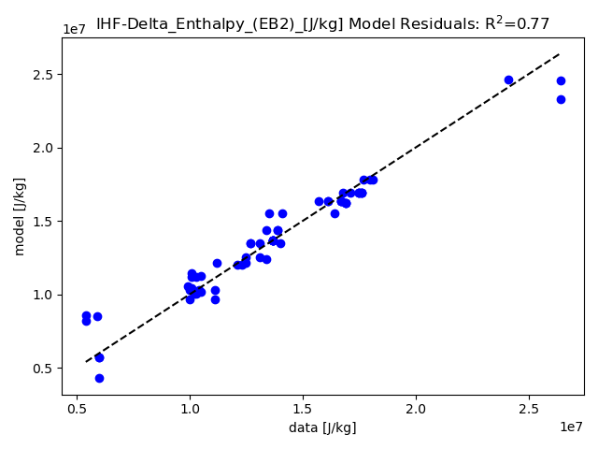
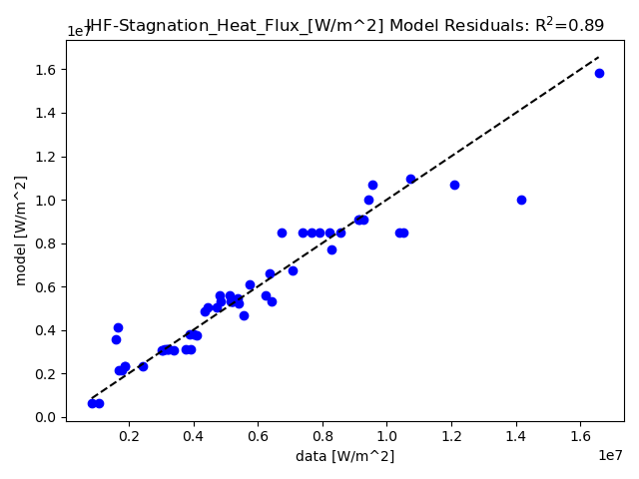
N-dimensional linear models
predict facility outputs (e.g., heat flux, enthalpy) from input settings & configuration (arc current, mass flow, model distance, nozzle etc.)
Benefits:
comprehensive, scalable and extendable
linear models are easily interpretable and exportable
automatically updated when new data is uploaded

Slide 13
BEAST status
Now.
By Fall 2023.
2+ TB historical data archive (data, reports)
Automated facility stats
Data view dashboards
Tutorial wiki
API for global search & data upload/download
Built in ML modeling for facility output predictions
Automated report generation
Video analysis tools
Spectra analysis tools
QR component tracking
User testing/customize user interface for arcjet facilities

Slide 14
Summary
Tailored arc jet data management system
  Searchable central repository for all facility data
  Integrated data visualization
  Built-in statistics and ML modeling
  Automated run sheets and test reports
  Simple software architecture suitable for in-house development
Saves significant time for arc jet PI’s, customers, and test engineers
Correlations from historic data can inform future projects
Inform ongoing upgrades from arc jet modernization efforts

