Slide 1
Process Qualification Concepts in NASA-STD-6030
Doug Wells / NASA Marshall Space Flight Center
Workshop:
Data Enabled Accelerated AM Process Qualification
America Makes
Youngstown OH
Dec 14-16, 2022

Slide 2

Hello
Douglas N. Wells
Mr. Douglas Wells is a structural materials engineer in the Materials and Processes Laboratory at the NASA Marshall Space Flight Center and serves as a deputy Technical Fellow for Materials for the NASA Engineering and Safety Center. Doug has thirty years of experience in fatigue, damage tolerance, and fracture control of flight structures. For the past ten years, he has focused on developing methodologies for the qualification and certification of additively manufactured spaceflight hardware, including the development of the NASA standards that establish requirements for incorporating additively manufactured hardware into flight vehicles for NASA and its commercial partners. In addition to standards development for NASA, Doug is actively engaged with the broader international standards community working in additive manufacturing, including ASTM and SAE. Currently, much of his time is spent on the interpretation of certification requirements for additively manufactured hardware on a variety of NASA missions. Doug came to NASA following his Bachelor of Science degree in Aerospace Engineering at Virginia Tech and also holds a Master of Science in Mechanical Engineering from Stanford University.

Slide 3
Discussion Points
Terminology
Definition and role of QMP in the NASA-STD-6030 framework
Qualification checklist for evaluating a candidate AM material process
Types of data needed to evaluate the metrics for a QMP
  Advocacy for a singular, contained data entity that enables QMP evaluation and other aspects of the AM ecosystem
  Material Engineering Equivalence Baseline
Discussion of Material Engineering Equivalence concepts
Summary

Slide 4
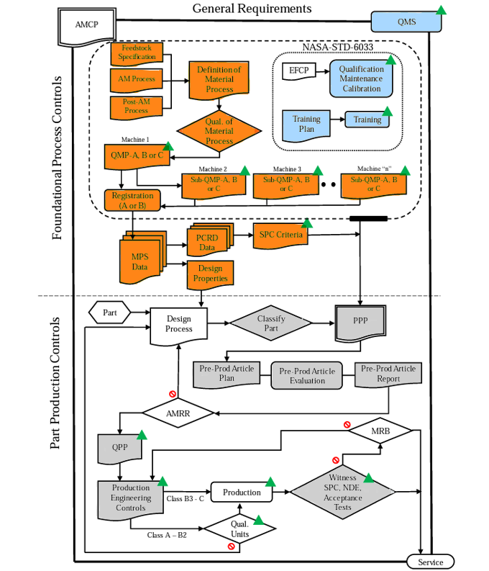
Terminology
Definition of IQ, OQ, PQ
Per ASTM 52930:2021 Additive Manufacturing – Qualification principles – Installation, operation, and performance (IQ/OQ/PQ) of PBF-LB equipment
IQ (Installation Qualification): Establishment by objective evidence that all key aspects of the process equipment and ancillary system installation adhere to OEM approved specification and that recommendations of the supplier of the equipment are suitably considered.
OQ (Operation Qualification): Establishment by objective evidence that the process control limits and action levels which results in product that meets all predetermined requirements.
PQ (Performance Qualification): Establishment by objective evidence that a process consistently produces result of product meeting its predetermined requirements
The Qualified Material Process of NASA-STD-6030 primarily lands in the OQ domain. The strong tie to material allowables and design values often crosses the lines into PQ, depending on definition.

Slide 5
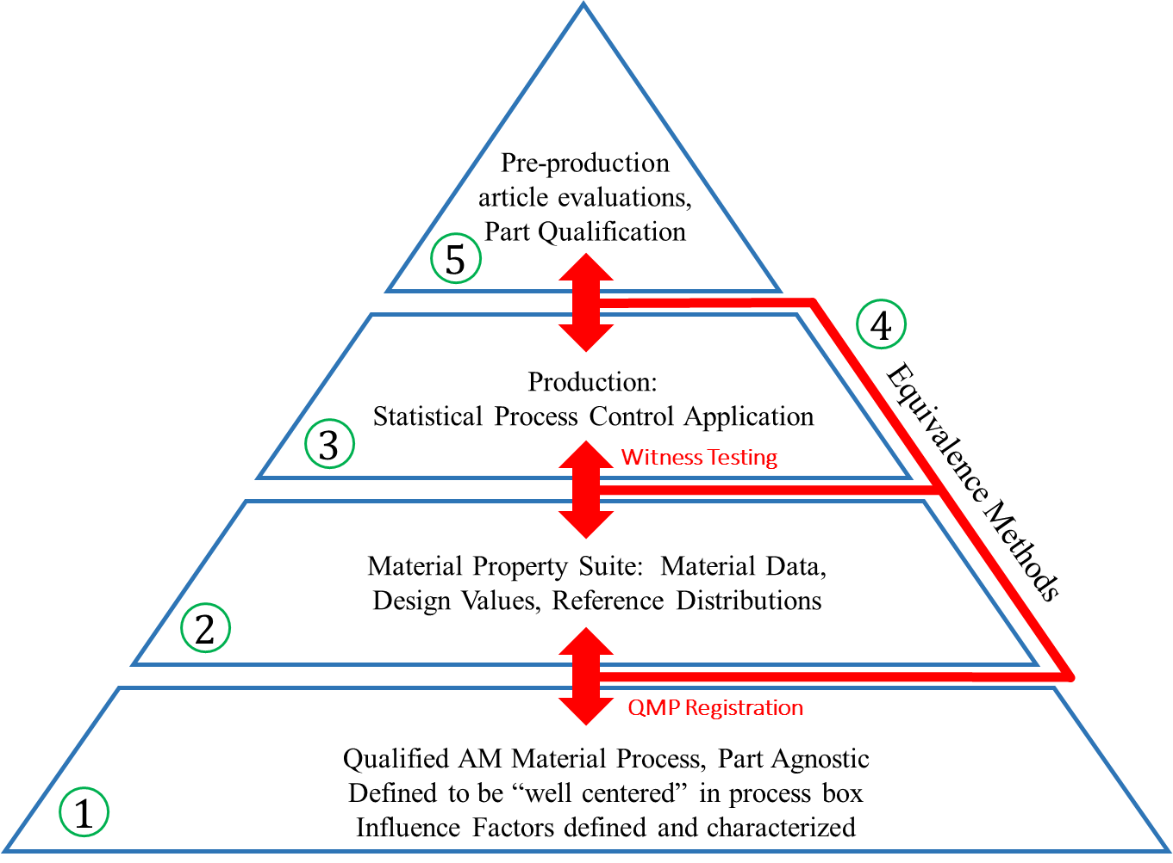
Role of the QMP: Foundational Process Control
Qualified Material Process
Begins as a Candidate Material Process
Defines aspects of the basic, part agnostic, fixed AM process:
  Feedstock
  Fusion Process
  Thermal Process
Enabling Concept
  The QMP sets a foundation for using material equivalence for
    Machine qualification and re-qualification, monitored by…
    Process control metrics, SPC, all feeding into…
    Sustained and substantiated Material Allowables and Design values
Key characteristics
  Locked process
  Rigor scales with part classification
  Nominally standardized builds
  Evaluation of process window
  Defined types of evaluations
  Per machine S/N
  Prerequisite (proper functionality by IQ, calibrations, maintenance, etc)

Slide 6
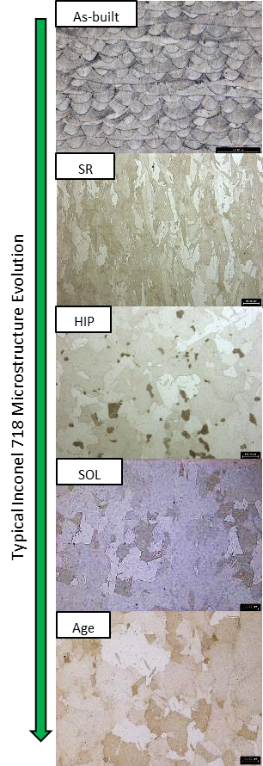
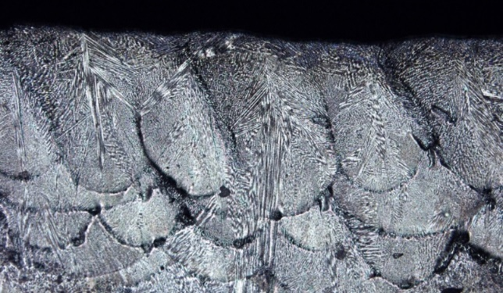
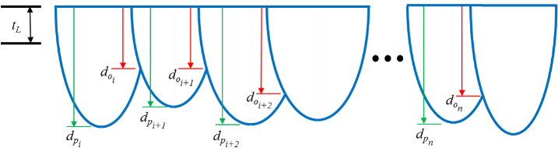
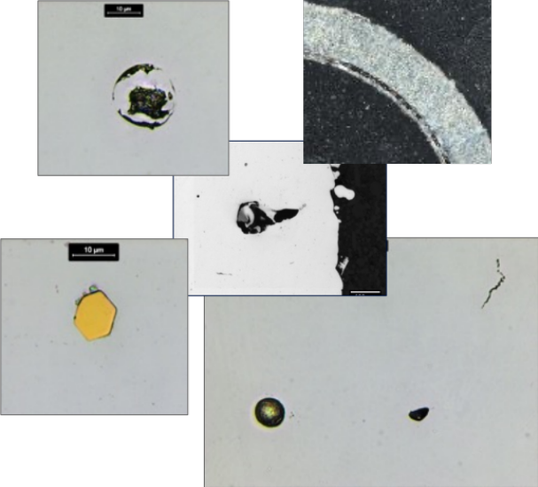
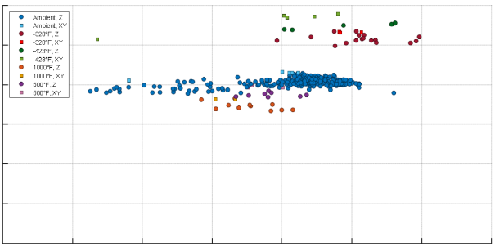
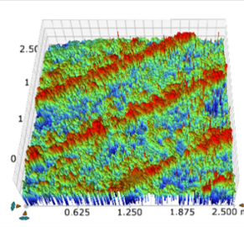
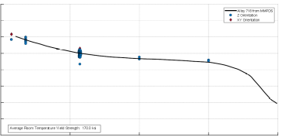
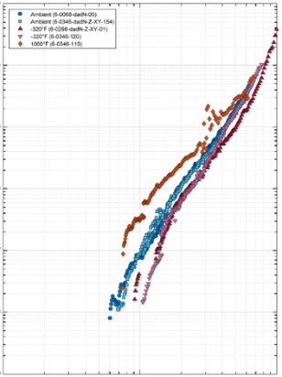
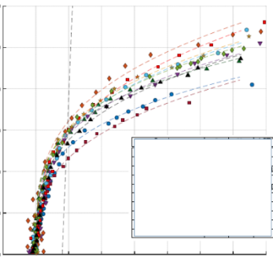
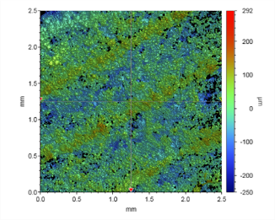
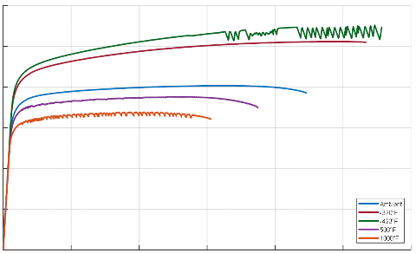
QMP Evaluation Checklist:
Feedstock controls adequate
  Feedstock reuse
Quality of as-built material
  Build area survey
  Process window robustness
  Microstructure and flaw state
  Interfaces or overlaps in build path (e.g., striping, islands, multi-laser overlap zones), surface contours, cosmetic passes, including any interface associated with a unique build parameter
  Typical geometry of as-built deposition (e.g. melt-pool geometry)
Microstructural Evolution
  As-built to final
  Microstructure and flaw state
Surface texture and detail resolution (center and edge) (acceptance data challenge)
Mechanical Properties
  Tensile
  High Cycle Fatigue
  Low Cycle Fatigue
  Toughness
  Temperature performance confirmation
Note: Process re-start qualifications are not listed, but they are required if re-starts are allowed.

Slide 7



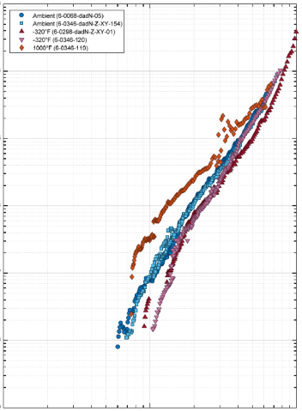

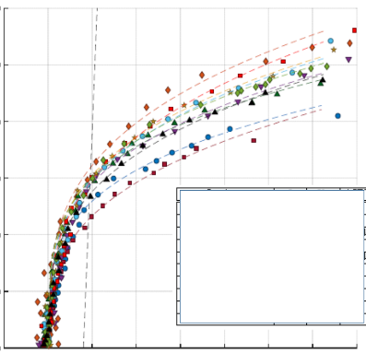

Data for a Material Engineering Equivalence Baseline
As-built
The QMP process yields (or typically utilizes) a core set of data that allows first-principal evaluations of material quality that derive from the Process → Structure → Properties → Performance relationship.
Advocating for a single data package called a Material Engineering Equivalence Baseline
  Includes nominal states and allowable variation for microstructure, flaw state, surface quality, and mechanical properties.
The baseline data set can be used to keep the AM ecosystem self-consistent and healthy from first principals of material quality and performance
SR
HIP
Typical Inconel 718 Microstructure Evolution
SOL
Age
Microstructure
Flaw State
Surface Quality
Mechanical Properties

Slide 8
What is Material Engineering Equivalence?
Engineering equivalence is a methodology for evaluating the quality of AM materials that acknowledges the broad range of characteristics that must be assured for an alloy to meet all its expectations.
Engineering equivalence as a concept differs from the determination of statistical equivalence for a material characteristic (such as ultimate strength) in that we determine equivalence holistically through engineering judgement by considering many interrelated and causal material characteristics as they contribute to the overall performance of the material
  Often equivalence determinations must be made in the absence of statistically significant pools of data
Engineering equivalence is the enabler that allows the AM material ecosystem to remain healthy and self-consistent in the face of sensitive processes with a multitude of known and unknown failure modes.
Engineering equivalence is not an easy task - it requires reliable and diverse datasets, depth of knowledge in materials, good engineering judgement, and collaboration between engineering and quality assurance organizations.

Slide 9
The purpose of an “engineering equivalence” approach
To maintain a healthy and consistent AM material ecosystem, and
To enable the continuous substantiation of material allowable and design value concepts in AM
By enabling a well-informed decision regarding the consistency of AM materials by leveraging all available information across a variety of metrics of engineering significance
Avoid fixating on strength alone as a determination of material equivalence
This is not a new concept, but as applied to AM, additional structure and standardization is needed
To leverage the concept that material performance is derived from the Process → Structure → Property → Performance relationship
Equivalence does not generally mean “better than or equal to,” e.g., exceeds the specification minimum.
Equivalence implies fundamental characteristics and performance are “in-family” with a baseline set of data
Making determinations of what is, or is not, “in-family” generally requires engineering judgement
In many applications of engineering equivalence there are inadequate data for any one performance characteristic to establish true statistical confidence for equivalence of that particular characteristic
Engineering judgement is needed to keep the “false-call” rate and associated engineering review in balance.

Slide 10
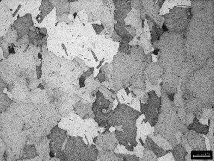
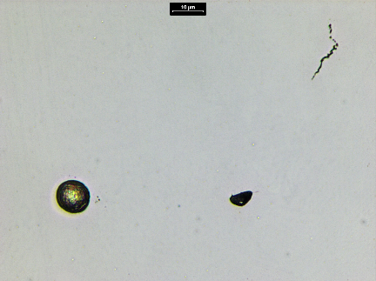

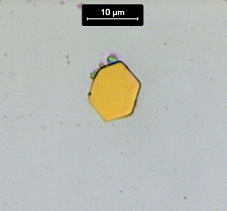
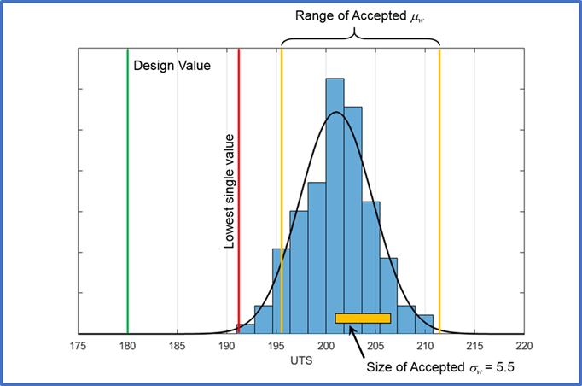
AM Material Engineering Equivalence Baselines
A mature baseline for material equivalence is valuable and enabling for qualification and certification in AM
Baselines mature with increasing quantities of data and should asymptotically converge on a consistent descriptor of the material
  Definition of what range of material characteristics are “equivalent”
A mature baseline provides a single data package that:
Provides a basis for all the core tools of engineering equivalence evaluations
Microstructure, flaw population, surface quality, mechanical properties
Provides full descriptions and interpretive information for evaluation
Provides recommended evaluation metrics and acceptance criteria for a variety of end uses of equivalence: qualification, SPC, etc.
Flaw State
microstructure
Flaw Population
Surface Quality
Mechanical Properties
Equivalence Baseline
See MPS in NASA-STD-6030
Allowables
Qualifications
SPC Criteria
Design
Production

Slide 11
In Summary
The NASA-STD-6030 QMP process integrates within a larger Q&C framework defined by 6030
The QMP defines (or is evaluated against) a baseline of data that describes the fundamental material quality and property characteristics
To establish a QMP, one requires metrics and acceptance criteria for several evaluations
  Microstructure (as-built and evolved)
  Flaw state (type, size, frequency, pattern)
  Surface quality (and detail resolution)
  Mechanical properties (tensile, yield, elongation, fatigue life, toughness …)
The data supporting these metrics are ideally collected as a single entity, Material Engineering Equivalence Baseline
  The baseline data are generally defined as nominal with allowable tolerances to allow engineering evaluation
  Baseline data will be numerical and image based.
  Evaluations require engineering judgement, aided through any appropriate tools, such as machine learning algorithms.
The baseline is used throughout the AM ecosystem to maintain material quality and consistency leveraging the
Process → Structure → Properties → Performance relationship
  On-going witness acceptance criteria and SPC
  Part qualification (coupon to part evaluations)
  Enabling “buy-in” or “further showing” for common databases of AM material properties

Slide 12

Thank you!

Slide 13
Back-up Content on QMP

Slide 14
Healthy Operational AM Ecosystem
Equipment & Facility Control
Feedstock Controls
QMPs
(Process)
Process Control & PCDs
Inspection & monitoring
SPC
Engineering Equivalence Baseline
Material quality and performance
Substantiated allowables and design values
Qualified Part Processes
Etc.
Proper Part Definitions
Feedstocks
Trained Operators
Etc.

Slide 15
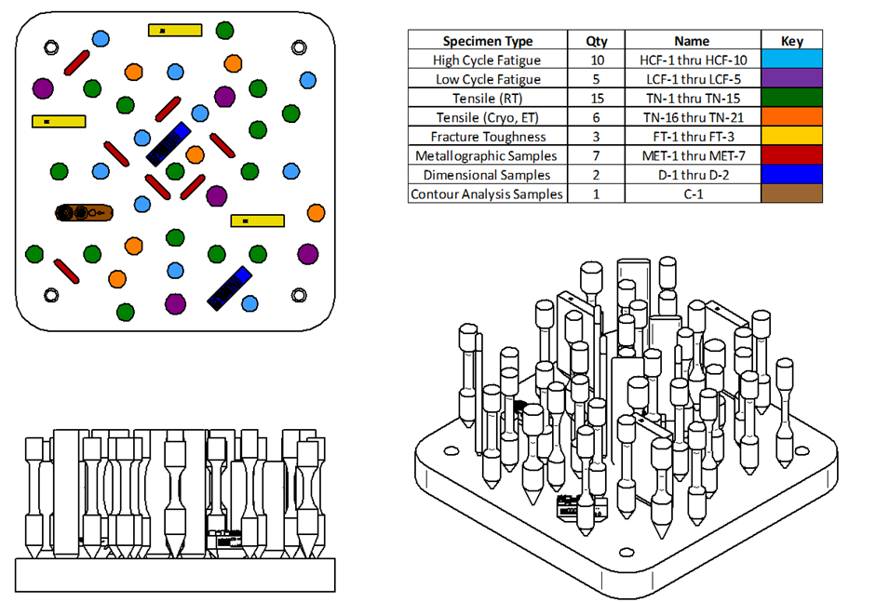
Machine/Process Qualification
See Qualified Material Process, QMP, and QMP Registration in NASA-STD-6030
Objective:
Demonstrate material quality from a specific machine under defined conditions is equivalent to past material used to set design properties.
Why use Engineering Equivalence?
Re-occurring operation required of every AM machine. Testing quantities for high statistical confidence is generally impractical, or limited to a single attribute (e.g., tensile).
Tools: (use them all)
Feedstock similitude, microstructure, flaw population, surface quality, mechanical properties, statistical assessment
Equivalence Confidence:
Moderate to high, based on limited evaluations available across all tools.

Slide 16
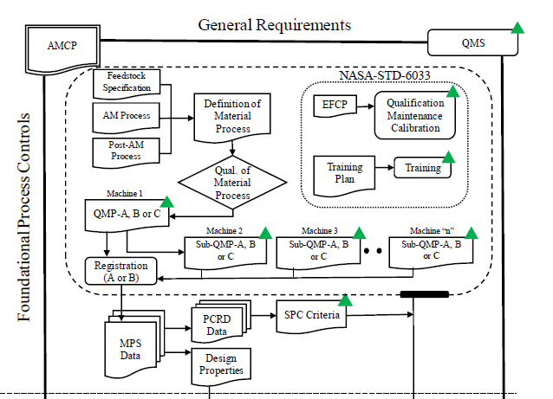
Qualified Material Process
Qualified Material Process
Begins as a Candidate Material Process
Defines aspects of the basic, part agnostic, fixed AM process:
  Feedstock
  Fusion Process
  Thermal Process
Enabling Concept
  Machine qualification and re-qualification, monitored by…
  Process control metrics, SPC, all feeding into…
  Design values
16
Notes:
Process Sensitive

Slide 17
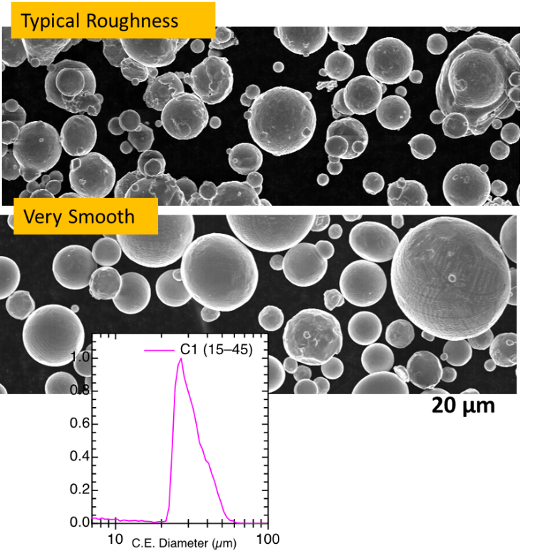
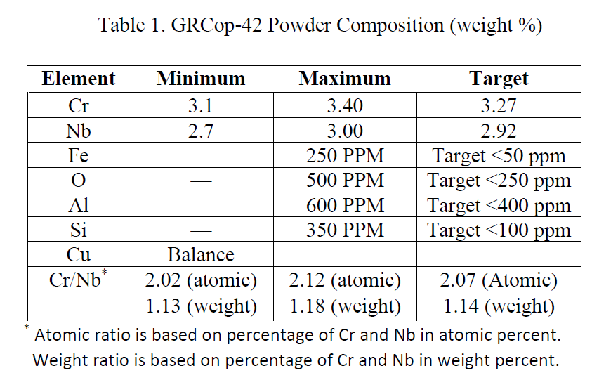
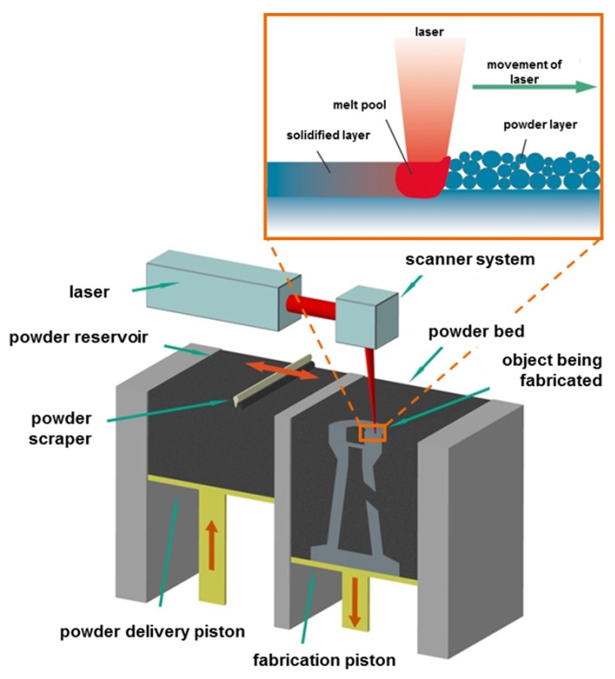
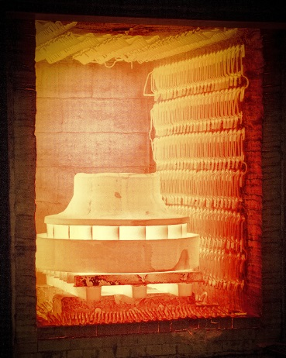
Process/Machine Qualification
Currently in AM, machine and process are indelibly linked
Step 1. Define a candidate process
  Material feedstock controls
  AM process conditions and machine configuration
  Post-processing that influences material performance
Step 2. Qualify the candidate process to well-defined metrics, for example:
  As-built material quality (fill and interfaces)
  Consistency throughout build envelope
  Appropriate detail and surface quality
  Tolerance to inherent process perturbations (thermal or otherwise)
  Mechanical and/or physical properties
  Locked process parameters, no dynamic feedback loops*
From: MSFC GRCop-42 Alloy Gas Atomized Powder Specification
*More and more systems are leveraging dynamic, closed-loop process control schema. NASA’s AM Team is in the process of getting smarter on these technologies to incorporate qualification guidance into the next revision of NASA-STD-6030.
17

Slide 18
Candidate Material Process
Definition of Material Process
Feedstock Specification
What you are building with
AM Process
How a machine operates
Post-AM Process
Control what evolves your material state
18

Slide 19
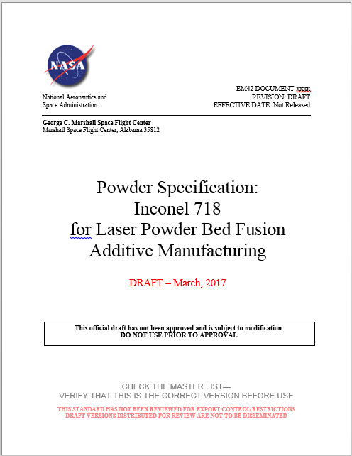
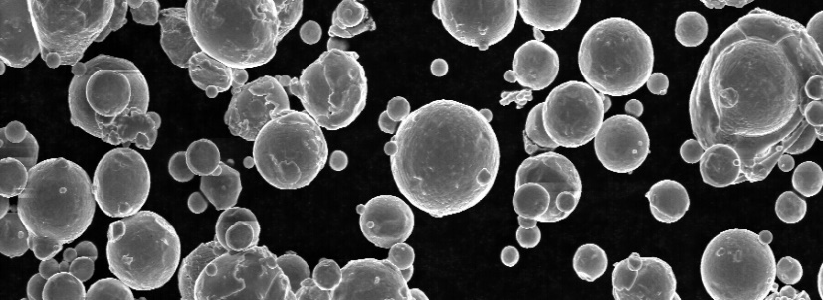
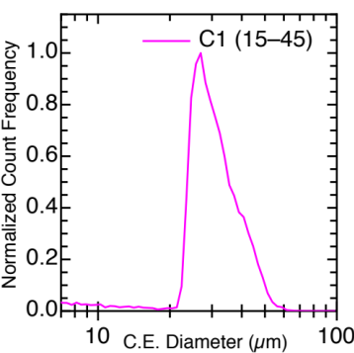
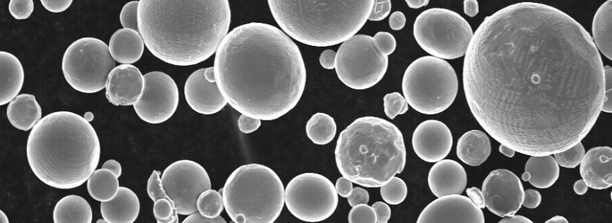
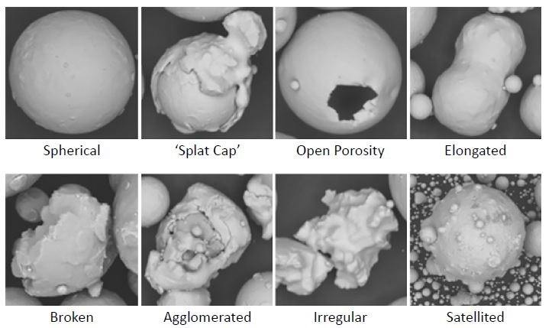
Feedstock Controls
Feedstock Controls
Method of manufacture
Chemistry
Particle Size Distribution
Particle morphology
Blending and doping controls
Cleanliness and contamination
Packaging, labeling, environmental controls
Reuse controls
Typical Roughness
Very Smooth
20 µm
Powder Morphology. Courtesy Metal AM, Winter 2017.
Ref AMS Specifications:
AMS7001: Nickel Alloy, Corrosion and Heat-Resistant, Powder for Additive Manufacturing, 62Ni - 21.5Cr - 9.0Mo - 3.65 Cb (Nb) Annealed
AMS7002: Process Requirements for Production of Metal Powder Feedstock for use in Additive Manufacturing of Aerospace parts
19

Slide 20
Candidate Material Process
Fusion Controls
Equipment:
  Make, Model, Serial Number
  Software/Firmware versions
  Settings (dosing, recoater speed & material)
Atmosphere Controls
  Oxygen limits
  Ventilation flow rate
  Gas quality (purity, dew point)
Fusion Parameters
  Layer thickness
  Area fill schemes
  Power, speed, hatch, contours…
Note: The values of the parameters may remain undisclosed and proprietary. To establish the QMP using the build control parameter file, the file name and its cryptographic hash are referenced in the QMP record.
Source: Fraunhofer IWU
Any Machine Parameter that affects Material Quality must be Controlled!
20
Notes:
Add Polymer

Slide 21
Candidate Material Process
Fusion Controls
Tolerance to variation
Part build scenarios create variation in process conditions
  Thermal history effects
  Scan patterns
“Process Box” evaluation for qualification
QMP needs to be “centered” in the process box to allow robust part build capability
Process Restarts
Hot
High Energy
Keyhole porosity
Overheating/burning
γ_{i}
Nominal
Bounding hot trial
Bounding cold trial
Process Limit Boundary
Outside boundary = defects
Cold
Low Energy
Lack-of-fusion
Variation Boundary due to part thermal history
Must stay within Process Limit Boundary
η_{i}
Process Box: Resulting variations in nominal commanded process due to part geometry, scan pattern and thermal history
Axes: Representative of any parameters, i.e., power, speed
21

Slide 22
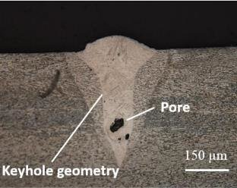
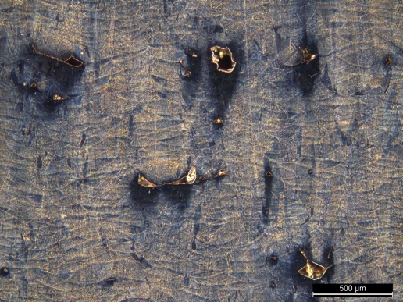
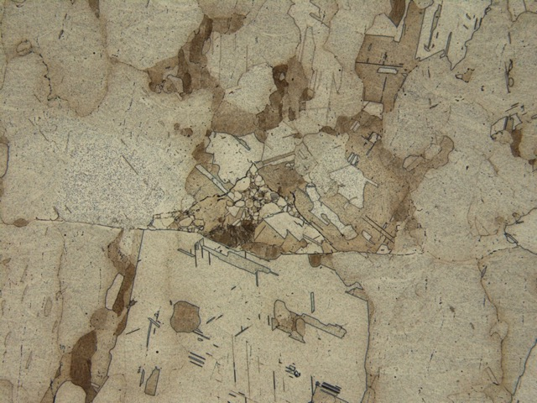
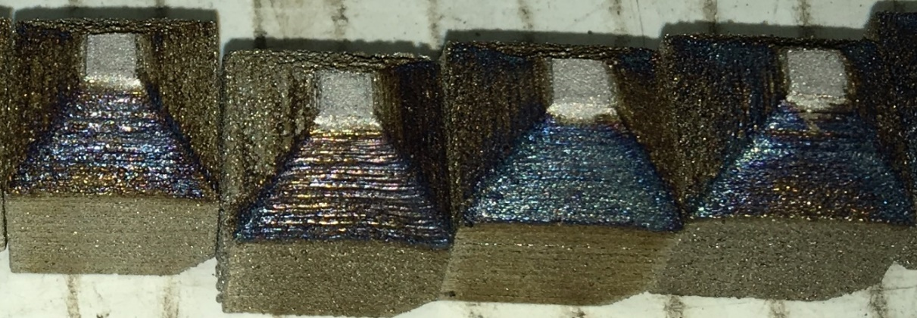
Parameter Influence on Defects
Lack of Fusion Defect
γ_{i}
Hot
High Energy
Keyhole porosity
Overheating/burning
Lack of Fusion Defect after HIP
Nominal
Everton, Sarah & Dickens, Philip & Tuck, Christopher & Dutton, B. (2019). IDENTIFICATION OF SUB-SURFACE DEFECTS IN PARTS PRODUCED BY ADDITIVE MANUFACTURING, USING LASER GENERATED ULTRASOUND.
Cold
Low Energy
Lack-of-fusion
η_{i}
Process Box: Resulting variations in nominal commanded process due to part geometry, scan pattern and thermal history
Axis: Representative of any parameters, i.e., power, speed
22

Slide 23
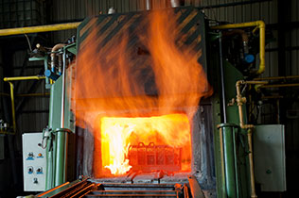
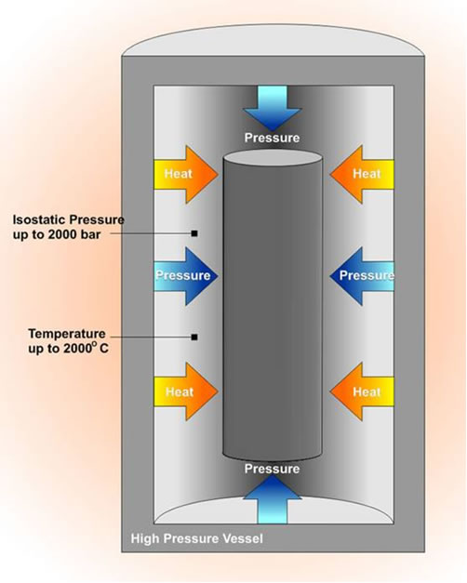
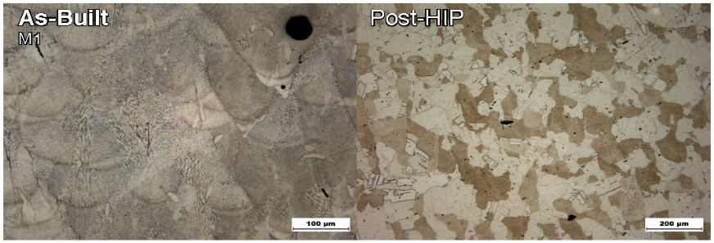
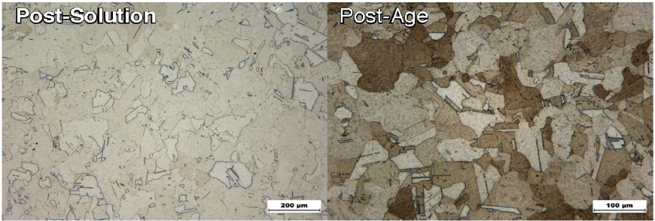
Candidate Material Process
Thermal Process
Post-build Thermal Processing
Includes definition of all thermal process steps
Evolution of microstructure with acceptance criteria for As Built and Final
Stress Relief, Hot Isostatic Pressing, Solution Treating, Aging, etc.
IN718 Microstructural Evolution
23

Slide 24
Qualified Material Process
Qualification of the Candidate Material Process
Establishing a QMP: Qualified Material Process
Four Step Process
Material Qualification
Surface Texture and Detail Resolution
Flaw Population
Mechanical Properties

Slide 25
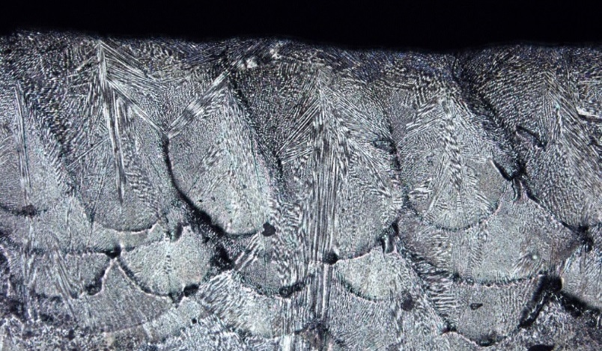
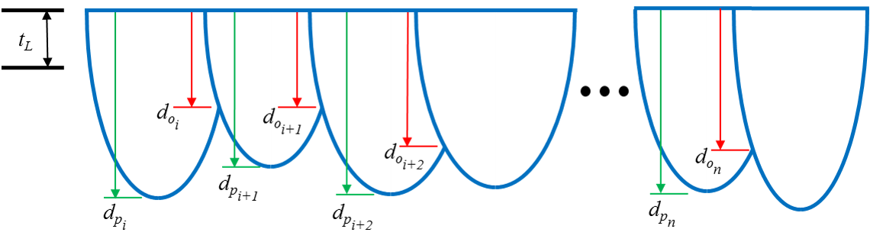

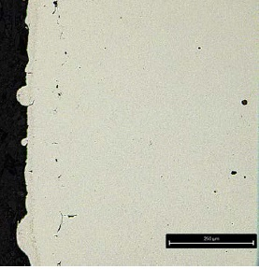
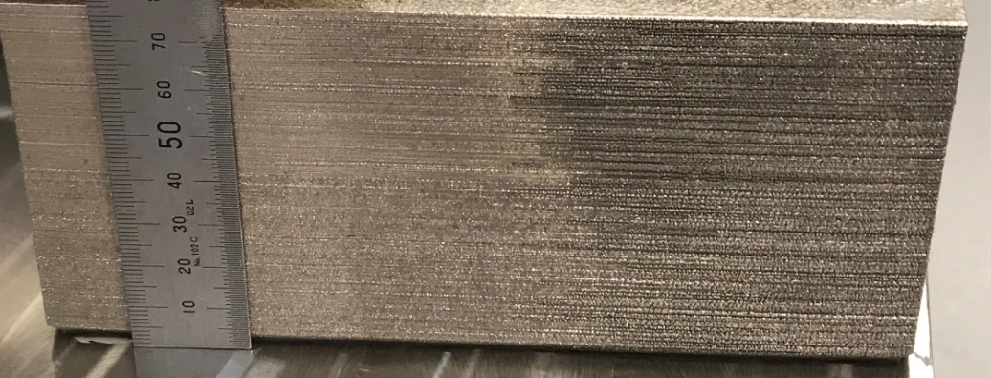
Qualified Material Process
Step 1: Material Qualification
  Consistency throughout build area
  Tolerance to variation
  Interface quality (restart, contour passes, striping,
  islands, multi-laser zones)
  Top layer melt pools
  Microstructural evolution
    Final state free of strong texture
    Acceptance criteria for As Built and Final
Melt Pool Evaluation
Transition Zone
Contour Evaluation
Microstructure Evolution

Slide 26
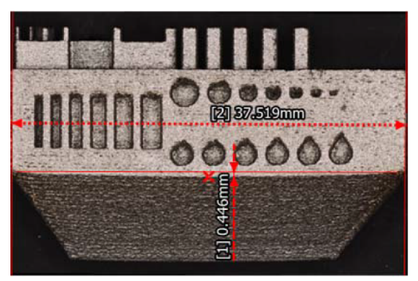
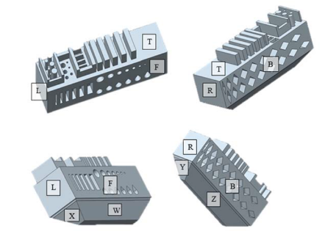
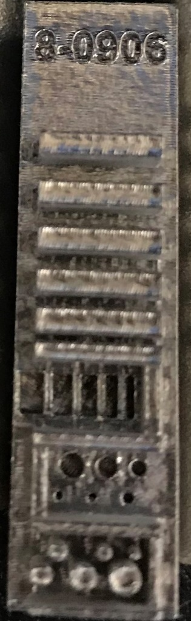
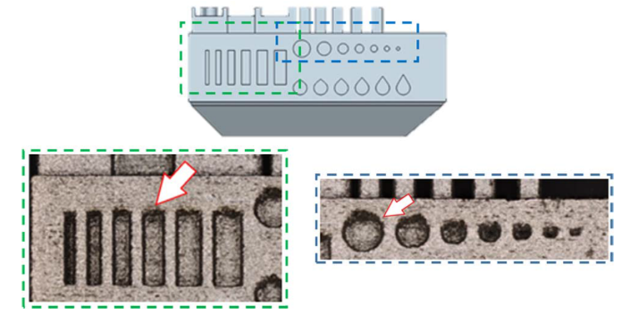
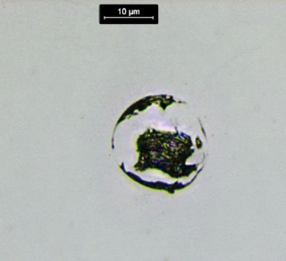
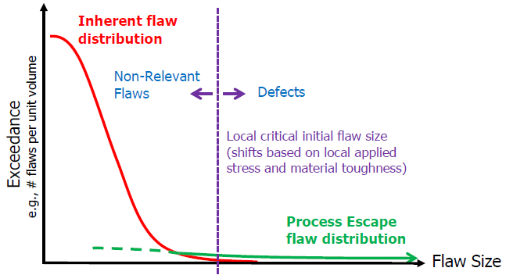
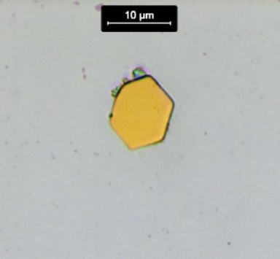
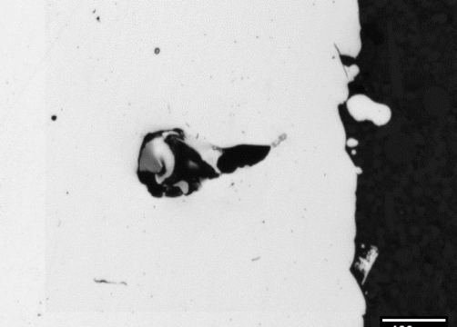


Qualified Material Process
Step 2: Surface texture and detail resolution
  Reference Parts
  Mix of qualitative and quantitative measures
Step 3: Flaw Population
  Quantifiable metrics to aid equivalency judgements for common inherent flaws (things we expect)
    Types, sizes, frequency of occurrence
    Process escape flaws are not the focus here

Slide 27



Qualified Material Process
Step 4: Mechanical properties
  Tensile, fatigue, toughness…
  Registration through Equivalence
    Material Property Suite (MPS):
      Actively maintained, alloy and condition specific material property information that includes material test data, design values, and SPC criteria
    “In-family” performance
QMP “Registration” is the process of demonstrating properties of the qualified process are equivalent to those in the applicable MPS
Notes:
An actively maintained collection of L-PBF specific to an alloy and condition that includes material test data, design values, and criteria needed to implement and maintain SPC for the L-PBF process.
Actively maintained, alloy and condition specific material property information that includes material test data, design values, and SPC criteria

Slide 28


Qualified Material Process
What do I need to build to produce a QMP?
Metallic Master QMP
Metallic Sub QMP and Requalification
Master QMP framework allows for reduced testing requirements in cases where the material process is identical
Note: NASA-STD-6030 Tables 15 and 16 list Polymeric QMP Requirements
If you have 5 M290’s running the same process and material this allows you to reduce testing requirements after the first machine is qualified!
28

Slide 29


Example: M290 IN 718 QMP – Plan & Build
QMP M290 Build Layout

Slide 30







Example: M290 IN 718 QMP – Example Results
Fatigue
Achievable Features & Dimensional Accuracy
250 µm
As-Built Microstructure
Mechanical Properties to Establish Design Values
250 µm
250 µm
2-D Micrograph
Tensile
Verdict: No detrimental defects observed (detailed in MSFC-SPEC-3717). Randomly dispersed and less than 1% of area.
Fully Heat-Treated Microstructure

