Slide 1
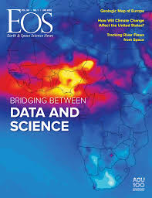
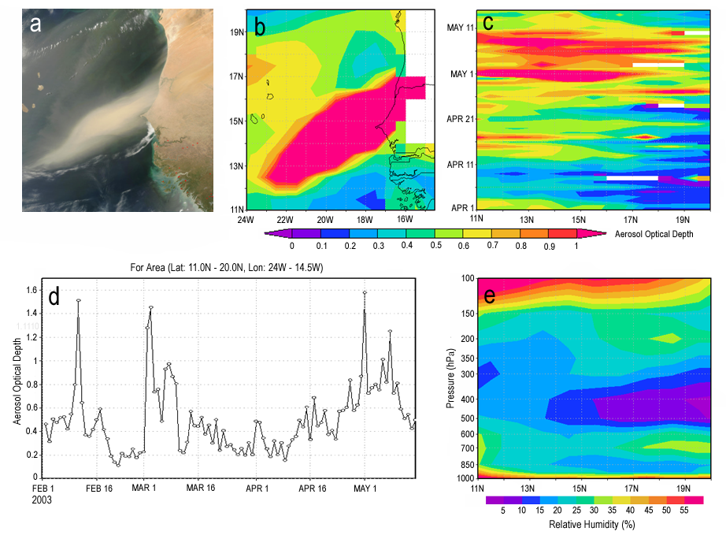
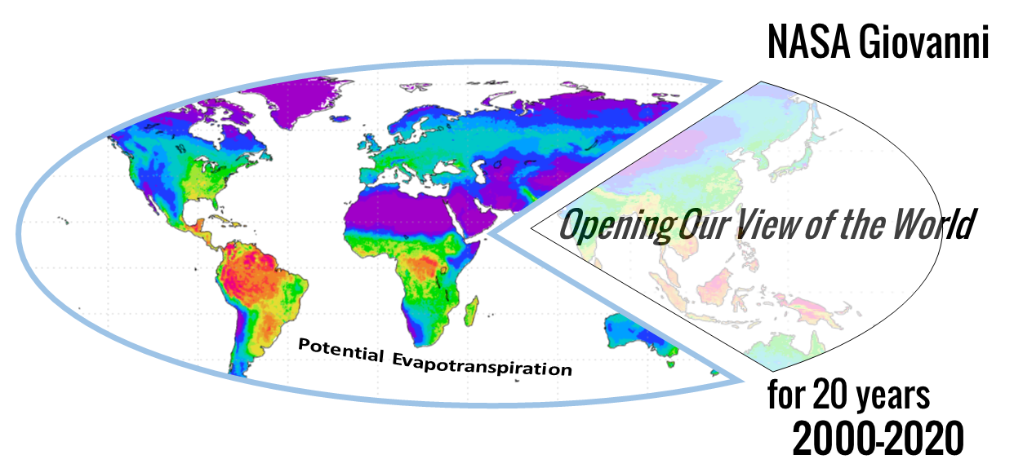
Examining 18 Years of Journal Publications to Characterize Usage Modes of Giovanni, a Versatile Earth Science Data Web Service
James Acker¹, Irina Gerasimov¹, Zhong Liu², Armin Mehrabian¹
¹Adnet Systems Inc;^{. 2} CSISS, George Mason University
2007
2020
IN26A-01
American Geophysical Union
Fall Meeting 2022
Chicago, Illinois
2017

Slide 2
Introduction to Giovanni (Geospatial Interactive Online Visualization ANd aNalysis Infrastructure)
Giovanni …
is a Web-based visualization and analysis system that provides 22 different visualization
and analysis options, operating on thousands of Earth science data variables generated by satellite instrument observations and from related model datasets
Giovanni …
was originally conceived as a data exploration tool, but its ease-of-use, analytical capabilities (spatial and temporal subsetting, multi-period averaging, data mapping and time-series, and more) have led to its use as a multi-discipline research tool
Giovanni …
provided unprecedented access to NASA Earth science data for many different disciplines, AND is still providing a simple way to find, analyze, visualize, and utilize such data for a wide spectrum of research topics

Slide 3
Tracking Giovanni Usage Through the Years
Soon after Giovanni became available, we began collecting journal articles and book chapters in which the use of the system was cited. The NASA GES DISC website provided guidance on how to cite Giovanni in publications. This practice allowed the collection of Giovanni citations in peer-review journal publications, and as increasing numbers of publications became available online, it became possible to acquire copies of many of these publications.
Number of Publications
Calendar Year

Slide 4
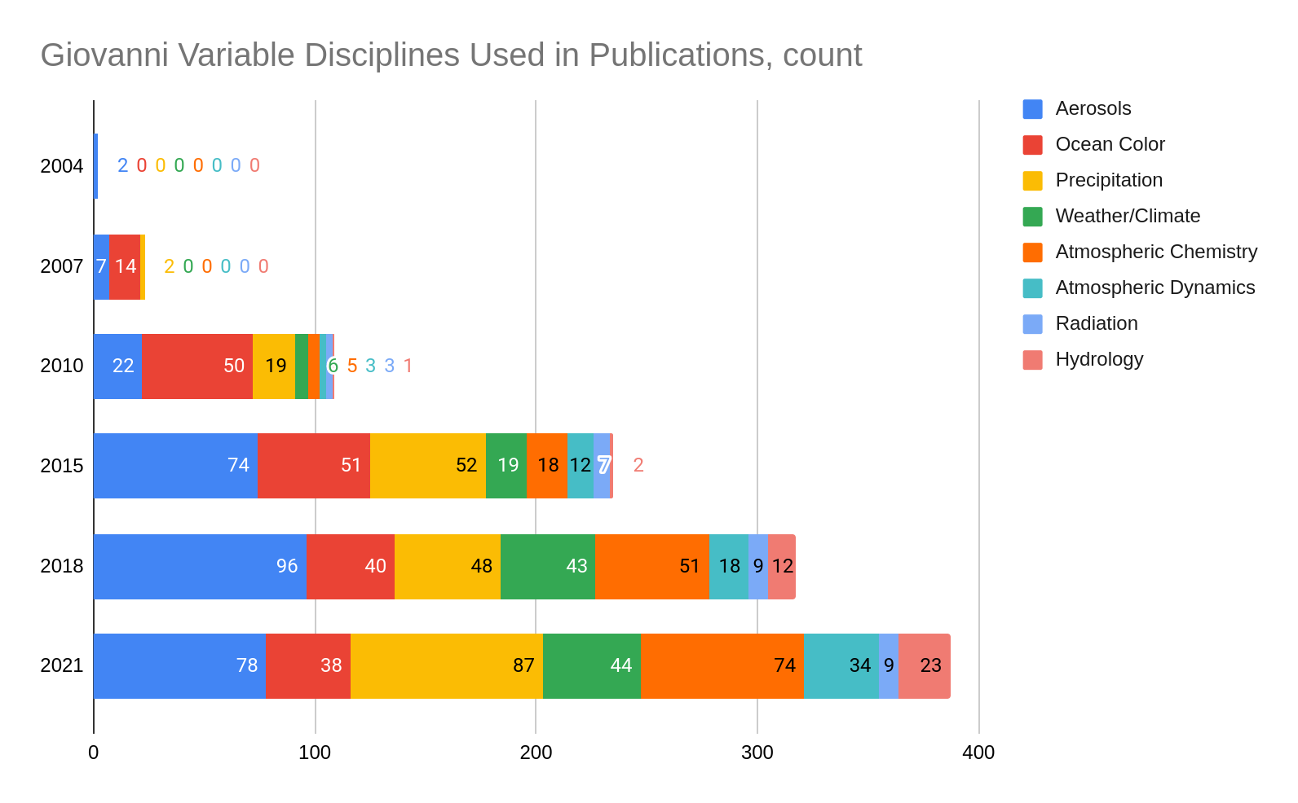
Changes in Giovanni Usage by Discipline
Significant changes:
Precipitation data usage increased significantly with the availability of Integrated Multi-SatellitE Retrievals for Global Precipitation Measurement (IMERG).
Weather/Climate usage increased with Modern-Era Retrospective Analysis for Research and Applications (MERRA, MERRA-2),
Atmospheric Chemistry usage increased with more species (SO₂, NO₂, HCHO) and in 2021, with COVID-19 related papers.
These statistics were generated using AI/ML analysis of abstracts.

Slide 5
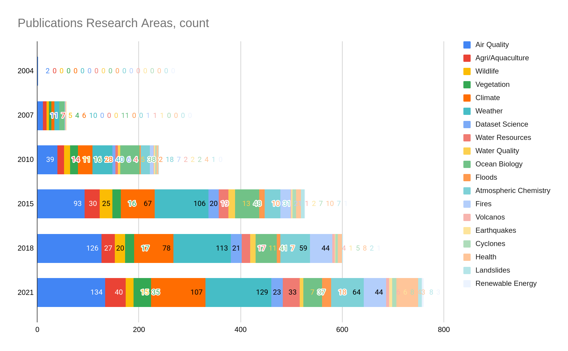
Changes in Giovanni Usage by Research Topic
Significant changes:
A steady increase in Air Quality Agri/Aquaculture and Water Resources papers is observed.
Climate-related papers increase notably with MERRA/MERRA-2.
Health-related papers became more common with studies related to the COVID-19 pandemic. Natural Hazards papers also rose in number.

Slide 6
Giovanni Usage Modes
Because we have been able to acquire many of the research papers that have cited the use of Giovanni, we have been able to observe how the system was actually used in the paper.
We will describe five different usage modes, which are shown at left.
Giovanni is a pioneering effort to make NASA Earth findable and analyzable online, removing many obstacles to data usage, both technical and societal. By examining how the system has been used for science, we inform our ongoing development efforts, and also provide information that can guide developers of other similar and emulative systems.
Supplemental
Illustrative
Comparative
Analytical
Critical

Slide 7
Supplemental Mode
Supplemental Mode usage of Giovanni means that a visualization is used to provide important background information or context for the research described in the paper, but what is shown in the visualization is not directly related to the research.

Slide 8
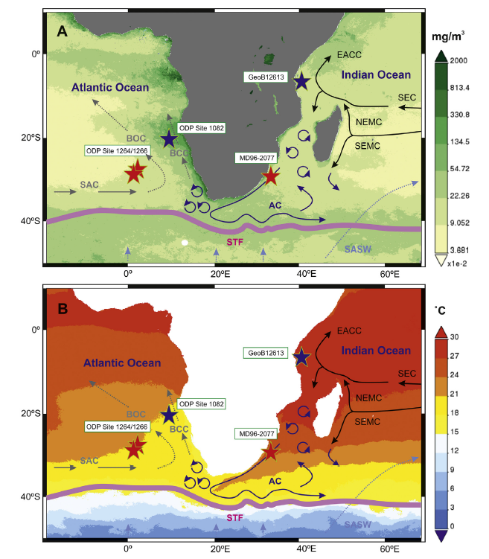
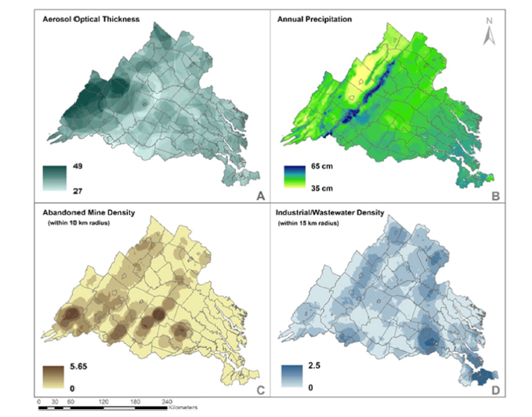
Supplemental Mode Examples
Tangunan, D., Baumann, K.H., and Fink, C. (2020) Variations in coccolithophore productivity off South Africa over the last 500 kyr. Marine Micropaleontology, 160, 13 pages, doi:10.1016/j.marmicro.2020.101909.
Coxon, T.M., Odhiambo, B.K., and Giancarlo, L.C. (2016) The impact of urban expansion and agricultural legacies on trace metal accumulation in fluvial and lacustrine sediments of the lower Chesapeake Bay basin, USA. Science of the Total Environment, 2016, 402–414, doi:10.1016/j.scitotenv.2016.06.022.

Slide 9
Illustrative Mode
Illustrative Mode usage of Giovanni means that a visualization created with Giovanni provides support for the analyses and conclusions described in the publication, but it is not used to derive results or conclusions.

Slide 10
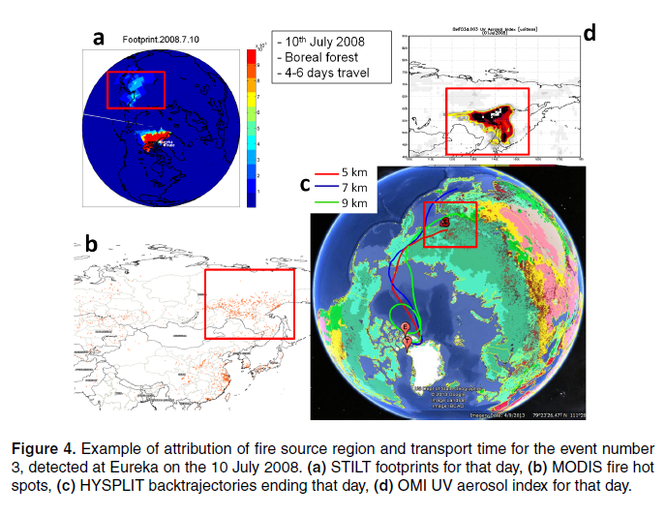
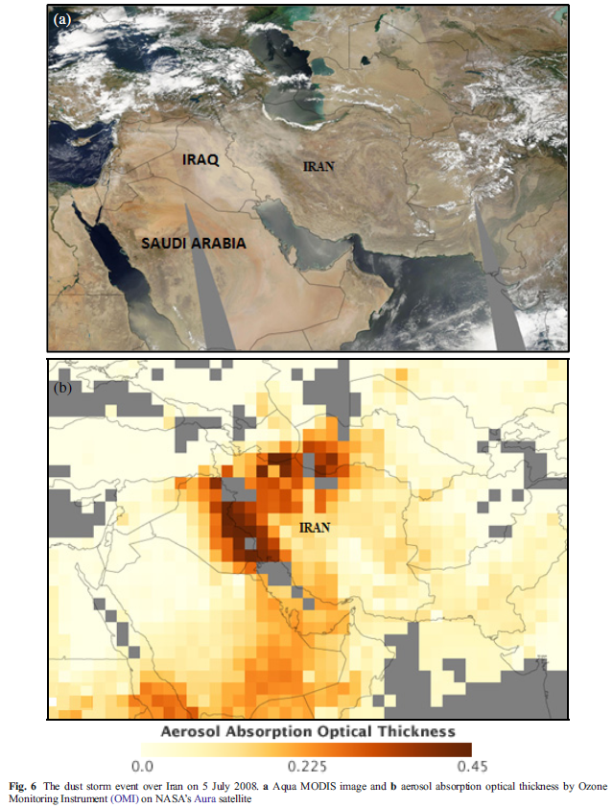
Illustrative Mode Examples
Arkian, F. (2017) Short-term variations of aerosol optical depth during the severe dust storm in 2015 over the Middle East and long-term variations of aerosol optical properties. Environmental Pollution and Climate Change, 1, 127-138, doi:10.4172/2573-458X.1000127.
Viatte, C., Strong, K., Hannigan, J., Nussbaumer, E., Emmons, L.K., Conway, S., Paton-Walsh, C., Hartley, J., Benmergui, J. and Lin, J. (2015) Identifying fire plumes in the Arctic with tropospheric FTIR measurements and transport models. Atmospheric Chemistry and Physics, 15(5), 2227-2246, doi:10.5194/acp-15-2227-2015.

Slide 11
Comparative Mode
Comparative Mode usage of Giovanni means that a visualization created either with Giovanni or with data obtained from Giovanni is actually compared, either qualitatively or quantitatively, to results and visualizations stemming from the research described in the paper.
In this case, Giovanni is used in either a confirming (more common) or disconfirming fashion when the data or visualization is compared to the research results.

Slide 12
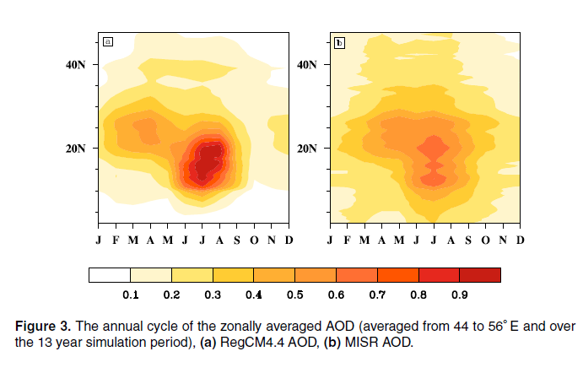
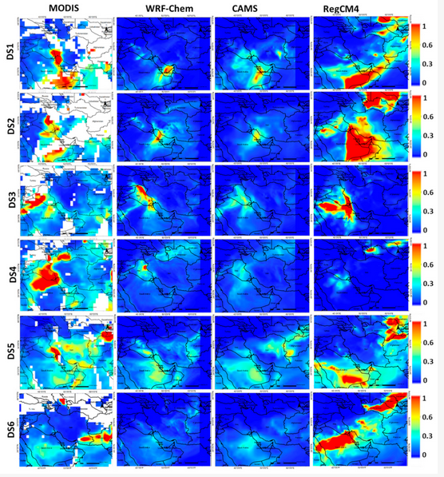
Comparative Mode Examples
Shalaby, A., Rappenglueck, B., and Eltahir, E.A.B. (2015) The climatology of dust aerosols over the Arabian Peninsula. Atmospheric Chemistry and Physics Discussions, 15, 1523–1571,
doi:10.5194/acpd-15-1523-2015.
Hamzeh, N.H., Karami, S., Kaskaoutis, D.G., Tegen, I., Moradi, M., and Opp, C. (2021) Atmospheric dynamics and numerical simulations of six frontal dust storms in the Middle East region. Atmosphere, 12(1), 27 pages, doi:10.3390/atmos12010125.

Slide 13
Analytical Mode
Analytical Mode usage of Giovanni describes using either the data or the visualization of the data obtained from the system in some manner to attain research results.
It is commonly seen for Analytical Mode usage of Giovanni that the system was used primarily as a data source, because of its easy-to-use spatial and temporal subsetting capability. Some of the most innovative visualizations in papers citing Giovanni have been seen in this usage mode.

Slide 14
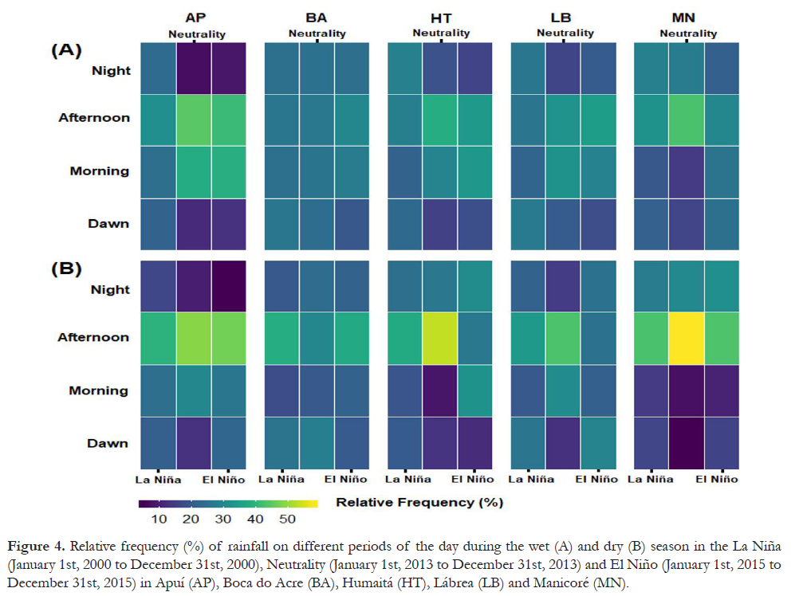
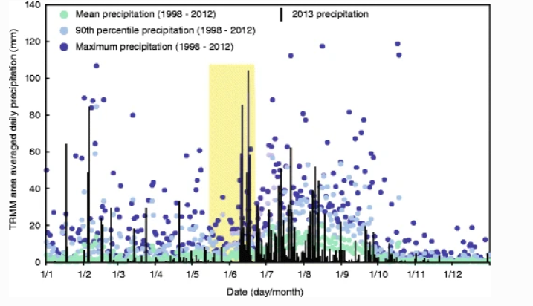
Analytical Mode Examples
Allen, S.K., Rastner, P., Arora, M. et al. (2016) Lake outburst and debris flow disaster at Kedarnath, June 2013: hydrometeorological triggering and topographic predisposition. Landslides, 13, 1479–1491, doi:10.1007/s10346.
Pedreira Junior, A.L., Querino, C.A.S., Biudes, M.S., Machado, N.G., Santos, L.O.F.D., and Ivo, I.O. (2020) Influence of El Niño and La Niña phenomena on seasonality of the relative frequency of rainfall in southern Amazonas mesoregion. Brazilian Journal of
Water Resources, 25(24), doi:10.1590/2318-0331.252020190152.

Slide 15
Critical Mode
Critical Mode usage of Giovanni describes a scientific publication in which the analysis and results are completely (or almost completely) reliant on the data obtained from, and visualizations created with, Giovanni.
In some cases, Giovanni is even mentioned in the title of the paper.
Characteristically, papers for which Giovanni had this critical role come from sources that are technologically or economically limited. In addition to its analysis capabilities, Giovanni is a free and easy-to-access data source, enabling research that might otherwise not be possible to perform.

Slide 16
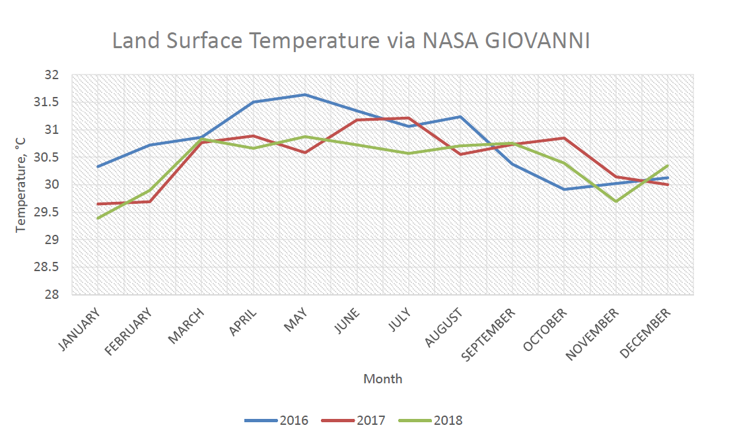
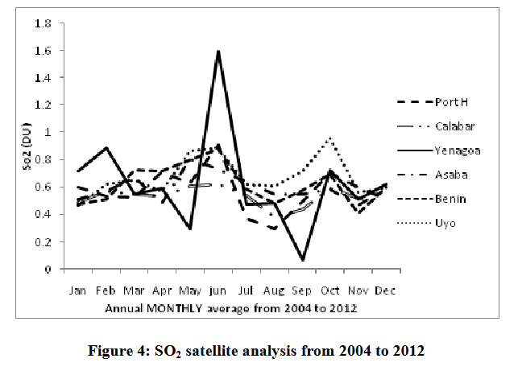
Critical Mode Examples
Md Kamaludin, K.F., Jumidali, M.M., Ahmad Sa’ad, F.N., and Mat Amin, A.R. (2022) Remote sensing study of the temperature profile over Penang Island using Nasa Giovanni system. ESTEEM Academic Journal, 18, 20-30.
Omotosho, T.V., Emetere, M.E., and Arase, O.S. (2015) Mathematical projections of air pollutants effects over Niger Delta Region using remotely sensed satellite data. International Journal of Applied Environmental Sciences, 10(2), 6651-664. (SO₂, NO₂, CO₂, and CH₄)

Slide 17
Summary and Conclusions
1. As Giovanni added more datasets and more analytical capabilities over the period when research publications have been collected, the discipline-specific research which utilized the data and analysis options also expanded. Furthermore, uses for the data in research became more diversified, with an increase in interdisciplinary and applications-related papers (natural hazards, agriculture, public health, wildlife, air and water quality) particularly notable. (I.e., if you make data accessible and analyzable, scientists will find ways to use it!)
2. The different usage modes of Giovanni demonstrate this system has provided data access and data opportunity for numerous research endeavors, many of which likely would not have used NASA Earth science data if the system did not exist. Thus, as NASA and the GES DISC migrate Earth science data to the cloud, it is imperative to maintain and improve the research capability that Giovanni empowers so that this opportunity is not lost.

Slide 18
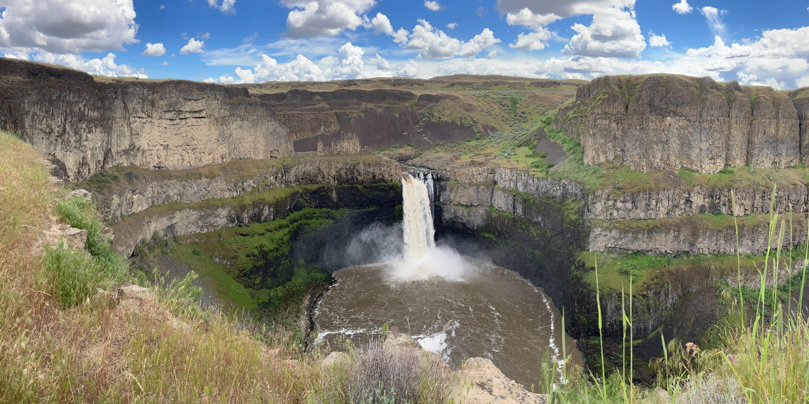
Palouse Falls, Washington State:
an interdisciplinary result of volcanism,
precipitation, hydrology, and climate change
Thank you for your attention and interest!

Slide 19
Summary and Conclusions
1. As Giovanni added more datasets and more analytical capabilities over the period when research publications have been collected, the discipline-specific research which utilized the data and analysis options also expanded. Furthermore, uses for the data in research became more diversified, with an increase in interdisciplinary and applications-related papers (natural hazards, agriculture, public health, wildlife, air and water quality) particularly notable. (I.e., if you make data accessible and analyzable, scientists will find ways to use it!)
2. The different usage modes of Giovanni demonstrate this system has provided data access and data opportunity for numerous research endeavors, many of which likely would not have used NASA Earth science data if the system did not exist. Thus, as NASA and the GES DISC migrate Earth science data to the cloud, it is imperative to maintain and improve the research capability that Giovanni empowers so that this opportunity is not lost.

