Slide 1

Open-Source Wireless Sensor Network For Flexible Deployment
Sebastian V. Colom, Magnus A. Haw
Analytical Mechanics Associates (AMA)
AIAA SciTech Forum and Exposition 2023, 1/23 - 1/27
Copyright © by Sebastian V Colom/AMA
Published by the American Institute of Aeronautics and Astronautics, Inc., with permission.

Slide 2
Outline
Background
Objectives
Wireless Sensor Networks
System Overview
  Hardware & Integration
  Software
Demonstration & Results
Conclusion

Slide 3
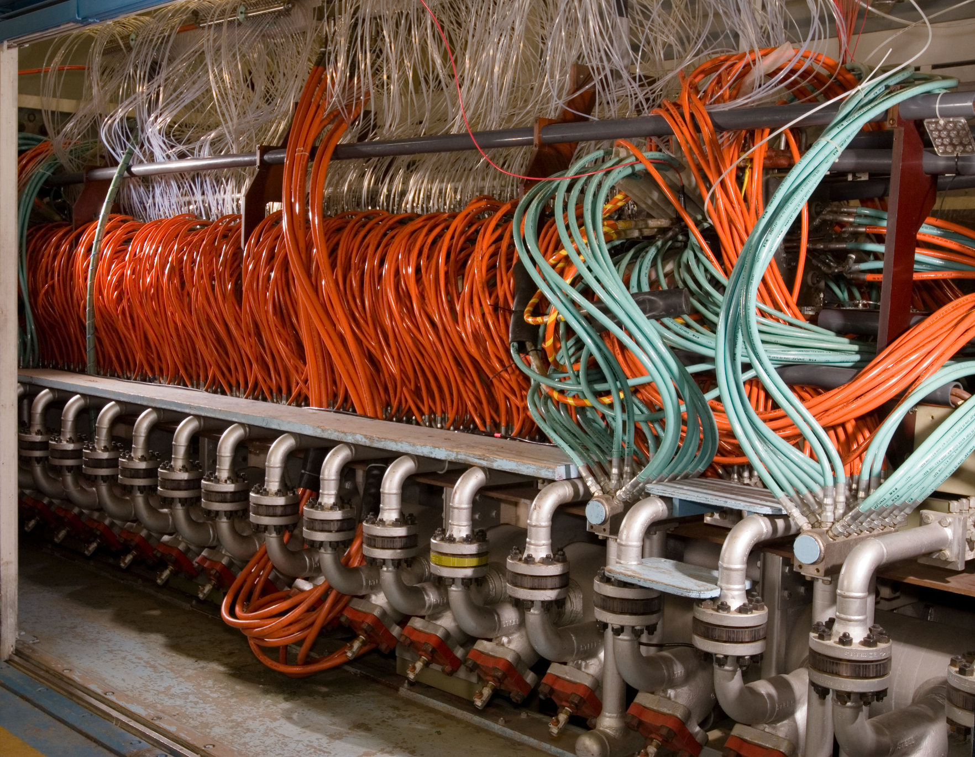
Background: Diagnostic Limitations at Arc Jet Complex
High-power facility that simulates extreme aerothermal conditions similar to atmospheric re-entry.
Produces high-voltage environment that poses limitations on diagnostics.
WSN technology offers an inexpensive, smaller in size, easy-to-integrate approach to distributed sensing and automation.

Slide 4
Objectives
Design and develop an open-source wireless sensor network that is flexible.
Integrate network in the mARC facility to evaluate performance and impact.
Implement to conduct thermal distribution measurements and control sweep-arm.

Slide 5
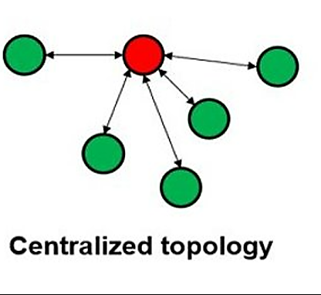

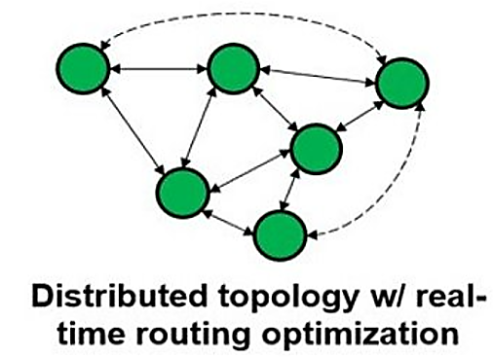
Wireless Sensor Networks
A collection of smart sensor nodes that gather information from the environment and, based one some local decision process, send the data to a sink for further processing.
Solves the many drawbacks that wire-based technology has, including:
Maintenance cost
Weight
Footprint size

Slide 6
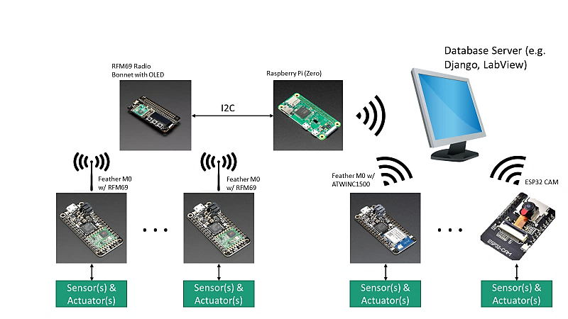
System Overview
Network implements centralized topology
Integrates the Feather M0 development board with on-board RFM69 radio transceiver as the basic node hardware
Image(s): https://learn.adafruit.com/
915 MHz
WiFi

Slide 7
System Overview: Network Components
Thermal Sensor Node: Transmit periodic measurements to central node
Controller Node: User-controlled interface to send commands to motor-driver
Motor-Driver Node: Receives commands from controller node to drive the sweep-arm and trigger DAQ systems
Central Node: Receives processed data and sends to data-sink for further processing
Data-Sink: Desktop with labView interface to data-log temperatures

Slide 8
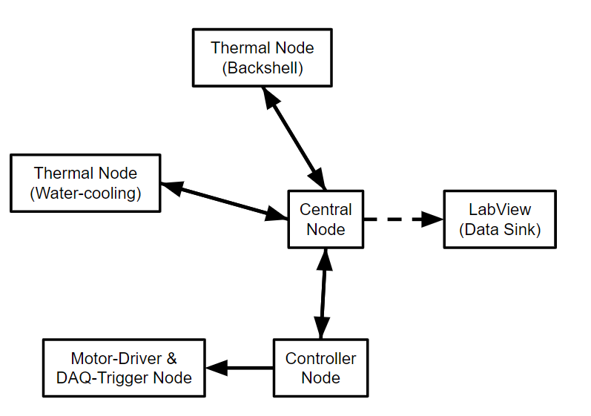
System Overview: Network Components

Slide 9
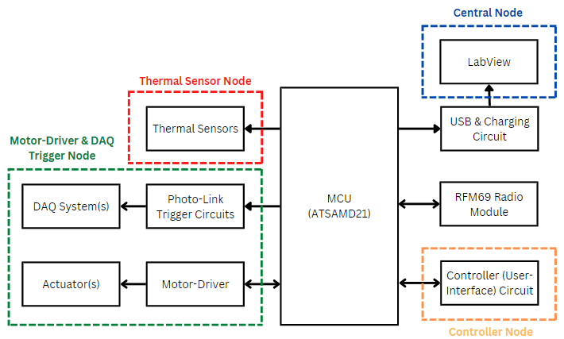
Hardware: Node Internal Structure

Slide 10
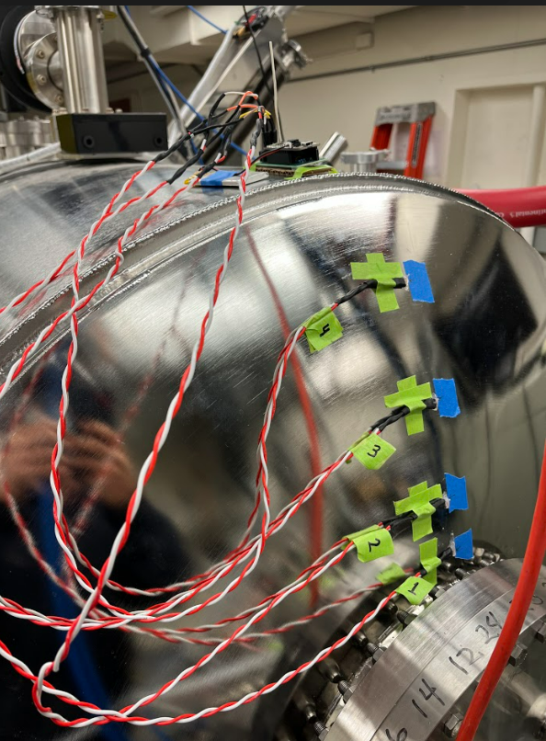
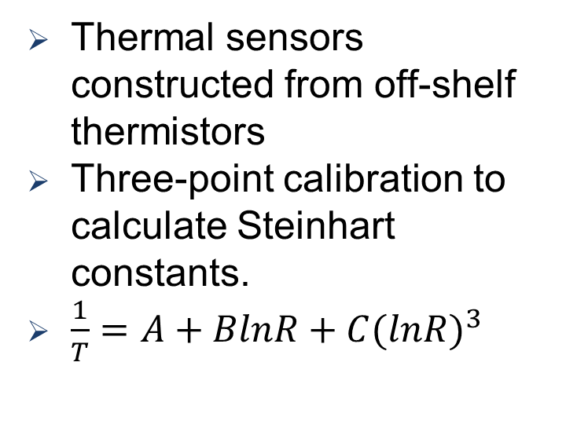
Hardware: Thermal Sensor Node
Transmitting Node
Thermal sensors constructed from off-shelf thermistors
Three-point calibration to calculate Steinhart constants.
$\frac{1}{T}=A+BlnR+C{(lnR)}^{3}$
Thermal Sensors

Slide 11
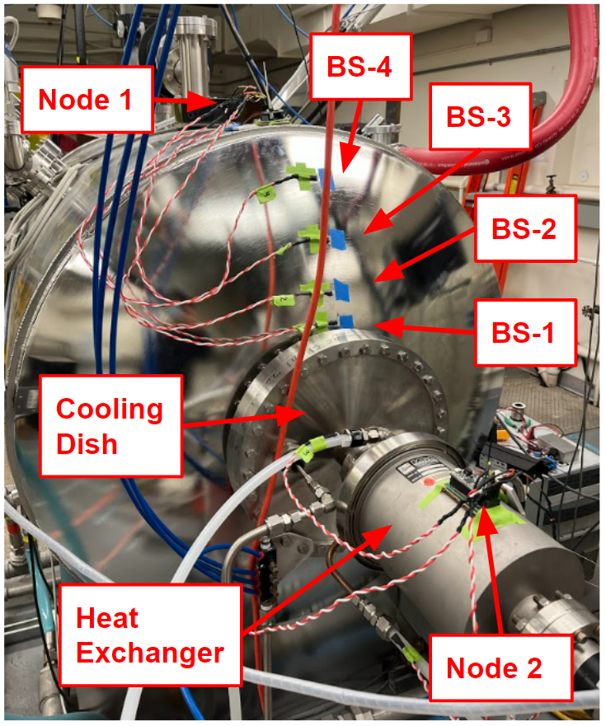
Integration at mARC Facility: Thermal Measurements
Thermal sensors placed along mARC backshell (BS) at 10, 20, 30, 40 cm from backshell center.
Thermal sensors placed across water-cooling (WC) lines for the cooling dish and heat-exchanger.
Measurements configured at sample-rate of 1 Hz.

Slide 12
Demonstration & Results: Thermal Distribution
Started temperature measurements before starting water-cooling pump.
Average 0.9 ° C decrease in water-cooling lines.
Highest increase of temperature in water-cooling line output for cooling dish (0.99 ± 0.05° C) and outer diameter of backshell (0.46 ± 0.05° C).

Slide 13
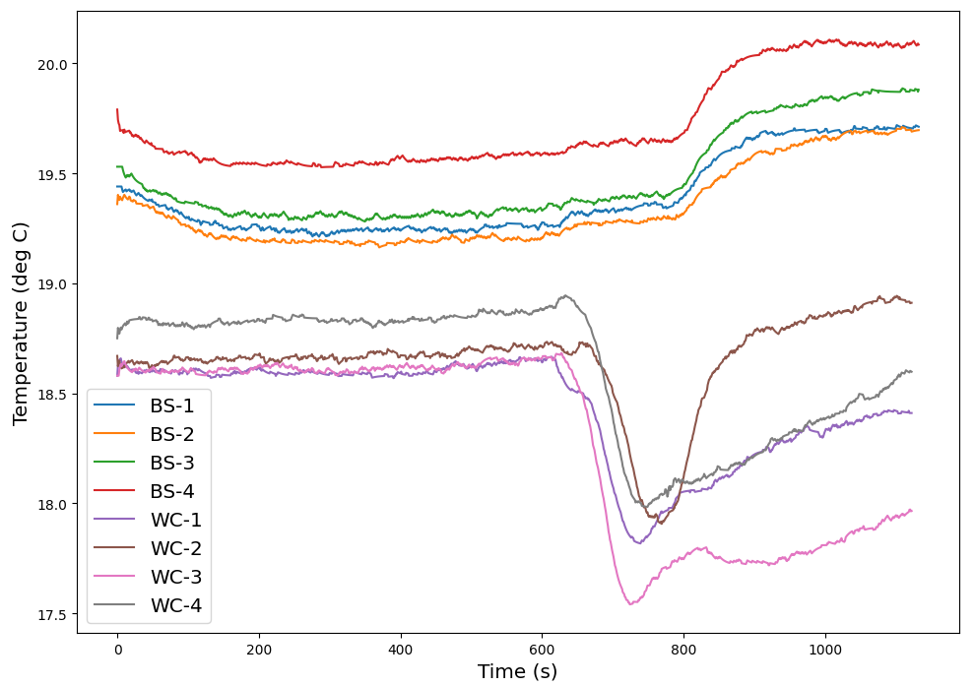
Demonstration & Results: Thermal Distribution

Slide 14
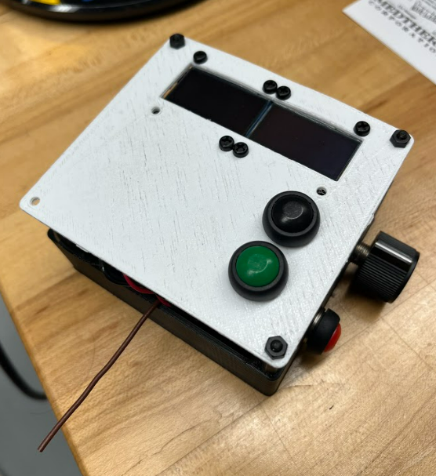
Hardware: Controller Node
Integrated array of push-buttons and OLED displays for navigating through program menu.
Integrated potentiometer for fine-tuning of input parameters.
Rechargeable through USB port

Slide 15
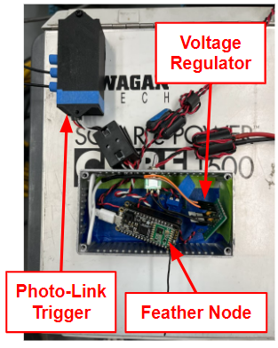
Hardware: Motor-Driver Node
Uses Feather wing motor-driver board to drive NEMA 17 stepper motor.
Integrates linear voltage regulator (7805T) to step down 12V, used to drive the motor, to a useable 5V for powering the node
Implemented metal enclosure and ferrite beads to protect node from high-EMI noise cause by arc activity.

Slide 16
Hardware: Motor-Driver Node (Cont.)
Communicate to other DAQ systems when sweep-arm is inserted through GPIO pins
Used photo-link transceivers to communicate toggling signal over a short-distance (~1m) without picking up high RF-noise

Slide 17
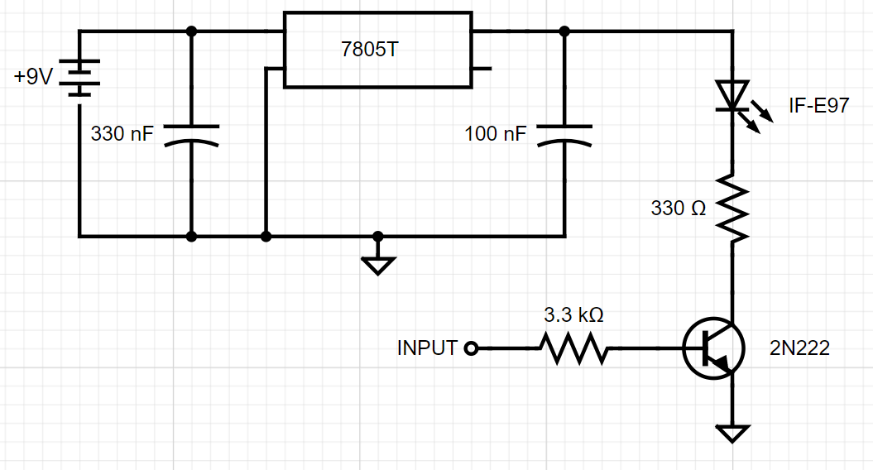
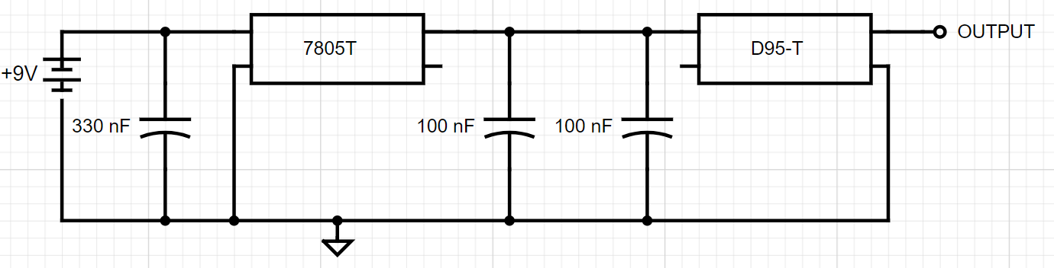
Hardware: Motor-Driver Node (Cont.)

Slide 18
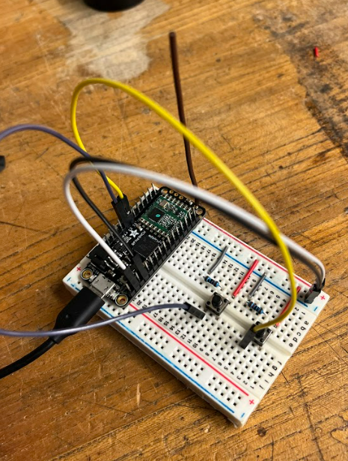
Hardware Overview: Central Node
Continuously receiving message packets from other nodes
Dual push-button for triggering transmission of over-the-air commands.
Interfaced with desktop via USB serial port to communicate collected data to LabView software.

Slide 19
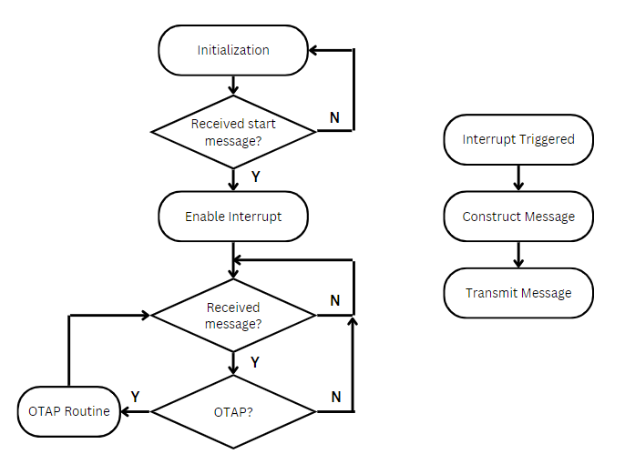
Software: Node Program
Implements interrupts for periodic measurements and real-time program changes.
Message-packet construction software for easy read & write operations.
Simple over-the-air programming software to reprogram nodes.

Slide 20
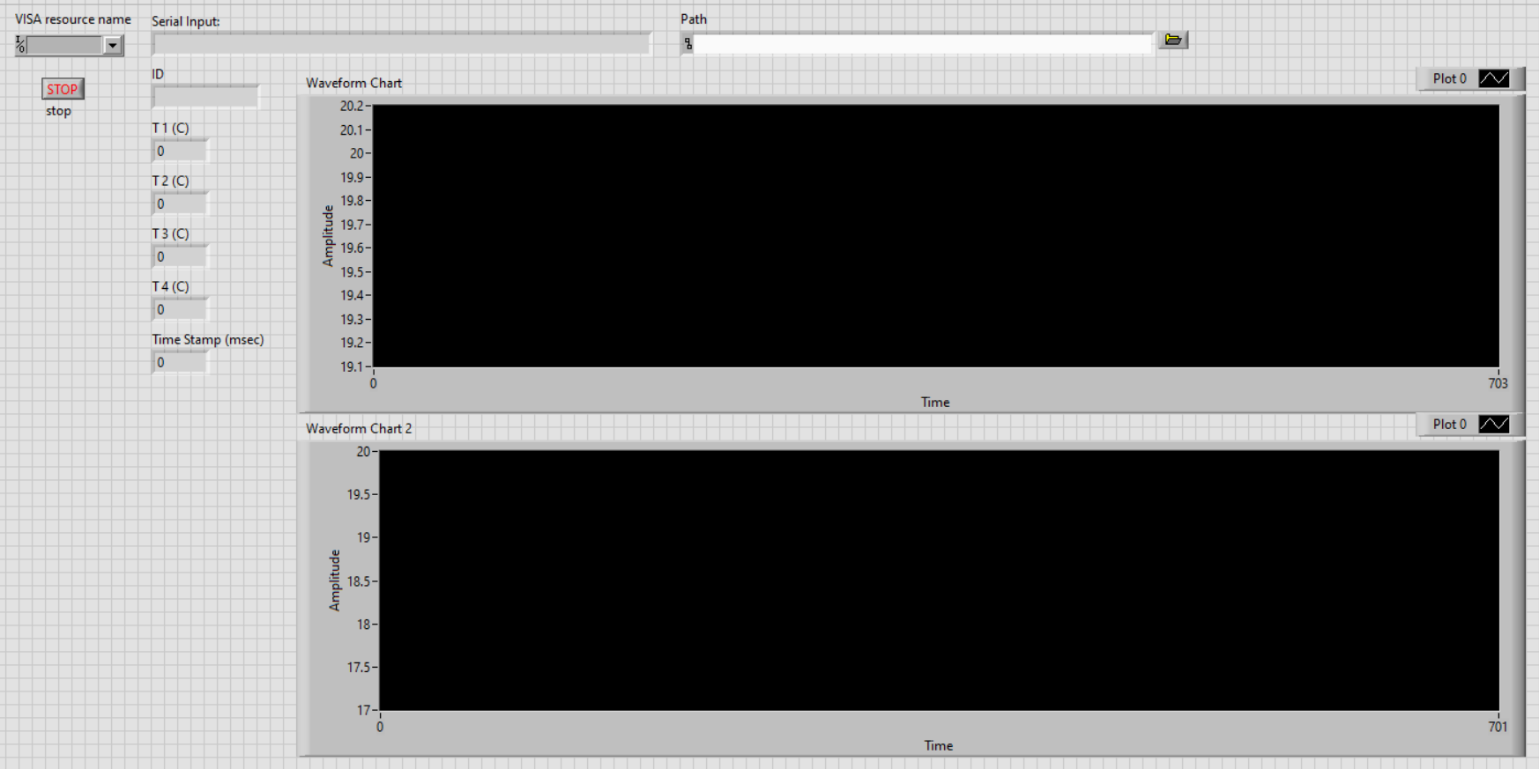
Software: LabView Interface

Slide 21
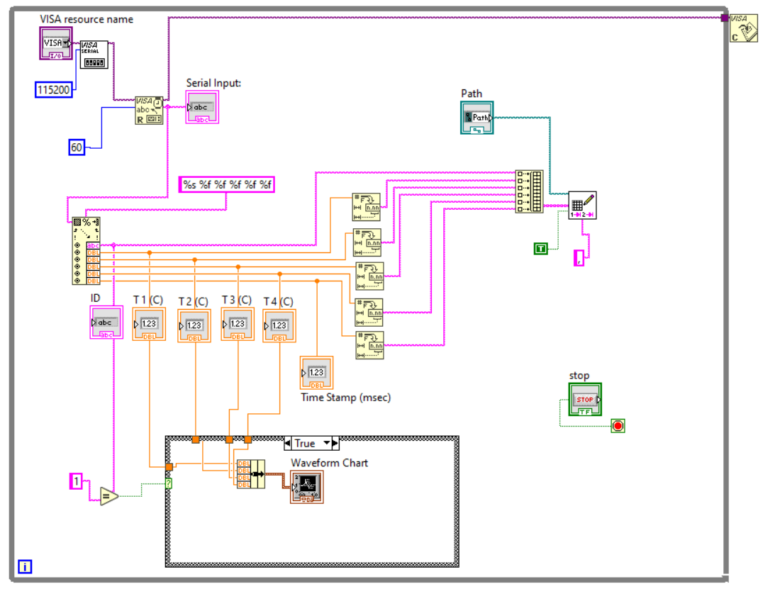
Software: LabView Interface

Slide 22
Conclusion
Developed flexible wireless sensor network that modernizes ground-test facilities.
A centralized network was integrated at the mARC facility for sweep-arm control and distributed thermal measurements on backshell and water-cooling lines.
Showed an effective, flexible monitoring and automation system without facing the challenges posed by wire-based technology.

Slide 23
Acknowledgements
This work was supported by the BEAST project (Megan E. MacDonald, PI) of NASA's Space Technology Mission Directorate and internal research and development funds from Thermophysics Branch at NASA Ames Research Center. The authors would particularly like to thank Megan E. MacDonald and Ramon Martinez for providing materials, tools, and advice.

Slide 24
Contact Information
Sebastian V Colom
sebastian.v.colom@ama-inc.com
956-465-8425

Slide 25
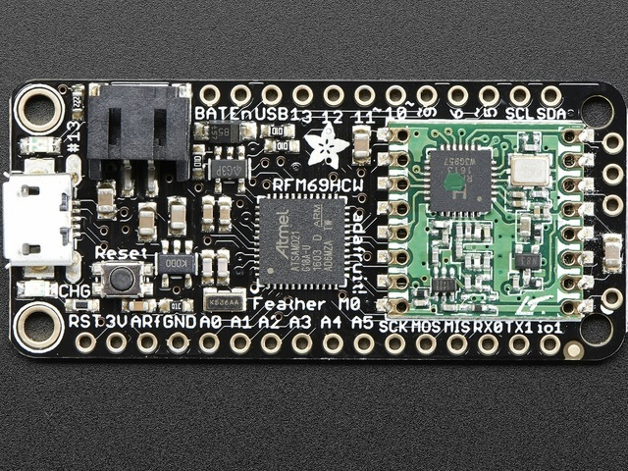
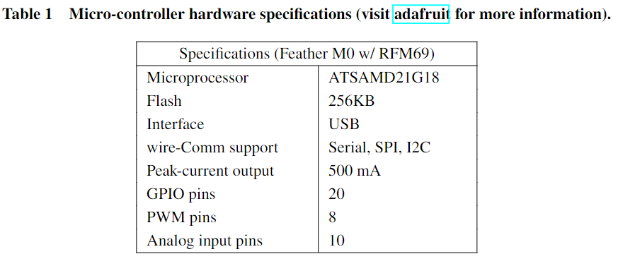
Appendix: Feather M0 Development Board
Image(s): https://learn.adafruit.com/

