Slide 1
Enabling Open Science with NASA's Earthdata in the Cloud
Winter ESIP 2023
Dana Shum
EED-3 Mission Engineer dana.l.shum@nasa.gov
This work was supported by NASA/GSFC under Raytheon Technologies contract number 80GSFC21CA001.
This document does not contain technology or Technical Data controlled under either the U.S. International Traffic in Arms Regulations or the U.S. Export Administration Regulations.

Slide 2
2022 Year in Review
Brief History
Our 2022 Goal
Process
Results

Slide 3
The Early Years
Go to the cloud!
What should we move? Where should it go? How should a user discover and use the data once it’s there? When do you need it by?
We trust you, go figure it out.
Ok, moving the data!
Given recent events, that was the wrong stuff, and it was too slow.

Slide 4
Enter 2022
Move the Top 50 datasets (75 if you can get there) by the end of 2022 so that NASA is ready to launch the ‘Year of Open Science’ in 2023.

Slide 5
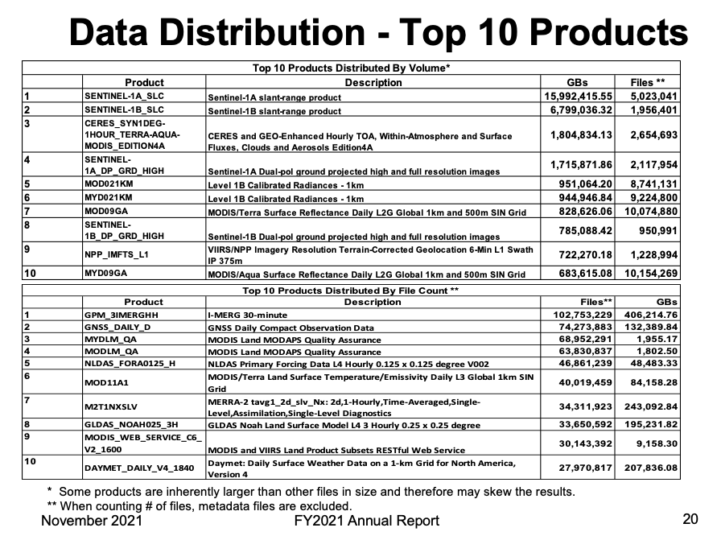
Step 1 – What data?
Image source: NASA / GSFC (https://www.earthdata.nasa.gov/sites/default/files/2022-02/FY21AnnualReport_v1.pptx Slide 20)
Notes:
We were able to rely on EOSDIS rich history of distribution metrics to identify popular products, but the initial list needed subject matter experts to scrub it.

Slide 6
Step 2 – Define ”done”
Final agreed upon acceptance criteria:
Data is publicly available and discoverable
For forward streaming datasets, migration of the forward processing is the minimum capability, and the historical data is secondary.
Data will live in Earthdata Cloud, specifically AWS (Amazon Web Services) us-west-2 region
Data requires Earthdata Login profile for access to ensure all End User License Agreements are signed and metrics are collected
Data is accessible with both s3:// and https://
Data distribution is behind an egress throttle to prevent run away costs
Metadata about the data is published to the Common Metadata Repository (CMR)
  S3 locations are discoverable in the collection and granule metadata
  Metadata is compliant with Spatio-Temporal Asset Catalog (STAC)
All ingest and distribution mechanisms are logged in the metrics system

Slide 7
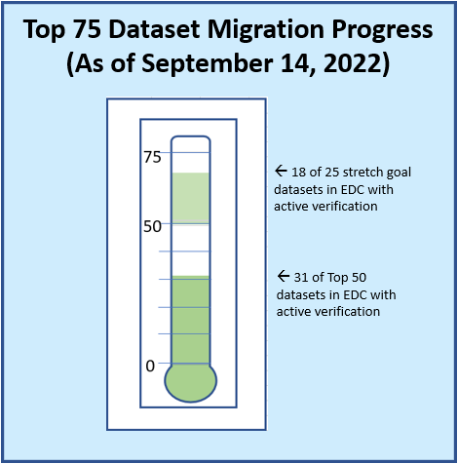
Step 3 – Execute & Monitor!
Image source: NASA / GSFC Robert L. Harberts
Notes:
We regularly measured progress and reported status up and down the organization

Slide 8
Step 4 – Measure & Improve
30 Days of Distribution Metrics:
2.8 PB
Out of Region or to Internet
1.5 PB
Https Access In Region
2.5 TB
Direct S3 Access In Region
Are users behaving as we hoped? What needs to change next?

Slide 9
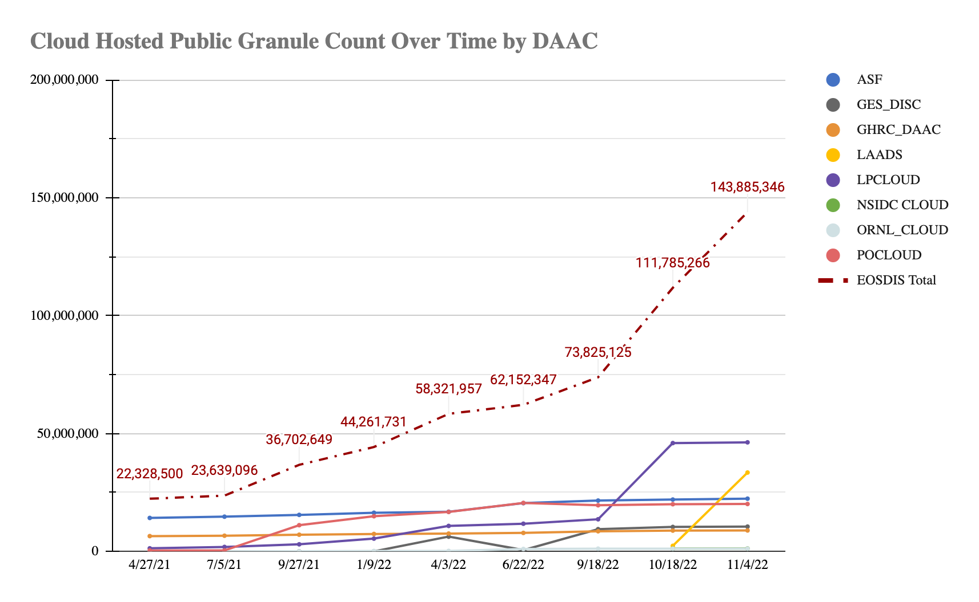
Step 5 – Celebrate
Image source: NASA / GSFC Dana L. Shum
Over 1,650 datasets and 140M granules publicly available in the cloud!
Data gathered from https://cmr.earthdata.nasa.gov inventory on 11/4/22.
Includes only publicly discoverable data in Earthdata Cloud.

Slide 10
Up Next
How to discover NASA's cloud holdings via STAC and the Earthdata Search application (Mark Reese)
How to use NASA's cloud holdings via direct access in the cloud (OpenScapes)
How to use cloud native transformation services to reduce the post processing needed (Amy/OpenScapes)
Lessons learned and pain points we are still working through (Patrick)
Open Conversation

Slide 11
This work was supported by NASA/GSFC under Raytheon Technologies contract number 80GSFC21CA001.

