Slide 1
Leveraging WIGOS metadata standards to make field study data products interoperable and reusable
Jörg Klausen¹
Chair TT-WIGOSMD, Co-chair ET-Metadata, Chair ET-ACDM
joerg.klausen@meteoswiss.ch
Tom Kralidis², Anna Milan³, Xiaoxia Chen³, Gao Chen⁴, Morgan L Silverman⁵, Guillaume Aubert⁶, Lara Ferrighi⁷, Enrico Fucile³, Øystein Godøy⁷, Shuli Han⁸, Xinqiang Han⁸, Hanane Kamil⁹, Rainer Maerz¹⁰, Ioannis Mallas¹¹, Jan Osusky¹², Franziska Stürzl¹ and Julia Sieland¹⁰
(1)MeteoSwiss Federal Office of Meteorology and Climatology, Zurich, Switzerland, (2)Environment and Climate Change Canada, Toronto, Canada, (3)World Meteorological Organization, Geneva, Switzerland, (4)NASA Langley Research Ctr, Hampton, VA, United States, (5)Science Systems and Applications, Inc., Hampton, United States, (6)European Organisation for the Exploitation of Meteorological Satellites, Darmstadt, Germany, (7)Norwegian Meteorological Institute, Oslo, Norway, (8)CMA China Meteorological Administration, Beijing, China, (9)Direction de la météorologie nationale du Maroc, Casablanca, Morocco, (10)Deutscher Wetterdienst (DWD), Offenbach am Main, Germany, (11)European Centre for Medium-Range Weather Forecasts, Reading, United Kingdom, (12)IBL Software Engineering, Ružinov, Slovakia

Slide 2
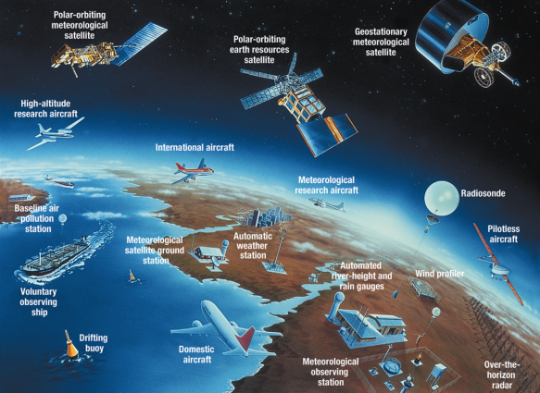
Motivation
Meteorology, climatology, environmental science
need many, globally distributed observations
  Feed numerical weather models
  Determine climate trends
  Support public health
  Support industry and transport
  Verify environmental policy measures
  Support science
Measurements obtained for different purposes,
with different quality requirements and different representativeness
→ Comprehensive metadata enable ‘Adequate use of observational data’ !

Slide 3
Two complementary types of metadata to maximize WIGOS observational data usefulness, i.e., being F.A.I.R.
WIS
Discovery
Metadata
WIGOS
Observational
Metadata
WMO Integrated Global Observing System metadata is tasked to provide proper description so that the data can be interpreted in context
WMO Information System (WIS) metadata supports data discovery, access, and retrieval

Slide 4







The WMO Information System (WIS 2.0)
1963 World Weather Watch
1970s Global Telecommunication System
2007 WMO Information System (WIS)
2019 WMO Reform (Earth System Approach)
2021 WMO Unified Data Policy
WIS 2.0
  … system of systems using Web-architecture and open standards to provide simple, timely and seamless sharing of trusted data and information …
  Open Standards (OGC, W3C, IETF, …)
  Data sharing through Web and publication/subscription (pub/sub) protocols
  Cloud ready (turn-key solutions)
  Web APIs (Application Programming Interface)
Notes:
A little history to start …
The WMO Global Telecommunications System (GTS), established in the 1970s was designed to enable WMO Members to share data and products with each other in support of operational weather forecasting. Over the last 40 years or so, the GTS has successfully moved indispensable, time-critical data between NMHSs day-in, day-out.
But weather and climate data is important to everyone. So WMO Congress commissioned the WMO Information System (WIS) in 2007.
WIS builds on and incorporates the GTS, adding a data catalogue, data discovery portal and additional mechanisms for users to subscribe to and download data shared on the GTS. It is comprised of hundreds of data providing centres from across the globe (Data Collection and Production Centres, and National Centres), plus 15 Global Information System Centres (or GISCs) that are regional hubs for search, discovery, and access to data.
The original WIS is a child of its time – designed circa 2005. It’s based on service-oriented architecture principles, uses complex ISO 19115/19139-based XML for metadata, and is not well integrated into the Web. Since 2005, we’ve seen a move towards “webby” applications, with good practice characterised in the W3C Data on the Web and W3C Spatial Data on the Web Best Practices. In summary: Resource-oriented architecture, RESTful Web services, and JSON and HTML as core formats.
This is a journey that OGC has been on for some time now, and many of the OGC API standards appear ripe for inclusion in WIS2.
Our aim for WIS2 is to increase data provider participation by lowering the technical barriers to entry, and from the data consumer perspective, make weather and climate data Findable, Accessible, Interoperable, and Reusable (FAIR).

Slide 5
WIS 2.0 discovery metadata
WMO Core Metadata Profile 2 (WCMP 2)
Multiple metadata types (datasets, services, processes, etc.)
Core properties
  Identification (Title, Abstract, Keywords, Topic Hierarchy, …)
  Extents (Spatial/Temporal)
  Data Policy
  Distribution (Actionable links)
Extensible (additional properties)

Slide 6
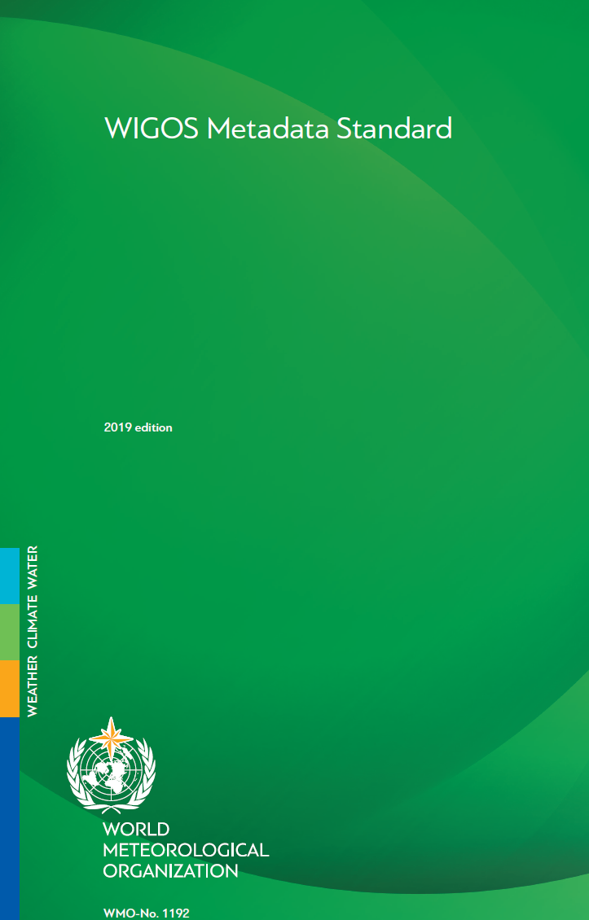
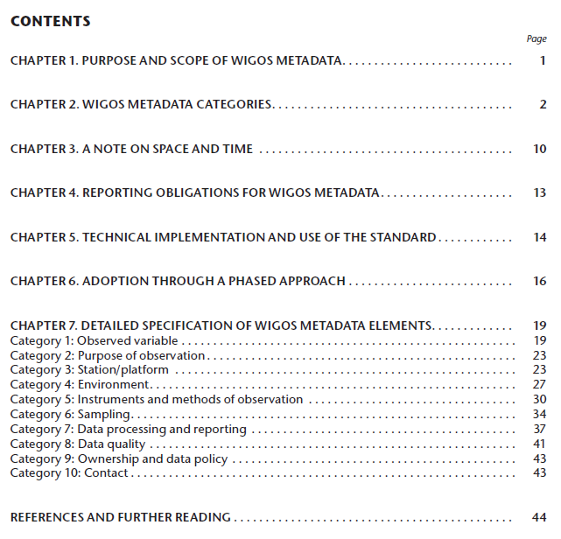
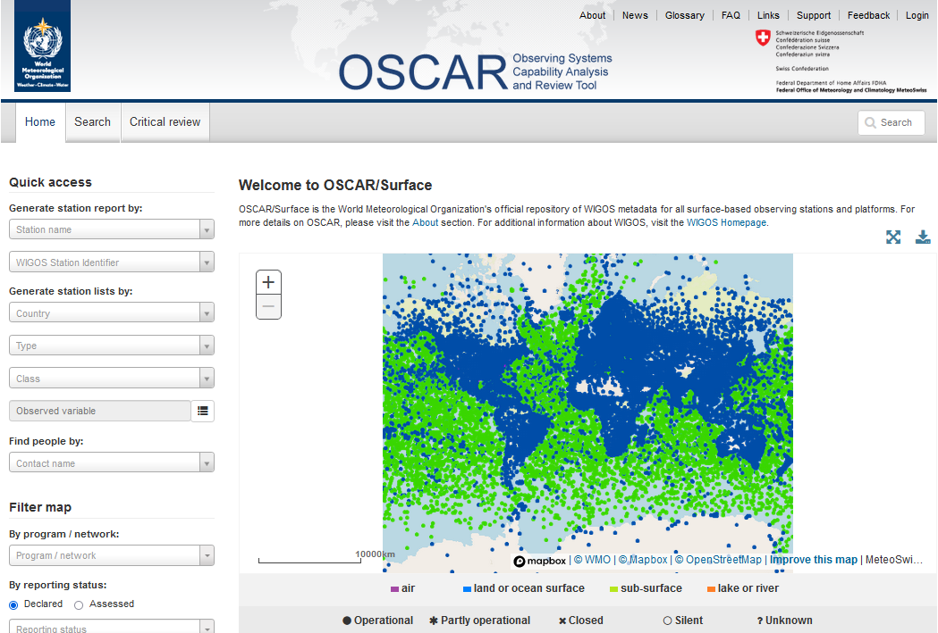
WIGOS Metadata Standard
  Atmosphere, land, ocean, space
  Fixed, mobile observing facilities
  In-situ, remote-sensing instruments
  Physical, chemical, biological, hydrological observations
  Weather, climate, hydrology, atmosphere, warnings, …
Descriptive
Standard
XML Schema
defining exchange
format (WMDR 1.0)
WMO Reference Implementation
Observed variable
Purpose of observation
Station/ platform
Environment
Instruments & methods of observation
Sampling
Data processing and reporting
Data Quality
Ownership and Data Policy
Contact
  https://library.wmo.int/index.php?lvl=notice_display&id=19925
  https://oscar.wmo.int/surface

Slide 7
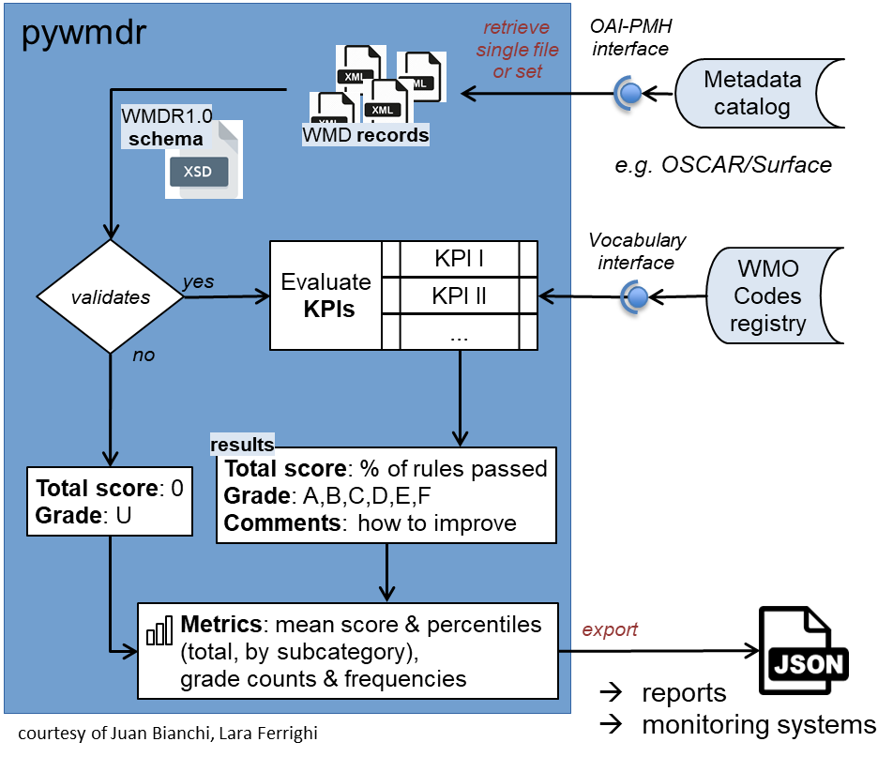
KPIs for WMDR XML quality assessment
Key Performance Indicators (KPI) developed by TT-WIGOSMD
  https://github.com/wmo-im/wmdr/tree/issue42
  set of rules grouped in 6 categories and 11 subcategories
    1 - Schema compliance
    2 - Station characteristics
    3 - Observation/measurements – deployment
    4 – Station contacts
    5 – Bibliographic references and documents
    6 – Value of a station for WIGOS
Pywmdr
  https://github.com/wmo-im/pywmdr
  Python application developed by TT-WIGOSMD
  based on similar tool by TT-WISMD (pywcmp)
  Features:
    Validation against WMDR 1.0 schema (XML)
    Validation of controlled vocabulary terms against https://codes.wmo.int/wmdr
    KPI evaluation of single metadata documents or entire collections
    assign grade to document according to the overall score
    calculate metrics for collections and present as .json
    bulk harvest of wmdr documents from a collection’s OAI web service
    schedule harvest, recalculate metrics to monitor evolution over time
    simple command line interface (CLI)

Slide 8
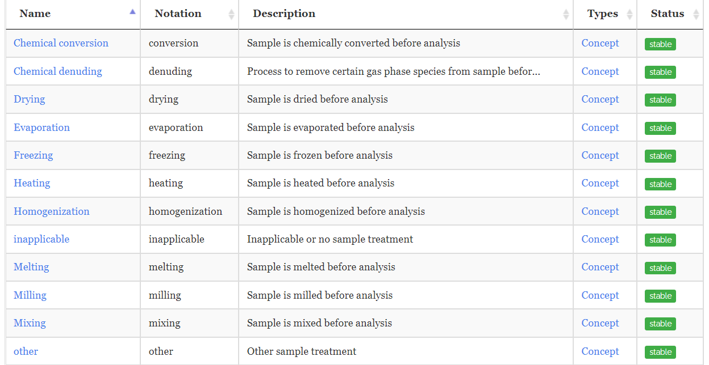
WIGOS Metadata Representation uses standardized vocabulary
Example “Sample Treatment” from http://codes.wmo.int/wmdr

Slide 9
Applications of WIGOS Metadata Standards
WIGOS Metadata Standards are operationally used with OSCAR/Surface, which leads steady improvements in terms of the usability, applicability and robustness
WIS and WIGOS metadata code tables are actively managed by the WMO Expert Team on Metadata (ET-Metadata) to resolve cross-community issues, improve the existing codes, and develop new codes, as necessary. This process often invites active researchers outside the team who have expertise in measurements and data use
WIGOS metadata is designed to be widely applicable to all earth science measurements. It is the most comprehensive metadata schema, especially for in-situ measurements

Slide 10
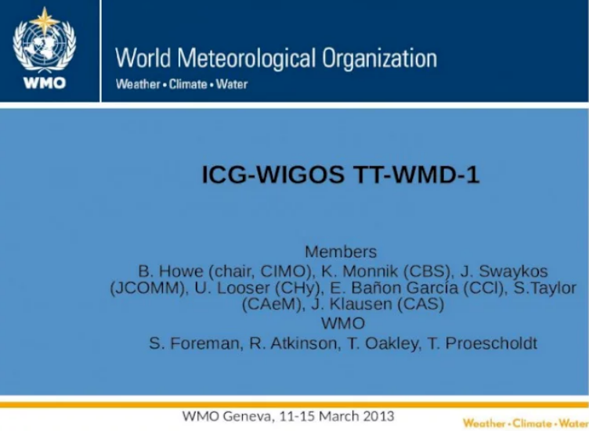
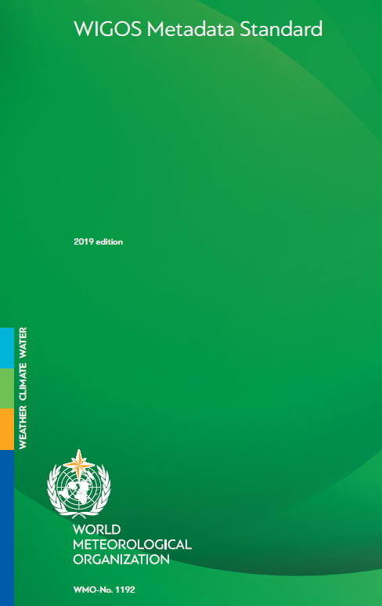
Evolution of WIGOS Metadata
WIGOS metadata model 1.0 developed based on experience from various communities under the WMO umbrella 2013/2014
Published and endorsed at WMO Cg-17 (WMDS 2015, update 2019)
Formally specified as a GML XSD,
based on ISO19156:2011 / OGC O&M (WMDR1.0)
(Most comprehensively) implemented in OSCAR/Surface (Observing Systems Capability Analysis and Review Tool), supported by an API for exchange of XML files
WMDS (2015) https://library.wmo.int/?lvl=notice_display&id=18648 (2015)
WMDS (2019) https://library.wmo.int/index.php?lvl=notice_display&id=19925 (2019)
WMDR1.0 https://github.com/wmo-im/wmdr
OSCAR/Surface https://oscar.wmo.int/surface

Slide 11
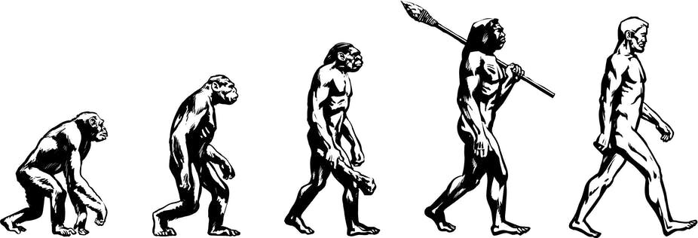
Not even a standard can stand still …
Why change?
  Basis for WIGOS metadata exchange format changes
    ISO 19156:2011 / OGC O&M → ISO 19156:2022 / OMS
  Experience with current model shows some deficiencies
    Submodel for observedVariable (“what’s observed”) has evolved significantly
    Deployment/instrument/data generation model is a bit awkward …
  General tendency to migrate from XML formats to JSON formats
Why change now?
  Climate data model and OpenCDMS being implemented now
  OSCAR/Surface undergoing life-cycle
  → Both need a stable information model
Credit: Uncle Leo/Shutterstock.com

Slide 12
Acknowledgements
WIGOS Metadata Standard
  WMO TT-WIGOSMD
  ET-ACDM members
Initial UML model
  Dominic Lowe (formerly BoM)
  Jeremy Tandy (UKMO)
  Tom Kralidis (EC)
Evolution of UML model
  Kathi Schleidt (DataCove)
  Barbara Magagna (I-ADOPT)
  OGC OMS SWG
Users
<wmdr:extension>
<wmdr:acknowledgement>
<gco:CharacterString>
Thank you for your attention
</gco:CharacterString>
</wmdr:acknowledgement>
</wmdr:extension>

