Slide 1
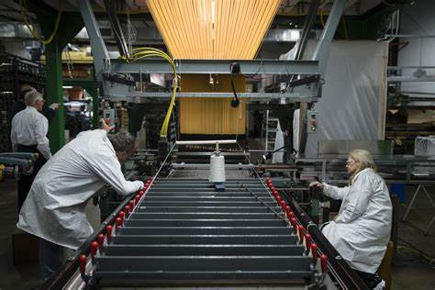
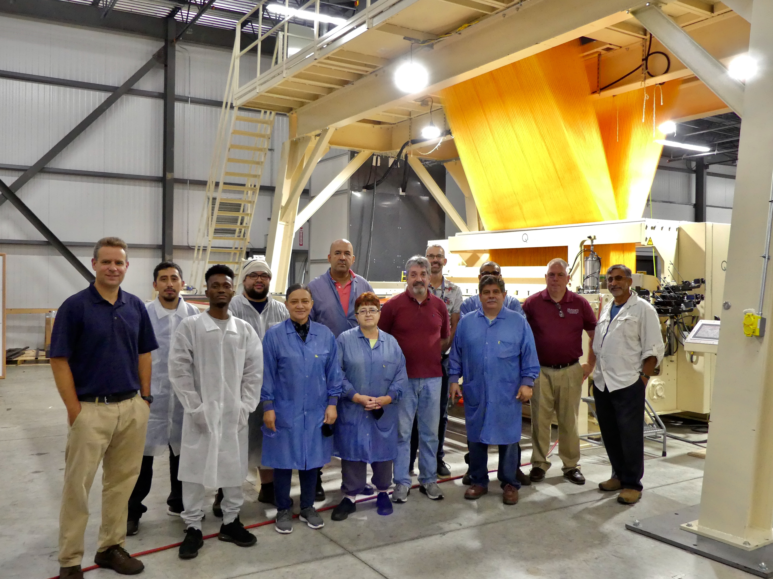
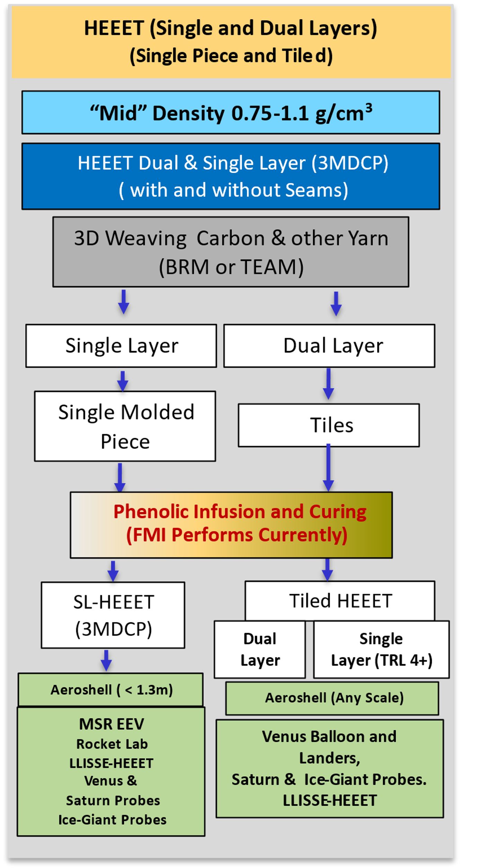
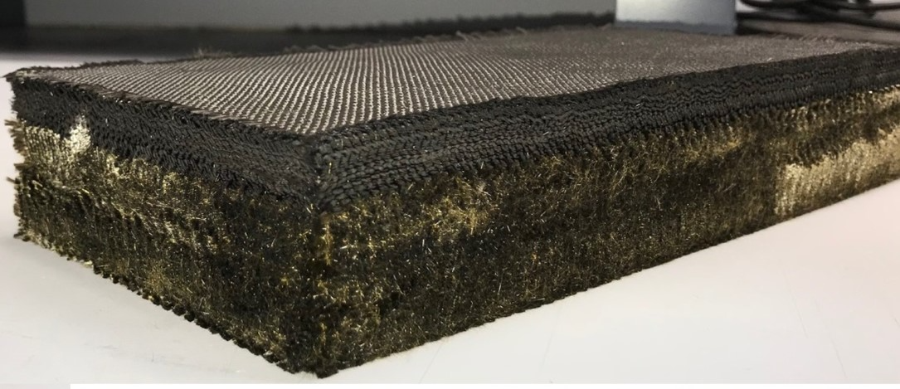
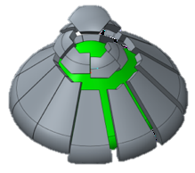
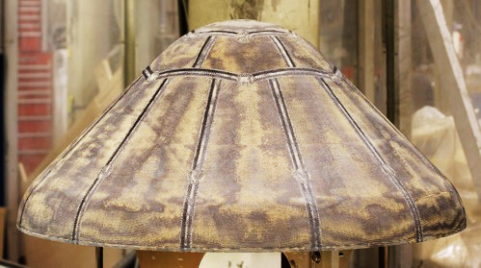
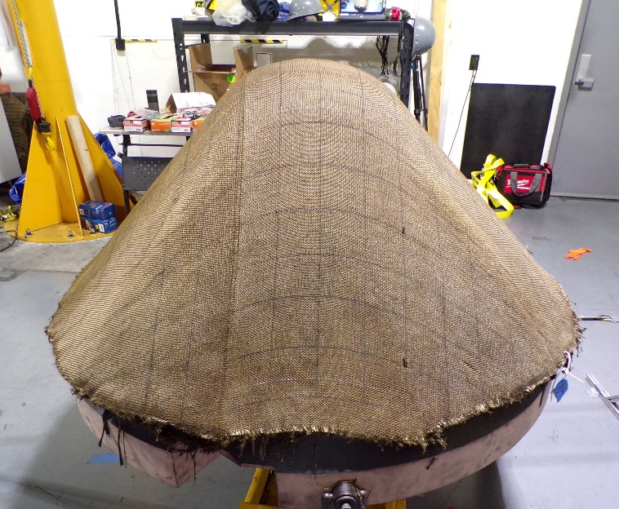
Enabling Planetary In-Situ and Sample Return Missions
NASA Developed 3-D Woven Thermal Protection / Heatshield Technology for Extreme Entry Environment
  Heatshield for Extreme Entry Environment Technology (HEEET) and 3-D Mid-Density Carbon-Phenolic (3MDCP) are two variants of 3-D Woven
  TPS funded by STMD and SMD. HEEET was matured to TRL 6 in 2019, and SMD offered it as incentivized technology.
  Mars Sample Return Earth Entry System has baselined a seamless 3MDCP heatshield, and it will reach TRL 6 by 2025.
  HEEET and 3MDCP have been tested to withstand entry peak heat-flux ~ 4500 W/cm², pressure ~ 6.5 atm, and shear ~ 4000 Pa.
  Bally Ribbon Mills and T.E.A.M. Inc developed looms and demonstrated their capability to weave HEEET and 3MDCP respectively.
  F.M.I. has demonstrated capability to form and resin infuse the preforms, and machine the TPS for final assembly.
  Expertise to integrate the parts reside at NASA, and NASA can transfer the knowhow to interested parties via technology transfer.
HEEET Dual-layer Preform
High-density Carbon-yarn Recession Layer
HEEET 24” Loom at BRM
Lower-density Blended-yarn Insulating Layer
3MDCP 80” Loom at TEAM
HEEET tiles and integration
Scalable HEEET - Engineering Test Unit
3MDCP Development Unit

Slide 2
Enabling Planetary In-Situ and Sample Return Missions
NASA Developed 3-D Woven Thermal Protection / Heatshield Technology for Extreme Entry Environment
  Heatshield for Extreme Entry Environment Technology (HEEET) and 3-D Mid-Density Carbon-Phenolic (3MDCP) are two variants of 3-D Woven
  TPS funded by STMD and SMD. HEEET was matured to TRL 6 in 2019, and SMD offered it as incentivized technology.
  Mars Sample Return Earth Entry System has baselined a seamless 3MDCP heatshield, and it will reach TRL 6 by 2025.
  HEEET and 3MDCP have been tested to withstand entry peak heat-flux ~ 4500 W/cm², pressure ~ 6.5 atm, and shear ~ 4000 Pa.
  Bally Ribbon Mills and T.E.A.M. Inc developed looms and demonstrated their capability to weave HEEET and 3MDCP respectively.
  F.M.I. has demonstrated capability to form and resin infuse the preforms, and machine the TPS for final assembly.
  Expertise to integrate the parts reside at NASA, and NASA can transfer the knowhow to interested parties via technology transfer.
HEEET Dual-layer Preform
High-density Carbon-yarn Recession Layer
HEEET 24” Loom at BRM
Lower-density Blended-yarn Insulating Layer
3MDCP 80” Loom at TEAM
HEEET tiles and integration
Engineering Test Unit
3MDCP Development Unit

