Slide 1

National Aeronautics and Space Administration
NASA Common Research Model (CRM) – Past, Present and Future

Slide 2
Outline
Origins
Experimental Tests
  National Transonic Facility
  Ames 11-Ft Wind Tunnel
  European Transonic Windtunnel
CRM Derivatives
CRM-HL
  Ecosystem overview
  Design
  Experimental tests – current and future
Concluding Remarks

Slide 3
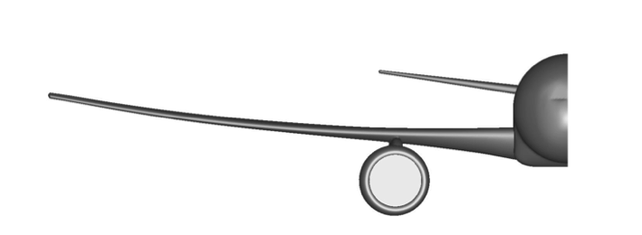
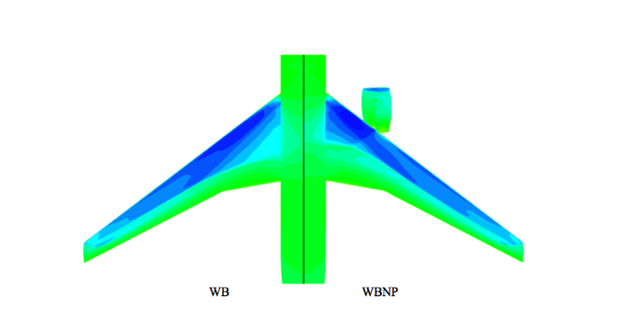
CRM Origins
DPW1, DPW2, DPW3 – some consistent (experimental) desires identified
  Need for a modern/relevant and open/public civil transport aircraft geometry suitable for applied CFD validation studies
  Need for traditional and detailed flow measurements for CFD validation
    Force/Moment/Shape/Pressure + skin friction, off body mean and unsteady data
January 2007 post-DPW3 discussion with US aero leaders at a NASA Aero Technical Working Group meeting
  Group definition of configuration, design guidelines
  One “volunteer” at Boeing identified for detailed design/iteration with the group
  NASA Fundamental Aeronautics/Subsonic Fixed Wing built and funded initial tests
  Design vetted with the SFW Aerodynamic Technical working group experts before freezing in 2008
AIAA 2008-6919 Vassberg et al

Slide 4
CRM Design
Contemporary supercritical transonic wing and a fuselage that is representative of a wide-body commercial transport aircraft
2.7% scale model designed for a cruise Mach number of M∞ = 0.85 with a design lift coefficient of C_{L} = 0.5
Pressures on both the left and right wings using 291 pressure orifices located in nine spanwise wing stations and on the left-hand nacelle by six orifices
Two wing root bending gauges and two Kulite pressure transducers were also installed in the wings
Five different configurations were designed and fabricated:
  wing/body (WB), wing/body/nacelle/pylon (WBNP), wing/body/horiz tail = 0° (WBT0), wing/body/horiz tail = +2° (WBT+2), wing/body/horiz tail = -2° (WBT-2)
Fabrication of the CRM model was performed by Microcraft in Tullahoma, TN

Slide 5
Outline
Origins
Experimental Tests
  National Transonic Facility
  Ames 11-Ft Wind Tunnel
  European Transonic Windtunnel
CRM Derivatives
CRM-HL
  Ecosystem overview
  Design
  Experimental tests – current and future
Concluding Remarks

Slide 6
Experimental Tests
NASA’s initial commitment: complete two tests that would provide data for the international Drag Prediction Workshop (DPW)-IV (2009, blind calculations)
Tests
  2010, National Transonic Facility (NTF) at the NASA Langley Research Center, NTF 197
  2010, 11-Foot Transonic Wind Tunnel Facility (11-Ft) at the NASA Ames Research Center, Ames 216
  2013, NTF to provide test-to-test repeatability data, NTF 215
  2014, European Transonic Windtunnel (ETW) as part of an EU initiative
  2019, NTF to provide test-to-test repeatability data after facility upgrades, NTF 229
To facilitate the dissemination of the acquired data, a website was set up to provide a place where people from all over the world can retrieve information specifically related to their needs
Notes:
along with an offer to entertain collaboration opportunities with additional organizations for further tests of the CRM to add to the public database.
The NASA SFW Project led the hardware design, fabrication, and initial testing of the NASA CRM to meet the broad objectives to provide open/public data for CFD validation studies and to provide an anchor for experimental measurements and correction methods between facilities.

Slide 7
Experimental Tests
Test | Mach | Re_{c}, million | α | T_{t}, ℉ | Configurations Tested
NTF 197 | 0.7 to 0.87 | 5, 19.8, 30 | -3° to +12° @ low Re_{c} -3° to +6° @ high Re_{c} | -250 up to 120 | WB, WBNP, WBT0, WBT-2, WBT+2
Ames 216 | 0.7 to 0.87 | 5 | -3° to +12° | 100 | WB, WBNP, WBT0, WBT-2, WBT+2
NTF 215 | 0.7 to 0.87 | 5, 19.8, 30 | -3° to +12° @ low Re_{c} -3° to +6° @ high Re_{c} | -250 up to 120 | WB, WBNP, WBT0
ETW | 0.25 to 0.87 | 5, 19.8, 30 | -3° to +12° @ low Re_{c} -3° to +6° @ high Re_{c} | -249 to 84 | WBT0
NTF 229 | 0.7 to 0.87 | 5, 19.8, 30 | -2° to +12° @ low Re_{c} -2° to +6° @ high Re_{c} | -250 up to 120 | WB, WBT0

Slide 8
Outline
Origins
Experimental Tests
  National Transonic Facility
  Ames 11-Ft Wind Tunnel
  European Transonic Windtunnel
CRM Derivatives
CRM-HL
  Ecosystem overview
  Design
  Experimental tests – current and future
Concluding Remarks

Slide 9
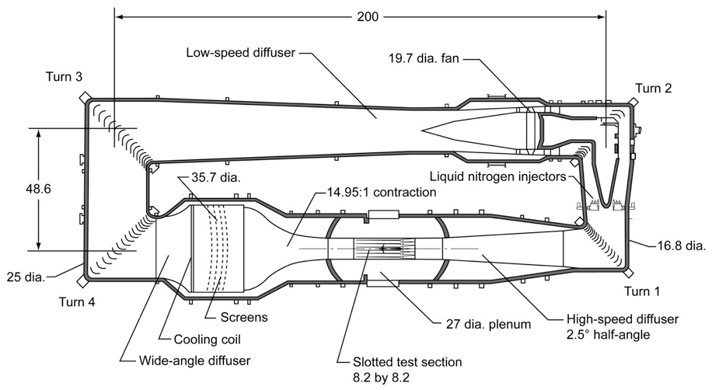
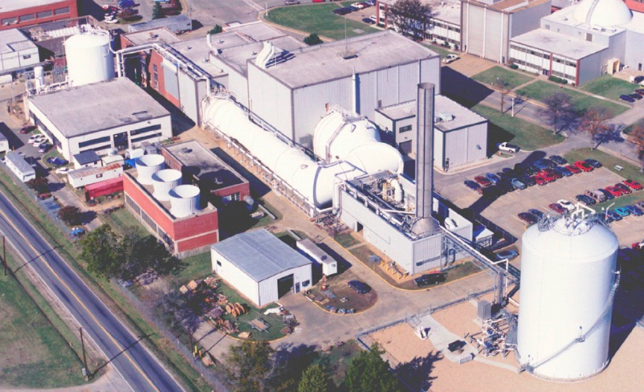
Experimental Tests
National Transonic Facility (NTF)
NTF
  Highest Re_{c} in the world
    146 million/ft at Mach 1
  Isolate Re_{c}, M, and q∞ effects
  Mach 0.2 - 1.2
  Air, mixed mode or nitrogen operation
  T_{t}: -250℉ to 120℉
  P_{t}: 15 to 125 psia
  Fan driven/closed circuit
  8.2 x 8.2 ft test section
    Slotted floor/ceiling

Slide 10
Experimental Tests
NTF 197 Test Conditions and Corrections
Force and moment, surface pressure, model deformation, surface flow visualization, wing bending moment and Kulite data obtained
Test Conditions
  M∞ = 0.7 to 0.87
  Re_{c} = 5, 19.8, 30 million
    Aeroelastic step at Re_{c} = 19.8 million
  α = -3 °to +12°for Re_{c} = 5 million
  α = -3°to +6°for Re_{c} = 19.8 and 30 million
  T_{t} = -250℉ up to 120℉
  Five configurations tested
    Wing/Body (WB), Wing/Body/Pylon/Nacelle (WBPN), Wing/Body/Tail=0°(WBT0), Wing/Body/Tail=+2°(WBT+2), Wing/Body/Tail=-2°(WBT-2)
Corrections Applied
  flow angularity, model blockage, wake blockage, tunnel buoyancy, and lift interference
Notes:
The reduced angle-of-attack range at the higher Reynolds number was required such that critical model stress levels would not be exceeded.

Slide 11
Experimental Tests
NTF 215 Test Conditions and Corrections
The purpose of this test was to obtain data to demonstrate improvements in the NTF and to provide long term test-to-test repeatability
Force and moment, surface pressure, and model deformation obtained
Test Conditions
  M∞ = 0.7 to 0.87
  Re_{c} = 5, 19.8, and 30 million
    Aeroelastic step at Re_{c} = 19.8 million
  α = -3° to +12°for Re_{c} = 5 million
  α = -3° to +6°for Re_{c} = 19.8 and 30 million
  T_{t} = -250℉ up to 120℉
  Three configurations
    Wing/Body (WB), Wing/Body/Pylon/Nacelle (WBPN), Wing/Body/Tail=0°(WBT0)
Corrections Applied
  flow angularity, model blockage, wake blockage, tunnel buoyancy, and lift interference
Notes:
The reduced angle-of-attack range at the higher Reynolds number was required such that critical model stress levels would not be exceeded.

Slide 12
Experimental Tests
NTF 229 Test Conditions and Corrections
The purpose of this test was to obtain data to provide long term test-to-test repeatability
Force and moment, surface pressure, and model deformation obtained
Test Conditions
  M∞ = 0.7 to 0.87
  Re_{c} = 5, 19.8, and 30 million
    Aeroelastic step at Re_{c} = 19.8 million
  α = -2° to +12°for Re_{c} = 5 million
  α = -2° to +6°for Re_{c} = 19.8 and 30 million
  T_{t} = -250℉ up to 120℉
  Three configurations
    Wing/Body (WB), Wing/Body/Tail=0°(WBT0)
Corrections Applied
  flow angularity, model blockage, wake blockage, tunnel buoyancy, and lift interference
Notes:
The reduced angle-of-attack range at the higher Reynolds number was required such that critical model stress levels would not be exceeded.

Slide 13
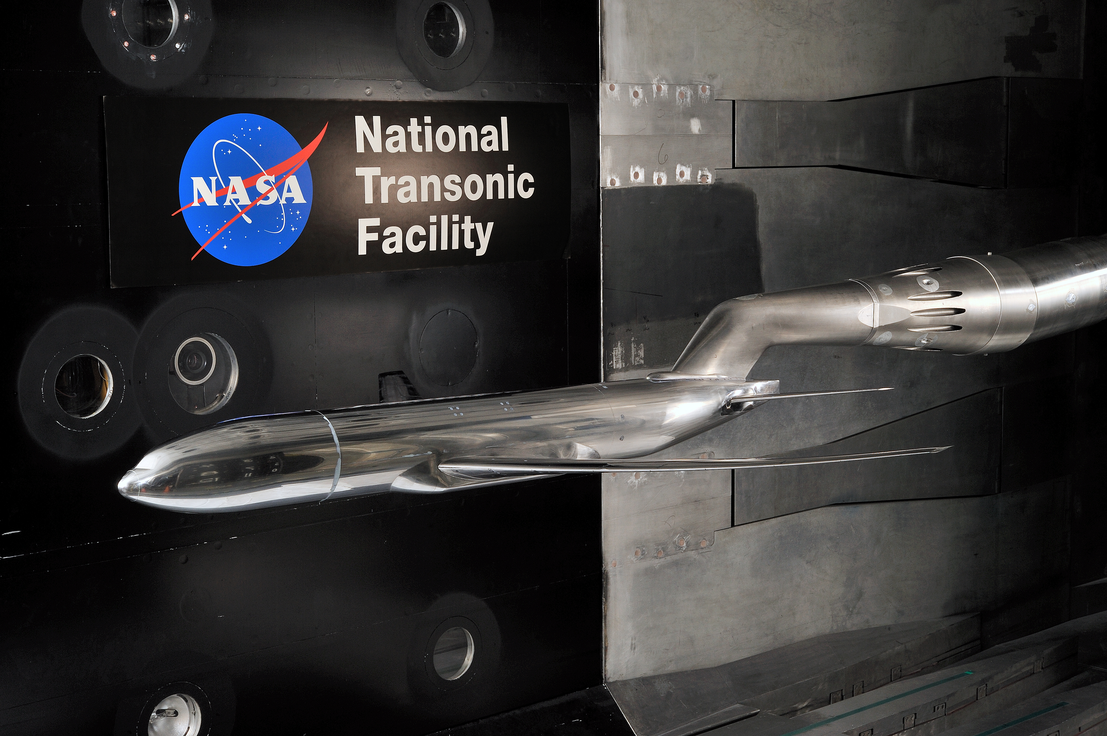
Experimental Tests
CRM mounted in the NTF for NTF 197

Slide 14
Results & Discussion
NTF 197 Reynolds Number Effects
WB, M∞ = 0.85
Increase in Re_{c} gives an increase in C_{L}, decrease in C_{D} and an increase in nose down pitching moment

Slide 15
Results & Discussion
NTF 197 and NTF 215 Test-to-Test Data Repeatability
WB, M∞ = 0.85, Re_{c} = 19.8x10⁶
ΔC_{L}
C_{L}
ΔC_{D}
C_{D}
Notes:
Solid line indicates 2-sigma limits based on the residual data.

Slide 16
Results & Discussion
NTF 197 and NTF 215 Test-to-Test Data Repeatability
WB, M∞ = 0.85, Re_{c} = 30x10⁶
ΔC_{L}
C_{L}
ΔC_{D}
C_{D}
Notes:
Solid line indicates 2-sigma limits based on the residual data.

Slide 17
Results & Discussion
NTF 197 and NTF 215 Test-to-Test Data Repeatability
WBT0, M∞ = 0.85, Re_{c} = 19.8x10⁶, high q∞
ΔC_{L}
C_{L}
ΔC_{D}
C_{D}

Slide 18








Results & Discussion
NTF 197, NTF 215, and NTF 229 Test-to-Test Data Repeatability
WB, M∞ = 0.7, Re_{c} = 30x10⁶
2
₁₀-3
0.7
ΔC_{L}
1
C_{L}
0.6
C_{L}
C_{L}
0
0.5
-1
0.4
-2
0.3
2
₁₀-4
0.03
1
0.025
C_{D}
ΔC_{D}
C_{D}
C_{D}
0
-1
0.02
-2
0.015

Slide 19
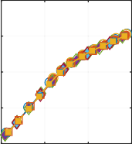

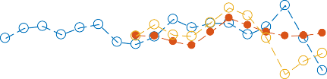




Results & Discussion
NTF 197, NTF 215, and NTF 229 Test-to-Test Data Repeatability
WB, M∞ = 0.85, Re_{c} = 30x10⁶
4
₁₀-3
0.8
ΔC_{L}
2
C_{L}
0.7
C_{L}
C_{L}
0
0.6
-2
0.5
-4
0.4
1
₁₀-3
0.06
0.5
0.05
C_{D}
C_{D}
C 0.04
ΔC_{D}
0
D
0.03
-0.5
0.02
-1
0.01

Slide 20
Results & Discussion
NTF 197, NTF 215, and NTF 229 Test-to-Test Data Repeatability
WB, M∞ = 0.85, Re_{c} = 30x10⁶
4
₁₀-3
0.8
ΔC_{L}
2
C_{L}
0.7
C_{L}
C_{L}
0
0.6
-2
0.5
-4
0.4
1
₁₀-3
0.06
0.5
0.05
C_{D}
C_{D}
C 0.04
ΔC_{D}
0
D
0.03
-0.5
0.02
-1
0.01

Slide 21
Outline
Origins
Experimental Tests
  National Transonic Facility
  Ames 11-Ft Wind Tunnel
  European Transonic Windtunnel
CRM Derivatives
CRM-HL
  Ecosystem overview
  Design
  Experimental tests – current and future
Concluding Remarks

Slide 22
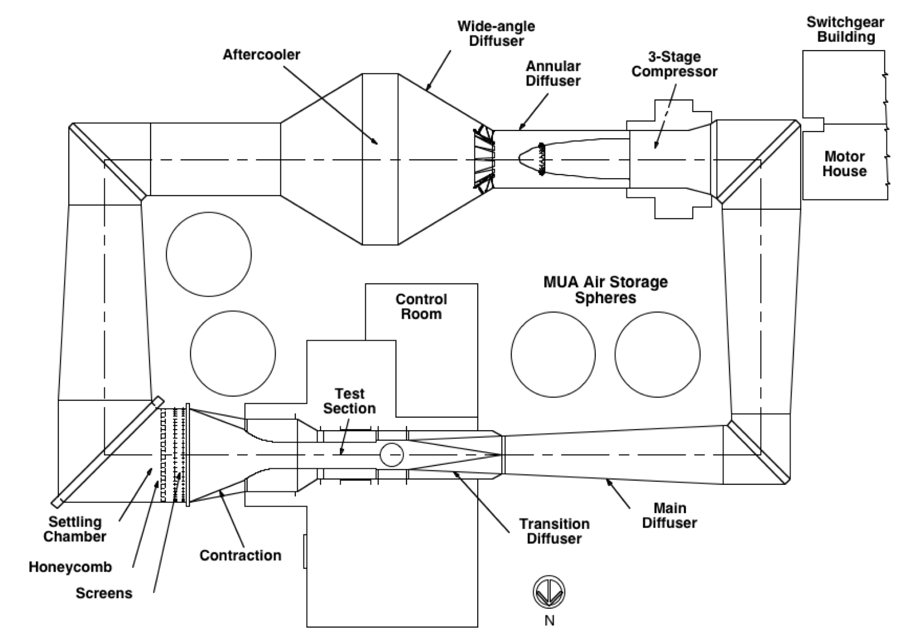
Experimental Tests
Ames 11-Foot Transonic Wind Tunnel Facility
Ames 11-Ft Wind Tunnel
  One section of the UPWT
    Two supersonic legs share a common 11-stage axial-flow compressor and aftercooler drive leg.
  Driven by a three-stage axial-flow compressor
  Closed circuit, variable-pressure, continuous operation
  11 x 11 ft test section
    All four walls slotted

Slide 23
Experimental Tests
Ames 11-Ft Test 216 Conditions and Corrections
Force and moment, surface pressure, and surface flow visualization data for comparison to the NTF data
Limited PSP and Flow Imaging Skin Friction (FISF) data
Test Conditions
  M∞ = 0.7 to 0.87
  Re_{c} = 5 million
  α = -3˚ to +12˚
  T_{t} = 100˚F
  Five configurations
    Wing/Body (WB), Wing/Body/Pylon/Nacelle (WBPN), Wing/Body/Tail = 0˚ (WBT0), Wing/Body/Tail = +2˚ (WBT+2), Wing/Body/Tail = -2˚ (WBT-2)
Corrections Applied
  flow angularity, tunnel buoyancy and lift interference

Slide 24
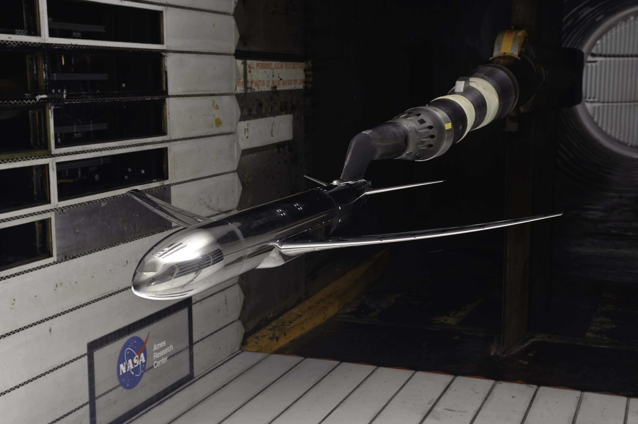
Experimental Tests
CRM Mounted in the Ames 11-Ft

Slide 25
Results & Discussion
NTF 197 and Ames 216 Tail effects
M∞ = 0.85, Re_{c} = 5x10⁶
Going from a -2°to a +2°tail setting gives an increase in C_{L}, a decrease in C_{D}, and an increase in nose down C_{m} for both wind tunnels

Slide 26
Outline
Origins
Experimental Tests
  National Transonic Facility
  Ames 11-Ft Wind Tunnel
  European Transonic Windtunnel
CRM Derivatives
CRM-HL
  Ecosystem overview
  Design
  Experimental tests – current and future
Concluding Remarks

Slide 27
Experimental Tests
European Transonic Windtunnel (ETW)
ETW
  Can be operated in closed and slotted wall configurations
  Isolate Re_{c}, M∞, and q∞ effects, similar to NTF
  Mach 0.15 – 1.35
  Only test gas is nitrogen
  T_{t}: 110K to 313K
  P_{t}: 110kPa to 450kPa
  Fan driven/closed circuit
  2.4m x 2m test section

Slide 28
Experimental Tests
ETW Test Conditions and Corrections
Force and moment, surface pressure, wing deformation and PIV data were obtained
Test Conditions
  M∞ = 0.25 to 0.87
    Focused on 0.7 and 0.85
  Re_{c} = 5, 19.8, 30 million
    Aeroelastic step at Re_{c} = 19.8 million
  α = -3˚ to +12˚ for Re_{c} = 5 million
  α = -3˚ to +6˚ for Re_{c} = 19.8 and 30 million
  T_{t} = -249˚F to 84˚F
  P_{t} = 44psia to 29psia
  Only WBT0 configuration was tested
Corrections Applied
  Corrected for wall interference based on the ETW experimental assessment established in the past

Slide 29
Experimental Tests
CRM Mounted in the ETW

Slide 30
Results & Discussion
NTF and ETW Test-to-Test Comparison
WBT0, M∞ = 0.85, Re_{c} = 5x10⁶
Notes:
NTF lift data are lower than the ETW data, NTF drag data are ~ three drag counts lower than the ETW data and NTF pitching moment data are lower nose down than the ETW data

Slide 31
Results & Discussion
NTF and ETW Test-to-Test Comparison
WBT0, M∞ = 0.85, Re_{c} = 30x10⁶

Slide 32
Outline
Origins
Experimental Tests
  National Transonic Facility
  Ames 11-Ft Wind Tunnel
  European Transonic Windtunnel
CRM Derivatives
CRM-HL
  Ecosystem overview
  Design
  Experimental tests – current and future
Concluding Remarks

Slide 33
CRM Derivatives
80% Scaled CRM Model
Installed in the JAXA 2m x 2m Transonic Wind Tunnel

Slide 34
CRM Derivatives
220% Scaled CRM Model (ONERA Large Reference Model)
Installed in the ONERA S1MA wind tunnel
Notes:
220% scale NASA CRM

Slide 35
CRM Derivatives
2.7% Scale CRM Semispan Model
Installed inverted in the Canadian NRC 5-Foot wind tunnel

Slide 36
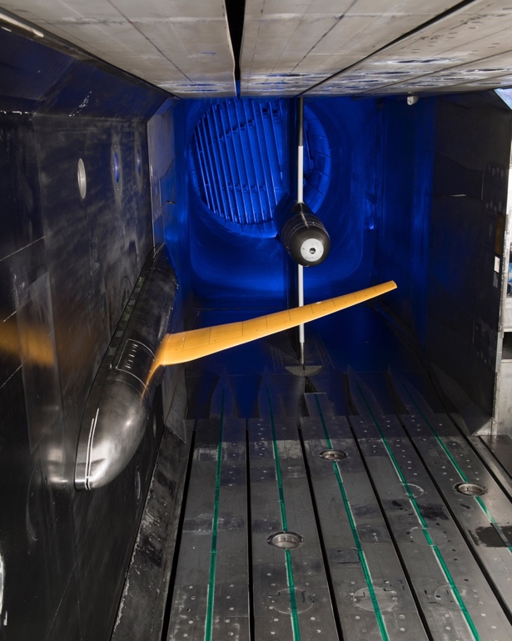
CRM Derivatives
5.2% Scale Semispan CRM-NLF Model
Installed in the NTF

Slide 37
NASA Common Research Model Derivatives
Many organizations worldwide have embraced the CRM geometry for both computational and experimental research
  Industry
  Academia
  Government agencies
Variations of the original CRM have been fabricated and tested in facilities all over the world
Further CRM-based collaborations and use of the configuration are wide and varied, including use as a basis for structural and aero/structural design optimization, – far beyond the initial expectations in 2007 when the concept was conceived

Slide 38
Outline
Introduction
Design and Fabrication
Experimental Tests
  National Transonic Facility
  Ames 11-Ft Wind Tunnel
  European Transonic Windtunnel
CRM Derivatives
CRM-HL
Concluding Remarks

Slide 39
Background
  Design, build, and test CRM-HL configuration(s) to:
  Generate high-quality wind tunnel data for use in CFD verification/validation studies and for method/model development efforts, primarily through open workshops involving the international aerospace community
  AIAA High Lift Prediction Workshops
Improve and utilize advanced WT test and measurement techniques
  build confidence that airplane characteristics are predicted for the right physical reasons, establish capability for US
  Support research activities in low-speed aerodynamic design, performance enhancement, noise reduction, and/or high lift system simplification
    slat/flap studies, flow control, etc.

Slide 40
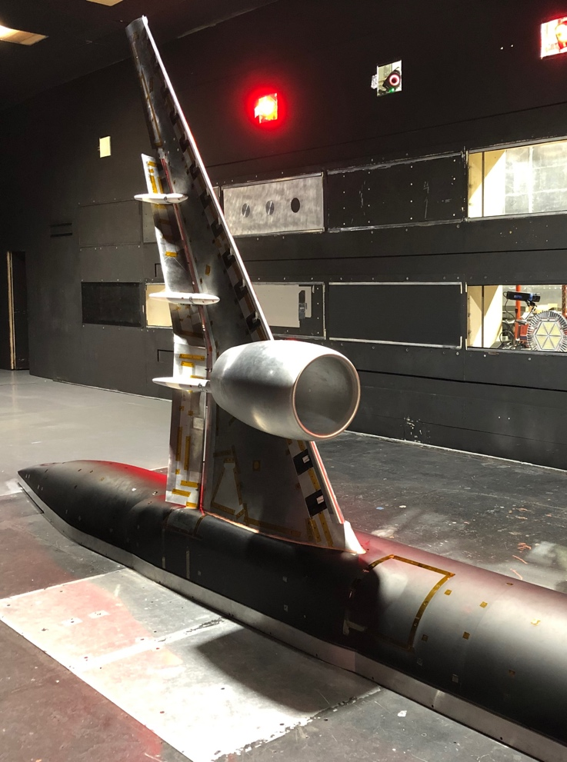
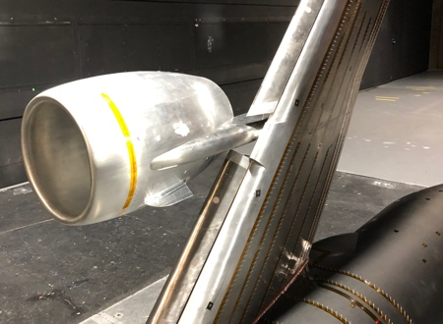
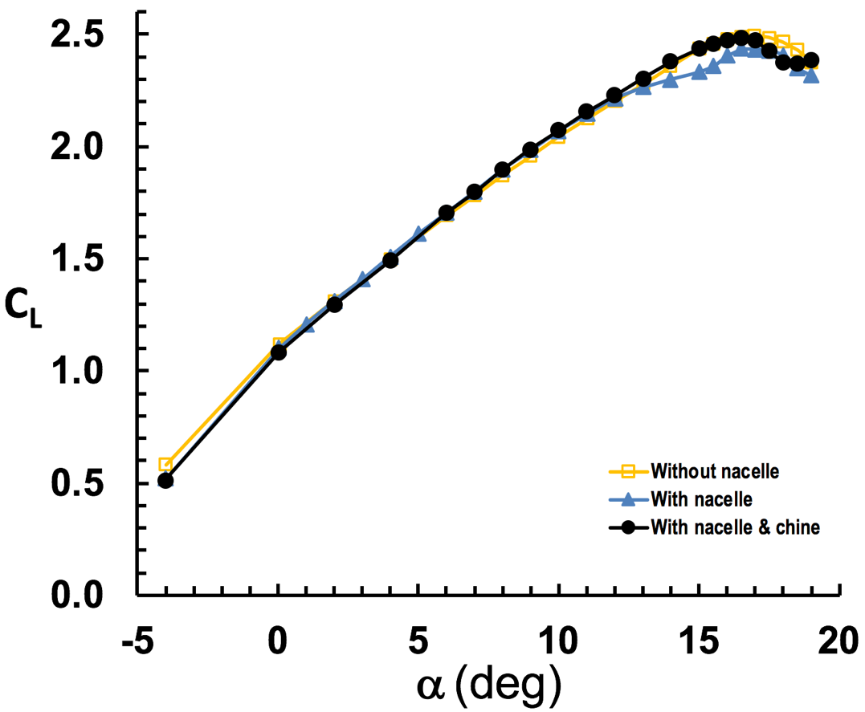
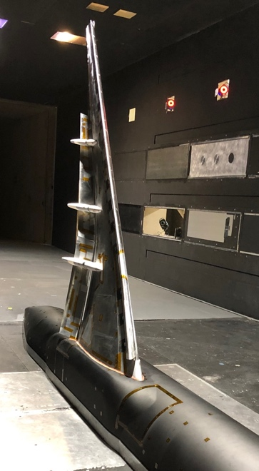
Semispan CRM-HL Test at LaRC 14x22
  Variant 1
  Variant 2
  Nacelle chine
  Variant 3
    Semispan (1/10th scale) CRM-HL tested at nominal landing configuration: 37° Fowler flaps and 30° slats
    M∞ = 0.2; Re_{C} = 3.27x10⁶
    Three variants of CRM-HL examined: (1) with nacelle, (2) with nacelle plus a chine, and (3) without nacelle
    A prestall lift performance degradation between α = 12° and 17° for the CRM-HL with nacelle was resolved with a properly placed nacelle chine.
    A good starting point for the rigging study at the QinetiQ 5M Wind Tunnel.

Slide 41
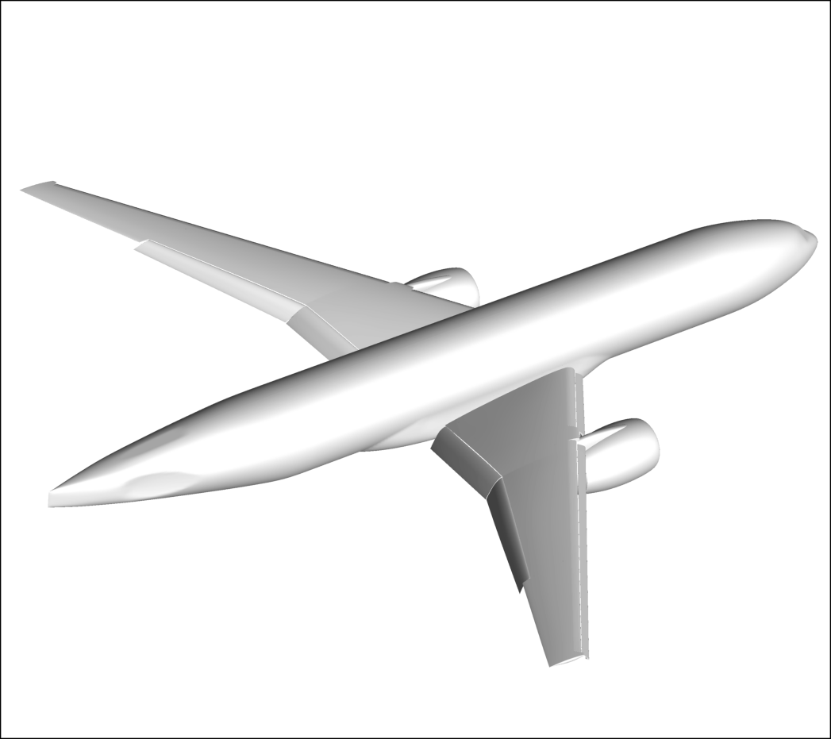
CRM-HL Ecosystem
Purpose:
Accelerate acceptance and utilization of advanced computational capabilities for low-speed, high-lift certification by analysis
Approach:
Precompetitive open R&D across borders to raise the water level together by benchmarking predictive methods
Benefit:
Open, community-wide data / workshops are key to development & broad confidence in capability in general, and best practices in particular

Slide 42
CRM-HL Objectives: Reference Configuration
Objective:
  Establish CRM-HL reference Takeoff and landing configurations that model representative high-lift flight physics over a range of flow conditions and Reynolds numbers.
Strategy
  Use 10% half model in QinetiQ to establish viable takeoff and landing configurations and understand positioning sensitivities around nominal positions.
  In subsequent tests, understand impacts of Reynolds number on reference configurations. If necessary, define a more aggressive High Reynolds reference configuration.
  Emphasis on force and moment, pressure and surface flow visualization data

Slide 43
CRM-HL Objectives: CFD Validation Data
Objective
  Gather data that will enable CFD validation and development for prediction of high-lift flow physics at flight Reynolds number.
Strategy
  Collect significant quantities of data relevant to CFD validation across multiple facilities and models, including surface flow visualization, as well as very near, near, and off body flow information
  Primary vehicle for this will be the 3.5m Q model, though data will be utilized for CFD validation from all models built and tested.

Slide 44
CRM-HL Objectives: Reynolds Number Effects
Objective:
  Develop understanding of Re # effects for relevant flow physics
  Determine which ones can be meaningfully investigated at lower than flight Re #
Strategy
  Use 5.2% half model in NTF to establish Re # trends from atmospheric to full cryogenic at pressure – bridges data near flight Re # to data at lower Re # achievable in tunnels with more options for data gathering (and enhanced productivity)
  Use half model data in the lower Re # facilities to connect across model and facility differences (Note: could also use Q model in NTF at mild cryo for part of this story)
  Can expand to analogous full model Re # exercise if required for relevant flow physics
  Emphasis on force and moment, pressure and surface flow visualization data

Slide 45
CRM-HL Objectives: Half (and Full) Model Effects
Objective:
  Understand the differences between full & half span configurations tunnel configurations
  Develop preferred method for half model testing to minimize these differences
  Develop better understanding of full tare and interference (for strut vs sting vs ???)
Strategy
  Test comparable models in full and half span configurations at the same facility
    Both the 6.0% QinetiQ model and the 2.7% NTF model will be capable of this
    Start with Q model / tunnel, expand to NTF if Re # deemed to be dominant influence
  Determine how we can potentially exploit half models to increase Re #, increase geometric fidelity, increase measurement options (through scale or optical access), etc.
  Design strut and sting mount capability into 6.0% model and test for differences

Slide 46
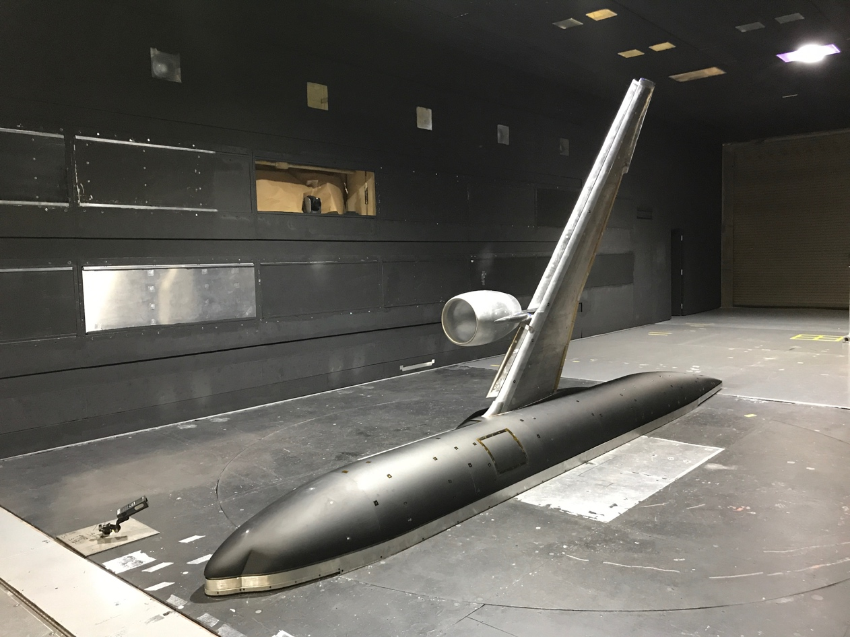
CRM-HL Ecosystem
Wing Planform & Layout
  Based on the 10% CRM-HL model built for 14x22
    Built - tested in NASA Langley 14x22 in 2018
    Limited “baseline” CRM-HL testing as primary objective associated with AFC
    Tested in Q 5mWT in 4th Qtr 2019
    Used high speed CRM as basis for design
    High lift system representative of devices on modern airliners
    Maintained as much realism in the constraints of the slat and WUSS surfaces as possible.
Fuselage
  Existing 5.2% and 2.7% Model
Mounting Hardware
  Sidewall mount
  Vertical blade mount
Other Existing Hardware
  Horizontal tail
  Balance
  ESP modules

Slide 47
NASA Contributions to CRM-HL Ecosystem
NASA 5.2% SS cryo (NTF/ETW/others)
  Reynolds number effect
  Model deformation measurements
  Kulites installed across the wing
  Wind tunnel wall effects
  Innovative measurements, additive manufacturing
NASA 2.7% SS/FS cryo (NTF/ETW/others)
  Semispan/Fullspan model effects
  Model deformation measurements
  Kulites installed across the wings
  Innovative measurements, additive manufacturing

Slide 48
Data Requirements – Types and Locations
Forces and moments
Surface pressures
(static, dynamic, paint)
Surface flow visualization
Off body velocity
measurements
  Very near surface
  (e.g. boundary layer)
  Near surface
  (e.g. bracket wakes over wing)
  Away from surface
  (e.g. wakes behind wing)
from AIAA 2019 AVIATION paper by M. Koklu

Slide 49

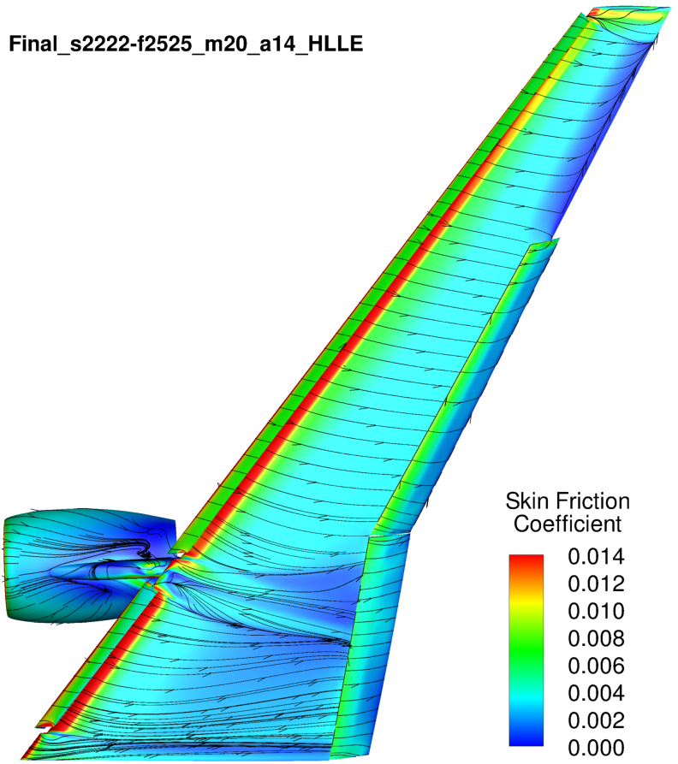
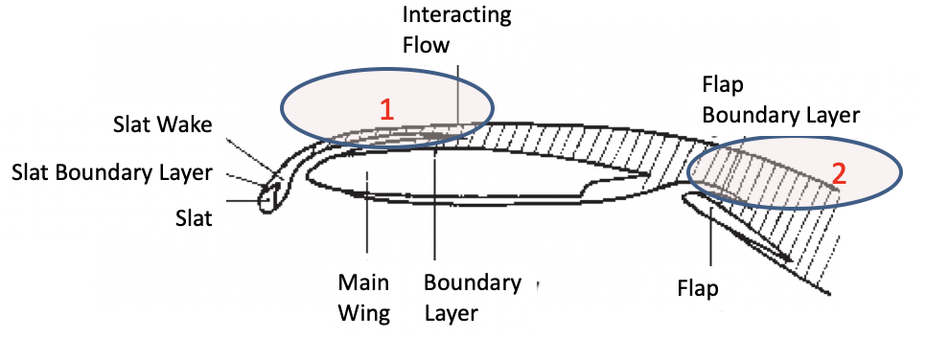
Advanced Measurement Needs: Off-body Locations
“the right answer for the right reasons”
Off body velocity measurements
(very near surface – e.g. boundary layer)
Off body velocity measurements
(near surface – e.g. bracket wakes over wing)
Off body velocity measurements
(away from surface – e.g. wakes behind wing)
High AoA

Slide 50
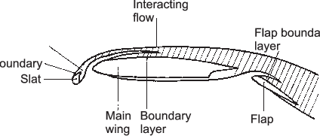
Advanced Measurement Needs: Off-body Locations
“the right answer for the right reasons”
Off body velocity measurements
(very near surface – e.g. boundary layer)
Off body velocity measurements
(near surface – e.g. bracket wakes over wing)
Off body velocity measurements
(away from surface – e.g. wakes behind wing)
Low AoA
Interacting
Flow
2
Flap
Boundary Layer
Slat Wake
Slat Boundary Layer
Slat
1
Main Boundary
Wing Layer
Flap

Slide 51
CQbA Integrated Roadmap
Update AIAA SciTech 2020
CY
2018 | 2019 | 2020 | 2021 | 2022 | 2023 | 2024 | 2025
CQbA = Certification Qualification by Analysis
MoC = Means of Compliance
CRM = Common Research Model
HL = High Lift
HS = High Speed
SS = semi-span
FS = full-span
HLPW = High Lift Prediction Workshop
JFPW = Juncture Flow Prediction Workshop
NRA = NASA Research Announcement
CP = Challenge Problem
UW = University of Washington
SBSE = Smooth Body Separation Experiment
NASA
Project
Grand Challenge Problem
High-Lift Tools
Application Ready
1st MoC
Vapp/CLmax
Integration
Formulated
Defined
CP #1
Released
CP #2
Released
AIAA CFD2030 Integration Committee
AIAA CQbA Community of Interest
CQbA Recommended Practices
TTT/RCA
CQbA NRA
1st Draft
CQbA Development Roadmap
Prediction Workshops
Data Fusion/Analytics/UQ (TBD)
JFPW?
HLPW-4
HLPW-5
HLPW-6
TTT/RCA
Computational Tools & Technology
Technology
Downselect:
high-lift
numerics/physics
Tool(s)
Tech Ready
high-lift
Physics, Numerics, Efficiency
formulate/implement
validate
Integrated Test & Evaluation
CRM-HL-SS #2* (cryo)
Airplane
proprietary by organization
CRM-HL-FS*
(Q)
CRM-HL-FS* (cryo)
CRM-HL-SS (14x22)
CRM-HL-SS (Q)
CRM-HL-SS
(14x22, Acoustics)
CRM-HL-SS* (cryo)
CRM-HL-SS 2.7%* (cryo)
NTF
CRM
Cryo NTF/ETW
Pressurized Q5m, F1
Atm 14x22
ETW
Unit
NASA Juncture Flow Model (JF)
Boeing Speed Bump (SBSE)
*
Q5m
*
*
*
14x22
TTT/IM
Experimental Tools & Technology
PIV
TDT
Advanced Measurements
Advanced Manufacturing (AM)
Rapid Testing (Active Systems)
PSP / FLEET / RS
PSP (Dynamic)
AETC CC
0.3m
RCA
UW 3x3
SMARCA: 787trans cryo (ETW)
SMARCA:
787trans cryo*
TBD
*proposed

Slide 52







CRM-HL Ecosystem Development Plan
Update AIAA SciTech 2020
NASA 10% SS (14x22/Q, 1atm / 3atm)
Confirm CRM-HL design features
Data for reference configurations
NASA research (AFC, noise)
Tie in to NTF-derived Re # trend data
NASA 5.2% SS (NTF/ETW/others, cryo)
Primary model for Re # trends
SS/FS model issues deemed Re # dependent
Wall effects
NASA research (Flow measurements, AM, others)
NASA 2.7% SS/FS (NTF/ETW/others, cryo)
SS/FS model issues deemed Re # dependent
NASA research (Flow measurements, AM, others)
Boeing 6.0% SS/FS (Q/F1/others, 3atm)
Configuration variation data
SS/FS model issues
Tie in to NTF-derived Re # trend data
Mounting system effects (T&I)
Wall effects (collaboration with ONERA)
Configuration-level PIV data
Boeing/UK 2.1% SS (Academic, 1atm)
Flow measurement technology development
Platform for UK aerodynamic research
ONERA 5.1% FS (F1/Q, 3.85atm)
Wall effects (collaboration with QinetiQ)
Exploit unique data collection opportunities
Tunnel Standard Model
2019 |  |  |  |  | 2020 |  |  |  | 2021 |  |  |  | 2022 |  |  |  | 2023
1Q | 2Q | 3Q | 4Q | 1Q | 2Q | 3Q | 4Q | 1Q | 2Q | 3Q | 4Q | 1Q | 2Q | 3Q | 4Q | 1Q | 2Q | 3Q | 4Q
MODEL
CY
NASA 10% SS 1atm NASA 5.2% SS cryo NASA 2.7% FS cryo NASA 2.7% SS cryo
✓
✓
CRM = Common Research Model
HL = High Lift
SS = Semi-Span
FS = Full Span
atm = Atmosphere
*
Boeing 6.0% (3.5m) FS 3atm
Boeing/UK 2.1% (1.2m) SS 1atm
NTF ETW
Q5m 14x22 TDT
ONERA F1 DNW-NSB
University
ONERA 5.1% (3.0m) FS 3atm
1. Reference Configuration
2. Optimization/Sensitivity Data
3. Reynolds Number Effects
Design/Fab
4. WT Modeling Effects
Test Objective
5. Flow Physics CFD Validation Data
Proposed
6. Ice Effects
7. Acoustics
8. Trailing Wake
*

Slide 53
Concluding Remarks
High Speed CRM
  CRM created to provide modern/industry-relevant data and open/public geometries
  Same model tested in three different facilities worldwide
  Extensive database has been developed for both computational and experimental research
  CRM derivatives continue to be developed and tested
CRM-HL
  Collaboration has started using CRM-HL as precompetitive approach/mechanism for sharing
  Draft 5 year roadmap has been developed – it is a living document
  Initial wind tunnel model and tests completed
  Next set of model and test requirements being finalized
  The value is in partnering and leveraging investment for mutual benefit
    Opportunities in CFD Tools/Tech, Test Tools/Technology, and advance airplane technology
Notes:
The NTF was chosen for testing transonic laminar flow concepts, as it enables testing scaled models at or near flight Reynolds numbers to better assess the extent of laminar flow.
This result is being investigated further, but may be due to a greater extent of laminar flow at the lower Reynolds numbers, which in turn could cause a thinner boundary layer at the trailing edge of the upper surface than the higher Reynolds numbers.

Slide 54
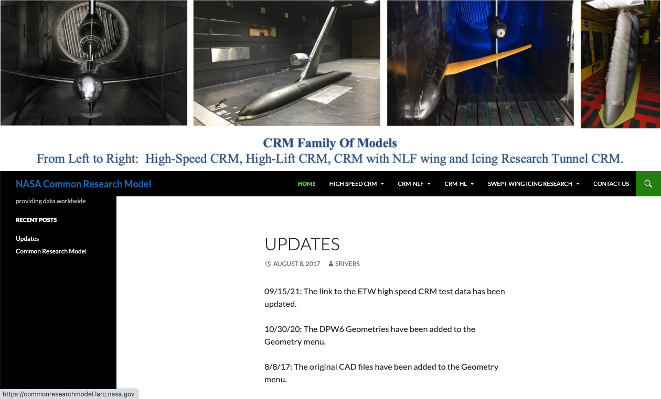
CRM website
http://commonresearchmodel.larc.nasa.gov/

