Slide 1

Open Science for Life in Space
Sylvain V. Costes, Ph.D.
Open Sciences Data Repository Project Manager
Biological and Physical Sciences Division
Space Biosciences Research Branch Chief
arc-dl-osdr-data@mail.nasa.gov
Notes:
Welcome
Name
HRP-IWS

Slide 2
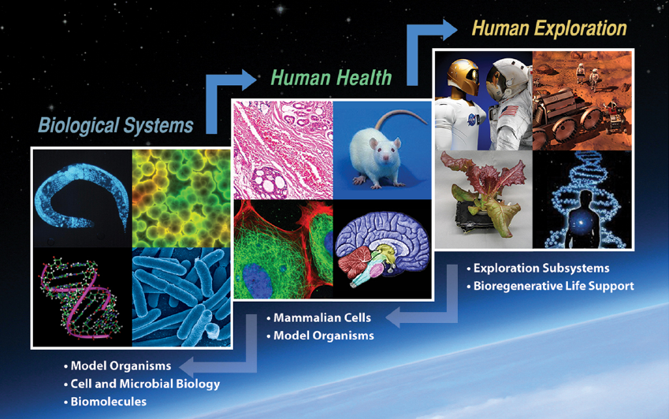
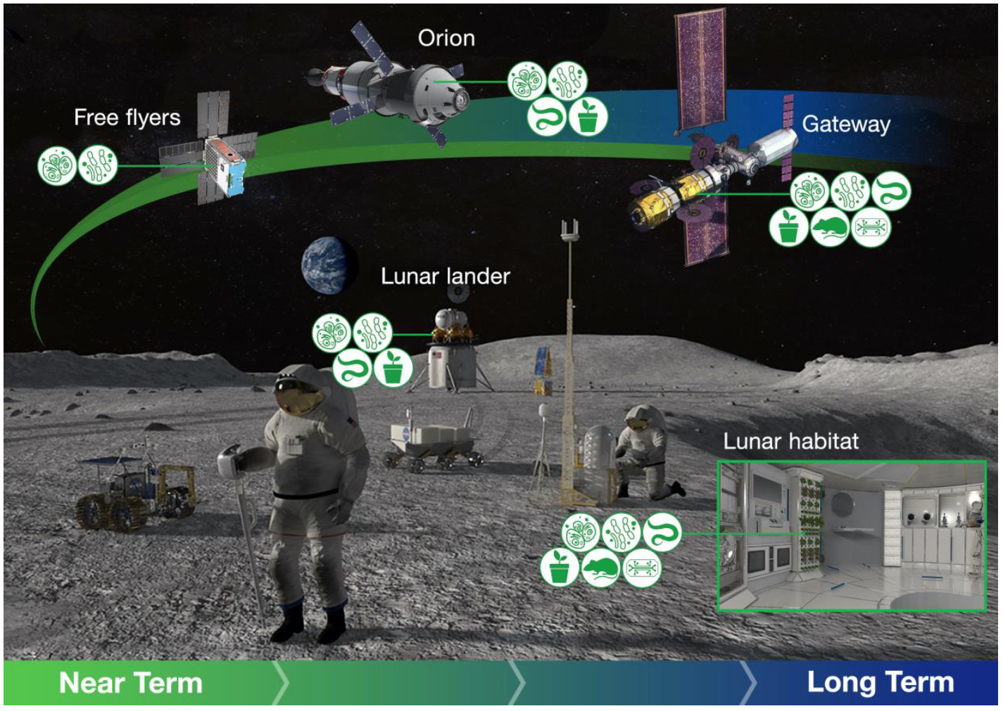
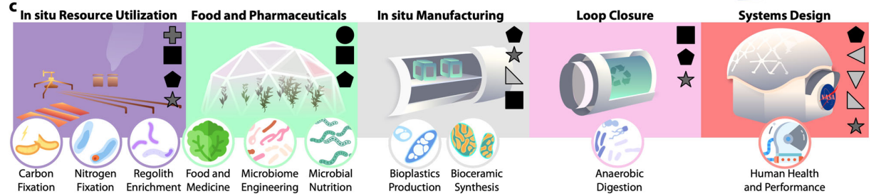
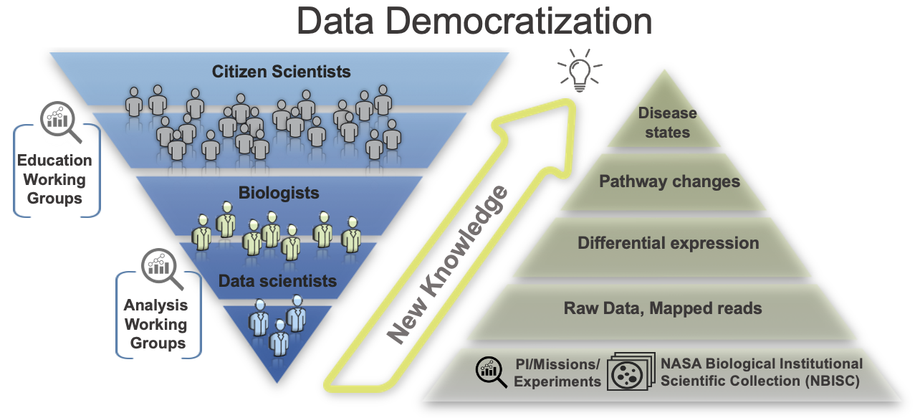
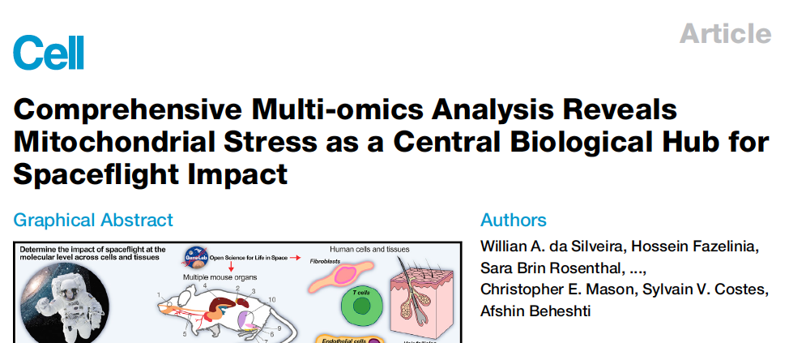
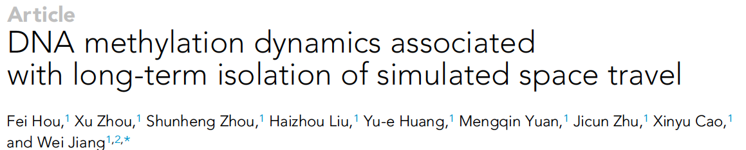

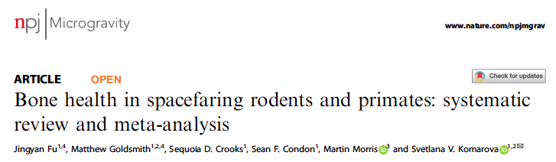
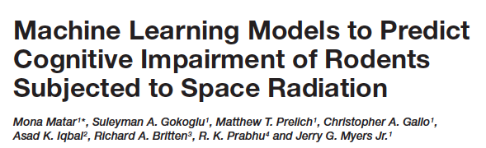
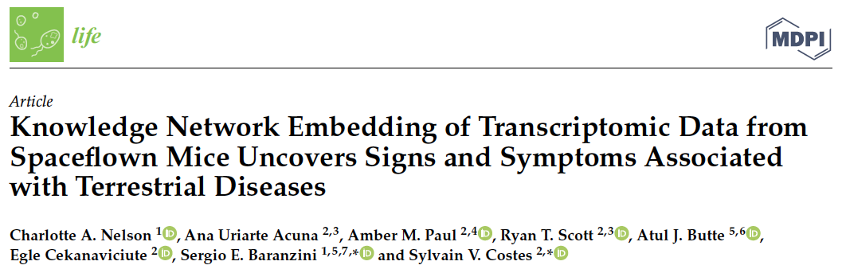

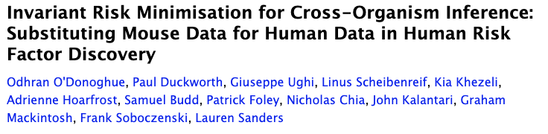

Space Biology and Data Sharing will enable human-based Lunar and Mars Missions
Support for Human Health & Risk Modeling
Novel Ecosystem Development
Involve the World in Spaceflight
Knowledge Discovery

Slide 3
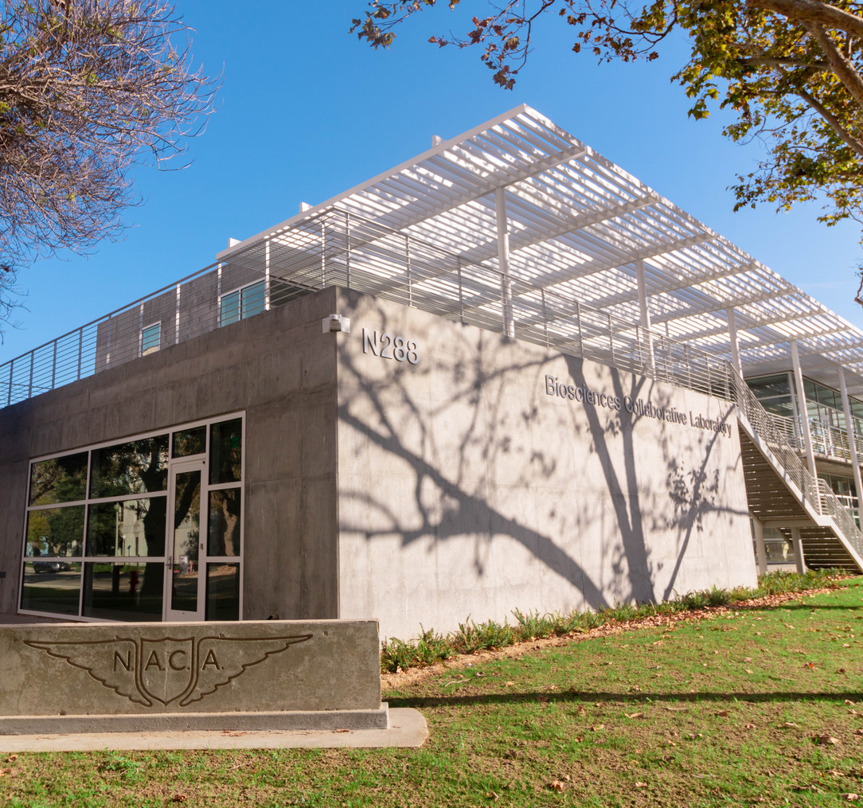
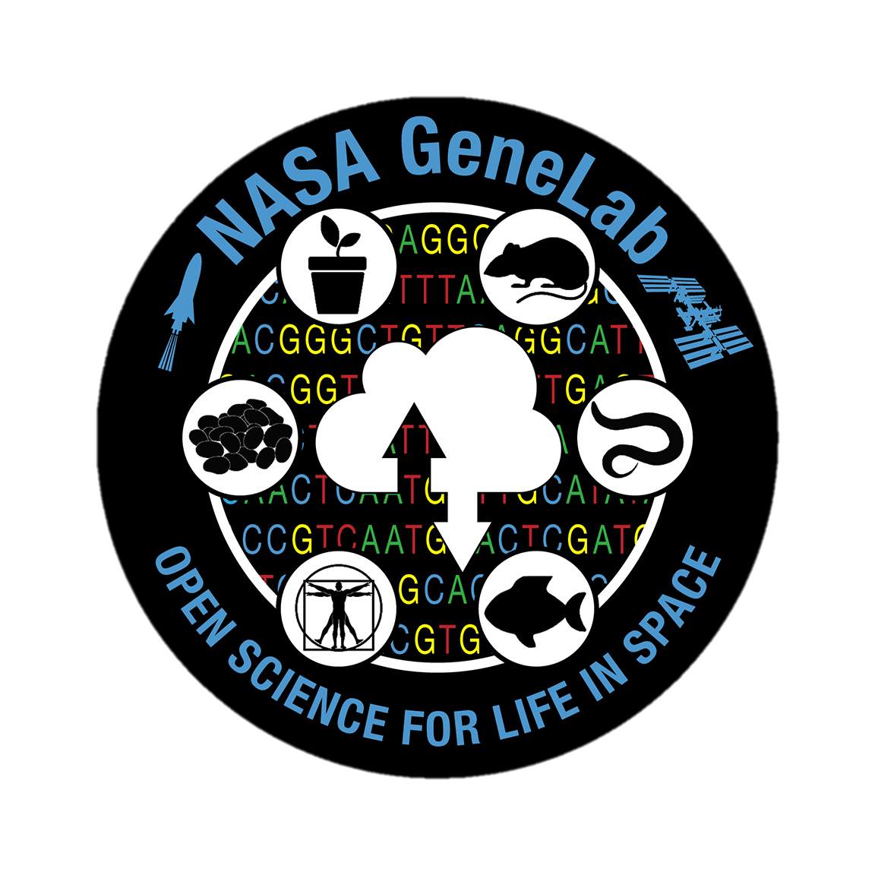
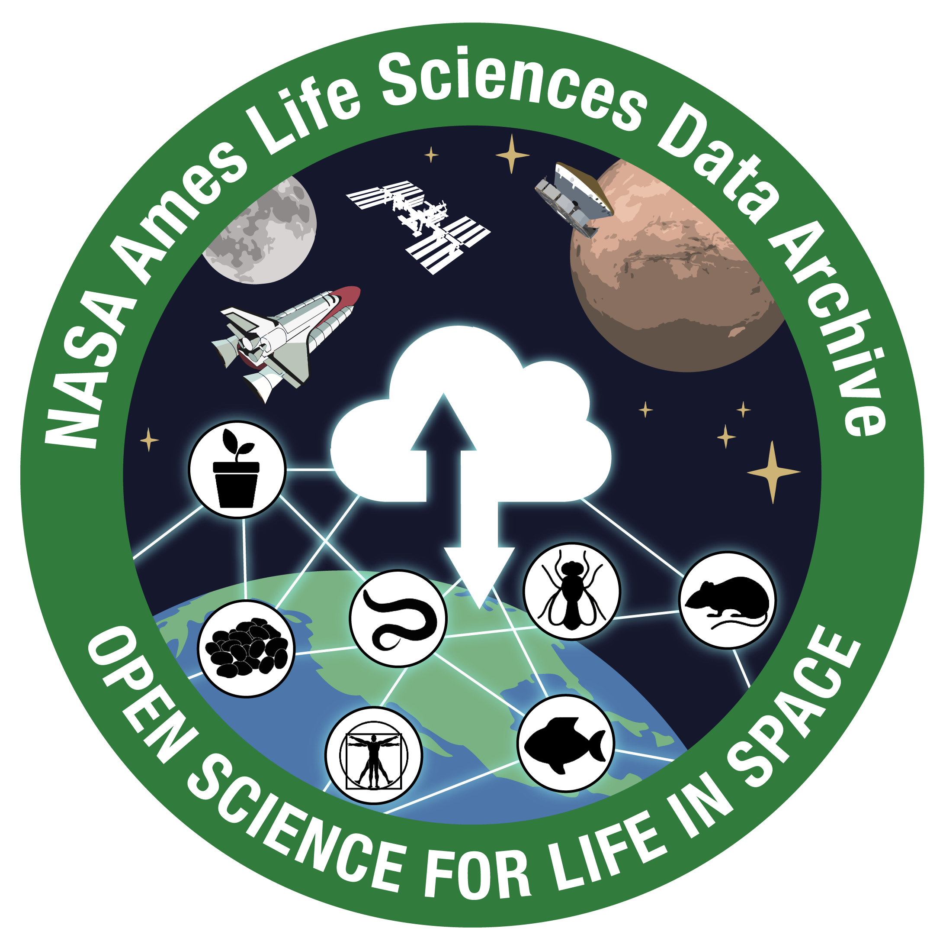
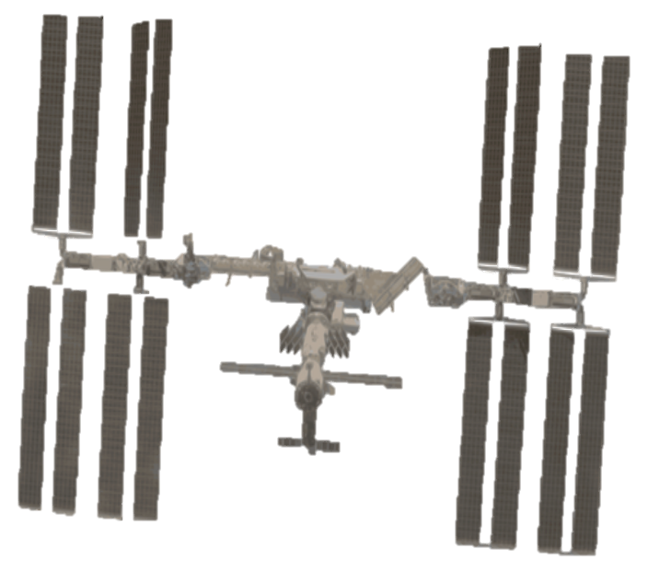
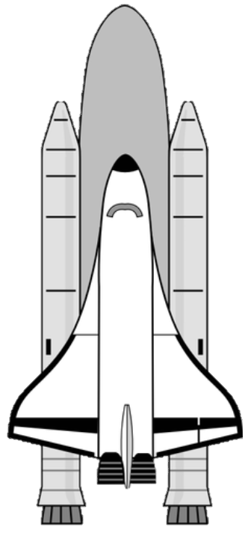
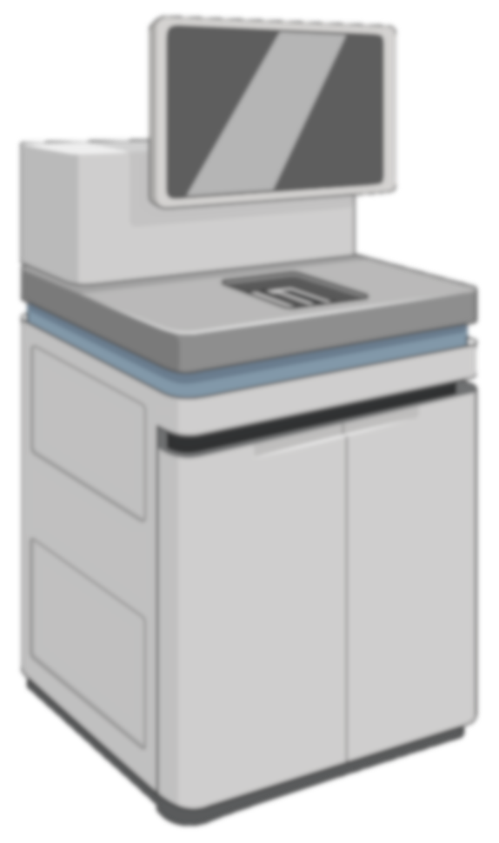
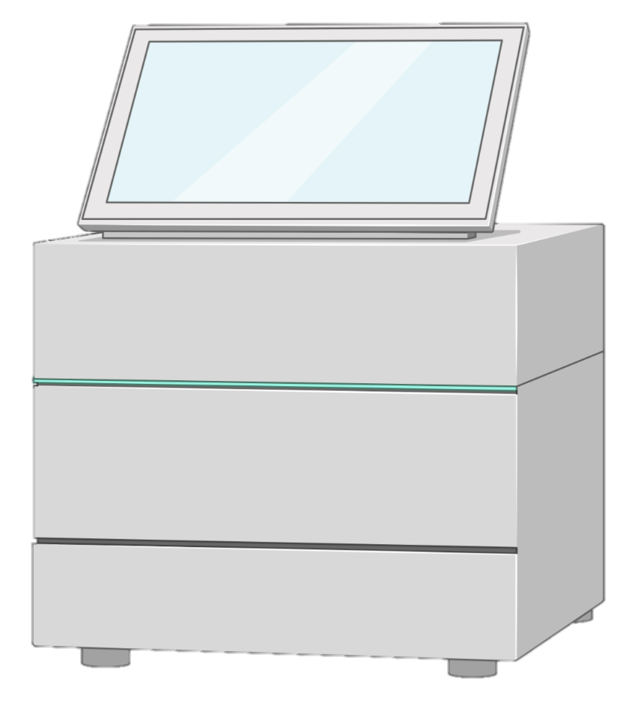
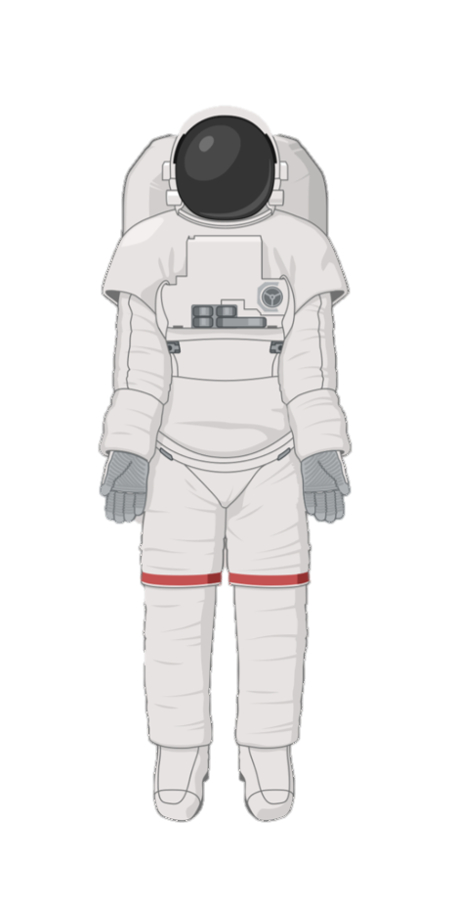
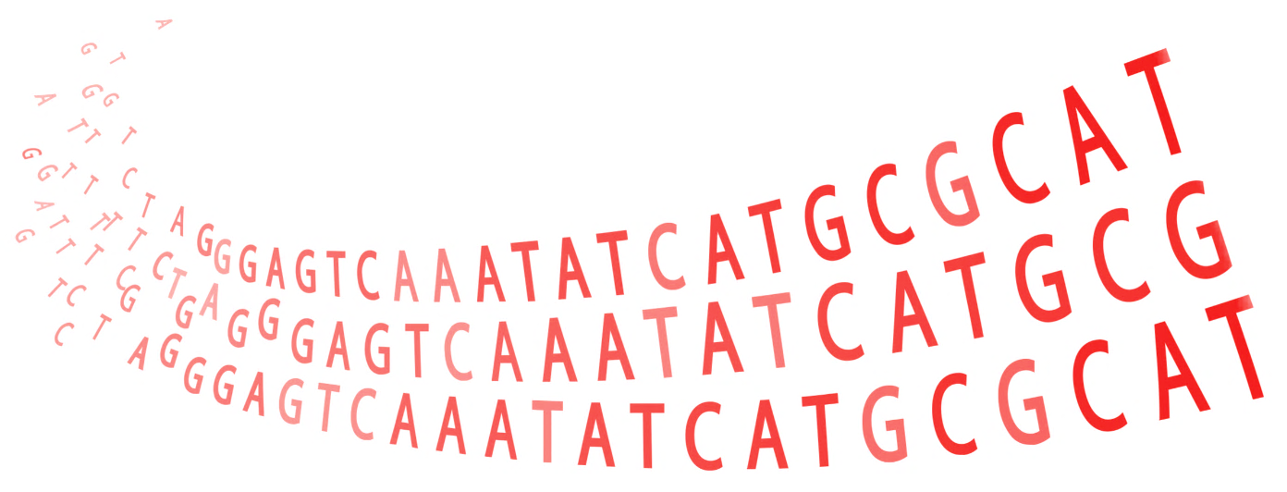
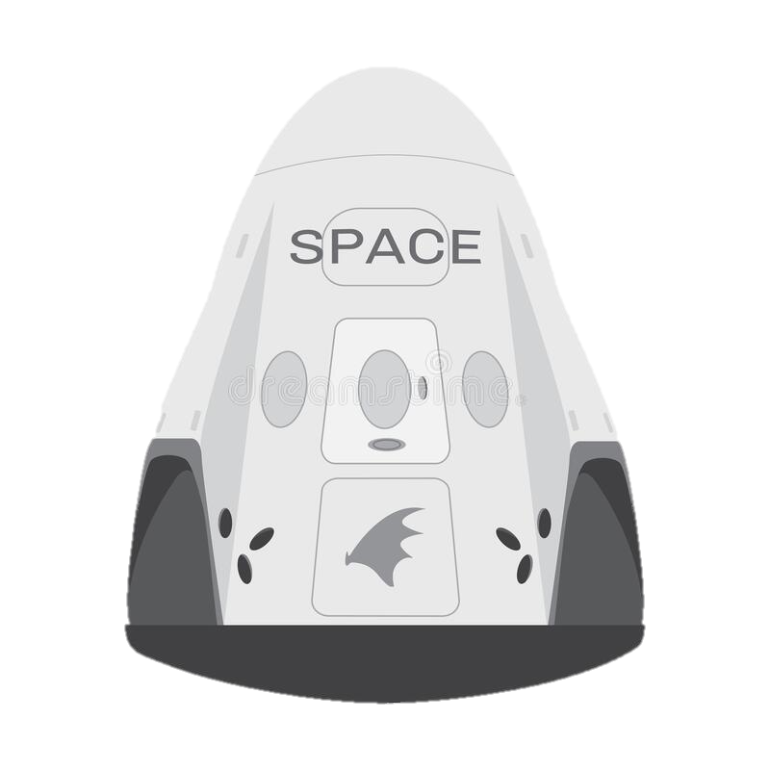
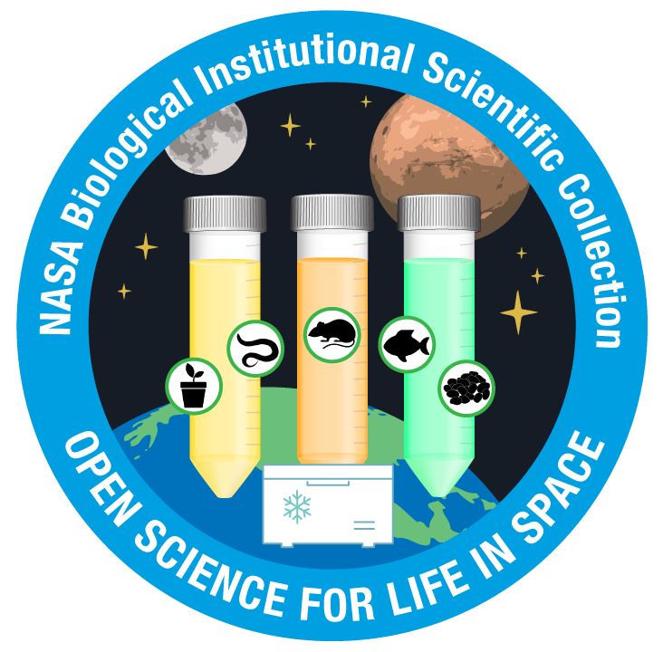

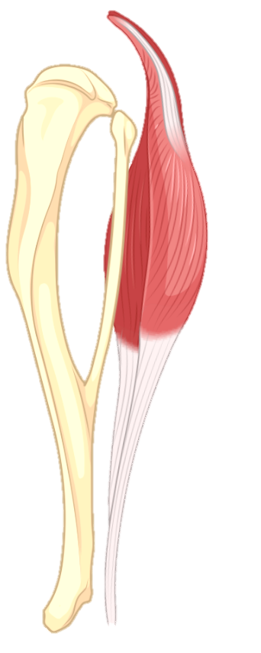
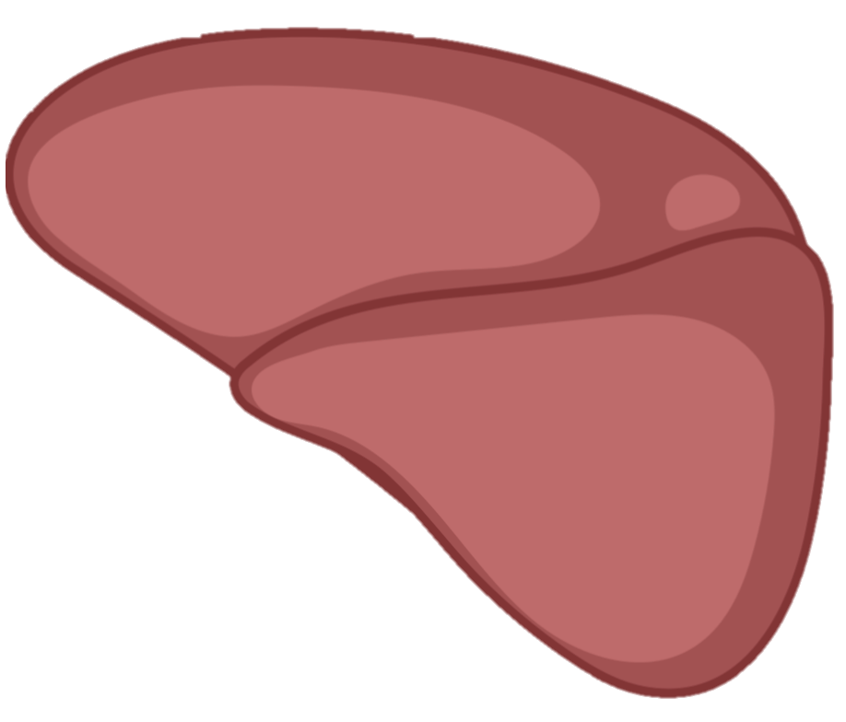
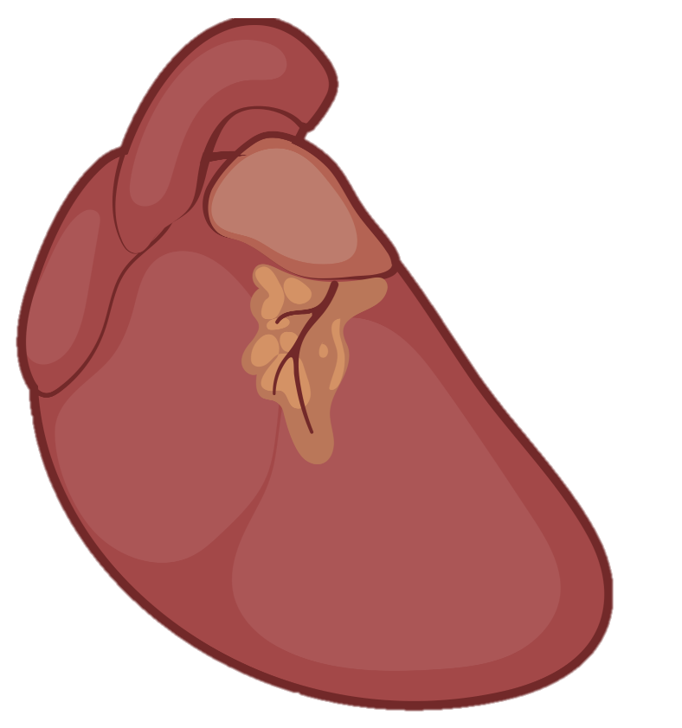
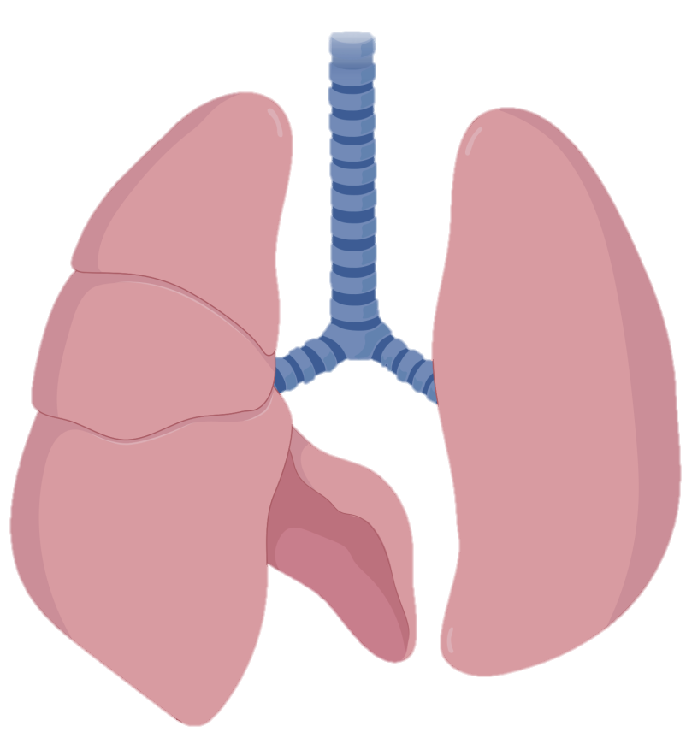
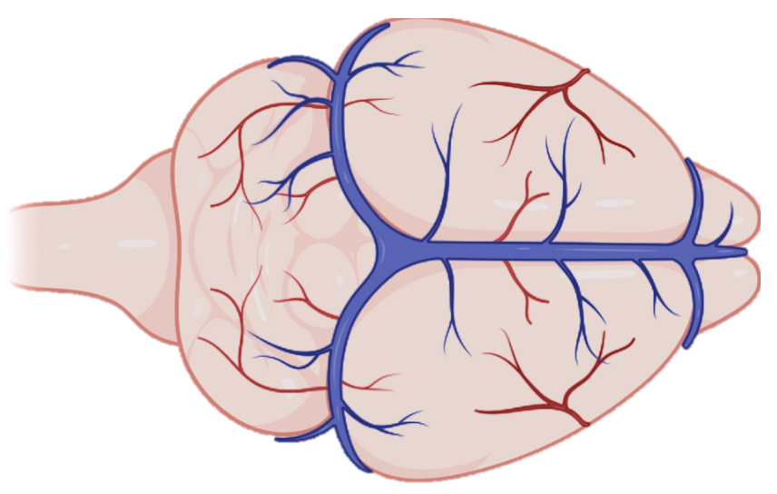
NASA BPS Open Science
Ames Life Sciences Data Archive (ALSDA)
GeneLab (GL)
Collects and curates physiological, mission, and imaging data
Collects and curates omics data from space-relevant samples
NASA Biological Institutional Scientific Collection (NBISC)
Collection of biospecimens from non-human subjects exposed to spaceflight and associated ground studies
Developed and Managed by Space Biosciences at NASA Ames Research Center

Slide 4
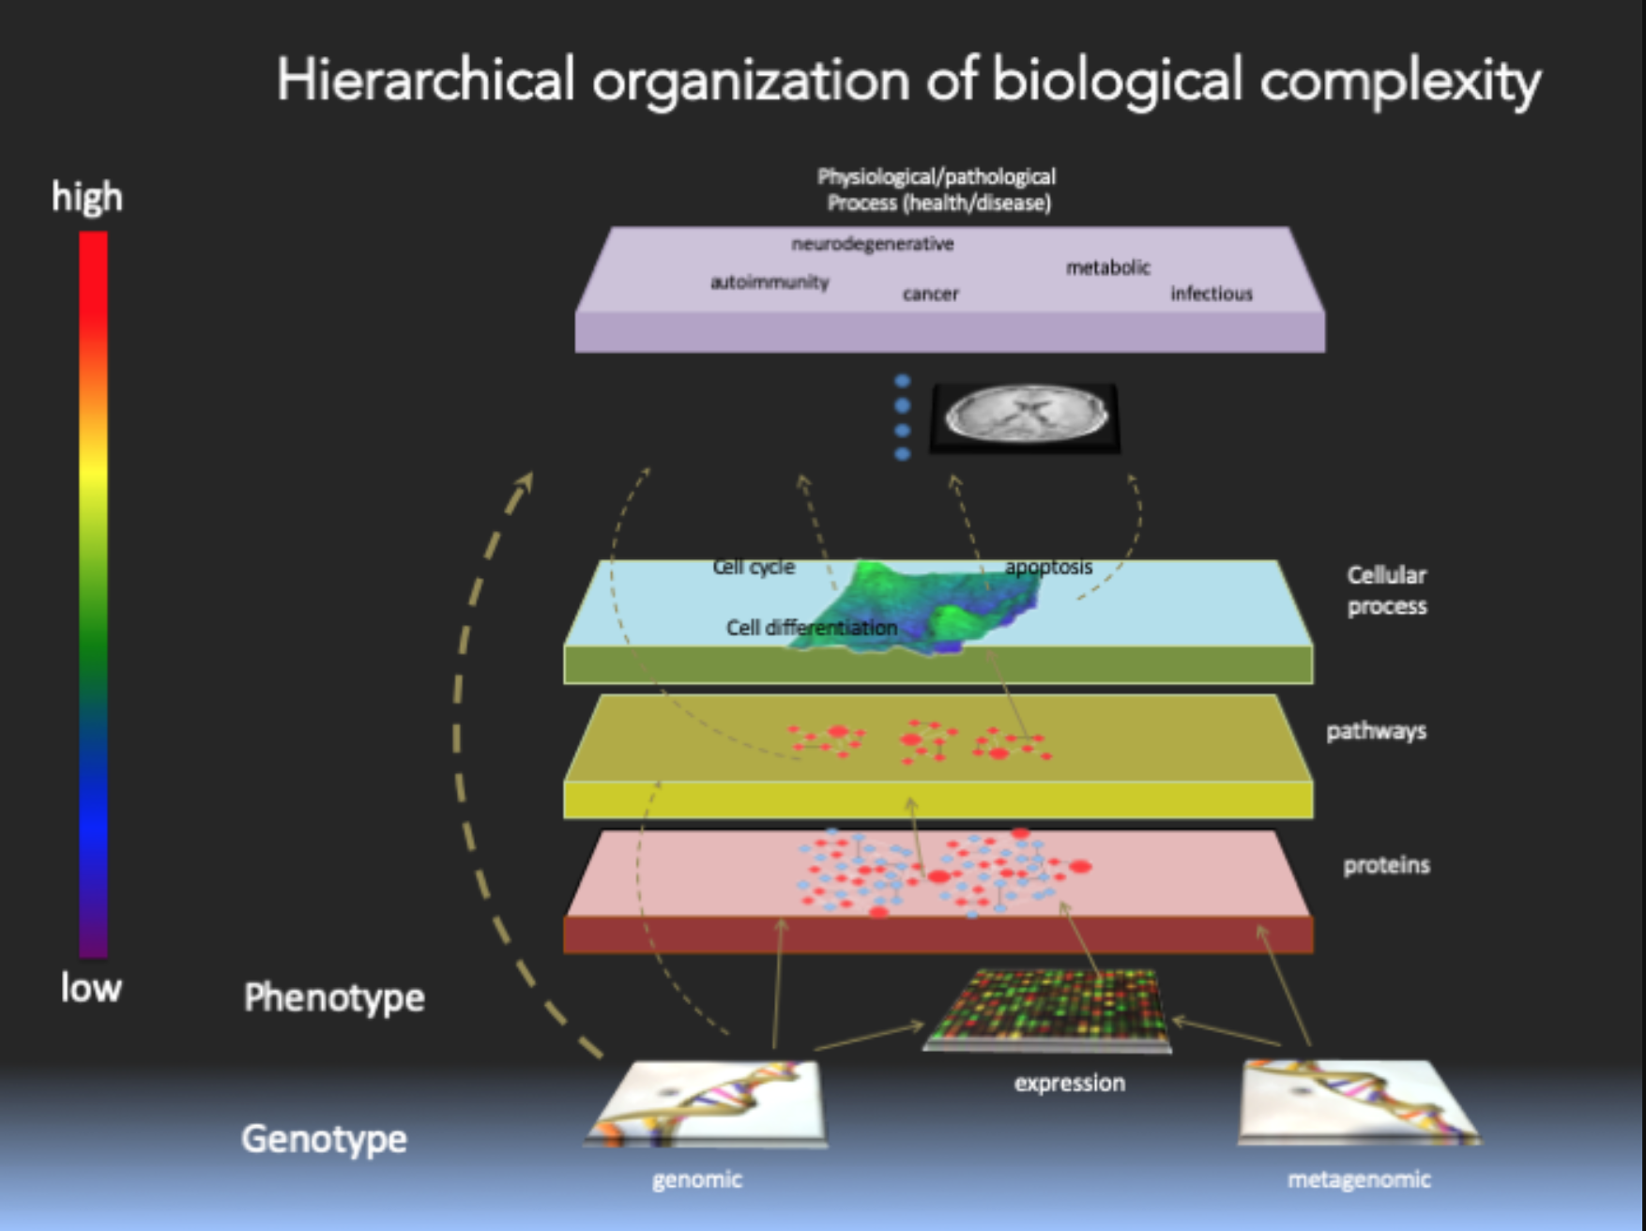
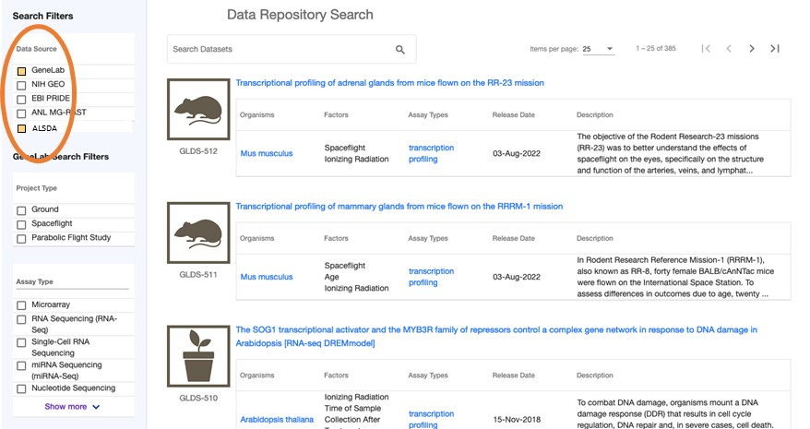

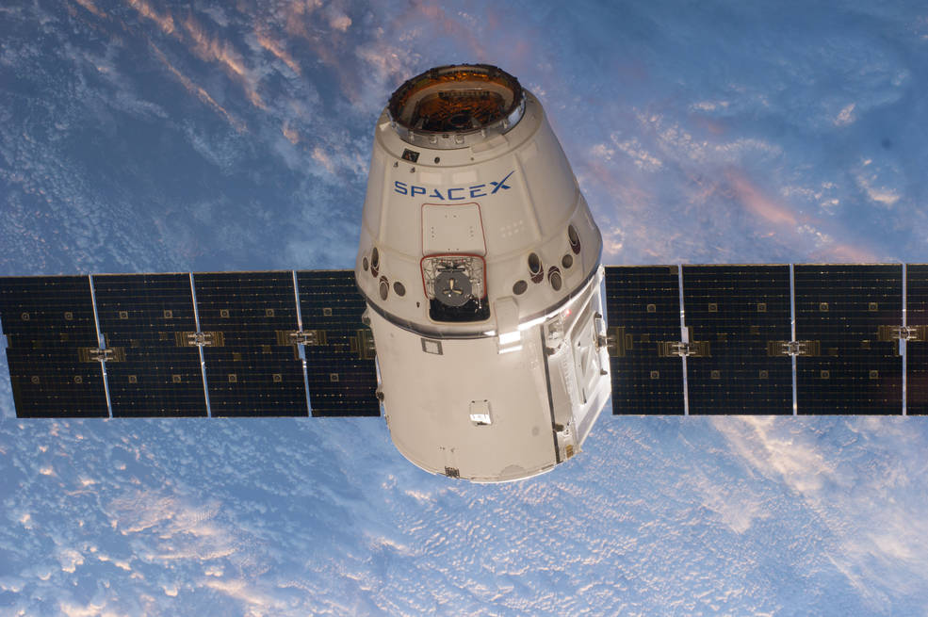
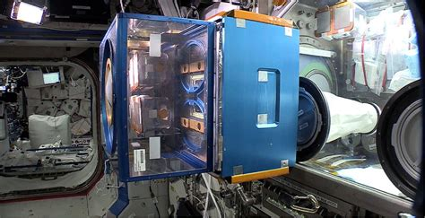
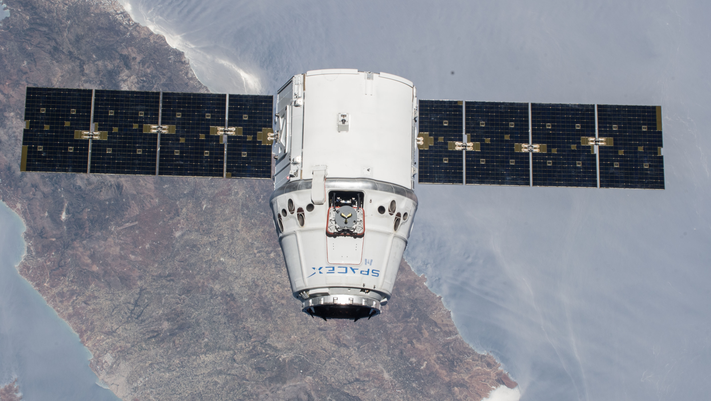
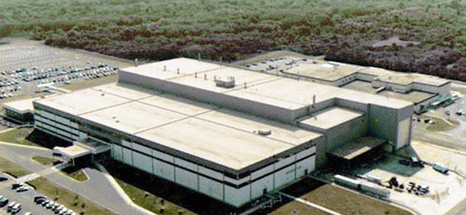
Centralizing information of different types of data
EXPERIMENTAL DATA
COMMON ONLINE SEARCH
Hierarchical Organization of Biological Complexity
Physiological, Pathological, Behavioral
Formats
-Tabular
-Bioimage
-Video
Phenotype
OMICS
Mission Telemetry Data
ENVIRONMENTAL DATA
(common to both)
Relative Humidity, Temperature, CO2, O2, Airflows, Acceleration, Radiation, Acoustics, etc.
Ascent
Flight
Multi-Hierarchical, Multi-Modal Data Mining Together, for Many Computational-Informatic Approaches Including AI/ML
Return
Ground Control
(Image Credit: Sergio Baranzini, UCSF; Scott et al., 2021
https://tinyurl.com/2j58nmn4; Scott et al., 2020
https://doi.org/10.1016/j.celrep.2020.108441)
4

Slide 5


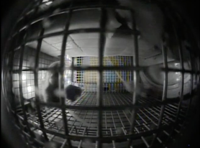
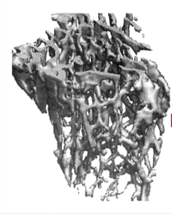
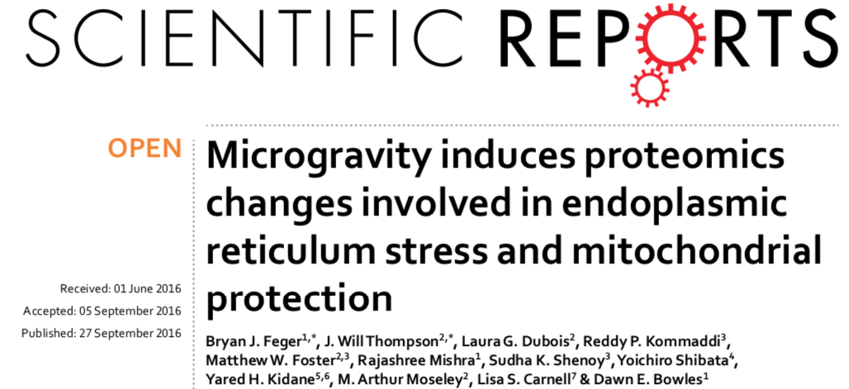
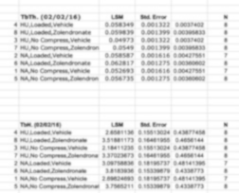

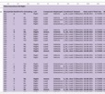

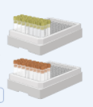






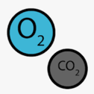

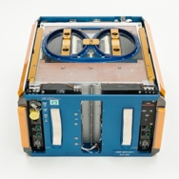
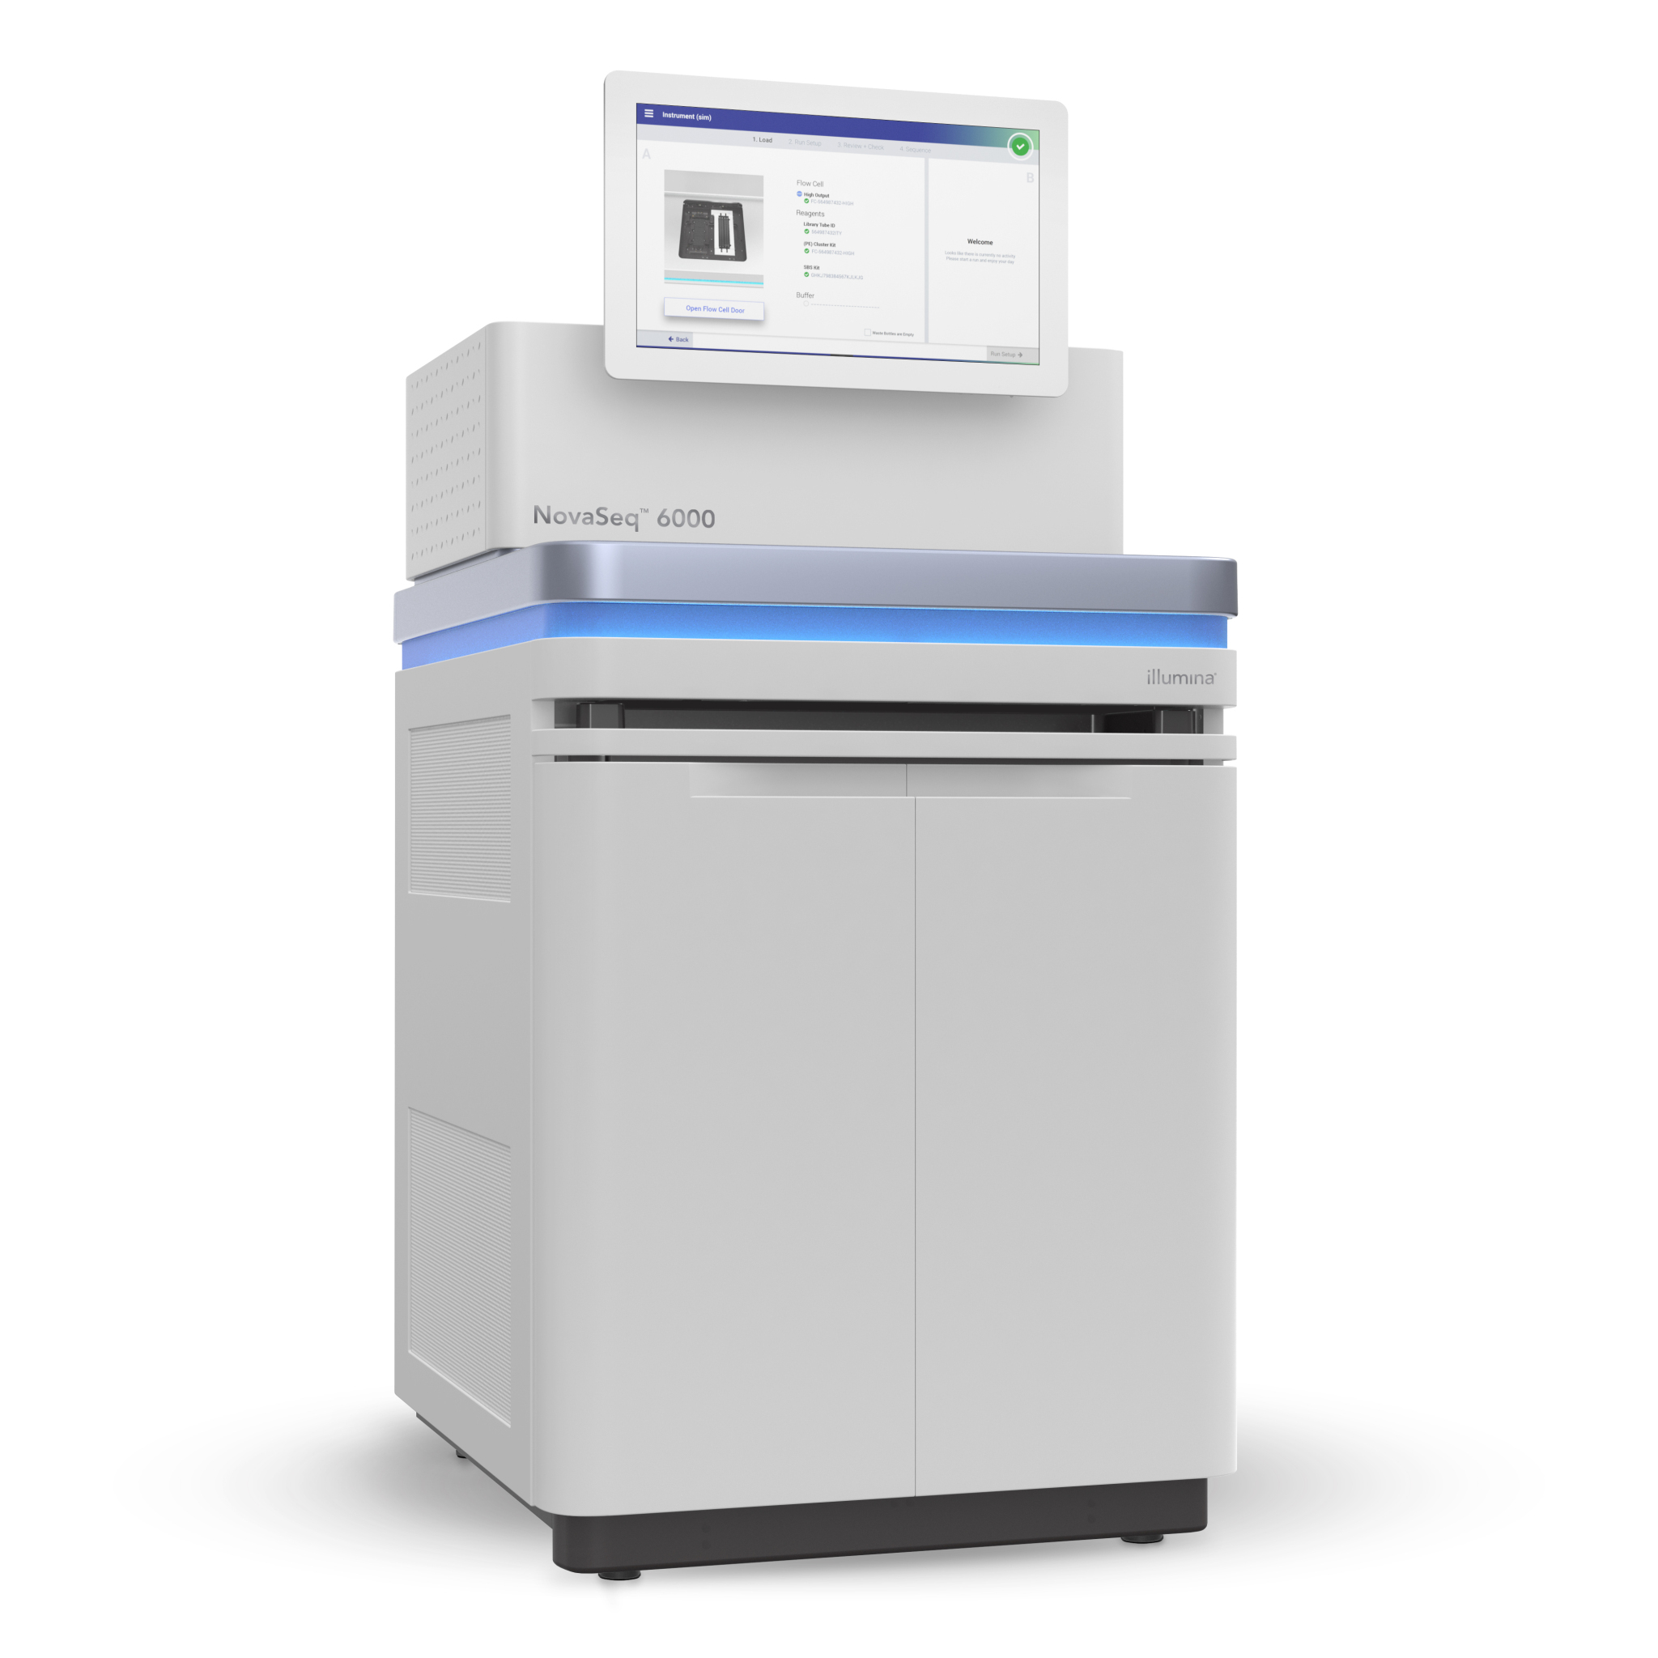
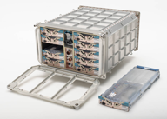

Two Data Repositories
85
Grants
406
Studies
Collects, curate, and distributes data from NASA funded
non-human life sciences investigations
GeneLab, an open science multi-omics repository, covering transcriptomics, metagenomics, epigenomics, proteomics, and metabolomics. Studies comprise of data from model organisms including microbes, plants, fruit flies, rodents and humans.
Grant managed between 2010-2022
457
Datasets
Established in 1994
859
Experiments
Raw & Processed Data
45
Species
Established in 2014
1975 to 2022
Data Repository
  Raw and high-order data
Environmental Data
Collaborative Workspace
Analysis Platform
Visualization Portal
In-house Sequencing Facility
356
Datasets (grouped)
Assay & Sample Metadata
Datasets grouped based on legacy structure
Environmental & Telemetry Data
15 TB
300 cf
Volume
>10
Assays
Mission & Hardware Data
PI Data: 1.3 TB
Mission Data: 2.7 TB
Images/Video: 11 TB
>140 TB
Volume
Notes:
This slides should be updated regularly by San-Huei

Slide 6







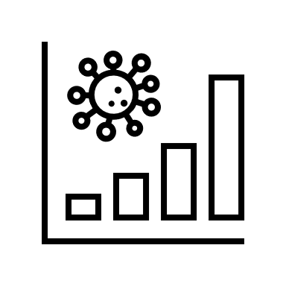

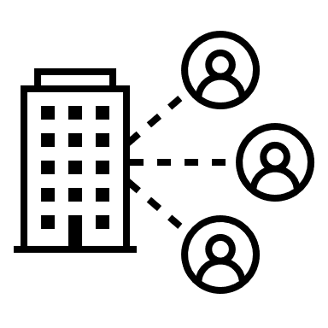
Accessibility, Inclusivity, Transparency, Reproducibility
Knowledge validation
Open Science BPS
Data Submission and Workspace
Data Repository & Visualization
Analytical Tools
Collaborative & Training
(AWG, GL4HS, GL4U)
New discoveries
Novel hypotheses and grants
ACCESSIBILITY and TRANSPARENCY: FAIR database, Findable Data with Rich metadata
Open access data enables discovery of new hypotheses and new ideas for grant proposal. Data from those new research experiments are generated and deposited back into GeneLab.
INCLUSIVITY: Provide project data by processing unused mission samples
ACCESSIBILITY/INCLUSIVITY: All raw data are processed, giving access to results to anyone, not just specialists and universities with large resources
REUSABILITY: GeneLab has enabled 40 new publications re-using data and performing meta-analysis.
REPRODUCIBILITY: All processing pipelines and script are shared
ACCESSIBILITY: Providing access to cloud resources – Goal: no download, work on data on the cloud directly
REPRODUCIBILITY / INCLUSIVITY: AWG community creates data & metadata standards and processing pipeline
INCLUSIVITY: HBCU/MSI focused bootcamp using available public tools

Slide 7
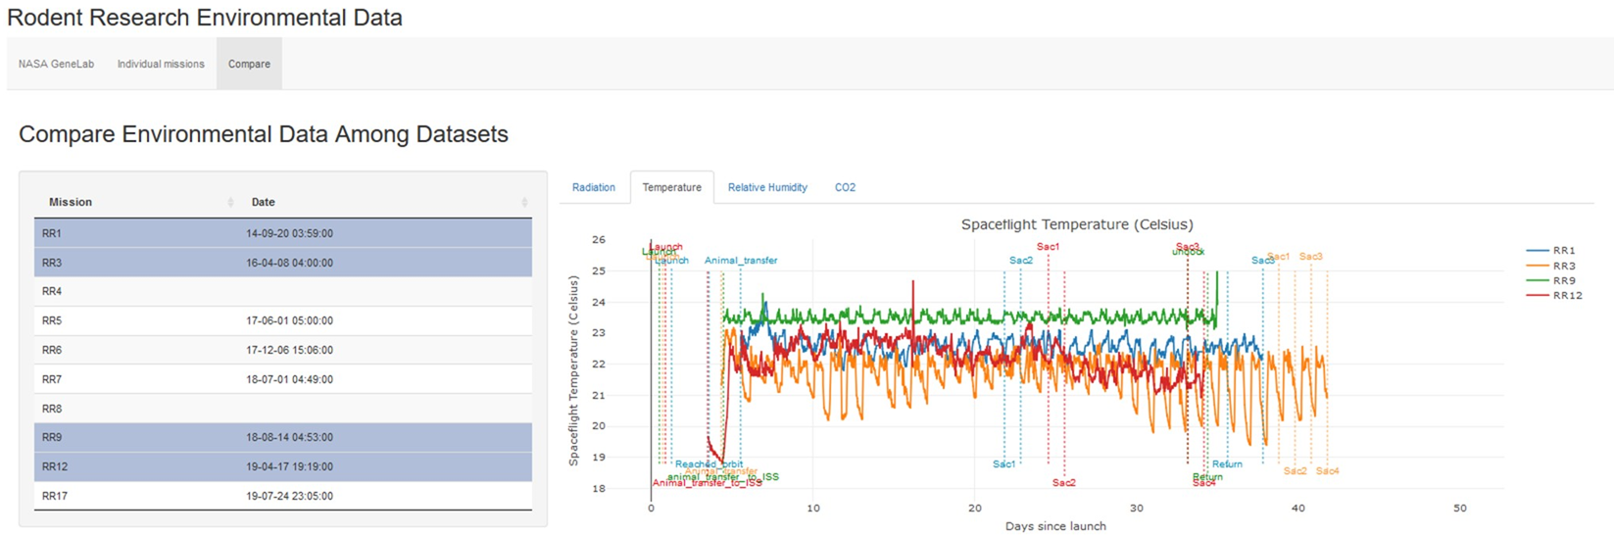


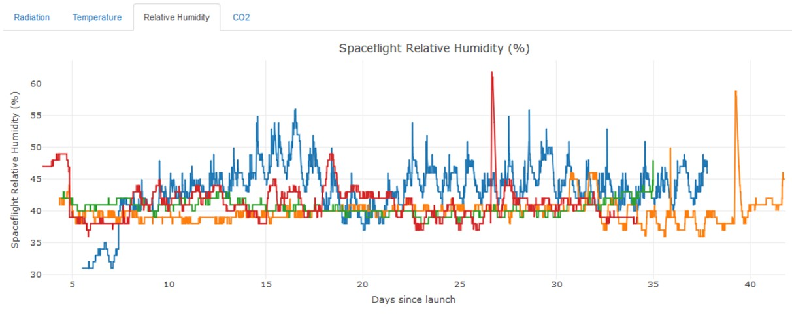
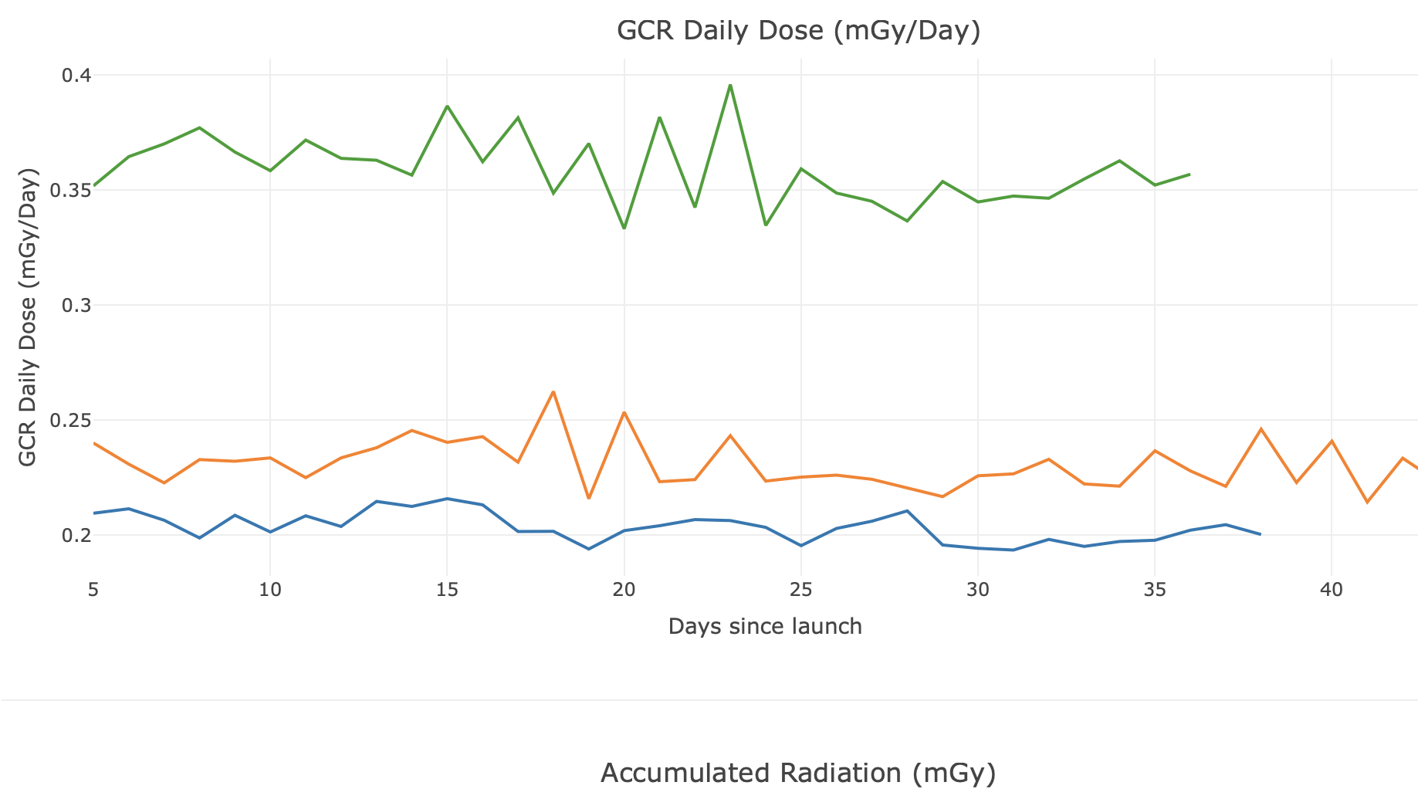

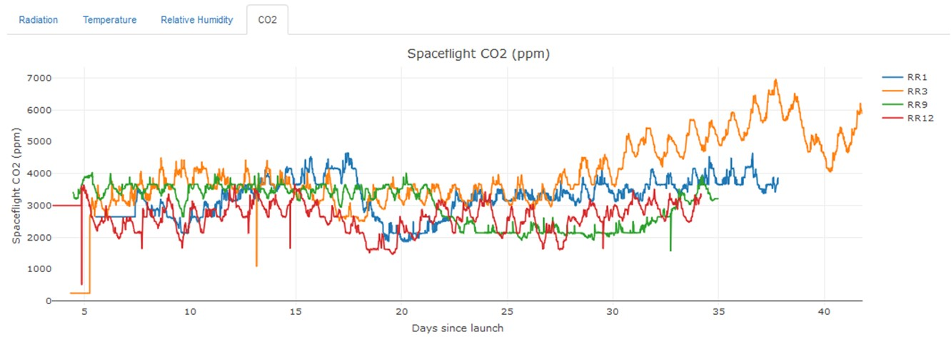
DATA SHARED ACROSS DATABASES
Application
Application
TEMPERATURE
RELATIVE HUMIDITY
Environmental Data
RADIATION MONITORING
CO2
  GCR dose highest at solar min
0.2-0.4 mGy/day

Slide 8
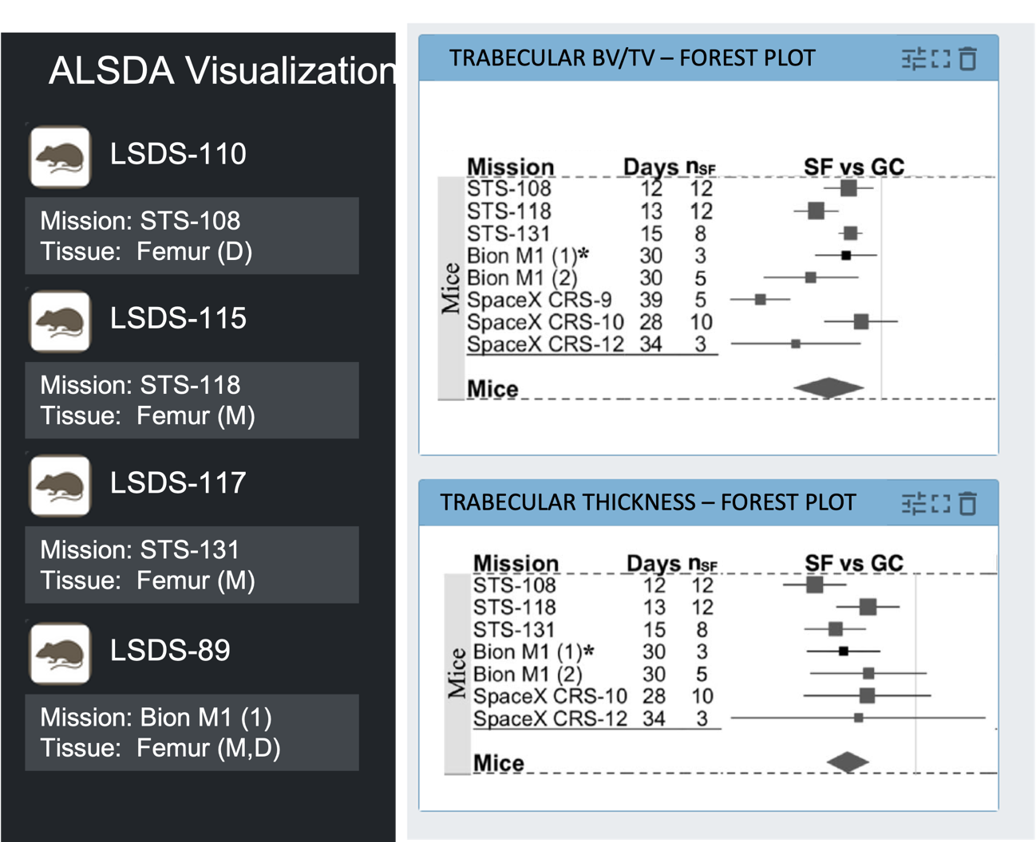
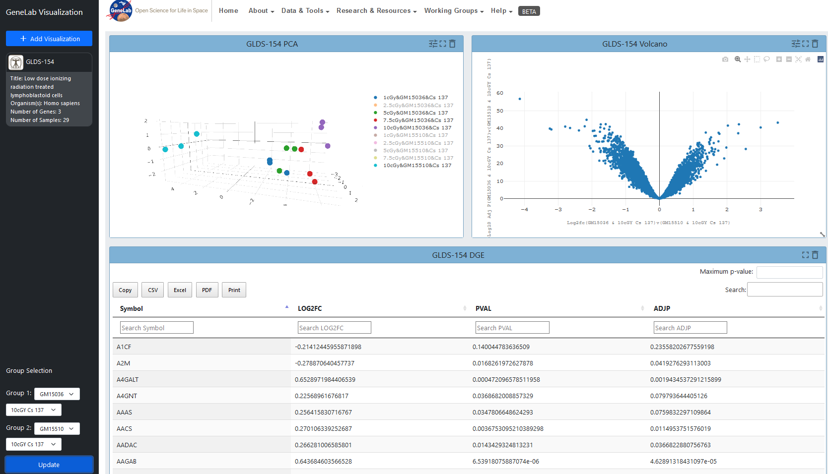


RAW DATA ARE PROCESSED TO ENABLE ACCESSIBILITY
REUSABILITY: ABLE TO HANDLE META-ANALYSIS
Application
DNA DAMAGE ALONG PARTICLES
(Credit: NASA GeneLab; NASA Radiation Biophysics Lab,
Fu et al., 2021, PMID: 34075059; PI: Svetlana Komarova)

Slide 9







Data Reuse: Open Science Data Modeling Portal
AI-ready FAIR data for modeling and risk assessment
NIH/PATIENT DB
Mission Scenarios’ Input conditions
Human phenotypes
Omics data
BIOLOGICAL
MODELING PORTAL
Heterogeneous
Data
+
Environmental
Data
Modeling Visualization
Portal
OPEN SCIENCE Submission
Portal
Phenotypic-Physiological data
Knowledge-based Predictor
(Image Credits: Nelson et al., 2021, PMID: 33445483; Genewein et al., 2020, arXiv:2010.12237v1 [cs.AI])

Slide 10



Enabling our scientific community
GL4U Indirect Approach
GL4U Direct Approach
MSI/HBCU Educators
SIX ANALYSIS WORKING GROUPS (500+ SCIENTISTS)
STANDARDIZATION:
Consensus pipelines for processing data
Metadata configuration
COLLABORATION:
Meta-analysis
Identifying data gap for DB
Grant proposal
MSI/HBCU Students
Notes:
The AWG community is a collection of volunteer international scientists that stem from 37 countries around the world with most coming from the US, UK, India, Canada, and Japan.

Slide 11


Metrics for success
3327
Avg Monthly Sessions
1558
Avg Monthly Users
Usage: May 2017- Sept 2020
Introduction of Analysis Working Groups
360
Avg Monthly Downloads
7189
Total Study Downloads
Introduction of Processed Data and Visualization
50 publications (12 publications produced by the AWGs) using data available in GeneLab.
Nov 2019
Notes:
Top 10 Countries – Sessions
United States
India
United Kingdom
Germany
Canada
France
South Korea
Japan
China
Australia

Slide 12
Challenges
Burden of data entries and curation (both on PI and DB)
PI Adoption – fear of giving away too much (especially true for software)
Lack of tools to facilitate Open Science (reduce burden for PI)
Provide a common environment between NASA and External Scientists
More financial incentives for our AWGs

