Slide 1
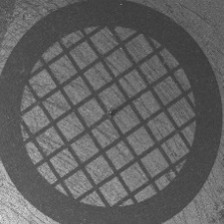
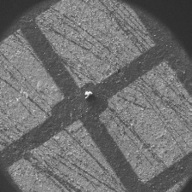
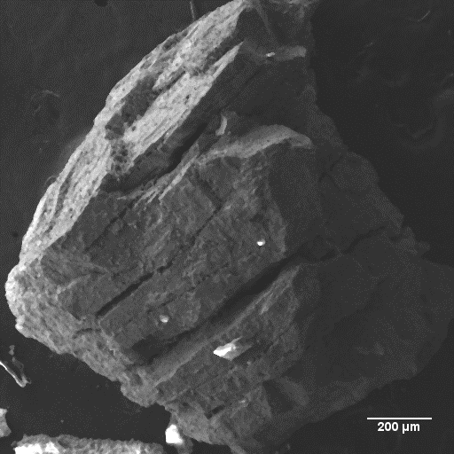
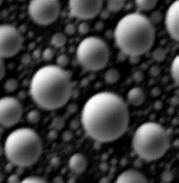
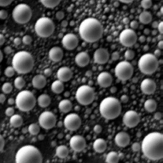
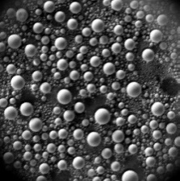
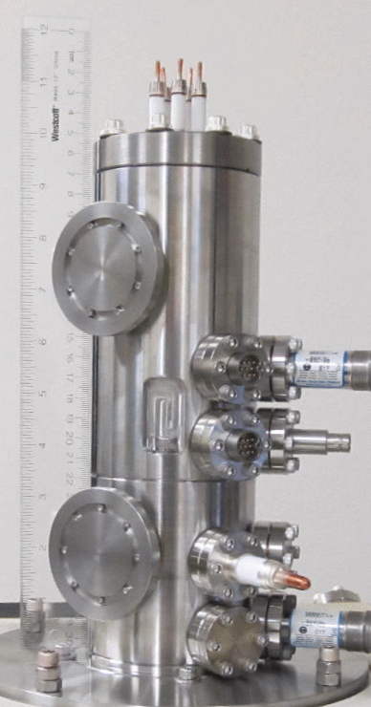
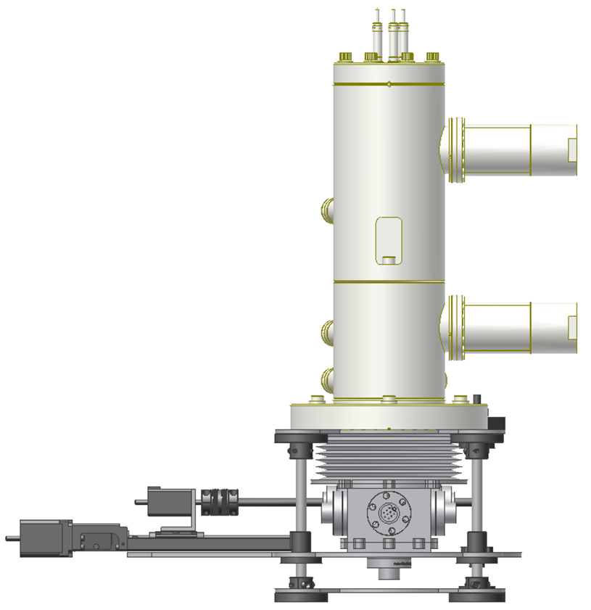
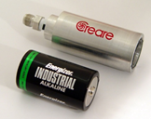
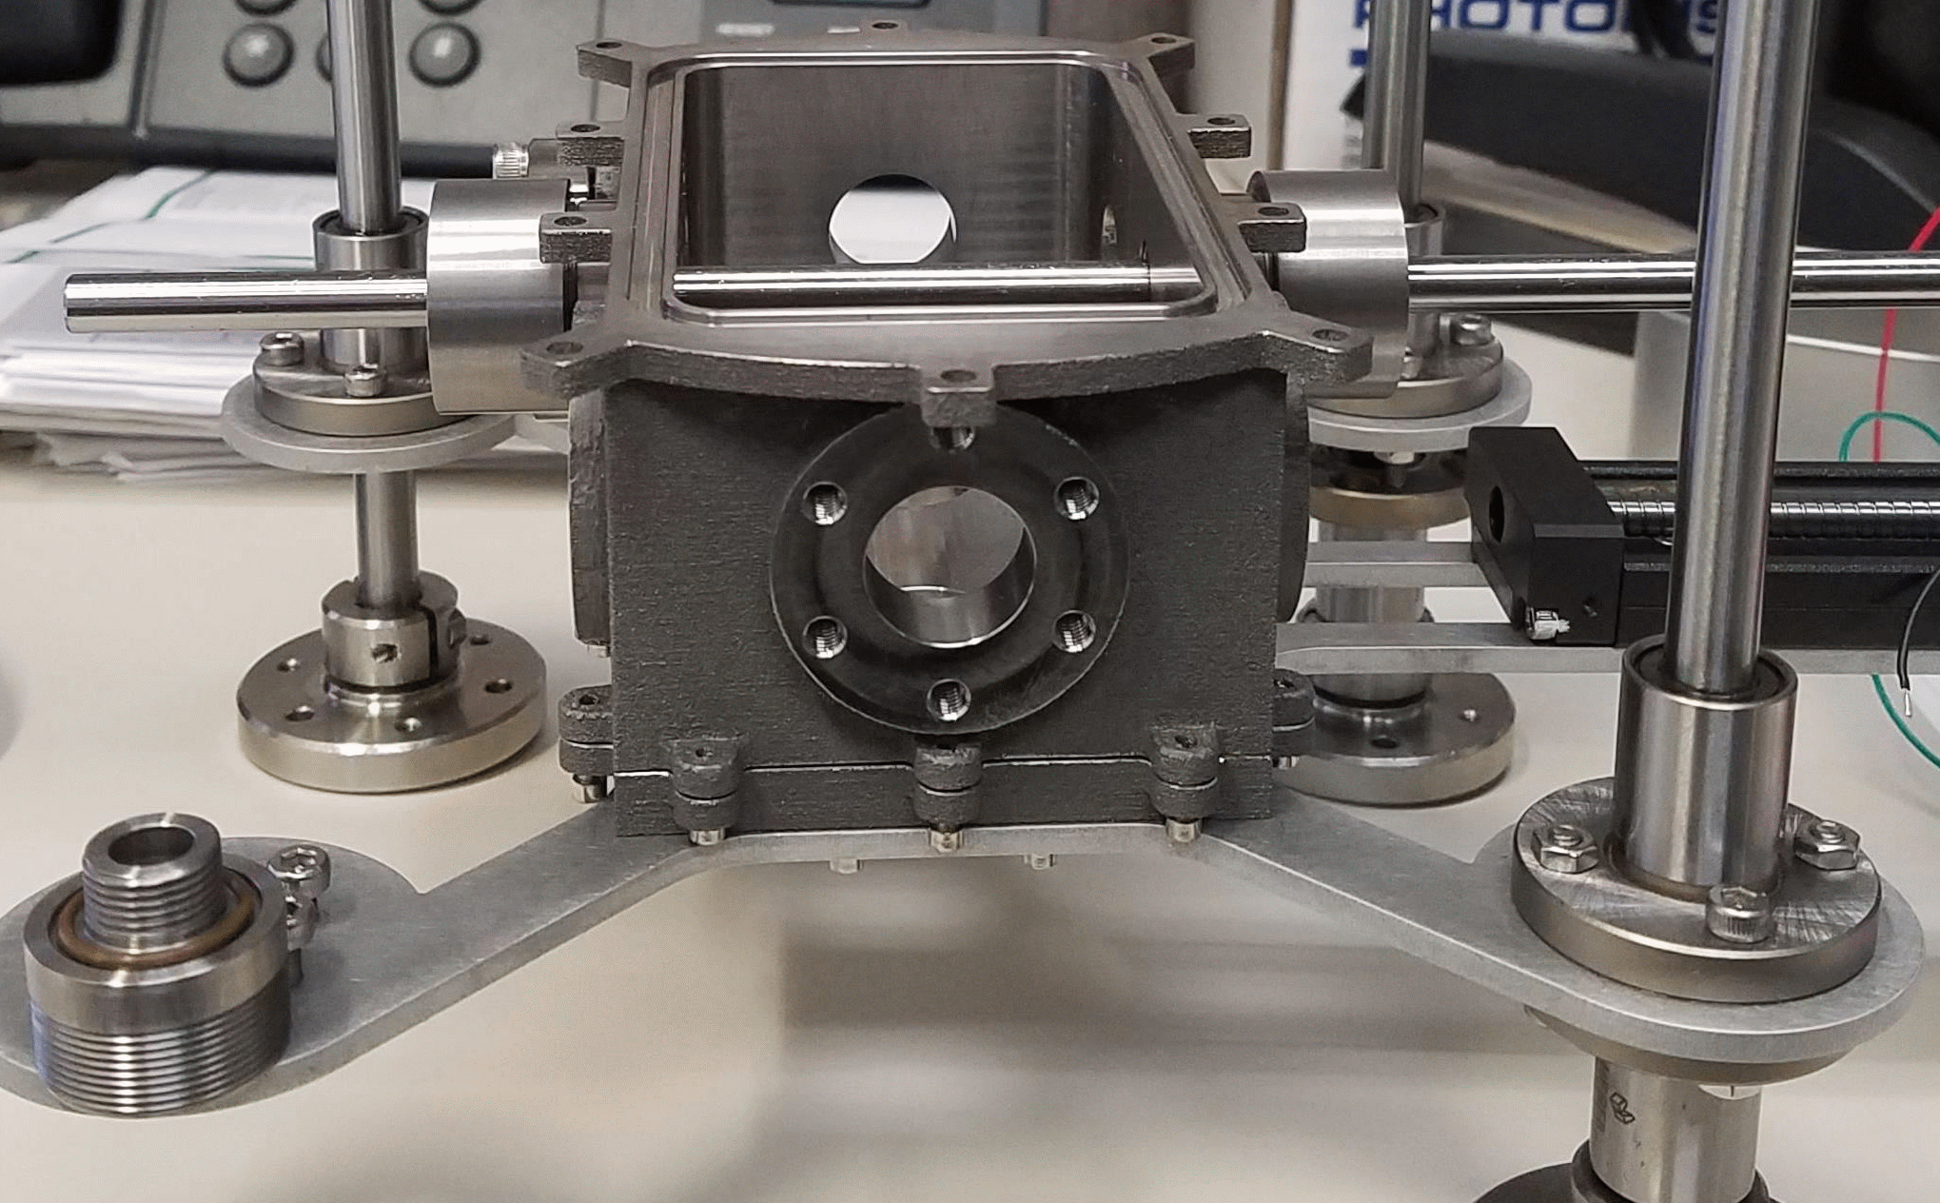
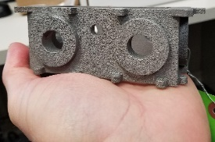
Focusing Column
Differential Pumping
Copper TEM Grid
Test Images
J-M Reef Ore
Test Sample
4800X
2400X
1200X
Sn Spheres on Carbon
The in-situ use of the MVP-SEM on a future Mars mission would answer numerous outstanding questions about the petrology, evolution, and habitability of Mars while providing understanding of the surface environment that will be critical to the success and health of future human exploration.
What is the makeup of Martian dust?
What is the “amorphous component”?
What can we learn about the evolution of the Martian surface?
Is, or was, there life on Mars?
Can humans live (safely) on Mars?
12.54”
5.14”
Sampling System
15.54”
Manufactured Sampling System Proof-of-Concept
Capability | Current Performance | Goal
Maximum Accelerating Voltage (kV) | 15 | 5 - 15
Working Distance (mm) | 20-23 | 20-23
Environmental Distance (mm) | 2-5 | 2-5
Emission Current (µA) | 30-50 | 30-50
Current at the sample (nA) | 0.2-2 | 0.2-2
Imaging Resolution (nm) | 100 | < 50 (based on modeling)
Magnification Range | 175X – 15kX | 175X – 20kX
Field of View Diameter (mm) | 0.8 @ 175X 0.004 @10kX | 0.8 @ 175X 0.002 @ 20kX
EDS Accuracy @ 0.6 Torr Chamber Pressure (Detector Dependent) | (Commercial EDS Accuracy) ±2% @ conc. > 10 wt% ±10% @ 1 - 10 wt% ±33% @ 0.3 – 1 wt% | (Est. MVP-SEM EDS Accuracy) ±5% @ conc. > 10 wt% ±25% @ 1 - 10 wt% ±75% @ 0.3 – 1 wt%
PI: Jessica Gaskin (NASA MSFC)
Jessica.Gaskin@NASA.gov
Critical Technical Partners:
APTech, Inc.
Creare LLC
NASA JPL
A Miniaturized Variable Pressure Scanning Electron Microscope (MVP-SEM) for Mars
Notes:
Talking Points:
The MVP-SEM is an environmental scanning electron microscope with nanometer resolution and chemical mapping capability.
The novel aspect of this instrument is that it uses the ambient atmosphere as an imaging gas to negate the need for complex sample prep
This instrument would provide the community with a precision instrument capable of extremely high-resolution imaging and energy dispersive spectroscopy (elemental mapping) of Martian samples.
In addition to high-impact science, the MVP-SEM would inform ISRU and space weathering of structures on the planet’s surface related to exploration
Proof-of-concept has been shown. The top images were taken with the MVP-SEM and simulations show that performance requirements can be met
While lots of work has already been done, there is still much to do to make the instrument flight ready.

Slide 2
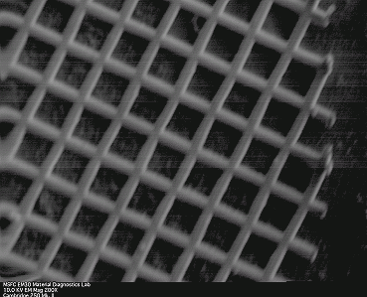
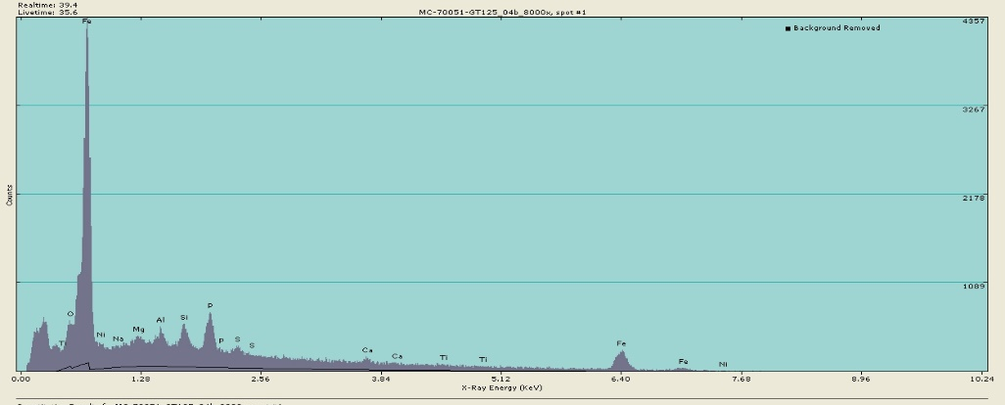
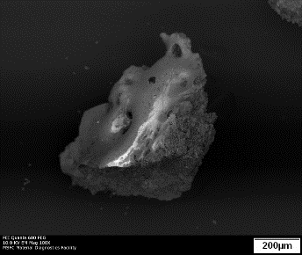
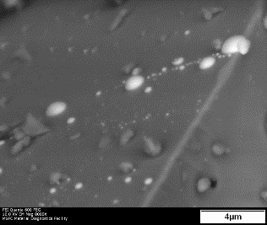
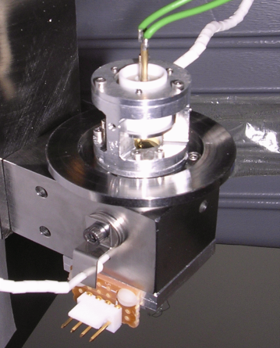
Miniature Scanning Electron Microscope for In-Situ Studies on the Moon
Electron
Gun
Focusing
Column
Scanning
System
First Light!
PI: Jessica Gaskin (NASA MSFC) , Jessica.Gaskin@NASA.gov
Or contact Mike Effinger (MSFC), michael.r.effinger@nasa.gov
~2”
NASA’s plan for returning to the Moon will require high precision instrumentation with an emphasis on low mass, low power and miniaturization. Detailed analyses of the lunar regolith that facilitates science and informs In-Situ Resource Utilization will be essential.
The miniaturized Scanning Electron Microscope (mSEM) could be operated remotely from Earth or by astronauts on the moon, that would perform detailed in-situ imaging and chemical analysis of lunar regolith.
A
mSEM Prototype
The above figure denotes the potential capability of the mESEM. Using a commercial SEM from FEI, this lunar sample (Apollo 17 sample 70051) was imaged at two different magnifications and point analysis EDS was performed on point “A”. These tests were done to determine operation feasibility of testing on an uncoated sample. Testing was done in collaboration with Larry Taylor and Kevin Thaisen (UTK, 2009).
Forward Work:
Complete miniaturization of electronics
Integrate EDS Detector
Design environment-specific housing
Design/integrate sampling system
Need to test in relevant environment
Parameters Goals Electron Gun-Column Assembly Size 2” long, <0.5” diameter Mass < 50g Imaging Resolution TBD (<100 nm) EDS – Detectable Elements C to Fe (k lines) Maximum Accelerating Voltage 10 kV Maximum Field of View 5-10mm square Sample Preparation Minimal – No Coatings Overall System Dimensions: < 8”x4”x4” *Total Power < 20W
*Based on our custom high-voltage power supplies which will account for the majority of the power budget.
Notes:
Talking points:
The mSEM uses a different electron gun than the MVP-SEM that makes use of the ultra-high vacuum of the Moon.
Operation would be either using low-current imaging or environmental imaging (the latter of which would require bringing along an inert gas)
Like the MVP-SEM, the mSEM would be capable of providing outstanding science and would facilitate ISRU, exploration, and long-term human presence.
Proof-of-concept has been shown, though a significant amount of work is needed to ready the instrument for flight.
Key message: If you are a mission that is landing on the Moon, Mars, other planet, or small body for regolith and rock characterization or life detection and are interested in bring aboard your mission a SEM with ancillary detectors such as EDS and CL, then please give me your business card or signup at the booth and note the mission, destination, and proposal due date.

