Slide 1
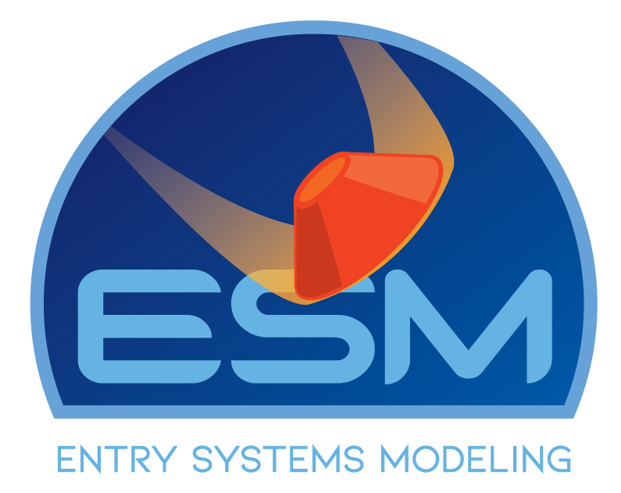

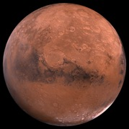
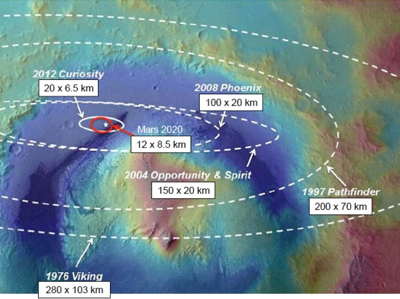
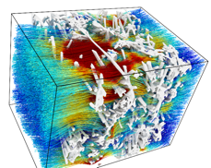
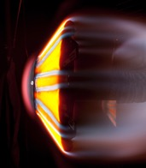
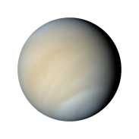
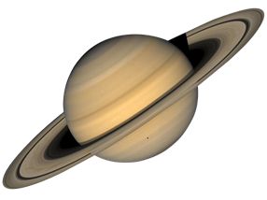
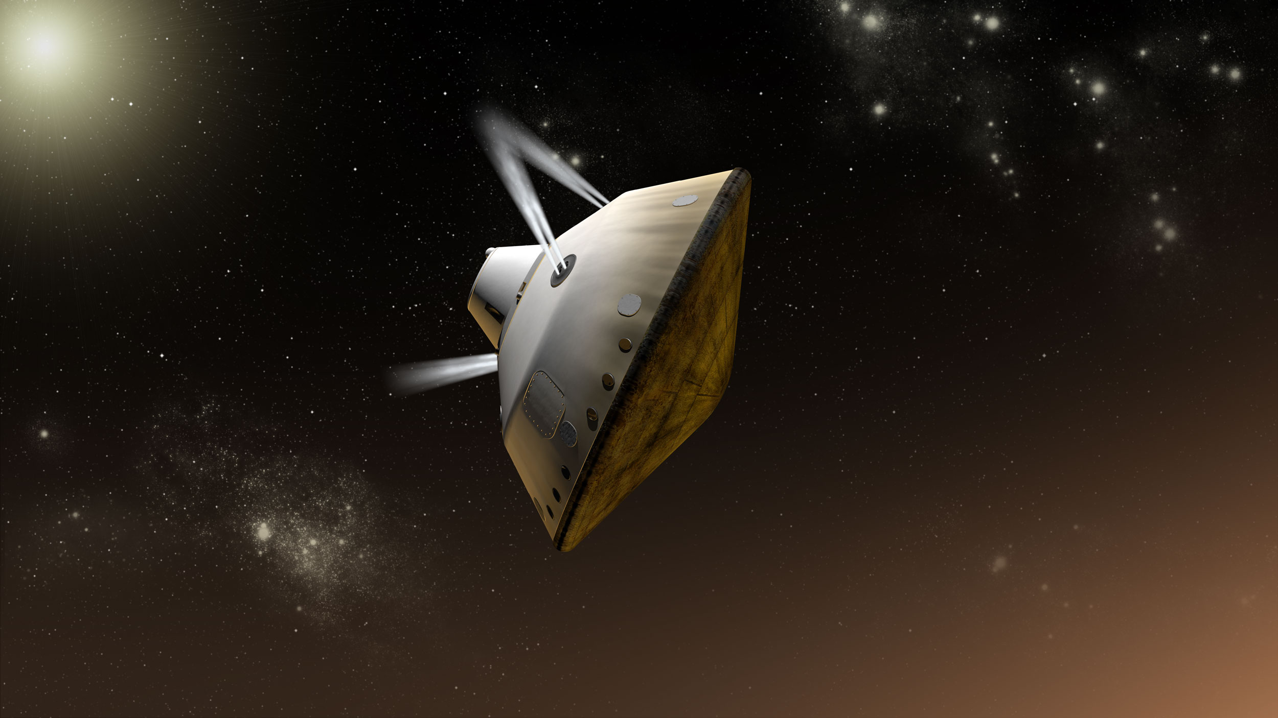



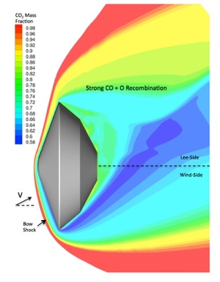
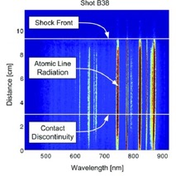
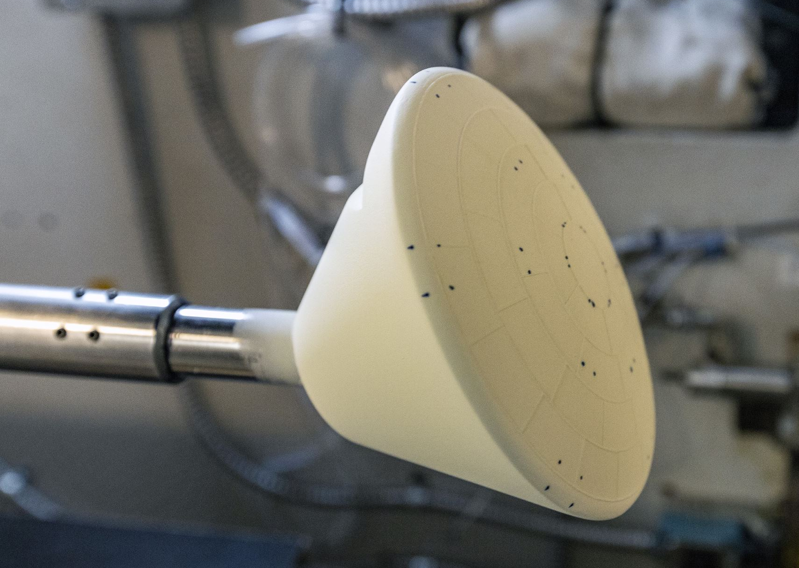
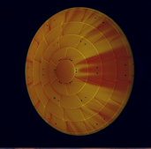
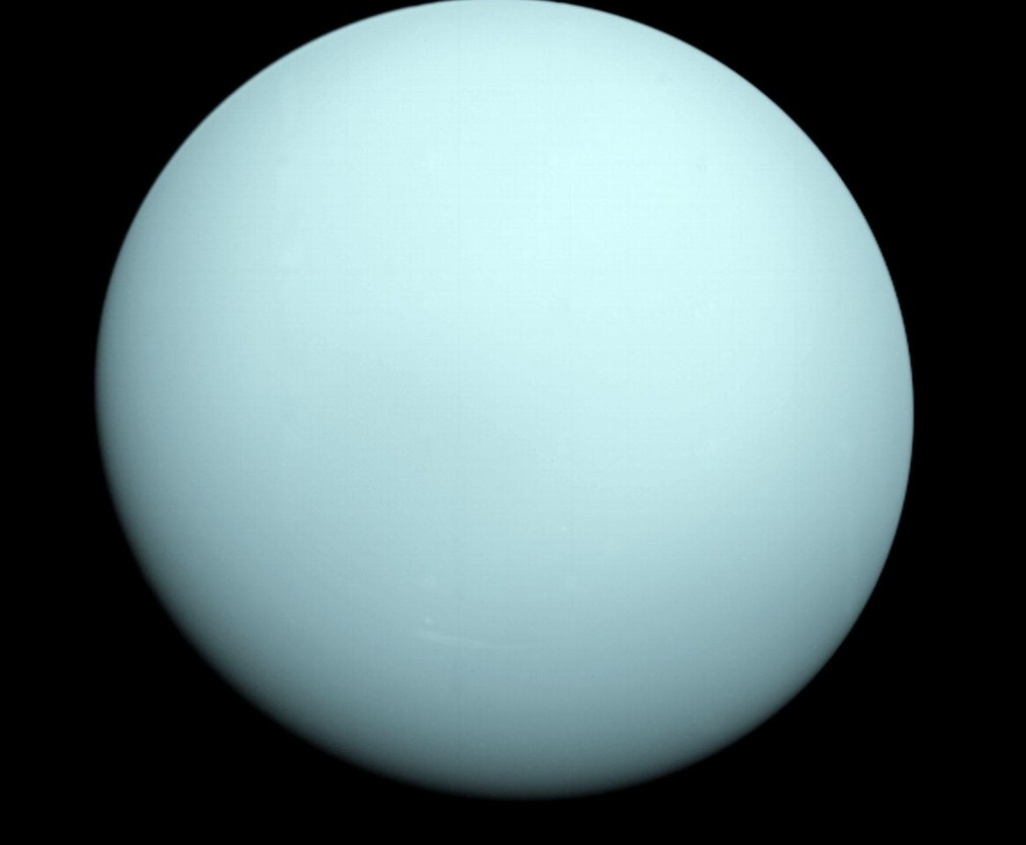
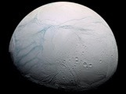
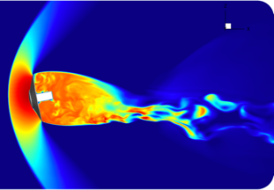

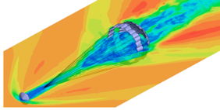
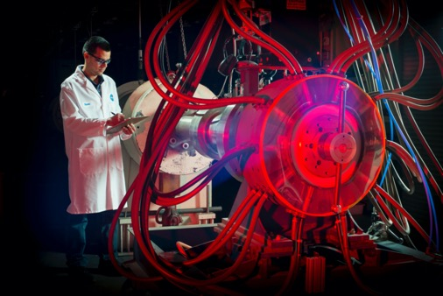
Entry Systems Modeling and Ground Testing:
Enabling Flight Performance and Risk Reduction
Contact: Michael Barnhardt (Michael.D.Barnhardt@nasa.gov), Aaron Brandis (Aaron.M.Brandis@nasa.gov)
Science Impact: Entry, Descent, and Landing (EDL) comprises a relatively small portion of a mission’s timeline, however, it is typically among the largest risks. Flying through a body’s atmosphere reliably and accurately – from orbit to ground or via aerocapture – is a critical step toward successful in situ exploration.
TPS Materials Modeling
Advanced material response models for HEEET and other next-gen woven composites; Arc jet testing for TPS performance qualification; Lab capabilities to characterize material properties
Guidance, Navigation, and Control
Guidance, Navigation, and Control models enable precision landing and aerocapture for scientific payloads
Aerodynamic Modeling
Free-flight CFD for vehicle dynamics and aerocapture; Turbulent heating models; Parachute modeling; Wind tunnels to characterize aerodynamic performance and heating environments
Shock Layer Kinetics and Radiation
High-fidelity aerothermal simulation for Mars, Gas Giants, Venus, and sample return to Earth; Electric Arc Shock Tube facility measures flight-similar radiative emission

Slide 2
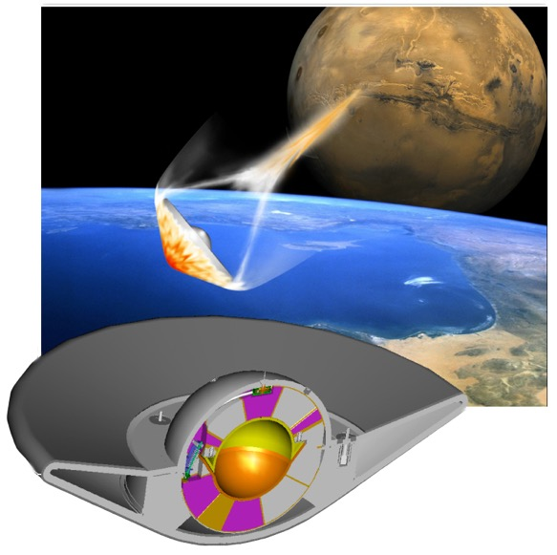
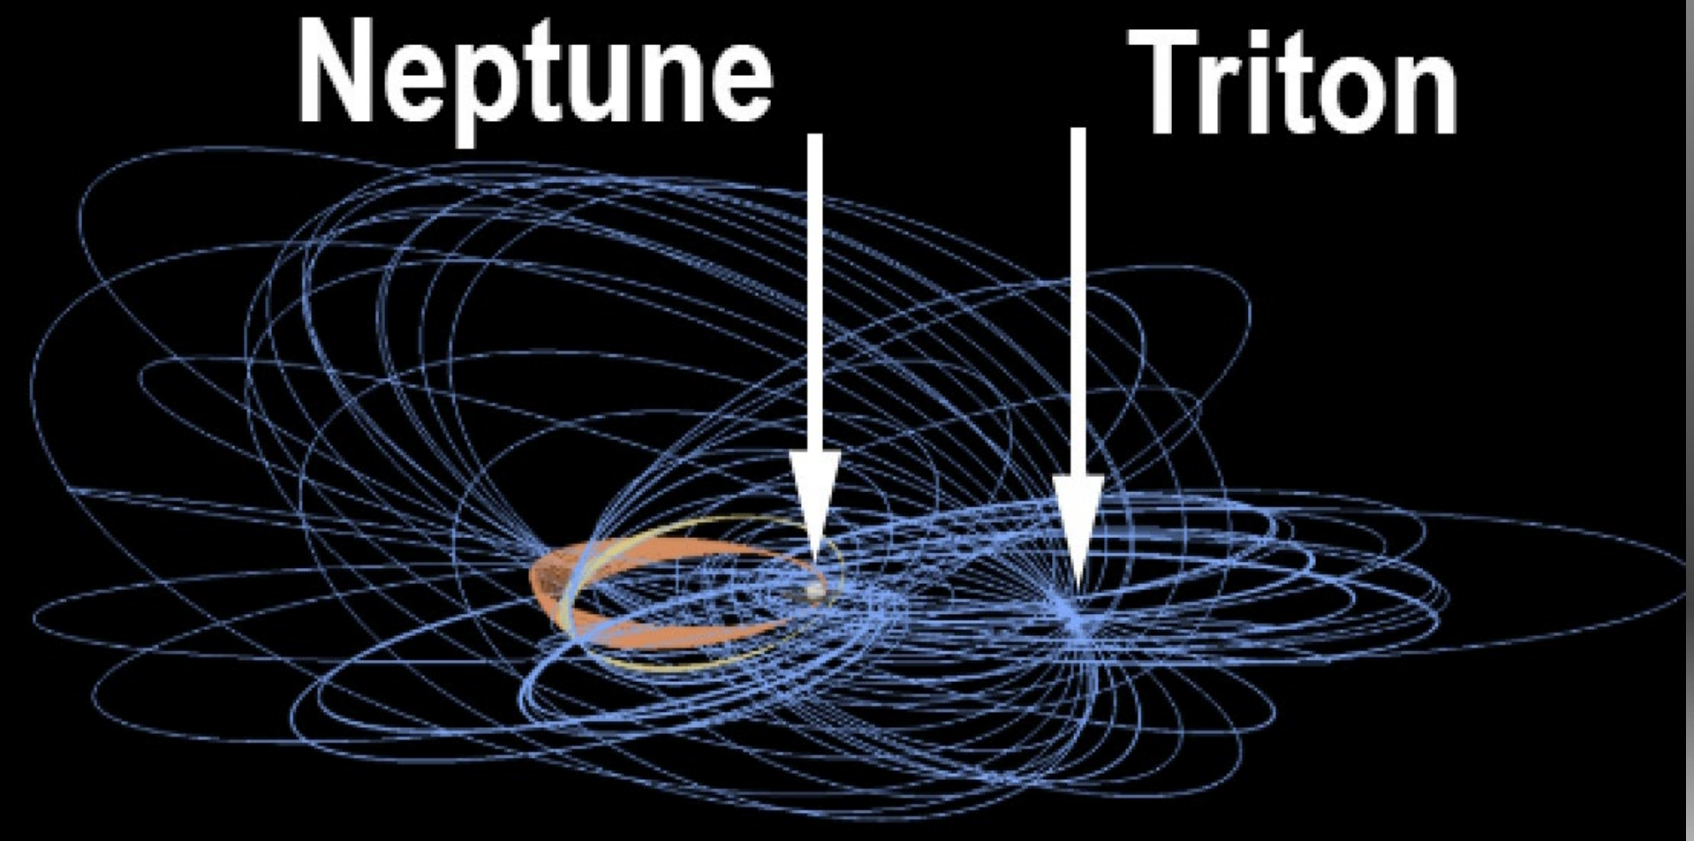
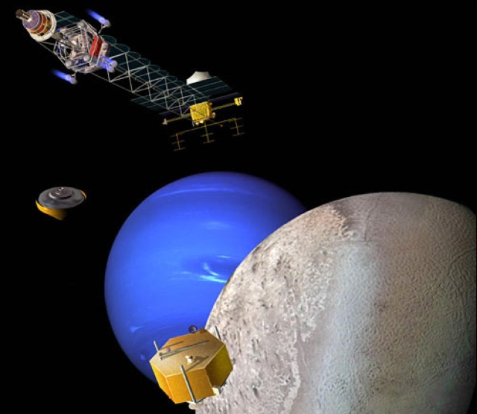
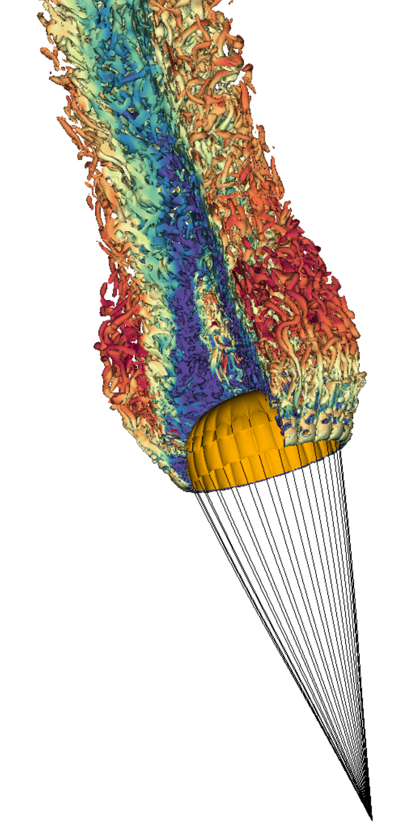
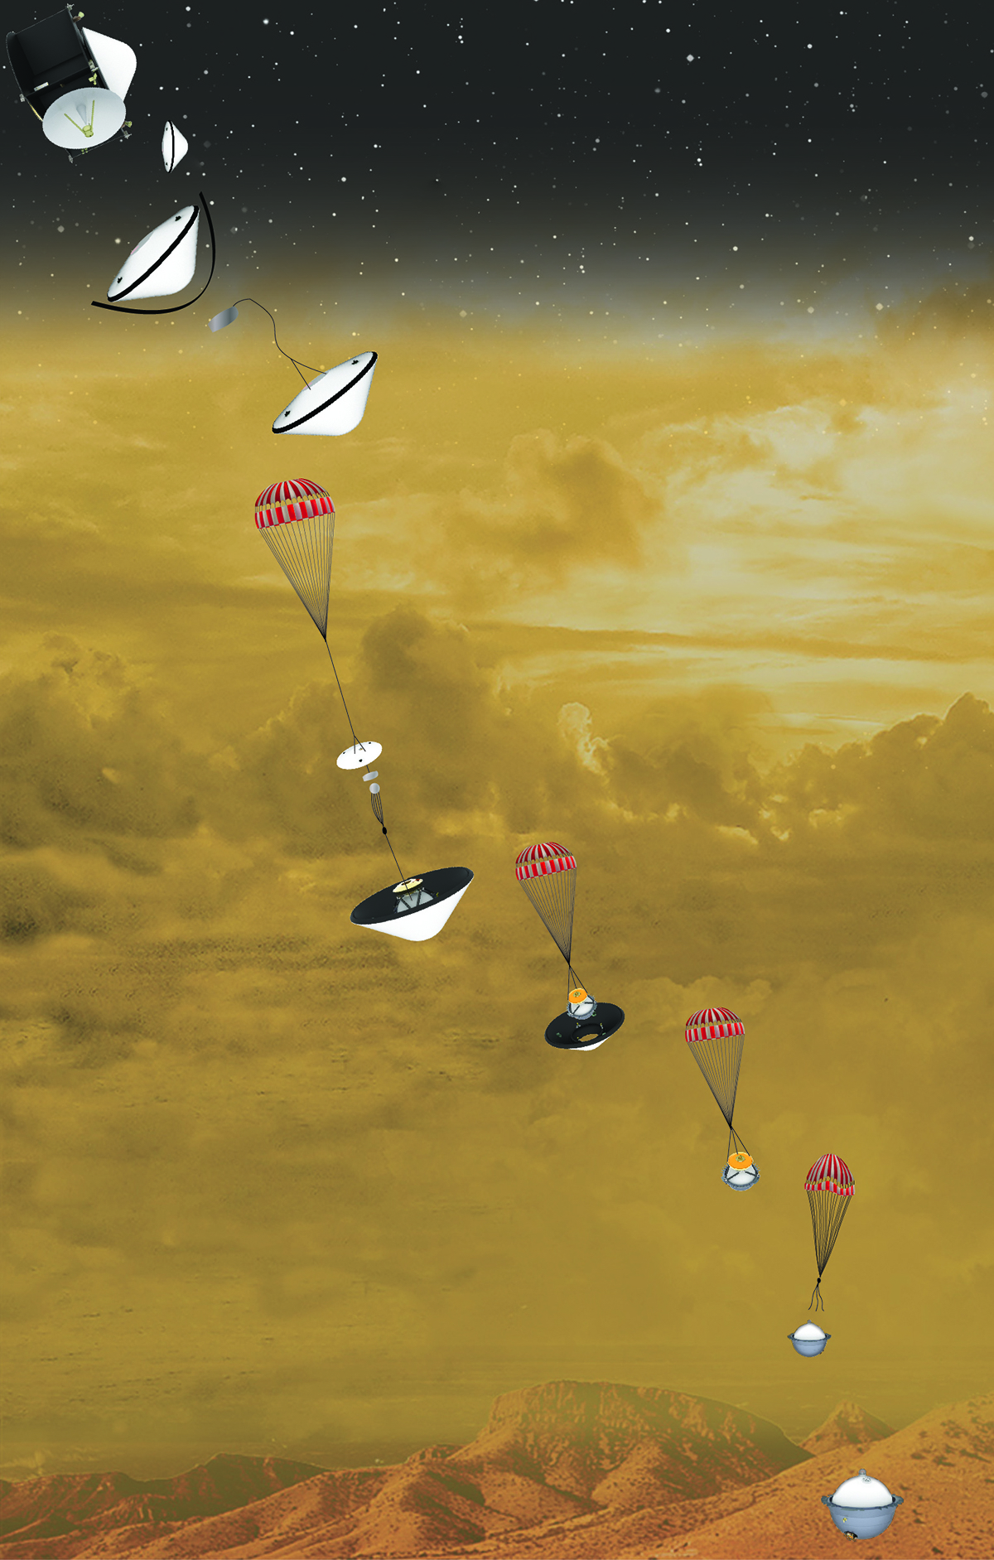

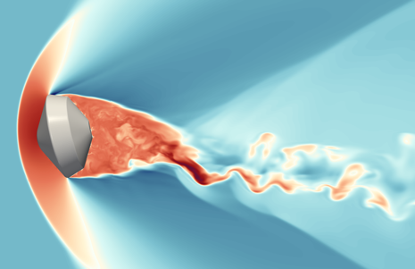
Entry Systems Modeling and Test Capabilities
Applied to Planetary Science Missions
Entry, Descent, and Landing (EDL) modeling and testing are critical components of a mission’s lifecycle, from concept through execution.
Elements of Spacecraft Flight:
Planetary Science Mission Infusion:
ARRIVAL: Trajectory Analysis
(POST2, Genesis)
Advanced guidance and control algorithms for precision aerocapture and landing
Launch-to-land guidance
Small Bodies / Sample Return
Advanced models are necessary to meet stringent reliability requirements:
Extreme aeroheating environments
High-fidelity woven TPS modeling
Quantify TPS failure & reliability
Simulation & testing of entry vehicle dynamics
Multi-destination mission concepts
Source: Neptune-Odyssey, OPAG, APL
ENTRY: Aerothermodynamics
(Shock tube, Ballistic range, Hypersonic wind tunnels, NEQAIR, HARA)
Thermal Protection System (TPS) Modeling
(Icarus, PATO, PuMA, Hydra)
Shock layer radiation for all destinations
Aeroheating environment test & simulation
Thermal protection system sizing
Aeroshell reliability, reduced TPS margins / mission risk
Outer Planets
New EDL challenges:
Unique H₂-He-CH₄ aerothermochemistry
Aerodynamics, guidance, and control for aerocapture at Ice Giants
High-fidelity woven TPS modeling
Mars Exploration
Expanding the performance envelope:
  Reduce TPS mass margins to accommodate greater scientific payloads
  Aero, guidance, and control for precision landing to higher latitude, elevation
Electric Arc Shock Tube
Hypersonic Wind Tunnels
Arc Jets
DESCENT: Aerodynamics
(Wind tunnels, Ballistic range, US3D, LAVA)
Entry vehicle dynamics test & simulation
Parachute inflation & descent dynamics
Ground-to-flight traceability
Venus Exploration
Extreme conditions:
  High-speed aerothermodynamics for dense CO₂/N₂ atmosphere
High-fidelity woven TPS modeling
  Simulation & testing of entry vehicle dynamics
  Simulation of parachute & separation dynamics
Free-flight CFD
ADEPT Concept
Genesis / Dragonfly
Parachute simulation

