Slide 1
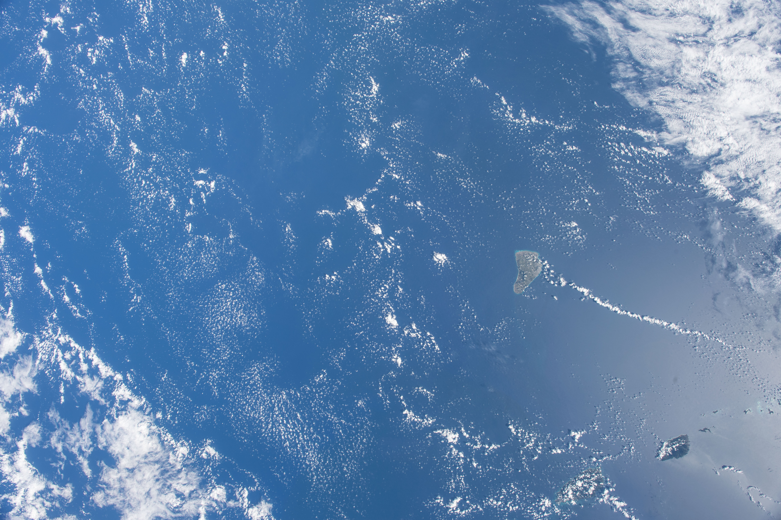
Critical Improvements to CALIOP Boundary Layer Cloud-Clearing in Version 4.5
Jason Tackett, Mark Vaughan, James Lambeth, Anne Garnier
Image courtesy of the Earth Science and Remote Sensing Unit, NASA Johnson Space Center
https://eol.jsc.nasa.gov/SearchPhotos/photo.pl?mission=ISS054&roll=E&frame=56983

Slide 2
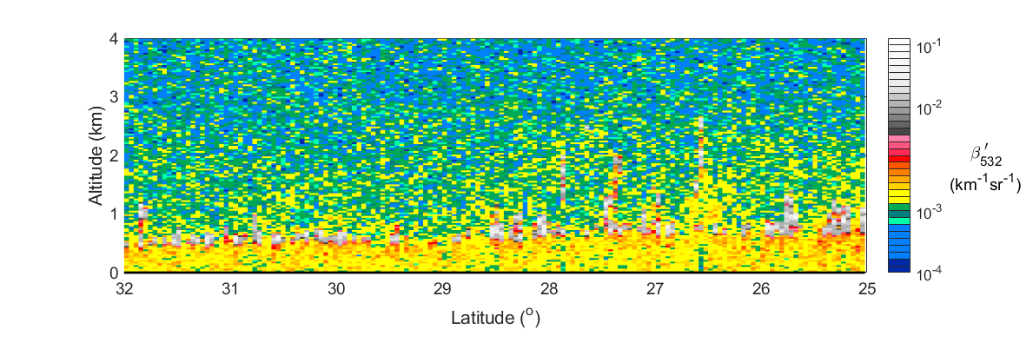

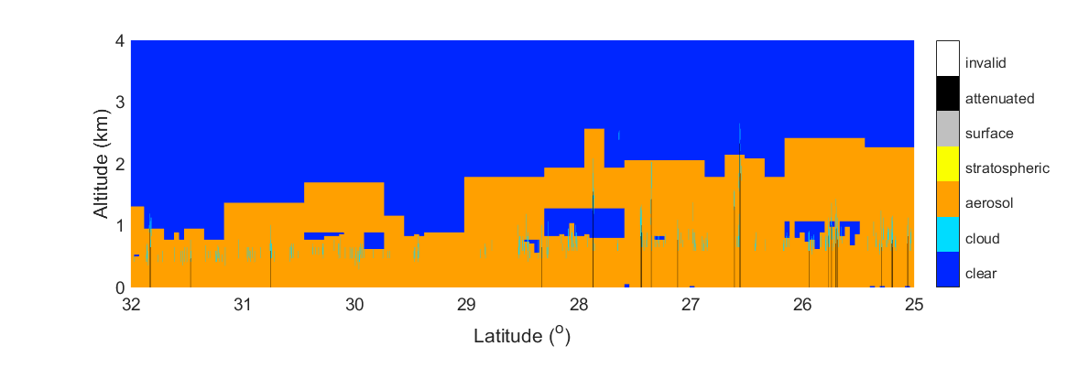
Boundary Layer Cloud Clearing, Ideal Case
V4.2
532 nm Attenuated Backscatter
Small-scale boundary layer clouds
Latitude (°)
Feature Detection
Clouds detected at 1/3 km resolution
2014-07-18T06-03-52ZN

Slide 3

Boundary Layer Cloud Clearing, Ideal Case
V4.2
532 nm Attenuated Backscatter
Small-scale boundary layer clouds
Latitude (°)
Feature Detection, 5-km and Coarser Resolution
After PBL cloud-clearing
2014-07-18T06-03-52ZN

Slide 4
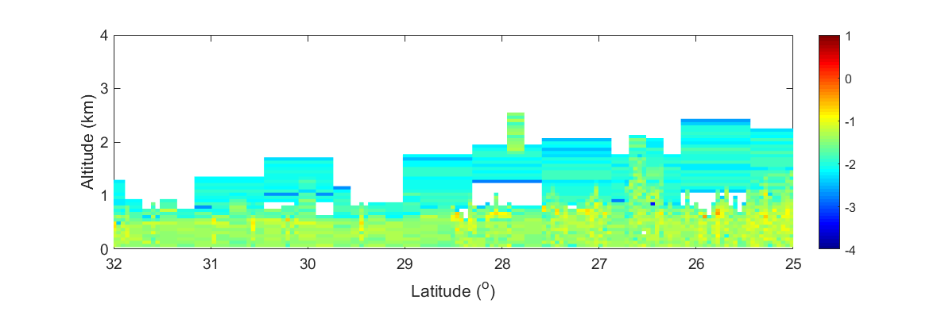
Boundary Layer Cloud Clearing, Ideal Case
V4.2
532 nm Aerosol Extinction
Log10
(km⁻¹)
Latitude (°)
Feature Detection, 5-km and Coarser Resolution
After PBL cloud-clearing
2014-07-18T06-03-52ZN

Slide 5
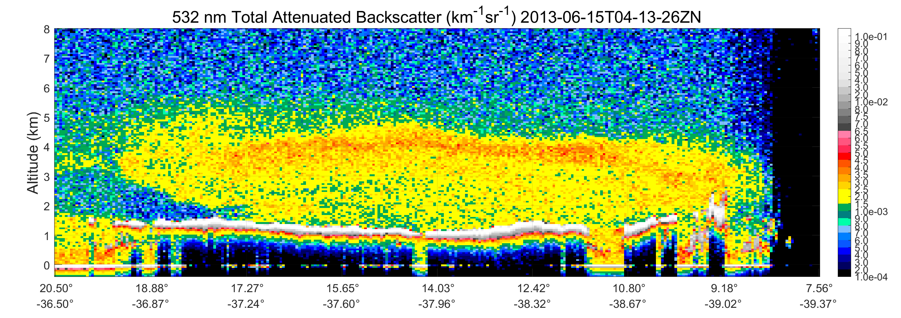
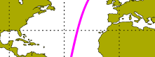
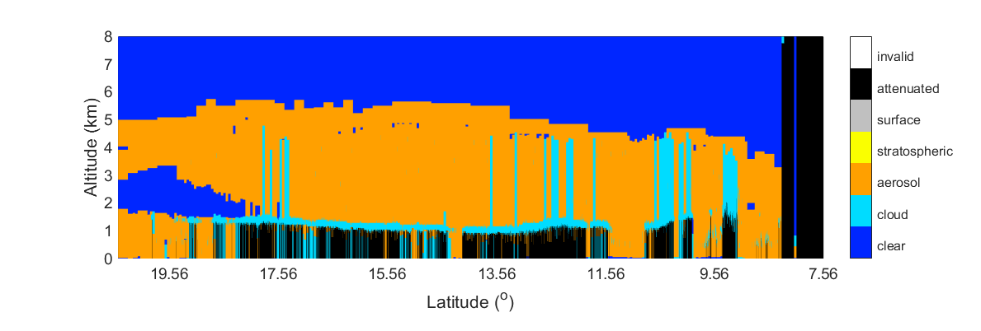
Incorrect Cloud-Clearing Example
V4.2
532 nm Attenuated Backscatter
Dust plume
(km⁻¹sr⁻¹)
Cloud layer
Latitude
Feature Detection
Clouds detected at 1/3 km resolution
2013-06-15T04-13-26ZN

Slide 6
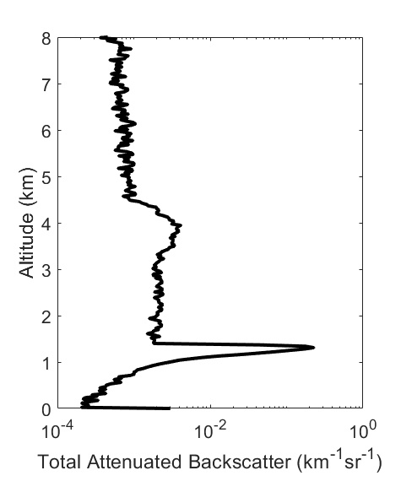
Incorrect Cloud-Clearing Example
V4.2
532 nm Attenuated Backscatter
Dust plume
Layer detection threshold (hypothetical)
(km⁻¹sr⁻¹)
Cloud layer
Latitude
Feature Detection
2013-06-15T04-13-26ZN

Slide 7
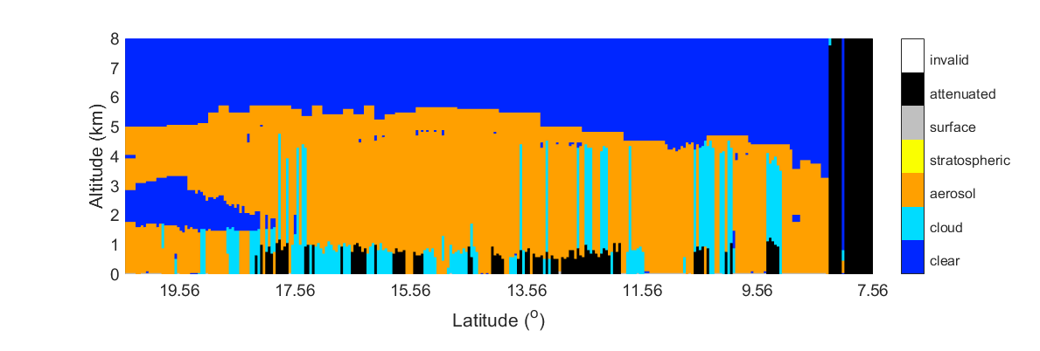
Incorrect Cloud-Clearing Example
V4.2
532 nm Attenuated Backscatter
Dust plume
(km⁻¹sr⁻¹)
Cloud layer
Latitude
Feature Detection, 5-km and Coarser Resolution
This is what goes into the aerosol extinction retrieval
2013-06-15T04-13-26ZN

Slide 8
Incorrect Cloud-Clearing Example
V4.2
532 nm Attenuated Backscatter
Dust plume
(km⁻¹sr⁻¹)
Cloud layer
These range bins are 100% filled with clouds, but are misclassified as aerosol
Latitude
Feature Detection, 5-km and Coarser Resolution
2013-06-15T04-13-26ZN

Slide 9
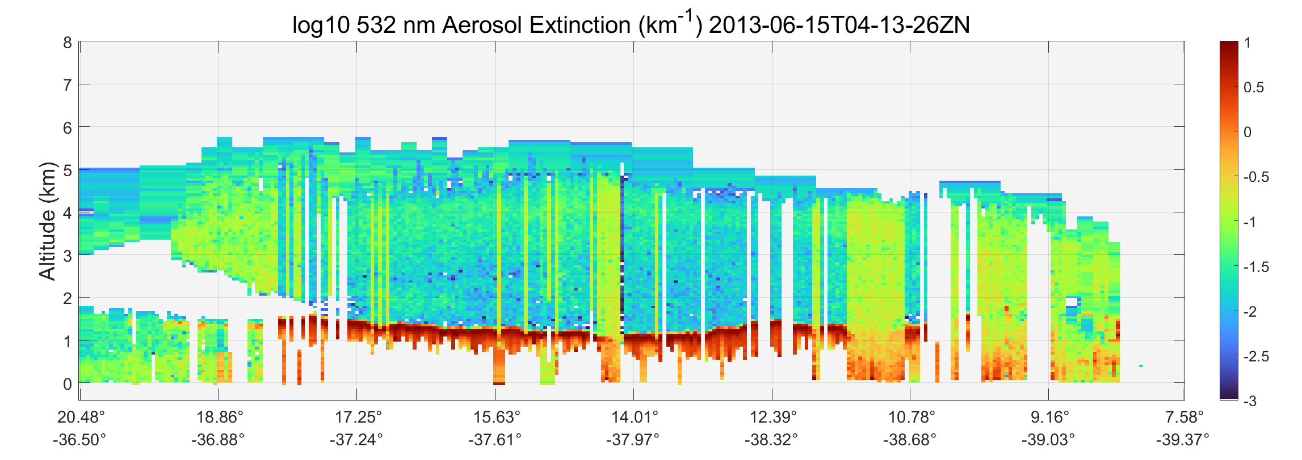
Incorrect Cloud-Clearing Example
V4.2
532 nm Aerosol Extinction
Log10
(km⁻¹)
Latitude
Cloud-clearing failures yield enormous biases in aerosol extinction
2013-06-15T04-13-26ZN

Slide 10
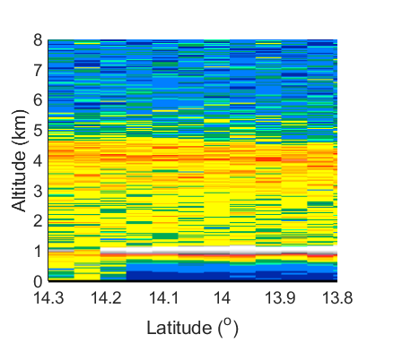
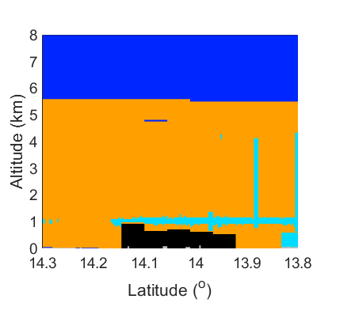
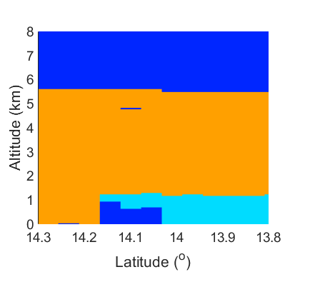
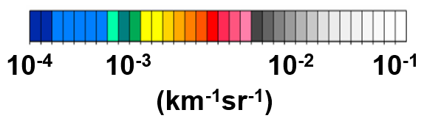
The Solution
Modify boundary layer cloud clearing for 5-km resolution layers containing single-shot resolution clouds in every profile.
532 nm Attenuated Backscatter
Feature Types, All Resolutions
Feature Types, ≥ 5 km Resolution
V4.2
aerosol
V4.5
aerosol
cloud
cloud
Overlying aerosol layer severed from mother layer
Detected as a single 5-km “mother layer” in V4.2
Underlying 1/3-km resolution clouds fused into a single 5-km cloud layer
2013-06-15T04-13-26ZN

Slide 11
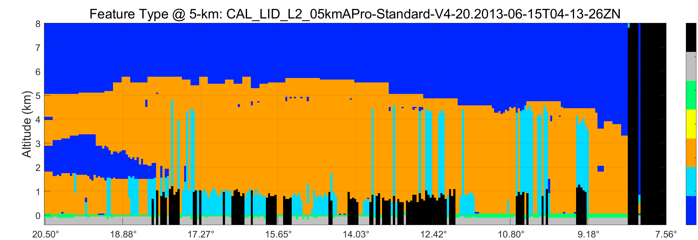
Incorrect Cloud-Clearing Example Again
V4.2
532 nm Aerosol Extinction
Log10
(km⁻¹)
Latitude
Feature Detection, 5-km and Coarser Resolution
totally attenuated
subsurface
surface
stratospheric
aerosol
cloud
clear air
Latitude
2013-06-15T04-13-26ZN

Slide 12
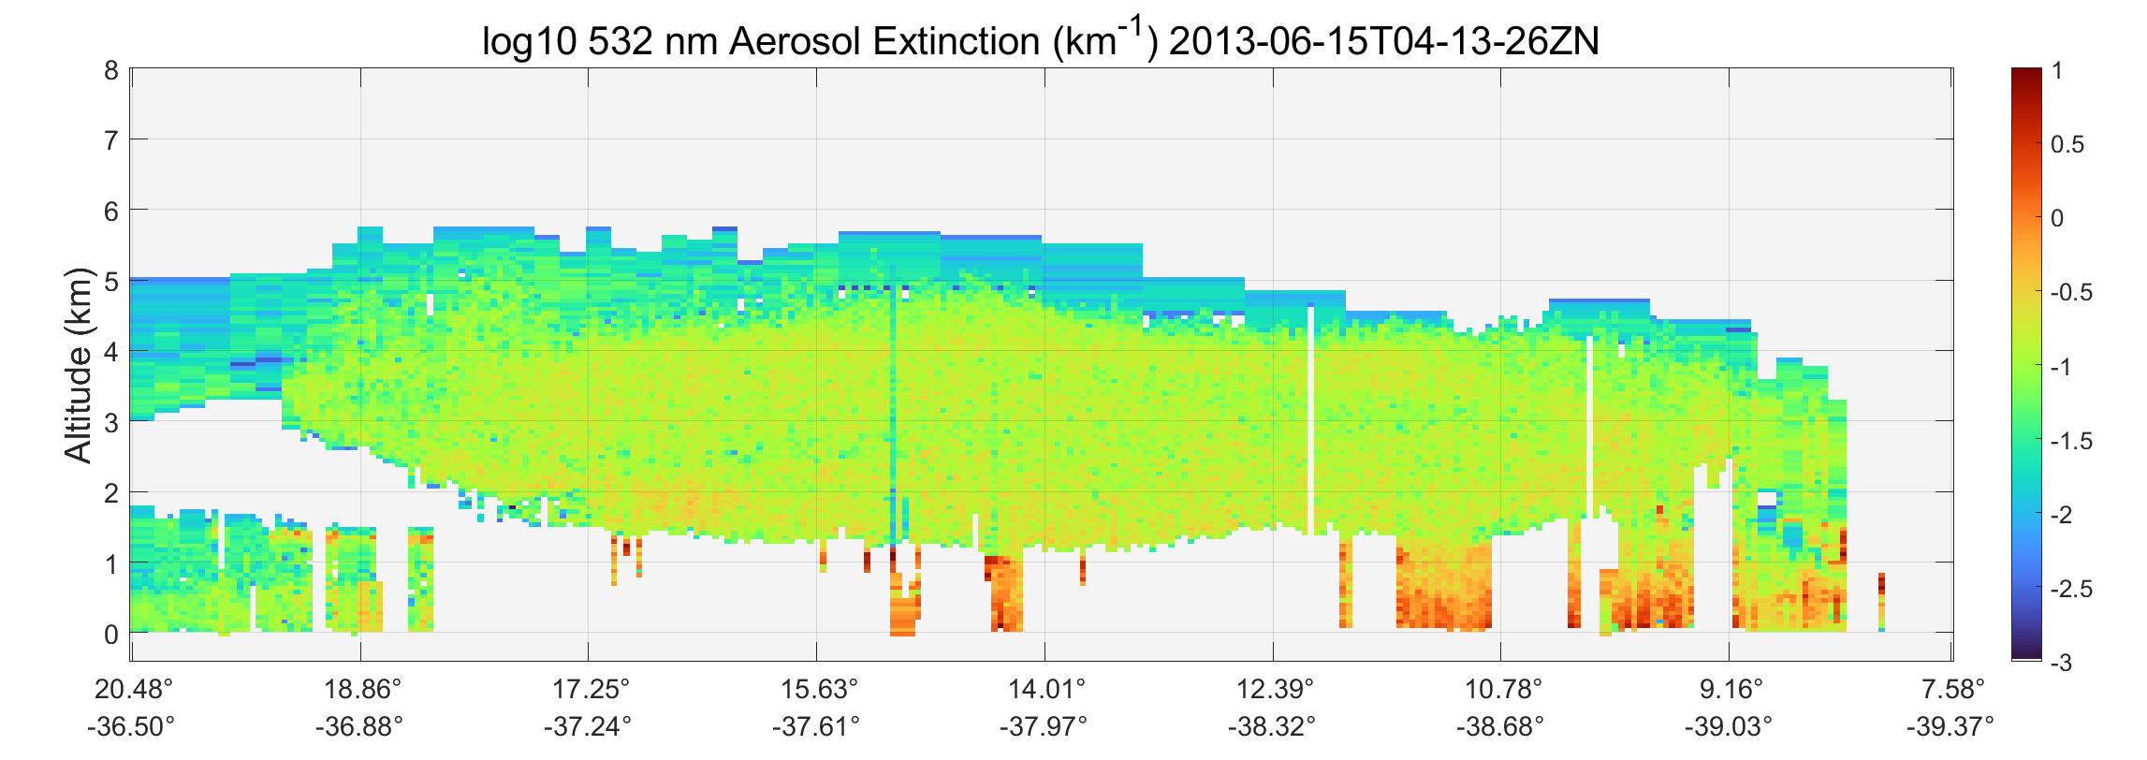
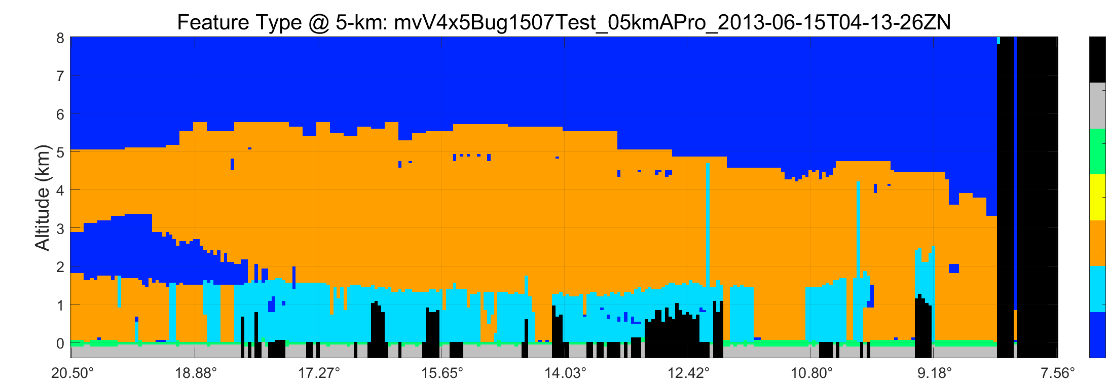
Improved Cloud-Clearing in V4.5
V4.5
532 nm Aerosol Extinction
Low bias corrected
Cloud contamination removed
Log10
(km⁻¹)
Latitude
Feature Detection, 5-km and Coarser Resolution
totally attenuated
subsurface
surface
Cloud layers correctly identified
stratospheric
aerosol
cloud
clear air
Latitude
2013-06-15T04-13-26ZN

Slide 13
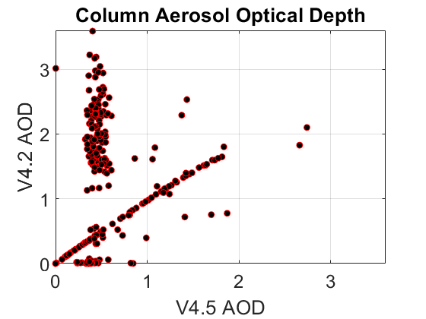
Improved Cloud-Clearing in V4.5
V4.5
532 nm Aerosol Extinction
Low bias corrected
Cloud contamination removed
Log10
(km⁻¹)
Errors of 100-500% are corrected in this scene
Latitude
Feature Detection, 5-km and Coarser Resolution
totally attenuated
subsurface
surface
stratospheric
aerosol
cloud
clear air
Latitude
2013-06-15T04-13-26ZN

Slide 14
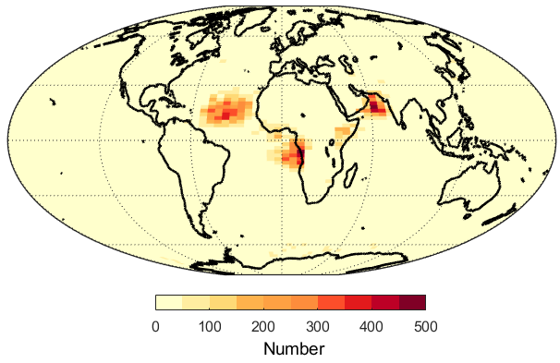
Impacts and Summary
Version 4.5 will include a critical improvement to boundary layer cloud-clearing
Around 2.7% of 5-km resolution layers are impacted, preventing substantial biases due to incorrect cloud-clearing.
JJA 2007, 2013, 2014
Number of Severed Aerosol Layers

