Slide 1





Medium-Range River Flood Forecasts Using a Long Short-Term Memory Network
Andrew T. White¹, Kristopher D. White², Christopher R. Hain³, Jonathan L. Case⁴, Kevin K. Fuell¹
¹University of Alabama in Huntsville/NASA SPoRT
²NWS/NASA SPoRT
³NASA MSFC/NASA SPoRT
⁴ENSCO Inc./NASA SPoRT

Slide 2
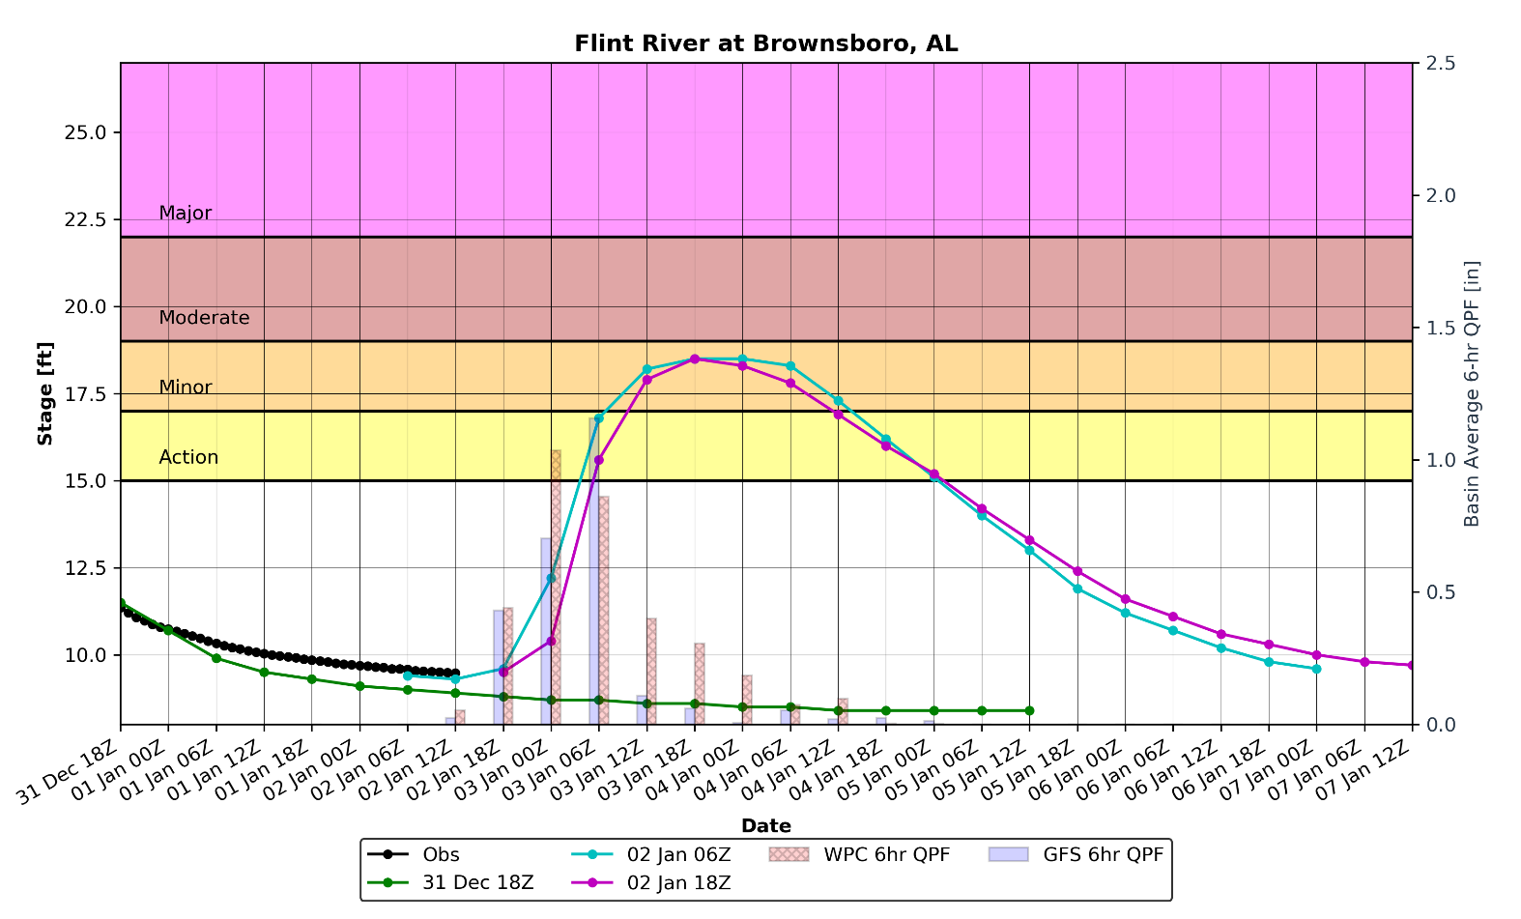
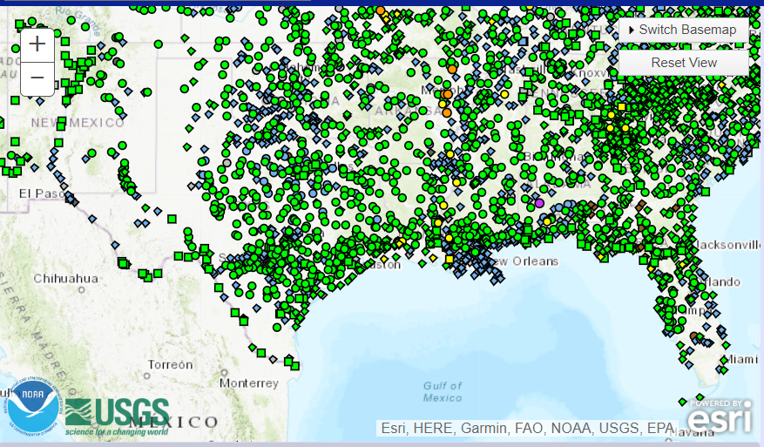
Motivation
Identification of operational gaps:
During approaching heavy rain events, NWS offices rely on river level or gauge predictions from the RFCs, however…
  gauge height forecasts may only account for only 1-2 days of QPF in the official forecast products
  forecasts are not available at all gauges, some of which exhibit problematic flooding
Official Forecast 2 days out is flat
~2-3 inches expected
Official Forecast with precipitation included
RFC forecasts for the Flint River in Northern Alabama.

Slide 3
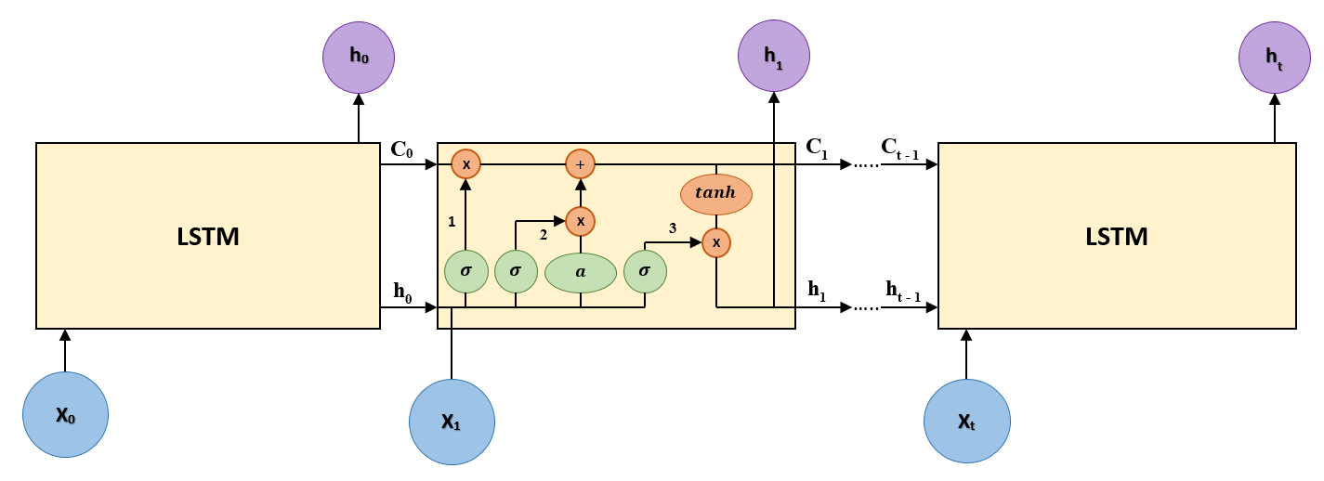
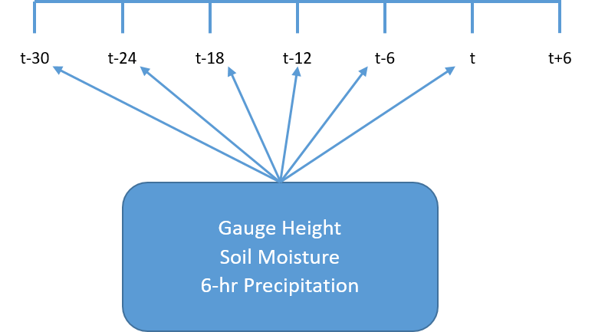
Machine Learning: Long Short-Term Memory (LSTM)
LSTM networks used for hydrologic prediction have been around since about the turn of the century (Sivakumar et al., 2002, Nagesh Kumar et al., 2004)
The SPoRT LSTM models are trained using available data over the Jan 2010 – Jul 2018 period
Input time-lagged training variables:
  SPoRT Land Information System (LIS) Relative Soil Moisture (RMS):
    0 – 10 cm, 10 – 40 cm, 40 – 100 cm, 100 – 200 cm, 0 – 200 cm
  Gauge Height
  MRMS 6hr QPE for training (replaced with QPF for forecasting)
Model validation conducted over the August 2018 to April 2019 period

Slide 4
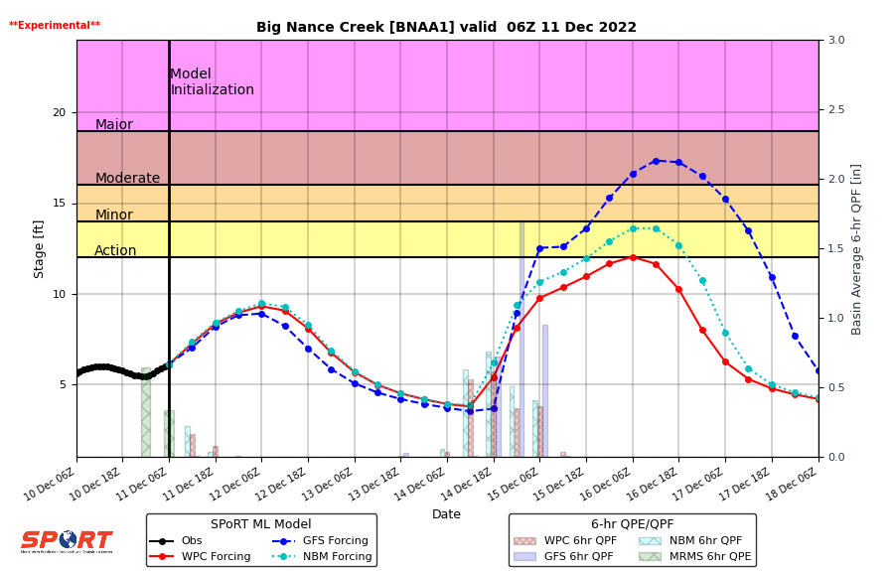
Operational Forecasts
Gauge height forecasts:
  6-hour resolution within a 7-day period
  updated every 6 hours, typically available around 0130Z, 0730Z, 1330Z, and 1930Z
Three different model scenarios are run with different QPF forcing (NBM, WPC, and GFS).
  Basin average precipitation is overlaid on the forecast graphs so that forecasters can see the different QPFs, and to allow them to observe the model response to different forcing.

Slide 5
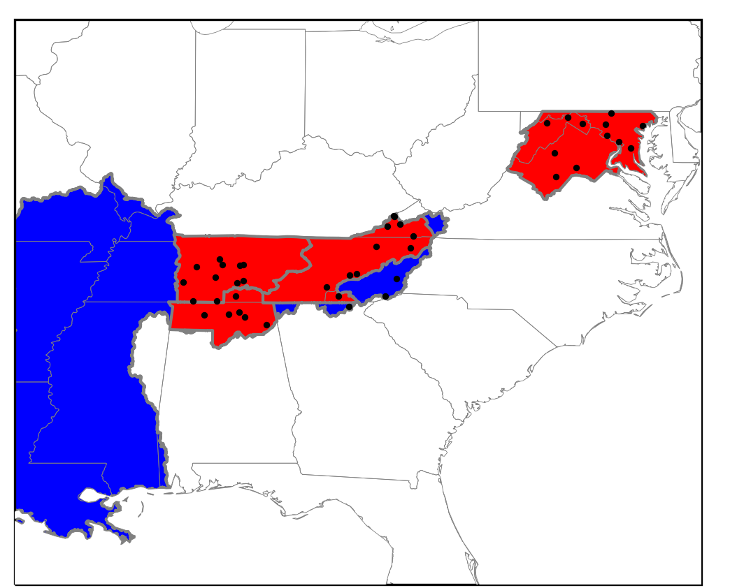
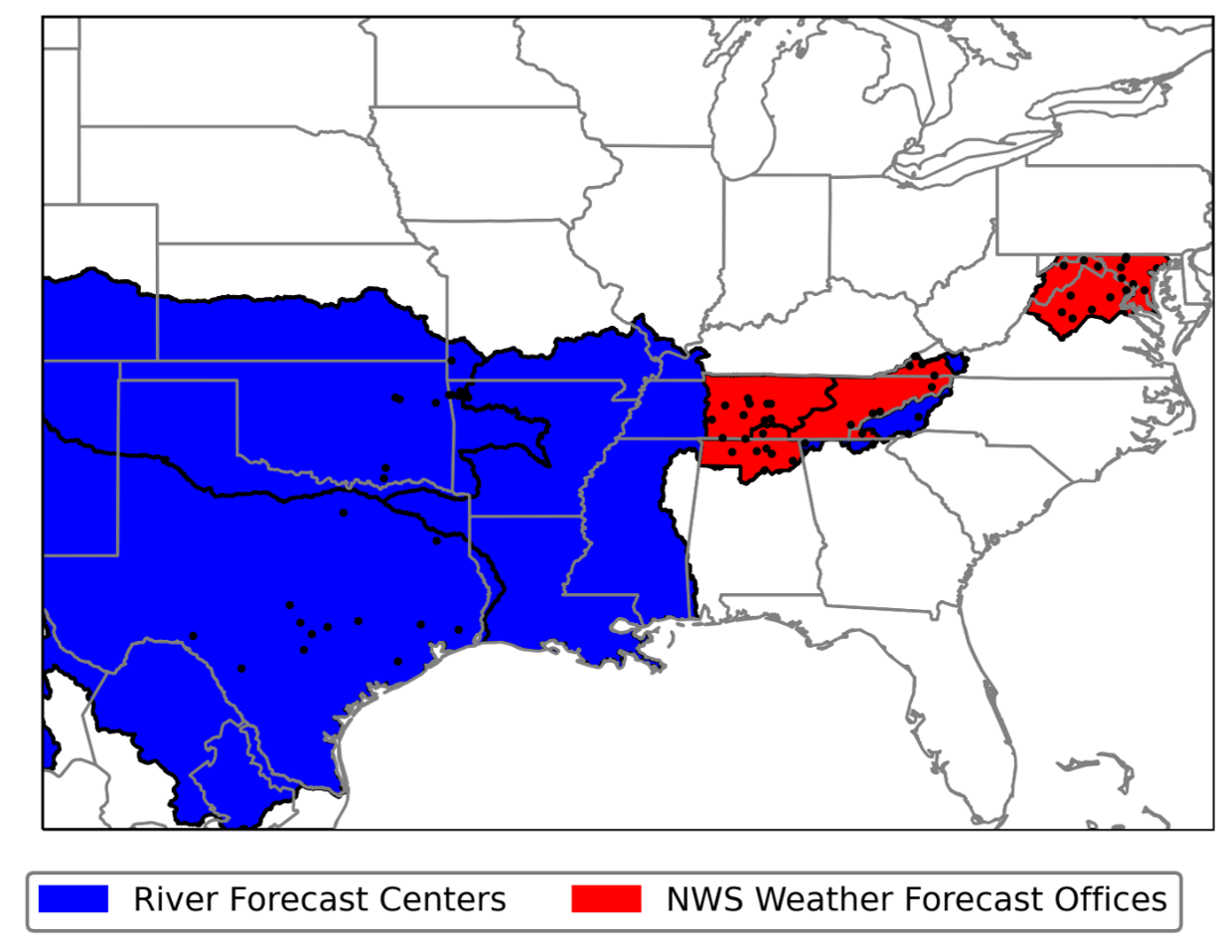
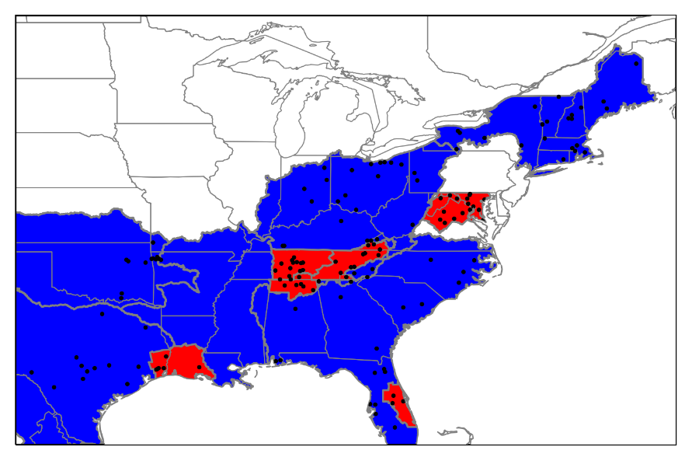
Current Project Domain
Nearly all project expansion has been user driven
  RFCs: Lower Mississippi, West Gulf, Arkansas-Red Basin, Northeast, Ohio, Southeast
  WFOs: Huntsville, Nashville, Morristown, Sterling, Lake Charles, Melbourne
Product additions have been focused on meeting user needs
  Addition of NBM QPF
  Extension of the forecast window
  Forecast data available via LDM

Slide 6
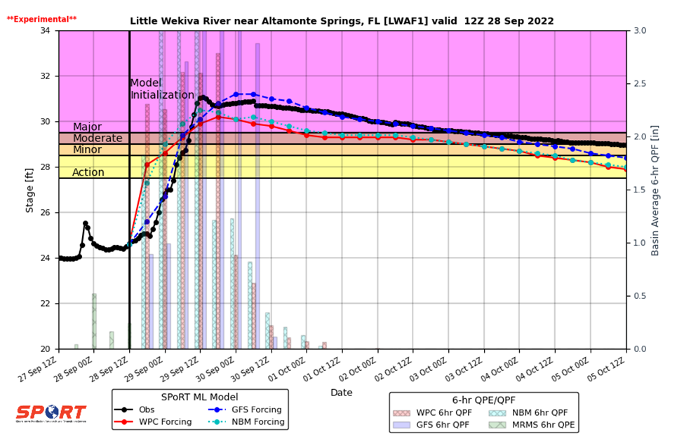
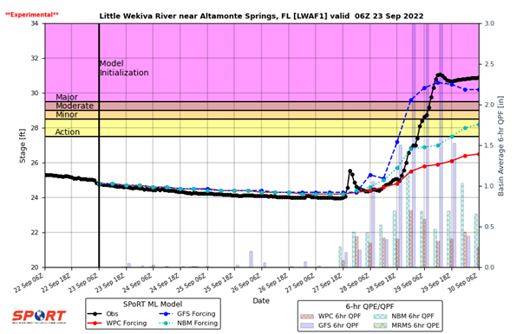
Recent Highlight: Hurricane Ian
GFS QPF, as much as 6 days in advance, indicated potential for excessive rainfall over central Florida.
SPoRT ML Forecast for the Little Wekiva River indicated the potential of a flood of record 6 days in advance.
  Consistent flood of record predictions 1-2 days in advance.

Slide 7
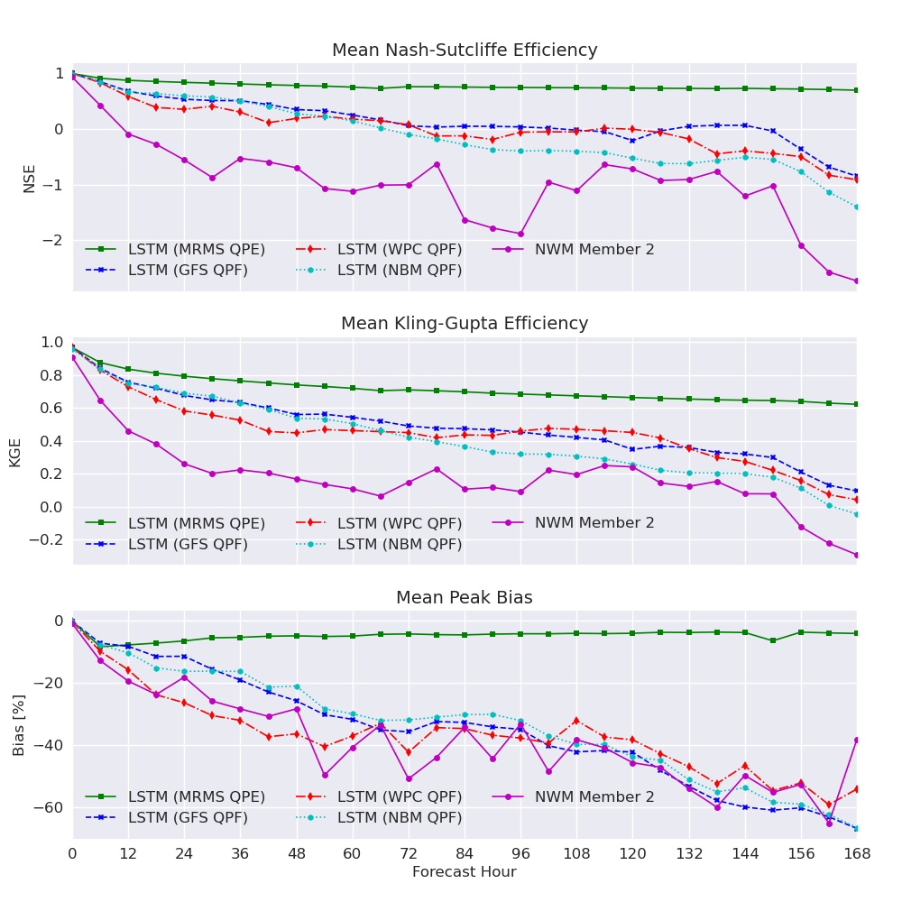
Validation
Preliminary validation conducted over the October 2020 – April 2021 time period.
SPoRT ML Forecasts statistically outperform the equivalent medium-range National Water Model ensemble member

Slide 8
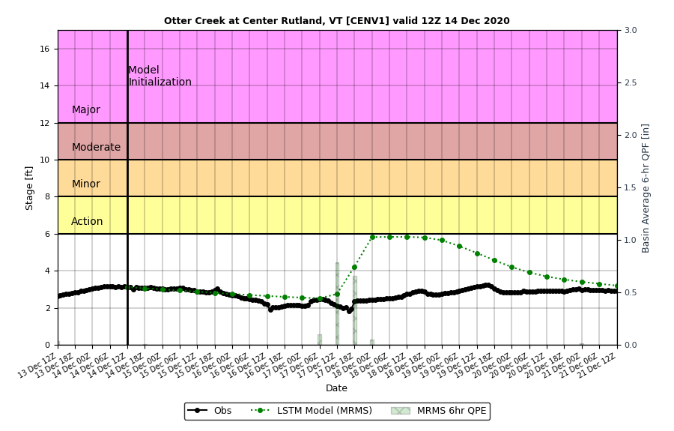
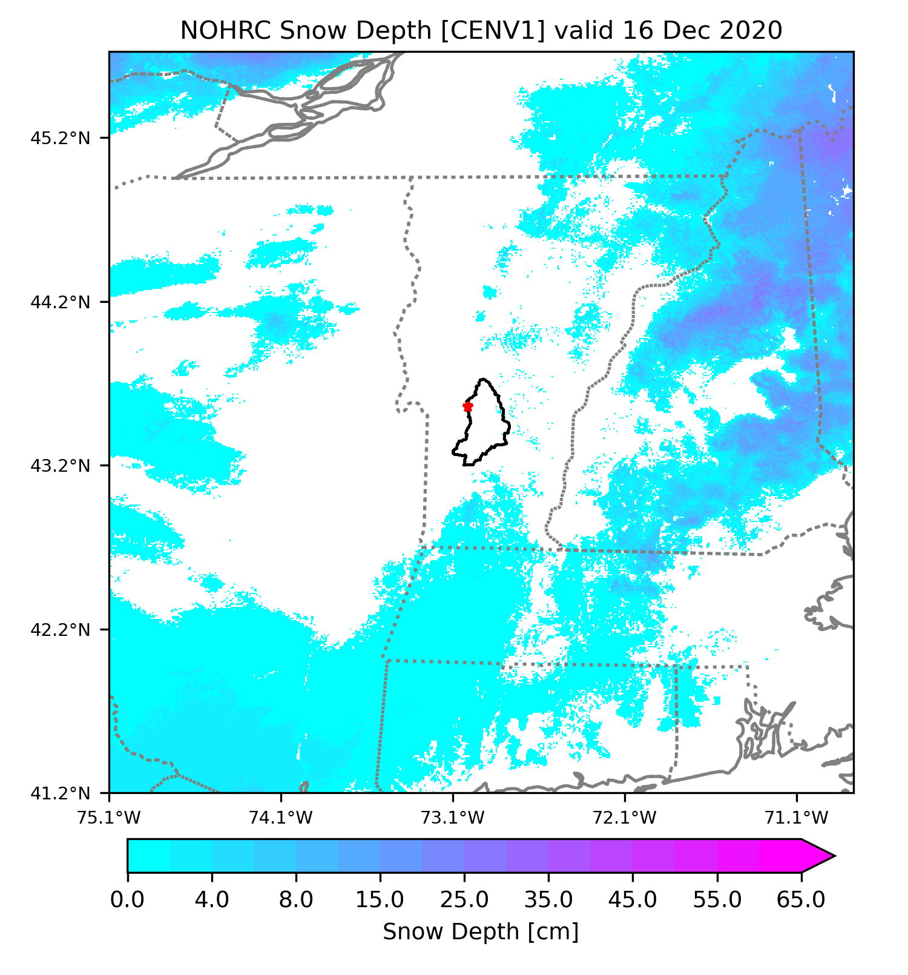
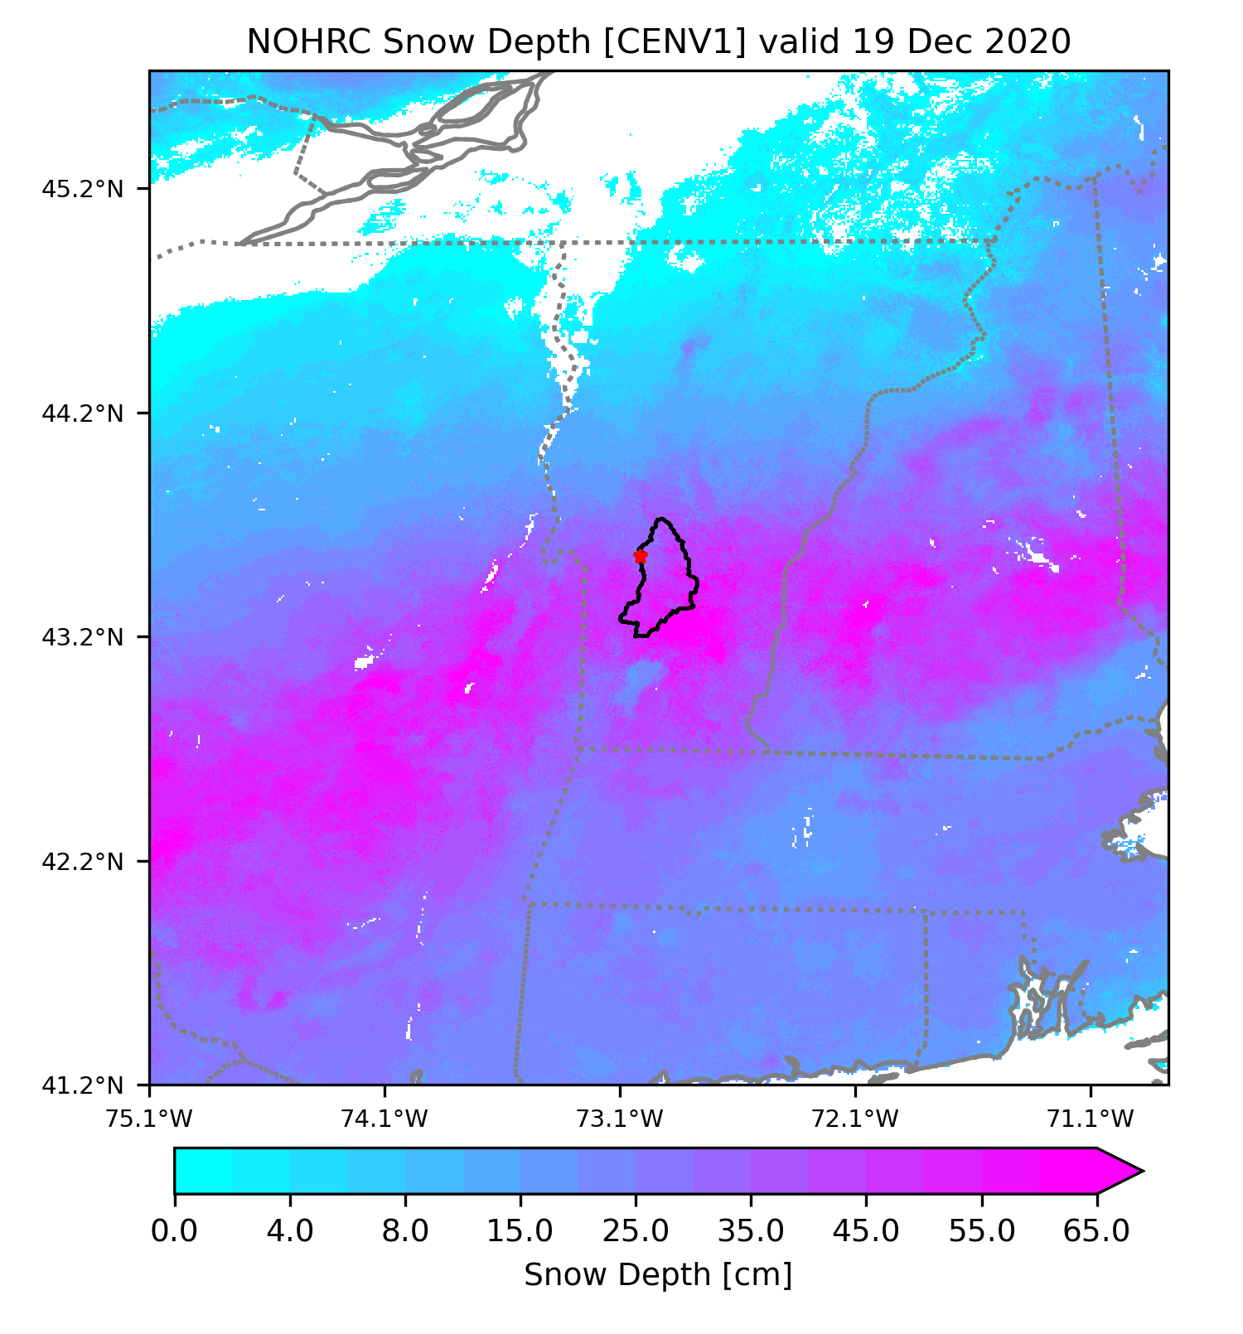
Snow/Ice Limitations
Original configuration thought the stream should rise.
~ 1.5” – 2.0” QPE
Original model was developed for rainfall dominated basins.
  Inadequate for expansion into northern climates: NERFC.
Very little change in the observed stage height

Slide 9
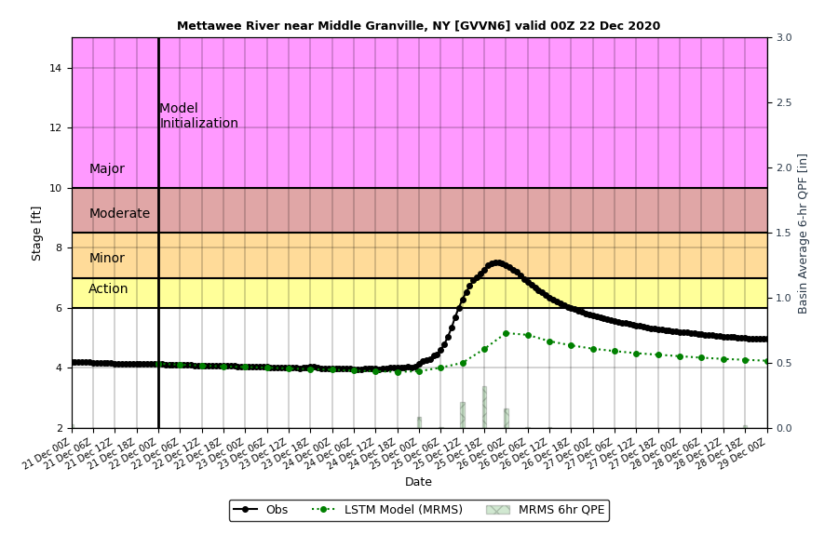
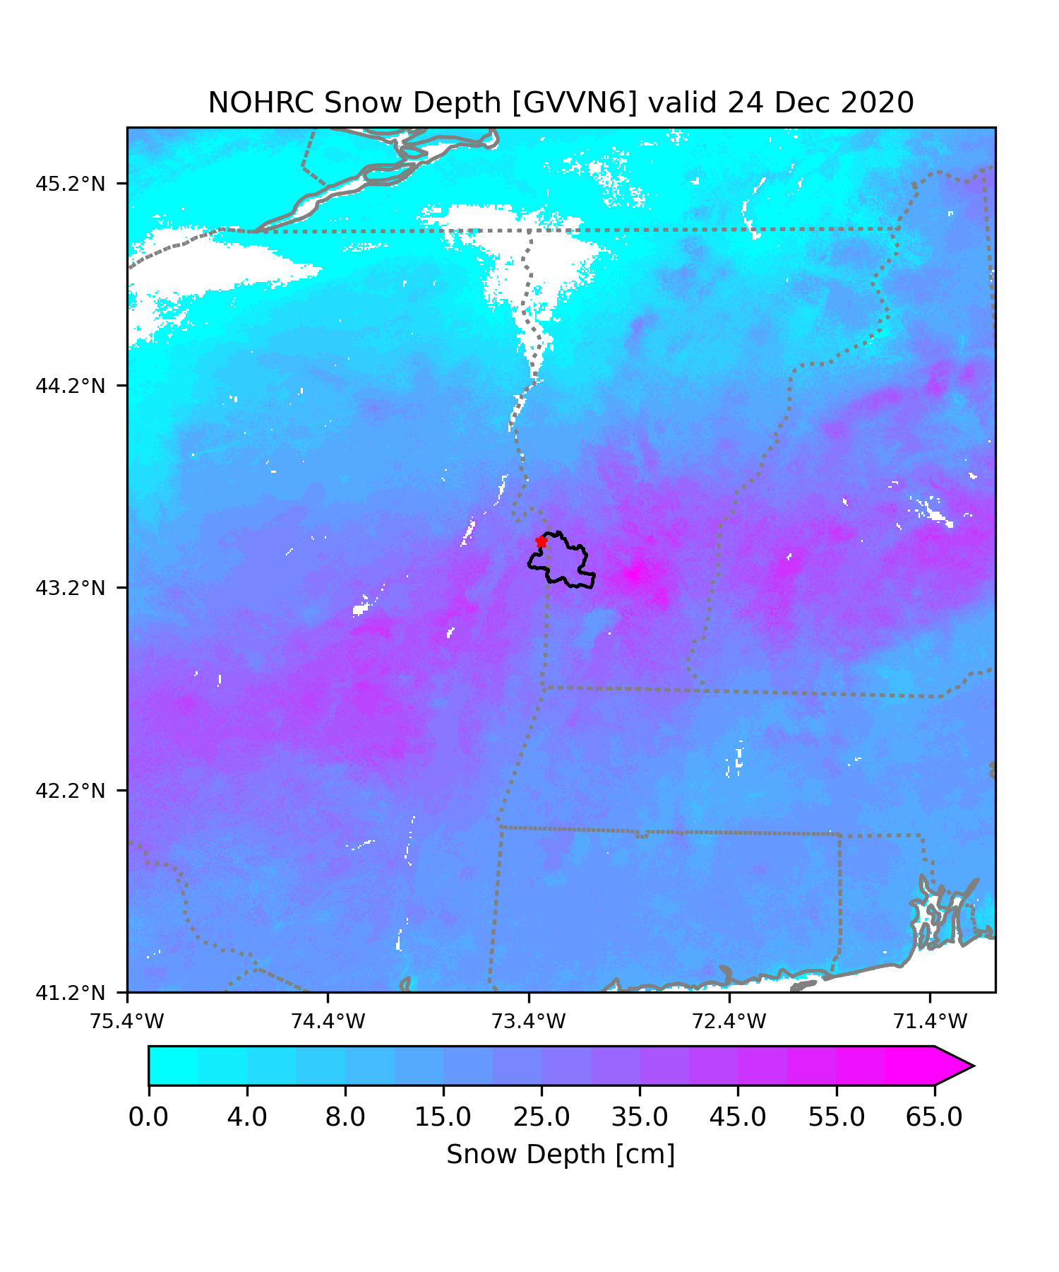
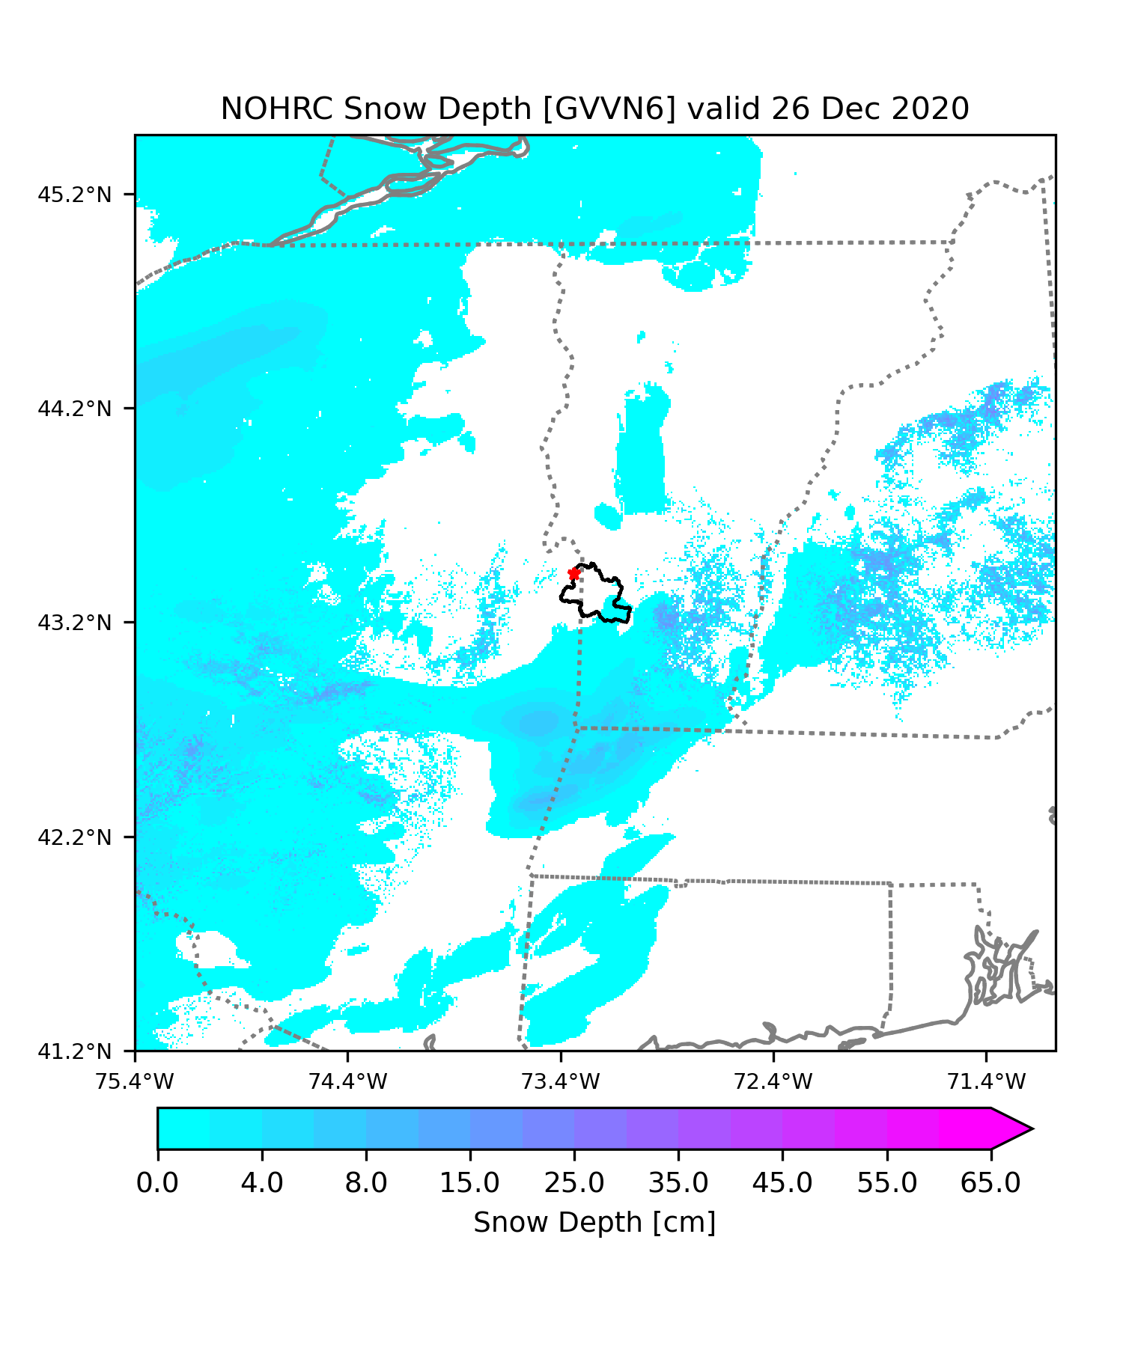
Snow/Ice Limitations
Large change in observed stage height
> 1.0” QPE
Original model was developed for rainfall dominated basins.
  Inadequate for expansion into northern climates: NERFC.
Small predicted rise in the stage height.

Slide 10
Introduction of Snowfall/Snowmelt Processes
Original model was developed for rainfall dominated basins.
  Inadequate for expansion into northern climates: NERFC.
Introduced four additional variables into the model from the SPoRT-LIS.
  Temperature
  Dew point
  Downwelling shortwave radiation
  Snow water equivalent (SWE)
t-30 h
t-24 h
t-18 h
t-12 h
t-6 h
t
t+6 h
Gauge Height
Soil Moisture
6-hr Precipitation
Temperature
Dew Point
Downwelling Shortwave Radiation
Snow Water Equivalent

Slide 11
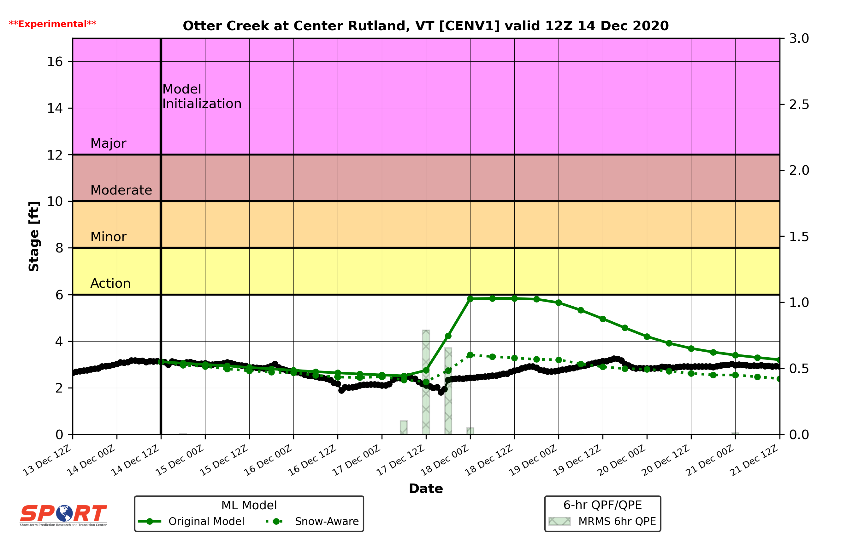
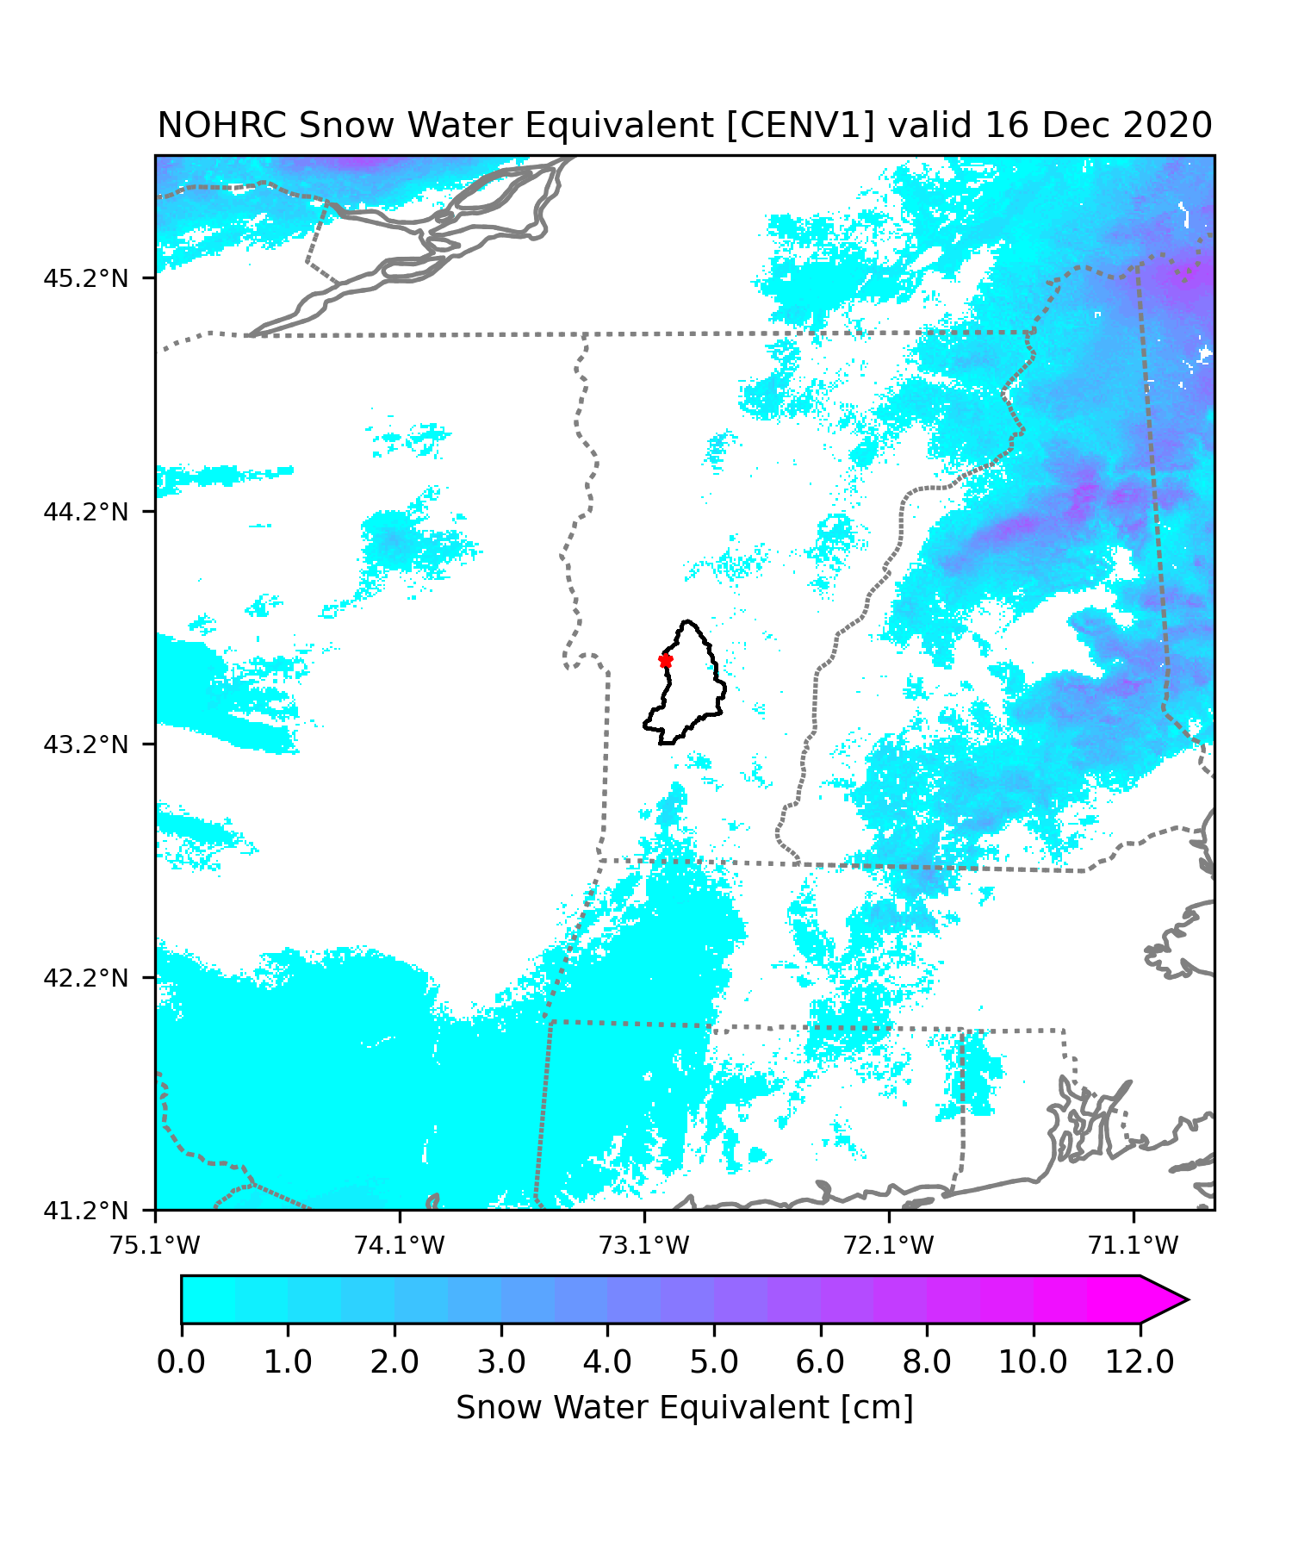
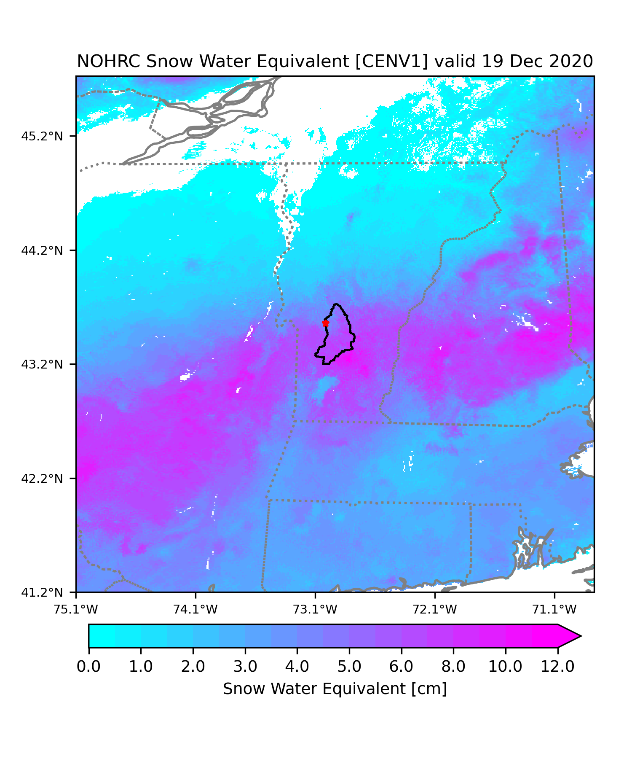
Snow/Ice Aware Model Improvements
The snow-aware model prediction is much closer to the observed height.
  Model realized that the precipitation fell as snow.

Slide 12
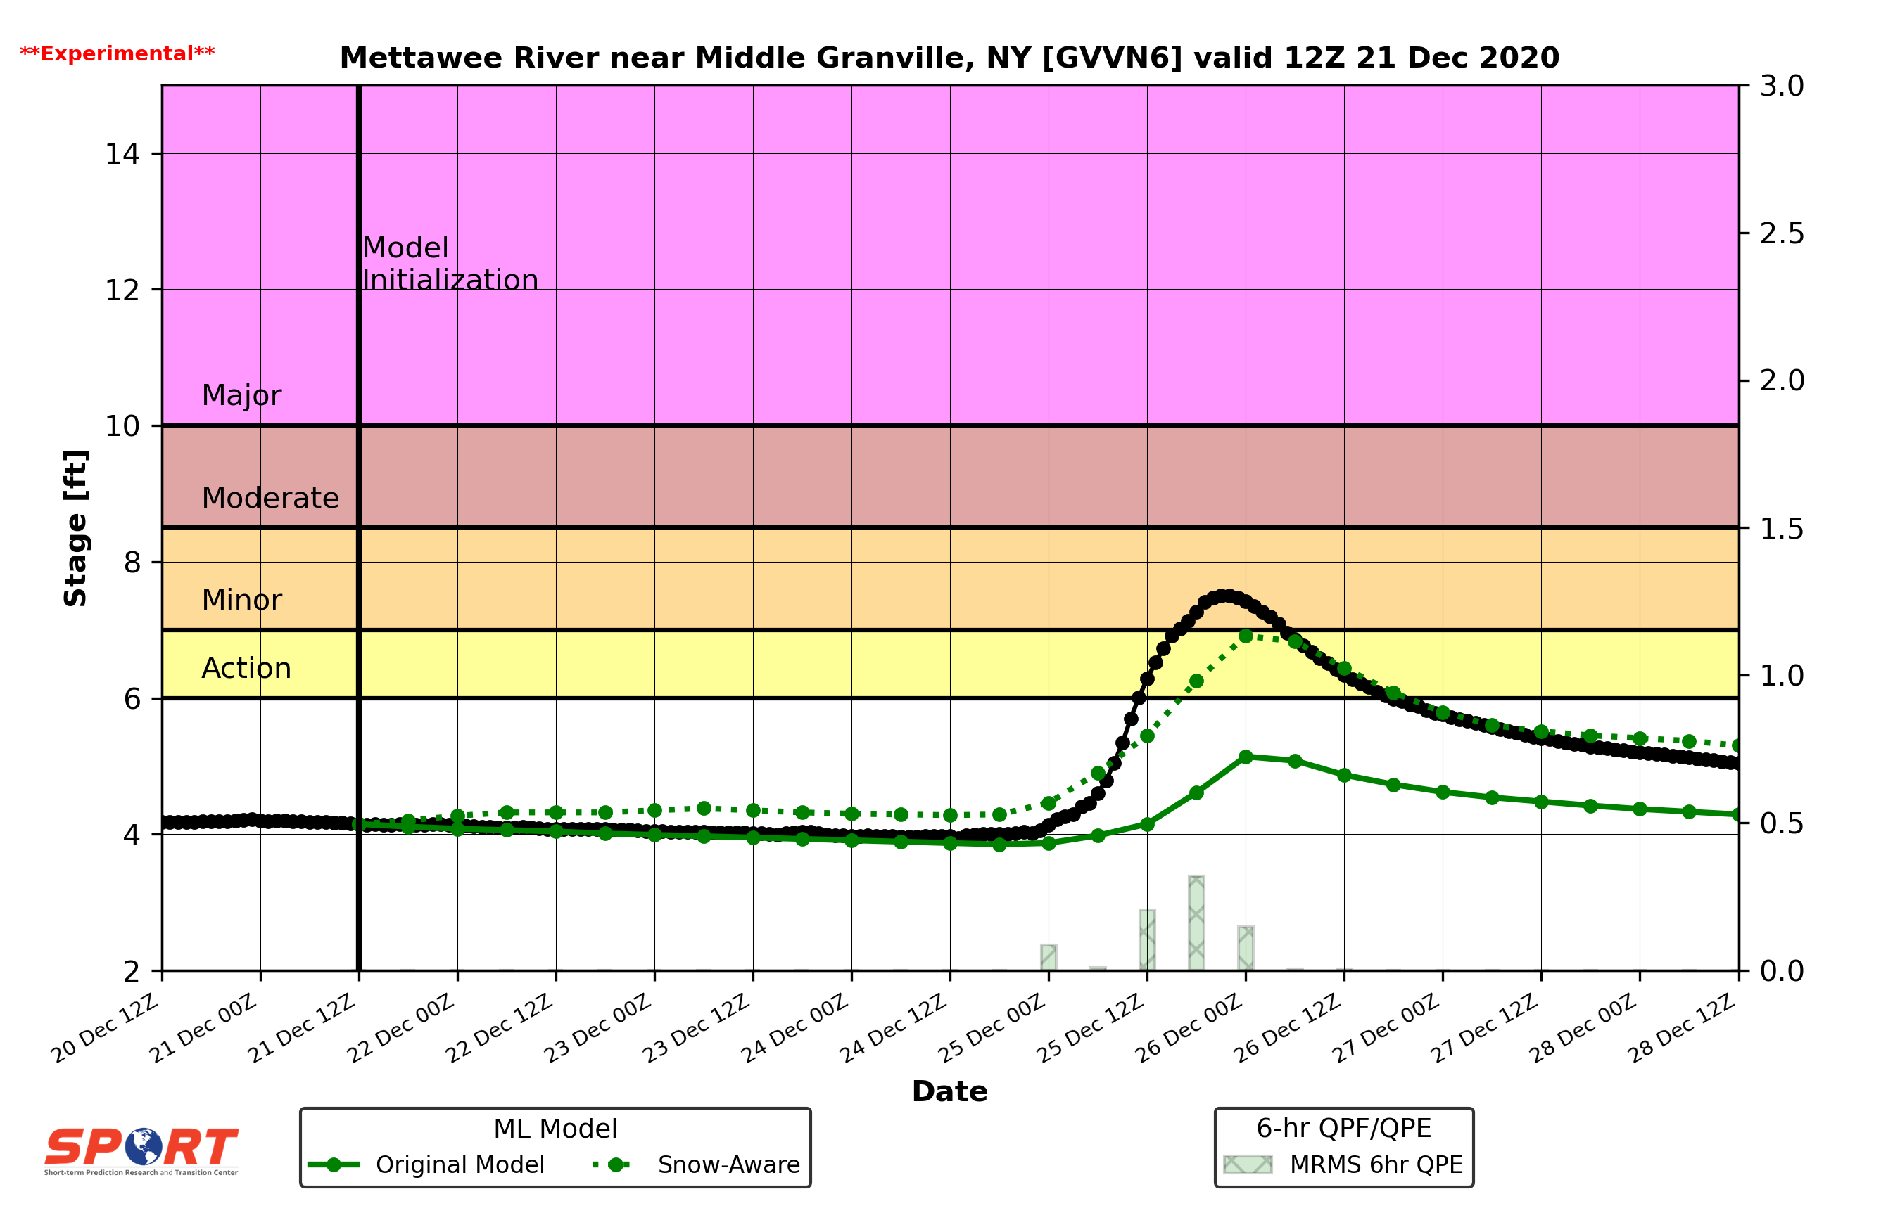
Snow/Ice Aware Model Improvements
Similarly, for a rain-on-snow event, the snow-aware model accounts for an additional runoff source.

Slide 13
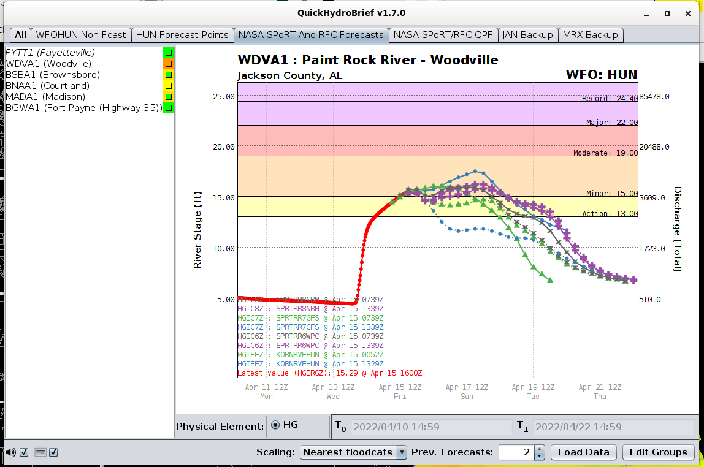
Project R2O/O2R Highlights
Accomplished
Added NBM data QPF scenario
Forecasts out to 7 days
SHEF encoded files available in AWIPS/CHPS and apps such as QuickHydroBrief
Model improvements for locations with significant amounts of snow and ice
User driven project expansion
With more to come…

Slide 14
Thanks for your time!
Questions?
Andrew White andrew.t.white@nasa.gov

