Slide 1

A Modeling and Simulation Study for the GeoXO Atmospheric Composition Instrument (ACX):
System Level SO₂ and O₃ Retrieval Performance as a Function of SNR
Monica Cook¹, Francis Padula¹, Aaron Pearlman¹, Boryana Efremova¹, Joel McCorkel², Joanna Joiner²
¹GeoThinkTank LLC
²NASA Goddard Space Flight Center
AMS 103rd Annual Meeting
8 – 12 January 2023
Denver, Colorado

Slide 2
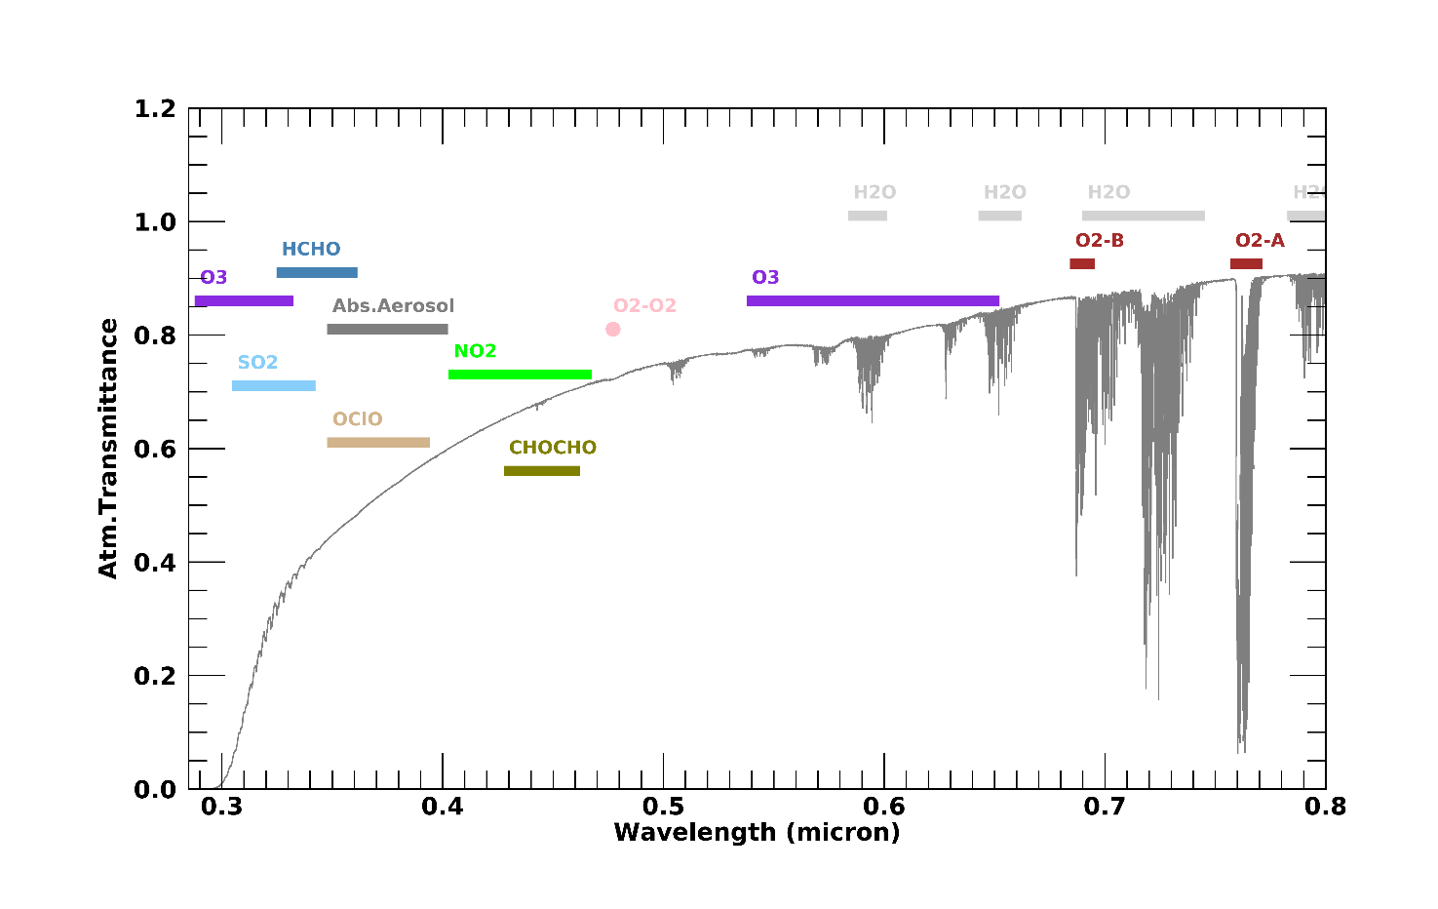
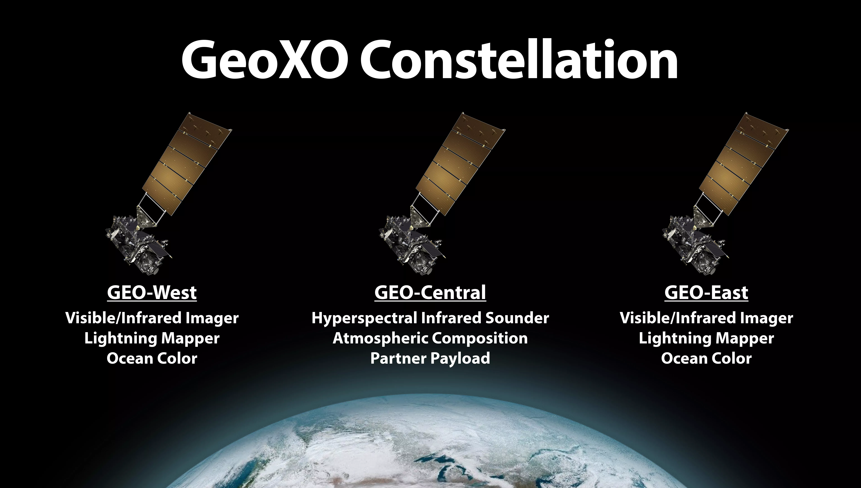
NOAAs Geostationary and Extended Observations (GeoXO) ACX Introduction
Atmospheric Composition Spectral Regions of Interest
ACX: observations of air pollutants to improve air quality monitoring and mitigate health impacts from severe pollution and smoke events
Planned ACX Instrument
Spectral Resolution | 0.6 nm
Spectral Sampling | 0.2 nm
Spectral Range | 300 – 500 nm; 540 – 740 nm
Temporal Revisit | 60 min
Spatial Resolution | 25 km² at nadir
Enhance NOAA’s current capabilities to monitor hourly variation in pollutants
Enhance NOAA’s air quality forecasting capabilities (pollution alerts, regulatory guidance, reduced health impacts)
https://www.nesdis.noaa.gov/next-generation/geostationary-extended-observations-geoxo

Slide 3
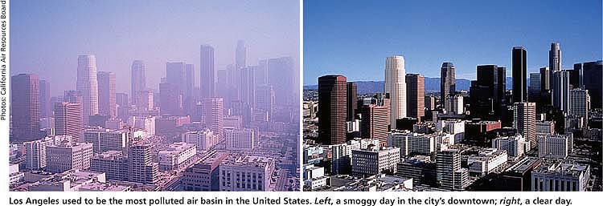
ACX Performance Assessment
ACX
Translate instrument specifications to science performance metrics
100 km
Stratospheric +
Composition
Objective:
Assess instrument performance considerations through end-to-end physics based imaging system & scene modeling & simulation to inform decision making.
Investigate the impacts of simulated ACX SNR specification on trace gas retrieval performance
Previously studied NO₂ (420 – 450 nm) [EUMETSAT 2021]
This study investigates SO₂ and O₃ retrievals (approx. 300 – 350 nm)
10 km
Tropospheric
Composition
2 km
Boundary Layer
Composition
NO₂
O₃
SO₂
High Concentration
Low Concentration
Urban
Vegetation
Water
Surface Reflectance
[reference]

Slide 4
Utility of the Instrument Performance Assessment Simulations
Objective:
Assess instrument performance considerations through end-to-end physics based imaging system & scene modeling & simulation
End-To-End Image Chain
Simulated At Sensor Radiance
ACX Quantitative Analysis to Inform Decision Makers
Scene Phenomenology
Simulated L2 Products
Instrument Model
Framework designed to rapidly facilitate various quantitative instrument performance assessment trade studies against engineering and science applications
Technical Trade

Slide 5
Modeling & Simulation Framework
Atmospheric Scene of Interest
At Sensor Radiance
Known Column Amounts
Distribution of
At Sensor
Radiance + Noise
Retrieved
Slant Column Amount
O₃ SO₂
RTM
Instrument Model
Retrieval Algorithm
Analysis
Error
(Retrieval – Truth)
MODTRAN 6
Results
Plots illustrating simulated instrument retrieval performance as a function of SNR
Inputs/Outputs

Slide 6
Modeling & Simulation Framework
Atmospheric Scene of Interest
At Sensor Radiance
Known Column Amounts
Distribution of
At Sensor
Radiance + Noise
Retrieved
Slant Column Amount
O₃ SO₂
RTM
Instrument Model
Retrieval Algorithm
Analysis
Error
(Retrieval – Truth)
MODTRAN 6
Results
Plots illustrating simulated instrument retrieval performance as a function of SNR
Inputs/Outputs

Slide 7
ACX SNR Performance Assessment – Scene Scenarios
Atmospheric Scene of Interest
RTM
Accounts for the variability of concentration amount for a given standard atmosphere under typical surface and aerosol conditions with varying view geometry and solar conditions from GEO-central orbital location (105°W)
Norman, OK
(near nadir)
Seattle, WA
(off nadir)
location
June 20 @ 1pm
March 20 @ 1pm
time of year
March 20 @ 5pm
March 20 @ 4pm
72 scene simulations were generated for each trace gas to span the bounding cases of observation conditions
rural: spring/summer
MODTRAN default aerosol
4%
6%
8%
typical surface reflectance
US Standard
MODTRAN standard atmosphere
low
medium
high
column amount
tropospheric
boundary layer
constituent height in profile
O₃
SO₂
trace gas constituent
7

Slide 8
Modeling & Simulation Framework
Atmospheric Scene of Interest
At Sensor Radiance
Known Column Amounts
Distribution of
At Sensor
Radiance + Noise
Retrieved
Slant Column Amount
O₃ SO₂
RTM
Instrument Model
Retrieval Algorithm
Analysis
Error
(Retrieval – Truth)
MODTRAN 6
Results
Plots illustrating simulated instrument retrieval performance as a function of SNR
Inputs/Outputs

Slide 9
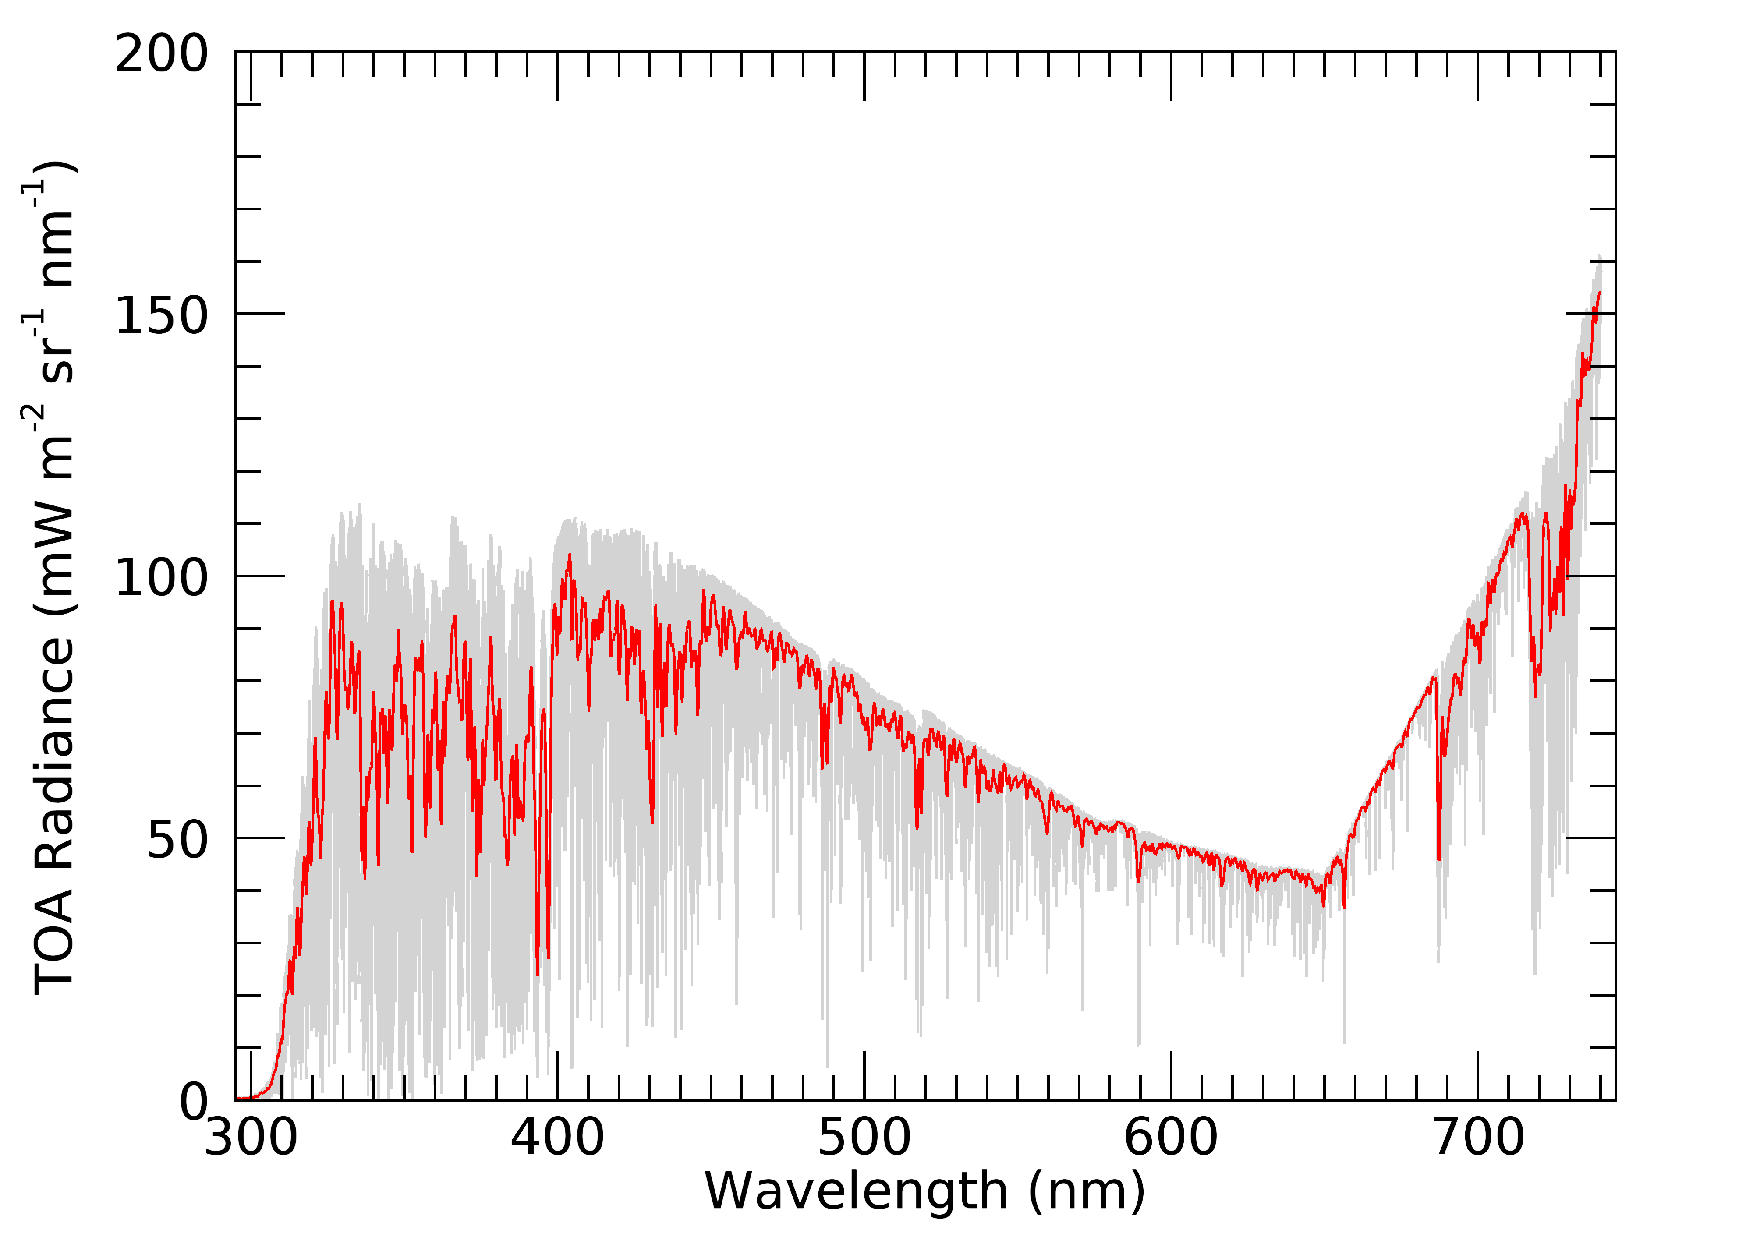
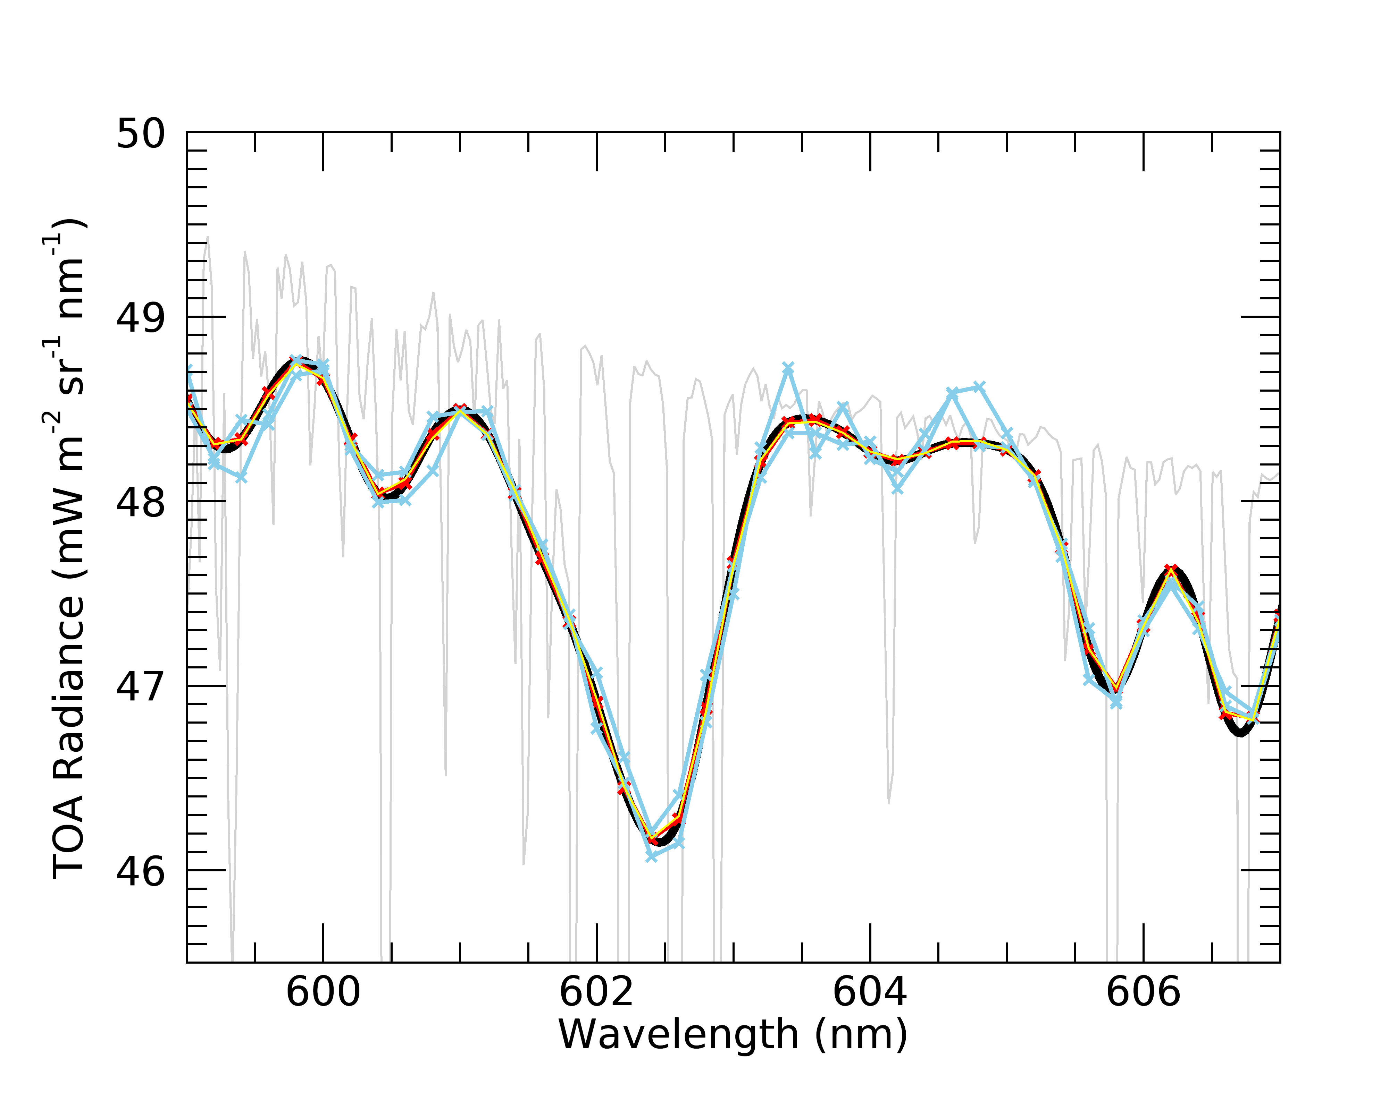
ACX Noise Simulation
Instrument Model
The ACX instrument model consists of the following steps:
The MODTRAN output spectra are convolved with a gaussian simulating the instrument spectral response function, resulting in a 0.6 nm spectral resolution
The degraded resolution spectrum is resampled to the expected instrument sampling of 0.2 nm/pix
Noise is added to achieve varying SNR as described below
Input Spectrum
0.6 nm resolution
Resampled to 0.2 nm
Noise Added
Average of 100 noise
added samples

Slide 10
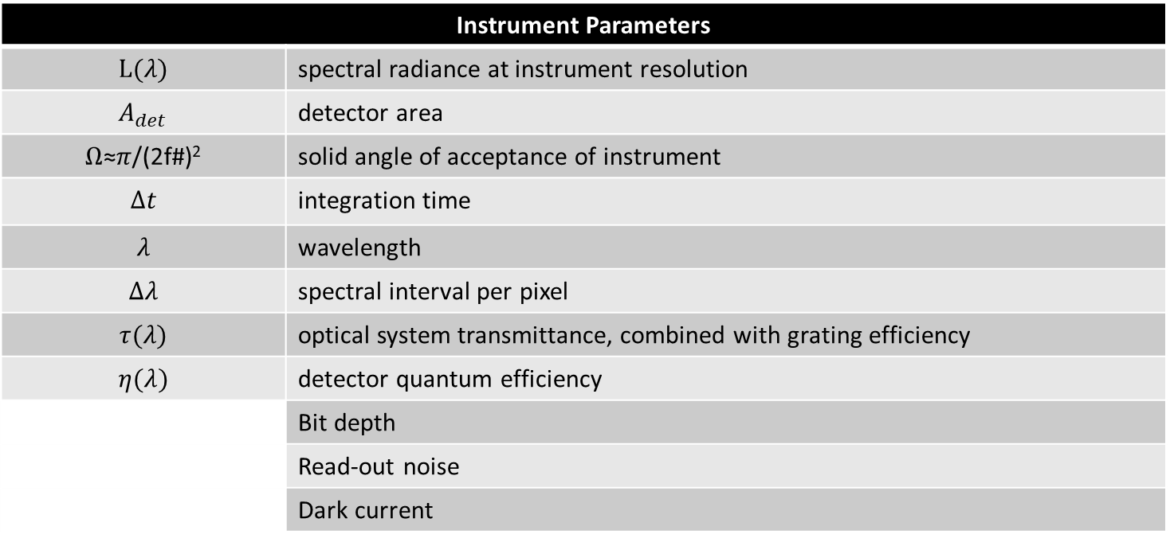
ACX Instrument Response Model
Instrument Model
Realistic baseline instrument parameters are used for setting up the tool
  Follows current GeoXO ACX Performance Operational Requirement Document (PORD) specifications
  Special thanks to Xiong Lu and Kelly Chance for assistance in this process
Can be updated as the ACX instrument evolves
Instrument Parameters
$$L(λ)$$ | spectral radiance at instrument resolution
$$A_{det}$$ | detector area
$Ω$≈𝜋/(2f#)² | solid angle of acceptance of instrument
$$Δt$$ | integration time
$$λ$$ | wavelength
$$Δλ$$ | spectral interval per pixel
$$τ(λ)$$ | optical system transmittance, combined with grating efficiency
$$η(λ)$$ | detector quantum efficiency
 | Bit depth
 | Read-out noise
 | Dark current

Slide 11
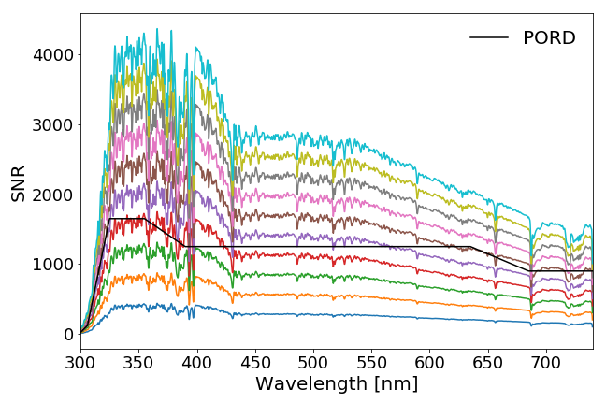
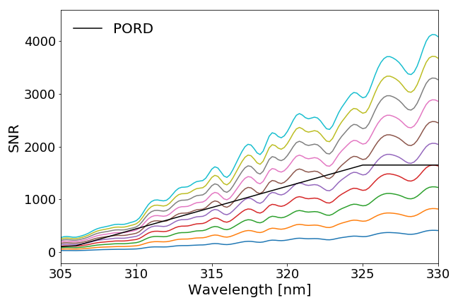
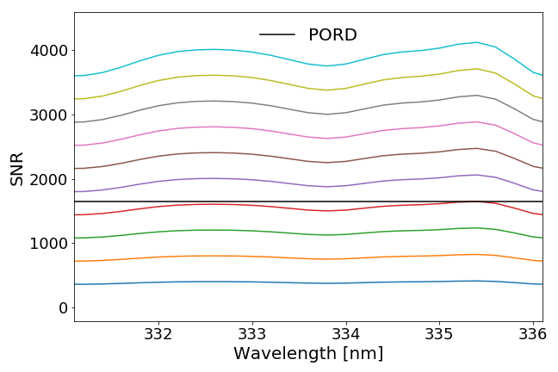
ACX SNR Simulations – 10 Levels Assessed
Instrument Model
For each spectrum, 1000 implementations for 10 different SNR levels are generated
  Each increasing SNR level decreases the noise by factors of 1 through 10, corresponding to averaging 1 - 100 samples
  1000 random normally distributed noise implementations are generated for each SNR level
Note that the SNR values are calculated using nominal radiance defined in PORD
ACX Wavelength Range
SO₂ Retrieval Range
O₃ Retrieval Range
300 – 740 nm
305 – 330 nm
331.1 – 336.1 nm

Slide 12
Modeling & Simulation Framework
Atmospheric Scene of Interest
At Sensor Radiance
Known Column Amounts
Distribution of
At Sensor
Radiance + Noise
Retrieved
Slant Column Amount
O₃ SO₂
RTM
Instrument Model
Retrieval Algorithm
Analysis
Error
(Retrieval – Truth)
MODTRAN 6
Results
Plots illustrating simulated instrument retrieval performance as a function of SNR
Inputs/Outputs

Slide 13
Simulated ACX Retrieval Algorithms and Analysis
Retrieval Algorithm
Analysis
Physical retrieval of concentration amount derived via comparison to a “Truth” LUT
Predicted at sensor radiance distribution as a function of SNR of known atmospheric concentrations
Concentration Amount: Low, Medium, High
Constrained Atmospheric Cases at a given SNR level
Fixed at a single view geometry
Truth LUT
Concentration Amount: none through extreme amount in finite step sizes
NO Noise Included
Fixed at a single view geometry
Searched for Best Match
Compute retrieval concentration amount error (retrieval – truth):
Computation: determine error as the standard deviation of (retrieval – truth) for each SNR
Output: Illustrates the simulated instrument retrieval performance as a function of SNR and physical parameters of the scene simulated

Slide 14
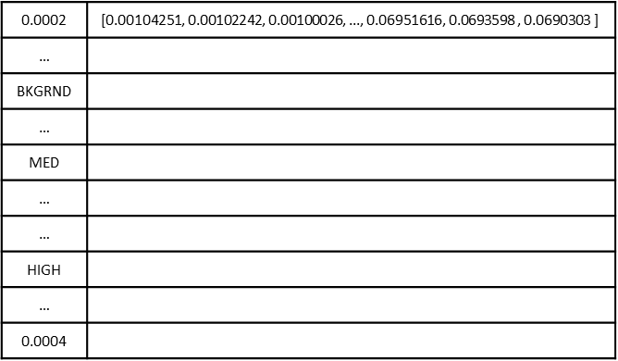
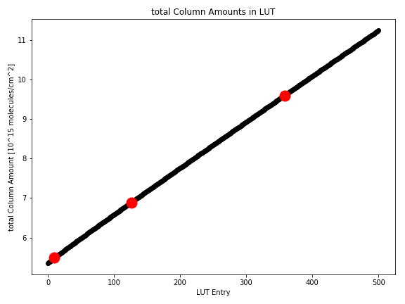
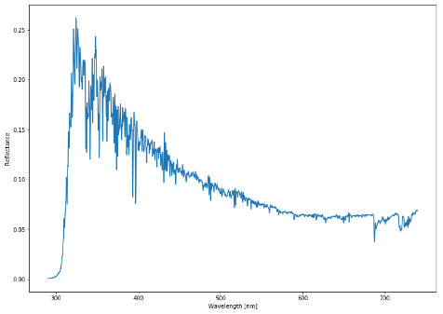
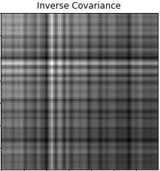


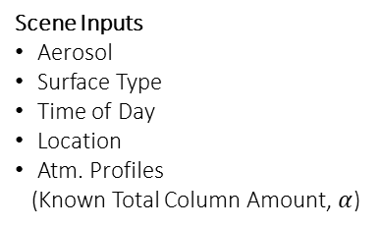


Retrieval Algorithm: Constrained Energy Minimization
Retrieval Algorithm
Step 1 – Build Look Up Table (LUT)
Result: Observed reflectance for a realistic range of known constituent amounts
$$ρ=\frac{L π r_{sun}^{2}}{E_{sun} cos⁡(θ_{zen})}$$
$$α$$
Reflectance Spectra
RTM
Solar Model
Solar Model
Radiance
$α$ NO_{2,} No Noise
Reflectance
$α$ NO_{2,} No Noise
Scene Inputs
Aerosol
Surface Type
Time of Day
Location
Atm. Profiles
(Known Total Column Amount, $α$)
…
HIGH
MED
LOW
Radiance
HIGH NO_{2,} SNR 01
Step 2 – Calculate mean and inverse covariance matrix of spectra from noise model
Result: m and S⁻¹
Radiance
HIGH NO_{2,} SNR 01
Radiance
HIGH NO_{2,} SNR 1270
Radiance
HIGH NO_{2,} SNR 01
Radiance
HIGH NO_{2,} SNR 01
Radiance
HIGH NO_{2,} SNR 1530
10 SNR Levels
1000 implementations
Radiance
HIGH NO_{2,} SNR 01
Radiance
HIGH NO_{2,} SNR 01
Radiance
HIGH NO_{2,} SNR 3820

Slide 15
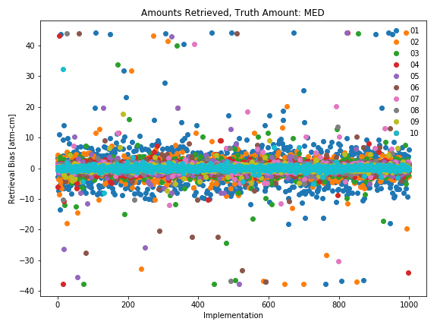
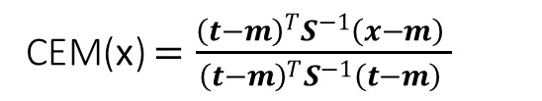


Retrieval Algorithm: Constrained Energy Minimization
Retrieval Algorithm
Analysis
Step 3 – For each spectra, x … use constrained energy minimization (CEM) to determine slant column amount
Result: Retrieved amount for each observed spectra
$$α$$
t
CEM Values
Radiance
HIGH NO_{2,} SNR 01
Radiance
HIGH NO_{2,} SNR 01
0.24
…
--0.5
…
0.74
…
…
1.001
…
0.664
Radiance
HIGH NO_{2,} SNR 1100
Reflectance = Radiance
Solar Model
Radiance
HIGH NO_{2,} SNR 01
Radiance
HIGH NO_{2,} SNR 01
Radiance
HIGH NO_{2,} SNR 1400
Reflectance
HIGH NO_{2,} SNR 1800
For each spectra…
10 SNR Levels
x = observed spectra
0.000360
Radiance
HIGH NO_{2,} SNR 01
Calculate CEM value for every spectra, t, in LUT
Radiance
HIGH NO_{2,} SNR 01
Search LUT for CEM Value closest to 1
$α$ from that LUT entry is retrieved value
Radiance
HIGH NO_{2,} SNR 4500
CEM(x) $=\frac{{\left(t−m\right)}^{T}S^{−1}\left(x−m\right) }{{\left(t−m\right)}^{T}S^{−1}\left(t−m\right) }$
Step 4 – For each SNR level, calculate bias and standard deviation (predicted error) from 1000 implementations
Result: Expected error for this SNR
Bias and standard deviation of 1000 implementations gives retrieval error
Repeat for each SNR level to plot as a function of SNR
Repeat with a new scene to plot as a function of constituent amount
END RESULT

Slide 16
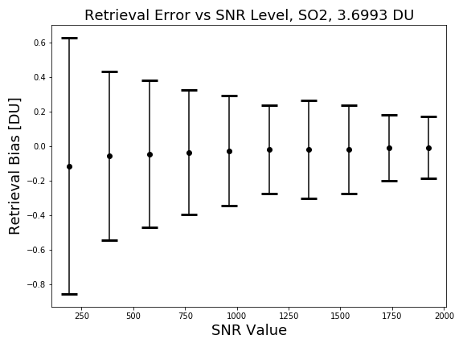
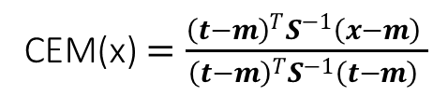
Baseline Retrieval and Analysis Framework For This Effort
RTM
Instrument Noise Model
Retrieval Algorithm
Analysis
Solar Model
Instrument Inputs
Detector Specs
Optical System Transmittance
Detector Quantum Efficiency
Bit-Depth
Read-out Noise
Dark Current
Predicted Slant Column Amount for each spectra output from instrument noise model
10 SNR levels
1000 implementations per SNR level
Constrained Energy Minimization (CEM) compares each observed spectra to a LUT with known constituent amounts
Calculate bias and standard deviation of 1000 implementations to determine retrieval error
Repeat for each SNR level
Repeat for each constituent amount
Scene Inputs
Aerosol
Surface Type
Time of Day
Location
Atm. Profiles
(Known Total Column Amount)
Radiance
HIGH NO_{2,} SNR 01
Radiance
HIGH NO_{2,} SNR 01
Radiance
HIGH NO_{2,} SNR 1270
Radiance
HIGH NO_{2,} No Noise
CEM(x) $=\frac{{\left(t−m\right)}^{T}S^{−1}\left(x−m\right) }{{\left(t−m\right)}^{T}S^{−1}\left(t−m\right) }$
Radiance
HIGH NO_{2,} SNR 01
Radiance
HIGH NO_{2,} SNR 01
Radiance
HIGH NO_{2,} SNR 1530
Note: Analysis based on a DOAS-like approach; results may vary with other operational approaches
10 SNR Levels
Radiance
HIGH NO_{2,} SNR 01
Radiance
HIGH NO_{2,} SNR 01
Radiance
HIGH NO_{2,} SNR 3820
1000 implementations

Slide 17
Modeling & Simulation Framework
Atmospheric Scene of Interest
At Sensor Radiance
Known Column Amounts
Distribution of
At Sensor
Radiance + Noise
Retrieved
Slant Column Amount
O₃ SO₂
RTM
Instrument Model
Retrieval Algorithm
Analysis
Error
(Retrieval – Truth)
MODTRAN 6
Results
Plots illustrating simulated instrument retrieval performance as a function of SNR
Inputs/Outputs

Slide 18
ACX SO₂ Modeling Scenarios
Two modeling scenarios:
  Boundary layer case: SO₂ injected into the atmosphere from 0 – 3 km (anthropogenic pollution)
    Three amounts of SO₂ (Low, Medium and High)
  5 km tropospheric plume: SO₂ injected into 1 km of the atmosphere at 5 km altitude (outgassing volcano)
    Three amounts of SO₂ (Low, Medium and High)
Different viewing geometries result in different slant column amounts for the same amount of SO₂ injected
100 km
100 km
 |  | Norman, OK (near-nadir) | Seattle, WA (oblique)
 | SO₂ Injected* | Slant Column Amount (SCA)
Low | 0.2 DU | 0.27 DU | 0.37 DU
Medium | 0.5 DU | 0.68 DU | 0.94 DU
High | 2.0 DU | 2.68 DU | 3.70 DU
10 km
10 km
5 km
5 km
* SO₂ was injected to US standard atmospheric profile
Oblique viewing results in larger SCAs than near-nadir viewing
5km Tropospheric Plume
Boundary Layer Case
Surface
Surface

Slide 19
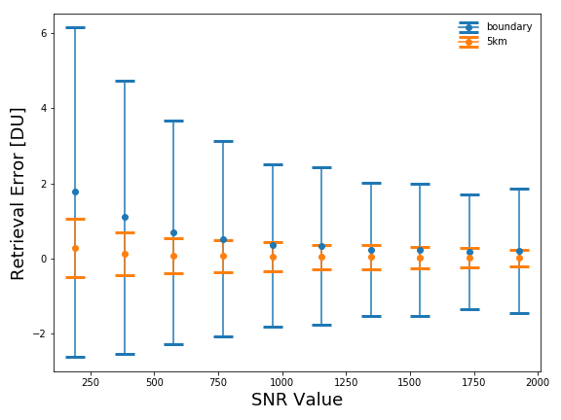
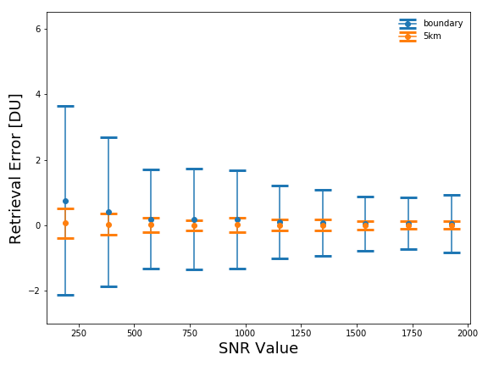
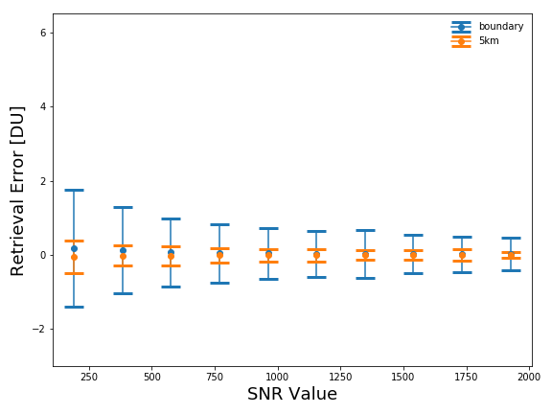
ACX Simulated Boundary Layer Case vs Tropospheric Plume
Each data point and error bars: (mean ± 1 σ) of 1000 simulations
Norman, OK: June 20, 2021 @ 1 pm (closer to nadir viewing)
Retrieval results improve for greater amounts of SO₂ in profile
Retrieval performance with a tropospheric plume outperforms retrieval performance for the boundary layer case
SCA = 0.27 DU
SCA = 0.68 DU
SCA = 2.68 DU
approximate PORD value
approximate PORD value
approximate PORD value

Slide 20
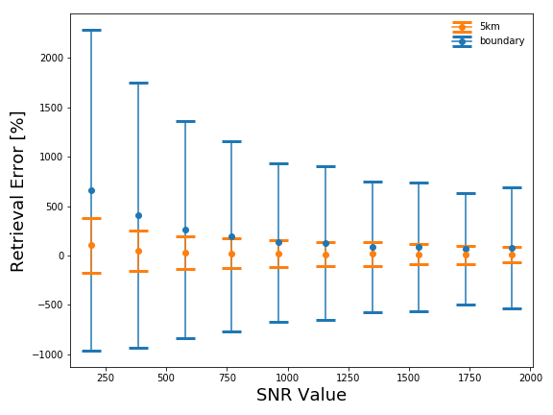
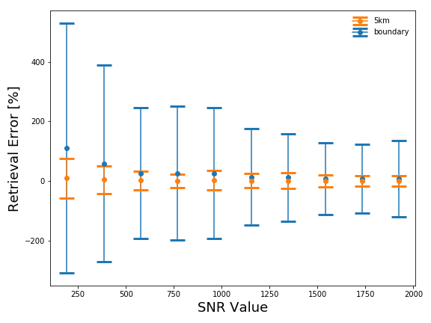
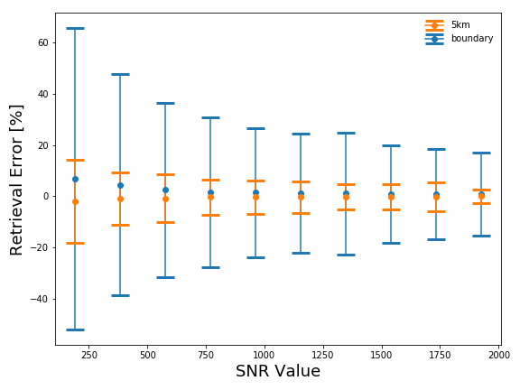
ACX Simulated Boundary Layer Case vs Tropospheric Plume
Each data point and error bars: (mean ± 1 σ) of 1000 simulations
Norman, OK: June 20, 2021 @ 1 pm (closer to nadir viewing)
Retrieval results improve for greater amounts of SO₂ in profile
Retrieval performance with a tropospheric plume outperforms retrieval performance for the boundary layer case
Results as a percentage of slant column amount show that boundary layer cases have extremely high error
note difference in axes
SCA = 0.27 DU
SCA = 0.68 DU
SCA = 2.68 DU
approximate PORD value
approximate PORD value
approximate PORD value
Similar results were found for the Seattle, WA: March 20, 2021 @ 1pm (backup slides)

Slide 21
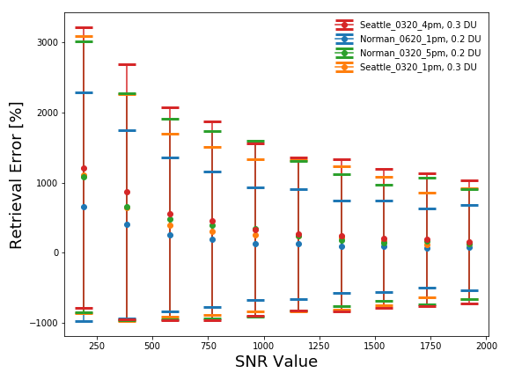
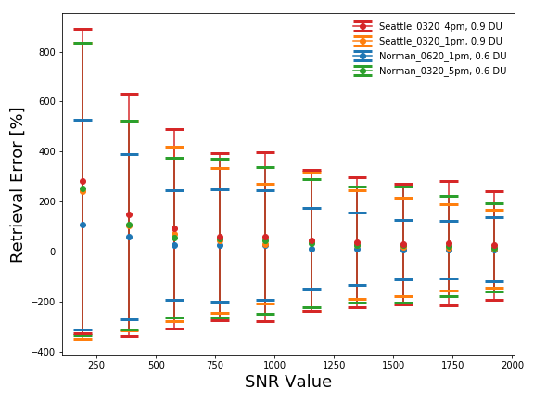
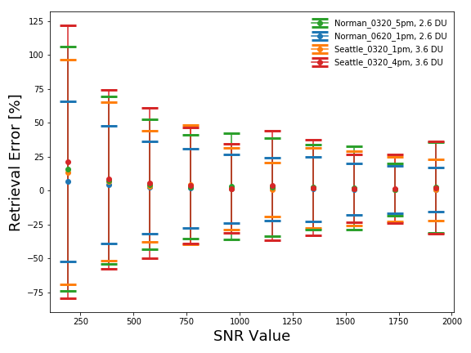
ACX Simulated View Geometries and Solar Zenith Angle
Each data point and error bars: (mean ± 1 σ) of 1000 simulations
All location, date and time combinations with SO₂ added to the boundary layer
Retrieval results improve for greater amounts of SO₂ in profile
Retrievals errors decrease as solar zenith angle decreases in most cases
Location | Date | Local Time | SZA
Norman, OK | June 20 | 1 pm | 13.63°
Norman, OK | March 20 | 5 pm | 58.72°
Seattle, WA | March 20 | 1 pm | 47.55°
Seattle, WA | March 20 | 4 pm | 59.12°
Boundary Layer Case
note difference in axes
approximate PORD value
approximate PORD value
approximate PORD value

Slide 22
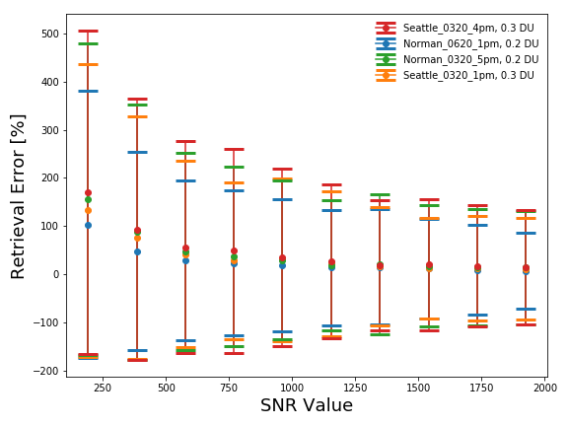
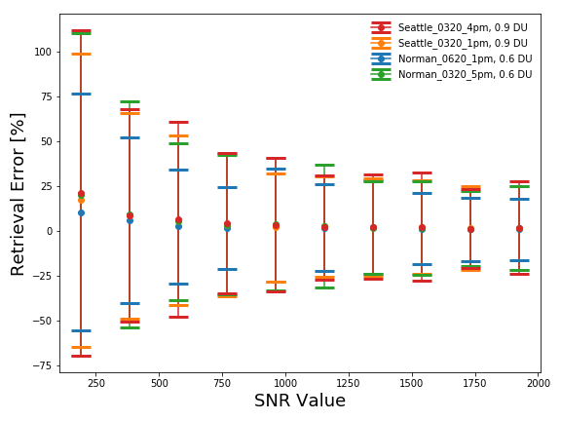
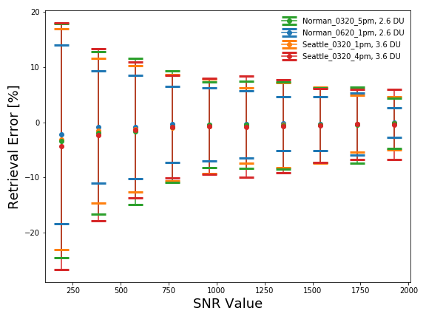
ACX Simulated View Geometries and Solar Zenith Angle
Each data point and error bars: (mean ± 1 σ) of 1000 simulations
All location, date and time combinations with SO₂ added @ 5km altitude
Retrieval results improve for greater amounts of SO₂ in profile
Retrievals errors decrease as solar zenith angle decreases in most cases
Location | Date | Local Time | SZA
Norman, OK | June 20 | 1 pm | 13.63°
Norman, OK | March 20 | 5 pm | 58.72°
Seattle, WA | March 20 | 1 pm | 47.55°
Seattle, WA | March 20 | 4 pm | 59.12°
5 km Tropospheric Plume
note difference in axes
approximate PORD value
approximate PORD value
approximate PORD value

Slide 23
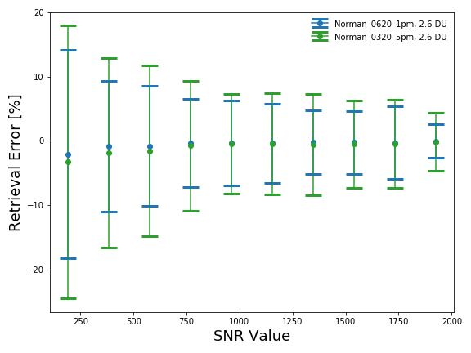
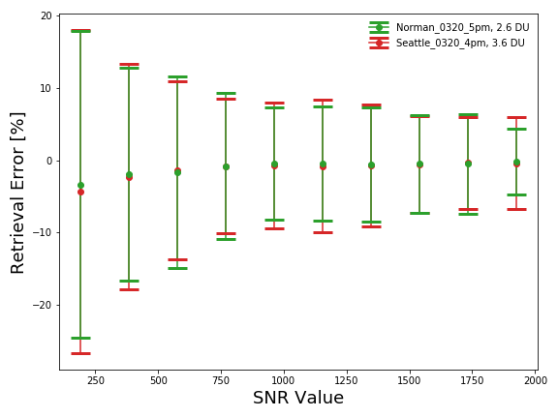
ACX Simulated View Geometries and Solar Zenith Angle
Each data point and error bars: (mean ± 1 σ) of 1000 simulations
See variation in retrieval performance with changes in solar zenith angle
Same location and SCA but different date and time – different results
Different locations and SCA with similar SZA – similar results
This illustrates the SZA impact on simulated retrieval performance
Location | Date | Local Time | SZA
Norman, OK | June 20 | 1 pm | 13.63°
Norman, OK | March 20 | 5 pm | 58.72°
Seattle, WA | March 20 | 1 pm | 47.55°
Seattle, WA | March 20 | 4 pm | 59.12°
13.63° vs 58.72° SZA
58.72° vs 59.12 ° SZA
approximate PORD value
approximate PORD value

Slide 24
ACX O₃ Modeling Scenarios
Two modeling scenarios:
  Boundary layer case: O₃ injected into the atmosphere from 0 – 3 km (smog)
    Three amounts of O₃ (Low, Medium and High)
  5 km tropospheric plume: O₃ injected into 2 km of the atmosphere at 5 km altitude (photochemical reactions)
    Three amounts of O₃ (Low, Medium and High)
Different viewing geometries result in different slant column amounts for the same amount of O₃ injected
Note: There are multiple O₃ operational retrieval algorithms; this study utilizes a DOAS-like approach
100 km
100 km
 |  | Norman, OK (near-nadir) | Seattle, WA (oblique)
 | O₃ Injected* | Slant Column Amount (SCA)
Low | 50 DU | 476 DU | 653 DU
Medium | 60 DU | 489 DU | 671 DU
High | 70 DU | 503 DU | 690 DU
10 km
10 km
5 km
5km Tropospheric Plume
5 km
* O₃ was injected to US standard atmospheric profile
Oblique viewing results in larger SCAs than near-nadir viewing
Boundary Layer Case
Surface
Surface

Slide 25
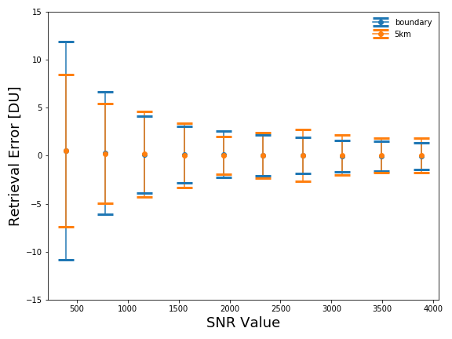
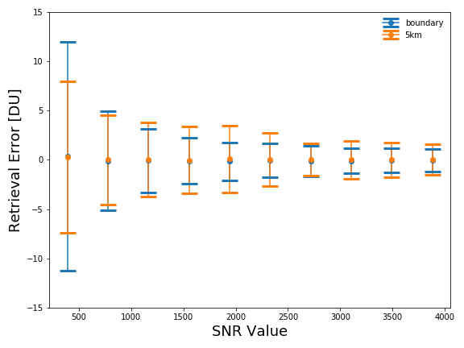
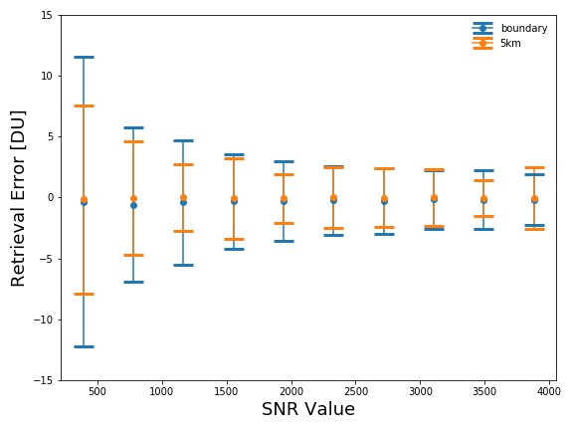
ACX Simulated Boundary Layer Case vs Tropospheric Plume
Each data point and error bars: (mean ± 1 σ) of 1000 simulations
At near-nadir viewing and small SZA, retrieval performance is comparable for O₃ injected into the boundary layer and at 5 km in the troposphere
Norman, OK: June 20, 2021 @ 1pm (near-nadir viewing, SZA = 13.63°)
approximate PORD value
approximate PORD value
approximate PORD value
SCA = 476 DU
SCA = 489 DU
SCA = 503 DU

Slide 26
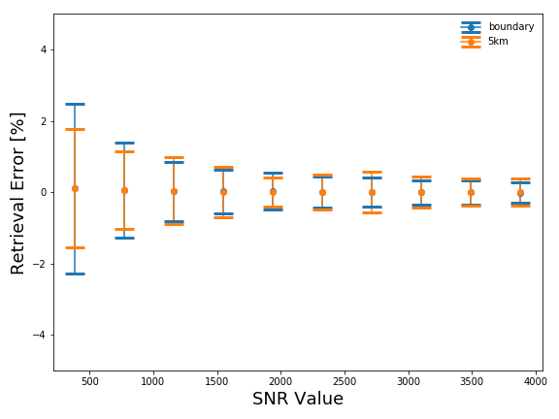
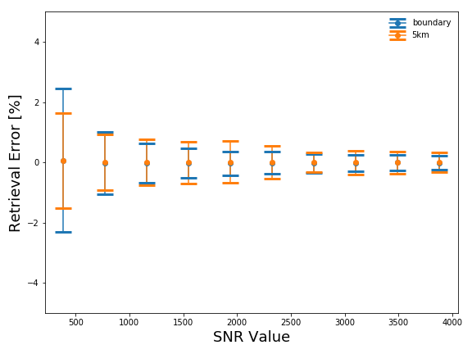
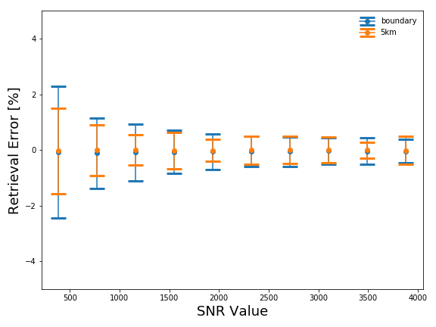
ACX Simulated Boundary Layer Case vs Tropospheric Plume
Each data point and error bars: (mean ± 1 σ) of 1000 simulations
At near-nadir viewing and small SZA, retrieval performance is comparable for O₃ injected into the boundary layer and at 5 km in the troposphere
Norman, OK: June 20, 2021 @ 1pm (near-nadir viewing, SZA = 13.63°)
approximate PORD value
approximate PORD value
approximate PORD value
SCA = 476 DU
SCA = 489 DU
SCA = 503 DU
Note that retrieval bias as a percentage is small because O₃ slant column amounts are large due to an increased amount of O₃ in the stratosphere

Slide 27
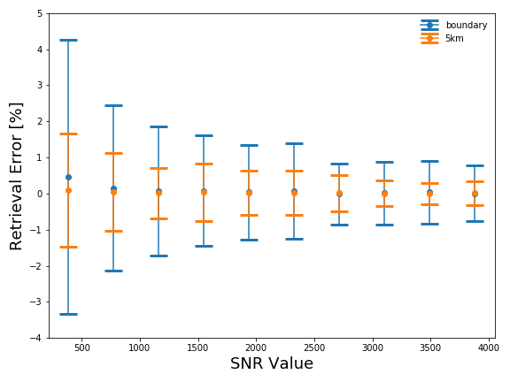
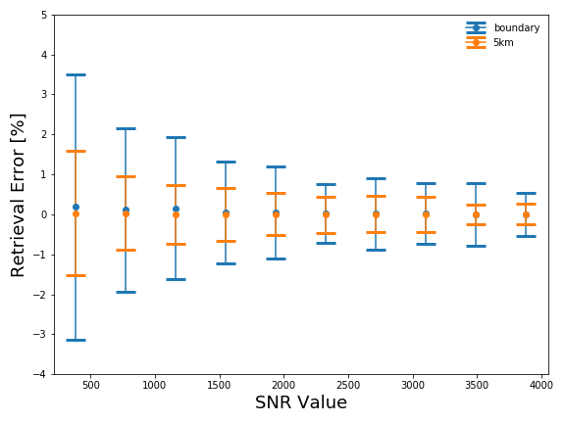
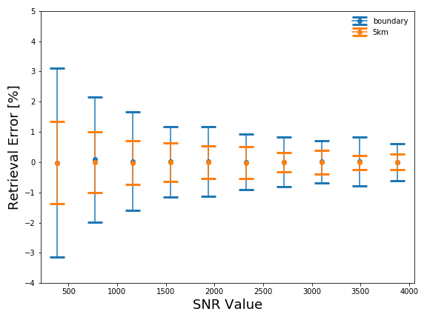
ACX Simulated Boundary Layer Case vs Tropospheric Plume
Each data point and error bars: (mean ± 1 σ) of 1000 simulations
At near-nadir viewing and small SZA, retrieval performance is comparable for O₃ injected into the boundary layer and at 5 km in the troposphere
At oblique viewing and larger SZA, retrieval performance is better for O₃ injected at 5 km in the troposphere compared to O₃ injected in the boundary layer
Seattle, WA: March 20, 2021 @ 1pm (oblique viewing, SZA = 47.55°)
approximate PORD value
approximate PORD value
approximate PORD value
SCA = 653 DU
SCA = 670 DU
SCA = 690 DU
Note that retrieval bias as a percentage is small because O₃ slant column amounts are large due to an increased amount of O₃ in the stratosphere

Slide 28
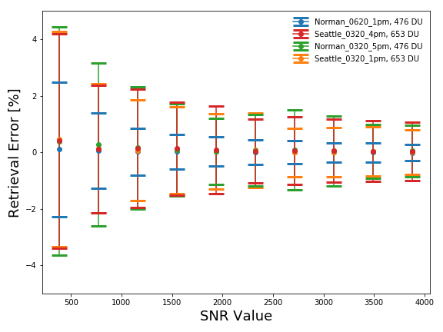
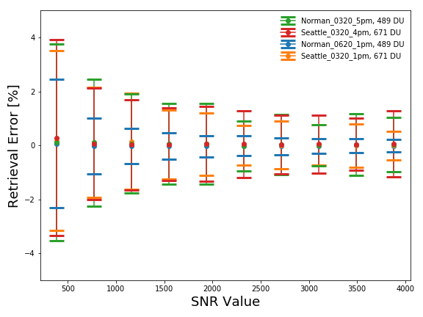
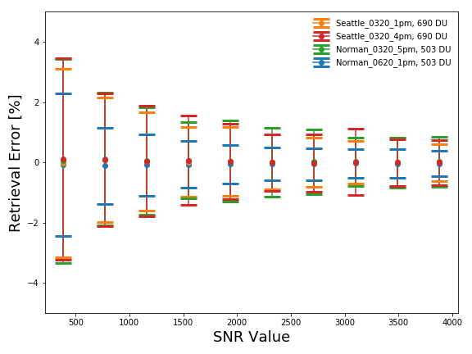
ACX Simulated View Geometries and Solar Zenith Angle
Each data point and error bars: (mean ± 1 σ) of 1000 simulations
All location, date and time combinations with O₃ added to the boundary layer
Retrieval performance is comparable for all view geometries and solar zenith angles simulated when O₃ is injected into the boundary layer, with the exception of near-nadir viewing on the summer solstice near solar noon (improved retrieval performance)
Location | Date | Local Time | SZA
Norman, OK | June 20 | 1 pm | 13.63°
Norman, OK | March 20 | 5 pm | 58.72°
Seattle, WA | March 20 | 1 pm | 47.55°
Seattle, WA | March 20 | 4 pm | 59.12°
Boundary Layer Case
approximate PORD value
approximate PORD value
approximate PORD value

Slide 29
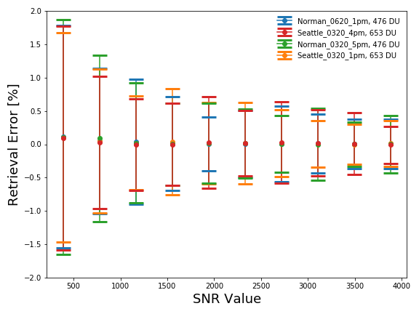
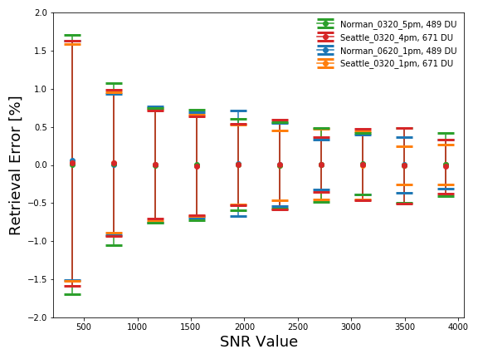
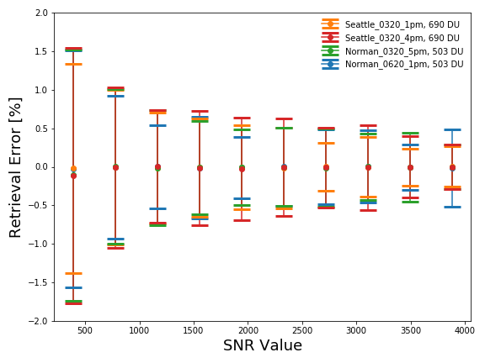
ACX Simulated View Geometries and Solar Zenith Angle
Each data point and error bars: (mean ± 1 σ) of 1000 simulations
All location, date and time combinations with O₃ added @ 5 km altitude
Retrieval performance is comparable for all view geometries and solar zenith angles simulated with O₃ injected at 5 km in the troposphere
Location | Date | Local Time | SZA
Norman, OK | June 20 | 1 pm | 13.63°
Norman, OK | March 20 | 5 pm | 58.72°
Seattle, WA | March 20 | 1 pm | 47.55°
Seattle, WA | March 20 | 4 pm | 59.12°
5 km Tropospheric Plume
approximate PORD value
approximate PORD value
approximate PORD value

Slide 30
Summary and Conclusions
An end-to-end physics based imaging system and scene modeling & simulation capability has been further developed in support of the GeoXO program to conduct quantitative instrument performance assessments and trade studies of the ACX system
This work investigated the impacts of simulated ACX SNR specifications on trace gas retrieval performance:
Previously studied NO₂ (420 – 450 nm) [EUMETSAT 2021]
This study investigated SO₂ and O₃ retrievals (approx. 300 – 350 nm)
Simulated ACX SO₂ Retrievals Summary
Retrieval uncertainty decreased as the slant column amount of SO₂ increased
Retrieval performance for a tropospheric plume outperforms retrieval performance for the boundary layer case
Retrievals errors decrease as solar zenith angle decreases in most cases
Simulated ACX O₃ Retrievals Summary
Retrieval performance is better for O₃ injected at 5 km in the troposphere compared to O₃ injected in the boundary layer
  Exception is near-nadir viewing on the summer solstice near solar noon
Retrieval performance is comparable for most view geometries and solar zenith angles simulated
  Exception is boundary layer O₃ injection with near-nadir viewing on the summer solstice near solar noon (improved retrieval performance)
Conclusions:
Retrieval of SO₂ and low amounts of O₃ in the boundary layer were found to be challenging regardless of SNR
Retrieval errors did not vary greatly with changes in SNR (up to 50%) for O₃ and large amounts of SO₂ at higher altitudes in the troposphere; performance for these scenarios was acceptable within this range of SNR values
Retrieval performance for O₃ and larger amounts of SO₂ at higher altitudes in the troposphere were shown to be sufficient with most SNRs modelled
Path Forward
Investigating variability in retrieval performance for different times throughout the day

Slide 31
Backup

Slide 32
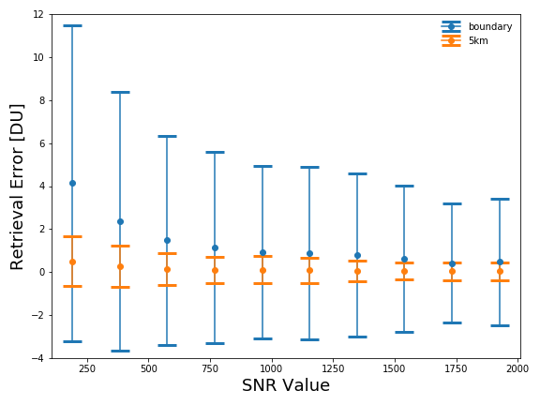
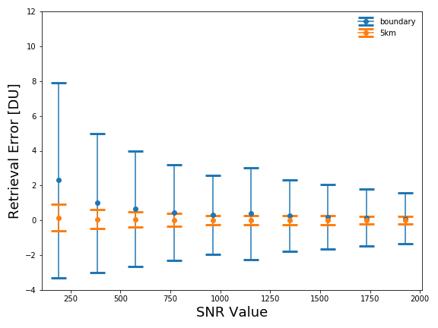
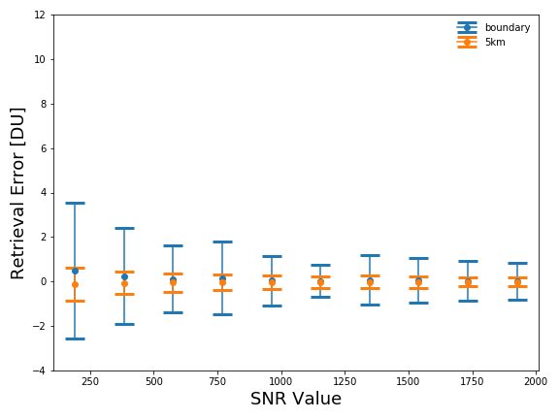
Boundary Layer Case vs Tropospheric Plume
Each data point and error bars: (mean ± 1 σ) of 1000 simulations
Seattle, WA: March 20, 2021 @ 1 pm (off-nadir viewing)
Retrieval results improve for greater amounts of SO₂ in profile
Retrieval performance with a tropospheric plume outperforms retrieval performance for the boundary layer case
SCA = 0.37 DU
SCA = 0.94 DU
SCA = 3.70 DU
approximate PORD value
approximate PORD value
approximate PORD value

Slide 33



Boundary Layer Case vs Tropospheric Plume
Each data point and error bars: (mean ± 1 σ) of 1000 simulations
Seattle, WA: March 20, 2021 @ 1 pm (off-nadir viewing)
Retrieval results improve for greater amounts of SO₂ in profile
Retrieval performance with a tropospheric plume outperforms retrieval performance for the boundary layer case
Results as a percentage of slant column amount show that boundary layer cases have extremely high error
note difference in axes
SCA = 0.37 DU
SCA = 0.94 DU
SCA = 3.70 DU
approximate PORD value
approximate PORD value
approximate PORD value

Slide 34
Boundary Layer Case vs Tropospheric Plume
Each data point and error bars: (mean ± 1 σ) of 1000 simulations
At near nadir viewing and small SZA, retrieval performance is comparable for O₃ injected into the boundary layer and at 5 km in the troposphere
Norman, OK: June 20, 2021 @ 1pm (closer to nadir viewing, SZA = 13.63°)
approximate PORD value
approximate PORD value
approximate PORD value
SCA = 476 DU
SCA = 489 DU
SCA = 503 DU

Slide 35



Boundary Layer Case vs Tropospheric Plume
Each data point and error bars: (mean ± 1 σ) of 1000 simulations
At near nadir viewing and small SZA, retrieval performance is comparable for O₃ injected into the boundary layer and at 5 km in the troposphere
At off-nadir viewing and larger SZA, retrieval performance is better for O₃ injected at 5 km in the troposphere compared to O₃ injected in the boundary layer
Seattle, WA: March 20, 2021 @ 1pm (off-nadir viewing, SZA = 47.55°)
approximate PORD value
approximate PORD value
approximate PORD value
SCA = 653 DU
SCA = 670 DU
SCA = 690 DU

