Slide 1
Integrated Rigorous Analysis of CPS: Examples from the Aerospace Domain
Paolo Masci
paolo.masci@nianet.org
National Institute of Aerospace (NIA)
NASA Langley Research Center
Dagstuhl Seminar 23041 - Integrated Rigorous Analysis in Cyber-Physical Systems Engineering, Jan 2023

Slide 2

ATM-X: Future Airspace Operations and Services https://www.nasa.gov/aeroresearch/programs/aosp/atm-x
Our future airspace will be safer, greener and quieter
New airspace services and new types of vehicles, from passenger carriers to package delivery aircraft, will need to be safely integrated
Automated navigation systems will be used to improve coordination and information sharing and help pilots fly in a more crowded airspace

Slide 3


Detect and Avoid (DAA) https://shemesh.larc.nasa.gov/fm/DAIDALUS/
Detect and Avoid (DAA) is the capability
of an aircraft to remain well clear and
avoid collisions
The concept was originally created for
Unmanned Aircraft (UAS) and is now being adapted to manned vehicles
DAIDALUS is a NASA-developed version of DAA
  Ownship-centric alerting and guidance
  Computations performed pair-wise using position and velocity vectors
  Sensor-agnostic
Alerting Time
WCV
Traffic
Ownship

Slide 4
Rigorous analysis of DAIDALUS
Formal verification was carried out to ensure correctness of the DAA algorithm specified in DAIDALUS
The Code of Federal Regulations requires that "vigilance is maintained by each person operating an aircraft to see and avoid other aircraft, maintaining well clear regardless of the type of operation"
A mathematical definition [1] of "well clear" was developed by the RTCA Special Committee SC-228
[1] "A Family of Well-Clear Boundary Models for the Integration of UAS in the NAS", Cesar A. Munoz et al., 14th AIAA Aviation Technology, Integration, and Operations Conference. 2014.

Slide 5
Rigorous analysis of DAIDALUS (cont'd)
The formal proof is for a real-valued version of the DAA algorithm
An implementation of DAIDALUS was created to assess the impact of numeric errors due to floating point computations
Testing was used to check the equivalence between the specification and the implementation
[1] "Software validation via model animation", A. Dutle et al., Intl. Conference on Tests and Proofs, Springer LNCS, 2015
[2] "The MINERVA software development process.", A. Narkawicz et al. NASA Formal Methods Symposium (NFM) 2017

Slide 6
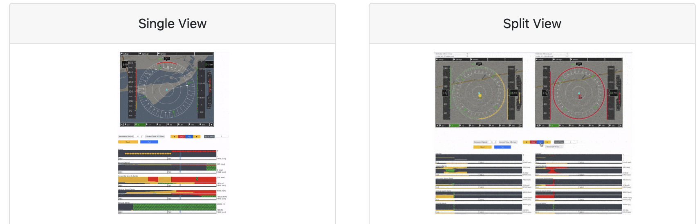
Rigorous analysis of DAIDALUS (cont'd)
Simulation was used to better support testing and explore ways to further improve the DAA algorithm of DAIDALUS
DAA-Display simulation toolkit
  Dedicated "views"
  Fast-time simulation
  Comparative analysis
  Analysis over time
  Modular architecture based on
  micro-servers, supports the execution
  of different DAIDALUS implementations (C++, Java) and specifications (PVS)
[1] A Graphical Toolkit for the Validation of Requirements for Detect and Avoid Systems", P. Masci et al, International Conference on Tests and Proofs, Springer LNCS, 2020

Slide 7
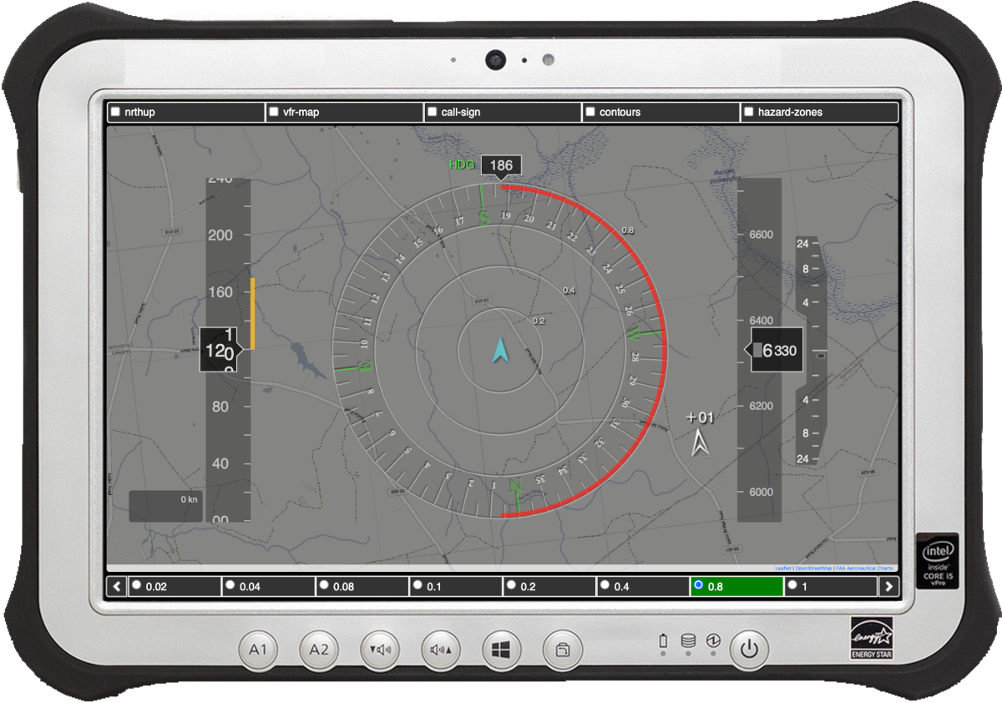
Rigorous analysis of DAIDALUS (cont'd) https://shemesh.larc.nasa.gov/fm/DANTi/
Components of the simulation environment were re-used to create Prototypes that could be used to explore design solutions for introducing the DAA technology in the cockpit
DANTi: DAA in an Electronic Flight Bag
Moving map
Compass
Tape indicators
Guidance shown as color-coded bands
Aural Annunciations
Resolution "Wedge"
Will soon be released as open source

Slide 8
Rigorous analysis of DAIDALUS (remarks)
Several technical concepts were needed to perform a rigorous analysis
  Formal analysis was key to check functional correctness
  Simulation and testing provided additional important insights that could not be gained with pure formal verification
  Rapid prototyping greatly simplified engagement with domain experts
Simulation was central to the verification and validation of DAIDALUS
  Natural bridge between formal analysis, testing and rapid prototyping
  Graphical analysis front-end was key to discover latent design anomalies

Slide 9
Example integrated development process
Design Documents
Validation
Validation
Model Animation
Rapid Prototyping
Formal Model
Simulation/Testing
Interactive Prototype
Test Vectors
Verification
Simulation/Testing Results
Implementation
Validation
Training Material
Verification
Results
Corner Cases

Slide 10
Remarks on formal methods tools
The quality of the front-end is key when using the tool in a multi-disciplinary team
The flexibility of the architecture should not be overlooked if the tool is to be used in conjunction with other analysis tools
Model animation is a convenient way to bridge verification with simulation and testing

Slide 11
Remarks on simulation/testing tools
The tool architecture should build on a clear separation of concerns between simulation engine and rendering front-end, so the tool can be easily integrated with other analysis tools
APIs for executing simulation runs with a classic read-eval-print loop is a simple but effective way to enable integration with external tools
Exporting simulation results in open formats (e.g., JSON) is desirable because complex simulation results usually need to be post-processed and further analyzed with external tools

Slide 12
Gaps and Opportunities
Usable front-ends should be a key design aspect of all tools
Graphical modeling languages should be further explored
  To reduce the learning curve for novice users
  To promote best modeling practices (e.g., through patterns/templates)
Code generation from executable formal models should become a standard feature in formal methods tools

Slide 13
Gaps and Opportunities (cont'd)
Open source protocols and APIs are needed to facilitate tool integration
  Language Server Protocol (LSP) for rapid integration of a tool in existing Integrated Development Environments (IDEs)
  Functional Mockup Interface (FMI) for model exchange and co-simulation
Realistic case studies and challenge problems are needed to speed up the development/improvement of rigorous analysis methods and tools
  Generic Infusion Pump (GIP) prototype created by the FDA to promote research and collaboration on infusion pump safety
  Integrated Clinical Environment (ICE) scenarios and prototype created by MGH to promote research on medical device interoperability

