Slide 1
Advances in EDL Flight Mechanics
Modeling & Simulation
Dr. Rafael Lugo
Langley Research Center
Atmospheric Flight & Entry Systems Branch, D205
AIAA Hampton Roads Section
2022-2023 Technical Talk Series
January 12th, 2022

Slide 2
Background
During Mars Pathfinder development (1995-7), a team at LaRC was assembled to help design, simulate, and assess performance of integrated EDL systems
  It was understood that the vehicle, trajectory, GN&C, and aerodynamics were closely coupled
  Significant differences from Viking (1976) and resulting concerns led to the integration of models from multiple disciplines into a single simulation framework (POST) JSR Vol 32, No. 6
  This approach blends flight mechanics/GN&C, aerosciences, and systems engineers as a cohesive, multidisciplinary unit
This type of end-to-end integrated performance analysis can provide enhanced insight and understanding of increasingly complicated flight systems
  Monte Carlo statistical analysis, system faults, off-nominal/abort scenarios, “what if?”
    We don’t just look at a single flight phase, we don’t just look at the nominal
  Historically, this has been computationally expensive
    Improvements in compute systems, hardware, and simulation software improves runtime, possible level of fidelity
    How do we take advantage of that and maintain flight-validated heritage?
But first…

Slide 3
Flight Mechanics Modeling & Simulation
What does this mean? Different groups have different definitions!
  3DOF? 6DOF? Flight dynamics? Trajectory optimization? GN&C?
Ultimately, “flight mechanics” is a very broad field that can include elements from other disciplines
For the purposes of this talk, flight mechanics is the study of the performance of the integrated “system of systems” that make up a flight vehicle and its environment
  3/6/Multi-DOF equations of motion
  Trajectory optimization
  Guidance, navigation, & control
  Aerodynamics
  Atmosphere & environments
  Mass & structures
  Propulsion
  Manual control effects
  Off-nominal and abort scenarios
  …
Many simulation environments or tools exist that can assess elements of flight mechanics
  Copernicus, DSENDS, Genesis, STK, QuickShot, OTIS, …
Not Comprehensive!

Slide 4
Example: Human Landing Systems (HLS) NASA Insight: DDL
Many different simulation environments from different disciplines work in tandem
  Overlap indicates shared data, handoffs, or analyses
Some tools focus on specific phases
We are going to focus on one tool
SPARTAN
LaSRS++
RPODU Performance
Human ITL Performance
Copernicus
On-Orbit Trajectory Optimization
GLASS
FRACTAL
GN&C Model Verification
POST2
Freq. Domain Performance
LinCov
3DOF Optimization & 6DOF Integrated Performance
Navigation Verification
Adams
Post-Touchdown Performance
IE Tool
Not Comprehensive!
Plume Surface & Aero Interaction

Slide 5
Program to Optimized Simulated Trajectories II
(POST2)

Slide 6
What is POST2?
Flight-validated, generalized, event-based, point-mass vehicle & trajectory simulation codebase
  3/6/Multi-DOF
  Continuously developed and maintained in-house at Langley Research Center
  “Developers-as-Users”
Key Features
  “Input deck”-based setup with custom, robust input language
  Interfaces with user-provided multidisciplinary engineering models and flight software
  Built-in trajectory optimization
  API permits external tools (e.g. Copernicus) to call POST2 and optimize on it directly (new for 2023!)
Key Applications
  Statistical analysis of end-to-end integrated performance
  Orbital & atmospheric trajectory optimization & design
  GN&C algorithm development & assessment
  Off-nominal, faults, aborts, and margin analysis
POST2
Integrated Performance Simulation
Vehicle
Propulsion
Terrain
Gravity
Ephemerides
Comms
Actuators
Sensors
Surface Interaction
GN&C / FSW
Aero & Aerothermal
Atmosphere
Multibody Dynamics

Slide 7
Sample POST2 Simulation Products (HLS)
POST2 simulation products are cross-disciplinary
  Thus, simulation developers/analysts must also have sufficient knowledge of these disciplines
Ownership of all inputs and outputs is key
  No finger-pointing or “because the algorithm said so”
  “Vertical Integration” of software development and flight mechanics analysis
CrewCo
Induced
Env.
Stressing Trajectories
Crew Loads
Stressing Trajectories
GN&C
Integrated
System
Fault Response
Mission Operations & Planning
FM
Integrated
GN&C Performance
Integrated Vehicle Performance
Slosh & Flex Dynamics
Safe & Precise Landing Performance
Touchdown States & Dynamics
Abort Performance
Commlink/LOS Performance
Separation Clearance Performance
Structures
Comms

Slide 8
Vertical Integration
Engineering/support tools may often be viewed as “black boxes”
  You don’t see the code, you don’t compile it, you don’t debug it
  If something goes wrong, you contact the software developer
POST2/D205 does not follow this model
  We write the code, we compile it, we use it
  Use of external libraries is avoided when possible
  If something goes wrong, we are the developers!
For delivered code/modules (e.g., flight software), we work closely with model authors to verify implementation
Design
New features proposed and discussed at Development Team meetings
Implementation
Prototypes developed by aerospace engineers
Production versions implemented by software engineers
Testing
Continuous unit & regression testing
Project-level testing (changes regressed against all active POST2-driven flight projects)
Distribution
Analysis
Internal versions include in-development engineering models
Flight projects, flight tests, ground tests, proposals, research, …
External versions are packaged for release nasa.gov/post2
Address bug fixes, maintenance issues, etc.

Slide 9
State of the POST2 Codebase
Versions have been used to support Shuttle, all NASA Mars EDL systems (except Viking), SLS, CCP, HLS/Artemis, numerous ground/flight tests …
  The current version (4.x) is slimmer, cleaner, more modular, more robust, and more flexible than any previous version
  Versions are maintained for distribution to other NASA centers, DOD, industry, and academia
But… it is based on Shuttle-heritage Fortran code from the 1970s
  Programming standards computer hardware paradigms have changed
  Previous upgrade work has included updating all code to C/C++ and adopting a unified development system
  Current efforts (2020+) are focused on updating the POST2 codebase to take advantage of more modern software and hardware, including flexible APIs and multi-threaded systems
Not Comprehensive!

Slide 10
Thread Safety Updates
To be Presented at AIAA SciTech 2023, Anthony Williams

Slide 11
Thread Safety Overview
High-Performance Computing (HPC) is a rapidly developing hardware field, and can:
  Accelerate development and implementation of state-of-the-art GN&C
  Accelerate implementation of optimization algorithms
  Enables interoperability with external applications that also utilize HPCs
Previously, POST2 could not take advantage of HPC systems because it was not thread-safe
  Software is thread-safe if multiple threads perform calculations concurrently, and the output is not adversely affected
  POST2 was structured such that the program, vehicle(s), and trajectory(ies) share global memory addresses
  So, POST2 has been re-architected to encapsulate these memory structures, such that they do not share memory addresses

Slide 12
Parallel Optimization Framework (OpenMP)
Default optimization scheme in POST2 is the projected gradient method
Multiple derivatives are needed to build a sensitivity or Jacobian matrix
  Controls for the optimization problem determine derivatives needed
Derivatives approximated via finite differencing
  Depending on type, i.e. central 2nd order, the number of trajectories needed changes
Before Thread-Safe Changes
Thread-Safe Changes Made
Nominal Run
Nominal Run
Setup Overhead
+ perturbation ctrl 1
+ perturbation ctrl 1
-
perturbation ctrl 1
+ perturbation ctrl 2
- perturbation ctrl 2
Time
Time
Separate, independent trajectories (sequential)
- perturbation ctrl 1
Separate, independent trajectories (parallel)
+ perturbation ctrl 2
Can achieve up to** 2n times speed up for Jacobian calculation, where n is the number of controls
- perturbation ctrl 2

Slide 13
Lunar Lander Trajectory Overall Time
Lower is Better

Slide 14
API Updates

Slide 15
API Overview
POST2 is a powerful “all-in-one” flight mechanics, trajectory design, trajectory optimization, and GN&C design tool
  Other tools are better-suited to long-period phases of flight (e.g., interplanetary transfers)
  What if we could use POST2 as the dynamics driver for more complex phases of flight (e.g, EDL, ascent) and seamlessly link with other tools?
Solution: Application Programming Interface (API)
  Recent POST2 development has focused on creating API that will permit POST2 to be called directly by external programs, with no write-to-disk penalties
  Data may now be passed directly between external apps and POST2 via memory, as opposed to writing out to disk
  Current external applications/languages that have been tested to call POST2 include MATLAB, Python, and Copernicus
  This could not have been accomplished without making POST2 thread-safe!
Notes:
Copernicus Slides will follow, which is where the real bang-for-your-buck will be

Slide 16
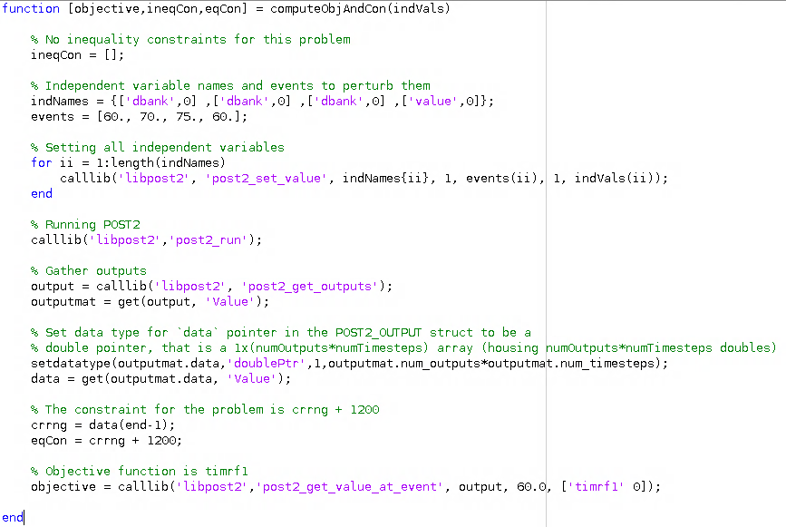
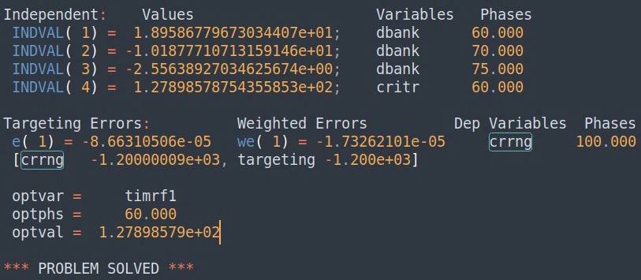
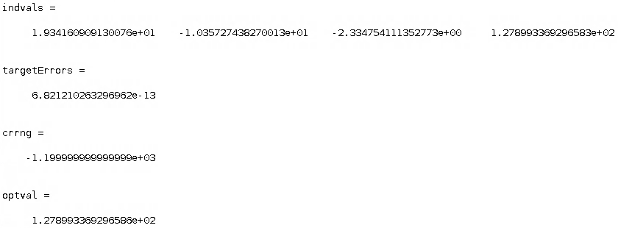
API Example: MATLAB
Used regression test from POST2 Core testing suite
Wrote MATLAB script to perform same optimization problem as regression test, using MATLAB’s fmincon()
  MATLAB calls POST2 API and returns optimization updates to console
  Interface script still in development
POST2
MATLAB

Slide 17
Navigation Performance Modeling Updates
AIAA 2022-0607

Slide 18
Safe & Precise Landing
Safe & precise crewed landing landings at the Moon and Mars will require evaluation of, and advances in, GN&C technologies
Safe and Precise Landing Integrated Capabilities Evolution (SPLICE) project assess these technologies and their performance effects
  Focus on deorbit/entry, descent, and landing (DDL/EDL)
  6DOF integrated performance simulations
  Modeling of GN&C systems with varying levels of quality and fidelity
POST2-based simulation framework updated with navigation sensors running in-the-loop
  Used this framework to assess government reference human-scale Lunar and Mars lander and entry systems
  Provides users with method of
  building detailed simulations with
  “off-the-shelf” models that can
  represent a variety of systems
  Fast simulation run time (~10 min
  for 8000-sample Monte Carlo) enables
  quick turnaround of trade studies
  AIAA 2022-0607, AIAA 2022-0609

Slide 19
Humans to Mars: NASA Reference EDL System
Low lift-to-drag (L/D) deployable decelerator
  Entry from 1 Sol polar orbit
  ~50 t entry mass, 20 t payload
  16.4 m inflatable decelerator (HIAD)
  Supersonic retropropulsion: 8x 100 kN @ 360 s Isp with differential throttling
Literature
  Architecture
    Overview: AIAA 2016-5494
    Phase 2 Summary: AIAA 2018-5190
    Phase 3 Summary: AIAA 2020-1509
  Vehicle Design
    Deployable Decelerators: AIAA 2018-5191
    Descent Systems: AIAA 2018-5193
    HIAD Shape Morphing: AIAA 2020-1266
  Simulation
    Simulation Framework: AIAA 2020-0366
  GN&C
    Guidance Design: AAS 17-254, AIAA 2020-0846
    Integrated Air Data System: AIAA 2019-0663
    Navigation Requirements: AIAA 2019-0661
    Navigation Performance: AIAA 2022-0607

Slide 20
Navigation Sensors
Inertial Measurement
Unit (IMU)
  Generalized strapdown
  model
  Scale factors, biases,
  internal misalignments,
  random walk/drift
Star Tracker
  Low-fidelity model
  (corrupted truth values)
Terrain-Relative Navigation (TRN) Camera
  Medium-fidelity model
  Feature matching algorithm with state estimation
Navigational Doppler LIDAR (NDL)
  Tri-beam system (beams intersect terrain DEM)
  Error model accounts for modulation period and bandwidth, beam wavelength, frequency, and pointing knowledge

Slide 21
Performance Trades
Investigated performance impacts of radio navigation and ground-relative sensor trades
Category | Trade ID | Trade | Plot Label | DSN (Pre-DOI) | DSN (Pre-EI) | TRN | NDL
Baseline | 1 | Perfect Navigation | Perfect Nav | None | None | None | None
 | 2 | High DSN Updates | Hi DSNs | High | High | High | Yes
DSN Trades | 3 | Single DSN Update | Single DSN | High | None | High | Yes
 | 4 | Medium DSN Updates | Med DSN | Medium | Medium | High | Yes
 | 5 | Ultra DSN Updates | Ult DSN | Ultra | Ultra | High | Yes
 | 6 | Low 2nd DSN Update | Low 2nd DSN | High | Low | High | Yes
Ground- Relative Sensor Trades | 7 | Medium TRN | Med TRN | High | High | Medium | Yes
 | 8 | Medium TRN, No NDL | Med TRN No NDL | High | High | Medium | None
 | 9 | Low TRN | Low TRN | High | High | Low | Yes
 | 10 | Low TRN, No NDL | Low TRN No NDL | High | High | Low | None

Slide 22
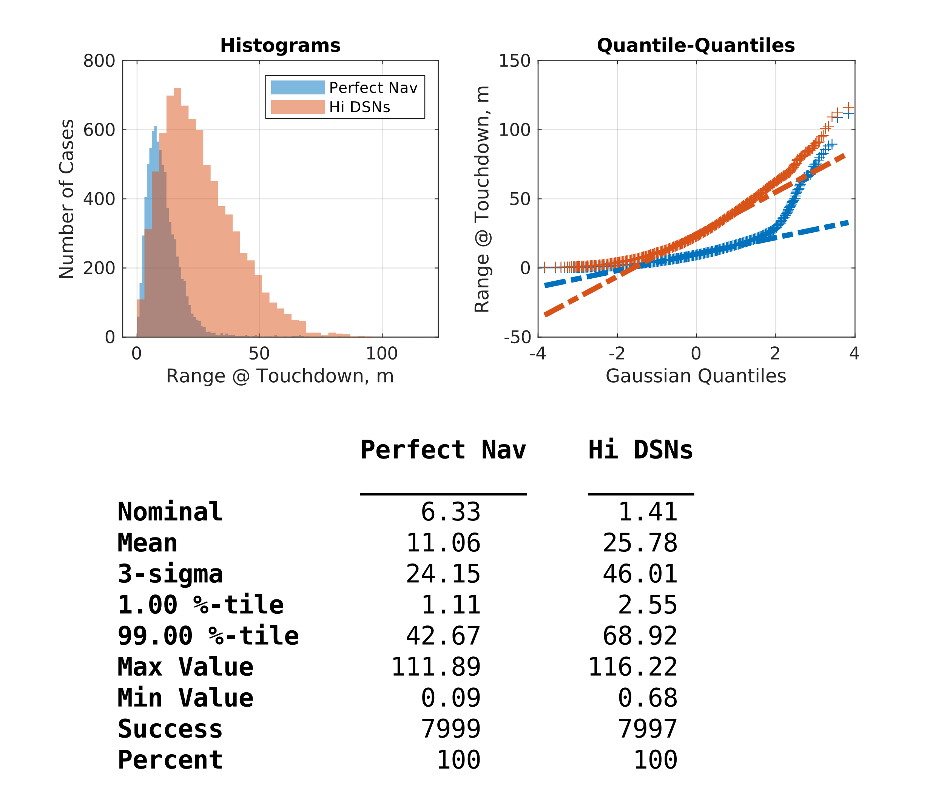
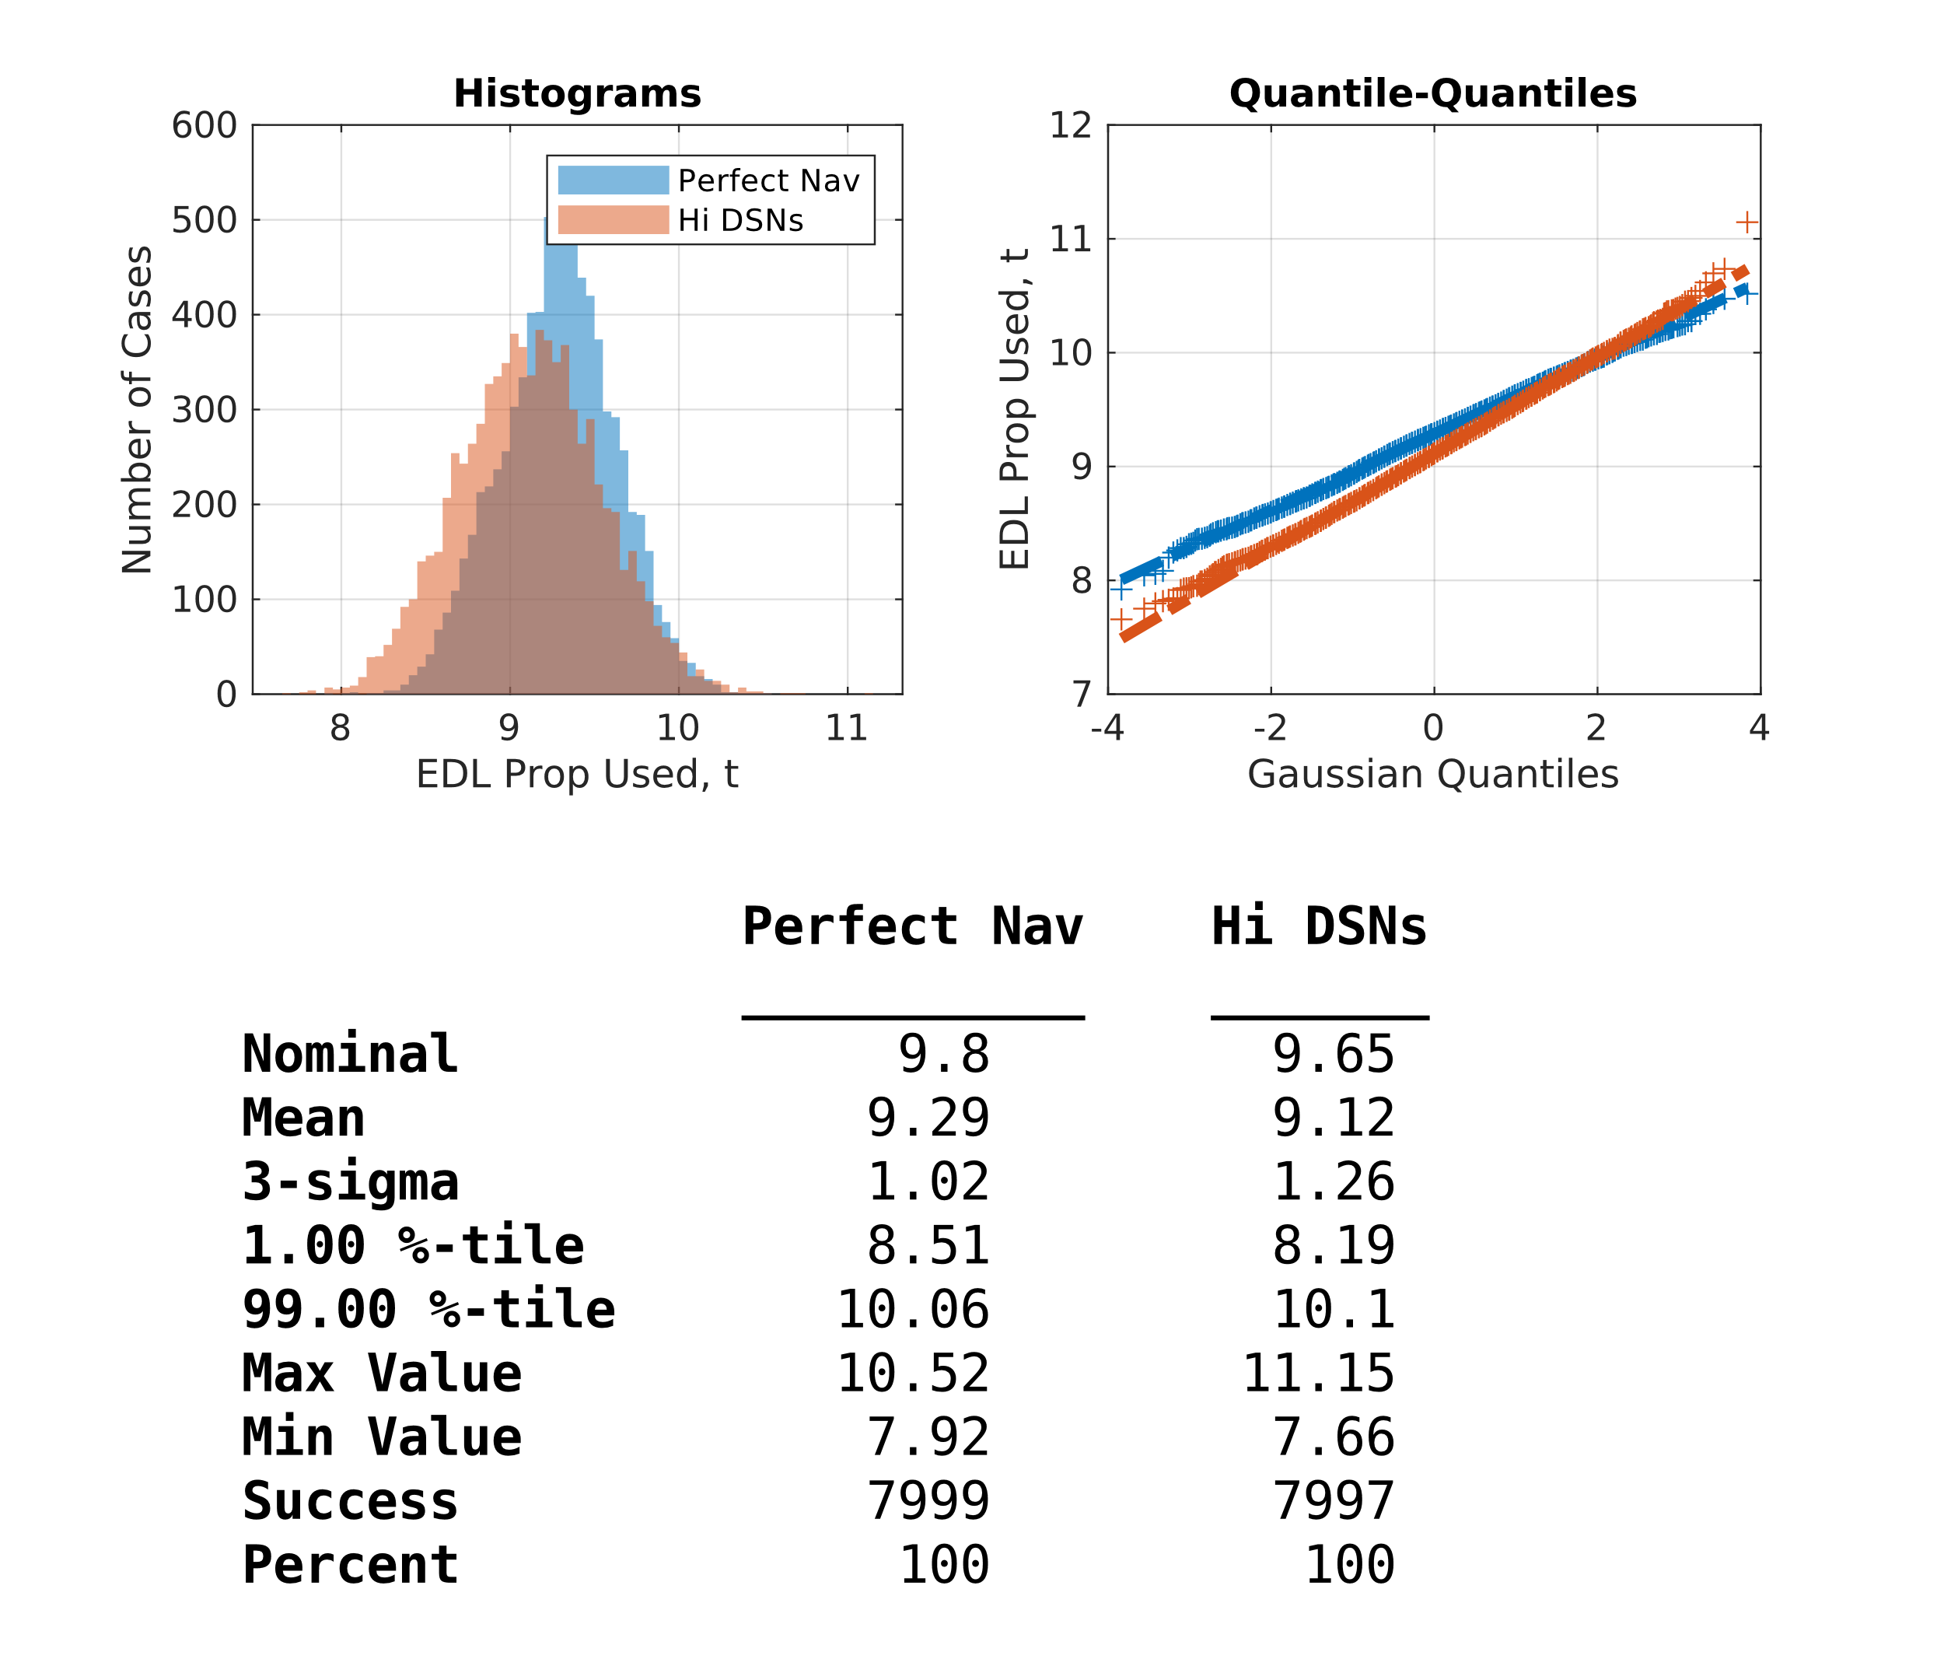
Baseline Results

Slide 23
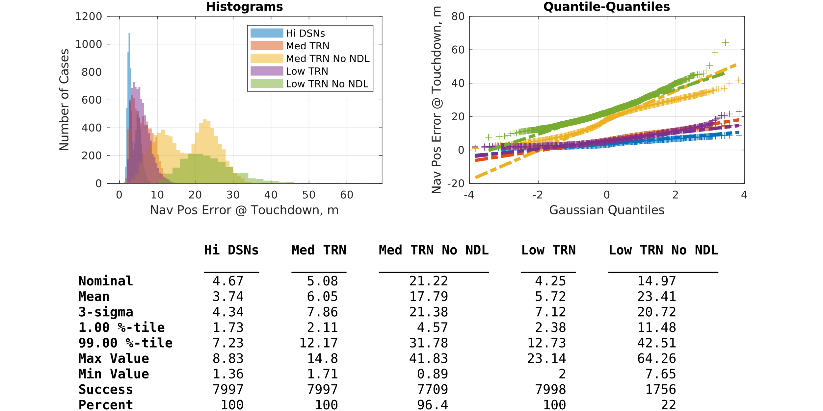
Ground-Relative Sensor Quality Trades
First case is baseline
  Because each sample is an integrated trajectory, can evaluate success rate
NDL sensor (late in EDL phase) “cleans up” TRN errors
A high-enough quality TRN sensor and no NDL may be able to meet requirements, but at the cost of success rate
  Could a high-altitude TRN buy back performance from DSN?

Slide 24
Summary & Future Work
Flight mechanics modeling & simulation covers a wide variety of disciplines
  Experience has shown that treating flight systems in an end-to-end, integrated sense can provide enhanced insight into flight mechanics performance
  POST2 is an example of a flight-validated flight mechanics modeling & simulation tool that can benefit from changes to programming and computer hardware paradigms
POST2 codebase updates
  Modified to be thread-safe, enabling faster internal trajectory optimization via parallel calculations
  Also enables the creation of an API, permitting POST2 to be used as dynamics driver within other applications
Navigation performance modeling updates
  Generalized navigation sensor models implemented into POST2 sim framework
  Enables fast analysis of closed-loop GN&C (nav-in-the-loop) integrated performance for a variety of flight systems
Future Work
  The road to POST3 – What will it look like?
  Confident that the “Developers-as-Users” vertical integration model is the standard to maintain

Slide 25
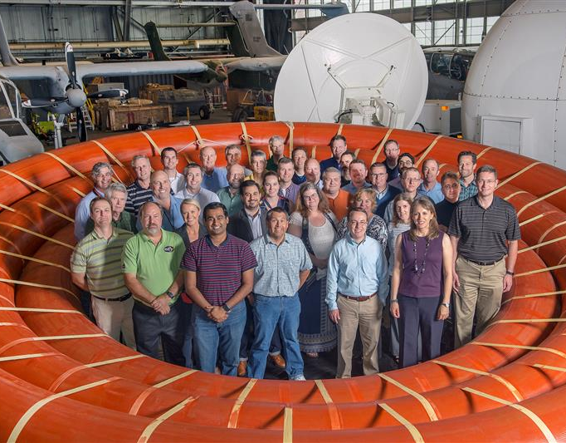
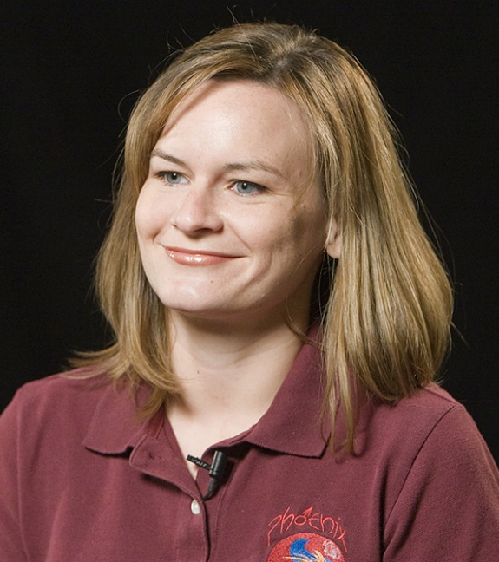



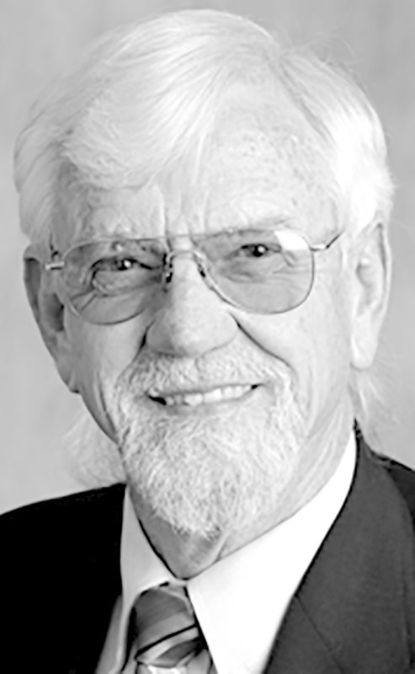
Acknowledgements
D205 & D205 Management
  Ron Merski & Monica Hughes
POST2 Development Team & Support Team
Jill Prince
Jeremy Shidner
Alicia Dwyer-Cianciolo
Richard Powell (ret.)
Robert Tolson (ret.)

Slide 26
Backup

Slide 27
Memory Restructuring
Before Thread-Safe Changes
  Many global memory structures, remnants of Fortran common blocks
  No grouping within global structures
  Branches of code written specifically for first, global vehicle
After Thread-Safe Changes
  Global memory space restructured into hierarchy based on instruction execution
  All vehicle-specific logic removed
Program
Problem
Trajectory
Vehicle

Slide 28
Workspace Structuring
More recent updates to the API introduced the concept of “workspaces”
Each POST2 workspace is an encapsulated set of inputs (usually defined by an input deck)
Permits the same POST2 instantiation to run multiple workspaces either in sequence or in parallel
Lunar Ascent
Lunar to Earth Transfer
Earth Entry
POST2
Workspace 1
POST2
Workspace 2
Copernicus

Slide 29
API Example: Copernicus
Set of POST2 functions are compiled into a callable Python module via CFFI package
JSON plugins are developed specific to Copernicus input decks (idecks) which handle inputs and outputs being passed to and from POST2
Python script is called by this plugin to interface with POST2
  Runs within same Python process as Copernicus
  Upon loading the plugin, the designated POST2 input deck is loaded into memory; only occurs a single time (only true I/O in this process)
  At this point, each time Copernicus makes a call to propagate:
    Inputs from JSON plugin are passed through Python module to POST2, then input deck is executed with updated inputs from Copernicus (does not alter input deck file)
    Outputs from POST2 are passed back through Python module (as a data stream in memory, not through I/O) to JSON plugin/Copernicus
Notes:
, thus eliminating the overhead of initializing a new Python process

Slide 30
Regression Tests Gradient Calculations
Lower is Better

Slide 31
Regression Tests Overall Time
Lower is Better

Slide 32
Lunar Lander Gradient Calculations
Lower is Better

Slide 33
Performance Metrics
Navigation error
  Describes overall behavior of navigation system
Landing precision
  Describes how well integrated vehicle lands near pre-designated target
  50 m range or better in a 3σ sense is desired (99%-tile statistics also assessed)
Success rate
  Describes percentage of 8,000 Monte Carlo samples that achieve a safe landing:
    Horizontal velocity of less than or equal to 1.0 m/s
    Vertical velocity of less than 3.0 m/s
    Angle off vertical of less than 3°
    Max angular rate about any axis of less than 0.5°/s
  Success rate of 99% or better is desired
Truth State
Dispersion
Navigation State
Dispersion
Target
Navigation
Error

Slide 34
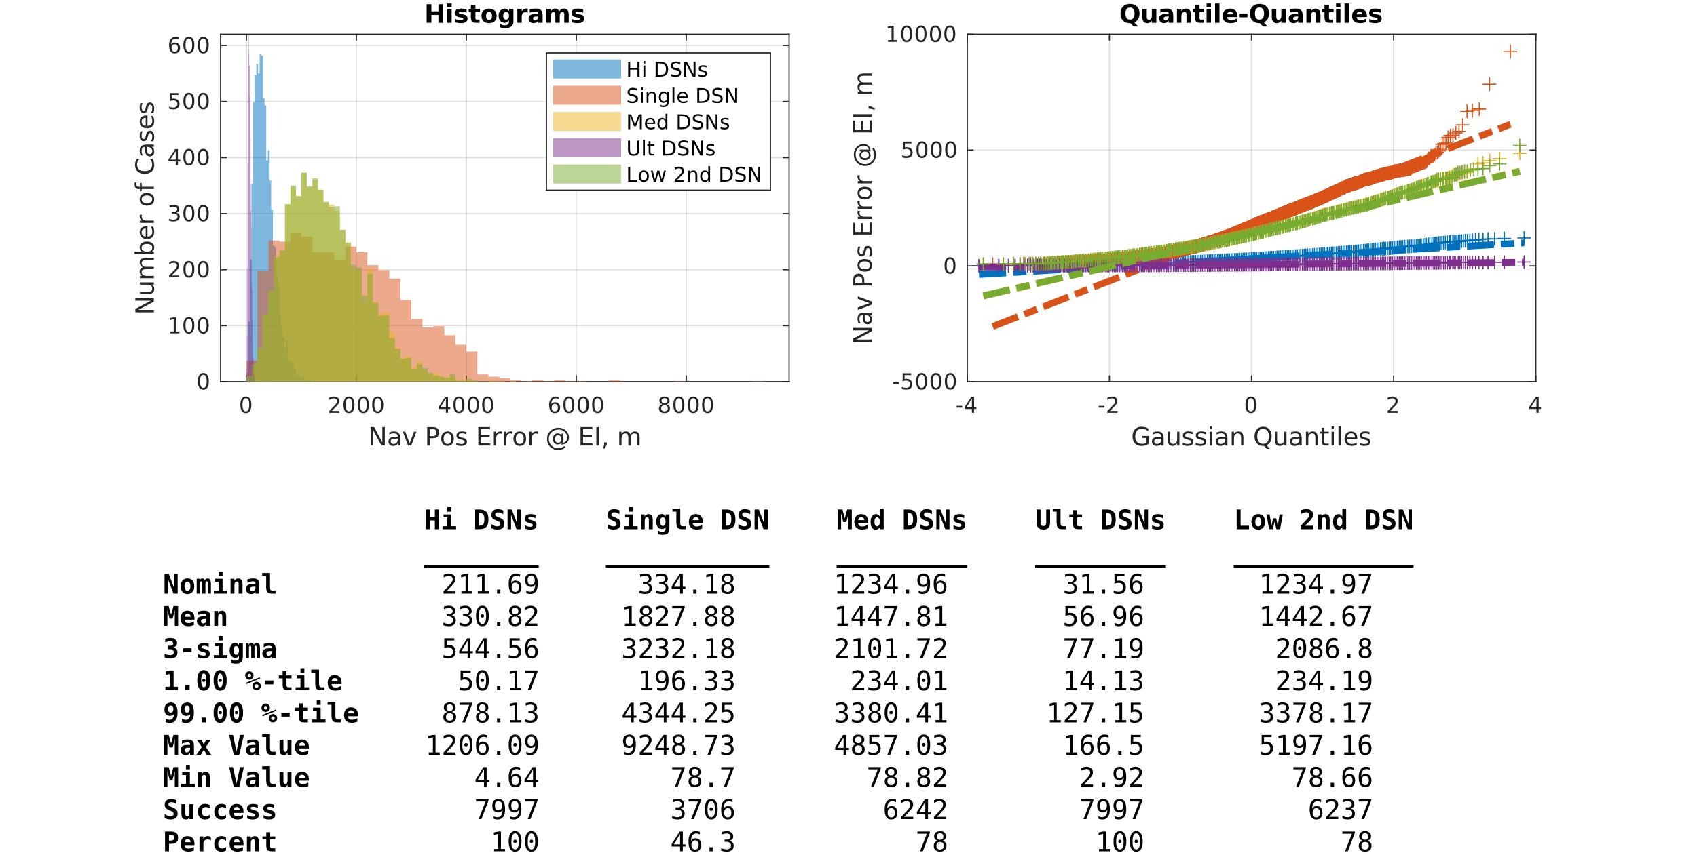
Deep Space Network Quality Trades
First case is baseline
2nd DSN Update prior to EI is critical
  Navigated position error is very sensitive to the final update (follows intuition)
Because each sample is an integrated trajectory, can evaluate success rate

Slide 35
Navigation Performance Summary
 | Trade | Success Rate % | Landing Precision 99%-tile, m | EDL Prop Used 99%-tile, t | Nav Pos Err @ TD 99%-tile, m | Nav Vel Err @ TD 99%-tile, m/s | Nav Att Err @ TD 3σ, deg
Baseline | Perfect Navigation | 100.0 | 42.67 | 10.06 | 0.00 | 0.00 | 0.00
 | High DSN Updates | 100.0 | 68.92 | 10.10 | 7.23 | 0.15 | 0.21
DSN Trades | Single DSN Update | 46.3 | 1871.56 | 10.11 | 11.49 | 0.22 | 0.27
 | Medium DSN Updates | 78.0 | 982.88 | 12.88 | 12.26 | 0.28 | 0.78
 | Ultra DSN Updates | 100.0 | 48.45 | 9.93 | 7.04 | 0.16 | 0.19
 | Low 2nd DSN Update | 78.0 | 938.60 | 12.70 | 12.10 | 0.28 | 0.63
Ground-Relative Sensor Trades | Medium TRN | 100.0 | 70.25 | 10.10 | 12.17 | 0.16 | 0.22
 | Medium TRN, No NDL | 96.4 | 67.54 | 10.19 | 31.78 | 1.02 | 0.03
 | Low TRN | 100.0 | 72.44 | 10.10 | 12.73 | 0.16 | 0.22
 | Low TRN, No NDL | 22.0 | 72.46 | 10.09 | 42.51 | 1.33 | 0.02

