Slide 1

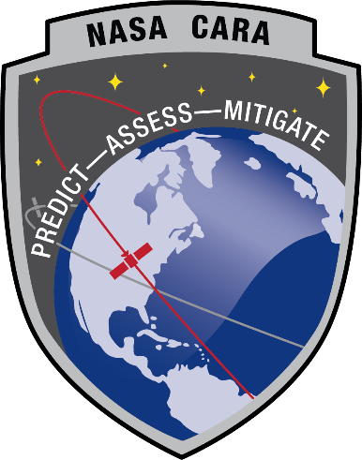
Conjunction Assessment Risk Analysis
M.D. Hejduk
NASA CARA

Slide 2
Overview
Introduce the RSO Catalog
Understand the anatomy of a conjunction
Describe the Conjunction Analysis Process
Describe Two-line Element Sets
Understand covariance and uncertainty
Describe conjunction assessment screenings
Explain the risk assessment for CA
Describe the conjunction situation
Explain the probability of collision algorithm
Describe practical problems in determining the probability of collision
Introduction to Conjunction Assessment
Conjunction Assessment Process
Covariance and Uncertainty
Probability of Collision
Practical Issues with CA
CA Risk Assessment and Mitigation
Adapted from information in:
Space Mission Analysis and Design (SMAD), Chapters 3 and 7 by Wertz
Human Spaceflight: Mission Analysis and Design (HSF), Chapter 9 by Boden and Hoffman
Orbital Mechanics by Logsdon
Space Domain Awareness, Chapter 4 by Ziebart, Frueh and Hejduk

Slide 3
Agenda
Conjunction Assessment (CA) terminology and very high-level concepts
Space catalogue maintenance basics
  Collecting satellite position data
  Updating and propagating orbits
Orbit Determination (OD) uncertainty modeling through covariance
Probability of collision computation
Conjunction Assessment screenings
Conjunction Data Message (CDM) contents

Slide 4
Conjunction Assessment Terms (1 of 6)
Conjunction Assessment (CA)
  An iterative process for determining the Time of Closest Approach (TCA) of two tracked orbiting objects or between a tracked orbiting object and a launch vehicle (including spent stages) or payload
    TCA will be defined shortly
  Further activities to identify high-interest conjunction events
Conjunction
  When the predicted miss distance between two on-orbit objects, or between a launch vehicle and an orbiting object, is less than a specified reporting volume
Risk Analysis (RA)
  For a particular conjunction, the determination of the collision likelihood and consequence
  This information is used to identify high-interest events (HIEs) that may require warnings and conjunction mitigation actions
Notes:
Iterative refers to not only primary and secondary runs, it also refers to the additional screening that will be performed until TCA

Slide 5
Conjunction Assessment Terms (2 of 6)
Primary Object
  The satellite asset, launched object or the ephemeris file that is being screened for potential conjunctions
Primary
Object
t₁
t₂
TCA = Time of Closest Approach
3.5 km
Secondary
Object
TCA
t₂
t₁

Slide 6
Conjunction Assessment Terms (3 of 6)
Secondary Object
  All other satellite objects (examples: payloads, debris, R/B, or analyst satellites) against which the primary object is being screened for potential conjunctions
Primary
Object
t₁
t₂
TCA = Time of Closest Approach
3.5 km
Secondary
Object
TCA
t₂
t₁

Slide 7
Conjunction Assessment Terms (4 of 6)
Time of Closest Approach (TCA)
  The time at which the distance between the two objects reaches a minimum
    This occurs when the relative position vector is perpendicular to the relative velocity vector for the two objects involved in a conjunction
Primary
Object
t₁
t₂
TCA = Time of Closest Approach
Miss Distance = 3.5 km
Secondary
Object
TCA
t₂
t₁

Slide 8
Conjunction Assessment Terms (5 of 6)
Overall Miss Distance
  The PCA of one object relative to another; i.e., the minimum range, miss distance, or relative position magnitude between two satellites at TCA
    Can also be expressed by individual three-dimensional component
Primary
Object
t₁
t₂
PCA = Point of Closest Approach
Miss Distance = 3.5 km
Secondary
Object
PCA
t₂
t₁

Slide 9
Conjunction Assessment Terms (6 of 6)
Probability of Collision (Pc)
  Statistical measure of the likelihood that the miss distance will be smaller than a specified threshold (usually the combined sizes of the two satellites)
  Pc calculation requires covariance data (i.e., uncertainty data) on each object’s position estimate; will be discussed later
  Pc values usually expressed in scientific notation, e.g., 1E-05
    Large values are 1E-04 and higher
    Small values are perhaps 1E-06 and lower
Screening Volume
  A spherical or ellipsoidal volume around the primary and secondary objects used to determine if a satellite pair is a conjunction candidate
Collision on Launch Assessments (COLA)
  Screening performed on powered flight launch trajectory
  Some entities use “COLA” to mean collision avoidance, or implementation of a risk mitigating action such as a maneuver; this is not standard nomenclature
Notes:
An example of the specified distance used in POC calculations is the joint exclusion volume

Slide 10
The Catalog Maintenance Cycle
Cycle in use since the late 50’s, in many forms
Sensors collect observations and send them to 18th Space Defense Squadron (18 SDS)
18 SDS associates submitted observations to objects
Orbits are updated using observations
Tasking informs sensors of amount of tracking data needed to maintain desired orbital accuracy
Observation
Association
Metric Obs
Tagged
Obs
Observation
Collection
(Sensors)
Orbit
Determination
Sensor Tasking
Updated Orbits
Sensor
Tasking
Notes:
Let’s start with a brief discussion of tasking (covered in detail in subsequent sessions)

Slide 11
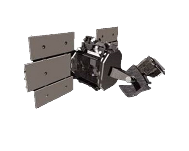



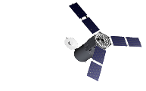

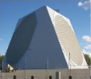

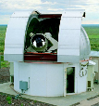
Space Surveillance Network
Space-based Sensors
GSSAP 1-4 SBSS STSS SAPPHIRE ORS-5
Thule
Globus II
Clear
Cavalier (US)
Fylingdales
Beale
LSSC
Cobra Dane
Cape Cod
18 SPCS
Socorro
18 SPCS Det 1
Maui
MSSS
Eglin
Reagan Test Site
Space Fence
Phased Array Radar
Ascension
Diego Garcia
Mechanical Radar
Holt
SST
Optical Telescope
Upcoming
SSN C2

Slide 12
Observation Types
Radars typically provide three observables
  Range to target (the most useful of the measurements)
  Two angles to target, typically azimuth and elevation
  Sometimes higher derivatives reported, although useful only if actually observed rather than just calculated
  Framework used is topocentric horizon coordinates, which rotates with earth
Optical sensors report only two observables, both angles
  If azimuth mount (axis normal to earth), then report azimuth and elevation
  If ra/dec mount (axis points to north star), then report right ascension and declination
    Inertial system better suited to fixed background of stars
  Space-based sensors usually provide sensor position along with observation

Slide 13
Sensor Tasking
Sensor capacity is a limited resource
Tasking function determines collection requirements per object
  Object type, mission, and orbit determination (OD) solution age determines tasking priority
    Called tasking “category” with range of values of 1 to 5
  Number and collection details of tracks required
    Called tasking “suffix” with large number of alphanumeric codes
Tasking allocates satellites to sensors
Establish tracking priority for each satellite
  Determine sensor/satellite visibility for each satellite/sensor pair
  Estimate sensor response (detectability) for each pair
  Specify the number of obs/tracks for each viable satellite/sensor pair
  “Decentralized execution”: sensors told tracking needs/priority for a given day but not precisely when to track
Composite Tasking List (CTL) sent to all tasked sensors
Operates on a 24-hour cycle; only one tasking request set per day

Slide 14
Site Mission Planning
Sites receive the CTL from 18 SDS and plan data collection
Mission planning allocates limited sensor resources to specific passes
  Calculate passes using Two-Line Elements (TLEs) from local catalog
  Estimate sensor response using radar range equation (radars) or visual magnitude (optical)
  Resource conflicts resolved by tasking category, i.e., when a conflict exists, higher priority satellite pursued
Observations are collected according to mission plan
  Plan may be superseded by special tasking in support of Space Situational Awareness (SSA)

Slide 15
Two-Line Orbital Elements (TLEs)
Two-Line Orbital Element (TLE) Format
Intl Designator
2nd Derivative
Mean motion
Ephemeris Type
Epoch Time:
Year, Julian Day.dec
Sat No.
1st Derivative
Mean motion
BSTAR
Drag term
Class
Elset No
1 35946U 09055A 12182.12787517 .00000032 00000-0 25025-4 0 240
2 35946 98.4805 261.3681 0002231 93.7109 266.4343 14.37662472142992
Check
Sum
Line No
Inclination
Argument
of
Perigee
Mean Motion
(rev/day)
Sat No.
Right
Ascension
Rev No
Mean
Anomaly
This example:
Worldview-2
Eccentricity
(decimal assumed)

Slide 16
Will All Tasked Satellites be Tracked? NO!
Sensor may experience an outage
Sensor may have bad value for satellite “size” in database
  Presume cannot be tracked, or allocate too little energy for detection
Sensor may not have enough energy/capacity to track object
  Tracking of higher-priority objects took more energy or time than expected
Position information from 18 SDS may be so poor that satellite not acquired by sensor
Observation quality may be so poor (large obs covariance) that the track is discarded
Sensor may mis-assign observations to a different satellite, thus “losing” the tracking information
  Tracking reported to 18 SDS but may not be associated with proper object in time to be useful

Slide 17
What does all of this have to do with Conjunction Assessment?
Close approach events become known only when sensors discover the conjuncting objects in the first place
  Need for wide-area surveillance systems
  No proposed systems to track down to the 1cm level, which is the hardening level for most spacecraft
As events develop, additional tracking is desired in order to refine the OD and thus the risk assessment
  Small objects can be tracked only by certain sensors, so much of SSN capability not helpful for these objects
  Conjuncting objects are often assigned tasking increases to improve tracking, but this is subject to the vicissitudes of the tasking process

Slide 18
Orbit Determination Concept Description
Orbit Determination applies a set of force models to a pre-existing orbit estimate and satellite tracking observation to produce an estimate of the orbital state (a “state estimate”) at a particular time (called the epoch time)
This state estimate can then be propagated forward to estimate the satellite’s position and velocity at a future time
CA processes involve predicting primary and secondary satellite states forward in time to find the PCA and TCA
  This process only as good as the underlying dynamical models that produce the epoch and TCA state estimates
  Thus, some familiarity with OD specifics is necessary to understand CA subtleties

Slide 19
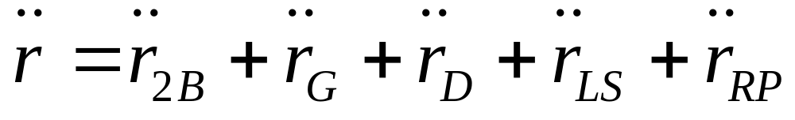
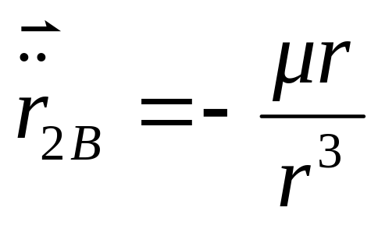

OD Force Modeling: 2-Body Motion
  2-Body
  where
      = Vector from the center of the earth to the object
      μ = Gravitational parameter (a constant)
      r = Magnitude (length) of the vector
Third Body Effects
Atmospheric Drag
Non-Spherical Earth
Solar Radiation Pressure
Notes:
The solution of the two-body “equations of motion” allow us to easily predict satellite position – but accuracy is terrible in the “real world”!

Slide 20
General vs Special Perturbations
General Perturbations (GP): the theory of TLEs
  Used for most of the space catalogue for most of SSA history due to computer processing limitations
  Simplified geopotential (J2-5) and analytic atmospheric drag models
  Some truncated expressions throughout to simplify calculations
  No solar radiation pressure modeled
  Fast but imprecise
Special Perturbations (SP): the theory of SP vectors
  All above perturbations represented and handled numerically
  All integration numeric
  Relatively slow but quite precise
TLEs should not be used for CA
  Not precise enough to drive risk assessment and mitigation
SP-based products routinely available
  Provide needed accuracy

Slide 21
Orbit Determination Fit: Sources of Error
18 SDS uses minimum variance batch approach to OD fitting
  Chosen historically because performs well with inaccurate/sparse data
Most common sources of OD fit error
  Poor a priori sensor observation error weighting
    Inaccurate sensor observations not de-weighted appropriately,
  Incorrectly-chosen update interval length
    Length of look-back period to choose observations for the OD batch update
    If too long, prediction capability suffers; if too short, drag solution is poor
  Aliasing between drag and mean motion
    Both heavily affect in-track position
    Can be addressed by subdividing drag solution into subdivisions (along-arc solutions)
OD fit error usually small when tracking is adequate
  For CA, greater error source is prediction error to TCA

Slide 22
What does all of this have to do with Conjunction Assessment?
Accuracy of close-approach prediction dependent on quality of OD for primary and secondary objects
  Primary usually more orbit-stable object and tracked more thoroughly
  OD quality issues arise more frequently with secondaries
Problems in modeling of atmospheric drag and solar radiation pressure frequent cause of OD difficulties for CA
  Solar storms, particularly those that arise in the middle of a CA event, cause particular difficulties
  Solar radiation pressure is relatively new problem for CA but does influence deep-space CA state estimates and covariances
If solution is poor, remediation approaches pursued
  Requests for additional tracking
  Manual execution of questionable ODs

Slide 23
Orbit Determination Solutions
Purpose of OD
  Generate estimate of the object’s state at a given time (called the epoch time)
  Generate additional parameters and constructs to allow object’s future states to be predicted (accomplished through orbit propagation)
  Generate a statement of the estimation error, both at epoch and for any predicted state (usually accomplished by means of a covariance matrix)
Error types
  OD approaches (either batch or filter) presume that they solve for all significant systematic errors
  Remaining solution error is thus presumed to be random (Gaussian) error
  Sometimes this error can be intentionally inflated to try to improve the fidelity of the error modeling
  Nonetheless, presumed to be Gaussian in form and unbiased

Slide 24
OD Parameters Generated by ASW Solutions
Orbit Determination performed by 18 SDS using Astrodynamics Support Workstation (ASW)
Solved for: State parameters
  Six parameters needed to determine 3-d state fully
  Cartesian: three position and three velocity parameters in orthogonal system
  Element: six orbital elements that describe the geometry of the orbit
Solved for: Non-conservative force parameters
  Ballistic coefficient (C_{D}A/m); describes vulnerability of spacecraft state to atmospheric drag
  Solar radiation pressure (SRP) coefficient (C_{R}A/m); describes vulnerability of spacecraft state to radiation momentum from sun
Considered: ballistic coefficient (and SRP) consider parameter
  Not solved for but “considered” as part of the solution
  Derived from information outside of the OD itself
  Discussed later

Slide 25
OD Uncertainty Modeling
Characterizes the overall uncertainty of the OD epoch and/or propagated state
  Uncertainty of each estimated parameter and their interactions
This is a characterization of a multivariate statistical distribution
In general, need the four cumulants to characterize the distribution
  Mean, variance, skewness, and kurtosis; and their mutual interactions
  Requires higher-order tensors to do this for a multivariate distribution
Assumptions about error distribution can simplify situation substantially
  Presuming the solution is unbiased places the mean error values at zero
  Presuming the error distribution is Gaussian eliminates the need for the third and fourth cumulants
  Error distribution can thus be expressed by means of variances of each solved-for component and their cross-correlations
  Thus, error can be fully represented by means of a covariance matrix

Slide 26
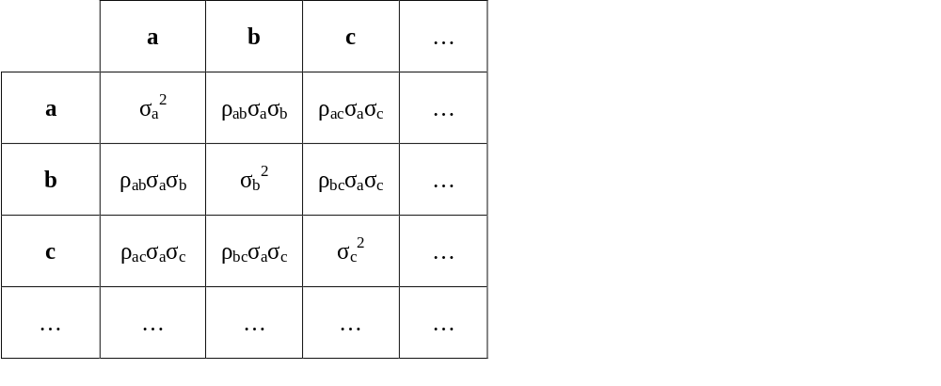
Covariance Matrix Construction: Symbolic Example
Three estimated parameters (a, b, and c)
Variances of each along diagonal
Off-diagonal terms the product of two standard deviations and the correlation coefficient (ρ); matrix is symmetric

Slide 27
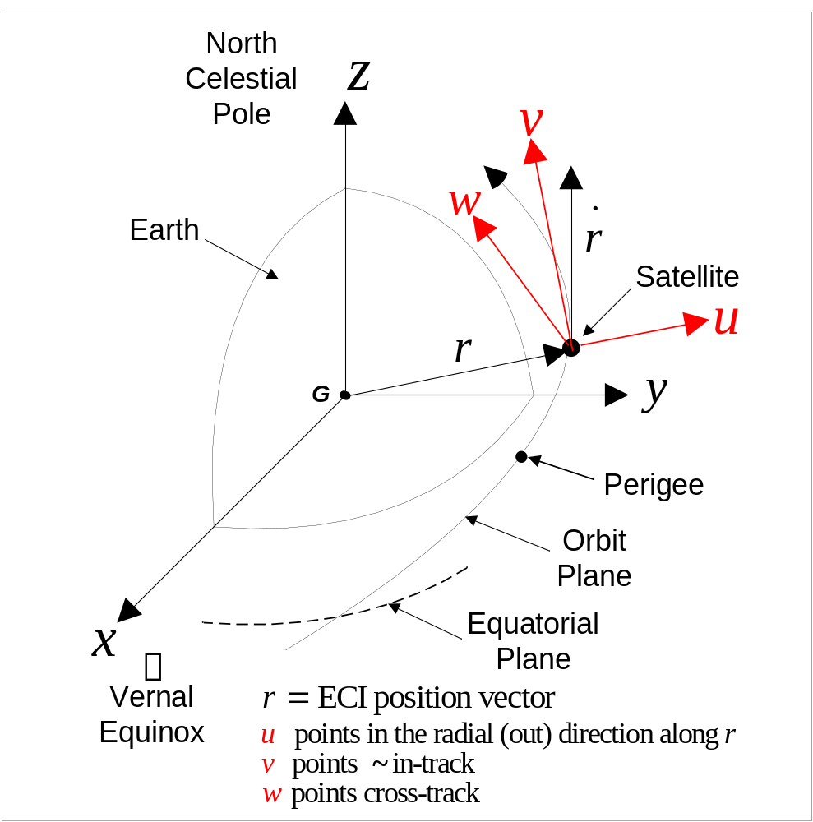
Covariance often Expressed in Satellite Centered (UVW) Coordinate Frame
Origin: at satellite
Fundamental plane: established by the instantaneous position and velocity vectors of the satellite
Principal direction: along the radius vector to the satellite
When valid/applicable:
  Valid at time tag for the point
  Used to represent miss distances relative to the Primary in an Conjunction Data Message (CDM)
Unit vectors: u, v, w
  w is perpendicular to the position and velocity vectors
  v established by the right-hand rule w X u = v

Coordinate frame diagram courtesy Omitron Inc.
Notes:
Using Arial font for unit vectors in text box in order to get bullets the right size. Or if go to Times New Roman and 24-size font then go to 90% instead of 125% on the bullet size.
Coordinate frame pictures from ASTRODYNAMICS CONCEPTS and TERMINOLOGY

Slide 28
Covariance Propagation Methods
OD produces covariance at epoch time
To obtain covariance at TCA, need to employ one of following propagation methods
  Full Monte Carlo
    Perturb state at epoch (using covariance), propagate each point forward to t_{n} with full non-linear dynamics, and summarize distribution at t_{n}
  Sigma point propagation
    Define small number of states to represent covariance statistically, propagate set forward by time-steps, reformulate sigma point set at each time-step, and use sigma point set at t_{n} to formulate covariance at t_{n}
  Linear mapping
    Create a state-transition matrix by linearization of the dynamics and use it to propagate the covariance to t_{n} by pre- and post-multiplication
All three of above methods legitimate
  List moves from highest to lowest fidelity and computational intensity
  18 SDS uses linear mapping approach

Slide 29
Pc Calculation: Methodologies
Two-dimensional approximation (“2-D Pc”)
  Most common calculation methodology—fast and straightforward
  Applicable to most conjunctions
  Tests and calculations enhancements developed to improve 2-D Pc accuracy and use
“3-D Pc”
  Expanded analytical technique proposed by V. Coppola (2012); improved by Hall (2021)
  Used in situations in which 2-D Pc suspected to miscarry potentially
Monte Carlo
  Most accurate methodology to calculate Pc—requires fewest assumptions
  Also most computationally demanding

Slide 30
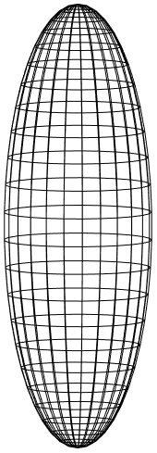
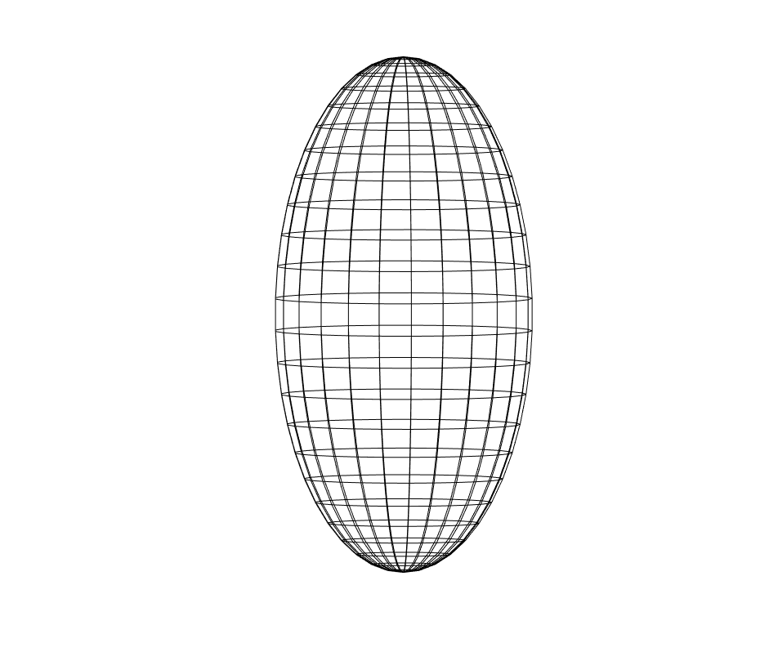
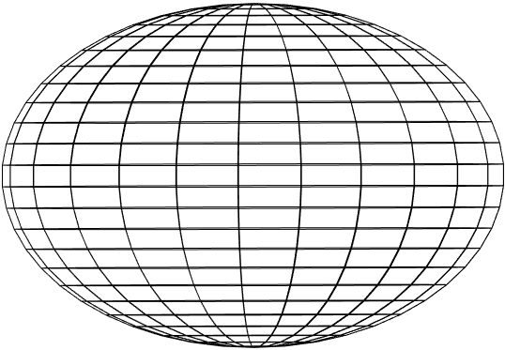
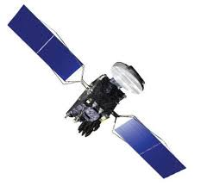



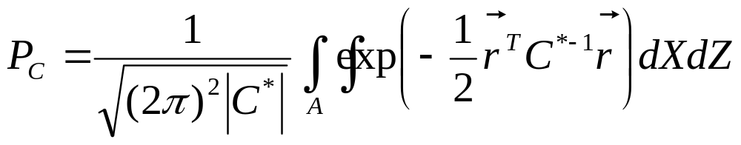

2-D Probability of Collision Calculation
Step I: Primary and Secondary uncertainties combined and placed at position of secondary
Step II: Primary and Secondary object sizes combined with circumscribing sphere and placed at position of primary
Step IV: Probability of collision is portion of covariance probability density that falls within hard-body radius (HBR) circle; as given by above integral
Step III: If collision hyperkinetic, motion approximated as rectilinear. Primary’s motion can be considered a straight cylinder, which marginalizes out that component’s contribution to probability--can then project situation into plane

Slide 31
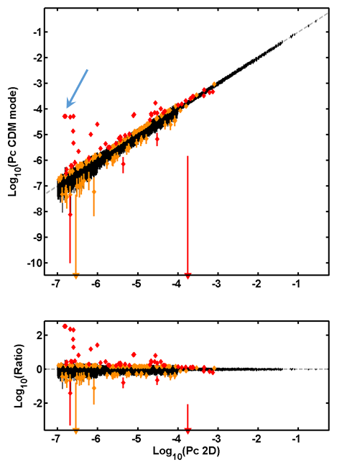
Monte Carlo Pc Calculation: Comparison with 2-D Pc Calculation
Analysis compares 28,652 conjunctions from CARA’s archive
  May 2017 to March 2018 with 2D-Pc ≥ 10⁻⁷
All subjected to a statistical test to find significant Pc differences
  Null hypothesis: CDM-Pc = 2D-Pc
  52 conjunctions have p-value ≤ 10⁻⁶
  99 more have 10⁻⁶ < p-value ≤ 10⁻³
Many more major deviations occur than expected from random variations
For a small fraction of temporally-isolated conjunctions, Monte Carlo yields significantly different results than the 2D P_{c} approximation0

Slide 32
CA Screenings: “Fly By” Ephemeris Comparison
Generate ephemerides for primary and secondaries that are possible threats
Construct screening volume box (or ellipsoid) about primary
“Fly” the box along the primary’s ephemeris
Any penetrations of box constitute possible conjunctions
For these conjunctions, generate CDM
  State estimates and covariances at TCA
  Relative encounter information
  OD information
Screening
Volume
Secondary
Primary

Slide 33
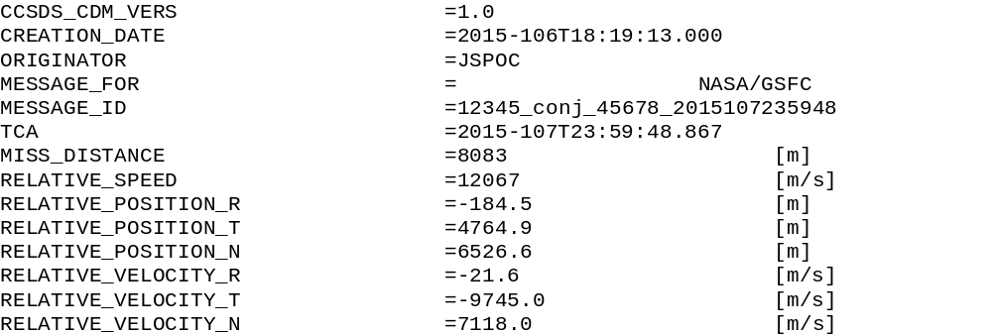
CDM Contents: Conjunction (rather than object) Information
Creation time – not necessarily the time of either OD
Time of closest approach (will change slightly with updates)
Overall miss distance and relative speed
Relative position/velocity in RTN coordinates (another name for RIC or UVW, previously defined)

Slide 34
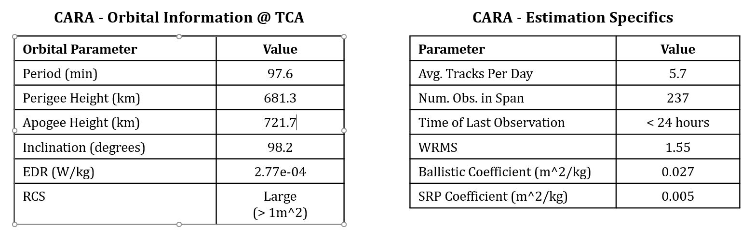
Sample Event: Information on Primary
Basic information on primary object helpful for orientation
  Usually this information known well, so mostly refresher
  If O/O ephemeris is used, estimation information not available or useful

Slide 35
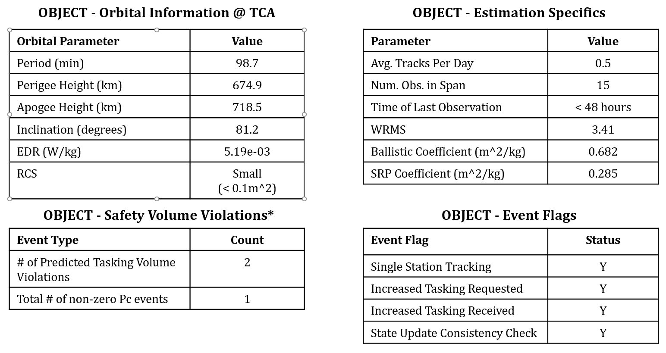
Sample Event: Information on Secondary
Basic information on primary object needed for evaluation
  Orbit/size information useful for establishing expected update quality
  Actual tracking and update information indicates actual quality level achieved

Slide 36
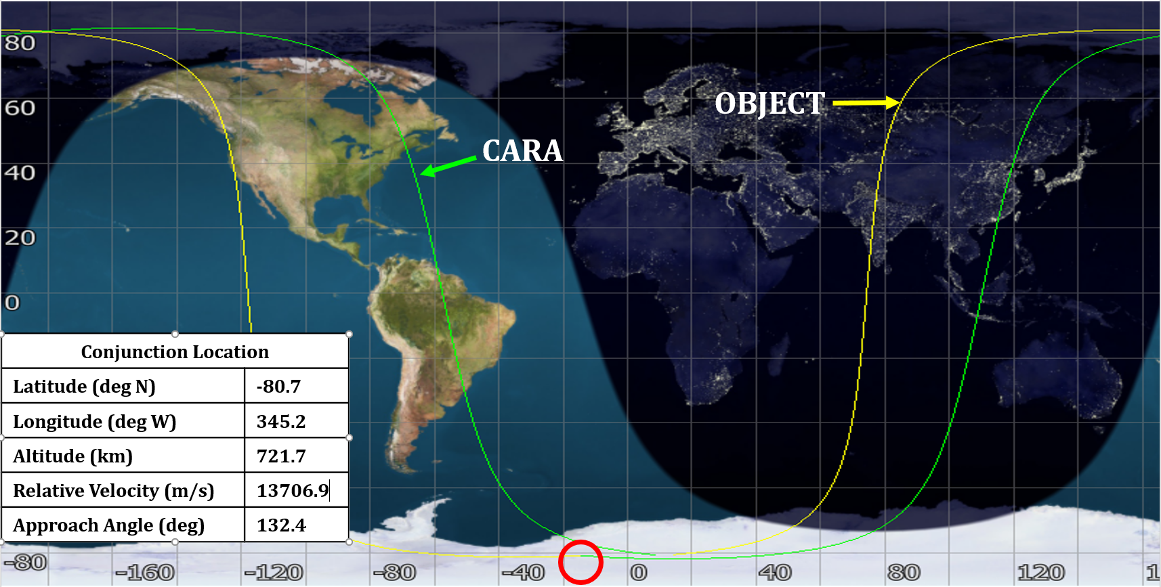
Sample Event: Ground Trace
Not essential for informing mitigation decision, but helpful for orientation

Slide 37
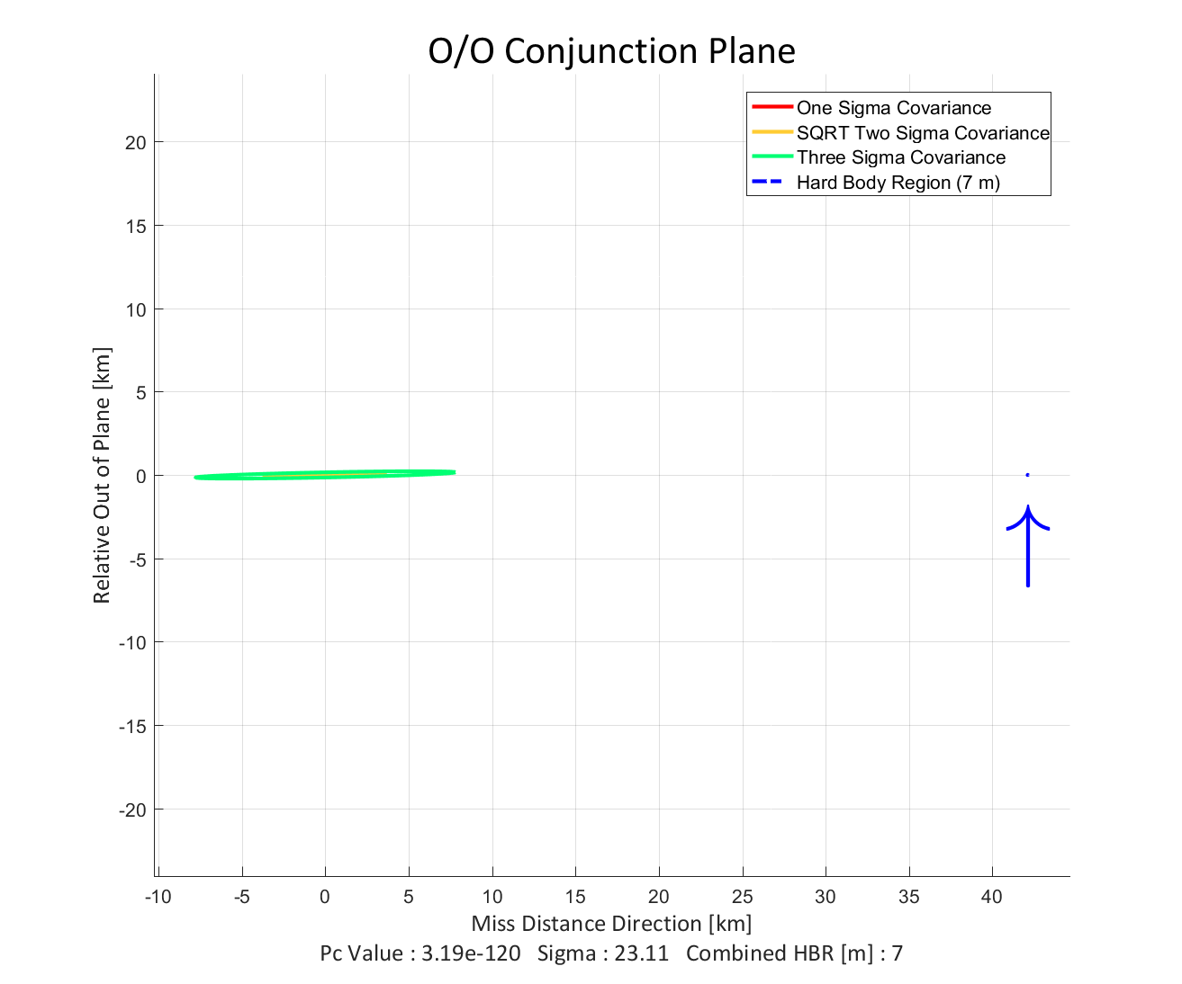
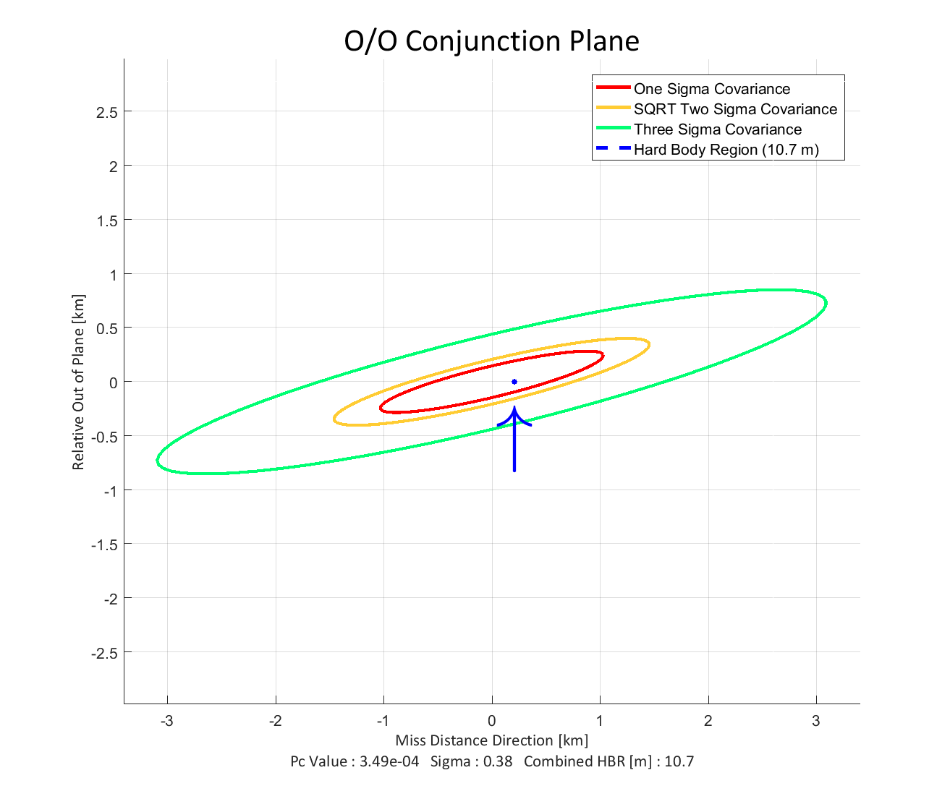
Sample Event: Conjunction Plane Plot
Orients miss distance in context of miss vector uncertainty
Low-risk situation at left; current event (high risk) at right

Slide 38
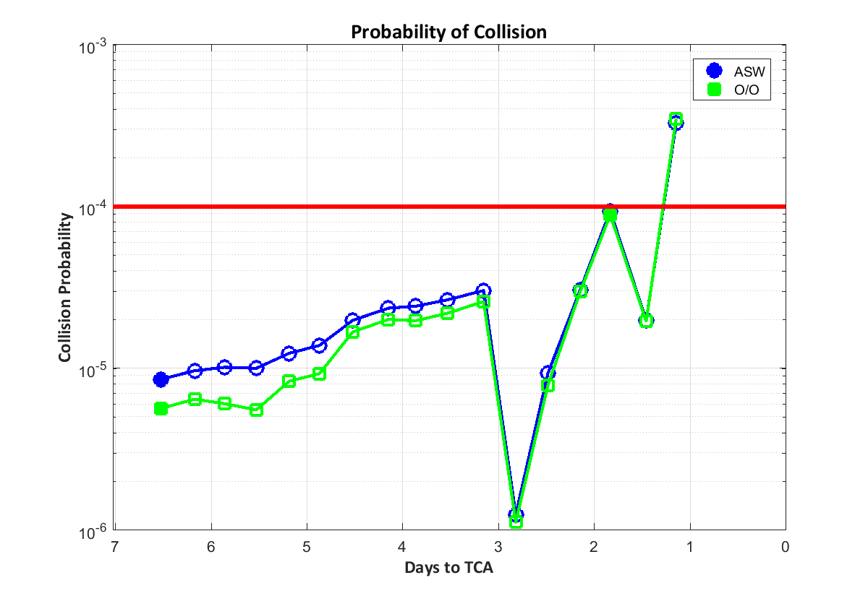
Sample Event: Pc Time History
Shows behavior of Pc over time, along with tracking information
  Indicates stability vs schizophrenia and thus imputed durability of latest point

Slide 39
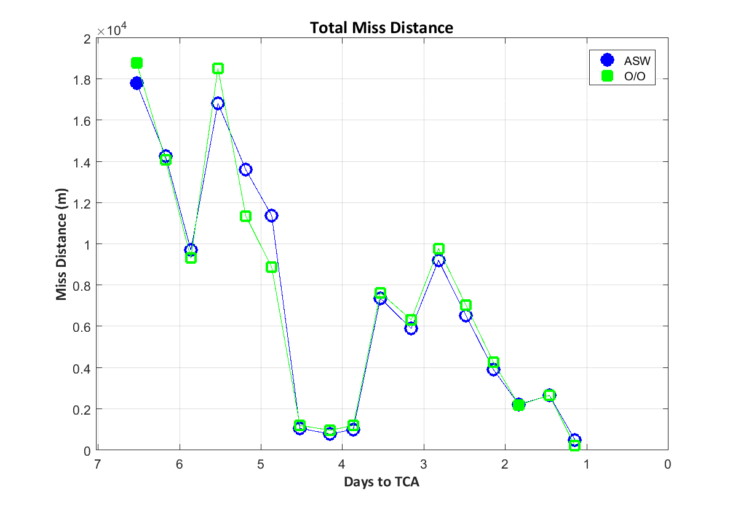
Sample Event: Miss Distance History
Shows event stability, but little else
  Componentized miss distance, especially with uncertainty values, more insightful

Slide 40
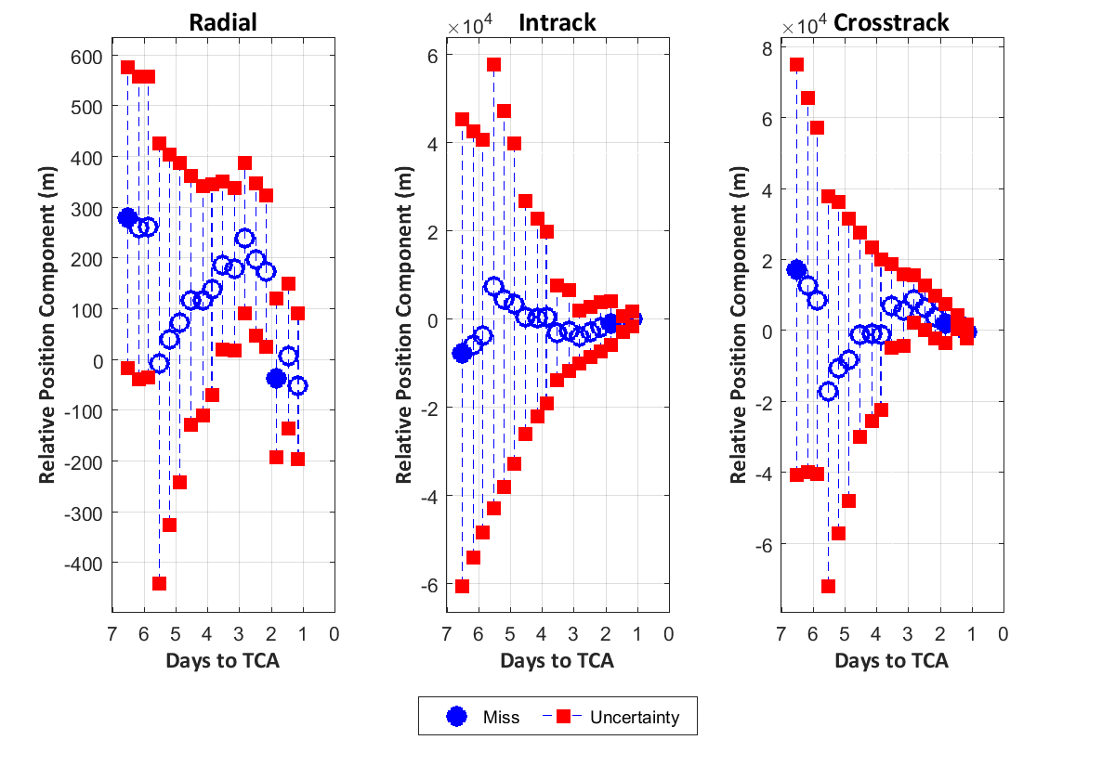
Sample Event: Position Uncertainties I
Shows event stability in relation to uncertainty
  Indicates which components unstable and therefore potential source of error

Slide 41
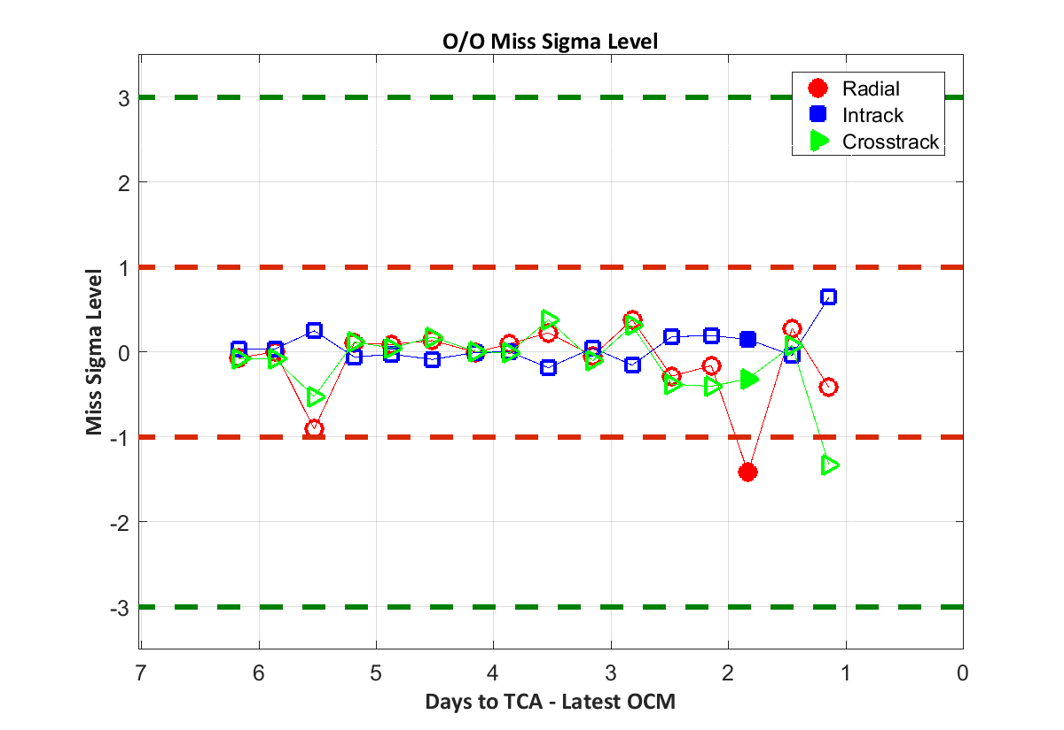
Sample Event: Position Uncertainties II
Shows event stability in relation to uncertainty, here in relative sense
  Sigma-level representation of magnitude of successive updates more meaningful

Slide 42
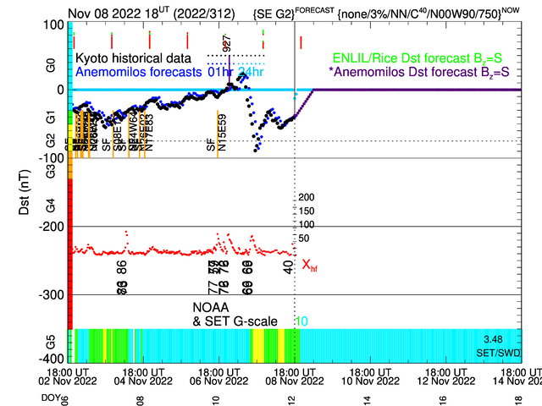
Sample Event: Space Weather Situation
Can explain past perturbed data and can predict future perturbations

Slide 43
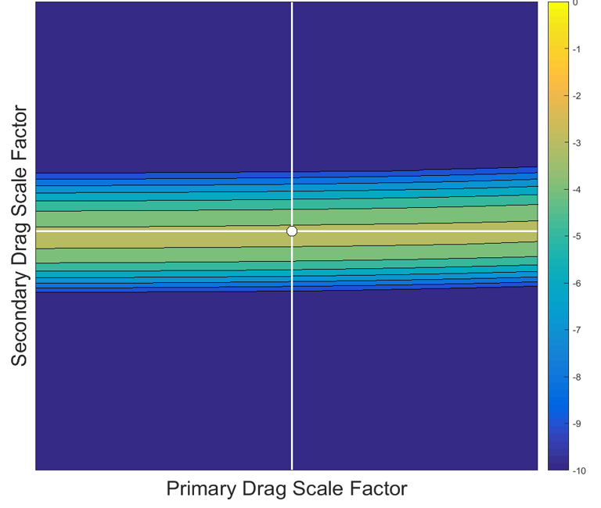
Sample Event: Space Weather Trade-Space
Determines potential effect on Pc by space weather perturbation
  Can identify situations in which event not sensitive to space weather perturbation or for which risk is presently at a maximum level and is likely only to decrease

Slide 44
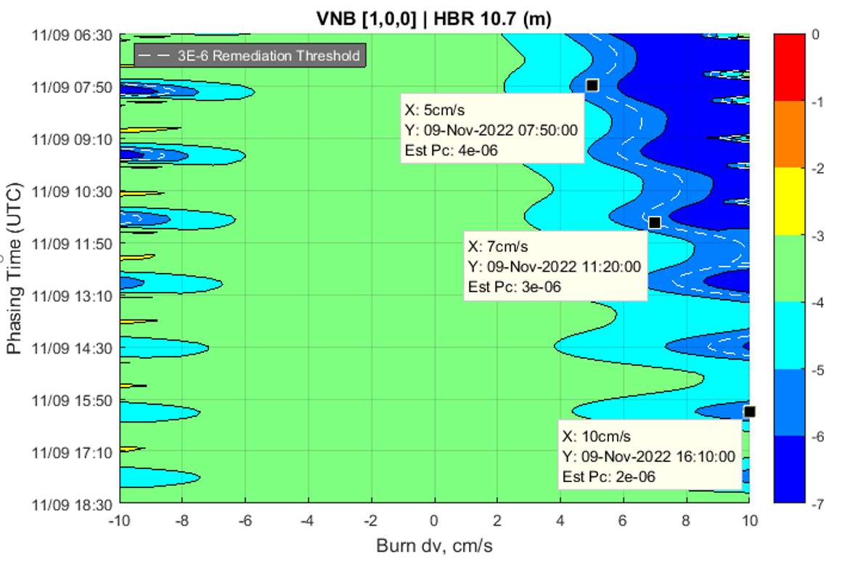
Sample Event: Maneuver Trade-Space
Identifies which maneuver intensities, at which times, would be required to reduce the Pc to an acceptable level

Slide 45
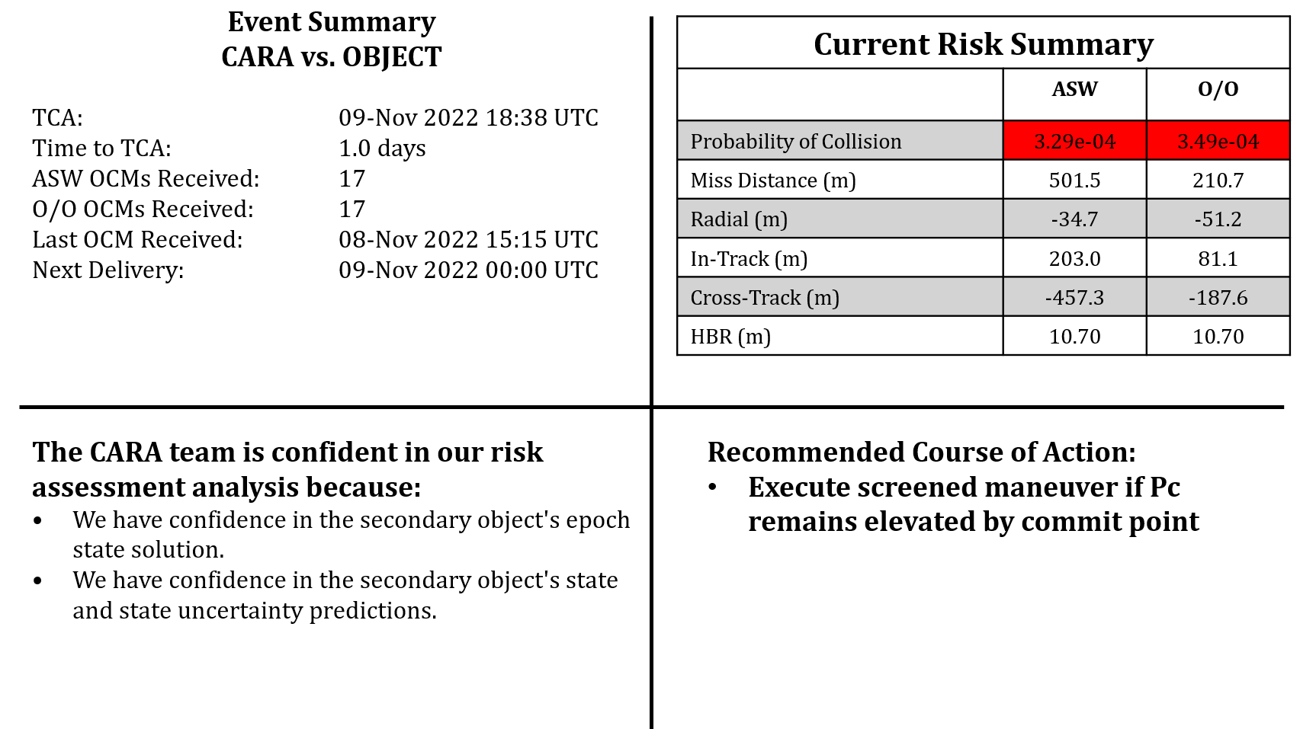
Sample Event: Summary Slide

