Slide 1
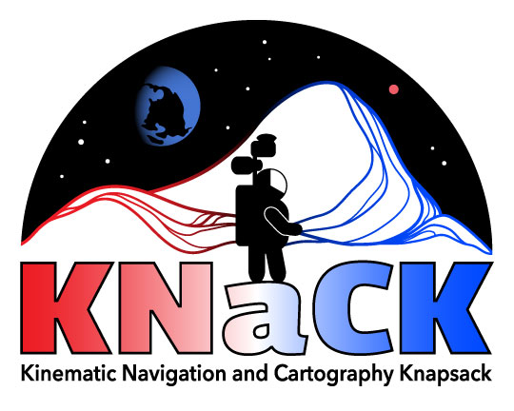
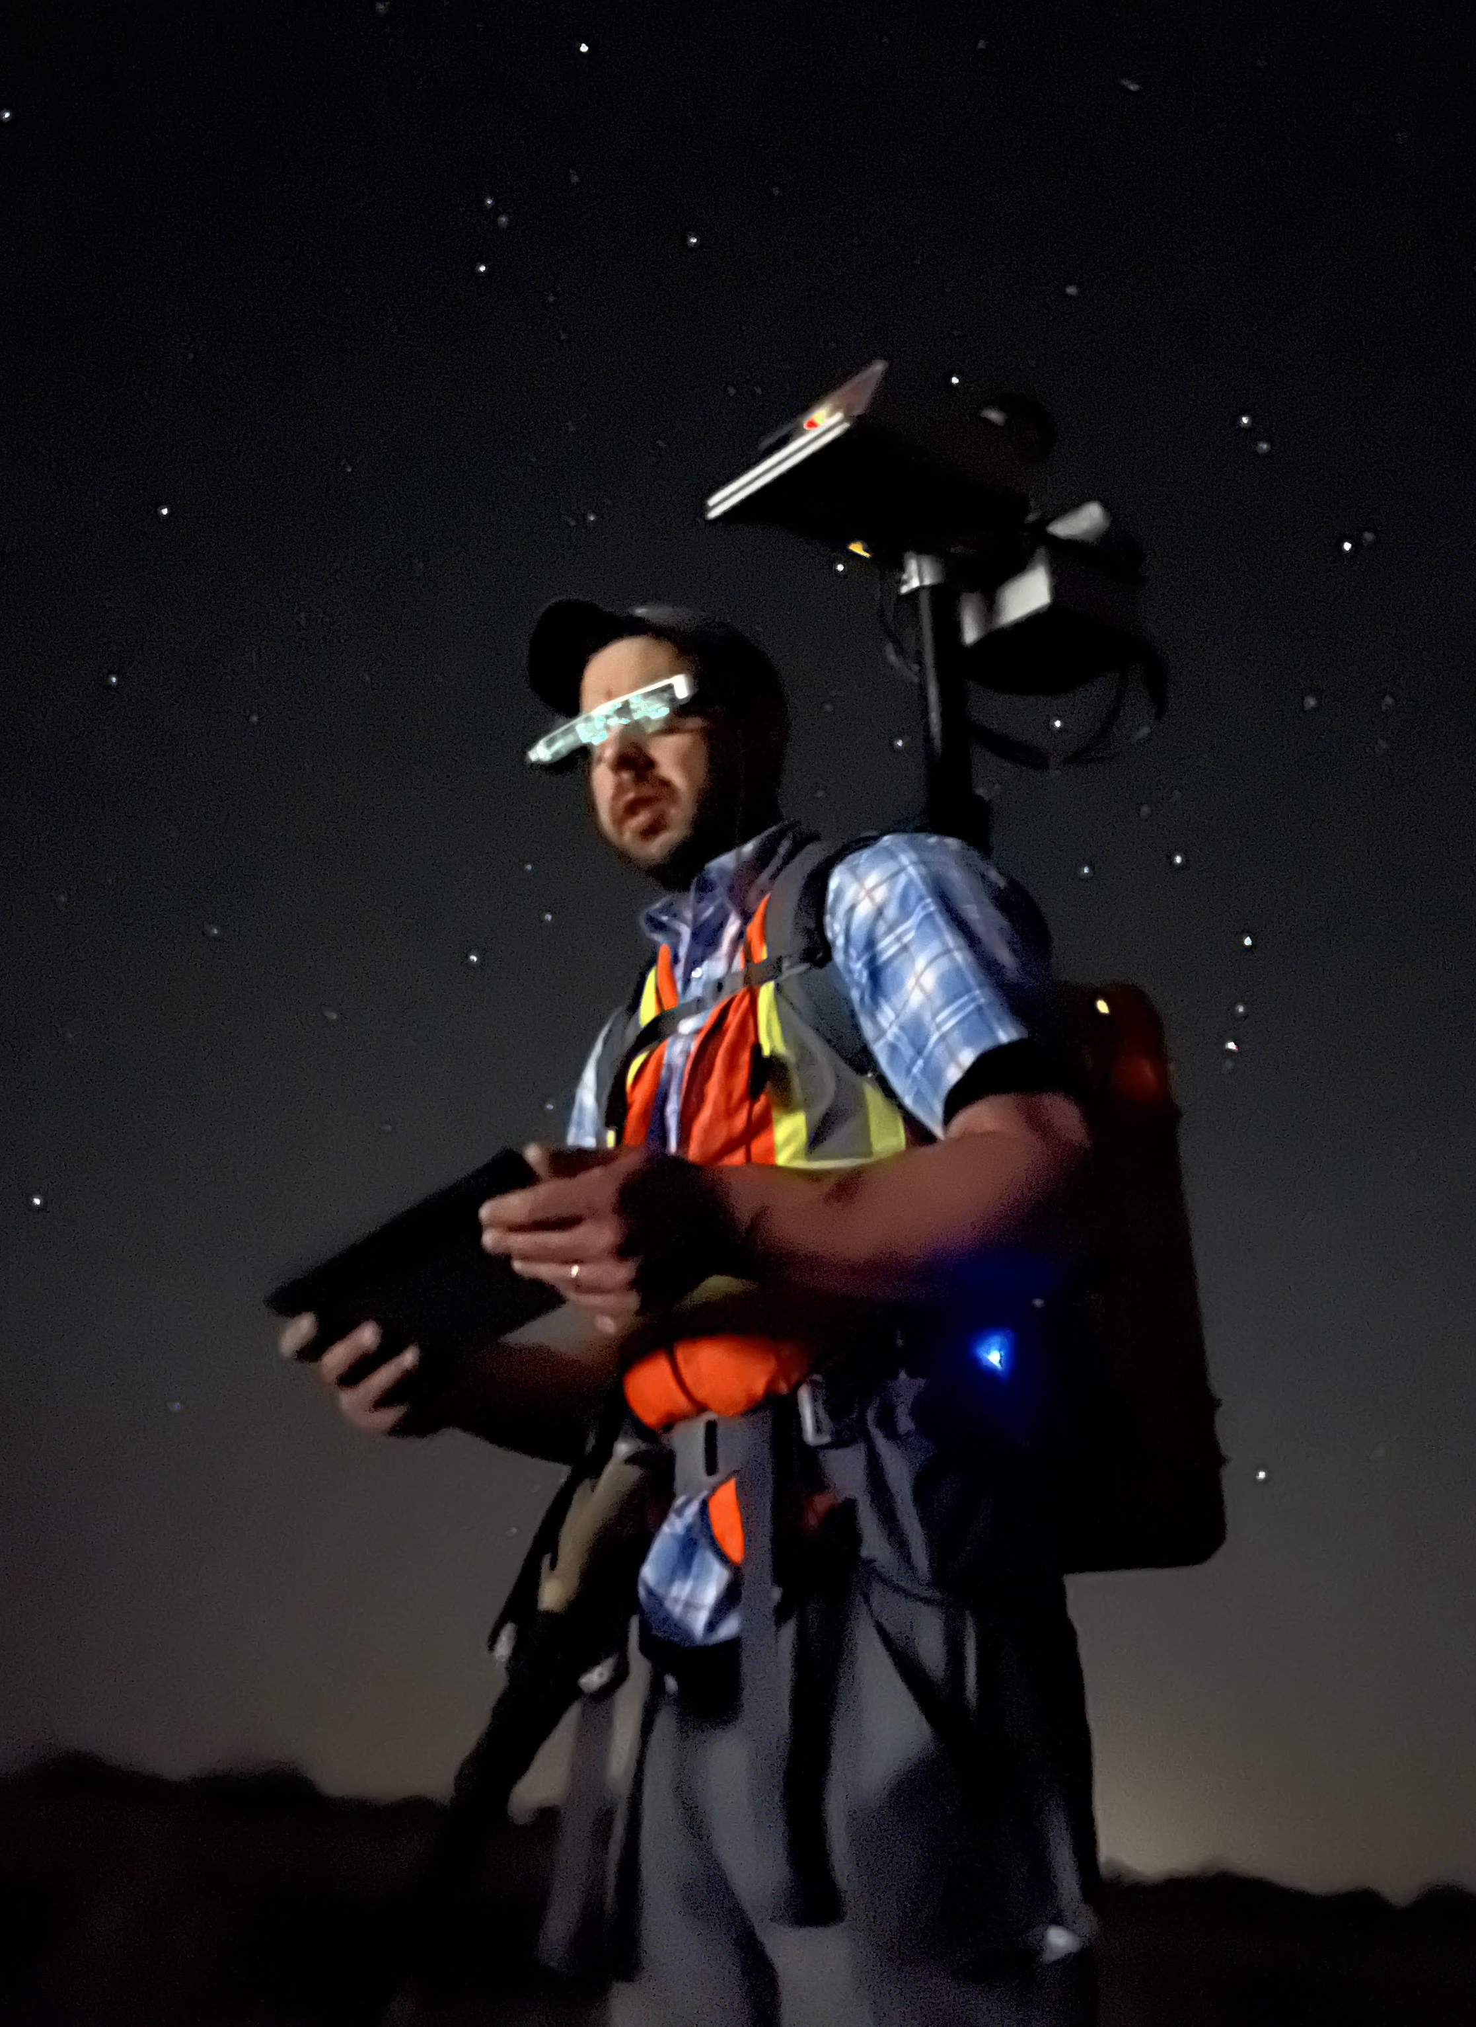
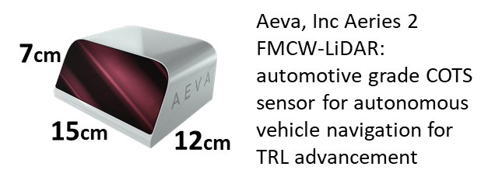
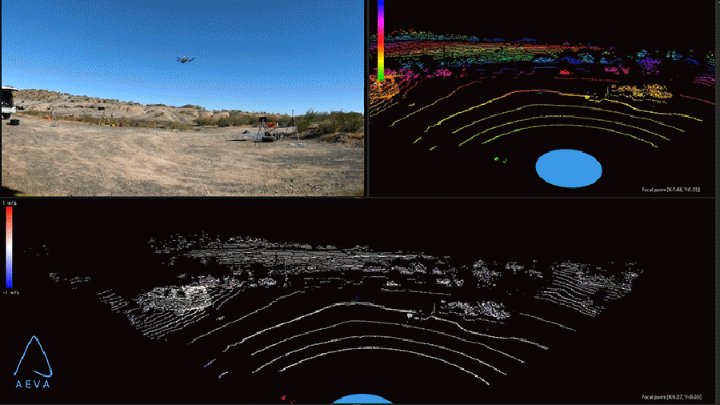
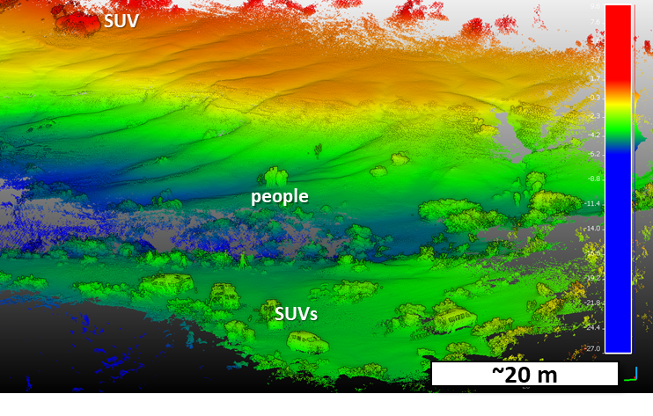
Kinematic Navigation and Cartography Knapsack (KNaCK)
PI: M. Zanetti (MSFC; Michael.R.Zanetti@nasa.gov) | STMD-funded Early Career Initiative (ECI) project
FMCW-LiDAR 3D terrain mapping and navigation proof-of-concept
Simultaneous velocity+range and SLAM algorithm development tool
Environmental testing prototype: T-Vac chamber ~Jan, 2023
No-light personal navigation test
JETT-3, Oct 2022, AZ
(GPS)
FMCW-LiDAR
HD Video
LiDAR Range (>500m)
Heads-up display
IMU
FMCW-LiDAR
Immune to Solar and LiDAR interference
Real-time Navigation AND 3D mapping in GPS-denied Environments
Rover and Astronaut applications
Batteries / Electronics
~2 million pts/sec
~12 minutes of Data
5cm/px DEM resolution 40M pts
Doppler Velocity ~10 cm/s – ~100 m/s

