Slide 1
Technology for the UVOIR Telescope
Lee Feinberg, NASA Goddard Space Flight Center
1/10/23

Slide 2

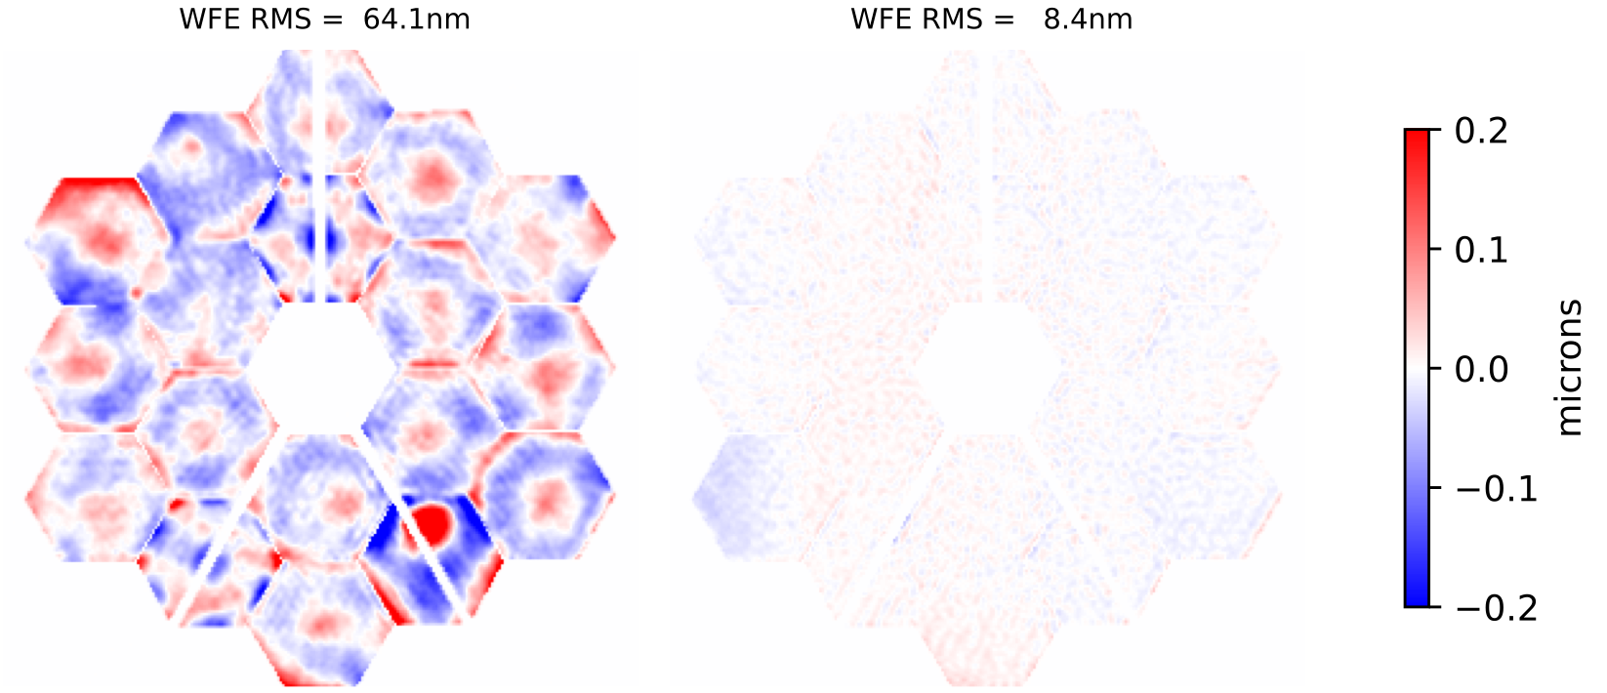
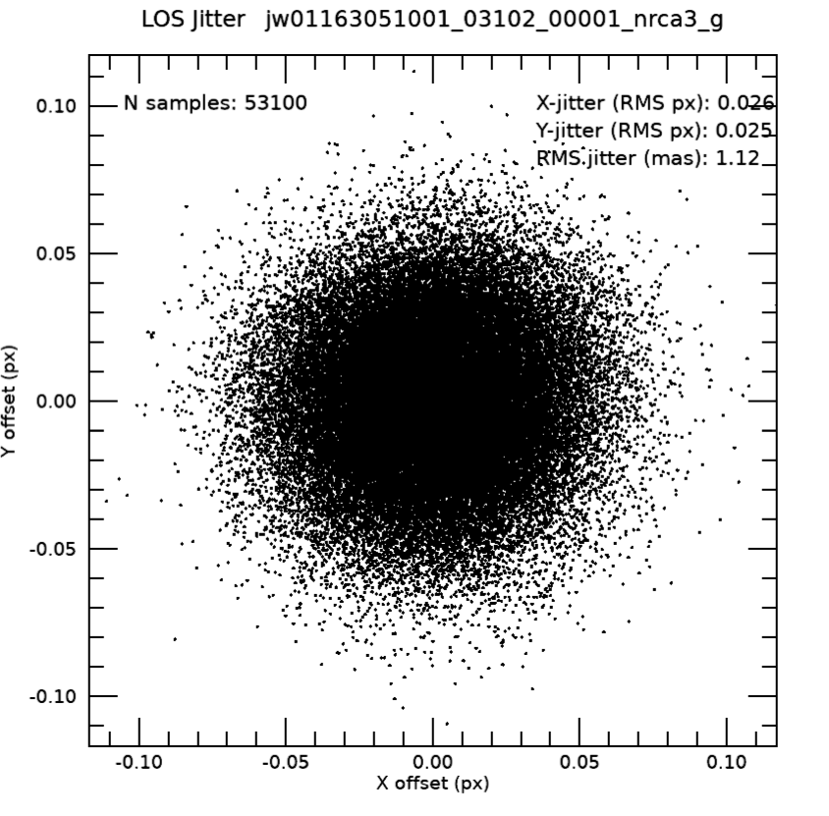
JWST Performance nearly 2x spec Gives High Confidence a .5um diffraction limited telescope is feasible
Telescope performance is dominated by the primary mirror
  WFE improvements needed for static WFE well within the state of the art (see “End-to-end assessment of a large aperture segmented Ultraviolet Optical Infrared (UVOIR) Telescope architecture” Feinberg, et al, SPIE/2016)
  HWO is expected to be diffraction limited at .5um or about 37.5nm RMS WFE
JWST’s 1 mas stability with simple isolation and 1hz fine steering loop
Micrometeoroids can be reduced 100x with a baffle
Telescope ~ 65 nm rms
Telescope + SIs ~ 70-130 nm
Absolute pointing < 0.2”
Line of sight jitter ~ 1 mas
Dither precision ~2-4 mas
As of July 12th
λ/14 at 1.1 µm
λ/25 at 2.0 µm
λ/100 at 10 µm…
No measurable vibration from
cryocooler or reaction wheels

Slide 3
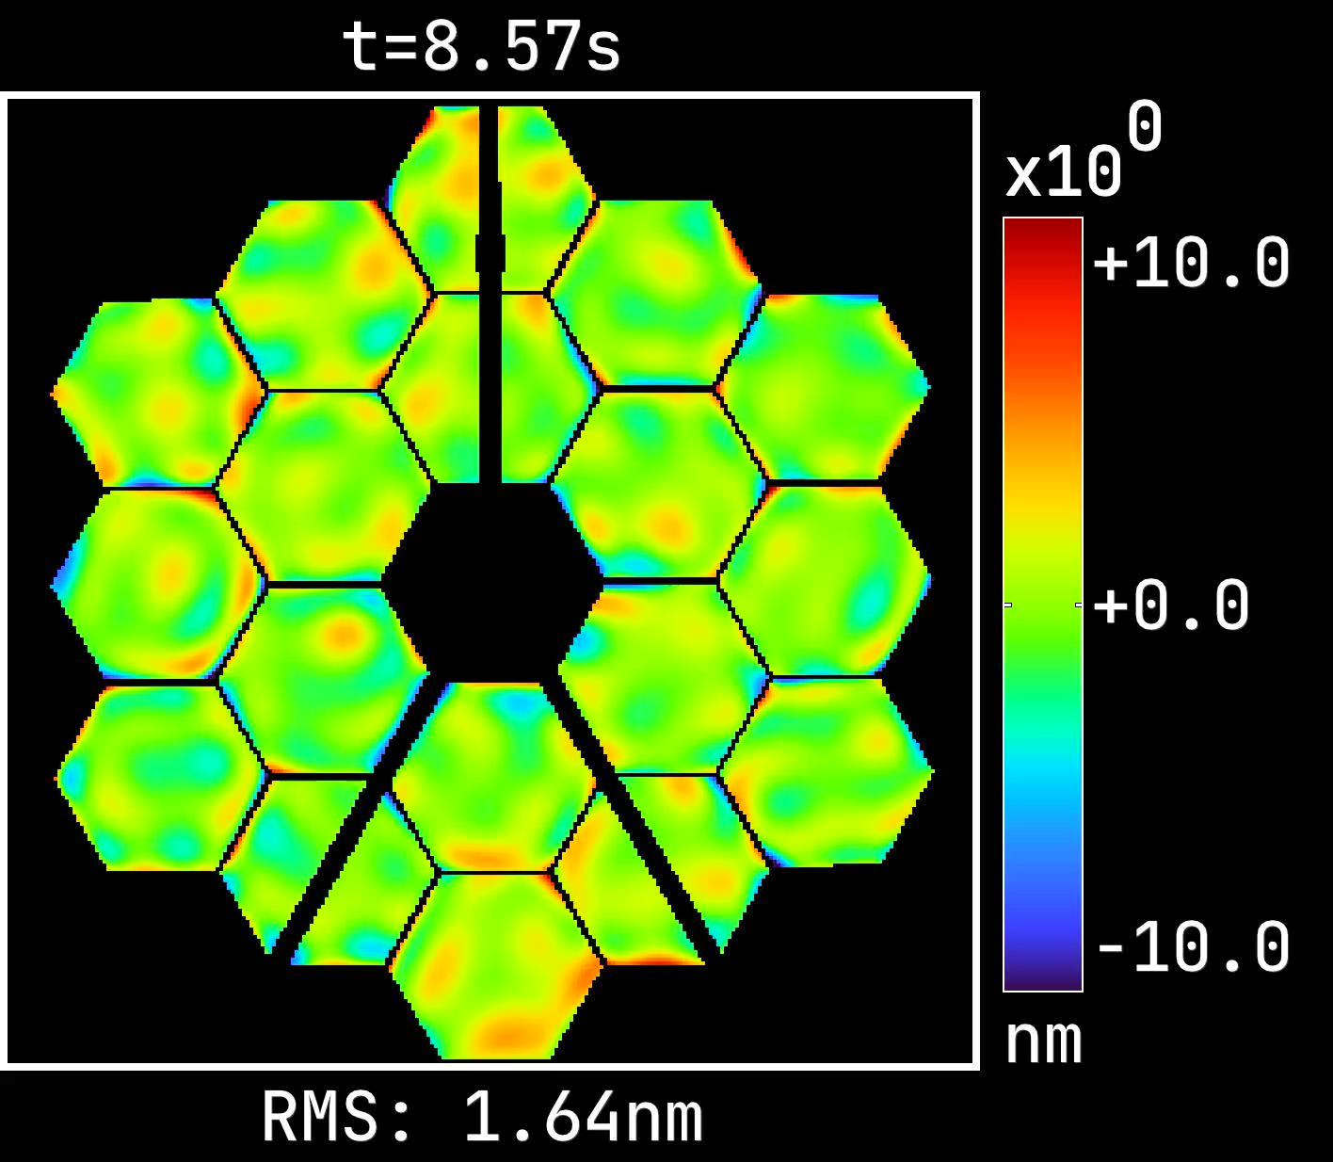
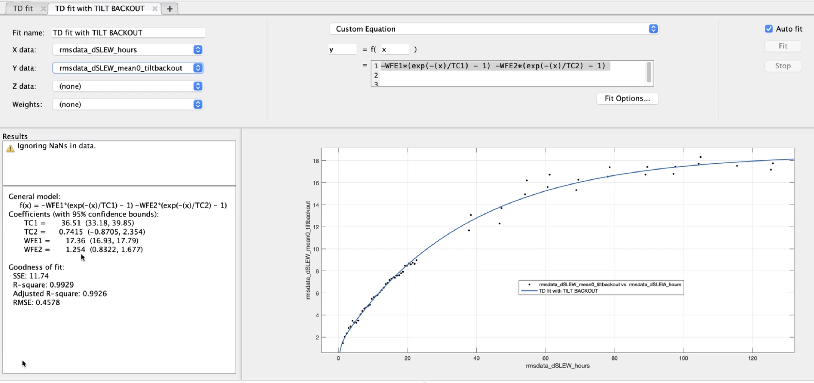
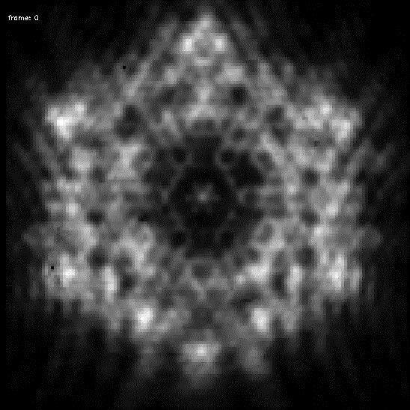
JWST passive thermal stability defines upper bounds for active controls
Alden Jurling, Joe Howard (NASA GSFC)
18 nm RMS WFE
over 8 days after nearly
worst case slew
37 hours
Short Term Oscillations result from heaters used on instrument electronics panels connected to PM with .5K deadband
RST predicts 1mK class control on PM

Slide 4
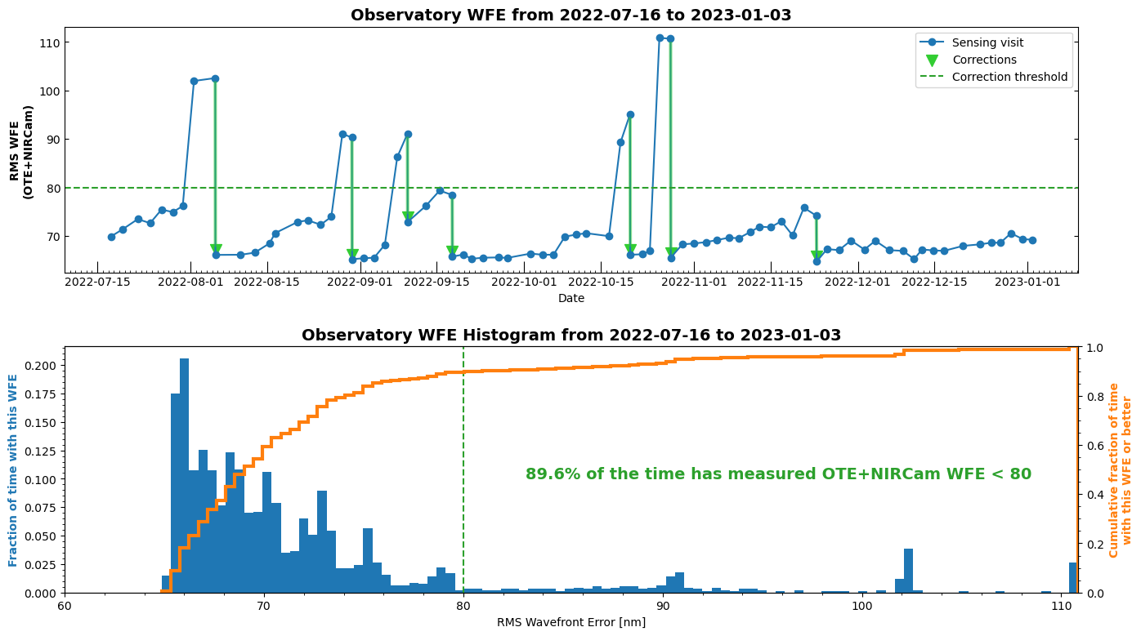
No significant tilt events in nearly 2.5 months
Occasional tilt events first few months after cooldown have diminished, can be removed with an active loop or calibration
Significant tilt events are defined as large enough to warrant WFE correction
Occasional tilt events the first few months after cooldown have diminished, can be removed with an active loop or calibration

Slide 5
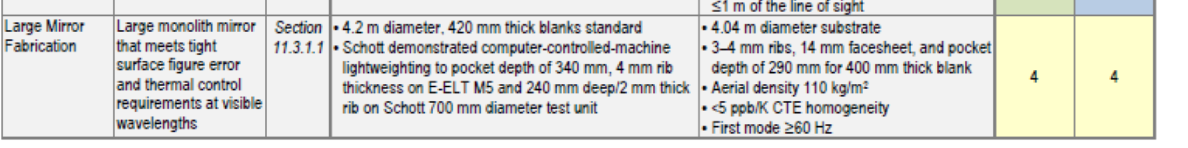
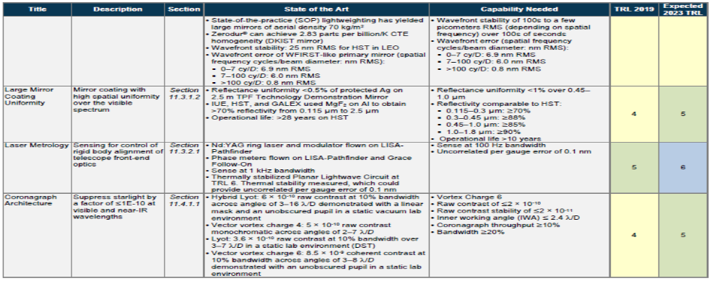
Habex Telescope Technologies (2019 assessment)
Assumed a 4m monolith

Slide 6
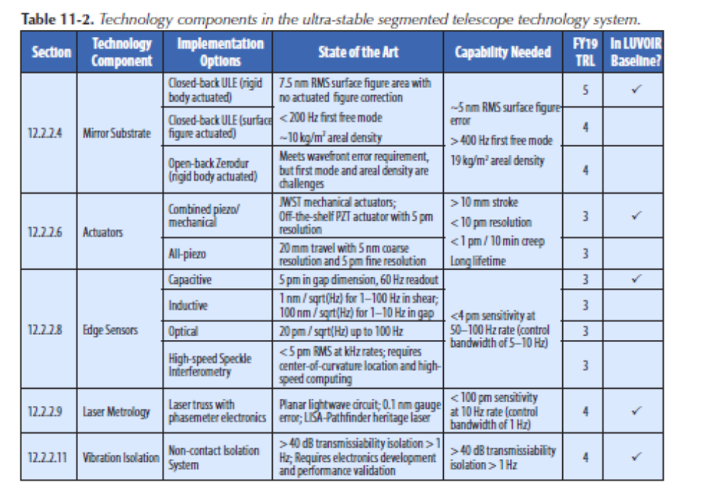
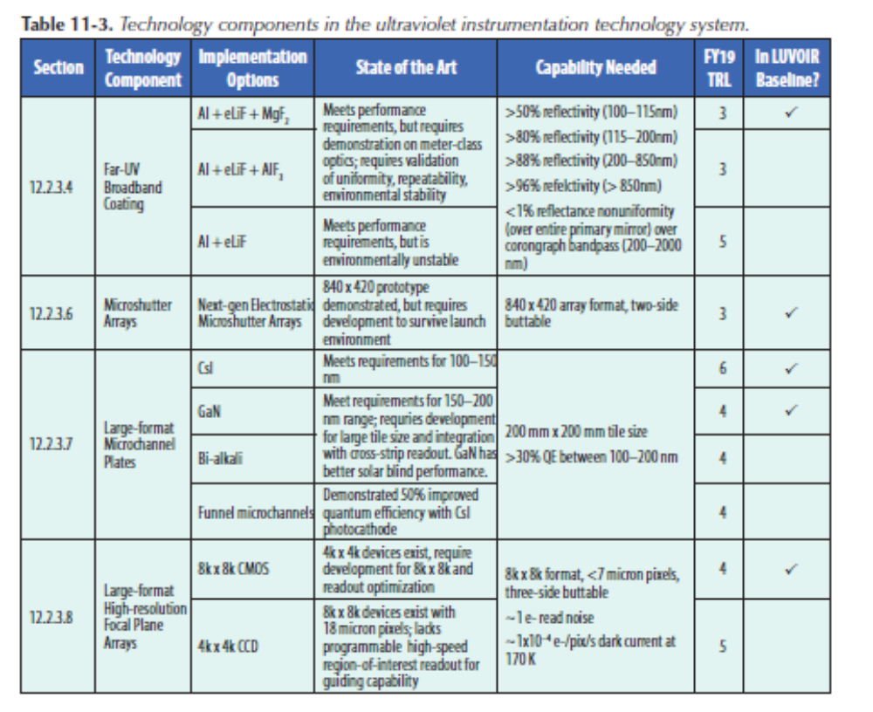
LUVOIR Telescope technologies (2019 assessment)

Slide 7
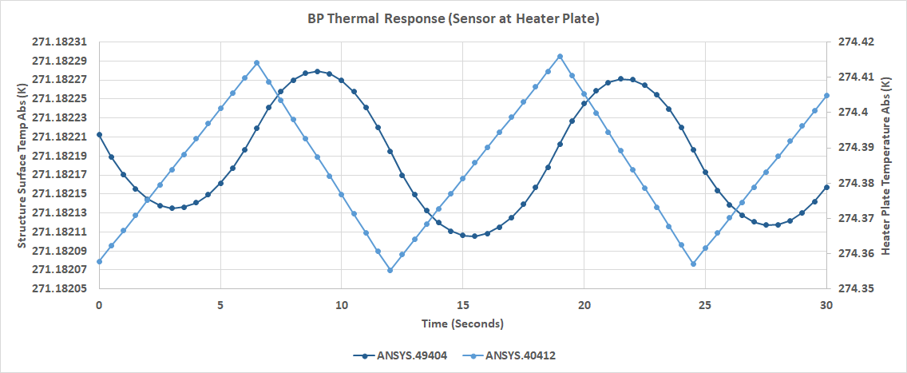
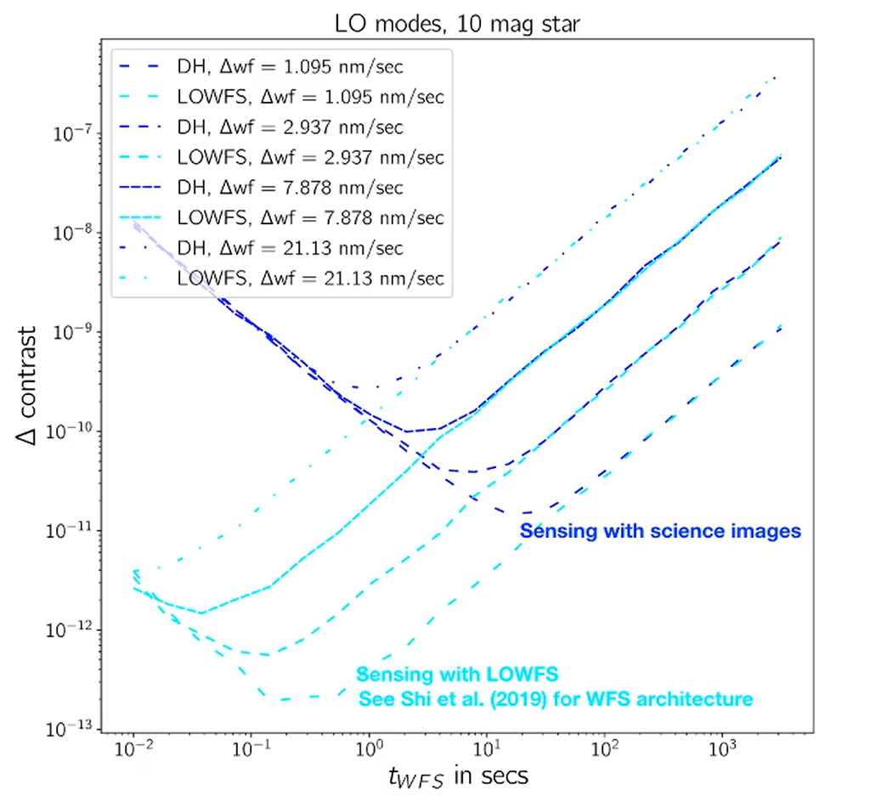
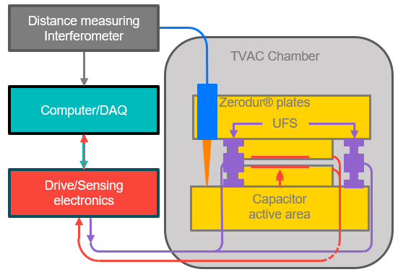
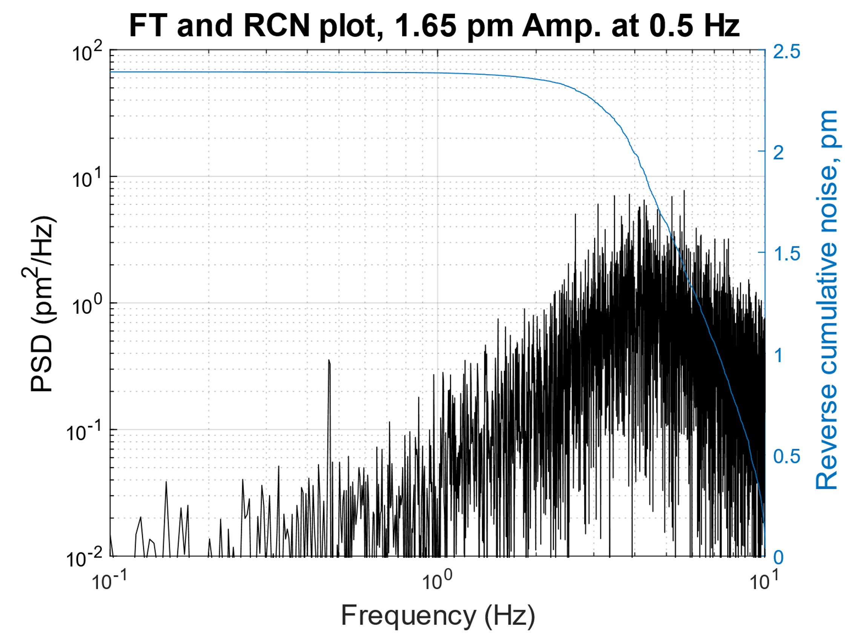
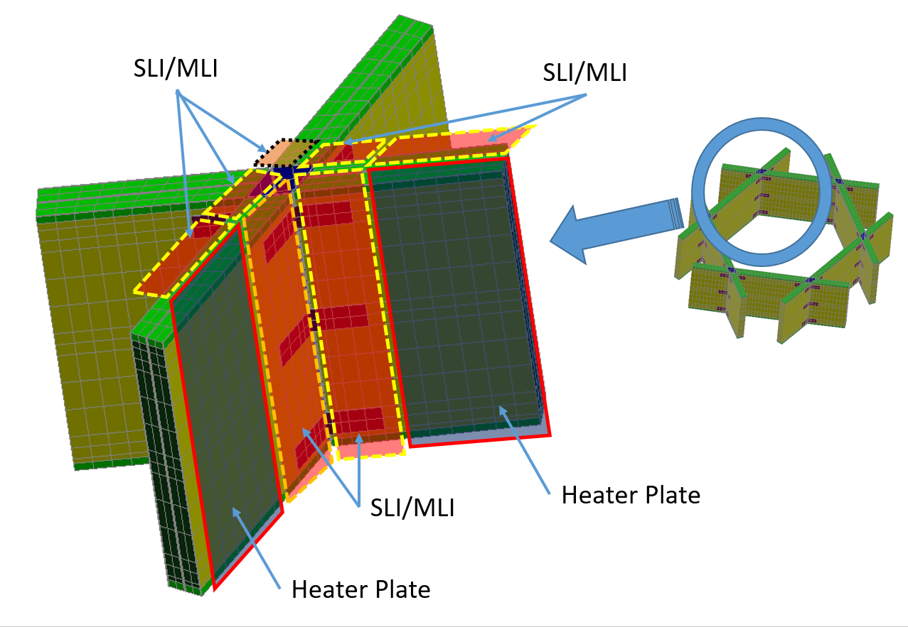
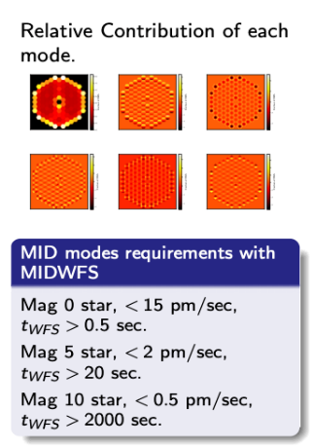
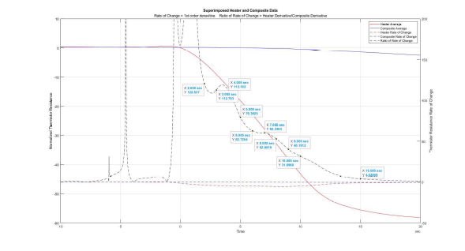
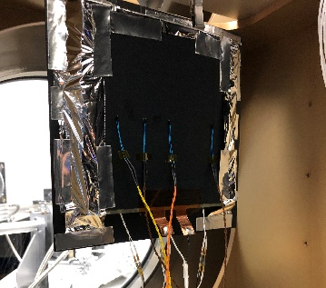
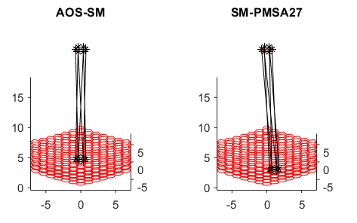
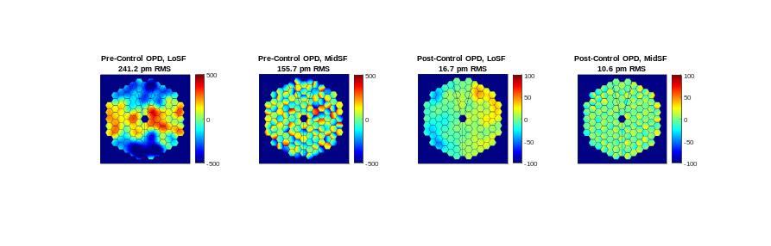
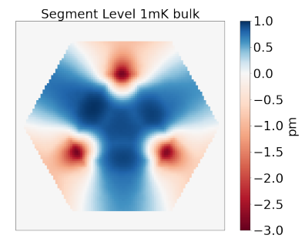
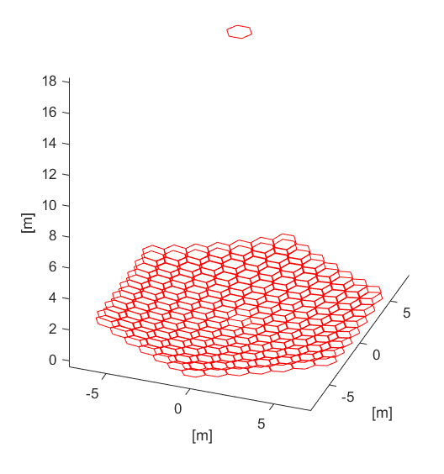
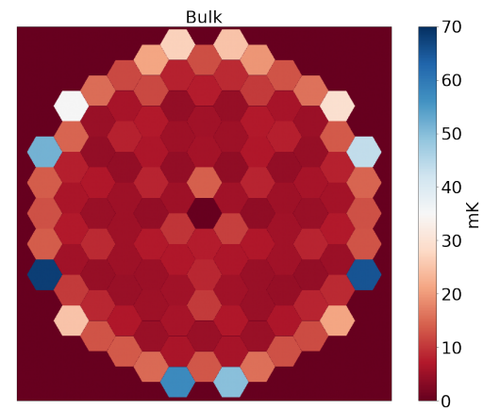
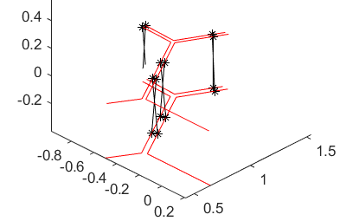
ULTRA-TM (Ball/NG/L3 Harris) Recent Progress
CORONAGRAPH SENSITIVITES
Calculate contrast stability vs. spatial-temporal domain, active WFSC in coronagraph, noise
SEGMENT SENSING AND CONTROL
Demonstrate picometer-level edge sensor and actuator components with flight-traceable designs. Model network performance.
THERMAL SENSING AND CONTROL
Develop a radiative heating approach with stability in the mK regime
Key Result: Derived allocations for system stability budget, set necessary performance for systems/ subsystems/components, used to evaluate technology gaps
Key Result: Achieved 2.5 pm RMS closed loop sense/actuate residual from 0.01-10 Hz.
Developed flexible time domain simulation for architecture trades and component evaluation
Key Result: Modeling and hardware demo of sub-mK thermal stability from rigid heater-integral-to-composite heater panel on structure element. Identified novel temp sensors.

Slide 8
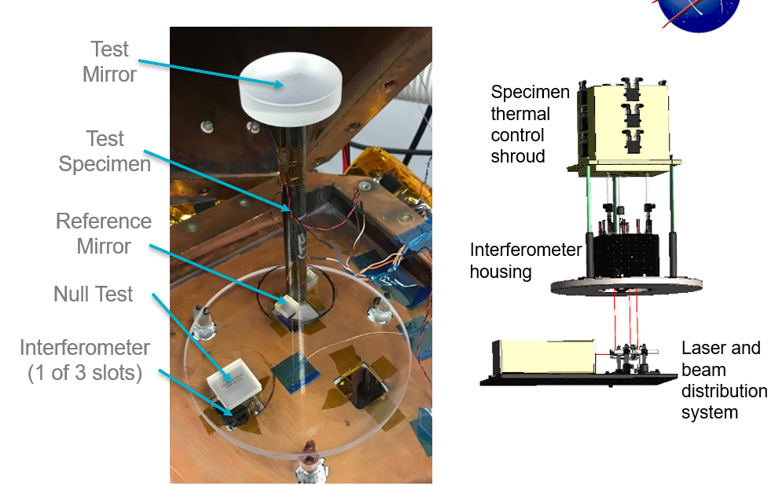
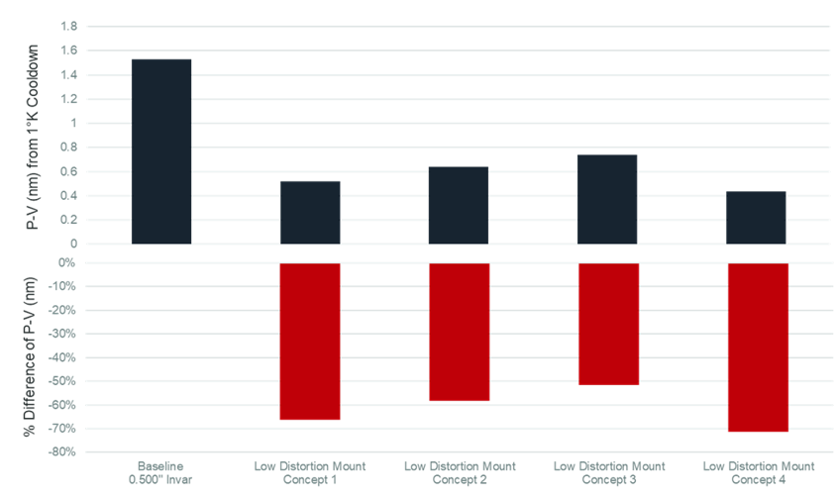
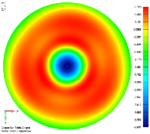
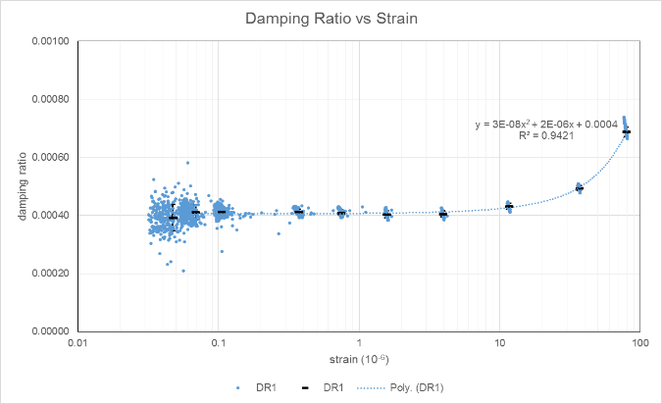
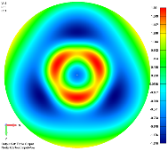
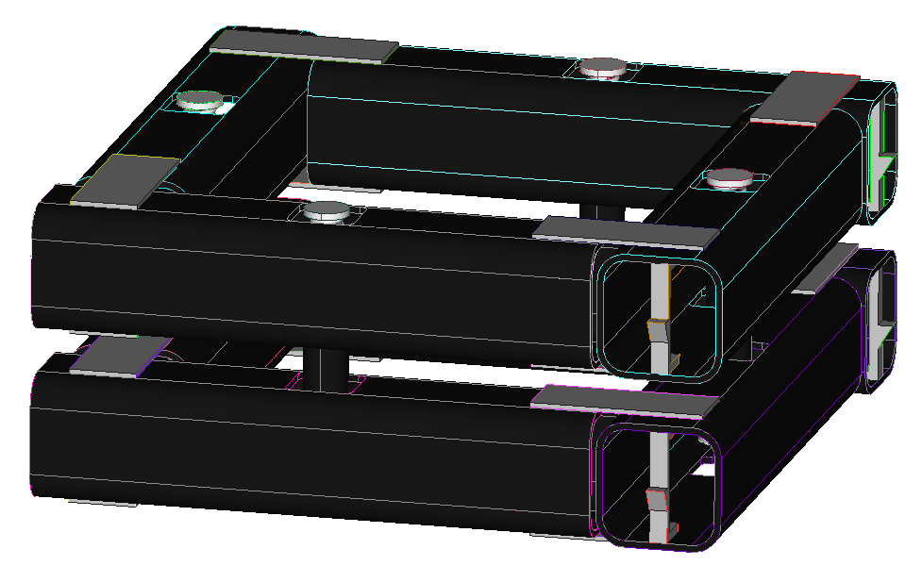
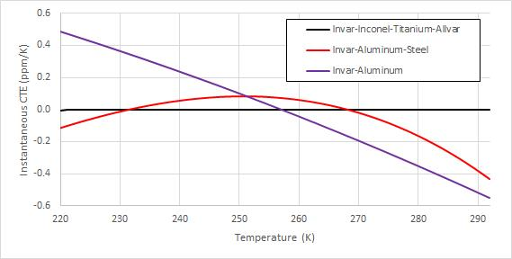
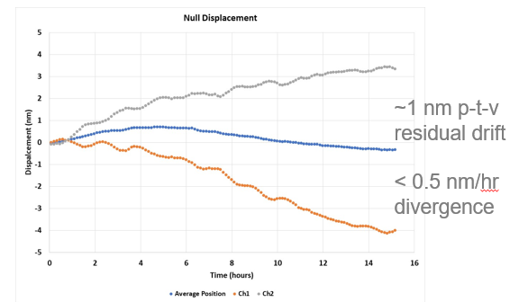
ULTRA-TM Progress (Continued)
STABLE MIRROR MOUNTING
Design of novel mount pads, struts with improved passive stability to reduce mirror distortion
STABLE STRUTURES – LATCHING AND DAMPING
Increase damping in large structures with foil treatment. Re-design latches to improve passive thermal & dynamic stability.
MATERIAL PROPERTY METROLOGY
Reduce uncertainty in measured CTE/CME of composites by 100X
10 K
Key Result: Design and hardware demo of novel pad geometry with predicted 15-20X reduction in SFE distortion over solid pad.
Developed strut design with metal alloys that has comparable CTE to ULE/Zerodur.
Key Result: Hardware demo showed foil appreciably increased damping ratio in composite coupons. Hardware demo of latchplane test article showed new design reduces deformation by several orders of magnitude.
Key Result: 10X improvement in displacement measurement. Improved isolation from lab environment. Completed analysis of alignment stability on displacement.

Slide 9
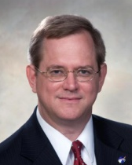

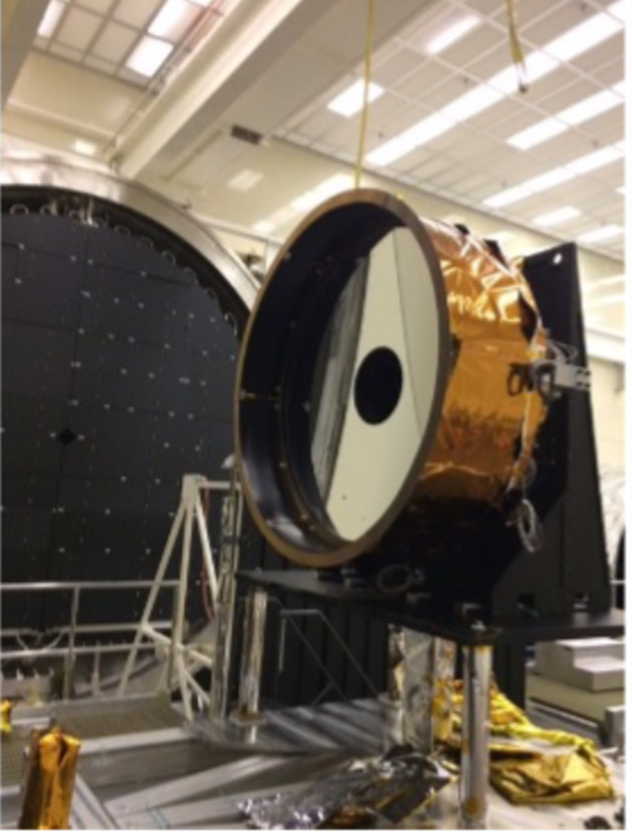
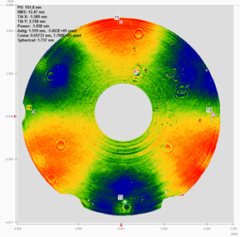
Predictive Thermal Control (PTC) Technology to Enable Thermally Stable Telescopes
PI: H. Philip Stahl / MSFC
Co-I Thomas Brooks / MSFC
Objectives and Key Challenges:
Validate models that predict thermal optical performance of real mirrors and structure based on their structural designs and constituent material properties, i.e. CTE distribution, thermal conductivity, thermal mass, etc.
Derive thermal system stability specifications from science-driven wavefront-stability requirement
Demonstrate utility of PTC system for achieving thermal stability
Significance of Work:
Thermally stable space telescopes enable the desired science of potential HabEx and LUVOIR missions
Integrated modeling tools enable better definition of system and component engineering specifications
PTC control system achieved 2K accuracy with 2mK stability of 1.5-m AMTD-2 ULE® mirror
Thermal zones able to impose 150 nm of trefoil
Approach:
Science-driven systems engineering
Mature technologies required to enable highest-priority science resulting in high-performance, low-cost, low-risk system
Mature technology in support of 2020 Decadal process
Accomplishments:
Successfully completed all initial PTC objectives and milestones
Demonstrated PTC multi-zone thermal control via test of a 1.5-m ULE® mirror in a relevant thermal/vacuum environment.
Demonstrated figure correction via multi-zone thermal control
Published study results in JATIS journal paper
Key Collaborators:
Thomas Brooks, Richard Siler, and Ron Eng (NASA/MSFC)
Carl Rosoti, Keith Harvey, and Rob Egerman (Harris Corp)
Applications:
Flagship and Explorer-class optical missions
Department of Defense and commercial observations
Funded Period of Performance:
Jan 2017 – Sep 2021
(awarded as competed SAT, converted to ISFM directed work)
TRL _{In} = 3 TRL _{Current} = 5+ TRL _{Target} = 4 - 5
(values depend on specific technology)

Slide 10
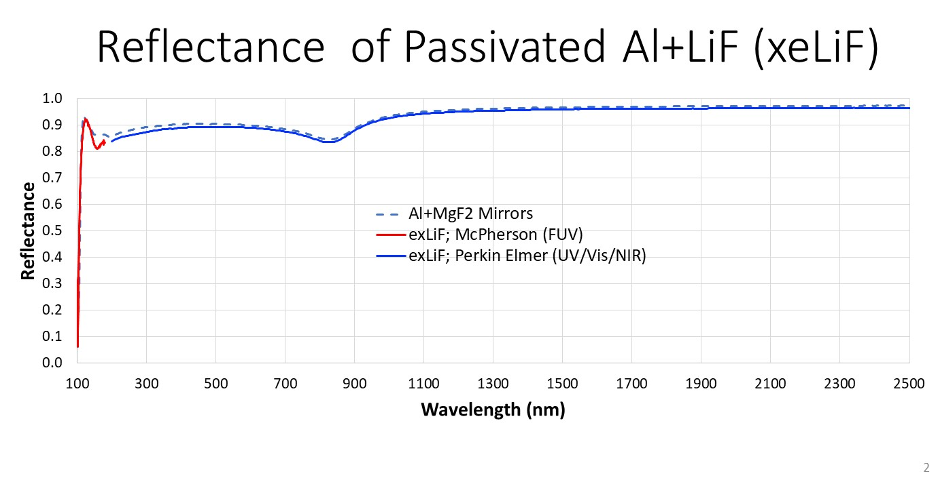
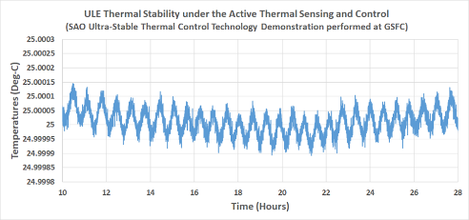
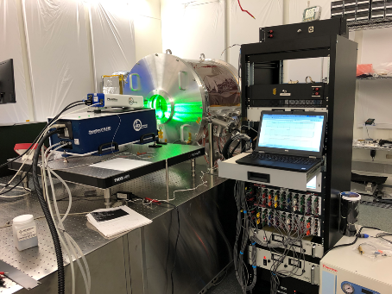
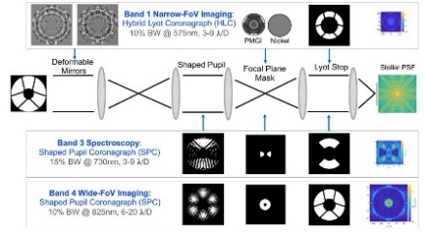
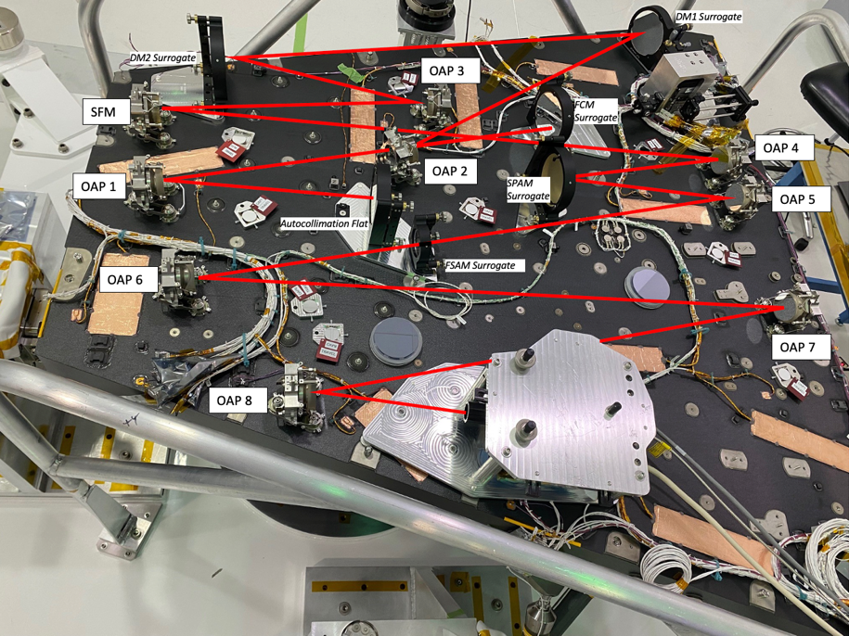
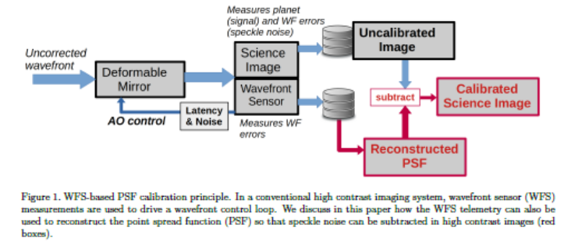
Other Examples of Technology Progress….
Ultrastable Telescopes
Manuel Quijada/GSFC
+-75uK thermal control, pm/s drift measurements
Coatings
M. Quijada/GSFC
Thermal stability was demonstrated to less than 0.15mK P-V (150uK or +/- 75 µK) over an hour with pm/s drifts measured interferometrically.
First Continuous PSF calibration Demonstrated
GSFC Ultrastable testbed/Picometer High Speed Interferometry
Roman Space Telescope Coronagraph/JPL
High Contrast Imaging with Photon Noise Limit Calibration, O. Guyon/SPIE/2022

Slide 11
Next Steps
Update Roadmaps Consistent both With Progress and The Decadal Recommendation and Develop Initial Investment Strategy
  Need updated investment strategy for next fiscal year
    Prioritize enabling technologies, tall polls, largely derived from LUVOIR and Habex Roadmaps
    Consider facilities and facility needs in the future
Science/Architecture/Technology Studies:
  Focus first on key driving architectural decisions
  Error budgets/sensitivities/calibration developed to flow requirements
Critical that science, technology development and system/architecture studies happen in parallel and iterate

