Slide 1


Additional Metadata Guidelines to Improve the Structure and Usability of HDF and NetCDF Files
Sean Leavor – SSAI/NASA LaRC
Megan Buzanowicz – SSAI/NASA LaRC, Matt Tisdale – NASA LaRC,
Michael Shook – NASA LaRC, Gao Chen – NASA LaRC

Slide 2
HDF and NetCDF File Format
Useful for handling large volumes of data
Able to host extensive metadata
Frequently used with remote sensing data
  Has been used to support numerous satellite, airborne, and ground-based measurements
Climate and Forecast (CF) conventions give a structure for data to follow
  Aim for self-describing data that can be read by both humans and software

Slide 3
Airborne HDF and NetCDF Files
Amount and content of metadata can vary wildly between campaigns or principal investigators
  Current guidelines are not always specific enough about what should be included with the metadata
The Measurements of Aerosols, Clouds, and their Interactions for ESMs (MACIE) group has started an effort to build upon existing metadata conventions
  Would help to ensure airborne data is better able to support their use for research

Slide 4
FAIR Principles
Findable
  Metadata and data should be easy to find for both humans and computers
Accessible
  Once found, the user needs to know how data can be accessed
Interoperable
  Vocabulary describing the data allows it to be integrated with other data or applications for analysis, storage, or processing
Reusable
  Metadata and data should be well-described so that it can be easily understood or replicated for future reuse
Notes:
Main focus is on interoperability and reusability

Slide 5
Goals
Primary goal is to enhance the interoperability and reusability of data. This can be achieved by:
Building upon current CF conventions
Improving the metadata structure and the way it is presented
Controlling domain relevant information
Making sure variables are dimension scaled
Ensuring data use standardized units
Making arrangements for standardized uncertainty reporting

Slide 6
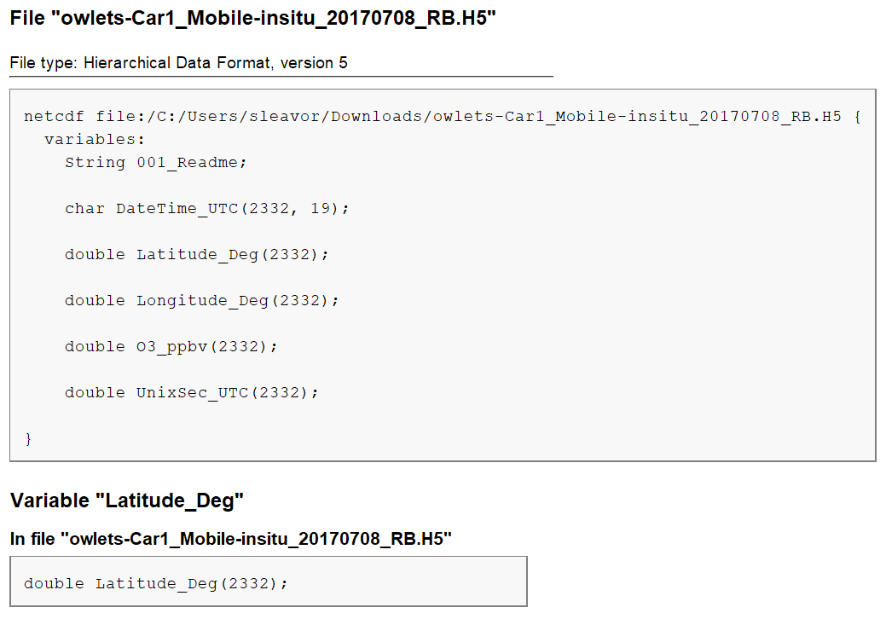
Common Airborne HDF/NetCDF Metadata Issues
Data does not have a predictable structure
Descriptive information about the file can be missing
Global attributes or variable information may not be present
Variable dimensions might not be labeled
Notes:
Descriptive information missing: PI information, location data was taken, time measurements were taken
Global attributes missing: Sometimes, useful information might not be available within the file such as a missing time variable
Image: For this file, the only information we have is the variable names and the units. The readme gives the name of the instrument and a PI to contact. There’s very little information present about what the measurements mean, how they were taken, or where they take place.

Slide 7
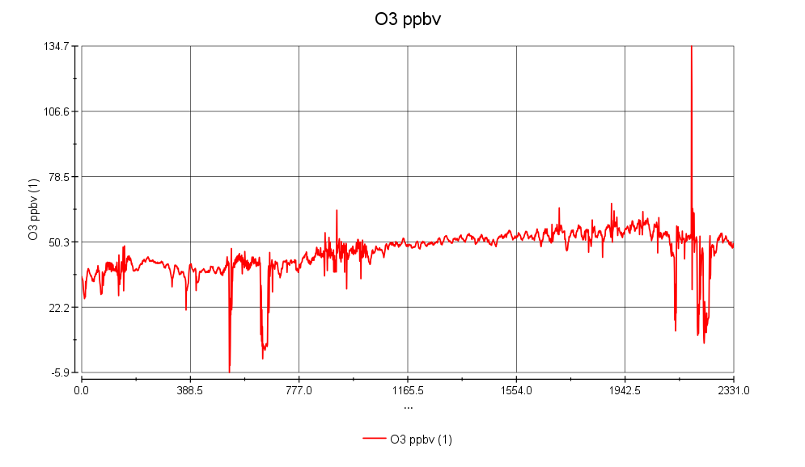
Common Airborne HDF/NetCDF Metadata Issues
Notes:
A plot of the O3 measurements from the same file. We can see that we have O3 plotted with units of ppbv, but since the measurement isn’t attached to a dimension, we don’t know what it’s being plotted against. It’s possible to find by looking around the file that it’s supposed to be time, but it’s not always immediately clear.

Slide 8
Proposed Guidelines
Standardize file structure based upon CF conventions
Use global attributes to host required general metadata information
Require use of CF global and variable attributes for domain relevant metadata
Indicate linked variables using CF attributes
Recommend using standardized variables
Ensure data variables are properly attached to dimensions
Allow for guidelines to be expanded upon to cater to specific types of data
Notes:
Indicate linked variables using CF attributes: Attach the uncertainty to the main variable, for example
Recommend using standardized variables: Potentially using variable standard names similar to those in the ICARTT v2.0 file format, standardized units

Slide 9
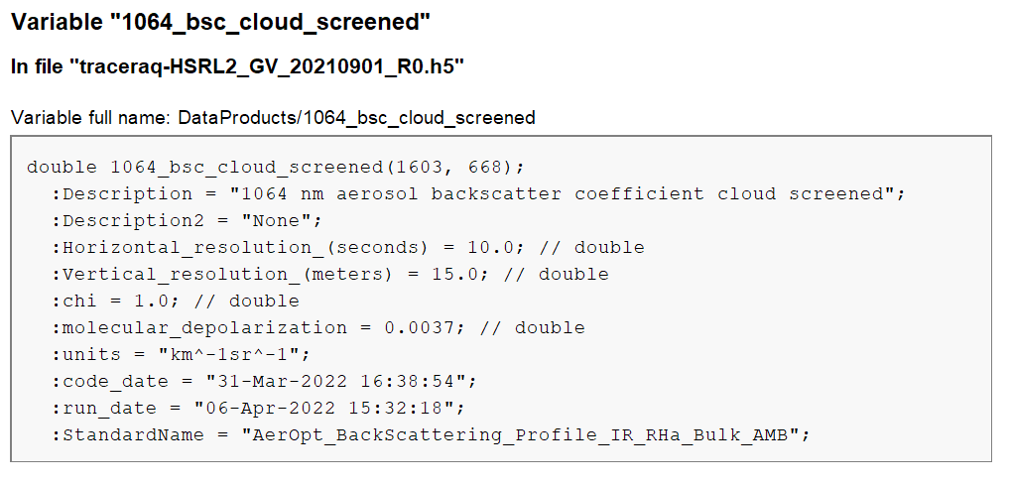
Proposed Guidelines
Notes:
This is an example of a lidar backscatter variable from a TRACER-AQ file. Here, we have a much more detailed description of what’s inside this variable, including the spatial/temporal resolution of the measurements and even the variable standard name.

Slide 10
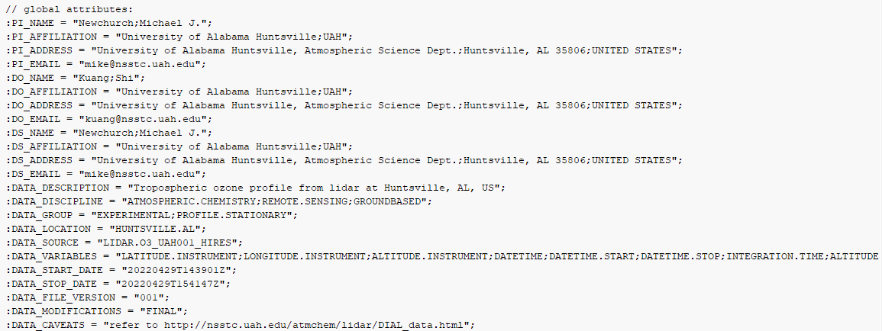
Proposed Guidelines
Notes:
This is an example of global attributes in a file from the TOLNet lidar group. We’re given information about the PI, their contact information, a description of data within the file, where it took place, and more.

Slide 11
Summary
Metadata for airborne HDF and NetCDF files can vary greatly between campaigns or PIs
Additional guidelines for the metadata structure will make data more interoperable and reusable
  Can aid data users in their use of measurements for research or for allowing data to be more easily ingested for archival
Updated standards may need to be catered to individual types of measurements
Proposed guidelines have been tested for several instruments
  High Spectral Resolution Lidar (HSRL)
  High Altitude Laser Observatory (HALO)
  Research Scanning Polarimeter (RSP)
  Geostationary Coastal and Air Pollution Event (GEO-CAPE) Airborne Simulator (GCAS)

