Slide 1

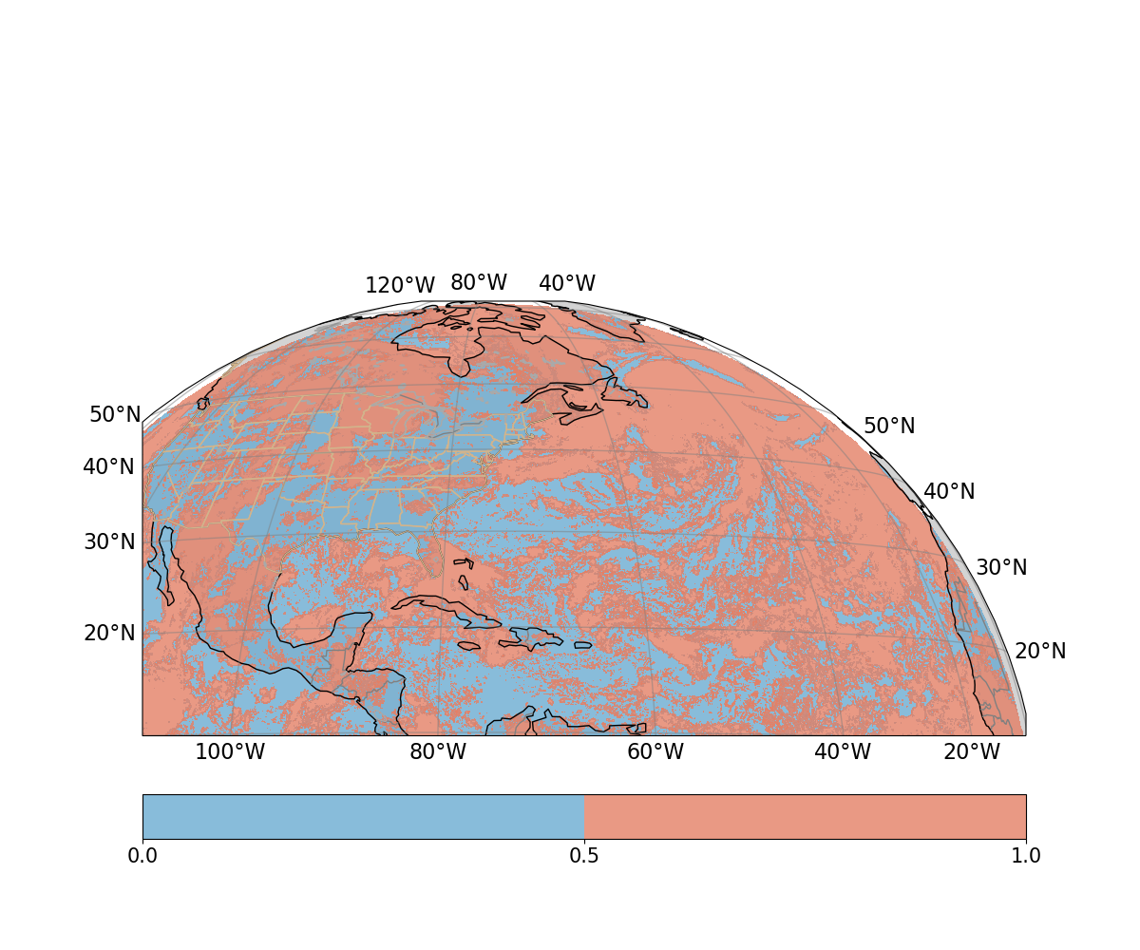
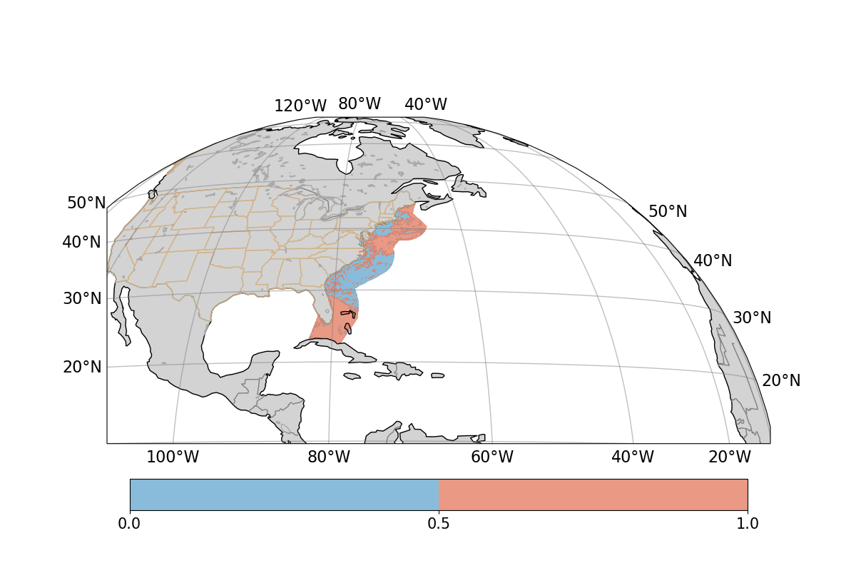
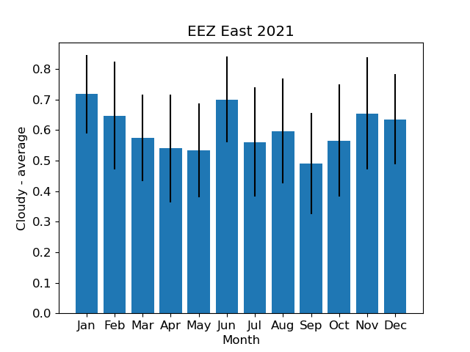
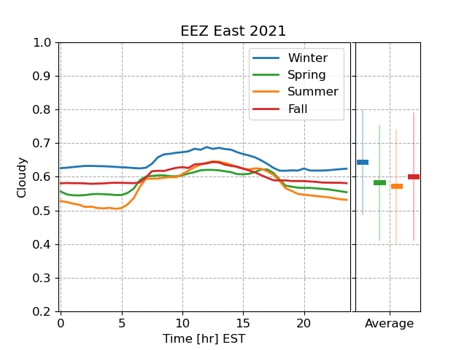
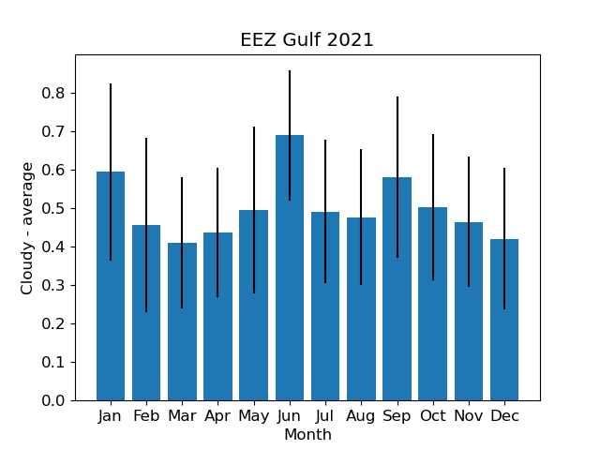
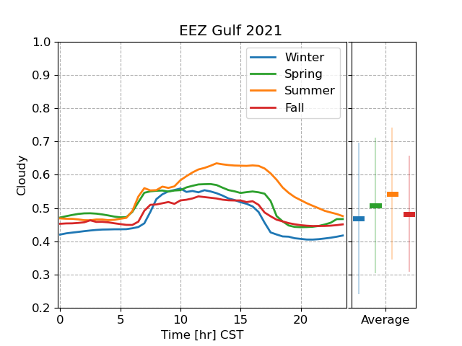
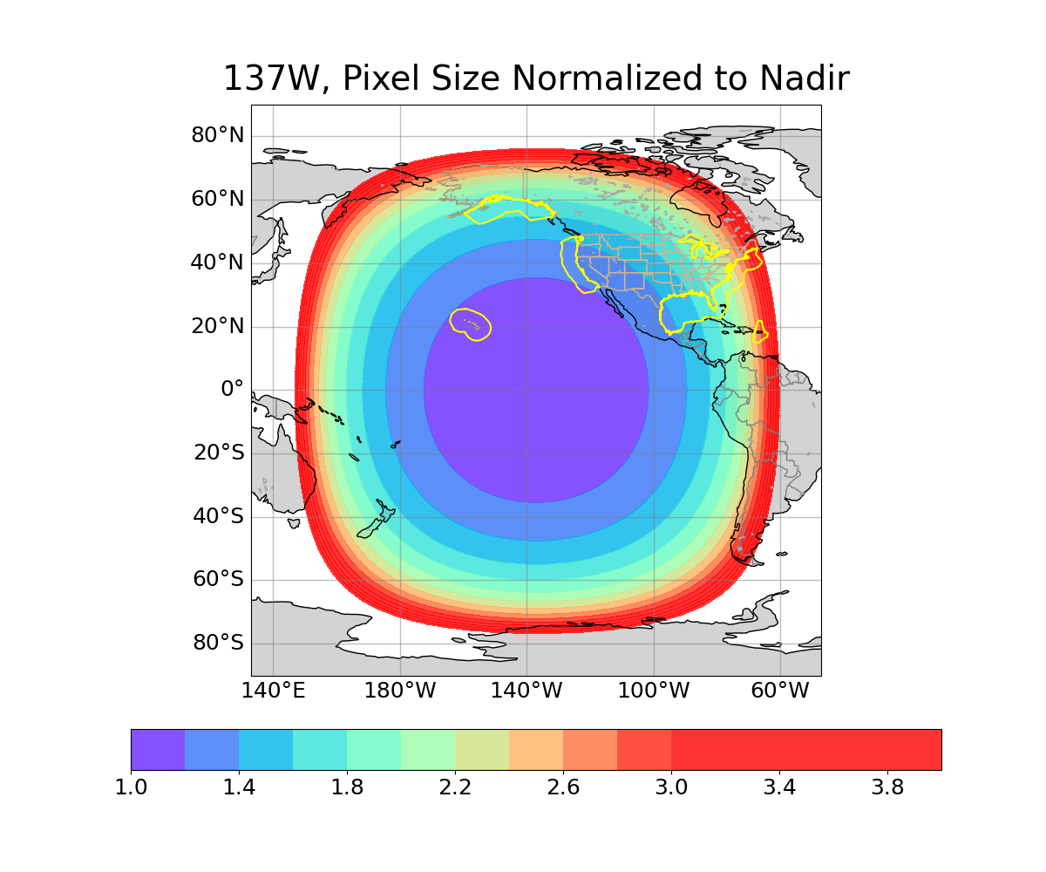
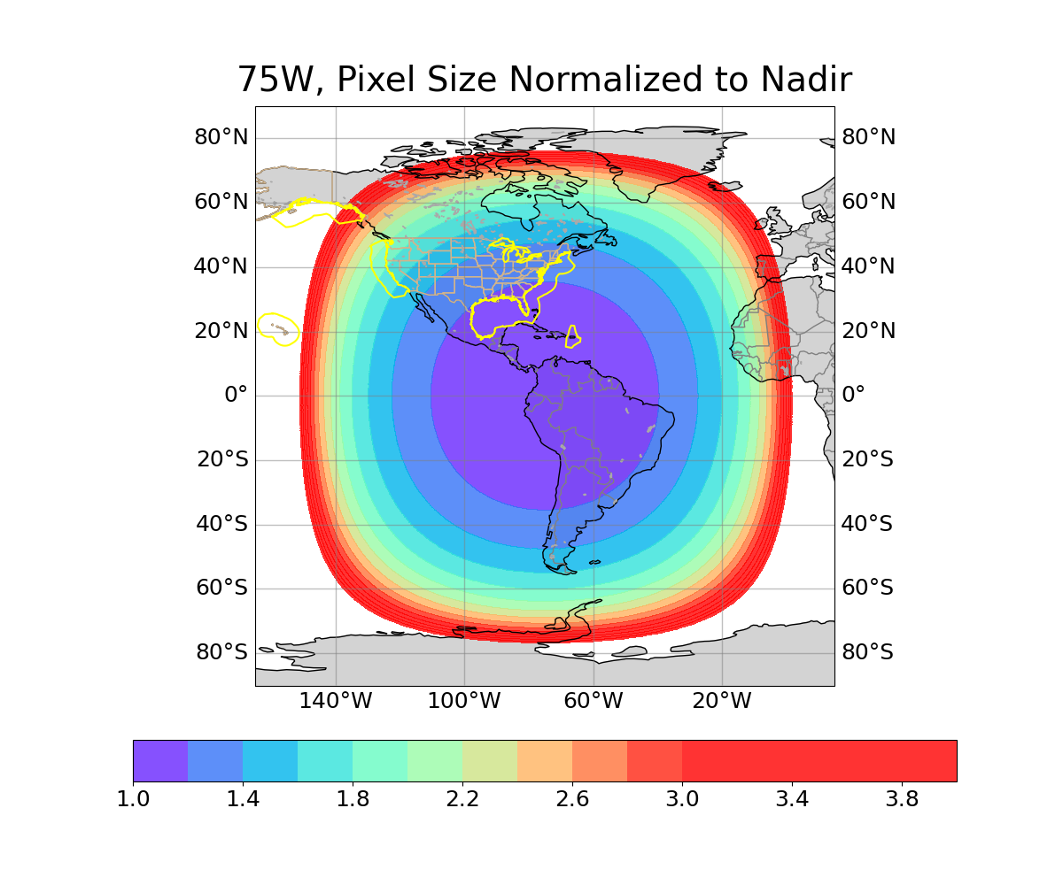
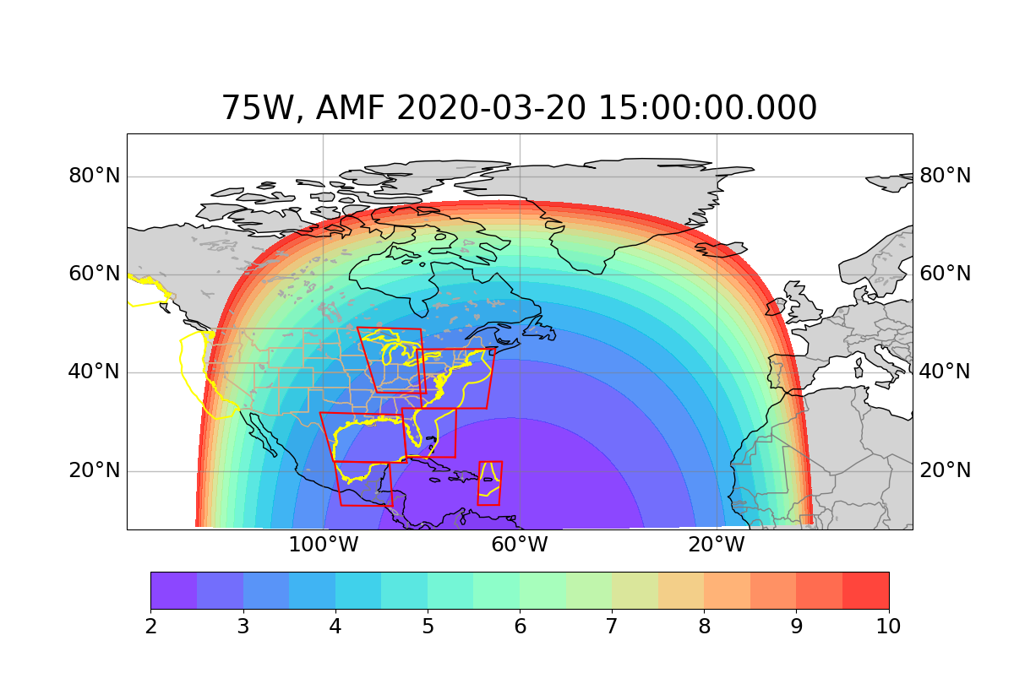
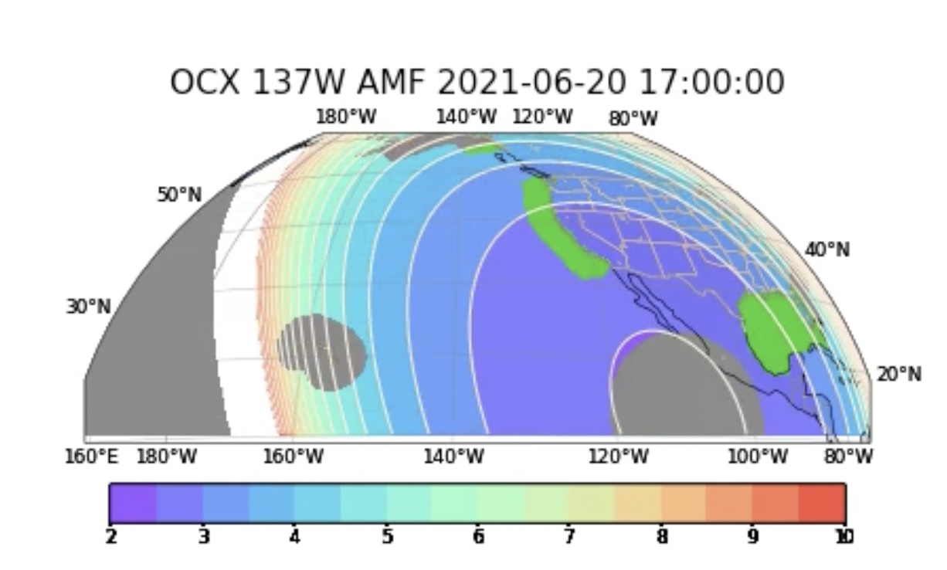
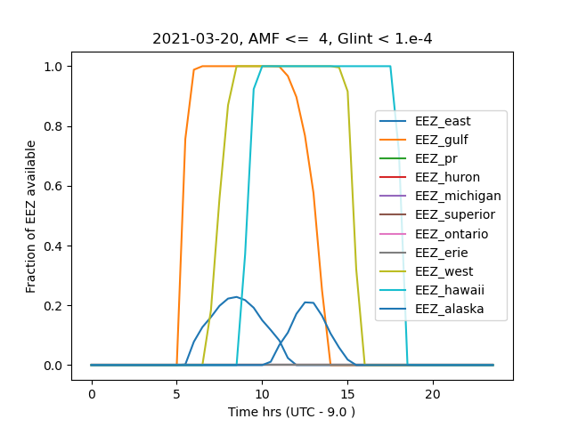

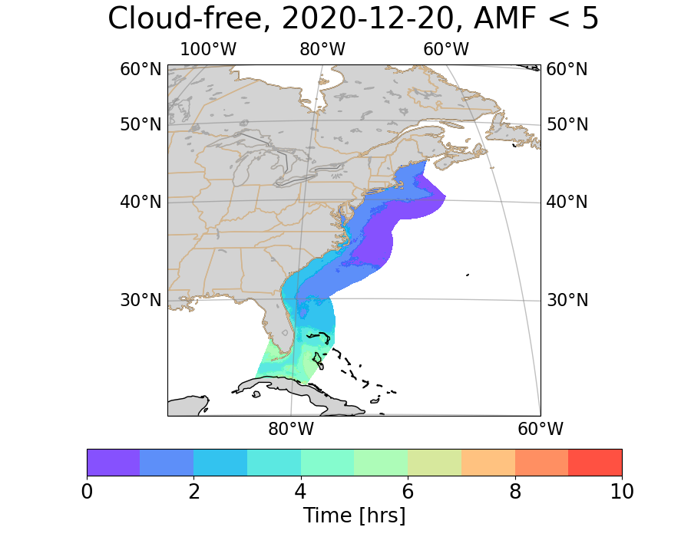
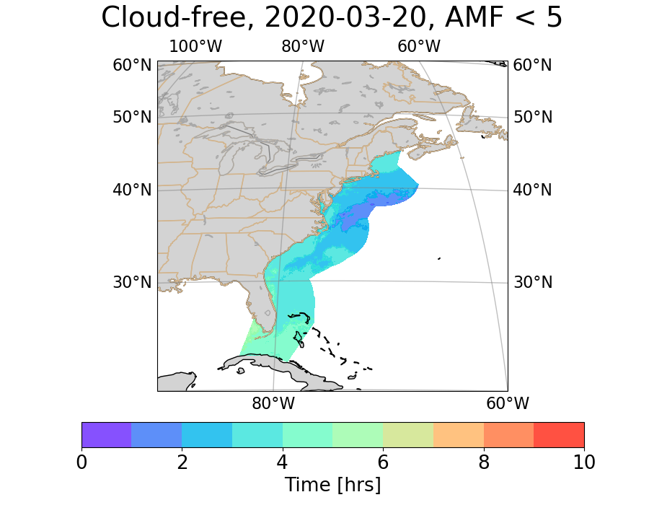
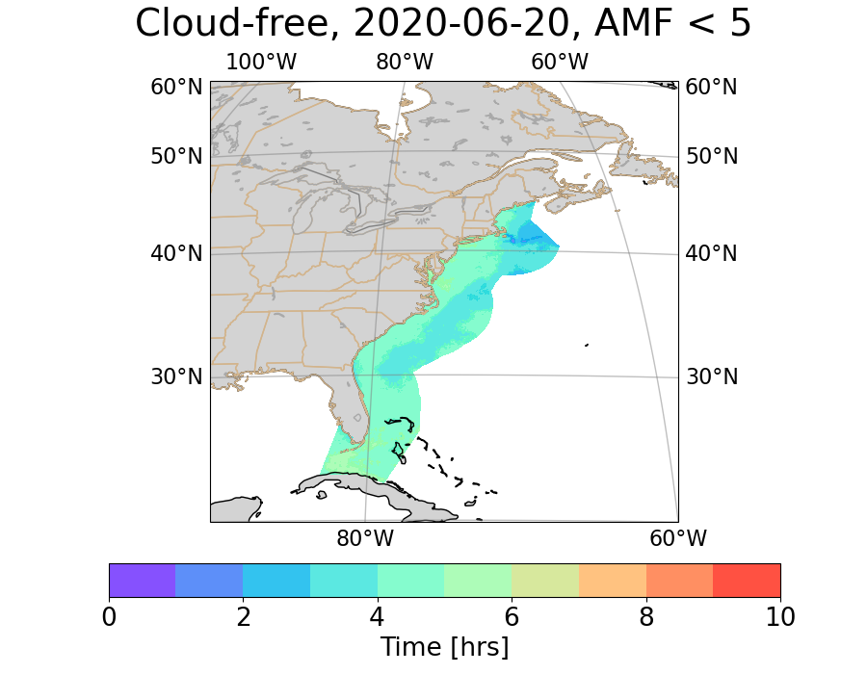
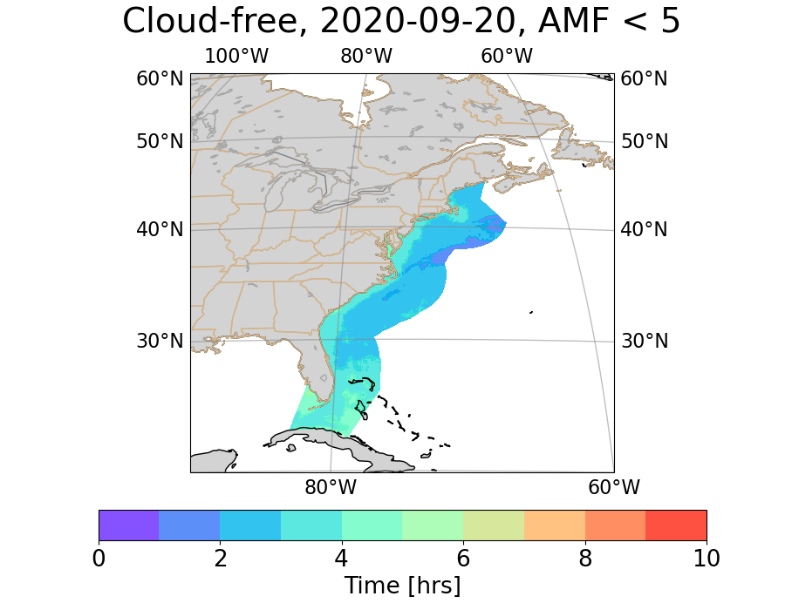

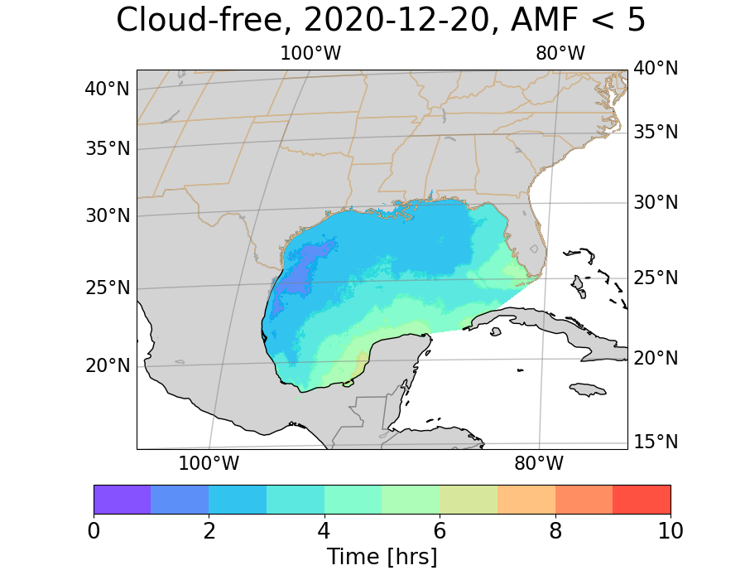
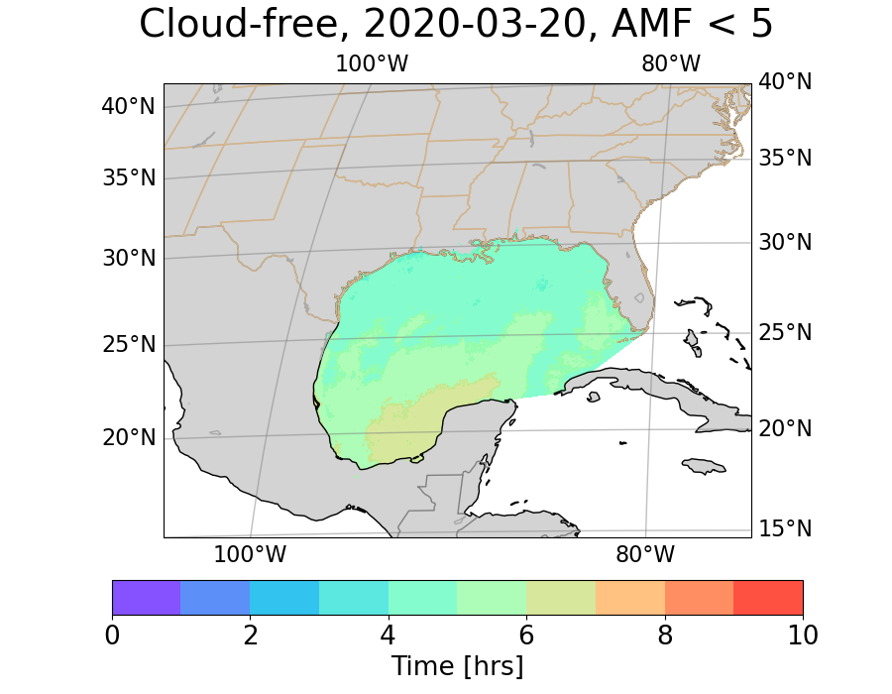
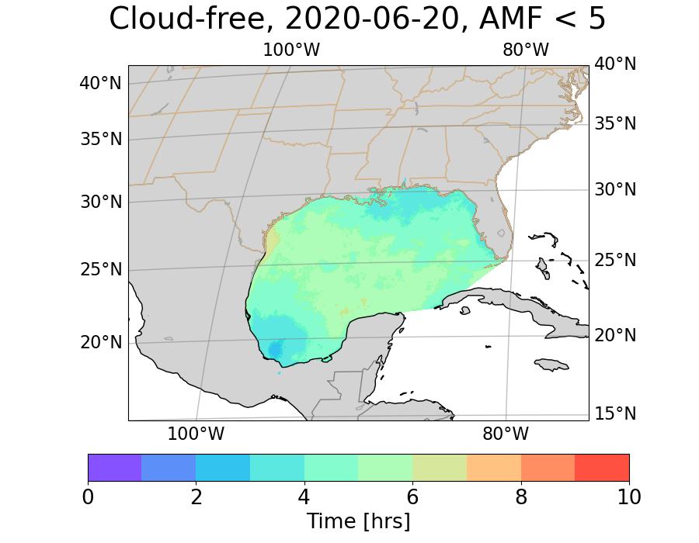
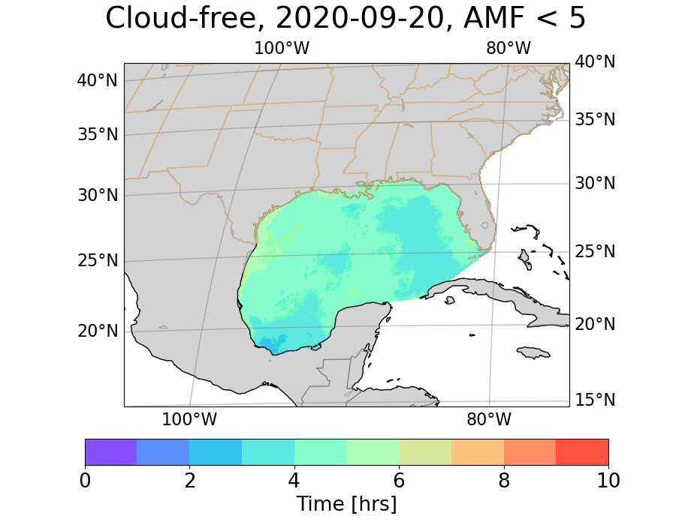
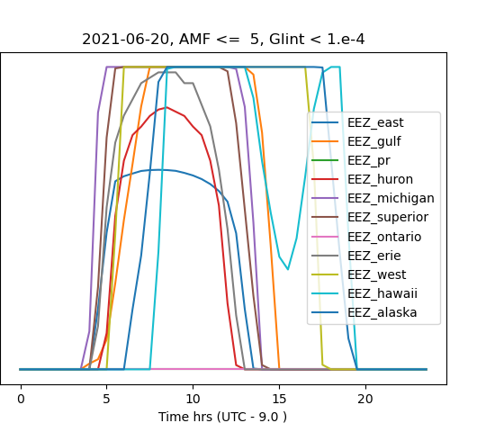
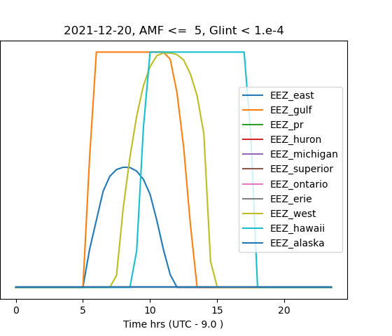
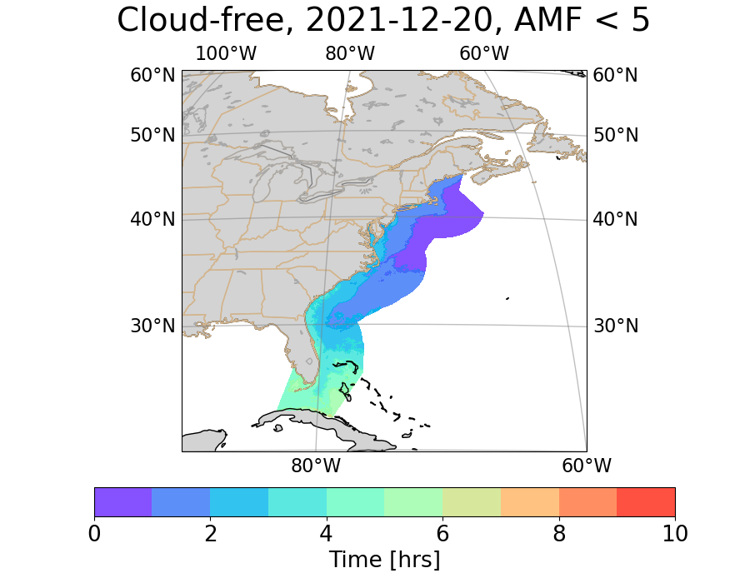
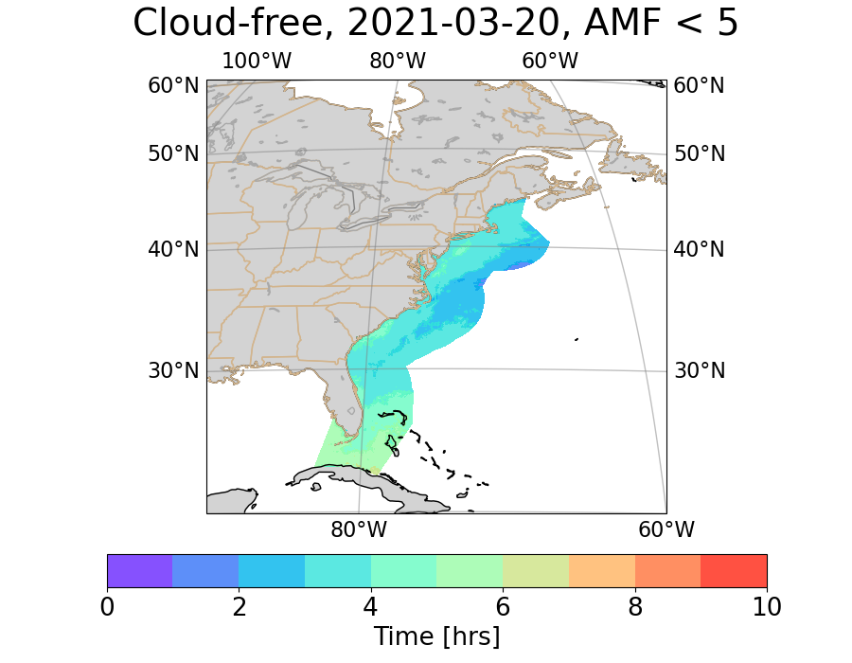
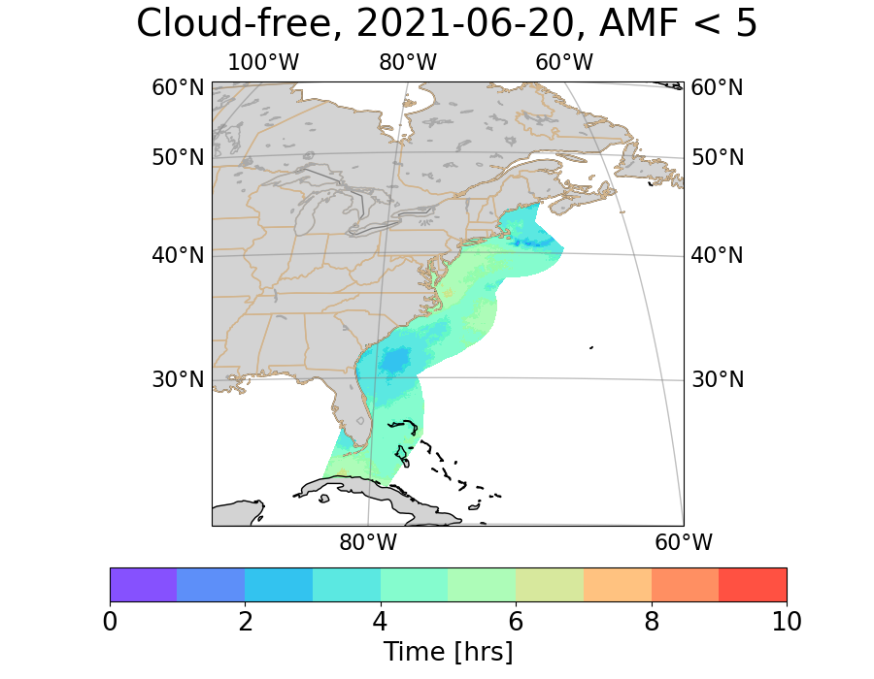



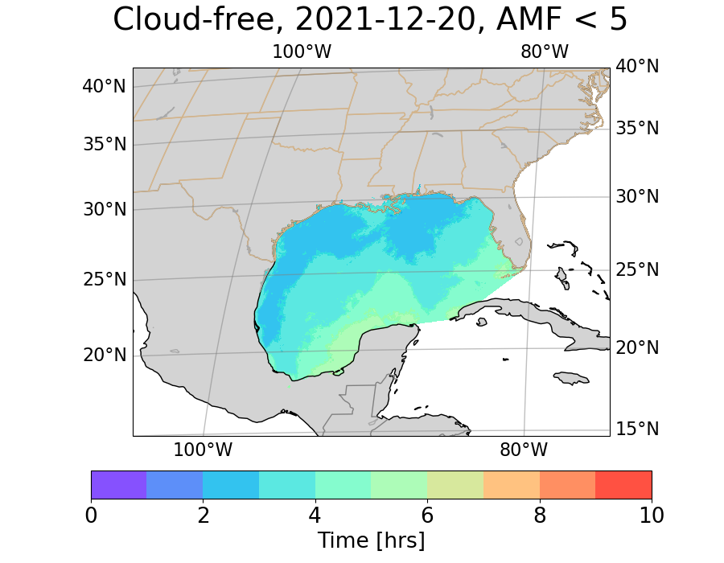
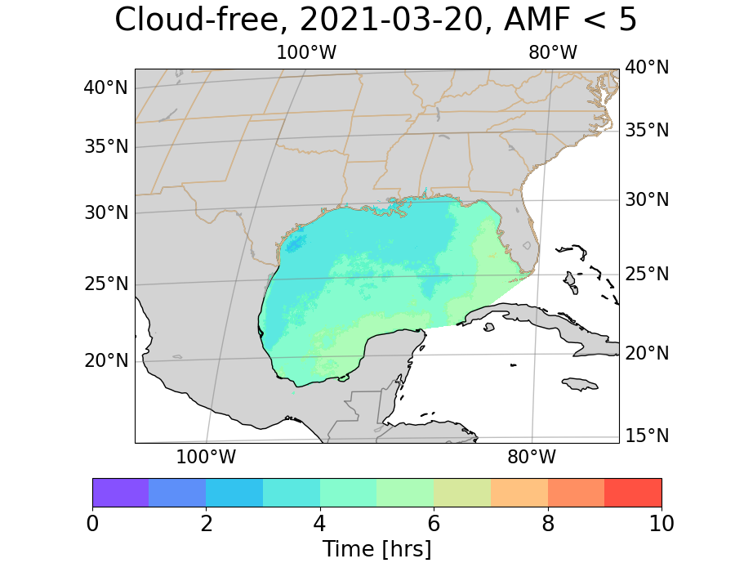
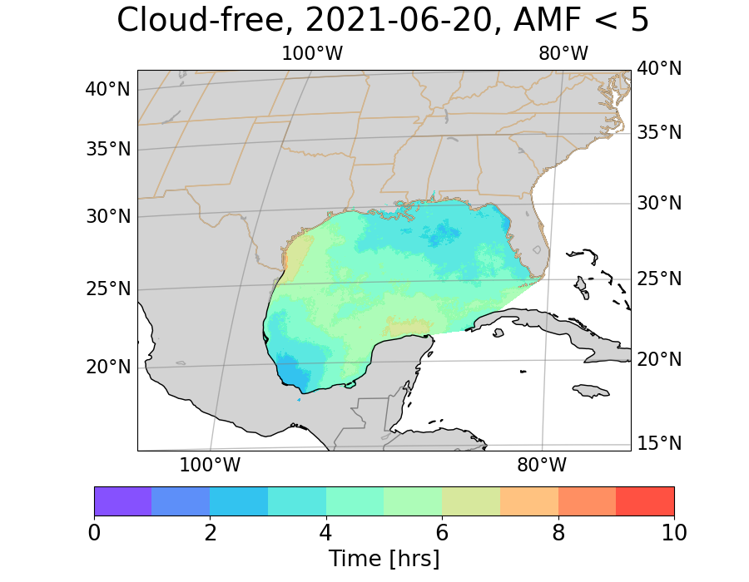
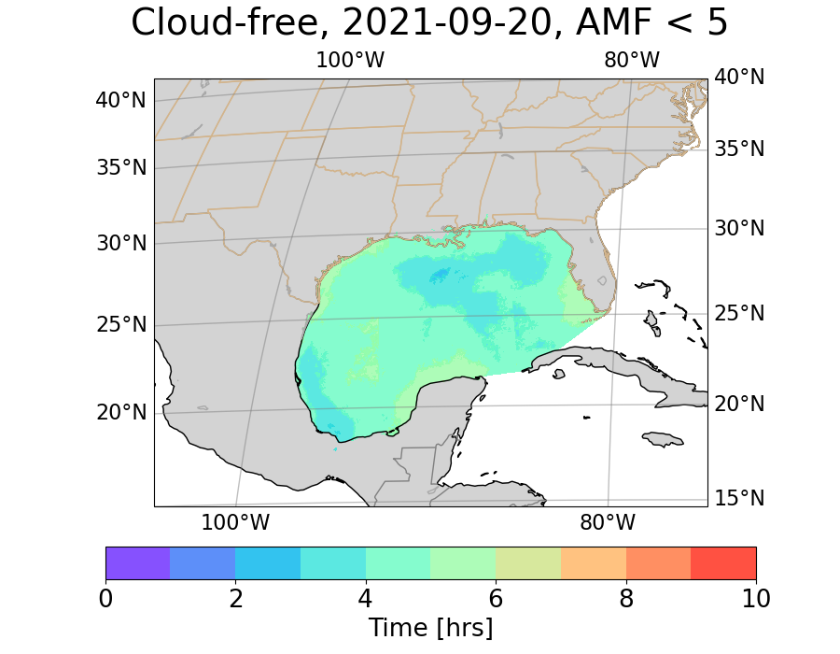
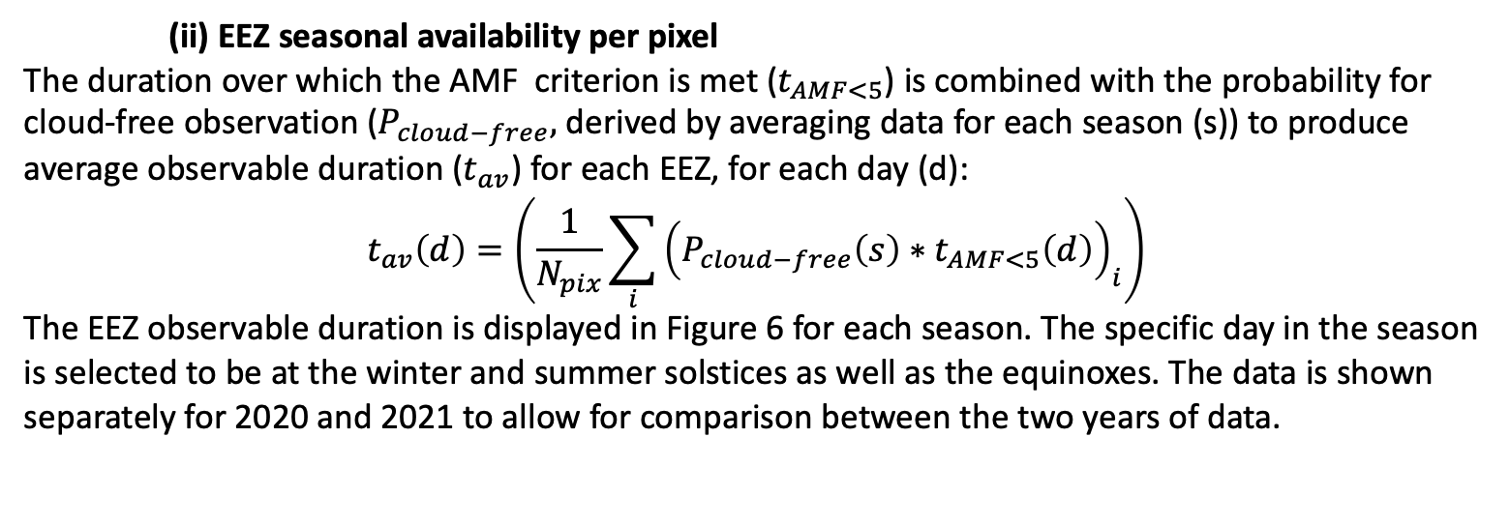
GeoXO Ocean Color Instrument (OCX) Spatial and Temporal Coverage Assessment
Boryana Efremovaª, Emery Baconª, Francis Padulaª, Antonio Mannino^{b}, and Joel McCorkel^{b}
ªGeoThinkTank LLC, Miami, FL 33131, USA
^{b}NASA Goddard Space Flight Center, Greenbelt, MD 20771, USA
Abstract
Cloud Climatology
Scan Example
NOAA’s next generation Geostationary Extended Observations (GeoXO) satellite system will advance Earth observations from geostationary orbit. GeoXO will supply vital information supporting the U.S. weather, ocean, and climate operations. The recommended three-satellite constellation includes spacecrafts at the current GOES-East and GOES-West positions that will carry an imager, lightning mapper, and an ocean color (OCX) instrument. In this poster we describe an assessment of U.S. Exclusive Economic Zone (EEZ) availability for OCX observations, based on EEZ view geometry, solar angle range over the year, sun glint, as well as cloud climatology. The availability for observations for each EEZ region is estimated per day of the year, as function of atmospheric mass factor (AMF) and sun glint. In addition, cloud climatology – based on statistics derived from three years of GOES-16 ABI cloud mask – is considered to determine the fraction of cloud-free OCX observations for each region as function of time of day and season. The results of such assessments can be used to optimize OCX collections and potentially explore regions outside the EEZ.
Three years of GOES-16 ABI binary cloud mask (BCM) data (2019, 2020, 2021) were aggregated at 30 min cadence in order to assess the availability for observations of the OCX regions of interest. In this poster we illustrate the process for the East Coast and Gulf of Mexico portions of the EEZ. The following metrics were obtained: (i) EEZ cloud-free fraction (Figures 4 and 5) and its variation with season and time of day, and (ii) seasonal cloudiness per EEZ pixel, which combined with solar and observational geometry data results in an estimate of the duration over which each EEZ pixel is available for observations (Figure 6).
(i) Cloud-free fraction of EEZ
All EEZ BCM values are averaged to obtain fraction of cloudy pixels at any given time.
The cloud climatology discussed in the previous section and summarized in Table 2 can be combined with OCX scan requirements, as well as instrument characteristics to estimate the typical amount of useable data that the instrument will collect.
Table 2. Duration of EEZ availability for AMF<5, glint < 1.e-4, under cloud-free conditions
 | Year | Winter | Spring | Summer | Fall
EEZ East | 2020 | 2.1 | 3.2 | 4.2 | 3.0
 | 2021 | 2.3 | 3.7 | 4.3 | 3.7
EEZ Gulf of Mexico | 2020 | 3.3 | 5.0 | 4.8 | 4.3
 | 2021 | 3.6 | 4.3 | 4.5 | 4.4
Solar and View Geometry
Figure 4. Each binary cloud mask (BCM) (top panel) is multiplied by EEZ mask, resulting in valid data only over the EEZ area (bottom panel).
The illustration shown in Figure 6 is a general example of a scanning pattern, which will be fine tuned as instrument concepts mature and implementation details become available. For the current example, the scan direction pixel size is set to to 8.4 μrad using the requirement of 300m ground sampling distance at nadir. The cross-scan field of view (FOV) is set somewhat arbitrarily to 1.45 degrees, to resemble the FOV of the GLIMR instrument⁴.
The scan pattern shown in this example combined with the 3-hour coverage requirement would require an average of about 0.5 seconds per scan execution, including all necessary calibration, positioning of the mirror etc.
We implemented tools to compute satellite view geometry¹, and sun angles². Maps of satellite zenith and azimuth angles, ground sampling distance (Figure 1), solar zenith, azimuth and glint angles³, as well as geometric airmass factor (AMF) can be used to compute the time periods over which the EEZ is available for observations.
Figure 5. Monthly and diurnal variation of cloudiness for the East Coast EEZ portion – left panels; Gulf of Mexico – right panels).
(ii) EEZ seasonal availability per pixel
The duration over which the AMF criterion is met ($t_{AMF<5}$) is combined with the probability for cloud-free observation ($P_{cloud−free},$ derived by averaging data for each season (s)) to produce average observable duration ($t_{av}$) for each EEZ, for each day (d):
$$t_{av}\left(d\right)=\left(\frac{1}{N_{pix}}\sum_{i}{{\left(P_{cloud−free}\left(s\right)∗t_{AMF<5}\left(d\right)\right)}_{i}}\right)$$
The EEZ observable duration is displayed in Figure 6 for each season. The specific day in the season is selected to be at the winter and summer solstices as well as the equinoxes. The data is shown separately for 2020 and 2021 to allow for comparison between the two years of data.
Figure 1. Pixel size normalized to nadir for West (left) and East (right) location. The EEZ contours are shown in yellow.
137W
Figure 6. Example scan pattern (red) covering the EEZ regions of interest from OCX at East location. The AMF near satellite noon for Mar 20, 2020 is also shown (see color bar).
2020
The scanning pattern shown above was combined with geometry calculations and ABI cloud mask for Mar 20, 2020 in order to derive an example of operations and estimate the fraction of cloud-free data collected. The results are consistent with the season-averaged values shown in Fig. 5 – about 40% of the East Coast portion of EEZ was collected as cloud-free data.
Figure 2. EEZ availability (green) as function of AMF and glint (left); Right: total duration of EEZ availability for 2021-03-20.
Summary
The availability for observations of each EEZ portion is shown in Table 1 and Figures 2 and 3. Different AMF criteria were explored. Figure 2 shows example of EEZ availability meeting AMF<4 and glint radiance < 1e-4 criteria. Figure 3 and Table 1 show availability for AMF<5.
In support of GeoXO Flight Project Science, tools were developed to translate OCX-East and West view geometry, weather conditions, OCX temporal requirements, and proposed instrument specifications to hours of scan time available for each EEZ section throughout the year. The following metrics are readily calculated:
Availability for observations per day per EEZ section from AMF and glint analysis
Estimates of the duration of clear-sky observations per EEZ section, per season, based on ABI cloud mask statistics
Number of clear-sky OCX observations to expect by EEZ region - based on sensor scan rate or requirements combined with the cloud climatology
Path forward: Refine and expand scan simulations using more realistic instrument parameters.
137W
2021
Figure 3. EEZ availability from OCX at West t location, for AMF<5, at summer and winter solstices
References
Table 1. Duration of EEZ availability (more than 40% of the section) for AMF<5, glint < 1.e-4
 | Date | East Coast | Lake Superior | Gulf of Mexico | Hawaii | West Coast | Alaska
East Location | 2021-03-20 | 7.0 | 4.5 | 9.0 | 10.0 | 9.5 | 6.0
 | 2021-06-20 | 8.0 | 8.5 | 9.0 | 10.0 | 12.0 | 11.0
 | 2021-12-20 | 3.5 | NA | 7.5 | 8.5 | 6.0 | NA
West Location | 2021-03-20 | 10.0 | 8.5 | 10.0 | NA | 8.0 | NA
 | 2021-06-20 | 11.5 | 12.0 | 11.5 | NA | 10.0 | NA
 | 2021-12-20 | 7.0 | 2.0 | 8.5 | NA | 5.0 | NA
[1] GOES-R L1b Product Users Guide https://www.goes-r.gov/users/docs/PUG-L1b-vol3.pdf
[2] Reda, I., Andreas, A. Solar Position Algorithm for the Solar Radiation Applications, 2019 NREL Technical Report NREL/TP-560-3402
[3] Jackson & Alpers 2010, https://doi.org/10.1029/2009JC006037
[4] https://eos.unh.edu/glimr/glimr-science/operations-overview
Figure 6. Cloud-free fraction of EEZ meeting also the observational criteria (AMF<5).

