Slide 1
Multiple CA Solutions:
Evaluating Data Quality and Creating Single Solutions for CA Operations
M.D. Hejduk
NASA CARA
February 2023

Slide 2
Agenda
Overview of the multiple solution problem
Is a data source in general reliable?
  The standard evaluation technique and the “three pillars” of quality data
Is a particular vector or product reliable?
  Assimilative and fusion approaches
NASA CARA experience with multiple solutions
Overall recommendations

Slide 3
The Multiple CA Solution Problem
When multiple CA solutions exist, how should an O/O respond?
  If both solutions counsel the same action, then no operational ambiguity
    Some would say this is advantageous, as two independent sources agree
    Others would argue that there is no advantage, since operational result the same
Two separate sub-problems lurking here
  Question 1: How does one know which solutions are good, or at least are not bad?
  Question 2: How does one adjudicate among multiple trustworthy solutions?
BLUF: this is a vexing issue that lacks a durable solution
  Presentation will try to summarize state of the industry on these questions
    What questions have been answered, and what questions remain
More study is needed, probably with both government and commercial providers working together

Slide 4
Question 1: Is a Data Source Reliable, or at least not Poor?
Time-honored approach is to compare historical predicted data to more recent truth data
  How well “yesterday’s” predictions match “today’s” reality
  Presumption is that established pattern of behavior will inhere in general, so that observed level of quality for recent historical data will apply to current data
Two modalities of data that can be analyzed this way
  Tracking (measurement) data from sensors
  Data products deriving from OD and prediction processes
  Each addressed in turn

Slide 5
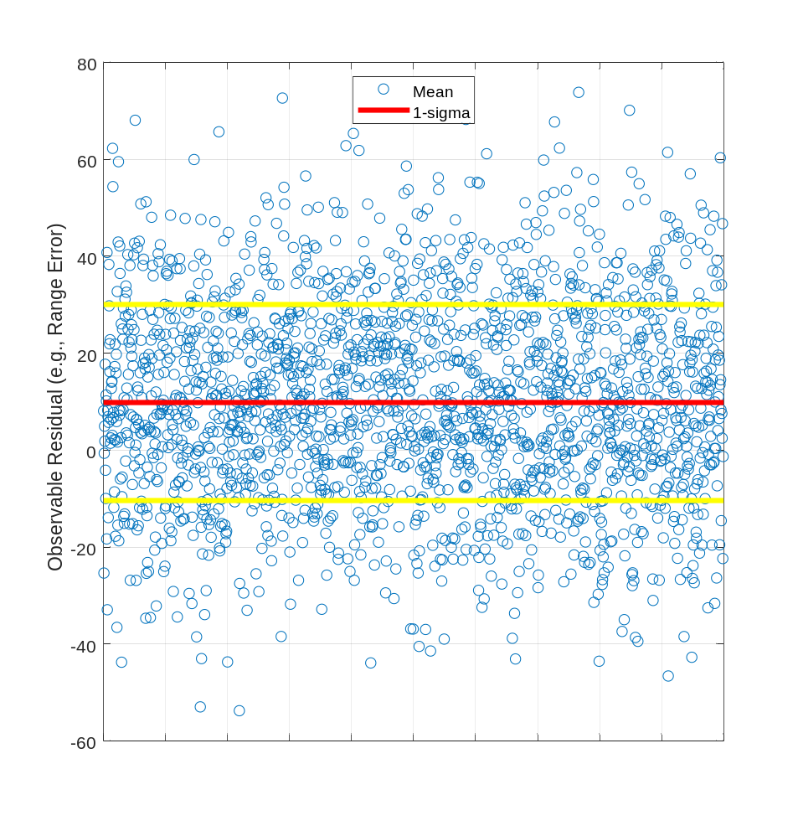
Question 1: Is a Data Source Reliable, or at least not Poor?
Sensor Measurement Data
Straightforward process for “calibrating,” which really means evaluating, sensor measurement data
  Track satellites that have external precision reference ephemerides available
    ILRS satellites, GPS/navigation, WAAS, certain cooperative payloads
  Compare tracking data to the precision ephemerides
  Characterize the residuals statistically
Basic statistical characterization (example at right)
  Mean error in an observable: the bias (which can be subtracted from future measurements)
  Variance in an observable: the weight (which can be used to weight data in an orbit determination, giving more precise data more weight)
More elaborate characterization
  Can consider additional factors (observation time of day, actual values of the observable, &c.) and develop fancier debiasing/weighting models
Regardless of specifics, procedure is relatively straightforward and unambiguous

Slide 6
Question 1: Is a Data Source Reliable, or at least not Poor?
Data Products
In evaluating product data, there are three quasi-nested evaluations to make
  Validity and Gaussianity (which combine to establish goodness), and then utility
  Each of these to be explained in turn
Is Data Valid?
Is Data Gaussian?
Is Data Good?
Is Data Useful?

Slide 7
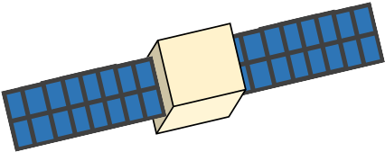
Data Validity: What is an Invalid State?
A Common Occurrence in SSA
Under normal uncertainty, we can bound where an object could be
“Events” and other perturbations can cause large changes in object location
  Maneuvers, cross-tagged observations, poor dynamics model, insufficient data, un-modeled bias, &c.
If such an occurrence is unmodelled, the nominal trajectory state is invalid
“Unexpected” trajectory
Large state/covariance mismatch
Event occurs
Nominal “expected” trajectory

Slide 8
What is an Invalid State?
This is an invalid state
Invalid states cause large, damaging errors for operations.
Actual trajectory
Event occurs
Provided ephemeris

Slide 9
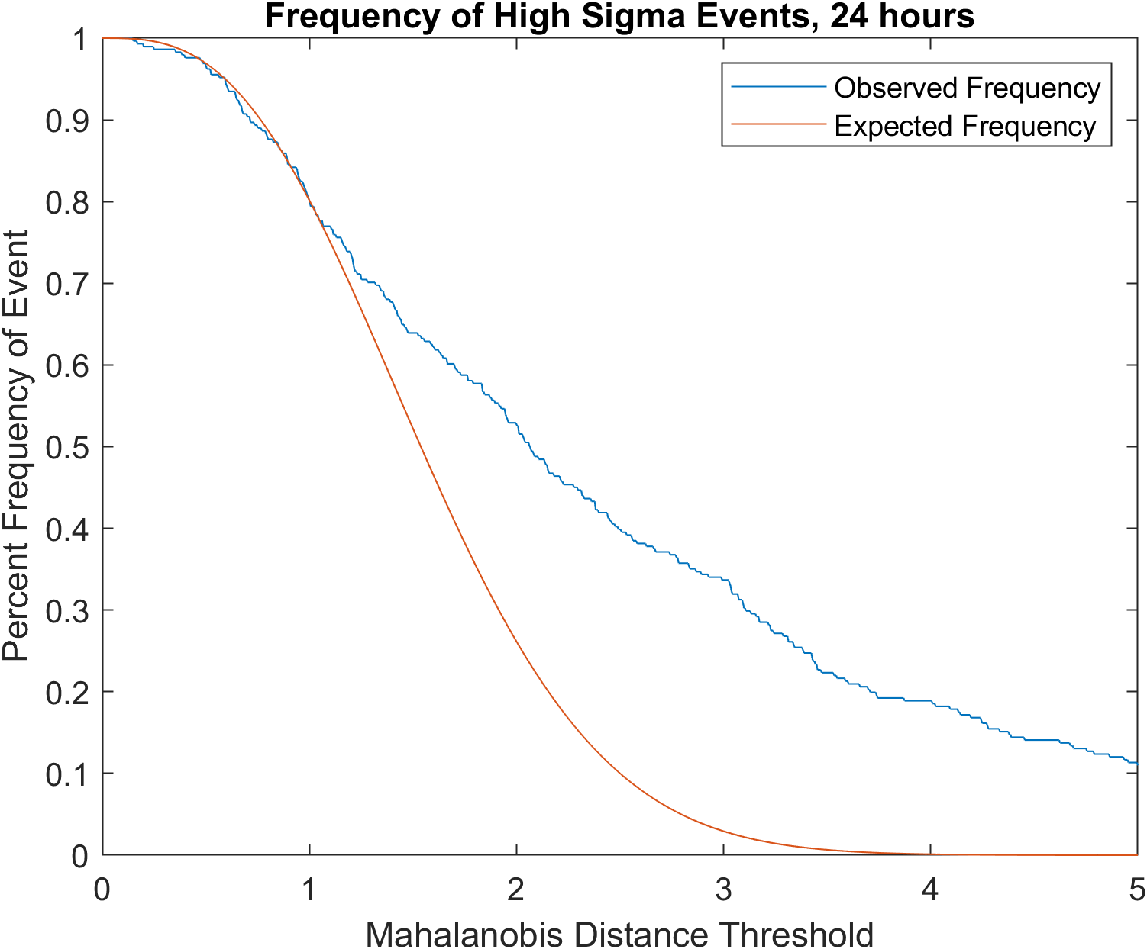
Invalidity: “Frequency of Invalidity” Plots
How Often is the Furnished Product “Just Plain Wrong”?
Mahalanobis Distance is a distance normalized w.r.t. error, used for how incorrect an estimate is
Mahalanobis distance has an expected frequency curve – we know what percentage of ephems should be 1, 2, 3 Mahalanobis distances away
Red Line – If the provider is correctly assessing their error, this is the percentage of ephems that should be at that value or lower
Blue Line – the actual percentage at that value
A result of 0.2 at the Mahalanobis threshold of 4 means 20% of this provider’s predicts have errors beyond 4. These predicts lead to substantially errant conjunction analyses
Calculation can only be done at single time step, not over entire ephemeris
Small
Mahalanobis
Large Mahalanobis
Actual Data from an Evaluation

Slide 10
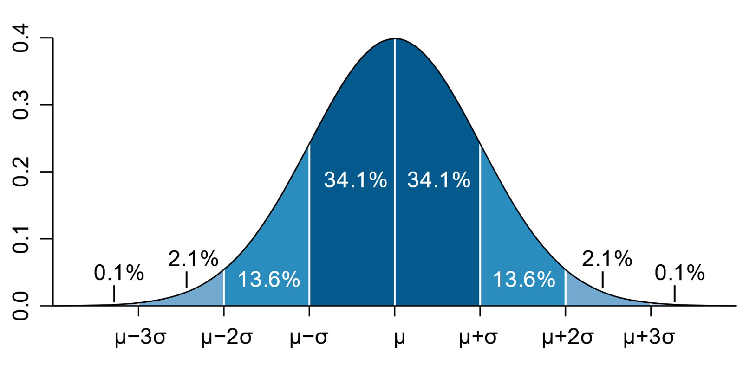
Gaussian Behavior of Errors
An Assumption Underpinning Nearly all CA-related Calculations
When providing data (e.g. spacecraft location), providers never perfectly know where something is
However, theory indicates that predicted component errors should follow a Gaussian distribution
Mean and covariance define a region with different likelihoods of containing the object: where it is likely to be, where it plausibly could be, and where it cannot plausibly be
Pros:
The Conjunction Data Message (CDM), Ephemeris file formats, &c. all use just mean and covariance to represent a space object location and error
Gaussians distributions are 1) fully characterized by mean and covariance and 2) computationally efficient to process (e.g. Kalman Filters vs Particle Filters)
Most best practice algorithms in STM (P_{c} calc) assume Gaussianity
Cons:
Dynamics is non-Gaussian, so estimation errors can manifest as non-Gaussian
While near-perfect Gaussianity is sometimes attainable, using it as a hard requirement is not feasible
Instead, we are looking for degrees of Non-Gaussian-model error that cause operational issues

Slide 11
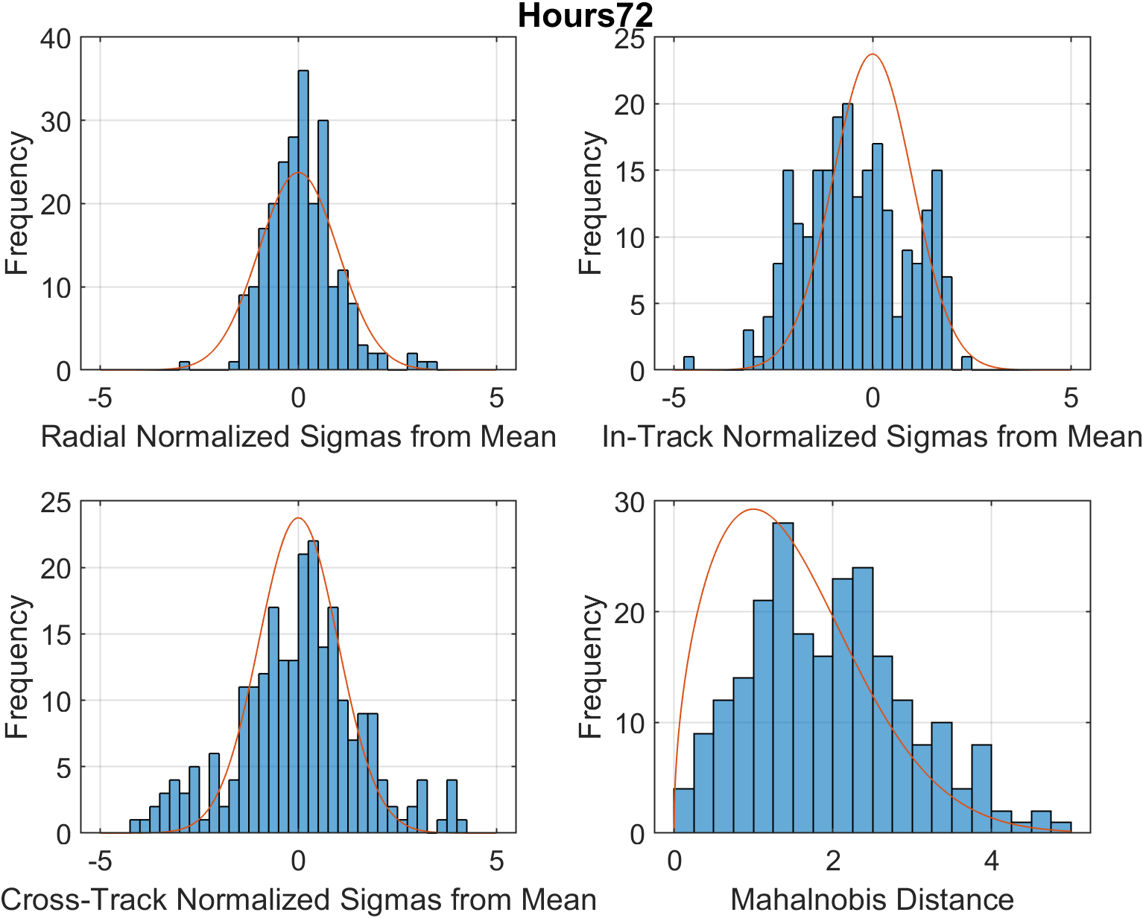
Gaussianity as a Requirement
Difficult to Establish Firm Thresholds for Compliance
Conservative in one axis
Bias and poor shape in one axis
Answering “how Gaussian are these results?” is difficult
  A simple/visual approach is to plot the actual error results with an idealized curve—does the error match what the mean and covariance thinks it should be?
  One can also run formal statistical tests for Gaussianity to establish the level of compliance
If the Gaussianity match is poor, errors could be:
  Overly conservative, the error is smaller than the provider predicted
  Overly smug, the error is bigger than the provider predicted
  Biased, the error tends to more often occur in one direction
  Poorly shaped, for various reasons the error may just not match a Gaussian curve.
Stays within 4-sigma
Smug in one axis
Actual Data from an Evaluation

Slide 12

Data Utility
Conceptually Simple; Implementation Harder
The previous two requirements are entirely about the characterization of error
In short, data could contain error that is both perfectly characterized, but also so large as to render the ephemerides unusable
Therefore, a measure of size of covariance is needed as a sanity check
Not all that straightforward to establish firm size/utility relationship for covariances

Slide 13
The Good, the Bad, and the Ambiguous
Data Validity Rate
Data Gaussianity
Data Usefulness
Examples
Is almost never invalid
Is very close to Gaussian
Excellent covariance size
SSN of Calsat, O/O of non-maneuvering object
Good Evaluation
Is valid to acceptable(?) rate ~5% or less
Distribution, while not Gaussian, is well characterized by mean and covariance
Good covariance size, usefulness hurt by validity/ Gaussianity
SSN on some Debris, O/O with odd dynamics, small sensor network
Ambiguous
Evaluation
Data invalid at rate over 20%
Invalid data, large bias on valid data, cause poor Gaussianity
Useless due to invalid data
SSN on marginally trackable debris, very small sensor network
Bad Evaluation

Slide 14
Summary: Disposition Based on Evaluation Level
For “good” evaluation, can use the product for decision support largely to entirely without question
For “bad” evaluation, should not really use the data at all
  Even for ensemble or comparative frameworks, just too unreliable to bear any real utility
For “ambiguous” evaluations, difficult to determine precisely how to proceed
  Should perform quality checks on each data product before use (to be described presently)
  If quality checks cleared, such data probably usable unless good reason to suppose are not usable
  Catalogues often have a mix of data quality, and problems not confined to static set of objects

Slide 15
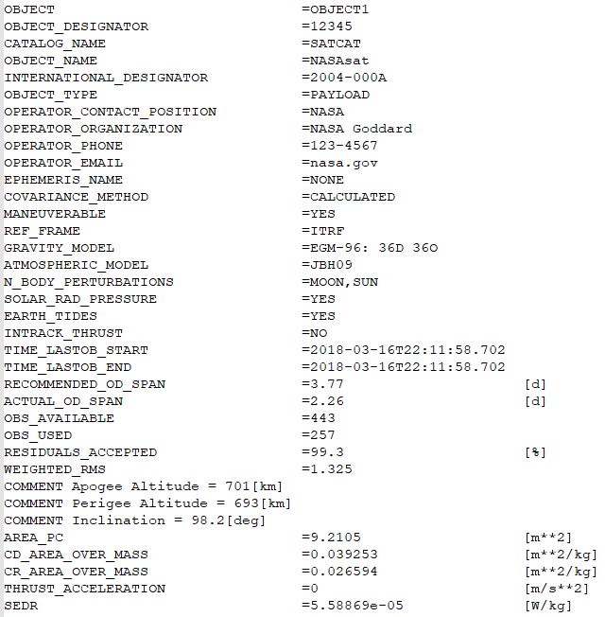
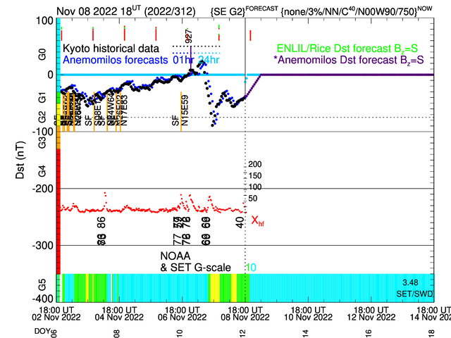
Question 2: Is a Particular CA Product Reliable “Right Now”?
Stand-Alone Indices of a Product’s Potential Poverty
CA products (predicted ephems, CDMs, &c.) always based on an underlying OD and propagation
Can examine OD and propagation attributes to identify problematic cases; attributes include the following:
  Appropriate force model settings and values for non-conservative force parameters (drag and solar radiation pressure)
  Amount of tracking data used on OD and temporal length of update interval (for batch updates)
  OD goodness-of-fit indices and duration of propagation span
  Stability of space weather situation
  For DoD CDMs, thresholds for above provided in NASA CA Handbook, Appendix P
If any of above values/situations inappropriate or poor, reject OD update and therefore derivative product
If all of above values check out, still not a guarantee of quality, but at least no red flags

Slide 16
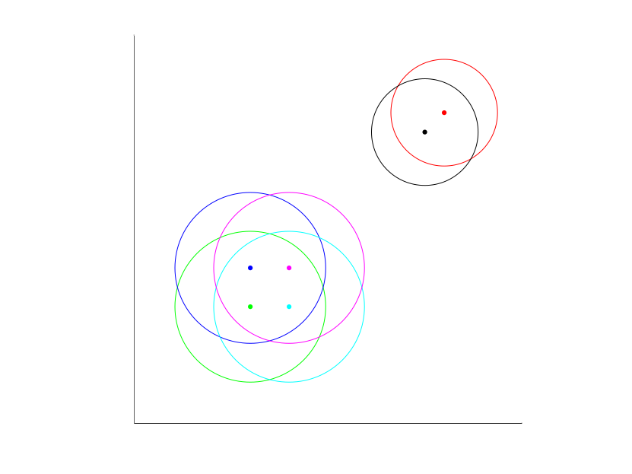
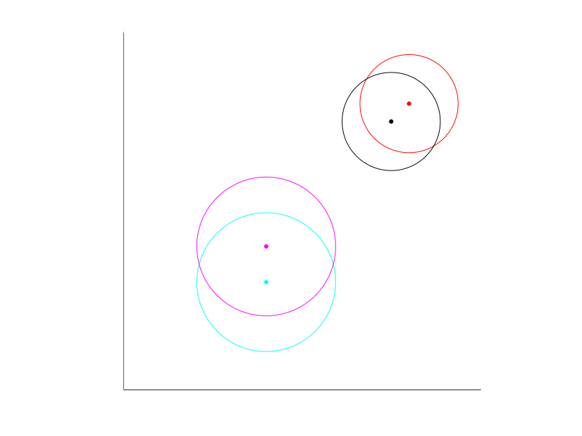
Is a Particular CA Product Reliable “Right Now”?
“In-Family” or Ensemble Modeling
If multiple solutions available, can compare submitted solutions to each other and examine clustering
  If most solutions cluster together (to within their solved-for errors), can presume that reliable solution exists in the cluster
    Can take mean of those solutions, or select individual solution closest to cluster’s centroid
    Solutions outside of the cluster can be set aside as “outliers”
  If large amount of scatter in solutions, then difficult to determine how to proceed
Number of issues with this approach
  Need a reasonable number of different, independent solutions to apply technique profitably
    With only a few solutions, approach not very powerful; and not possible with only two solutions
  In SSA, the “outlier” solution sitting apart from the others can often be the best solution
    Easy to fail to consider factors that change results significantly, such as maneuvers, reorientations, sheddings, &c.
    Better non-conservative-force modeling (drag, SRP) can create large differences in results
    Minority of providers who have improved approaches for a particular satellite may submit results that are substantially better but that appear as outliers
Such an approach not really possible for some time, especially in LEO

Slide 17
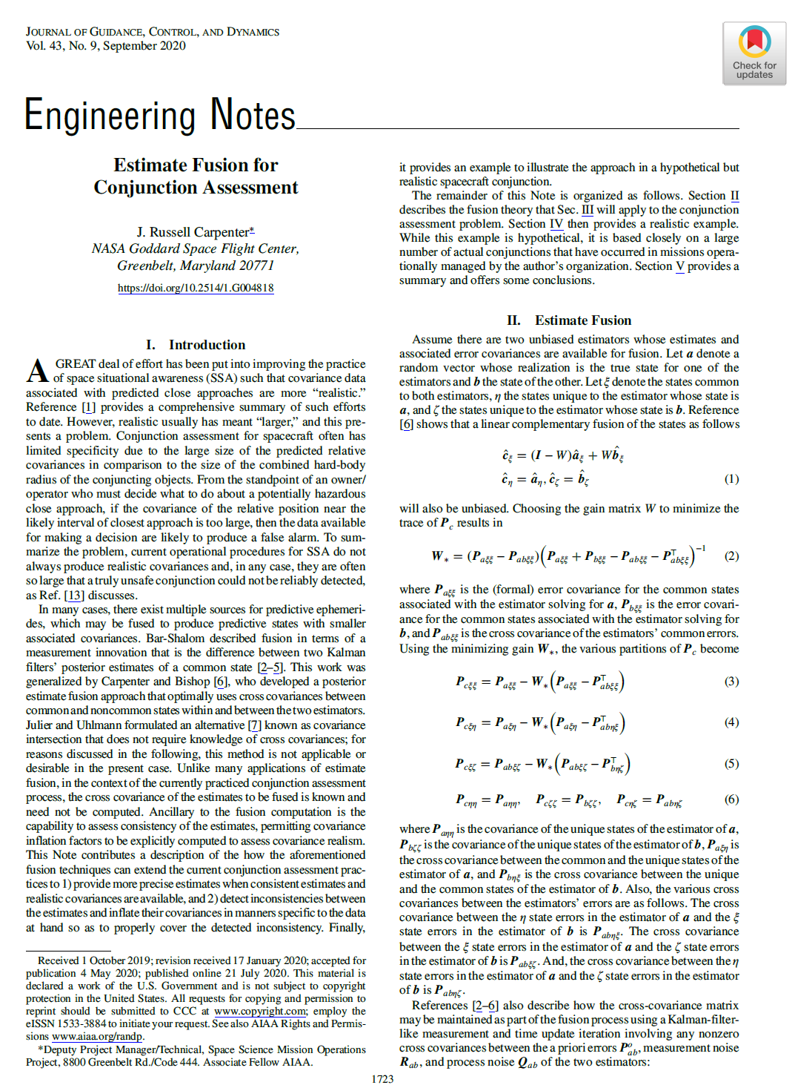
Is a Particular CA Product Reliable “Right Now”?
Product Fusion
Theoretical constructs exist for the fusion of SSA data products, such as ephemerides and CDMs
  Most promising proposal shown at right
Theory irrefragable, but practical impediments significant
  Covariances associated with products must be highly reliable
  Cross-correlations between the two covariances need to be
  characterized and considered in fusion process
    No obvious way to perform this
  Approach would need to be studied deeply to verify it truly
  produces enhanced results
Approach is in its infancy and requires much more investigation

Slide 18
CARA Dual-Solution Experience
Owner/Operator vs DoD Solution for Primaries
Most CARA CA situations are dual-solution situations
  One calculation using O/O predicted ephemeris for primary; a second using DoD prediction for primary
Not clear a priori which is superior
  O/O typically has on-board GPS tracking data and other telemetry, so should be able to produce better and more timely epoch position
  However, many O/Os have poor atmospheric density models (especially in forecast), are not OD specialists, and do not perform covariance tuning well or in some cases at all
When both O/O and DoD solutions agree in terms of operational outcome, no real issue
  Because primary object (especially primary covariance) is minority contributor to solution, generally reasonable agreement is observed between both results; so this is the common outcome
When there is disagreement, difficulties arise

Slide 19
CARA Dual-Solution Experience
How to Proceed with Disagreements
Conservative approach is to take Pc “high water mark” and act on more worrisome solution
  Could be a way to limp along in present particular situation, in which disagreement os unusual
  Not a durable solution to the general problem because does not scale, especially for large constellations
CARA procedure
  If disagreements occur with some frequency between the O/O and DoD solution for the primary, validation effort undertaken to determine preferred source for primary predicted position
    Outcomes from such validation exercises have in some cases favored the O/O solution, in others DoD
    Arduous process but often necessary to establish solution precedence
  In the absence of a validation effort, general approach depends on O/O capabilities
    If satellite is not maneuverable, favor DoD solution—better understood and regularly reliable
    If satellite is maneuverable and regularly maneuvers, favor O/O solution as it may well contain planned maneuvers
    Favored solution can switch based on exigencies proper to the event (e.g., O/O asserts will not be maneuvering and perturbed space weather situation encountered, which is better modeled by DoD)

Slide 20
Overall Summary and Recommendations
Establishing data quality is difficult
  Time-tested approach requires protracted analysis
  Other approaches do not fit the present problem well, ultimately rely on the time-tested approach, or are insufficiently explored
Presence of multiple solutions is not eo ipso an advantage
  High watermarking not a scalable process
To make multiple solutions helpful, one of two things needed
  Rubric for how to select preferred solution in every operational case
    Difficult and sometimes somewhat arbitrary, but achievable—providers should assist with this
    First step is to ensure CDMs contain provider fit and prediction quality information
  Perfection of a fusion technique that can produce a single solution superior to both individual solutions

