Slide 1


VIPER Lunar Rover Agile Mission Systems
SpaceOps 2023
Dubai
Jay Trimble
MARCH 6, 2023
Notes:
STILL

Slide 2
The Mission

Slide 3
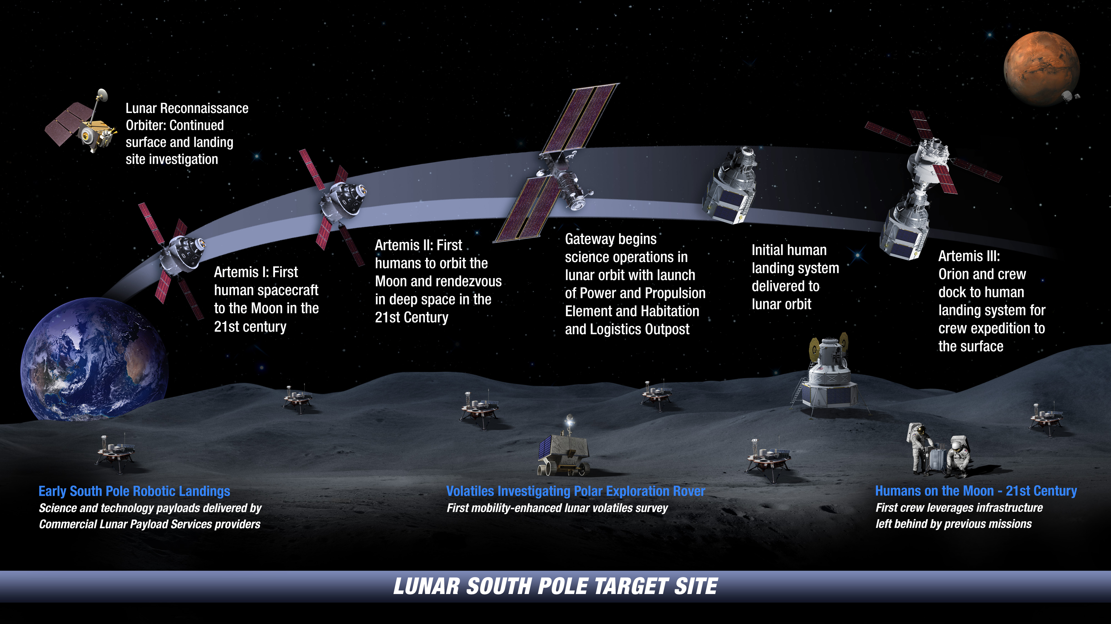

: Landing Humans On the Moon in 2024

Slide 4
Why VIPER?
Direct science measurement of polar volatiles
  LCROSS ground-truthed the water - VIPER will reveal the lateral / vertical distribution and physical state / composition of the volatiles
Enables research into in-situ lunar resources
  VIPER will build lunar resource maps, which may steer the future commercial marketplace
  VIPER will assess availability of ore grade lunar volatiles for human sustainment and fuel
    Q: Are some polar regions better than others (feasibility, economics, safety)?

Slide 5
Where will VIPER explore?
VIPER will explore four “Ice Stability Regions” (ISRs)*:
“Surface” - Ice expected stable on the surface (PSR’s**)
“Shallow” - Ice expected stable between 0-50cm of the surface
“Deep” - Ice expected stable between 50-100 cm of the surface
“Dry” - Ice not expected stable (0-100cm too warm to be stable)
* ISRs are based on the predicted thermal stability of ice with depth
** PSR = Permanently Shadowed Region

Slide 6
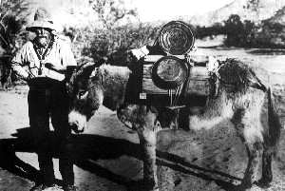
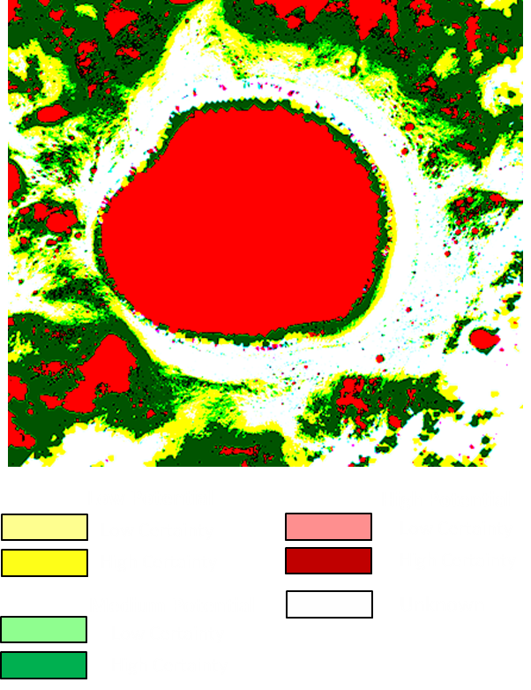
Resource Exploration
Luck
  The mission must sufficiently characterize an area to evaluate the resource need or physical processes
An ultimate outcome of resource exploration is the development of a Mineral Model, or for the Moon, a water Resource Model
Applied Science
Ice Stability Regions
Four environments defined based on the predicted thermal stability of ice with depth, the Ice Stability Regions (ISRs):
  Dry: Temperatures in the top meter expected to be too warm for ice to be stable
  Deep: Ice expected to be stable between 50-100 cm of the surface
  Shallow: Ice expected to be stable within 50cm of surface
  Surface: Ice expected to be stable at the surface (ie., within a Permanently Shadowed Region, PSR)

Slide 7
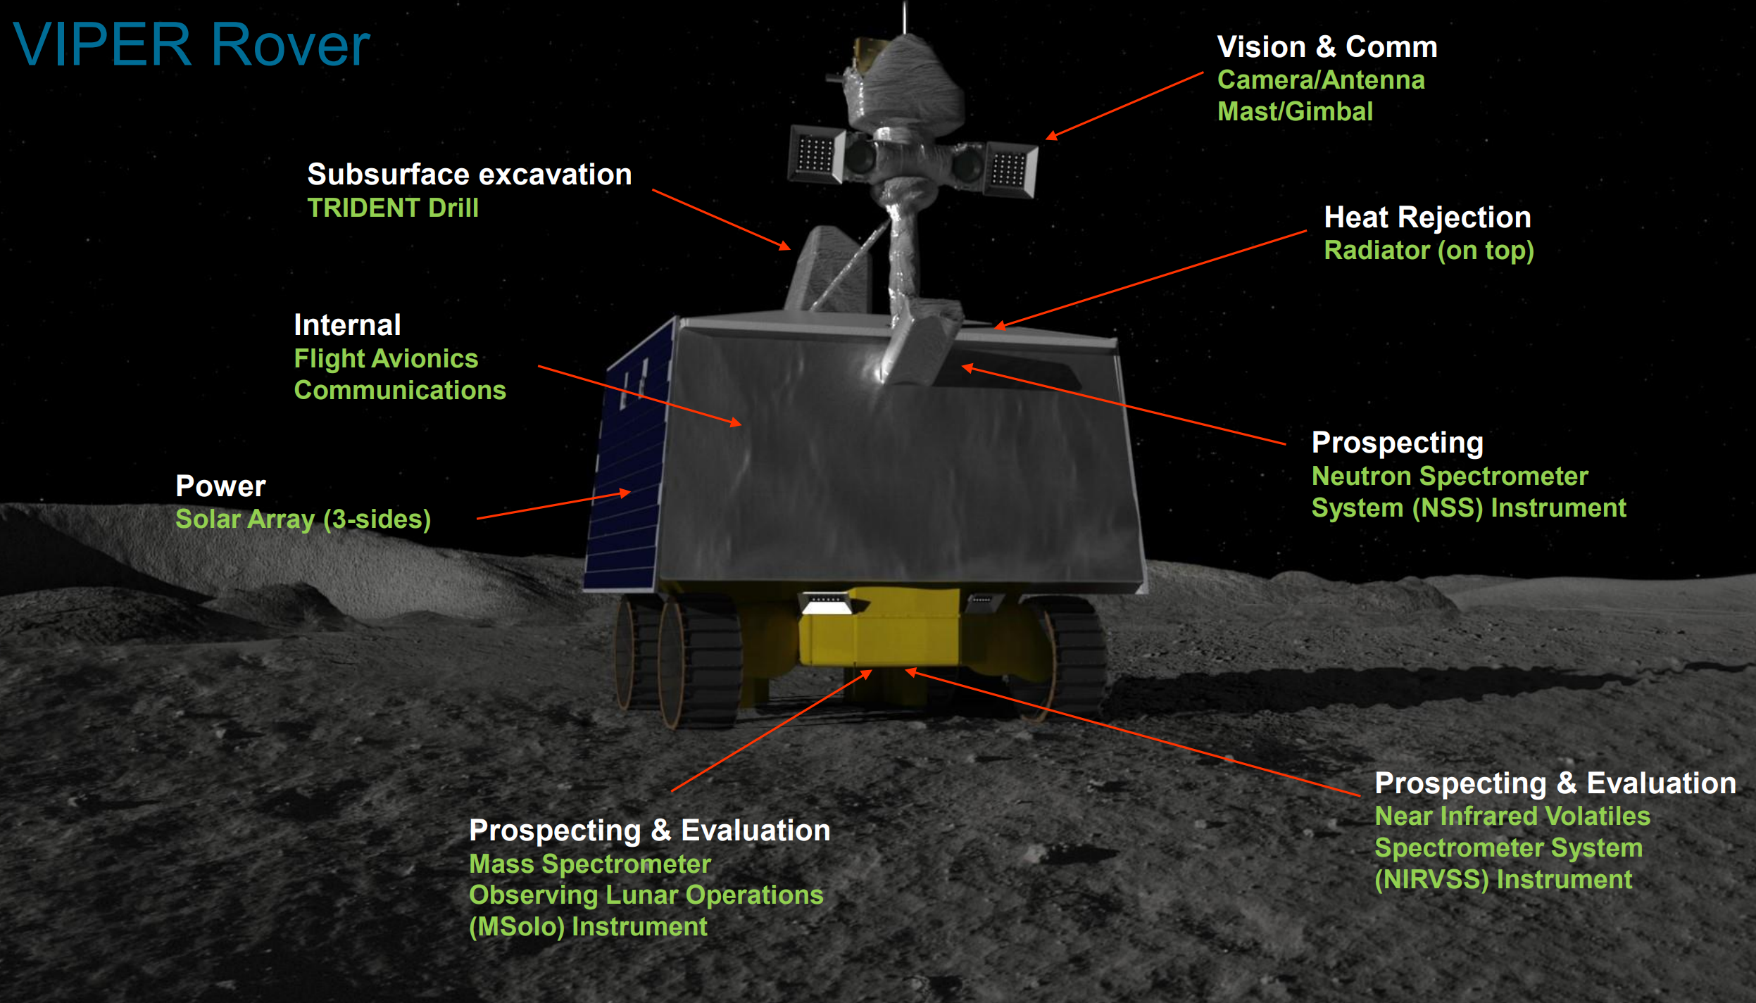
Notes:
Mission plan – driving direction, driver selects the orientation, they will choose based on driving using front cams, may have less power. When moving towards the Sun if driving forward then we have less power, otherwise using aft cams and then going more slowly due to aft cam limitations. Trade between power and vision capability. So while we do not have instrument trades, we have trades that are a product of the vehicle and the environment.

Slide 8
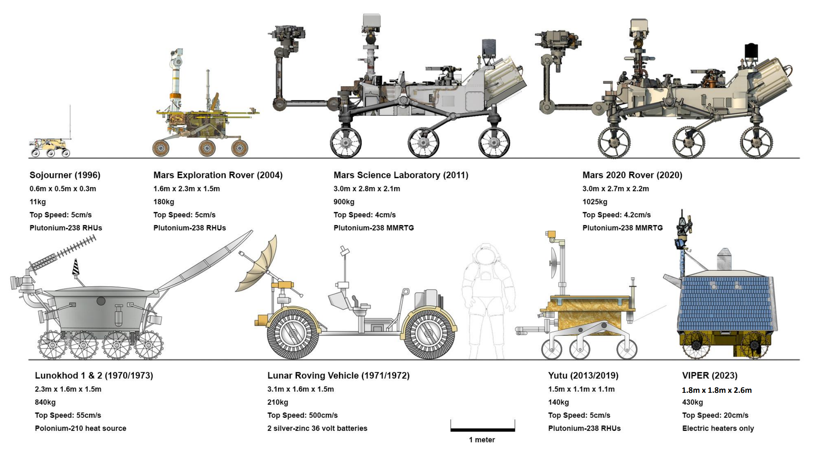
(Augmented) credit: historicspacecraft.com

Slide 9
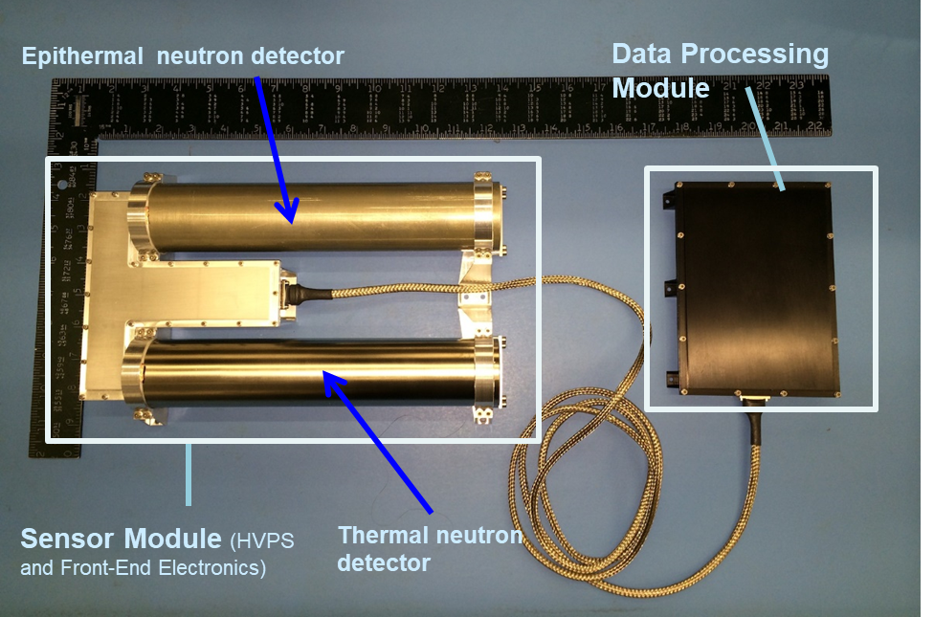
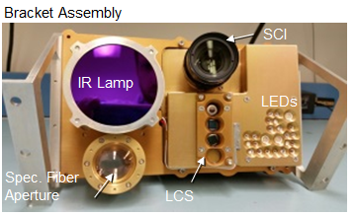
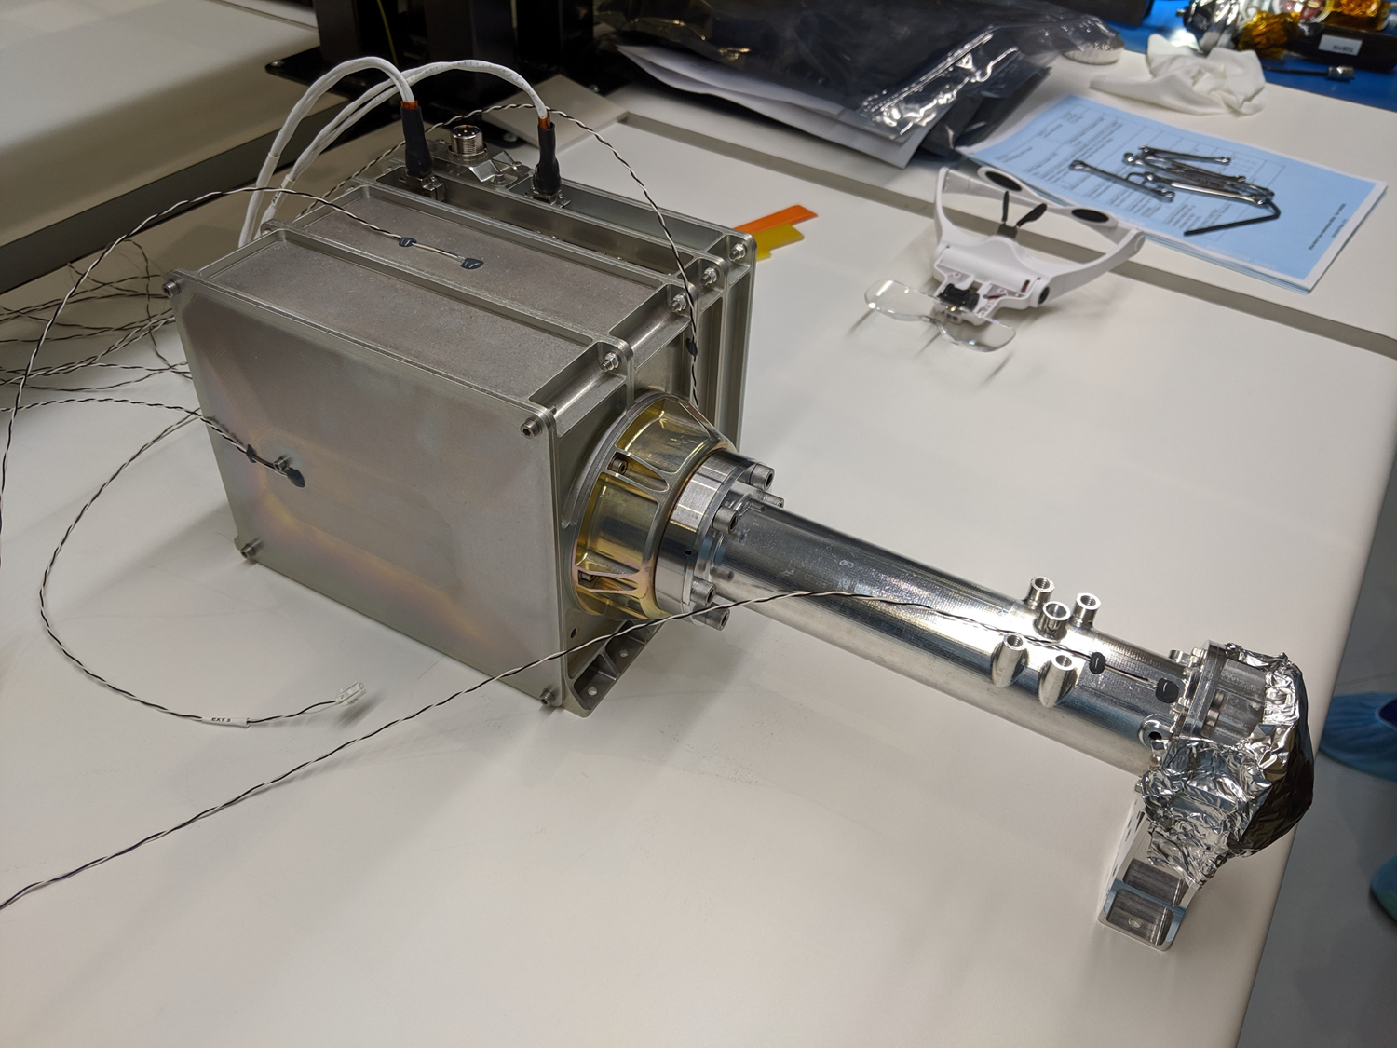
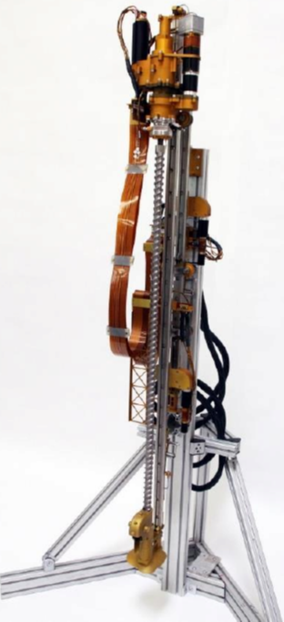
VIPER Science Instruments
NSS (NASA ARC/Lockheed Martin ATC)
PI: Rick Elphic (NASA ARC)
Instrument Type: Two channel neutron spectrometer
Key Measurements: NSS assesses hydrogen and bulk composition in the top meter of regolith, measuring down to 0.5% (wt) WEH to 3σ while roving
NIRVSS (ARC, Brimrose Corporation)
PI: Anthony Colaprete (NASA ARC)
Instrument Type: NIR Spectrometer, 4Mpxl Imager with 7 banks of color LEDs, four channel thermal radiometer
Key Measurements: Volatiles including H₂O, OH, and CO₂ and, minerology, surface morphology and temperatures
NSS
MSolo (KSC, INFICON, NSF– SHREC Space Processor, & Blue Sun – Virtual Machine Language)
PI: Janine Captain (NASA KSC)
Instrument Type: Quadrupole mass spectrometer
Key Measurements: Identify low-molecular weight volatiles between 1-100 amu, unit mass resolution to measure isotopes including D/H and 0^{18/}0¹⁶
TRIDENT (Honeybee Robotics)
PI: Kris Zacny (Honeybee Robotics)
Instrument Type: 1-meter percussive drill
Key Measurements: Excavation of subsurface material to 100 cm; Subsurface temperature vs depth; Strength of regolith vs depth (info on ice-cemented ground vs. ice-soil mixture)
NIRVSS
MSolo
TRIDENT

Slide 10
Operations

Slide 11
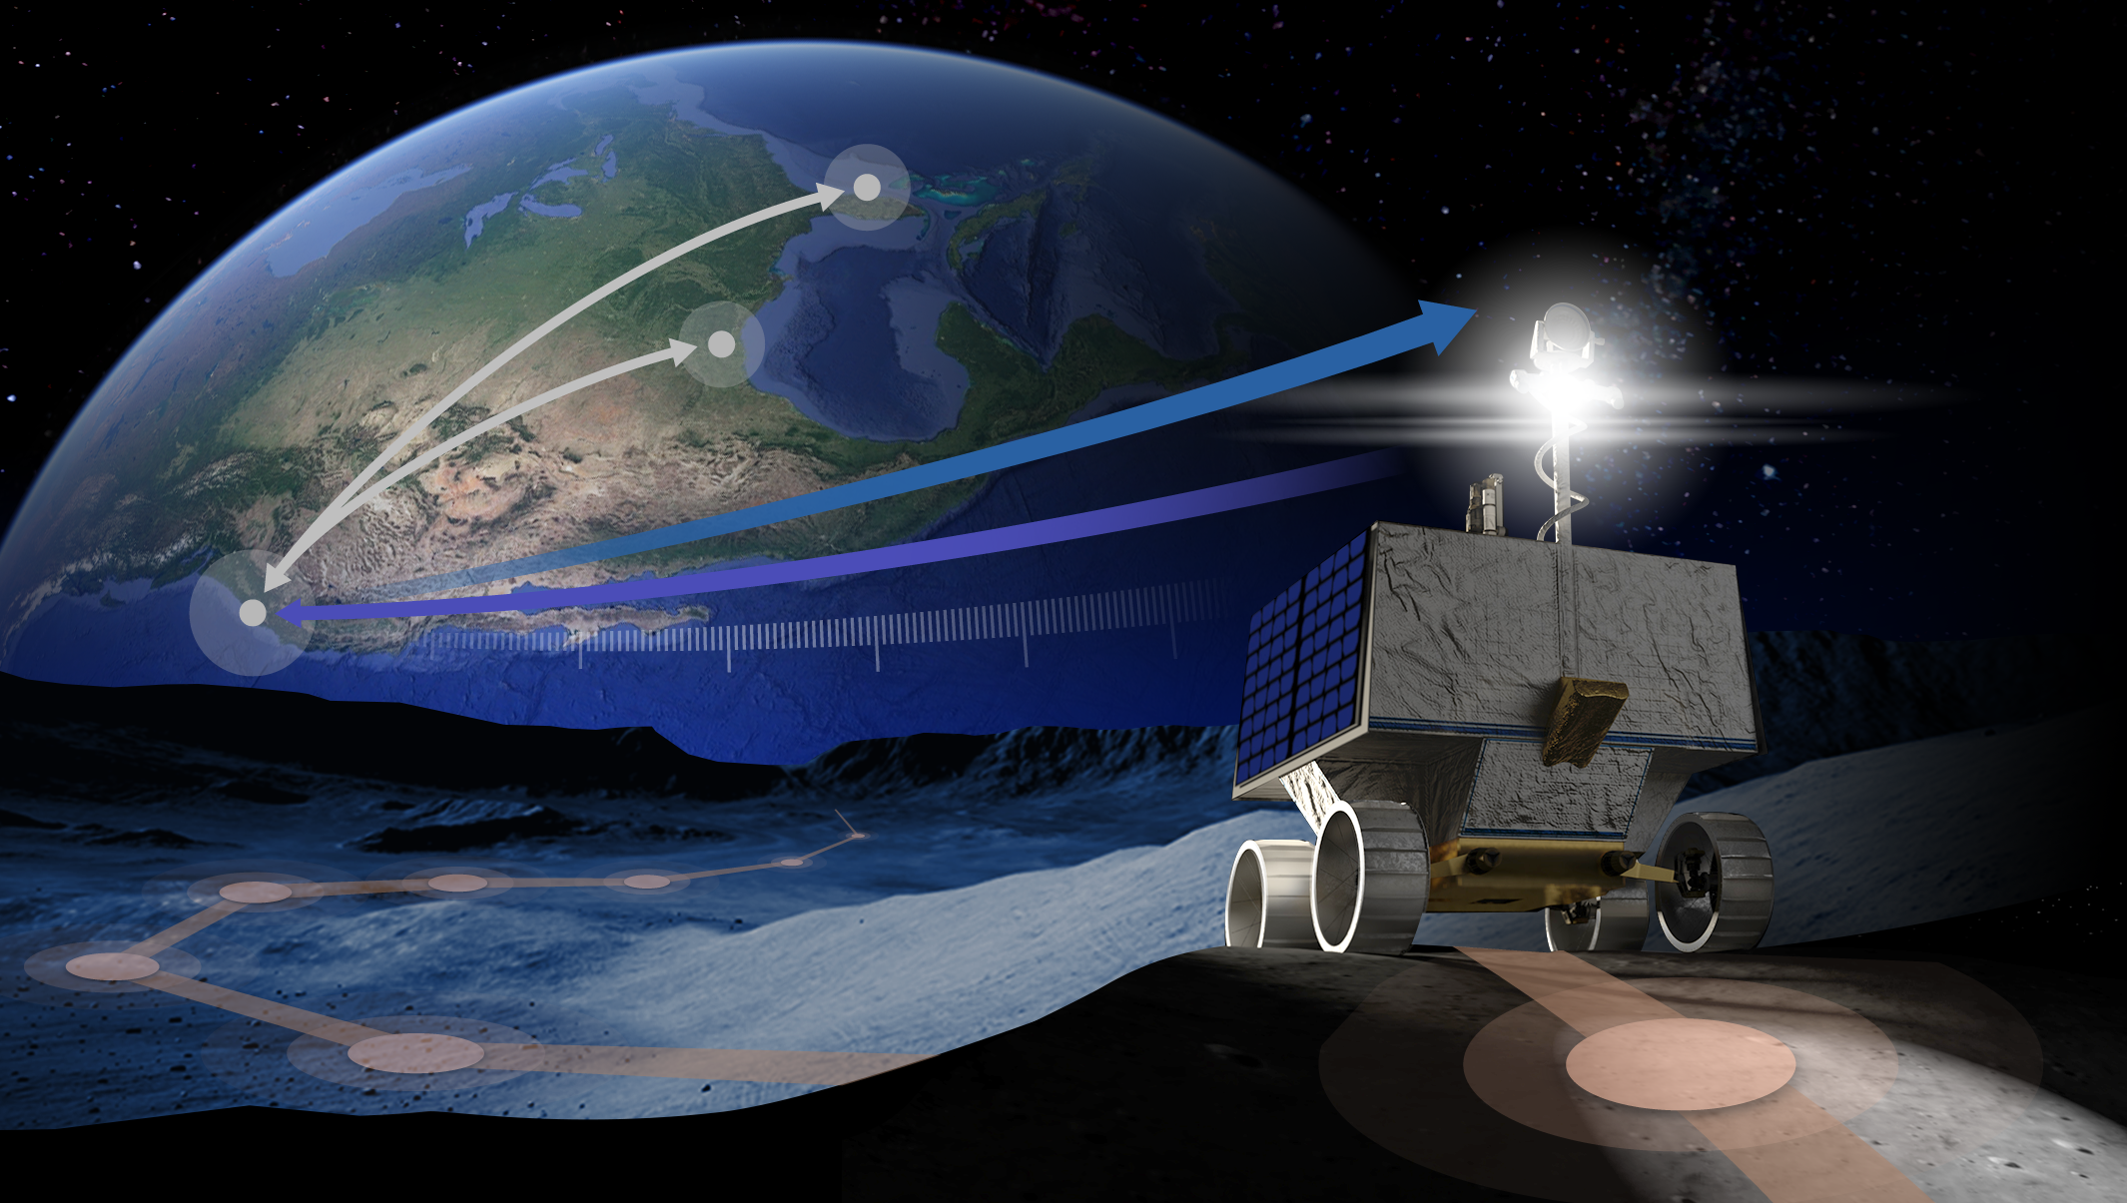
VIPER Surface Ops
KSC
MSOLO
JSC
Rover Systems
Commands
ARC
MOC, POC, Science
Telemetry
Comms round trip ~6 – 10 sec
Waypoints ~4.5m
Notes:
STILL

Slide 12
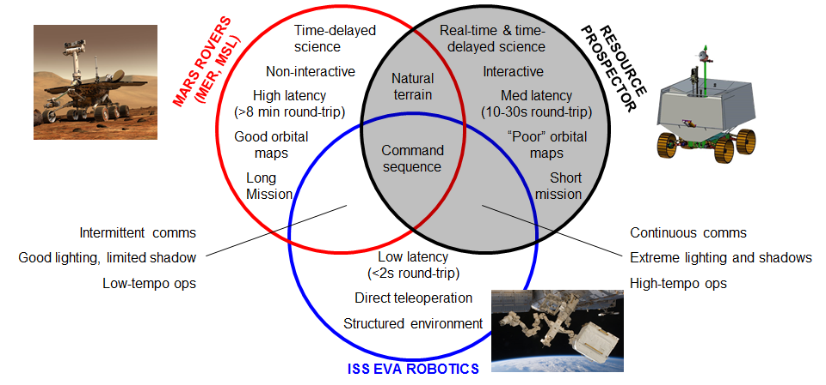
Ops Approach: VIPER vs. Mars Rovers vs. ISS
 | VIPER | MER/MSL | ISS EVA Robotics
Comms | continuous | ~once per Sol | continuous
Latency | 6-25 sec | 20-40 minutes | <=2 sec
Environment | unstructured | unstructured | engineered
Approach | waypoint commands | command sequences | direct teleoperation

Slide 13
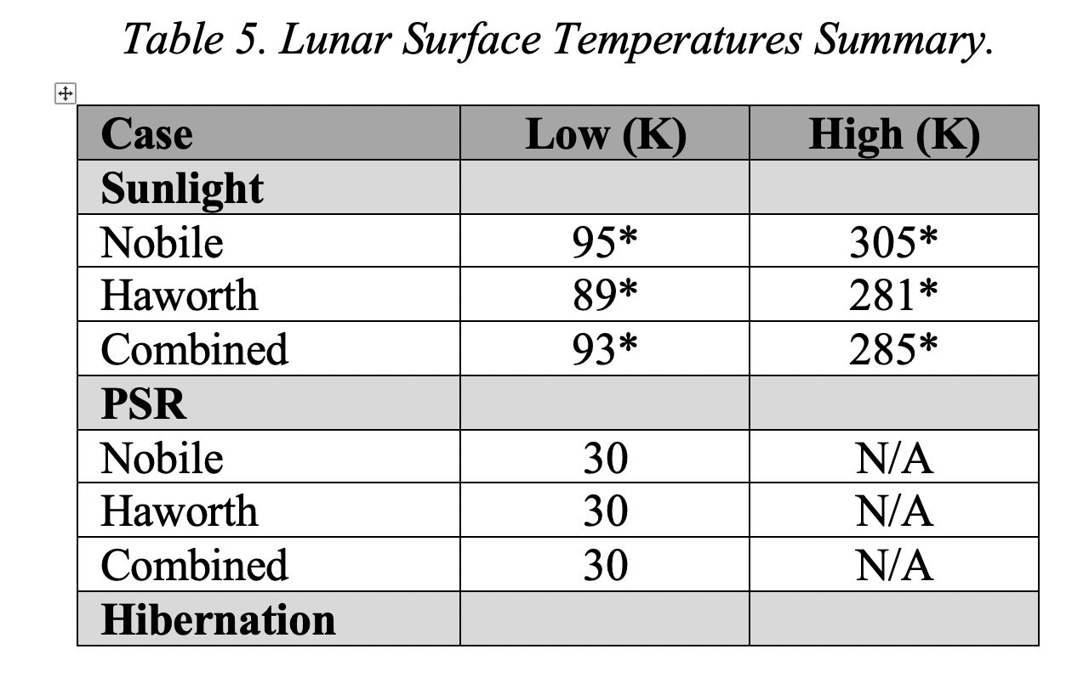
Surface Environment Key Operational Drivers
Regolith/Rocks/Craters
  Vehicle design to environmental spec
  Drivers responsible to stay within vehicle mobility limits
  Real-time science inputs
Lighting
Line of Site Comm
Temperature

Slide 14
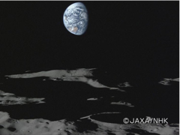
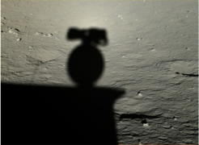
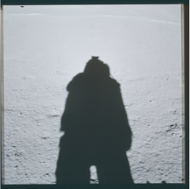

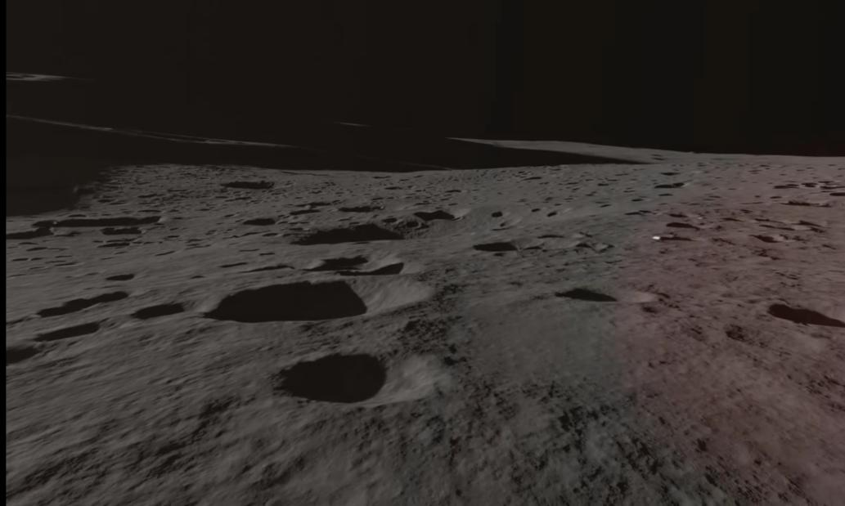
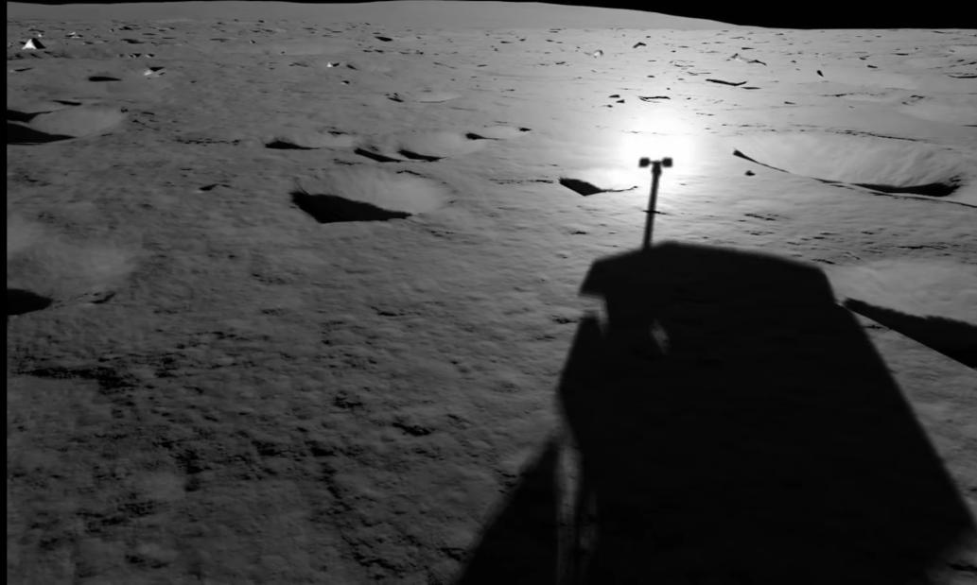
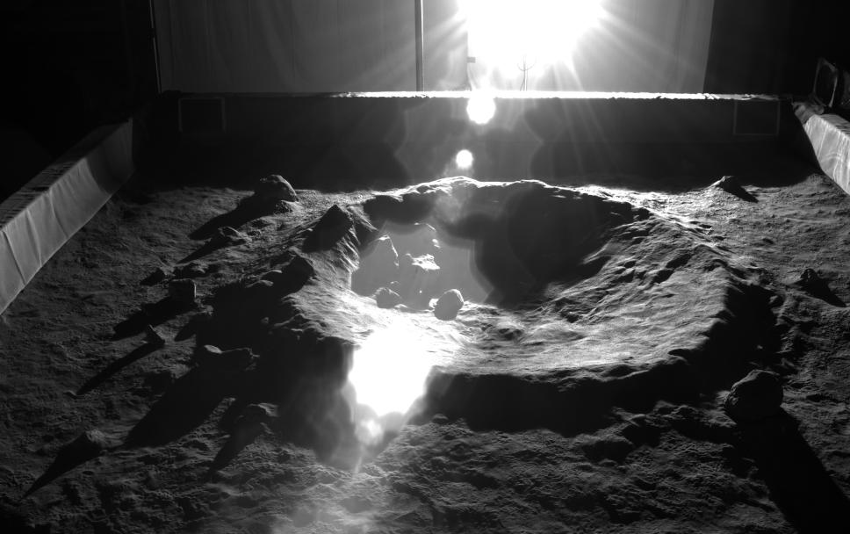
Lighting
Cast shadows, occluded terrain, opposition effect, and lens flare

Slide 15
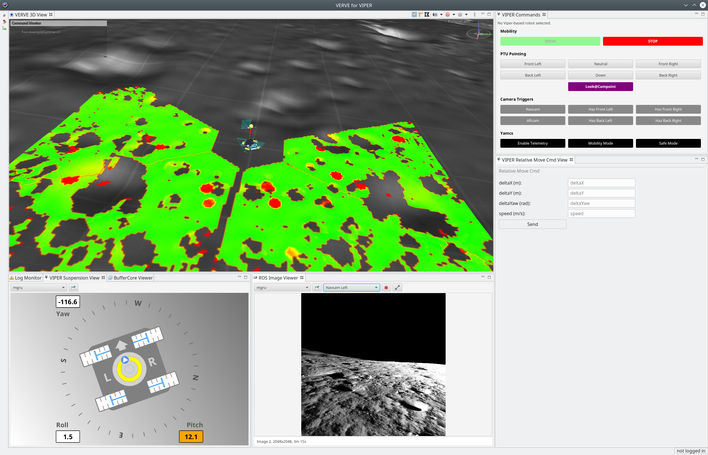
Driving
Continuous communication with Earth
  Low bandwidth: 256 kbps
  Latency: 6-10 sec nominal round-trip
Limited computing, smarts on the rover
Waypoint Driving
    Command rover to drive to a waypoint ~4.5m away, based on lookahead distance and predictability of mobility (e.g. wheel slip)
    Rover onboard control achieves the waypoint, minus wheel slip or other errors
Need to drive using data from the rover
  Driver/co-driver responsible for safe driving
  Real-Time Science to interpret terrain when needed (Science Station)
Not continuous “rate control” input, e.g. joystick or gas pedal
Not sol command sequences, e.g. MER/MSL rovers
Notes:
Terry

Slide 16
Agile

Slide 17
VIPER: A new approach to planetary missions
VIPER follows NPR 7120.8 with augmentation
  Apply ARC and NASA engineering processes and standards with tailoring to improve efficiency while reducing cost and schedule
  VIPER Review Team (VRT) provides streamlined approach to continuously review the project
  VIPER does not have a formal risk classification, but is “like” Class D
Adapt and use NPR 7120.5 “constructs” as needed
  Control plans should be baselined and used when needed
  Reviews should focus on content, not on slide preparation and travel
  Focus on what provides value & rigor, not just satisfying process
Rapid design and development
  Apply agile software development practices as much as possible
  Use iterative design and test rather than lengthy “waterfall” process
  Extensive use of collaboration tools (Atlassian suite, Google docs, Microsoft Teams)

Slide 18
Agile
A culture of doing
v
a culture of meetings and documents

Slide 19
In the Beginning (Software)
Delivery every 6 months
The 6 month delivery cycle created too much time for customer expectations to diverge from what we were building
  Customers needed to see the product more frequently
Progress difficult to measure
Long and formal design specs
Too much time talking, not enough time doing
Subsystem1
Subsystem2
Subsystem3
Subsystem4
6 Months
6 Months
6 Months
6 Months

Slide 20
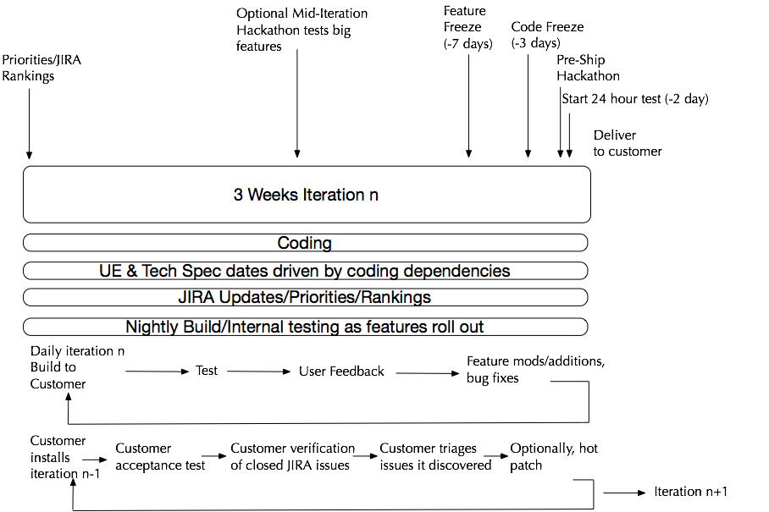
Agile Sprint
Agile Tailored for our team
Deliver to customer every 3 weeks
Nightly build
Release every 3 months
Emphasis on constant interaction and use
jay.p.trimble@nasa.gov

Slide 21
Key attributes of our tailored agile process for software
The measure of progress is working code
Demonstrations, not presentations
Constant use of the software in a relevant environment, such as mission simulations
Visible progress - nightly or continuous builds
Ship on time, features that are not ready go into the next sprint or release
Validation using both QA and customer use in context

Slide 22
Agile Mission Operations

Slide 23
Agile for Mission Operations
“Standard” process is waterfall
Requirements --? Verification and Validation
Why change a proven process?
Effectiveness
Efficiency
Cost reductions
Team engagement, culture of doing

Slide 24
Tailored Agile
MOS
The measure of progress is demonstrated mission capability
Early and frequent builds and tests
Risk reduction through prototypes, walk-throughs and simulation
Maturation of tools and processes through use
Software
The measure of progress is working code
Demonstrations, not presentations
Interactions and use over meetings
Continuous visibility of progress (continuous builds)
Sprints ship on time, features that are not ready go into the next sprint

Slide 25
Agile Ops Products Development
Sprints/Simulations
Ops products developed just in time to support simulations
Ops products iterated throughout simulations, mature by operations readiness testing
Before testing ops products in simulation, conduct walkthroughs
Walkthroughs
Not a meeting
Before a simulation walkthrough each procedure step with the team

Slide 26
Say it then sim it
Use this for meetings. Instead of long debates, after someone says it, sim it

Slide 27
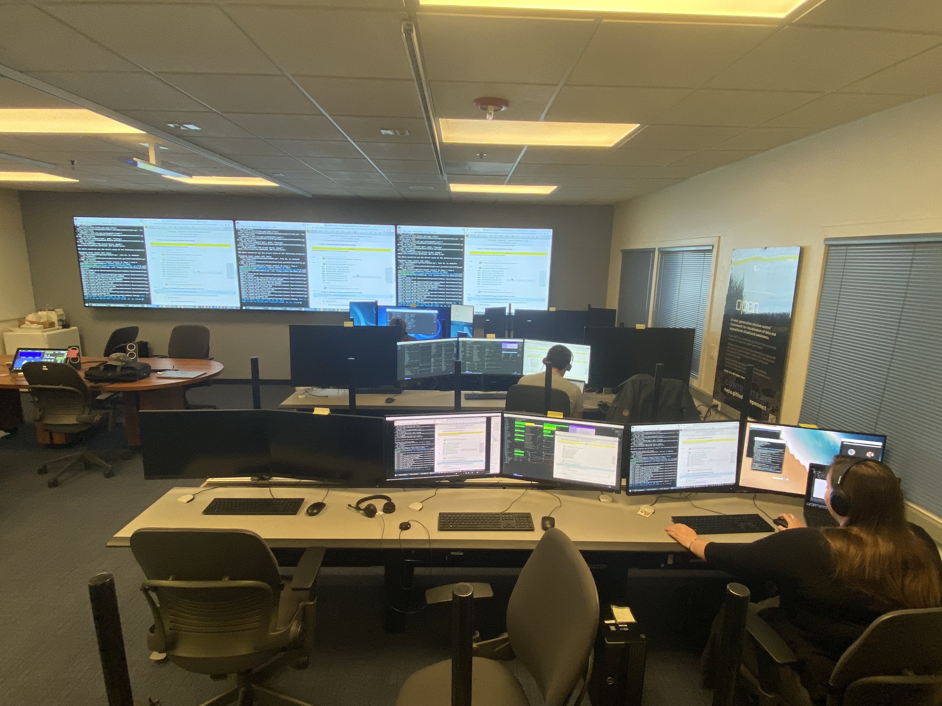
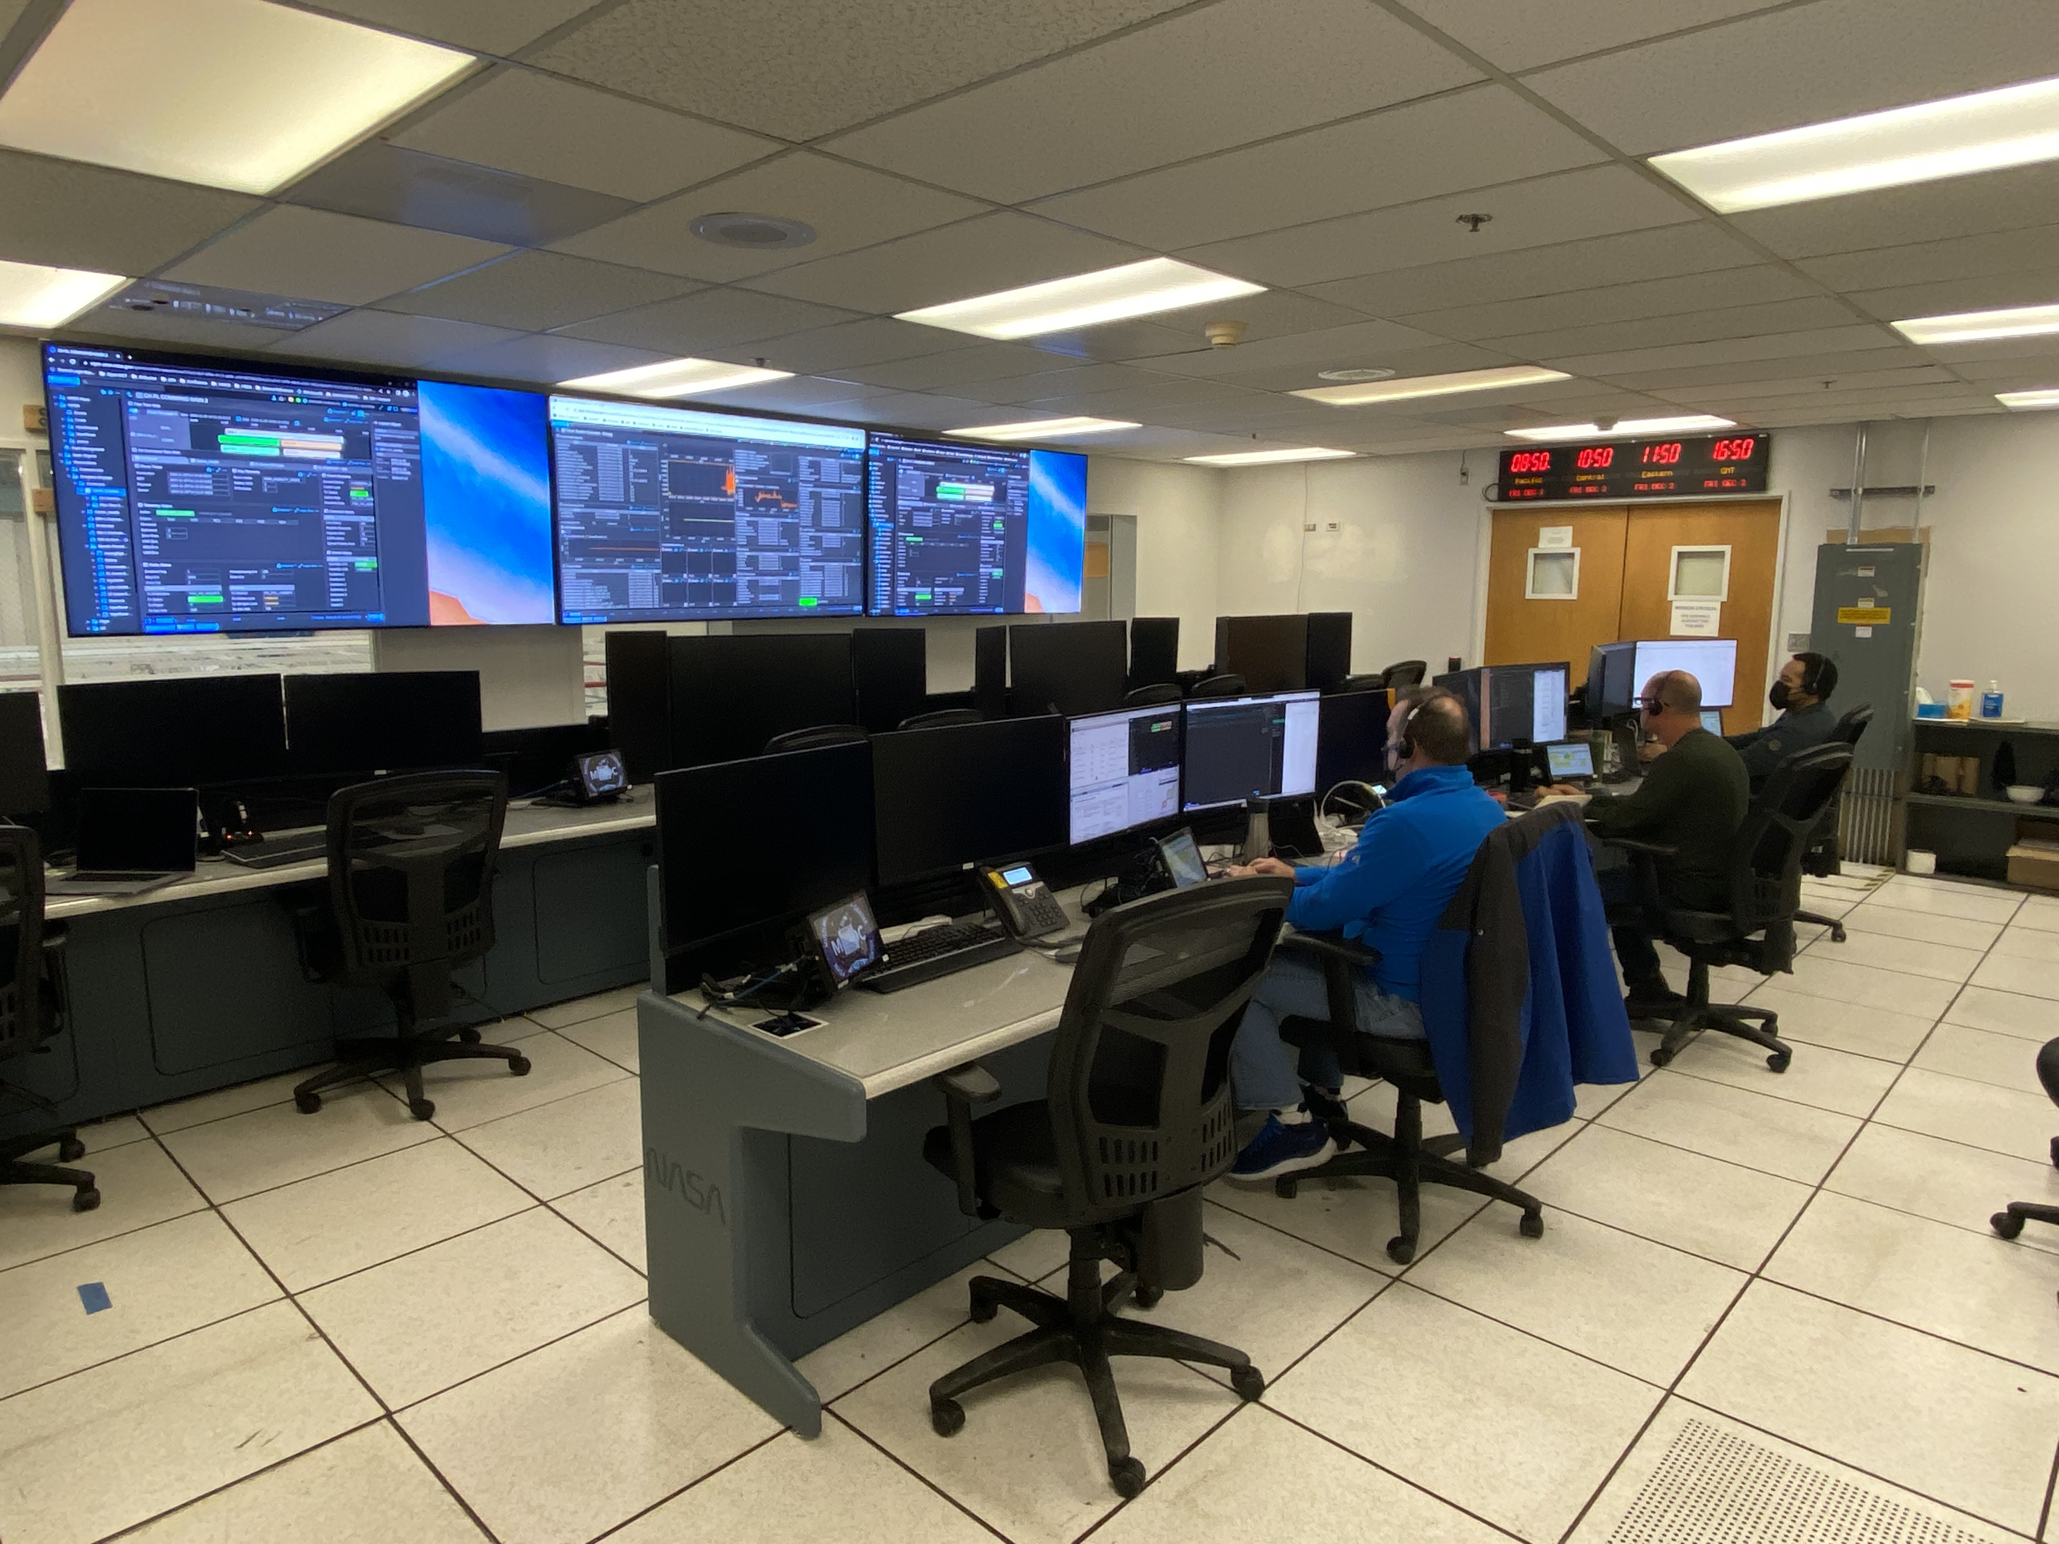
Simulation
Lab
Control Center

Slide 28
Organizational Issues
Traditional development
Gate Reviews
Verification and Validation

