Slide 1




Examination of Mars2020 shock-layer conditions via infrared emission spectroscopy of CO2
Augustin Tibère-Inglesse¹
Thomas K. West IV²
Christopher C. Jelloian, Nicolas Q. Minesi, R. Mitchell Spearrin³
Justin Clarke, Luca di Mare, Matthew McGilvray⁴
Brett A. Cruden⁵
¹ NASA Postdoctoral Program Fellow at NASA Ames Research Center
²NASA Langley Research Center, Hampton
³University of California, Los Angeles (UCLA)
⁴University of Oxford, England
⁵AMA Inc at NASA Ames Research Center, Mountain View
AIAA Scitech Forum, 23-27 January 2023, National Harbor, MD

Slide 2
Outline
1) Introduction: MEDLI2
  2) OES results
  3) Comparison with LAS measurements
  4) Conclusion

Slide 3
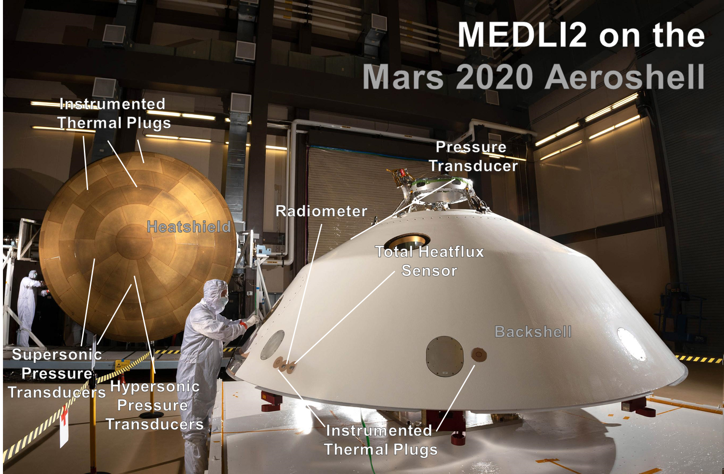
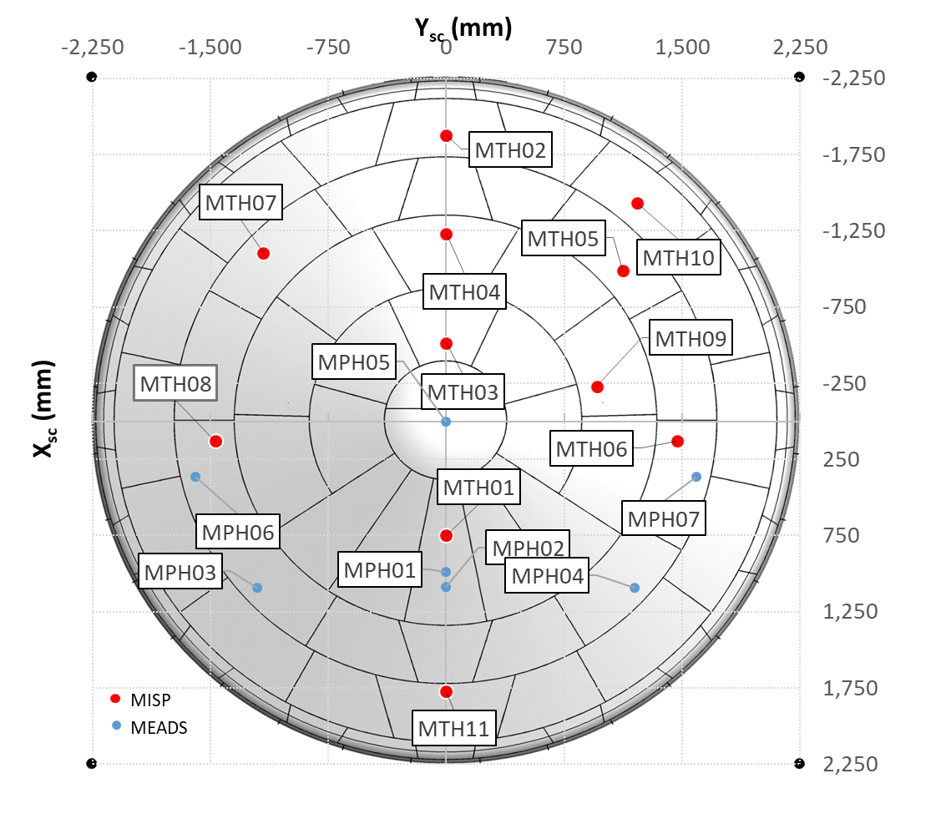
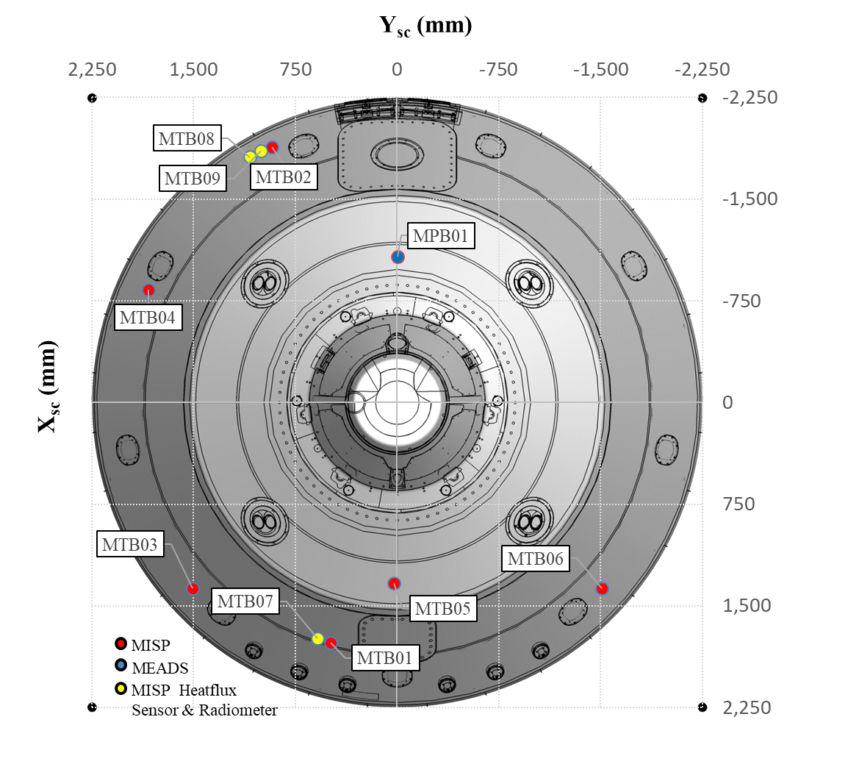
Mars2020 Entry Descent and Landing Instrumentation 2 (MEDLI2)
Forebody
Afterbody
Total and radiative heat fluxes were measured during the Mars2020 atmospheric entry
Comparison with ground testing measurements

Slide 4
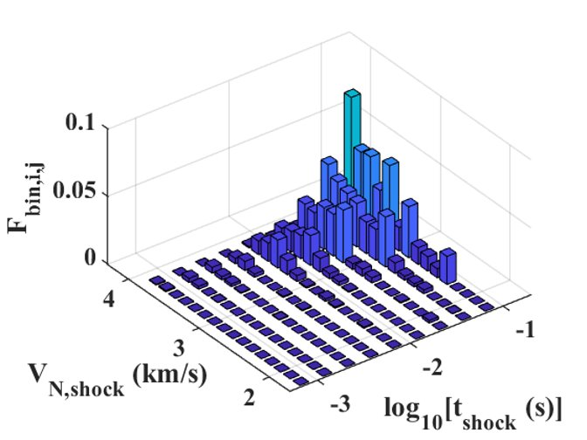
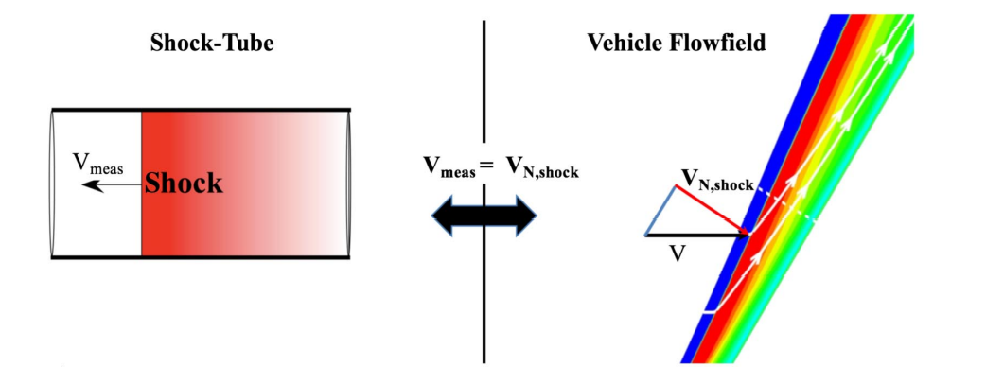
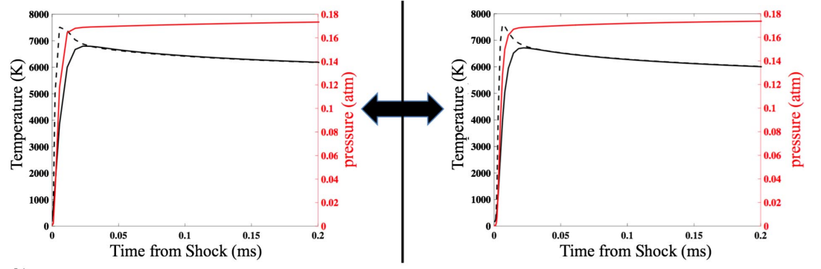
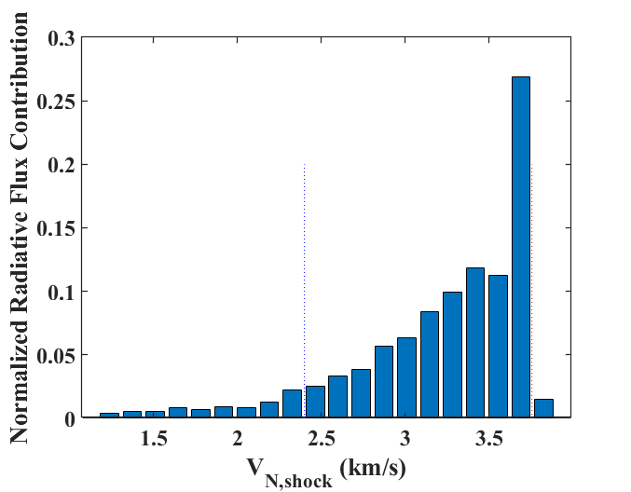
Shock Tube Informed Bias (STIB) methodology
Similarity between oblique and normal
shocks in particle time
The contribution of every flowfield point to the wall radiative heat flux is evaluated
Mapping of the contribution in terms of velocities and particle time
MTB08/09
10% Lower Bound
90% Lower Bound
MTB07
Evaluated at 9 time points and the two sensor locations
(MTB07/08) to obtain the test series matrix

Slide 5
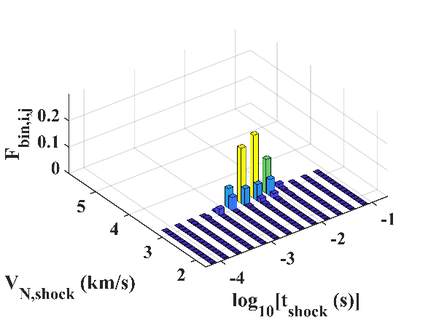
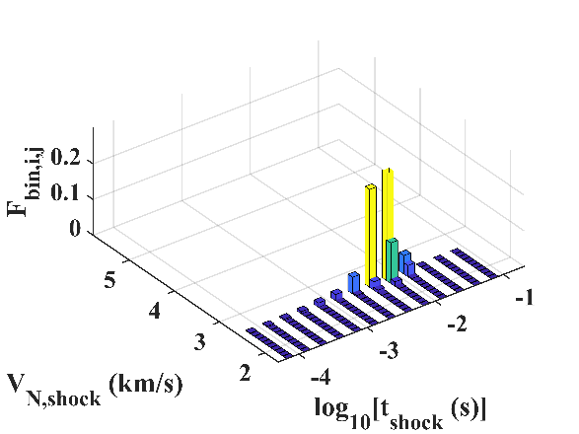
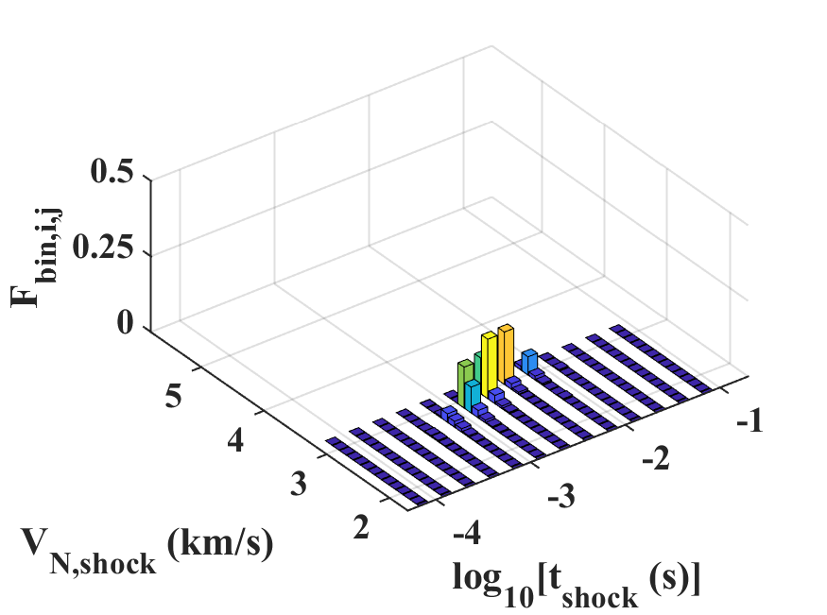
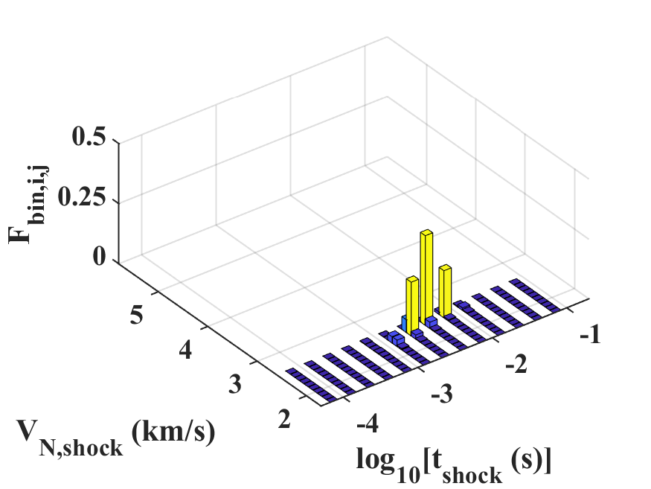
Focus of current EAST test series
1.1 Torr (92s)
1.5 Torr (101s)
Total heat flux measurement compared to radiative flux predictions
Cruden model seems predicts faster increase, Johnston slower decay
Conditions near and after the peak of the heat pulse
Relevant velocities and particle times are extracted from STIB analysis
3.0-3.2 km/s
1-8 ms
2.5-2.6 km/s
3-12 ms
MTB08/09
2.7-3.0 km/s
1-7 ms
MTB07
2.4-2.5 km/s
2-10 ms

Slide 6
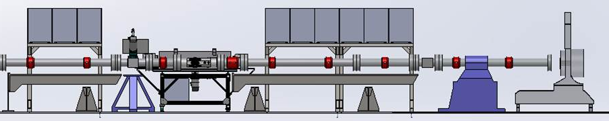
Experimental setup of EAST
Driven
Driver
2 spectrometers
(Blue,IR)
Pressure sensors
Test conditions:
  Test gas is Mars atmosphere (95.4% CO₂, 2.6% N₂, 2.0% Ar)
  Conditions: 1.2 to 3.75 km/s at 1.1, 1.5 and 2 Torr
  Focus on IR radiation:
    From CO₂ fundamental bands at 4.2 μm
    From CO₂ overtone bands at 2.7 μm
Notes:
Drop configurations

Slide 7
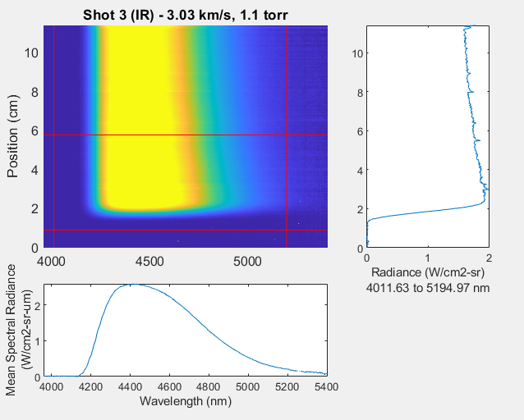
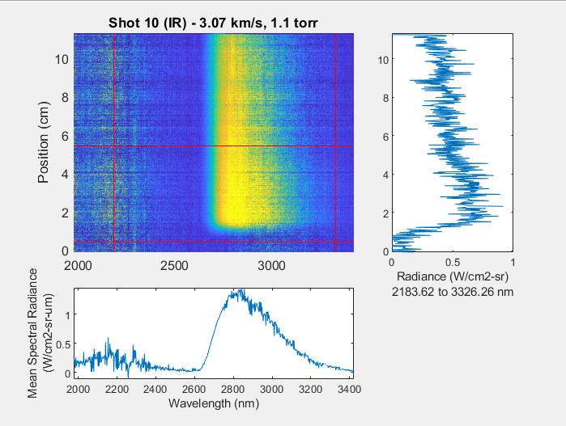
Typical emission data
CO₂ fundamental
CO₂ overtone
~ 10 cm of measurements → up to 0.4 ms in particle time
Spatial integrated radiance profiles (vertical) compared with simulations

Slide 8
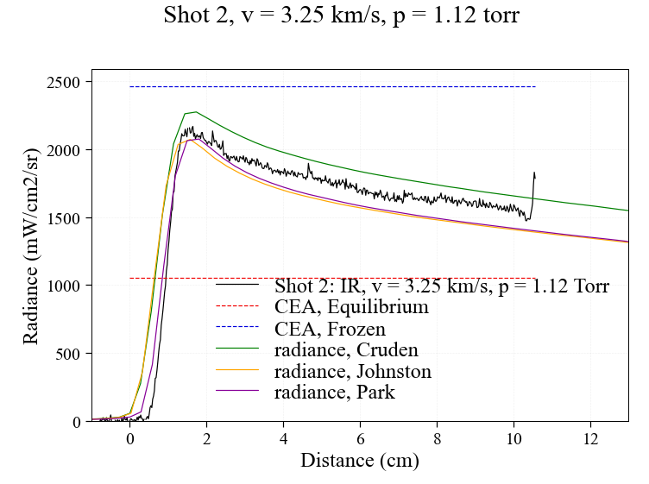
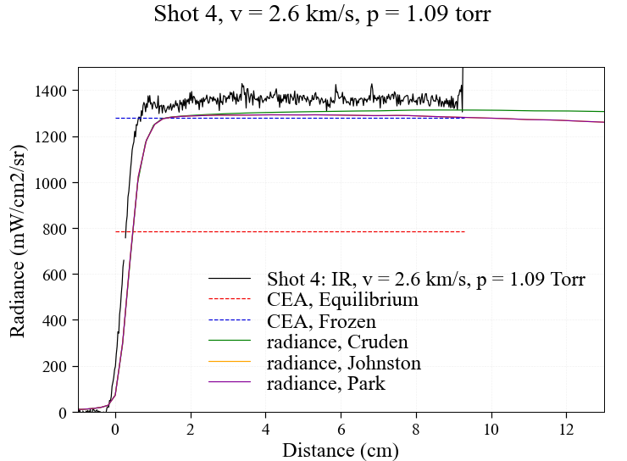
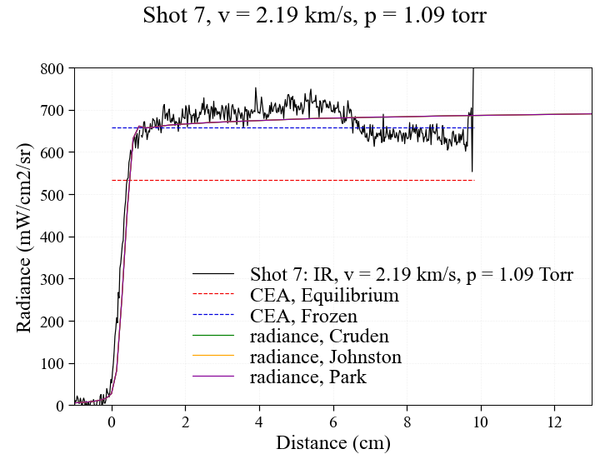
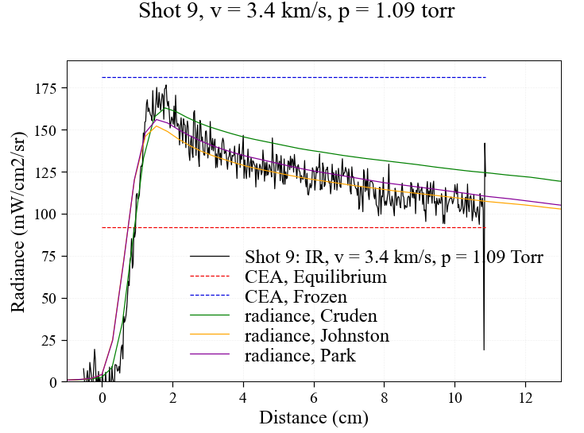
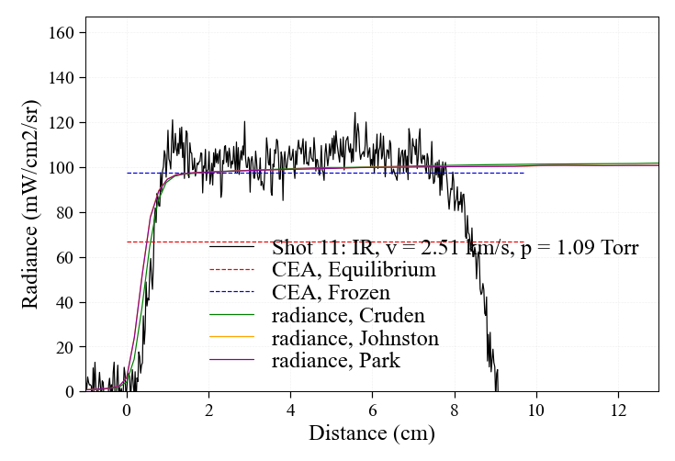
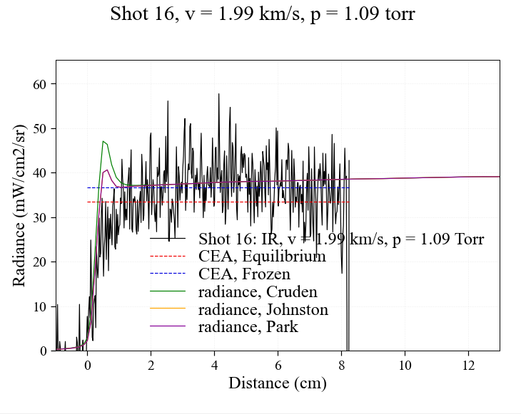
Spectral radiance (1.1 Torr)
v > 3.2 km/s
v ≈ 2.6 km/s
v < 2.2 km/s
250-350 μs
4.2 μm band
2.7 μm band
Underprediction of radiance in frozen cases (<2.7 km/s)
Measurements between the models at higher velocities

Slide 9
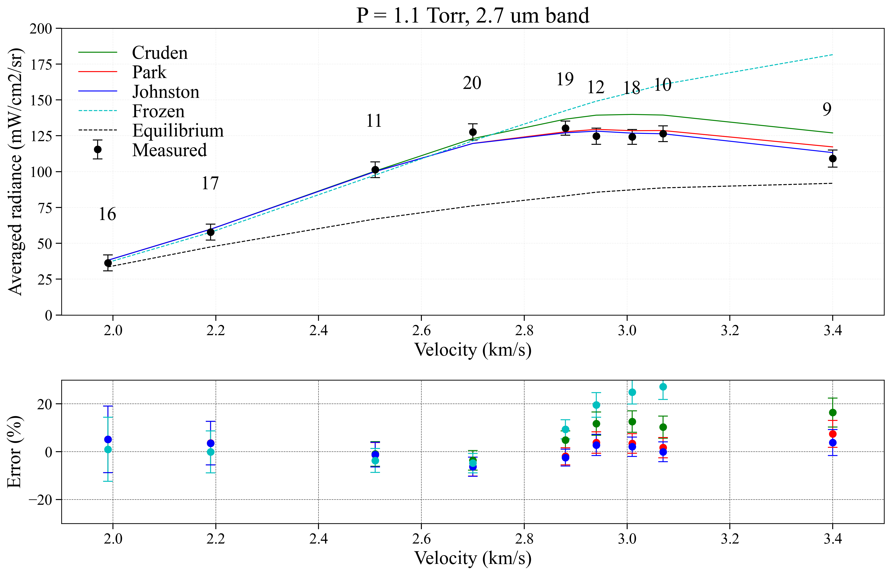
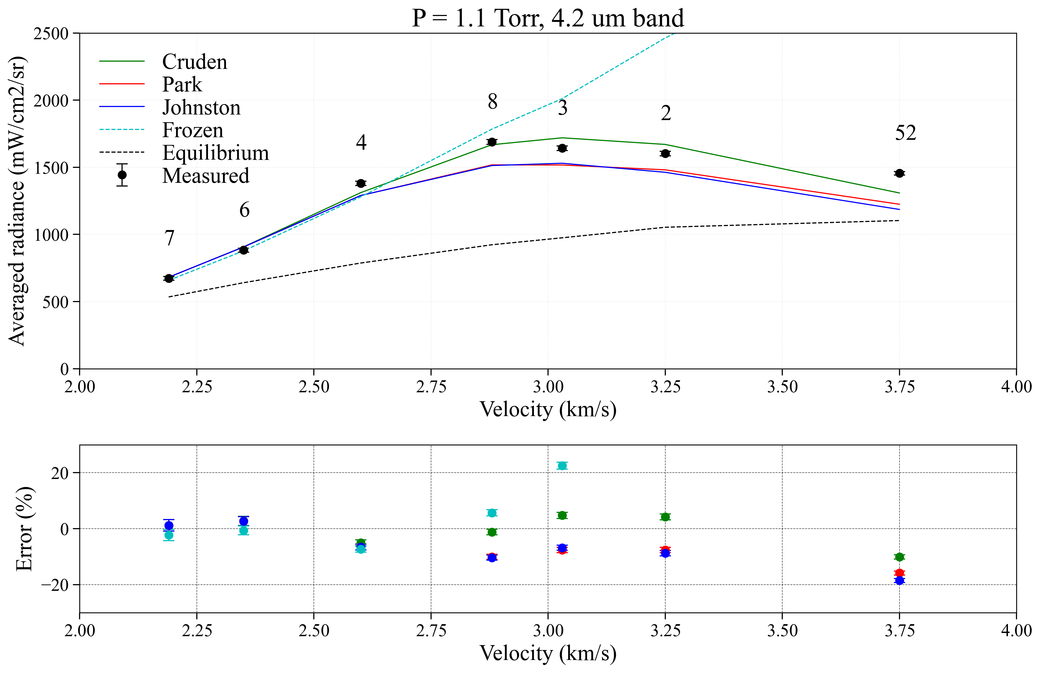
Summary at t_{part} = 300 μs (1.1 Torr)
Chemistry frozen below 2.7 km/s
The 2.7 μm band appears better predicted with Johnston/Park while the 4.2 μm generally closer to Cruden

Slide 10
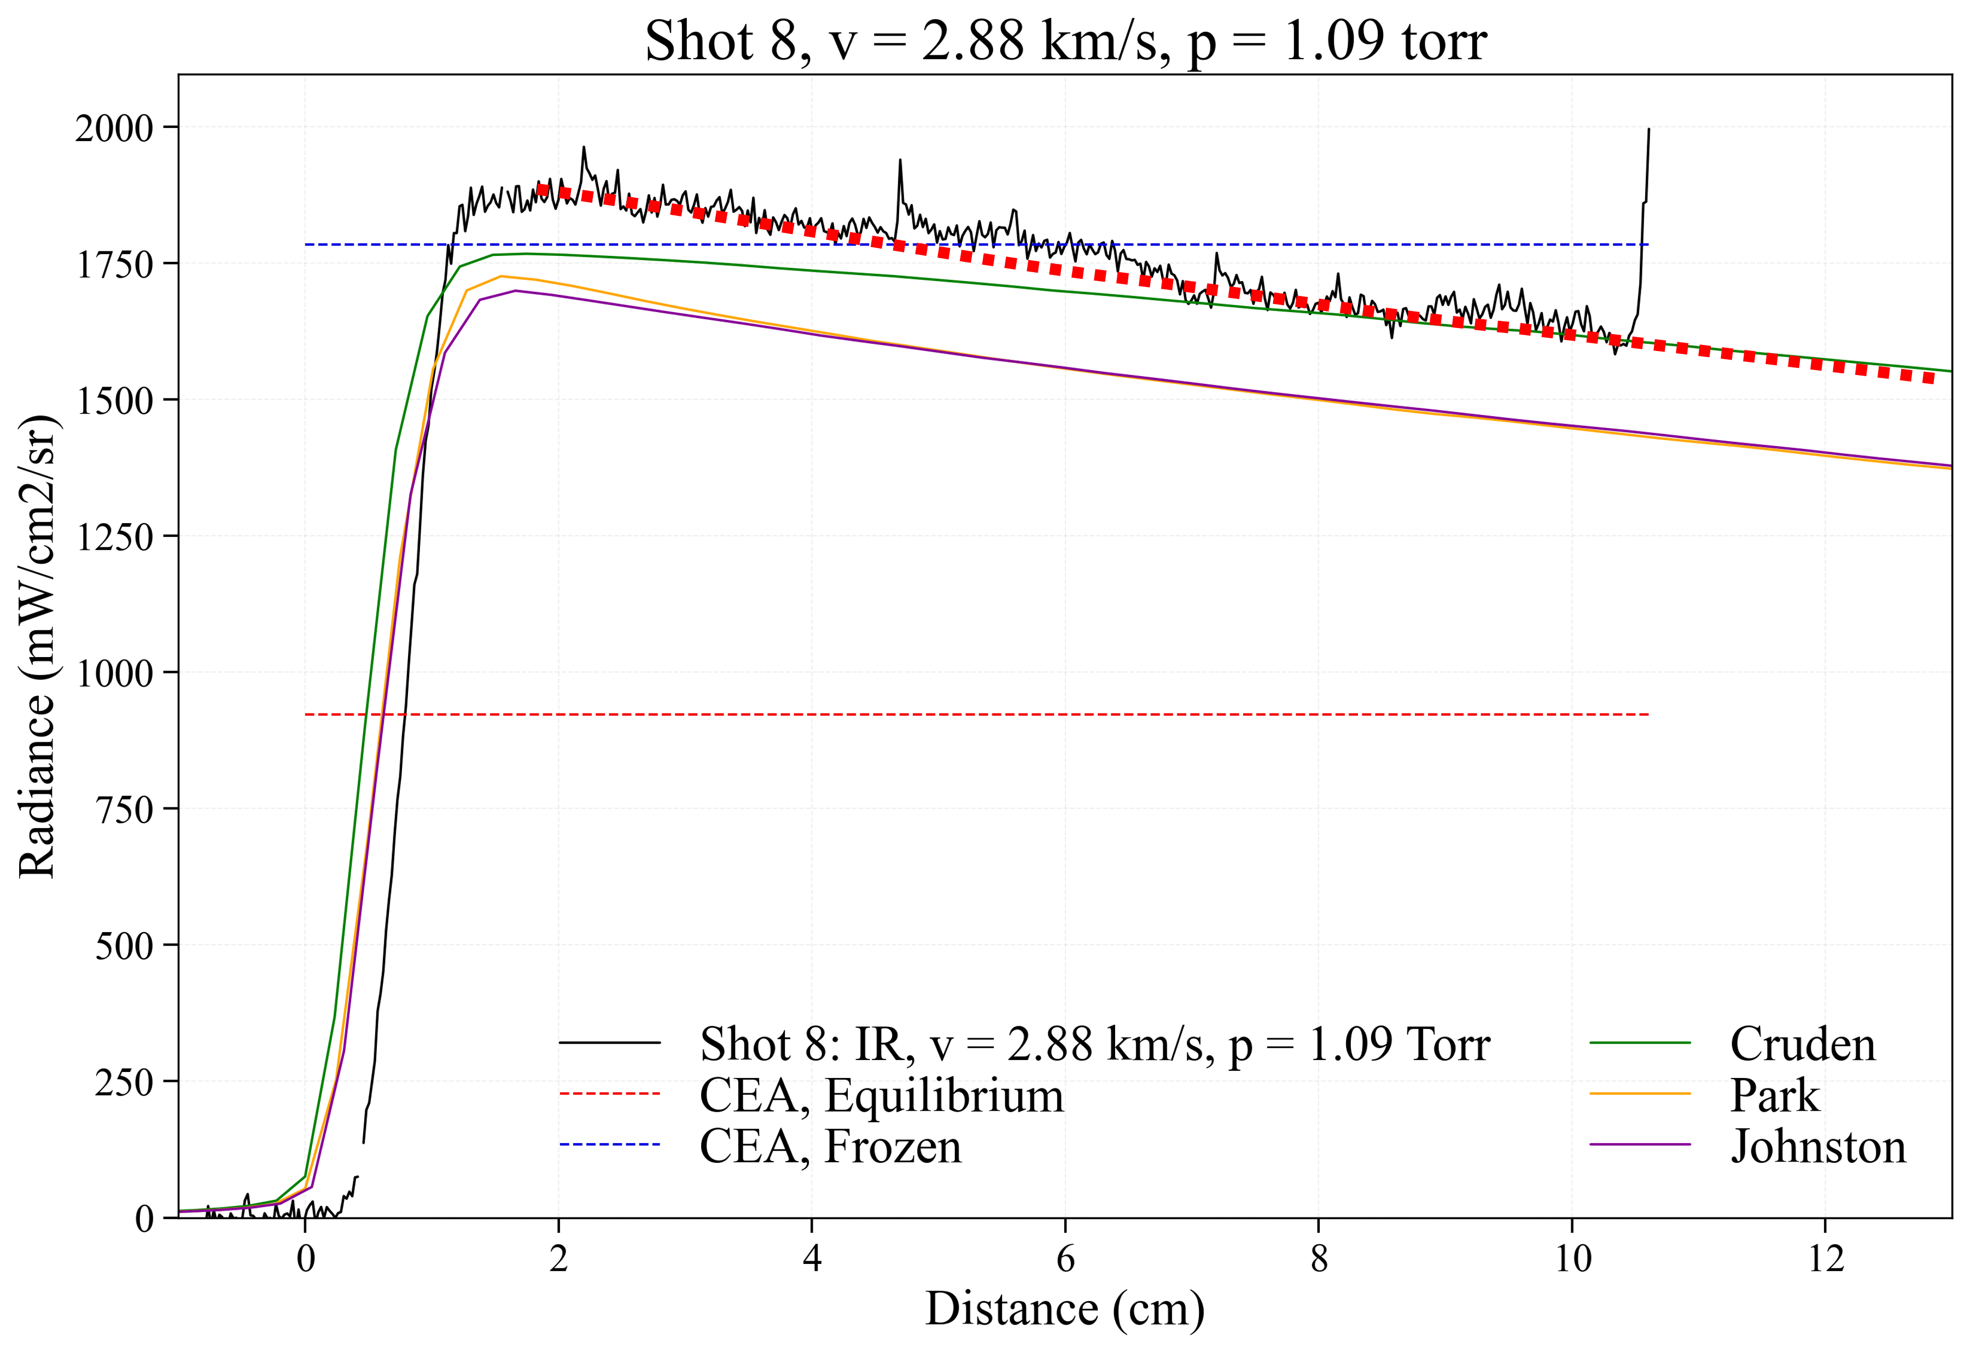
Extrapolating to larger test time (1.1 Torr)
MTB08: 3.0-3.2 km/s, 1-8 ms
MTB07: 2.7-3.0 km/s, 1-7 ms
3.0-3.2 km/s
1-8 ms
~0.4 ms
Measured radiance profiles are extrapolated using an exponential curve

Slide 11
Extrapolating to larger test time (1.1 Torr)
MTB08: 3.0-3.2 km/s, 1-8 ms
MTB07: 2.7-3.0 km/s, 1-7 ms
~0.4 ms
MTB08/09
MTB07

Slide 12
Extrapolating to larger test time (1.1 Torr)
MTB08/09
MTB08: 3.0-3.2 km/s, 1-8 ms
MTB07: 2.7-3.0 km/s, 1-7 ms
MTB07
Estimated total error:
  At MTB08 location: -3% (Johnston), +2 % (Cruden)
  At MTB07 location: -6.5% (Johnston), +2 % (Cruden)
Discrepancy between the models consistent with real flight simulation → validation of STIB method
Estimation at 1.5 Torr could not be made since the chemistry was frozen at the timescale of the experiment
~0.4 ms

Slide 13
Spectral radiance (1.1 Torr)
v > 3.2 km/s
v ≈ 2.6 km/s
v < 2.2 km/s
4.2 μm band
2.7 μm band
Underprediction of radiance in frozen cases (<2.7 km/s)
Measurements between the models at higher velocities

Slide 14
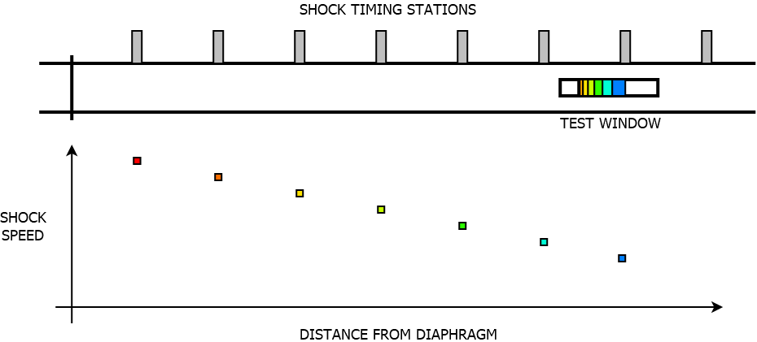
Shock trajectory affect on test gas properties
Shock timing stations (PCB)
Test window
Shock is decelerating as it traverses the tube

Slide 15
Shock trajectory affect on test gas properties
Shock timing stations (PCB)
Test window
Shock is decelerating as it traverses the tube

Slide 16
Shock trajectory affect on test gas properties
Shock timing stations (PCB)
Test window
Shock is decelerating as it traverses the tube
Test gas is accumulated from points upstream of the observation

Slide 17
Shock trajectory affect on test gas properties
Shock timing stations (PCB)
Test window
Shock is decelerating as it traverses the tube
Test gas is accumulated from points upstream of the observation

Slide 18
Shock trajectory affect on test gas properties
Shock timing stations (PCB)
Test window
Shock is decelerating as it traverses the tube
Test gas is accumulated from points upstream of the observation

Slide 19
Shock trajectory affect on test gas properties
Shock timing stations (PCB)
Test window
Shock is decelerating as it traverses the tube
Test gas is accumulated from points upstream of the observation

Slide 20
Shock trajectory affect on test gas properties
Shock timing stations (PCB)
Test window
Shock is decelerating as it traverses the tube
Test gas is accumulated from points upstream of the observation

Slide 21
Shock trajectory affect on test gas properties
Shock timing stations (PCB)
Test window
Shock is decelerating as it traverses the tube
Test gas is accumulated from points upstream of the observation
Post shock condition modelled with Lagrangian code, LASTA
  For frozen shocks, Frozen solution is propagated
  For reacting shocks, 0D reaction calculated over the time of flight

Slide 22
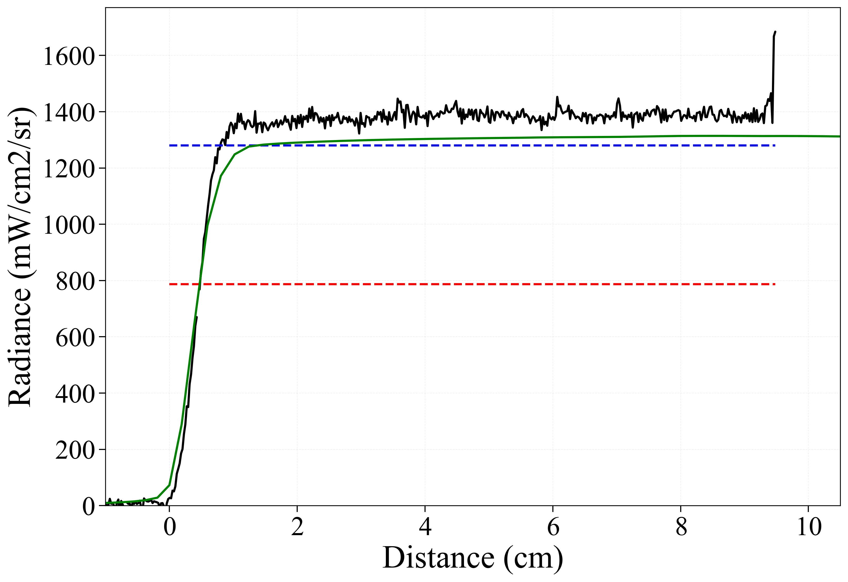
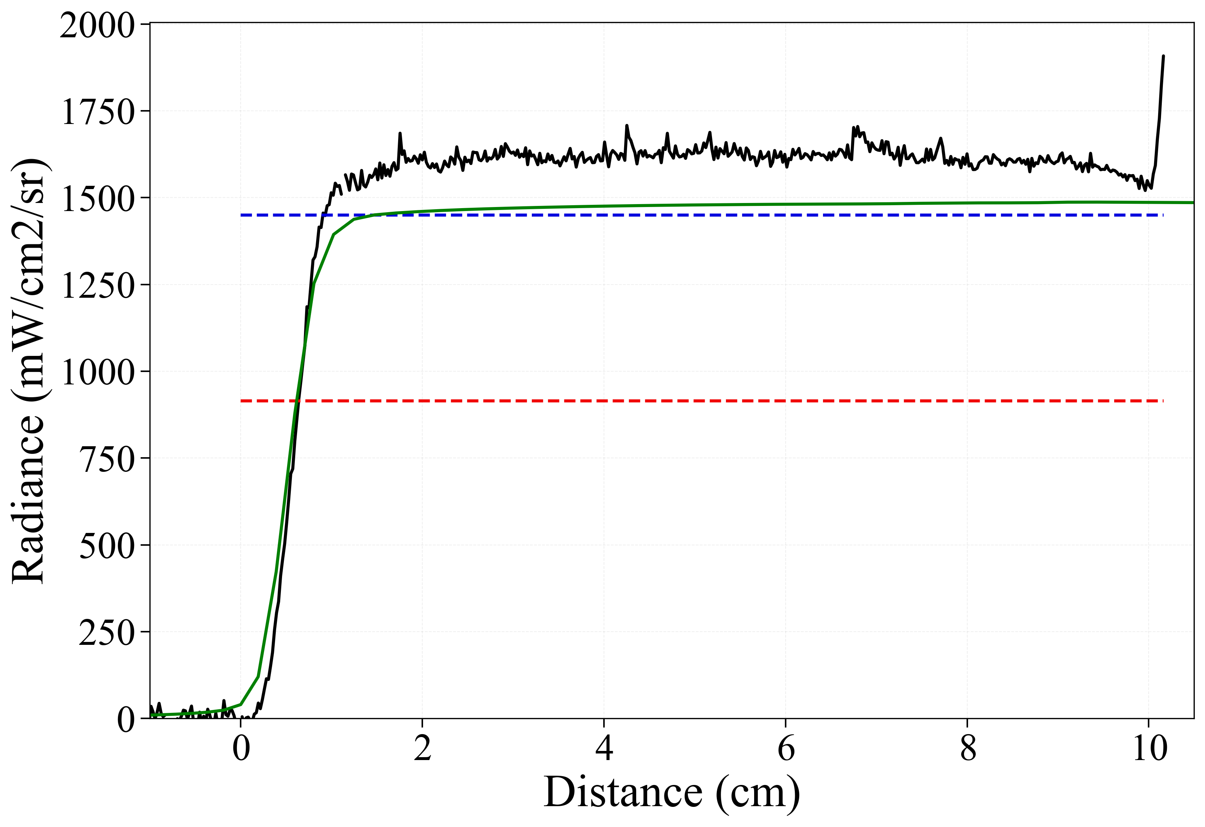
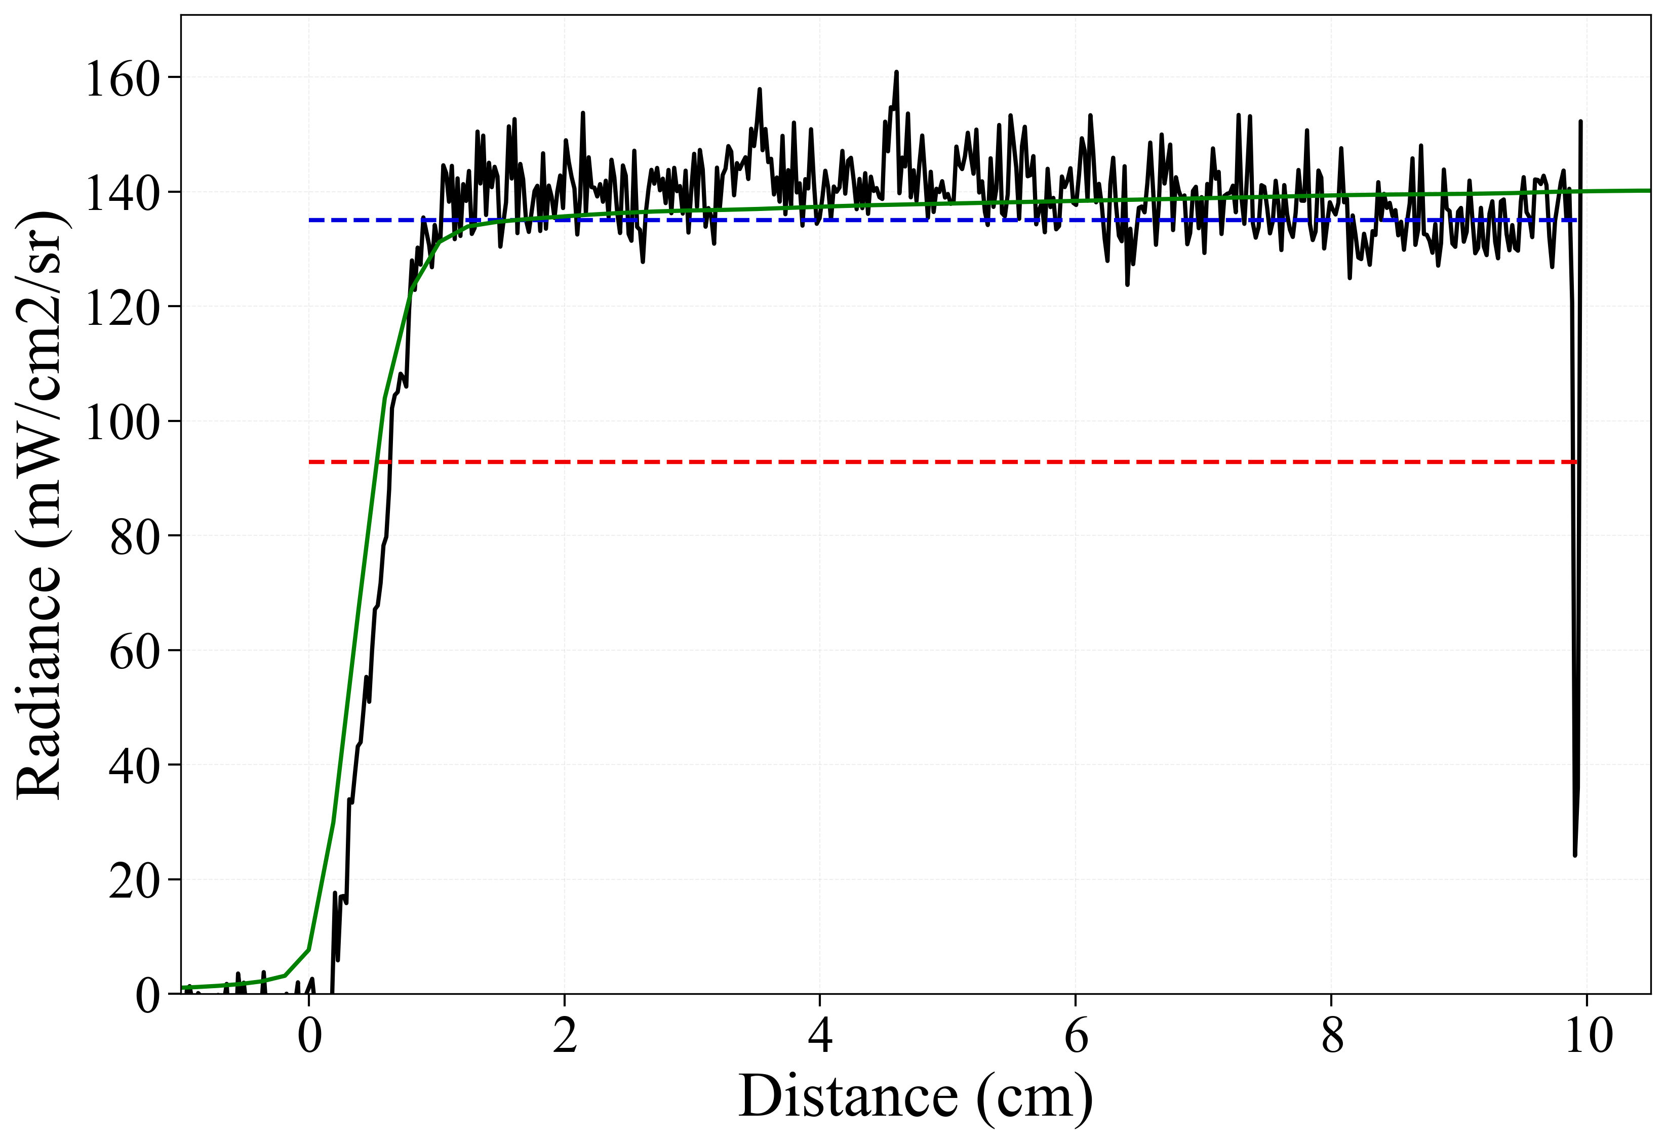
Effect of shock deceleration on measured radiance
2.6 km/s, 1.1 Torr
2.57 km/s, 1.5 Torr
2.6 km/s, 1.5 Torr
Measured
DPLR/NEQAIR
Frozen
Equilibrium
DPLR simulations insensitive to kinetic model (frozen chemistry)

Slide 23
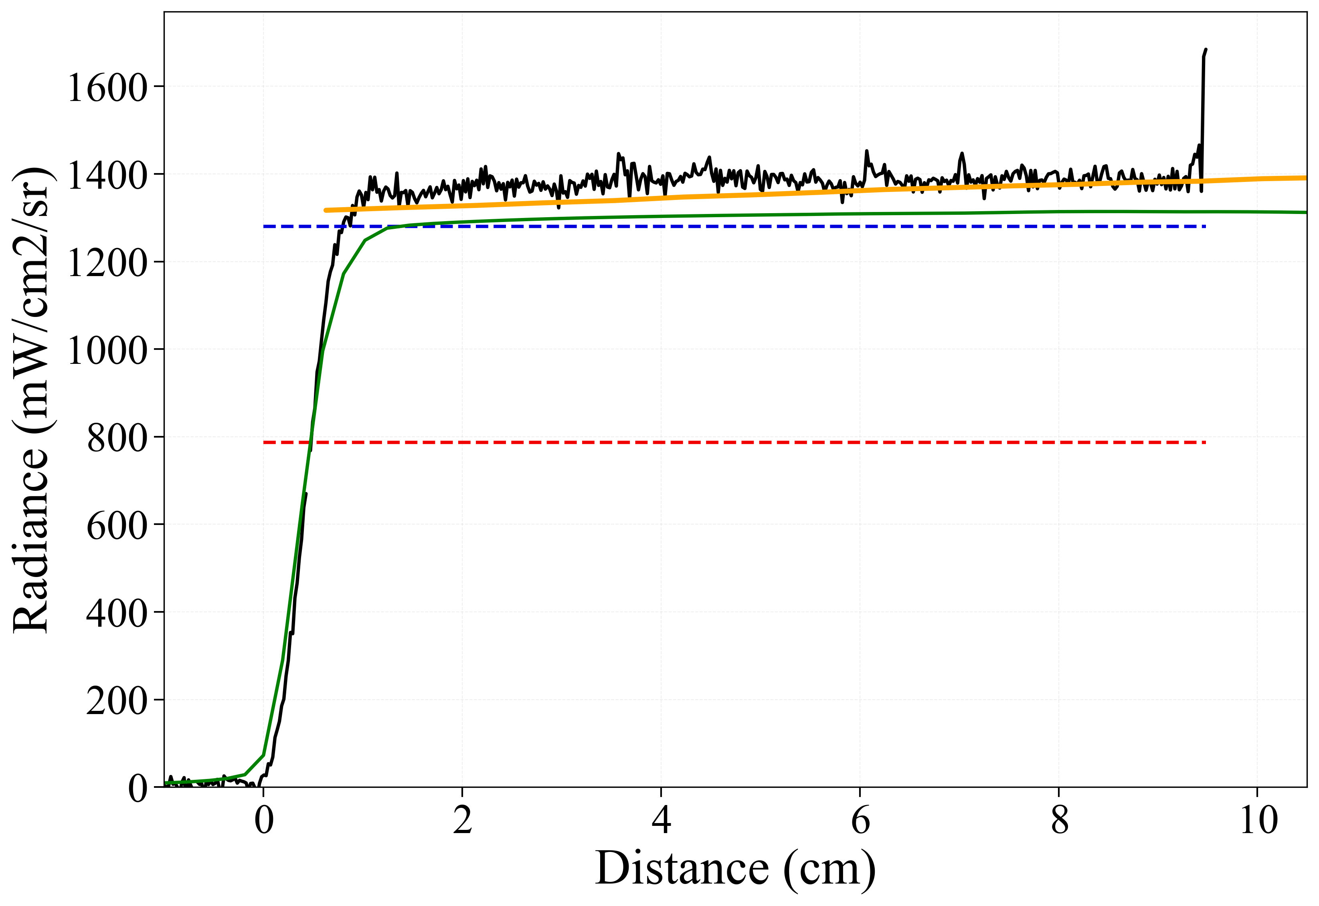
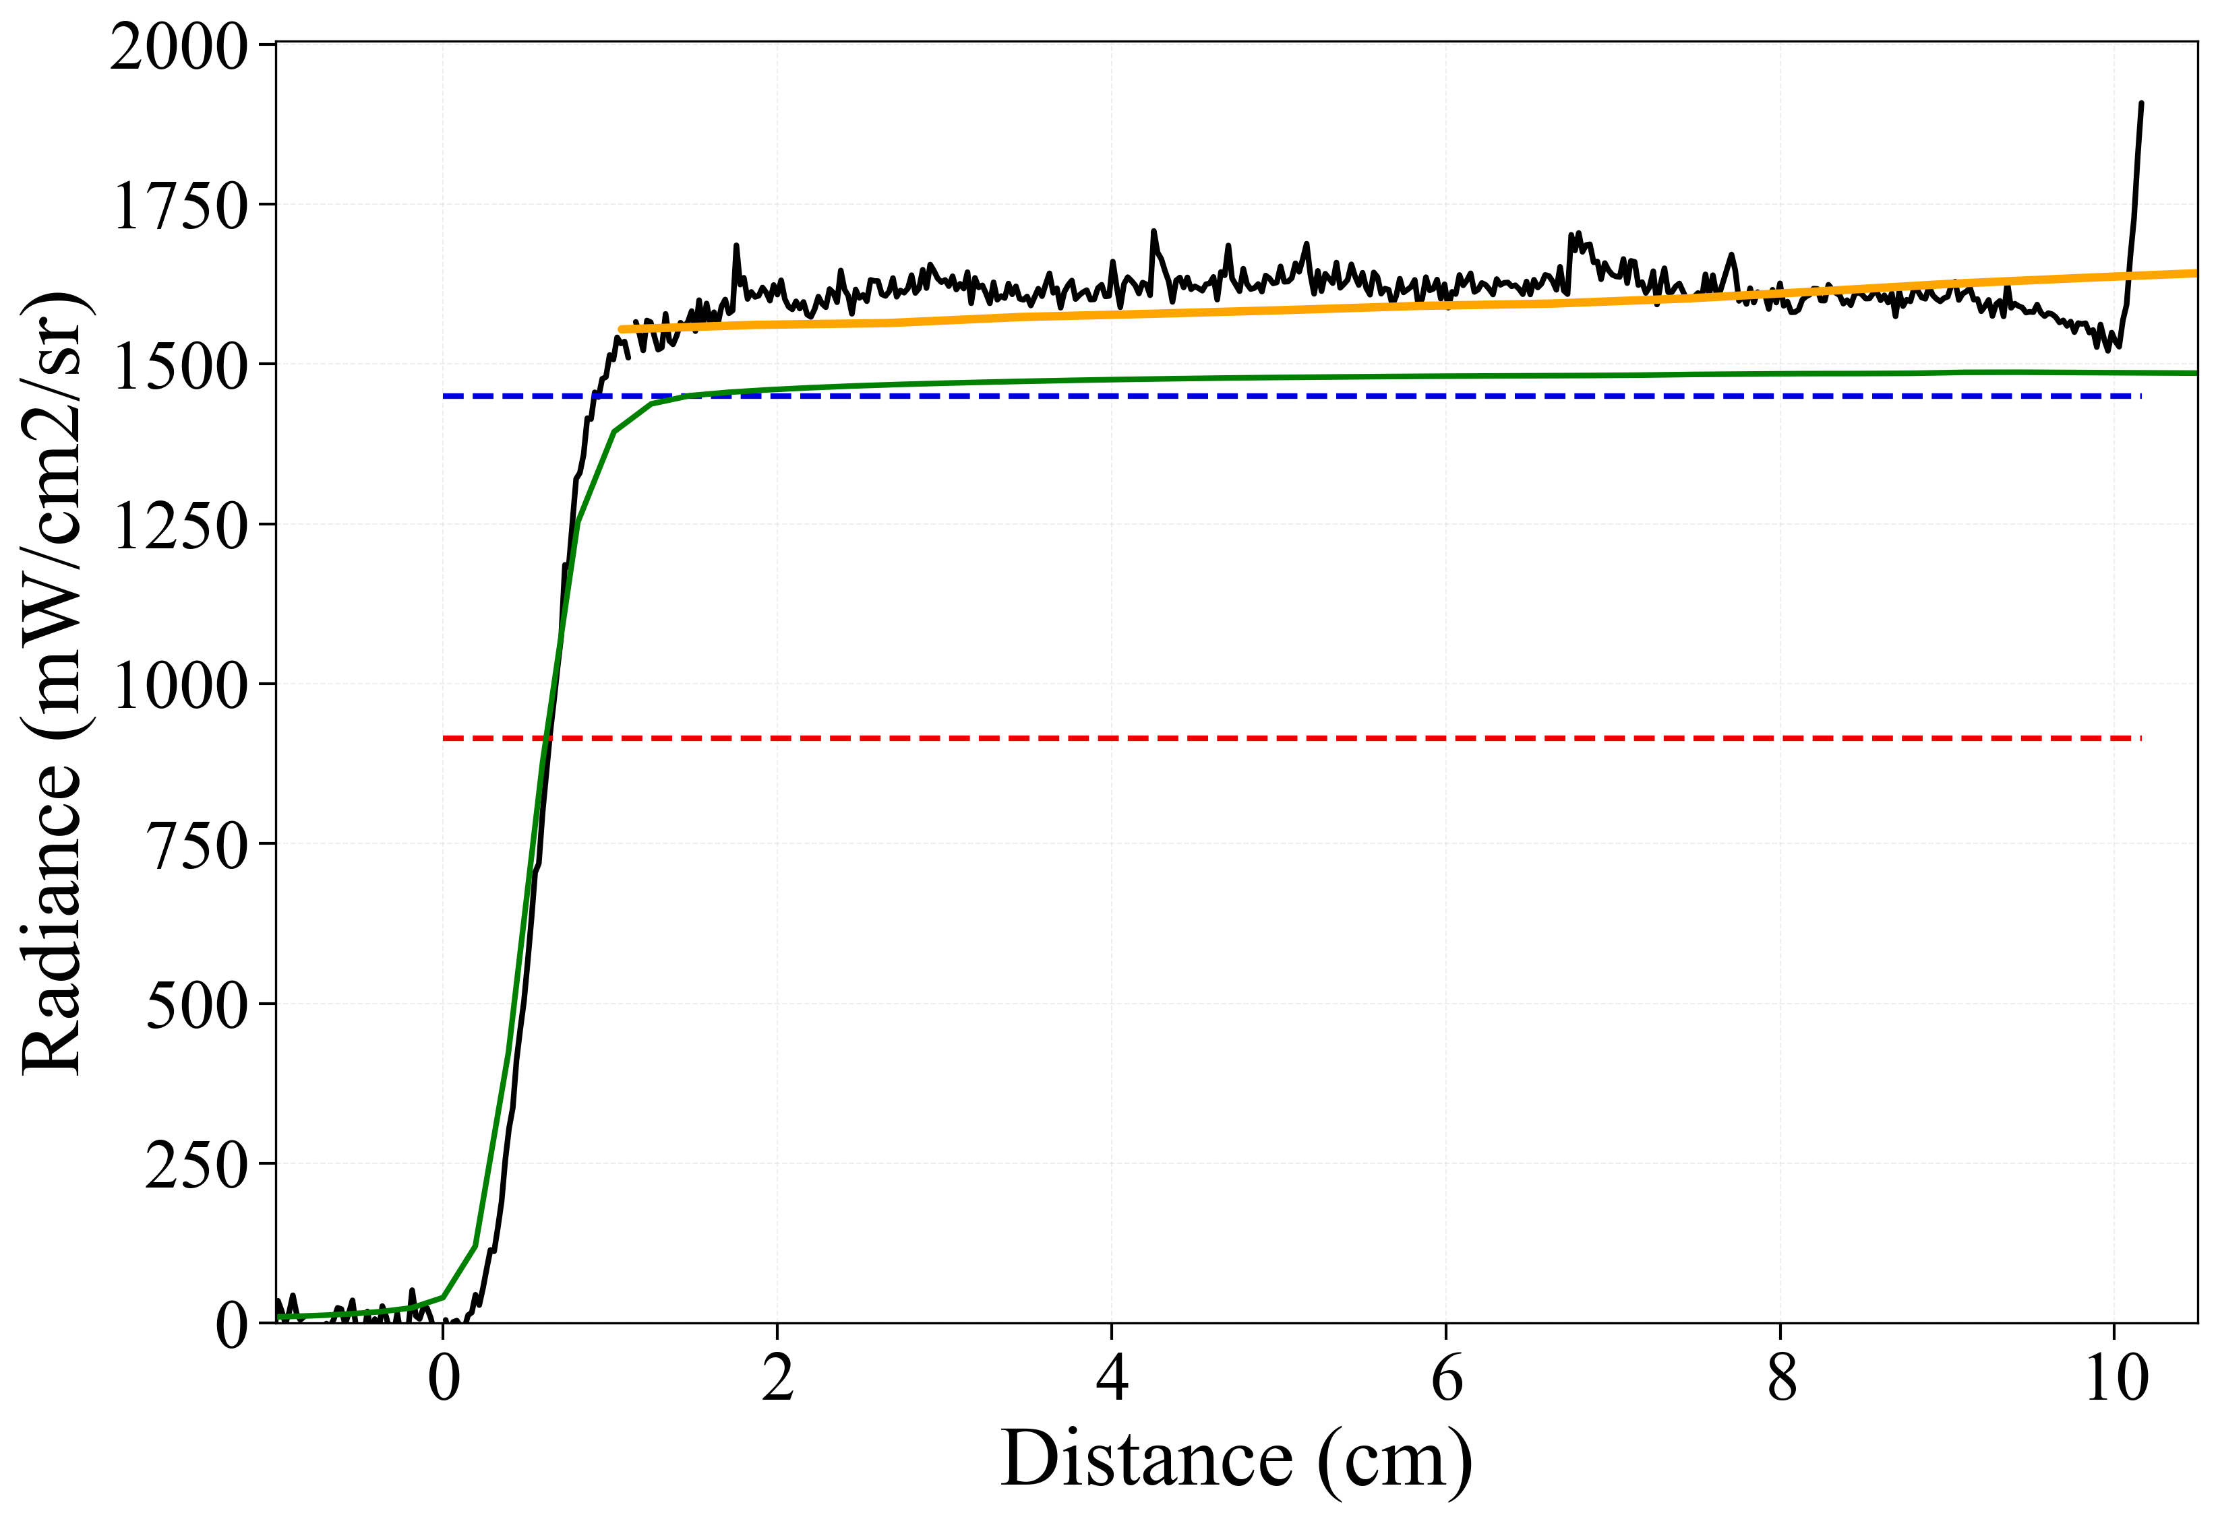
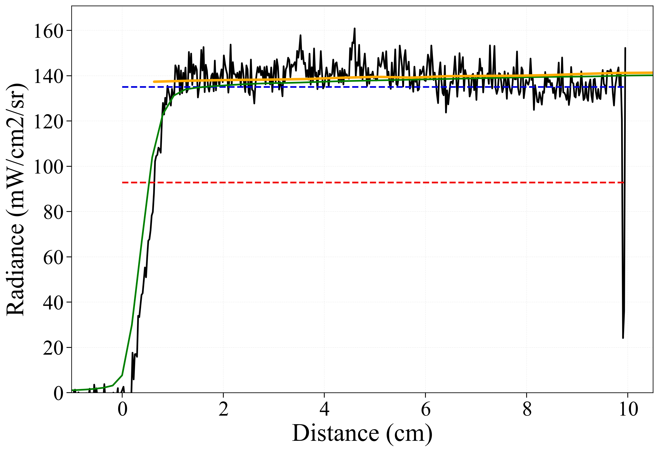
Effect of shock deceleration on measured radiance
2.6 km/s, 1.1 Torr
2.57 km/s, 1.5 Torr
2.6 km/s, 1.5 Torr
Measured
LASTA
Frozen
DPLR/NEQAIR
Equilibrium
DPLR simulations insensitive to kinetic model (frozen chemistry)
LASTA correctly predicts measured radiance in all cases and explains a discrepancy up to 15% with CEA (frozen)
Shock deceleration effects must be taken into account

Slide 24
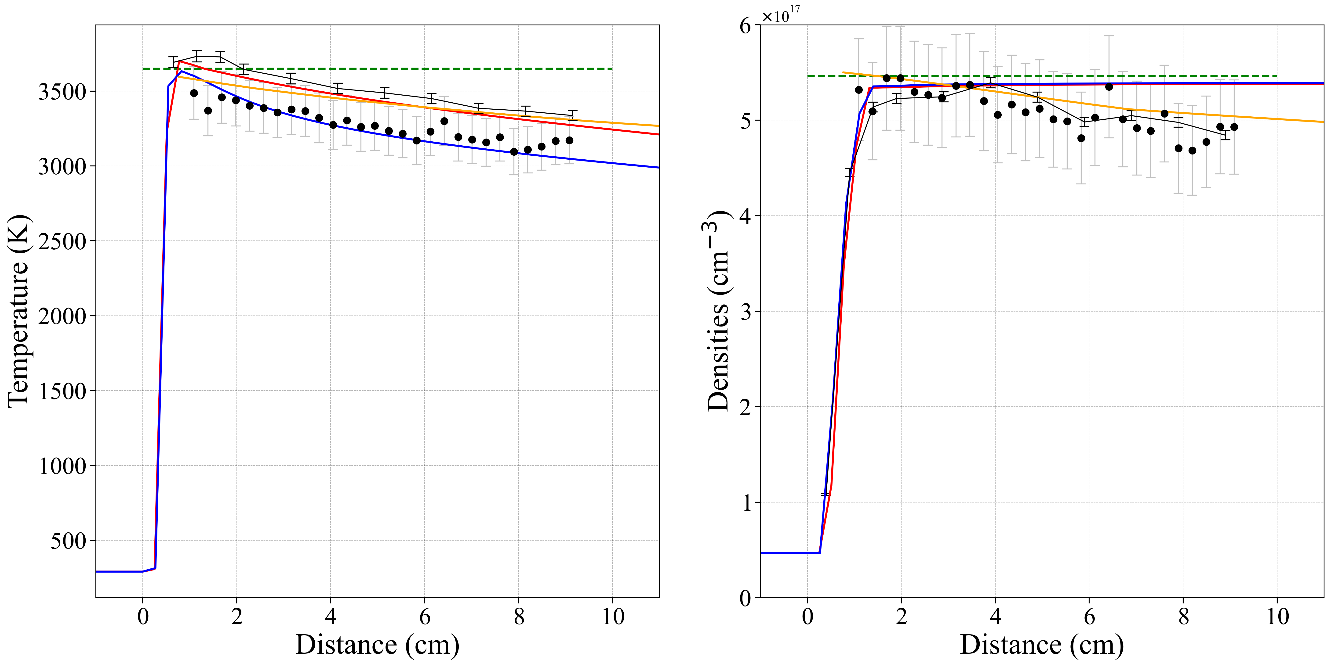
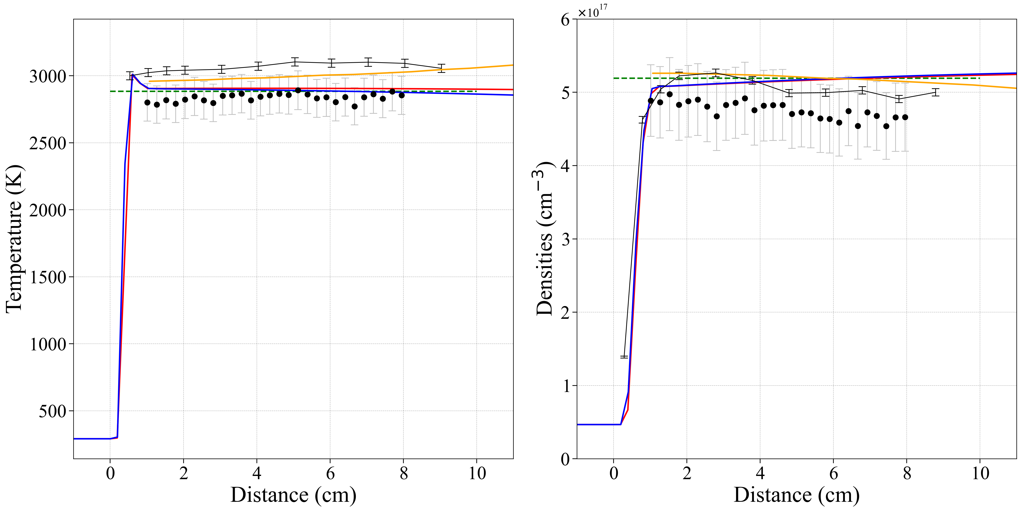
Comparison with Laser Absorption Spectroscopy measurements
Reacting case : v = 2.96 km/s
Frozen case : v = 2.56 km/s
Frozen
Frozen
LASTA
LASTA (cruden)
Cruden
Cruden
Johnston
Johnston
Circle: Laser Absorption
Line: Emission
Temperature
CO₂
Temperature
CO₂
T and n extracted from OES measurements by fitting spectra using NEQAIR
Reacting case:
  Emission closer to Cruden mechanism, Absorption to Johnston
  Discrepancies from Boundary Layer absorption on the LAS measurements, error under-estimated on Emission
Frozen cases:
  Absorption temperature in agreement with CEA/Frozen but below LASTA
  Emission temperature above frozen and close to LASTA prediction
Temperature measured using Laer Absorption are up to 10% lower than Emission measurements
CO₂ number density profiles in good agreement (5%)

Slide 25
Conclusions
Test series aimed at reproducing Mars2020 atmospheric entry was performed
Emission measurements were compared with DPLR/NEQAIR simulations using three kinetic models
  Below 2.7 km/s: Chemistry frozen on experimental timescale
  Above 2.7 km/s: Radiance lies between the kinetic models
Error for predicting flight based on STIB
  At 1.1 Torr (92s) : -3/+2% (Windside) or -6.5/+2% (Leeside) for Johnston/Cruden models
  At 1.5 and 2 Torr (>100 s): could not estimate due to frozen chemistry
Shock deceleration impacts post-shock radiation profiles
  Predicted by Lagrangian code LASTA
  Explains up to 15% increase in frozen radiance
Comparison with simultaneous laser absorption measurements:
  Temperature profiles within 10% agreement
  Number density profiles within error (<5% difference)

Slide 26
Total error on backshell location (1.1 Torr)
MTB08/9
MTB07
Velocity range: 3-3.2km/s (MTB08) and 2.7-3 km/s (MTB08)
Particle time: 1-8 ms and 1-7 ms
Profiles fitted using exponential curve and extrapolated
to 8 and 7 ms
Estimated total error:
  At MTB08 location: -3% (Johnston), +2 % (Cruden)
  At MTB07 location: -6.5% (Johnston), +2 % (Cruden)
~0.4 ms

Slide 27
Test 64A matrix
Densities were chosen corresponding to near peak heating, ½ of peak heating and at end of heat pulse
The velocity range is swept to cover most of the histogram
A follow up test in the low-density EAST tube (64B) will study earlier time points

Slide 28
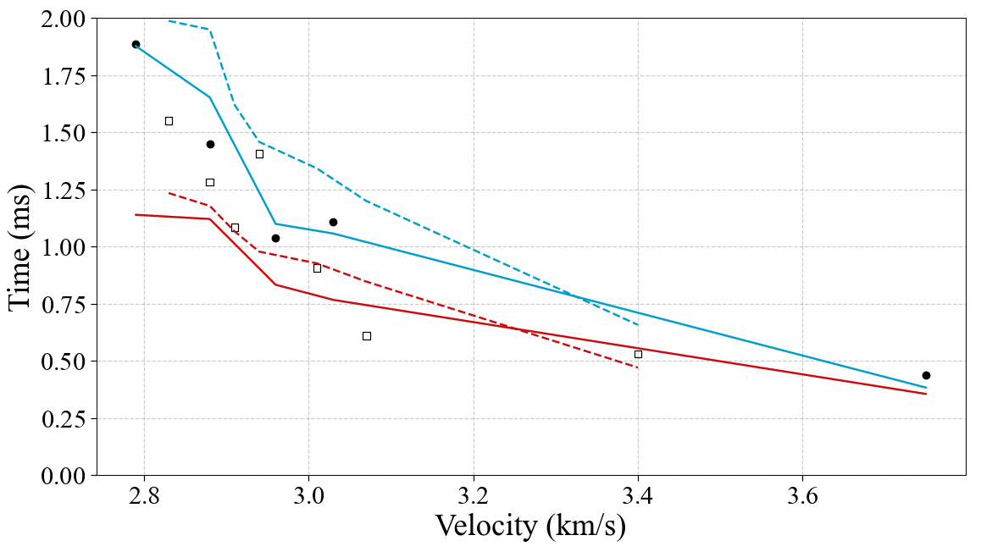
Extrapolating to larger test time (1.1 Torr)
MTB08: 3.0-3.2 km/s, 1-8 ms
MTB07: 2.7-3.0 km/s, 1-7 ms
Relaxation time
3.0-3.2 km/s
1-8 ms
Solid: 4.2 μm
Dash: 2.7 μm
Cruden
~0.4 ms
Johnston
Measured radiance profiles are extrapolated using an exponential curve
Relaxation time to equilibrium extracted from the extrapolation:
  4.2 μm: relatively good agreement with Cruden
  2.7 μm: lie in between the models, closer to Johnston
  Johnston model predicts a faster relaxation to equilibrium

