Slide 1
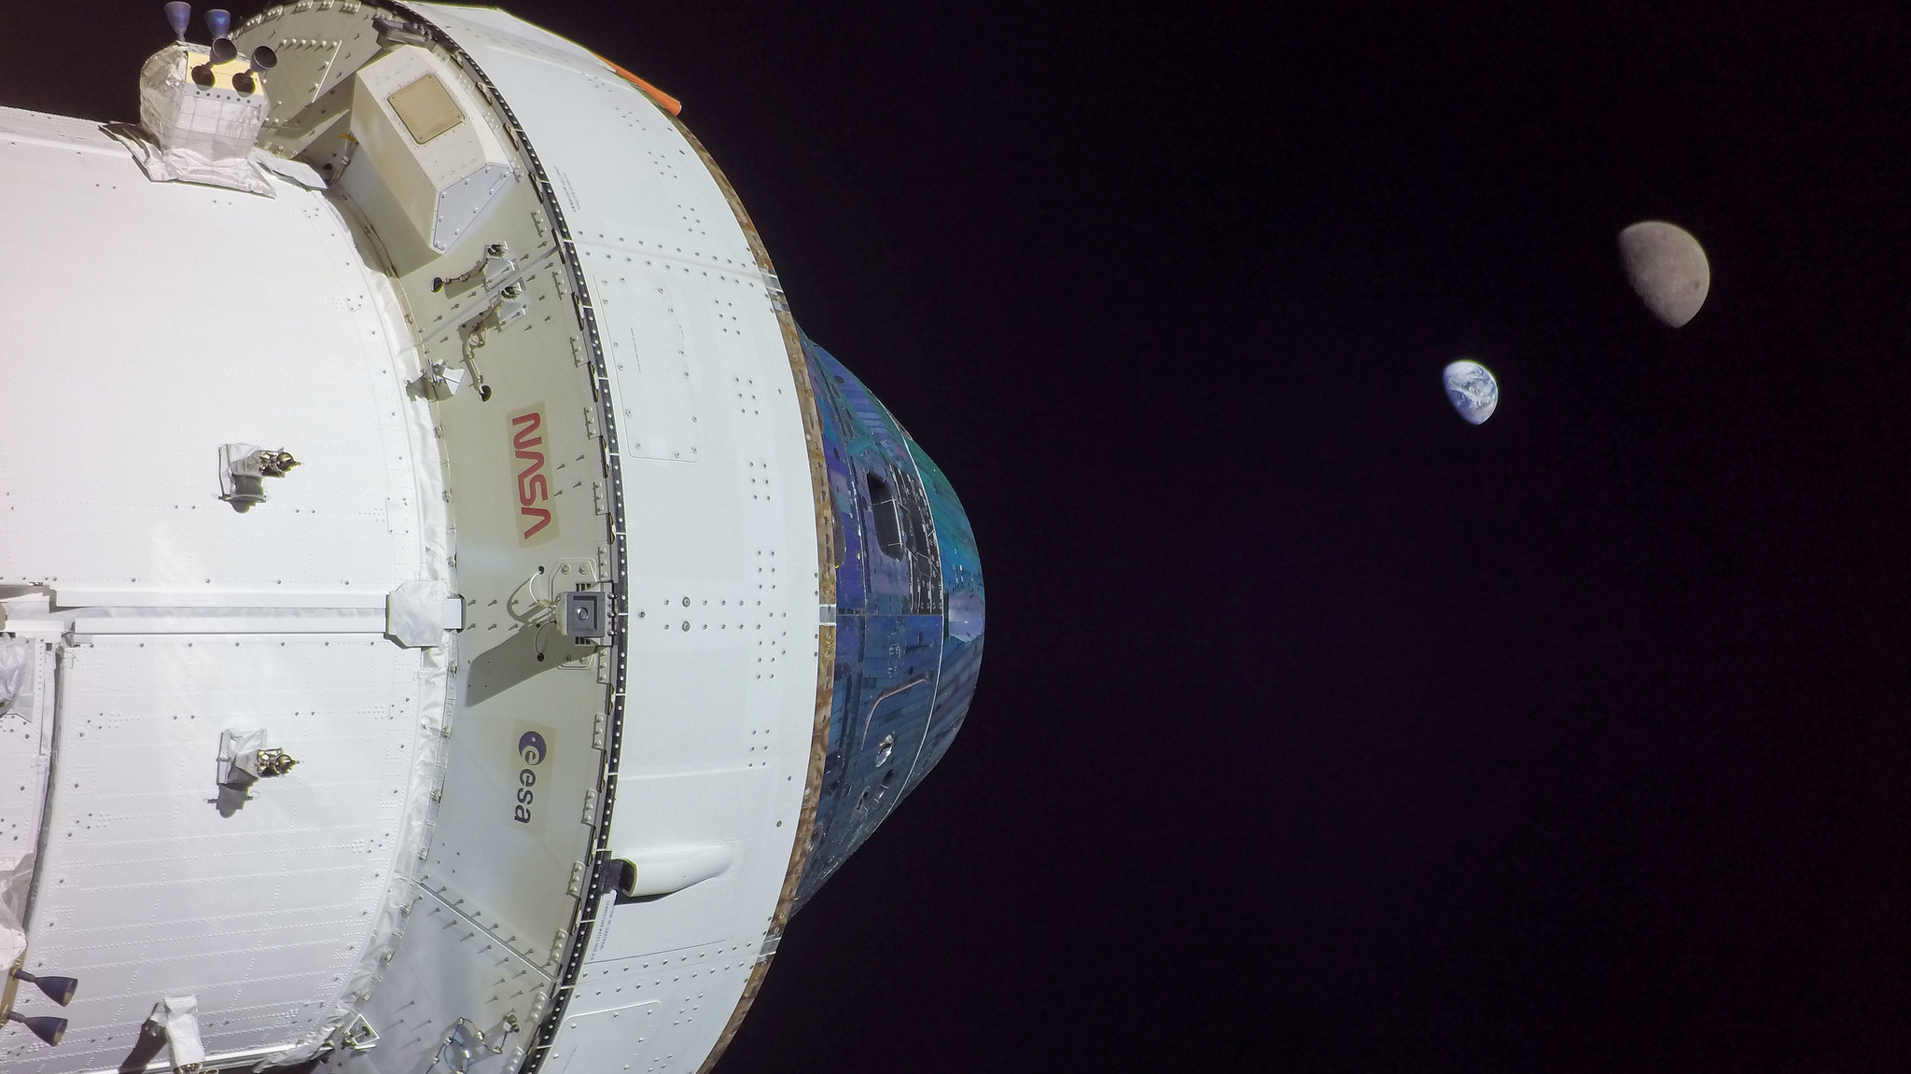
Extended Kalman Filter Performance on the Artemis-1 Mission
Jacob Sullivan, NASA/EG6
Christopher D’Souza, NASA/EG6
45th AAS GN&C Conference, February 3-8, 2023

Slide 2
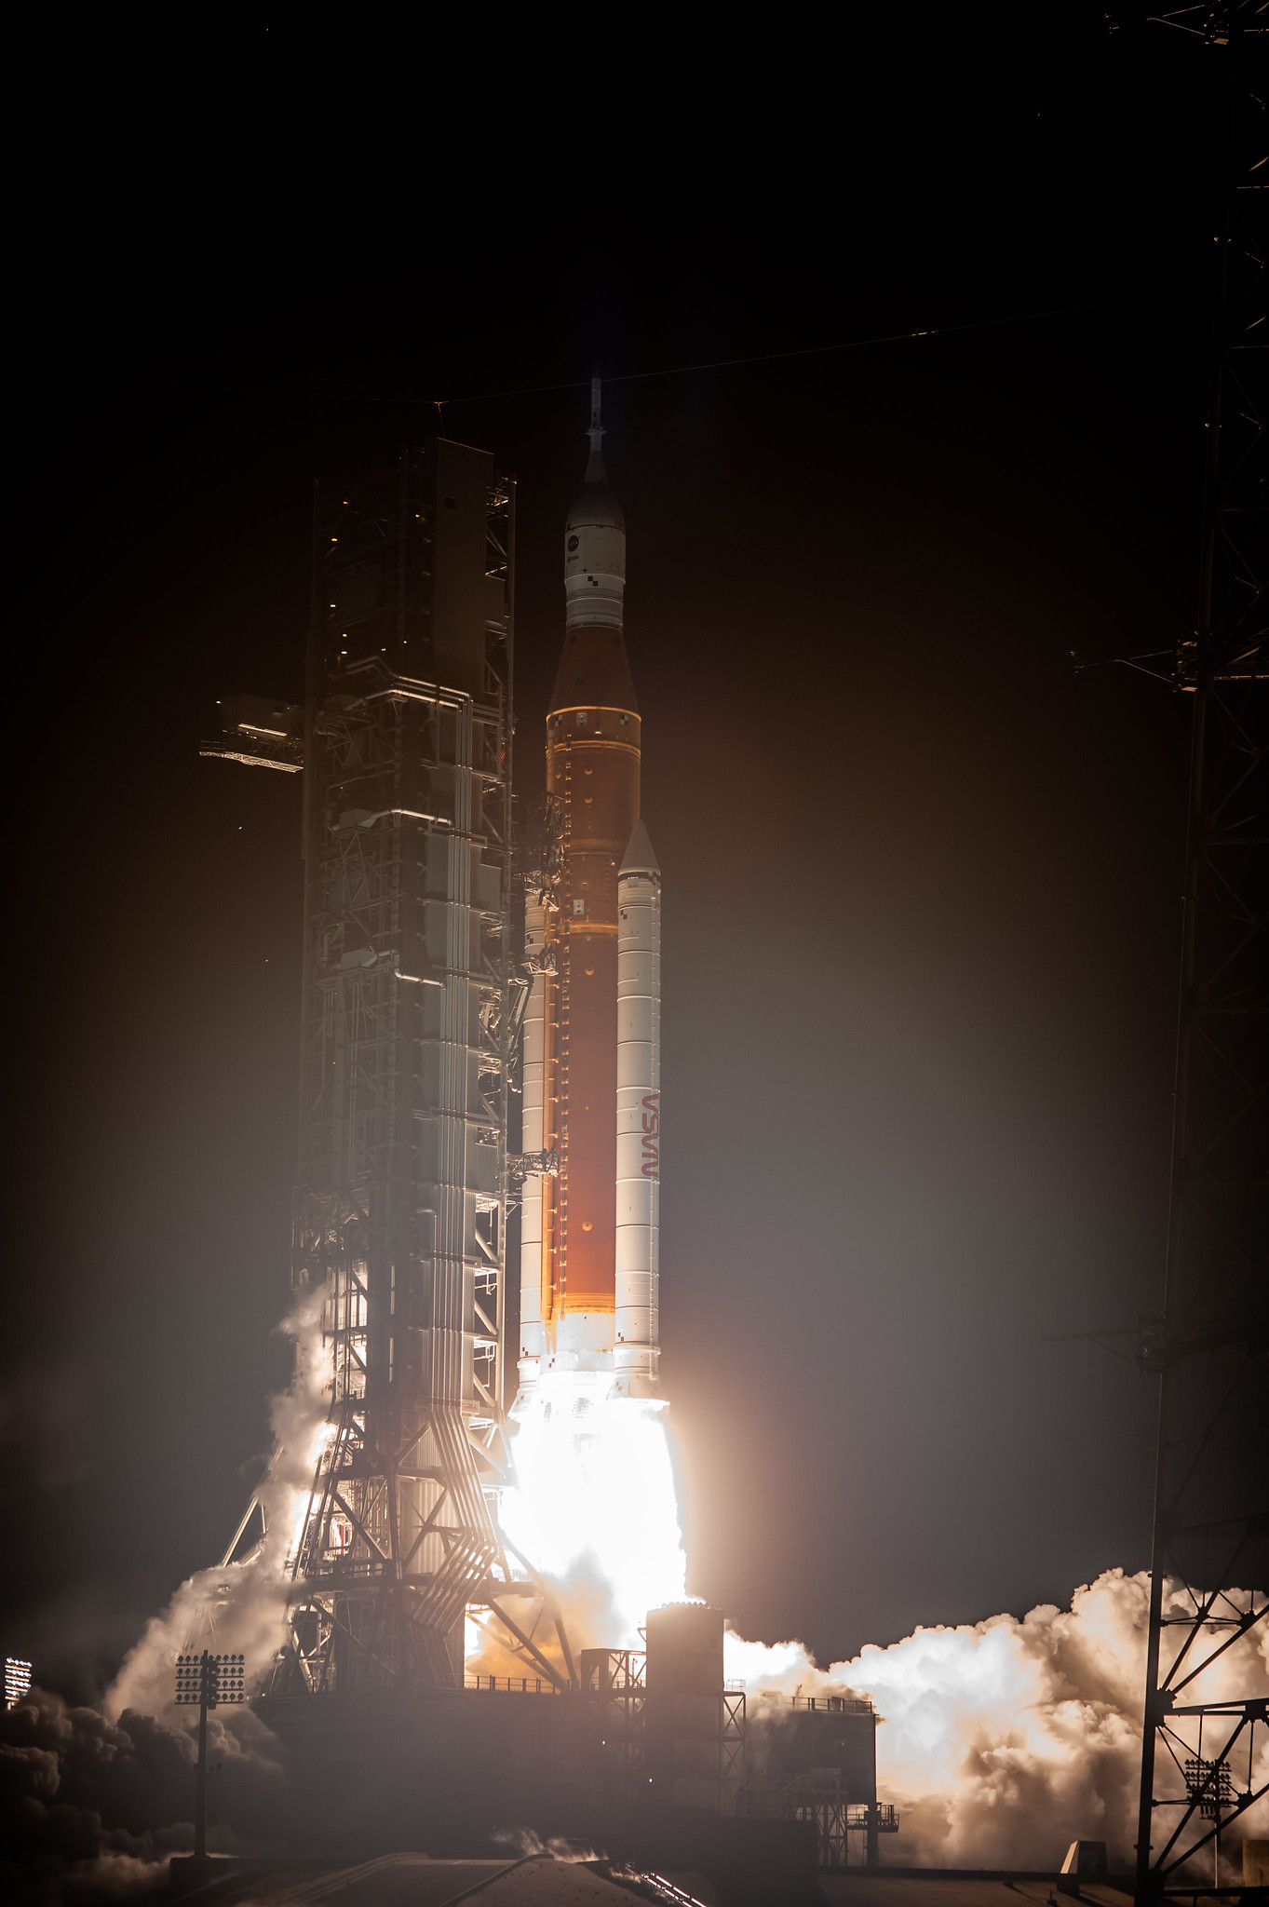
Overview
Artemis-1 Mission Summary
Orion Absolute Navigation (NVA) System
  NVA architecture
  Sensor usage
EKF Implementation Considerations
  Efficiency and robustness
  State-space partitioning
  Attitude filter
Mission performance
  Pre-launch
  Ascent/Outbound Orbit
  Cislunar flight
  Inbound/Entry

Slide 3
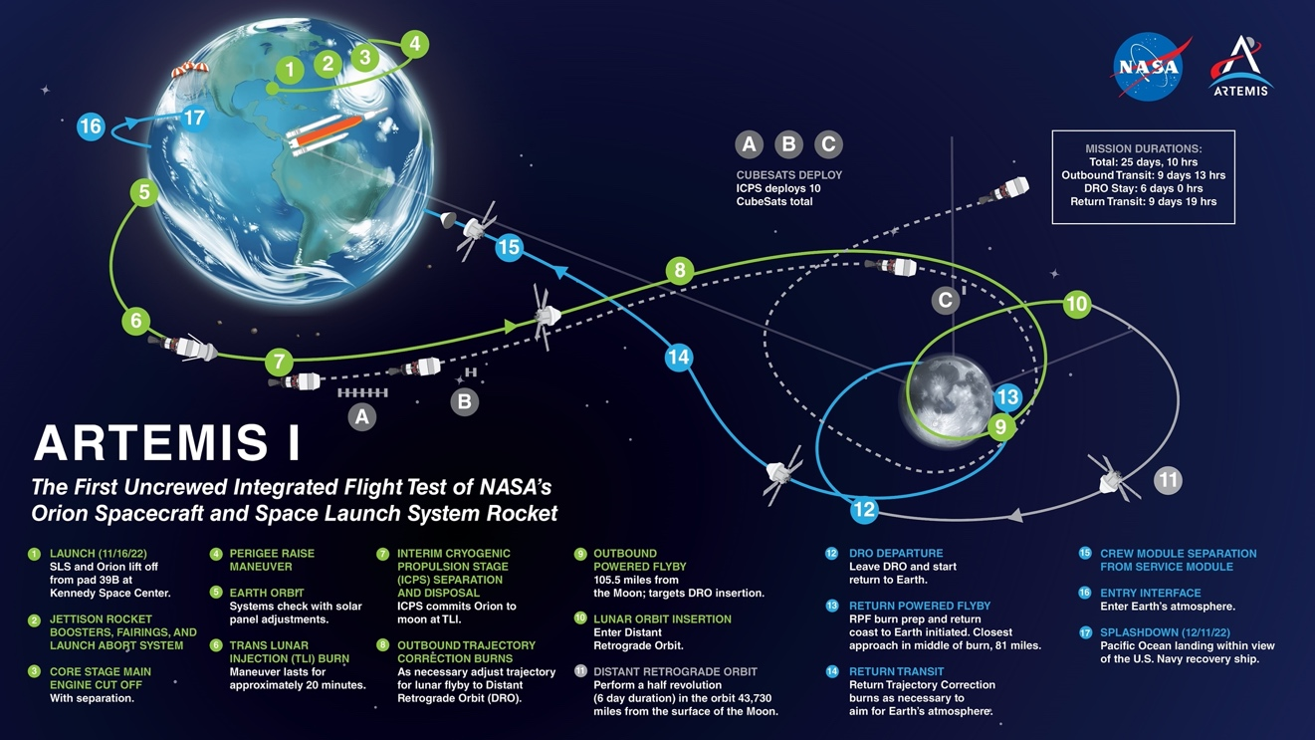
Artemis-1 Mission Overview
Launch
  11/16/2022, 6:47:44 UTC
LEO Checkout
  Perigee Raise Maneuver (PRM)
Trans-Lunar Injection (TLI)
  Interim Cryogenic Propulsion System (ICPS) Disposal
  Outbound Trajectory Correction (OTC) Burns
Outbound Powered Flyby (OPF)
Distant Retrograde Orbit (DRO)
  Orbit Maintenance (OM) Burns
Return Powered Flyby (RPF)
  Return Trajectory Correction (RTC) Burns
Entry
Splashdown
  12/11/2022, 17:40:30 UTC

Slide 4
Absolute Navigation (NVA) Subsystem
Running Pre-launch to Post-splashdown (Never don’t navigate!)
4 iterations of Multiplicative Extended Kalman Filter (MEKF)
  Atmospheric Extended Kalman Filter (ATMEKF)
    Prelaunch, Ascent, Entry
  Earth Orbit Extended Kalman Filter (EOEKF)
    Outbound/Inbound (within GPS constellation)
  Cislunar Extended Kalman Filter (CLEKF)
    Translation beyond GPS constellation
  Attitude Extended Kalman Filter (ATTEKF)
    Exo-atmospheric flight
Split design allows for different filters to process different sensors
  Pad position, GPS, star tracker, ground update, optical navigation…
  Reduce software complexity and allow re-use of algorithms

Slide 5
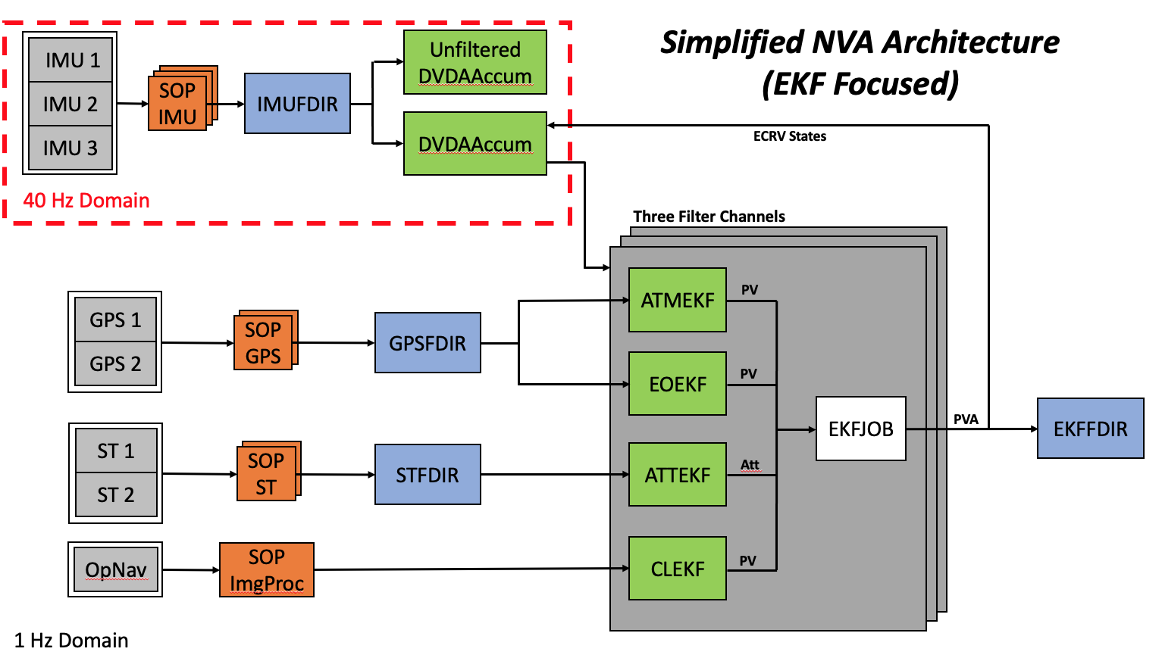
NVA Architecture Diagram

Slide 6
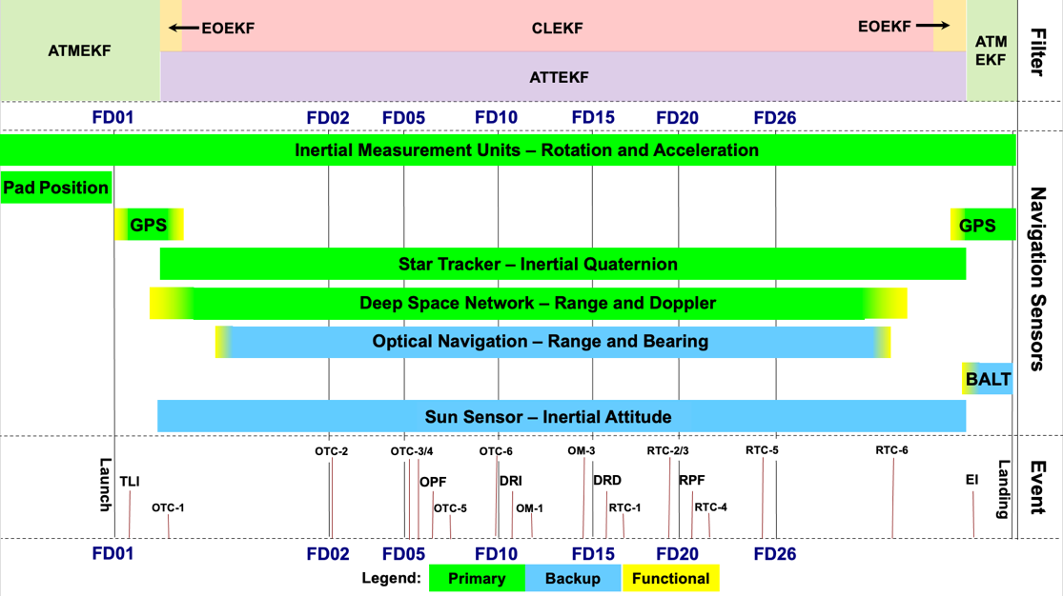
EKF Moding and Sensor Utilization

Slide 7
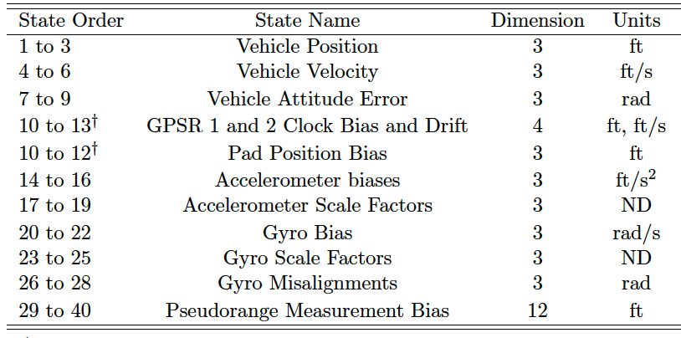
EKF Implementation Considerations
Filters designed for computational efficiency and robustness
  Hybrid linear/extended Kalman filter update
  U-D-U formulation with rank-one updates
  First-order approximations
  Buffering for latent measurements
Partitioned state space
  Dynamics states
  Filter-specific parameters (ECRVs)
Measurement editing/underweighting
ATMEKF State Vector
Dynamics
ECRV
Parameters

Slide 8
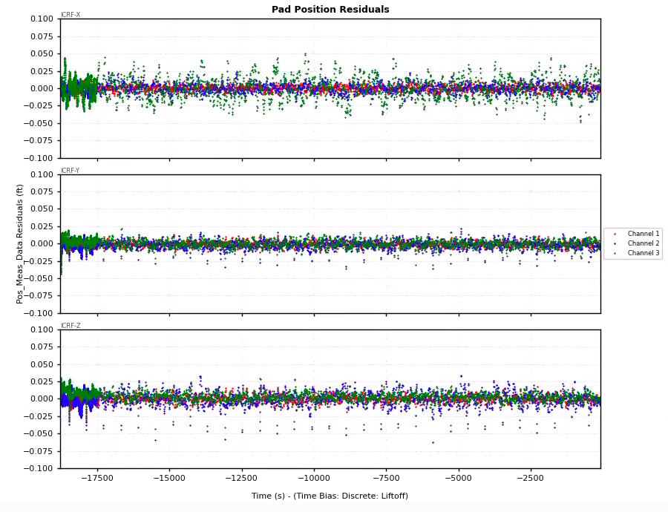
Prelaunch – Pad Position Measurements
Surveyed pad position mapped to inertial frame
Survey error bookkept as an ECRV state (Pad position bias)
Provides estimates of pre-launch attitude errors and IMU error ECRV states

Slide 9
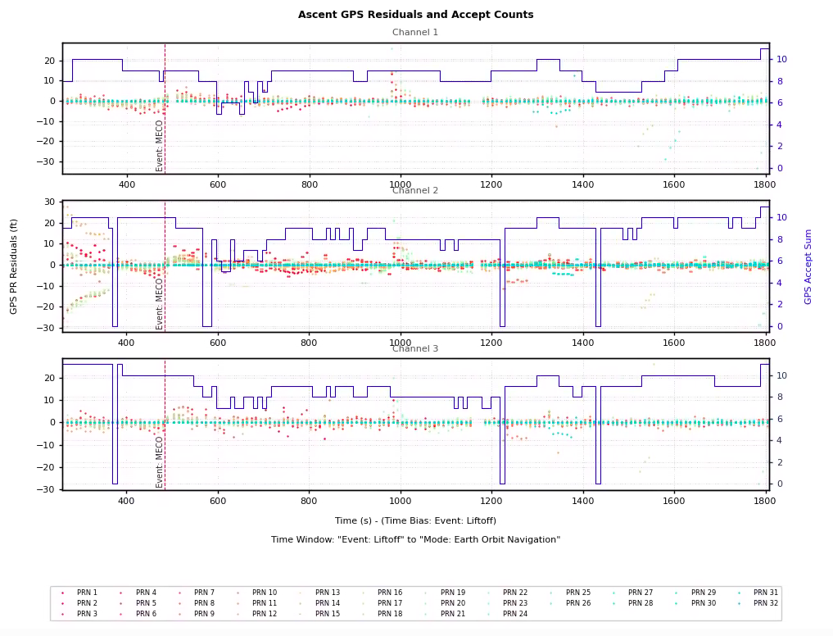
Ascent – GPS Measurements
LAS jettison occurred at L+207 sec
GPS acquires and filters begin processing pseudorange measurements within 1 minute
Some dropouts in CH2 but normally between 5-11 SVs processed
Residuals (and pseudorange biases) stabilize quickly and appear well-distributed

Slide 10
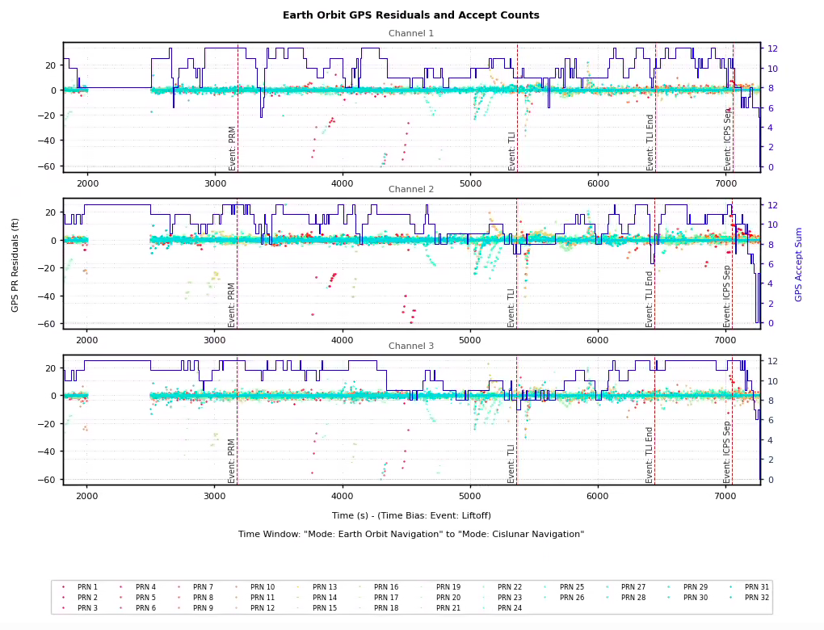
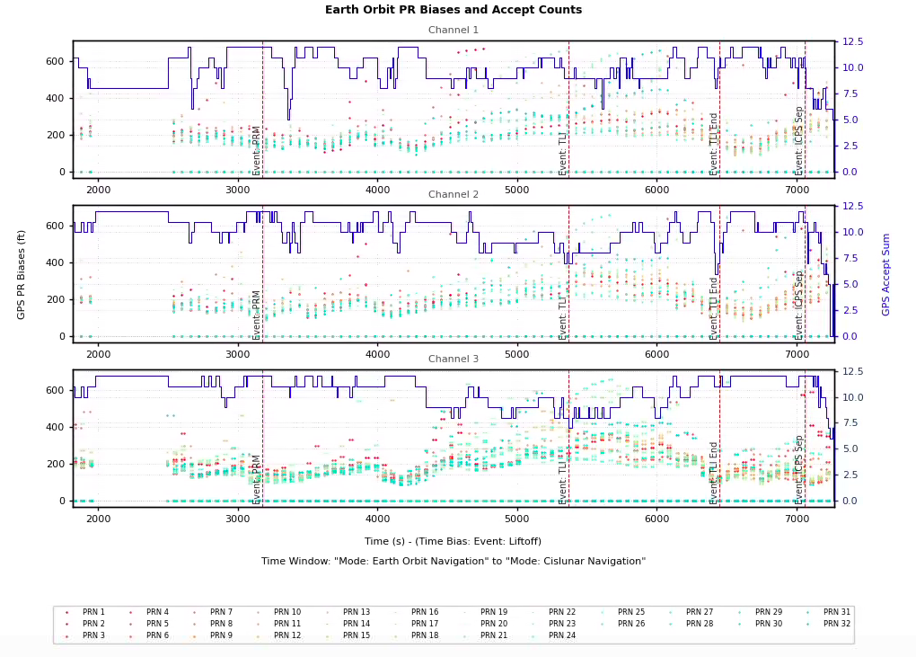
Outbound Orbit – GPS Measurements
Continual processing of of 8-12 SVs through ICPS separation event

Slide 11
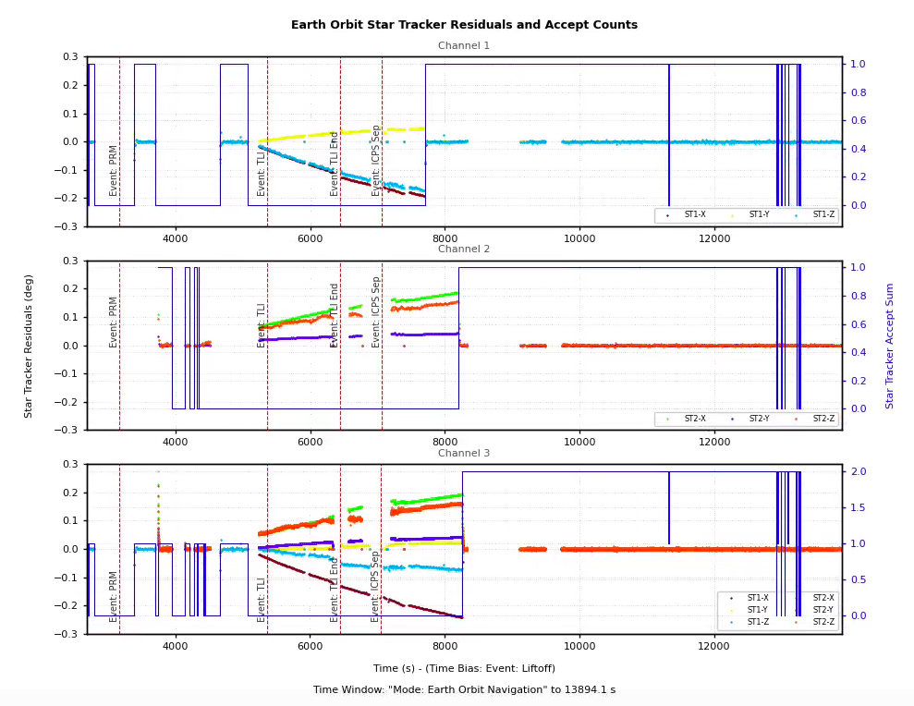
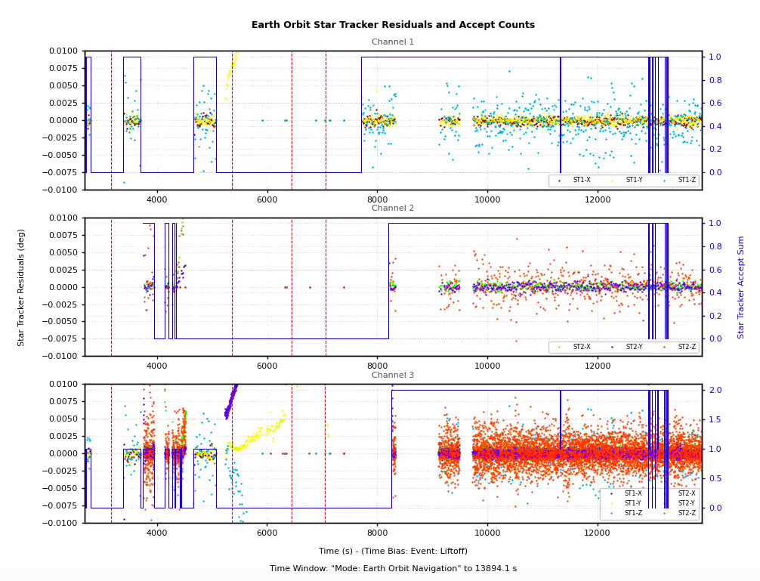
Outbound Orbit – Star Tracker Measurements
Initial growing pains with ST processing from debris cloud prior to ICPS separation

Slide 12
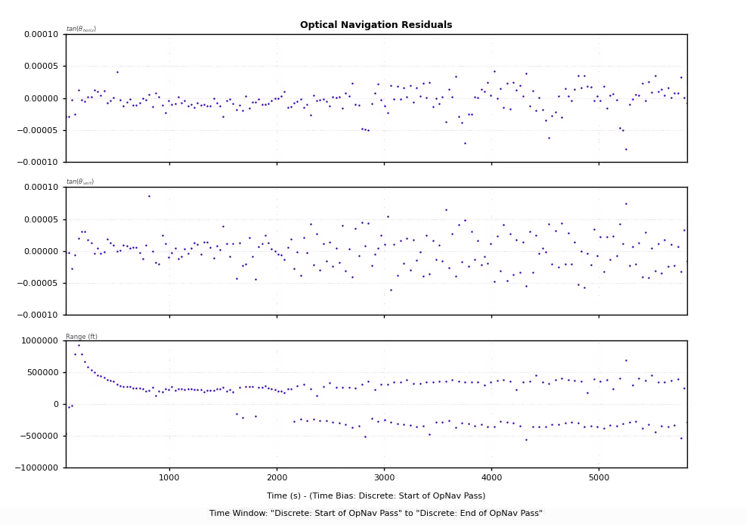
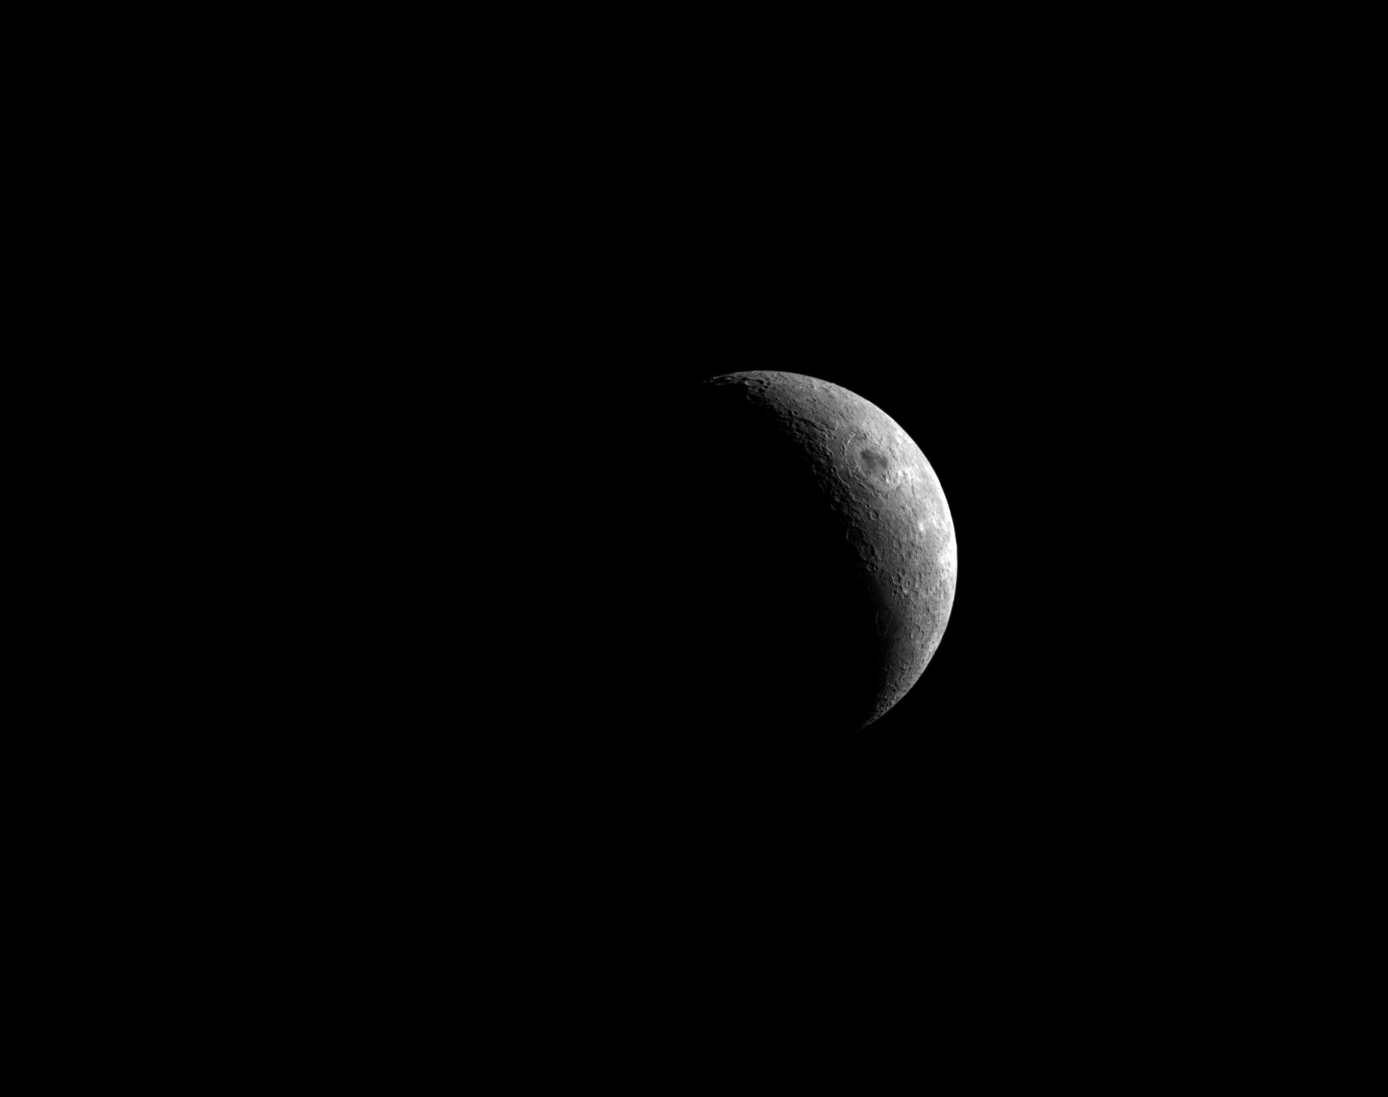

Cislunar – OpNav Measurements
Translatonal state during exoLEO flight updated via ground update (state replacement) or Optical Navigation (OpNav)
Camera images provide tangent angles to centroid of body and range from apparent diameter
OpNav Earth Certification Pass

Slide 13
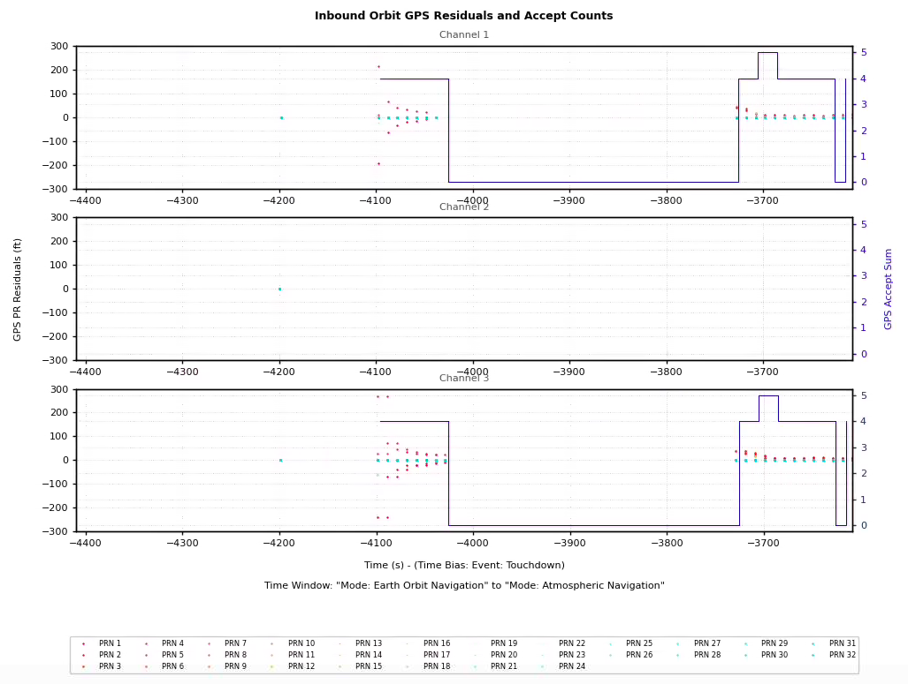
Inbound Orbit – GPS Measurements
Navigation system moded to EOEKF as vehicle nears GPS constellation
Channels 1 and 3 (both using GPSR 1) acquire early and begin to converge with 4 satellites before dropping out
Channel 2 (using GPSR 2) does not acquire for another half-hour

Slide 14
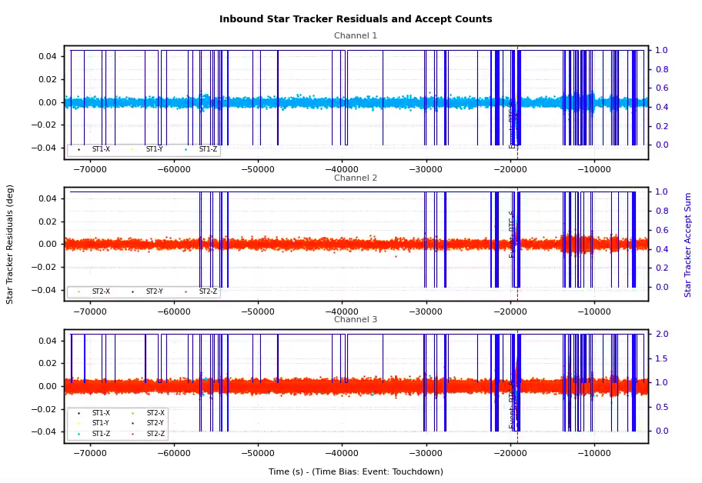
Inbound Orbit – Star Tracker Measurements
Star trackers processed successfully across entire 25.5-day mission
Momentary “dropouts” due to RCS thruster firings
Residual magnitudes were consistent with outbound steady-state and across the cislunar phase

Slide 15
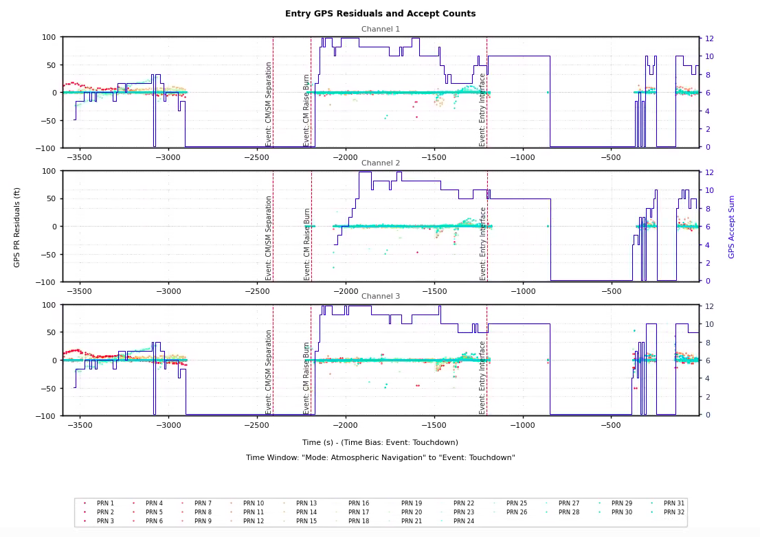
Entry – GPS Measurements
Channels 1 and 3 continue processing and gradually pick up more SVs
Measurement processing drops out until after the CM Raise Burn
  GPSR 2 acquires satellites
No processing after EI through skip entry until the last few minutes of descent and landing

Slide 16
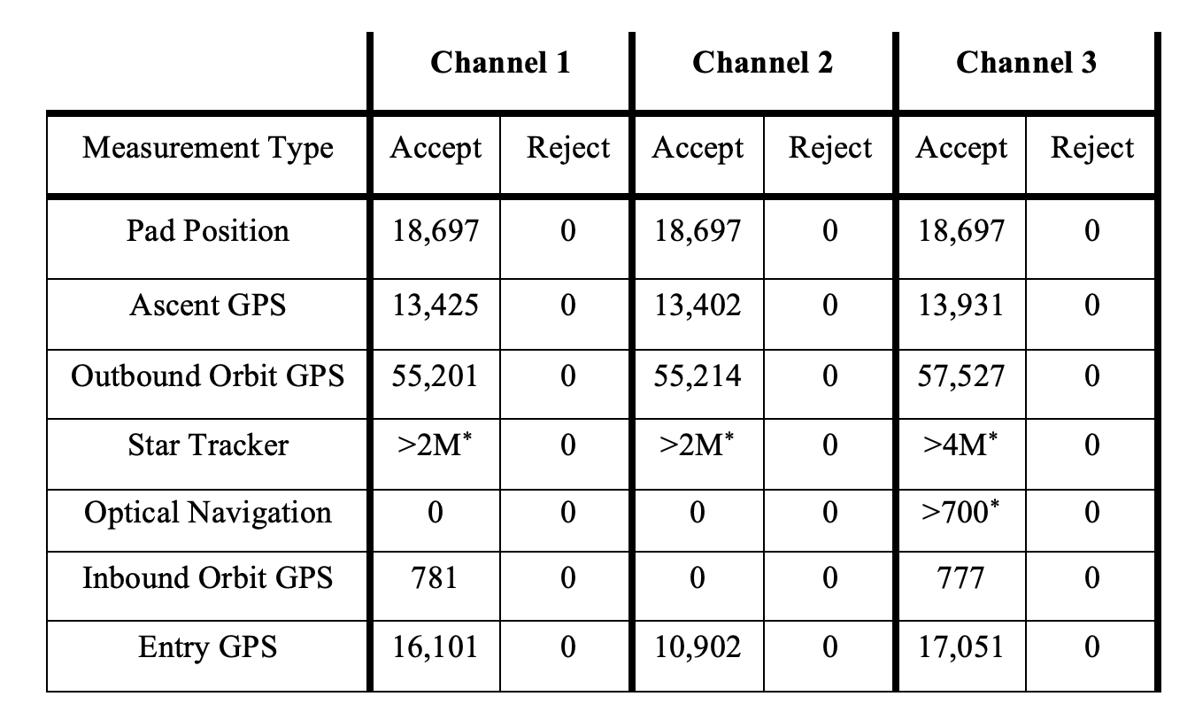
Measurement Processing Summary
1 Hz processing over 25.5 days accumulated millions of measurements
No measurement rejections
Some GPS measurements underweighted on first/last flight days
Measurement Counts over Artemis-1 Mission
*Precise count of total accepted measurements requires additional post-flight data processing

Slide 17
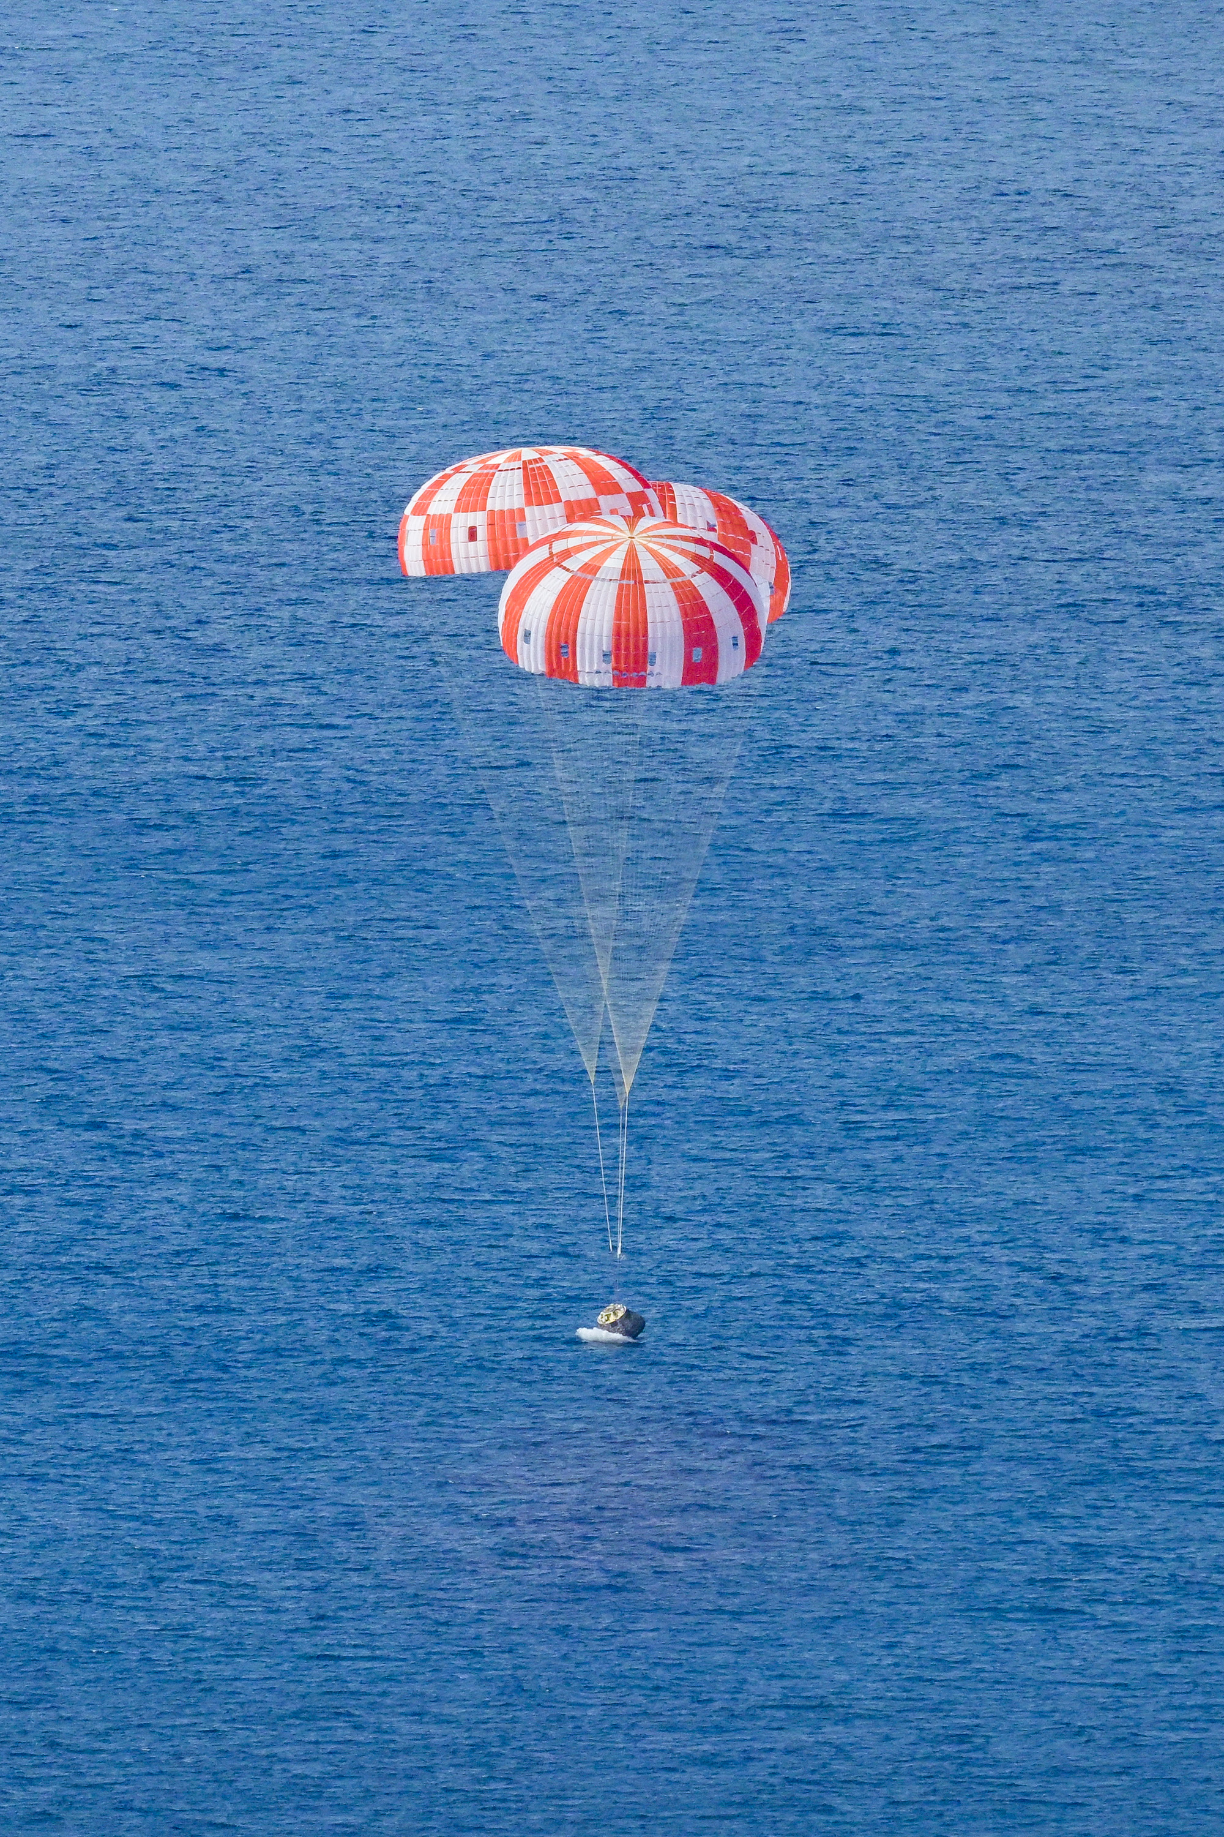

Summary
Navigation system performed magnificently during all phases of mission
  EKFs processed measurements without issues or rejections
Optical Navigation certified on outbound leg
  Available in case of permanent communication loss
Increased confidence in GN&C system
Valuable data for Artemis-2 in 2024
Questions?

