Slide 1
Global analysis of nonlinear second-mode development in a Mach-6 boundary layer from high-speed schlieren data
SciTech Transition Open Forum
Cole Sousa¹, Richard Kennedy¹, Rudolph King², Brett Bathel³, Joshua Weisberger³, and Stuart Laurence¹
¹University of Maryland, College Park, Department of Aerospace Engineering
²NASA Langley Research Center, Flow Physics and Control Branch
³NASA Langley Research Center, Advanced Measurements and Data Systems Branch

Slide 2
Overview
Pointwise Temporal Signal Reconstruction
Global Modal Reduction Techniques
Spectral Proper Orthogonal Decomposition
Bispectral Mode Decomposition
Model and Test Conditions
Results
Power-Spectral Densities
Spectral Proper Orthogonal Decomposition
Bispectral Mode Decomposition

Slide 3
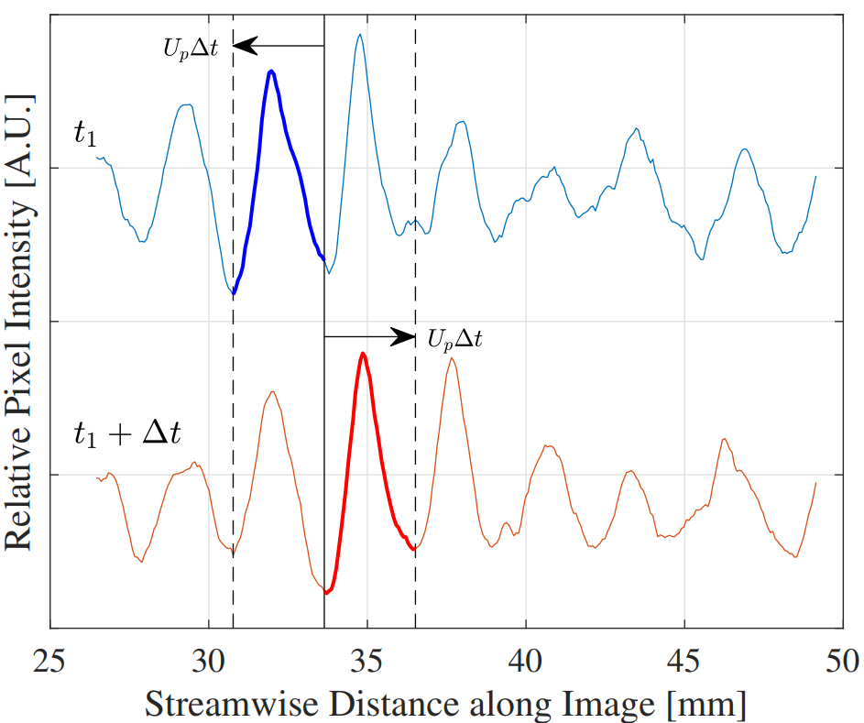
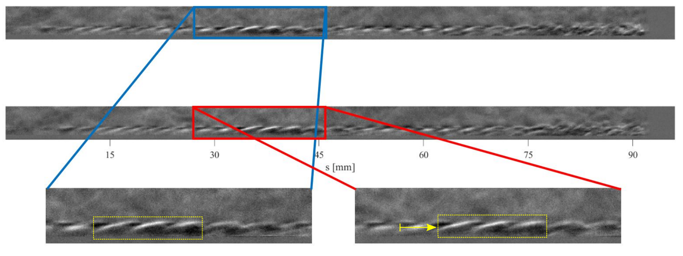
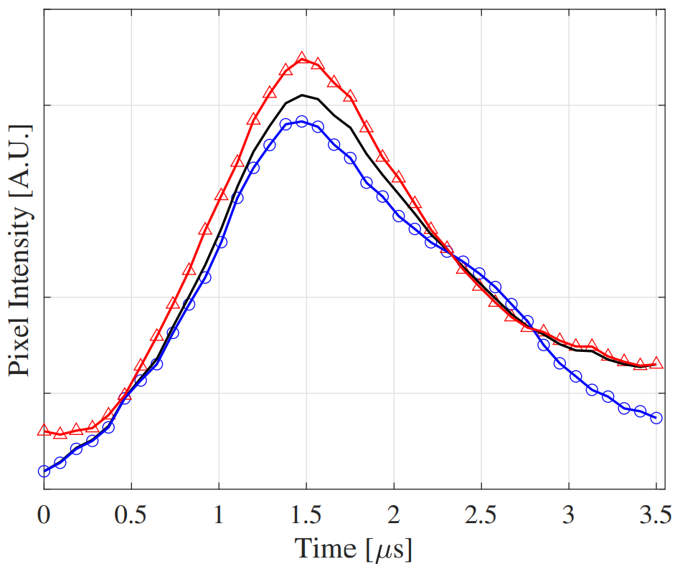
Time-Resolved Pixel Intensity Signal Reconstruction
X
Info about to pass over X
Schlieren pointwise signal reconstruction
Utilizes spatially available data in the images
Increases the effective frame rate
Enables analysis of second-mode harmonics
schlieren data along the same row
Info that has just passed over X
$$t_{1}$$
$$t_{1}+∆t$$
Schlieren images from straight cone boundary layer at Mach 6

Slide 4
Time-Resolved Pixel Intensity Signal Reconstruction
X
Schlieren pointwise signal reconstruction
Utilizes spatially available data in the images
Increases the effective frame rate
Enables analysis of second-mode harmonics
Accuracy of the method relies on
An approximately constant propagation speed of all relevant content
Sufficiently high frame-rate, such that second-mode wave-packets do not evolve significantly between sequential images
A frame rate of ~1/2 the fundamental second-mode frequency is recommended
Original application
Select interrogation points in the BL along the maximum second-mode disturbance streamline
Various global modal reduction techniques have since been developed
Spectral Proper Orthogonal Decomposition
Bispectral Mode Decomposition
This motivates a generalization of the reconstruction technique to the full schlieren field of view

Slide 5
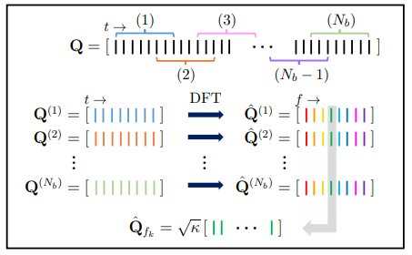
Spectral Proper Orthogonal Decomposition (SPOD)
Towne et al. (2018)
SPOD is an estimation of orthogonal eigenmodes that depend on space and time
Eigenmodes are the left and right eigenvectors of the Cross-Spectral Density matrix for each frequency bin of the DFT of the Data Matrix
Each column vector of the data matrix, Q, contains the pixel intensities of a single image
CSD = ${\hat{Q}}_{fk}{\hat{Q} }_{fk}^{T}$
SPOD
SPOD Mode 1 at 286 kHz

Slide 6
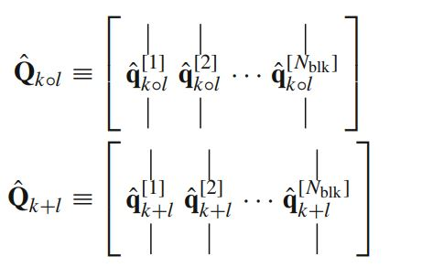
Bispectral Mode Decomposition (BMD)
Schmidt (2020)
$${\hat{q}}_{k∘l}= \hat{q}(x,f_{k})∘\hat{q}(x,f_{l})$$
$${\hat{q}}_{k+l}= \hat{q}(x,f_{k+l})$$
Extension of SPOD to higher-order spectra
Estimates the Bispectral Density Matrix, B = ${\hat{Q} }_{k∘l}^{H}{\hat{Q}}_{k+l}$
Produces coherent structures associated with triadic interactions (bispectral modes) and maps indicating regions of triadic interaction activity (nonnormalized bispectral quantity)
Bispectral Mode at 593 kHz
Interaction Map

Slide 7
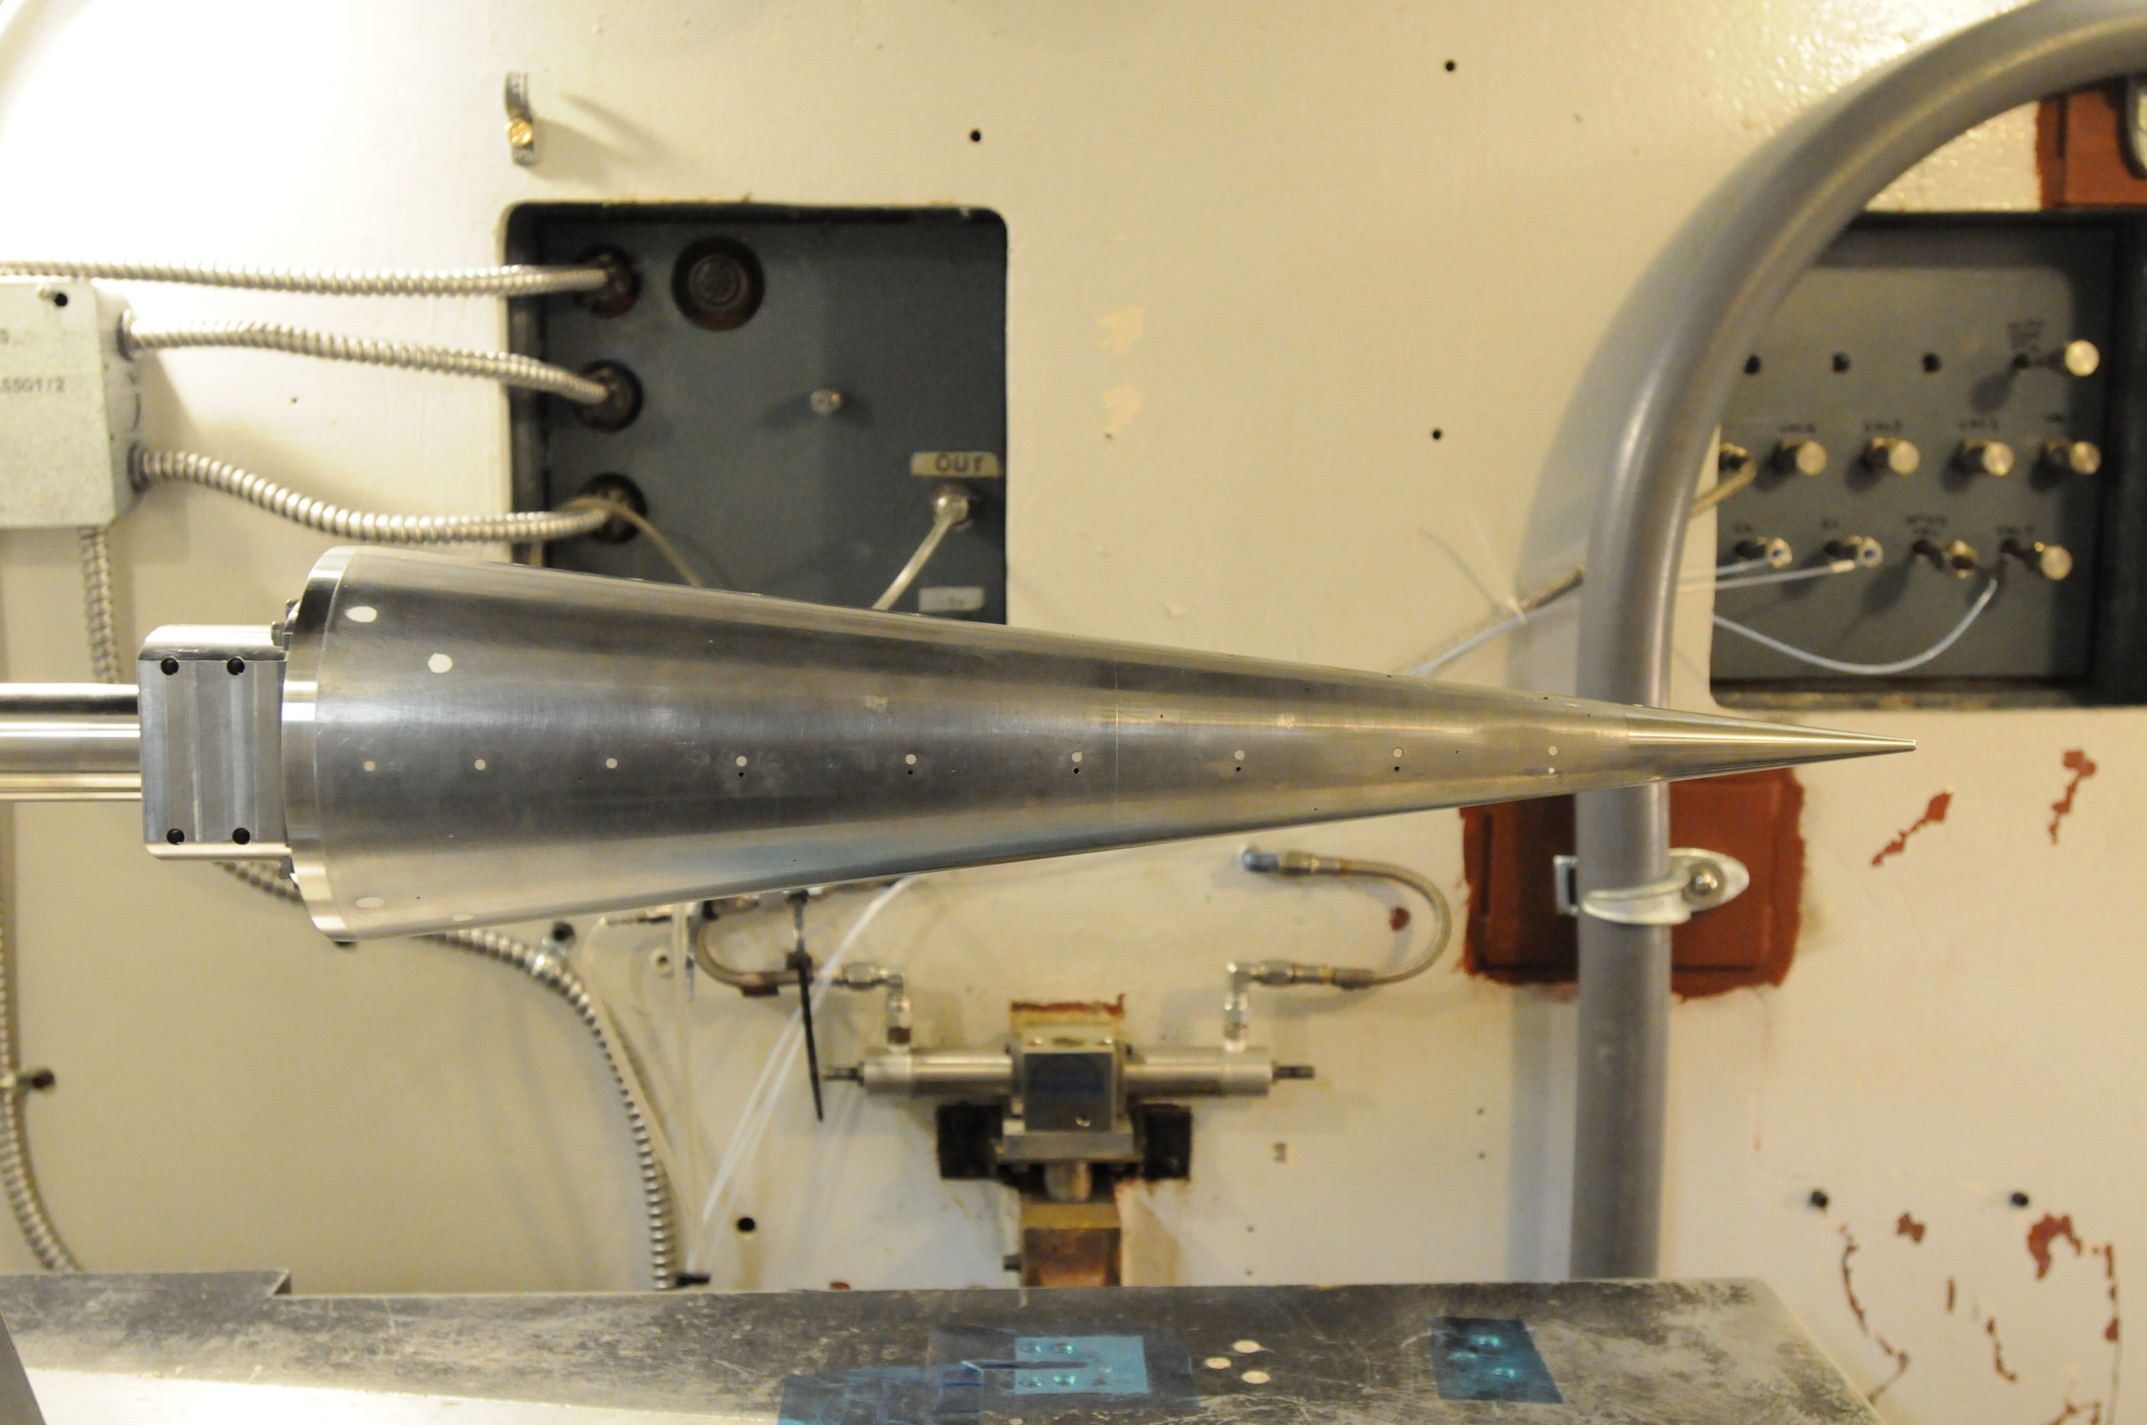
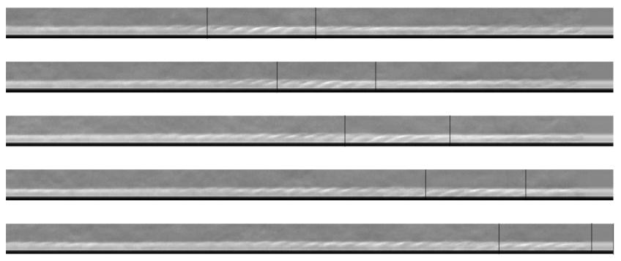
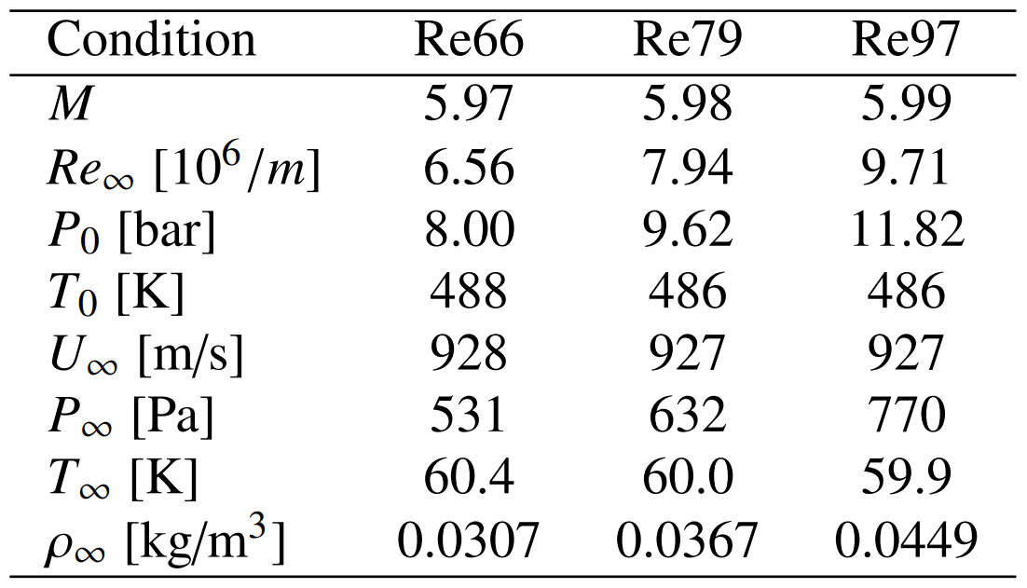
Model and Flow Conditions
Mach 6 experiments on sharp nose-tip T9 Cone
Nose Tip Radius: 0.006”
All data captured with calibrated schlieren imagery
Frame Rate: 286 kHz
Field of View: 285-385 [mm] from nose tip
Resolution: 1280 x 64 pix
Scale: 0.0756 mm/pix

Slide 8
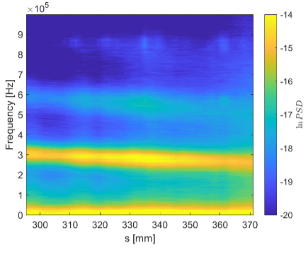
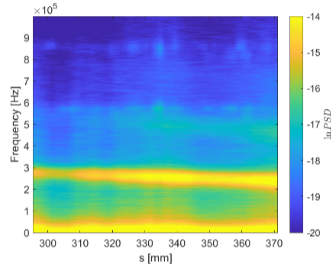
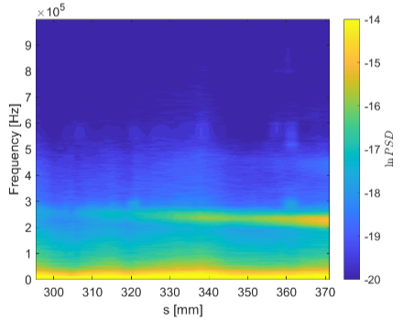
Power Spectral Density (PSD)
Re97
PSD at each condition shows significant growth in the fundamental and harmonic frequency bands
Re97
Re79
Re66

Slide 9
second-mode fundamental
Global PSD
second-mode 1st harmonic
second-mode fundamental
SPOD
second-mode 1st harmonic
second-mode 2nd harmonic
$f_{0}+f_{0}→2f_{0}$
${2f}_{0}+f_{0}→3f_{0}$
Pixel-wise autobicoherence
${3f}_{0}+f_{0}→4f_{0}$
$$f_{0}−f_{0}→0$$
$${2f}_{0}−{2f}_{0}→0$$

Slide 10
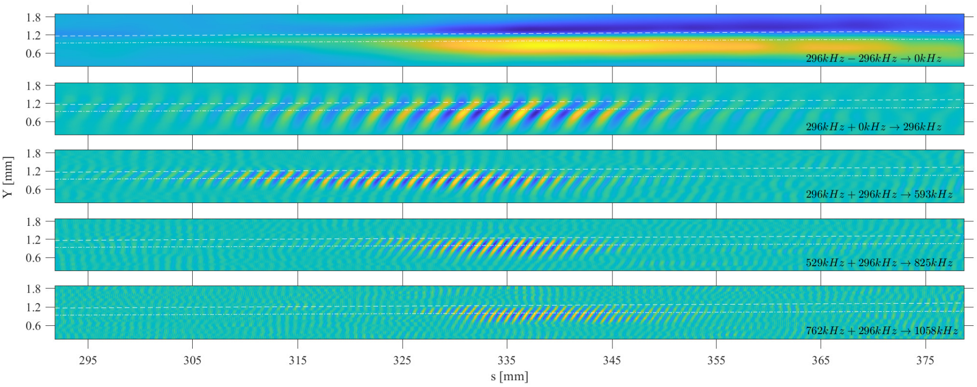
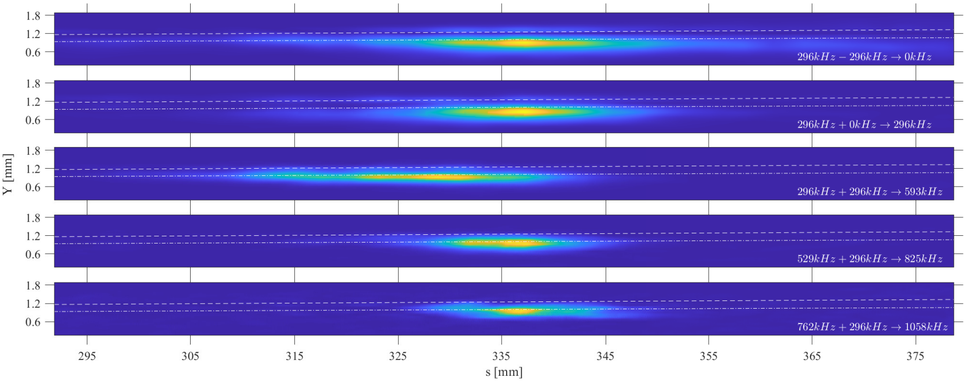
$$f_{0}−f_{0}→0$$
$f_{0}+0→f_{0}$
BMD
Bispectral Modes
$f_{0}+f_{0}→2f_{0}$
$${2f}_{0}+f_{0}→{3f}_{0}$$
$${3f}_{0}+f_{0}→{4f}_{0}$$
$$f_{0}−f_{0}→0$$
$f_{0}+0→f_{0}$
BMD
Interaction Maps
$f_{0}+f_{0}→2f_{0}$
$${2f}_{0}+f_{0}→{3f}_{0}$$
$${3f}_{0}+f_{0}→{4f}_{0}$$

Slide 11
Future Work
Manuscript submission to Experiments in Fluids (in review)
Application of analysis methodology to other experimental data sets
Straight cone at non-zero angles of attack
Flared cone (straight cone followed by axisymmetric compression)
Application of pixel-wise temporal reconstruction technique requires development of new techniques to handle disturbance streamlines that are no longer straight

