Slide 1
The Dragonfly Entry and Descent System
AIAA SciTech 2023
January 23, 2023
Michael Wright (Dragonfly EDL Phase Lead)
Karl Edquist (Dragonfly Deputy EDL Phase Lead)
Notes:
APL led
EDL Partners include : NASA ARC&LaRC, Lockheed Martin, U. Central Florida, Airborne Systems, Vorticity LTD, Spirit/FMI

Slide 2
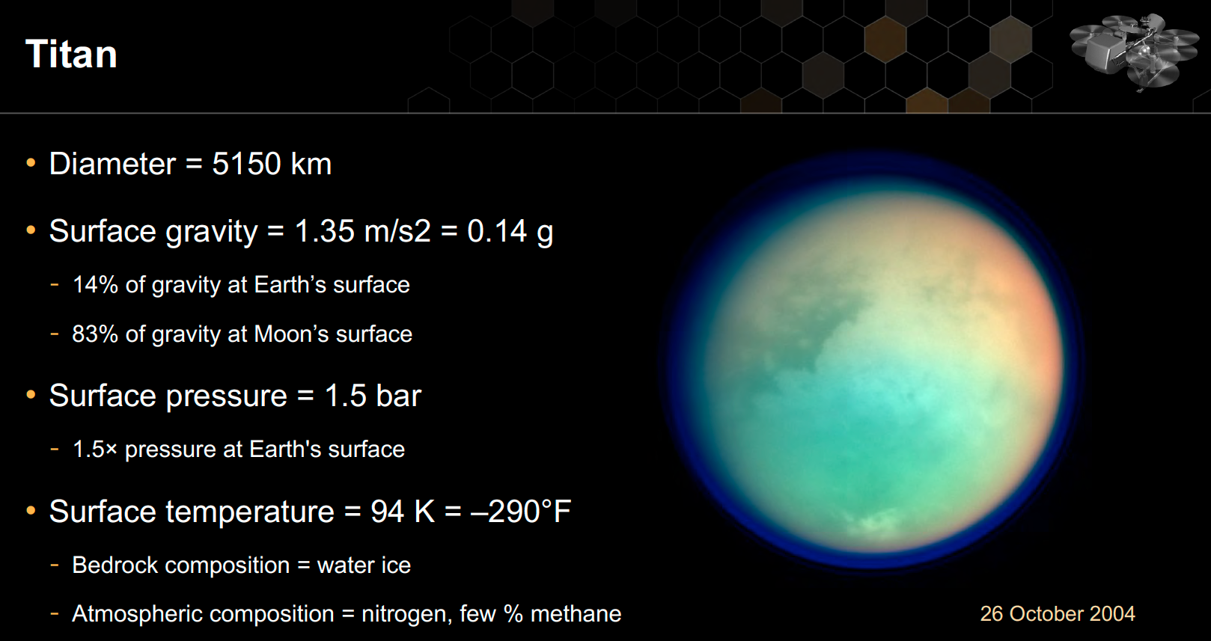
: Largest of Saturn’s Moons
(4× density)
2
Notes:
At Titan temperatures, water is a rock

Slide 3
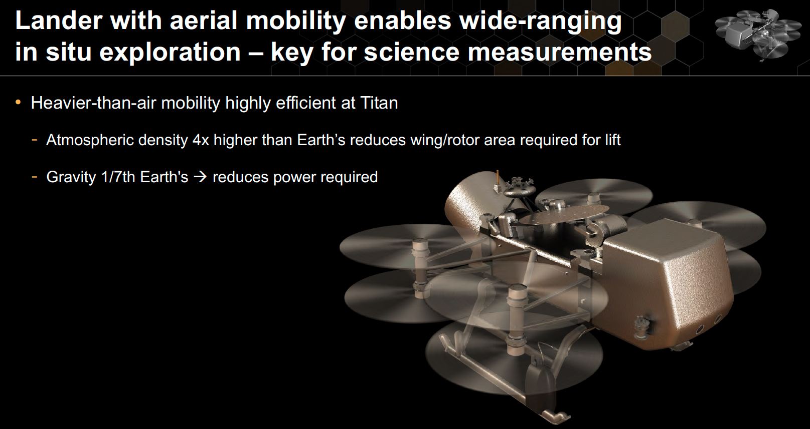
Launch: 2027
Arrival: 2034
3

Slide 4
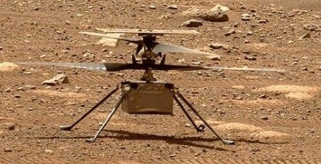
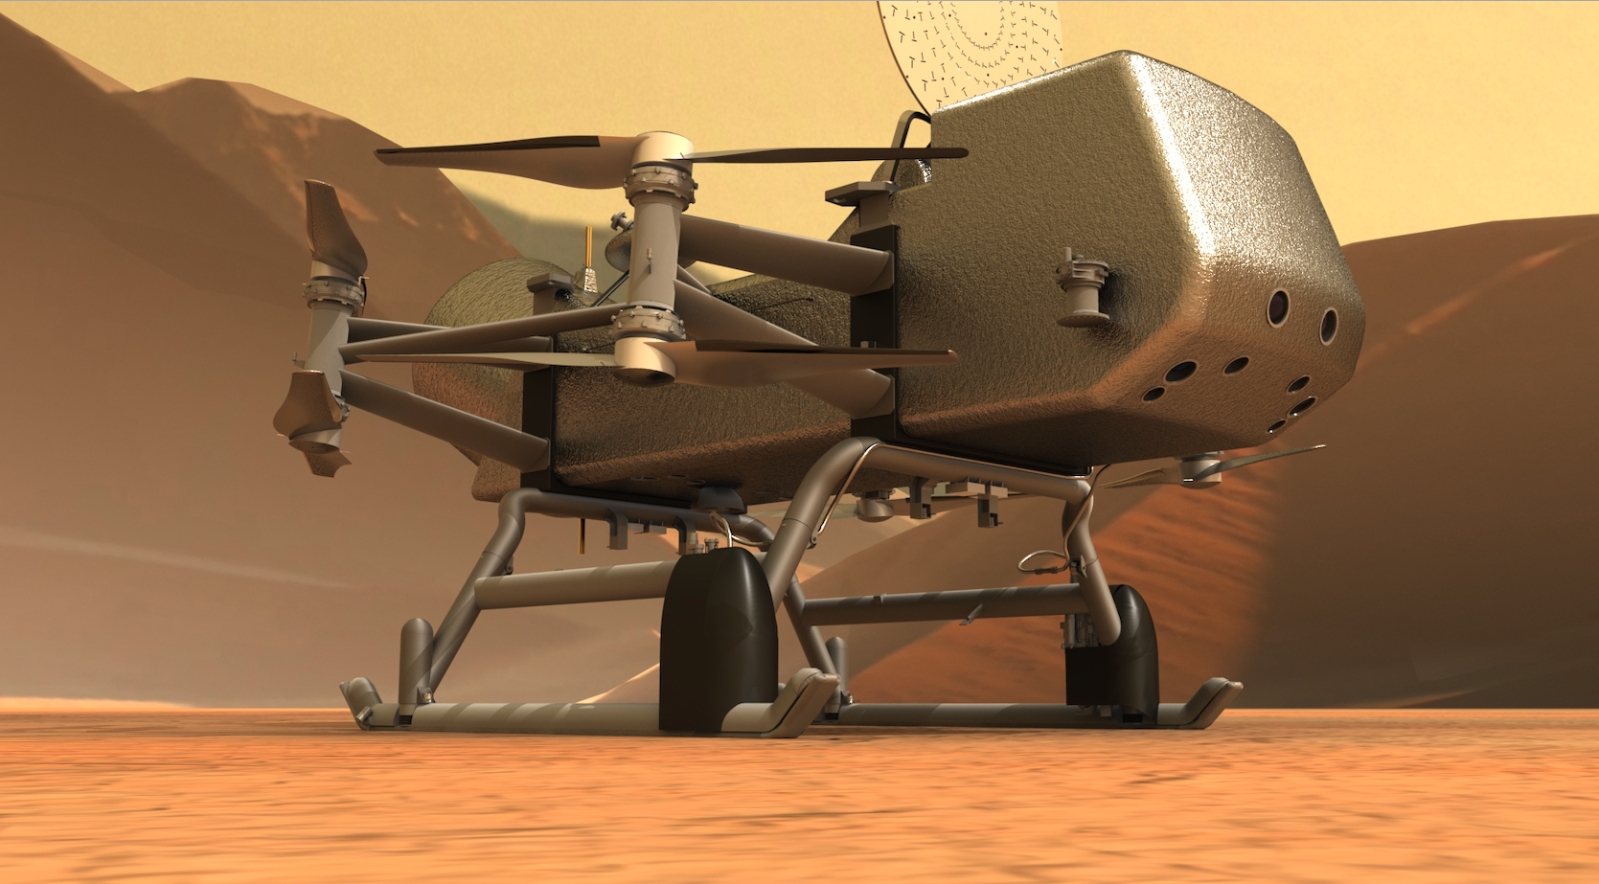
A Note on Scale
Ingenuity
Dragonfly
Key Dimensions:
Fuselage: 13.6x19.5x16.3 cm
Rotor Diameter: 1.2 m
Total Mass: 1.8 kg
Key Dimensions:
Fuselage: ~3.85 m long
Rotor Diameter: ~1.35 m
Total Mass: ~900 kg
4

Slide 5
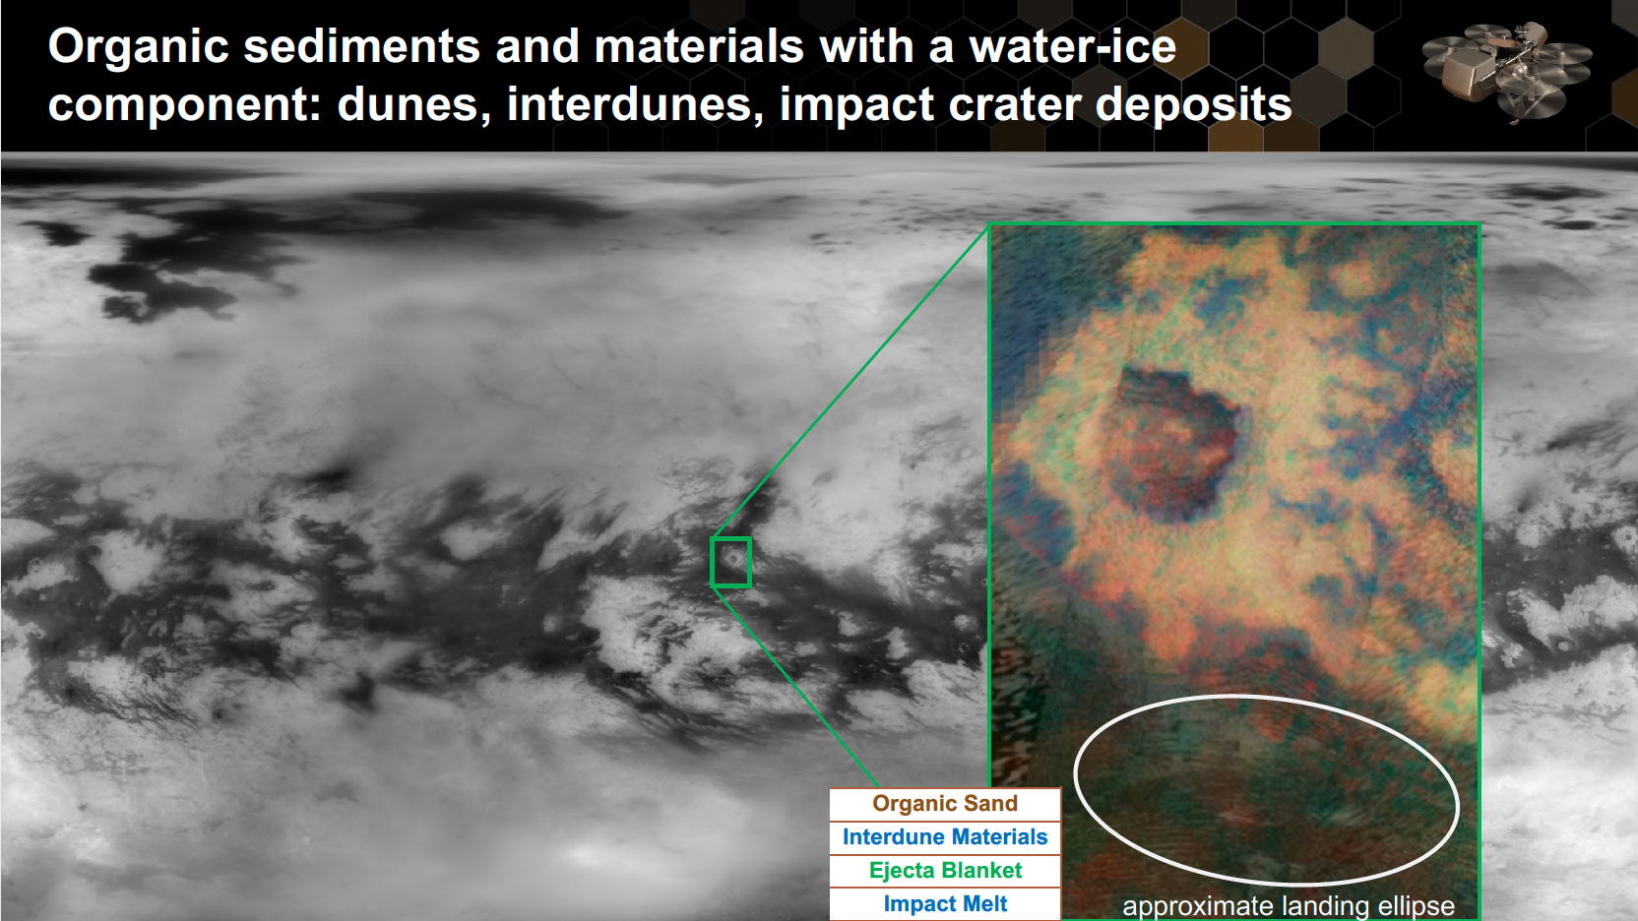
Selk Crater
5
Notes:
Namib dunes provide a clear terrestrial analog
Interdune region tends to be flat and clear of hazards

Slide 6
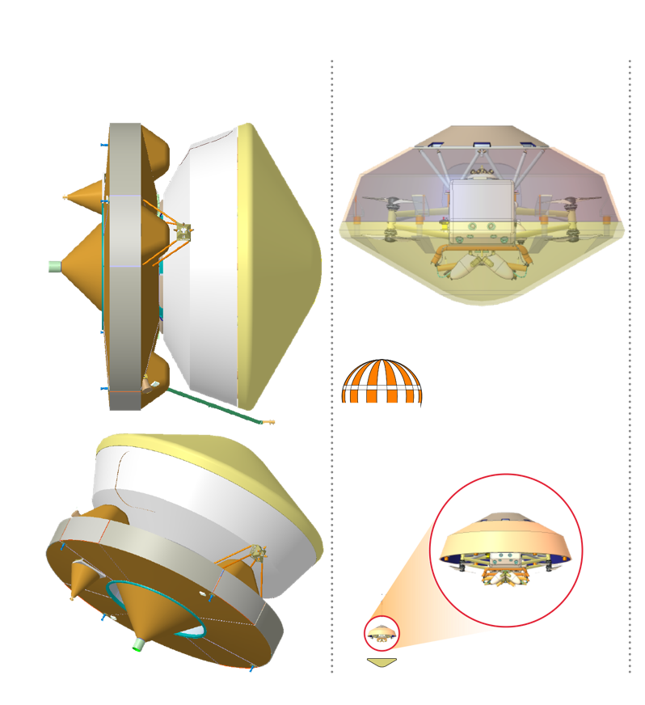
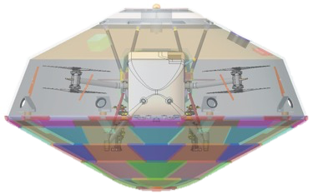
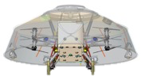
Flight System Elements
Rotorcraft Lander
Flight configuration with HGA stowed
Cruise stage provides functions needed for travel between Earth and Titan
  Propulsion, guidance & control, (attitude control) and telecommunications
EDL Assembly provides functions needed for safe descent through Titan’s atmosphere
  Heatshield, backshell, parachute system, separation systems, and LGA
(Rotorcraft) Lander provides functions needed for surface exploration at Titan
  Octocopter for mobility (flight) at Titan
  Science instruments for studying Titan’s surface and atmosphere
Note: Images above are used to delineate elements and do not reflect current configuration

Slide 7
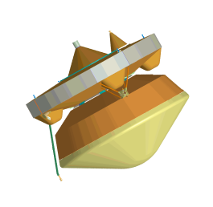
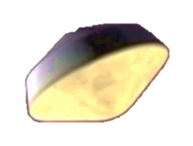
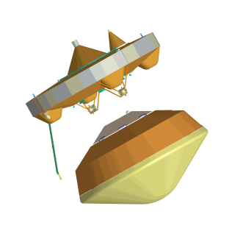
Wake up; E-190 min
Entry
Turn to entry, spin up to 2 rpm; E-27 min
Cut thermal loop; E-16 min
MDNav to EDL Handoff (7800 km); E–10 min
Cruise Stage Separation; E–10 min
Peak heating
254 km; E+227 s
Peak deceleration
232 km; E+241 s
See talks by Brandis (Aerothermal) and Stern (TPS) in this session
* Times referenced to DAC1b CBE Mean
Notes:
Wake up from hibernation EI-3h
Entry beta = 106 kg/m2, FPA = - 47.8°
Very Mars-like to this point. Peak heating about 4m after EI, pushing 300 W/cm2 with a large contribution from shock layer radiation.
Peak deceleration 15s later, about 10.5g predicted, comfortably under 12g requirement

Slide 8
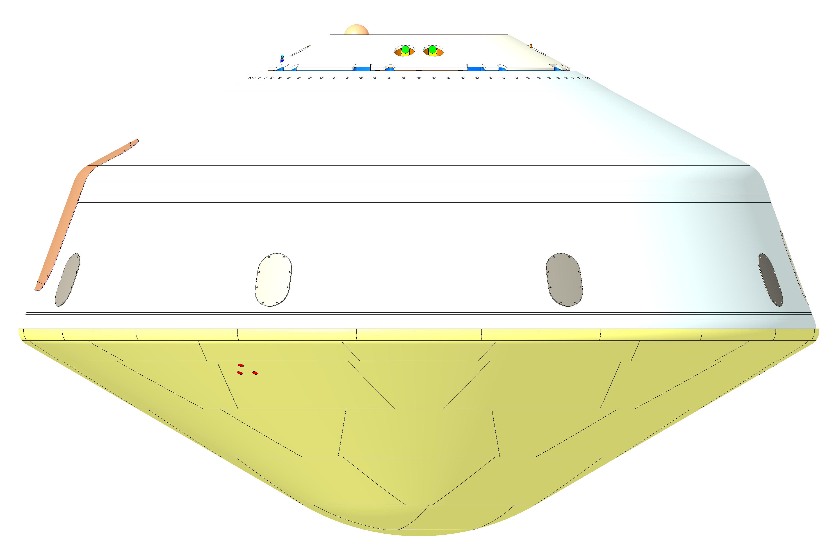
Dragonfly Aeroshell
ELGA Radome (SLA-220)
Parachute Cone
SLA 561V
Backshell
EDL
Assembly
Aeroshell
Heatshield
PICA-D
4.5m Diameter
8
Notes:
Not shown: Vent, Parachute lid/cover, access doors

Slide 9
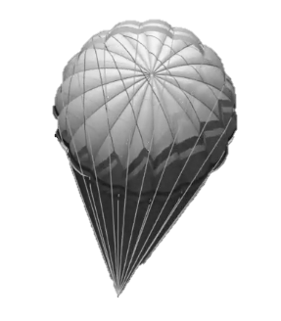
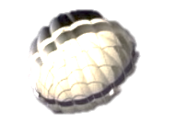
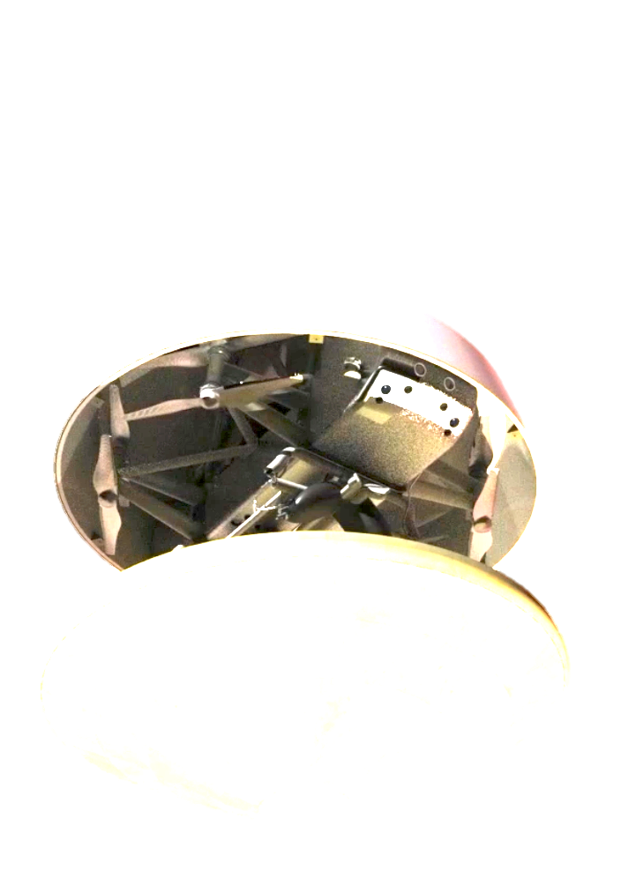
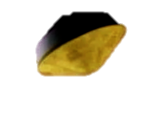
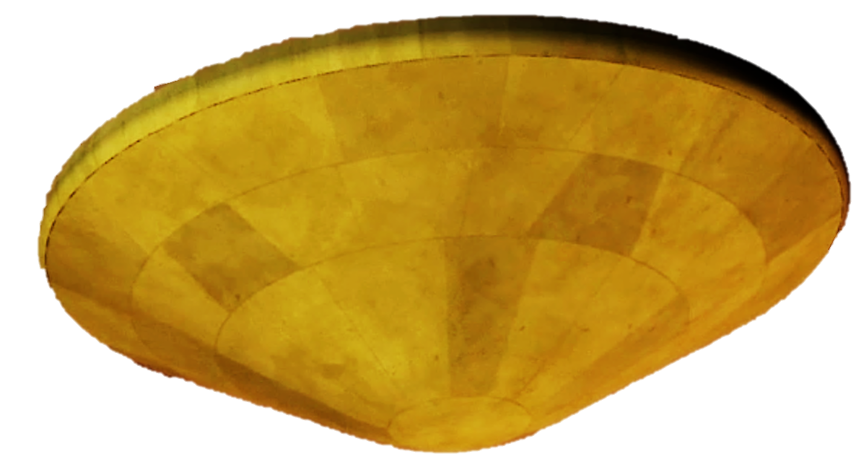
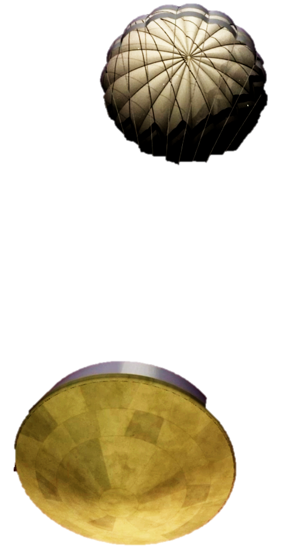
Descent
Entry Interface (1270 km); E=0
Main parachute deployment 5km; E+92 min
Heatshield separation
4.5 km; E+94 min
Drogue deployment
157 km; E+374 s
90 min Descent under drogue
See talk by Winski (Flight Mechanics) in this session
* Times referenced to DAC1b CBE Mean
Notes:
This is where the time dilation begins; drogue is deployed at EI+6m, but then we are on it for 86 minutes
Drogue: 5.4m DGB, opening load < 14.7kN, deploy M=1.5, ~9s above 1.4, ~30s supersonic
Three functions: stability, deceleration, deploy the main
Main: 16.55m DGB, opening load < 8kN, low speed deploy @5km
Functions: stability, deceleration, facilitate heat shield and lander release

Slide 10
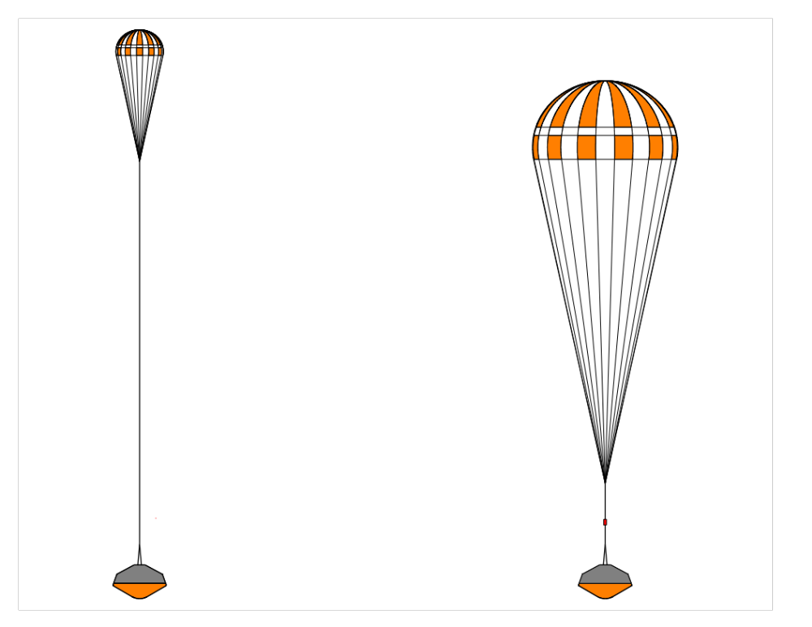
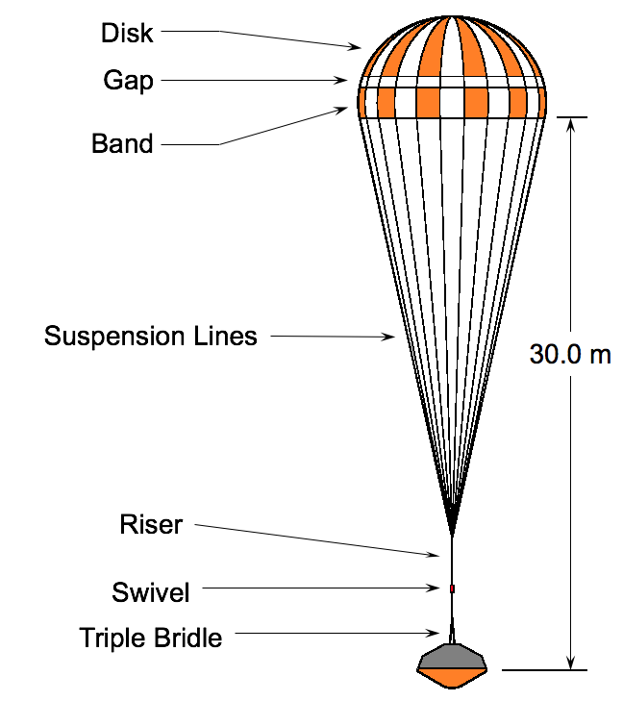
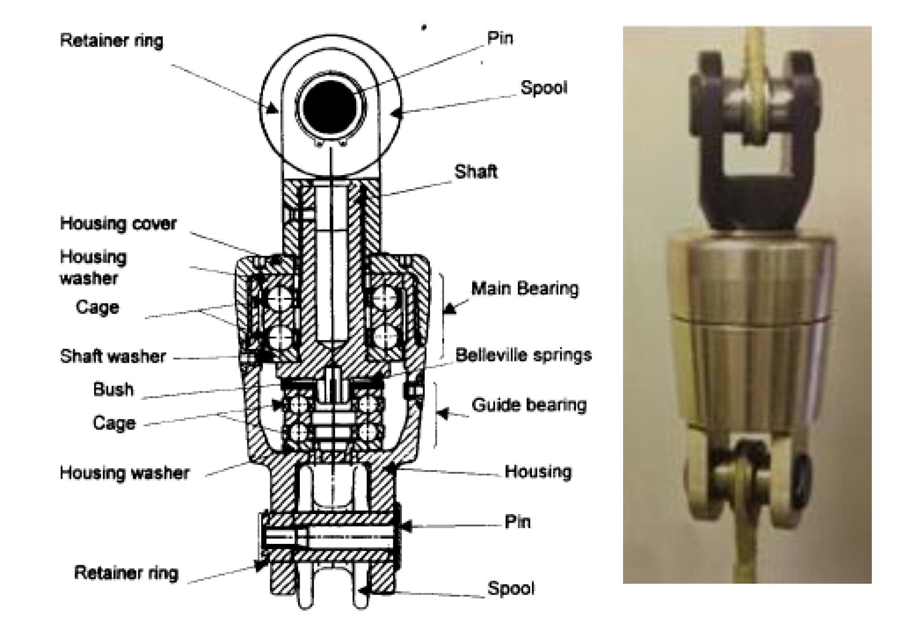
Parachute Deceleration System (Airborne / Vorticity)
Drogue Parachute (5.4 m DGB)
  Mortar deploy via trigger at Mach 1.5
  Functions: stabilize capsule, decelerate through atmosphere, extract main chute
Main Parachute (16.55 m DGB)
  Low speed subsonic deploy
  Functions: stabilize capsule, facilitate heat shield and lander release
  Exploring alternate canopies (inflation & stability)
36.0 m
45.0 m
37.5 m
Huygens heritage swivels
  Prevent line twisting
Notes:
MSL parachute design for peak load of 286 kN as opposed to 14.7 kN for the drogue and 6.1 kN for the main
Drogue:4.5m DGB (M2020 fabric, Kevlar lines, 10 diameter trailing distance); Main 16.55 m DGB (M2020 fabric, Kevlar lines, 8 diameter trailing distance)
Note that the parachute vendor is currently conducting a trade study for the main canopy (inflation and stability)
Swivel: Molybdenum disulphide dry film lubricant

Slide 11
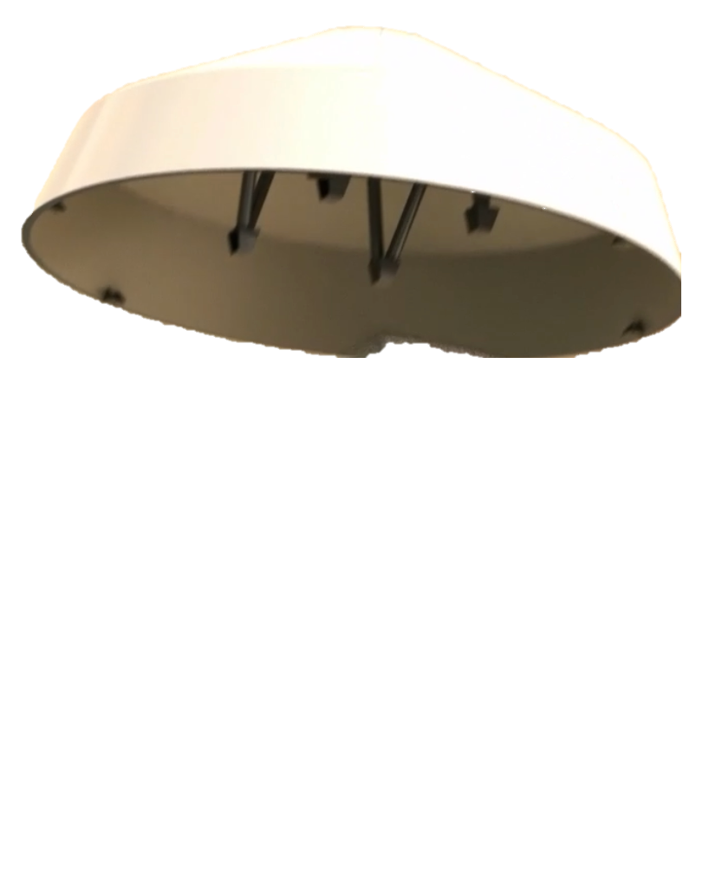
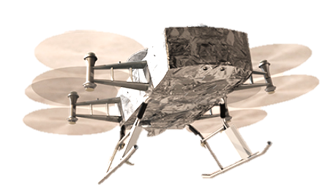
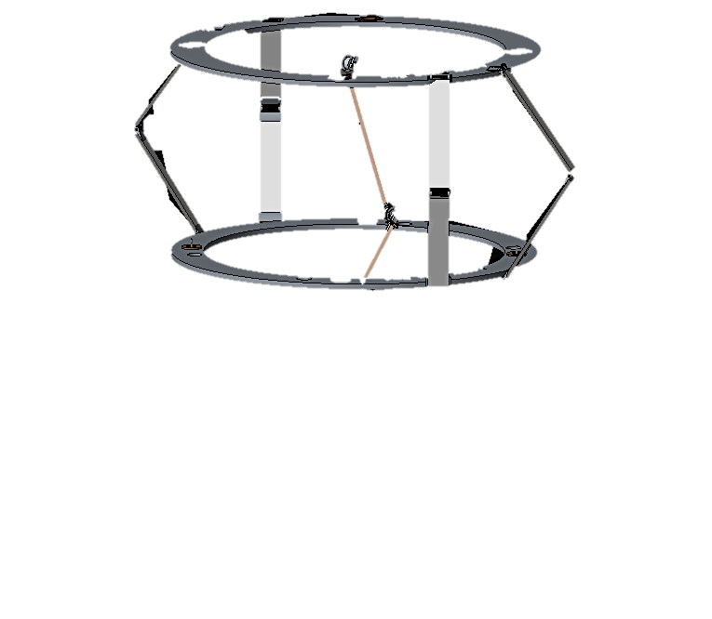

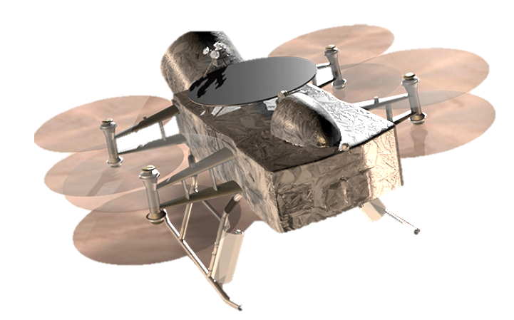
Preparation for Powered Flight
Reconfigure EDL thermal loop;
2.3 km; E+107 min
Lander Pose
2.2 km; E+109 min
Despin
2.1 km; E+110 min
Lidar Ground Lock
2 km; E+111 min
Lander Separation
0.8 km; E+118 min; 2.9 m/s
Transition to Powered Flight
Release + 1 s
* Times referenced to DAC1b CBE Mean
Notes:
This is the “new” part. We have a whole series of activities who’se purpose is to release the lander in a state from which it can successfully transition to powered flight
EDL should probably be “EDR” for this mission; our responsibility ends once this goal is achieved and the lander will locate its first safe landing site and complete its first landing under the auspices of the onboard mobility system

Slide 12
Wake up; E-190 min
Entry and Descent Con-Ops
Turn to entry, spin up to 2 rpm; E-27 min
Cut thermal loop; E-16 min
MDNav to EDL Handoff (7800 km); E–10 min
Cruise Stage Separation; E–10 min
Entry Interface (1270 km); E=0
Peak heating
254 km; E+227 s
Peak deceleration
232 km; E+241 s
Main parachute deployment 5km; E+92 min
Heatshield separation
4.5 km; E+94 min
Reconfigure EDL thermal loop;
2.3 km; E+107 min
Lander Pose
2.2 km; E+109 min
Drogue deployment
157 km; E+374 s
90 min Descent under drogue
Despin
2.1 km; E+110 min
Lidar Ground Lock
2 km; E+111 min
Lander Separation
0.8 km; E+118 min; 2.9 m/s
Transition to Powered Flight
Release + 1 s
* Times referenced to DAC1b CBE Mean
Notes:
Wake up from hibernation EI-3h
Entry beta = 106 kg/m2, FPA = - 47.8°
Drogue: 5.4m DGB, opening load < 14.7kN, deploy M=1.5, ~9s above 1.4, ~30s supersonic
Main: 16.55m DGB, opening load < 8kN, low speed deploy @5km

Slide 13
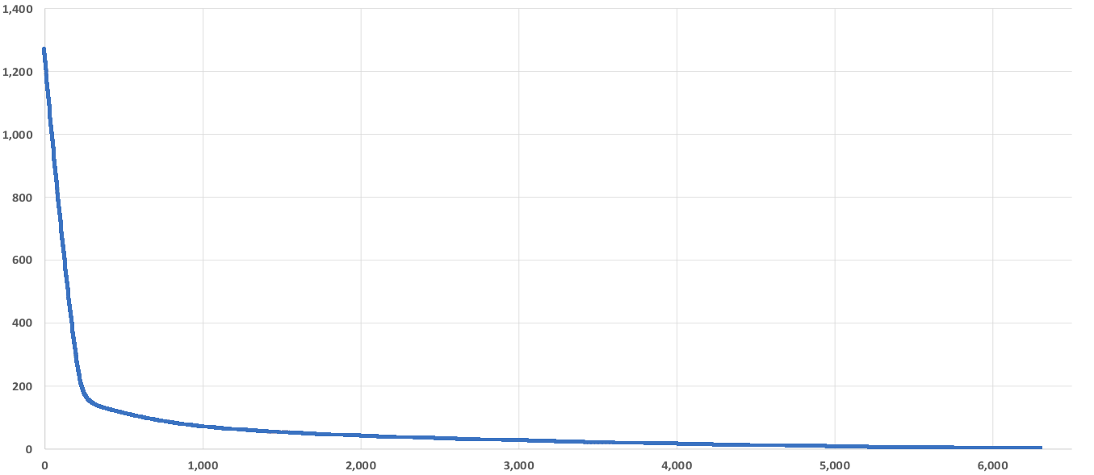
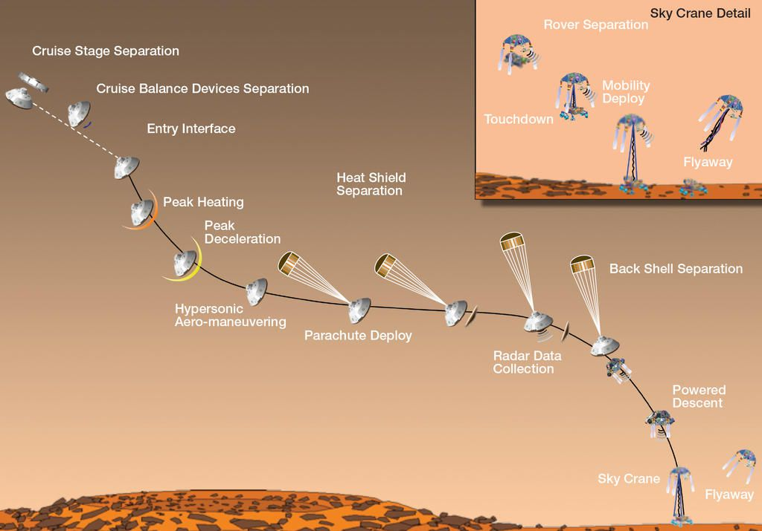
EDL Timeline Comparison
Altitude (km)
Max Deceleration
This is MSL…
Drogue Deploy
Lander Release
Main Chute
Time (s)
Notes:
Seven minutes of terror became “2 hours of mild discomfort” for proposal purposes
As we learn more it is becoming more like “an interminable time of considerable angst”

Slide 14
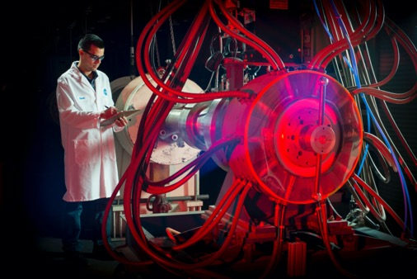
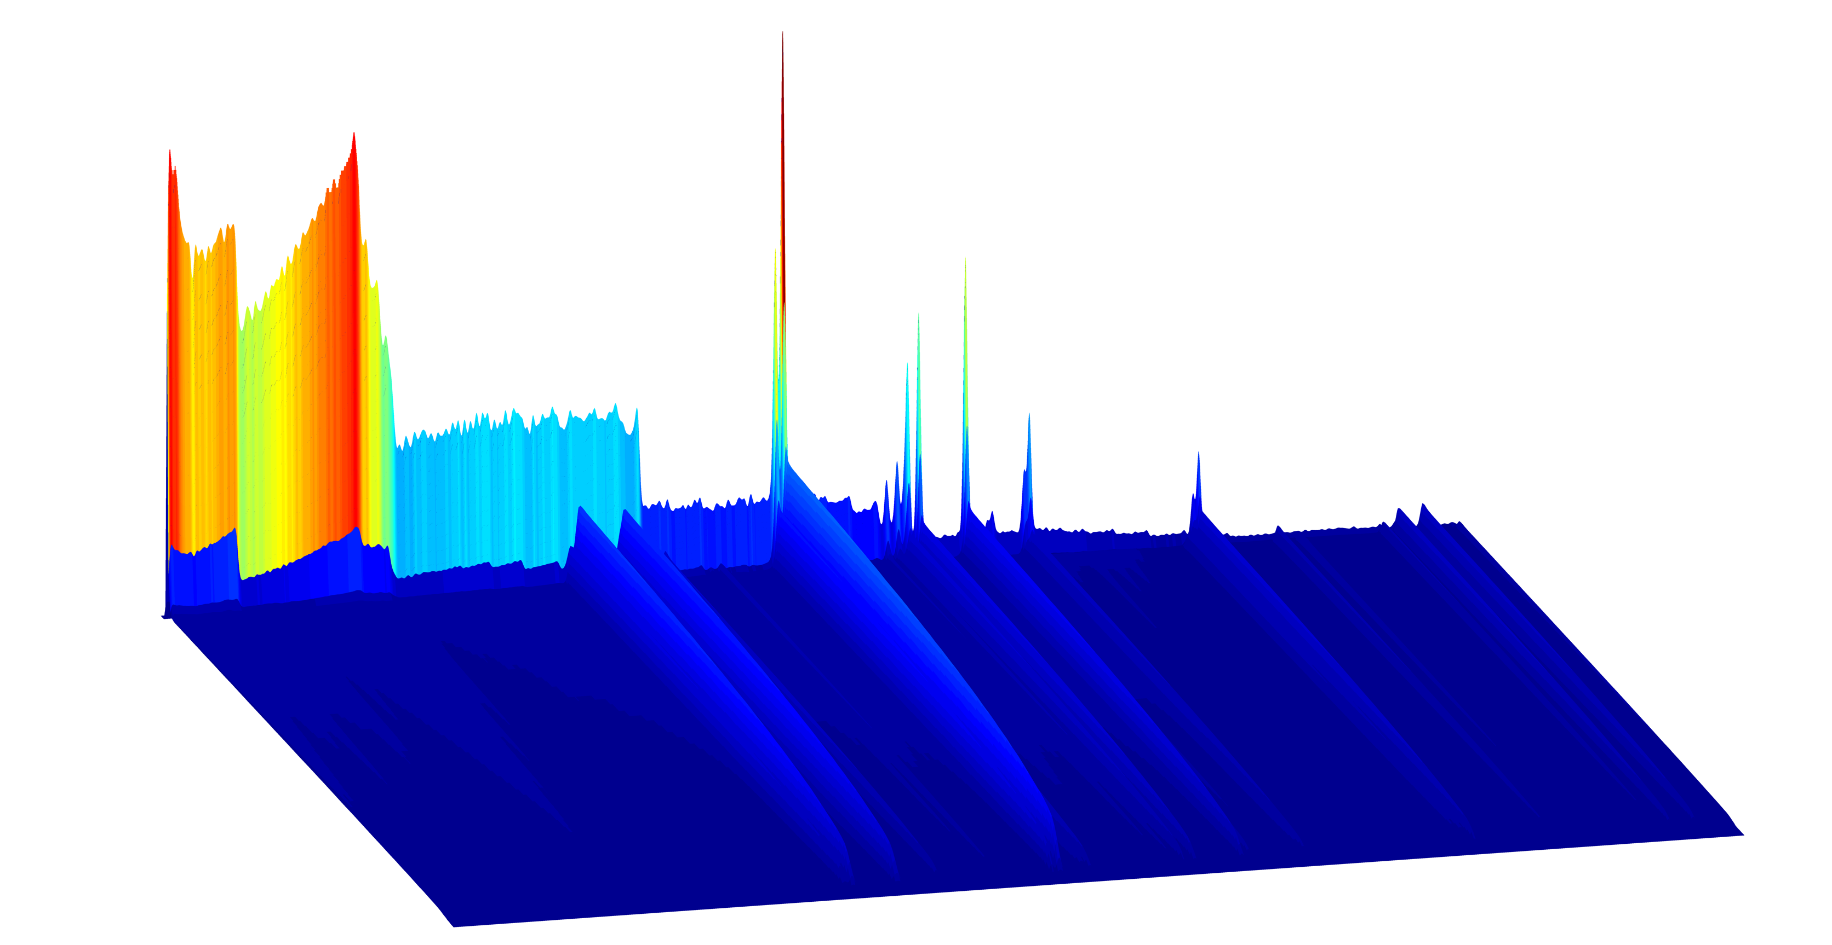
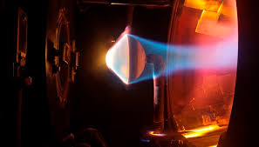
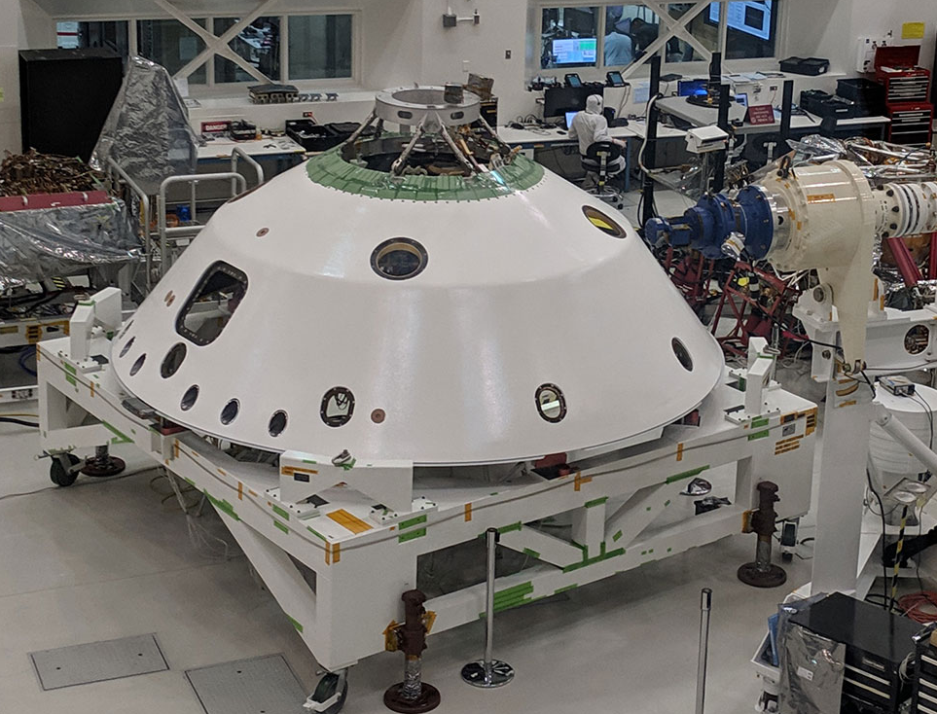
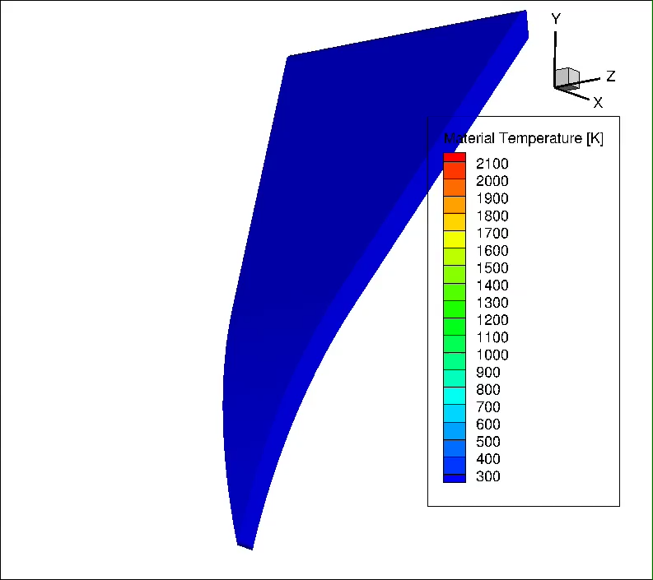
Key Entry Phase Challenges
Quantifying heating due to shock layer radiation
  dominated by CN-red and violet emission
  Less validated than air or CO2
  NASA/ESM has completed a test series in EAST focused on refining shock tube informed bias uncertainties.
TPS material qualification
  Non-oxidizing environment, radiation dominated heating
  Performance of RTV gap filler in such an environment
Singularities
  Radiative heating on main seal
  RF transparency of radome materials
  Heating on backshell singularities
EDL Phase thermal analysis
  Long descent time, cryogenic exterior,
  internal heat source
EAST Testing
Arc Jet / Lamp Testing
3D Material Response
M2020 Closeouts

Slide 15
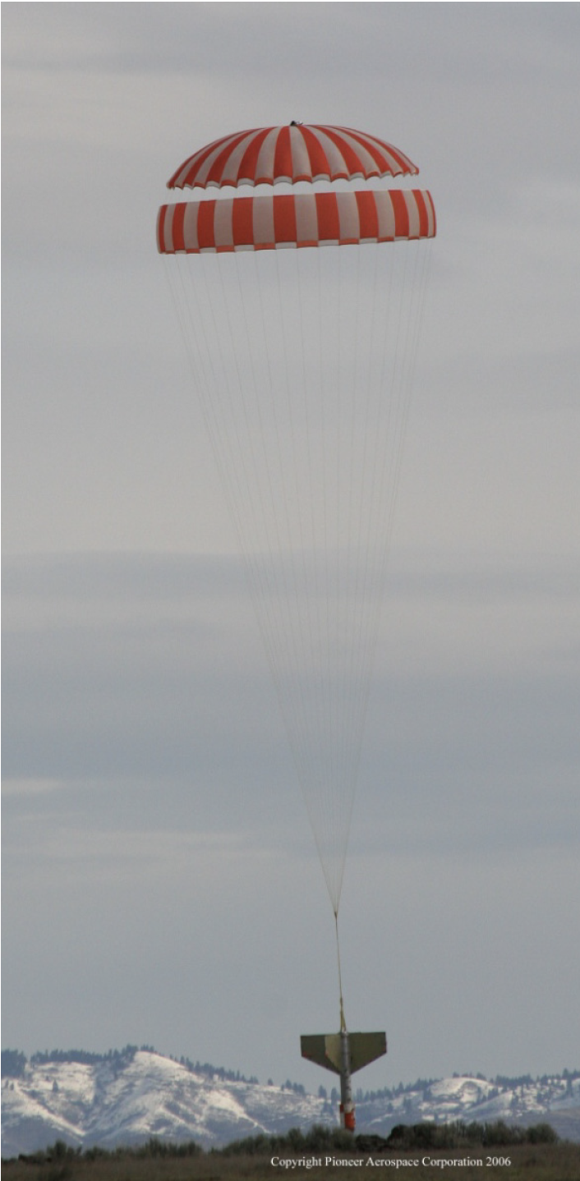
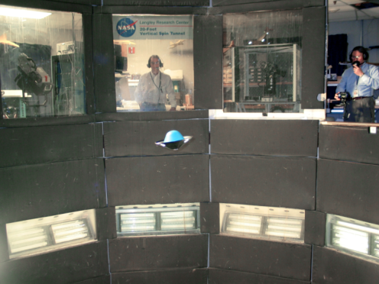
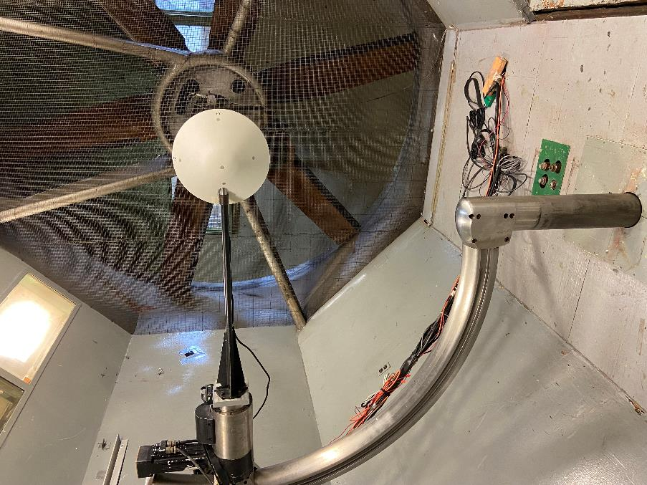
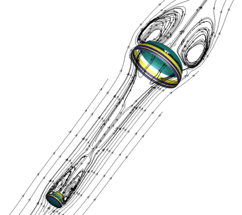
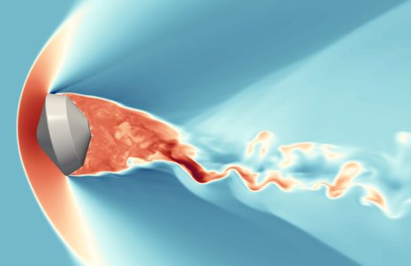
Key Descent Phase Challenges
Roll Coupling
  Initial roll rate of 2RPM, but over 100min for that to change
  Very difficult to assess potential sources of pitch-roll coupling
Transonic-subsonic aerodynamics
  Drogue chute is relatively smaller than that for Genesis
  Initial analysis shows that capsule dynamics dominates
  system dynamics
  Considerable time spent with an open backshell
Very long inflation time and possible high
angle of attack at deploy for main chute
  Anti-inversion netting baselined
  Drop testing is planned
Thermal Analysis
  Once the heatshield is released, our “hot” problem
  immediately becomes a cold problem
  Exposed mechanisms require heaters
VST/TDT/12’ Testing
Drop Test
Parachute FSI
Free Flight CFD

Slide 16
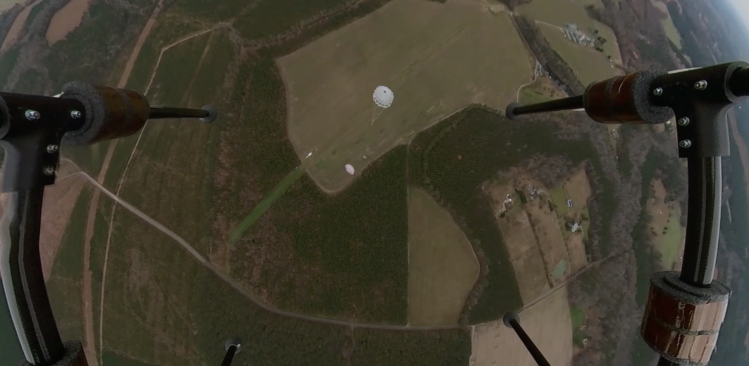
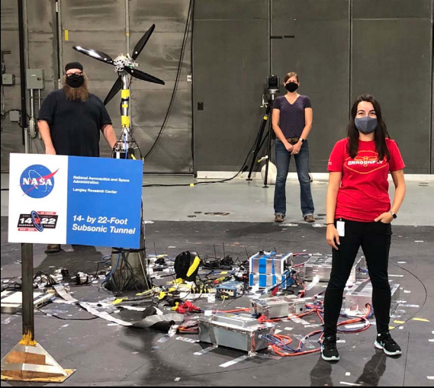
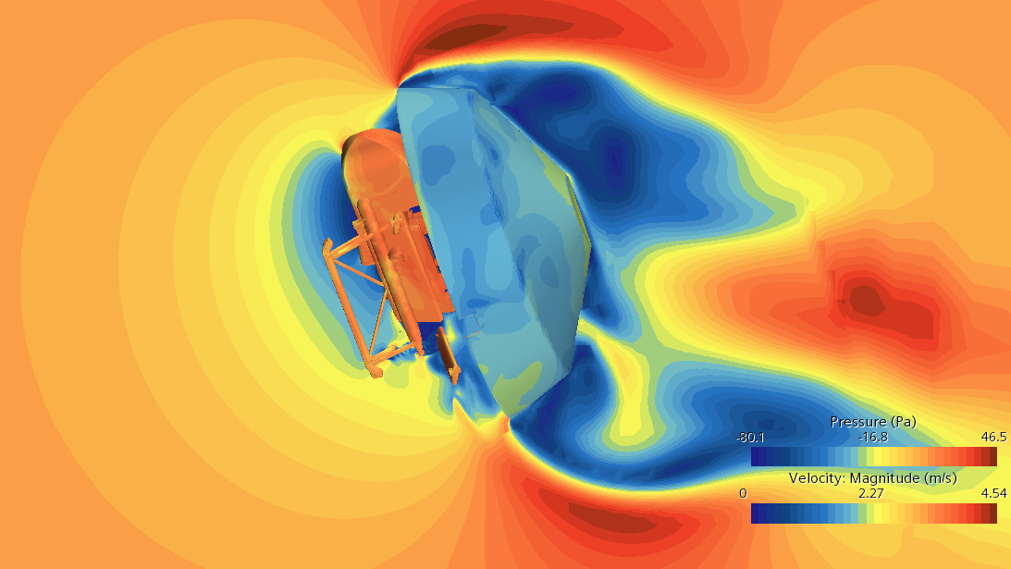
Key Preparation for Powered Flight Challenges
Open Backshell Dynamics
  Considerably amount of time spent on chute with no heatshield
  Two configurations: stowed and posed
Rotor-Backshell Aero Interactions
  Operating rotors at 1100RPM while attached to backshell
  Highly dynamically coupled problem
Altitude Knowledge
  We have no rangefinding until Lidar lock (potentially as
  low as 1km AGL
Releasing lander in a state from which it can
transition to powered flight
  Requires specific range of yaw moment, strongly prefers
  pitch down rate at release
12’ Testing
Posed Lander
Drop Testing
14x22 Testing
TPF CFD

Slide 18
Backup
18

